Slide 1

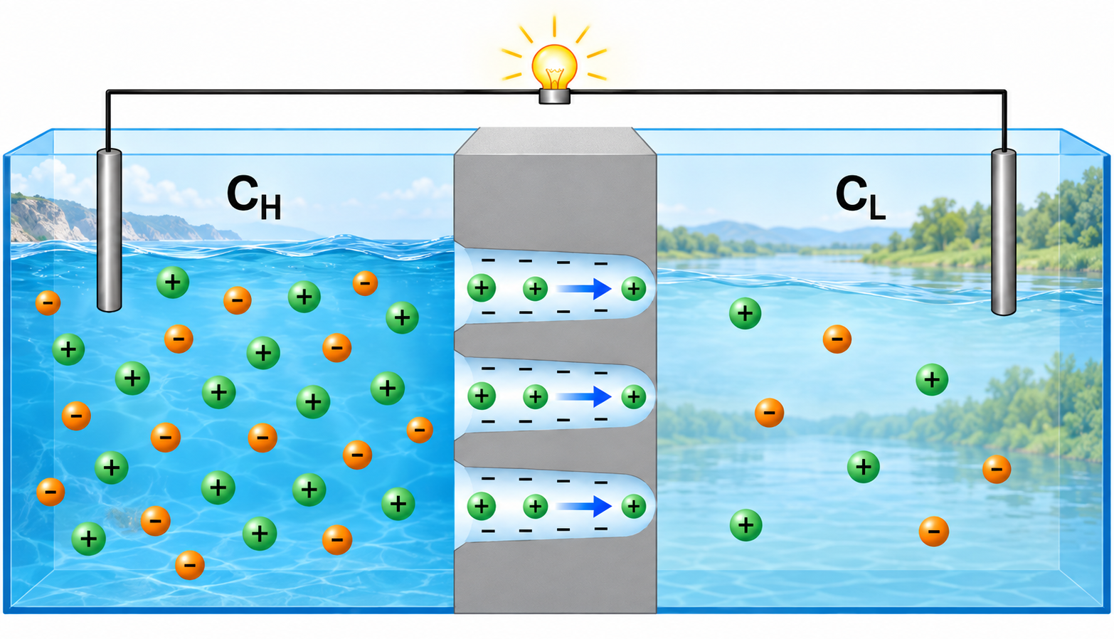
Insights into Scaling of Osmotic Power in
Bullet-Shaped Nanochannels
Dila Kaya, Onur Cem Polat, Gregorio Laucirica,
Maria Eugenia Toimil-Molares
Materials Research Department, GSI Helmholtzzentrum für Schwerionenforschung, Darmstadt, Germany
Notes:
Today I will discuss how osmotic power generation evolves when we move from one bullet-shaped PET nanochannel to multiporous membranes.
I’ll briefly introduce the motivation and fabrication, establish the single-channel behavior, and then and then spend most of the time on the main question: what happens to the power output as we add more and more channels.

Slide 2
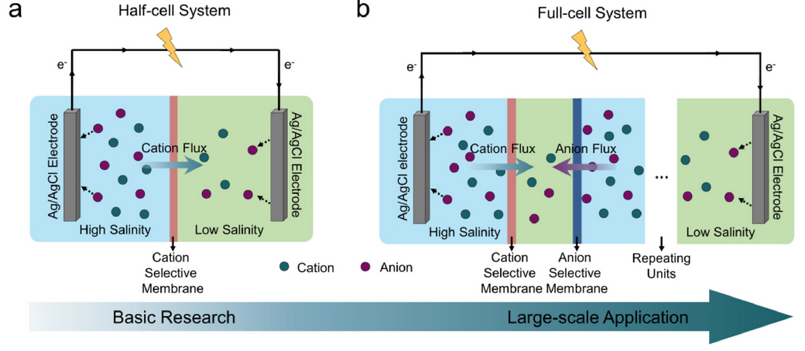
Power from Salinity Gradients
1 - MOTIVATION
Salinity gradient energy is a largely untapped energy resource
Nanofluidic reverse electrodialysis:
ion-selective nanochannels convert a salt concentration gradient into electrical current
Track-etched polymer membranes offer tunable channel geometry and density to investigate their impact on maximum power output
Chen, W., Xiang, Y., Kong, X. Y., & Wen, L. (2022). Giant, 10, 100094.
Notes:
$∆G_{mixing}$ is converted into electrical energy
37000 km³/yr
of freshwater discharges into the sea globally:
When concentrated and dilute solutions mix, Gibbs free energy is released. Nanofluidic reverse electrodialysis converts part of that energy into electricity by using charged nanochannels that preferentially transport counterions. Track-etched PET is useful because both pore geometry and pore population can be controlled.

Slide 3
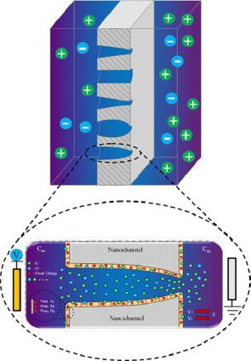
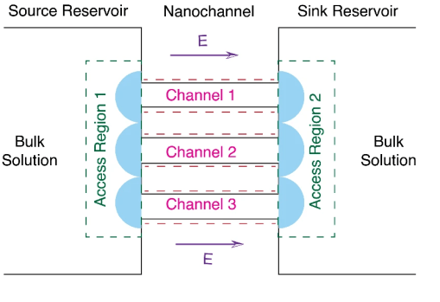
Scalability of Osmotic Energy Harvesting
1 - MOTIVATION
Single Nanochannels
Multi-Pore Membranes
Addressing the Gap
Energy-conversion performance across low channel densities
Where does linear scaling actually break down?
Overlapping access regions and concentration polarization reduce contribution of each channel
Single bullet nanochannels demonstrate superior power output*
*Laucirica, G., et al. (2020). Nano Energy, 71, 104612.
Siwy, Z. S., et al. (2023). Chem.Soc. Rev., 52(6), 1983.
Manikandan, D., et al. (2024). 2D Mat. and App., 8(1), 47.
Karimzadeh, M., et.al. (2021). Electro.Acta, 399, 139376.
Notes:
There are two facts that we already know: 1. Single bullet shaped nanochannels yield a higher power output than other geometries. Low resistance and high selectivity.
2. Single-pore performance ≠ multiporous membrane performance
Bullet-shaped PET nanopores show the highest reported single-channel power output among canonical geometries (Laucirica et al. 2020) lower channel resistance due to the high base diameter and, at the same time, the high ionic selectivity achieved by the tip region.
Neighboring access regions and concentration-polarization zones can overlap
a partial disconnect [between single-pore and multipore fields] hinders scientific progress"

Slide 4
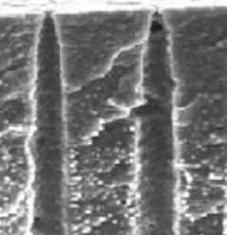
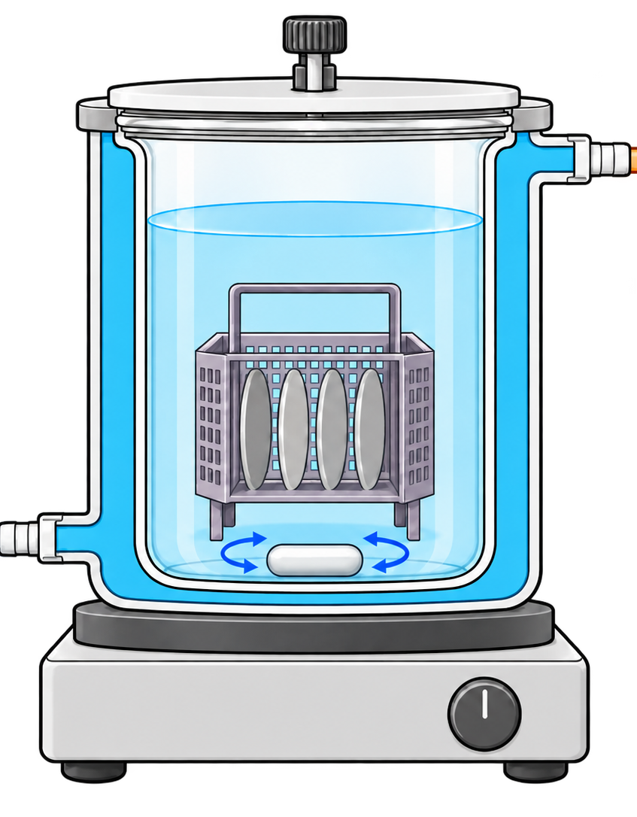
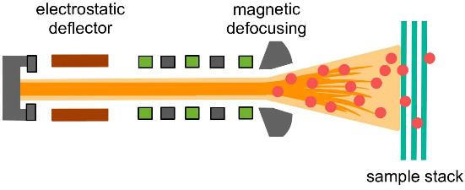
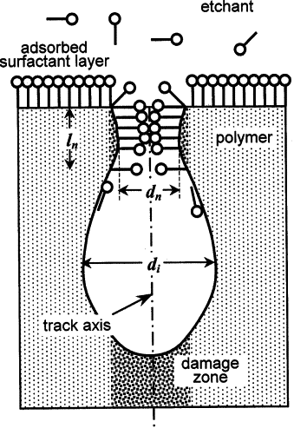
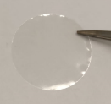
Fabrication of Bullet-Shaped Nanochannels
2 - METHODS
1. Ion-track formation
3. Chemical etching
aperture
detector
500 nm
trigger
6 M NaOH surfactant, 60°C,
4 -10 min
2. One-sided UV exposure for 24 hours:
Increases susceptibility to chemical attack.
Decreases hydrophobic binding to surfactant.
12 µm
PET Membrane
Apel, P. Y., et al. (2007), Nanotechnology, 18(30), 305302.
Notes:
Photo-oxidative degradation:
12 µm PET foils irradiated with Au ions (8.6 GeV), fluence 1–10⁷ ions/cm² (UNILAC, GSI)

Slide 5
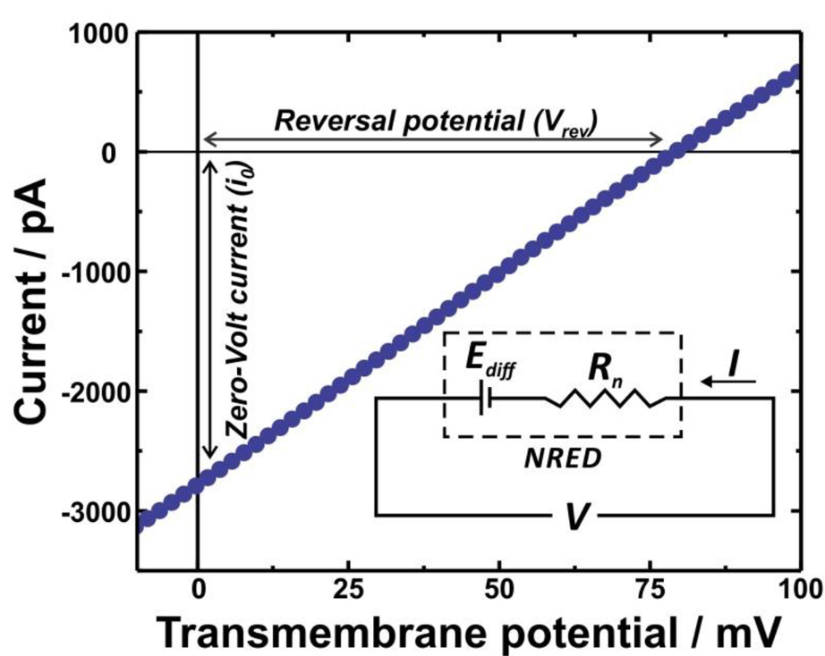
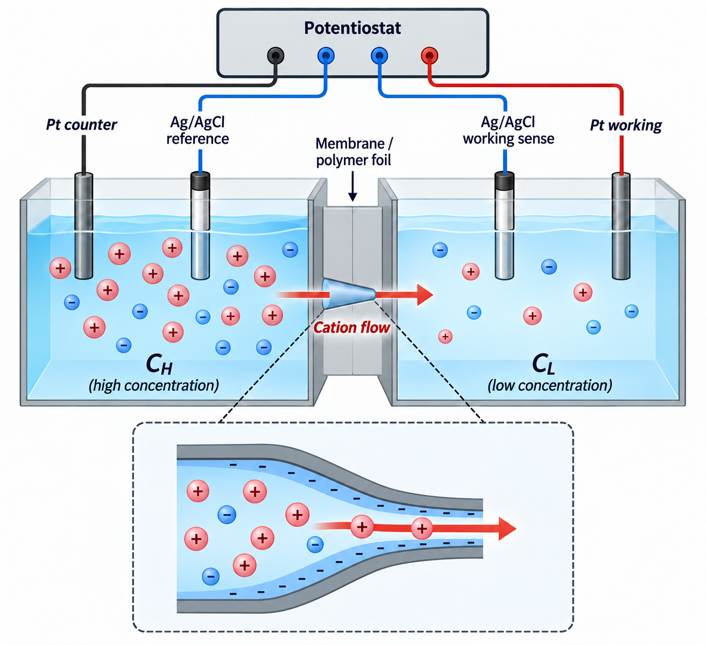
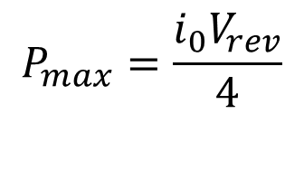
Energy Conversion Measurements
2 - METHODS
$$P_{max}=\frac{i_{0}V_{rev}}{4}$$
10×, 20×, 100× 1000× KCl
Laucirica, G., et al. (2020). Nano Energy, 71, 104612.
Notes:
To measure energy conversion, we place the membrane between two compartments with different KCl concentrations,
i₀ = current at V = 0 Also called a short circuit current i0​: the salinity-gradient-driven current measured at zero applied voltage. It reflects the membrane’s ion-transport capacity.
Vᵣₑᵥ = voltage at I = 0 also open circuit potental Vrev​: the voltage required to stop the salinity-gradient-driven current. Its magnitude reflects the membrane’s ion selectivity.
concentration-gradient-driven cation transport
Maximum power depends on both quantities, according to $P_{max}=i_{0}V_{rev}/4$. Therefore, increasing current alone is insufficient if the reversal potential decreases.”
We treat the membrane like a battery with internal resistance. The open-circuit voltage V_rev is the battery's voltage, and the short-circuit current i₀ is the most current it can deliver. You get the most power out when the load matches the membrane's own resistance. At that point you're running at half the voltage and half the current, so the maximum power is V_rev times i₀ divided by four."

Slide 6
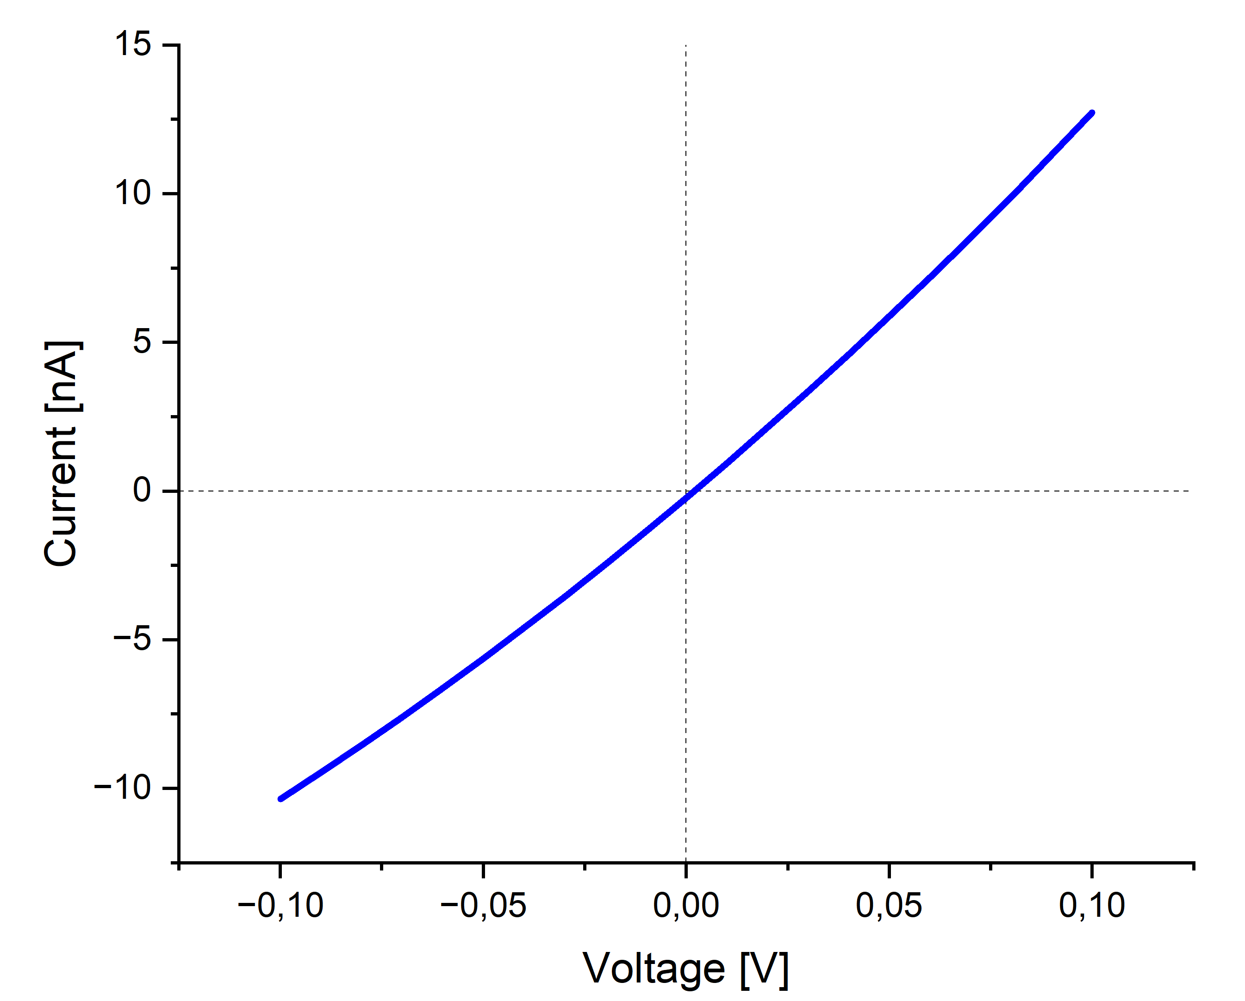
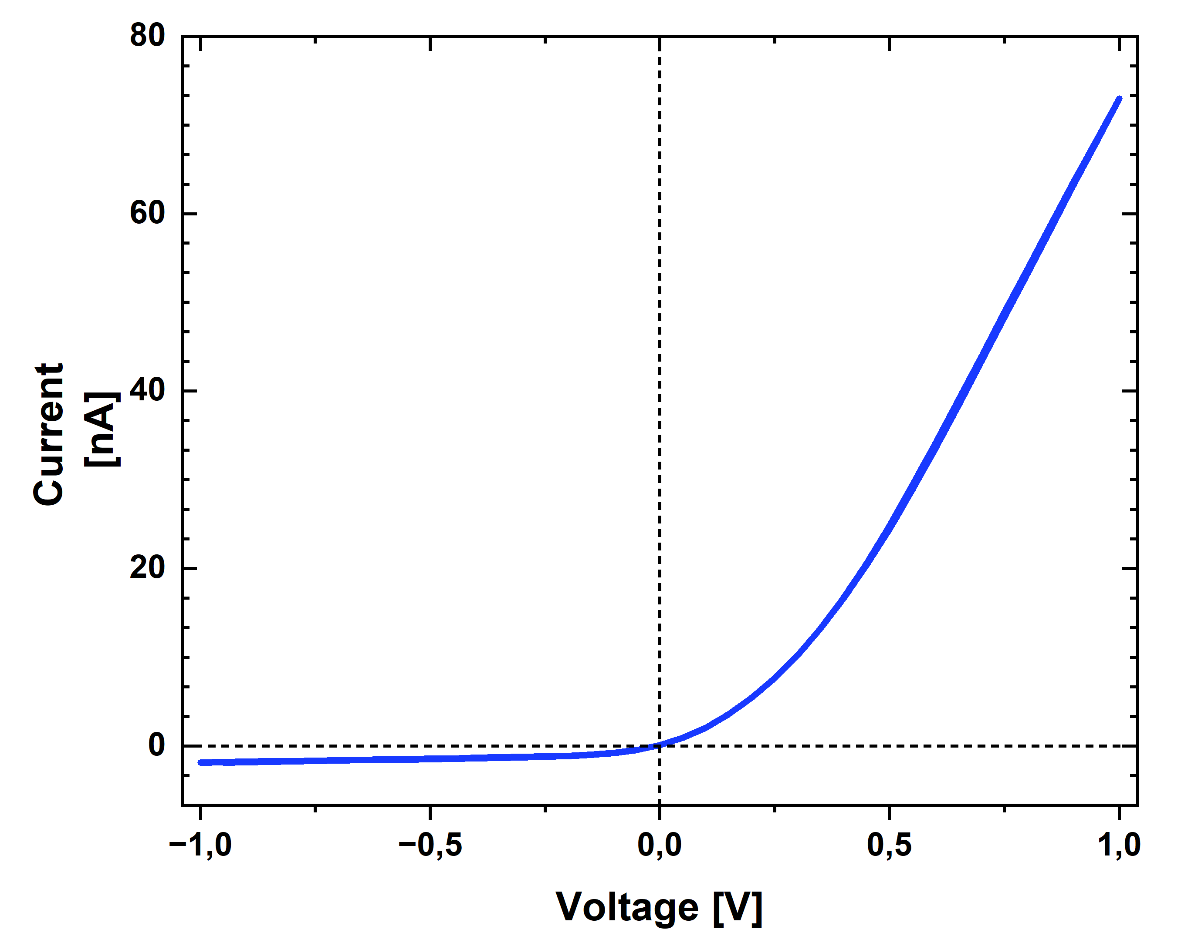
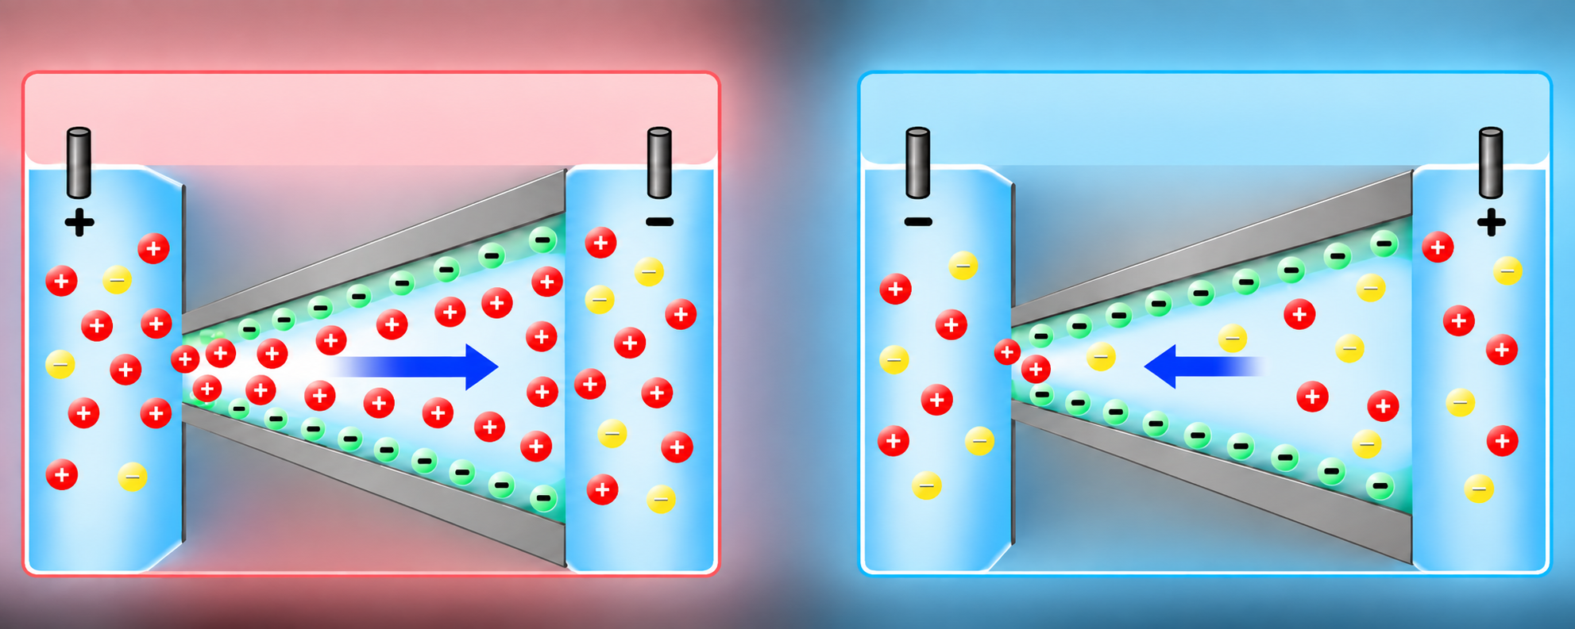


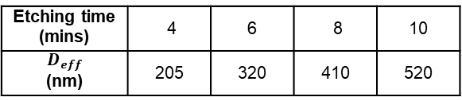
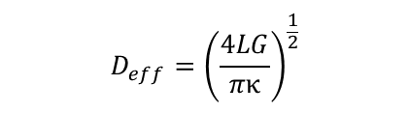
Electrochemical Characterization
3 – SINGLE NANOCHANNELS
Effective Diameter
Rectification
$$D_{eff}={\left(\frac{4LG}{πκ}\right)}^{\frac{1}{2}}$$
$f_{rec}= \frac{\left|{I }_{1 V}\right|}{\left|I_{−1 V}\right|}$
I-V curve in 1 M KCl (Etched 8 mins)
$$f_{rec}=38$$
Etching time (mins) | 4 | 6 | 8 | 10
$D_{eff}$ (nm) | 205 | 320 | 410 | 520
D_{eff ​}= (51.3 nm min⁻¹) t + 2.5 nm
I-V curve in 0.1 M KCl (D_{eff} = 410 nm)
Notes:
useful to use a single effective parameter characterizing the conductance response. effective diameter correlates with the bullet geometry parameters
L: the membrane thickness,
G is the experimentally determined conductance in a range between 0.1 V and +0.1 V with 1 M KCl,
kappa is the specific conductivity of the solution
Diode-like I–V response confirms asymmetric ion transport. We did not see a correlation between the rectification ratio and the generated power output

Slide 7
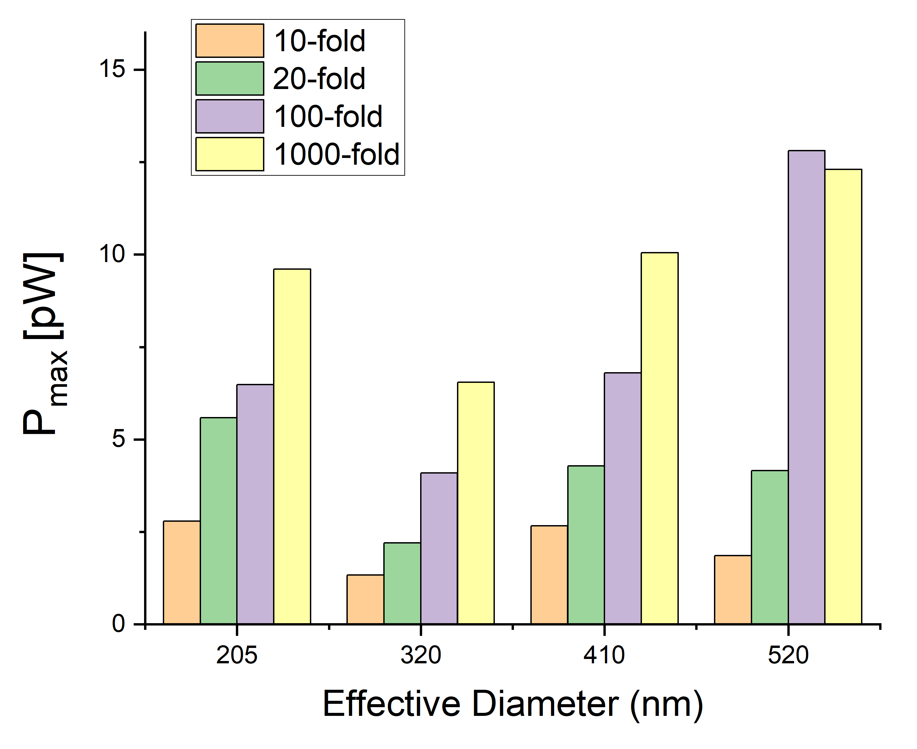
Single Nanochannel Power Output
3 – SINGLE NANOCHANNELS
Highest P_{max} :
1000x concentration gradient
10 min etched sample / 520 nm
Notes:
there is no direct correlation between the channel effective size and maximum power, as observed in
pH is ascribed to an increase of surface charges. Moreover, for pH>10, the OH- concentration would lead to a
decrease in the rectification factor because of the high diffusion coefficient of OH- in comparison with Cl-

Slide 8
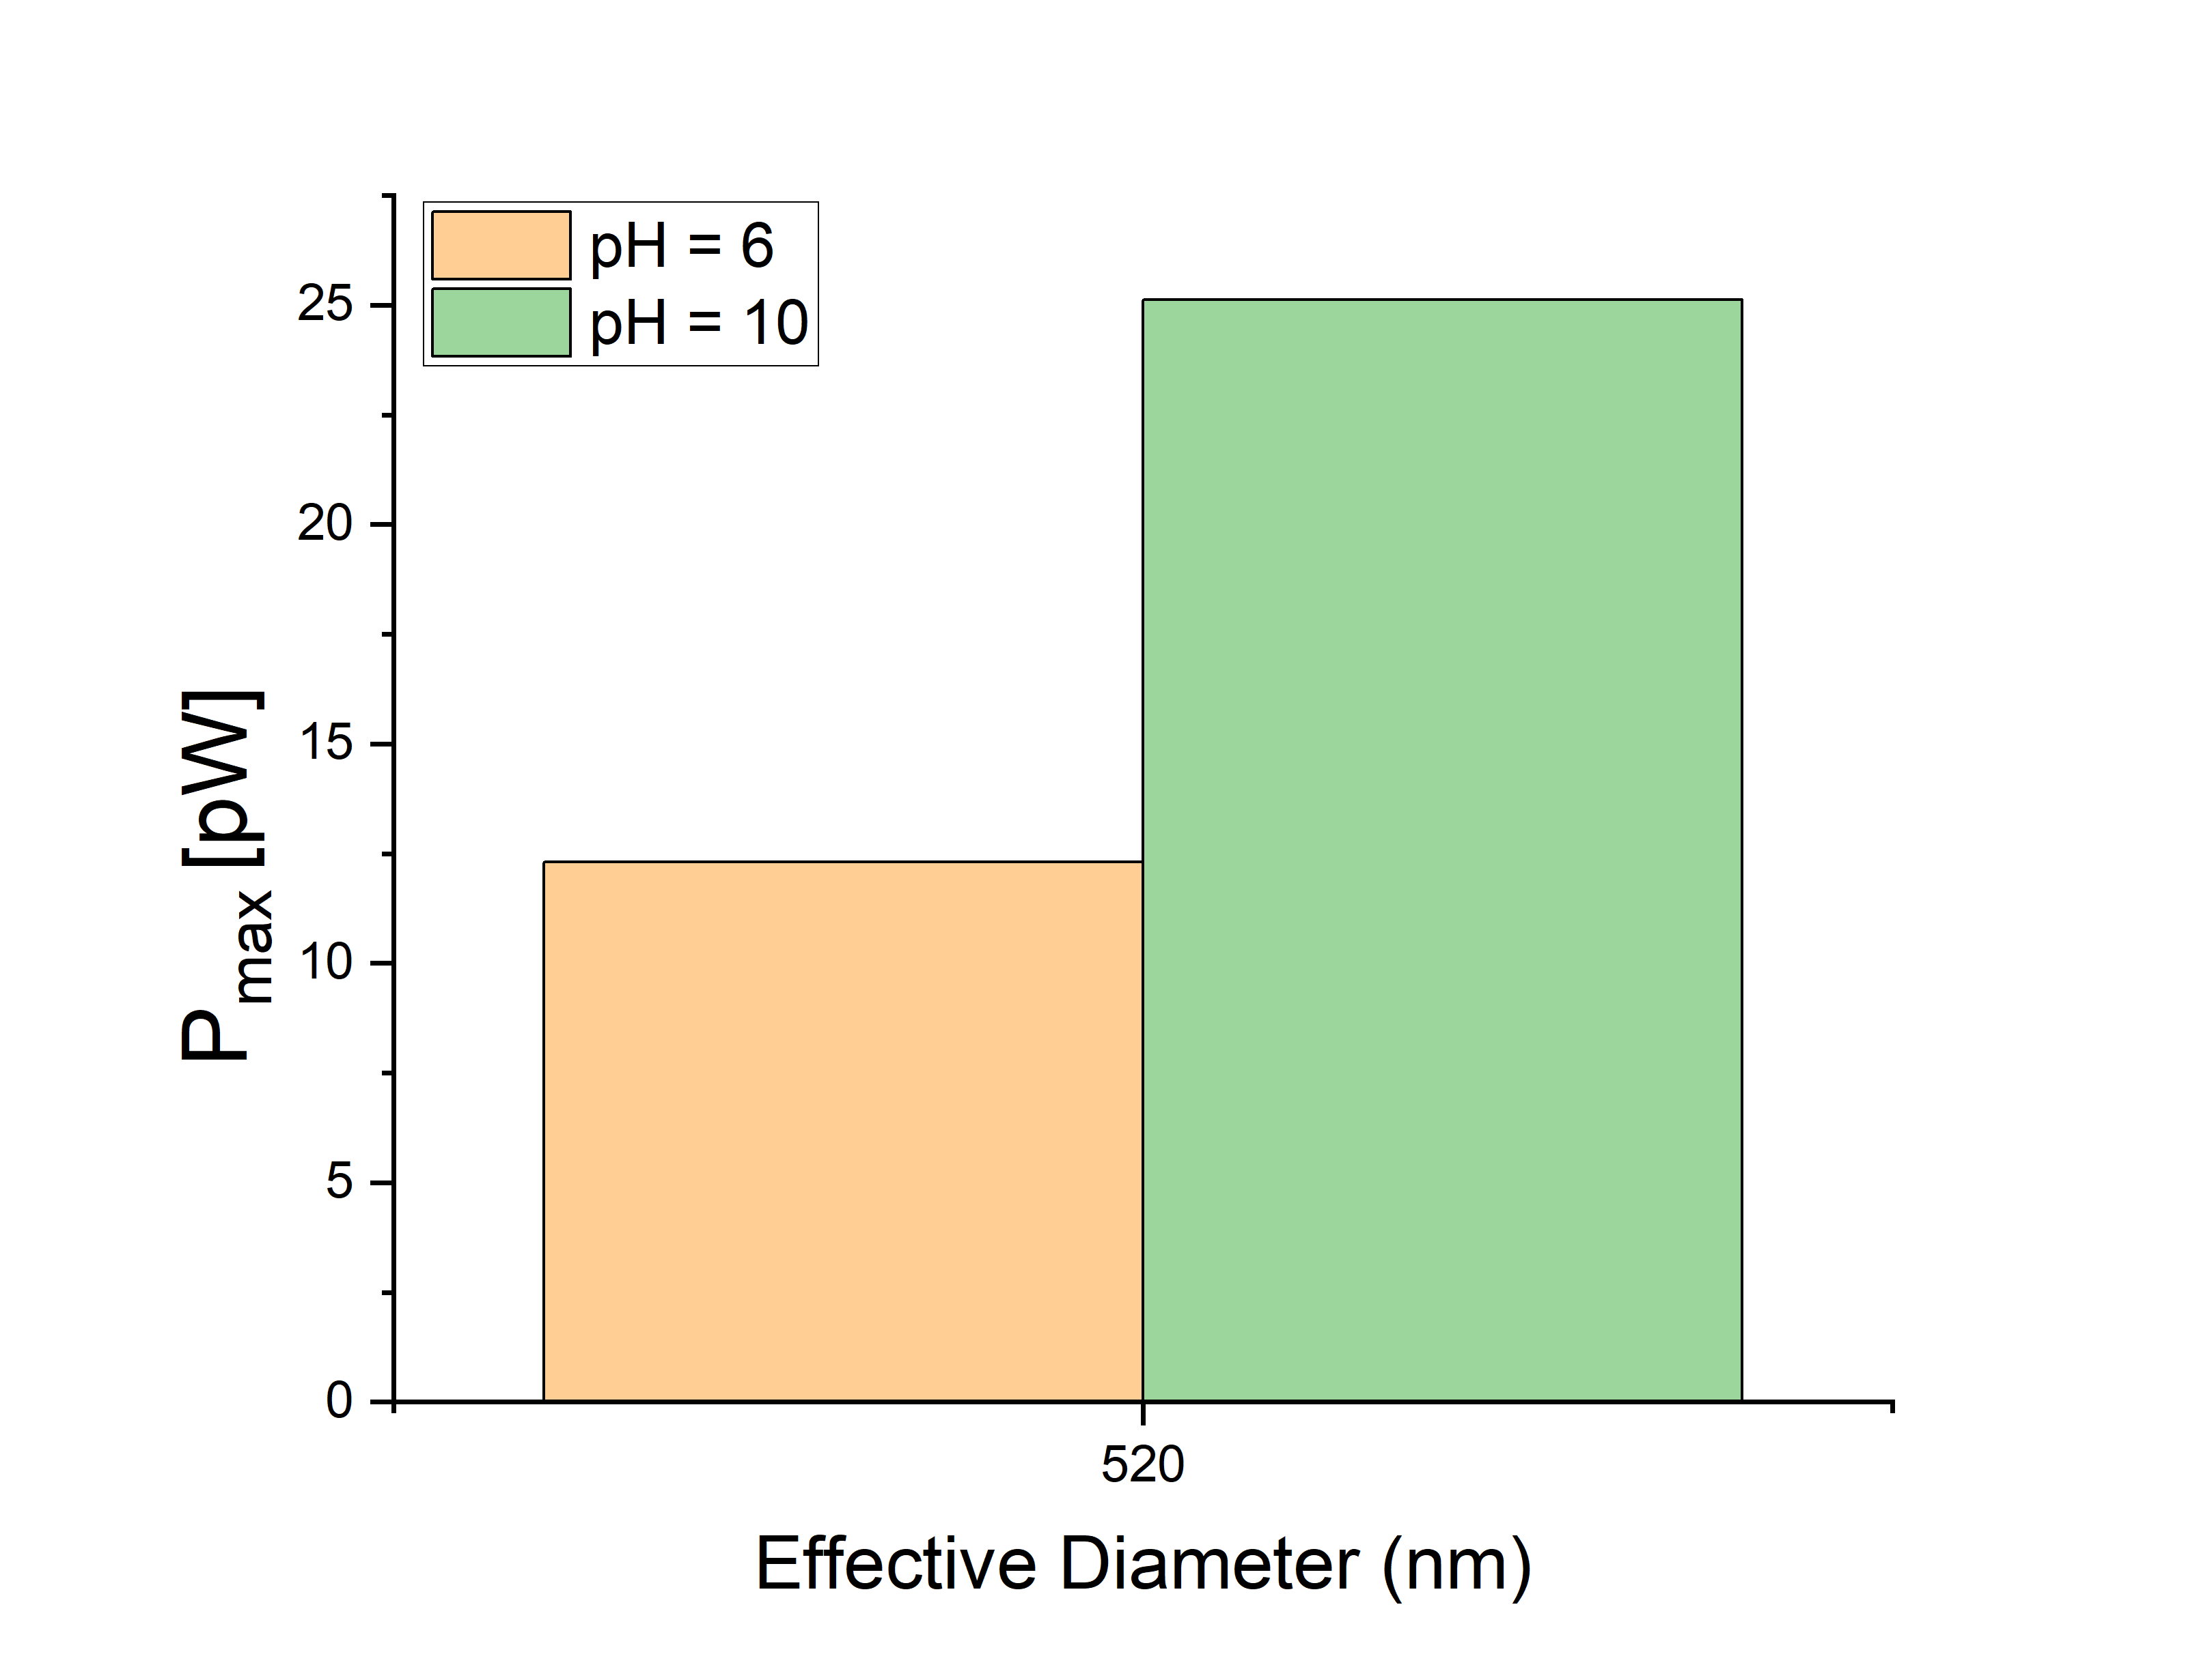
Single Nanochannel Power Output
3 – SINGLE NANOCHANNELS
Highest P_{max} :
1000x concentration gradient
10 min etched sample / 520 nm
At pH = 10
P_{max} increases from 12 to 25 pW
  Higher pH → promotes deprotonation on nanochannel wall→ stronger cation selectivity
Notes:
pH is ascribed to an increase of surface charges. Moreover, for pH>10, the OH- concentration would lead to a
decrease in the rectification factor because of the high diffusion coefficient of OH- in comparison with Cl-

Slide 9
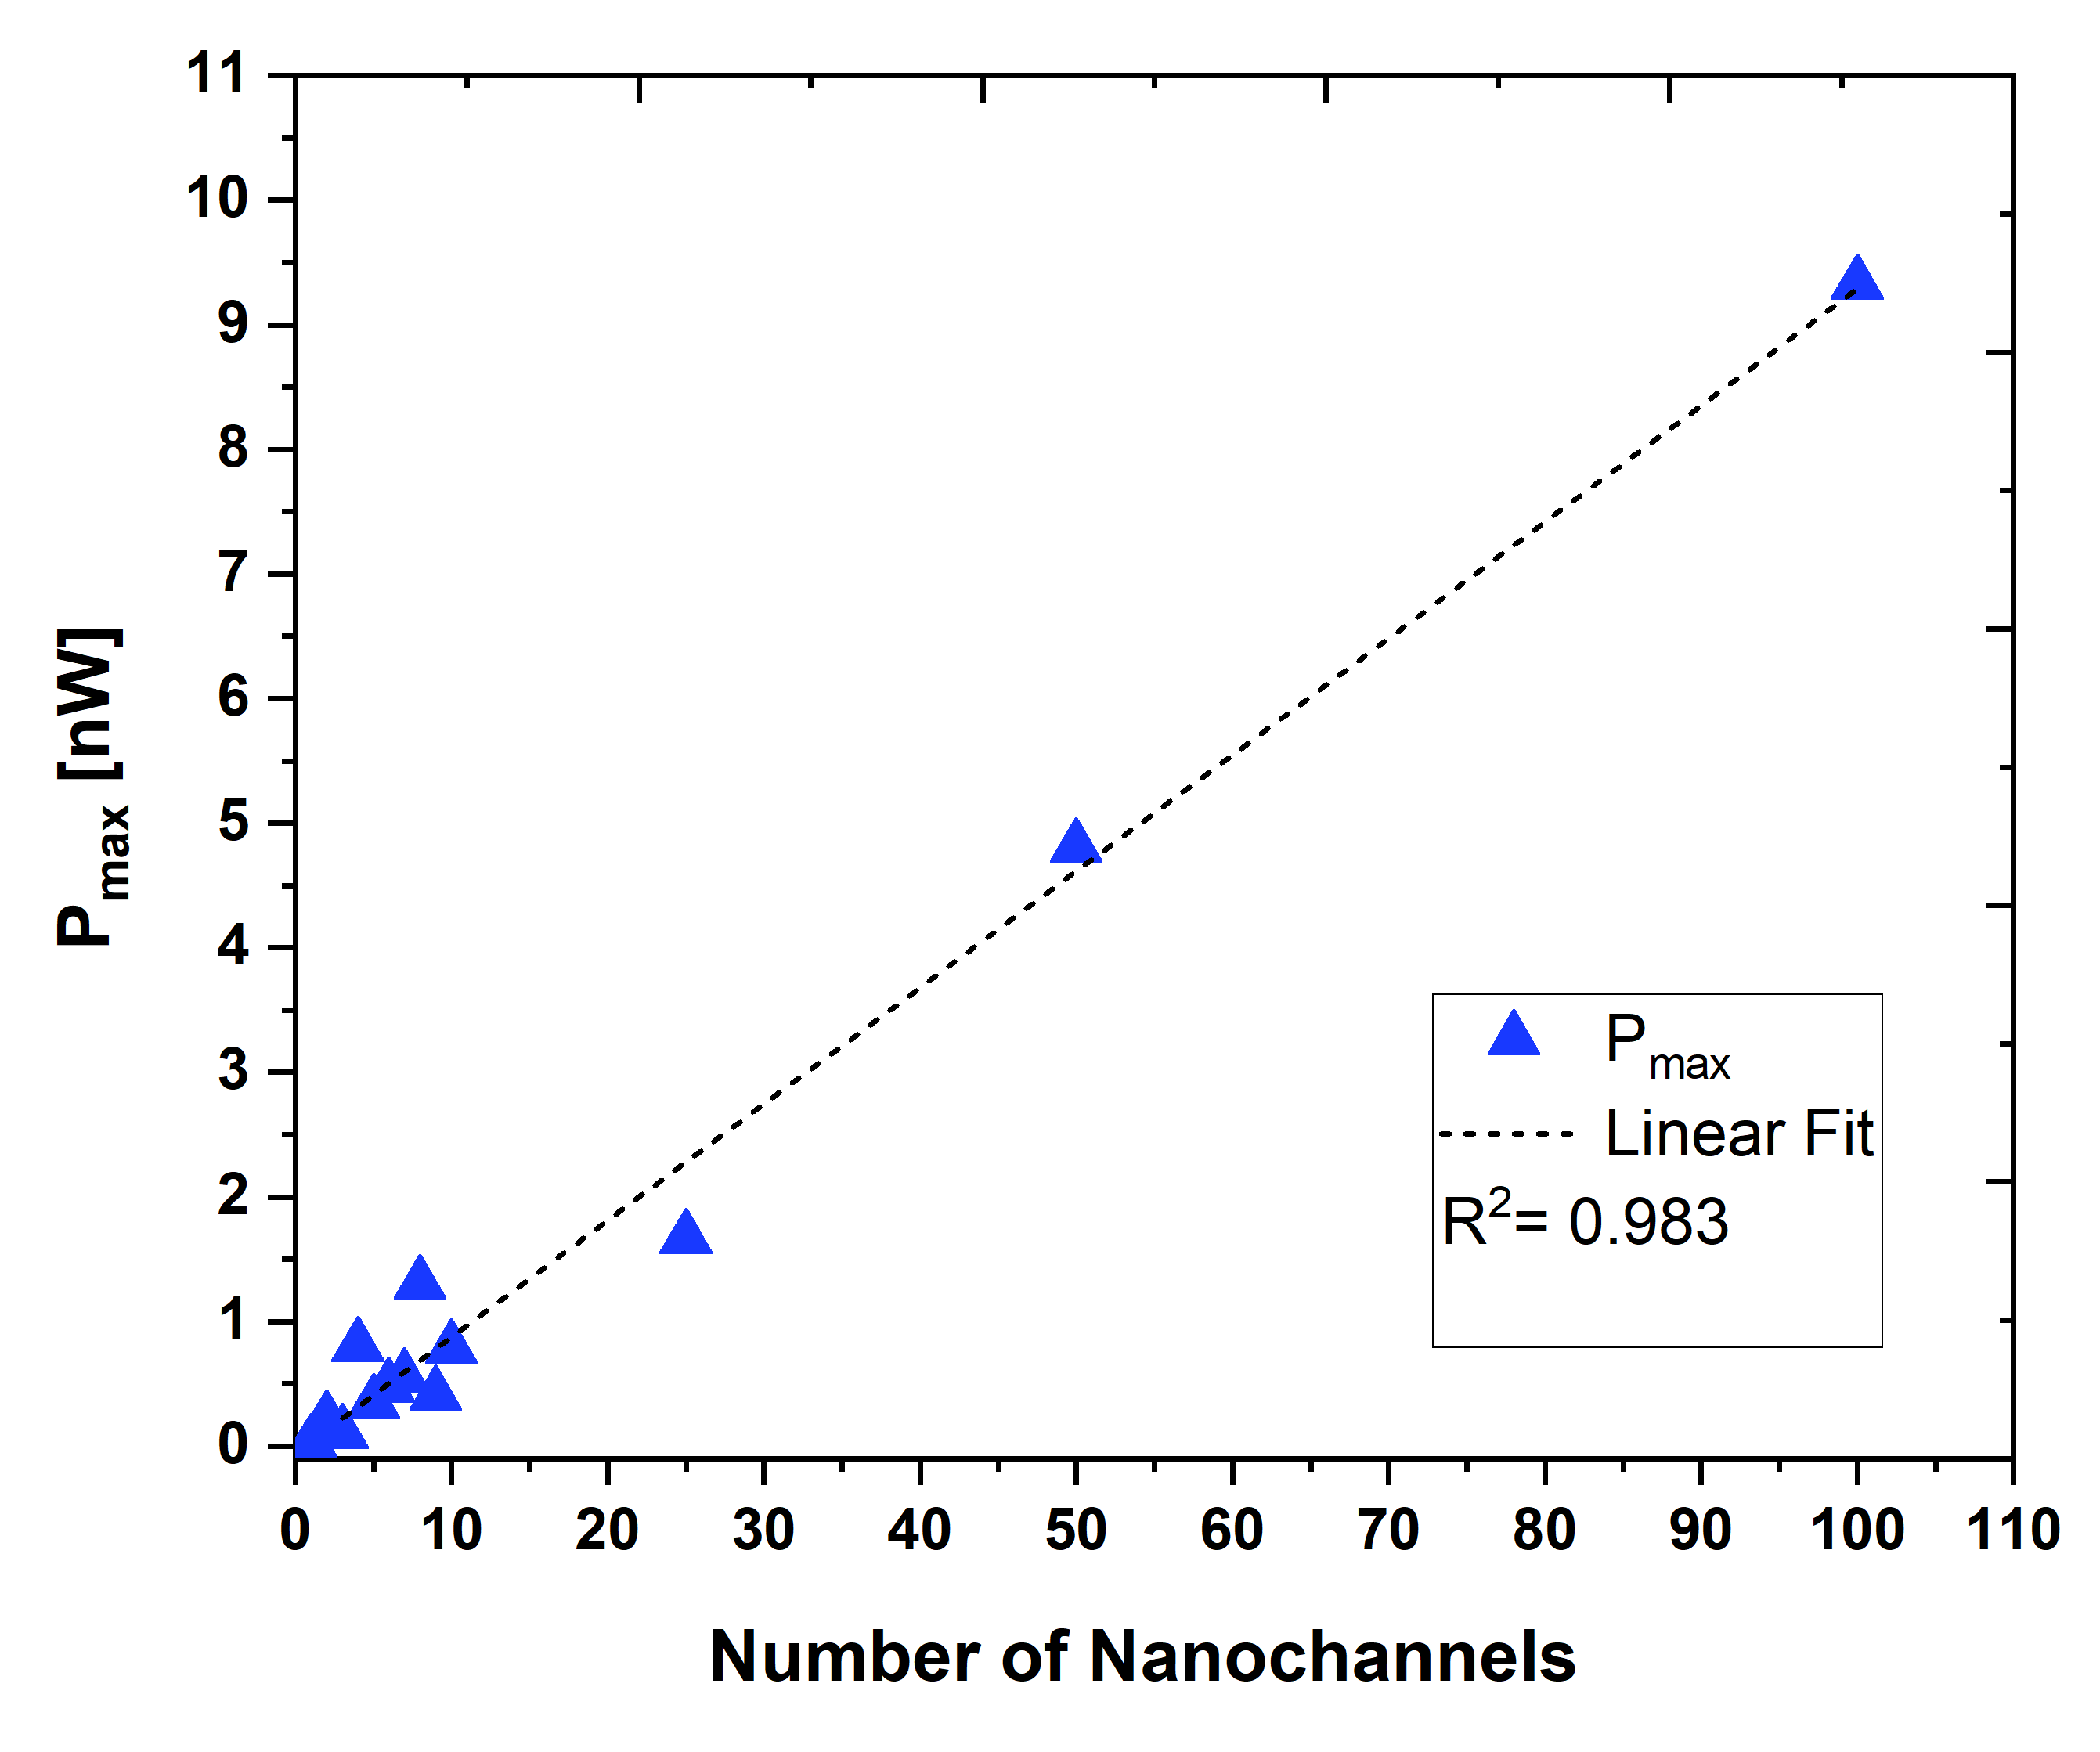
1 – 100 Nanochannels
4 – LOW FLUENCE SCALING
Maximum power output scales linearly up to 100 nanochannels
Average P_{max} per nanochannel is
~87 pW, in agreement with ~80 pW previously reported by Laucirica et al.
Laucirica, G., et al. (2020). Nano Energy, 71, 104612.

Slide 10
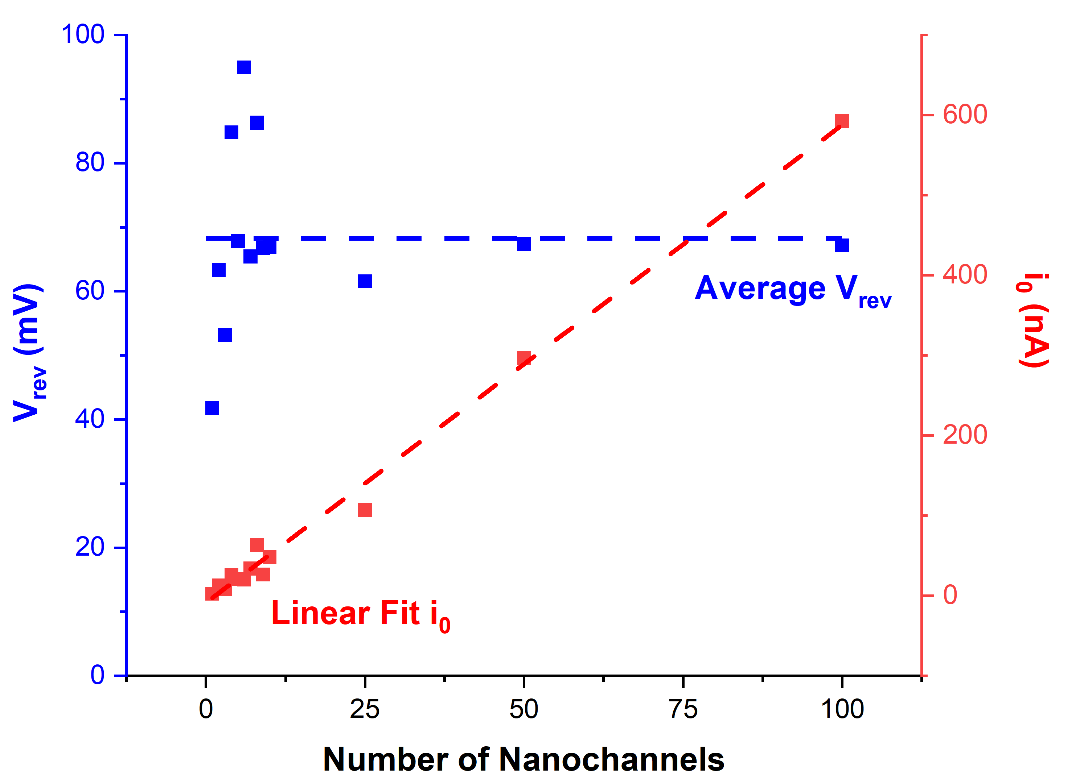
1 – 100 Nanochannels
4 – LOW FLUENCE SCALING
At low density and identical salt concentration gradient
(1000-fold), additional nanochannels linearly increase current without reducing reversal potential
V_{rev} = 68 ± 13 mV
i₀ = (6.0 ± 0.15) nA – 8.8 nA
R² = 0,992
Notes:
Although there is a high variance in rev pot. especially in the very low density region, whatever effect is averaged in the slightly higher densities and the obtained rev pot overlaps with the average value.

Slide 11
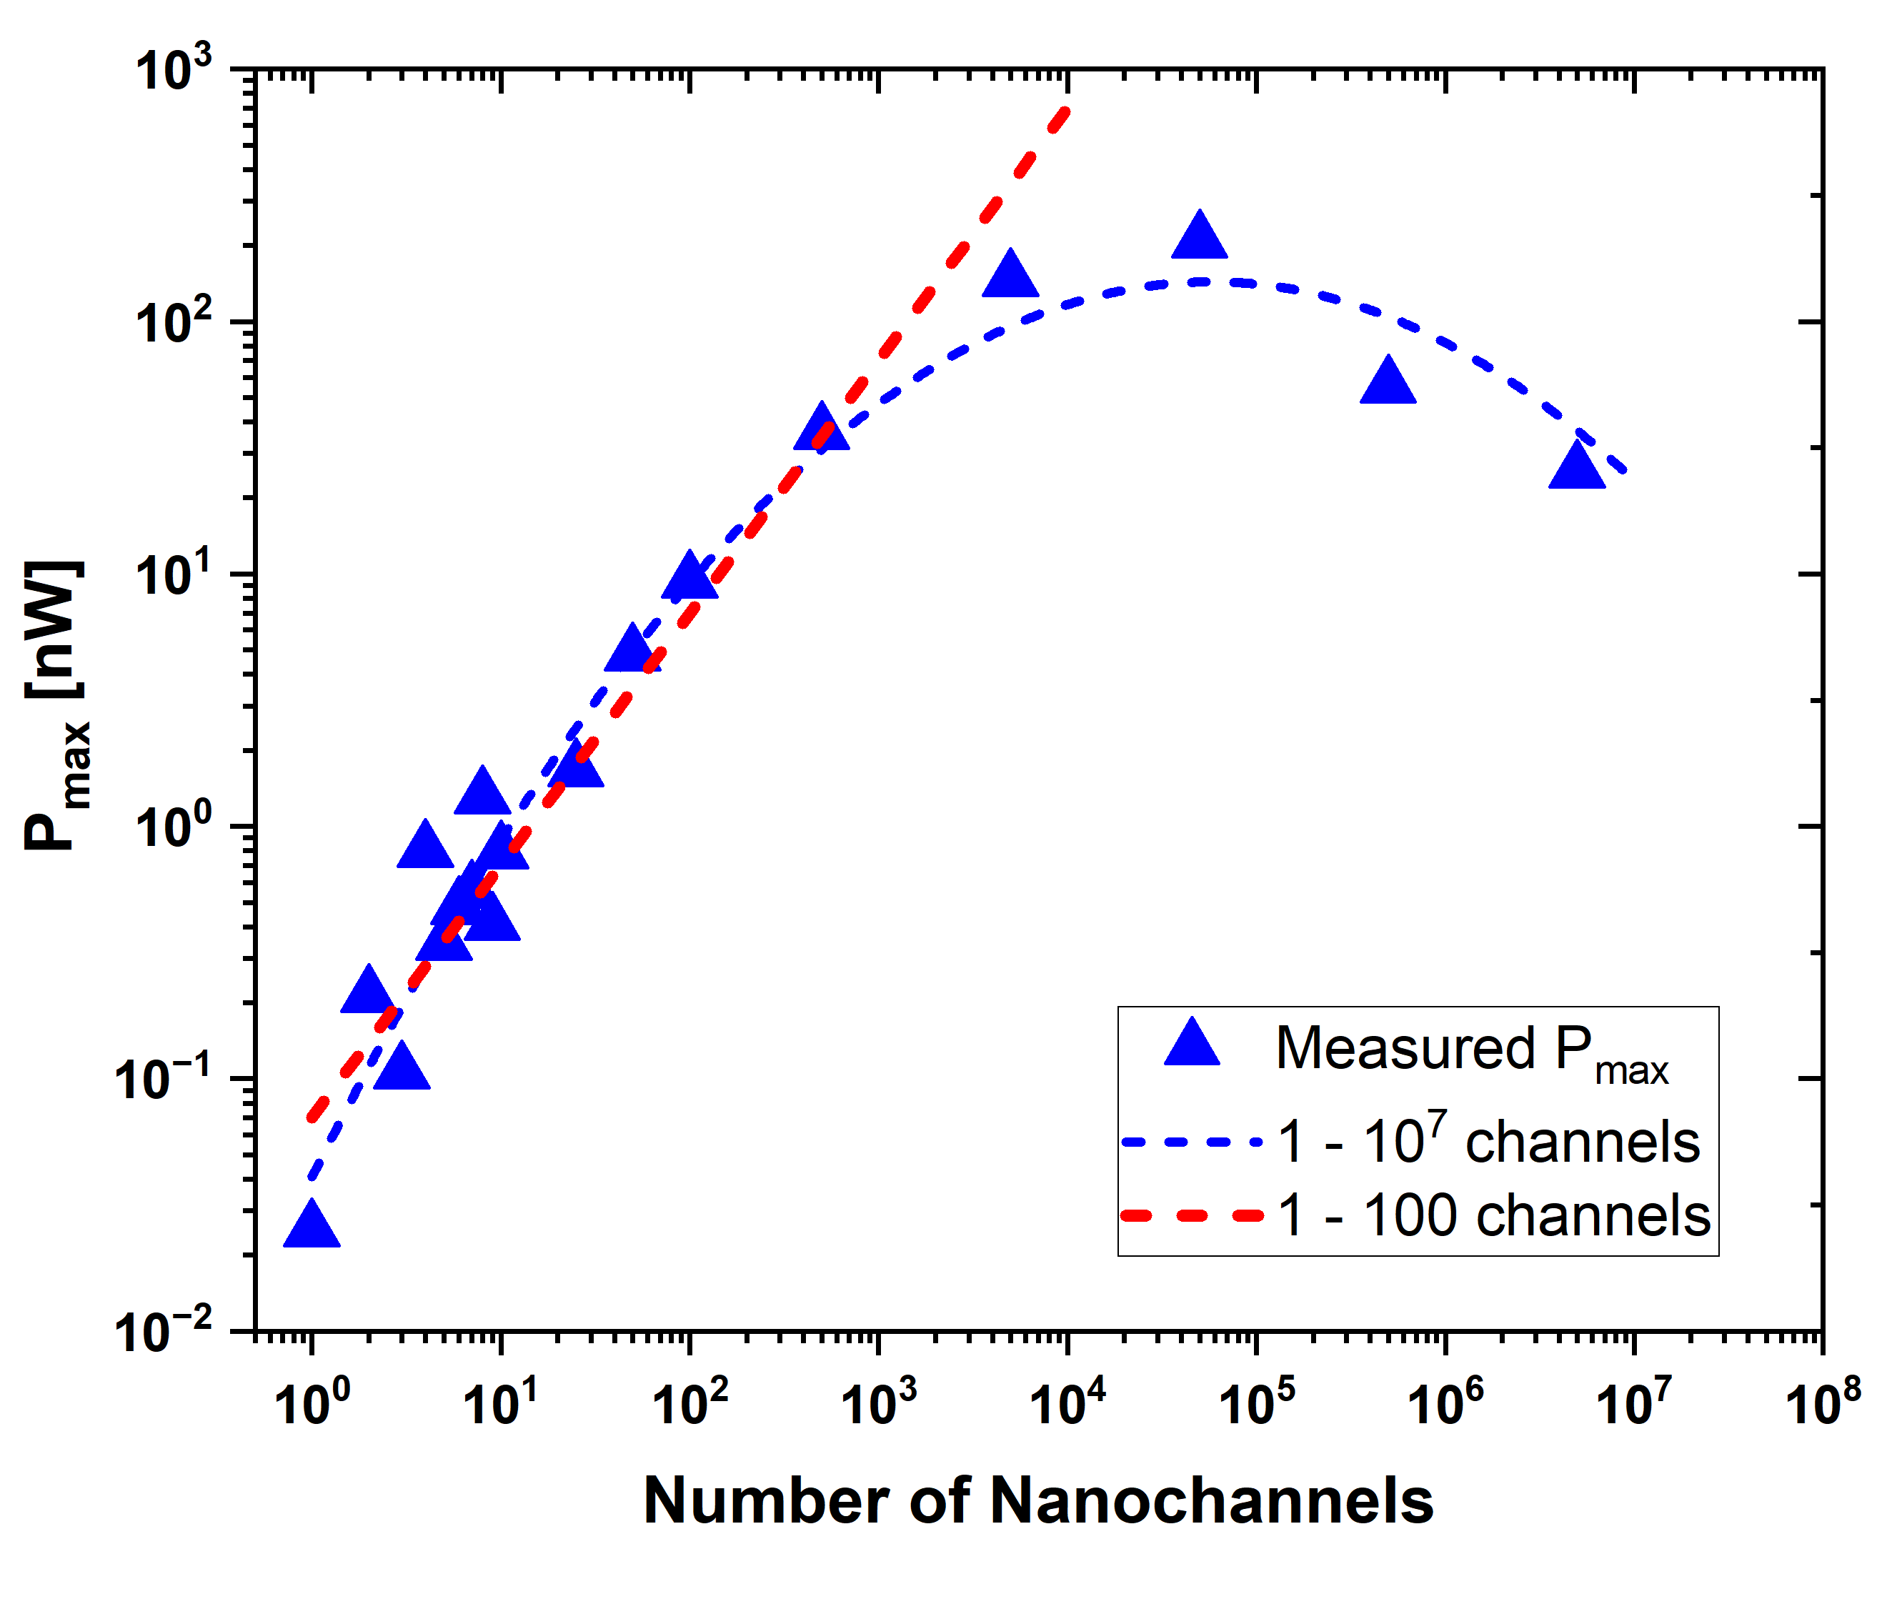
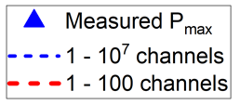
Extending to Higher Fluences
4 – LOW FLUENCE SCALING
Channels act largely independently
Depletion/ enrichment zones of neighboring channels begin to overlap
Interpore interactions start to dominate
Notes:
Of note, in high pore density systems, the
total ion concentration near the low‐concentration entrance is
obviously larger than that of the low pore density systems, which
implies stronger ion concentration polarization (ICP

Slide 12
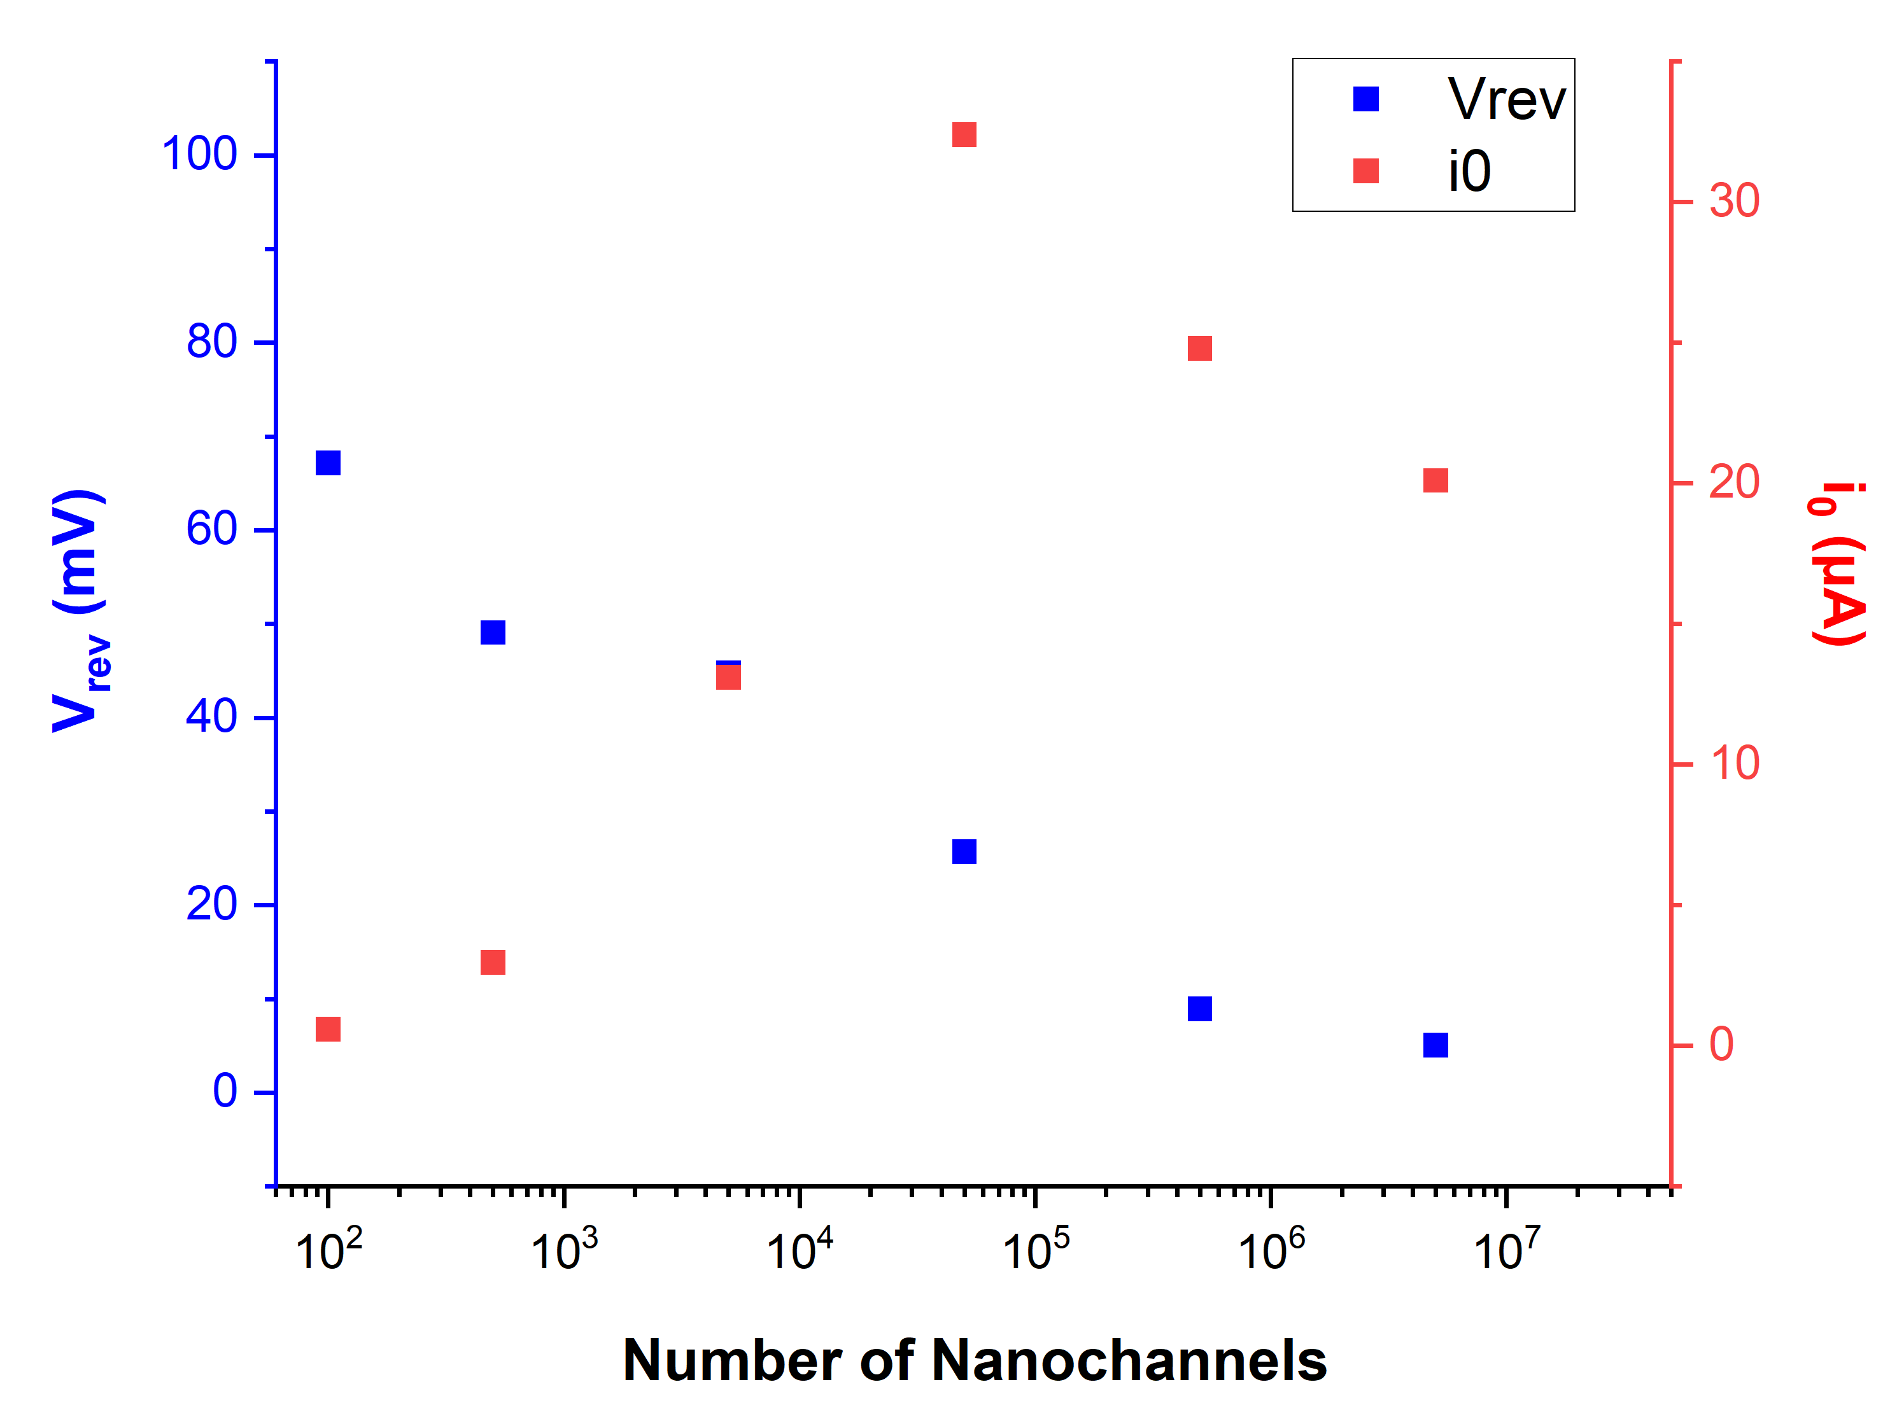
Extending to Higher Fluences
4 – LOW FLUENCE SCALING
At high density, V_{rev} decreases and i₀ no longer scales proportionally
This indicates loss of charge selectivity due to concentration polarization
Notes:
The reason is visible in V_rev and i₀. At high density, the reversal potential decreases and the current no longer scales proportionally. This means the membrane is losing charge selectivity, and the cause is concentration polarization: the pores are so close that the ion concentration near their entrances is no longer what we set in the bulk.
short-circuit current is the difference between cation and anion flux, so as selectivity drops, the two increasingly cancel, and you can see this in the reversal potential falling from about 67 to about 5 millivolts. Since power is i₀ times V_rev over four, both factors falling makes the power drop even faster.

Slide 13
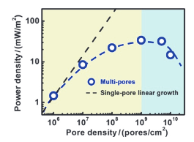
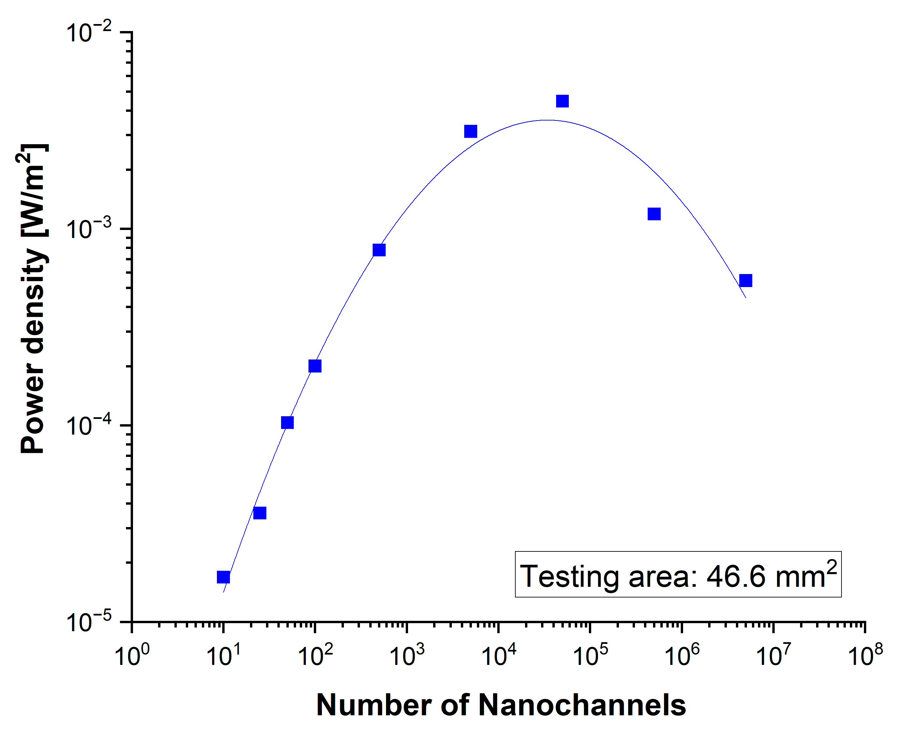
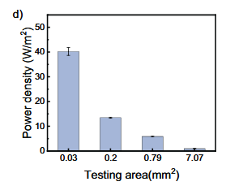
Power Density Comparison
4 – LOW FLUENCE SCALING
4.7 × 10⁻³ W/ m²
Su, J., et al. (2018). Chinese Journal of Chemistry, 36(5), 417-420.
Commercial Goal: 5.0 W/ m²
Duan, R., et al. (2024). Adv. Func. Mat., 34(12), 2311258.
Notes:
Commercial goal is 5 W/m2
Peak power density: 4.66×10⁻³ W/m² at 10⁵ ions/cm²
Theoretical analysis of cylindrical nanopore arrays by Su et al. Qualitative trend numerically calculated by a PNP model
The cylindrical-pore PNP model reproduces the qualitative turnover, but it does not model the bullet-shaped geometry directly.
Tsutsui says that 10 µm thick membranes can hold many more pores (up to 10^8) without without significant effects of the pore-pore electrostatic couplings.

Slide 14
Conclusions and Outlook
SINGLE NANOCHANNEL
LOW DENSITY
TRANSITION
HIGH DENSITY
1000-fold salinity gradient and pH ~10
approximately additive
P ∝ N
access regions start to overlap: sublinear
concentration polarization becomes dominant: decrease
N = 1
1 – 10³ ions/cm²
10⁴ – 10⁵ ions/cm²
10⁶ – 10⁷ ions/cm²
Next Steps
Dialogue between single and multipore research can be established via
low/ intermediate nanochannel densities
Surface/ geometry optimization
Coupled effects with thermal gradient
Membrane thickness and test area optimization
Notes:
Another possible performance enhancement could be the combination of optimal geometry and pore density together with voltage-gate controlled nanochannels, which has been observed to highly enhance ion selectivity while maintaining an effective concentration gradient
The low- and intermediate-density regime provides a useful bridge between single-pore physics and practical multipore membranes.”
ICP is much less with diodes (partially positive, partially negative surface charge)

Slide 15


THANK YOU!
Results presented here are based on an experiment, performed at the X0 beamline of GSI Helmholtzzentrum für Schwerionenforschung, Darmstadt (Germany) in the frame of FAIR Phase-0

Slide 17
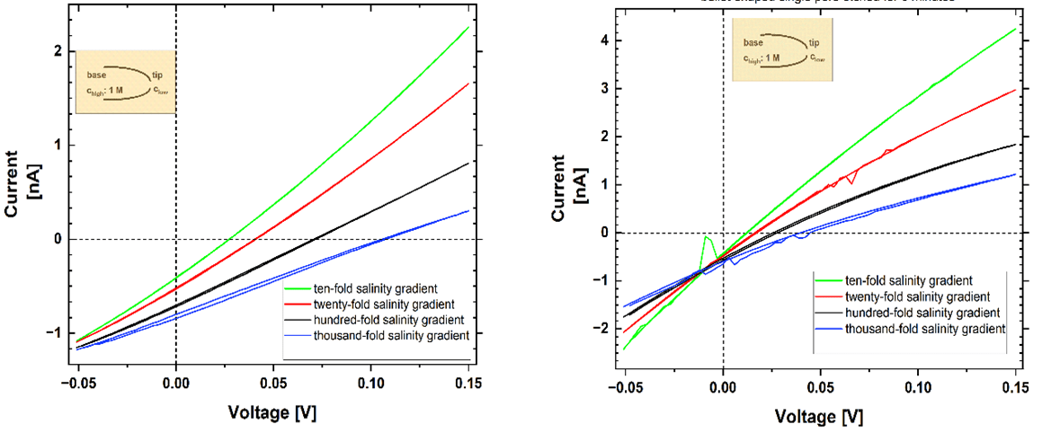
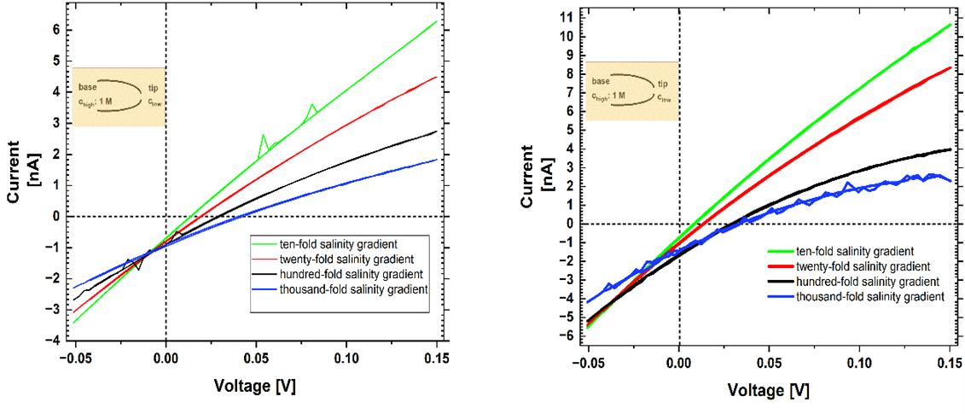
4 min.
6 min.
8 min.
10 min.

Slide 18
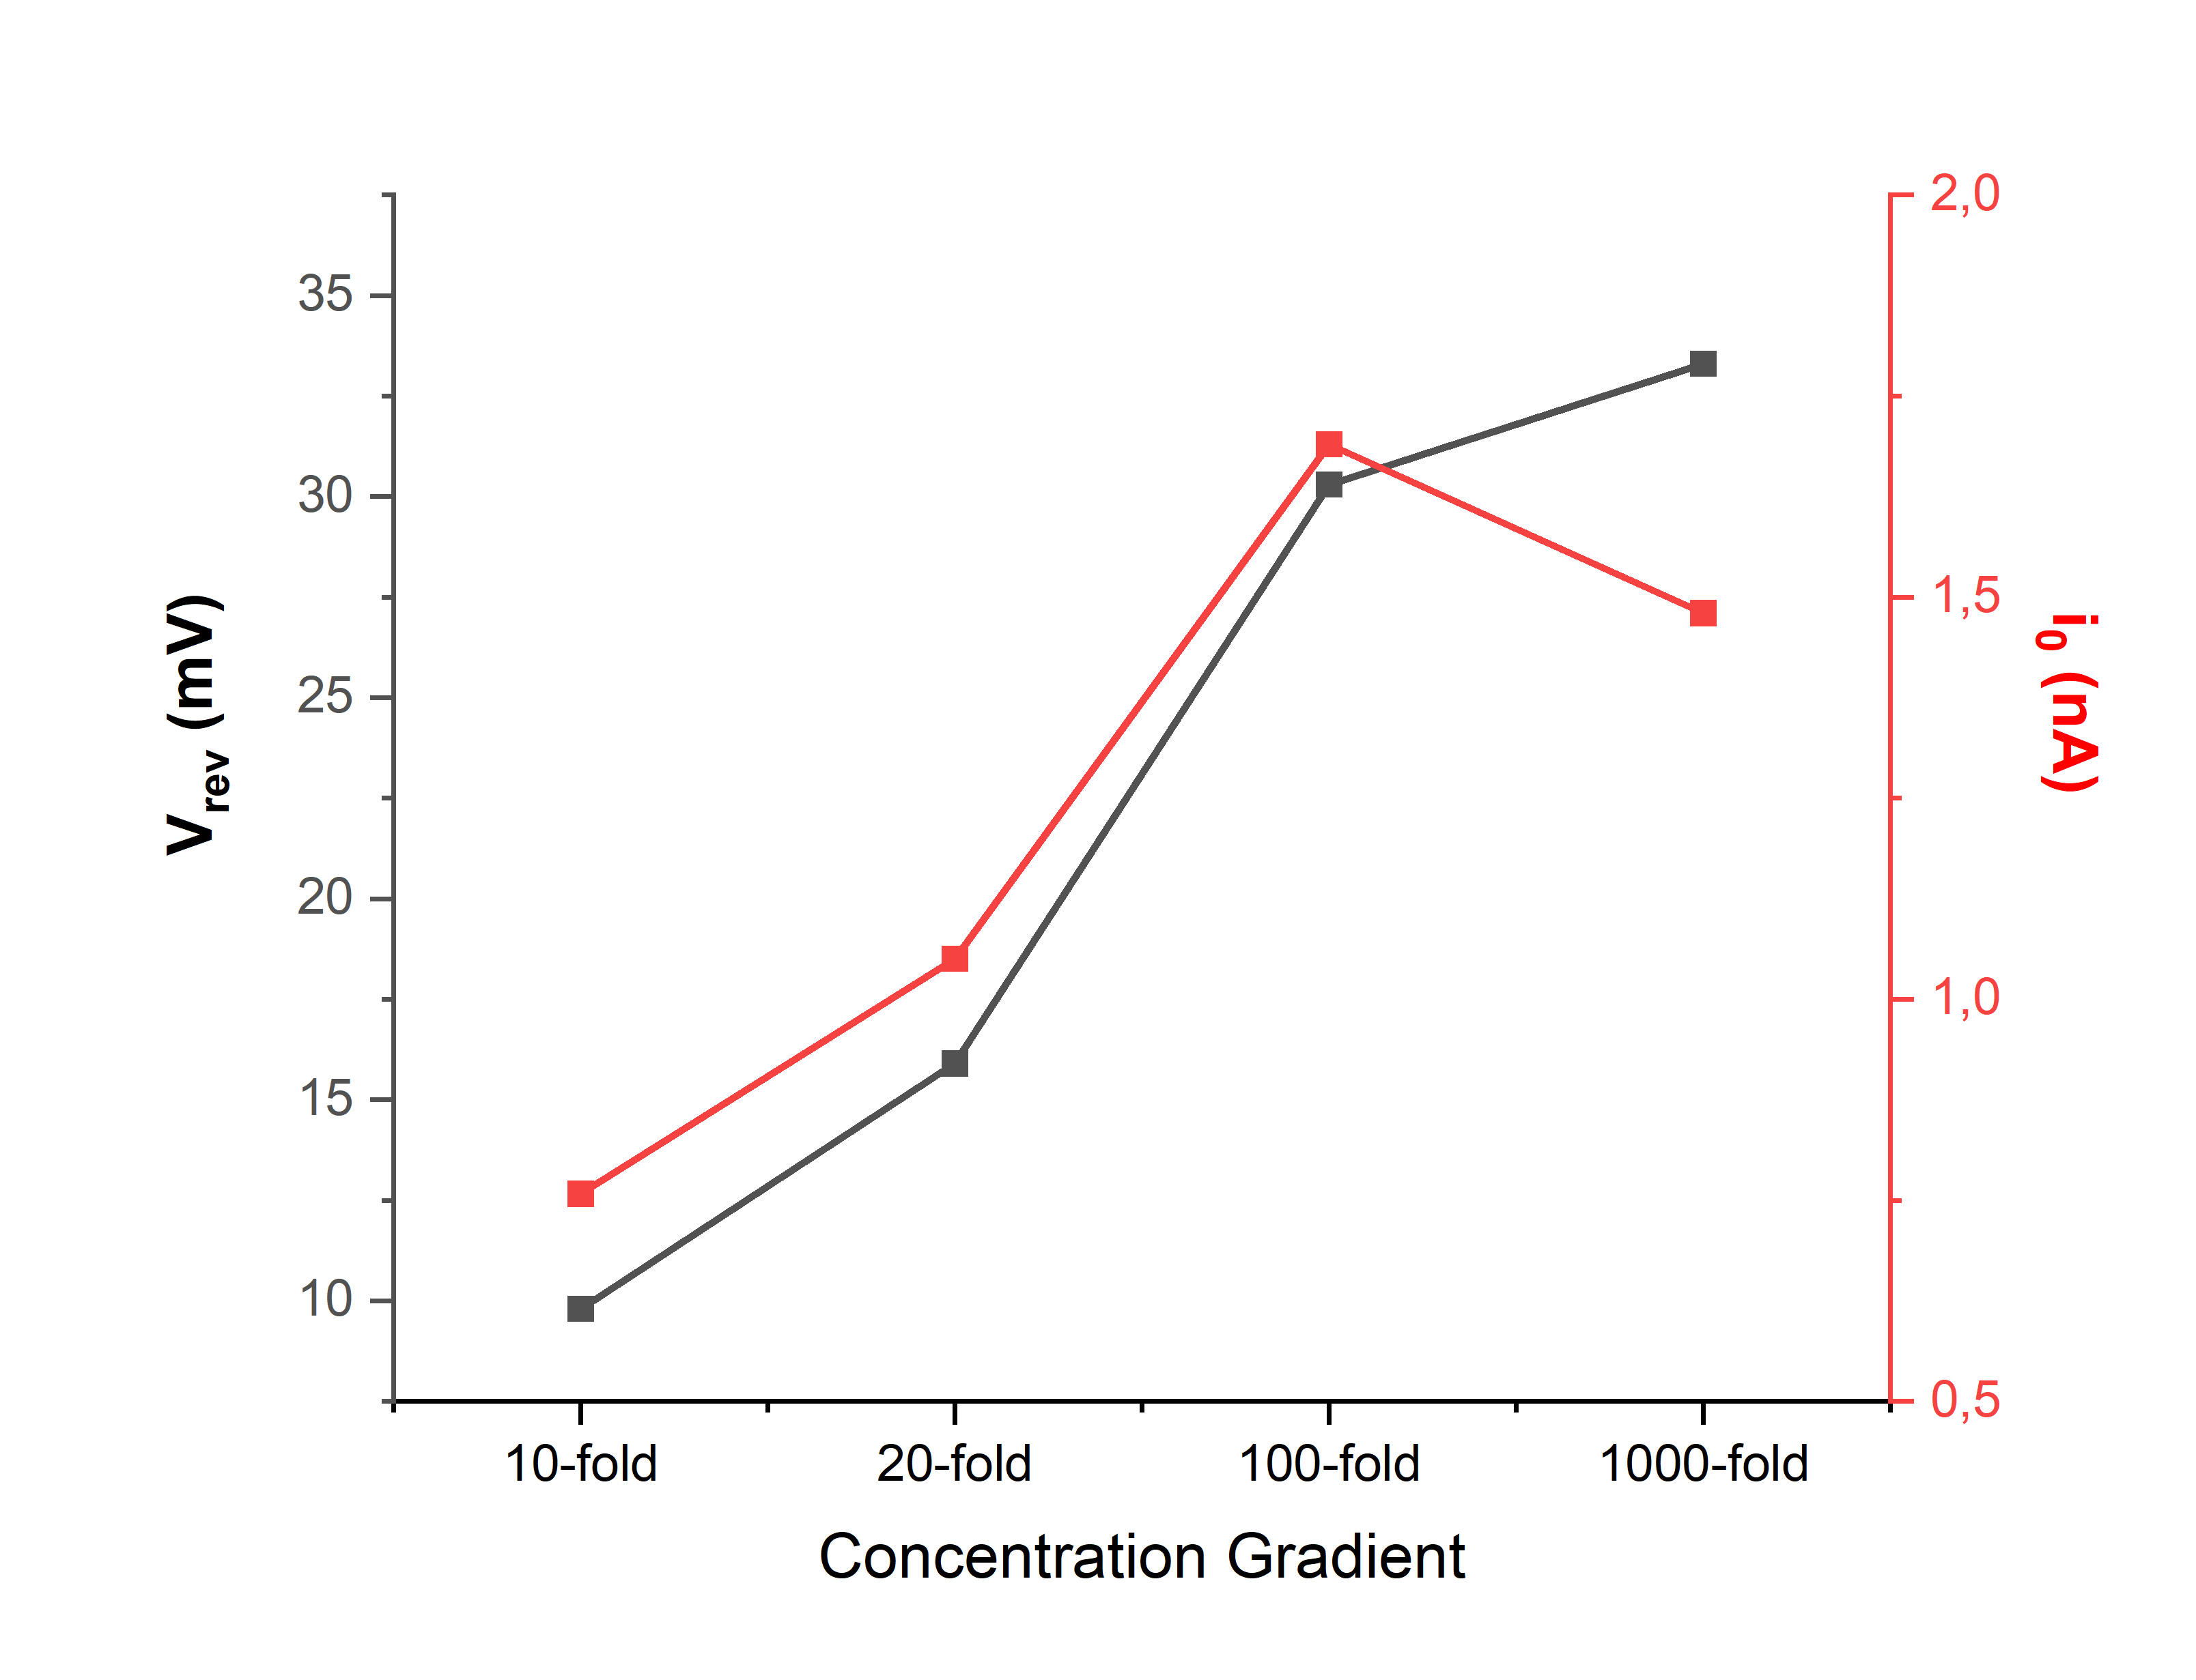
Concentration gradient on Vrev and i0

Slide 19
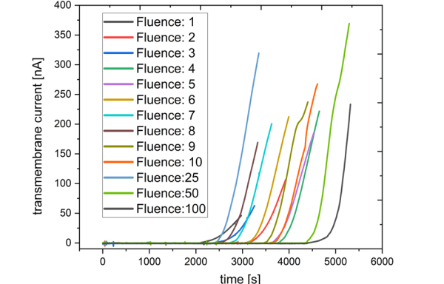
Cell-etching curves of low-fluence cylindrical PET nanochannels
9 M NaOH, constant applied voltage of 1 V
Determination of the nanochannels available for ion transport after etching by I-t measurements
Room temperature cell-etching with lower etching rate
Duration for the first breakthrough event observations independent of fluence
higher temporal resolution of the etching process

Slide 20
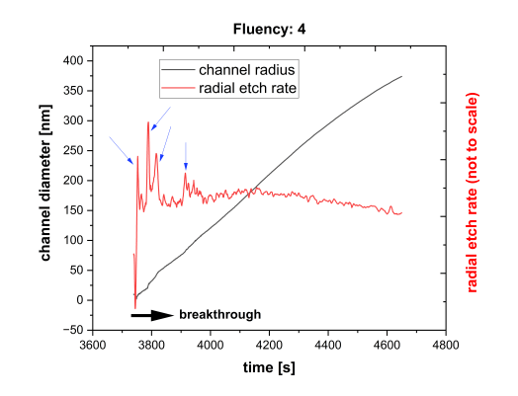
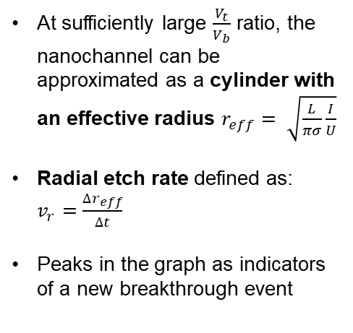

Cell-etching curves of low-fluence cylindrical PET nanochannels
$$\text{Fluence}\text{: }4 ions/{cm}^{2}$$
At sufficiently large $\frac{V_{t}}{V_{b}}$ ratio, the nanochannel can be approximated as a cylinder with an effective radius $r_{eff}= \sqrt{\frac{L}{πσ}\frac{I}{U}}$
Radial etch rate defined as: $v_{r}=\frac{∆r_{eff}}{∆t}$
Peaks in the graph as indicators of a new breakthrough event

Slide 21
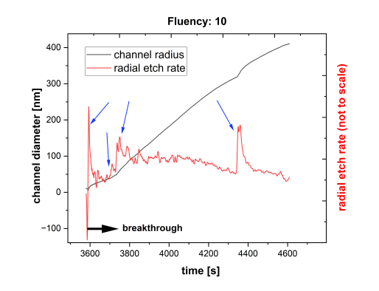

Cell-etching curves of low-fluence cylindrical PET nanochannels
$$\text{Fluence}\text{: }10 ions/{cm}^{2}$$
Graphically distinguishing the breakthrough events as current increases at higher fluences proved in this case to be ineffective
Prone for external mechanical stimuli and differentiating overlap of peaks
Can be further improved via the usage of a Faraday cage and improved data analysis

Slide 22
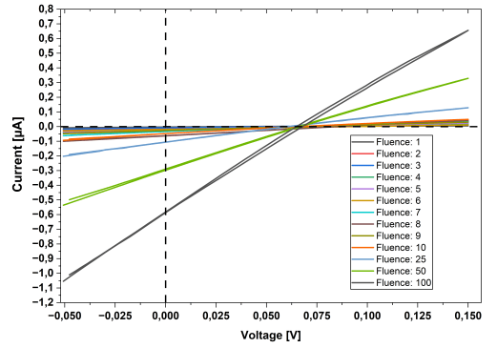
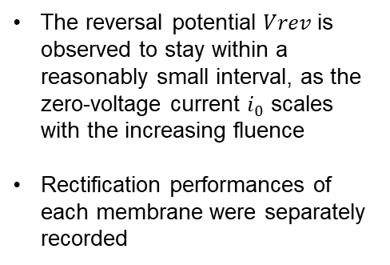
  Energy conversion performance of low-fluence (1-100) bullet-shaped nanochannels
The reversal potential 𝑉𝑟𝑒𝑣 is observed to stay within a reasonably small interval, as the zero-voltage current $i_{0}$ scales with the increasing fluence
Rectification performances of each membrane were separately recorded

Slide 23
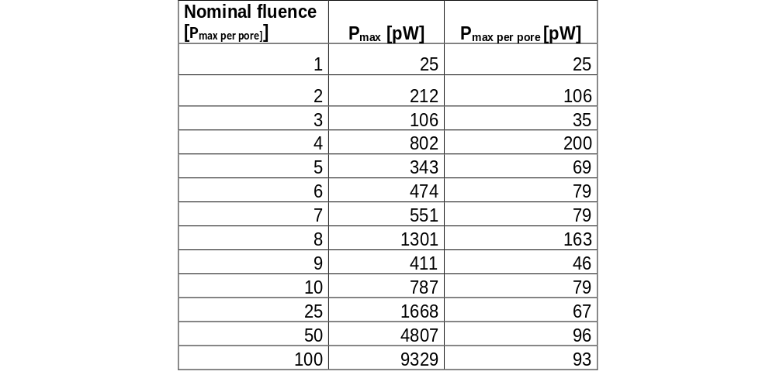
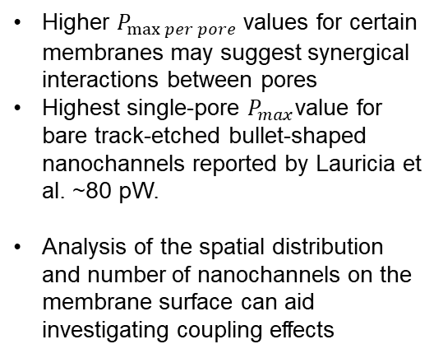
Energy conversion performance of low-fluence (1-10² ions/cm²) bullet-shaped PET nanochannels
Higher $P_{\max{per pore}}$values for certain membranes may suggest synergical interactions between pores
Highest single-pore $P_{max}$value for bare track-etched bullet-shaped nanochannels reported by Lauricia et al. ~80 pW.
Analysis of the spatial distribution and number of nanochannels on the membrane surface can aid investigating coupling effects

Slide 24
Outline
1
Motivation & Background
Blue energy, nRED principle, bullet-shaped nanochannels
2
Fabrication & Methods
Ion-track etching, electrochemical characterization
3
Single Nanochannels
Geometry, rectification, energy conversion, pH effects
4
Low-Fluence Scaling Study
Pore-density dependence of power output (1 – 10⁷ ions/cm²)
5
Conclusions & Outlook
Key findings and future directions
Notes:
I’ll briefly introduce the motivation and fabrication, establish the single-channel behavior, and then and then spend most of the time on the main question: what happens to the power output as we add more and more channels.

