Slide 1



An Expression of Interest
In-situ investigation of tuning of magnetic
properties during ion irradiation
Sachin Pathak • Ajay Gupta • D. K. Avasthi
UPES Dehradun, India
• Ranjeeta Gupta
SSJ Subodh PG College, Jaipur

Slide 2
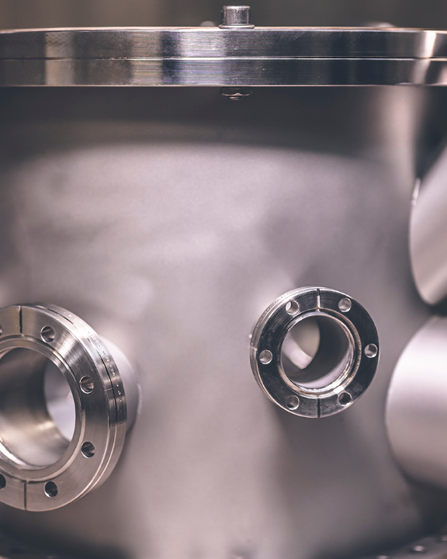
FACILITY PROPOSAL
In-Situ MOKE Integration
Real-time magneto-optic Kerr effect (MOKE) tracking @ ion accelerator beamline
High-vacuum compatible installation
Real-time magnetic parameter extraction
Non-destructive target probing

Slide 3
Significance of in-situ MOKE
MOKE provides a sensitive route to follow magnetic anisotropy, coercivity and related hysteretic parameters during ion irradiation
Journal of Magnetism and Magnetic Materials 310 (2007) 2491-2493
Conventional ex-situ approach
• Irradiation and characterization are performed as separate steps.
• Intermediate magnetic states can be missed.
• Repeated handling can introduce uncertainty or contamination.
in-situ MOKE approach
• Hysteresis response analysed as a function of ion fluence.
Non-contact monitoring inside the irradiation chamber.
Fluence dependence of processes like, stress relaxation, phase transformation, morphological changes: correlation with the associated changes in the magnetic properties
Other Advantages
• Direct correlation between ion dose and magnetic evolution.
• Identification of transition/optimization fluence.
• Real-time feedback for engineering of magnetic materials

Slide 4
Instrument Purpose & Utility
Real-Time Tracking
Monitoring anisotropy during irradiation.
Tracking coercivity and saturation fields.
Vacuum Preservation
Tuning materials inside the end-station.
Eliminating post-process contamination.
Diverse User Base
Serving cutting-edge spintronics groups.
Enabling novel quantum materials research.

Slide 5
Role of Ion Irradiation in magnetic nanoparticles embedded in Silica matrix: an example
Swift heavy ion (SHI) interactions drive magnetic property changes.
SHI irradiation
Electronic energy Deposition
Thermal spike
Dissolution and Reprecipitation
Localized energy deposition | intense electronic excitation along the ion trajectory
Thermal-spike formation | transient nanometric high-temperature region
Defect & interface modification | defect creation/annihilation, stress relaxation and intermixing
Nanostructure engineering | growth, dissolution, elongation, phase decomposition, reprecipitation and morphological modification
Property tuning | Elongation: introduction of magnetic anisotropy in prolate nanoparticles J. Appl. Phys. 115 174304 (2014) Structural and functional properties through ion fluence

Slide 6
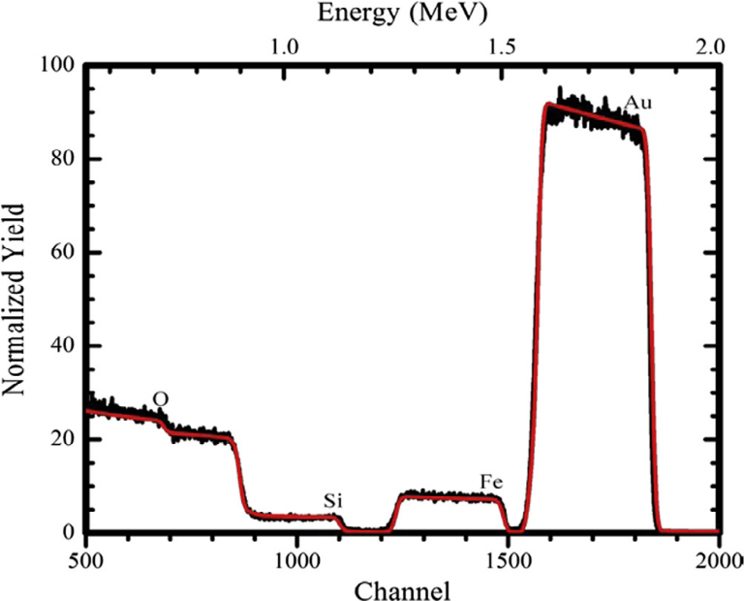
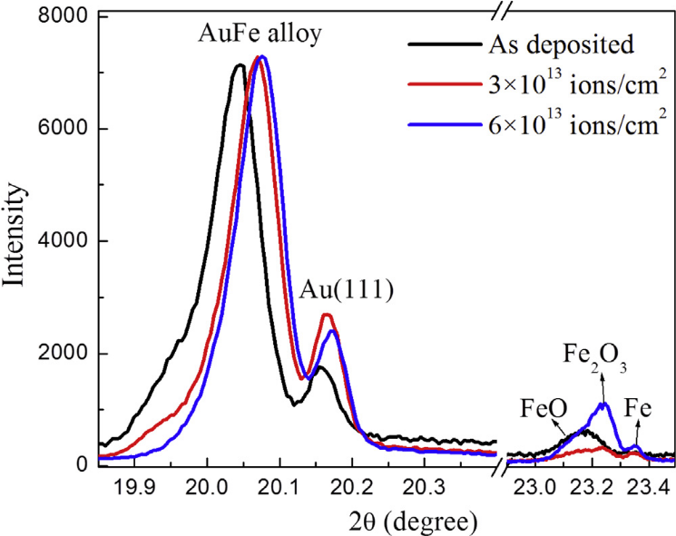
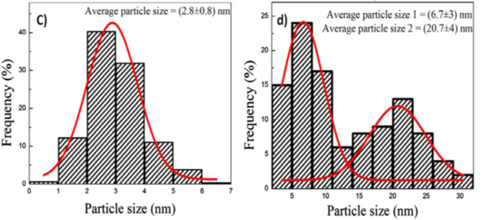
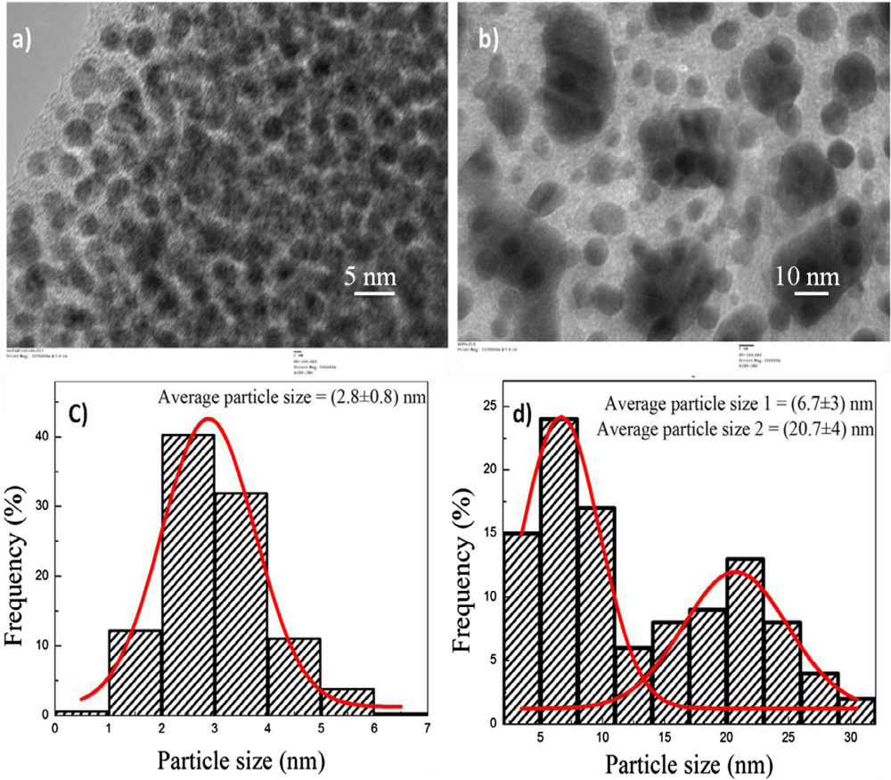
Some Existing Results: SHI modification
RBS spectra of as-deposited AuFe/SiO₂ nanocomposite thin film.
Metal composition
Au 19 at. % and Fe 14 at. %
GIXRD pattern of as deposited and irradiated thin films at different fluences
(a)
(b)
SHI induced phase decomposition
Phase decomposition: Au-Fe → Au + Fe NPs.
Mechanism: Dissolution → diffusion → reprecipitation.
Nanoparticles size distribution: (a) as deposited thin film (b) irradiated at a fluence of 6×10¹³ ions/cm²
TEM micrographs AuFe film: (a) as deposited thin film (b) irradiated at a fluence of 6×10¹³ ions/cm²
Nuclear Instruments and Methods in Physics Research B 379 (2016) 206-210

Slide 7
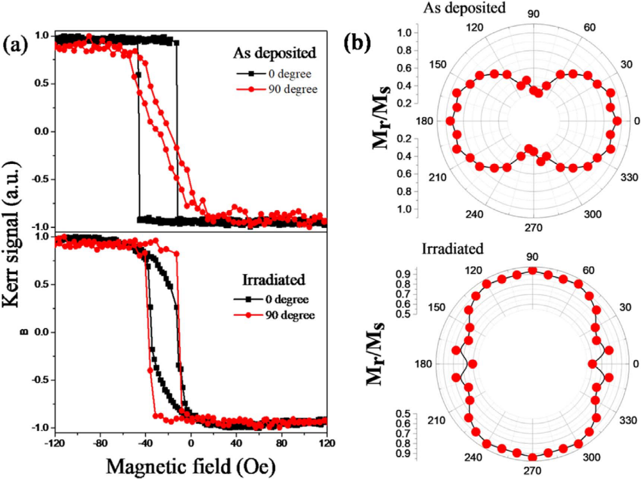
Au-Fe alloy thin film: MOKE before and after SHI irradiation.
As-deposited: Pronounced uniaxial magnetic anisotropy with Stone-Wohlfarth-type behaviour.
After irradiation: Reduced anisotropy due to irradiation-induced defects.
Remanence: Significant change in azimuthal dependence after irradiation.
Exchange bias: SHI irradiation modifies the exchange-bias response.
Saturation field: < 100 Oe, indicating suitability for low-field applications.
Mater. Res. Express
7 (2020) 076102
(a) Hysteresis loops at different azimuthal angles for as-deposited and irradiated film; (b) azimuthal angle dependence of remanence magnetization of as-deposited and irradiated film

Slide 8
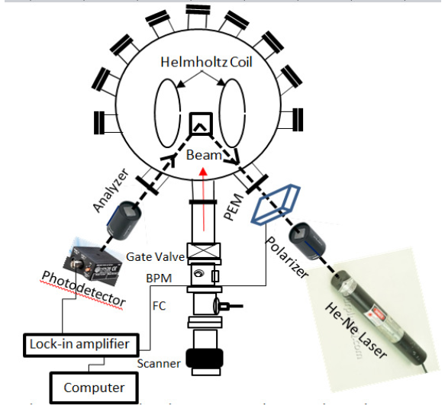
Proposed in-situ MOKE @beam line
Already tested set up @IUAC: a make shift arrangement: Not permanently installed
Optical module
• 632.8 nm He-Ne laser; ~ 45° incidence.
• Polarizer → PEM → sample → analyzer → detector.
Magnetic module
• Helmholtz coils integrated around the sample.
• In-plane applied magnetic field for longitudinal MOKE.
Detection & control
• Photodiode + lock-in amplifier.
• Computer-controlled acquisition synchronized with ion fluence.
Sample stage
• Goniometer head for sample alignment
• In-plane rotation: to study of magnetic anisotropy
• Temperature variation
Instrument Schematic

Slide 9
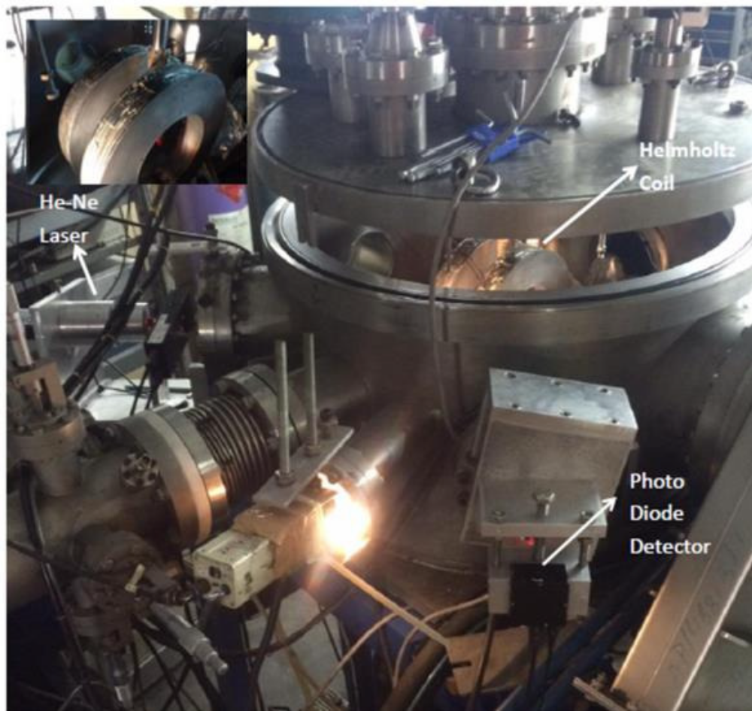
Photograph of the in-situ MOKE measurement setup integrated with the ion irradiation chamber at the Materials Science Beamline, IUAC, New Delhi.

Slide 10
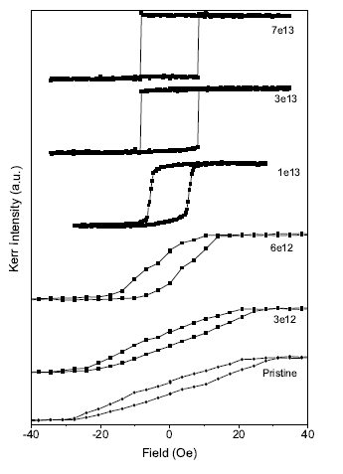
Results from In-situ Moke set up: Magnetic Parameters vs Ion Fluence
in-situ MOKE hysteresis loops as a function of fluence
In-situ MOKE facility developed for real-time monitoring during SHI irradiation.
Fe₁₁Au₈₉ film irradiated with 100 MeV Au ions.
Pristine film: In-plane uniaxial magnetic anisotropy due to internal stress.
Increasing fluence: Stress relaxation reduces magnetic anisotropy.
3 × 10¹³ ions/cm²: Rectangular hysteresis loop due to complete stress relaxation.

Slide 11
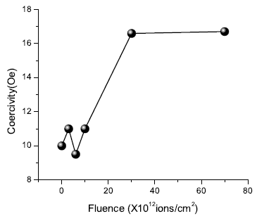
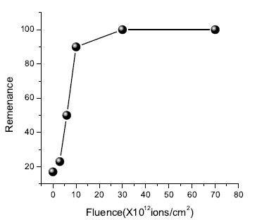
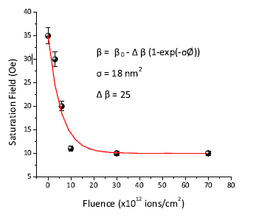
Results from In-situ set Moke set up: Magnetic Parameters vs Ion Fluence
Saturation field decreases with fluence
Coercivity increases with fluence
Remanence increases with fluence

Slide 12
Potential User Base & Collaborative Scope
Interested Researchers
UPES: Sachin Pathak, A. Gupta, D.K. Avasthi
SSJ Subodh PG College, Jaipur: Ranjeeta Gupta
DESY Germany: Sarathlal K V
UGC DAE CSR Indore: Mukul Gupta, V.R. Reddy
Devi Ahilya Vishwavidyalaya: Ratnesh Gupta
IIT Delhi: S. Ghosh
VECC Kolkata: P. Karmakar
Saurashtra University: Utpal Joshi
Spintronics & magnetic materials
Thin films and multilayers
• Magnetic anisotropy engineering
• Ion-induced defect and stress modification
• Real-time coercivity / saturation-field tracking
Collaborative network
• UPES Dehradun:
• DESY, Germany
• UGC-DAE CSR, Indore
• IIT Delhi
• VECC Kolkata
• Other participating materials-science groups
Designed and proposed as a shared multi-user facility
at the end of beamline after irradiation chamber

Slide 13
Interested Researchers in India
UPES Dehradun: Sachin Pathak, A. Gupta, D.K. Avasthi
SSJ Subodh PG College, Jaipur: Ranjeeta Gupta
DESY Germany: Sarathlal K V
UGC DAE CSR Indore: Mukul Gupta, R. Reddy
Devi Ahilya University: Ratnesh Gupta
IIT Delhi: S. Ghosh
VECC Kolkata: P. Karmakar
Saurashtra University: Utpal Joshi
Special Thanks to Niladri: PhD student@UPES for making PPT at short notice

Slide 14
Thank you
Thank you
Sachin Pathak • Ajay Gupta • D. K. Avasthi • Ranjeeta Gupta

Slide 15
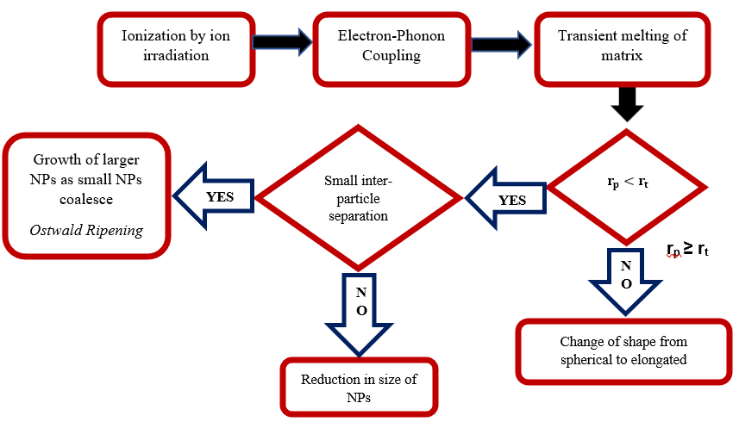
Role of Ion Irradiation (continued)
Conditions governing the changes under electronic energy deposition. ‘r_{t}’ is the track radius and ‘r_{p}’ is the radius of spherical nanoparticle

Slide 16
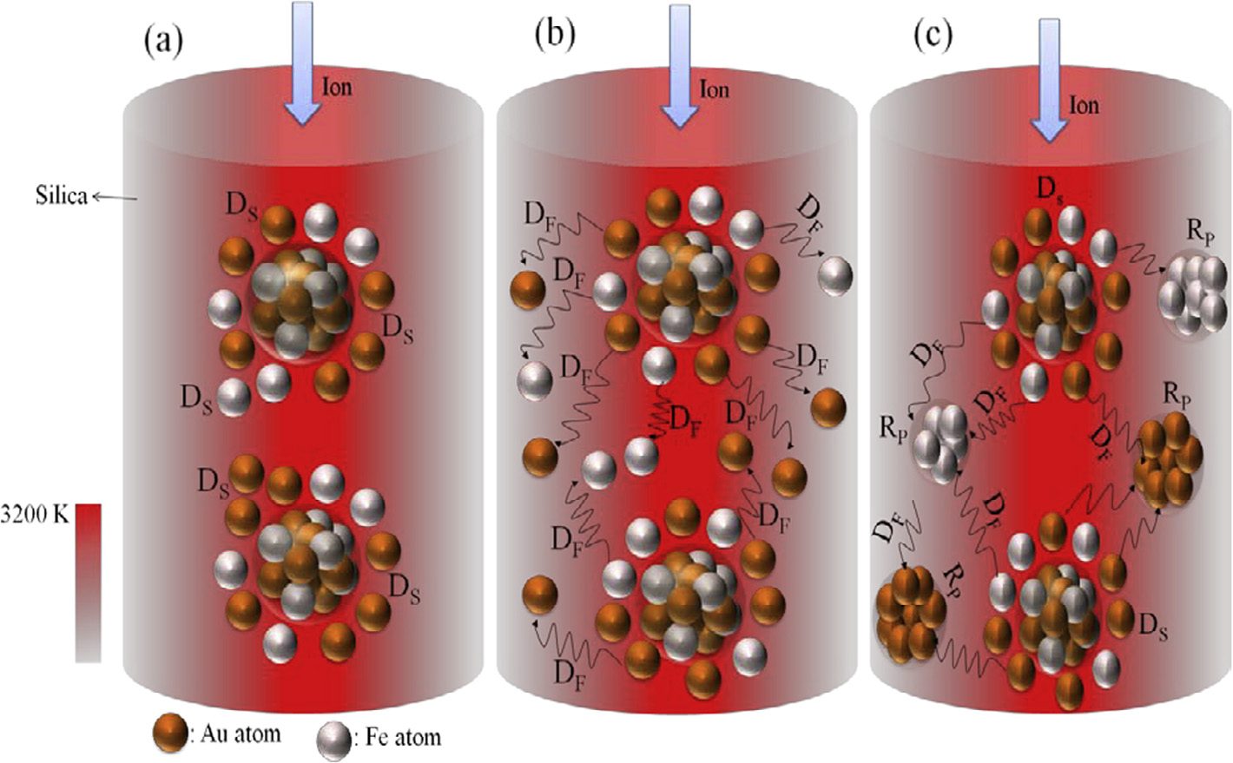
Role of Ion Irradiation (continued)
Schematic of ion track in silica and process of (a) dissolution of alloy nanoparticles (b) diffusion of dissolved atoms from surface of alloy nanoparticles in molten silica and (c) reprecipitation of individual element nanoparticles, D_{S}, D_{F} and R_{P} in the figure stands for dissolution, diffusion and reprecipitation of atomic species.
Nuclear Instruments and Methods in Physics Research B 379 (2016) 206-210

