Slide 1
Nanowires by Design: From Size-Dependent Properties to Functional Architectures
M.F.P. Wagner, M. Li, I. Schubert, E. Elmorsy, C. Schröck,
M.E. Toimil Molares
Notes:
Hello everyone. In my talk I will show you a bit of how we use the template route to fabricate nanowires and also trying to show you some of our recent works on sample fabrication and research activities.

Slide 2
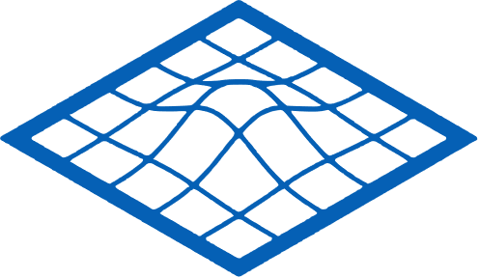

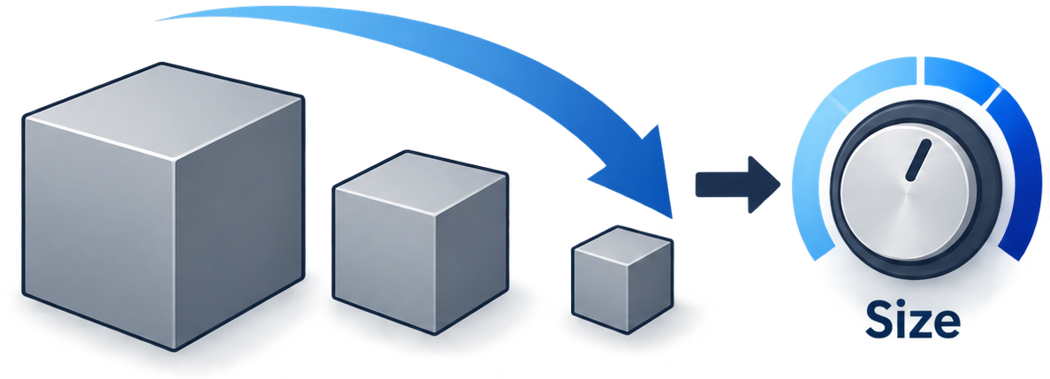
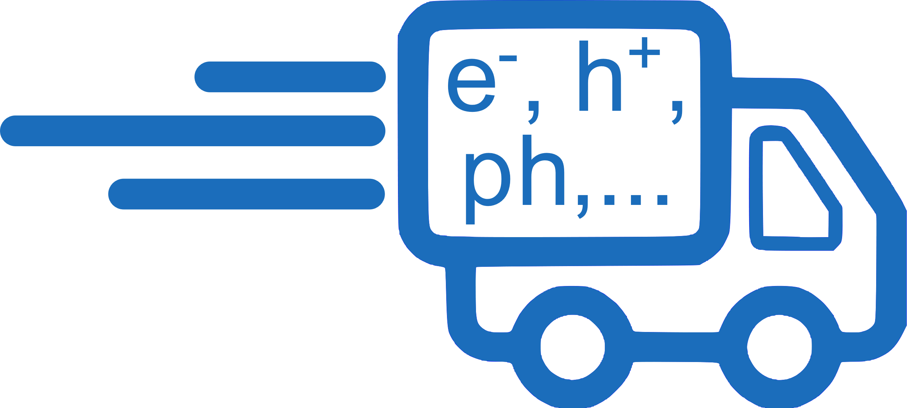

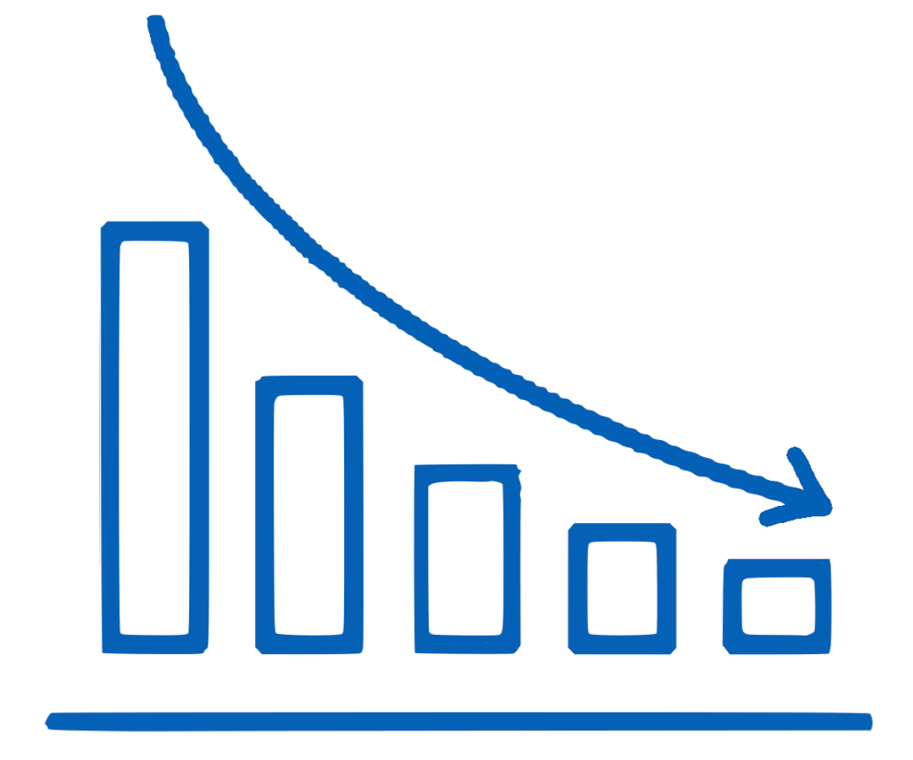
Motivation
Low dimensional materials can provide various advantages:
Size effects influence transport → Tunability material properties
High surface-to-volume ratio → Higher sensitivity, lower detection limits, faster response times, more active sites
Miniaturization → low material usage
Surface
Transport
Mass
Notes:
Why low dimensional materials or more specific nanowires? Basically by reducing the size of the materials we can access properties materials dont have in bulk format, because whenever the material has a size similar to lengthscales like for example the mean free path of charge carriers or phonons, the fermi wavelenght or domain sizes, then processes must adapt, which gives rise to different behaviours. So size can be a tuning nob to influence a lot of sample properties.
By reducing the size we also generate matrials with a larger surface to volume ration. For sensor applications this is interesting because it can lead to faster response times, higher sensitivities and lower detection limits. Also for catalisis this is interesting as more surface means moreactive sites on the same footprint area.
Last but not least also we can safe on the amount of material used which conserves resources

Slide 3
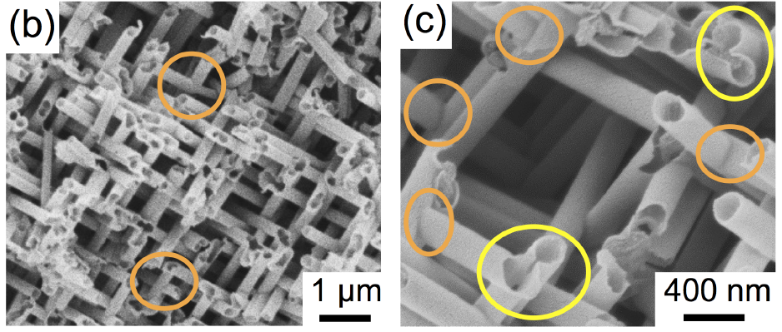
Motivation
Geometries and architecture of nanowires can further tune their properties:
  Tubes: even higher surface to volume ratio
A. Spende, TU Darmstadt, PhD Thesis (2016)
Notes:
Size is not the only aspect we shoudld keep in mind. Geometry can also play an important role. So you can for axample use tubes instead of wires to get a material with even more surface, If we want to have a mechanical stable systems long and thin nanowires tend to bend or in the worst case break, as you can see down here for increasing aspec ration nanowires.

Slide 4
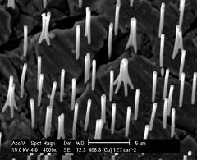
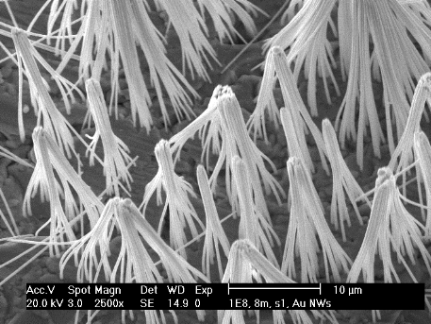
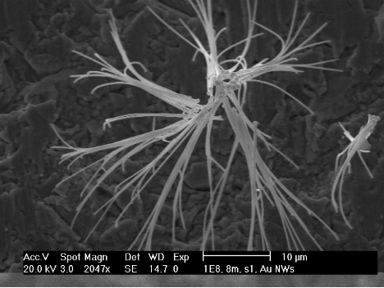
Motivation
Geometries and architecture of nanowires can further tune their properties:
  Tubes: even higher surface to volume ratio
  Conical nanowires and networks: mechanically self supporting, changes from macro-to-nano properties
Increasing
aspect ratio
Increasing
aspect ratio
Notes:
Size is not the only aspect we shoudld keep in mind. Geometry can also play an important role. So you can for axample use tubes instead of wires to get a material with even more surface, If we want to have a mechanical stable systems long and thin nanowires tend to bend or in the worst case break, as you can see down here for increasing aspec ration nanowires.

Slide 5
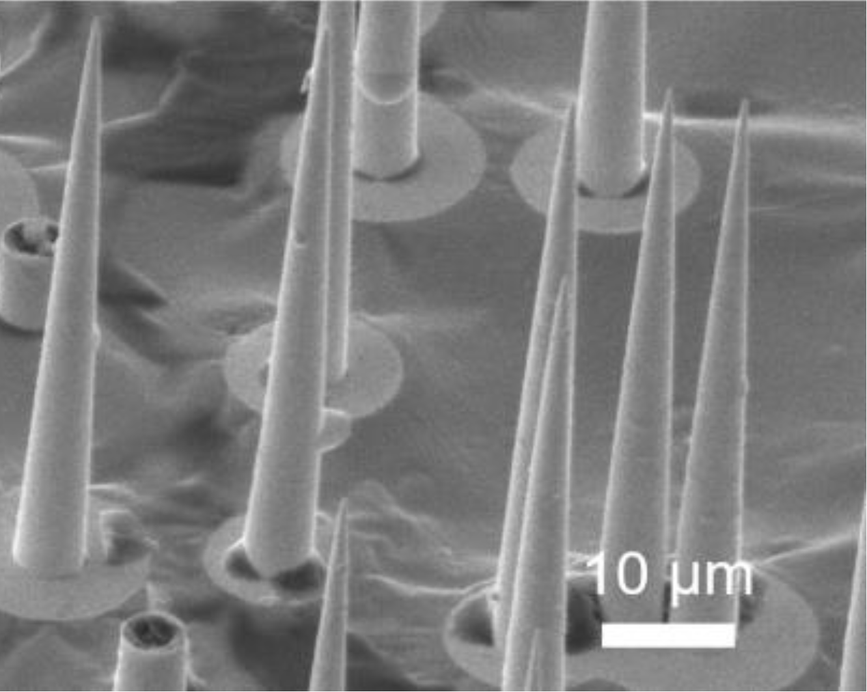
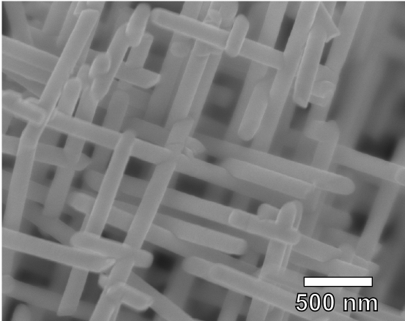
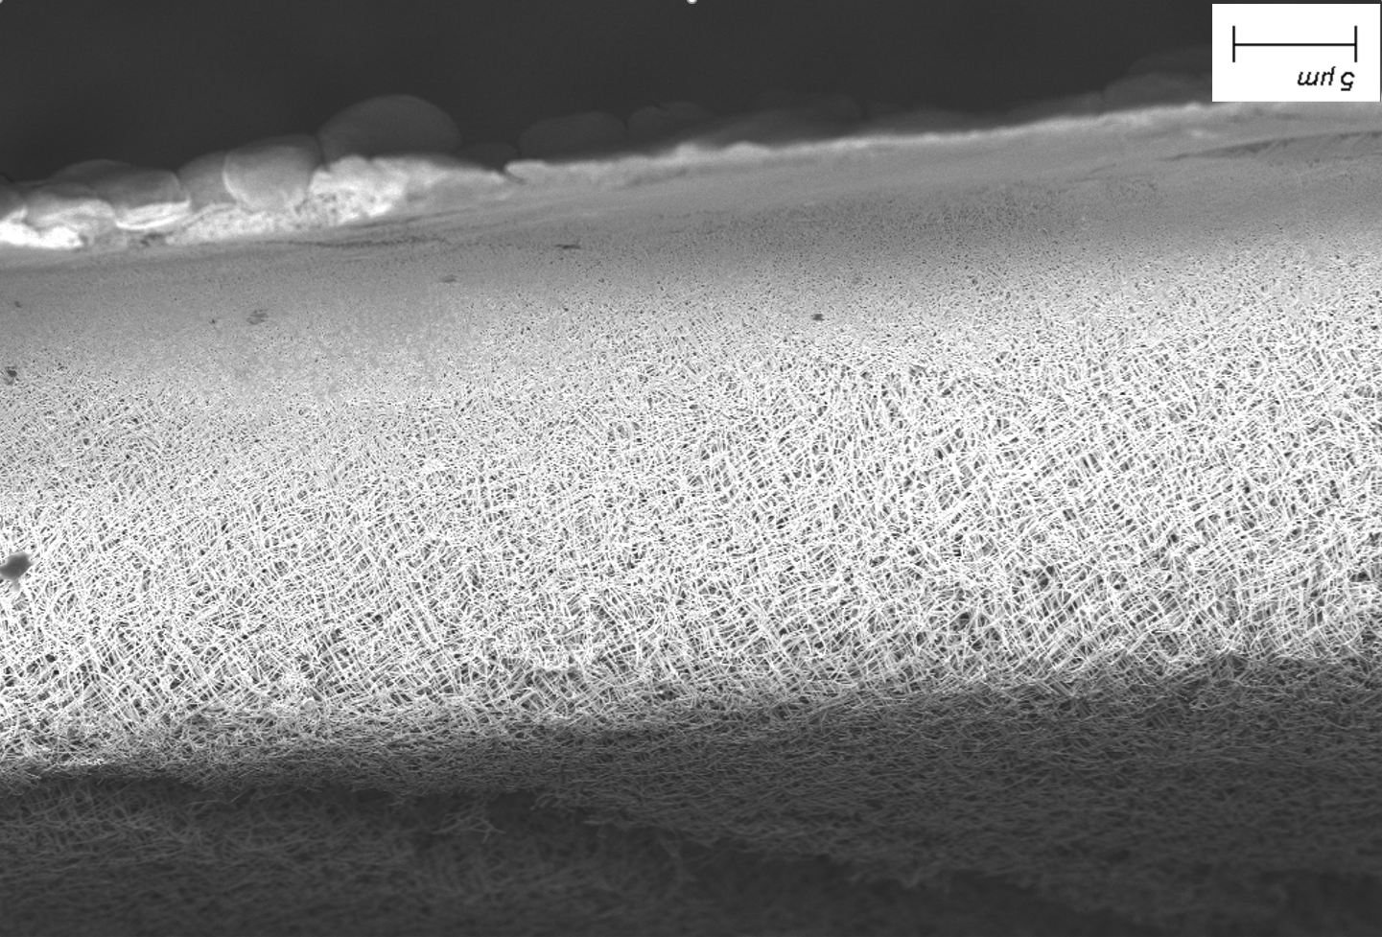
Motivation
Geometries and architecture of nanowires can further tune their properties:
  Tubes: even higher surface to volume ratio
  Conical nanowires and networks: mechanically self supporting, changes from macro-to-nano properties
  Networks: reliable electrical transport vs. damage, „nano“ properties in macroscopic objects, unique transport properties depending on interconnections
L. Burr, TU Darmstadt, PhD Thesis (2016) | M.Li, TU Darmstadt, PhD Thesis (2025)
Notes:
So we could go for systems consisting of conical nanowires or interconected nanowire networks to keep the wires in place, but the interconnected networks are also interresting for applications as damage to single wires can be easily compensated by parallel paths making it more eletrically reliable but one can also use the interconnections to influence transport.

Slide 6
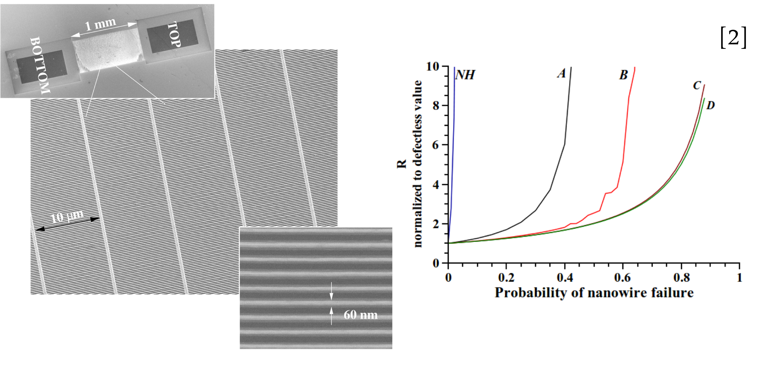
Motivation
Geometries and architecture of nanowires can further tune their properties:
  Tubes: even higher surface to volume ratio
  Conical nanowires and networks: mechanically self supporting, changes from macro-to-nano properties
  Networks: reliable electrical transport vs. damage, „nano“ properties in macroscopic objects, unique transport properties depending on interconnections
From A to D number of parallel interconnected nanowires increases
G. Pennelli, Nano Letters 12 (2013)
Notes:
So we could go for systems consisting of conical nanowires or interconected nanowire networks to keep the wires in place, but the interconnected networks are also interresting for applications as damage to single wires can be easily compensated by parallel paths making it more eletrically reliable but one can also use the interconnections to influence transport.

Slide 7
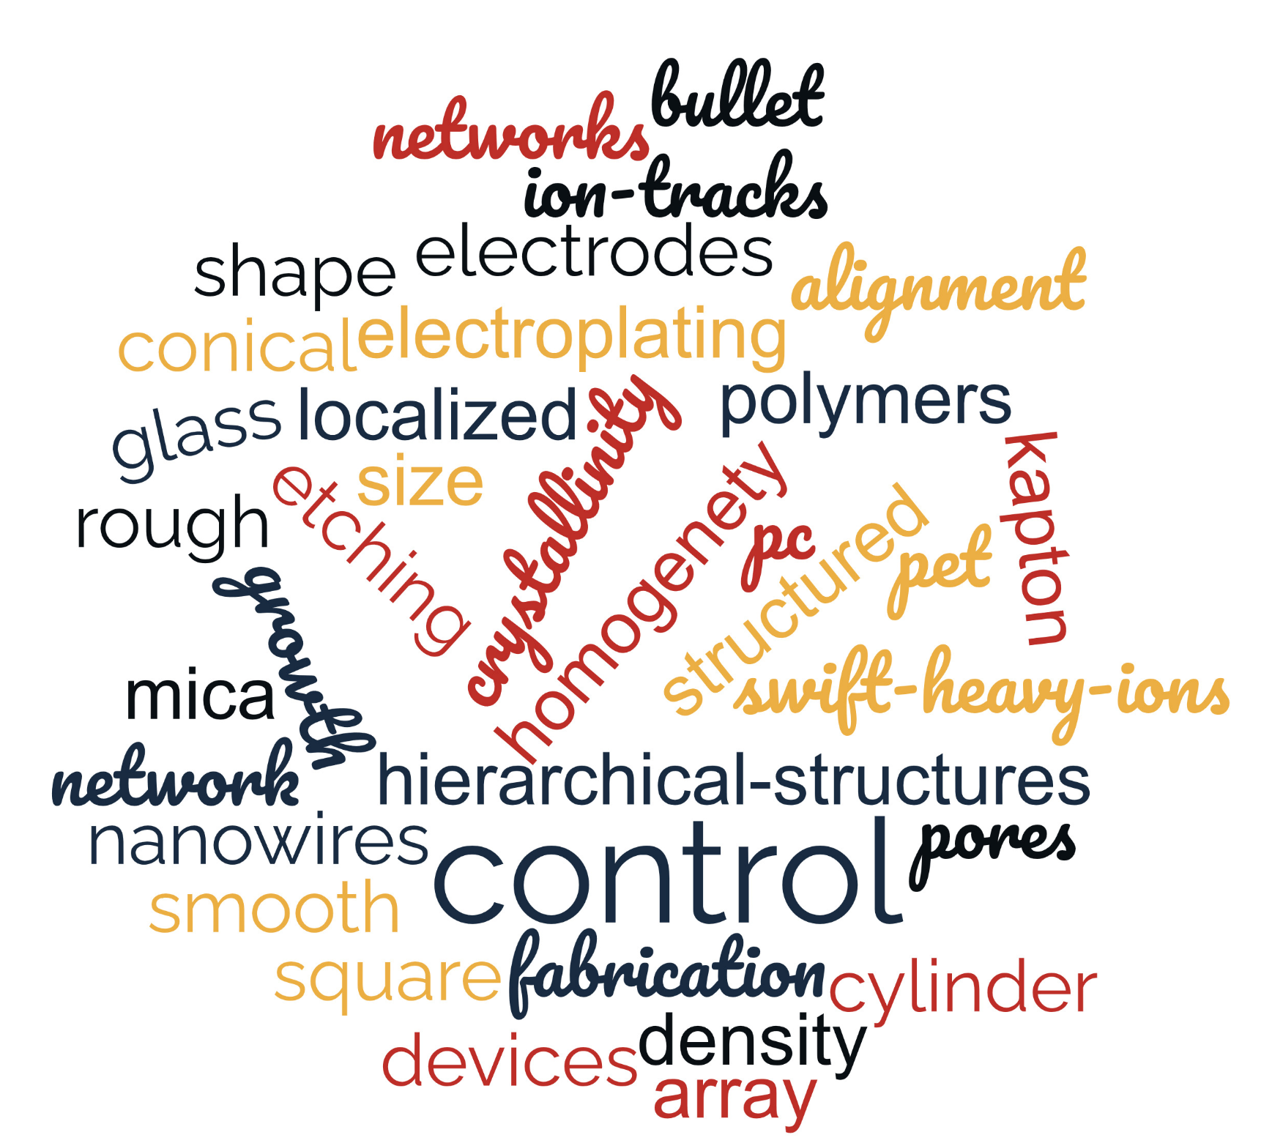
Nanowires for Functional Architectures
Track etched templates + Electroplating
=
Tailored low-dimensional materials
Template defines geometry and architecture
Filling process defines composition and structure
Loïc Burr, PhD Thesis, TU Darmstadt (2016)
PC
Notes:
So ideally we would like to have a fabrication aproach that can access alot of different parameters and the combination of ion track techologie and various methods to fill the fabricates pores is exactly that. We can control the geometrie, alignment and number density of wires via the template and the composition, structure and morphology via the filling processes, which really allows us to tailor our samples.

Slide 8
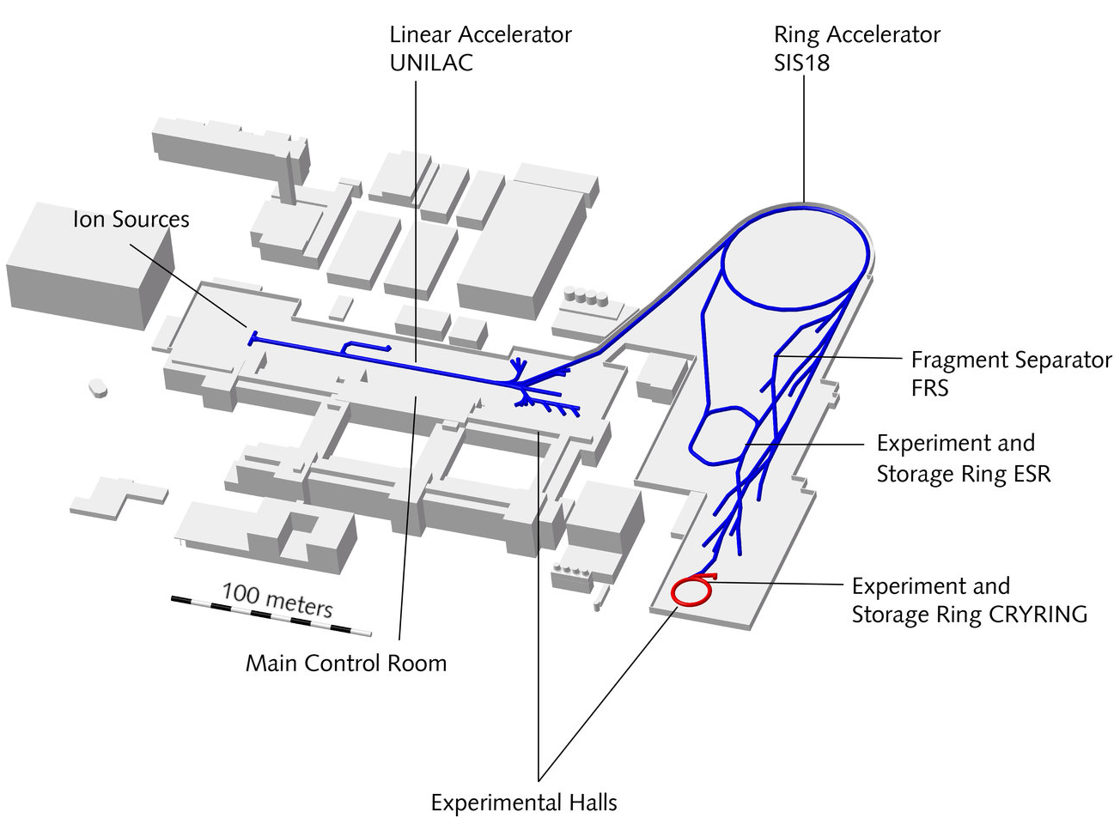
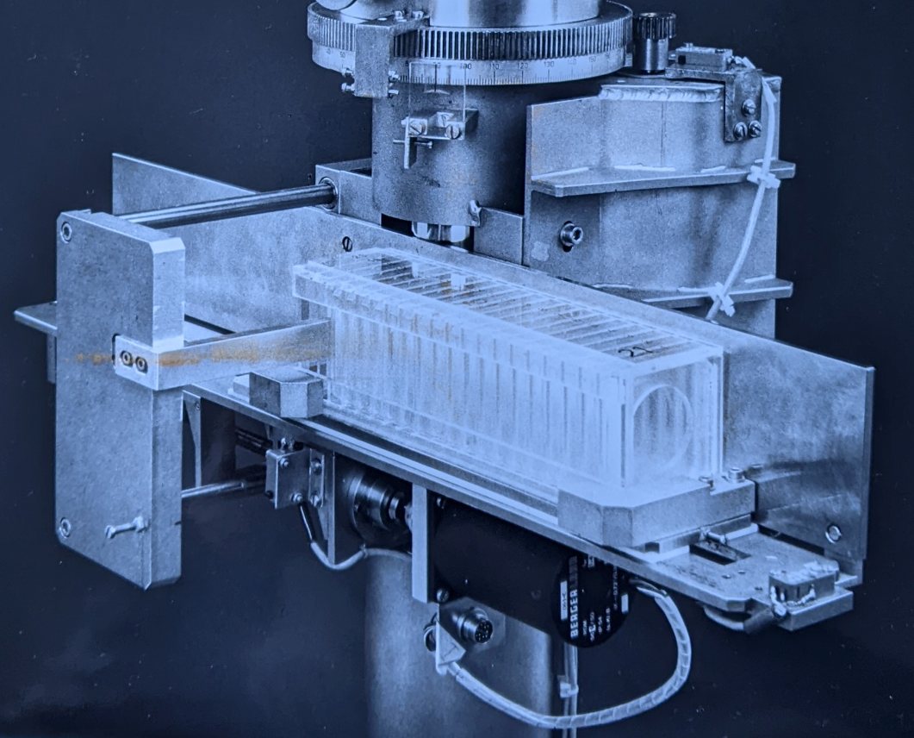
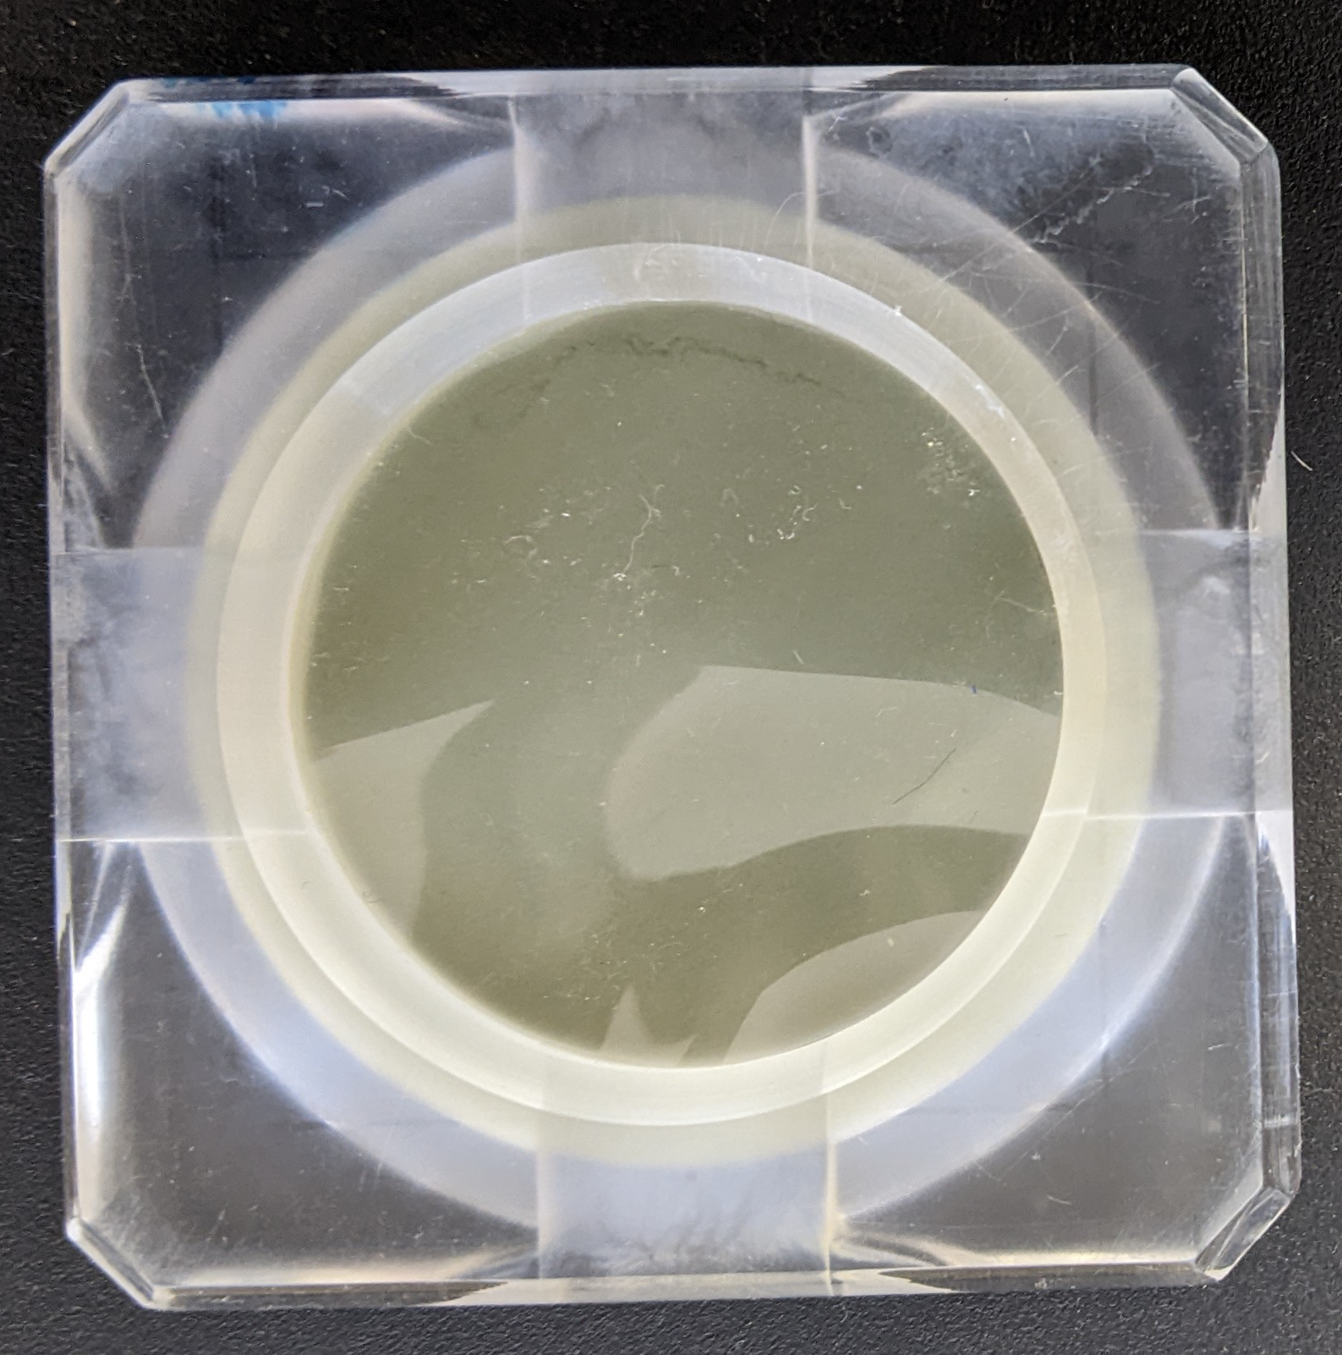
Ion Irradiation at X0
Exchange system
~ 500 samples/h
X0-Cave:
E ~ 11.4 MeV/u max
f: single ion to 1e10 i/cm²
Notes:
For Template fabrication at gsi we irradiate stacks of polymer foils at the X0 beamline using an automatic sample exchange systemm that allows us to irradiate up to 500 samples per hour. The foils in this case are clamped into these kinds of holders which, depending on the holders allow to irradiate samples up to 50 mm diameter but typically 30 mm. At the energies of the ions we use each ion generates ist own contious track, so fluence and angle of irradiation defines our later wire numbers and orientations of them. So in case of networks we usually irradiete the foils from 4 different directions at an angle of 45° to the foil normal.

Slide 9
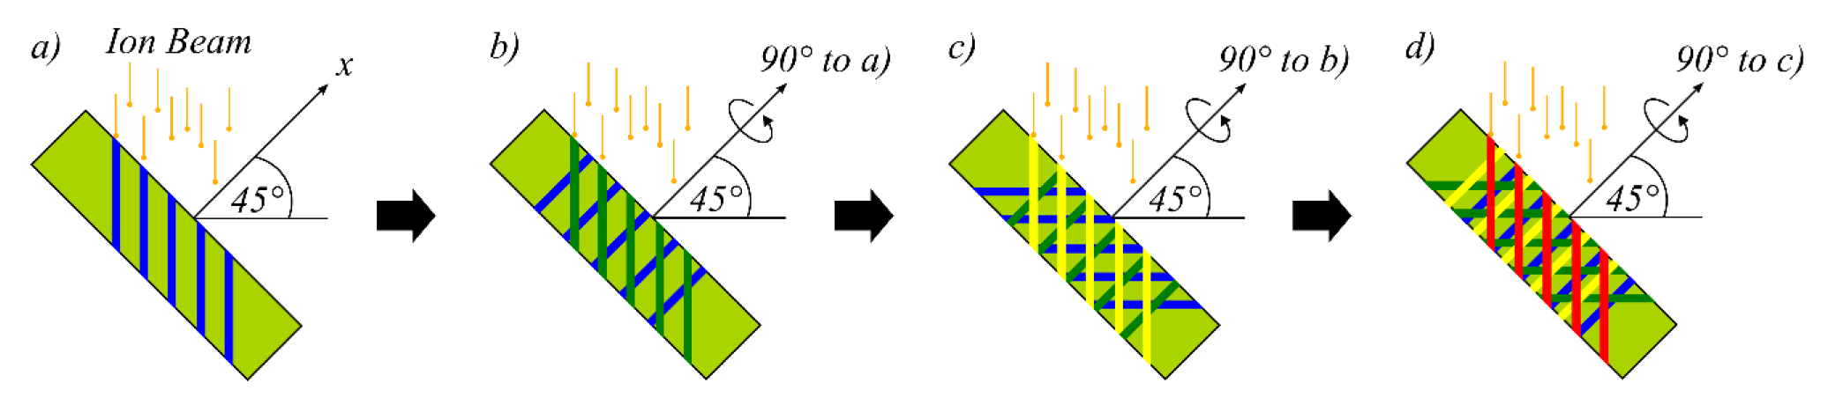
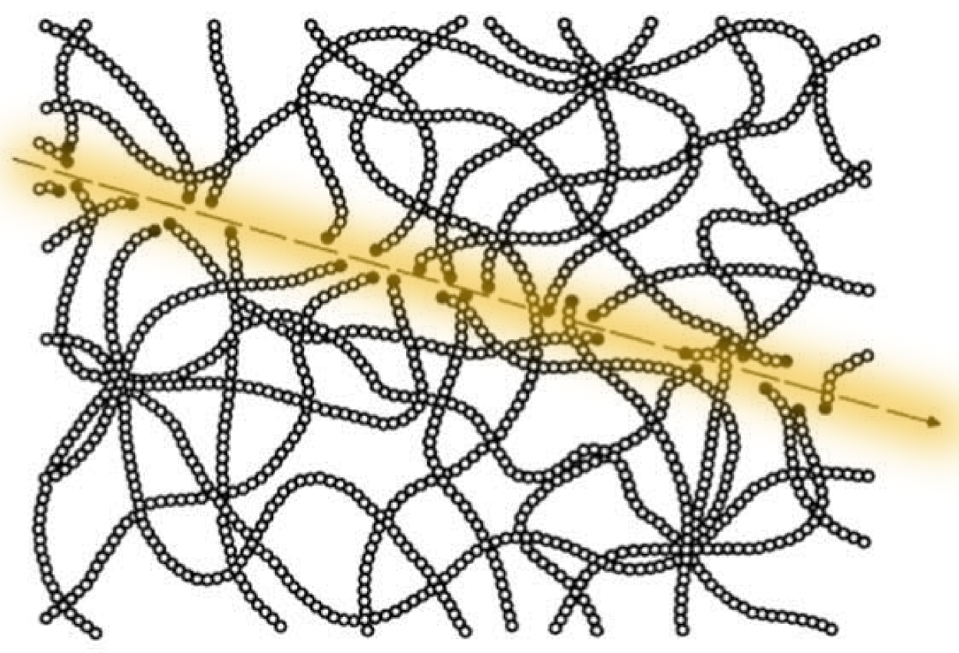
Template Irradiation at X0
Each swift heavy ions generate damage tracks in polymers
Irradiation defines number density of pores and their alignment
Along ion track: chain scission, creation of unsaturated bonds,
formation of radicals, outgassing of small molecules (CO_{n}, C_{n}H_{m},...)
etc...
Fleischer, Nuclear Tracks in Solids, University of California Press (1975)
Notes:
Very important, at the energies of the ions we use each ion generates ist own contious track, so fluence and angle of irradiation defines our later wire numbers and orientations of them. So in case of networks we usually irradiete the foils from 4 different directions at an angle of 45° to the foil normal.

Slide 10
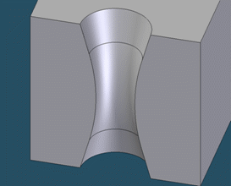
Ion Track Etching
A. Akimenko, JINR, Dubna (2004)
Etching process defines shape
Etching time defines size
Notes:
For Template fabrication at gsi we irradiate stacks of polymer foils at the X0 beamline using an automatic sample exchange systemm that allows us to irradiate up to 500 samples per hour. The foils in this case are clamped into these kinds of holders which, depending on the holders allow to irradiate samples up to 50 mm diameter but typically 30 mm. At the energies of the ions we use each ion generates ist own contious track, so fluence and angle of irradiation defines our later wire numbers and orientations of them. So in case of networks we usually irradiete the foils from 4 different directions at an angle of 45° to the foil normal.

Slide 11
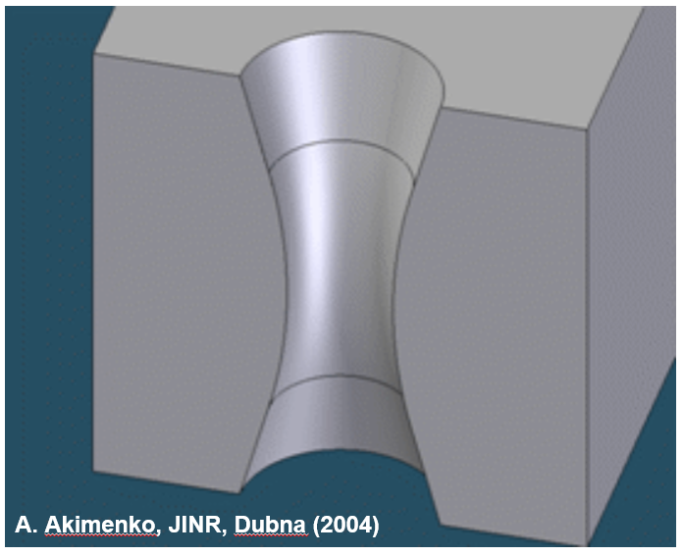
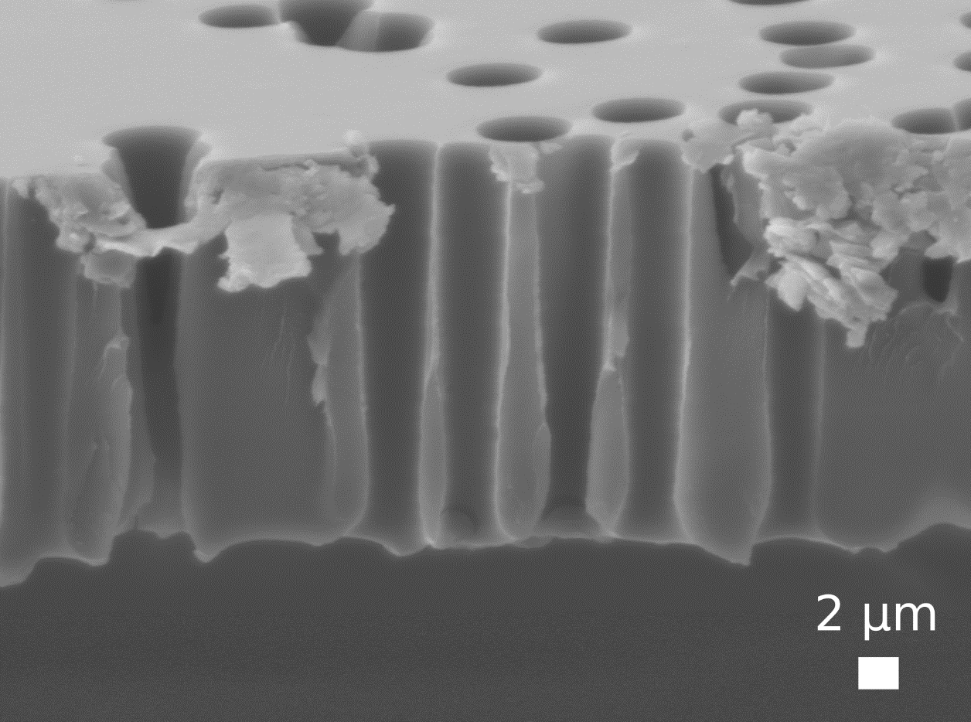
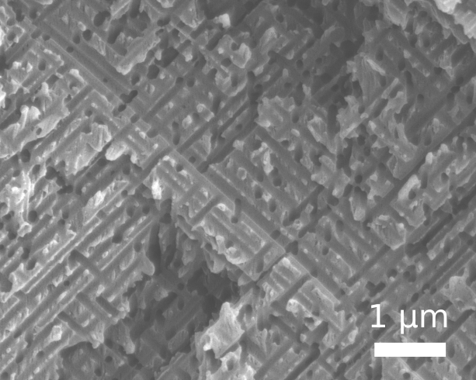
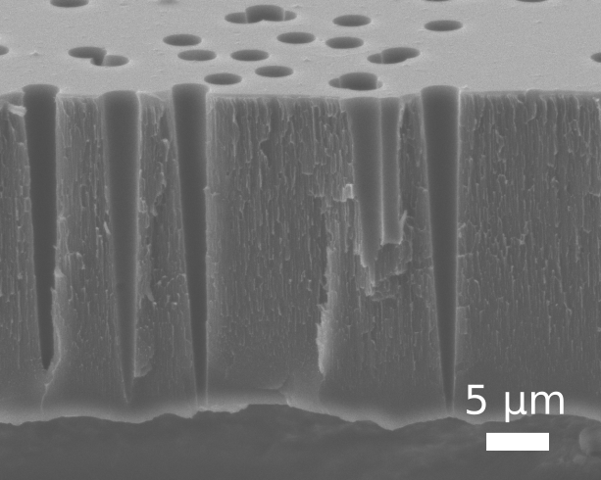
Ion Track Etching
Array / Cylindrical
Network / Cylindrical
Array / Conical
Combinations
A. Akimenko, JINR, Dubna (2004)
Etching process defines shape
Etching time defines size
2 µm
Notes:
For Template fabrication at gsi we irradiate stacks of polymer foils at the X0 beamline using an automatic sample exchange systemm that allows us to irradiate up to 500 samples per hour. The foils in this case are clamped into these kinds of holders which, depending on the holders allow to irradiate samples up to 50 mm diameter but typically 30 mm. At the energies of the ions we use each ion generates ist own contious track, so fluence and angle of irradiation defines our later wire numbers and orientations of them. So in case of networks we usually irradiete the foils from 4 different directions at an angle of 45° to the foil normal.

Slide 12
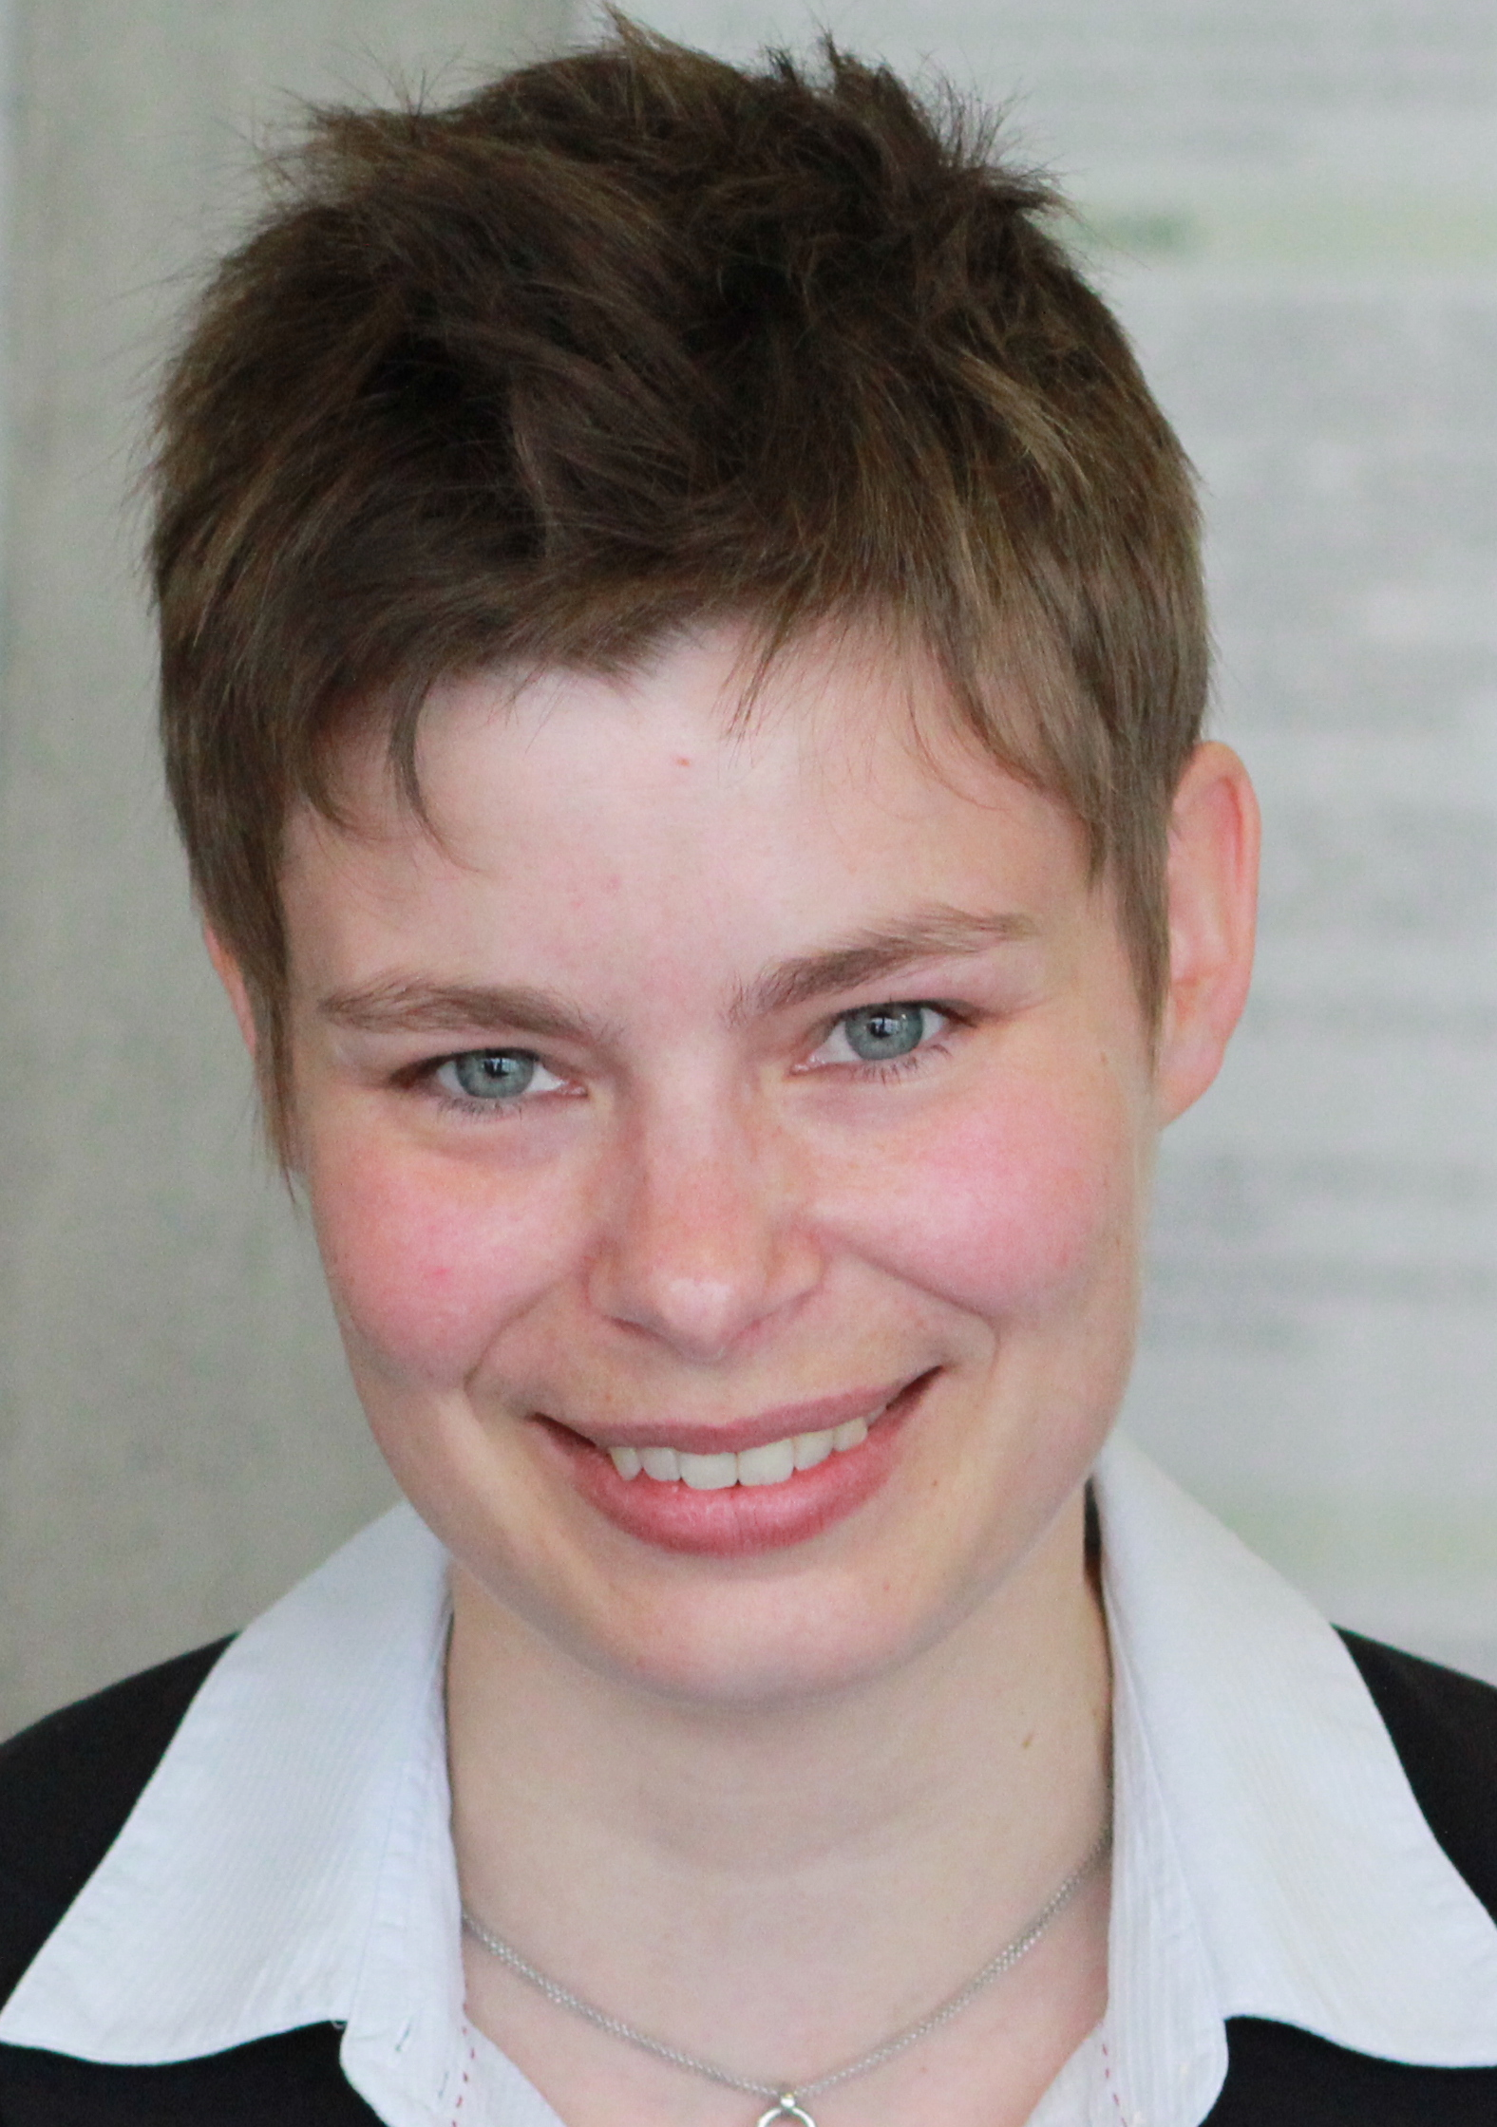
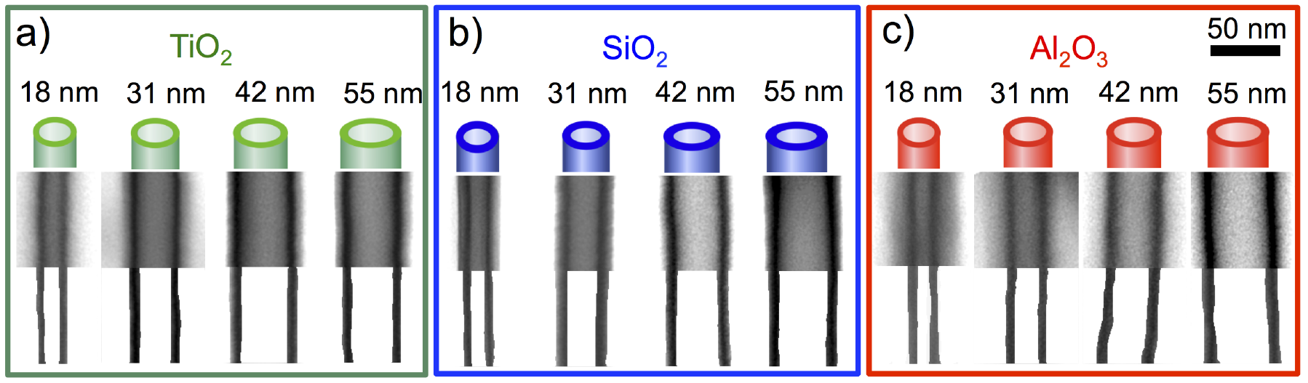
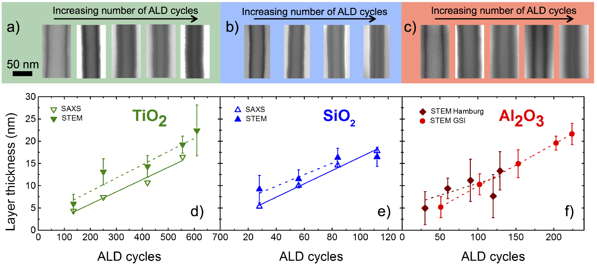
Channel Filling - Atomic Layer Deposition
A.Spende
Self-Limiting Reactions → Homogeneous Layer
→ Controled Thickness
http://cnx.org/content/m25737/1.2/, Jul 13, 2009 | A.Spende, Thesis, TU Darmstadt, 2016

Slide 13
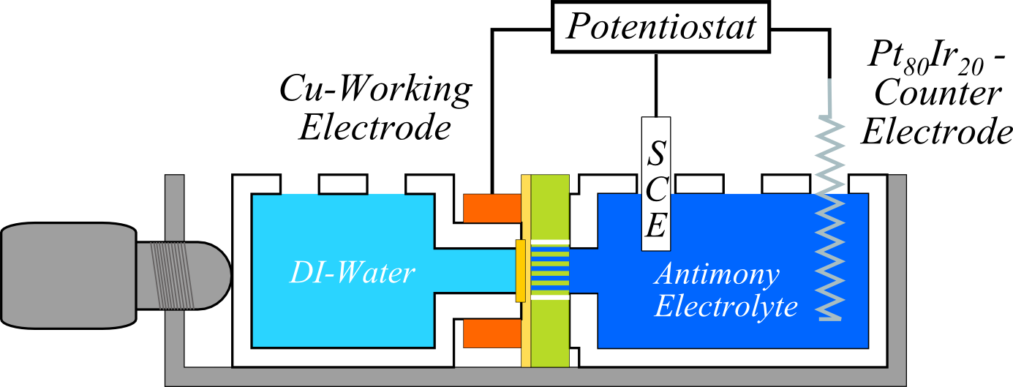


Channel Filling - Electroplating
*
R
e
f
Electrolyte
*Ref: Reference electrode
Template with metal layer
Electroplating
M.E. Toimil-Molares, Beilstein J. Nanotechnol. 3 (2012)
Notes:
In order to fill these pores several methods can be used like Atomic layer deposition and electroless or electroplating. Due to time constrains I will not talk about the ALD process which we use at GSI to fabricate tubes of aluminaoxide and titaniaoxide and will istead focus on the electroplating part. In oder for the electroplating to be done first a metal contact is fabricated on one side of the template. For electroplating we then make use of a three electrode setup to control an applied potential which allows us to reduce the ions within our choosen electrolyte.

Slide 14
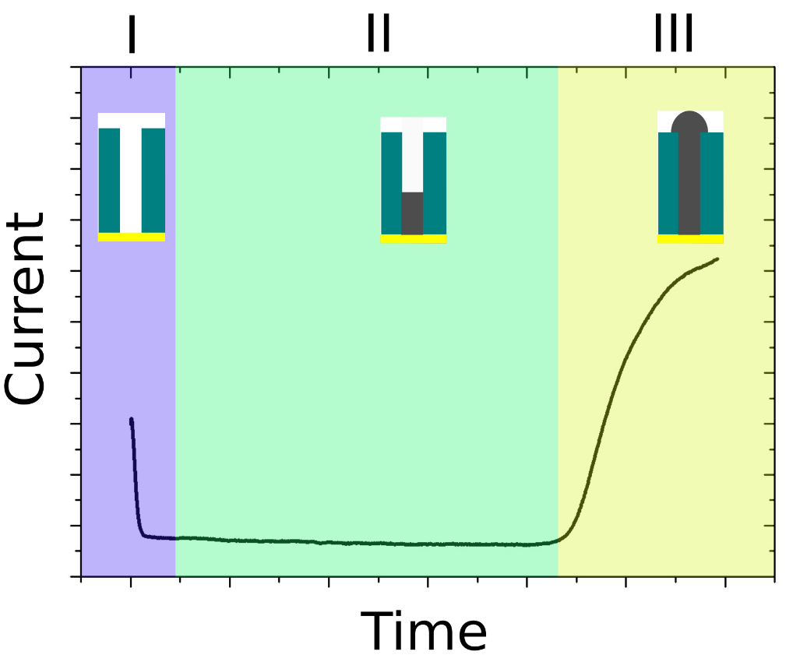
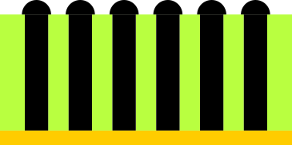
Channel Filling - Electroplating
*
R
e
f
Electrolyte
*Ref: Reference electrode
Template with metal layer
Electroplating
Finished Sample
Parameters must be optimized for homogeneous growth with preferred crystallinity
M.E. Toimil-Molares, Beilstein J. Nanotechnol. 3 (2012)
Notes:
The nice thing about this aproach is that we can follow the process by observing the current during plating. It starts high in the begining when the electric double layer is charged and a diffusion zone is established, then becomes constant when we fill the pores and in the end rises quickly because the growth is not limited by the pore area anymore and so called caps are formed. The nice thing is that electroplating is relatively easy and low-price process that allows for alot of materials to be deposited. Also the parameters of the plating and the composition of the bath can influence your material structure which is important for their later properties. Alot of our research is about investigating the effects of these parameters on the wire growth. To show you one example we can look at the growth of antimony nanowire cones.

Slide 15
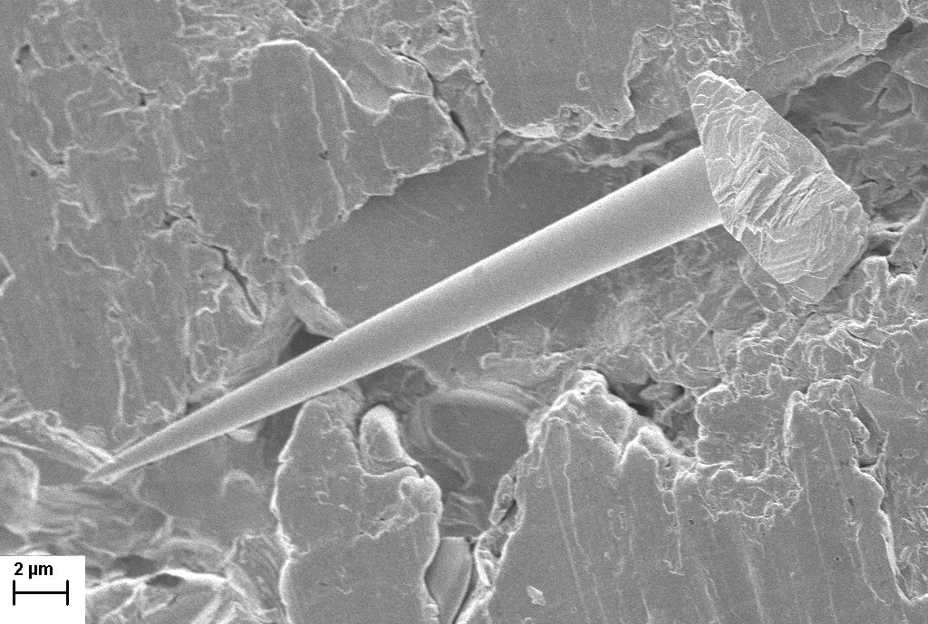
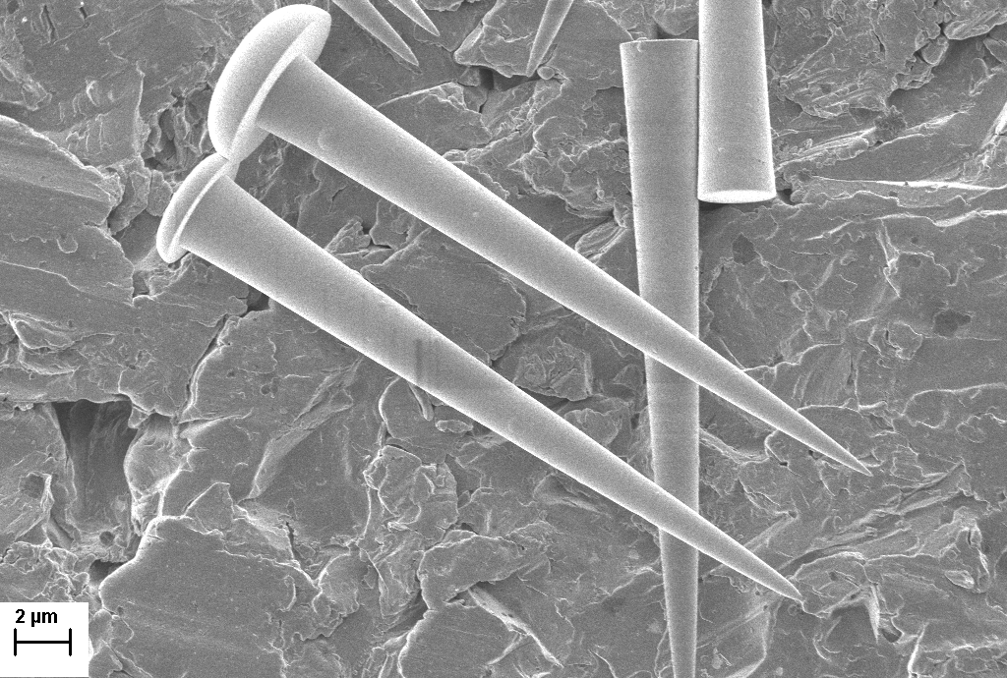
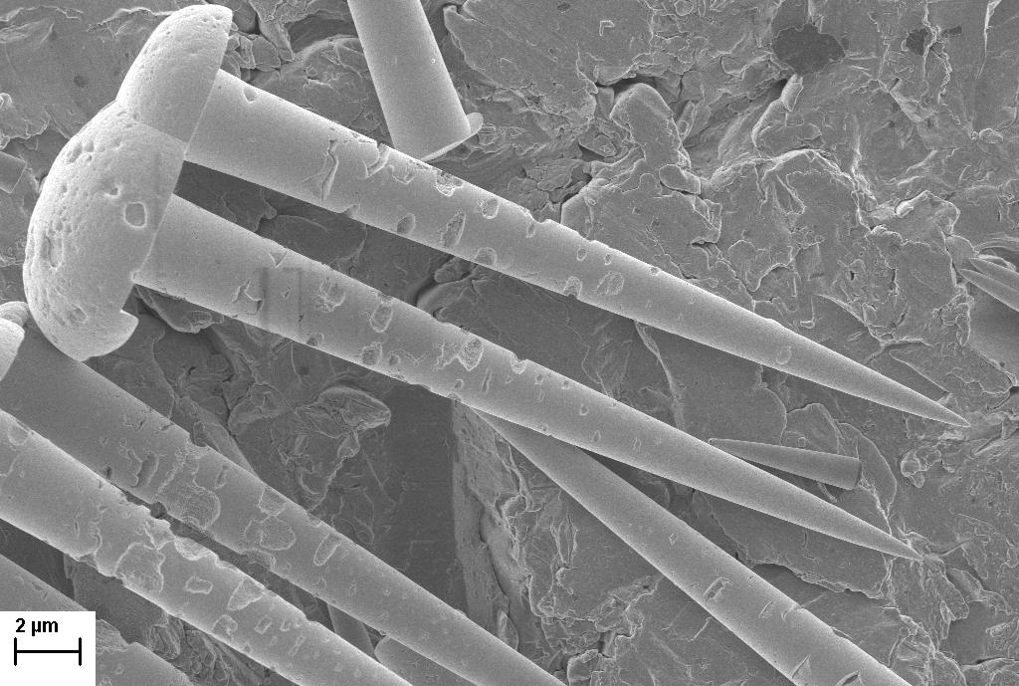
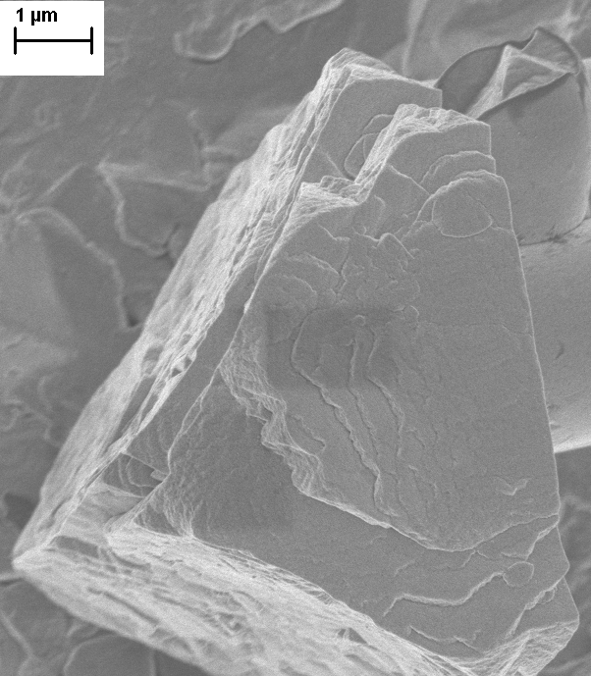
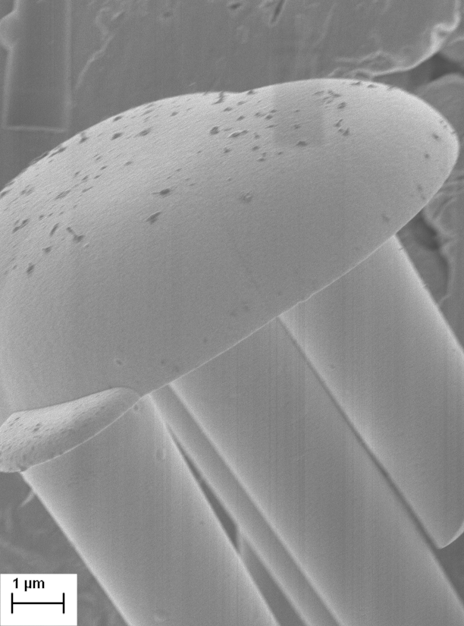
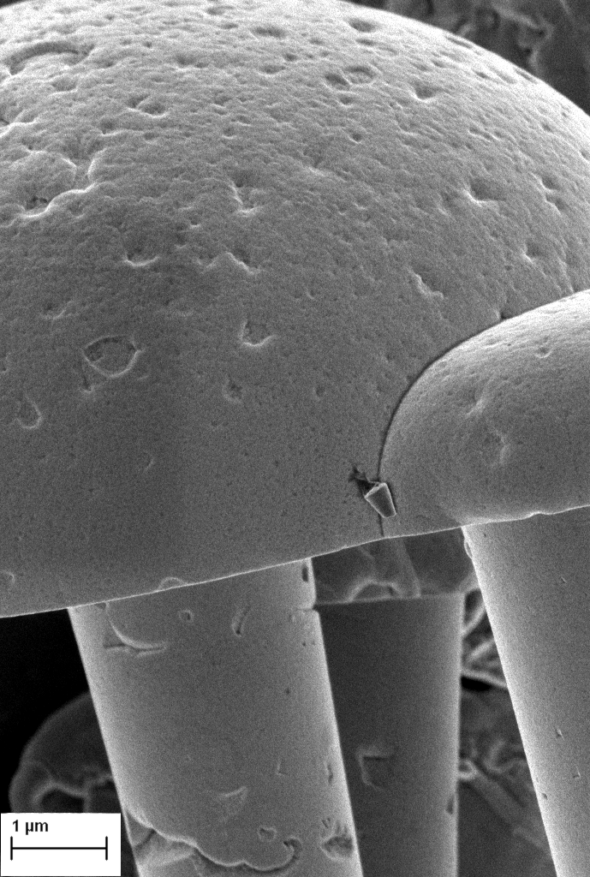
Effects of Plating Conditions for Sb - Potential
facetted
smooth
porous
-185mV
-215mV
-260mV
Notes:
So here we see SEM images of fabricated nanocones, All the cones have a tip diameter of ~ 50 nm and a base diameter of around 3 µm. From left to right the plating potential was increased. For the the lets say low and medium overpotential platings we see the wires have a smoot surface but the caps for the low overpotential samples show these crystal facetes while the medium overpotential wires have these semi spherical apperance. For the high overpottential grown wires we generally keep the shape of the medium wires, but also see that they become porous.

Slide 16
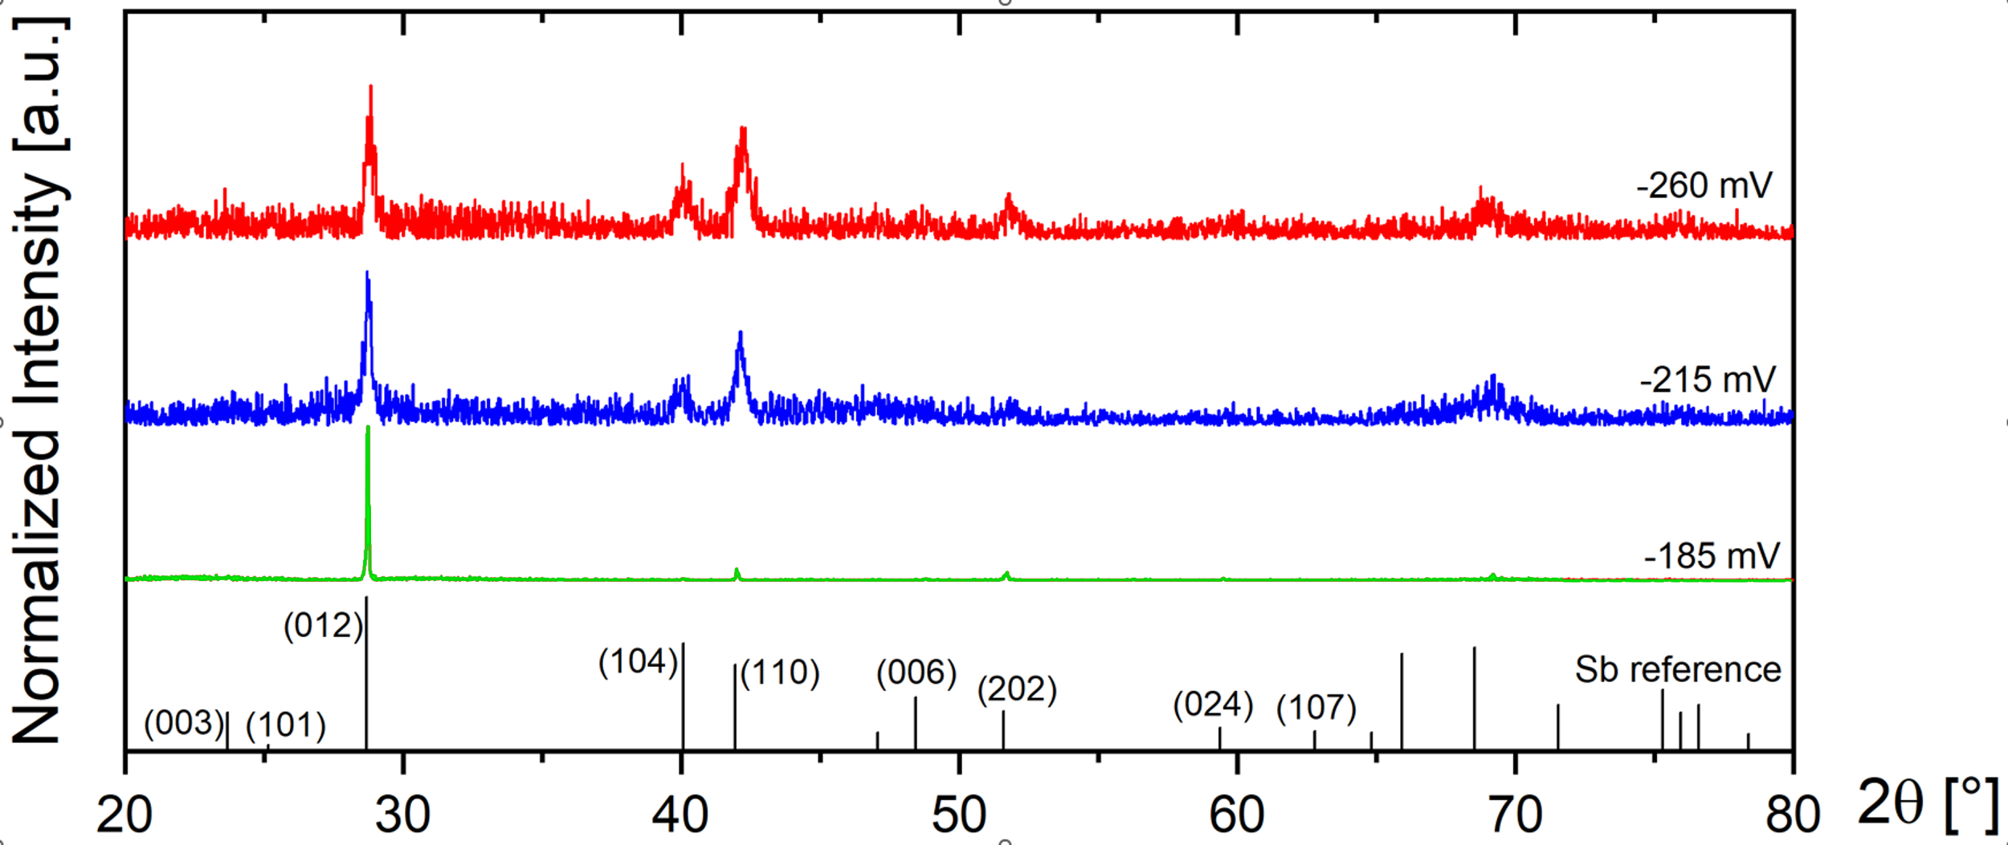
Effects of Plating Conditions for Sb - Potential
facetted
smooth
porous
-185mV
-215mV
-260mV
Higher potentials:
Reflections broaden
Texture decreases indicating polycrystallinity
→ Lower potential:
Highly textured material
Potential controls wire crystallinity
Notes:
We can also see the changes in the crystal structure. So down here we have the diffractigrams of the planes perpendicular to the nanowire axis. So these measurements are done while the wires are still embedded in polymer in order to guarantee their orientation. And we see that for the low overpotentials we have a strong 012 texture of the wires. Whereas for the higer overpotentials this changes a bit also showing stronger contributions of the 104 and 110 planes

Slide 17

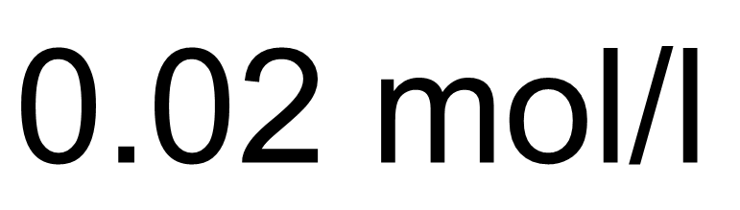


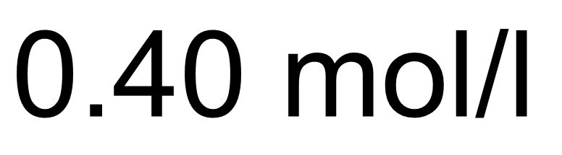
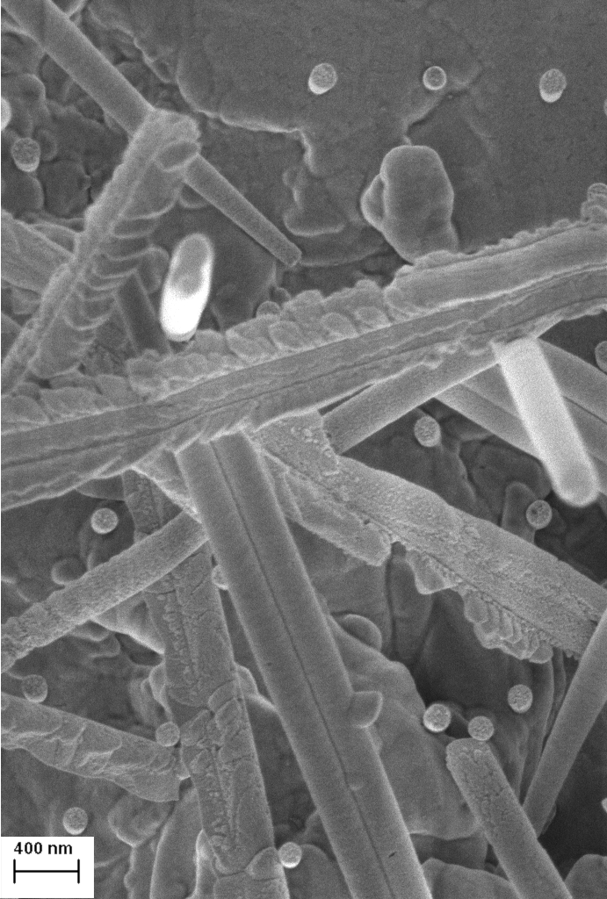
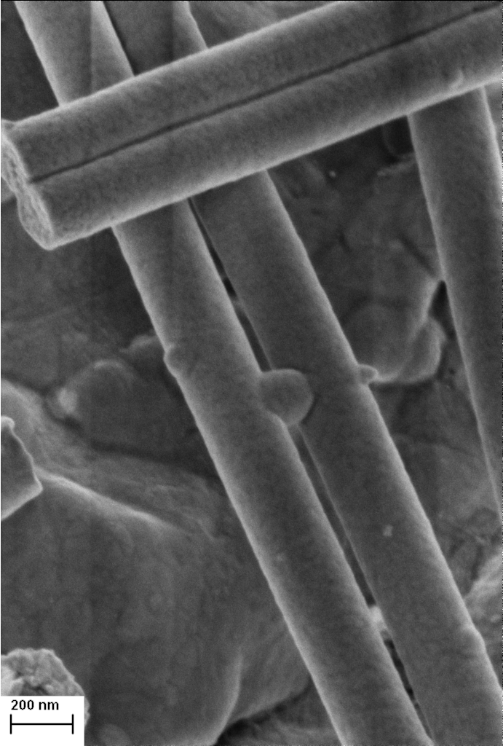
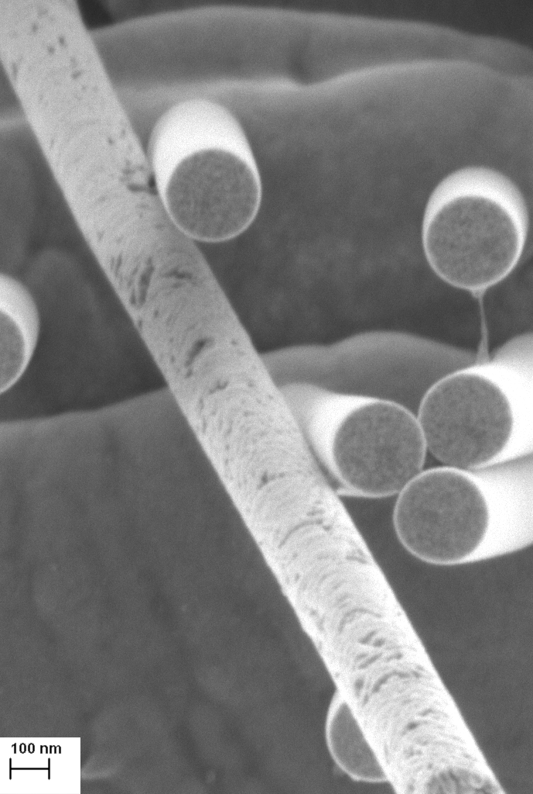
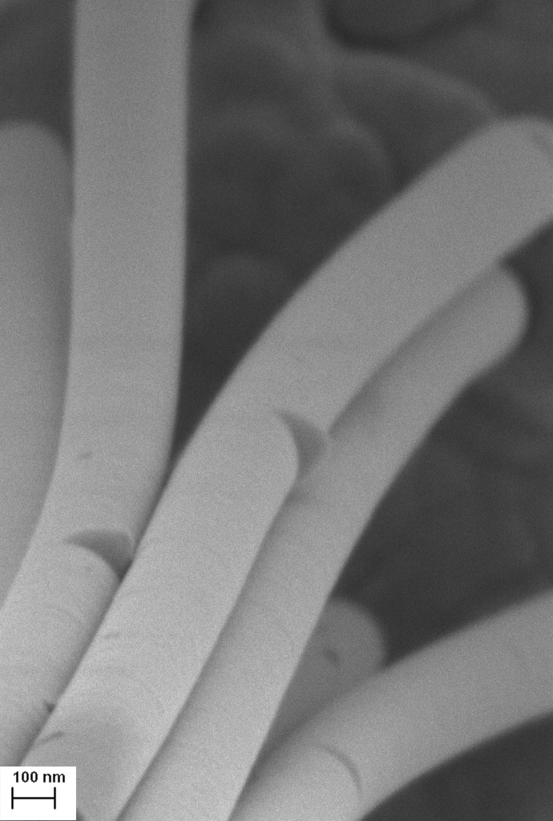
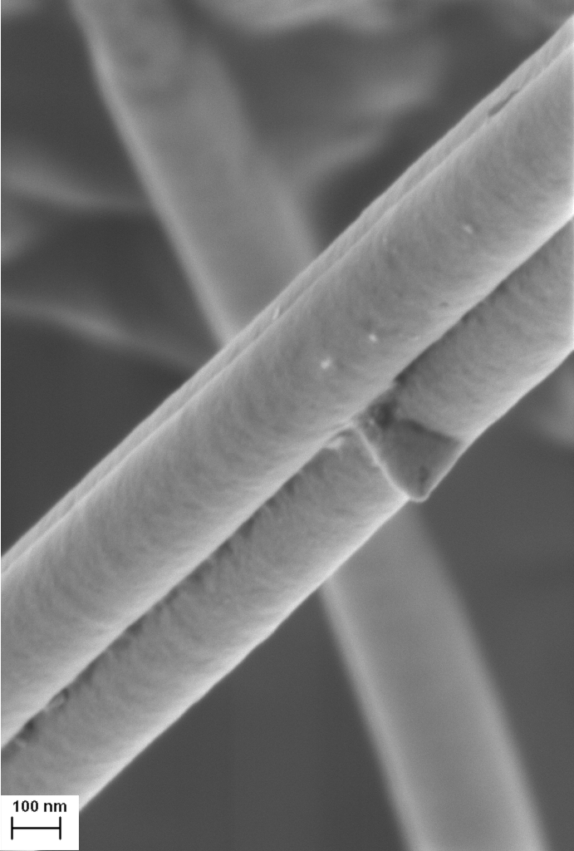
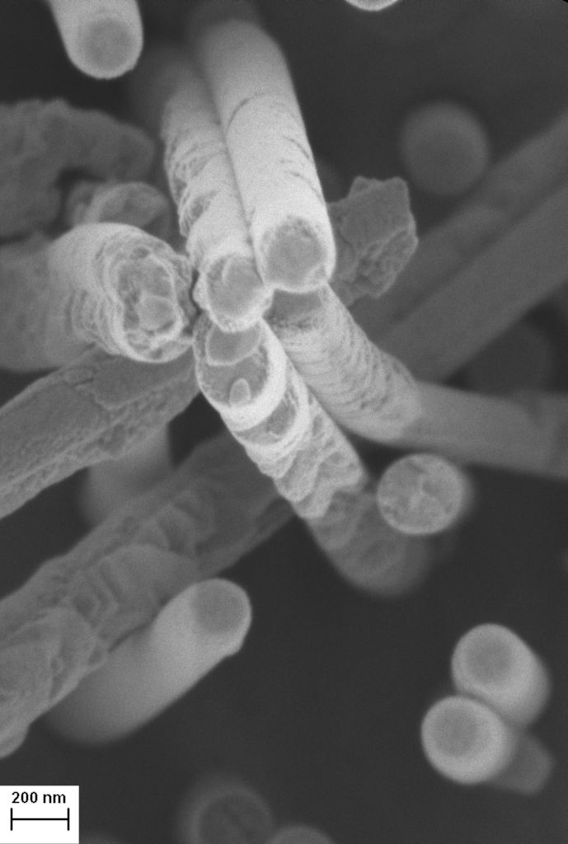
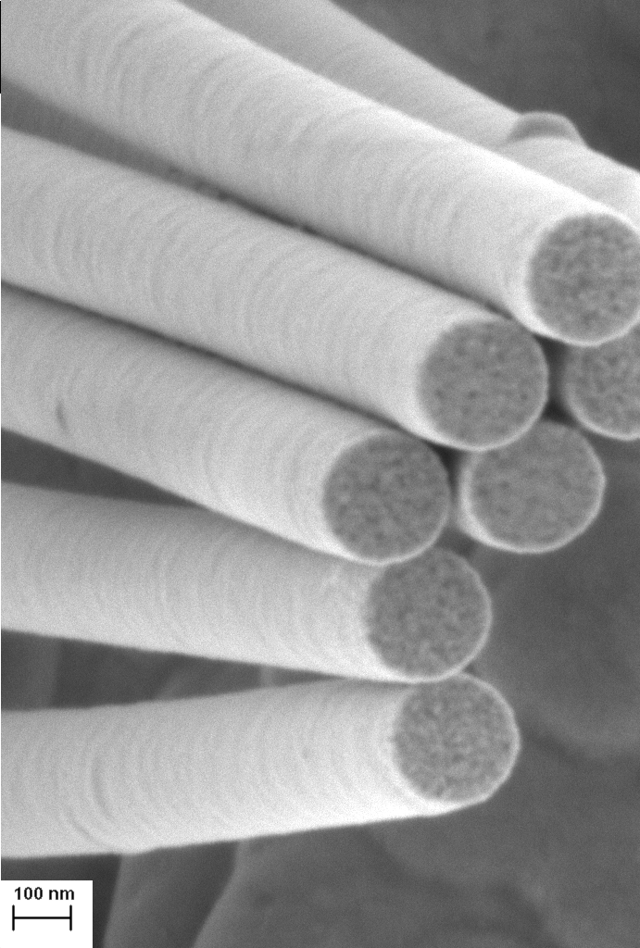
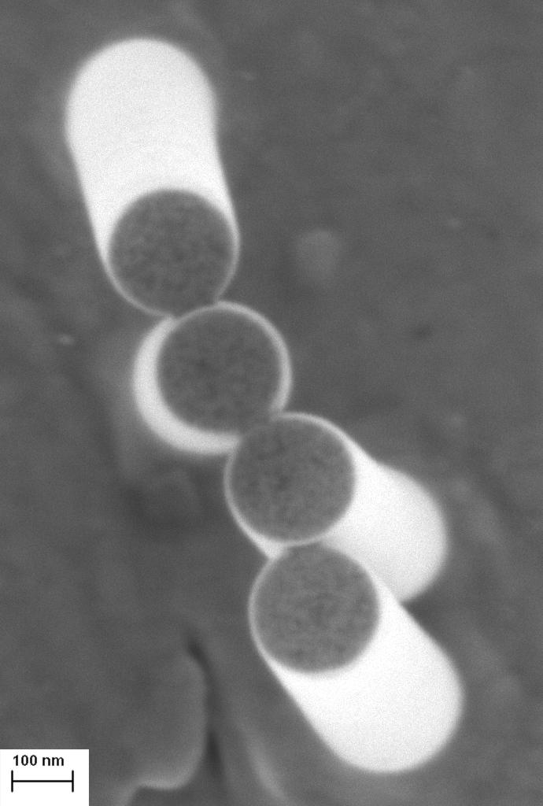
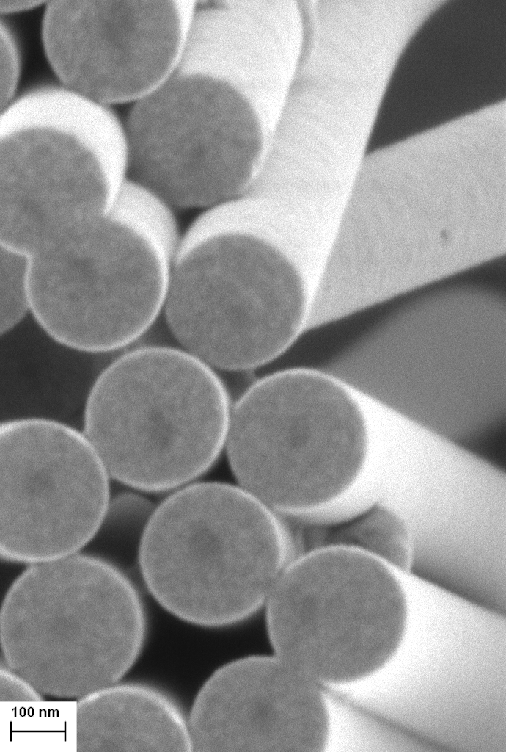
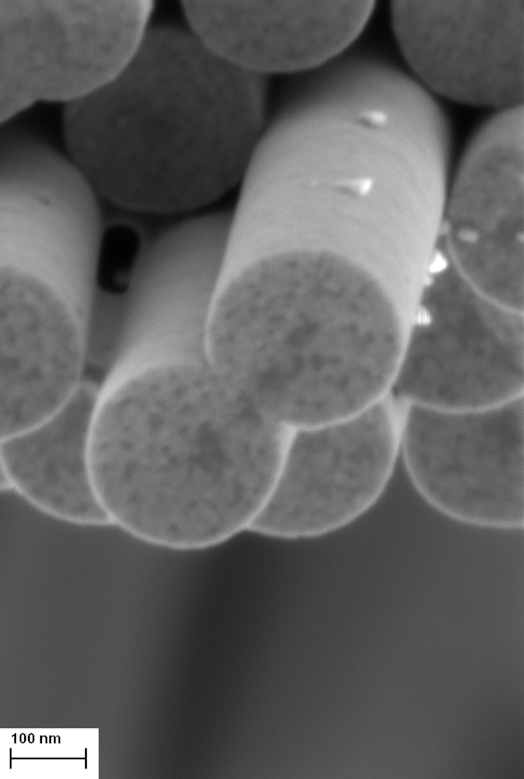
Effects of Plating Conditions for Sb - Bath Additives
Notes:
In this case the nanowires grown without surfactant appear to be made up of larger crystals and show this facetted growth, while the ones with surfactant appear smooth and made up of smaller grains

Slide 18
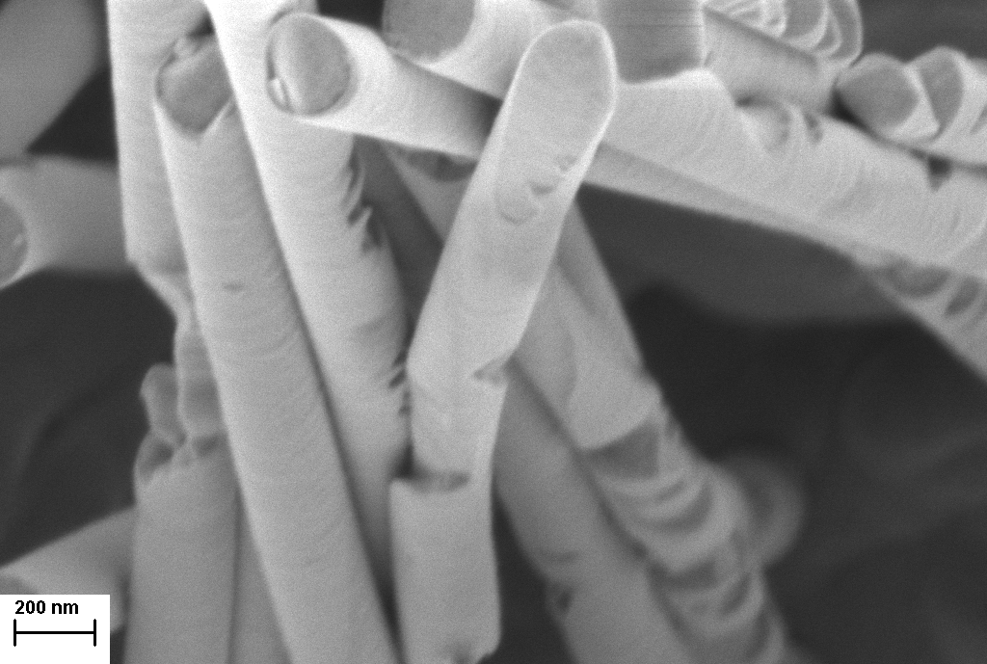
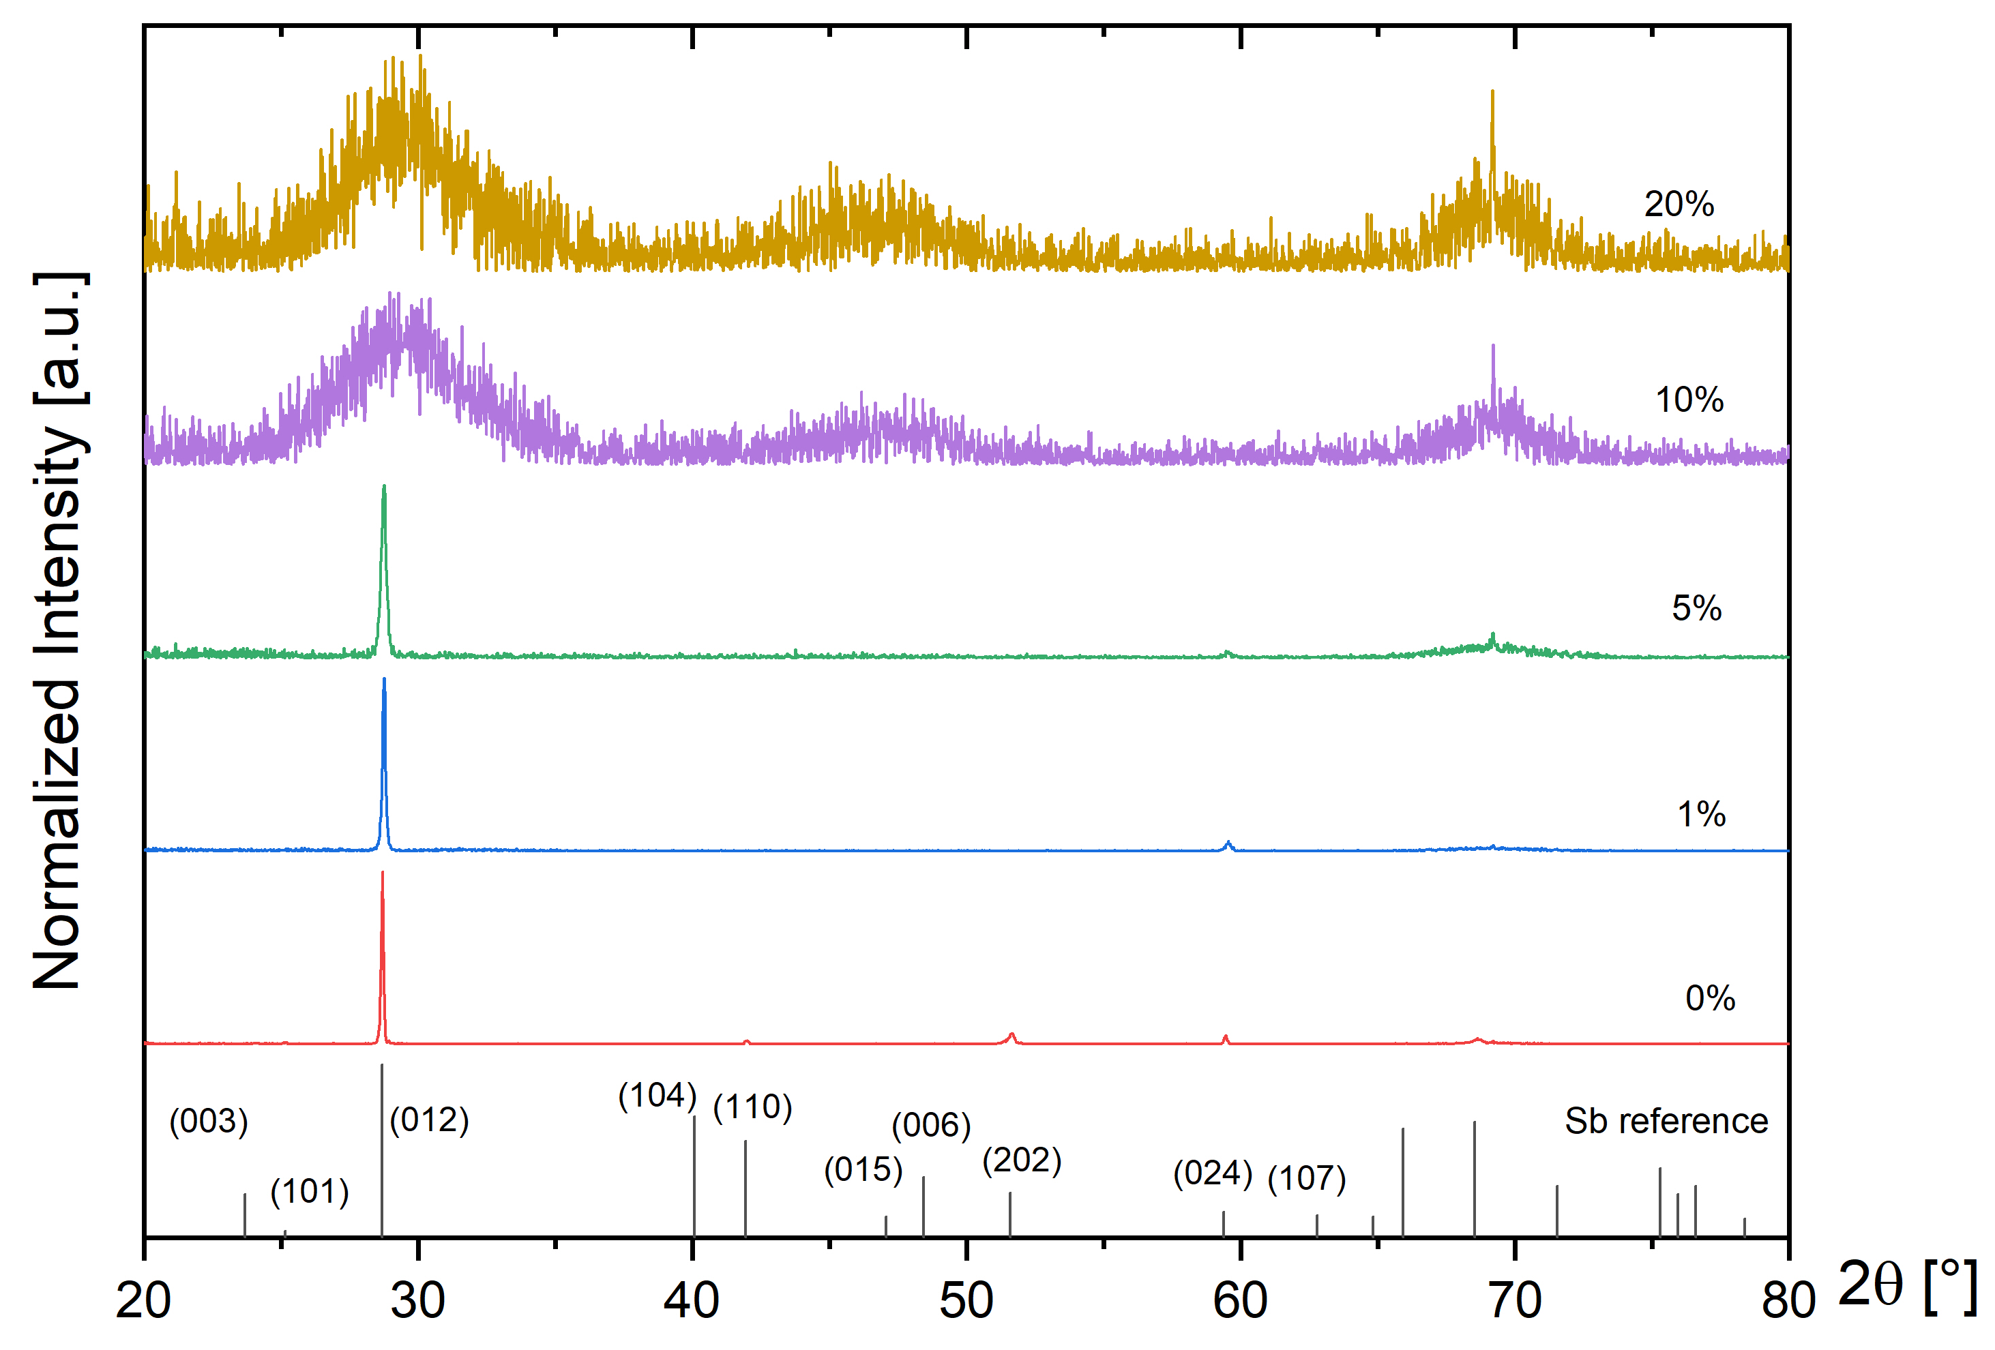


Effects of Plating Conditions for Sb - Bath Additives
High concentration:
Broad reflections
Low signal to noise ratio
No surfactant
Low concentration:
Highly textured material
Surfactant
M.F.P. Wagner et al., J. Electrochem. Soc. 173 (2026)
Notes:
when looking at the XRD we again see that the surfactant causes the reflections to vanish, alsthough at much higher concentrations than in the case of the cones. But nevertheless we can go to the TEM with these samples.

Slide 19


Novel Amorphous Structure of Sb Nanowires
TEM measurements
No surfactant
Surfactant
M.F.P. Wagner et al., J. Electrochem. Soc. 173 (2026)
Notes:
And yess wenn looking at the samples we could not find any planes confirming that the wire was amorphous.

Slide 20


Recrystallization during TEM
TEM measurements
No surfactant
Surfactant
M.F.P. Wagner et al., J. Electrochem. Soc. 173 (2026)
Notes:
Due to beam damage however these also started to recristalize, so investigations werent so easy, and we will continue to look into the transport properties of these wire soon.

Slide 21





More on Nanowire Growth on Thursday
Fabrication of Hierarchical Nanoporous Au Nanowire Networks with Tunable Electrochemical Functionality
Engineering 3D Nickel Nanowire Networks for Electrochemical Applications
Esraa Elmorsy
Mohan Li
Notes:
If you want to learn more about the growth and wire fabrication we have two posters by Esraa and Mohan tomorrow in the poster session where you can learn more. For now lets have a look at the topics we investigate at at GSI

Slide 22










From Tailored Architectures to Functional Nanowires
Thermoelectrics
Photoelectrochemical Watersplitting
CO₂ Reduction
Methanol Oxidation
Field Emitters
Topological Insulators
Plasmonics
Surface Engineering
Ion Irradiation
High Pressure
Notes:
We use nanowires as model systems to investigate a rather broad range of questions and applications. On the one hand, we look at their energy-related applications, for example thermoelectrics, photoelectrochemical water splitting, CO₂ reduction, and methanol electrooxidation.
But we are also interested in the fundamental properties of nanowires — for example their topological and plasmonic properties, as well as how we can engineer their surfaces to control properties such as wettability.
And finally, we use study how their structure and morphology respond to external conditions, such as high pressure and ion irradiation.

Slide 23
From Tailored Architectures to Functional Nanowires
Thermoelectrics
Surface Engineering
High Pressure
Notes:
We use nanowires as model systems to investigate a rather broad range of questions and applications. On the one hand, we look at their energy-related applications, for example thermoelectrics, photoelectrochemical water splitting, CO₂ reduction, and methanol electrooxidation.
But we are also interested in the fundamental properties of nanowires — for example their topological and plasmonic properties, as well as how we can engineer their surfaces to control properties such as wettability.
And finally, we use study how their structure and morphology respond to external conditions, such as high pressure and ion irradiation.

Slide 24


More on Ion Irradiation by Ina on Thursday
Bi Nanowire Networks
Swift Heavy Ion–Induced Modifications in Nanostructures and Thin Films
Ina Schubert
C. Schröck et al., PHD Thesis (2026)
Notes:
For those of you specifically interested in the effects of ion irradiation, there will be a talk by Ina on THursday

Slide 25



Thermoelectrics – Seebeck Coefficient of Bi Nanowires
Temperature [K]
Voltage [µV]
Time [min]
Time [min]
Voltage [µV]
Seebeck coefficient [µV/K]
$$V=S∆T$$
ΔT [K]
Temperature [K]
M.F.P. Wagner et al., Scientific Reports 13 (2023) | M. Murata et al., J. Appl. Phys. 121 (2017)

Slide 26


Thermoelectrics – Seebeck Coefficient of Bi Nanowires
Bulk
Negative Seebeck coefficient at RT as expected for Bi (n-type)
Sign change of Seebeck coefficient with decreasing temperature
The smaller the diameter the larger the temperature for sign change
M.F.P. Wagner et al., Scientific Reports 13 (2023) | M. Murata et al., J. Appl. Phys. 121 (2017)

Slide 27


Thermoelectrics – Seebeck Coefficient of Bi Nanowires
Bulk
$$S= \frac{S_{n}σ_{n}+S_{p}σ_{p}}{σ_{n}{+σ}_{p}}$$
Negative Seebeck coefficient at RT as expected for Bi (n-type)
Sign change of Seebeck coefficient with decreasing temperature
The smaller the diameter the larger the temperature for sign change
M.F.P. Wagner et al., Scientific Reports 13 (2023) | M. Murata et al., J. Appl. Phys. 121 (2017)

Slide 28




Thermoelectrics – Sb Nanowire Networks
Effective Medium Theory:
λ_{eff} = x_{Sb} λ_{Sb} + x_{PC} λ_{PC}
λ_{eff}(Array)@RT: 0.49 W/mK
λ_{eff}(NWNW)@RT: 9.48 W/mK
Networks have significantly reduced thermal conductivity compared to theorie λ_{eff} value (9.48 W/mK)
→ increased thermoelectric efficiency
$$zT= \frac{σ∙S^{2}}{λ}∙T$$
S: Seebeck coefficient; λ: Thermal conductivity
σ: Electrical conductivity; T: Absolute temperature
M.F.P. Wagner et al., Phys.Stat.Soli. 213 (2016) | M.F.P. Wagner et al., Scientific Reports 13 (2023)

Slide 29



From Thermoelectrics to IR Sensing
Fabrication of nanowire structures and nanowire-based IR-Sensors based on ion-track nanotechnology on a larger scale is feasible
M. Lindeberg, PhD thesis, Univ. Uppsala, 2003 | Lindeberg et al., Sens. Actuat. A 105 (2003)

Slide 30

Tailored Wetting Using Au NWNW
Mohan Li
M. Li et al., Small, 21 (2025) | Liu, Liying, et al. Adv. Mater. Interf. 8 (2021)

Slide 31



Tailored Wetting Using Au NWNW
Mohan Li
$$\begin{aligned}\cos\left(θ\right)={\left(γ_{S}−γ_{SL}\right)}/{γ_{L}}\#\end{aligned}$$
$γ_{S}$ : surface energy of the solid
$γ_{L}$ : surface energy of the liquid
$γ_{SL}$ : energy of the solid-liquid interface
M. Li et al., Small, 21 (2025) | Liu, Liying, et al. Adv. Mater. Interf. 8 (2021)

Slide 32

Tailored Wetting with Au NWNW
Mohan Li
Low porosity → Hydrophilic (imbibition)
M. Li et al., Small, 21 (2025)

Slide 33

Tailored Wetting with Au NWNW
Mohan Li
Medium prositity → Super-hydrophilic (imbibition)
M. Li et al., Small, 21 (2025)

Slide 34





Tailored Wetting with Au NWNW
Mohan Li
High Porosity → Superhydrophobic (Rose-Petal effect)
nanowires
rose petal
• High contact-angle
• High contact-angle hysteresis
• High adhesion
M. Li et al., Small, 21 (2025)

Slide 35

Nanowires as Model Systems – High Pressure
Christopher Schröck
C. Schröck et al., PHD Thesis (2026) | C. Schröck et al., Physical Review B 112 (2025)
Notes:
Christopher Schröck investigated the behaviour of Bismuth wires and microcrystals under high pressure. For high pressure experiments the samples are placed within a dimond anvil cell as depicted here. Were the sample is kept inside a pressure medium and then the system is compressed using two dimonds.

Slide 36

Nanowires as Model Systems – High Pressure
Christopher Schröck
C. Schröck et al., PHD Thesis (2026) | C. Schröck et al., Physical Review B 112 (2025)
Notes:
To give you an idea about the sizes of things, here you can see a microskope picture looking inside the cell showing two nanowire network samples as well as a rubi which is used as a pressure reference,

Slide 37


Nanowires as Model Systems – High Pressure
Christopher Schröck
Phase transition sets in at higher pressures the smaller the nanowire is
C. Schröck et al., PHD Thesis (2026) | C. Schröck et al., Physical Review B 112 (2025)

Slide 38

Nanowires as Model Systems – High Pressure
Christopher Schröck
Phase transition sets in at higher pressures the smaller the nanowire is
C. Schröck et al., PHD Thesis (2026) | C. Schröck et al., Physical Review B 112 (2025)

Slide 39

More on Extreme Environments by Christopher on Friday
Materials In Coupled Extreme Environments: High-Pressure and Swift Heavy Ion Irradiation
Christopher Schröck
C. Schröck et al., PHD Thesis (2026) | C. Schröck et al., Physical Review B 112 (2025)
I. Tzifas et al.,Phys. Rev. Research 8 (2026) | J. Liang Phys. Chem. Chem. Phys. 28 (2026)

Slide 40
Summary – Nanowires by Design
Tailored Ion-Track Templates
Ion Track Technology + Electroplating
=
Tailored Low-Dimensional Materials
Geometry
Material
Interface
Nanowire Architectures
Model systems → Size-Property Relationships
Transport and Phase Stability
Applications
Energy, Sensing, Catalysis and more
Model Systems
Functional Materials
Energy
Sensing
Surfaces
Catalysis
Notes:
To summarize: Ion track technologie combined with electroplating is an ideal Approach to tailor nanowires. And at GSI we use them as model systems to investigate their fundamental properties, their respond to external conditions, such as high pressure and ion irradiation and their use for energy-related applications.

Slide 41
Acknowledgements
The results presented here are based on experiments, which were performed at the X0 beamline at the GSI Helmholtzzentrum für Schwerionenforschung GmbH, Darmstadt (Germany) in the frame of FAIR Phase-0.

Slide 42


Thank you and have a good time!
Notes:
And with this let me thank you for your attention and wish you a good time at this meeting.

