Slide 1
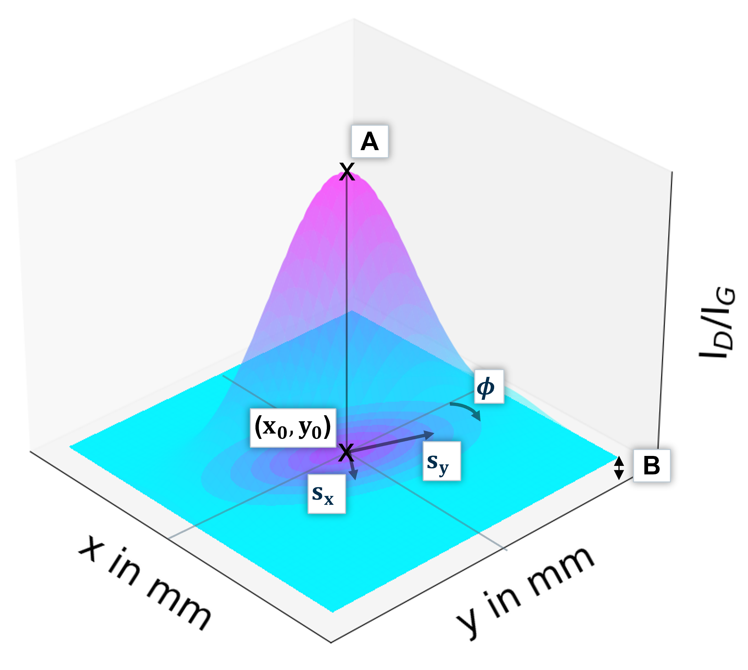
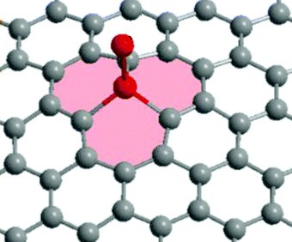
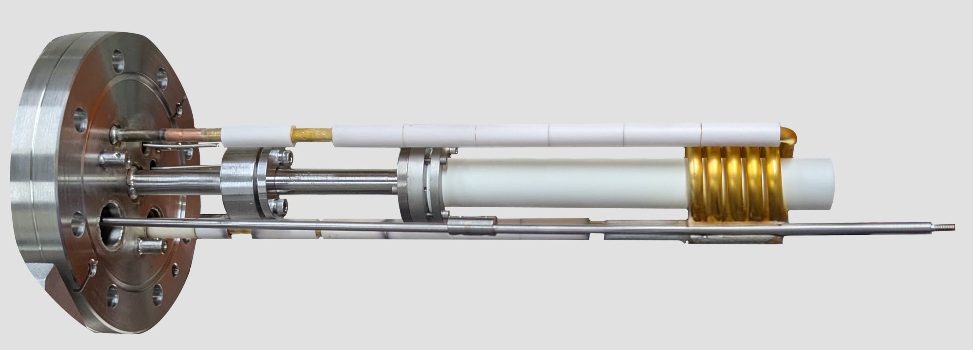
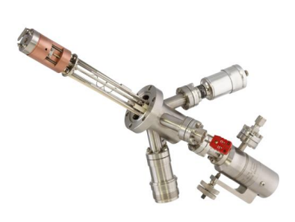
Characterization of atomic hydrogen beams for future neutrino mass experiments
David Frese, Genrich Zeller, Caroline Rodenbeck

Slide 2
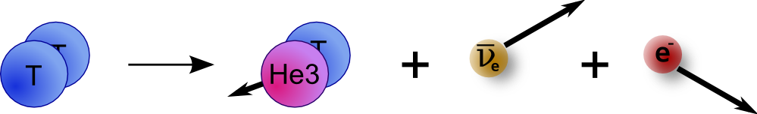
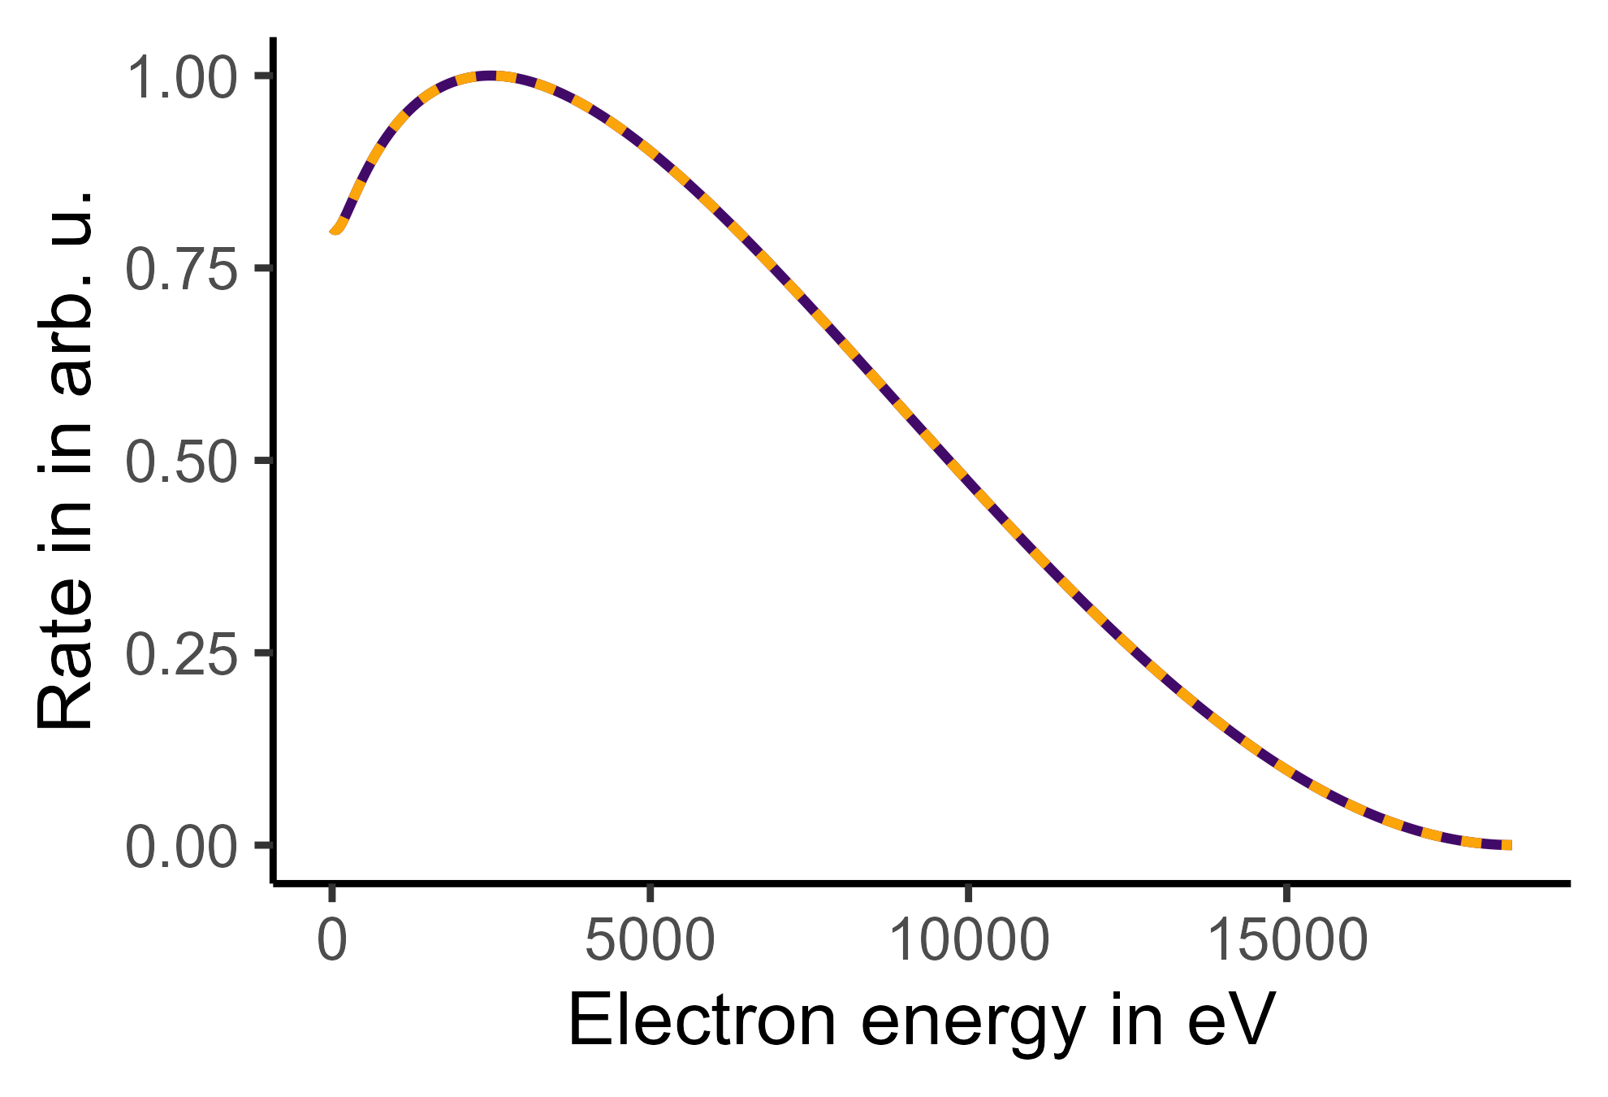
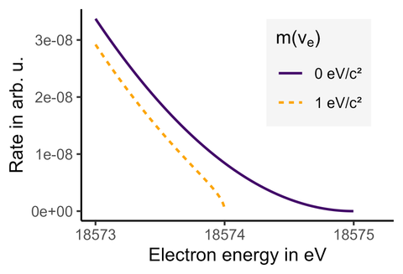

Tritium based neutrino mass measurements
Measure shape of the endpoint region of the spectrum
)))
(((
More details in the slides of:
Juliana Stachurska
Francesca Maria Pofi
Christian Weinheimer
Sonja Schneidewind
Karo Erhardt

Slide 3
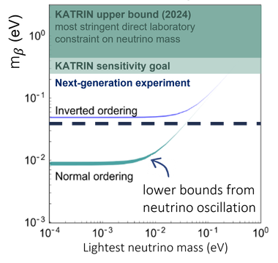
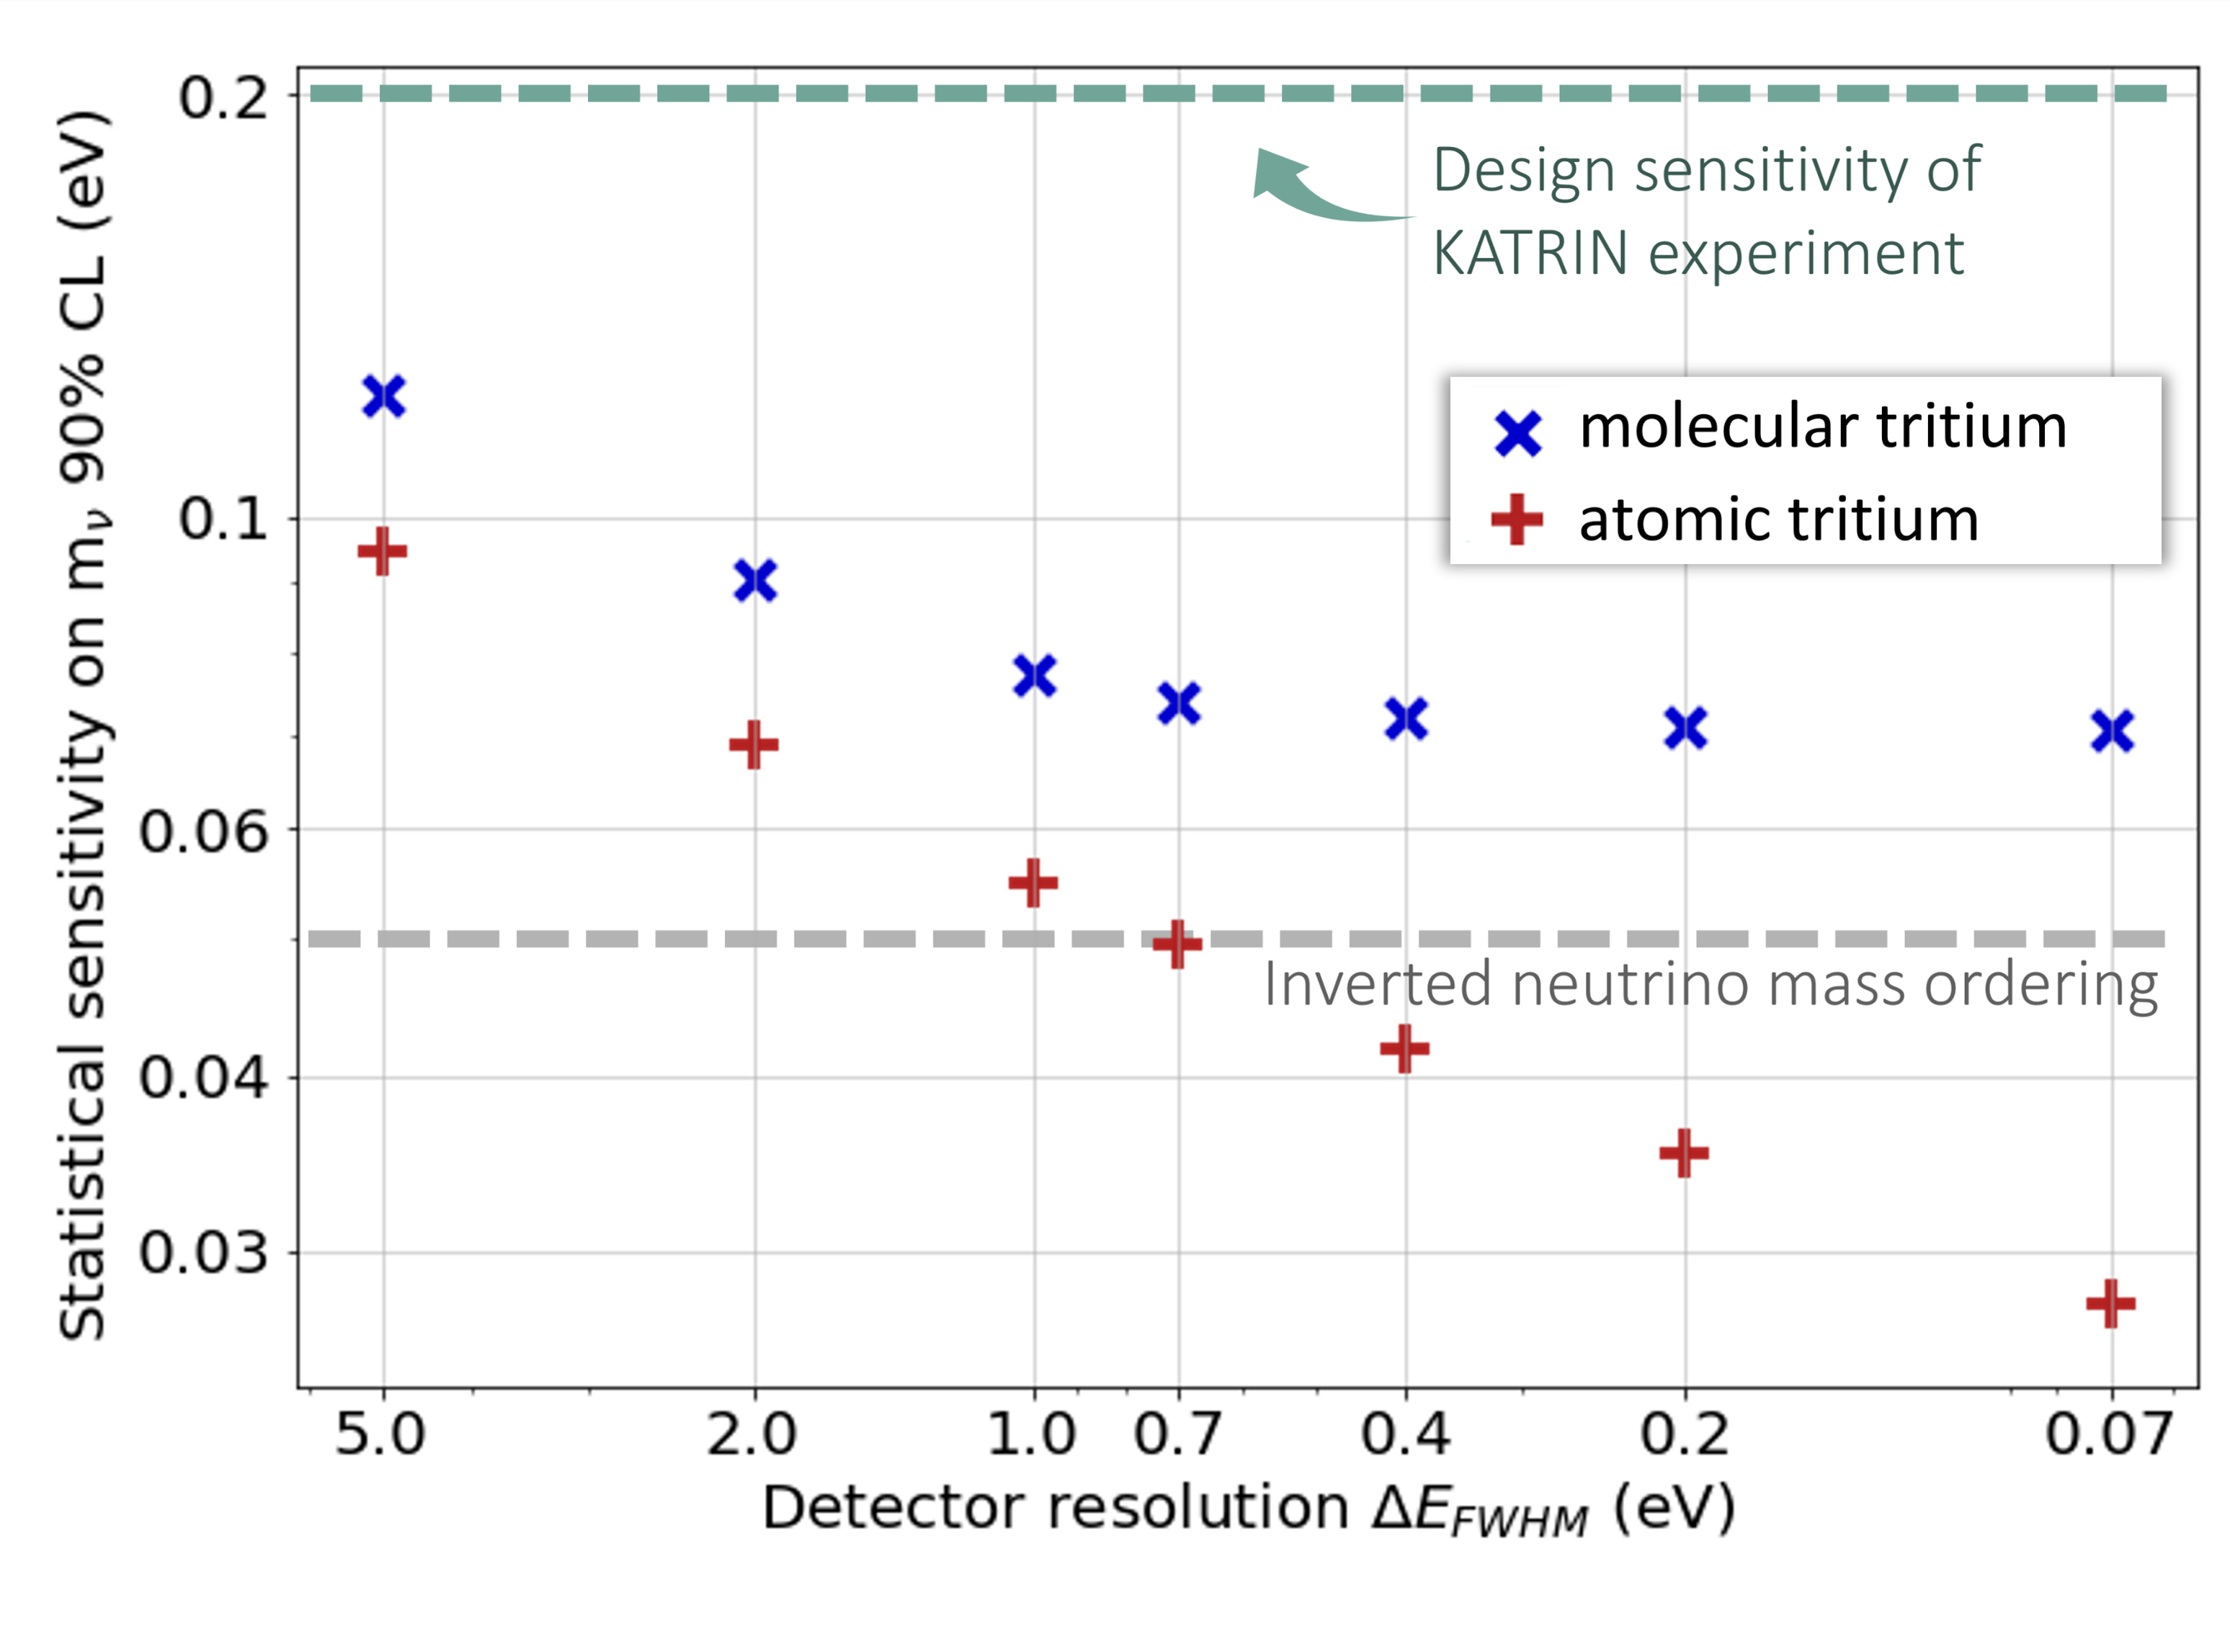
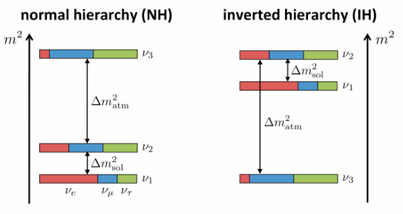
Increasing sensitivity for future neutrino mass experiments
Sensitivity study by S. Heyns
Credit: S. Heyns

Slide 4
Improving sensitivity for future neutrino mass experiments
Development of new technologies is necessary to reach below inverted mass ordering
Differential detector
Atomic tritium
More details in the slides of:
Juliana Stachurska
Francesca Maria Pofi
Christian Weinheimer
Svitlana Hoienko
Jan Küpperbusch
Lorenzo Calza
Raghav Pandey
Sensitivity study by S. Heyns

Slide 5
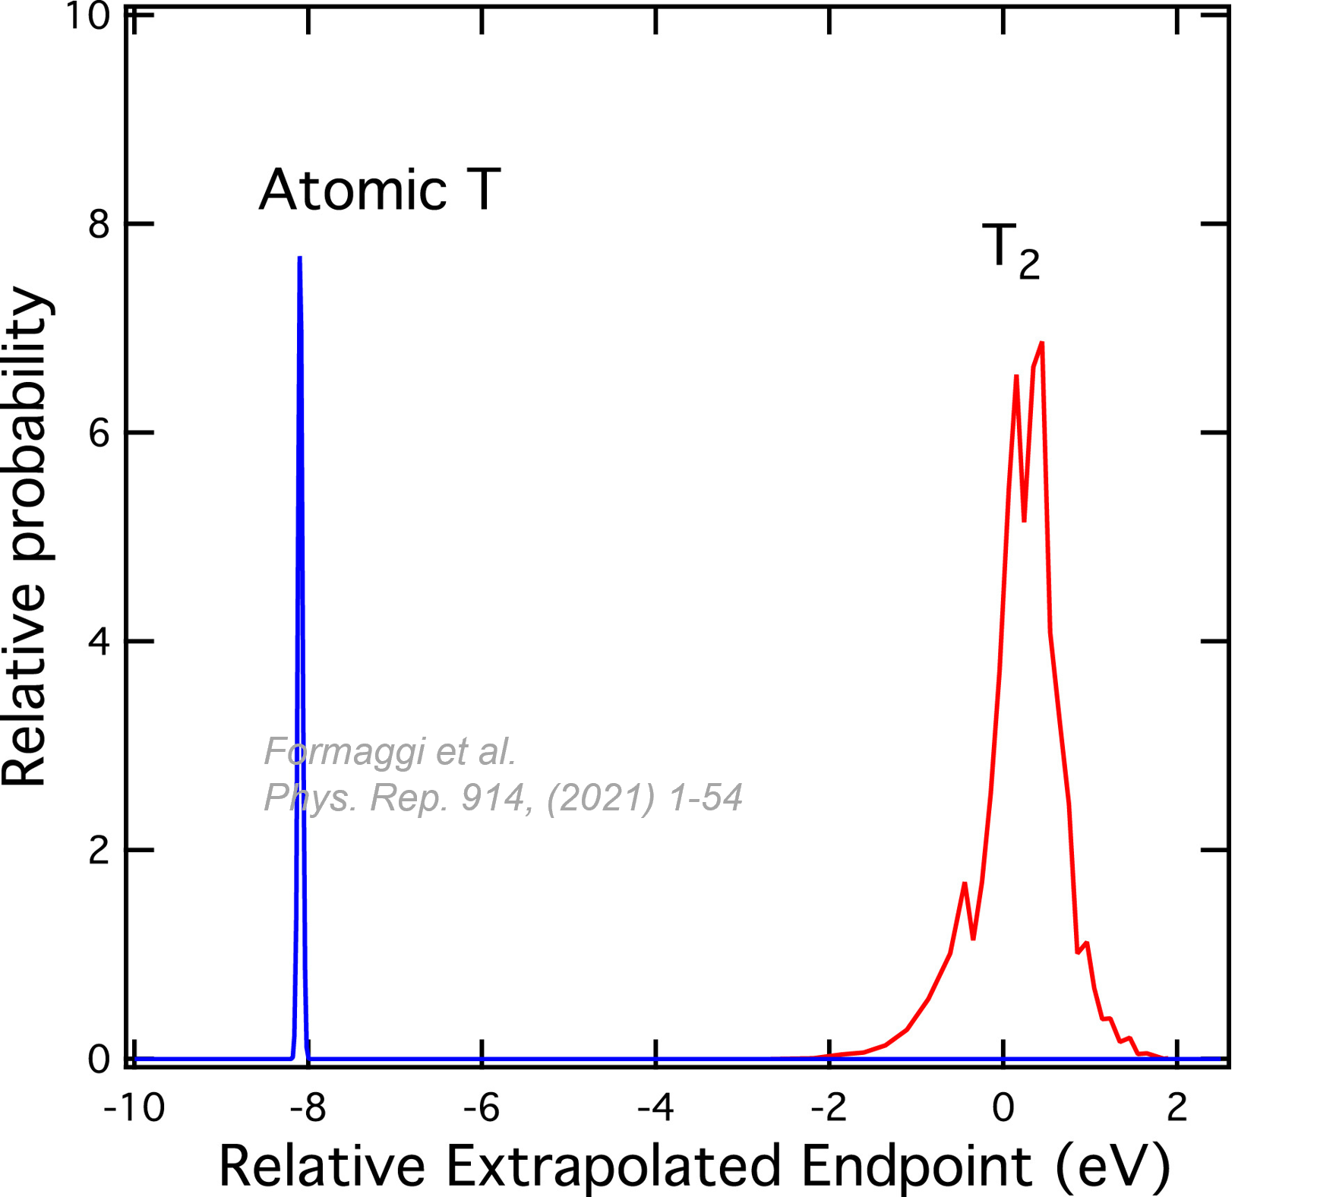
Improving sensitivity with atomic tritium
)))
(((
Sensitivity study by S. Heyns
Intrinsic broadening of ground state (FWHM 1 eV)

Slide 6

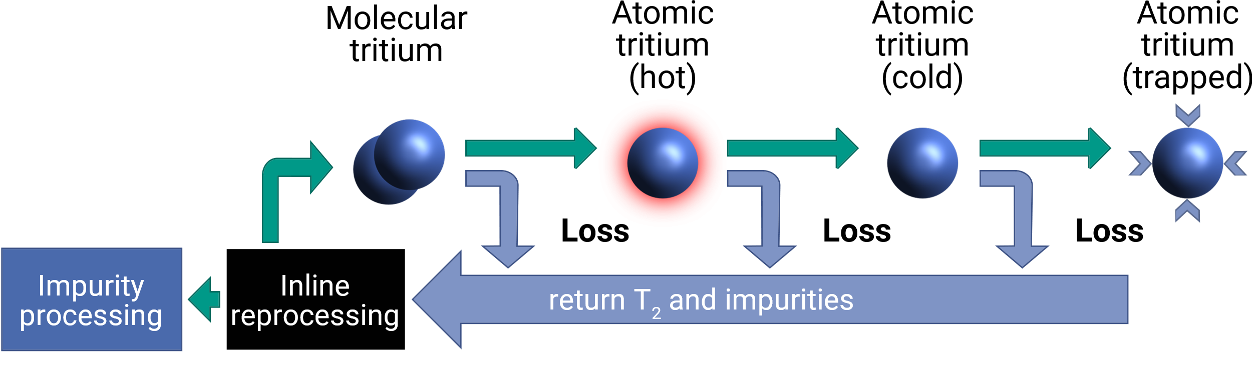


Steps toward an atomic tritium source
Slide from C. Rodenbeck
  Aim: Generate a source of mK-cold tritium atoms with
  high activity (ultimately >10¹¹Bq ≈ KATRIN)
  Efficiency of each processing step needs to be optimized to achieve a high total efficiency
  Solve challenges together! Ongoing collaborative effort: Karlsruhe Mainz Atomic Tritium Experiment: KAMATE
Future
Established technology at TLK

Slide 7




Milestones within KAMATE
Slide adapted from C. Rodenbeck
KAMATE 0.5
KAMATE 1.0
KAMATE 2.0
KAMATE 3.0
  Identify the best dissociation technology
  Thermal dissociator
  Plasma dissociator
  Using nonradioactive hydrogen
  Tritium operation.
  Operate KAMATE 0.5
  setup at TLK with tritium.
  Cooling I.
  Add accommodator to achieve atoms of O(100K).
  Cooling II.
  Add nozzle to achieve atoms of O(1 K).
  Add beam-temperature measurement setup using time of flight.

Slide 8
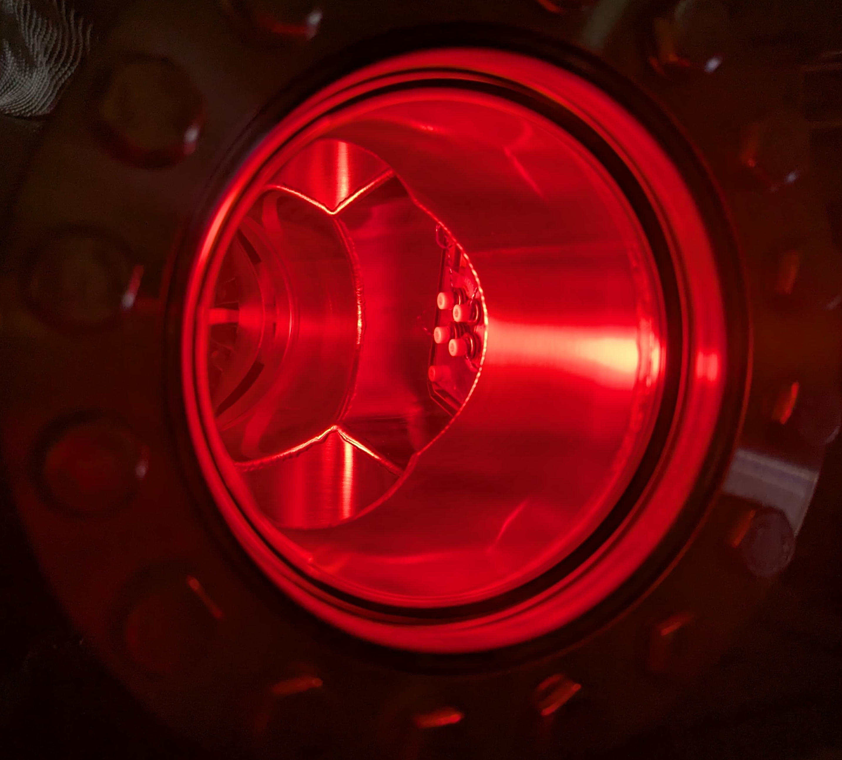
Techniques to characterize atomic hydrogen beams
Hydrogenated graphene
Laser ionisation
Quadrupole Mass Spectrometer (QMS)
Calorimetric methods
Hydrogenation of graphene (H-Gr)
Advantages of H-Gr:
Large beam coverage possible
Sensitivity to single atom adsorption possible
Adsorption of tritium demonstrated
Killian et al. (GRASIAN) Eur. Phys. J. D 77, 50 (2023)
Astaschov, M., et al. Eur. Phys. J. D 79, 60 (2025)
Graphene exposed to a plasma
F. Schedin et al. Nature Materials 6(9):652-5 (2007)
Zeller et al, Nanoscale Adv.,2024

Slide 9
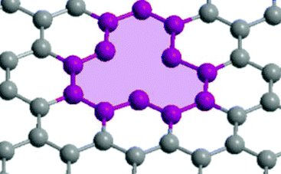
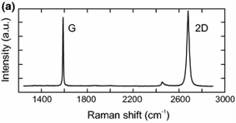
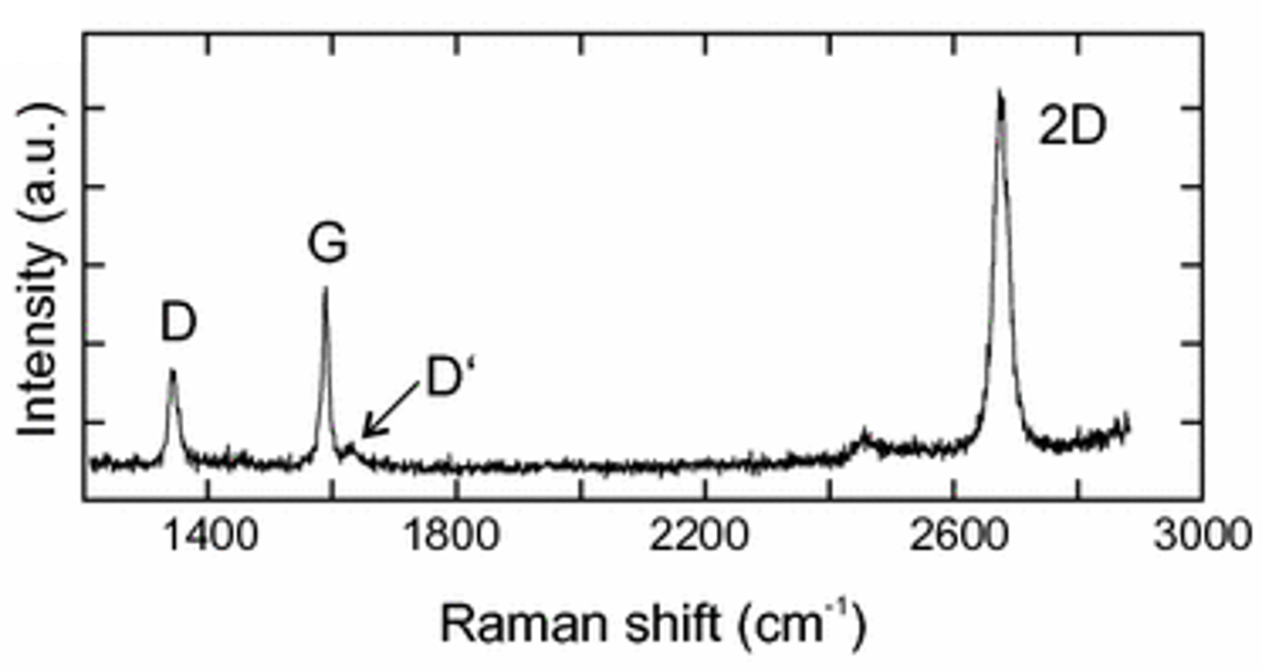
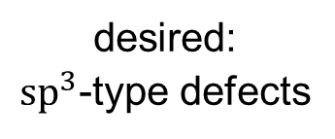
Hydrogenation of graphene: H-Gr
2D material consisting of C in honey comb structure
Adsorption is selective to atomic/ionic hydrogen
Two type of defects occur mainly during exposure to H-beams
Diagnostic methods:
In-situ: Sheet resistance measurement
Defect production removes a charge carrier
Ex-situ: Raman Microscopy
Complex dedicated optical setup for Raman microscopy
desired:
$sp^{3}$-type defects
undesired:
vacancy-type defects
pristine graphene
defective graphene
Barrero et al. Sensors 2022, 22(24),101013
Neumann and Stampfer, Springer, 2018

Slide 10
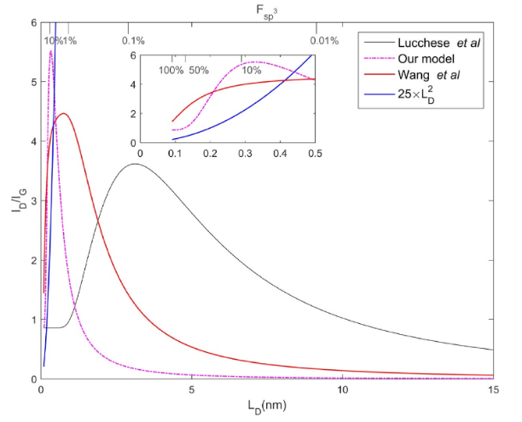
Ex-situ diagnostic: Raman spectroscopy
defective graphene
Neumann and Stampfer, Springer, 2018
2D/G intensity ratio: existence of graphene
D/D‘ intensity ratio: defect type
D/G intensity ratio: defect density is determined from theoretical (=idealized) calculations
T Fournier et al., Carbon 244 (2025) 120657
Interpretation of Raman spectra can be non trivial

Slide 11
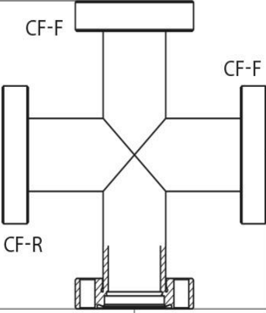
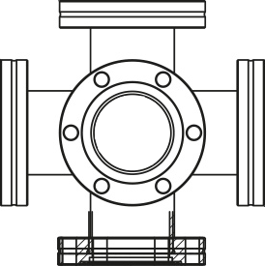
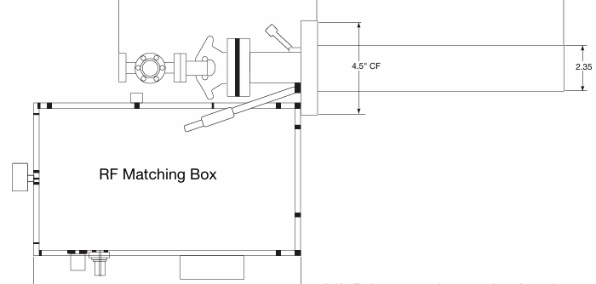
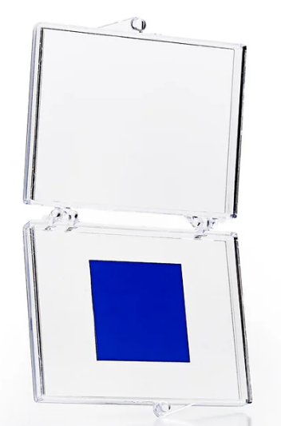
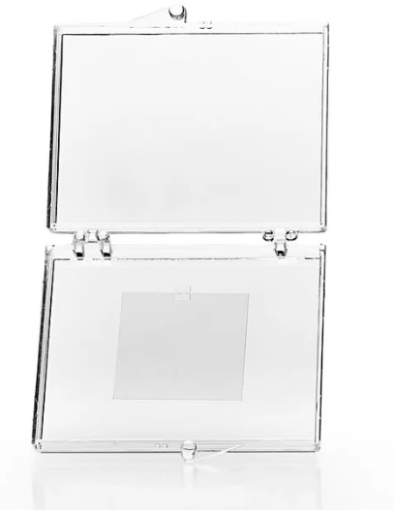
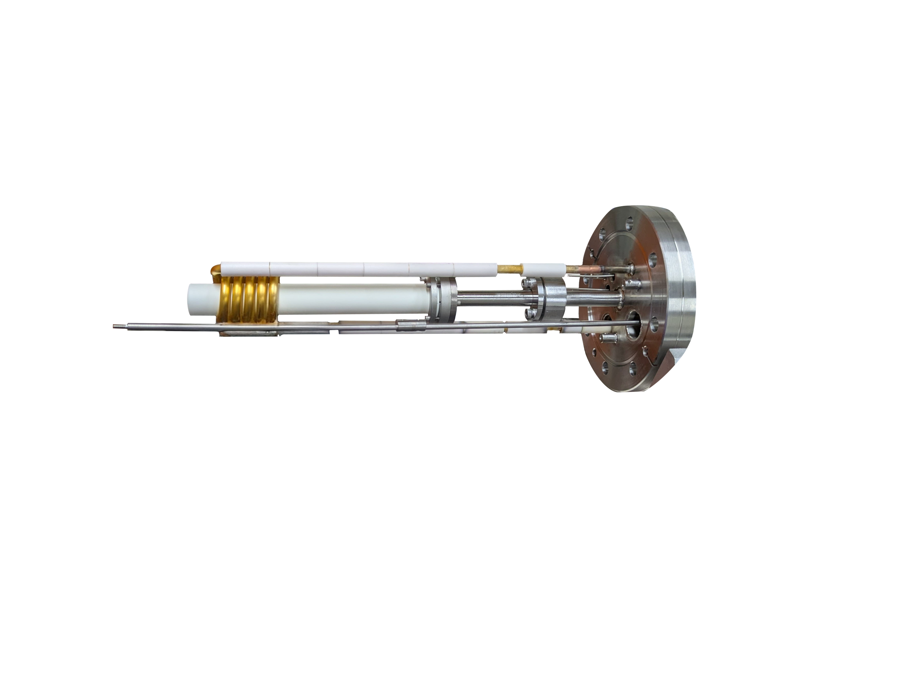

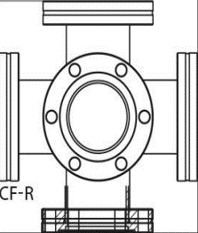
Experimental setup
Hydrogen beam
H-gas inlet
Dissociator
Graphene samples
Graphenea.com
Thermal cracker
Plasma-based dissociation
$Si/SiO_{2}$ substrate
Quartz substrate

Slide 12
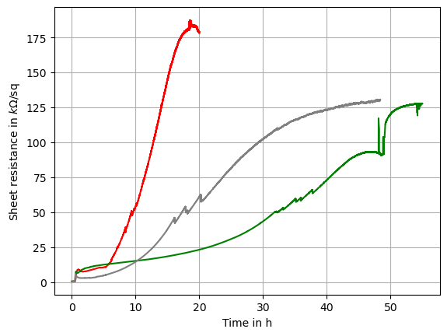
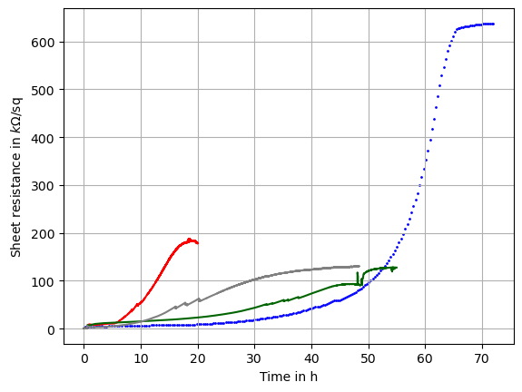



Measurement: Sheet resistance
$Si/SiO_{2}$ substrate
Preliminary
Preliminary
H from thermal on quartz substrate
Plasma source
$Si/SiO_{2}$ substrate
$T_{2}$ gas
Zeller et al, Nanoscale Adv.,2024
Thermal cracker

Slide 13
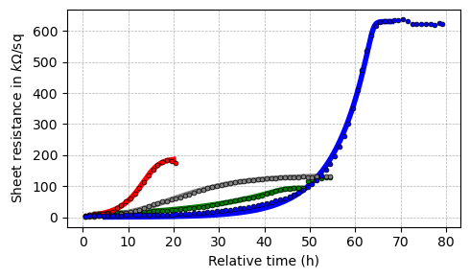
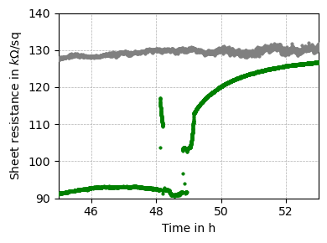
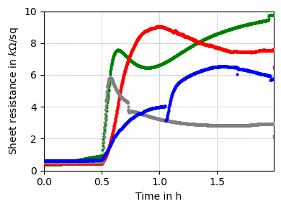
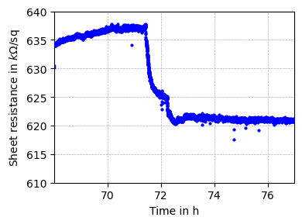
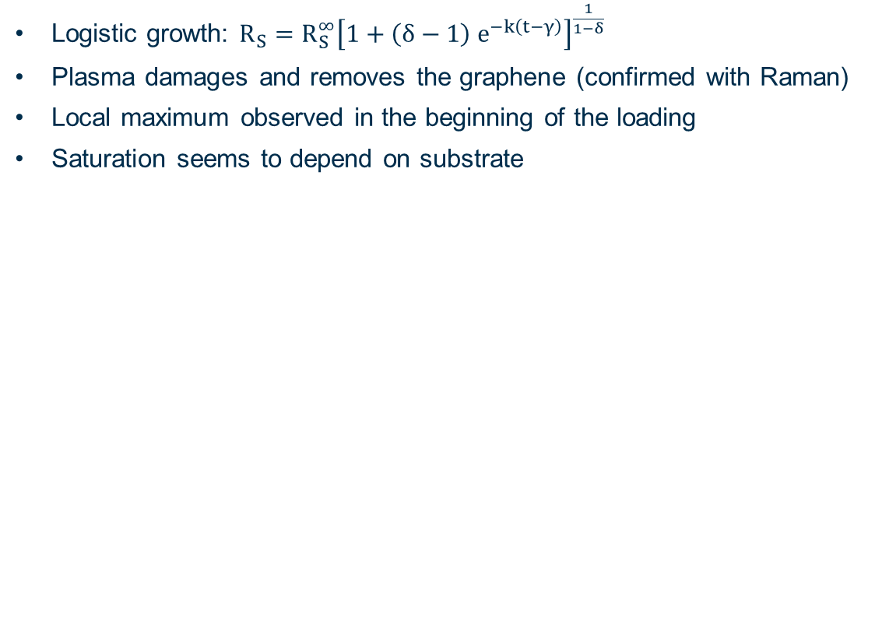

Results: Sheet resistance
Preliminary
Bin width: 1h
Data
H from thermal on quartz
Fit
Richards, Journal of Experimental Botany, 10.1093, pp. 290–301 (1959)
$R_{s}$ ($×{10}^{3}Ω/$ )
Logistic growth: $R_{S}=R_{S}^{∞}{\left[1+\left(δ−1\right) e^{−k\left(t−γ\right)}\right]}^{\frac{1}{1−δ}}$
Plasma damages and removes the graphene (confirmed with Raman)
Local maximum observed in the beginning of the loading
Saturation seems to depend on substrate
H from Plasma
$T_{2}$ gas
H from thermal
Relative time (h)
Preliminary
Preliminary
$R_{s}$ ($×{10}^{3}Ω/$ )
$R_{s}$ ($×{10}^{3}Ω/$ )
$R_{s}$ ($×{10}^{3}Ω/$ )
Preliminary
Relative time (h)
Relative time (h)
Relative time (h)

Slide 14
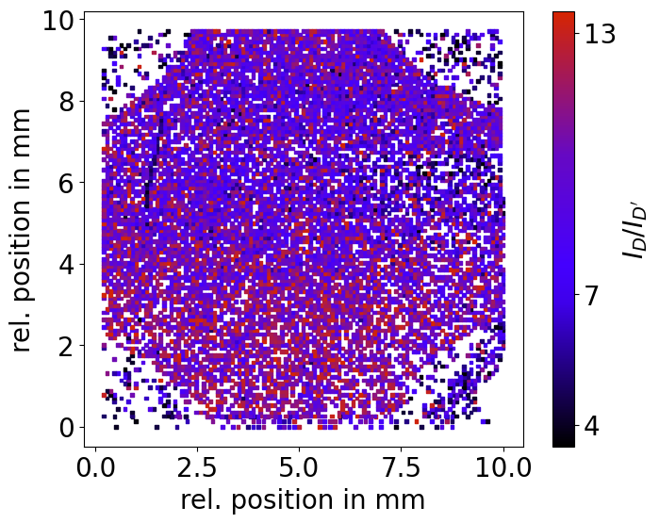
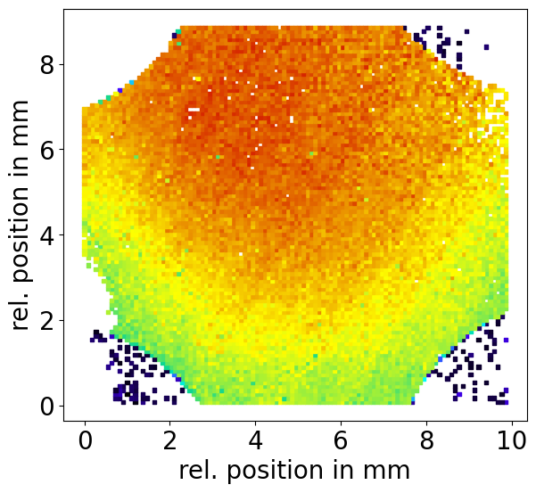
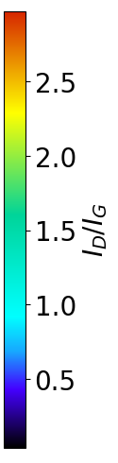
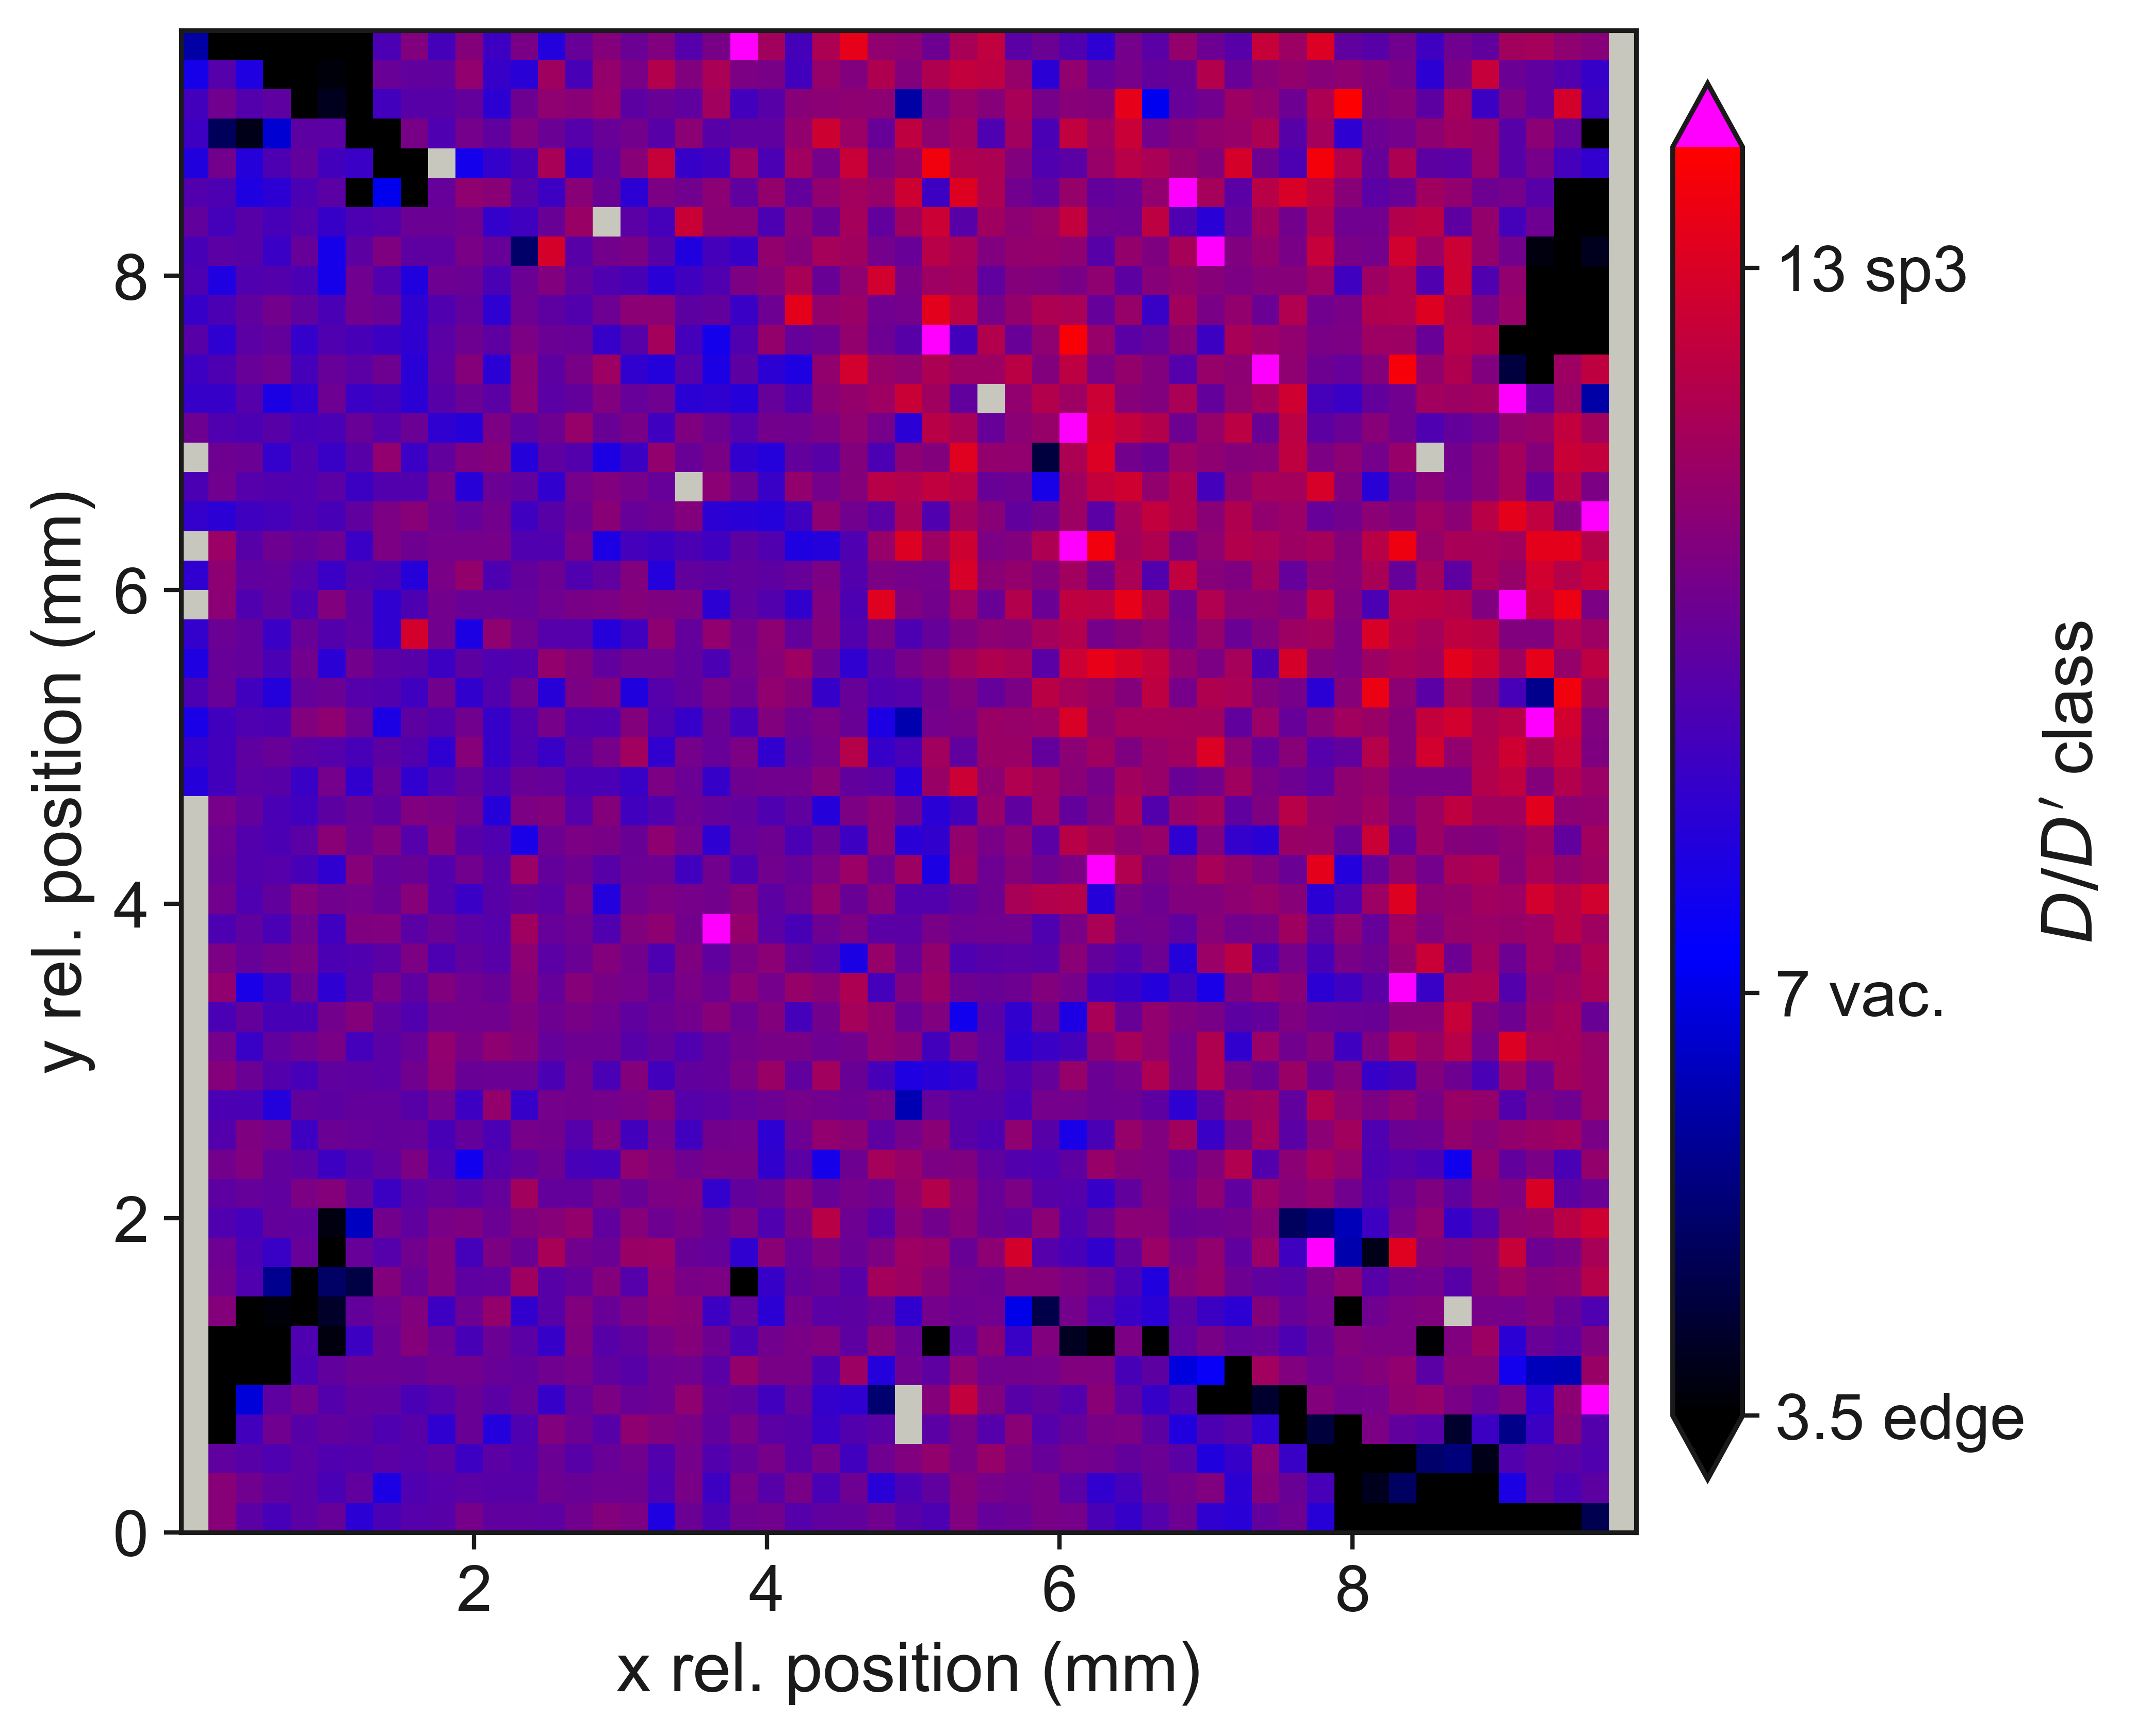
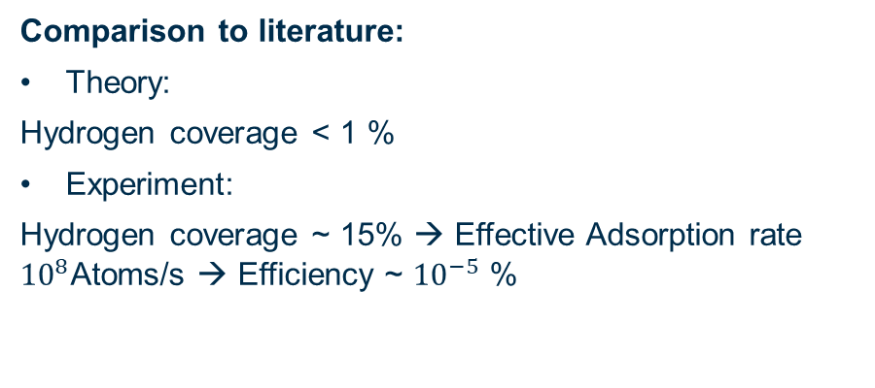




Raman results: Defect type & Defect density
Defect type
$$Si/SiO_{2}$$
Defect density $L_{D}$
Loading with plasma
Loading time: 53 min
Very little hydrogenation
Many vacancies
Beam profile visible in defect density
(hydrogenated)
(mix of defect types)
$$∝L_{D}$$
(vacancy defects)
Loading with thermal cracker
Loading time: 48 h
Much more hydrogenation
Beamprofile-like structure visible in defect type
Comparison to literature:
Theory:
Hydrogen coverage < 1 %
Experiment:
Hydrogen coverage ~ 15% → Effective Adsorption rate ${10}^{8}$Atoms/s → Efficiency ~ ${10}^{−5}$ %
T Fournier et al., Carbon 244 (2025) 120657
Son et al., Nat Commun 7, 13261 (2016)
Preliminary
$$Si/SiO_{2}$$

Slide 15
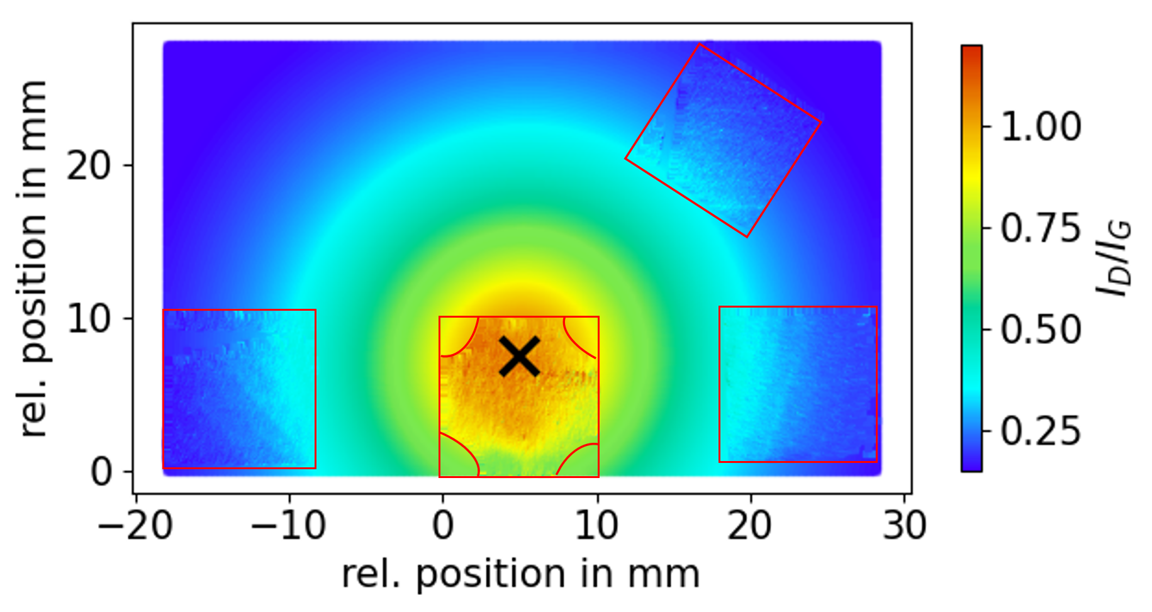
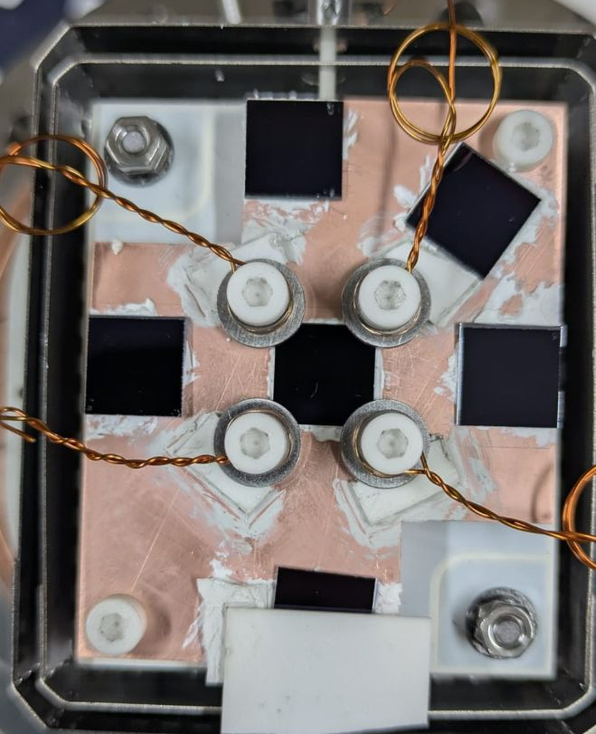
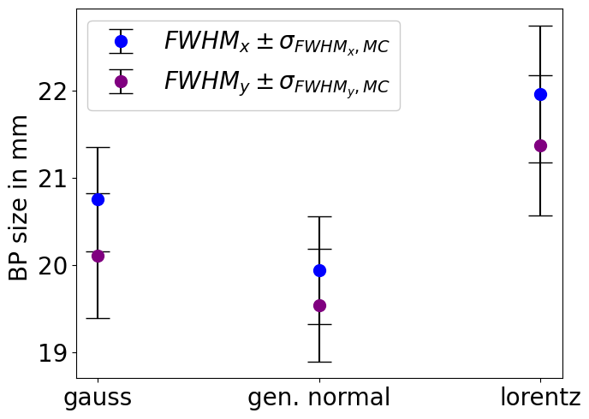
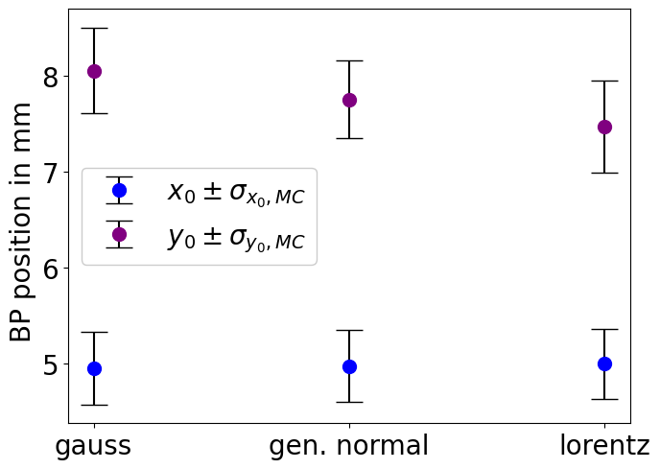
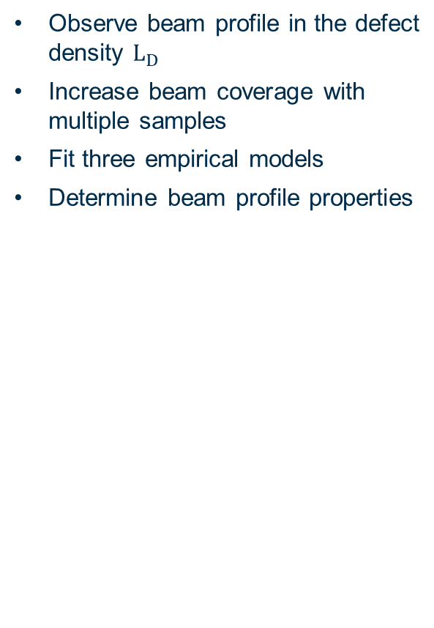


Raman results of loading with plasma: Beam profile in defect density
Lorentzian fit
Observe beam profile in the defect density $L_{D}$
Increase beam coverage with multiple samples
Fit three empirical models
Determine beam profile properties
$$σ_{res}=87.5 μm$$
$$∝L_{D}$$
$$∝L_{D}$$

Slide 16

Summary & Outlook
Preliminary
Bin width: 1h
Data
H from thermal on quartz
Fit
A sub-K atomic tritium source is needed for future neutrino mass experiments
KAMATE aims to develop diagnostics to characterize atomic tritium beams
Graphene is succesfully used to characterize hot atomic hydrogen beams (Paper in preparation)
Next up: Will this also work for cold beams?
$R_{s}$ ($×{10}^{3}Ω/$ )
H from Plasma
$T_{2}$ gas
H from thermal
Relative time (h)
Preliminary
$$∝L_{D}$$

Slide 17
Backup

Slide 18
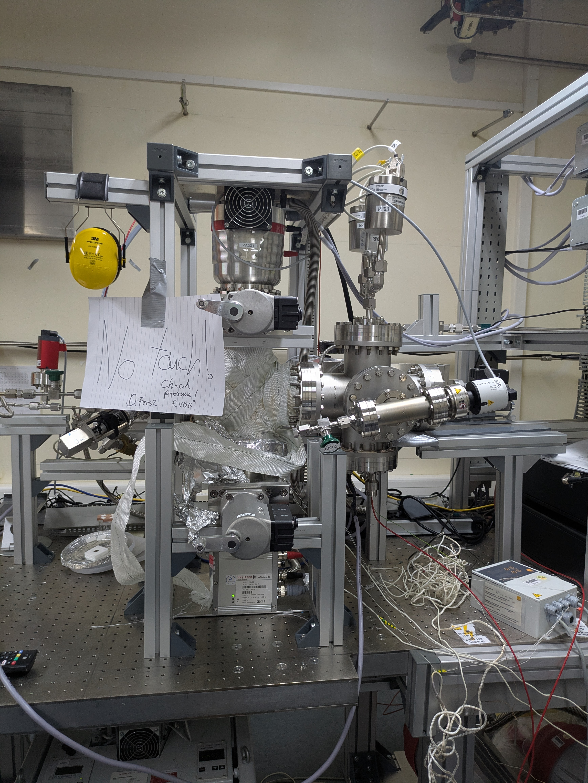
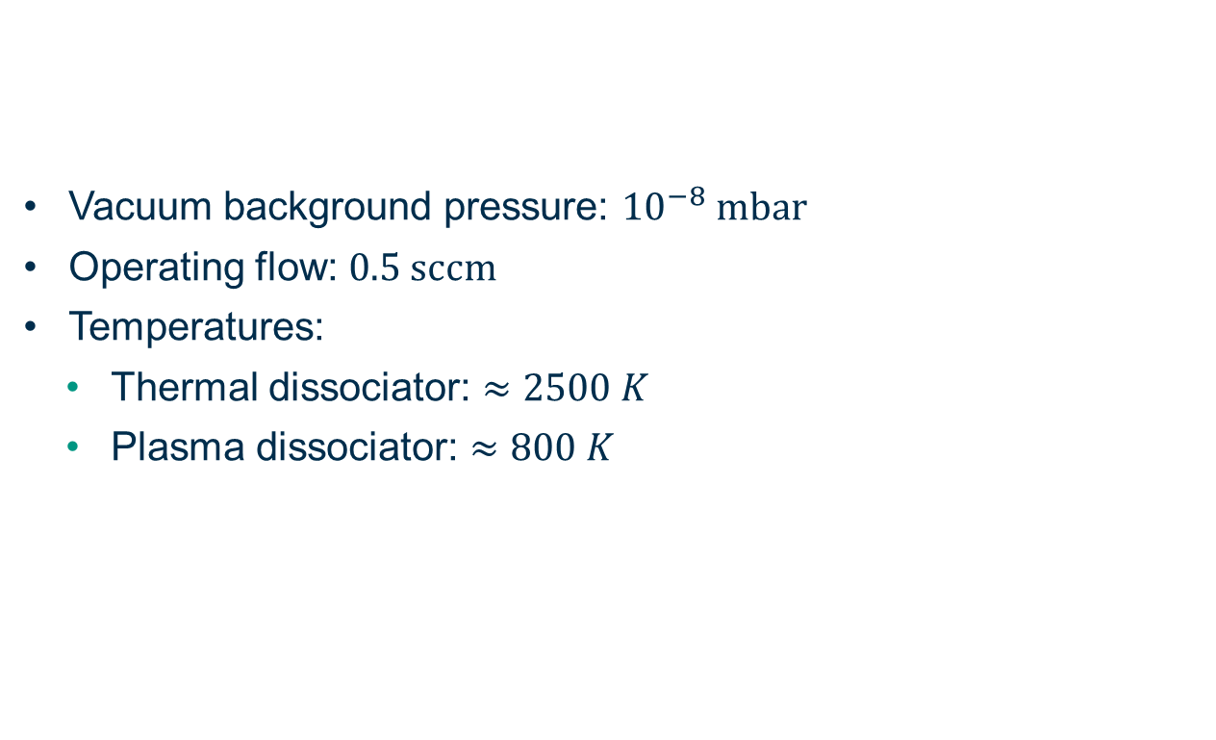
Experimental setup key facts
Vacuum background pressure: ${10}^{−8} mbar$
Operating flow: $0.5 sccm$
Temperatures:
  Thermal dissociator: $≈2500 K$
  Plasma dissociator: $≈800 K$

Slide 19
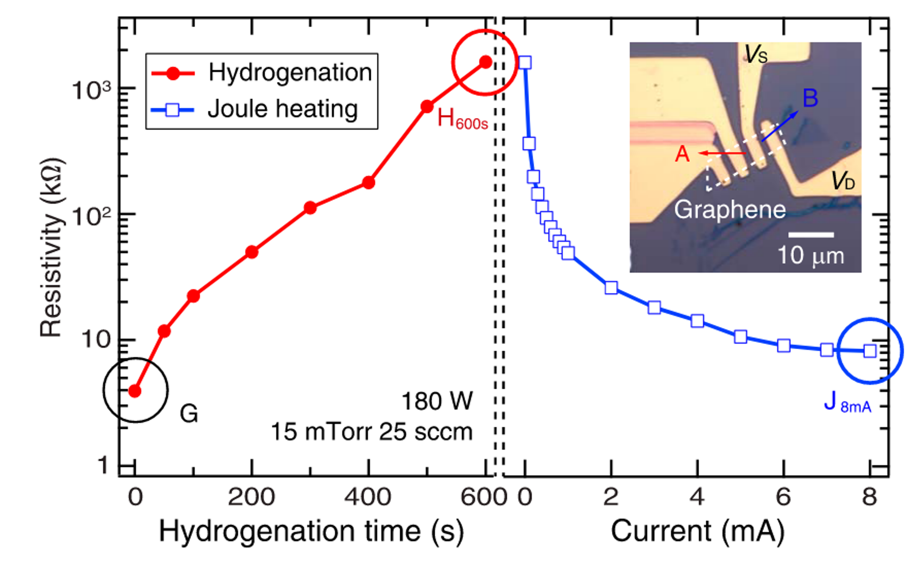
Graphene as an atomic hydrogen sensor – In-situ diagnostic
Idea
Sheet resistance increases with hydrogenation
Thermal annealing to 300°C to distinguish defect type
Realisation
Sheet resistance via Van der Pauw (VdP) method
  4 wire contact method
  Averaging of all contacting permutations
  Independent of contacting quality and geometry
Engineering balance between:
  Fullfilling VdP contacting requirements
  Contacting robust against heating of 300°C
  UHV compatible
  Tritium compatible
Cha et al, Appl.Phys Express 15.1, 2022

Slide 20
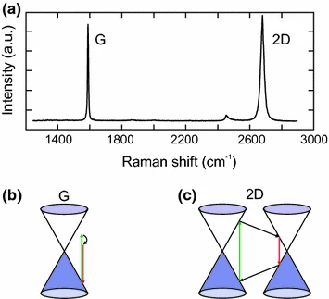
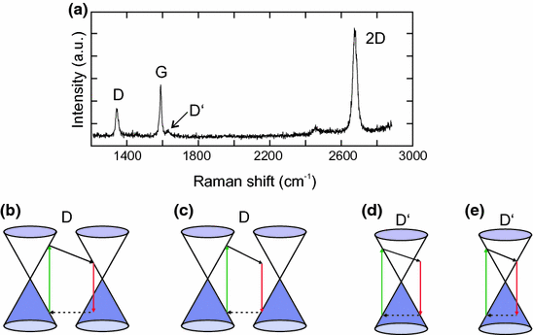
Ex-situ diagnostic: Raman spectroscopy
Graphene-structure-dependend wavelength shift of 532 nm laser
pristine graphene
defective graphene
Neumann and Stampfer, Springer, 2018

Slide 21
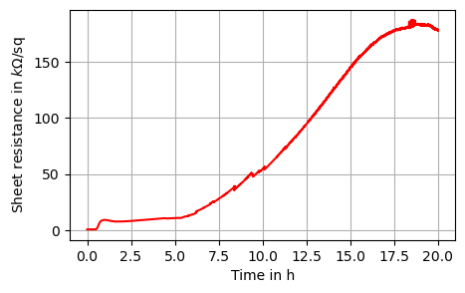
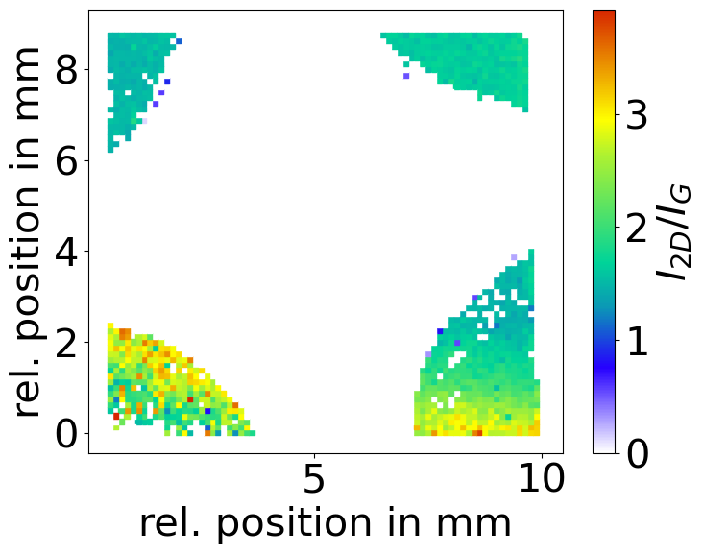
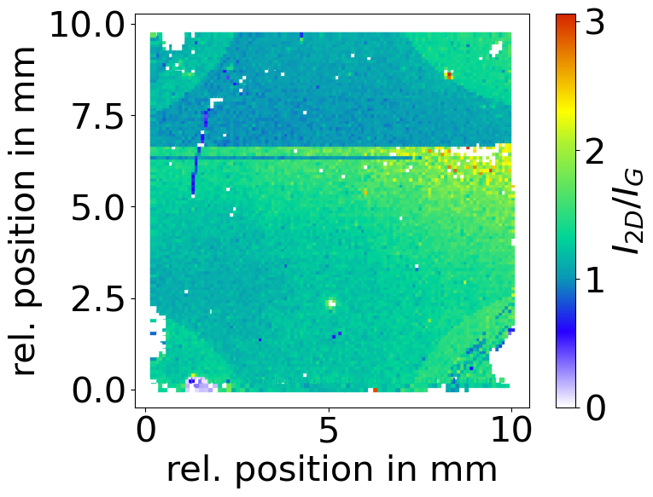


Loading experiments: Dissociator comparison – plasma
Full loading with plasma removed graphene → existence of high energy species
Defect type for loading time: 45 min
$Si/SiO_{2}$ substrate
Loading time: 17h
Loading time: 45 min
Plasma source
Defect density
Loading time: 45 min
(hydrogenated)
Mixture of vacancies and $sp^{3}$-type defects
→ Very few atoms
(mix of
defect types)
(vacancy defects)

Slide 22

Loading experiments: Substrate comparison
Preliminary
Preliminary
Plasma source
Quartz substrate
$Si/SiO_{2}$ substrate
$T_{2}$ gas
Zeller et al, Nanoscale Adv.,2024
Thermal cracker
Sheet resistance indicates increased hydrogen coverage. Confirmed by first Raman scans (coverage >20%)

Slide 23


Outlook: Implementation of PTFE tube
skimmer
PTFE tube
H-gas inlet
dissociator
Graphene sample
4 wire resistance of DAQ
Start loading

Slide 24

Graphene for cold atoms?
Calculations T with Gr
Gr temperature
Exact adsorption potential unclear
Classical chemisoprtion probably not possible due to potential well of ~0.1 eV
Investigate adsorption mechanisms by measuring at different beam temperatures
Wu et al. Nuclear Engineering
and Technology 54 (2022) 4022e4029
Easy experimental realization…

Slide 25



Low-energy particle beams
Thin film deposition
Low energy: average kinetic energy of sub eV
Particles: ions, molecules, atoms
Fields that are interested:
Atomic tritium research
Satish, M. J Bio Tribo Corros 9, 35 (2023)
Surface cleaning
Basic beam properties:
Beam alignment
Opening angle
A D Lambert et al 1999 Semicond. Sci. Technol. 14 L1

Slide 26




Raman spectroscopy limitations
Width $w_{D}$ determines defect stage
  Stage 1: $L_{D}>3 nm$
  Stage 2: $L_{D}<3 nm$
      No assignment for defect type!
T Fournier et al., Carbon 244 (2025) 120657
L.G. Cancado et al., Nano Letters11.8 (2011)
Eckmann et al. Nano Lett.
12.8, 2012

Slide 27





Observed defect types
Raman spectrum of defective Graphene
Mixture of vacancies and $sp^{3}$-type defects
hydrogenation: $sp^{3}$-type defects
vacancy-type defects
Eckmann et al. Nano Lett.
12.8, 2012
D/D‘ intensity ratio
(hydrogenated)
D/D‘ intensity ratio histogram
Defect type in the D/D‘
intensity ratio
$$I_{D}/I_{G}$$
(mix of
defect types)
(vacancy defects)
$$I_{D^{′}}/I_{G}$$

Slide 28
Beam profiles

Slide 29






Empirical beam profile models
$Σ=R D R^{T}$
$D=diag\left(s_{x}^{2},s_{y}^{2}\right)$
$R=[\left[\cos\left(φ\right),−sin\left(φ\right)\right]$
$[sin\left(φ\right), \cos\left(φ\right)]]$
Choose models empirically
Three models evaluated:
  Gaussian $p=2$ and $α=2$
  Generalized Normal with p = free parameter and $α=1$
  Lorentzian
$$I_{D/G}=A⋅\exp\left[−{\left(\frac{1}{α}⋅{\left(\vec{r}−\vec{r_{0}}\right)}^{T} Σ^{−1} \left(\vec{r}−\vec{r_{0}}\right)\right)}^{p}\right]+B$$
$$∝L_{D}$$
$$I_{D/G}=\frac{A}{1+{\left(\vec{r}−\vec{r_{0}}\right)}^{T} Σ^{−1} \left(\vec{r}−\vec{r_{0}}\right)}+B$$
Beam profile parameters $θ$

Slide 30





Fit results – 3 models
Compare data and lorentzian fit
Residuals: $Δ_{ij}{=\left(\frac{I_{D}}{I_{G}}\right)}_{ij, model}−{\left(\frac{I_{D}}{I_{G}}\right)}_{ij, data }$
Goodness of the fit $χ^{2}$:
$$χ^{2}=\sum_{i,j}{{\left( \frac{Δ_{ij}}{σ_{ij}}\right)}^{2}}$$
And reduced $χ^{2}$:
$$χ_{ν}^{2}= \frac{χ^{2}}{ν}$$
Beam center
$$∝L_{D}$$
Degrees of
freedom
 | Lorentzian | Generalized normal | Gaussian
$$\frac{χ^{2}}{10^{4}}$$ | $$7.3±0.93$$ | $$7.7±0.7$$ | $$7.4±0.64$$
$$\frac{χ^{2}}{ν}$$ | $$2.35±0.3$$ | $$2.34±0.2$$ | $$2.37±0.2$$
Successful development of graphene chips as a new beam diagnostic tool

Slide 31





Determination of beam profile parameters - Model comparison
Beam profile (BP) parameters $θ$
Determine ${FWHM}_{x,y}$ from $s_{x}$ and $s_{y}$ for model comparison
Model | Conversion factor
Lorentzian | 2
Generalized normal | 1.98
Gaussian | 1.62
$$∝L_{D}$$
Models are compatible in the determination of beam profile position and size

Slide 32

Beam profile models
$Σ=R D R^{T}$
$D=diag\left(s_{x}^{2},s_{y}^{2}\right)$
$R=[\left[\cos\left(φ\right),−sin\left(φ\right)\right]$
$[sin\left(φ\right), \cos\left(φ\right)]]$
Choose models empirically
Three models evaluated:
  Gaussian $p=2$ and $α=2$
  Generalized Normal with p = free parameter and $α=1$
  Lorentzian
$$I_{D/G}=A⋅\exp\left[−{\left(\frac{1}{α}⋅{\left(\vec{r}−\vec{r_{0}}\right)}^{T} Σ^{−1} \left(\vec{r}−\vec{r_{0}}\right)\right)}^{p}\right]+B$$
$$∝L_{D}$$
$$I_{D/G}=\frac{A}{1+{\left(\vec{r}−\vec{r_{0}}\right)}^{T} Σ^{−1} \left(\vec{r}−\vec{r_{0}}\right)}+B$$
Beam profile parameters $θ$

Slide 33




Fit parameter uncertainty $σ_{θ}$
Beam profile (BP) parameters $θ$
Uncertainty $σ_{ij}$ of the D-G ratio of every pixel: $σ_{ij}= \sqrt{σ_{stat}^{2}+σ_{sys}^{2}}$
  $σ_{stat}$ from the fit of the D and the G peak
  $σ_{sys}$ from intensity calibration of the Confocal Raman Microscope
  Propagation via approximation of the Hessian matrix of the $χ^{2}$-function
Uncertainty $σ_{MC}$ yielding from variations in the mapping of the Raman scans to the photo.
  $→$ Monte Carlo uncertainty propagation
  Shifting the graphene samples by random value from a uniform distribution with limits:
      x-position : $±1.065 mm$
      y-position : $±1.065 mm$
      Rotation: $±{0.21}^{∘}$
    Perform 1000 fits

Slide 34


$σ_{MC}$- Monte Carlo based uncertainty estimation for the lorentzian model
Beam profile (BP) parameters $θ$
$σ_{θ,MC}$= std. dev. of parameter 𝜃

Slide 35


Correlation of parameters - Lorentzian
Beam profile (BP) parameters $θ$

Slide 36




Hydrogenation of graphene
Hydrogen bonds covalently with $p_{z}$ electron of carbon atom
$π$-bond misses an electron
$sp^{2}→sp^{3}$
Band gap forms
Jonathan Guillemette PHD Thesis (2014)

Slide 37





Correlation of sheet resistance (in-situ) and
D-G intensity ratio from Raman scans (ex-situ)
Raman spectrum of defective Graphene
Neumann and Stampfer, Springer, 2018
D-G intensity ratio is proportional to the defect density $L_{D}$
$I_{D}/I_{G}$ correlates positively with R
$I_{D}/I_{G}$ and R correlate positively with loading time t and plasma driving power $P_{RF}$
Generation | t in minutes | $P_{RF}$ in W | $Φ$ in sccm
2 | 237 | 250 | 0.5
 | 1058 | 350 | 1.0
3 | 56 | 350 | 0.5
4 | 30 | 50 | 0.5
 | 13 | 250 | 0.5
Gen. 3 pristine
Gen. 3 plasma exposed and heated
Gen. 4 pristine
Gen. 4 plasma exposed and heated
Sheet resistance R is an indicator for defect density $L_{D}$
R
Sheet resistance in k$Ω/$□

Slide 38






Hydrogenation of graphene
Raman spectrum of defective Graphene
Neumann and Stampfer, Springer, 2018
Defect density $L_{D}$ depends on the defect type
Distinguish sp³-defects (hydrogenation) from vacancies by D-D‘ intensity ratio
Gen 3 – $σ_{res}=91.25μm$
data gen 3
Eckmann et al. Nano Lett.
12.8, 2012
$$I_{D}/I_{G}$$
Gen 4 – $σ_{res}=87.5μm$
data gen 4
$$I_{D^{′}}/I_{G}$$
Generation 3 contains mainly vacancies
→ assign defect density $L_{D}$=5.5 nm
sp³-defects decrease and vacancies increase with loading time

