Slide 1


Search for the neutrinoless double electron capture of ³⁶Ar in LEGEND-200
Gloria Senatore - University of Zurich
INTERNATIONAL SCHOOL OF NUCLEAR PHYSICS -
47th Course “Neutrinos in Cosmology, in Astro-, Particle- and Nuclear Physics”, Erice
21 September 2026

Slide 2
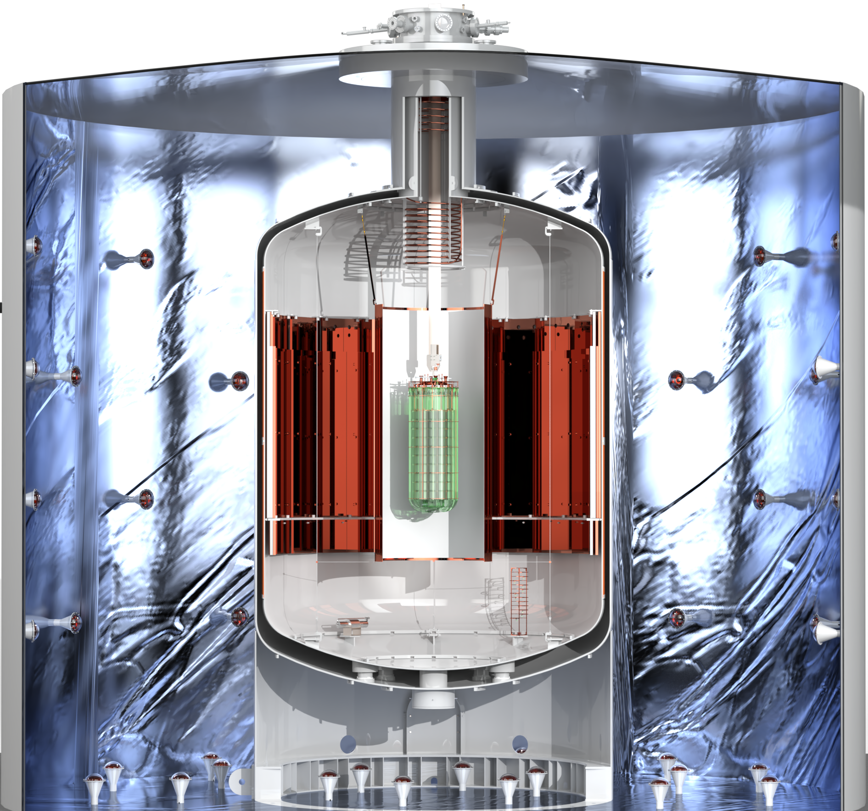

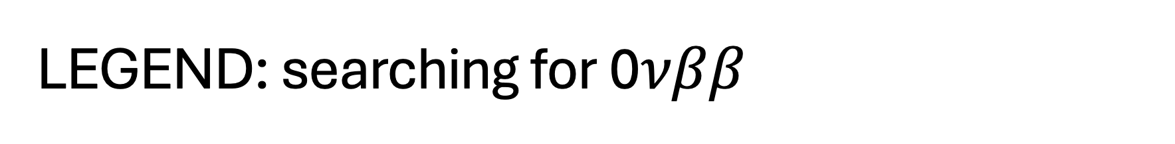
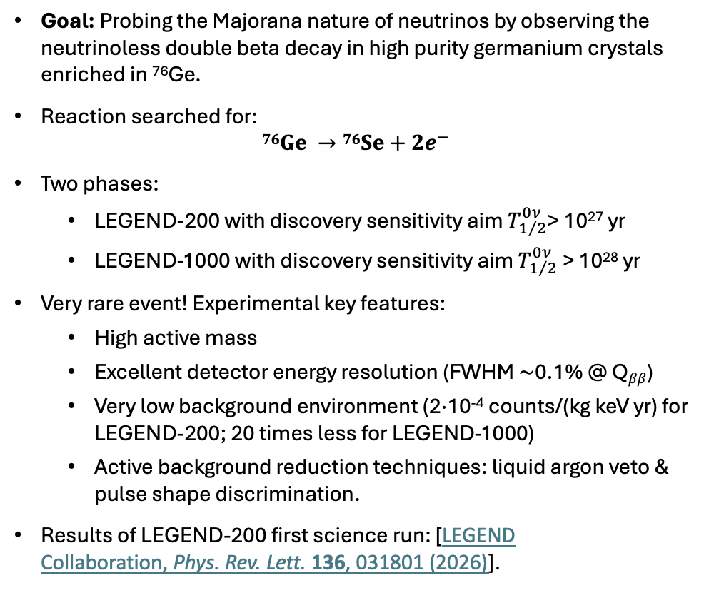
LEGEND: searching for 0$νββ$
LAr instrumentation:
diffuse wavelength-shifting reflector
+
green wavelength-shifting fibers
+
optical sensors (SiPMs)
Goal: Probing the Majorana nature of neutrinos by observing the neutrinoless double beta decay in high purity germanium crystals enriched in ⁷⁶Ge.
Reaction searched for:
$$76Ge →76Se+2e^{−}$$
Two phases:
  LEGEND-200 with discovery sensitivity aim $T_{1/2}^{0ν}$> 10²⁷ yr
  LEGEND-1000 with discovery sensitivity aim $T_{1/2}^{0ν}$> 10²⁸ yr
Very rare event! Experimental key features:
  High active mass
  Excellent detector energy resolution (FWHM $\sim$0.1% @ Q$ββ$)
  Very low background environment (2·10⁻⁴ counts/(kg keV yr) for LEGEND-200; 20 times less for LEGEND-1000)
  Active background reduction techniques: liquid argon veto & pulse shape discrimination.
Results of LEGEND-200 first science run: [LEGEND Collaboration, Phys. Rev. Lett. 136, 031801 (2026)].
HPGe strings
Cryostat filled with 64 m³ of pure liquid argon (LAr)
Tank with 590 m³ of purified water with PMTs (muon veto)
LEGEND-200. Location: Gran Sasso National Laboratory

Slide 3

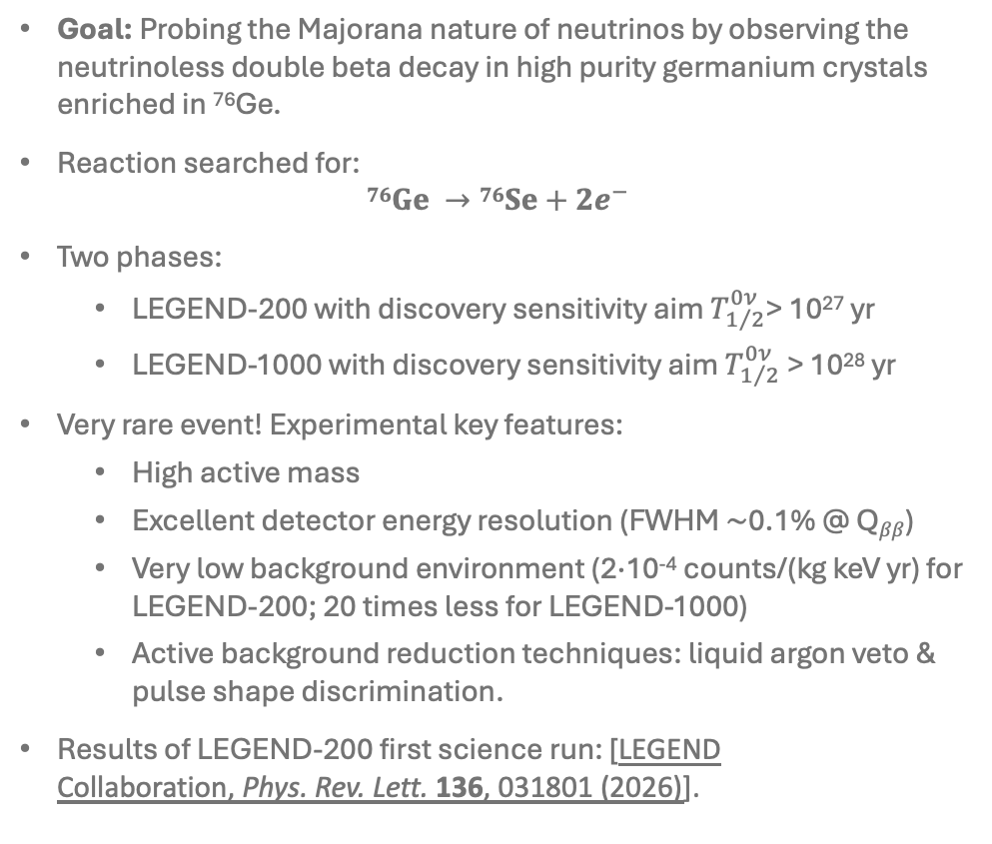
LEGEND: searching for 0$νββ$ → but not only!
LAr instrumentation:
diffuse wavelength-shifting reflector
+
green wavelength-shifting fibers
+
optical sensors (SiPMs)
Goal: Probing the Majorana nature of neutrinos by observing the neutrinoless double beta decay in high purity germanium crystals enriched in ⁷⁶Ge.
Reaction searched for:
$$76Ge →76Se+2e^{−}$$
Two phases:
  LEGEND-200 with discovery sensitivity aim $T_{1/2}^{0ν}$> 10²⁷ yr
  LEGEND-1000 with discovery sensitivity aim $T_{1/2}^{0ν}$> 10²⁸ yr
Very rare event! Experimental key features:
  High active mass
  Excellent detector energy resolution (FWHM $\sim$0.1% @ Q$ββ$)
  Very low background environment (2·10⁻⁴ counts/(kg keV yr) for LEGEND-200; 20 times less for LEGEND-1000)
  Active background reduction techniques: liquid argon veto & pulse shape discrimination.
Results of LEGEND-200 first science run: [LEGEND Collaboration, Phys. Rev. Lett. 136, 031801 (2026)].
LAr instrumentation:
diffuse wavelength-shifting reflector
+
green wavelength-shifting fibers
+
optical sensors (SiPMs)
HPGe strings
The excellent energy resolution, ultra-pure environment and effective background mitigation techniques make LEGEND suitable for other BSM searches!
Cryostat filled with 64 m³ of pure liquid argon (LAr)
Tank with 590 m³ of purified water with PMTs (muon veto)
LEGEND-200. Location: Gran Sasso National Laboratory

Slide 4
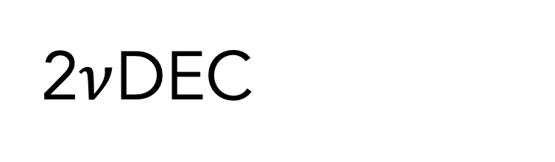

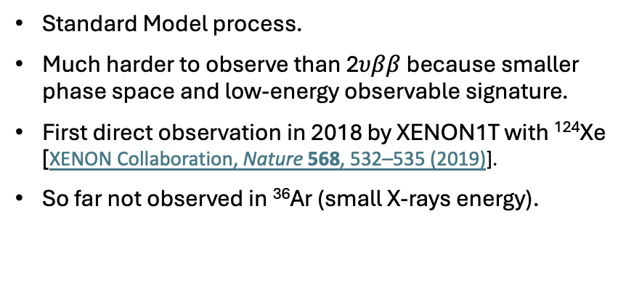
2$ν$DEC
e
$$ν$$
X
Electron capture
Neutrino emission
& atomic relaxation
Standard Model process.
Much harder to observe than 2$υββ$ because smaller phase space and low-energy observable signature.
First direct observation in 2018 by XENON1T with ¹²⁴Xe [XENON Collaboration, Nature 568, 532–535 (2019)].
So far not observed in ³⁶Ar (small X-rays energy).

Slide 5
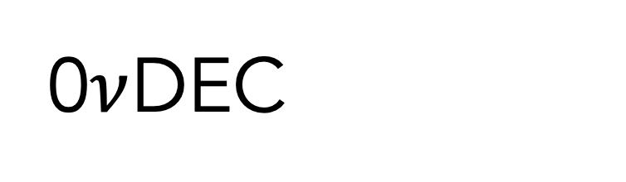

2$ν$DEC
0$ν$DEC
e
e
$$ν$$
X
X
p
Electron capture
Neutrino emission
& atomic relaxation
Electron capture
Neutrino emission
Atomic relaxation
& additional particle
emission
Standard Model process.
Much harder to observe than 2$υββ$ because smaller phase space and low-energy observable signature.
First direct observation in 2018 by XENON1T with ¹²⁴Xe [XENON Collaboration, Nature 568, 532–535 (2019)].
So far not observed in ³⁶Ar (small X-rays energy).
Beyond Standard Model process.
Observation would imply lepton-number violation and the Majorana nature of neutrinos.

Slide 6
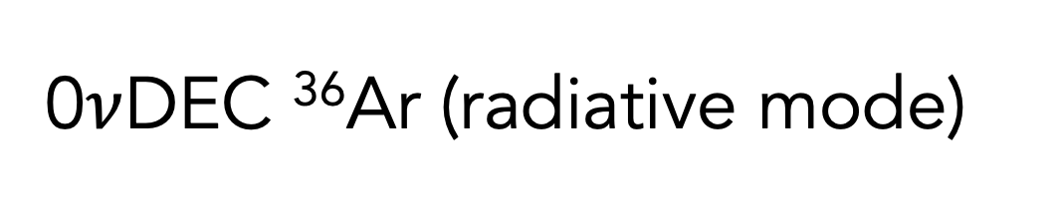
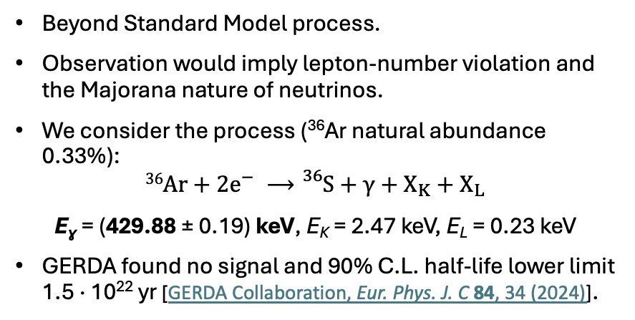

2$ν$DEC
0$ν$DEC ³⁶Ar (radiative mode)
e
e
$$ν$$
X
X_{K}
$$γ$$
X_{L}
Electron capture
Neutrino emission
& atomic relaxation
Electron capture
Neutrino emission
Atomic relaxation
& gamma emission
Standard Model process.
Much harder to observe than 2$υββ$ because smaller phase space and low-energy observable signature.
First direct observation in 2018 by XENON1T with ¹²⁴Xe [XENON Collaboration, Nature 568, 532–535 (2019)].
So far not observed in ³⁶Ar (small X-rays energy).
Beyond Standard Model process.
Observation would imply lepton-number violation and the Majorana nature of neutrinos.
We consider the process (³⁶Ar natural abundance 0.33%):
$$36Ar+2e^{−} ⟶{}_{}^{36}S+γ+X_{K}+X_{L}$$
E_{ɣ} = (429.88 ± 0.19) keV, E_{K} = 2.47 keV, E_{L} = 0.23 keV
GERDA found no signal and 90% C.L. half-life lower limit 1.5 · 10²² yr [GERDA Collaboration, Eur. Phys. J. C 84, 34 (2024)].

Slide 7
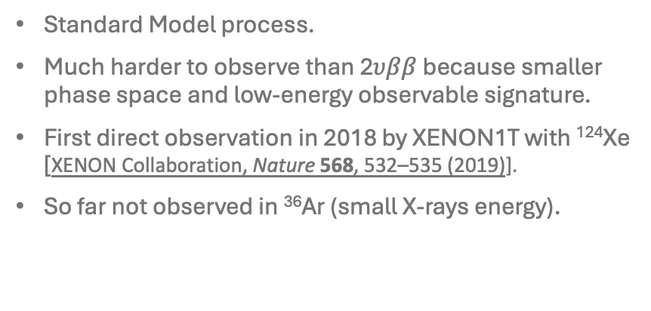
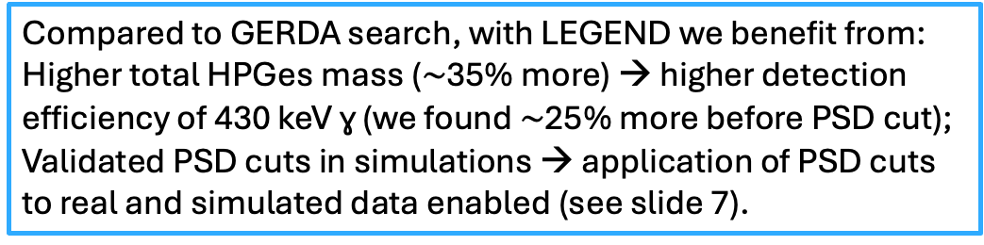
2$ν$DEC
0$ν$DEC ³⁶Ar (radiative mode)
e
e
$$ν$$
X
X_{K}
$$γ$$
X_{L}
Electron capture
Neutrino emission
& atomic relaxation
Electron capture
Neutrino emission
Atomic relaxation
& gamma emission
Standard Model process.
Much harder to observe than 2$υββ$ because smaller phase space and low-energy observable signature.
First direct observation in 2018 by XENON1T with ¹²⁴Xe [XENON Collaboration, Nature 568, 532–535 (2019)].
So far not observed in ³⁶Ar (small X-rays energy).
Beyond Standard Model process.
Observation would imply lepton-number violation and the Majorana nature of neutrinos.
We consider the process (³⁶Ar natural abundance 0.33%):
$$36Ar+2e^{−} ⟶{}_{}^{36}S+γ+X_{K}+X_{L}$$
E_{ɣ} = (429.88 ± 0.19) keV, E_{K} = 2.47 keV, E_{L} = 0.23 keV
GERDA found no signal and 90% C.L. half-life lower limit 1.5 · 10²² yr [GERDA Collaboration, Eur. Phys. J. C 84, 34 (2024)].
Compared to GERDA search, with LEGEND we benefit from:
Higher total HPGes mass ($\sim$35% more) → higher detection efficiency of 430 keV ɣ (we found $\sim$25% more before PSD cut);
Validated PSD cuts in simulations → application of PSD cuts to real and simulated data enabled (see slide 7).

Slide 8
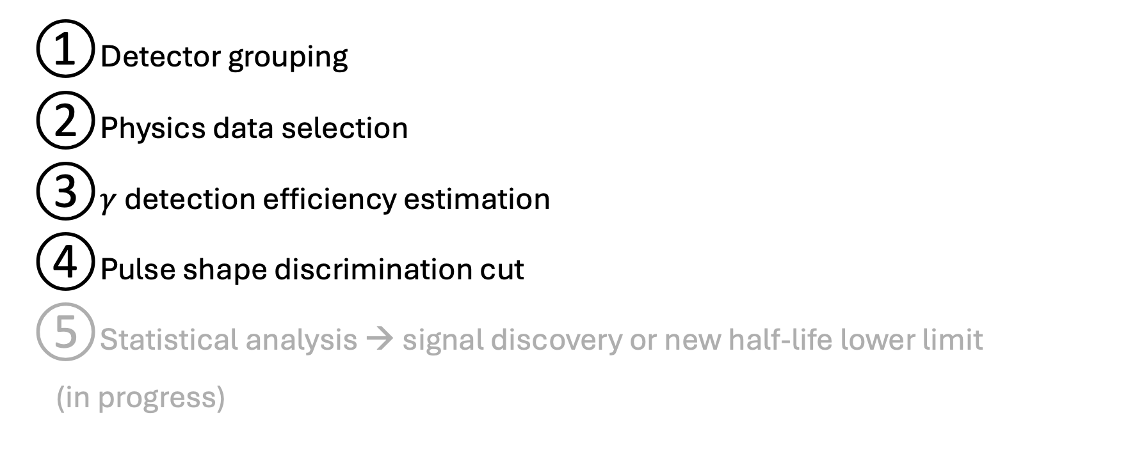
Search steps
Detector grouping
Physics data selection
$γ$ detection efficiency estimation
Pulse shape discrimination cut
Statistical analysis → signal discovery or new half-life lower limit
(in progress)

Slide 9
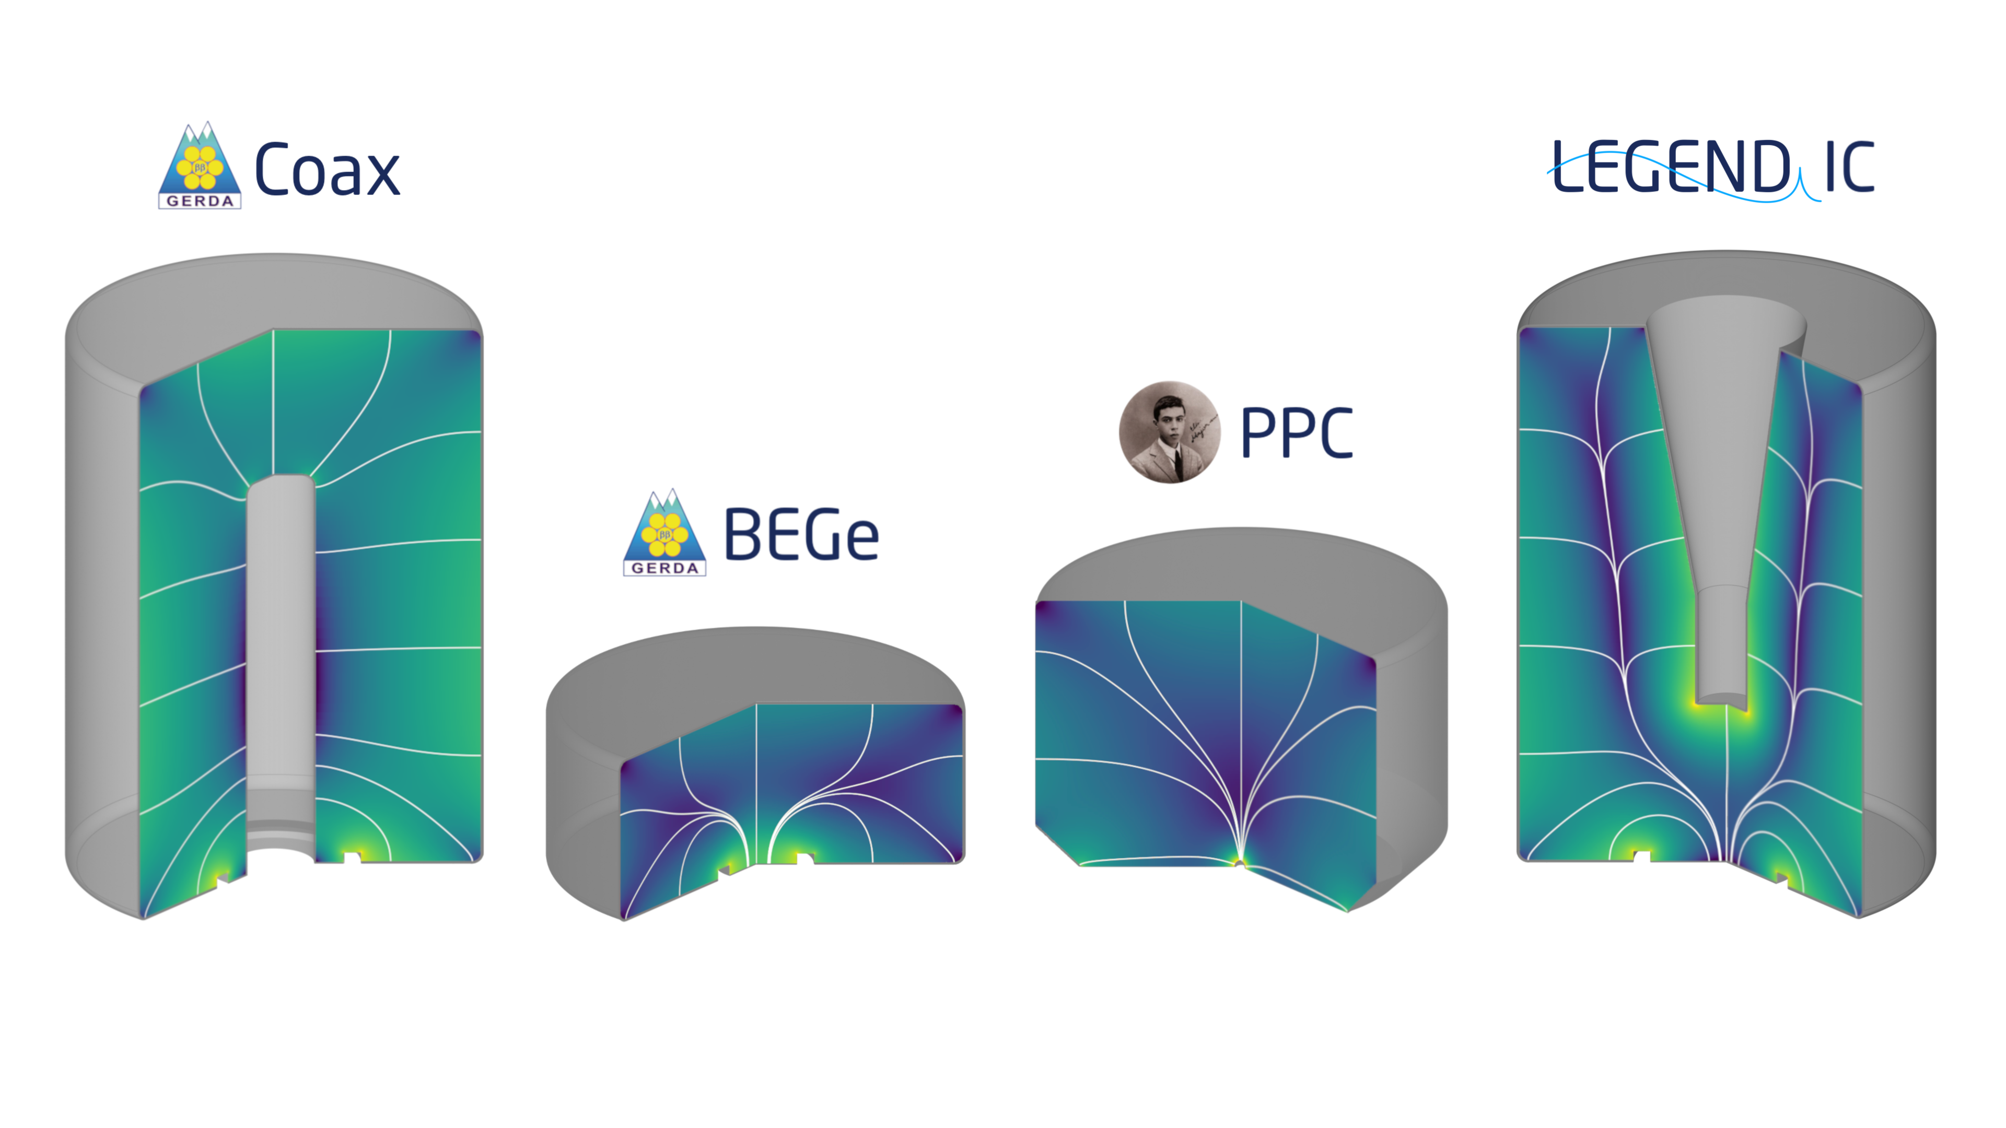
Detector grouping
Four detector geometries in LEGEND-200 first science run:
Since they have different features and energy response, analysis is performed in five different detector groups. Each group considers detectors of the same geometry and with similar energy resolution:
Inverted Coaxial
Point Contact (ICPC)
Broad Energy
Germanium
Semi-Coaxial
P-type Point Contact
 | ICPC with FWHM @ 430 keV < 1.6 keV | ICPC with FWHM @ 430 keV > 1.6 keV | BEGEs | PPCs | COAX | Total
Exposure [kg yr] | 26.1 | 19.8 | 10.9 | 9.7 | 7.8 | 74.2
Exposure-weighted average FWHM @ 430 keV [keV] | 1.38 ± 0.25 | 2.29 ± 0.42 | 1.18 ± 0.05 | 1.29 ± 0.11 | 3.92 ± 0.35

Slide 10
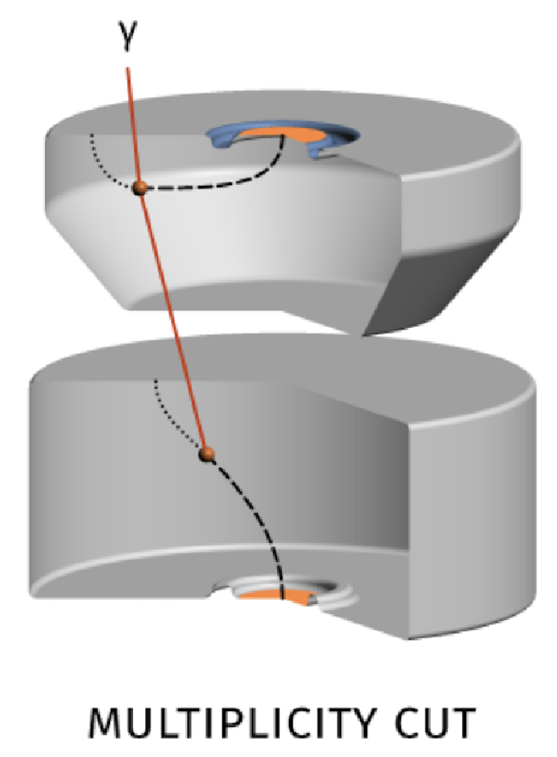
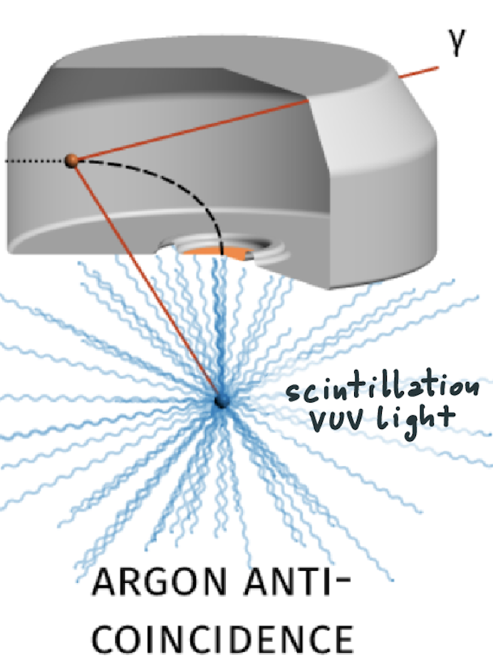
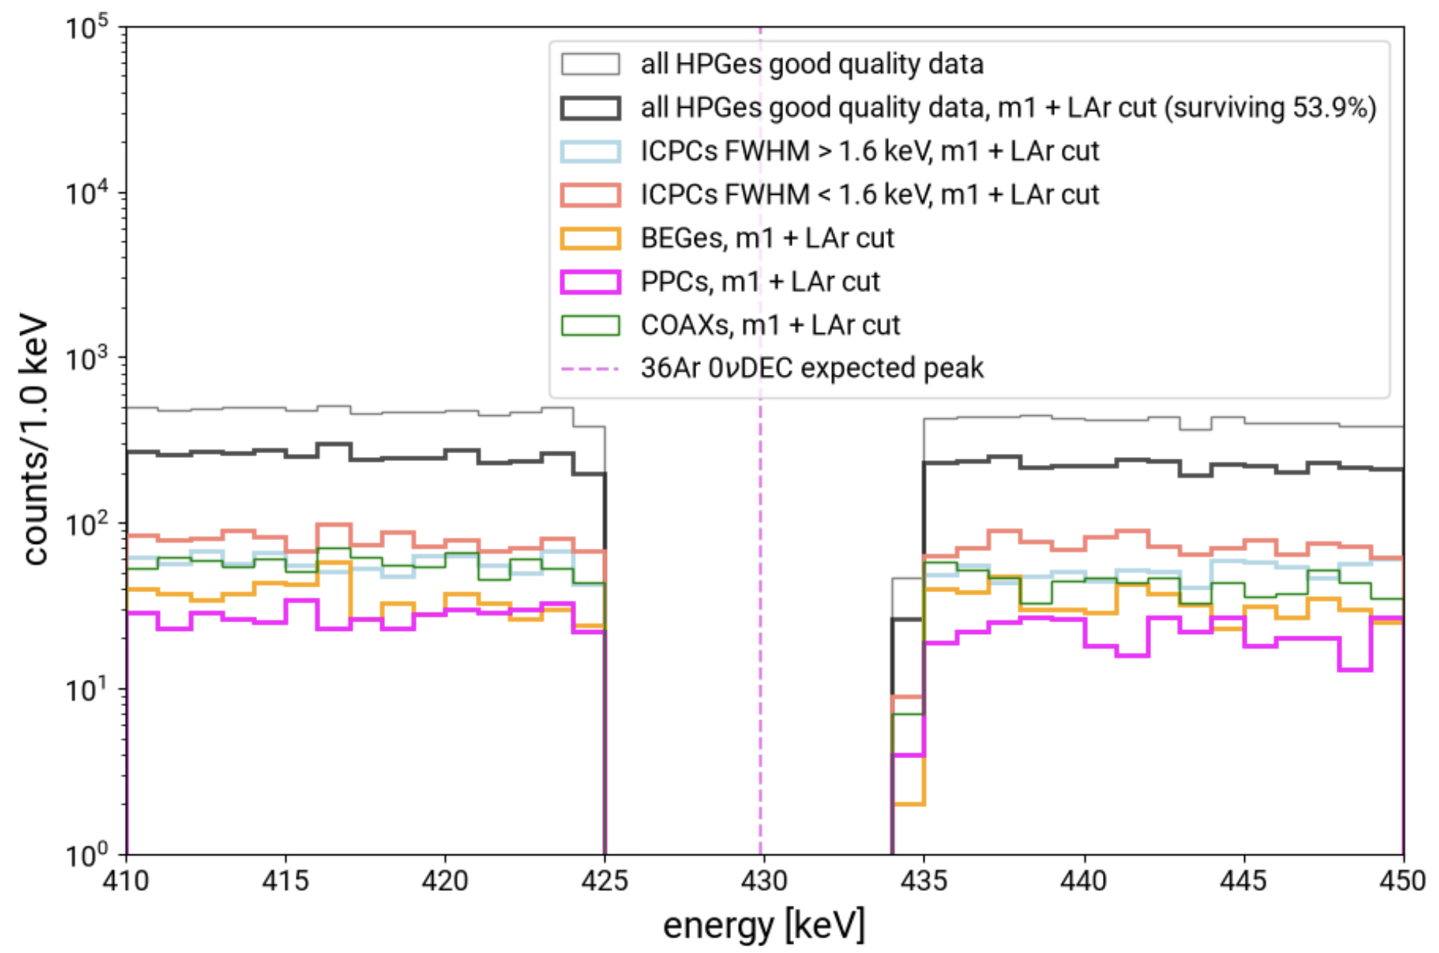
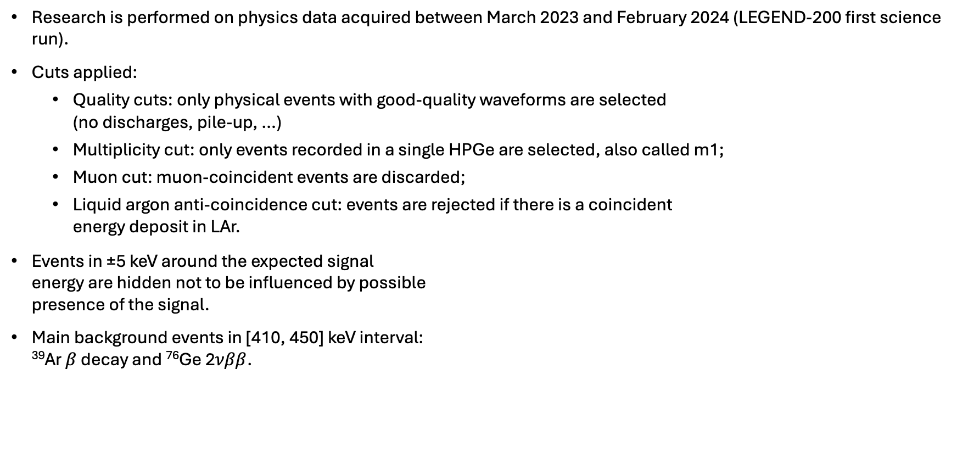
Physics data selection
Research is performed on physics data acquired between March 2023 and February 2024 (LEGEND-200 first science run).
Cuts applied:
  Quality cuts: only physical events with good-quality waveforms are selected
  (no discharges, pile-up, …)
  Multiplicity cut: only events recorded in a single HPGe are selected, also called m1;
  Muon cut: muon-coincident events are discarded;
  Liquid argon anti-coincidence cut: events are rejected if there is a coincident
  energy deposit in LAr.
Events in ±5 keV around the expected signal
energy are hidden not to be influenced by possible
presence of the signal.
Main background events in [410, 450] keV interval:
³⁹Ar $β$ decay and ⁷⁶Ge 2$νββ$.

Slide 11
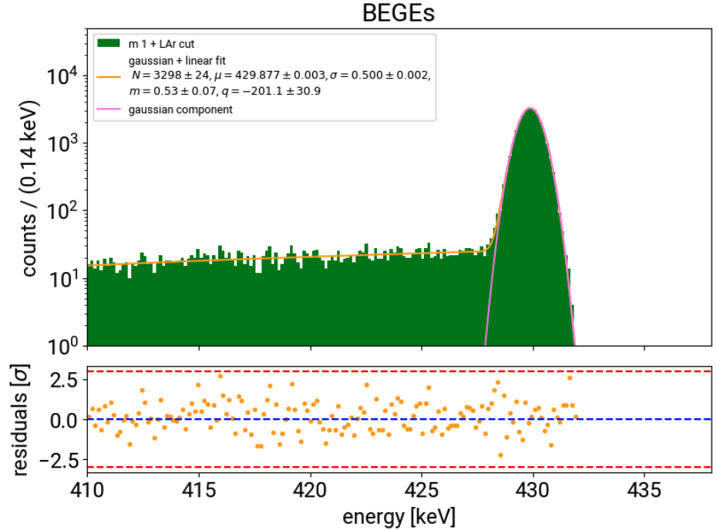
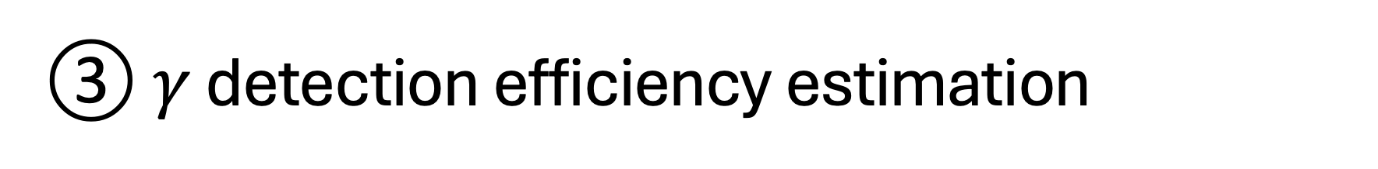
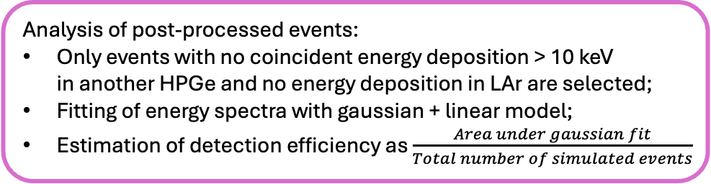
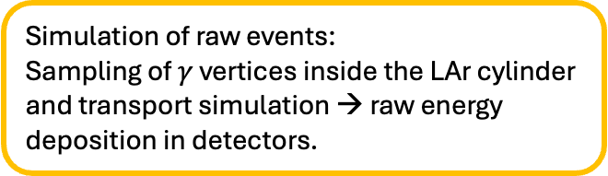
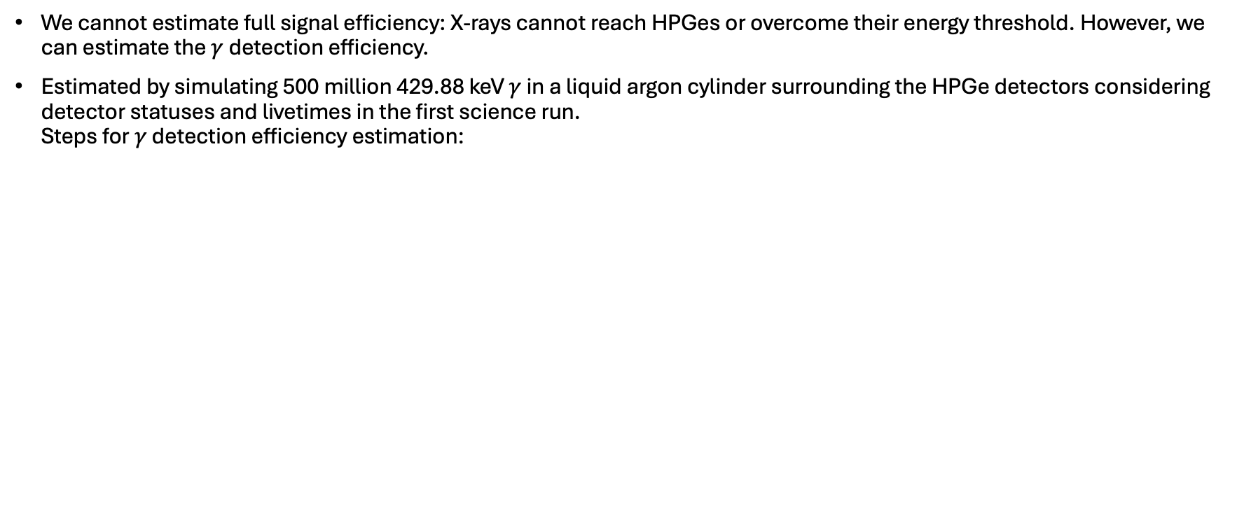
$γ$ detection efficiency estimation
We cannot estimate full signal efficiency: X-rays cannot reach HPGes or overcome their energy threshold. However, we can estimate the $γ$detection efficiency.
Estimated by simulating 500 million 429.88 keV $γ$ in a liquid argon cylinder surrounding the HPGe detectors considering detector statuses and livetimes in the first science run.
Steps for $γ$ detection efficiency estimation:
2
Post-processing of raw events:
Energy resolution smearing;
Correction for HPGe dead- and
transition layers, where charge collection
is not possible or inefficient.
1
Simulation of raw events:
Sampling of $γ$ vertices inside the LAr cylinder
and transport simulation → raw energy
deposition in detectors.
Example of spectrum fitting for BEGes detectors
3
Analysis of post-processed events:
Only events with no coincident energy deposition > 10 keV
in another HPGe and no energy deposition in LAr are selected;
Fitting of energy spectra with gaussian + linear model;
Estimation of detection efficiency as $\frac{Area under gaussian fit}{Total number of simulated events}$
Steps 1 & 2 performed with legend-simflow package
Documentation: https://legend-simflow.readthedocs.io/en/latest/

Slide 12
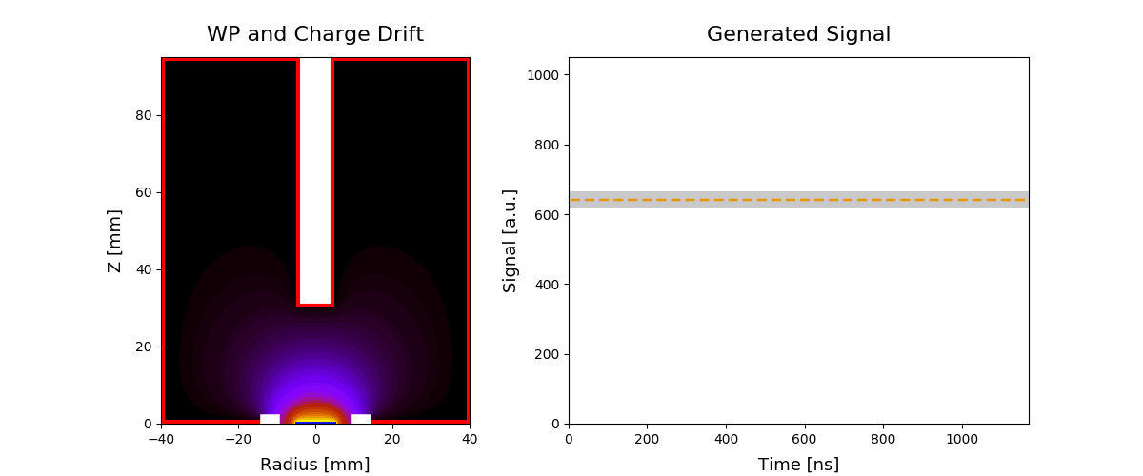
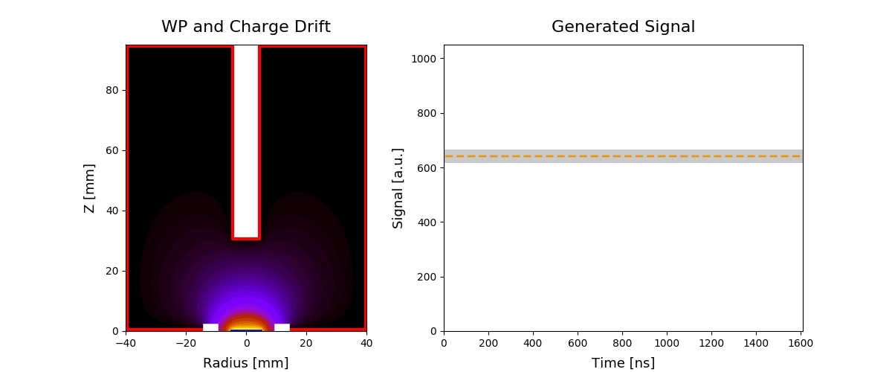
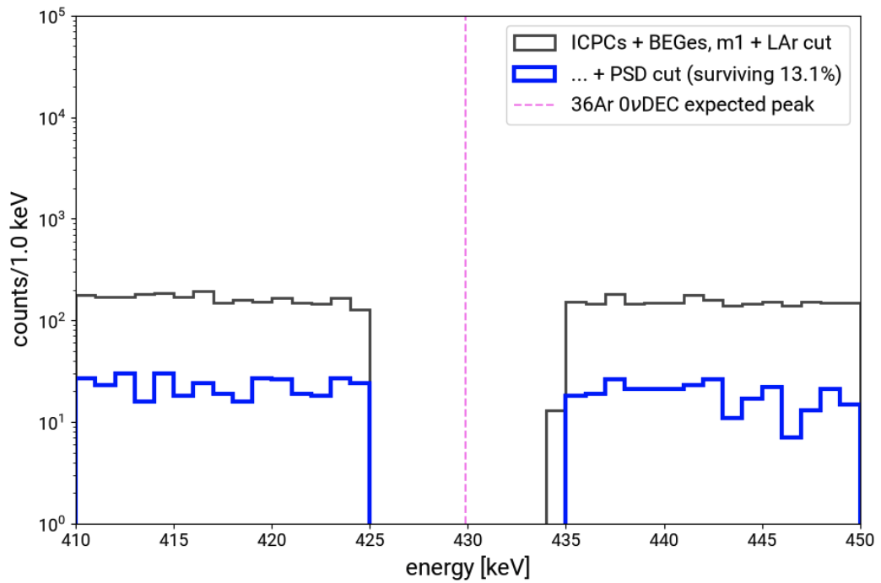
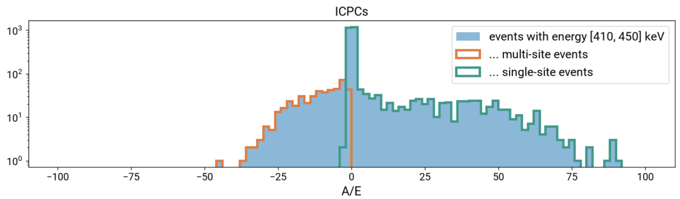
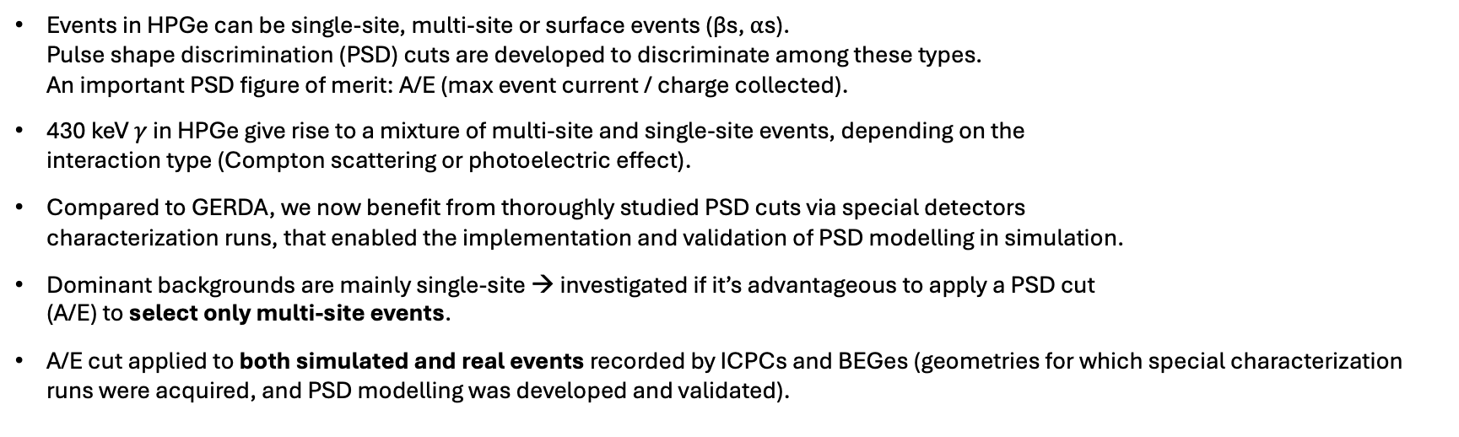
Pulse shape discrimination cut
charge
current
Events in HPGe can be single-site, multi-site or surface events (βs, ⍺s).
Pulse shape discrimination (PSD) cuts are developed to discriminate among these types.
An important PSD figure of merit: A/E (max event current / charge collected).
430 keV $γ$ in HPGe give rise to a mixture of multi-site and single-site events, depending on the
interaction type (Compton scattering or photoelectric effect).
Compared to GERDA, we now benefit from thoroughly studied PSD cuts via special detectors
characterization runs, that enabled the implementation and validation of PSD modelling in simulation.
Dominant backgrounds are mainly single-site → investigated if it’s advantageous to apply a PSD cut
(A/E) to select only multi-site events.
A/E cut applied to both simulated and real events recorded by ICPCs and BEGes (geometries for which special characterization runs were acquired, and PSD modelling was developed and validated).
Single-site
Multi-site
Physics data
A/E distribution – physics data
-87%

Slide 13
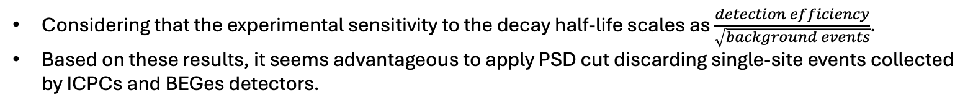
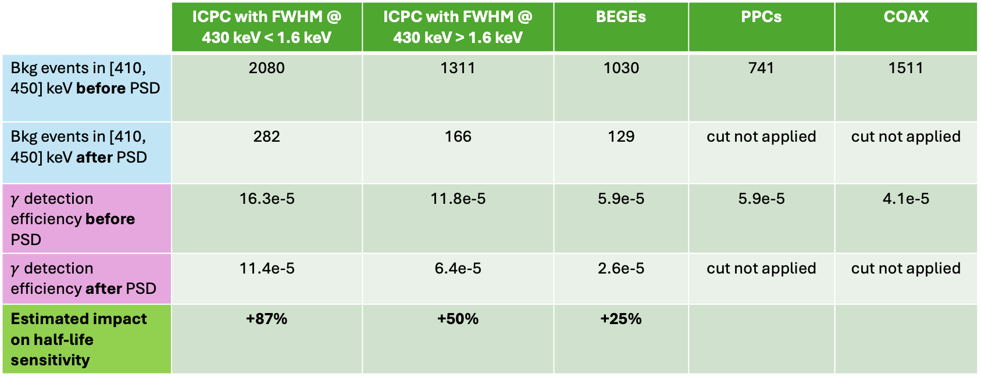
Pulse shape discrimination cut: impact on the sensitivity
 | ICPC with FWHM @ 430 keV < 1.6 keV | ICPC with FWHM @ 430 keV > 1.6 keV | BEGEs | PPCs | COAX
Bkg events in [410, 450] keV before PSD | 2080 | 1311 | 1030 | 741 | 1511
Bkg events in [410, 450] keV after PSD | 282 | 166 | 129 | cut not applied | cut not applied
$γ$detection efficiency before PSD | 16.3e-5 | 11.8e-5 | 5.9e-5 | 5.9e-5 | 4.1e-5
$γ$detection efficiency after PSD | 11.4e-5 | 6.4e-5 | 2.6e-5 | cut not applied | cut not applied
Estimated impact on half-life sensitivity | +87% | +50% | +25%
-86%
-87%
-87%
Physics data
-30%
-46%
-55%
Simulated signal
Considering that the experimental sensitivity to the decay half-life scales as $\frac{detection efficiency}{\sqrt{background events}}$.
Based on these results, it seems advantageous to apply PSD cut discarding single-site events collected
by ICPCs and BEGes detectors.

Slide 14
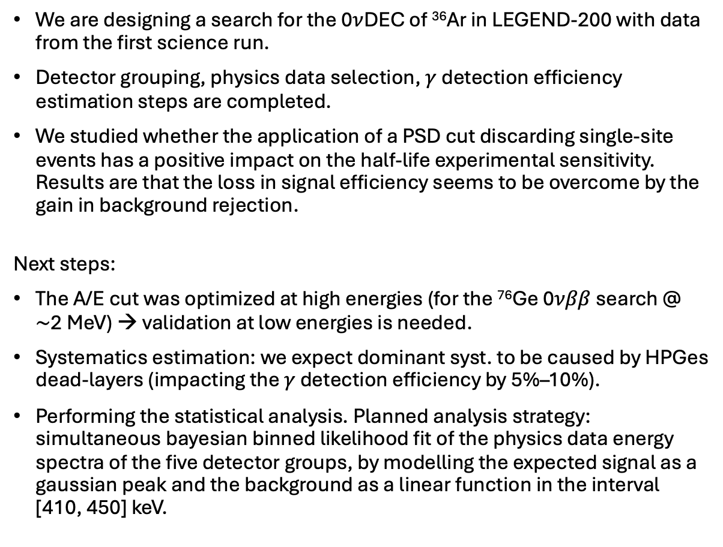
Summary & next steps
We are designing a search for the 0$ν$DEC of ³⁶Ar in LEGEND-200 with data from the first science run.
Detector grouping, physics data selection, $γ$ detection efficiency estimation steps are completed.
We studied whether the application of a PSD cut discarding single-site events has a positive impact on the half-life experimental sensitivity. Results are that the loss in signal efficiency seems to be overcome by the gain in background rejection.
Next steps:
The A/E cut was optimized at high energies (for the ⁷⁶Ge 0$νββ$ search @
$\sim$2 MeV) → validation at low energies is needed.
Systematics estimation: we expect dominant syst. to be caused by HPGes dead-layers (impacting the $γ$ detection efficiency by 5%–10%).
Performing the statistical analysis. Planned analysis strategy: simultaneous bayesian binned likelihood fit of the physics data energy spectra of the five detector groups, by modelling the expected signal as a gaussian peak and the background as a linear function in the interval
[410, 450] keV.

Slide 15
Summary & next steps
We are designing a search for the 0$ν$DEC of ³⁶Ar in LEGEND-200 with data from the first science run.
Detector grouping, physics data selection, $γ$ detection efficiency estimation steps are completed.
We studied whether the application of a PSD cut discarding single-site events has a positive impact on the half-life experimental sensitivity. Results are that the loss in signal efficiency seems to be overcome by the gain in background rejection.
Next steps:
The A/E cut was optimized at high energies (for the ⁷⁶Ge 0$νββ$ search @
$\sim$2 MeV) → validation at low energies is needed.
Systematics estimation: we expect dominant syst. to be caused by HPGes dead-layers (impacting the $γ$ detection efficiency by 5%–10%).
Performing the statistical analysis. Planned analysis strategy: simultaneous bayesian binned likelihood fit of the physics data energy spectra of the five detector groups, by modelling the expected signal as a gaussian peak and the background as a linear function in the interval
[410, 450] keV.
Thank you very much!

Slide 16
Backup

Slide 17
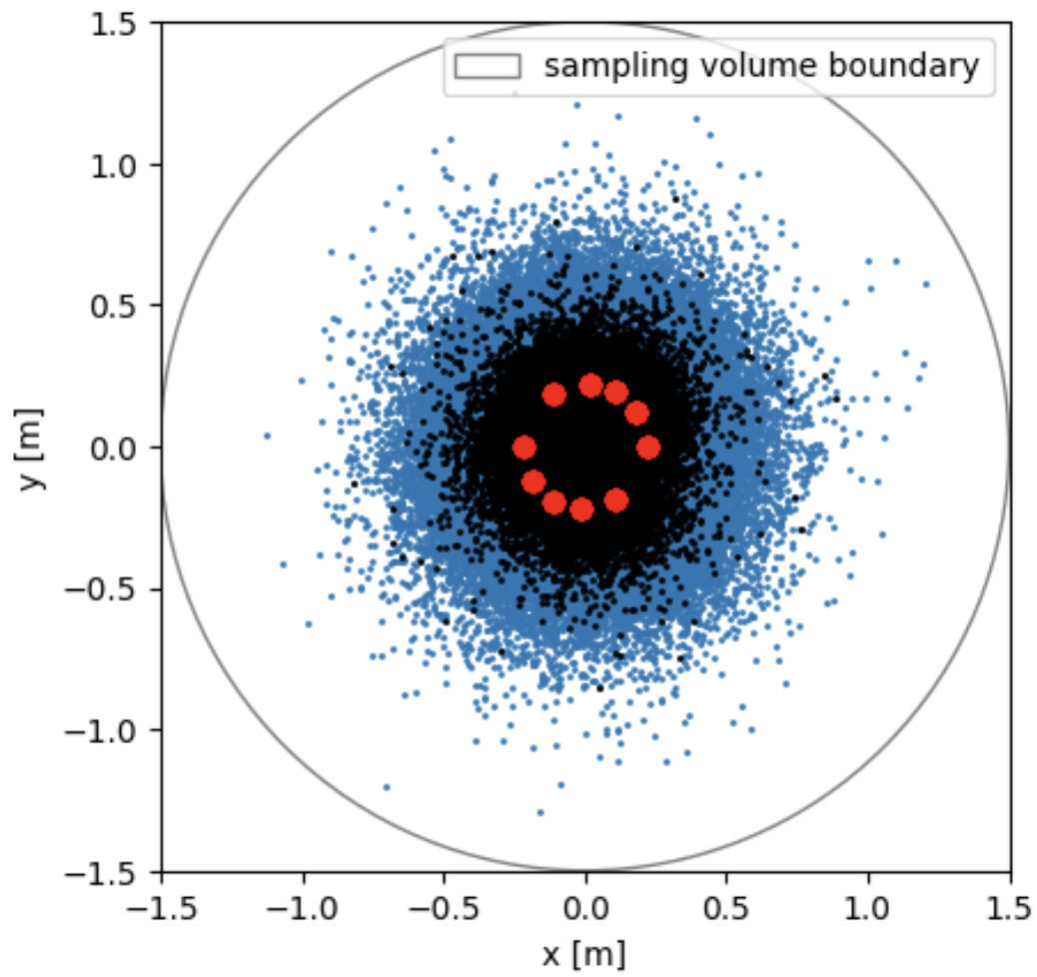
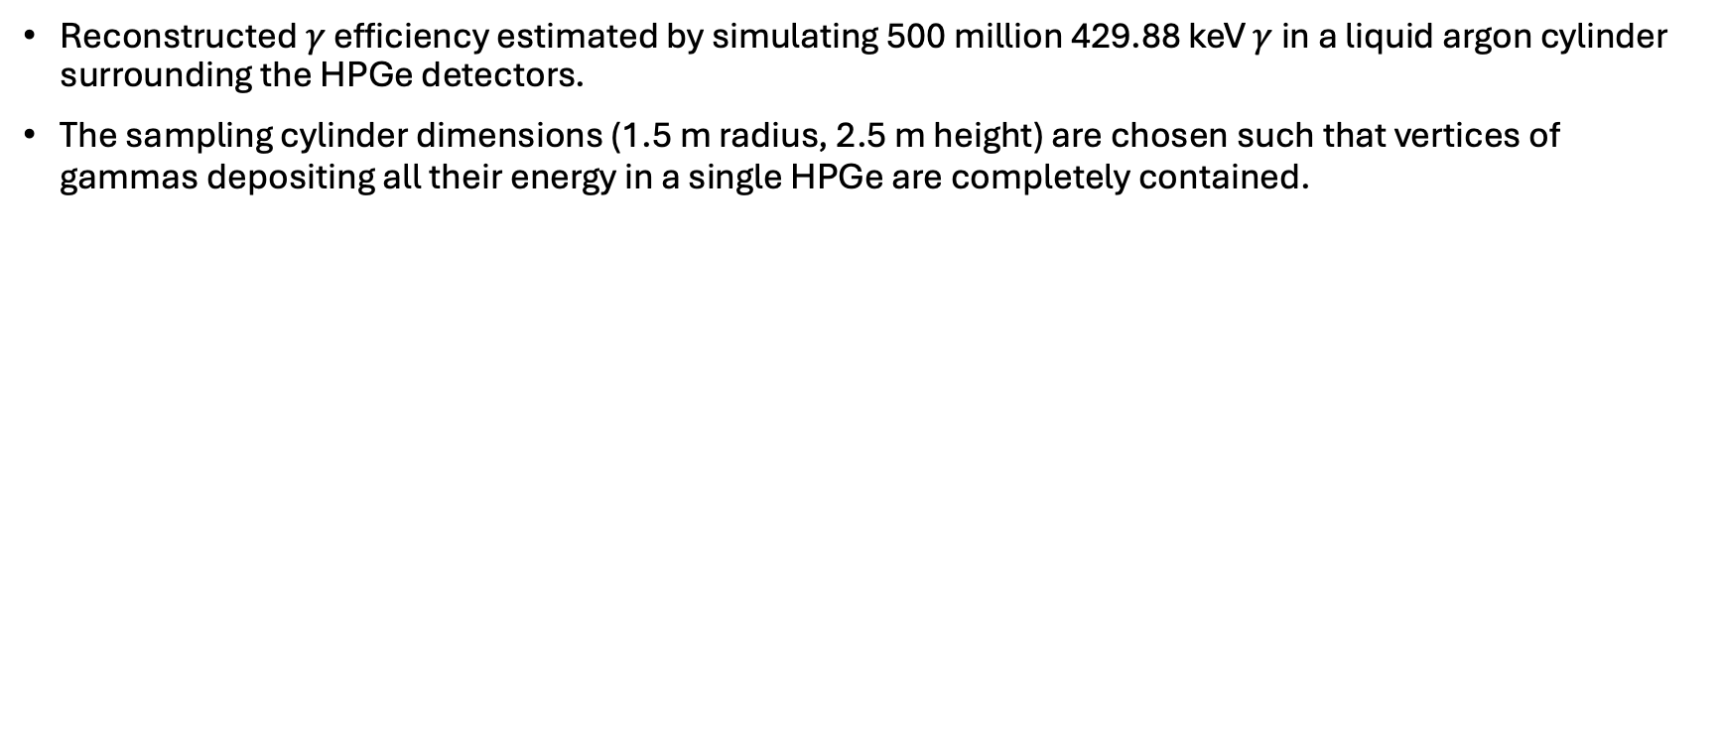

More about $γ$ simulation
Reconstructed $γ$ efficiency estimated by simulating 500 million 429.88 keV $γ$ in a liquid argon cylinder surrounding the HPGe detectors.
The sampling cylinder dimensions (1.5 m radius, 2.5 m height) are chosen such that vertices of gammas depositing all their energy in a single HPGe are completely contained.
LEGEND top view
Mean free path of 430 keV ɣ in LAr ~10 cm
Detector centres
Vertices of gammas depositing some energy in the Ge
Vertices of gammas depositing all their energy in a single Ge (black points superimposed on the blue points)

Slide 18
LEGEND-200 detectors during first science run
n+ high voltage contact (lithium layer)
Broad Energy Germanium
mass < 1 kg
19 kg in total
good PSD performance
high energy resolution
p+ readout contact (boron implantation)
Semi-coaxial:
mass < 3 kg
14.7 kg in total
not extremely good PSD performance
quite high energy resolution
P-type Point Contact:
mass < 1 kg
22.1 kg in total
high energy resolution
Inverted Coaxial Point Contact:
large mass (2-4 kg)
86.7 kg in total
excellent PSD performance
high energy resolution

Slide 19
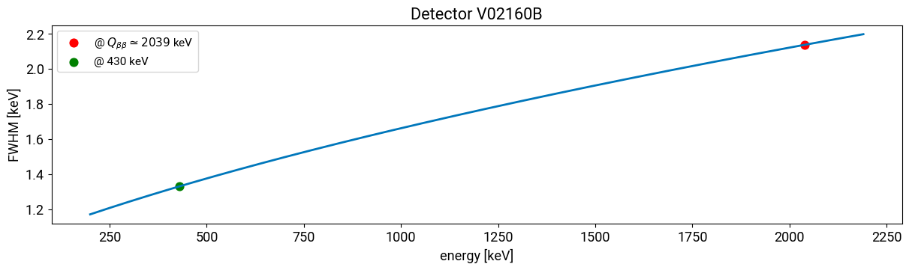
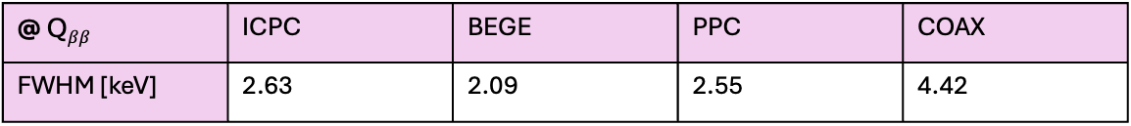

Energy resolution estimation
We estimated the energy resolution of our detector groups by extrapolating the resolution @ photo-peak of each detector from its energy resolution curve and then combining energy resolutions of detectors in the same group with an exposure-weighted average.
$$FWHM\left(E\right)=\sqrt{a+bE}$$
Example of energy resolution curve
@ 430 keV | ICPC FWHM > 1.6 keV | ICPC FWHM < 1.6 keV | BEGE | PPC | COAX
FWHM [keV] | 2.29 | 1.38 | 1.18 | 1.29 | 3.92
FWHM @ Q$ββ$ reported in the LEGEND paper The LEGEND Collaboration et al. (2026), arXiv:2605.22479 :
@ Q$ββ$ | ICPC | BEGE | PPC | COAX
FWHM [keV] | 2.63 | 2.09 | 2.55 | 4.42

Slide 20
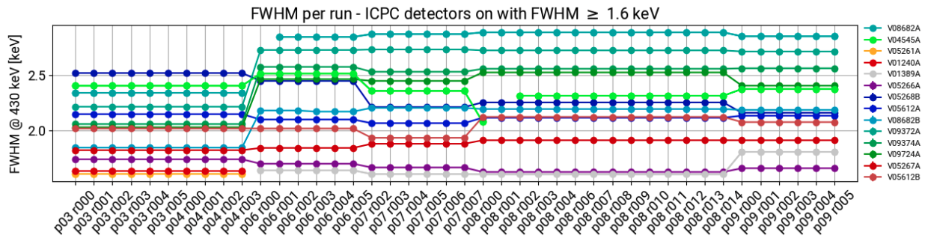
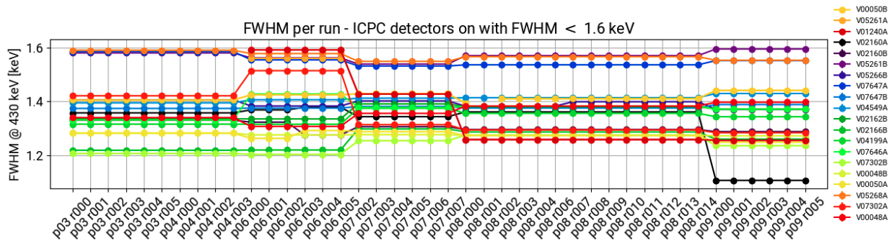
Energy resolution of detector groups

Slide 21
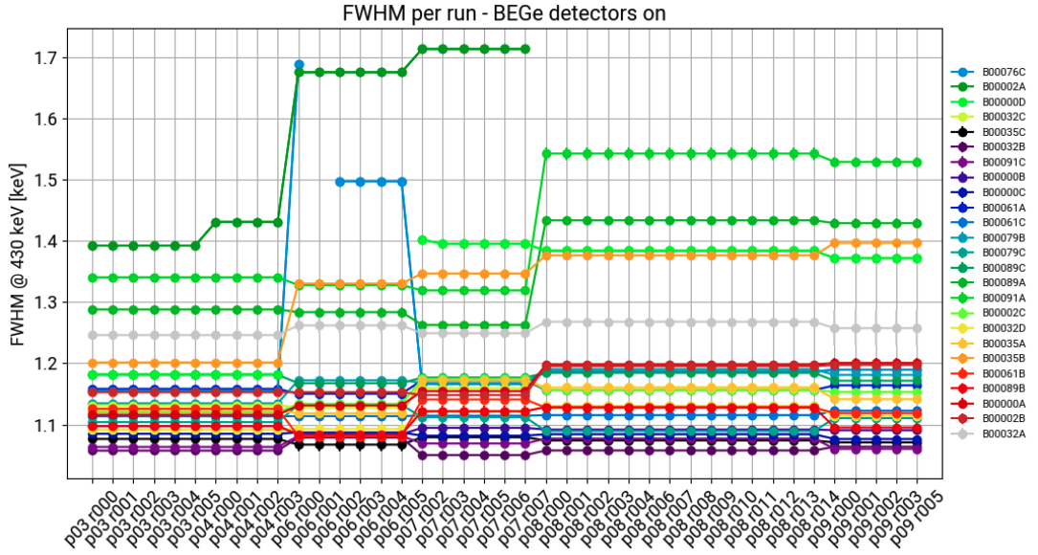
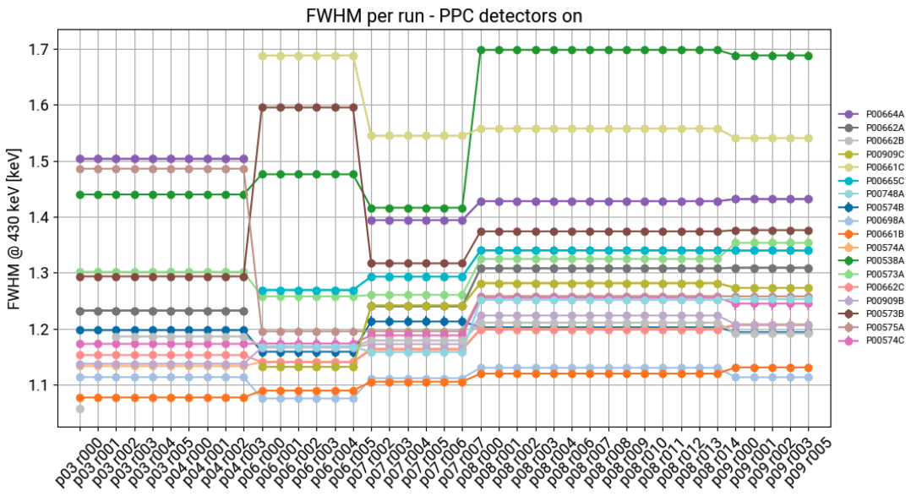
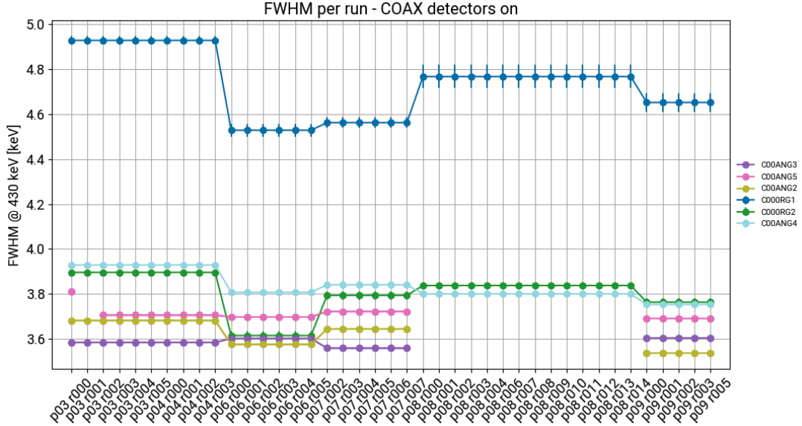

Slide 22
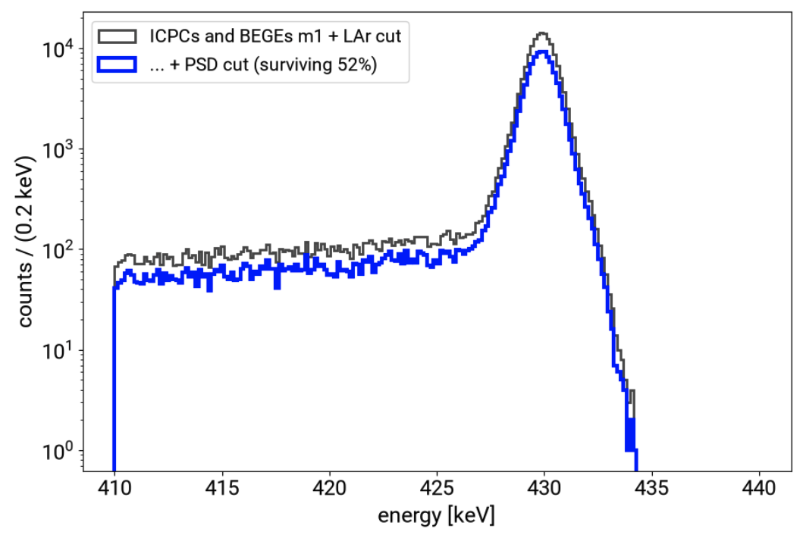
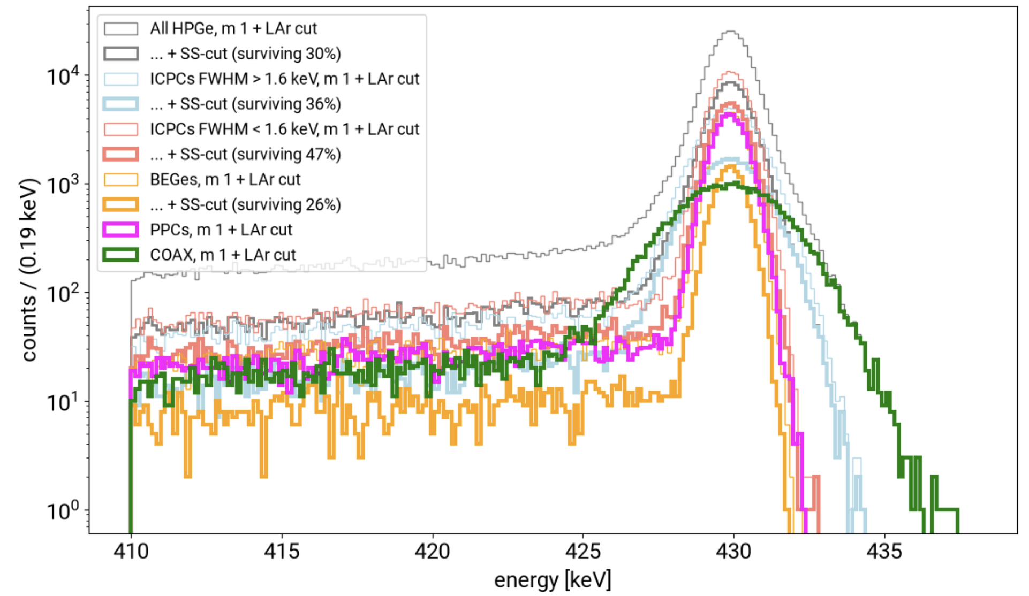
More on pulse shape discrimination cut applied to sim data
Exemplary plot of A/E cut applied to simulated data:
Effect of A/E cut applied to different detector types (apart from
PPCs and COAX, for which the cut is not applied):
In the legend “SS-cut” is the PSD cut applied.
-48%

Slide 23
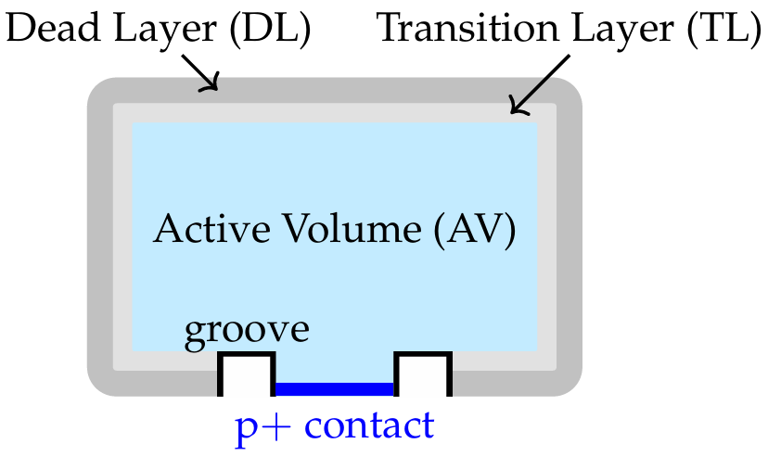
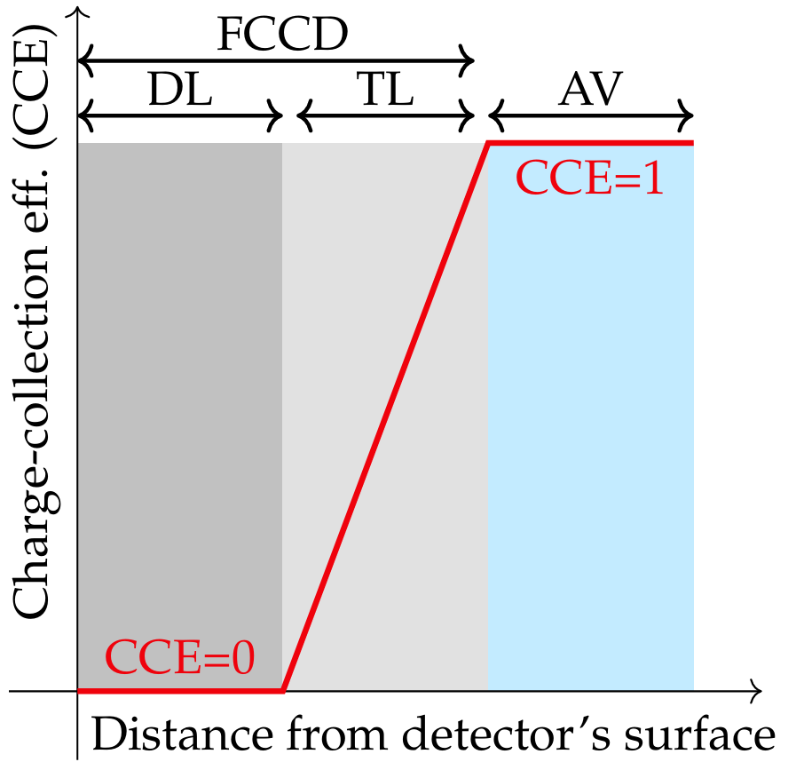
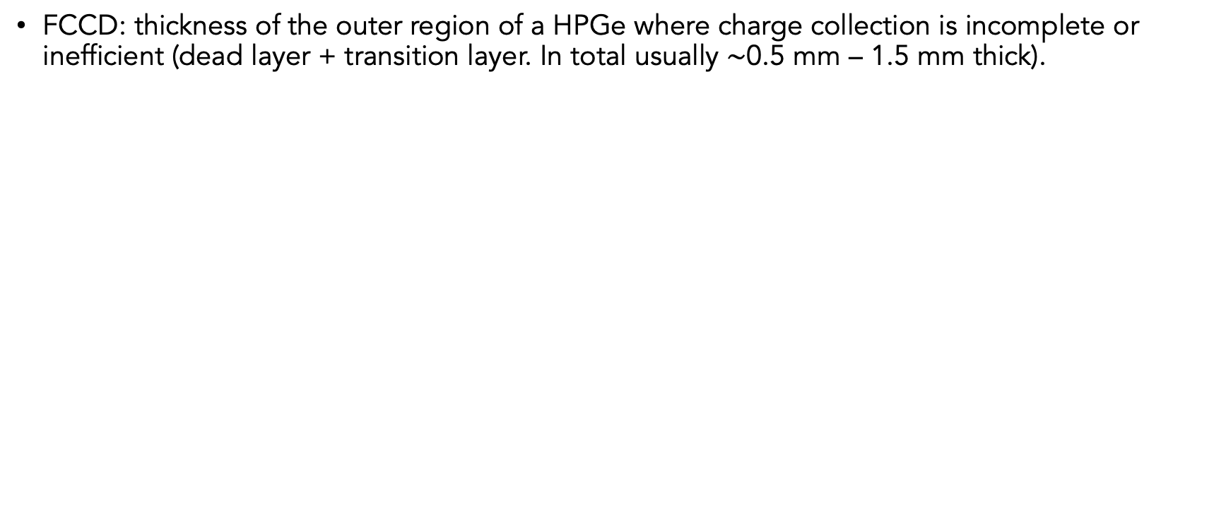
FCCD: full charge collection depth
FCCD: thickness of the outer region of a HPGe where charge collection is incomplete or inefficient (dead layer + transition layer. In total usually $\sim$0.5 mm – 1.5 mm thick).

Slide 24
X-rays detection
Mean free path of 2.7 keV
X-ray in LAr ~20 μm
$$36Ar+2e^{−} ⟶{}_{}^{36}S+γ+X_{K}+X_{L}$$
Any chance to detect the X-rays with the Ge and/or the optical photons generated by the X-rays with the SiPMs? Useful for this search and maybe for ³⁶Ar 2$ν$DEC search (for which no gamma is emitted, just X-rays or Auger electrons).
Any chance to detect the X-rays with the Ge and/or the optical photons generated by the X-rays with the SiPMs? Useful for this search and maybe for ³⁶Ar 2𝝂DEC search (for which no gamma is emitted, just X-rays or Auger electrons).
We simulated 5 million 2.70 keV X-rays (coming from 2.47 keV + 0.23 keV) in the same previous LAr cylinder enabling optical physics processes.
No X-rays reach the Ge and overcome the FCCD layer.
For the SiPMs, we found an efficiency (# X-rays for which at least one photon is detected by the SiPMs / # total X-rays simulated) of 2.354 ± 0.007(stat) %.
Very low photon-per-event value → this makes a 2$ν$DEC search very difficult.
Very low photon-per-event value → this makes a 2𝝂DEC search very difficult.
But at least, this tells us how often those X-rays would accidentally veto the 0$ν$DEC radiative signal.
But at least, this tells us how often those X-rays would accidentally veto the 0𝝂DEC radiative signal.

