Slide 1





Collective Neutrino-Antineutrino
Pairing Oscillations
Shih-Jie Huang
National Taiwan University
Institute of Physics Academia Sinica
Erice INTERNATIONAL SCHOOL OF NUCLEAR PHYSICS, 47th Course 2026/9/17
Huang & Wu 2026 [arxiv:2604.25687] under review
Notes:
Good afternoon, everyone.
My name is Shih-Jie Huang, and I am a PhD student at National Taiwan University, working at the Institute of Physics, Academia Sinica, in Taiwan.
Today, I would like to share with you some results from our recent work on collective neutrino-antineutrino pairing oscillations.
This work is available as an arXiv preprint, and the QR code on the left will take you directly to the paper if you are interested in more details.
With that, let me start with the physical motivation.

Slide 2
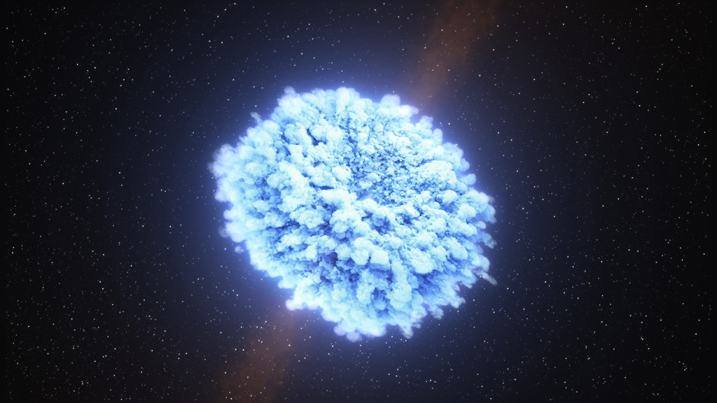



Why Dense Neutrino Gases
Extreme environments
Core-collapse supernovae
Binary neutron-star mergers
Consequence
Neutrinos oscillate collectively
Shaping the dynamics
Element compositions
$$ν_{μ}$$
$$ν_{e}$$
$$ν_{τ}$$
Credit: NASA, AAVSO
Notes:
Dense neutrino gases naturally occur in extreme environments such as core-collapse supernovae and binary neutron-star mergers.
In these environments, the neutrino density is enormous, so even though the weak interaction is weak, neutrino-neutrino forward scattering becomes important.
As a result, the evolution of one neutrino depends on the whole neutrino ensemble, leading to nonlinear collective phenomena.
In particular, collective flavor evolution can affect the dynamics of the system and the resulting element abundances.
Most studies, however, have focused on flavor evolution.
Here, we explore a different collective channel: neutrino-antineutrino pairing.

Slide 3

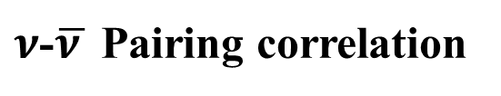









neutrino-neutrino forward scattering
$$ν_{α}(p)$$
$$ν_{α}(p′)$$
$$ν_{α}(p)$$
$${\overline{ν}}_{α}(p′)$$
$z$
$z$
$$ν_{β}(q)$$
$$ν_{β}(q′)$$
$${\overline{ν}}_{β}(q)$$
$$ν_{β}(q′)$$
Flavor correlation
$ν$-$\overline{ν }$ Pairing correlation
C. Volpe, D. Vaananen, C. Espinoza 2013
J. Serreau & C. Volpe 2014
Notes:
Before discussing the pairing instability, let me first illustrate the two types of correlations that we are interested in.
On the left, we have the familiar neutrino-neutrino forward scattering.
Two neutrinos interact through the weak interaction, and this neutrino-neutrino interaction is the basic ingredient behind collective flavor evolution in a dense neutrino gas.

Slide 4
neutrino-neutrino forward scattering
$$ν_{α}(p)$$
$$ν_{α}(p′)$$
$$ν_{α}(p)$$
$${\overline{ν}}_{α}(p′)$$
$z$
$z$
$$ν_{β}(q)$$
$$ν_{β}(q′)$$
$${\overline{ν}}_{β}(q)$$
$$ν_{β}(q′)$$
Flavor correlation
$ν$-$\overline{ν }$ Pairing correlation
C. Volpe, D. Vaananen, C. Espinoza 2013
J. Serreau & C. Volpe 2014
Notes:
The usual collective evolution is associated with neutrino-neutrino flavor correlations in the mean-field description.
But the more general mean-field description should also contains a neutrino-antineutrino pairing channel.
This pairing correlation was identified in the work of Serreau and Volpe.
Our question is: can this correlation itself become collectively unstable?

Slide 5
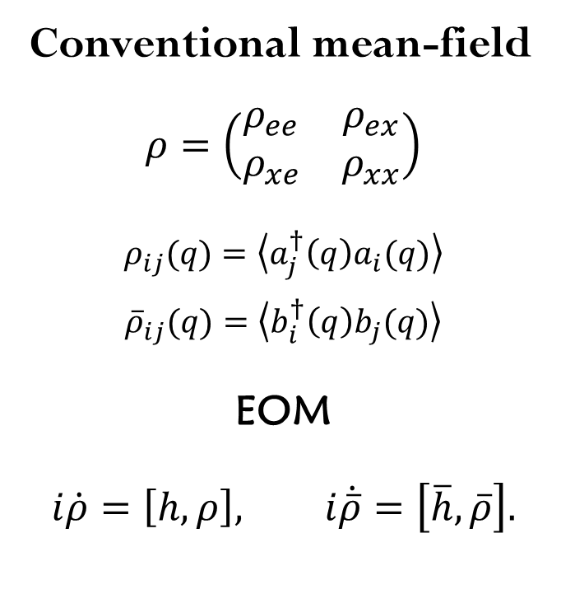
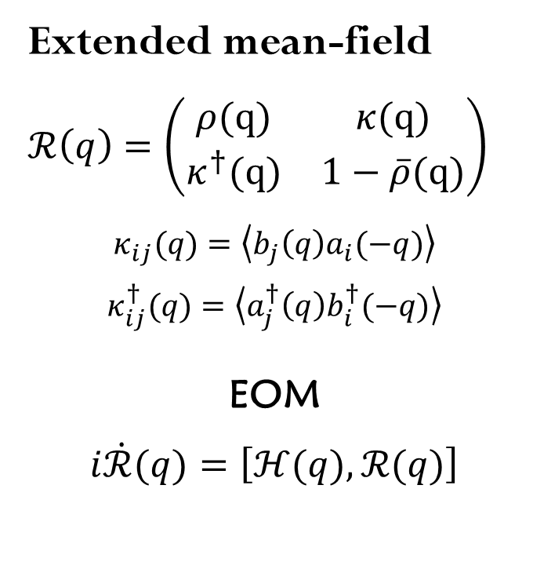
Beyond Flavor: Neutrino–Antineutrino Pairing
Conventional mean-field
$$ρ=\left(\begin{matrix}ρ_{ee} & ρ_{ex} \\ ρ_{xe} & ρ_{xx}\end{matrix}\right)$$
$$ρ_{ij}(q)=\left\langle a_{j}^{†}\left(q\right)a_{i}(q)\right\rangle$$
$${\overline{ρ}}_{ij}(q)=\left\langle b_{i}^{†}\left(q\right)b_{j}(q)\right\rangle$$
EOM
$$i\dot{ρ}=\left[h,ρ\right], i\dot{\overline{ρ}}=\left[\overline{h},\overline{ρ}\right].$$
Extended mean-field
$ℛ\left(q\right)=\left(\begin{matrix}ρ(q) & κ(q) \\ κ^{†}(q) & 1−\overline{ρ}(q)\end{matrix}\right)$
$$κ_{ij}(q)=\left\langle b_{j}\left(q\right)a_{i}(−q)\right\rangle$$
$$κ_{ij}^{†}(q)=\left\langle a_{j}^{†}\left(q\right)b_{i}^{†}(−q)\right\rangle$$
EOM
$i\dot{ℛ}(q)=\left[ℋ(q),ℛ(q)\right]$
C. Volpe, D. Vaananen, C. Espinoza 2013
J. Serreau & C. Volpe 2014
Notes:
To see where this pairing degree of freedom comes from, let me briefly compare the conventional and extended mean-field descriptions.
we use density matrix formalism to describe the flavor evolution.
For a two-flavor system, the diagonal elements represent the occupation numbers of each flavor, while the off-diagonal elements encode flavor correlations.
In the conventional treatment, we keep separate density matrices for neutrinos and antineutrinos, \rho and \bar\rho.

Slide 6
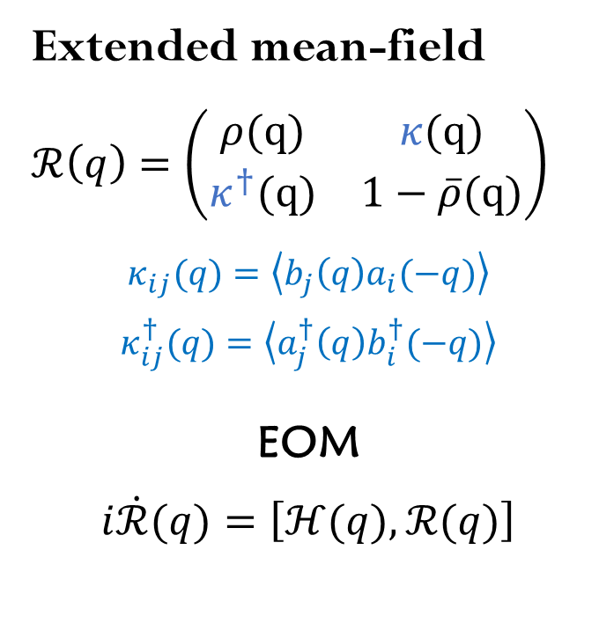
Beyond Flavor: Neutrino–Antineutrino Pairing
Conventional mean-field
$$ρ=\left(\begin{matrix}ρ_{ee} & ρ_{ex} \\ ρ_{xe} & ρ_{xx}\end{matrix}\right)$$
$$ρ_{ij}(q)=\left\langle a_{j}^{†}\left(q\right)a_{i}(q)\right\rangle$$
$${\overline{ρ}}_{ij}(q)=\left\langle b_{i}^{†}\left(q\right)b_{j}(q)\right\rangle$$
EOM
$$i\dot{ρ}=\left[h,ρ\right], i\dot{\overline{ρ}}=\left[\overline{h},\overline{ρ}\right].$$
Extended mean-field
$ℛ\left(q\right)=\left(\begin{matrix}ρ(q) & κ(q) \\ κ^{†}(q) & 1−\overline{ρ}(q)\end{matrix}\right)$
$$κ_{ij}(q)=\left\langle b_{j}\left(q\right)a_{i}(−q)\right\rangle$$
$$κ_{ij}^{†}(q)=\left\langle a_{j}^{†}\left(q\right)b_{i}^{†}(−q)\right\rangle$$
EOM
$i\dot{ℛ}(q)=\left[ℋ(q),ℛ(q)\right]$
C. Volpe, D. Vaananen, C. Espinoza 2013
J. Serreau & C. Volpe 2014
Notes:
In the extended mean-field framework developed by Serreau and Volpe,
the density matrix is enlarged by including an off-diagonal block, κ\kappa.

Slide 7
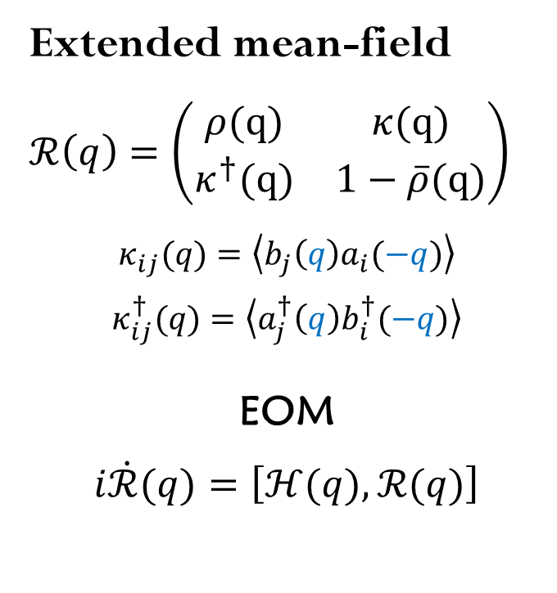
Beyond Flavor: Neutrino–Antineutrino Pairing
Conventional mean-field
$$ρ=\left(\begin{matrix}ρ_{ee} & ρ_{ex} \\ ρ_{xe} & ρ_{xx}\end{matrix}\right)$$
$$ρ_{ij}(q)=\left\langle a_{j}^{†}\left(q\right)a_{i}(q)\right\rangle$$
$${\overline{ρ}}_{ij}(q)=\left\langle b_{i}^{†}\left(q\right)b_{j}(q)\right\rangle$$
EOM
$$i\dot{ρ}=\left[h,ρ\right], i\dot{\overline{ρ}}=\left[\overline{h},\overline{ρ}\right].$$
Extended mean-field
$ℛ\left(q\right)=\left(\begin{matrix}ρ(q) & κ(q) \\ κ^{†}(q) & 1−\overline{ρ}(q)\end{matrix}\right)$
$$κ_{ij}(q)=\left\langle b_{j}\left(q\right)a_{i}(−q)\right\rangle$$
$$κ_{ij}^{†}(q)=\left\langle a_{j}^{†}\left(q\right)b_{i}^{†}(−q)\right\rangle$$
EOM
$i\dot{ℛ}(q)=\left[ℋ(q),ℛ(q)\right]$
Pairing correlation
C. Volpe, D. Vaananen, C. Espinoza 2013
J. Serreau & C. Volpe 2014
Notes:
This \kappa describes a neutrino-antineutrino pairing correlation.
Notice that this pairing correlation is defined as a coupling of annihilation operator between neutrino and antineutrino with opposite momentum.
An important result of the earlier work is that these correlations can be sourced by the ordinary neutrino and antineutrino densities when the medium is anisotropic.
For today's talk, I will not go into the details of the extended quantum kinetic equations.
Instead, I want to focus on the next question:
Once this pairing degree of freedom is present, can it become unstable and evolve collectively?

Slide 8
Can neutrino–antineutrino pairing correlations become collectively unstable?
Pairing correlations are expected to be small.
But the estimate assumes a stationary evolution.
A. Kartavtsev, G. Raffelt & H. Vogel 2015
Our question:
Notes:
However, another previous study also suggested that neutrino-antineutrino pairing correlations should be very small, based on a stationary estimate.
But a small correlation does not necessarily mean a small effect.
If the system is unstable, even a tiny perturbation can grow exponentially.
So we ask:
Can neutrino–antineutrino pairing correlations become collectively unstable?

Slide 9
There are three questions we would like to answer
What condition triggers the instability?
How fast does it grow?
What does the nonlinear evolution look like?
We try to consider the simplest possible system.
Notes:
So there are three questions we would like to answer.
First, what condition triggers the pairing instability?
Second, how fast does it grow?
And third, what happens after the instability develops?
To isolate the essential physics, we start from the simplest possible system.
we consider a toy model with discretized neutrino-antineutrino momentum pairs.
This allows us to identify the basic mechanism of the instability.

Slide 10
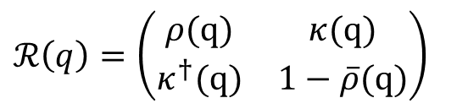
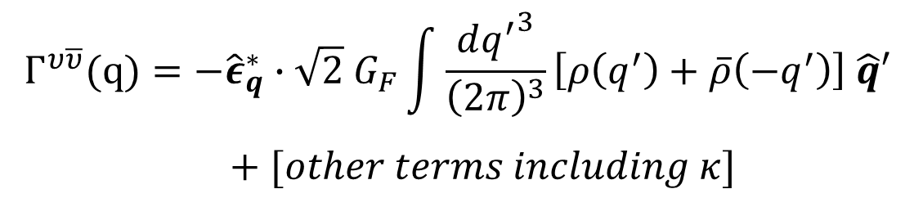
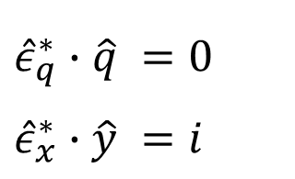
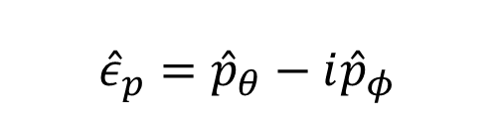
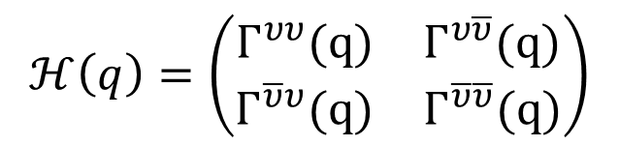
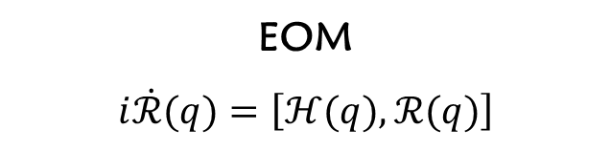
We need to consider the model at least
2D in space
$$Γ^{υ\overline{υ}}(q)=−{\hat{ε}}_{q}^{∗}∙\sqrt{2} G_{F}\int{\frac{d{q^{′}}^{3}}{{\left(2π\right)}^{3}}}\left[ρ\left(q^{′}\right)+\overline{ρ}\left(−q^{′}\right)\right] \hat{q}′$$
$+ [other terms including κ]$
$$ℋ\left(q\right)=\left(\begin{matrix}Γ^{υυ}(q) & Γ^{υ\overline{υ}}(q) \\ Γ^{\overline{υ}υ}(q) & Γ^{\overline{υ}\overline{υ}}(q)\end{matrix}\right)$$
EOM
$i\dot{ℛ}(q)=\left[ℋ(q),ℛ(q)\right]$
e.g.
$${\hat{ε}}_{p}={\hat{p}}_{θ}−i{\hat{p}}_{φ}$$
$${\hat{ε}}_{q}^{∗}∙\hat{q} =0$$
$${\hat{ε}}_{x}^{∗}∙\hat{y} =i$$
$ℛ\left(q\right)=\left(\begin{matrix}ρ(q) & κ(q) \\ κ^{†}(q) & 1−\overline{ρ}(q)\end{matrix}\right)$
Notes:
There is one important point before we define the model.
The system has to be at least two-dimensional.
The reason is geometric.

Slide 11
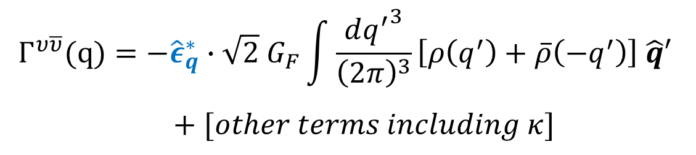
We need to consider the model at least
2D in space
$$Γ^{υ\overline{υ}}(q)=−{\hat{ε}}_{q}^{∗}∙\sqrt{2} G_{F}\int{\frac{d{q^{′}}^{3}}{{\left(2π\right)}^{3}}}\left[ρ\left(q^{′}\right)+\overline{ρ}\left(−q^{′}\right)\right] \hat{q}′$$
$+ [other terms including κ]$
$$ℋ\left(q\right)=\left(\begin{matrix}Γ^{υυ}(q) & Γ^{υ\overline{υ}}(q) \\ Γ^{\overline{υ}υ}(q) & Γ^{\overline{υ}\overline{υ}}(q)\end{matrix}\right)$$
EOM
$i\dot{ℛ}(q)=\left[ℋ(q),ℛ(q)\right]$
e.g.
$${\hat{ε}}_{p}={\hat{p}}_{θ}−i{\hat{p}}_{φ}$$
$${\hat{ε}}_{q}^{∗}∙\hat{q} =0$$
$${\hat{ε}}_{x}^{∗}∙\hat{y} =i$$
$ℛ\left(q\right)=\left(\begin{matrix}ρ(q) & κ(q) \\ κ^{†}(q) & 1−\overline{ρ}(q)\end{matrix}\right)$
Notes:
The pairing part of the Hamiltonian contains a polarization vector that is perpendicular to the neutrino momentum.
If all neutrinos propagate in the same direction, the relevant geometric coupling vanishes.
Therefore, a strictly one-dimensional setup cannot capture the pairing effect.
We therefore need at least two different momentum directions.

Slide 12




the simplest possible system
A single-flavor two-pair model
z
$$\overline{ν}$$
x
$$ν$$
For the fist step, we consider the single-energy neutrino.
$$\overline{ν}$$
$$ν$$
Notes:
Here is the simplest model we consider.
We take two single-flavor neutrino-antineutrino pairs propagating in two different momentum directions: one along the xx-axis and the other along the zz-axis.
For the fist step, we consider the single-energy neutrino.
This gives us the minimal system in which the pairing interaction can operate.

Slide 13
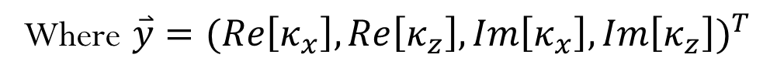

Linearized Instability Analysis
Monochromatic, Two Pair
$$i\dot{ℛ}(q)=\left[ℋ(q),ℛ(q)\right]$$
The discretized linear EOM :
$\dot{\overset{⃑}{y}}=A\overset{⃑}{y}+c,$ $\overset{⃑}{y} \left(t\right)=e^{At} {\overset{⃑}{y}}_{0}+c t.$
Where $\overset{⃑}{y}={(Re\left[κ_{x}\right],Re\left[κ_{z}\right],Im\left[κ_{x}\right],Im\left[κ_{z}\right])}^{T}$
The growth rate is the real part eigenvalues of the matrix $A$.
Notes:
To answer the questions what condition triggers the pairing instability? And how fast does it grow?
We then linearize the equations of motion.
The pairing correlation κ\kappa can be decomposed into its real and imaginary components, giving a linear equation of the form like this
The important point is that the eigenvalues of matrix A determine the stability.
If an eigenvalue has a positive real part, the pairing correlation grows exponentially.
So the question of whether a pairing instability exists becomes an eigenvalue problem.
Also, one crucial feature is the presence of a constant term in the equation.
This means that even if kappa is initially zero, a small value can still be generated dynamically.

Slide 14


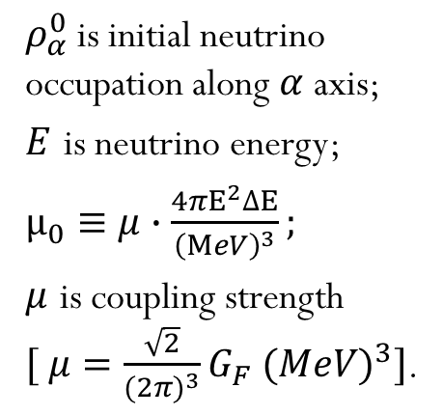


Linearized Instability Analysis
Monochromatic, Two Pair
Excessive Pair-occupation Number
A Simple Instability Criterion
$${(EPN)}_{α}≡ρ_{α}^{0}+{\overline{ρ}}_{−α}^{0}−1$$
${(EPN)}_{x}{(EPN)}_{z}<1$
Note:
Exponential growth of pairing correlations
$ρ_{α}^{0}$ is initial neutrino occupation along $α$ axis;
$E$ is neutrino energy;
$μ_{0}≡μ∙\frac{4πE^{2}∆E}{{\left(MeV\right)}^{3}};$
$μ$ is coupling strength
$[ μ=\frac{\sqrt{2}}{{(2π)}^{3}}G_{F} {(MeV)}^{3}]$.
$$κ∝e^{γt}$$
$$γ=2μ_{0}\sqrt{|{(EPN)}_{x}{(EPN)}_{z}|}$$
Huang & Wu 2026 [arxiv:2604.25687]
Notes:
Now we come to the main result of the linear analysis.
We define the excessive pair-occupation number, or EPN, as the sum of the neutrino and antineutrino initial occupation numbers of a pair, minus one
The subscript alpha here denotes the direction neutrino propagate.
For the two-pair system, we find a very simple criterion.
The pairing instability occurs when the EPNs of the two momentum modes have opposite signs.
In other words,
an EPN crossing is the signature of the pairing instability.
Once this condition is satisfied, a small initial pairing correlation grows exponentially,
The growth rate gamma is detremined by the neutrino coupling strength.
Here we define the coupling strength mu like this, and mu0 is mu times a constant.
So this gives us a simple diagnostic:
to look for pairing instabilities, we should look for an EPN crossing in momentum space.

Slide 15

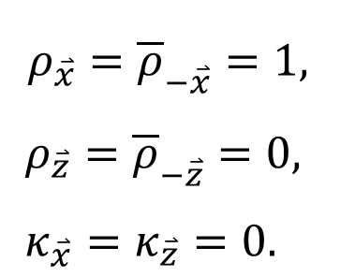



What happens nonlinearly
A single-flavor toy model
The initial value setting
z
$$ρ_{\overset{⃑}{x}}={\overline{ρ}}_{−\overset{⃑}{x}}=1,$$
$ρ_{\overset{⃑}{z}}={\overline{ρ}}_{−\overset{⃑}{z}}=0,$
$κ_{\overset{⃑}{x}}=κ_{\overset{⃑}{z}}=0.$
$$\overline{ν}$$
x
$$ν$$
$$\overline{ν}$$
$$ν$$
Notes:
But an instability is only the beginning.
We now ask what happens in the nonlinear regime.
We use the same two-pair model.
Initially, the pair propagating along the xx-direction is fully occupied, while the pair along the zz-direction is empty.
And kappa are initially zeros.

Slide 16
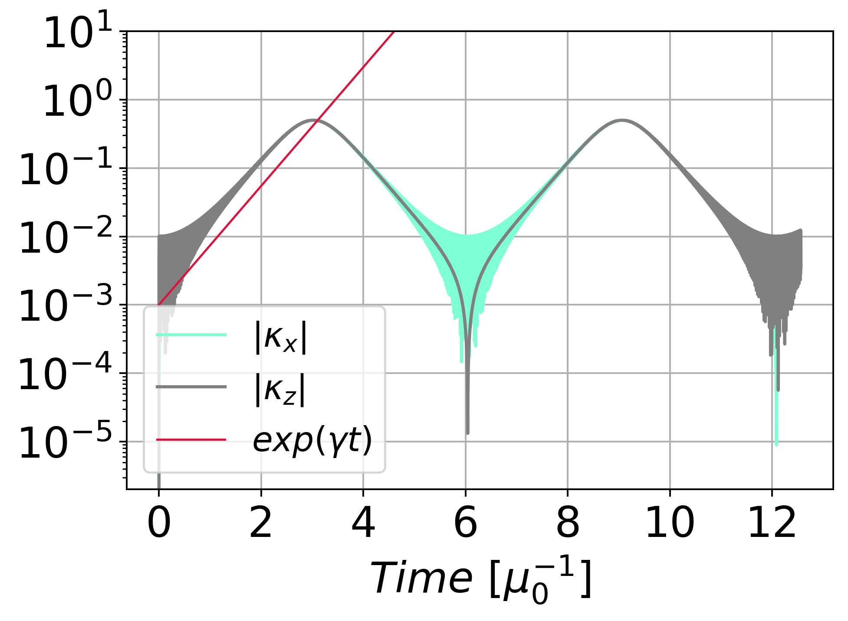

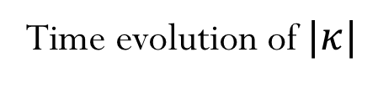




Evolution in Nonlinear regime
Monochromatic, Two Pair
z
Time evolution of $|κ|$
$$i\dot{ℛ}(q)=\left[ℋ(q),ℛ(q)\right]$$
$$\overline{ν}$$
x
$$ν$$
$$\overline{ν}$$
$$ν$$
The linear analysis correctly predicts the growth of the nonlinear collective evolution.
Huang & Wu 2026 [arxiv:2604.25687]
Notes:
Now we can see what the instability actually does.
With the extended mean-field equation, we did a non-linear simulation for this two-pair model.
On the left panel, we show the magnitude of the pairing correlation, ∣κ∣.
At early times, it grows exponentially, and the numerical evolution agrees well with the growth rate predicted by the linear stability analysis, shown by the red line.
So the linear analysis correctly predicts the growth of the nonlinear collective evolution.

Slide 17
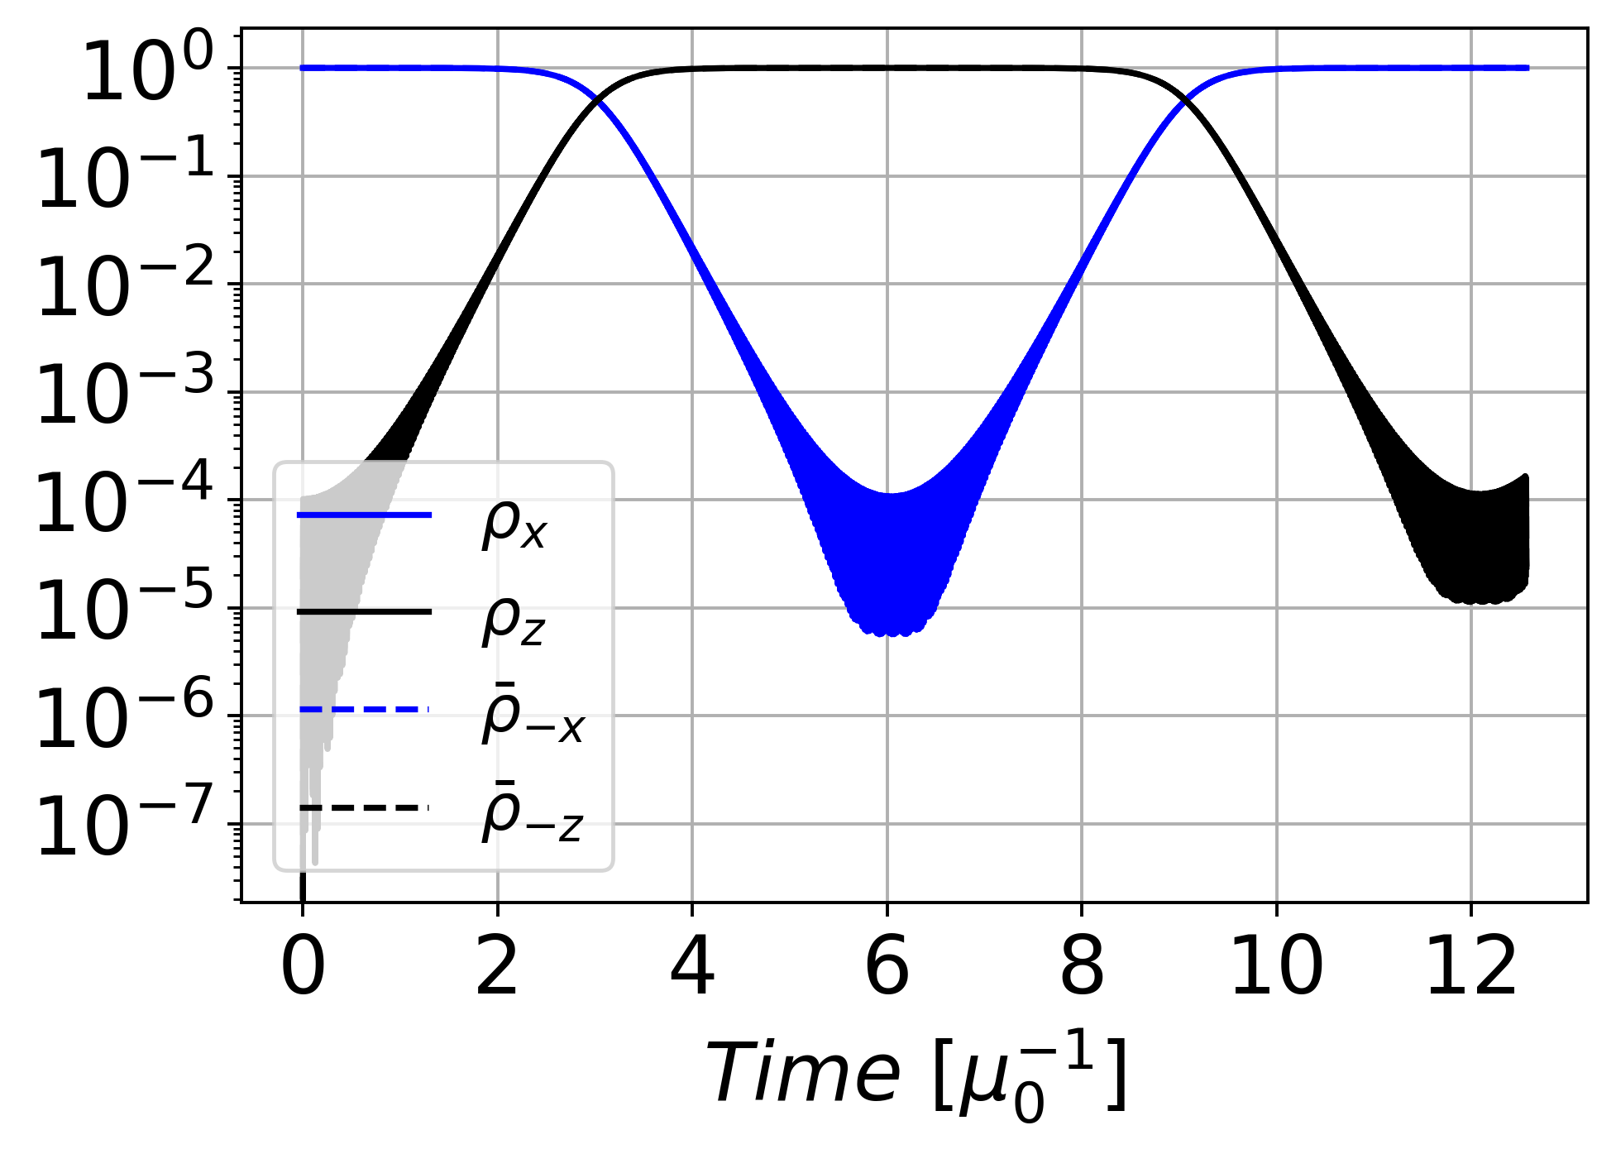
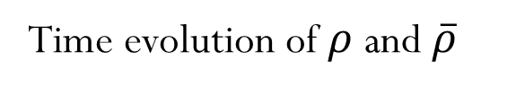
Evolution in Nonlinear regime
Monochromatic, Two Pair
z
Time evolution of $ρ$ and $\overline{ρ}$
$$i\dot{ℛ}(q)=\left[ℋ(q),ℛ(q)\right]$$
$$\overline{ν}$$
x
$$ν$$
$$\overline{ν}$$
$$ν$$
The pairing instability produces a collective conversion between different momentum modes.
Huang & Wu 2026 [arxiv:2604.25687]
Notes:
Next is the time evolution for neutrino and antineutrino occupation.
Let’s look at the left panel.
The solid lines show the neutrino occupations, while the dashed lines show the antineutrino occupations.
The neutrino and antineutrino curves almost overlap throughout the evolution, indicating coherent evolution in the pairing channel.
More importantly, the occupation initially stored in one momentum pair is transferred to the other momentum pair.
The pairing instability produces a collective conversion between different momentum modes.
This is what we call collective neutrino-antineutrino pair oscillation.

Slide 18
Take-home messages
Pairing correlation could introduce a new instability
The instability can trigger collective pairing conversions.
Outlook
Extend the toy model to more realistic condition, and examine whether the instability can still survive. If so, then it could have the potential influence in supernova dynamics.
Notes:
So let me finish with two take-home messages.
First, neutrino–antineutrino pairing correlations can introduce a new type of instability,
Second, this pairing instability can trigger collective pairing conversions.
Extend the toy model to more realistic condition, and examine whether the instability can still survive.
If so, then it could have the potential influence in supernova dynamics.
Thank you very much for your attention.

Slide 19
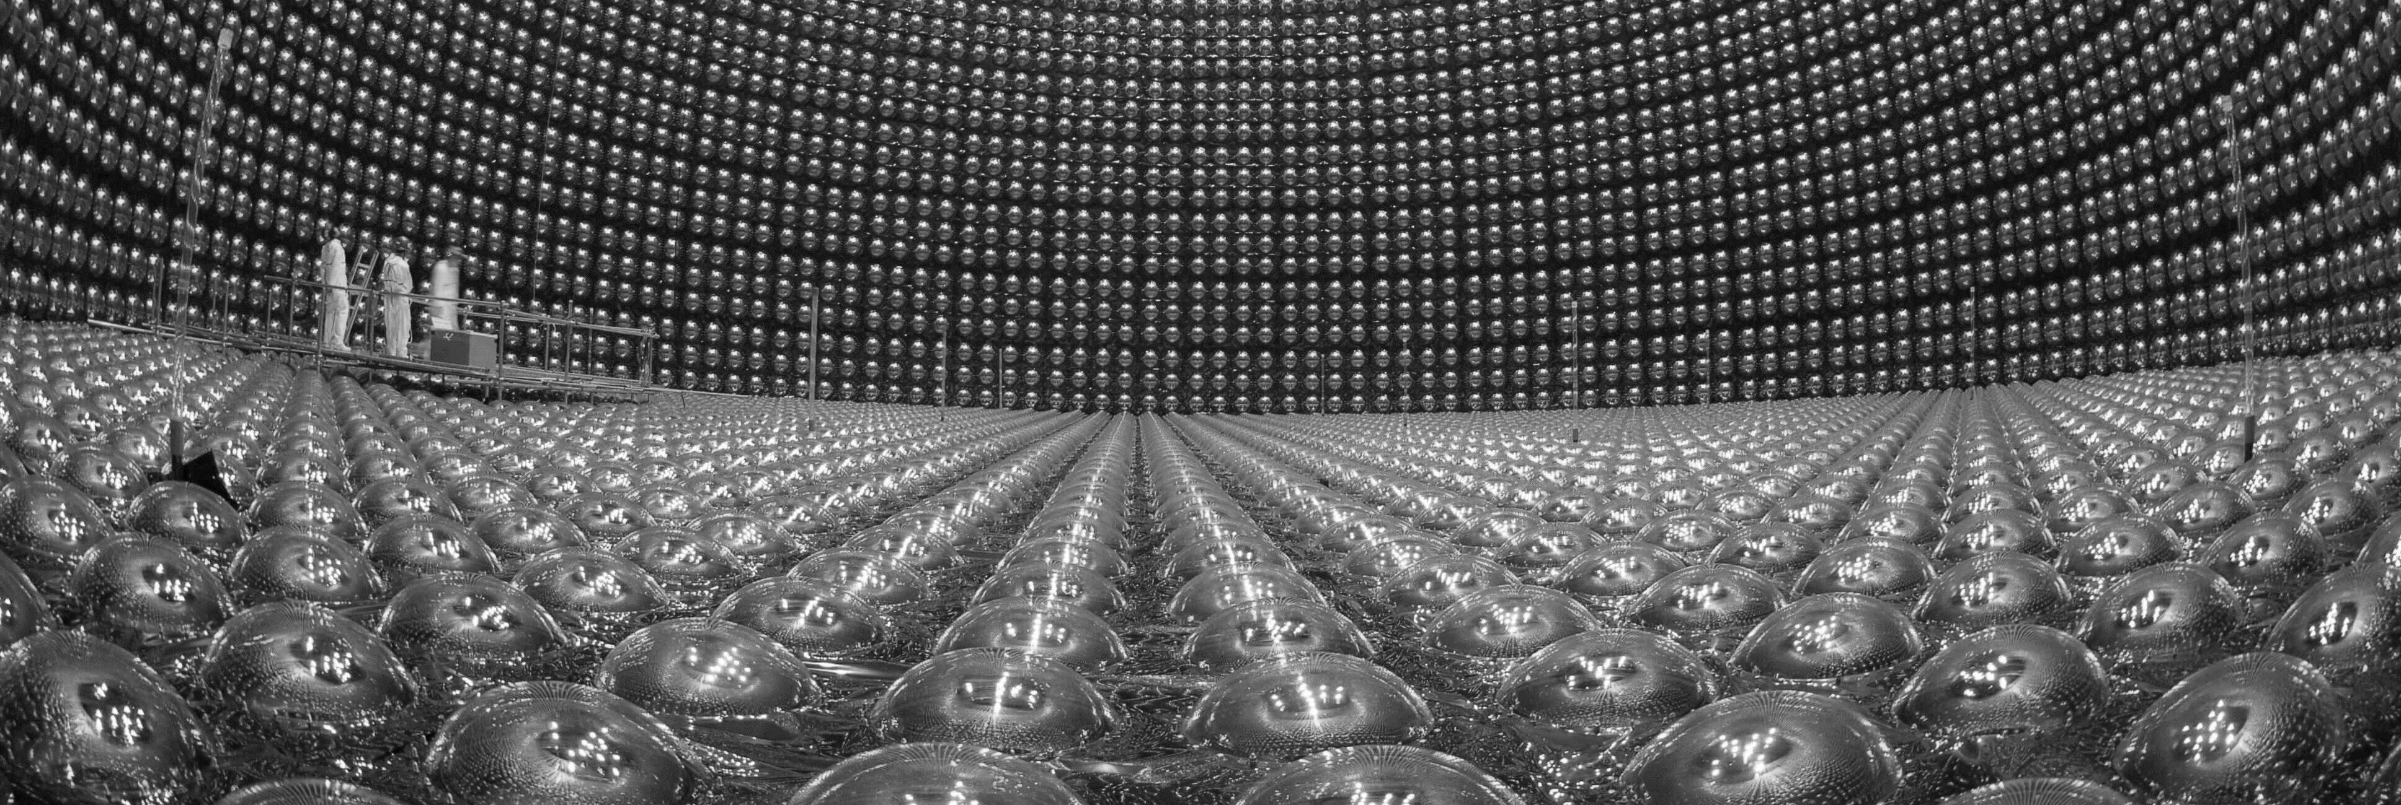
Super-K

Slide 20
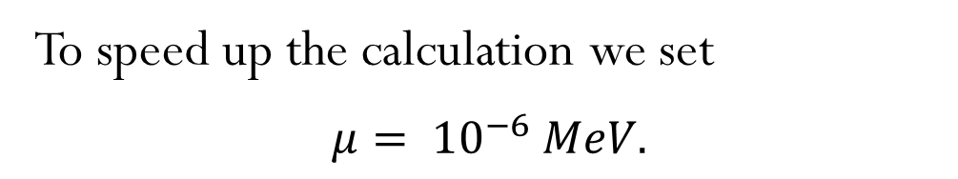
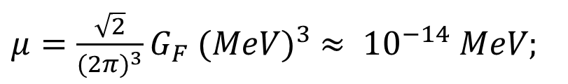
Appendix
We define the coupling strength as follow :
$μ=\frac{\sqrt{2}}{{(2π)}^{3}}G_{F} {(MeV)}^{3} ≈ {10}^{−14} MeV;$
To speed up the calculation we set
$$μ= {10}^{−6} MeV.$$
Notes:
We characterize the strength of the neutrino-neutrino interaction by the coupling μ\mu.
This provides the characteristic scale for the collective evolution.

Slide 21
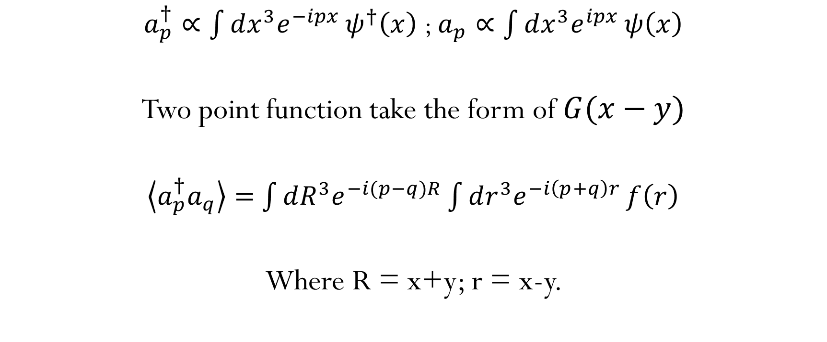
Appendix
$a_{p}^{†}∝\int{dx^{3}e^{−ipx}}ψ^{†}\left(x\right)$ ; $a_{p}∝\int{dx^{3}e^{ipx}}ψ\left(x\right)$
Two point function take the form of $G(x−y)$
$\left\langle a_{p}^{†}a_{q}\right\rangle =$ $\int{dR^{3}e^{−i(p−q)R}}\int{dr^{3}e^{−i\left(p+q\right)r}}f\left(r\right)$
Where R = x+y; r = x-y.

Slide 22
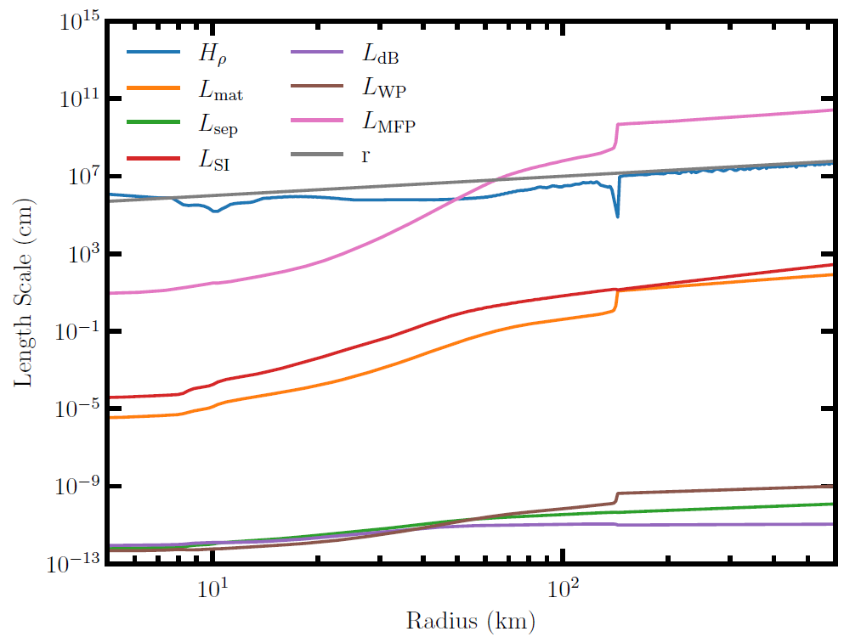
Length Scales
1D CCSN simulation at the time of maximum shock radius

Slide 23
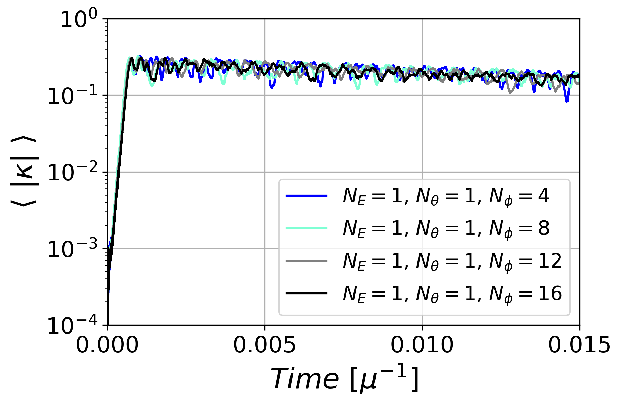
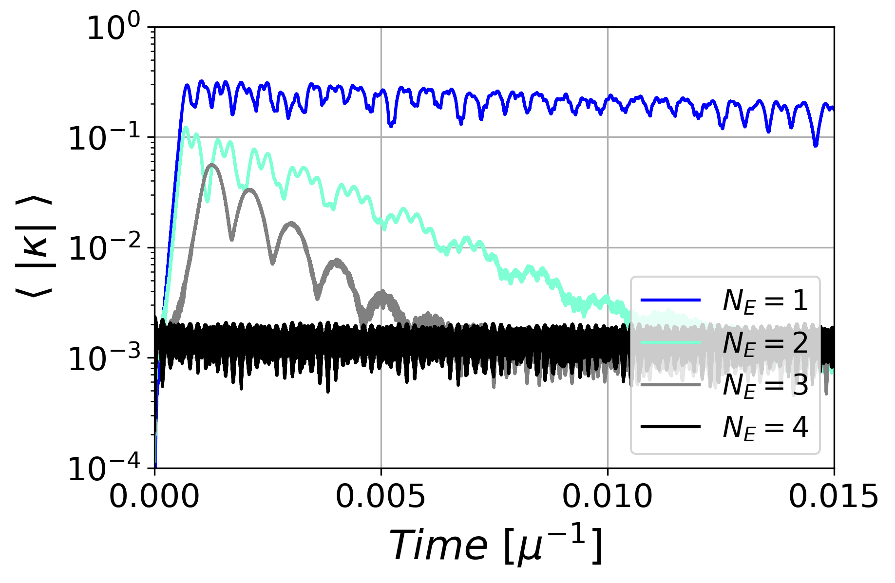
Beyond the two-pair system
Multiple angular modes
Multiple energy modes
Not sensitive to multiple angular distribution.
Instability is restricted to particular energy regions.
Notes:
Of course, the two-pair model is only a starting point.
We therefore extend the system to multiple angular and energy modes.
For multiple angular modes, the qualitative picture remains the same:
pairing instabilities are associated with EPN crossings.
However, the multi-energy case gives us an important new effect.
The instability can become restricted to particular energy regions, rather than developing coherently across the whole spectrum.
As a result, increasing the number of energy bins can strongly suppress the overall pairing conversion.

