Slide 1

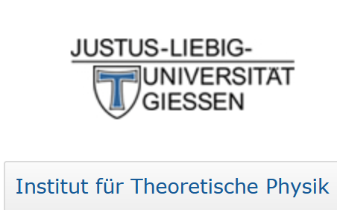
Lepton Number Violating Electron Scattering
Horst Lenske
Institut für Theoretische Physik, JLU Giessen
&
NUMEN Collaboration, INFN/LNS Catania

Slide 2
Search for New Physics
Beyond the Standard Model
(BSM)
“The discovery of nonzero neutrino masses is among the most important particle physics results of the last two decades: It indicates that the Standard Model of particle physics is incomplete. After 20* years of intense experimental and theoretical research, we still do not know the physics that leads to nonzero neutrino masses.”
(André de Gueva, Annu. Rev. Nucl. Part. Sci. 2016. 66:197)
*You may add another 10 years by now!

Slide 3
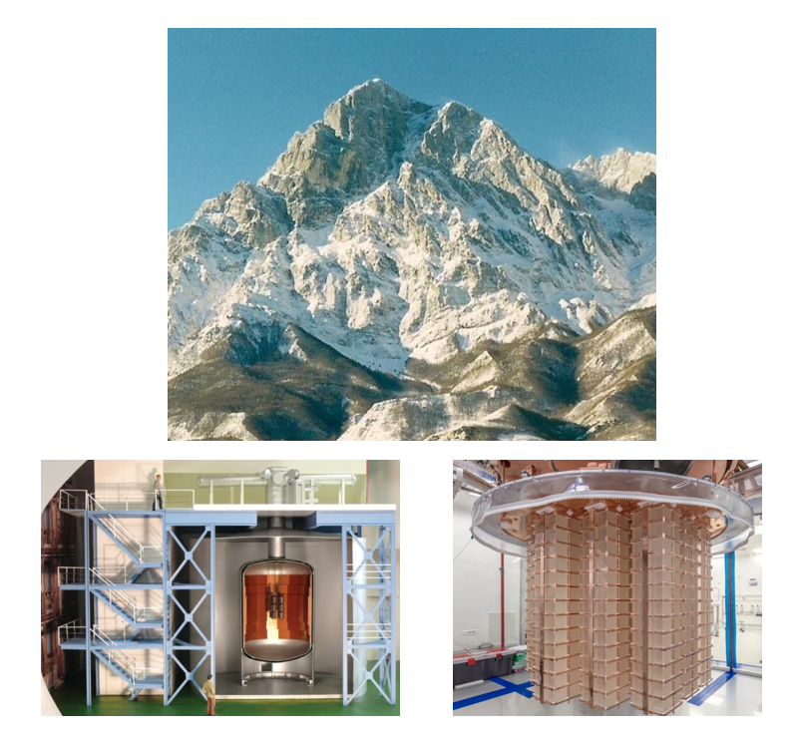
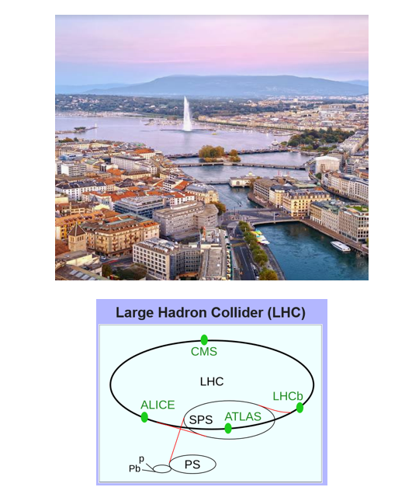
Search for Alternative LNV Probes
…beside
Double Beta Decay@MeV and ℓ^{±2}j² Production@TeV
Gap of 10^{6…9} (!) eV
GERDA & CUORE
ATLAS & CMS

Slide 4
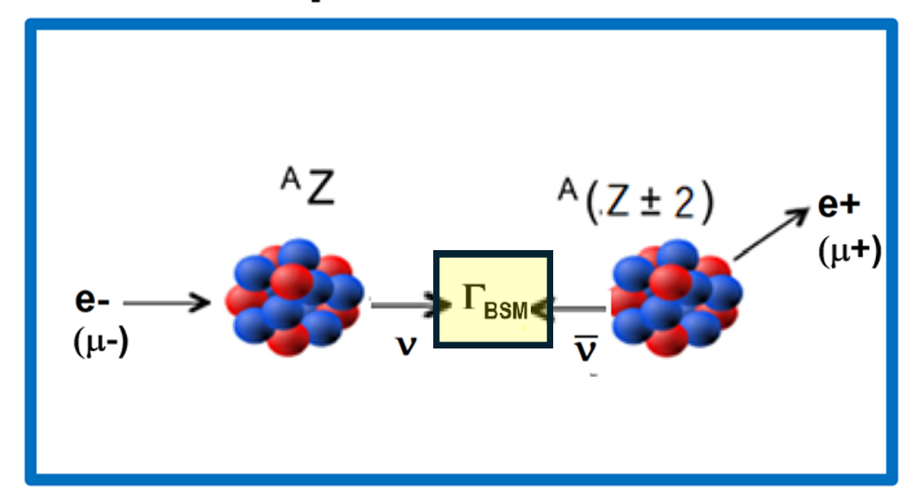
Motivations and Aims
Bridging the Gap between LNV@MeV and LNV@TeV
by using
Non-Exotic Methods for eploring Exotic BSM Physics
Lepton DCE Reactions : New independent probe for Lepton Number Violation → A(e-,e+)B reactions at accelerator facilities
Disclaimer:
LDCE reactions are not for
measuring or investigating nuclear DBD matrix elements!

Slide 5
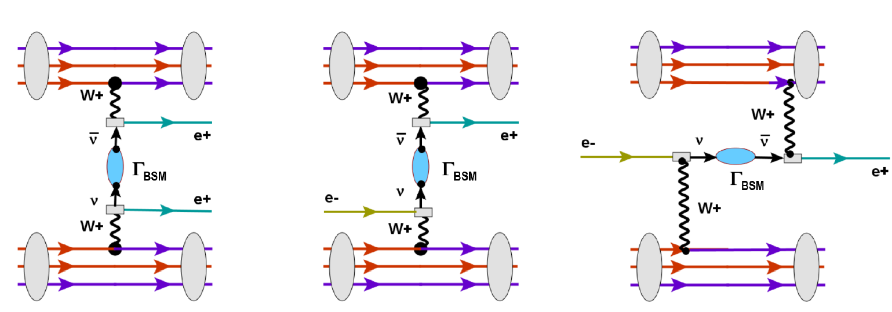
Lepton DCE Processes on Nuclei
time
Decay Capture Reaction
H.L., F. Cappuzzello, A. Spatafora, 2603.21997 [nucl-th]
H.L., 2603.21903 [nucl-th]
New LNV Probe

Slide 6
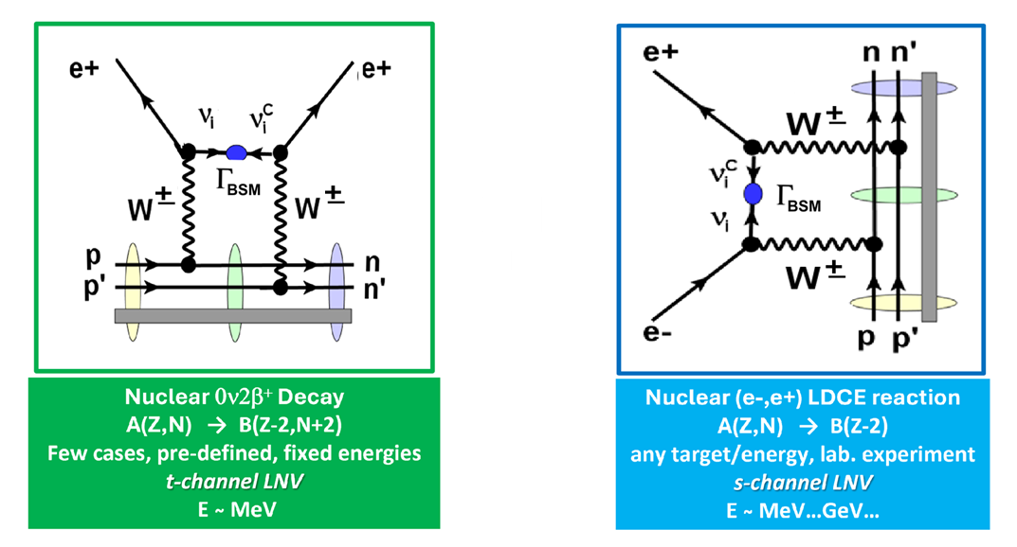
LNV (Re-)Search with Lepton Double Charge Exchange Reactions
t-channel
s-channel
Time

Slide 7
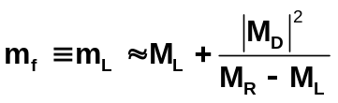
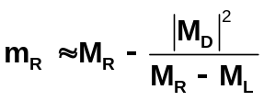

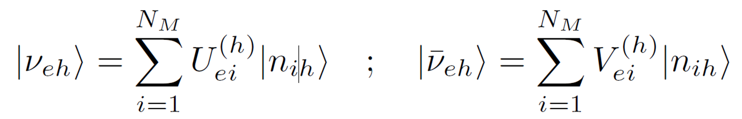
Neutral Leptons and Mass Eigenstates
Light Neutrino Mass Puzzle
Lepton Number Violation in nuclear 0ν2β –decay@MeV and l±l ± jj-events@TeV:
there must be a hidden sector of N_{M} ≥ 3 massive Majorana Fermions n_{i} = n^{c}_{i}
Flavor ↔ Mass Eigenstates: Change of Basis by Pontecorvo–Maki–Nakagawa–Sakata (PMNS) Trafo

Slide 8
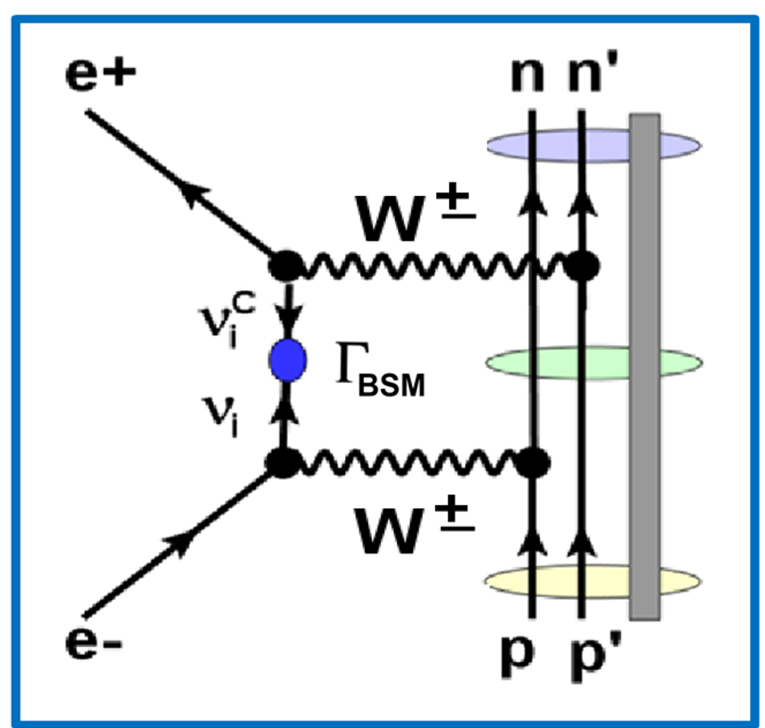
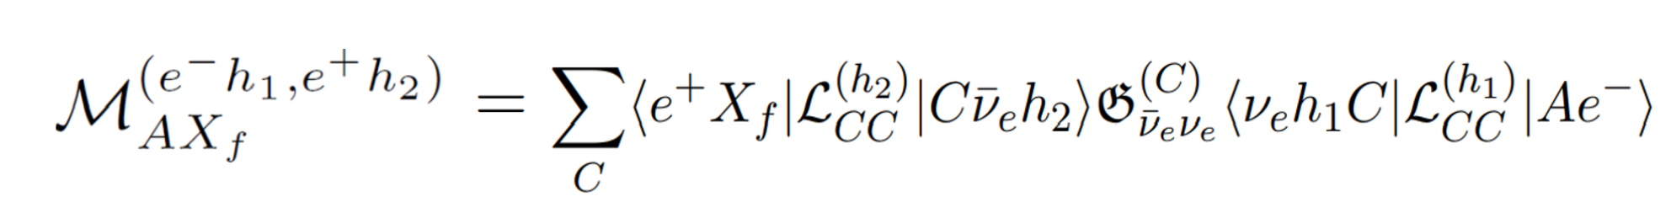
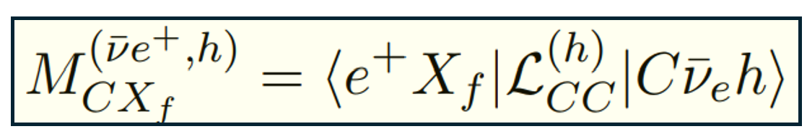
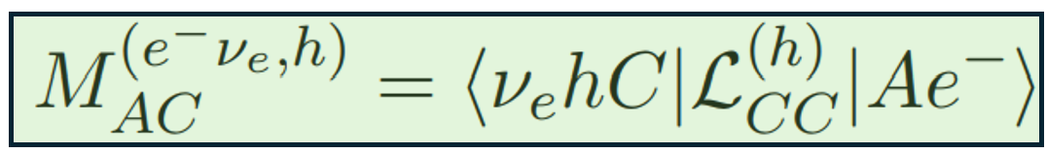
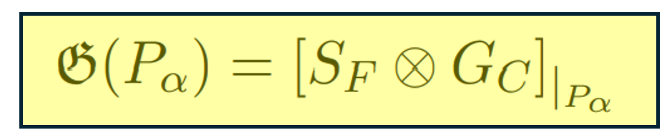
LDCE Reaction Amplitudes in the
Left-Right (LR) Symmetric Model

Slide 9
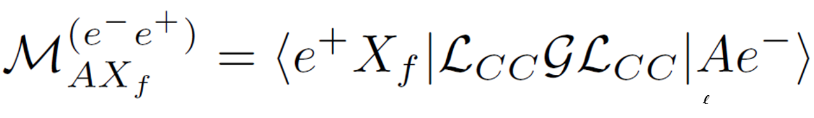
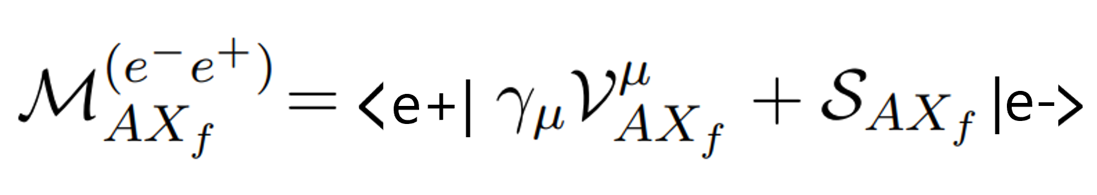

LDCE Amplitude and Cross Section
~ O(Γ_{L/R} E_{e-}) ~ 10⁻⁷ E_{e-} ~ O(m_{ν}) ~ 10⁻⁷ m_{e}

Slide 10
What do we know about LDCE Reactions?
Estimating LDCE Reaction Yields
…nothing!
…but A(ν_{ℓ},ℓ)C Single Charged Current (CC) nuclear reaction data are available!

Slide 11
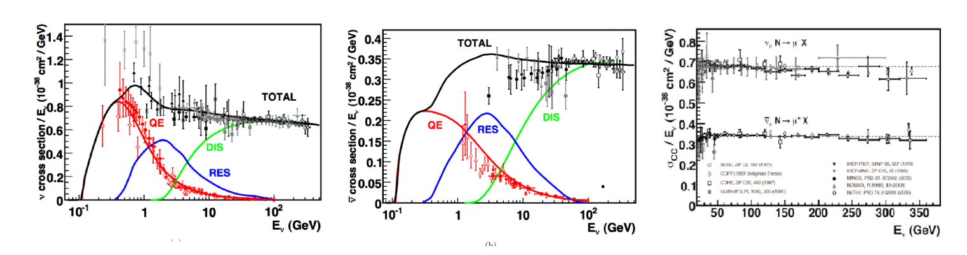


World Data Set on (ν,μ) Charged Current (CC) Data
3-Component Structure
Total Cross Sections per Mass Number and per Energy
Lepton Universality:
(ν_{μ},μ) ↔ (ν_{e},e) ↔ (ν_{ℓ},ℓ)

Slide 12
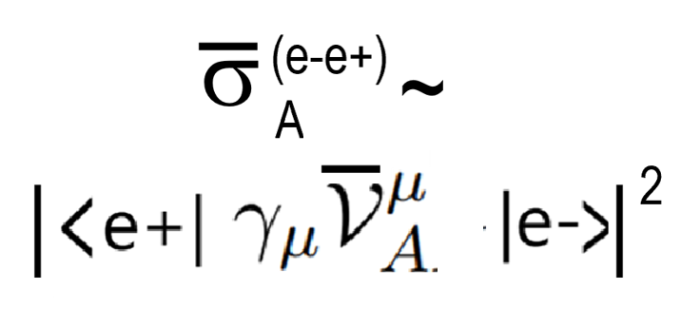
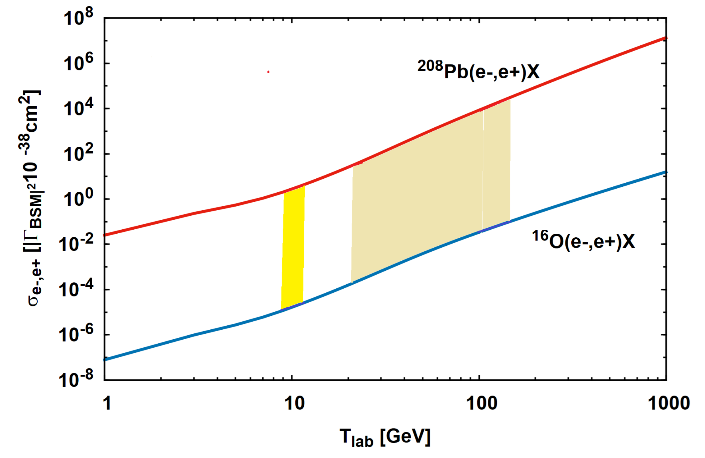


Incident Energy Dependence of LDCE Total Cross Sections
¹⁶O(e-,e+)X ↔ ²⁰⁸Pb(e-,e+)X
Jlab
(HERA@DESY e⁻/e⁺ + p collider)
(1991-2007)
x |Γ_{BSM}|² ~ O(10⁻¹⁰…10⁻¹⁴)!
EIC

Slide 13
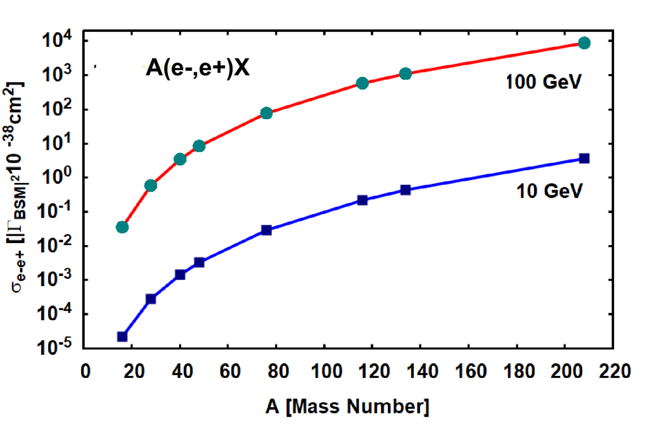
Mass Dependence of LDCE Total Cross Sections
Challenge Experiment:
Heavy target nuclei at the highest possible beam energy
single out prompt (!) e+
x |Γ_{BSM}|² ~ O(10⁻¹⁰…10⁻¹⁴)!
Challenge Theory:
EFT for η,κ,λ−dynamics@multi-GeV
Unified LDCE Reaction Theory
from QE to DI Energies

Slide 14
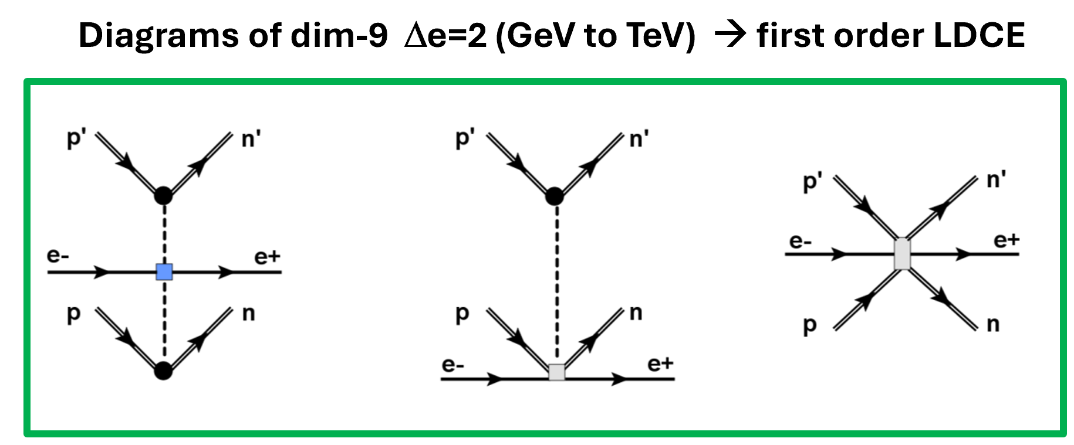
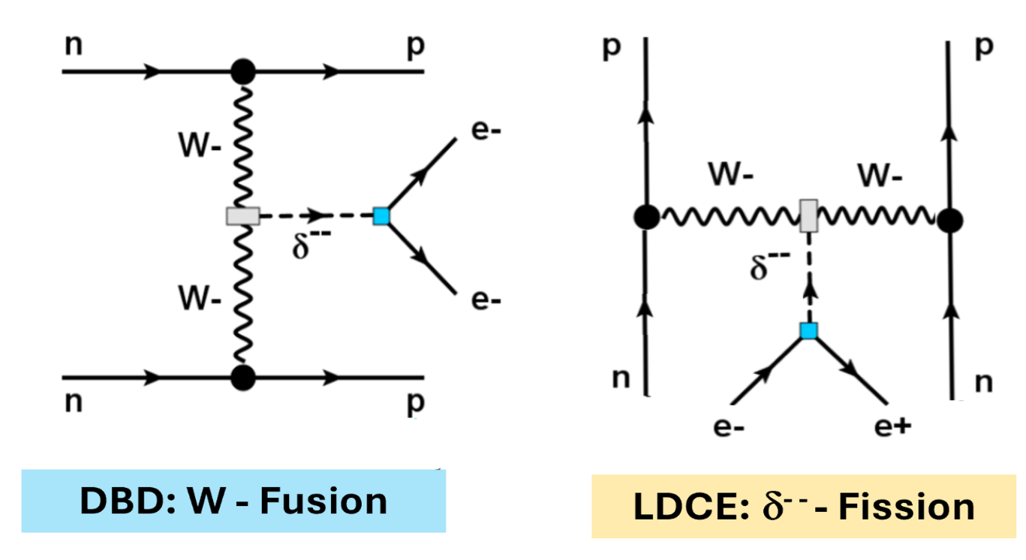
Status and Future
Lepton DCE reactions at accelerators as a new Probe for LNV
Focus on η,κ,λ-terms by energy-momentum enhancement
Outlook LDCE: Heavy Neutral Leptons, m_{HNL}>> M_{p}
Perspective LDCE : Higher-dim operators & Higgs sector
Connection MDCE ↔ LDCE
Isotensor (!!) Higgs Boson
H.L., F. Cappuzzello, A. Spatafora, 2603.21997 [nucl-th]
Supported by DFG, grant Le439/17, and INFN

Slide 16
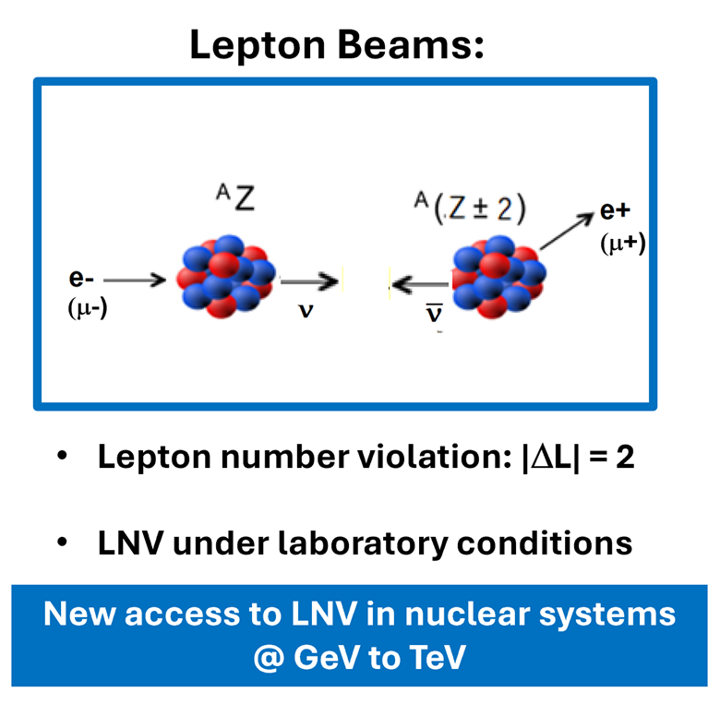

Exploring new LNV territory with…
Nuclear LDCE Reaction Studies at Accelerator Facilities
No Nuclear Structure Constraints!

Slide 17
Motivation and Goals
Research on Nuclear Isotensor Modes within the NUMEN*@LNS Catania Project
Rank-2 Isotensor Response by Heavy Ion Double Charge Exchange (DCE) Reactions:
Collisonal Hadronic DCE Processes
New Probe for Lepton Number Violation
Weak Lepton Double Charge Exchange (LDCE) Reactions on Nuclei at Accelerators
Probing Nuclear Isotensor Response in
Strong and Weak Interactions
as Tools for LNV Research
*NUclear Matrix Elements for Neutrinoless Double Beta Decay, see Eur. Phys. J. A 62:151 (2026)

