Slide 1

AXEL: high-pressure Xe gas TPC for neutrinoless double beta decay search
Hayato SASAKI, Kyoto University(Japan)
On behalf of the AXEL collaboration
21th September. 2026
International School of Nuclear Physics, 47th Course @Erice
Notes:
Nice to meet you.
I‘m Hayato SASAKI from Kyoto University.
I’ll talk about “AXEL: high-pressure Xe gas TPC for neutrinoless
double beta decay search”, on behalf of the AXEL collaboration.

Slide 2
Outline
AXEL experiment
Performance evaluation of 180L-size prototype
R&D for 1000L-size detector
Summary
Notes:
Here is the outline of my presentation.

Slide 3
Outline
AXEL experiment
Performance evaluation of 180L-size prototype
R&D for 1000L-size detector
Summary
Notes:
First, I‘ll talk about the AXEL experiment.

Slide 4
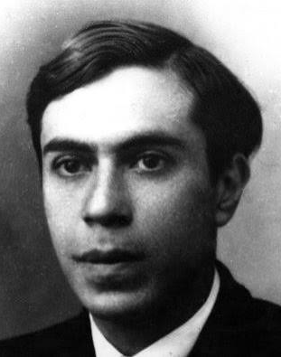
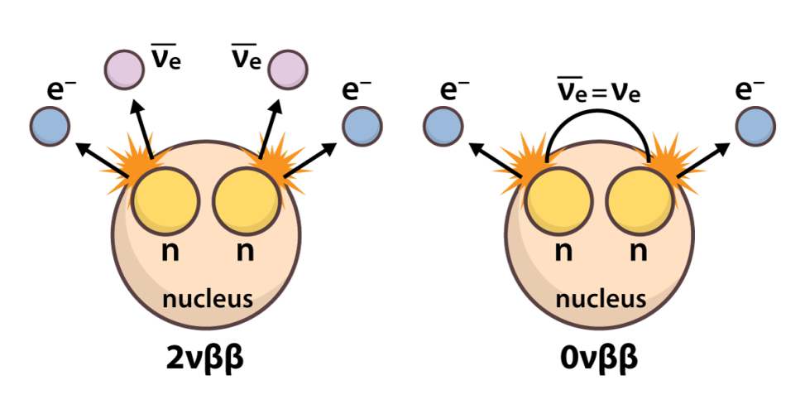

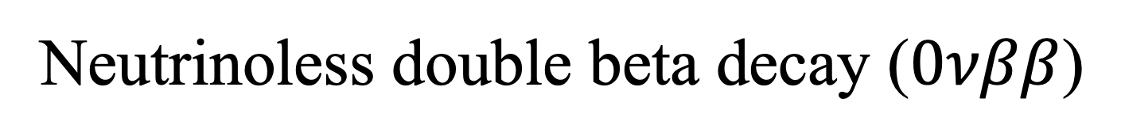

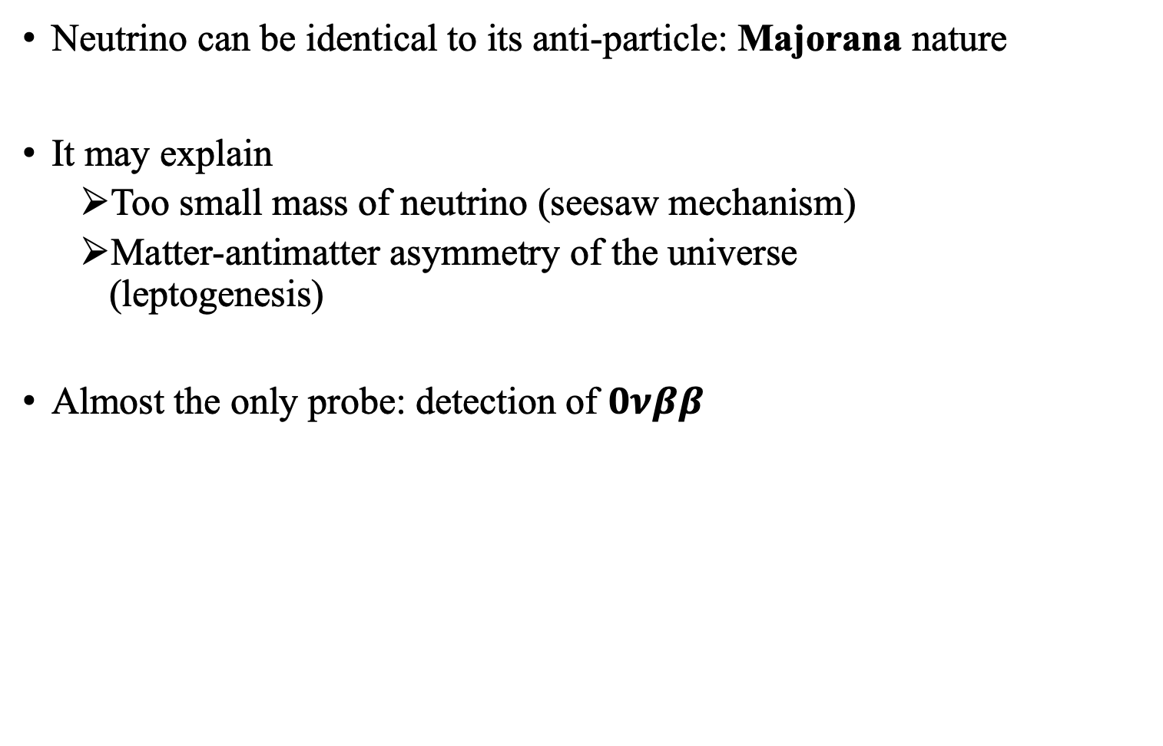
Neutrinoless double beta decay ($0νββ$)
Neutrino can be identical to its anti-particle: Majorana nature
It may explain
  Too small mass of neutrino (seesaw mechanism)
  Matter-antimatter asymmetry of the universe
  (leptogenesis)
Almost the only probe: detection of $0νββ$
Ettore Majorana
majorana
$$2νββ$$
$$0νββ$$
Notes:
First, as an introduction, I’ll talk about neutrinoless double beta decay.
Neutrino can be identical to anti-particle, I mean, anti-neutrino.
It is called majorana nature, proposed by Ettore Majorana.
If neutrino has majorana nature, it may solve some problems.
First, it can explain the origin of neutrino’s too small mass compared to the other particles, with the model called seesaw mechanism.
Second, it may explain the Matter-antimatter asymmetry of the universe through the scenario called leptogenesis.
In order to verify that neutrino has majorana nature, the almost only probe is that detecting neutrinoless double beta decay, 0nbb, which occurs only if neutrino has majorana nature.

Slide 5
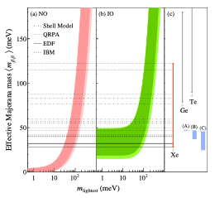
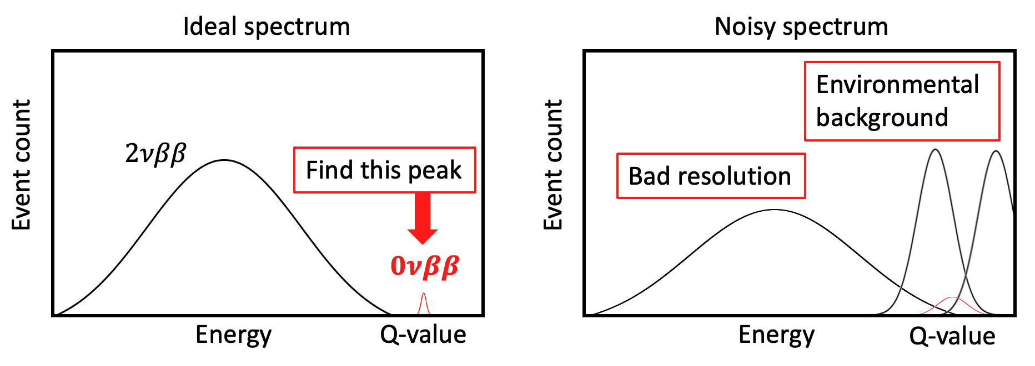
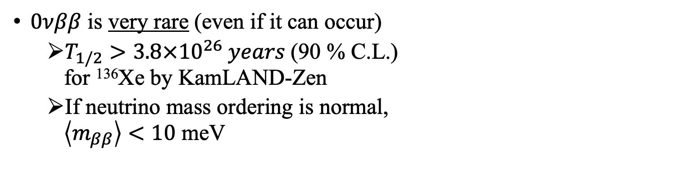

Result and requirements of $0νββ$ search
$0νββ$ is very rare (even if it can occur)
  $T_{1/2}>3.8×{10}^{26} years$(90 % C.L.)
  for ¹³⁶Xe by KamLAND-Zen
  If neutrino mass ordering is normal,
  $\left\langle m_{ββ}\right\rangle <10$ meV
Requirements for more sensitive search:
  High energy resolution
  Environmental
  radiation
  discrimination
  Mass
  scalability
S.Abe et al., Phys. Rev. Lett. 135, 262501
Notes:
Next, I’ll talk the result and requirements about onbb.
Even if neutrino has majorana. nature, onbb is very rare event.
The half-life is 3.8 times 10 to 26 years for Xe 136 measured by KamLAND-Zen experiment, corresponding to the Effective majorana mass of 28 to 122 meV.
Otherwise, it is expected to be less than 10 meV, if neutrino mass ordering is normal.
So more sensitive search requires to meet all of these conditions,
High energy resolution, Environmental radiation discrimination, and Mass scalability
for the measurement with ideal spectrum

Slide 6
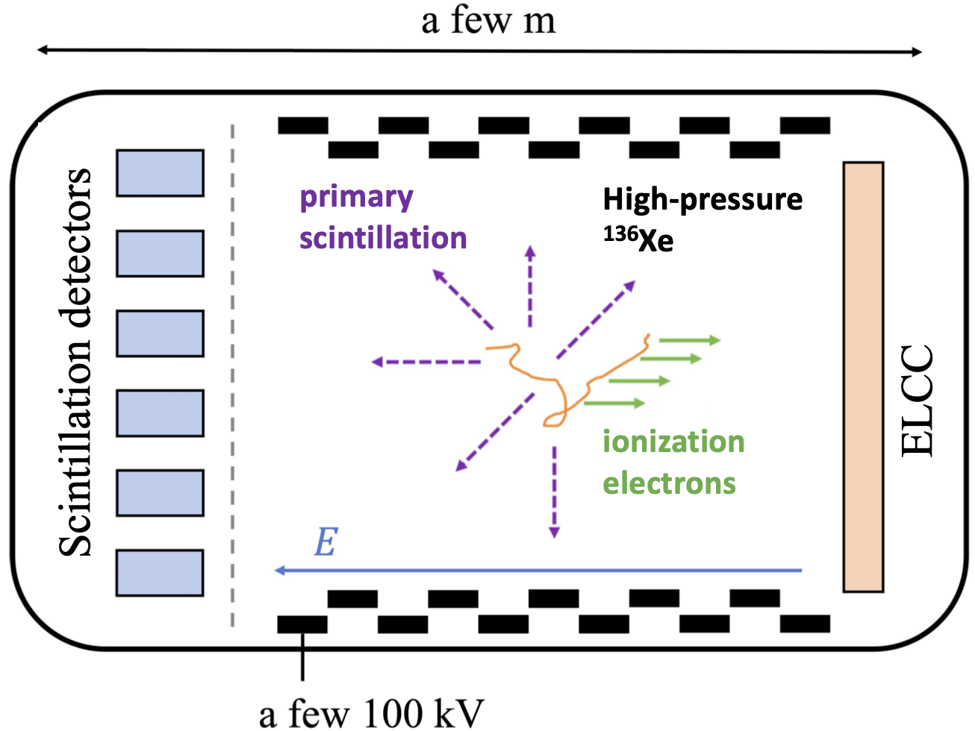
AXEL: A Xenon ElectroLuminescence
AXEL: High pressure Xe gas Time Projection Chamber (TPC)
  Detection system ELCC: High energy resolution + Scalability (p7)
  Tracking ability: Background rejection by topology (p15-16)
Details in
Next slide!
Notes:
Then, I‘ll introduce the AXEL experiment.
AXEL detector is a high-pressure Xe gas time projection chamber aimed to search 0nbb.
When charged particle pass through the detector, it ionizes atoms, and ionized electrons are drifted along the electric field inside the chamber.
Ionization electrons are detected by a unique system called ELCC, and I enables the detector to achieve high energy resolution and scalability.
I’ll talk about ELCC’s detail in next slide.
Also, AXEL detector has tracking ability with TPC principle.
It enables background discrimination by topology.
I’ll also talk about it later.

Slide 7
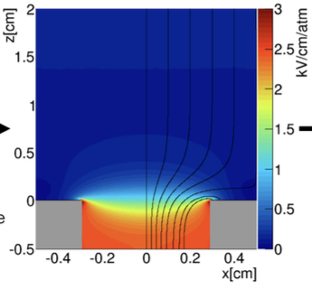
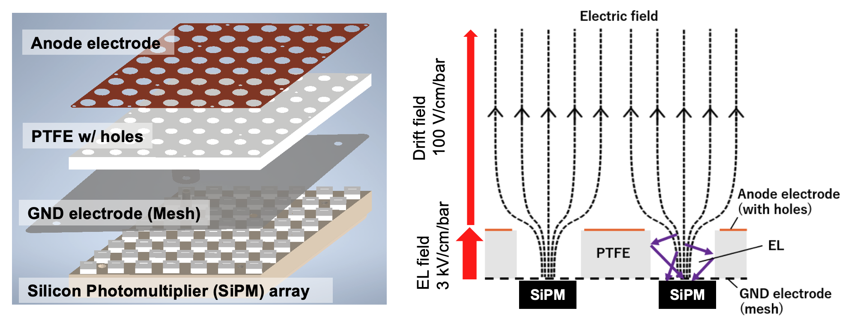

ELCC: Electroluminescence Light Collection Cell
Pulling ionization electrons into cells and detect through electroluminescence (EL)
Low fluctuation process due to linear amplification
→ High energy resolution
Rigid structure and modular extension
→ Good Scalability
EL process
Field simulation
$$e^{−}$$
Linear
amplification
Structure
Principle
Notes:
Then I’ll explain ELCC.
This picture shows the structure of ELCC.
PTFE-made body with many holes is sandwiched by copper anode and mesh ground electrode.
The electric field is shown in next picture.
Ionization electrons are drifted along the drift field, and they are pulled into cell.
In the cells, they undergo electroluminescence, EL process with high EL field, and they generate multiple photons.
Finally, these photons are detected by SiPM or MPPC behind the ground mesh.
Since the EL process is linear amplification, the fluctuation is small and it leads to high energy resolution.
Also, since it has a rigid structure and we can extend it by adding additional module, ELCC has good scalability to have a large mass of decay nuclei.

Slide 8
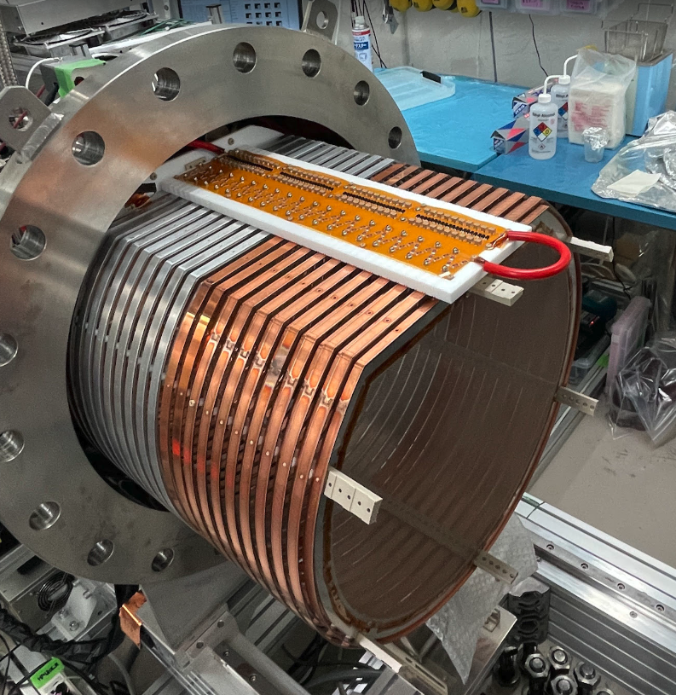
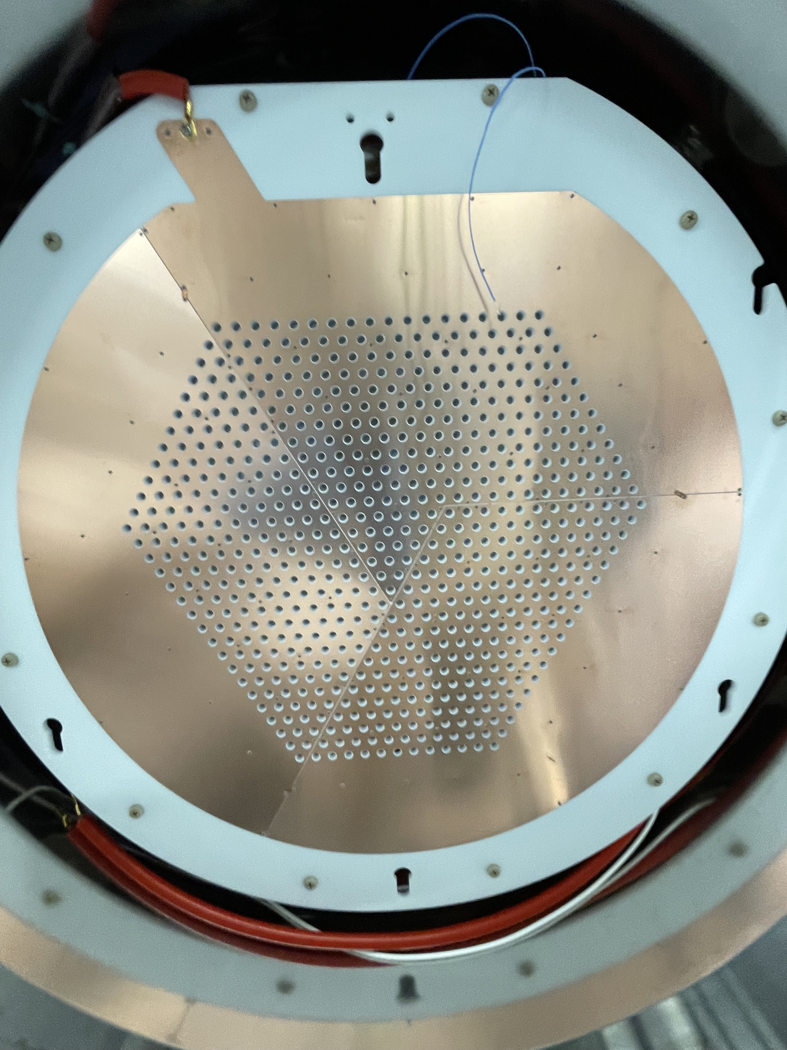
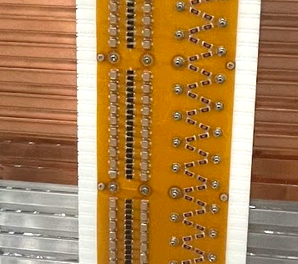
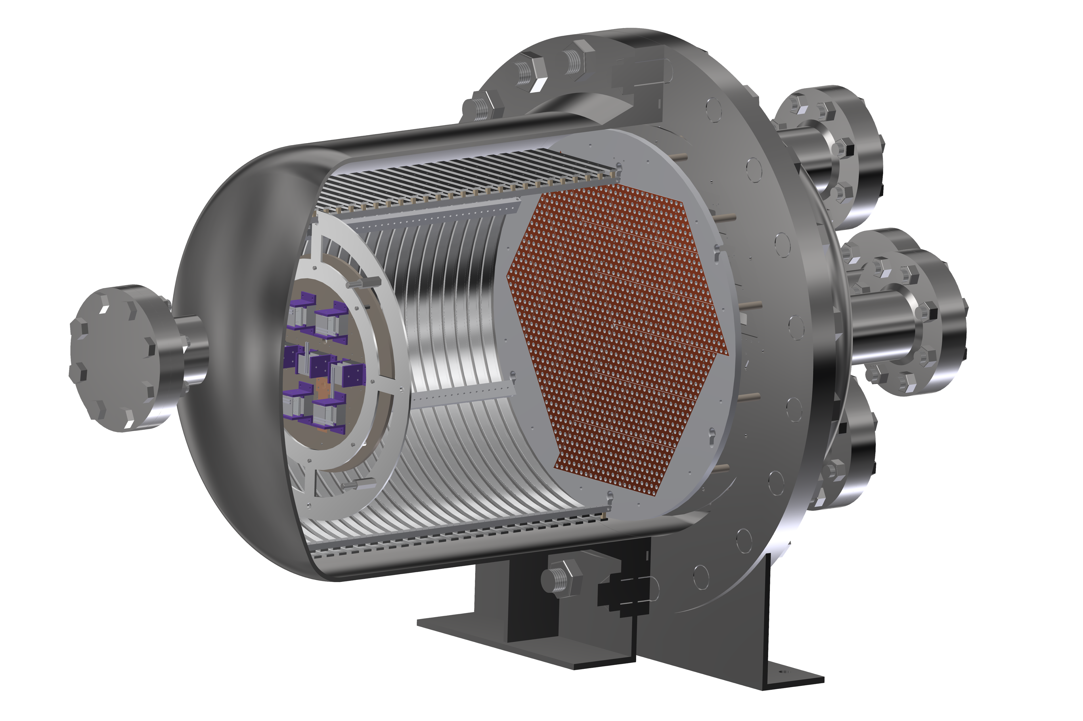
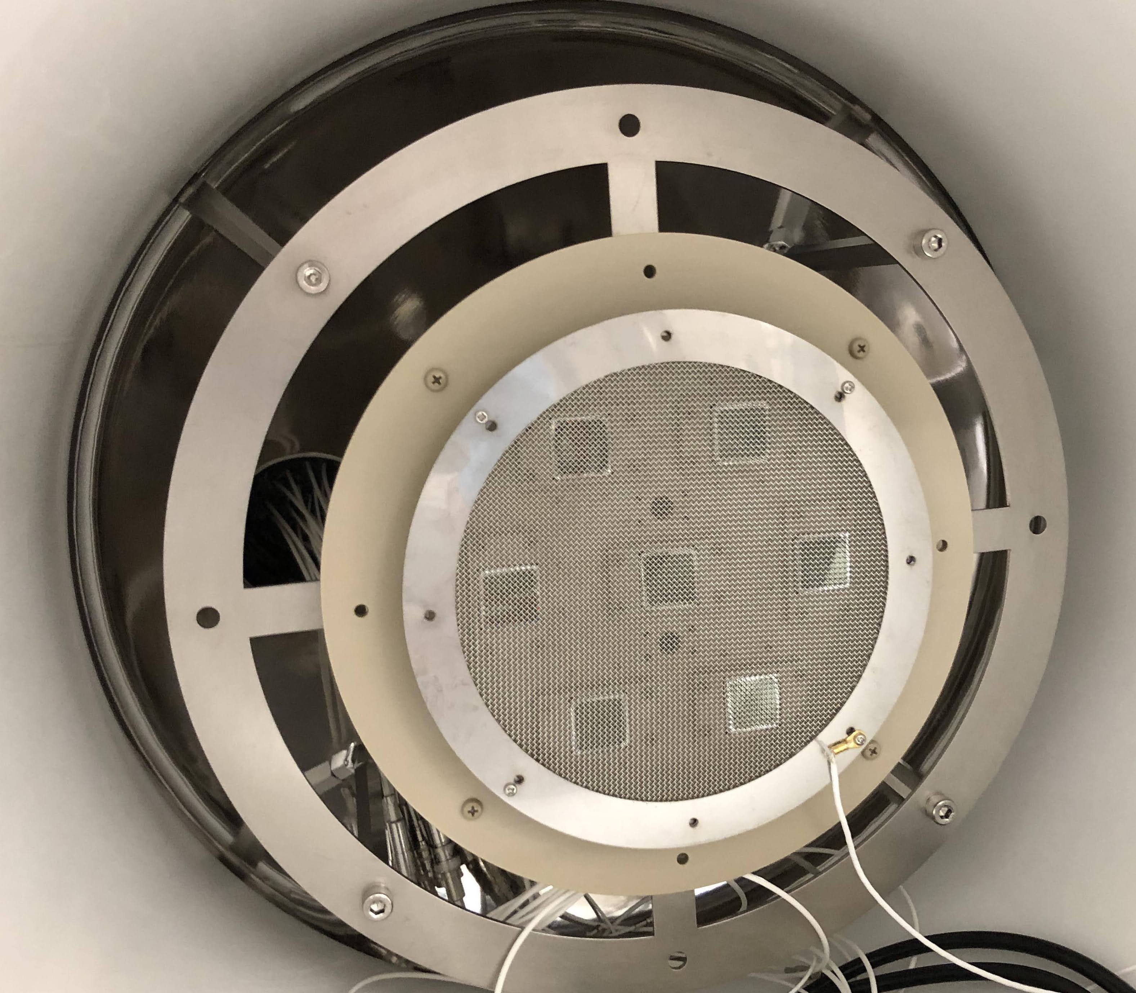
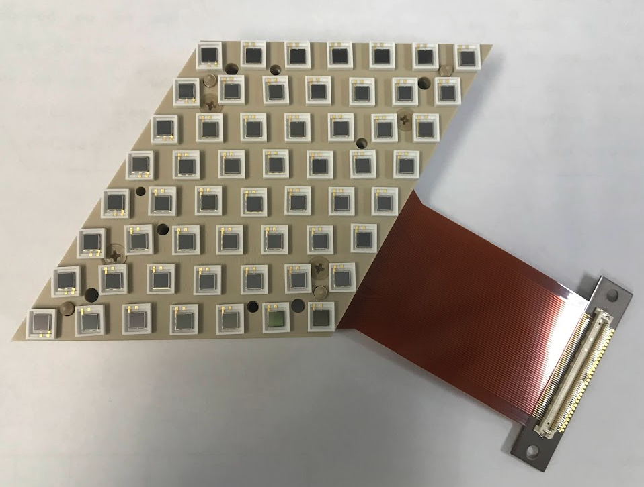
Overview of AXEL detector (180L-size prototype)
Field cage
Cockcroft-Walton generator
ELCC: 672 ch
Aluminum for test
Cathode
mesh
Oxygen-free copper
SiPM (MPPC) array of
one ELCC module
VUV PMT array
Cad model of 180L prototype
Notes:
This slide shows the overview of AXEL detector.
The center is cad of our 180L-size prototype, which we are operating now.
The right side are the surface of ELCC and a MPPC array used in ELCC.
This is field cage generating drift electric field. It is made by copper and aluminum.
On the field cage, there is cockcroft-walton generator for supplying high voltage on cathode and field cage.
Finally, on the opposite side of ELCC, there is PMT array for scintillation detection.

Slide 9
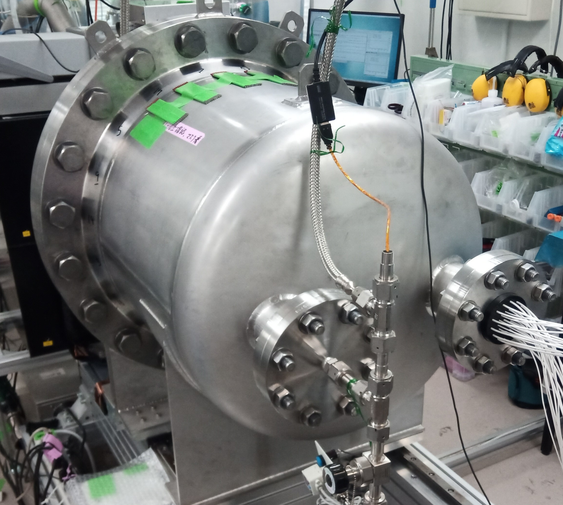
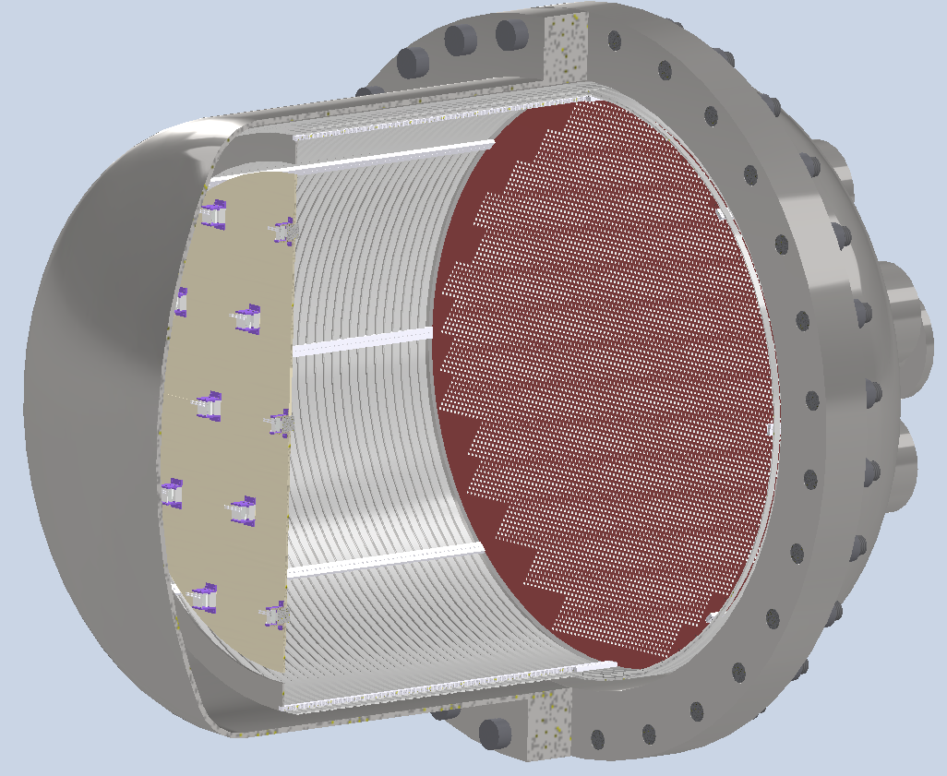
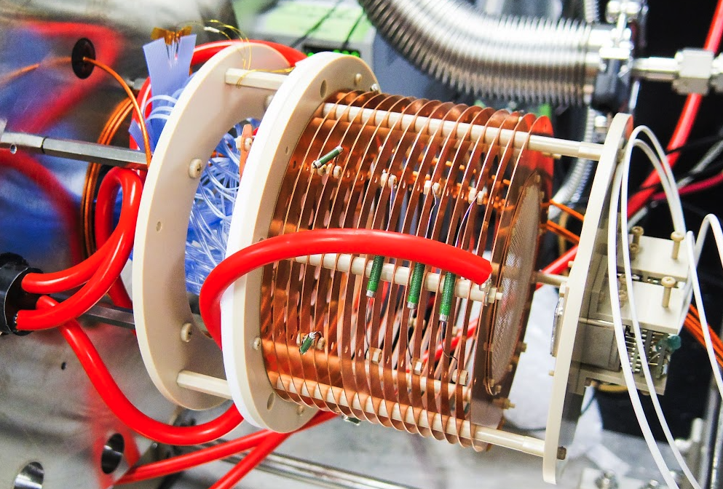
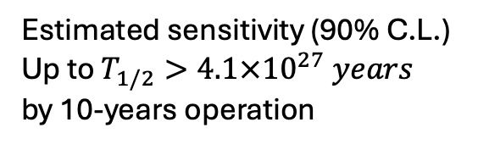
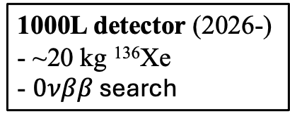
Road map of AXEL experiment
@Kyoto university
Estimated sensitivity (90% C.L.) Up to $T_{1/2}>4.1×{10}^{27} years$
by 10-years operation
10-ton detector
1-ton detector
100-kg detector (2028-)
50 cm
1000L detector (2026-)
- ~20 kg ¹³⁶Xe
- $0νββ$ search
Collaboration with NEXT experiment is undergoing
80 cm
150 cm
180L prototype (2018-)
- ~4.5 kg Xe
- R&D of components
- Scalable structure
9 cm
10 cm
10L prototype (2014-2018)
- ~50 g Xe
- ELCC proof of principle
100 cm
@Kamioka underground
Notes:
Then, I’ll talk about the road map of AXEL experiment.
It was started from 10L-size prototype for investigating ELCC principle.
From 2018, we are operating 180L-size prototype now, to do many R & D components and confirm the scalability.
As a next step, we are planning the 1000L-size detector at Kamioka underground laboratory.
We will do the first 0nbb search with this detector using 20 kg xenon, to demonstrate the background rejection ability.
Also, toward the 100kg-size experiment, collaborating with NEXT experiment is undergoing.
We will install the ELCC into NEXT detector.

Slide 10
Outline
AXEL experiment
Performance evaluation of 180L-size prototype
R&D for 1000L-size detector
Summary
Notes:
From now, I’ll talk about results of performance evaluation with 180L-size prototype.

Slide 11
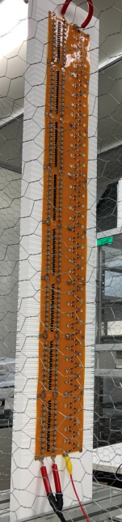
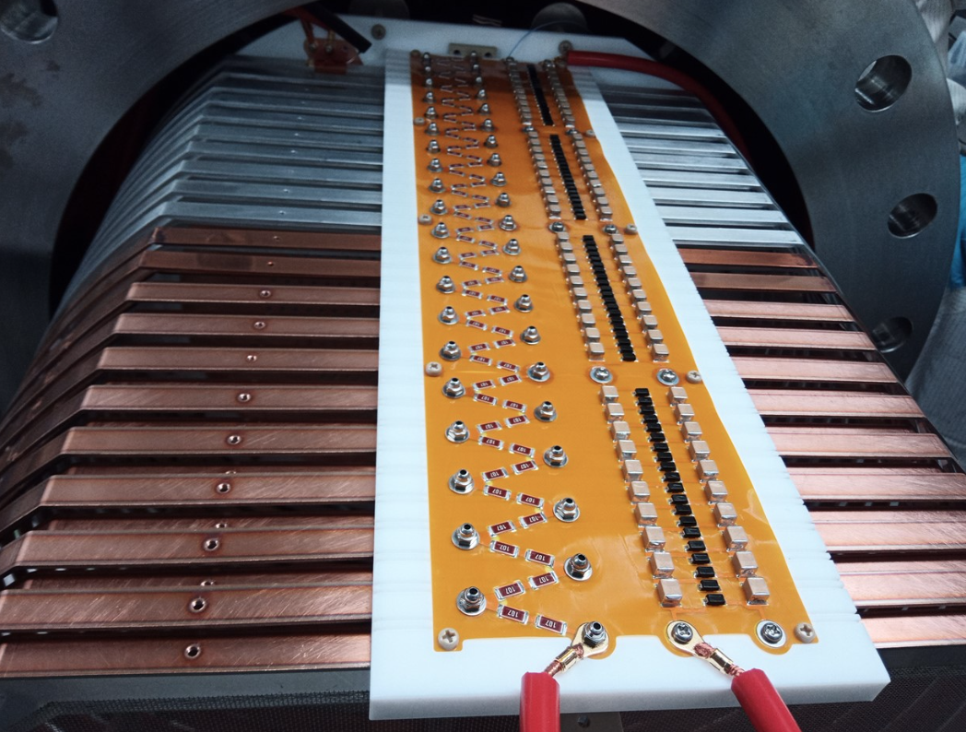
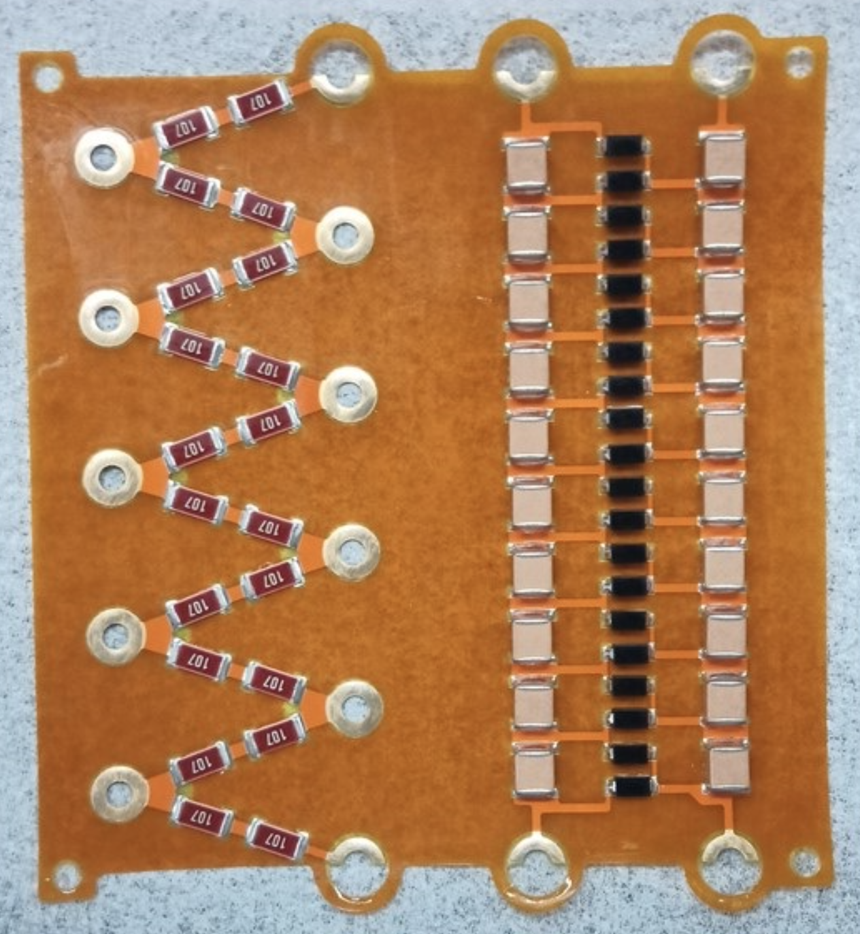
Cockcroft-Walton generator
High DC voltage generation from low AC input
  No need to develop special feedthrough
  for high pressure and HV
-35.3 kV was achieved in 6.0 bar Xe with 1.2 kV_{pp} input
  First operation demonstration for TPC in the world!
AC input
10 cm
Amplify
DC output
AC output
40-step generator in 180L prototype
10-step generator
Also, -76.4 kV was achieved with 80-step generator
in atmosphere for the 1000L-size upgrade (p18).
@Tohoku
univ.
Notes:
First topic is cockcroft-Walton generator.
It outputs high DC voltage with low AC input, so the advantage is that we need not to develop special feedthrough
for high pressure and HV.
They are made of flexible printed circuit. This is the picture installed in 180L prototype, and one FPC is this.
One FPC has 10 step generator.
We achieved ー35.3 kV in 6 bar xenon with 1.2 kV input.
It was the First operation demonstration for TPC in the world.
Also, -76.4 kV was achieved with 80-step generator in atmosphere.

Slide 12
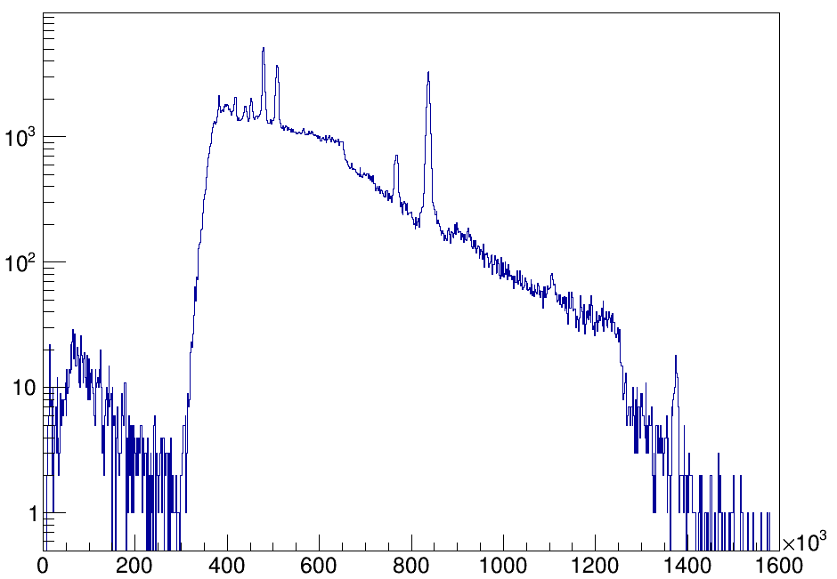
Energy Spectrum
Measurement Conditions
²⁰⁸Tl source
Xe gas pressure:
6.8 bar
Anode Voltage:
-9.2 kV
Cathode Voltage
(CW output):
-34.1 kV
EL field:
2.7 kV/cm/bar
Drift field:
90 V/cm/bar
40 days operation
environmental ⁴⁰K 1461 keV
Entry/bin
characteristic X-ray
²⁰⁸Tl double escape peak 1593 keV
²⁰⁸Tl single escape peak 2104 keV
²⁰⁸Tl 2615 keV
²²⁸Ac 911 keV
²²⁸Ac 965 keV + 969 keV
down sampling
EL photon
Detail: S.Akiyama et al., PTEP 2025(2025) 053H03
Notes:
Measured energy spectrum is this histogram.
The measurement conditions are as shown.
You can see some sharp peaks.

Slide 13
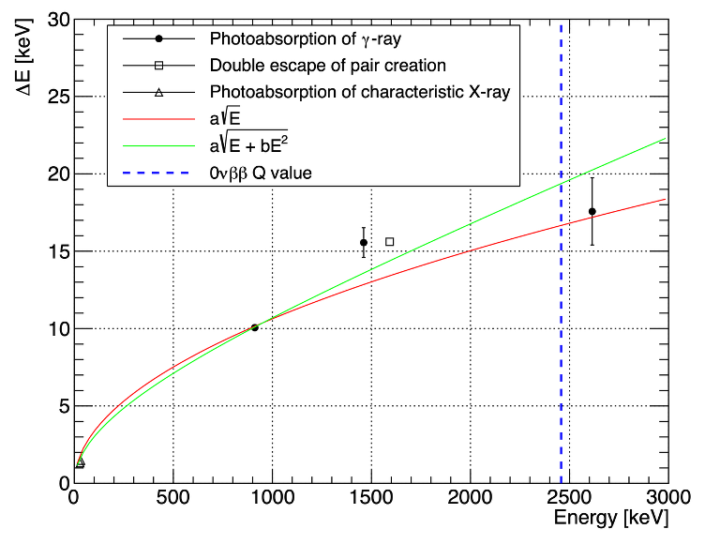
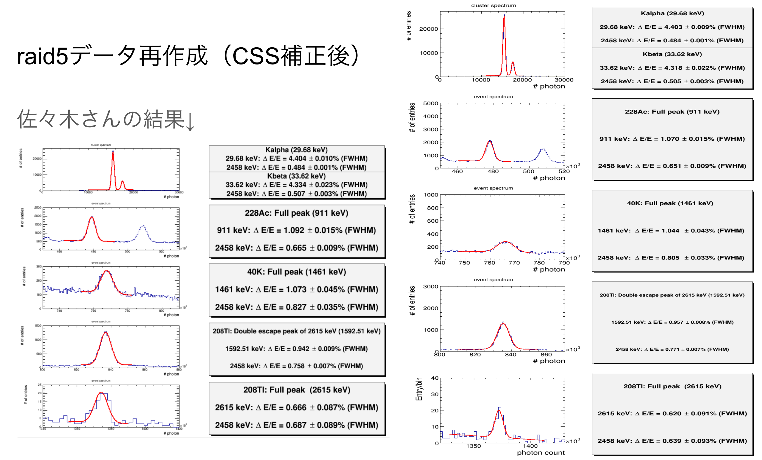
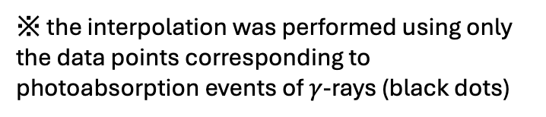
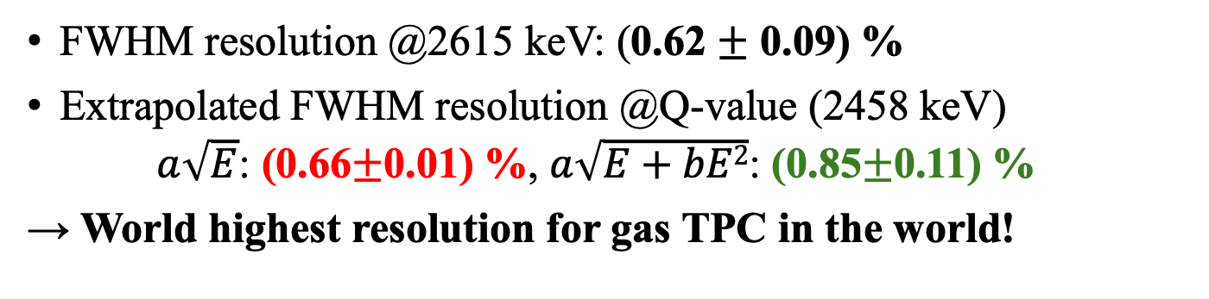
Energy resolution
FWHM resolution @2615 keV: (0.62 $±$ 0.09) %
Extrapolated FWHM resolution @Q-value (2458 keV)
$a\sqrt{E}$: (0.66$±$0.01) %, $a\sqrt{E+bE2}$: (0.85$±$0.11) %
→ World highest resolution for gas TPC in the world!
2615 keV peak
(0.62±0.09) % FWHM
※ the interpolation was performed using only the data points corresponding to photoabsorption events of $γ$-rays (black dots)
Extrapolation of resolution
Notes:
The energy resolution is 0.62 % for 2.6 MeV.
It is the world highest resolution for gas TPC in the world!
The extrapolated resolution is 0.66 % or 0.85 % for the Q-value of Xe 136.

Slide 14
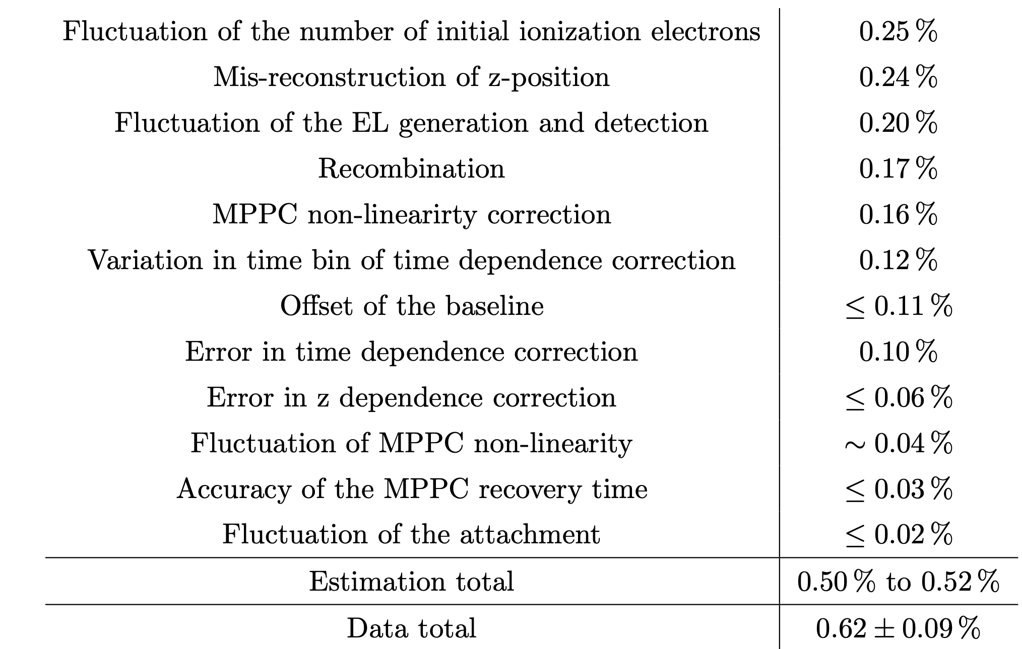
Breakdown of energy resolution
Prospect for
further improvement
@ 2615 keV
Enhancing scintillation detection efficiency (p23)
More statistics of EL photons detected by MPPC (p20)
Higher drift field (100 V/cm/bar) by more discharge resistive structure (p19)
Precise correction with deconvoluted waveform (p24)
Notes:
This is the breakdown of the energy resolution at 2.6 MeV.
About main contributions, we have prospects for further improvement.
I’ll talk about them on next chapter.

Slide 15
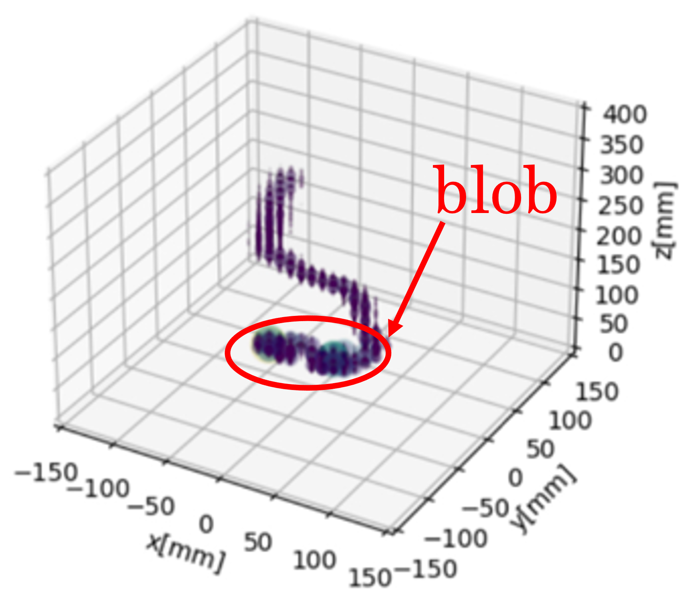
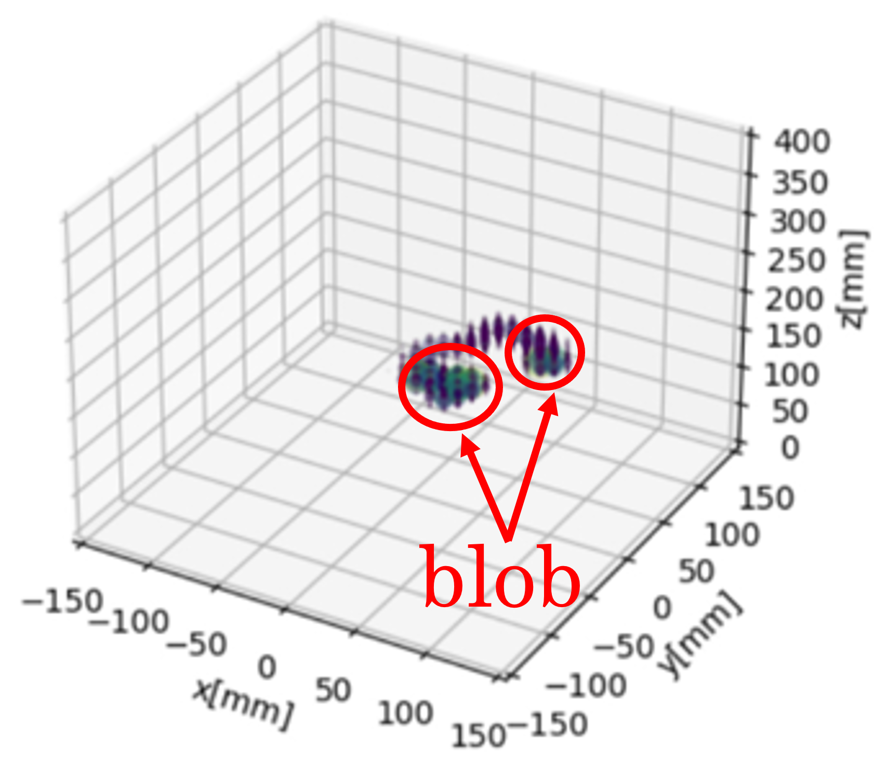
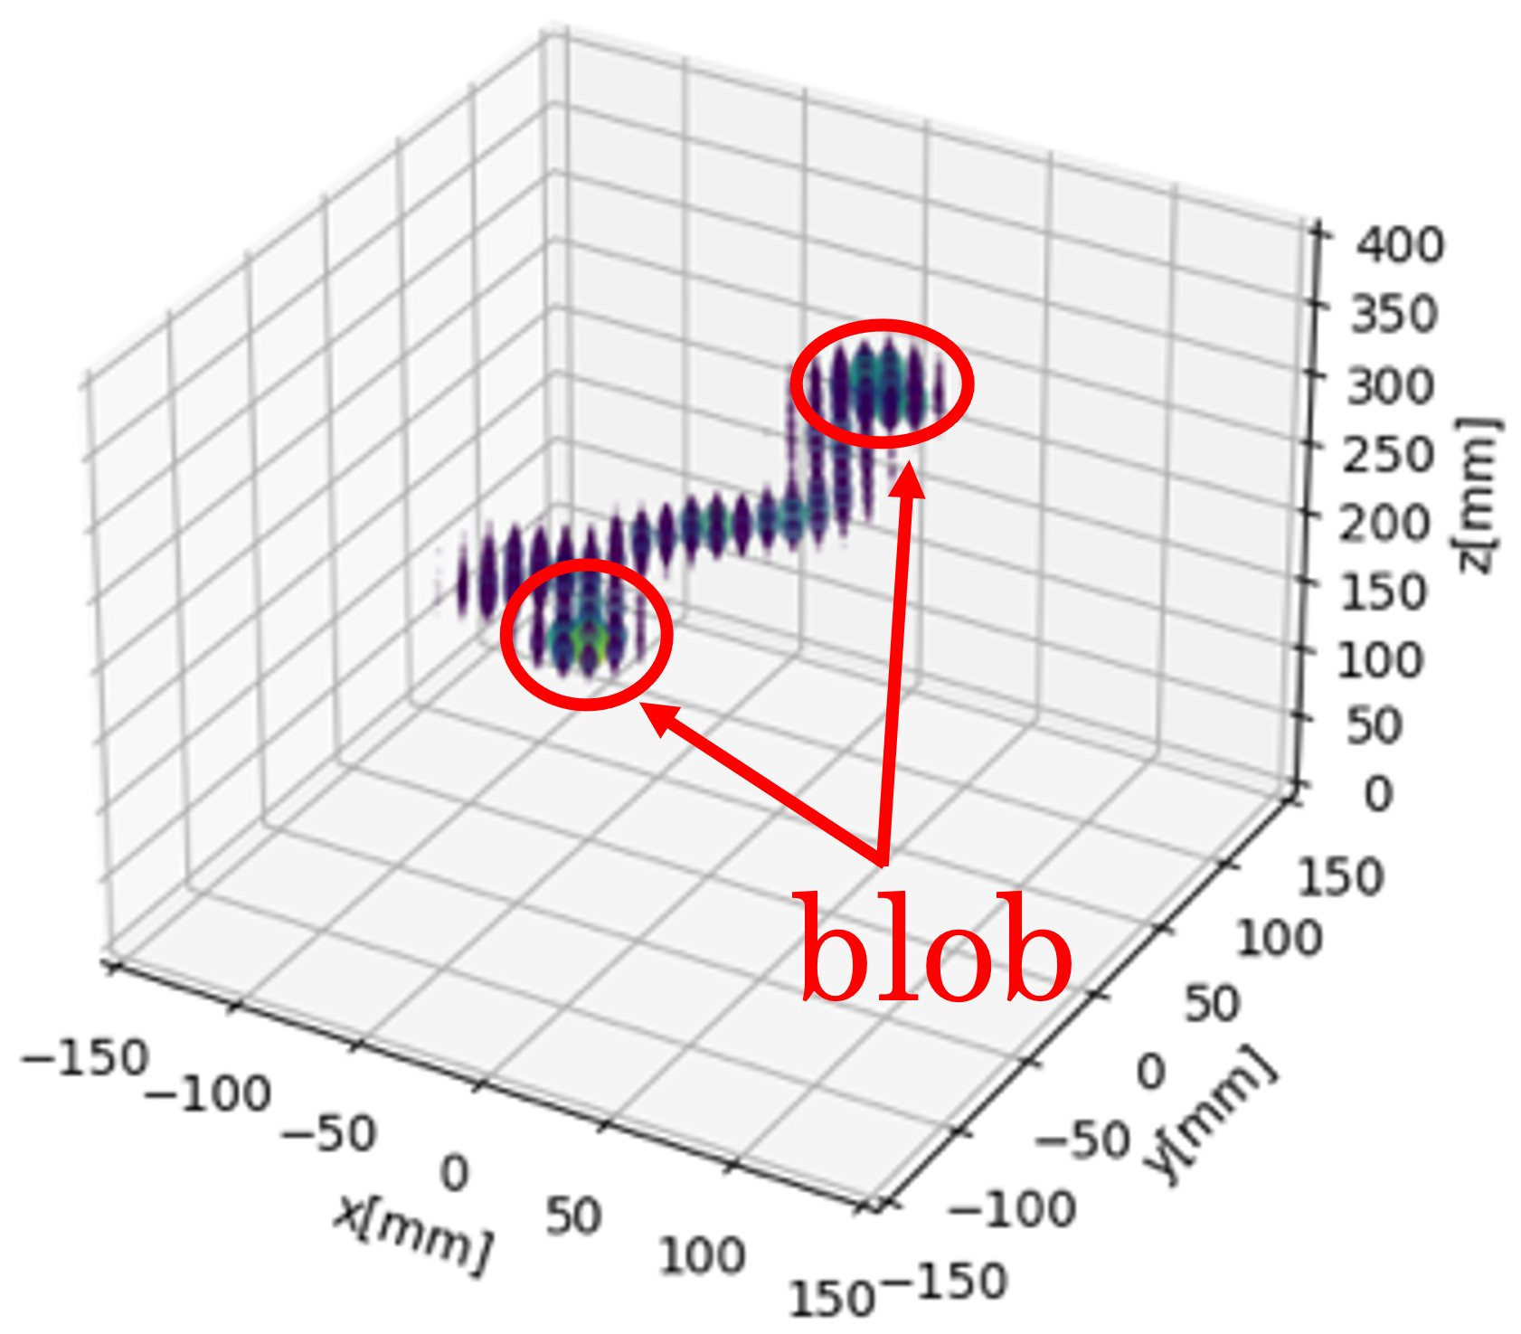
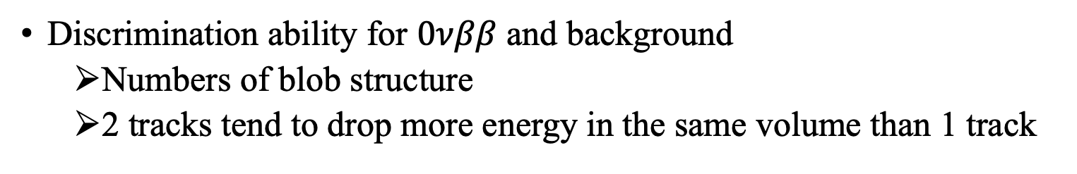


Track pattern recognition
Background feature: 1 track
Signal feature: 2 tracks
$γ$-ray photoabsorption 2615 keV
Pair creation 1593 keV
$0νββ$ 2458 keV (simulated)
Discrimination ability for $0νββ$ and background
  Numbers of blob structure
  2 tracks tend to drop more energy in the same volume than 1 track
Notes:
By the way, I‘ll talk about track pattern recognition.
There are pictures of reconstructed tracks measured by 180L prototype.
The left one is 𝛾-ray photoabsorption event, which composes of 1 track.
On the contrary, the pair creation event has 2 tracks, which is the same characteristic with 0nbb.
You can find the differences of the blob structure number.
We can discriminate 0nbb and backgrounds using this feature.

Slide 16
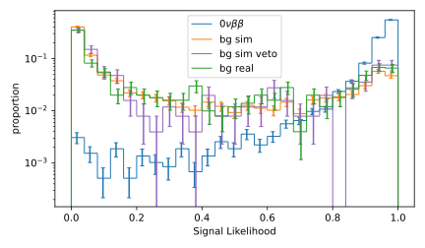
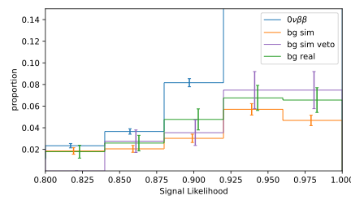
BG rejection with machine learning
CNN-based ML was constructed using tracks calculated by GEANT4
  Input: Photon counts in each voxel (10×10×2.5 mm³)
  95 % BG rejection with 60 % signal efficiency
Real BG data tends to be more signal-like than simulated data
  Due to dead channels on measurement
→ Simulated data with the same dead channels shows similar tendency
Signal likelihood distribution
Notes:
For the background rejection, CNN-based Machine Learning was constructed using GEANT4 simulated tracks.
The input information is Photon counts in each voxel.
The efficiency is that 95 % BG rejection with 60 % signal efficiency.
This is the signal likelihood distribution and on the right is the close-up near high likelihood.
The green hist is for data of real tracks, and it tends to be more signal-like than simulated validation data shown by orange hist.
It is due to dead channels on measurement and simulated data with the same dead channels, shown by purple hist, shows similar tendency.

Slide 17
Outline
AXEL experiment
Performance evaluation of 180L-size prototype
R&D for 1000L-size detector
Summary
Notes:
Then, I’ll talk about the R&D for 1000L-size detector.

Slide 18
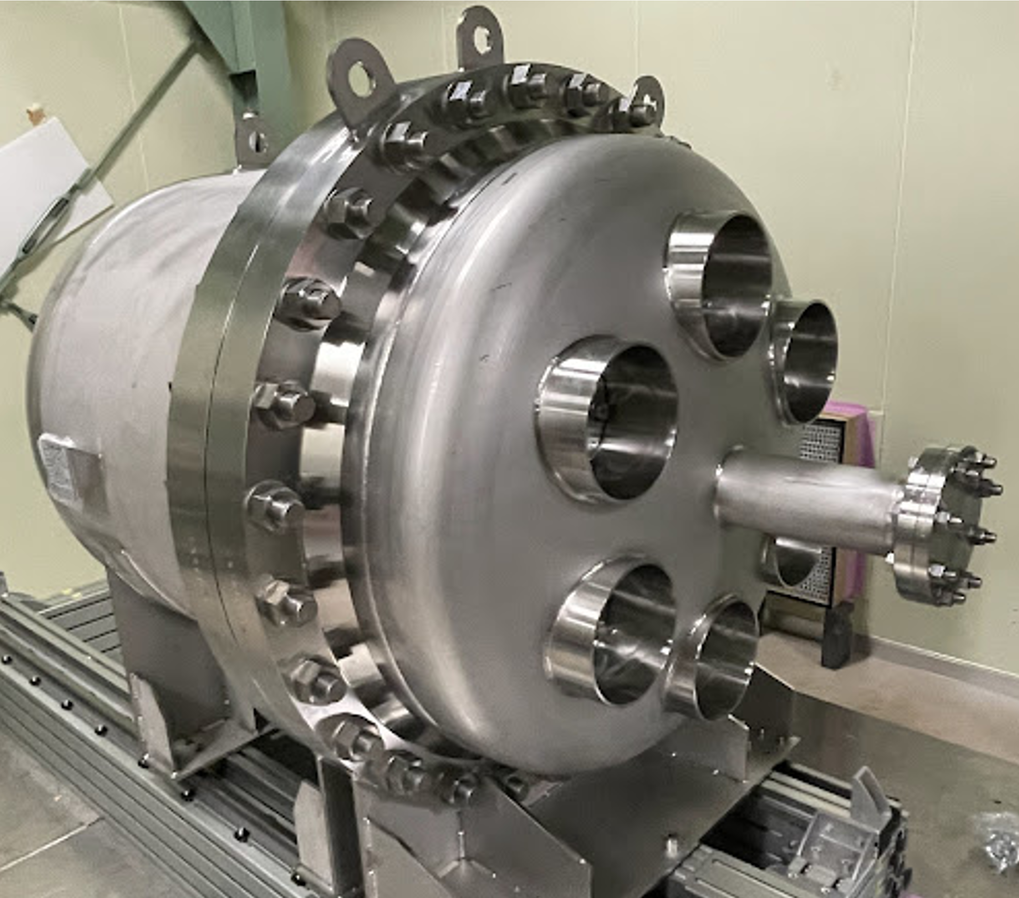
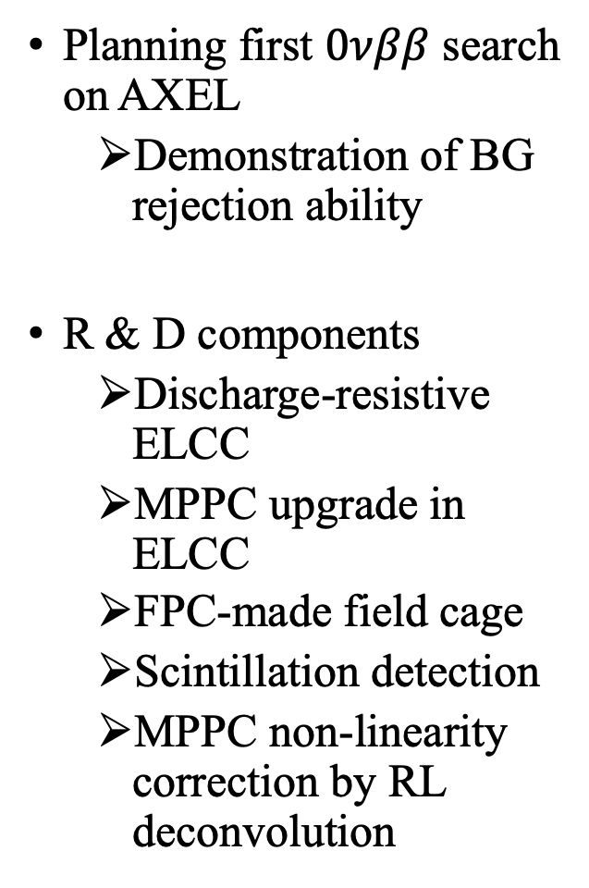
1000L-size detector project
Planning first $0νββ$ search
on AXEL
  Demonstration of BG rejection ability
R & D components
  Discharge-resistive ELCC
  MPPC upgrade in ELCC
  FPC-made field cage
  Scintillation detection
  MPPC non-linearity correction by RL deconvolution
100 cm
150 cm
@Kamioka underground
Notes:
As our next step, 1000L-size detector aims to do the first 0nbb search for demonstration of AXEL detector’s BG rejection ability.
I’ll talk about some R&D components.

Slide 19
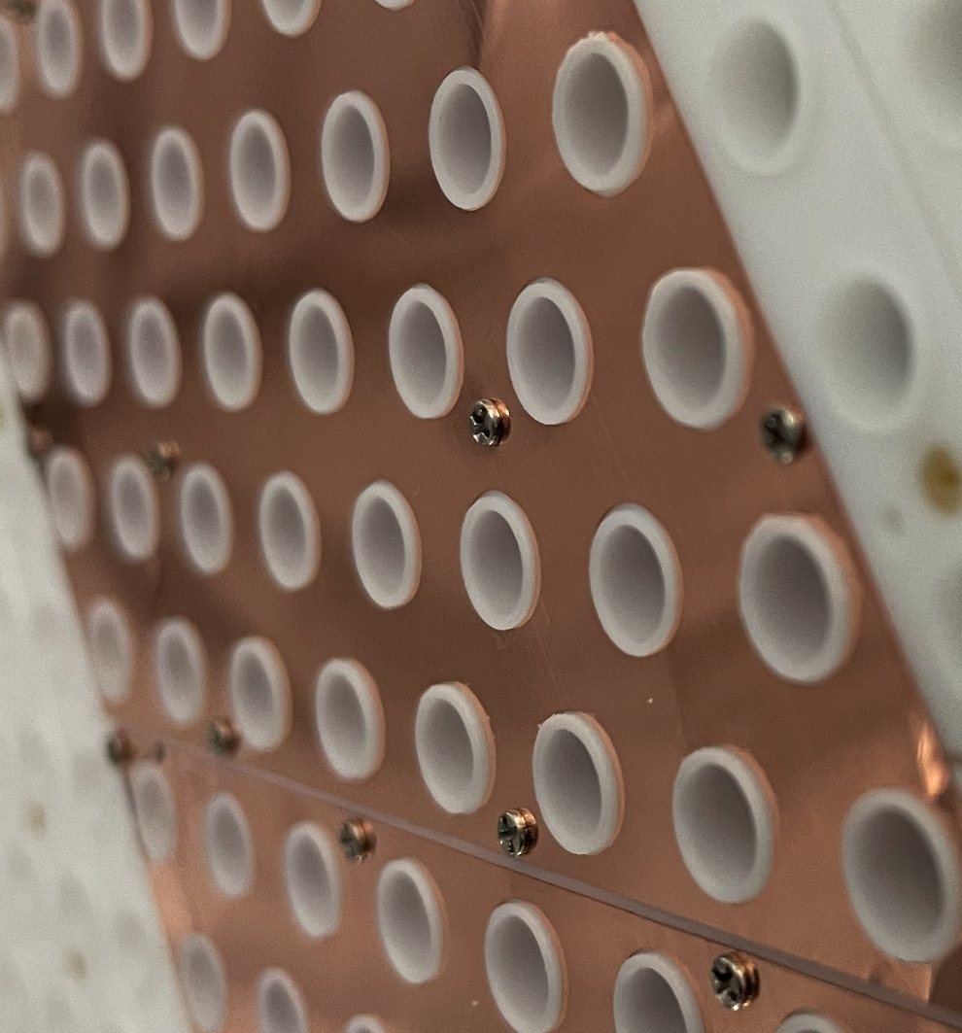
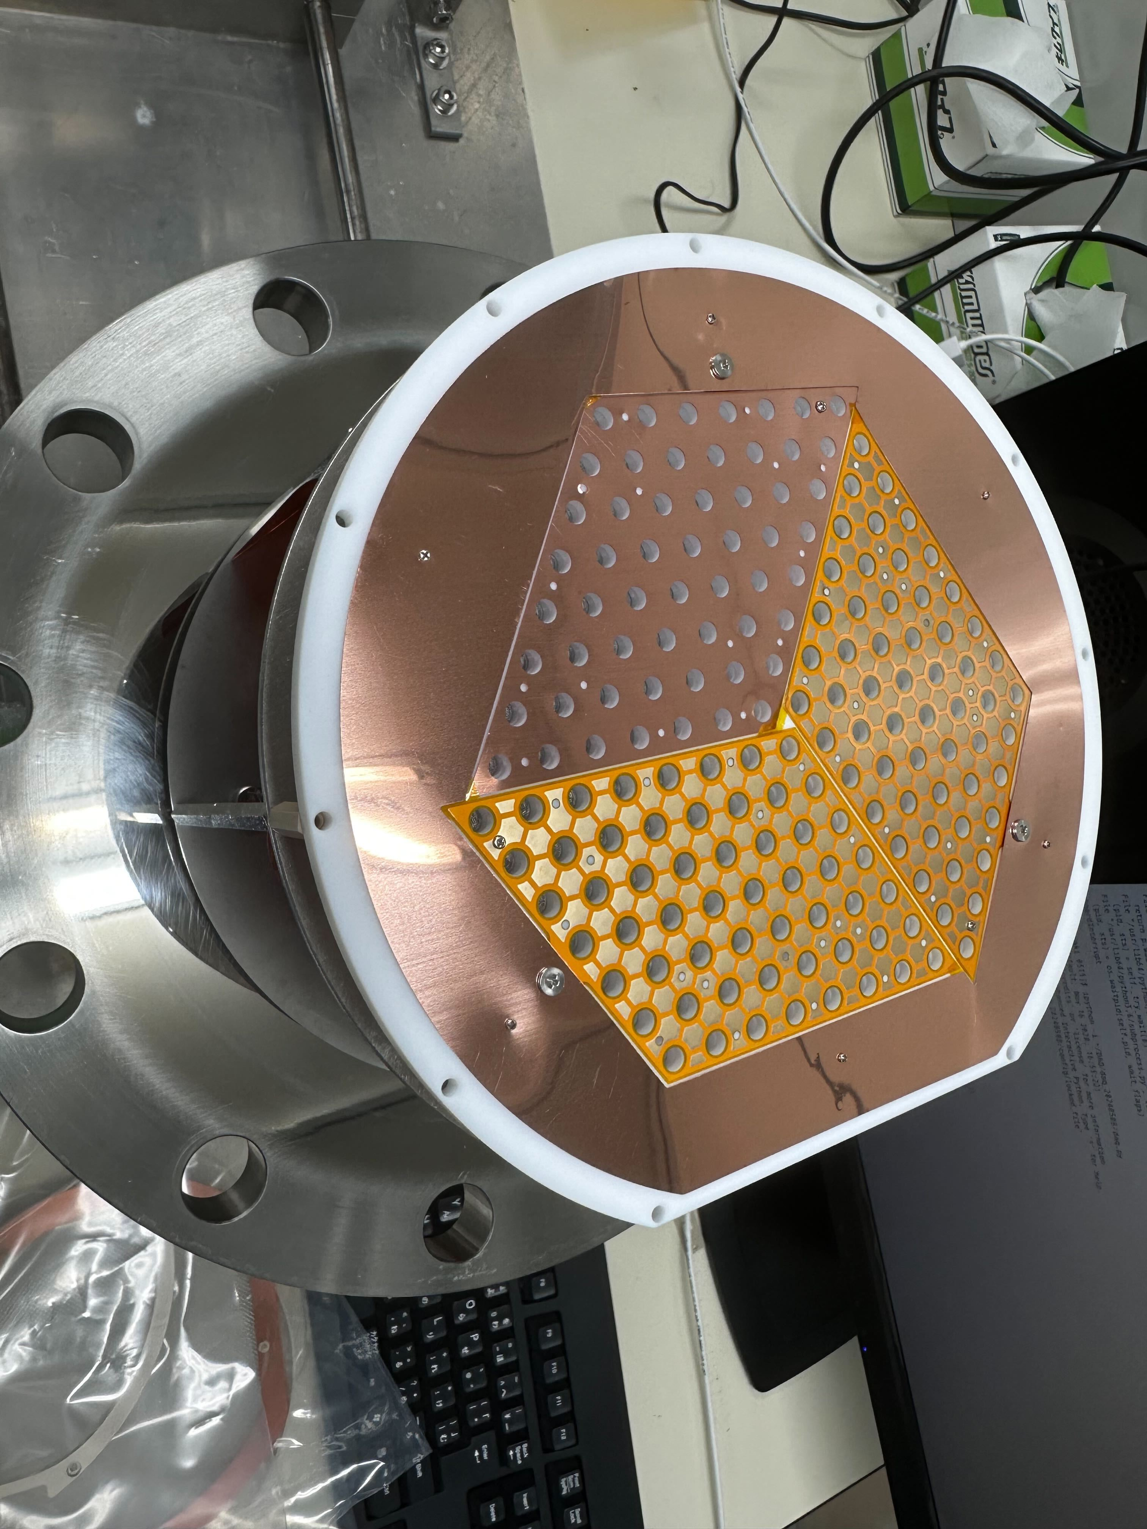
Discharge-resistive ELCC
Creeping discharge along the cell prevent achieving the target
electric field (EL field: 3 kV/cm/bar, Drift field: 100 V/cm/bar)
→ More resistive structure is being developed.
0.5 mm
1.Step around the cell
MPPC
Discharge path
Copper
anode
  Achieved target voltage in 6 bar Xe
  Enough EL yield was confirmed
PTFE
GND
mesh
Polyimide cover
MPPC
2.Flexible printed
circuit (FPC) anode
MPPC
  Achieved target voltage in 7 bar Xe
  EL yield is now under evaluation
Notes:
First topic is discharge resistive ELCC.
On ELCC, creeping discharge can happen along the cell wall like this, and it prevent achieving the target electric field.
To suppress the discharge, more resistive structure is being developed now.
First one is to make step around the cell.
You can see the steps in this picture,
It was confirmed that target voltage was achieved in 6 bar xenon and there was enough EL yield.
Second one is FPC-made anode.
You can see the structure on the pictures.
It extends the discharge path by polyimide cover.
We achieved the target voltage in 7 bar xenon, and the EL yield is now under evaluation.

Slide 20
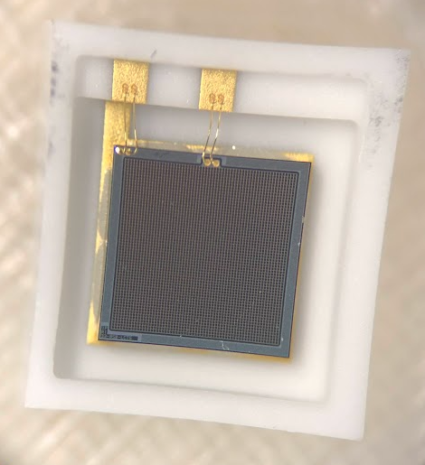
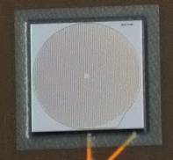
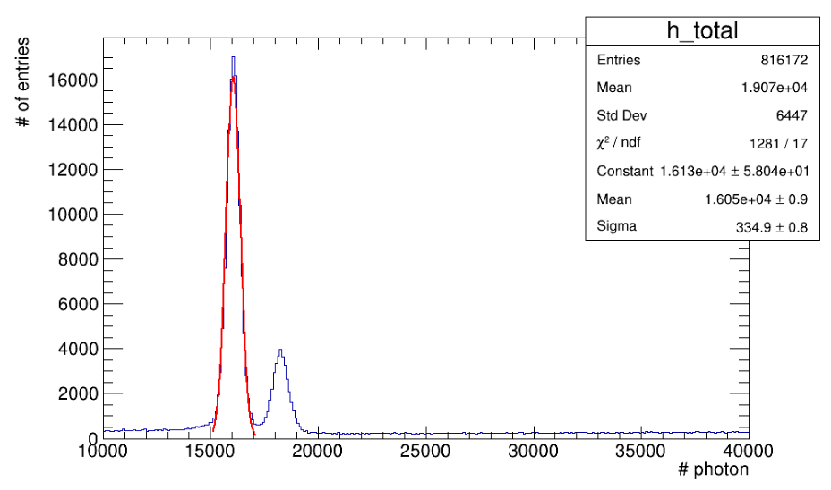
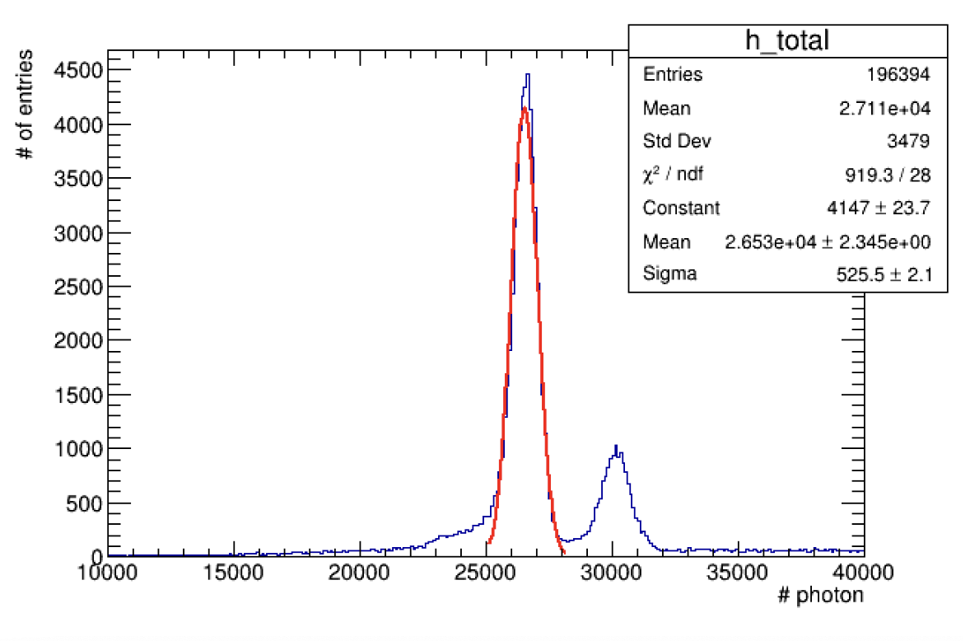

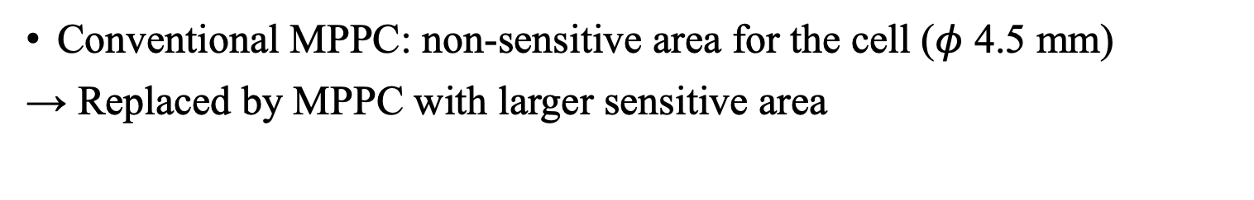
MPPC upgrade in ELCC
Conventional MPPC: non-sensitive area for the cell ($φ$ 4.5 mm)
→ Replaced by MPPC with larger sensitive area
3x3 mm²
φ4.7 mm
$φ$ 4.5 mm
4.90 %
(FWHM)
4.65 %
(FWHM)
EL field:
2.75 kV/cm/bar
EL field:
2.40 kV/cm/bar
EL photon counts increased greatly, even with lower EL field!
Notes:
Next, I’ll talk about MPPC upgrade in ELCC.
The conventional MPPC used in prototype has non-sensitive area for the cell diameter, shown in left pictures.
So we replaced it with larger one which covers all the region.
The measured peaks of 30 keV characteristic X-ray is compared in these pictures.
Detected EL photons has increased greatly, and energy resolution also has improved.

Slide 21
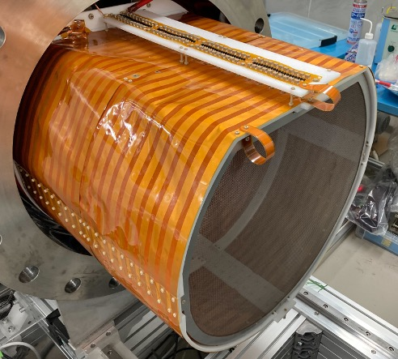



FPC-made field cage
Replacing copper and aluminum rings to FPC
  Low material budget, less dead space, production cost reduction
3mm
Polyimide：25$μm$
outer layer：17.5$μm$
outer ring
inner ring
5mm
inner layer ：17.5$μm$
HV endurance: 98.1 % of target drift field was achieved.
Notes:
Next, I’ll talk about field cage update.
Conventional field cage is made of copper and aluminum rings.
However, to reduce the material budget, and to reduce the dead space between inner and outer rings, and to cut the production cost, FPC-made field cage was developed and installed.
The achieved high-voltage endurance was 98.1 % of the target value.

Slide 22
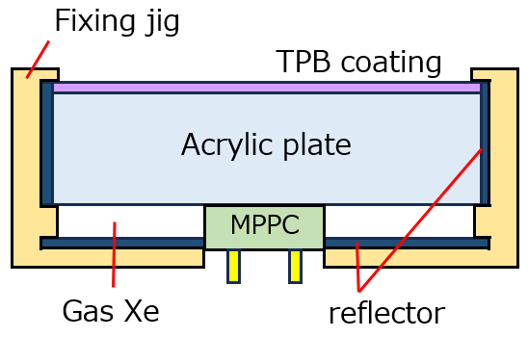
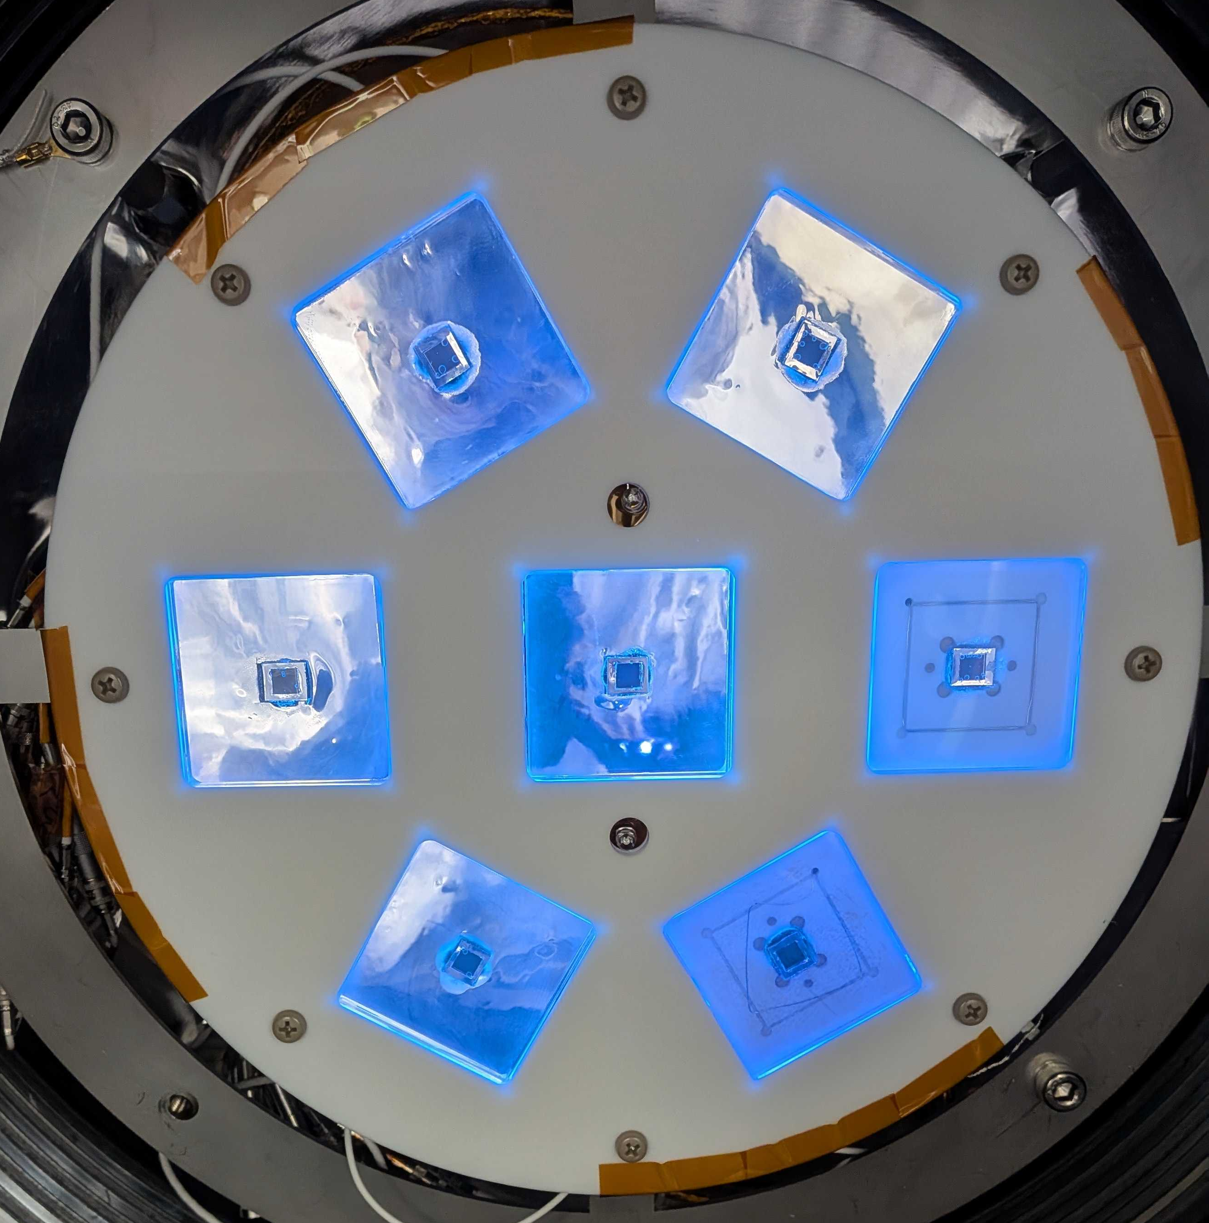
Scintillation detection
Low scintillation detection efficiency on PMTs leads to frequent
the Z (location along the drift direction) mis-reconstruction
New scintillation detector
  Large detection area
  Trapping photon by reflectors
  Estimated photon detection: 7.6 times more than that of PMTs
Structure
PMTs
New scintillation detectors
Notes:
Next topic is about scintillation detection.
Since the scintillation detection efficiency on PMTs is low, it leads to frequent
mis-reconstruction of Z position and finally worsens energy resolution.
To increase the detection efficiency, a unique scintillation detector is being developed.
You can see the array replaced by them.
It has larger detection area compared to the conventional PMT.
The structure is shown in the left picture.
It traps photons by reflectors and finally detects by MPPC.
The estimated photon detection is 7.6 times more than that of PMT.

Slide 23
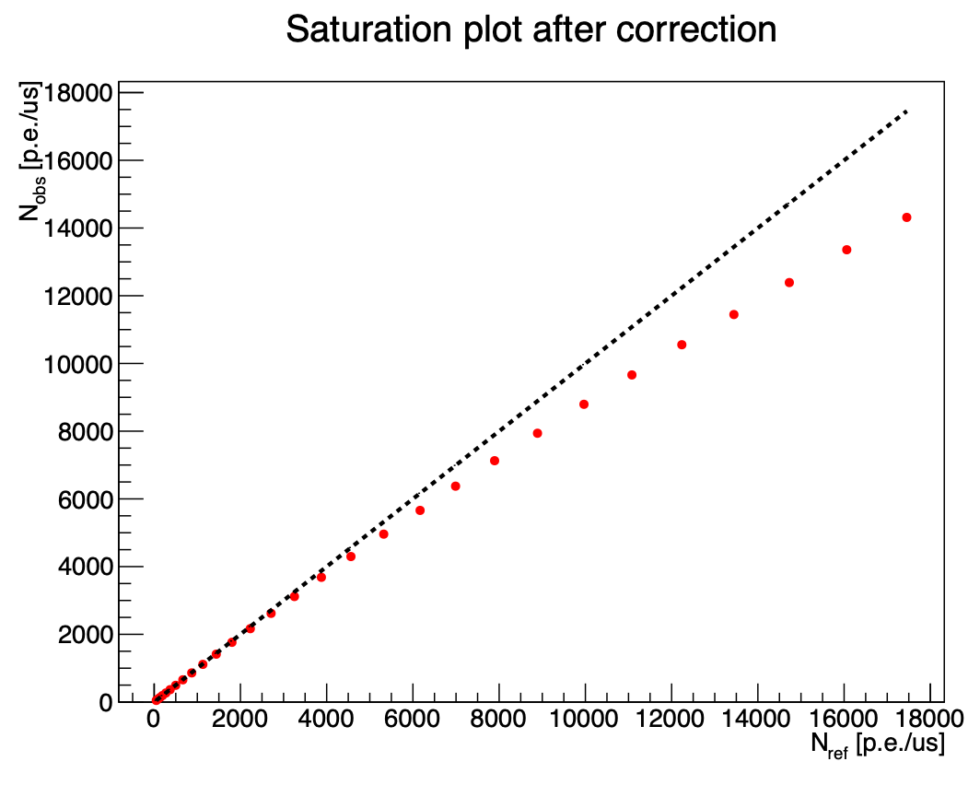
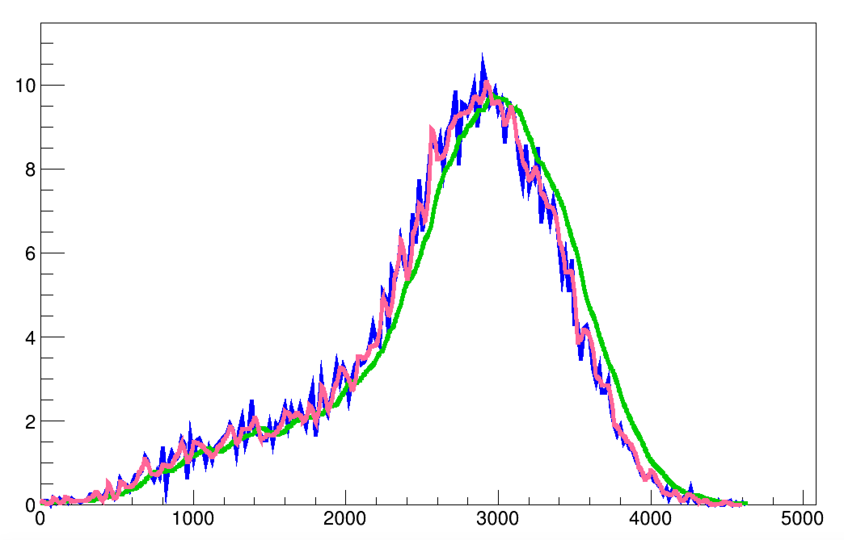
MPPC non-linearity correction by RL deconvolution
MPPC shows non-linear response → Corrected on each sampling clock
Sampling is 5 MHz, after low-pass filter (~ 200 MHz in original wave)
  LPF worsens non-linearity correction accuracy
RL deconvolution was applied to waveform for more precise correction
→ Energy resolution contribution reduced from 0.16 % to 0.042 %!
MPPC non-linearity
Waveform before and after RL deconvolution
blue: original
green: observed
pink: deconvoluted
N_{obs} [photon/μs]
N_{true} [photon/μs]
Notes:
As a last topic, I’ll talk about MPPC non-linearity correction.
MPPC shows non-linear response like shown in the left picture.
So we are correcting it on each sampling clock.
However, while the sampling clock is 5 MHz, the original wave has up to 200 MHz components, and this is cut off by low-pass filter.
And it was found that the low-frequency wave worsens the non-linearity correction accuracy.
So we have developed a Richardson-Lucy deconvolution method to subtract the effect of low-pass filter.
If we use this deconvoluted waveform for correction, the energy resolution contribution reduced from 0.16 % to 0.042 %!

Slide 24
Outline
AXEL experiment
Performance evaluation of 180L-size prototype
R&D for 1000L-size detector
Summary

Slide 25

Summary
AXEL experiment is developing high-pressure Xe gas TPC to do $0νββ$ search under ideal conditions.
Performance was evaluated with 180L-size prototype.
  Energy resolution: 0.62 % @2615 keV (FWHM)
  BG rejection with ML: 95 % rejection with 60 % signal efficiency
First $0νββ$ search is planned with 1000L-size detector and
many R & D are ongoing for it.
ELCC installation for NEXT‑100 is under active discussion between AXEL and NEXT.

Slide 26
Backup

Slide 27



MPPC ~Multi-Pixel Photon Counter
Produced by Hamamatsu Photonics
Arrange a lot of pixels in parallel
Operated by applying higher voltage than breakdown voltage
→ Output charge is proportional to over voltage
Constant charge output in 1 pixel detection
→ Count # of detected photon as # of output pixel
output waveform
giger-mode APD pixel
quenching resistance

Slide 28
Cause of MPPC nonlinearity
When some pixels detect photons successively before they finish recovering (typical recovering time: ~100 ns),
the effective gain is decreased
When readout voltage is not negligible compared to over voltage applied to MPPC, the effective gain is decreased.
(shown in figure below)
photon
ΔV – ΔV’– δV
ΔV’
δV
ΔV
Equivalent circuit of MPPC
Input impedance
ΔV – δV

Slide 29

Principle of CW generator
1 step composed of 2 capacitors and 2 diodes
Voltage oscillation of capacitors in oscillating column supply charges to capacitors in smoothing column
→ Ideal output voltage: $2NV$
Voltage drop occurs by discharge of capacitors in smoothing column due to ripple effect:
$ΔV=\frac{I}{fC}\left(\frac{2}{3}N^{3}+\frac{1}{2}N^{3}+\frac{1}{3}N\right)$
$N$: number of steps
$I$: current in resister chain
$f$: frequency of input AC
$C$: capacitance
1 step
oscillating column
amplitude: $V$
smoothing column
Drawing of Cockcroft-Walton circuit

Slide 30

Field cage RI contamination

