Slide 1
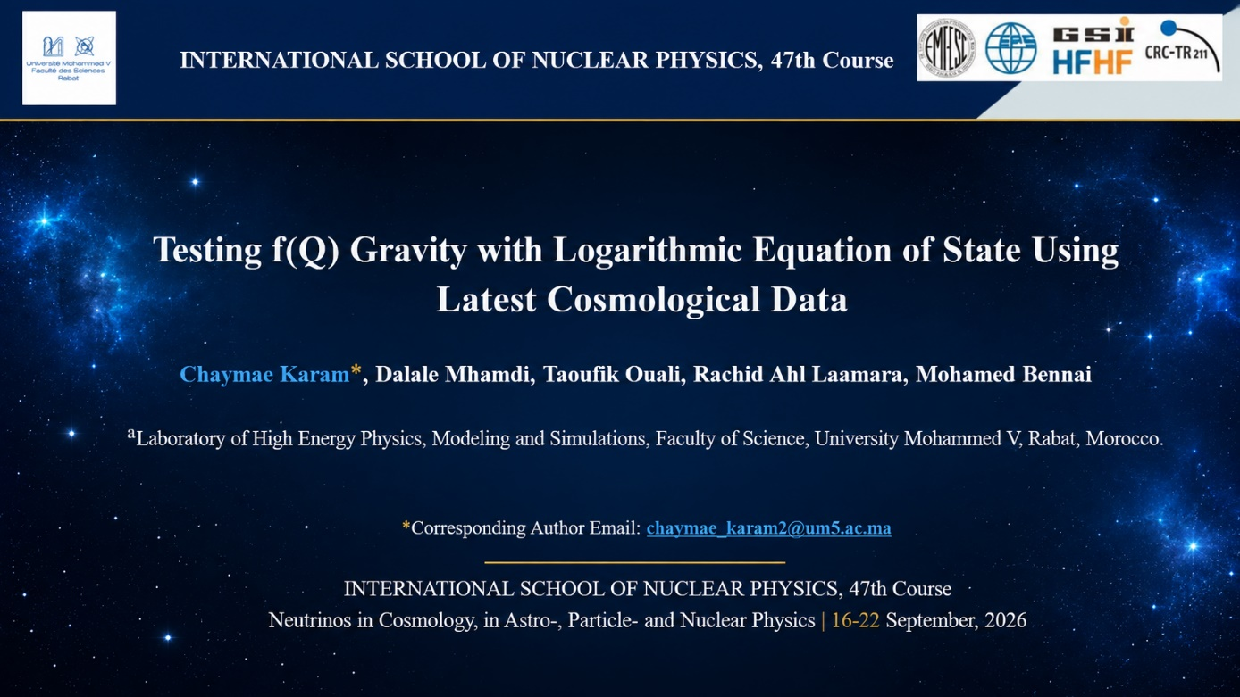

Slide 2
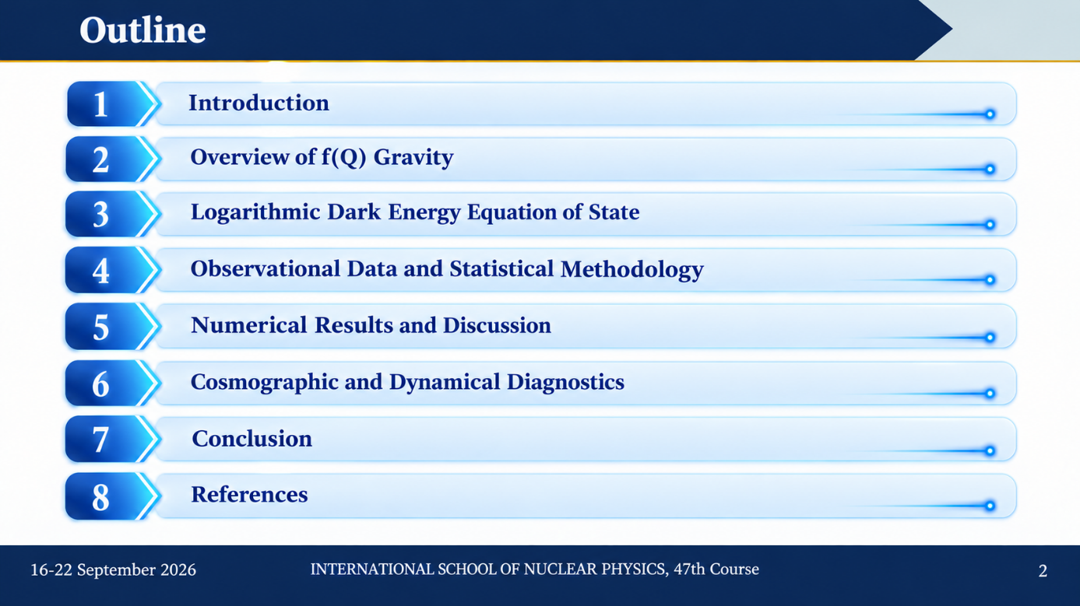

Slide 3
Introduction
The late-time accelerated expansion of the Universe is a major challenge in modern cosmology.
The standard ΛCDM model has been highly successful in describing a wide range of observations. However, it still faces some fundamental issues, such as:
⊲ Fine-tuning problem
⊲ Coincidence problem
To overcome these limitations, several alternatives have been proposed. Among them, modified gravity provides an alternative framework beyond General Relativity.
f (Q) gravity, based on the non-metricity scalar Q, is a promising approach.
In this work, we consider:
⊲ A power-law f (Q) model
⊲ A logarithmic dark energy EoS
This parametrization allows a smooth and flexible evolution of dark energy.
The model is tested using recent observational data:
⊲ Pantheon⁺
⊲ DESI DR2
⊲ Cosmic Chronometers

Slide 4
Modified Gravity
Why Modified Gravity?
General Relativity describes gravity through spacetime geometry, while modified gravity generalizes the gravitational sector to study the accelerated expansion of the Universe.
L_{GR} ∼ R
f (R) Gravity
f (T) Gravity
f (Q) Gravity
R → f (R)
T → f (T)
Q → f (Q)
Curvature-based formulation
Torsion-based formulation
Non-metricity-based formulation

Slide 5
FLRW Cosmology in f (Q) Gravity
Action
Modified Friedmann equations
1
⁻ 2𝜅 ²
4
1
2
S =
∫
dx √-g f (Q) + S
6f H − f = 8 𝜋G 𝜌
f (Q)
matter
Q
2
Generalization of GR: replace curvature R by non-metricity Q
(12f_{QQ}H² + f_{Q} ) H˙ = −4 𝜋G (𝜌 + p)
Modified Friedmann equations governing the expansion dynamics
GR Limit
f (Q) = Q → General Relativity
Consistency check: recovers standard cosmology
Non-metricity Scalar
Q = 6H ²
Key relation: directly links geometry to cosmic expansion

Slide 6
Our Approach
Modified Gravity Scenario
We explore an alternative to ΛCDM based on f (Q) gravity
Power-law Model
2
n
f (Q) = Q + 6𝛾H (Q
/Q )
0
0
Dark Energy Description
𝜔_{de} (z) = 𝜔₀ + 𝜔₁ ln(1 + z)
Smooth dynamical evolution

Slide 7
Logarithmic Equation of State
Hubble Function
Modified continuity equation
Logarithmic EoS
Dark Energy
dH ² ₌ 3 1 + 𝜔 ₀ + 𝜔 ₁ ln(1 + z) _{dz}
_{H} 2
n 1 + z
Solution
𝜔 _{de} (z) = 𝜔 ₀ + 𝜔 ₁ ln(1 + z)
2
2
3(1+𝜔 )
0 3𝜔
1
2
H (z) = H (1 + z
) exp ln (1 + z
)
𝜔 Present-day EoS
0
n
2n
0
𝜔₁ Redshift evolution
Key result
𝜔 _{d e} (z) → H (z)
𝜔 ₁ = 0 → constant EoS

Slide 8
Observational Data and Statistical Methodology
Observational datasets
Pantheon⁺
DESI DR2 BAO Cosmic Chronometers
1701 SNe Ia
12 BAO measurements 32 H (z) measurements
MCMC Analysis
Combined 𝜒²
For independent datasets
MCMC explores the cosmological parameter space.
Converged chains give the posterior distributions of the parameters.
We obtain the best-fit values and confidence intervals for all parameters.
2 2
𝜒² = 𝜒² + 𝜒 + 𝜒
tot Pantheon⁺ DESI CC

Slide 9
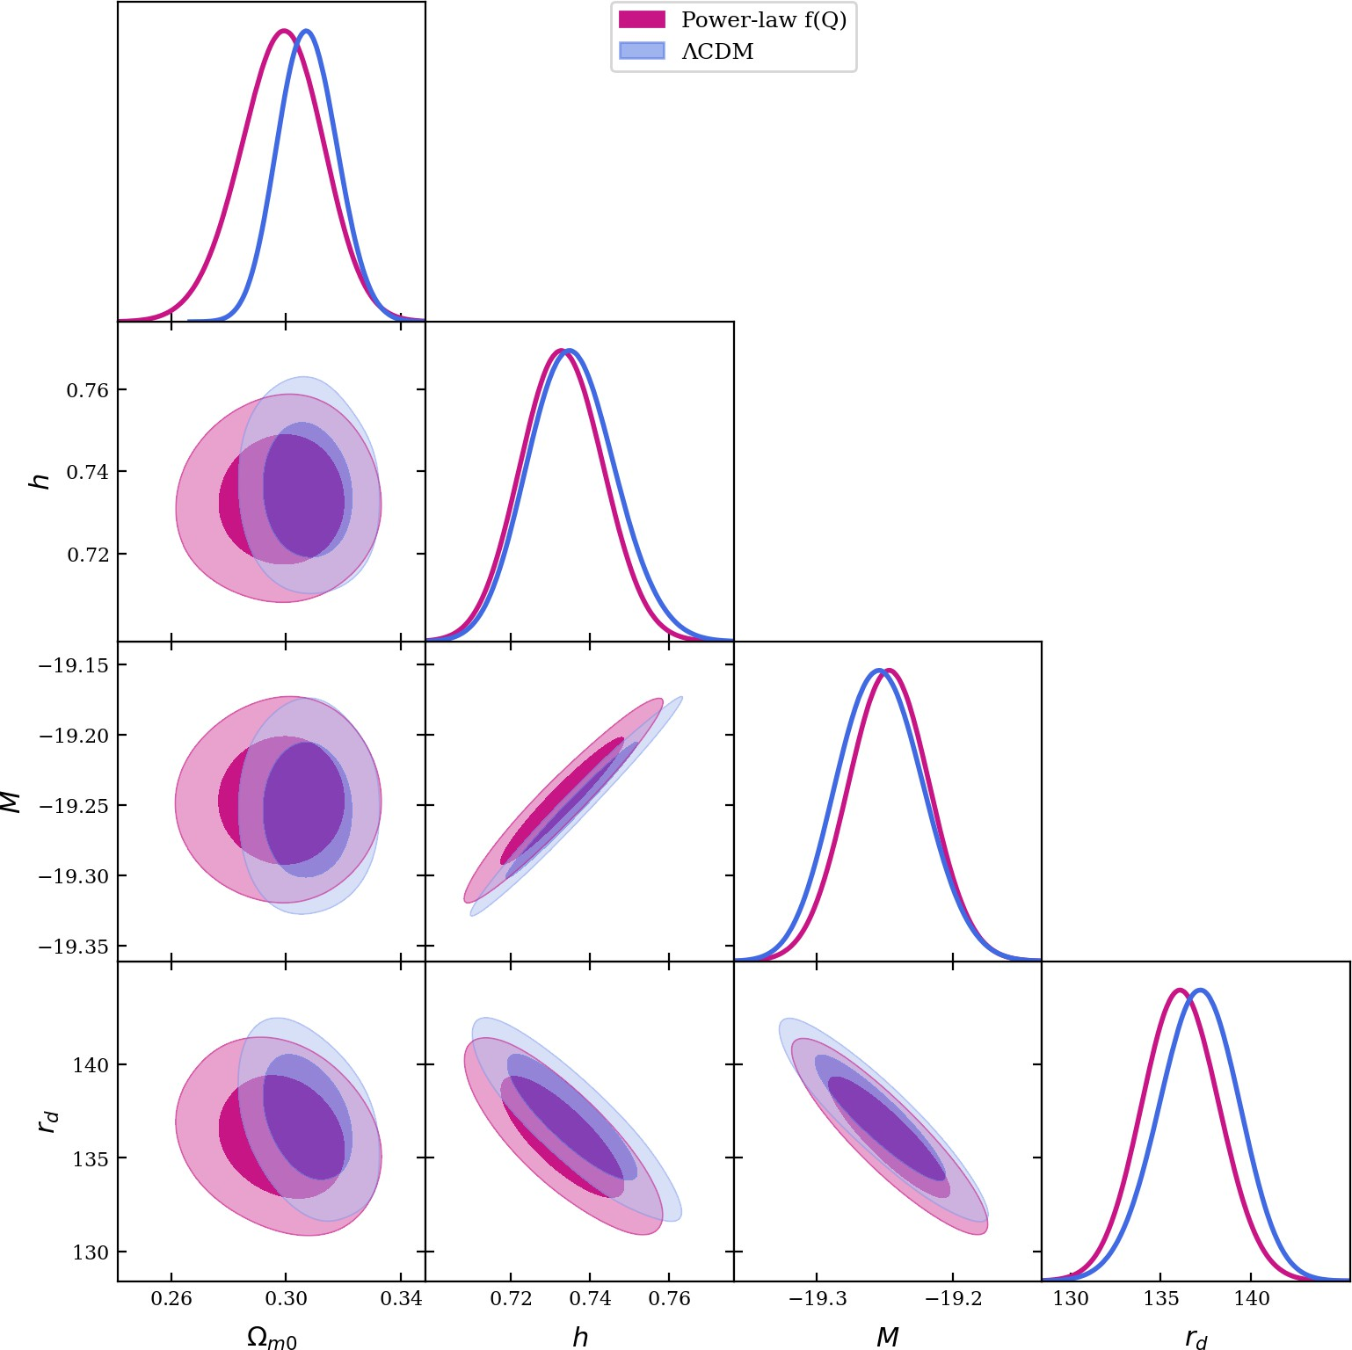
Numerical Results and Discussion
Key Observations
The figure shows the confidence contours and posterior distributions for the power-law f (Q) and ΛCDM models using the Pantheon⁺ + DESI DR2 + CC datasets. The contours of the power-law f (Q) model (pink) and ΛCDM (blue) significantly overlap, indicating strong statistical consistency. The parameters h, M, and rd exhibit very similar constraints in both models, highlighting the robustness of the cosmological measurements. A slight shift in Ωm0 is observed in the f (Q) model, suggesting a small deviation from ΛCDM. The f (Q) model successfully reproduces ΛCDM constraints while allowing additional flexibility.

Slide 10
Model Comparison: AIC & BIC
How to decide if a model is better than ΛCDM?
→ Use information criteria: AIC and BIC
AIC (corrected)
Akaike Information Criterion
BIC
Bayesian Information Criterion
AIC = 𝜒²
_{+ 2k +} 2k (k + 1)
BIC = 𝜒² + k ln N
c
min
N − k − 1
min
Notation:
k: number of parameters
N: number of data points
Key points:
Stronger penalty than AIC
Penalty increases with ln N

Slide 11
Model Comparison: AIC & BIC
Table 2: The corresponding 𝜒² , AICc and BIC for the examined cosmological models
min
Model
_{𝝌}2 _{𝝌}2
AIC 𝚫AIC BIC 𝚫BIC
min red
 |  | Pantheon⁺ + DESI | DR2
ΛCDM | 1536.31 | 0.899 1544.31 | 0 | 1566.11 | 0
Power law | 1531.22 | 0.897 1545.22 | 0.91 | 1583.37 | 17.26
Pantheon⁺ + DESI DR2 + CC
ΛCDM | 1546.71 0.888 1554.71 |  | 0 | 1576.55 | 0
Power law | 1541.77 0.887 1555.77 |  | 1.06 | 1593.99 | 17.44
Interpretation
(Δ = value(model) − value(reference))
|ΔAIC| or |ΔBIC| | Interpretation
< 2 | Models statistically equivalent
2 − 6 > 6 | Moderate preference Strong preference
→ Lower AIC / BIC = better model

Slide 12
Cosmographic and Dynamical Diagnostics
2.0
2.0
Pantheon⁺
Pantheon⁺+DESI DR2 Pantheon⁺+DESI DR2+CC
Pantheon⁺
Pantheon⁺+DESI DR2
1.5
1.0
1.5
+
Pantheon +DESI DR2+CC
q(z)
0.5
j(z)
1.0
0.0
-0.5
0.5
-1.0
-0.5
0.0 0.5
1.0
z
1.5
2.0
2.5
1.0
z
-0.5
0.0
0.5
1.5
2.0
2.5
Key Observations q(z)
The deceleration parameter, q(z), is a key quantity used to describe the expansion dynamics of the Universe. It shows a clear transition from a decelerating phase, q(z) > 0, to an accelerating phase, q(z) < 0. The present value, q0 < 0, confirms the current accelerated expansion of the Universe.
Key Observations j(z)
The jerk parameter j (z) probes deviations from ΛCDM through the third derivative of the expansion history. For ΛCDM, j = 1, which serves as a key reference for comparison. Our results show j (z) ≈ 1 at low redshift, with mild deviations at higher redshift, suggesting possible dynamical dark energy effects.

Slide 13
Cosmographic and Dynamical Diagnostics
10
8
Pantheon⁺
Pantheon⁺+DESI DR2 Pantheon⁺+DESI DR2+CC
-0.8
6
4
^{ω}de^{(z)}
-0.9
s(z)
2
-1.0
Pantheon⁺
Pantheon⁺+DESI DR2 Pantheon⁺+DESI DR2+CC
1 2
z
0
-2
-1.1
-4
-1
0
3
-0.5
0.0 0.5
1.0
z
1.5
2.0
2.5
Key Observations s(z)
The snap parameter s(z) probes the higher-order dynamics of the cosmic expansion. Its smooth evolution is consistent with a stable late-time accelerated Universe. Small deviations from ΛCDM may indicate dynamical dark energy effects.
Key Observations 𝜔 _{d e} (z)
The EoS parameter describes the dynamical behavior of dark energy. At low redshift, 𝜔_{de} ≈ −1, consistent with ΛCDM. Deviations at higher redshift suggest a possible evolution of dark energy.

Slide 14
Cosmographic and Dynamical Diagnostics
1.0
1.0
Pantheon⁺
Pantheon⁺+DESI DR2 Pantheon⁺+DESI DR2+CC
0.8
0.8
0.6
0.6
^{Ω}m^{(z)}
^{Ω}de^{(z)}
0.4
Pantheon⁺
Pantheon⁺+DESI DR2 Pantheon⁺+DESI DR2+CC
0.4
0.2
0.2
0.0
-0.5 | 0.0 | 0.5 1.0 | 1.5 | 2.0 | 2.5 | -0.5 0.0 | 0.5 1.0 | 1.5 | 2.0 | 2.5
 |  | z |  |  |  |  | z
0.0
Key Observations Ωm (z)
The matter density parameter Ωm (z) describes the fractional contribution of matter to the total energy content of the Universe. It increases with redshift, indicating a matter-dominated early Universe, while decreasing at low redshift as dark energy becomes dominant. The transition between matter and dark energy domination is smooth and continuous.
Key Observations Ω_{de} (z)
The dark energy density parameter Ω_{de} (z) quantifies the contribution of dark energy to the total energy content of the Universe. It decreases with redshift, dominating at low z and becoming subdominant at high z. Its smooth evolution is consistent with the transition from matter domination to a late-time accelerated phase.

Slide 15
Cosmographic and Dynamical Diagnostics
Key Observations Om(z)
The Om(z) diagnostic provides a useful test to distinguish between ΛCDM and dynamical dark energy models. For ΛCDM, Om(z) is constant, while any redshift dependence indicates a deviation from the standard model. The obtained curves show a slight evolution with redshift, suggesting a possible dynamical dark energy behavior. The curves lie below the ΛCDM reference, suggesting a phantom-like behavior. All datasets show consistent behavior, and adding DESI DR2 and CC reduces the dispersion and improves the constraints.
0.50
Pantheon⁺
Pantheon⁺+DESI DR2 Pantheon⁺+DESI DR2+CC ΛCDM
0.45
0.40
Om(z)
0.35
0.30
0.25
0.20
1.5
z
0.0
0.5
1.0
2.0
2.5
3.0

Slide 16
Conclusions
We studied the late-time accelerated expansion of the Universe within a power-law f (Q) gravity framework coupled with
a logarithmic dark energy equation of state.
Using recent datasets (Pantheon⁺, DESI DR2, and Cosmic Chronometers), we obtained tight and robust constraints on the model parameters.
The model successfully reproduces the observed expansion history, including the transition from deceleration to acceleration.
The logarithmic parametrization introduces a dynamical dark energy behavior, extending beyond the standard ΛCDM scenario.
Cosmographic diagnostics (q, j, s, Om(z)) confirm the consistency of the model with observations while revealing small
but meaningful deviations from ΛCDM.
These deviations suggest a richer late-time cosmology that may become detectable with future high-precision data.
Overall, the power-law f (Q) model with logarithmic EoS provides a viable and competitive alternative to standard cosmology.

Slide 17
References
Perlmutter, S., Aldering, G., Goldhaber, G., Knop, R. A., Nugent, P., Castro, P. G., et al. & Supernova Cosmology Project, Measurements of Ω and Λ from 42 high-redshift supernovae, The Astrophysical Journal, 517(2), 565 (1999).
Riess, A. G., Filippenko, A. V., Challis, P., Clocchiatti, A., Diercks, A., Garnavich, P. M., et al. & Tonry, J., Observational evidence from supernovae for an accelerating universe and a cosmological constant, The Astronomical Journal, 116(3), 1009 (1998).
Peebles, P. J. E., & Ratra, B., The cosmological constant and dark energy, Reviews of Modern Physics, 75(2), 559 (2003).
Padmanabhan, T., Cosmological constant—the weight of the vacuum, Physics Reports, 380(5-6), 235-320 (2003).
Copeland, E. J., Sami, M., & Tsujikawa, S., Dynamics of dark energy, International Journal of Modern Physics D, 15(11), 1753-1935 (2006).
Frieman, J. A., Turner, M. S., & Huterer, D., Dark energy and the accelerating universe, Annual Review of Astronomy and Astrophysics, 46(1), 385-432 (2008).
Caldwell, R. R., A phantom menace? Cosmological consequences of a dark energy component with super-negative equation of state, Physics Letters B, 545(1-2), 23-29 (2002).
Silvestri, A., & Trodden, M., Approaches to modifying gravity for dark energy, Reports on Progress in Physics, 72, 096901 (2009).

Slide 18
