Slide 1



Neutrino Astrophysics : a Window
on New Physics
M. Cristina VOLPE
French National Center for Research (CNRS),
Astroparticle and Cosmology (APC) Laboratory, Paris, France
Masterproject NUFRONT
47th Erice Course, « Neutrinos in Cosmology, in Astro-, Particle- and Nuclear Physics », 16th-22nd September 2026

Slide 2
OUTLINE
General Introduction :
Neutrinos from dense environments
SN1987A and GW170817
Theoretical developments
Flavor mechanisms in dense media
Future observations of core-collapse supernovae and the diffuse supernova
neutrino background
Conclusions
47th Erice Course, « Neutrinos in Cosmology, in Astro-, Particle- and Nuclear Physics », 16th-22nd September 2026

Slide 3
Neutrinos are everywhere,
on the Earth and in the Universe !
    Image : élémentaire n.5 «Les neutrinos»
47th Erice Course, « Neutrinos in Cosmology, in Astro-, Particle- and Nuclear Physics », 16th-22nd September 2026

Slide 4
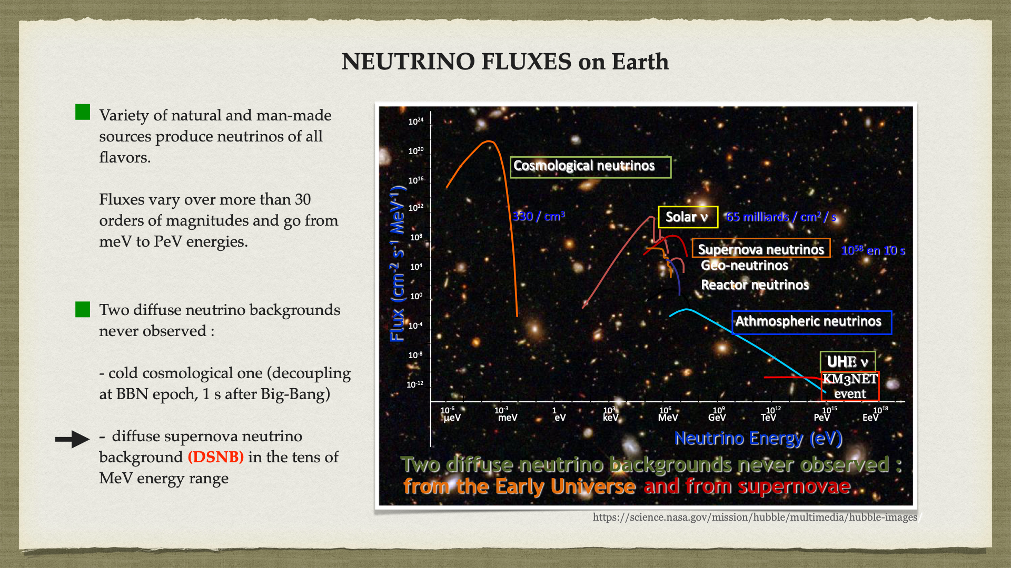
47th Erice Course, « Neutrinos in Cosmology, in Astro-, Particle- and Nuclear Physics », 16th-22nd September 2026

Slide 5

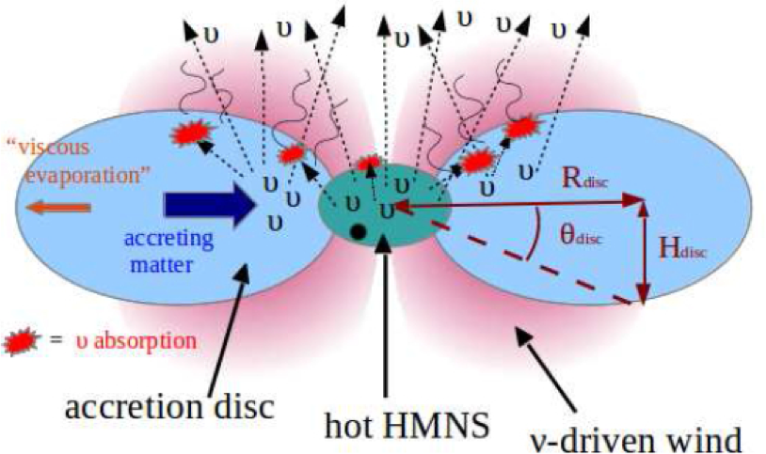
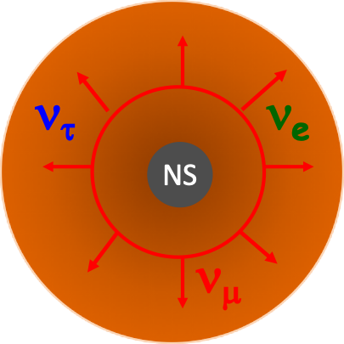
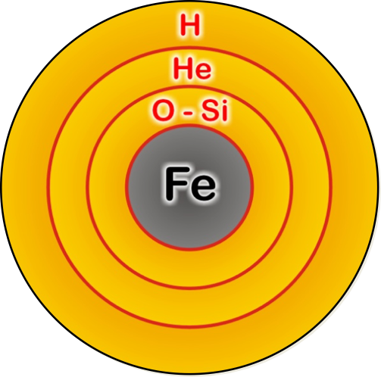



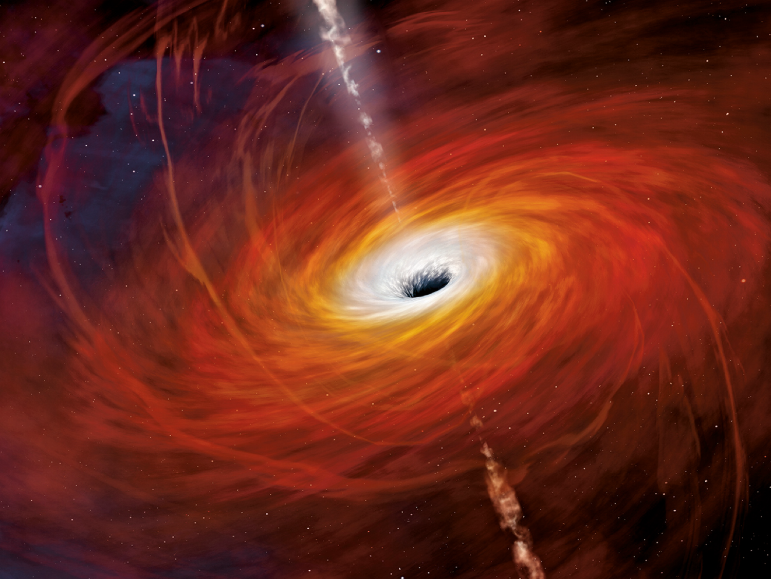
DENSE
ENVIRONMENTS
NEUTRON STAR MERGERS
CORE-COLLAPSE SUPERNOVAE
NS
NS
NEUTRON STAR
ACCRETION-DISKS around BLACK-HOLES
BLACK-HOLE
(Artist image)
FINAL STAGES
EARLY UNIVERSE
47th Erice Course, « Neutrinos in Cosmology, in Astro-, Particle- and Nuclear Physics », 16th-22nd September 2026

Slide 6

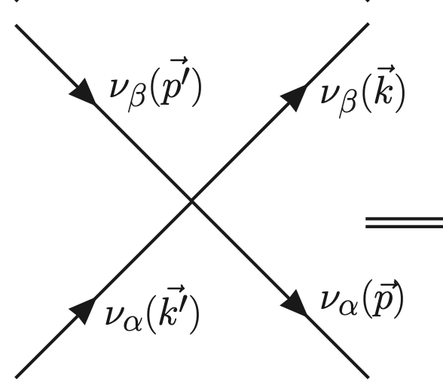
DENSE ENVIRONMENTS
DENSE = a medium that can reach densities of 10¹⁰ g/cm³ and to
up a few 10¹⁴ g/cm³ (limits of matter compressibility).
Dense also in neutrinos. E.g. when a massive star explodes about
10⁵⁸ neutrinos are produced in ten seconds with an average
energy of 10 MeV.
The neutrino-neutrino
interaction becomes
sizeable.
A weakly interacting
many-body system !
Pantaleone, PLB 1992
47th Erice Course, « Neutrinos in Cosmology, in Astro-, Particle- and Nuclear Physics », 16th-22nd September 2026

Slide 7
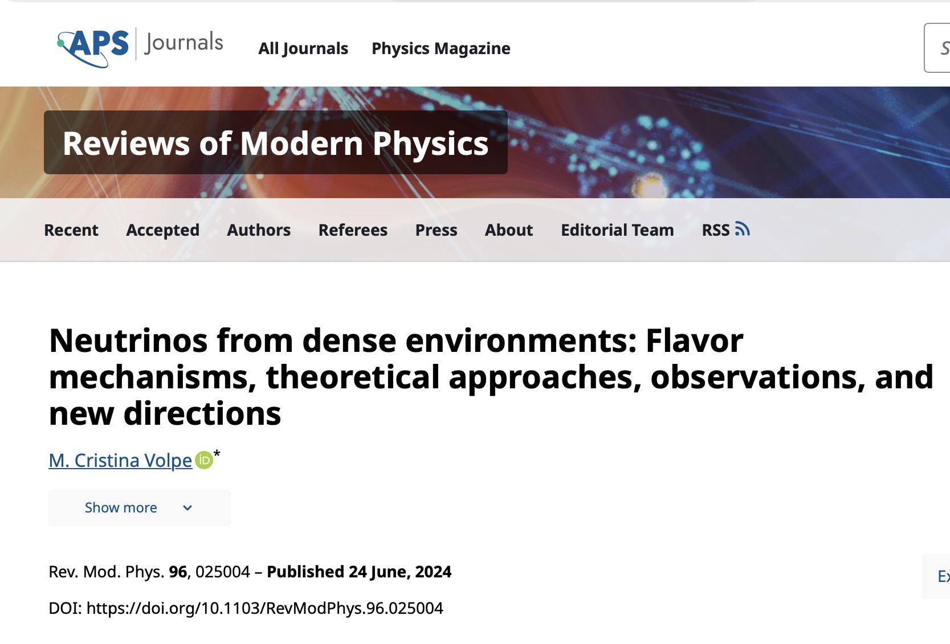
MOTIVATION
How do massive stars
explode ?
How are elements heavier than
iron formed ?
NEUTRINOS
FROM DENSE
ENVIRONMENTS
Searches for physics beyond the
Standard Model (BSM),
Dark Matter particles
Predictions for future
observations
Intrisically theoretically interesting:
Flavor evolution in dense media
47th Erice Course, « Neutrinos in Cosmology, in Astro-, Particle- and Nuclear Physics », 16th-22nd September 2026

Slide 8
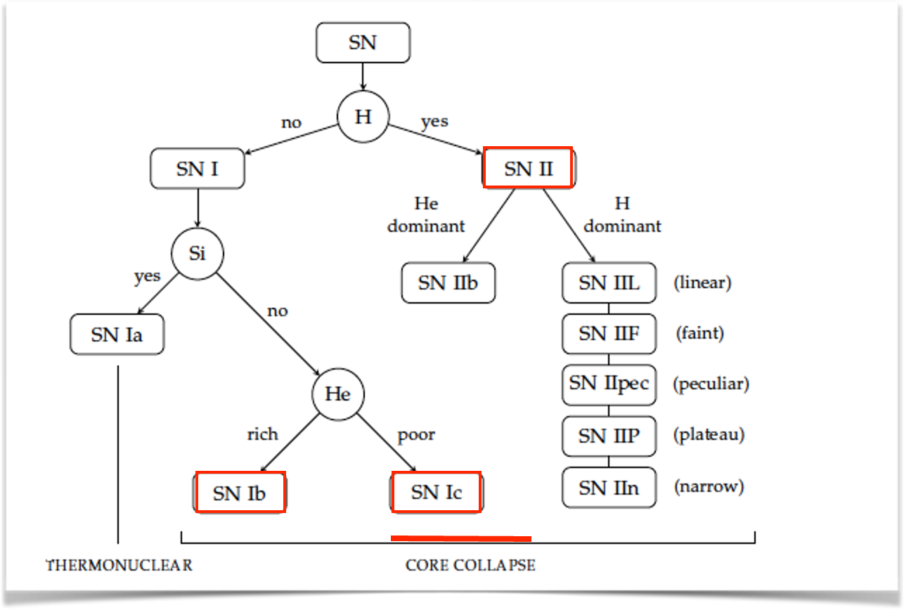

CORE-COLLAPSE supernovae
Core-collapse supernovae include supernovae type II, Ib and Ic.
47th Erice Course, « Neutrinos in Cosmology, in Astro-, Particle- and Nuclear Physics », 16th-22nd September 2026

Slide 9


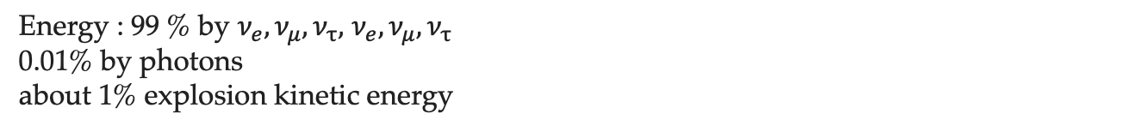
Spectral classification of supernovae
Neutrinos from core-collapse supernovae
Schematic evolution of a core-collapse supernova (25 Msun)
Weaver, Woosley (1980)
NEUTRON STAR
H
He
BLACK-HOLE
(Artist image)
H burning
T= 0.09 10⁹ K
Burning time = 7 My
He burning
T= o.2 10⁹ K
Burning time = 5 10⁵ y
C (Si) burning
T= o.8 (3.5) 10⁹ K
Burning time = 600 y (1 d)
Supernova
(core-collapse and
explosion)
FINAL STAGES
$$E_{grav}≈\frac{GM^{2}}{R}=3×{10}^{53}ergs$$
Energy : 99 % by $ν_{e}, ν_{μ},ν_{τ},$ $ν_{e}, ν_{μ},ν_{τ}$
0.01% by photons
about 1% explosion kinetic energy
47th Erice Course, « Neutrinos in Cosmology, in Astro-, Particle- and Nuclear Physics », 16th-22nd September 2026

Slide 10

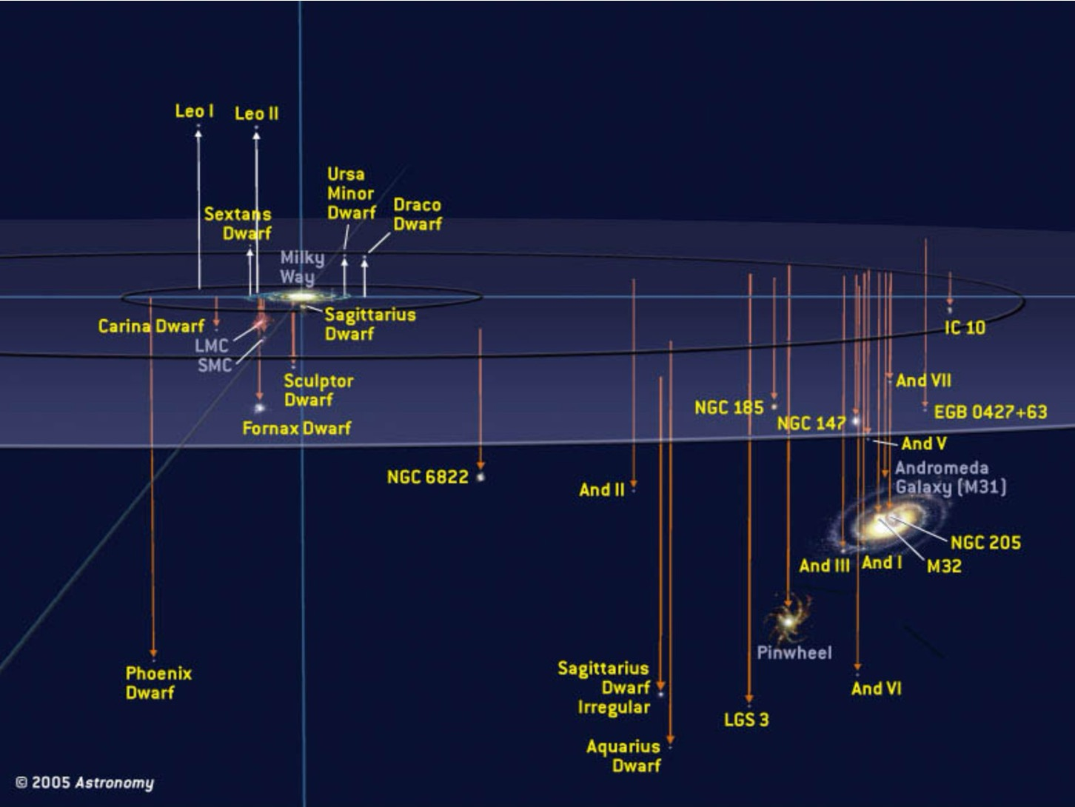


LOCAL GROUPs
47th Erice Course, « Neutrinos in Cosmology, in Astro-, Particle- and Nuclear Physics », 16th-22nd September 2026

Slide 11
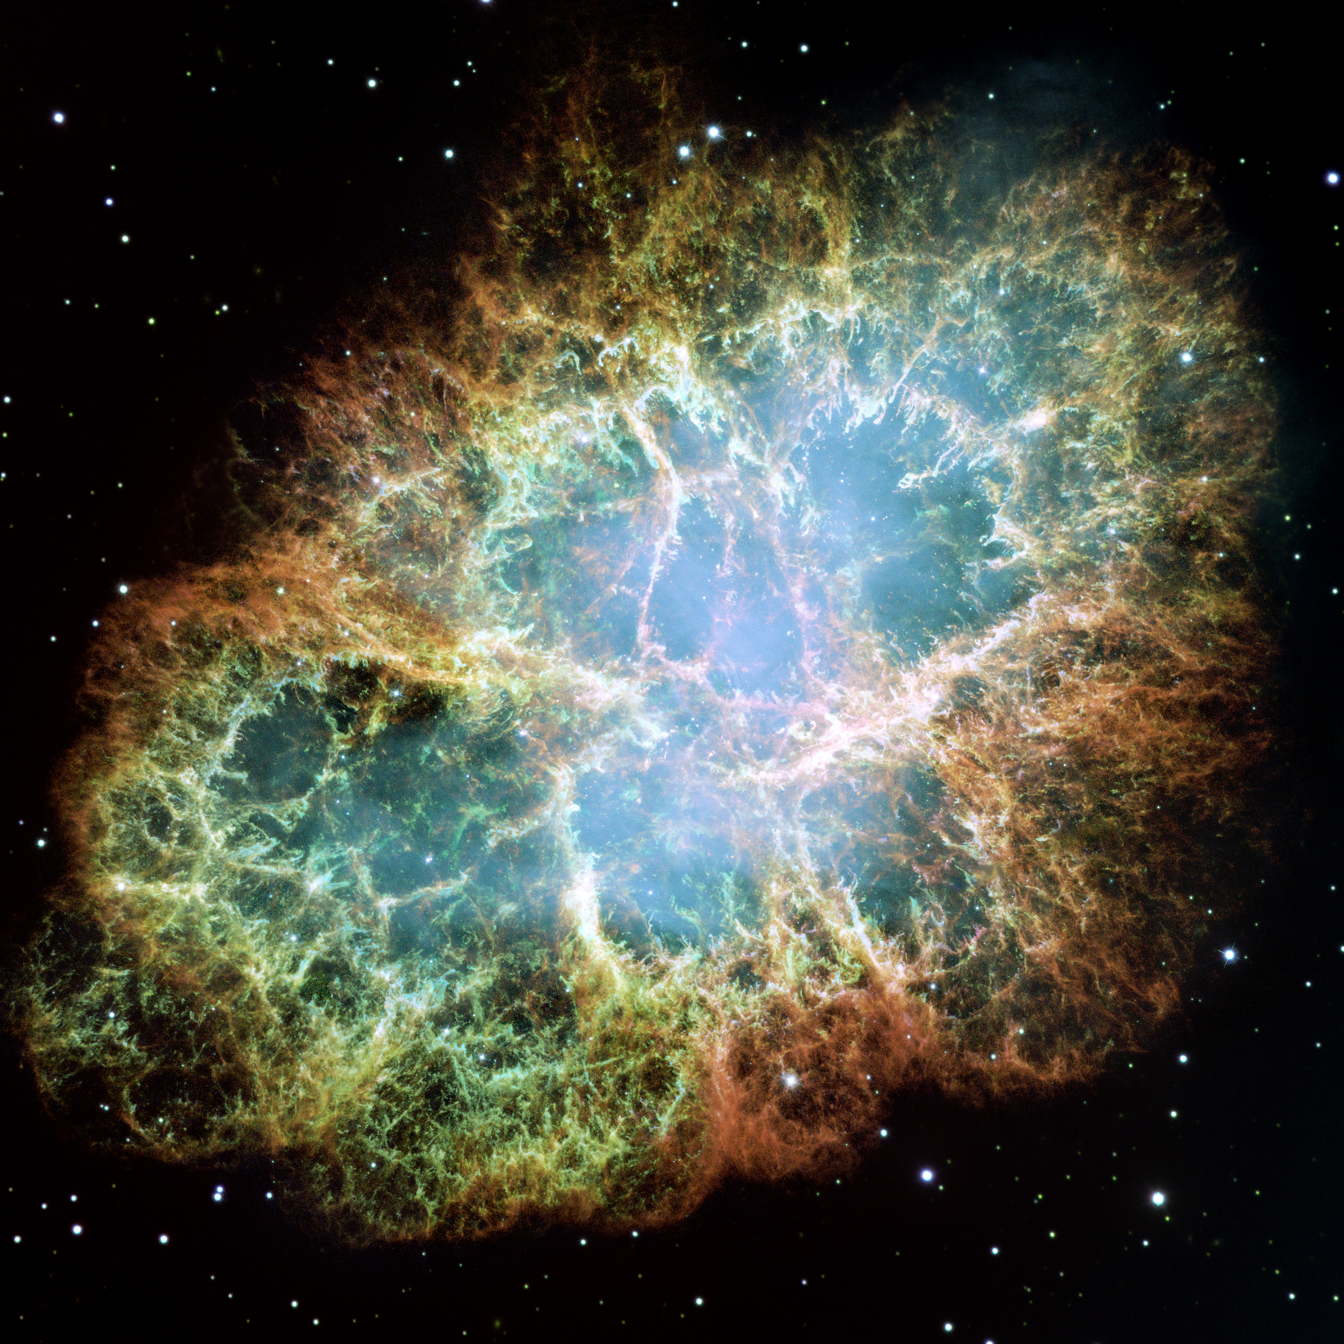
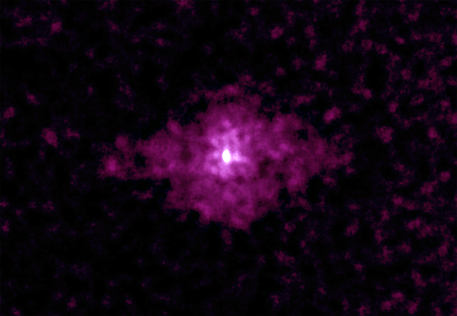
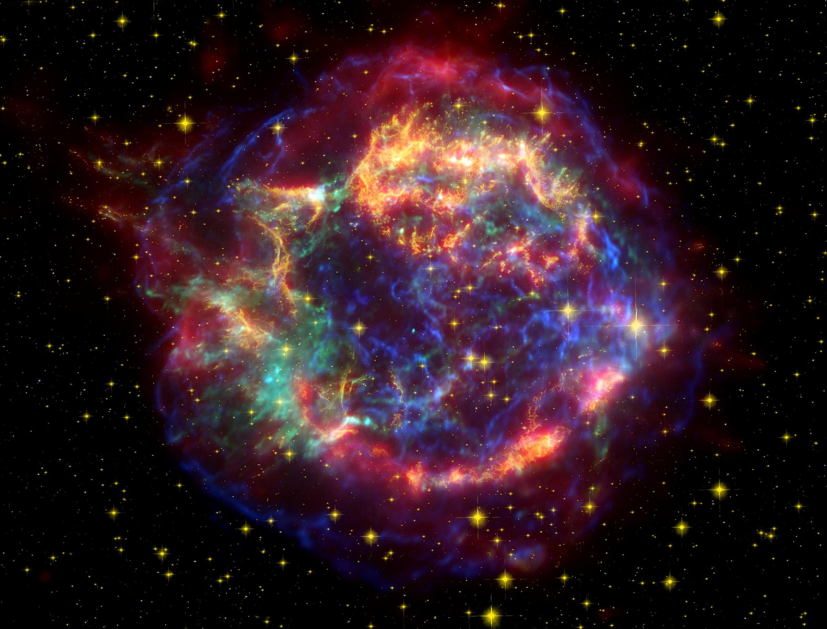


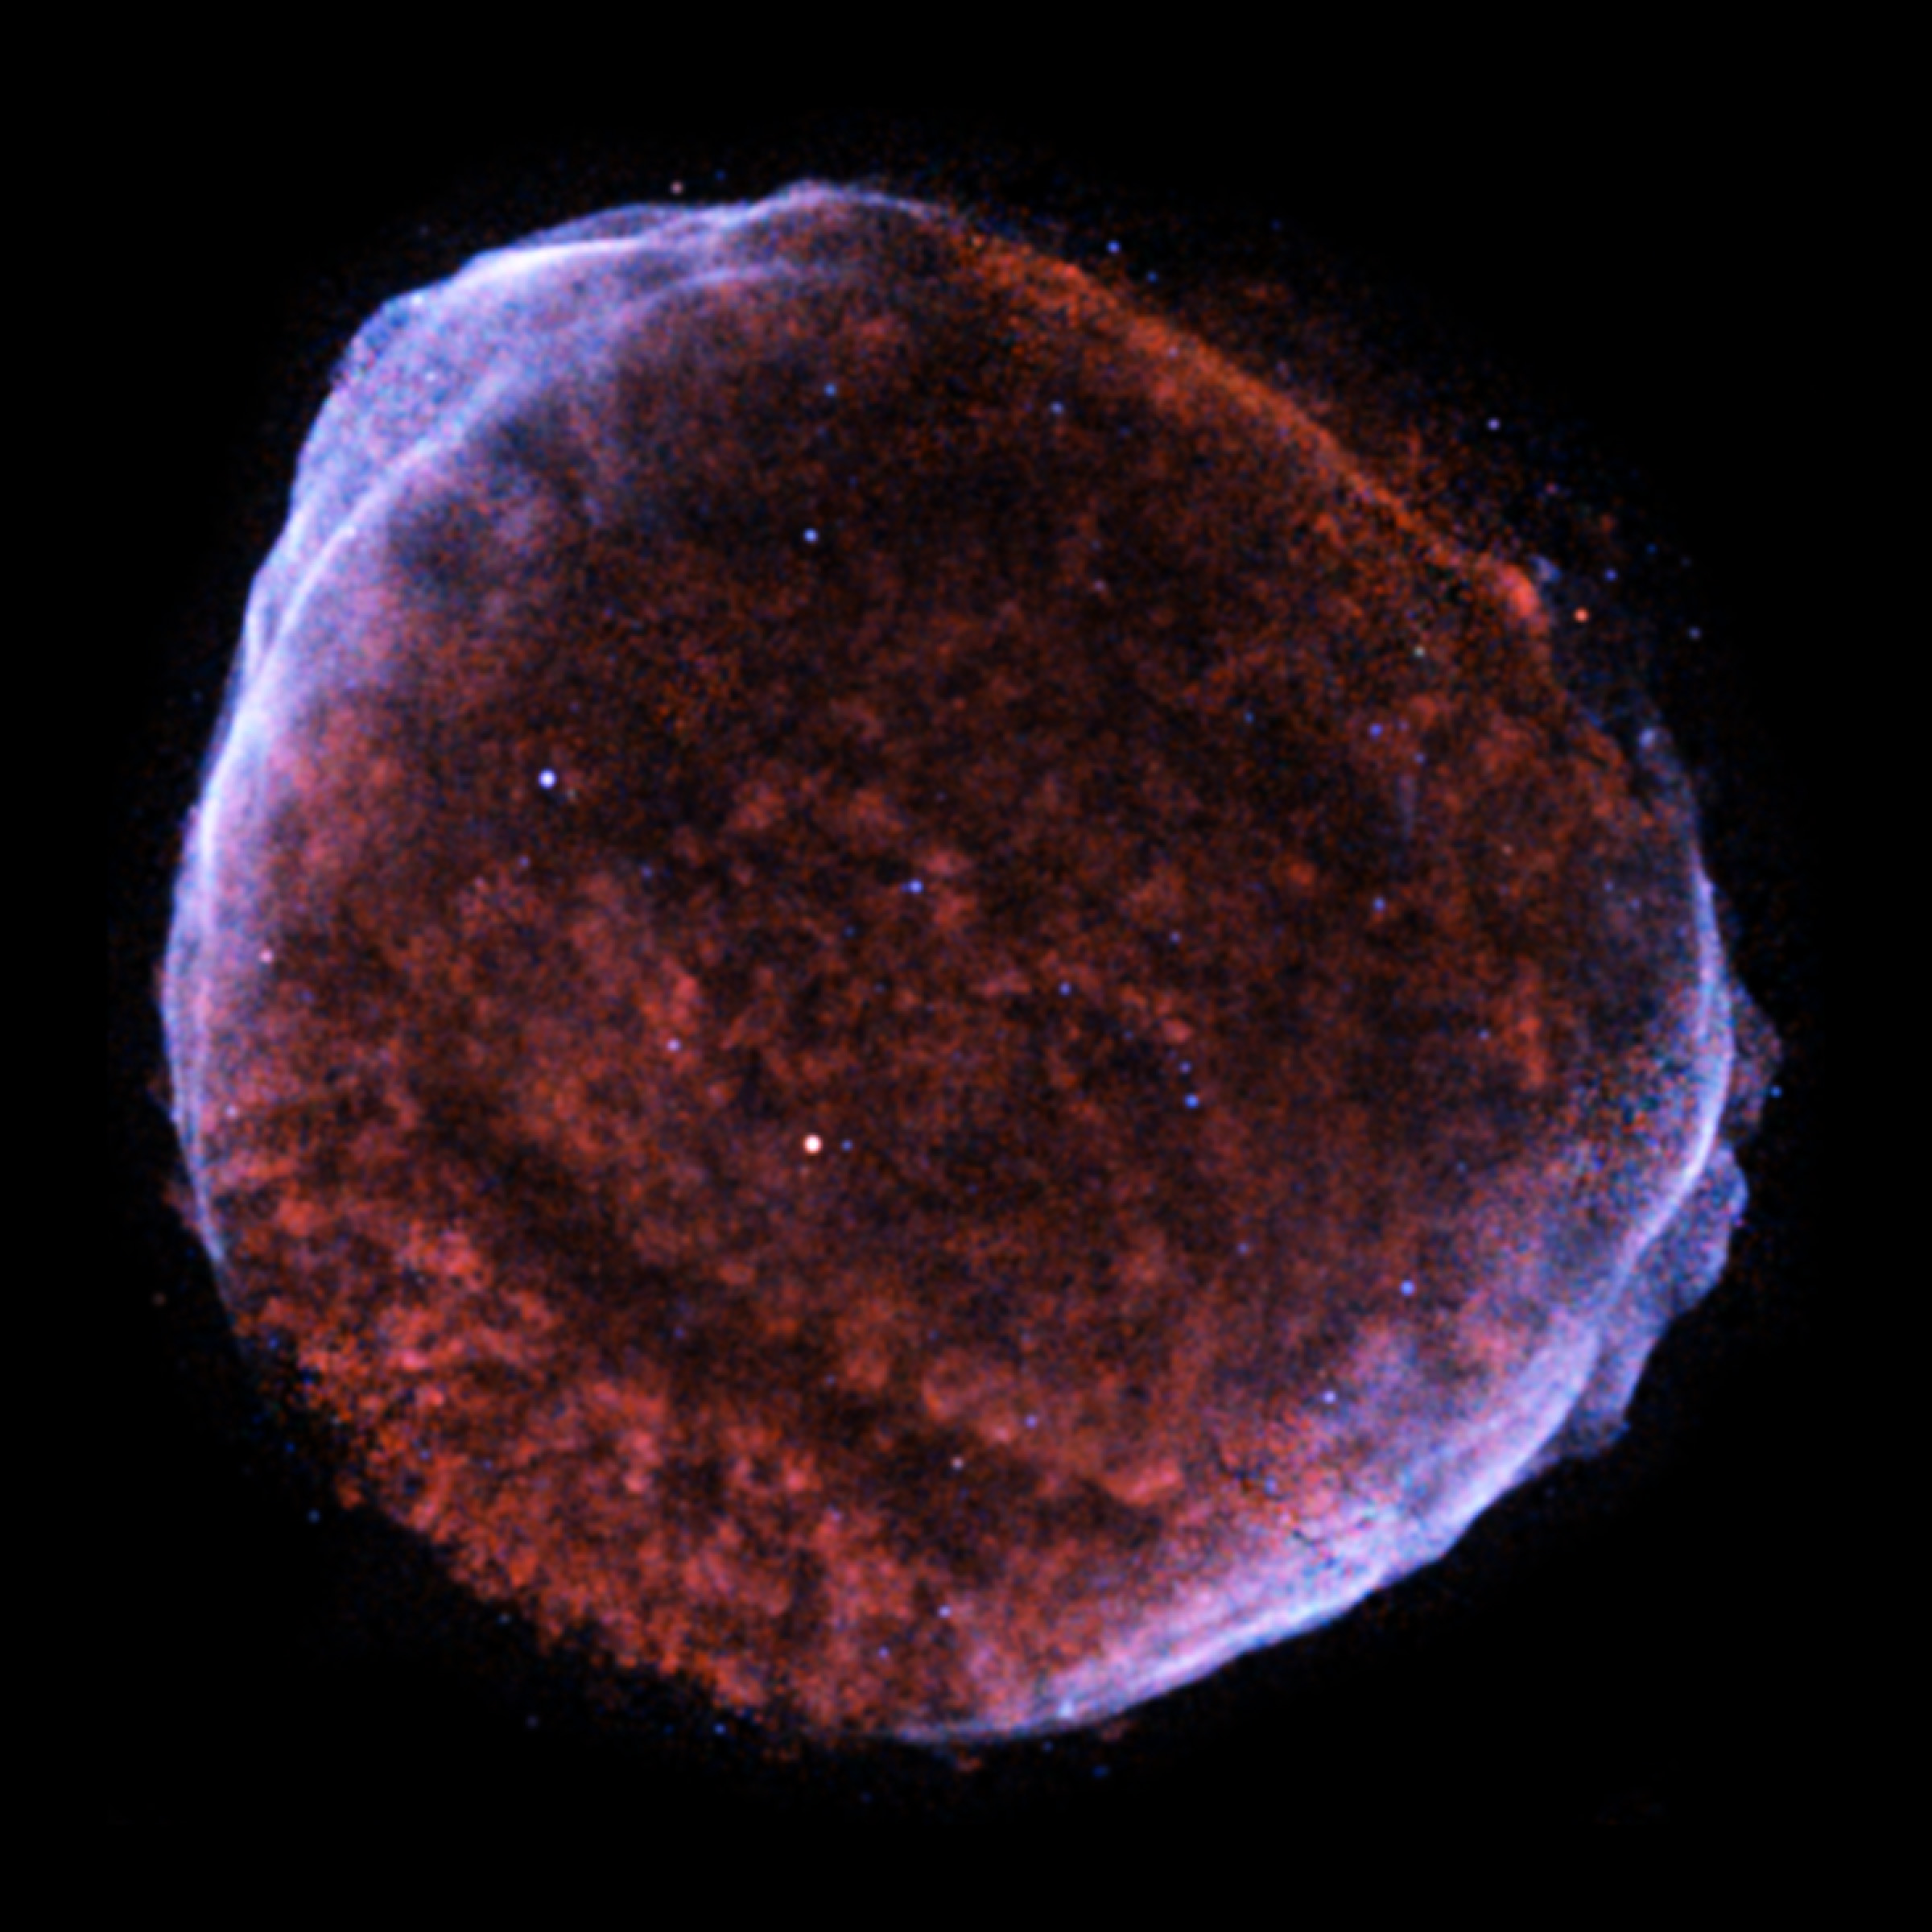
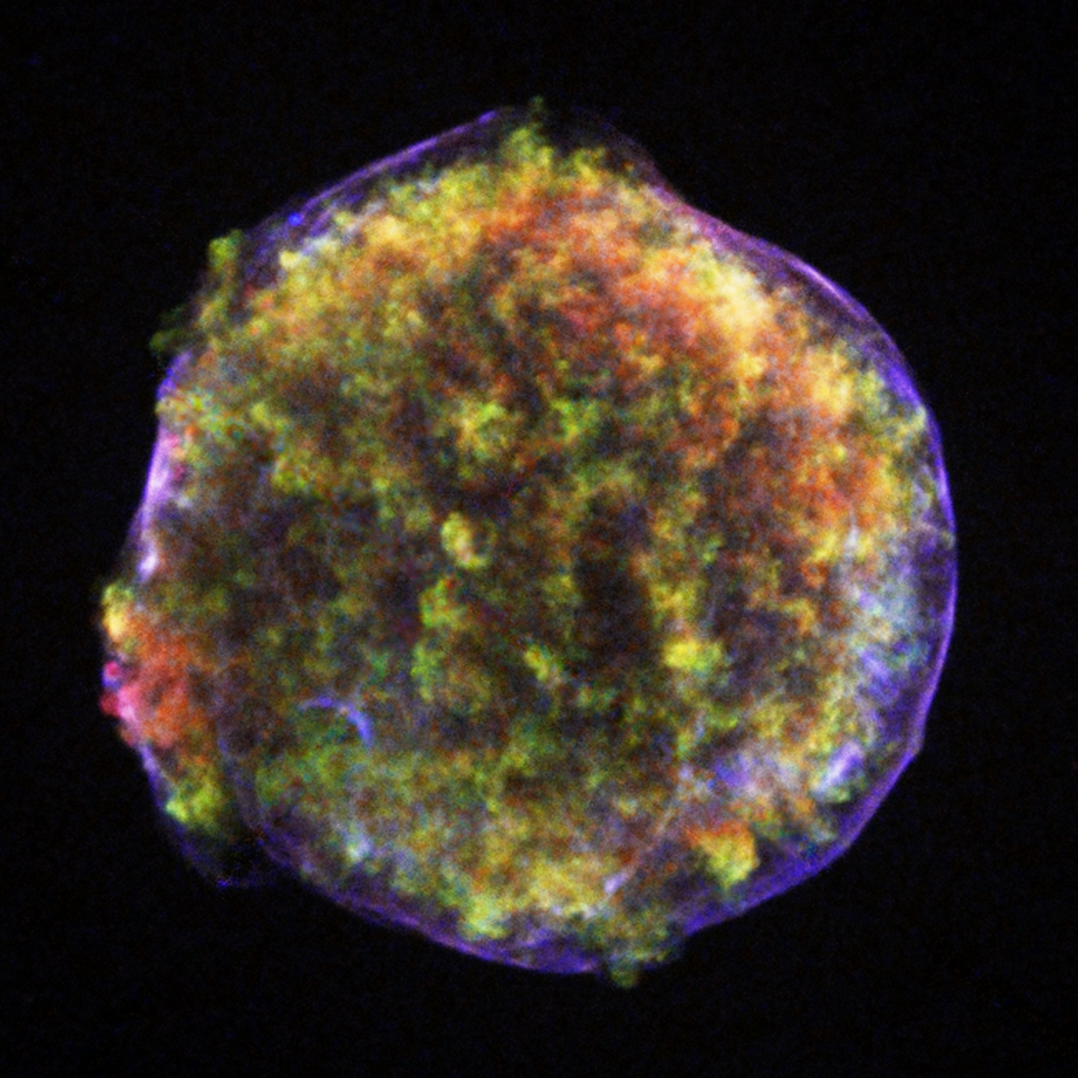
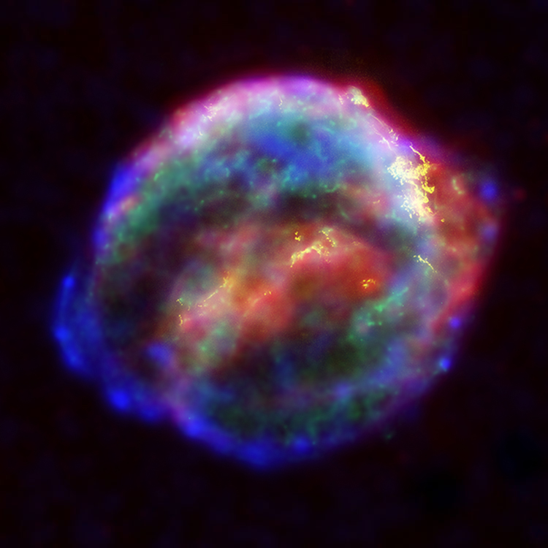

SUPERNOVAE IN THE MILKY WAY and in THE LOCAL GROUP
Since 1000 y, in the Milky Way : 6 supernova events.
SN 1006
SN 1572
SN 1604
NASA, ESA, J. Hester and A. Loll
NASA/CXC/SAO/S.Murray et al.
Courtesy NASA/JPL-Caltech
SN 1054
Crab Nebula
SN 1667 (Cas A)
SN 1181
Smithsonian Institution
NASA/CXC/Rutgers/J.Warren & J.Hughes et al.
NASA/ESA/JHU/R.Sankrit & W.Blair
Combined evaluations of the galactic core-collapse supernova rate give:
$$1.63±0.46$$
per 100 y.
Rozwadowska et al, 2021
In the MILKY WAY, RARE EVENTS
Last 100 y, Local Group :
SN1987A (LMC), SN 1885 (Andromeda).
47th Erice Course, « Neutrinos in Cosmology, in Astro-, Particle- and Nuclear Physics », 16th-22nd September 2026

Slide 12
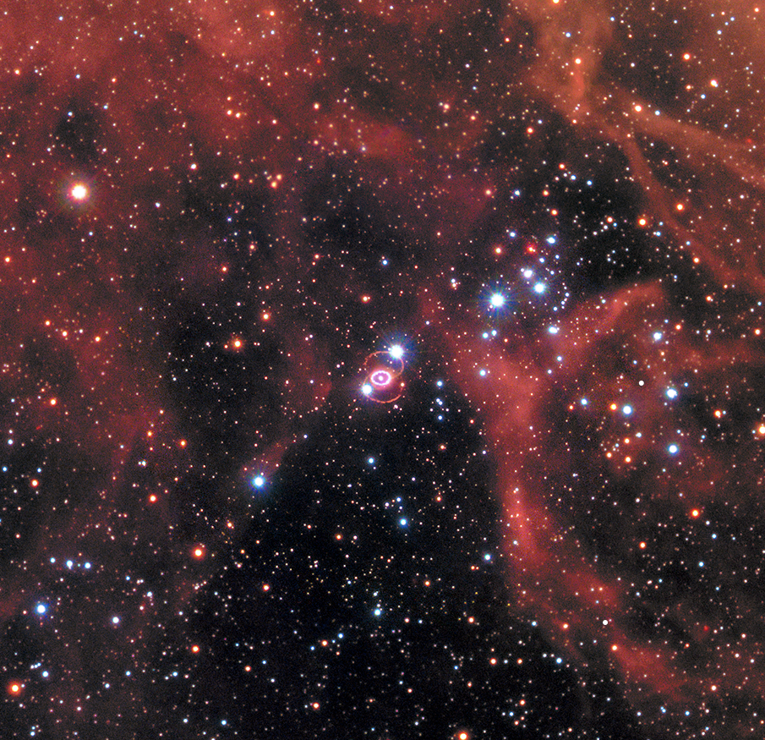
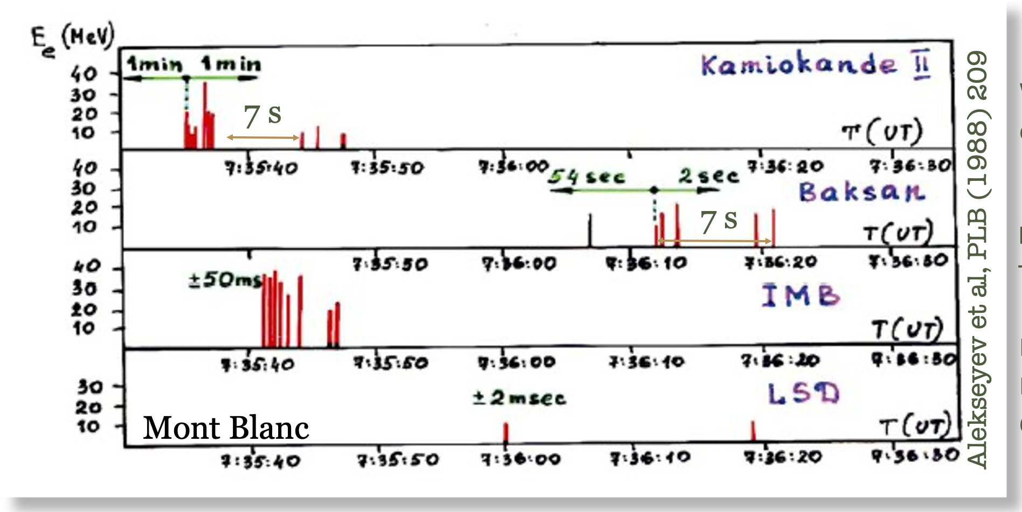
SN1987A : a unique event
On the 23rd February 1987, Sanduleak 69⁰202
exploded, in the Large Magellanic Cloud,
a satellite galaxy of the Milky Way.
Water Cherenkov,
2140 tons, 11 events
TODAY
Hirata et al,PRL58, 1987
Scintillator Telescope,
200 tons, 5 events
Alekseev al,PLB205, 1988
Water Cherenkov,
6800 tons, 8 events
Bionta et al,PRL58, 1987
Aglietta et al, EPL3, 1987
Suzuki, J. Phys. Conf. Ser. (2008)
Hubble Space Telescope, NASA, E., R. K. H.-S. C. for Astrophysics,
Gordon, B. M. Foundation), and P. C. H.-S. C. for Astrophysics) (2017b),
https://esahubble.org/images/heic1704a/
  First observation of neutrinos - 24 events,
  from the core of an exploding massive star
  (core-collapse supernova).
49.59 ± 0.09 (stat) ± 0.54 (sys) kpc
(163,000 light-years)
Pietrzynski et al., 2019
47th Erice Course, « Neutrinos in Cosmology, in Astro-, Particle- and Nuclear Physics », 16th-22nd September 2026

Slide 13
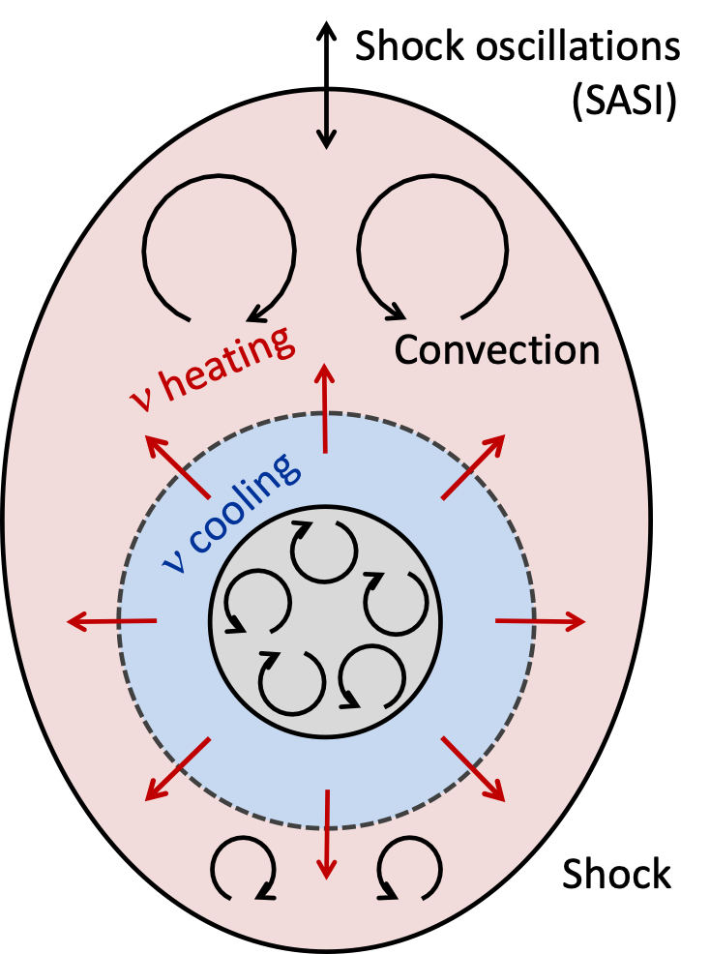
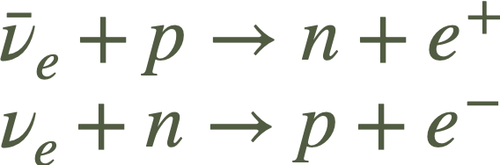
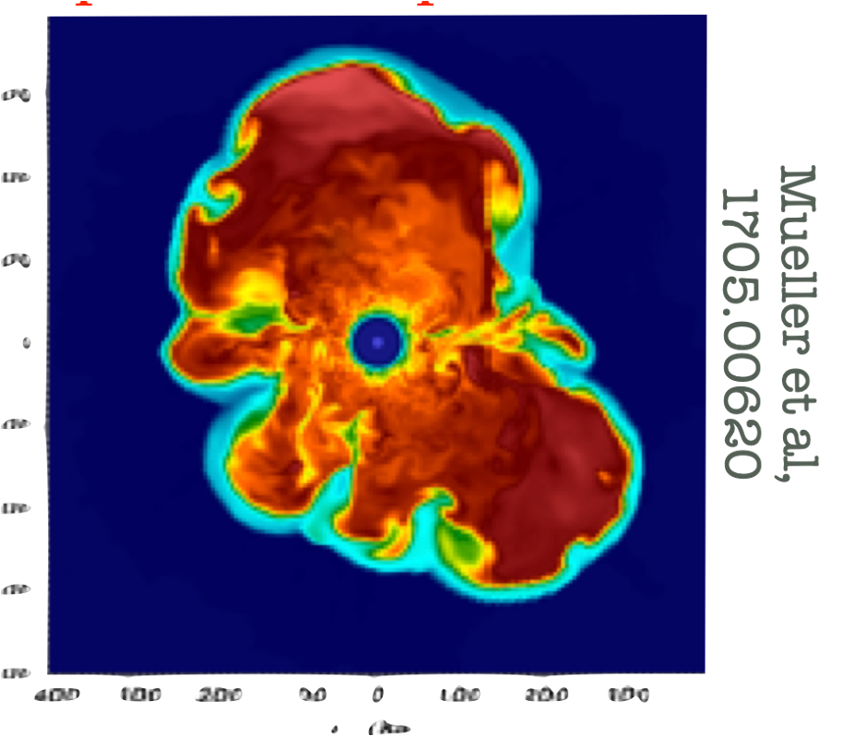
HOW do CORE-COLLAPSE SUPERNOVAE EXPLODE ? A six-decade quest
A major step forward every decade:
Mezzacappa, 2022, 2205.13438
Wilson,1982
Bethe, Wilson,1985
Colgate, White,1966
Herant et al,1992
Blondin et al,1993
Murphy et al,2013
2020--
Neutrinos deposit
energy behind the
shock, trigger explosion:
« Prompt model »
Neutrinos make
the shock dynamical:
« Delayed neutrino
heating mechanism»
2D simulations
Shock wave
unstable (SASI)
Turbulent
pressure pushes
shock
LESA -
Tamborra et al,2014
Refuted by SN1987A
neutrinos
« Delayed neutrino heating
mechanism » : Neutrinos reheat
the shock aided by convection,
turbulence and SASI.
Loredo, Lamb, 1988
SUCCESFULL
EXPLOSIONS
by different groups and
for various progenitors
47th Erice Course, « Neutrinos in Cosmology, in Astro-, Particle- and Nuclear Physics », 16th-22nd September 2026

Slide 14
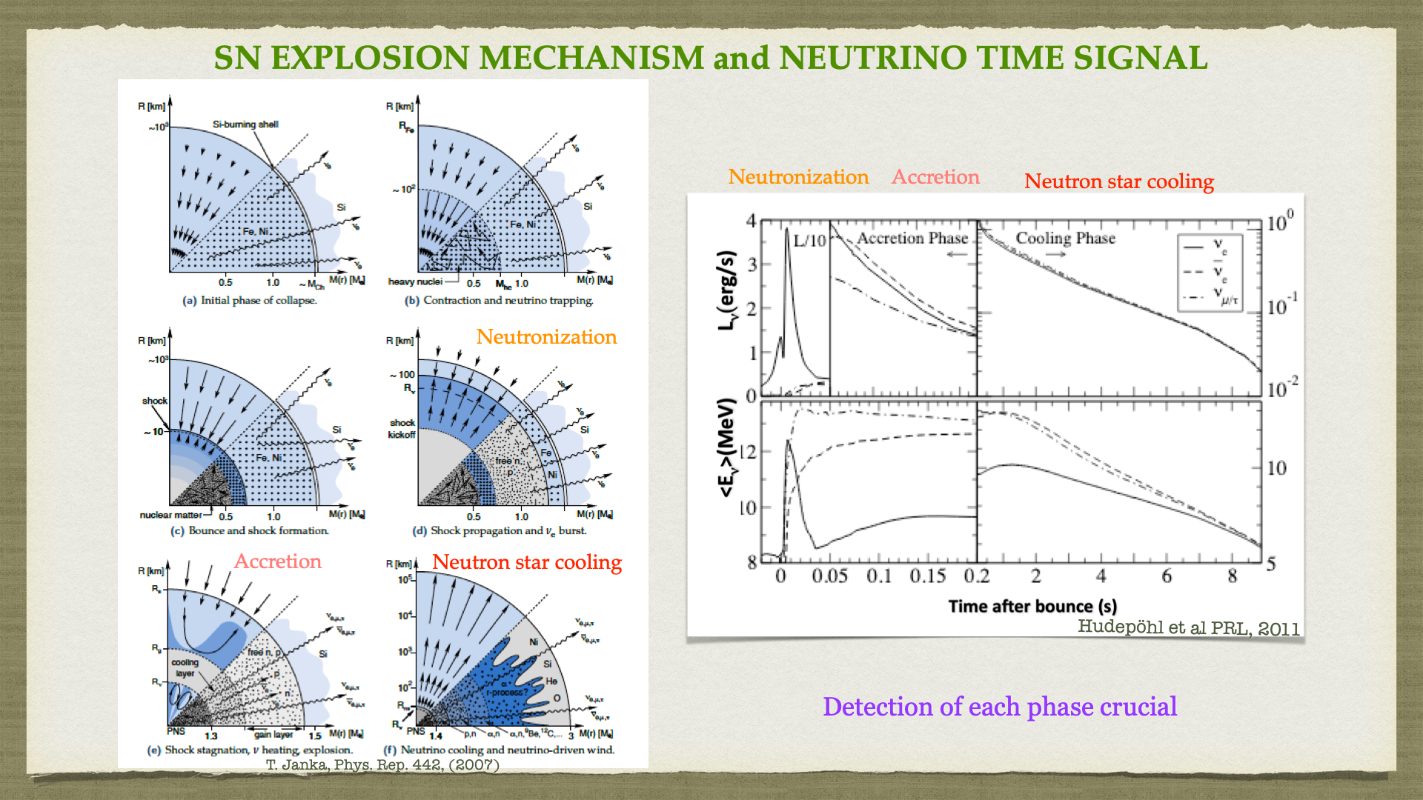
47th Erice Course, « Neutrinos in Cosmology, in Astro-, Particle- and Nuclear Physics », 16th-22nd September 2026

Slide 15
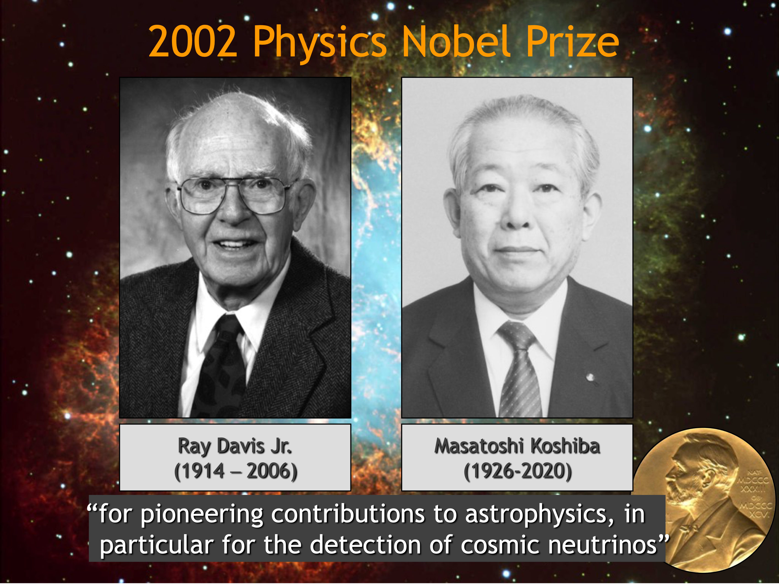
2002 Physics Nobel Prize
«for pioneering contributions to astrophysics, in particular for the detection of cosmic neutrinos »
Raymond Davis
Masatoshi Koshiba
First detection of neutrinos
from the Sun (Homestake)
First detection of neutrinos
from a core-collapse supernova (Kamiokande)
+ ½ to Riccardo Giacconi for X-ray astronomy
47th Erice Course, « Neutrinos in Cosmology, in Astro-, Particle- and Nuclear Physics », 16th-22nd September 2026

Slide 16



Neutrino decay
In vacuum
In matter
Radiative
(well constrained, SN1987A)
Non-radiative
Invisible
$$ν_{h}→ν_{l}+φ$$
$$ν_{h}→χ+φ$$
$$ν_{h}→ν_{l}+γ$$
$ν$decay, solar neutrino problem. Bahcall, Cabibbo, Yahil, PRL 28 (1972)
A vaste literature
DSNB and decay in vacuum –
Ando PLB 570 (2003), Fogli, Lisi, Mirizzi, Montanino, PRD70 (2004), De Gouvea et al, PRD 101 (2020), Akita et al JHEP 12 (2022)…
SN1987A and decay in matter –
Berezhiani, Smirnov PLB 220 (1989), Kachelriess PRD 62 (2000), Farzan PRD 67 (2000), Tomàs, Päs, Valle, PRD 64 (2001)
Theor. aspects, decay and SNe, cosmo, exp limits, etc.. –
Chikashige, Mohapatra, Peccei PLB 981 (1980), Gelmini, Nussinov, Roncadelli, Nucl. Phys. B 209 (1982), Schechter, Valle PRD 25 (1982), Chupp et al PRL 62 (1989), Kolb, Turner PRL 62 (1989), Kim, Lam (1990), Fuller, Mayle, Wilson, Astrop. J. 332 (1998), Joshipura et al PRD 66 (2002), Beacom, Bell PRD 65 (2002), Gonzalez-Garcia, Maltoni PLB 663 (2008), Berryman et al PLB 742 (2015), Huang, Ohlsson, Zhou, PRD 97 (2018), Escudero, Fairbairn PRD100 (2019), Brune, Pas, PRD 99 (2019), Chattopadhyay et al, PRL 129 (2022), Fiorillo, Raffelt, Vitagliano, PRL 131 (2023), Martinez-Mirave et al, JCAP 05 (2024), ….
47th Erice Course, « Neutrinos in Cosmology, in Astro-, Particle- and Nuclear Physics », 16th-22nd September 2026

Slide 17
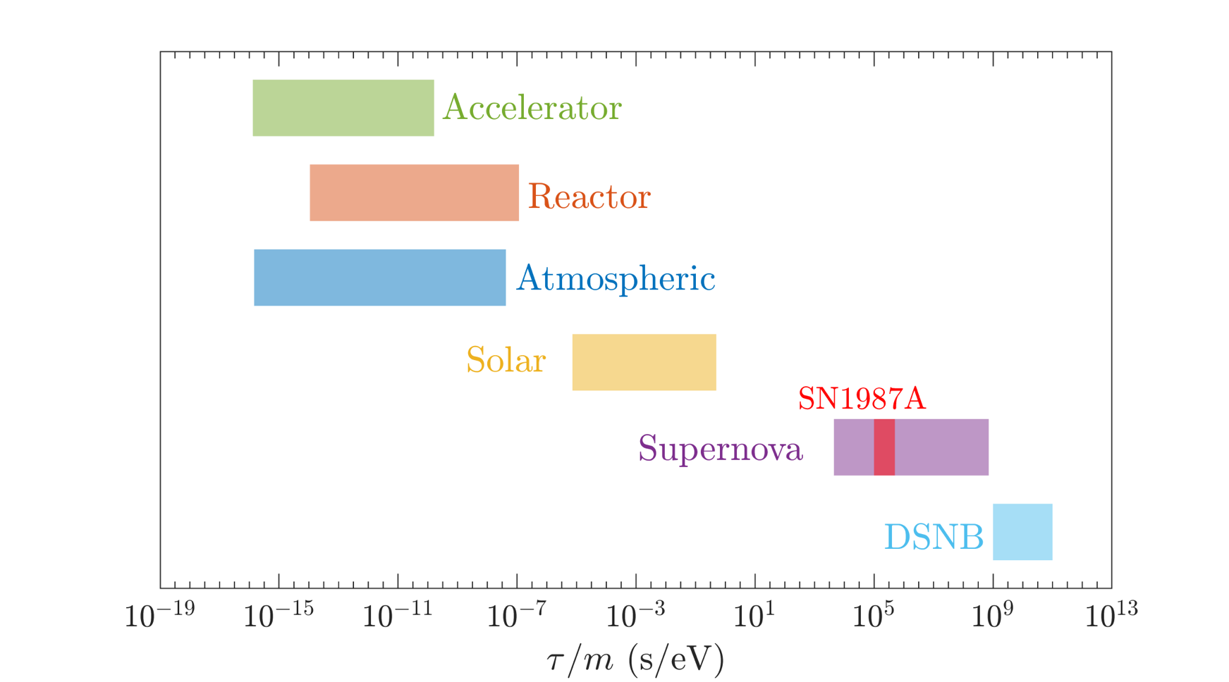
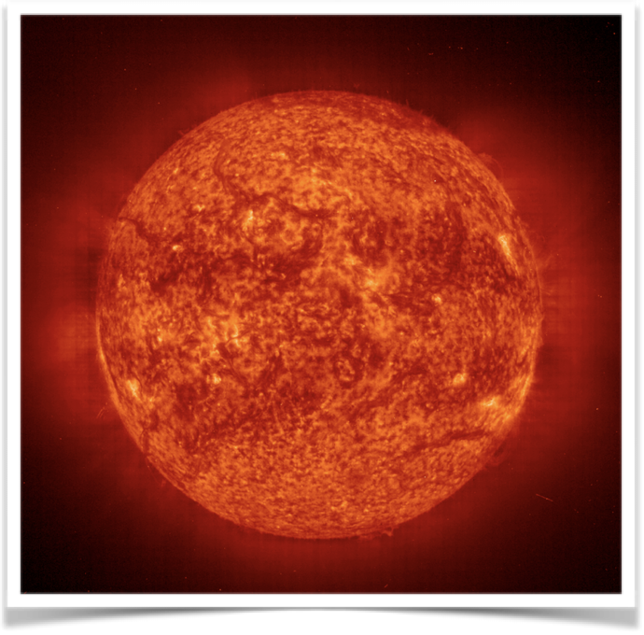


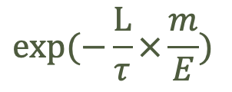
Neutrino non-radiative two-body decay in vacuum
  Massive neutrinos can decay non radiatively :
  Sensitivity from different neutrino sources
a massless/massive (pseudo)scalar
  source
  detector
  mass
  The neutrino fluxes
  suppressed by
$$exp(−\frac{L}{τ}×\frac{m}{E})$$
  lifetime
  energy
Ivanez-Ballesteros,Volpe, PLB 847 (2023), 2307.03549
First likelihood analysis of the 24 electron anti-neutrino events
from SN1987A in Kamiokande, IMB and Baksan, including decay:
due to tree-level (pseudo)scalar couplings.
$$\frac{τ}{m}>1.2×{10}^{5}\left(90\%C.L.\right) for{ ν}_{1} and{ ν}_{2}\left(IO\right) −PDG2024.$$
With the next supernova competitive bounds on long tau/m
47th Erice Course, « Neutrinos in Cosmology, in Astro-, Particle- and Nuclear Physics », 16th-22nd September 2026

Slide 18
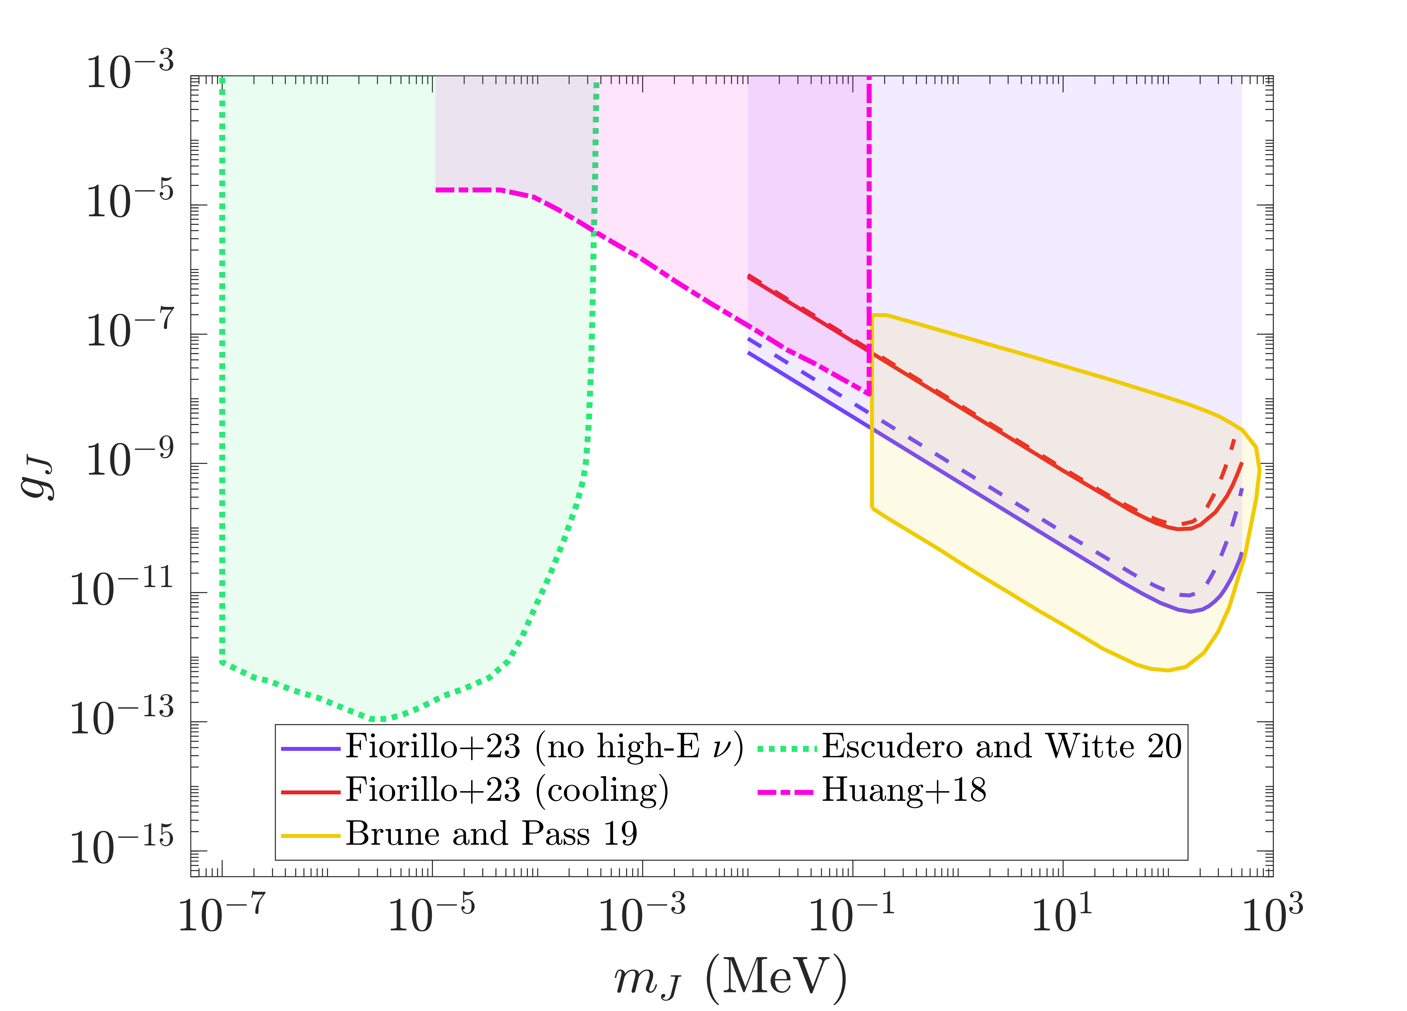
(Some) Bounds on neutrino-Majoron (Majoron-like) couplings
Majorons – Goldstone bosons associated with spontaneous Lepton number breaking, for Majorana neutrinos.
Chikashige, Mohapatra, Peccei PLB988 (1981),
Gelmini, Nussinov, Roncadelli, Nucl. Phys. B209 (1982).
SN1987A: Absence of high energy neutrinos, see Akita et al, JHEP 2022,
Fiorillo et al, PRL 2023
BBN
SN1987A:
Limits for massless
Majorons from neutrino decay in matter (not shown)
CMB
SN1987A: Energy loss argument
SN1987A: Cooling argument,
and deleptonization…
Based on the prompt SN model,
ruled out.
Ivanez-Ballesteros,Volpe, JCAP 02 (2026) 069, 2507.21845
  For massless Majorons investigations of neutrino decay in matter dated 2000.
47th Erice Course, « Neutrinos in Cosmology, in Astro-, Particle- and Nuclear Physics », 16th-22nd September 2026

Slide 19


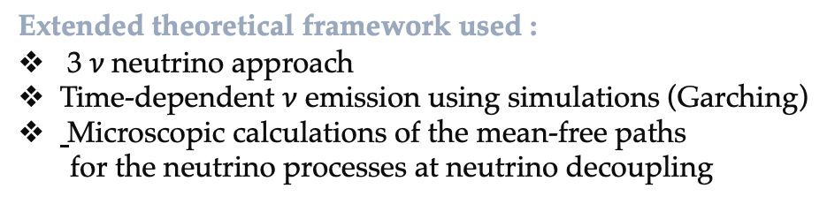


SN1987A and neutrino decay in matter
Majoron models
$$m_{i}∝ g_{ij} δ_{\left\{ij\right\}}$$
neutrino mass
neutrino-Majoron couplings
Extended theoretical framework used :
3 $ν$neutrino approach
Time-dependent $ν$ emission using simulations (Garching)
Microscopic calculations of the mean-free paths
for the neutrino processes at neutrino decoupling
Raffelt (2012)
MSW
region
ν_{μ}
$$ντ$$
Suppression factor(s) due to neutrino decay in matter
ν_{τ}
DECAY REGION
ν_{e}
neutrino
decoupling
Ivanez-Ballesteros,Volpe, PRD 112, L101301 (2025) - $PDG$ 2026
ν_{e}
47th Erice Course, « Neutrinos in Cosmology, in Astro-, Particle- and Nuclear Physics », 16th-22nd September 2026

Slide 20

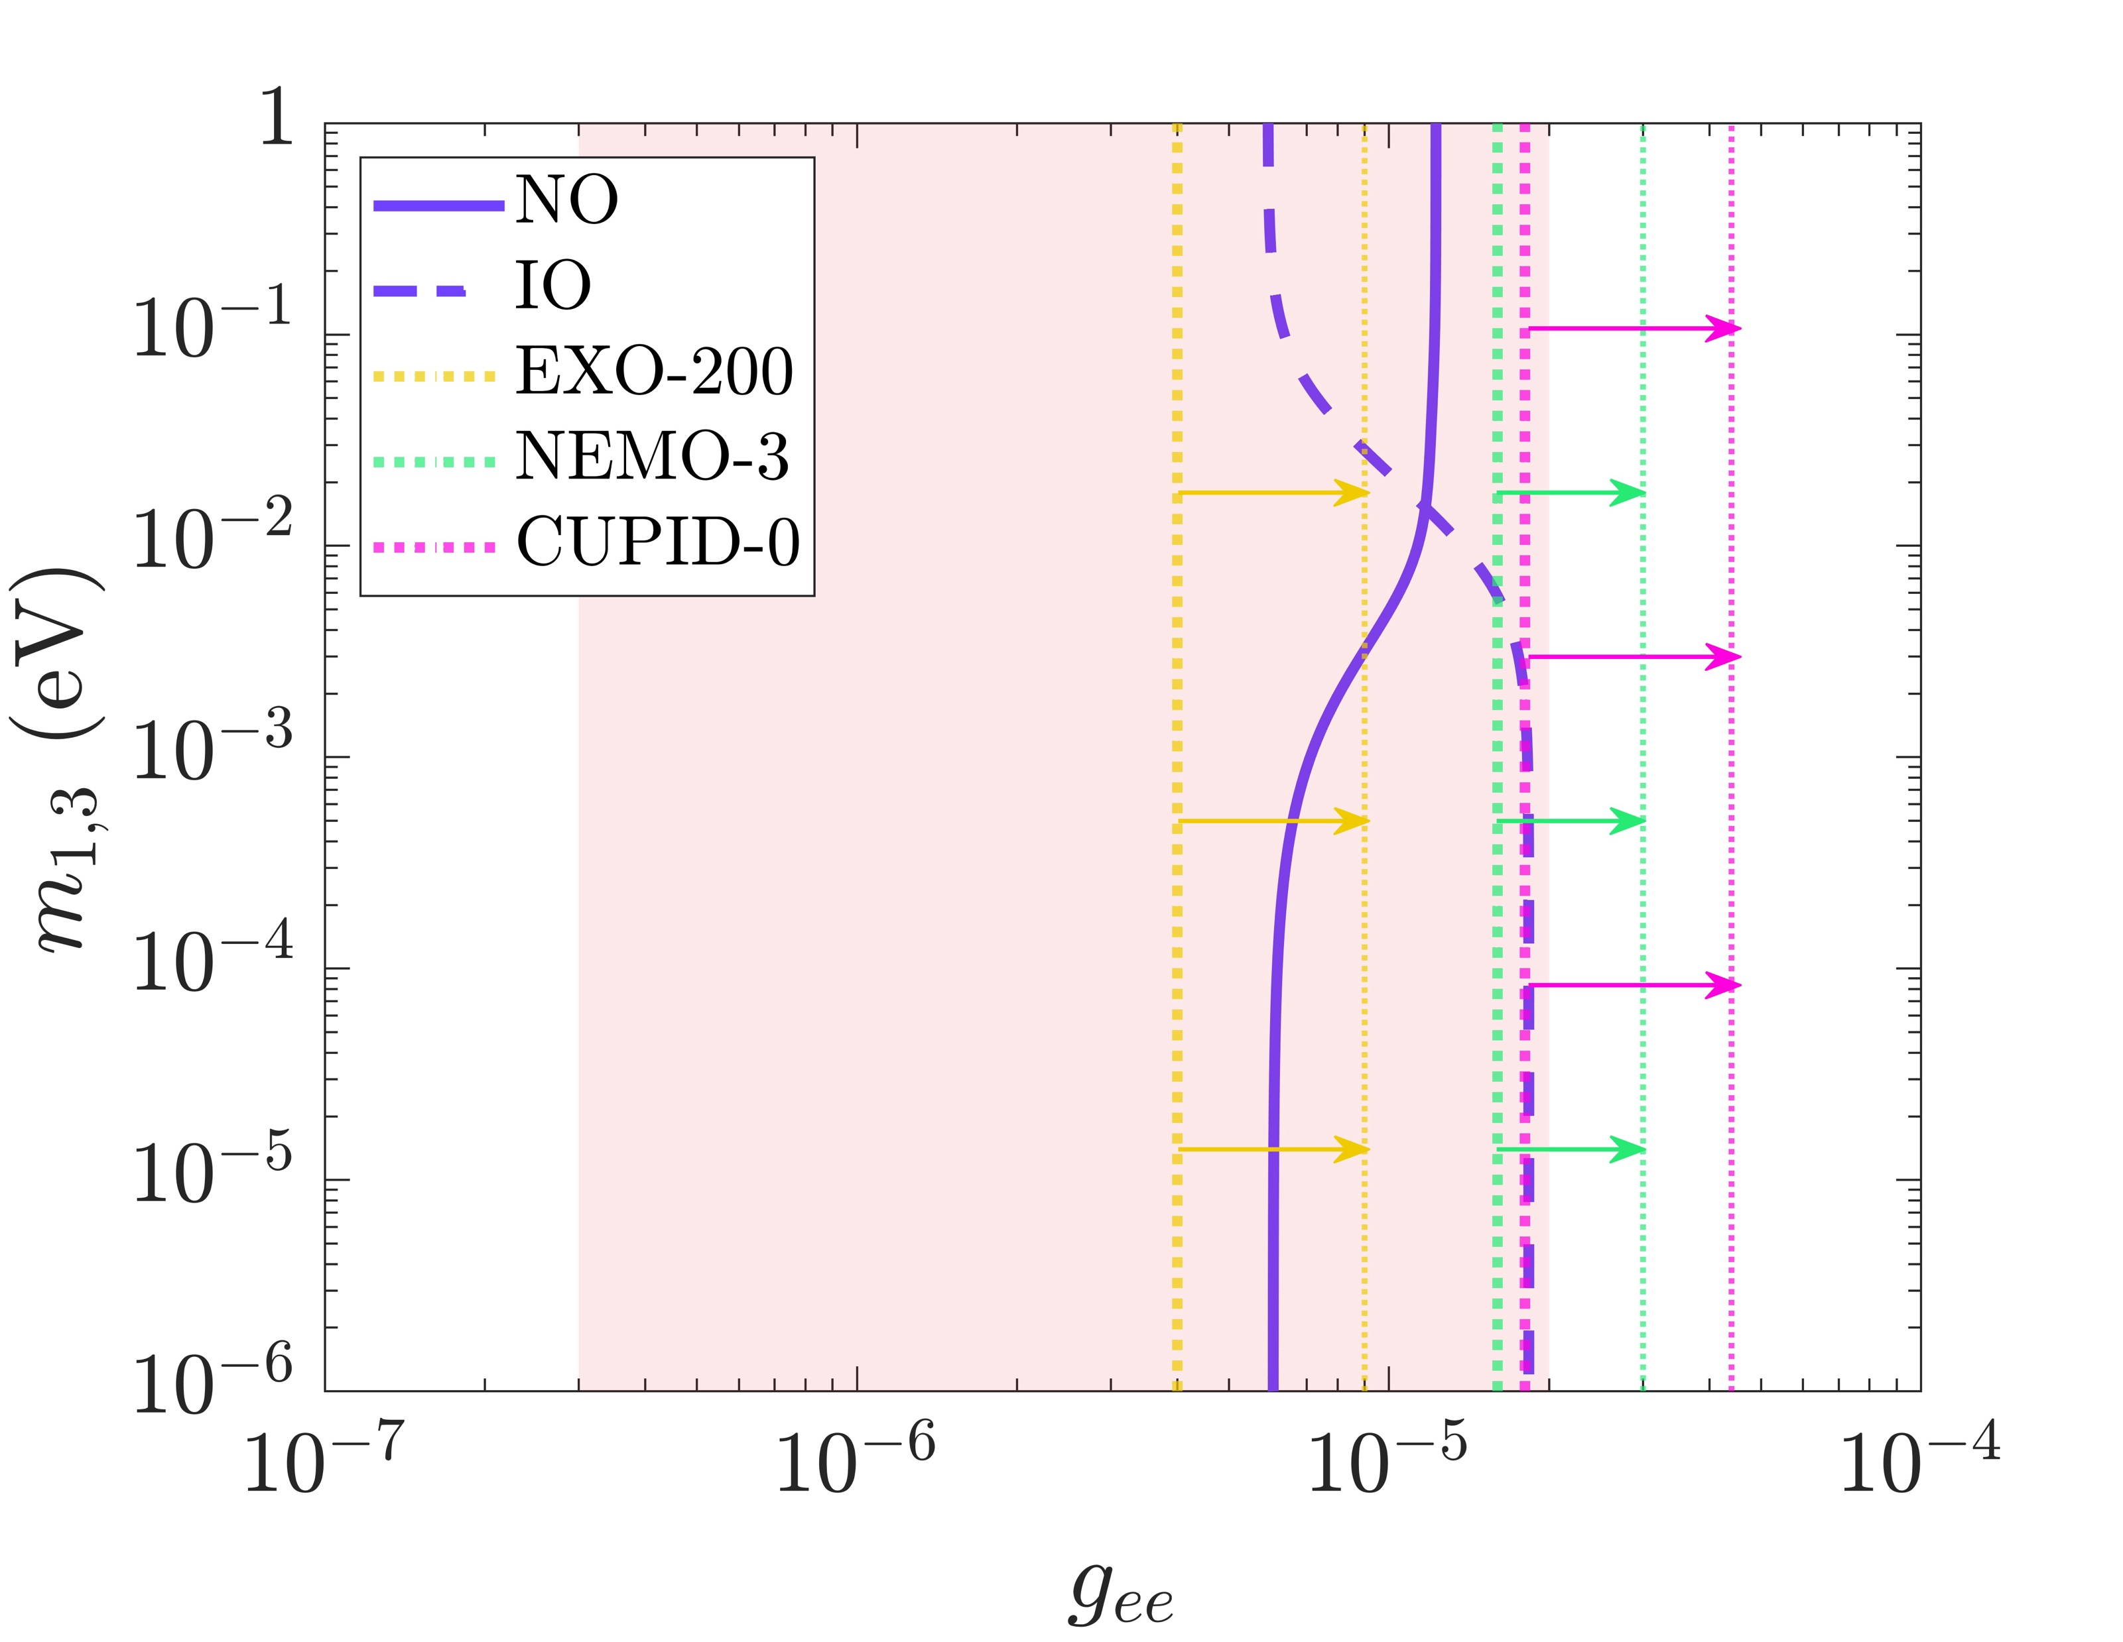
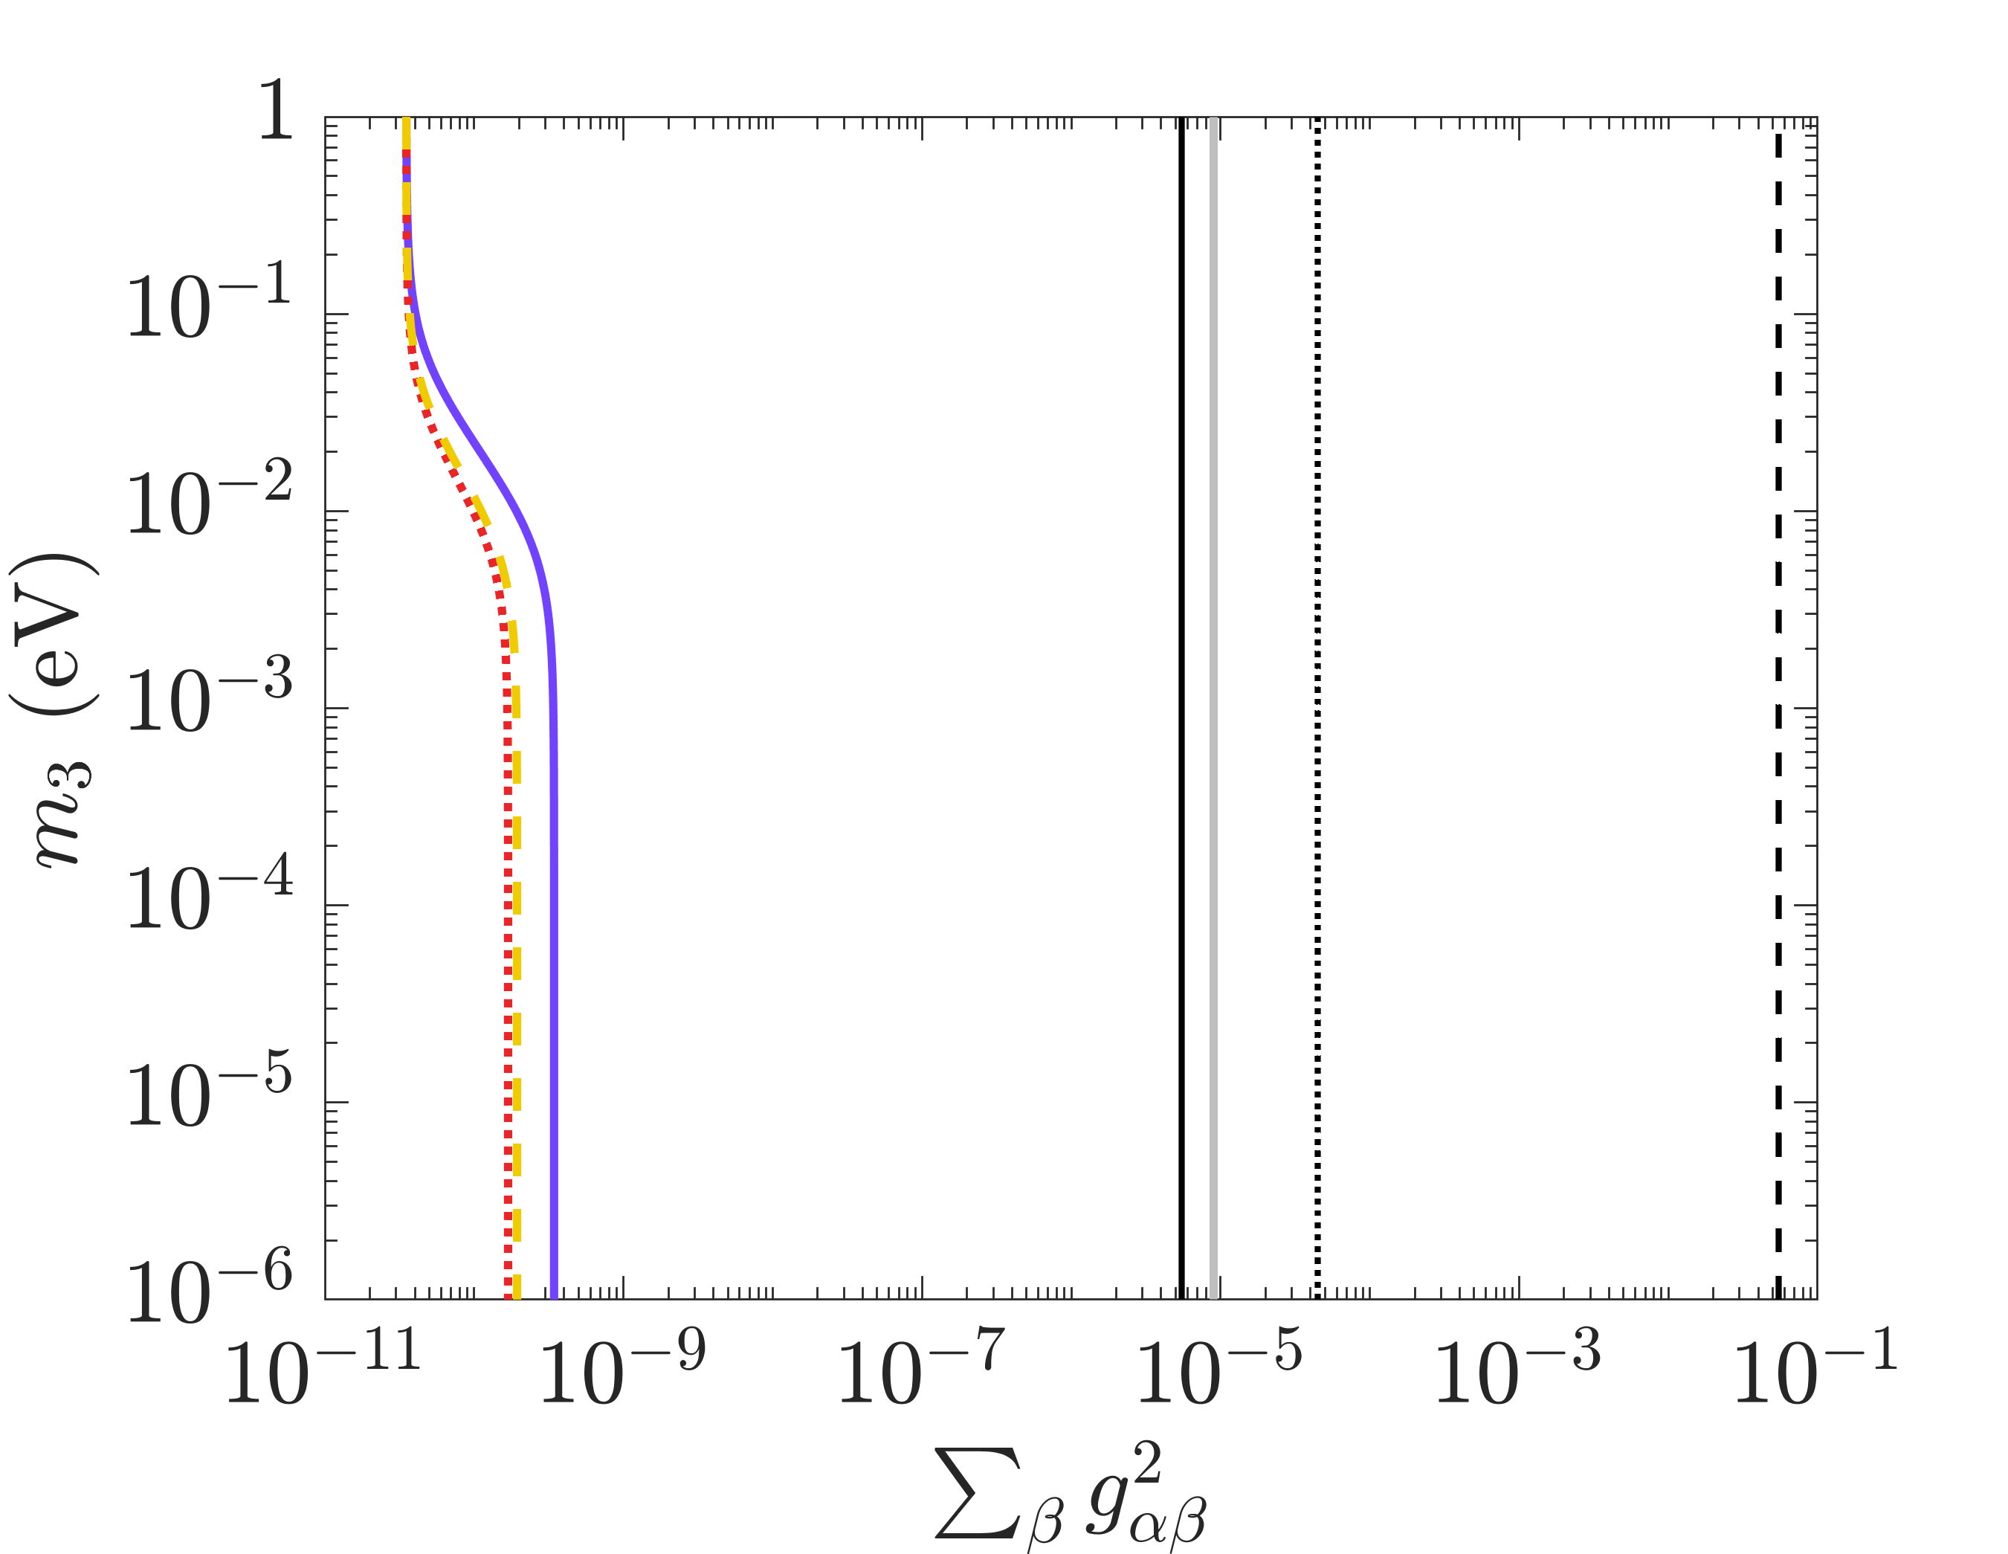

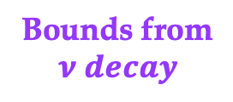

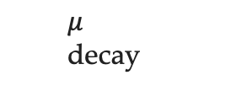



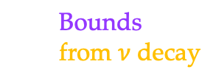




SN1987A and decay in matter : Neutrino-Majoron bounds
First likelihood analysis using spectral distortion from neutrino decay.
Comparison with neutrinoless-double beta and particle decays.
Bounds from
$$ν decay$$
  Bounds
  from $ν$ decay
Majoron
models
  $τ$ decay
(0$υ)2β$
  Kaon
  decay
  $μ$
  decay
$$m_{i}∝ g_{ij} δ_{\left\{ij\right\}}$$
  pion
  decay
m (a.u.)
$$ν_{3}$$
$$ν_{2}$$
$$ν_{2}$$
$$ν_{1}$$
Luminosity
argument
$$ν_{1}$$
$$ν_{3}$$
Normal
mass
ordering
(NO)
Inverted
Mass
Ordering
(IO)
Ivanez-Ballesteros, Volpe, arXiv: 2410.11517
Uncertainty from the
nuclear matrix elements
Ivanez-Ballesteros,Volpe, PRD 112, L101301 (2025) - $PDG$ 2026
  Bounds competitive with neutrinoless double-beta decay experiments, and particle decays.
47th Erice Course, « Neutrinos in Cosmology, in Astro-, Particle- and Nuclear Physics », 16th-22nd September 2026

Slide 21

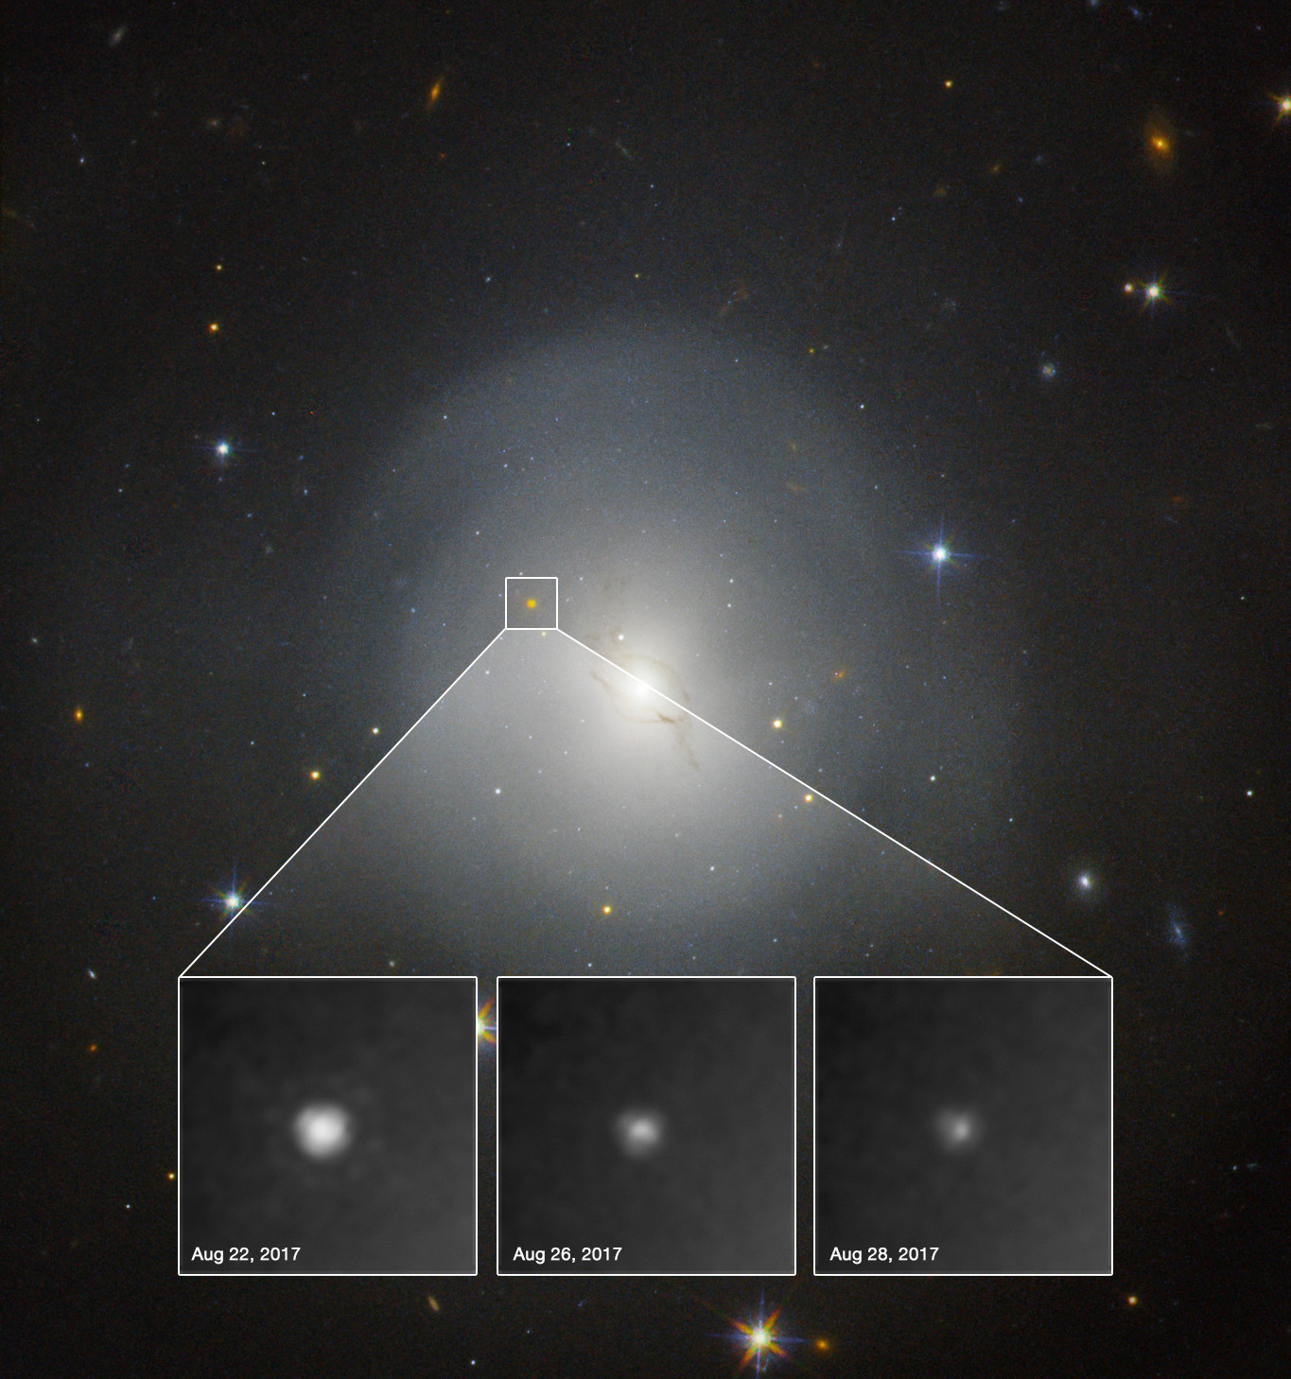
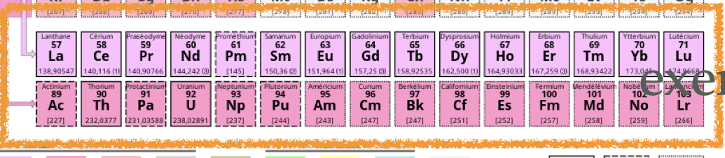
GW170817 : a unique event
  First observation of gravitational
  waves from a binary neutron-star merger, with short gamma ray burst
  and a kilonova.
Longstanding open question in nuclear astrophysics:
In which astrophysical sites and conditions
are elements heavier than iron formed (r-process) ?
Candidate sites :
core-collapse supernovae
binary neutron-star mergers
From the electromagnetic signal, indirect evidence
for the presence of r-process elements – lanthanides
and actinides.
Kilonova, gradually fading away, in
NGC 4993, 40 Mpc (140 million light-yrs)
Cameron, Ann. Rev. 8 (1958)
Lattimer, Schramm, Astrop. J, (1974), (1976)
Neutrinos impact heavy-elements nucleosynthesis,
setting neutron/proton ratio.
Flavor phenomena also influence the abundances.
Hubble Space Telescope, NASA,, N. T. U. L. ESA. Acknowledgment:
A.J Levan(U. Warwick), A. Fruchter, and O. F. (STScI) (2017a);
47th Erice Course, « Neutrinos in Cosmology, in Astro-, Particle- and Nuclear Physics », 16th-22nd September 2026

Slide 22
Theoretical developments
Impressive theoretical progress made in the last two decades
47th Erice Course, « Neutrinos in Cosmology, in Astro-, Particle- and Nuclear Physics », 16th-22nd September 2026

Slide 23

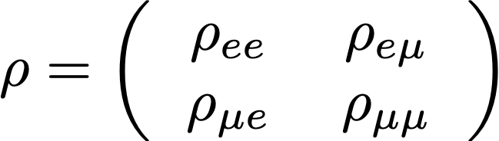
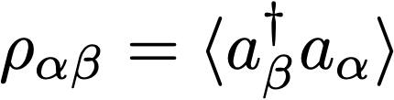
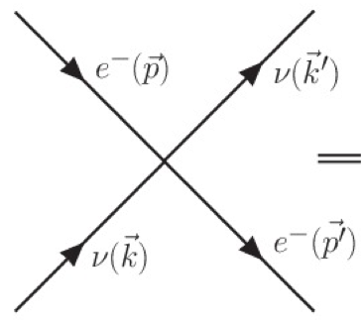
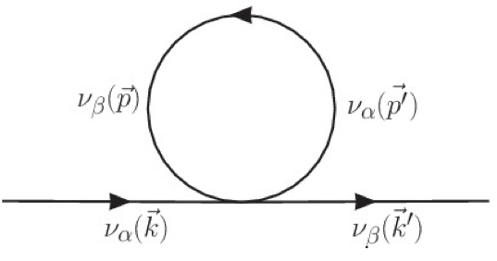
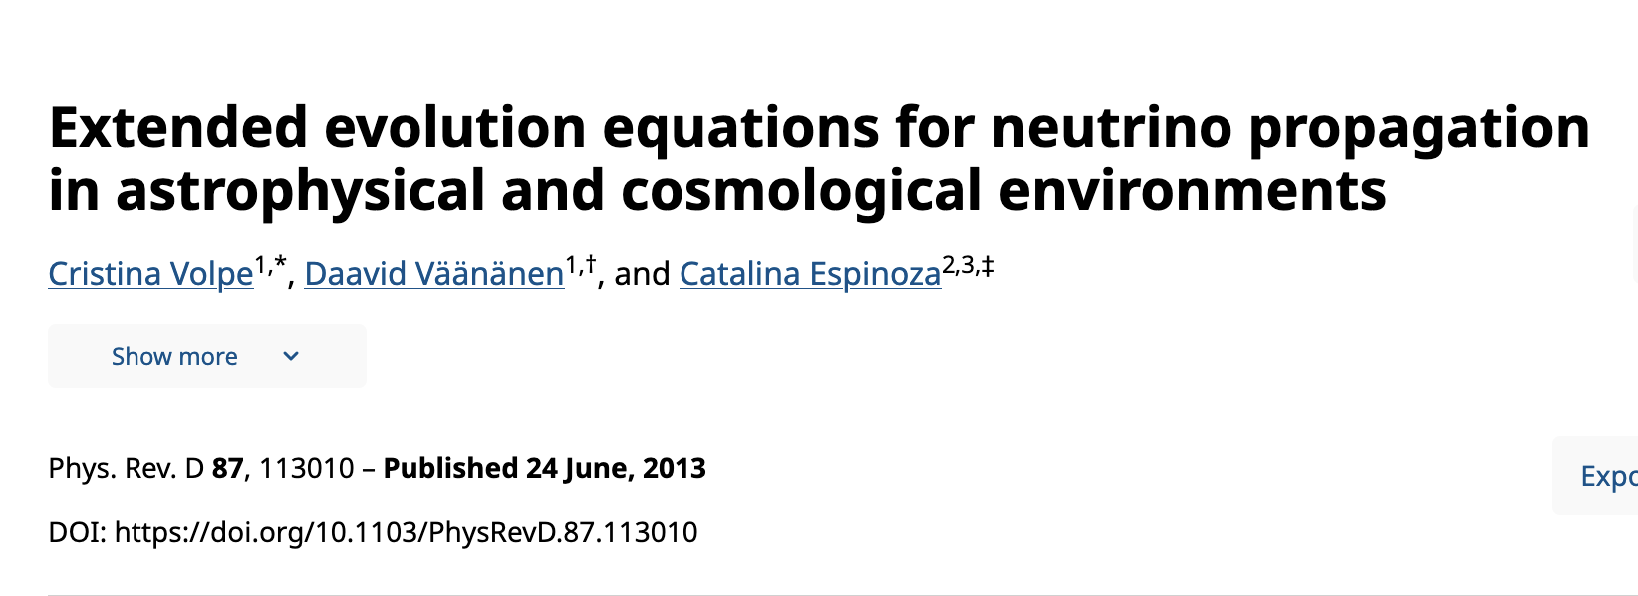
NEUTRINOS EVOLUTION EQUATIONS in DENSE MEDIA
Density matrix in 2nu framework
  In the inner dense regions, neutrinos are trapped.
  When matter becomes dilute they start-free streaming.
In dense environments, one should solve the neutrino
quantum kinetic equations (QKE) :
Raffelt (2012)
$$i(∂_{t}+v⋅∇_{x}+F⋅∇_{p})ρ_{x,p}=[h_{x,p},ρ_{x,p}]+iC[ρ,\overline{ρ}],$$
Liouville operator
mean-field
collisions
(phase space 7-dimensional)
  Intensive theoretical studies with
  schematic models since two decades : Emergence of novel flavor phenomena
interplay
collision
mean-field
QKE in the Early Universe (BBN epoch) :
  Solved (off-diagonal collision term in the damping approx.),
  Full collision term, a precise value for Neff = 3.0440 .
Horn and Volpe, 2011 - unpublished , Horn’s Diploma Thesis.
Froustey, Pitrou, Volpe, JCAP 12, 2020
47th Erice Course, « Neutrinos in Cosmology, in Astro-, Particle- and Nuclear Physics », 16th-22nd September 2026

Slide 24
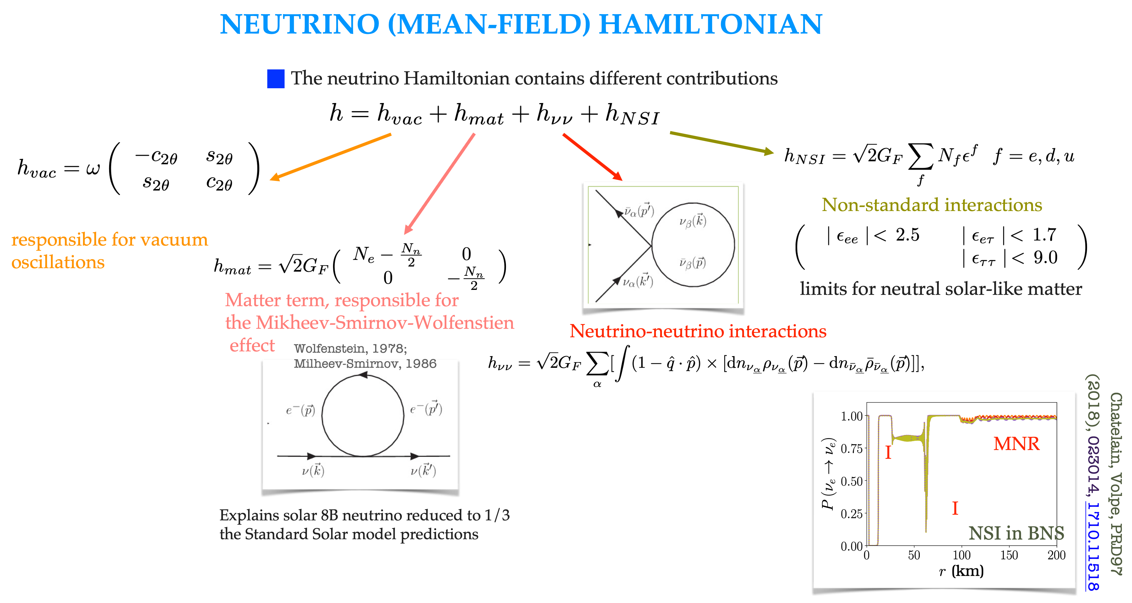


$$k=k^{′}p=p^{′}$$
$$k=k^{′}p=p^{′}$$
47th Erice Course, « Neutrinos in Cosmology, in Astro-, Particle- and Nuclear Physics », 16th-22nd September 2026

Slide 25
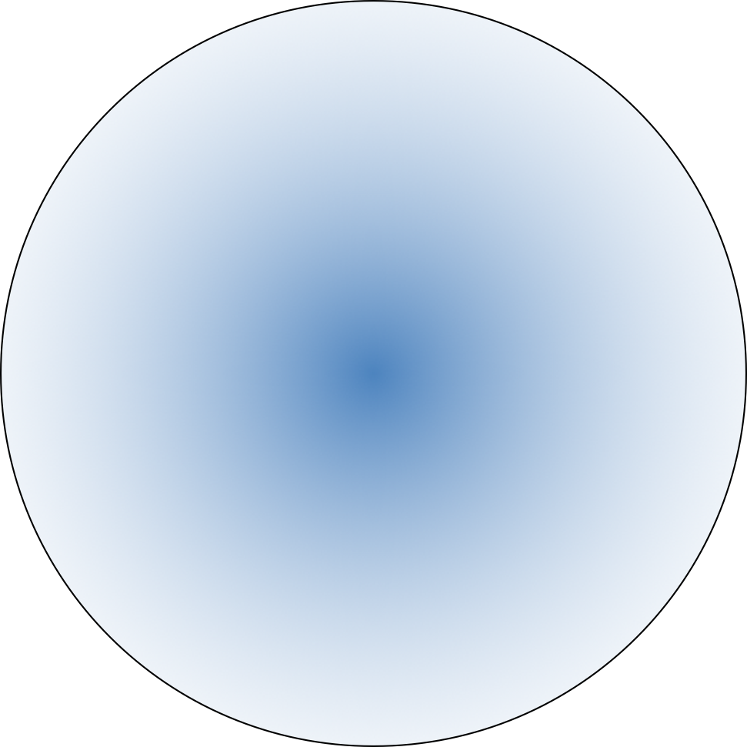







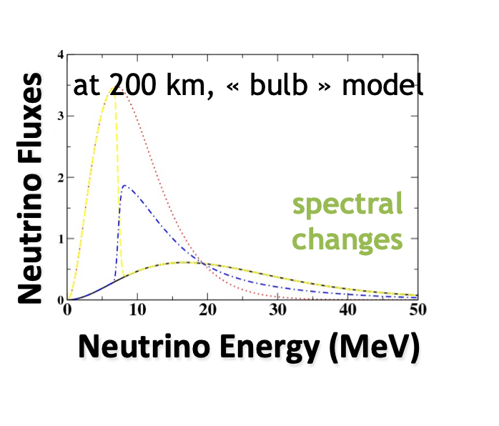
NOVEL NEUTRINO FLAVOR PHENOMENA IN DENSE ENVIRONMENTS
Neutrino-neutrino
interactions
Mikheev-Smirnov-Wolfenstein effect
MSW
region
Dighe and Smirnov, 2000
NS
shock
wave
Shock wave effects
Schirato and Fuller, hep-ph/0205390
Duan, Fuller, Carlson, Qian, 2006
slow modes
fast modes (m scale or less)
Sawyer PRD 2005, PRL 2016.
Turbulence effects
Loreti et al, 1995
Collisional instabilities
Johns, 2023
Impact the supernova dynamics,
nucleosynthesis processes, observations
Many aspects understood, the neutrino-neutrino
interactions is a challenging open problem.
47th Erice Course, « Neutrinos in Cosmology, in Astro-, Particle- and Nuclear Physics », 16th-22nd September 2026

Slide 26
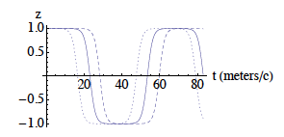
CHALLENGING OPEN ISSUES
Fast modes
New numerical treatments (subgrid scale)
to study their effects on the neutrino spectra
(flavor thermalization).
.
Need for consistent treatments of collisions and mean-field terms.
Sawyer PRL 2016
Interplay between them being studied.
Uncovered short scale modes
(better description of the neutrino angular
emission, crossings for nue and nuebar).
Impacts the supernova dynamics, as shown
by recent parametric studies.
Impact nucleosynthesis processes
(r-process, nu-i process).
Slow modes
Duan et al, 2006
Connections and approches to other domains, e.g. with nuclear and condensed matter physics
or plasma physics - « flavomons ».
Volpe, Espinoza, Väänänen, PRD 87 2013.
Fiorillo, Raffelt, PRL 2025.
  New developments using quantum algorithms and devices ongoing.
Solving this open problem crucial to assess the impact of neutrino flavor phenomena
47th Erice Course, « Neutrinos in Cosmology, in Astro-, Particle- and Nuclear Physics », 16th-22nd September 2026

Slide 27
Future observations
« It doesn’t matter how beautiful your theory is, it doesn’t matter how smart you are.
If it doesn’t agree with experiment, it’s wrong. »
R. Feynman
47th Erice Course, « Neutrinos in Cosmology, in Astro-, Particle- and Nuclear Physics », 16th-22nd September 2026

Slide 28
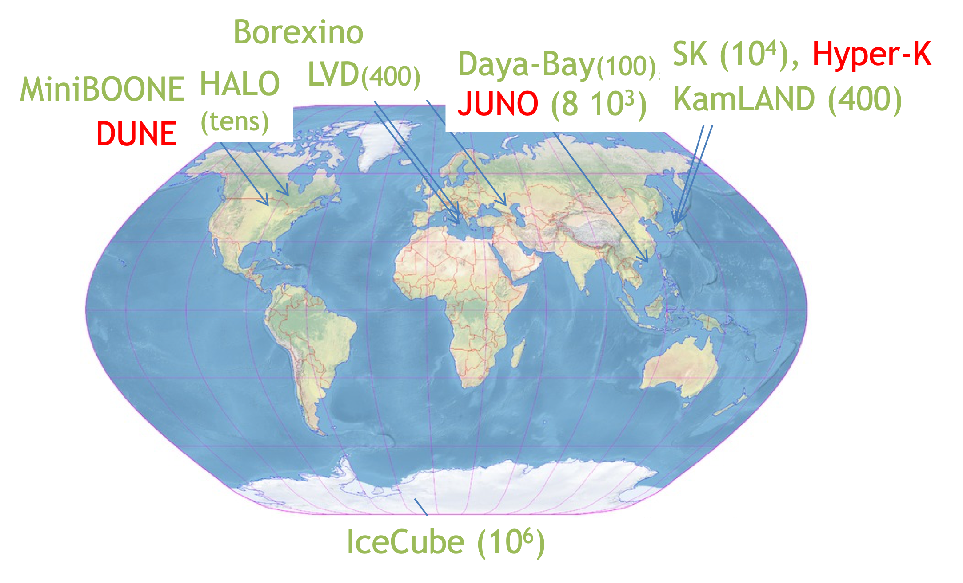
NEUTRINOS from NEXT SUPERNOVA
Supernova Early Warning System (SNEWS) :
A network of neutrino detectors that should
alert astronomers and gravitational wave
collaborations (multimessanger).
Scholberg 1999, 2008; SNEWS Coll. 2021
KM3NET
From the next supernova in our Galaxy, expected neutrino events range from few hundreds, also in dark-matter
detectors, to 10⁶ (IceCube).
Measure all neutrino flavors, time and energy signal
-nu-electrons, nu-nucleus incoherent, nu-proton and coherent
nu-nucleus scattering.
47th Erice Course, « Neutrinos in Cosmology, in Astro-, Particle- and Nuclear Physics », 16th-22nd September 2026

Slide 29
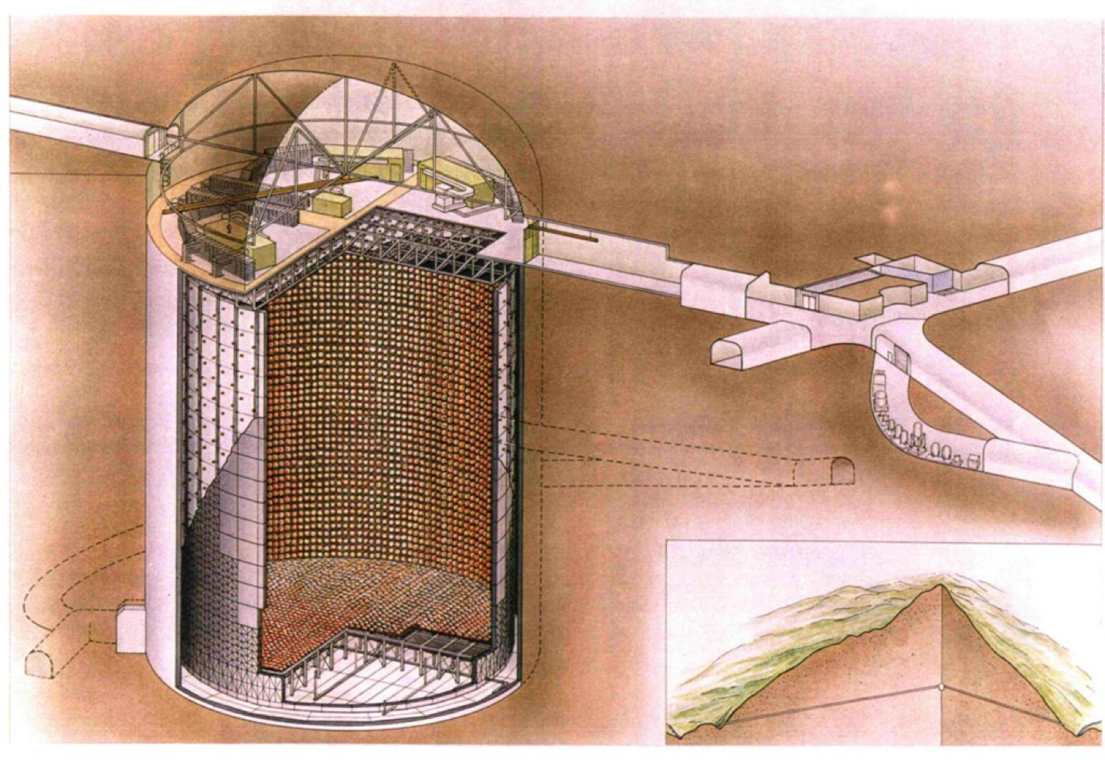


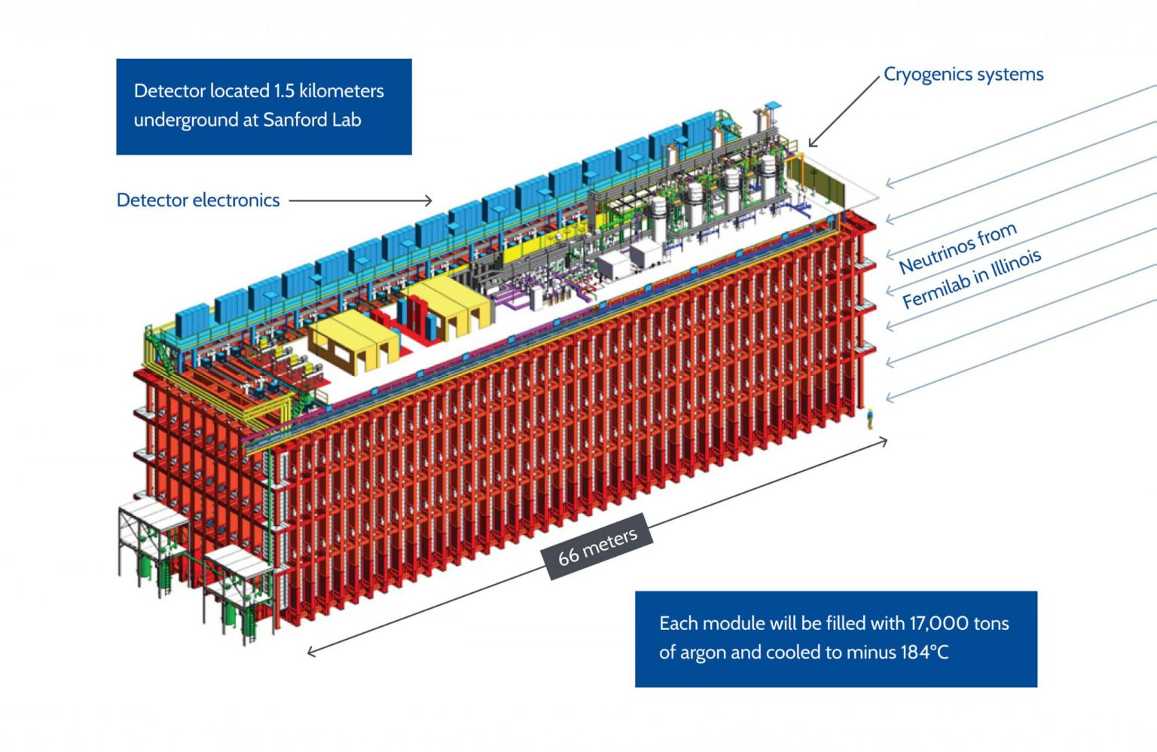

NEUTRINO DETECTORS as SN observatories
Examples of running and upcoming detectors that will
serve as supernova neutrino observatories:
Neutrino-nucleus coherent scattering (qR < 1, R nuclear radius,
few keV recoils)
D.Z. Freedman. Phys. Rev. D9, 1389 (1974)
Super-Kamiokande
50 kton water (Japan)
Running (2020) + Gd
Hyper-Kamiokande
178 kton (FV) water (Japan)
Starting 2028
DUNE
40 kton
liquid argon
(US)
Starting 2029
JUNO
50 kton scintillator
(China)
started 2025
Observed in 2017 (6.7 sigma) by the COHERENT Collaboration
at SNS (Oak Ridge)
COHERENT Coll, Science 357 (2017) 6356 1708.01294 [
Sentivity to all flavors, time and energy signal through nu-electrons,
nu-nucleus incoherent, nu-proton and coherent nu-nucleus scattering
47th Erice Course, « Neutrinos in Cosmology, in Astro-, Particle- and Nuclear Physics », 16th-22nd September 2026

Slide 30
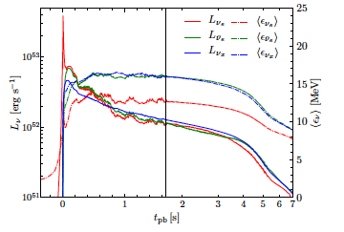

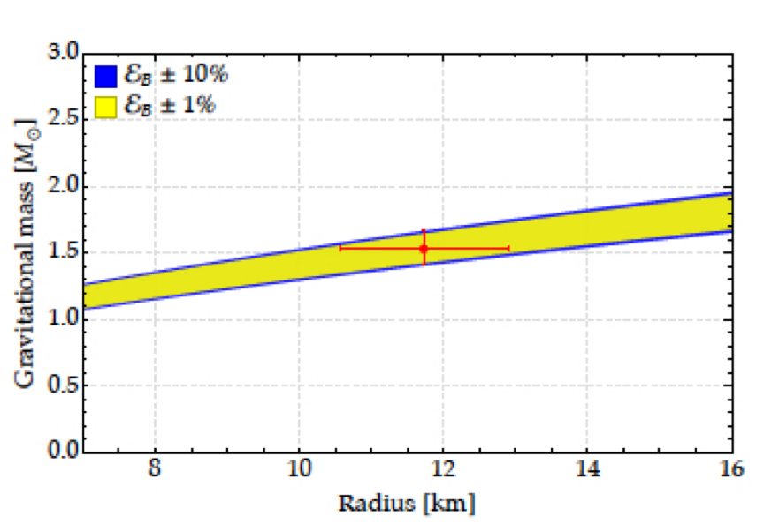



SUPERNOVA NEUTRINOS : TIME SIGNAL
neutronization peak
Neutronization peak:
> only MSW effect operates
> non-standard properties, ex. decay or NSI
accretion phase
De Gouvea et al, PRD101, 2020; Das et al, JCAP
05, 2017; etc…
Total neutrino luminosity (SN at 10 kpc):
> 11% (SK) and 3% (HK) precision
neutron star
cooling
fit to EOS for NS
Lattimer & Prakash,
Phys. Rep. 2007
3D, 19 Msun progenitor, explosion energy 1O⁵¹ erg
A star like SN1987A
Böllig et al, 2021
Detection of each phase crucial
Gallo Rosso, Vissani, Volpe, JCAP 11, 2017
Compactness of newly born neutron star
Future constrains on EOS from GW observations.
47th Erice Course, « Neutrinos in Cosmology, in Astro-, Particle- and Nuclear Physics », 16th-22nd September 2026

Slide 31
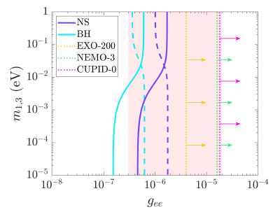






Neutrino decay in matter : Prospects for next supernova
A supernova in the Milky Way (10 kpc), leaving a neutron-star (NS) or a black hole (BH).
Bounds on the Neutrino-Majoron (Majoron-like particle) from a
likelihood analysis based on the neutrino spectral distortion due to
neutrino decay in JUNO, DUNE, DARWIN and Hyper-Kamiokande.
Majoron
models
SN1987A
(0$υ)2β$
Next SN
$$m_{i}∝ g_{ij} δ_{\left\{ij\right\}}$$
m (a.u.)
$$ν_{3}$$
$$ν_{2}$$
$$ν_{2}$$
$$ν_{1}$$
BH
NS
$$ν_{1}$$
$$ν_{3}$$
Luminosity argument
Normal
mass
ordering
(NO)
Inverted
Mass
Ordering
(IO)
Ivanez-Ballesteros,Volpe, JCAP 02
(2026) 069, 2507.21845
  An improvement by orders of magnitudes
47th Erice Course, « Neutrinos in Cosmology, in Astro-, Particle- and Nuclear Physics », 16th-22nd September 2026

Slide 32

CONFIRM the SUPERNOVA EXPLOSION MECHANISM
Delayed neutrino-heating mechanism:
the hydrodynamic instabilities (SASI) have a characteristic imprint on
the neutrino time signal. One of the features.
Imprint of SASI on the neutrino time signal
GW signatures (different frequencies) from
core bounce (rotating progenitor);
neutrino-driven convection (PNS);
neutrino-driven convection in the gain layer;
SASI.
see e.g. Mezzacappa and Zaolin, 2401.11635.
Walk, Tamborra, Janka,
Summa, Kresse, 2020
OBSERVING THE NEXT SUPERNOVA CRUCIAL
47th Erice Course, « Neutrinos in Cosmology, in Astro-, Particle- and Nuclear Physics », 16th-22nd September 2026

Slide 33


A UNIQUE LABORATORY for FLAVOR PHENOMENA in DENSE MEDIA
First Bayesian analysis to discriminate
flavor phenomena.,
Supernova distance not known, no neutrino flux parameters fixed.
Abbar and Volpe, PRD 111 (2025), 2401.10851.
DISCRIMINATING FLAVOR MECHANISMS COULD BE POSSIBLE
47th Erice Course, « Neutrinos in Cosmology, in Astro-, Particle- and Nuclear Physics », 16th-22nd September 2026

Slide 34
SUPERNOVA SIGNALS
Neutrinos - SN fate (BH vs NS), explosion mechanism,
EOS and compactness of the PNS, PNS cooling,
progenitor structure, stellar evolution (pre-SN neutrinos),
localization via triangulation, flavor mechanisms in dense media,
neutrino properties - magnetic moment, non-radiative decay,…
Optical- localization and distance,
progenitor, …
ex. All Sky Automated Survey
for Supernovae (ASAS-SN)
Gravitational waves - explosion mechanism,
M-R, …
47th Erice Course, « Neutrinos in Cosmology, in Astro-, Particle- and Nuclear Physics », 16th-22nd September 2026

Slide 35

UNIVERSE EVOLUTION
DSNB

Slide 36
DSNB DETECTION
Running (2020--) ,
Gd 0.01 % (SKVI), 0.03 % (SKVII)
Running (2025--)
Starting 2028--
Expected in 2030
Super-Kamiokande (Japan)
Abusleme et al,
JCAP10, 2022
Abi et al, 2022
Abe et al, 2511.02222
JUNO (China)
50 kton scintillator
started 2025
Abe et al, 2018
DUNE
40 kton liquid argon (US)
Hyper-Kamiokande (Japan)
178 kton water,
Expected DSNB events :
10 for SK-Gd (10 year), and DUNE (20 years), 10-40 for JUNO (20 years)
several hundreds for Hyper-Kamiokande (10-20 years).
Four experiments have the potential to discover
the diffuse supernova neutrino background.
47th Erice Course, « Neutrinos in Cosmology, in Astro-, Particle- and Nuclear Physics », 16th-22nd September 2026

Slide 37











DIFFUSE SUPERNOVA NEUTRINO BACKGROUND
The DSNB flux depends on the evolving core-collapse supernova rate, the neutrino fluxes
from a supernova, the cosmological model through the cosmic time
$$z∈[0,5]$$
M $∈\left[8, 100\right] M_{Sun}$
Debated fraction of failed supernovae
leaving a black-hole
(debated in the astrophysical community)
Flavor evolution, beyond the Standard
Model physics, ex. decay
model
Better constrain the cosmic
core-collapse supernova rate
(uncertain by about a factor of 2)
$$ν_{h}→\overline{ν_{i}} +φ$$
Normal
mass
ordering
Inverted
mass
ordering
A NEW WINDOW ON THE UNIVERSE
Uncertainty from
the evolving core-
collapse supernova
rate R_{SN}(z)
no-decay
N. Roux, M. Cristina Volpe,
JCAP 04 (2025) 021, 2412.14681.
Ivanez-Ballesteros, Volpe, PRD 107(2023);
2209.12465
47th Erice Course, « Neutrinos in Cosmology, in Astro-, Particle- and Nuclear Physics », 16th-22nd September 2026

Slide 38






Upper limits on DSNB flux and rates, as of 2021
Flux upper limits from SKI-IV and SNO data
Abe et al, 2109.11174
SNO data, Aharmim et al, Astrophys. J. 2006
Peres and Lunardini,. JCAP 2008
The sensitivity of the combined analysis
is on par with 4 predictions.
A hint at 1.5 $σ$ (model-dependent analysis).
Sample of
DSNB available
predictions
Abe et al, 2109.11174
Super-Kamiokande Running (2020--)
Gd 0.01 % (SKVI), 0.03 % (SKVII)
Abe et al, 2109.11174
Super-Kamiokande analyses (20 years) :
DSNB rates (90% C.L.), best fit values (1 sig.)
and expected sensitivity from SK-I and SK-IV data
1.2 $σ$, model-dependent analysis,
Astrophys.J. 1005 (2026), Abe et al, 2511.02222
47th Erice Course, « Neutrinos in Cosmology, in Astro-, Particle- and Nuclear Physics », 16th-22nd September 2026

Slide 39






Super-Kamiokande results - Gadolinium (NEUTRINO 2026)
Preliminary
Model-independent analysis :
Tension with the background only
hypothesis at the 1.8-2.4 sigma level.
Model-dependent analysis : a signal
See also
Galais et al
PRD 2010.
THEORETICAL
PREDICTIONS
Include shock-wave
effects and the $νν$
interaction
Abe et al, 2511.02222
The discovery of the diffuse supernova neutrino background might be close.
47th Erice Course, « Neutrinos in Cosmology, in Astro-, Particle- and Nuclear Physics », 16th-22nd September 2026

Slide 40



CONCLUSIONS
Neutrinos from dense environments are unique probes for astrophysics, particle
physics and the search for new physics.
The next supernova will be unique to confirm the supernova
explosion mechanism, to study flavor conversion mechanisms in dense
environments ($νν$interaction, shock wave effects,…) and to search for
new physics -neutrino decay, neutrino-Majoron couplings, …
The discovery of the diffuse supernova neutrino background might
be imminent.
It would open a new window in low energy astrophysics.
« Une femme jouant de la guitare », Vermeer, 1672
47th Erice Course, « Neutrinos in Cosmology, in Astro-, Particle- and Nuclear Physics », 16th-22nd September 2026

Slide 41

My personal view
on Neutrino Physics
Thank you !
A very
interdisciplinary
domain
47th Erice Course, « Neutrinos in Cosmology, in Astro-, Particle- and Nuclear Physics », 16th-22nd September 2026

