Slide 1
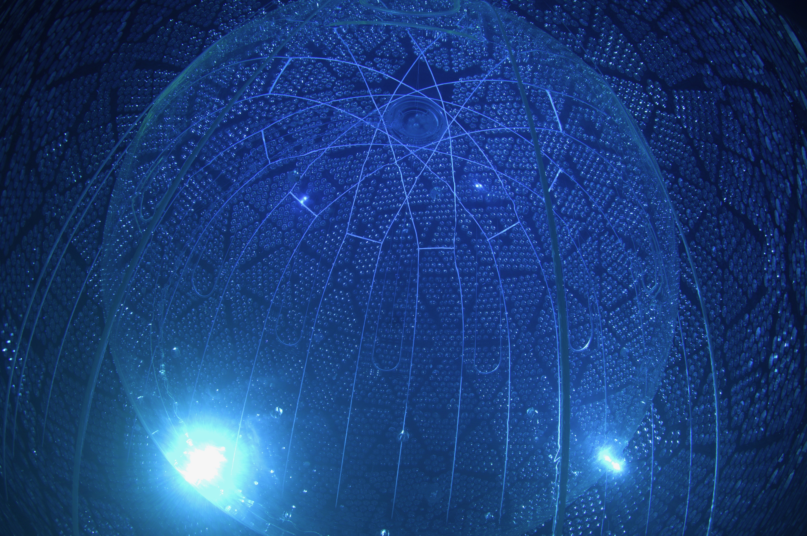
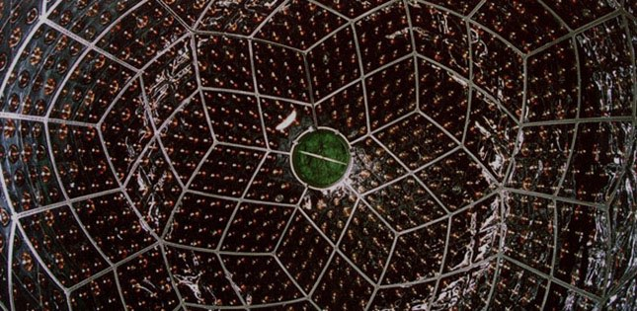
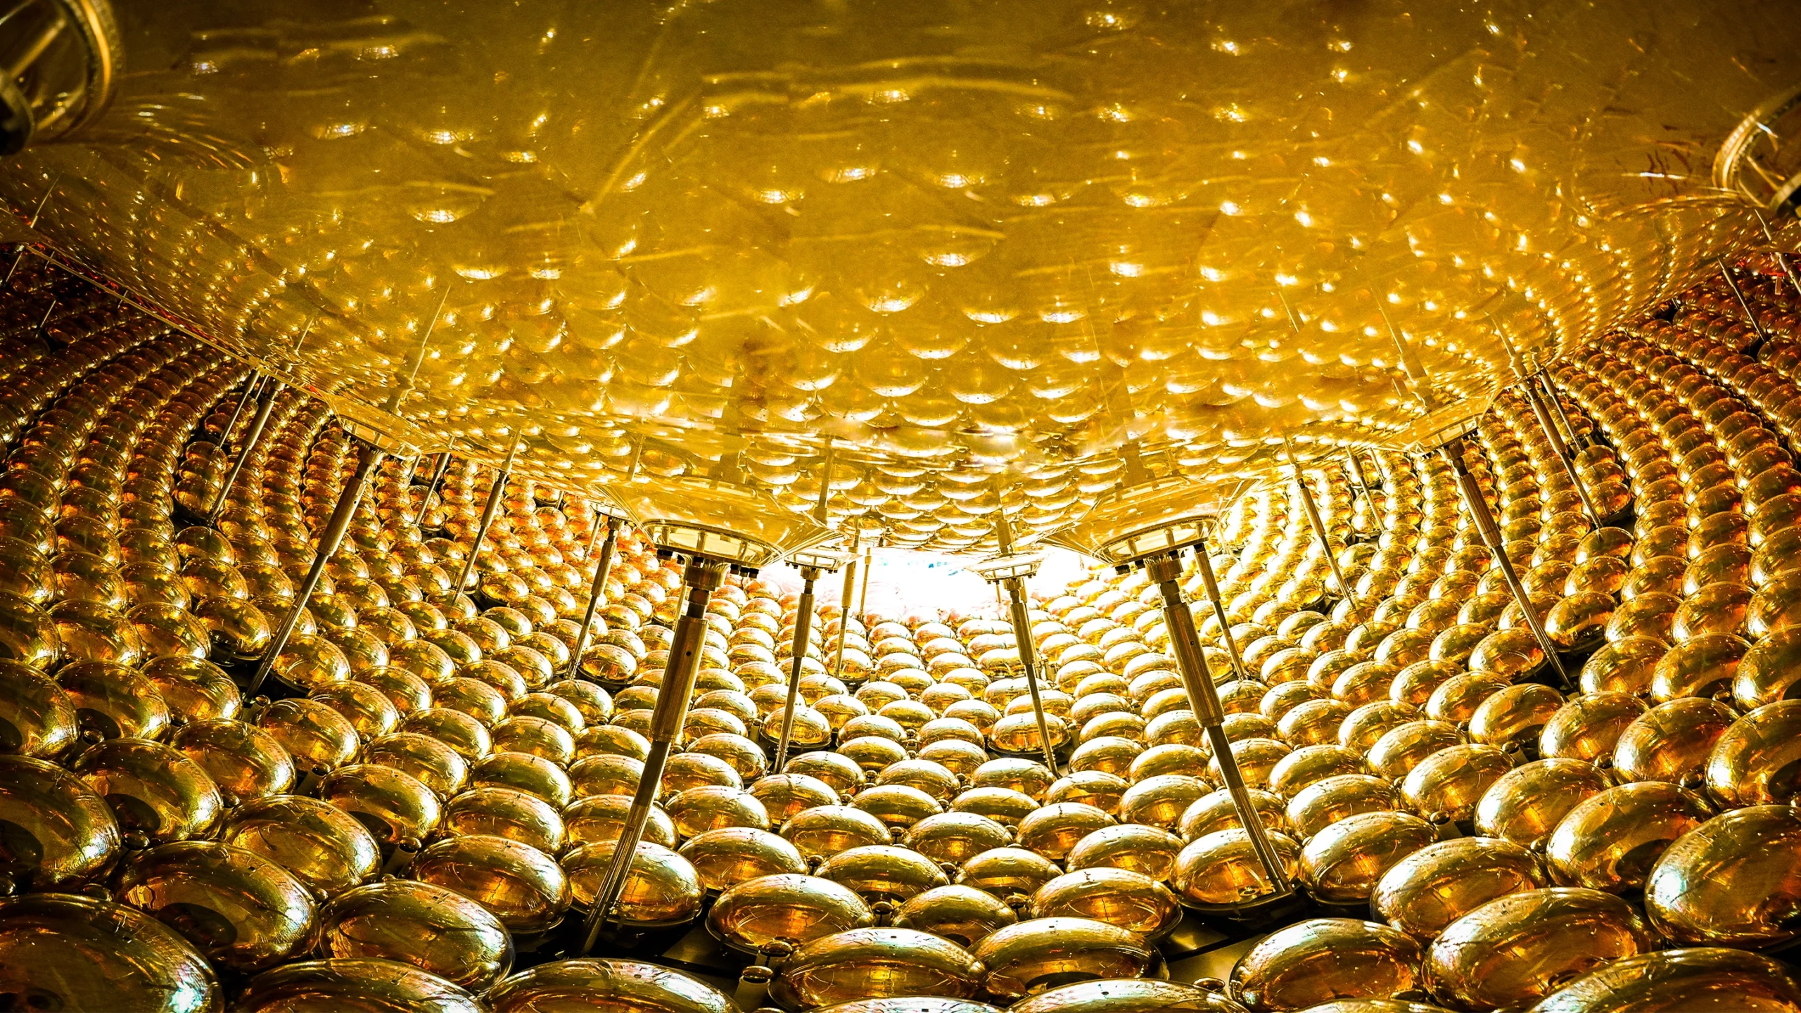


Overview on
Geoneutrinos
Mark Chen
Queen’s University

Slide 2
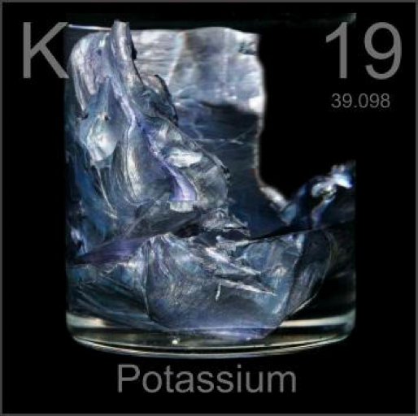

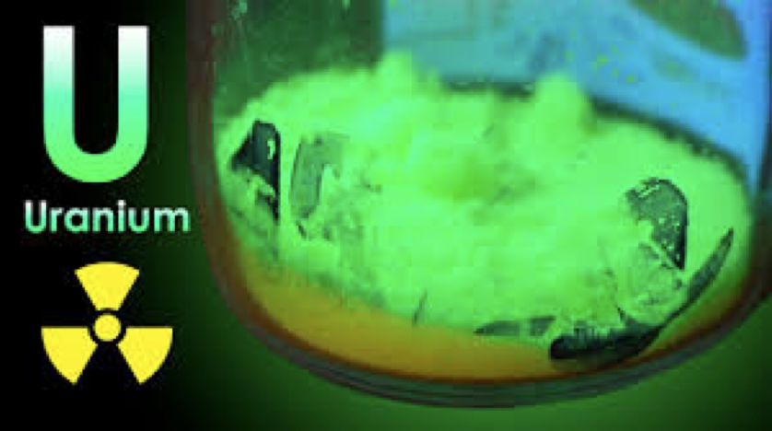
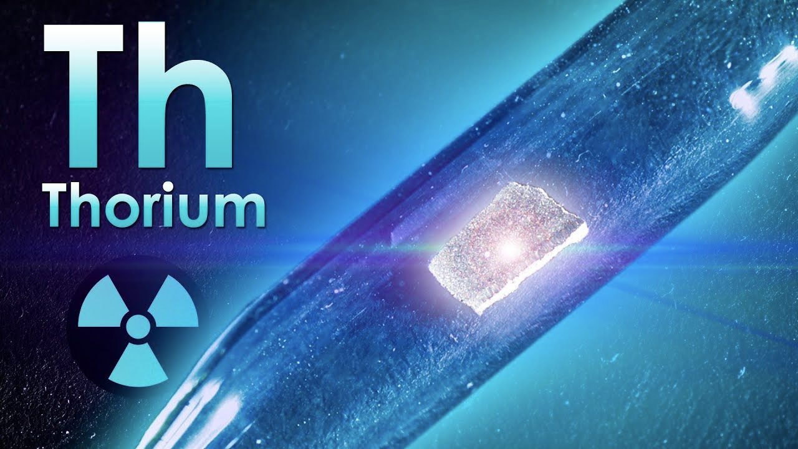

Geoneutrinos: ${\overset{¯}{ν}}_{e}$ emitted by the Earth
from the β– decay of naturally-occurring radioactive elements in the crust and mantle
U, Th, K account for >99% of Earth’s radiogenic heat production
(and a large fraction ~40% of Earth’s total heat flow)
40K
~20% of
radiogenic
heat

Slide 3
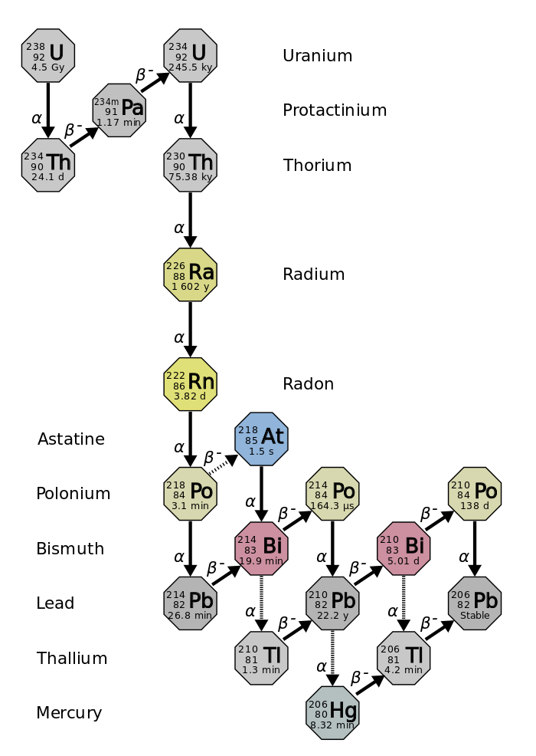
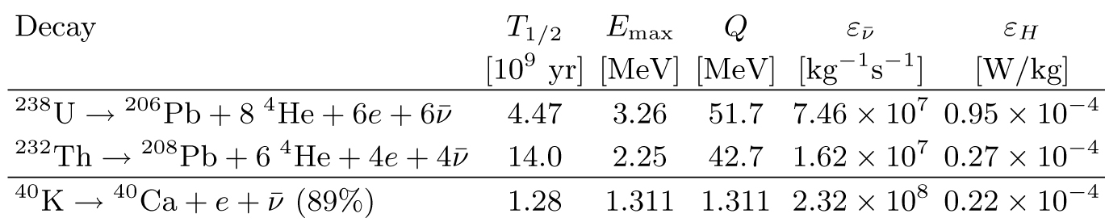
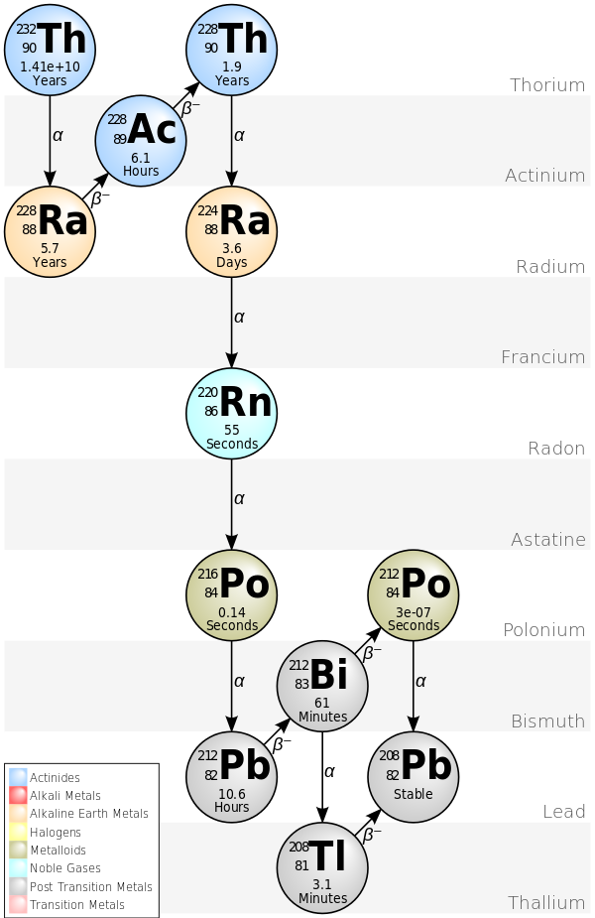
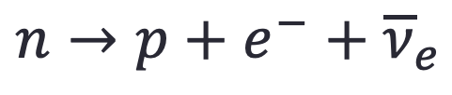
Uranium, Thorium and Potassium Decay
when neutron-rich
heavy elements
undergo beta decay
antineutrinos
(electron-flavour)
are emitted
$$n→p+e^{−}+{\overline{ν}}_{e}$$

Slide 4
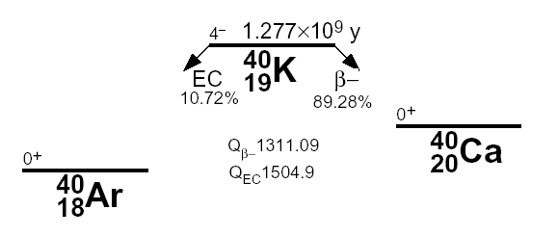
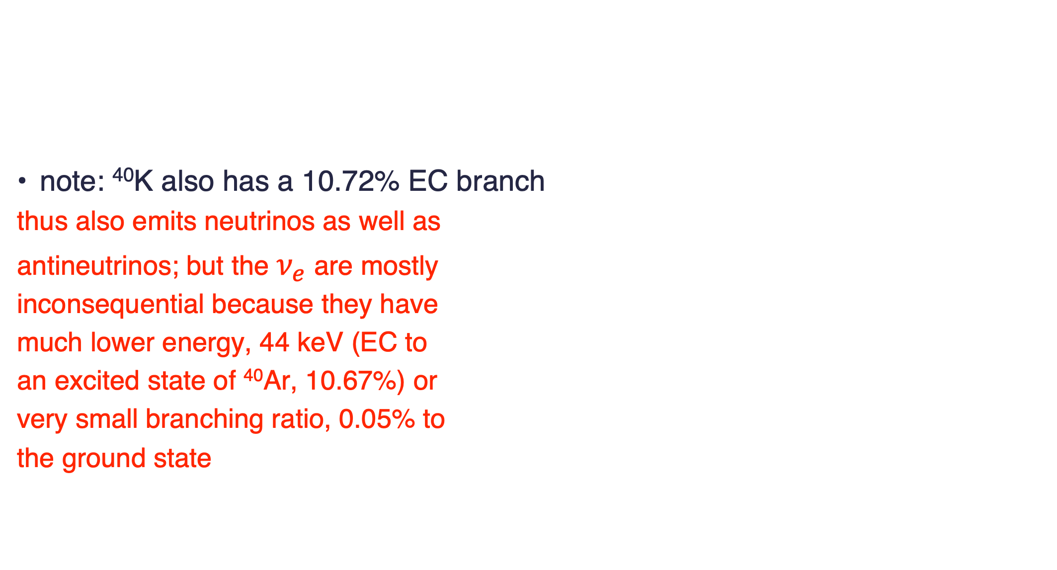
Uranium, Thorium and Potassium Decay
note: ⁴⁰K also has a 10.72% EC branch
  thus also emits neutrinos as well as
  antineutrinos; but the $ν_{e}$ are mostly
  inconsequential because they have
  much lower energy, 44 keV (EC to
  an excited state of ⁴⁰Ar, 10.67%) or
  very small branching ratio, 0.05% to
  the ground state
0.0117% isotopic abundance

Slide 5
Important Questions in Geosciences
related to geoneutrinos
what is the radiogenic contribution (U, Th, ⁴⁰K) to heat flow and energetics in the deep Earth? – seismology and geophysics give us structure and density but not chemical composition
  mantle: convective Urey ratio
  geoneutrinos can probe
Goal: assay the entire Earth by looking at its
“neutrino glow”
ratio of heat generation to heat loss in
mantle convection models – important
Radiogenic heat producing elements (HPEs) play an crucial role in Earth energetics: mantle convection, plate tectonics, volcanism, and Earth’s thermal history

Slide 6
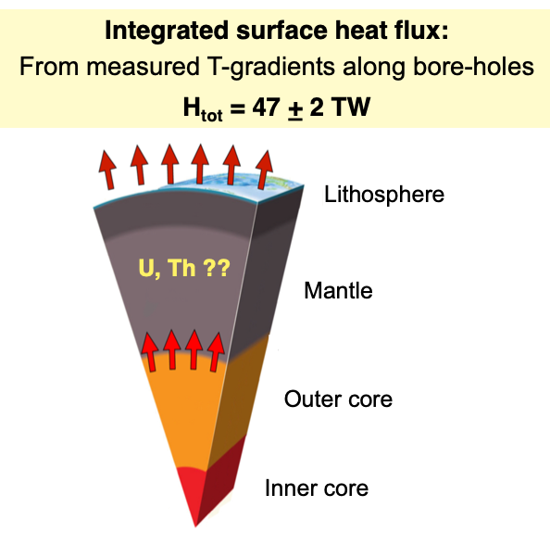
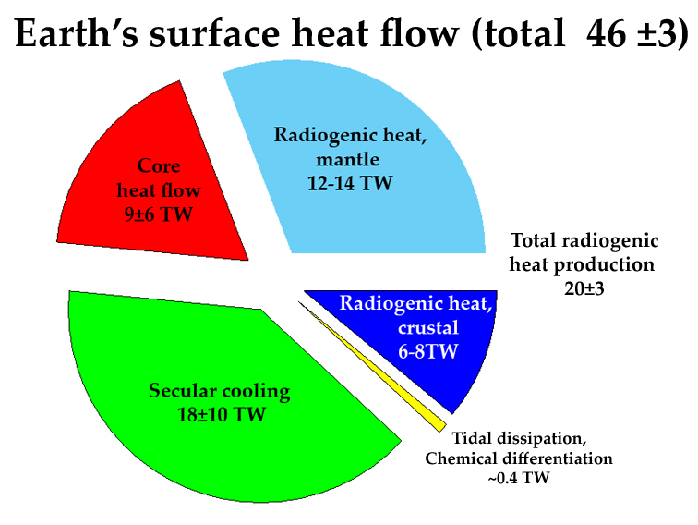

$$47±2TW$$
figure from Livia Ludhova
breakdown of what we think gives rise to
the measured heat flow
figure from Bill McDonough

Slide 7
Important Questions in Geosciences
related to geoneutrinos
what is the radiogenic contribution (U, Th, ⁴⁰K) to heat flow and energetics in the deep Earth? – seismology and geophysics give us structure and density but not chemical composition
  mantle: convective Urey ratio?
  geoneutrinos can probe
are the fundamental ideas about Earth’s origin and thus bulk chemical composition correct?
are the basic models of the composition of the crust correct?
  geoneutrinos can try to test which ones are
Goal: assay the entire Earth by looking at its
“neutrino glow”

Slide 8

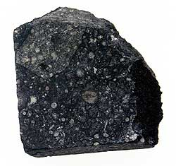
all the data points (dots) are
each an element
the outliers are labeled
H
O
C
N
Solar photosphere
(atoms Si = 1E6)
B
Li
CI carbonaceous chondrite
(atoms Si = 1E6)

Slide 9
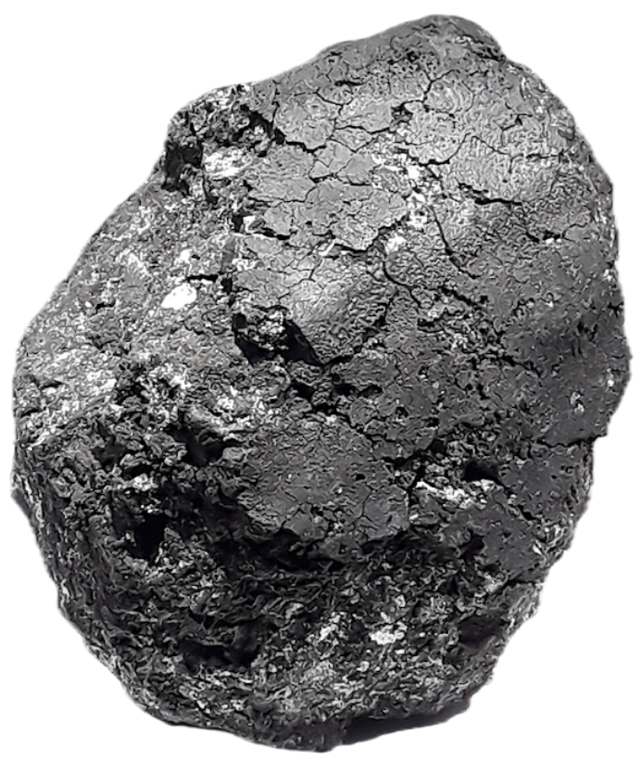
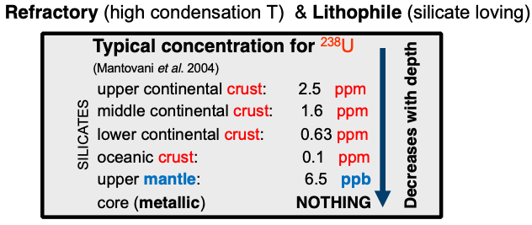

Models of Earth’s Origin
Lithophile elements have an affinity with oxygen, enriches the crust in U and Th
rock
primitive mantle
differentiated
crust-mantle
metal
core
Notes:
Model of the Earth
Iron core
How do we know? Seismology…doesn’t tell us chemistry though

Slide 10
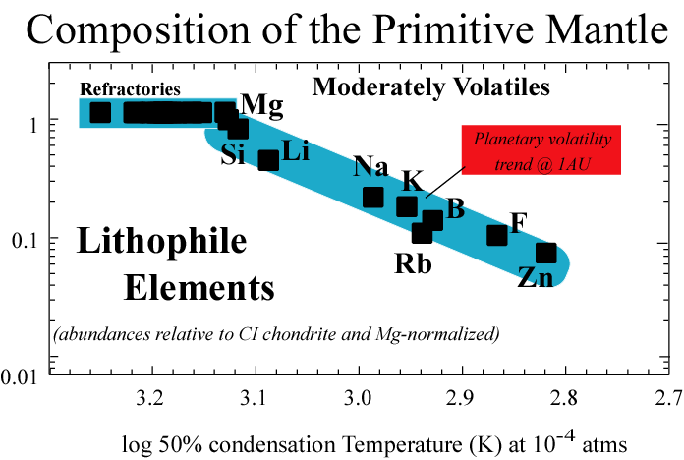
Th & U
Volatility trend
@1AU from Sun
slide from Bill McDonough
Notes:
Neutrinos can tell us about U and Th (theoretically K) in the deep Earth, otherwise inaccessible
This test models of Earth’s (chemical) origin
We have to be able to detect geo neutrinos, and measure how many are coming from the deep Earth to shed light on this fundamental, BIG question

Slide 11
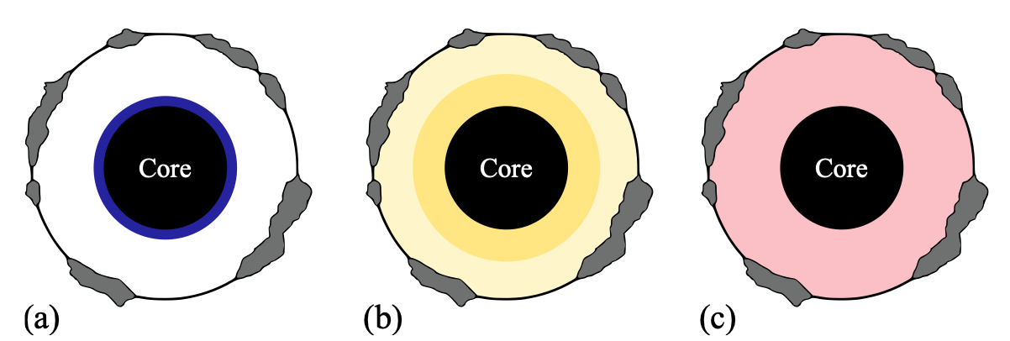
Bulk Silicate Earth Models and Distribution of Heat Producing Elements (HPEs)
“Cosmochemical” models – based on isotope geochemistry (of meteorites)
  EH enstatite chondrite (Javoy et al., 2010)
    11-14 TW radiogenic heat
“Geochemical” models – based on meteorite elemental composition
  CI chondrite (Rocholl & Jochum, 1993; McDonough & Sun 1995)
    17-19 TW radiogenic heat
“Physical” or “Geodynamical” models
  energetics of mantle convection (Turcotte & Schubert, 2002)
    27-35 TW radiogenic heat
illustrations of layered mantle HPE distributions from “Ferrara group”
11
Notes:
Some mantle convection models suggest that the radiogenic heat produced should a larger fraction of the total heat flow. So at least one of the following have some problems: the total heat flow measured, the estimated amounts of U, Th or K, or the mantle convection model. So, by measuring the antineutrinos from beta decays of daughter nuclei in the U and Th decay chains, we can maybe serve as a cross-check of the radiogenic heat production rate.

Slide 12
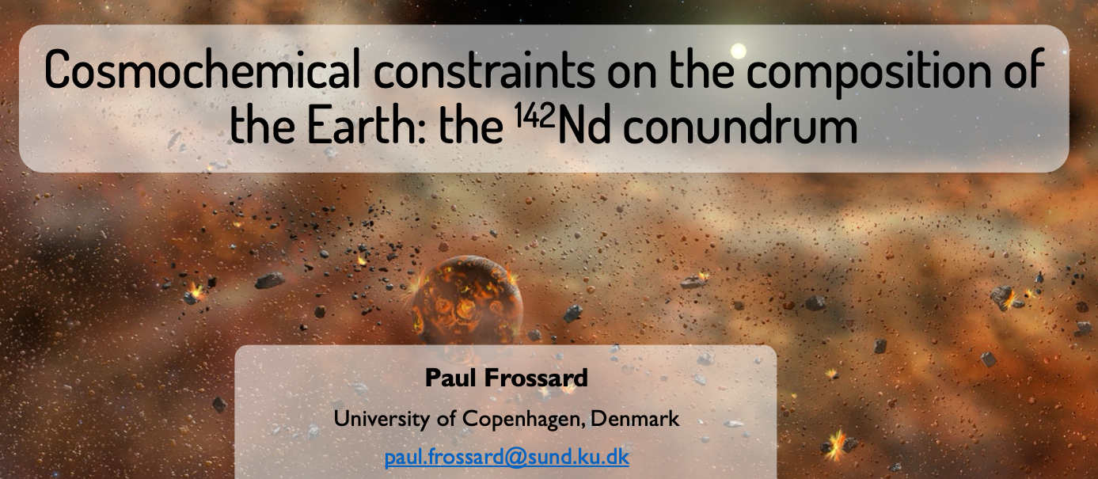
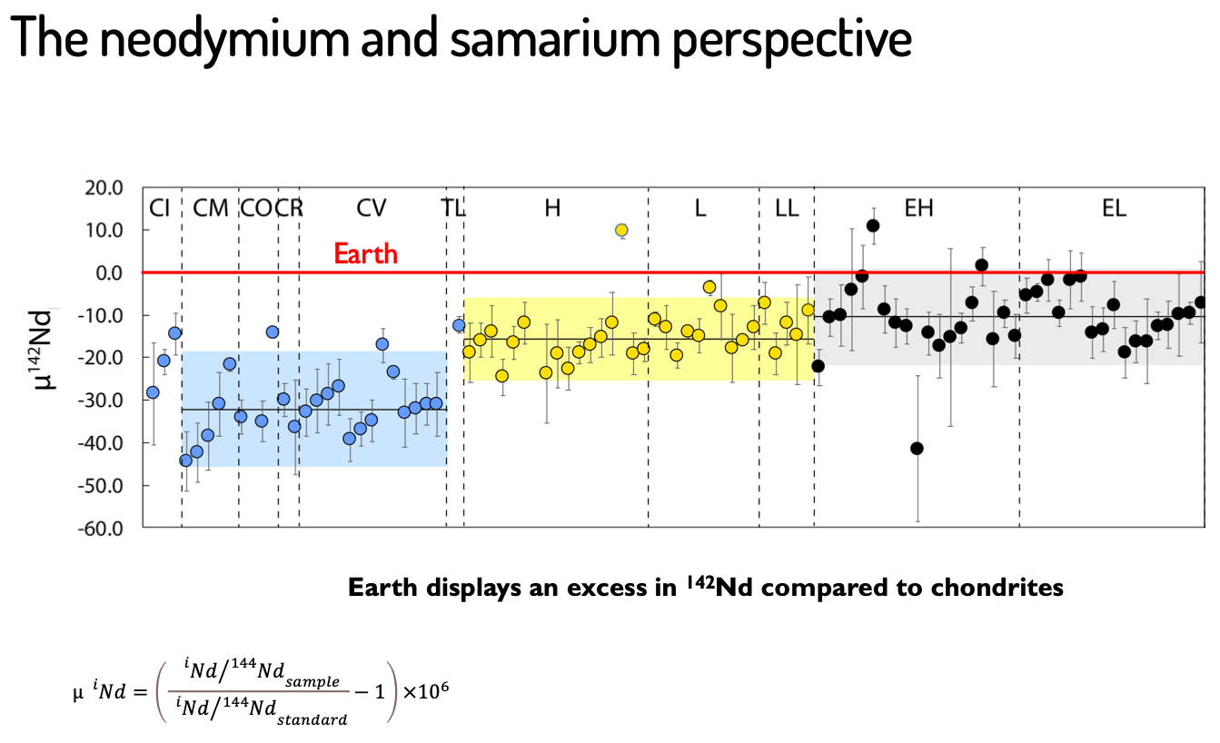
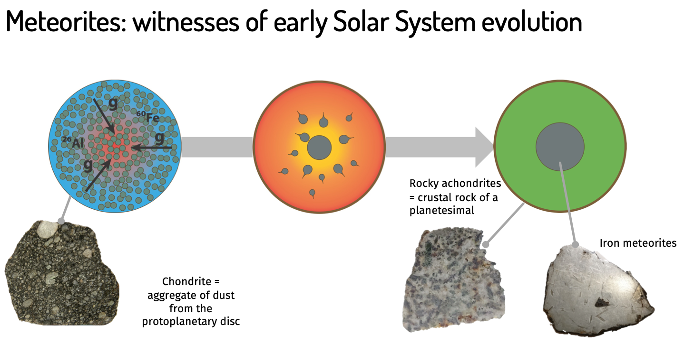
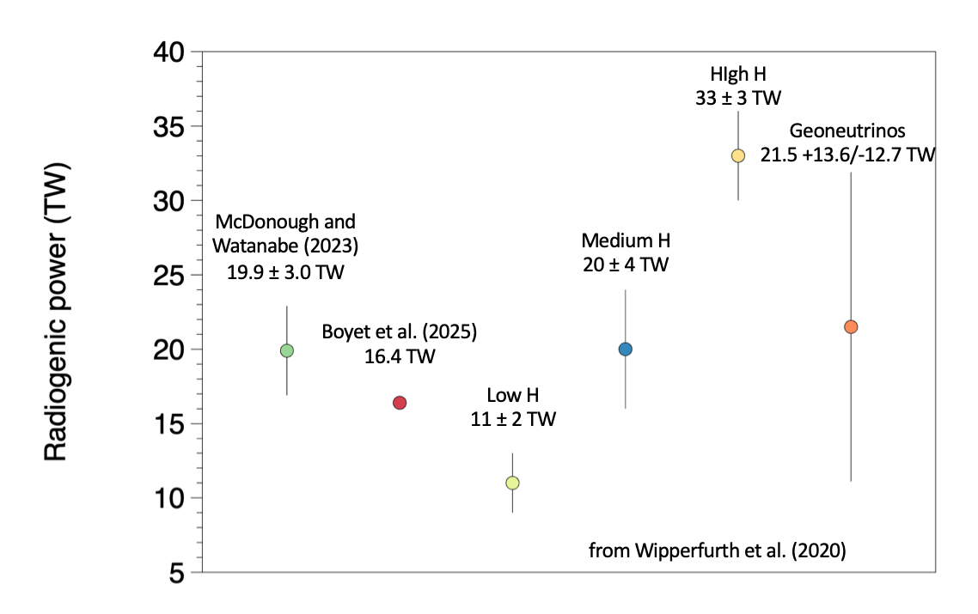
Earth composition models continue to be studied
Notes:
Some mantle convection models suggest that the radiogenic heat produced should a larger fraction of the total heat flow. So at least one of the following have some problems: the total heat flow measured, the estimated amounts of U, Th or K, or the mantle convection model. So, by measuring the antineutrinos from beta decays of daughter nuclei in the U and Th decay chains, we can maybe serve as a cross-check of the radiogenic heat production rate.

Slide 13
Important Questions in Geosciences
related to geoneutrinos
what is the radiogenic contribution (U, Th, ⁴⁰K) to heat flow and energetics in the deep Earth? – seismology and geophysics give us structure and density but not chemical composition
  mantle: convective Urey ratio?
  geoneutrinos can probe
are the fundamental ideas about Earth’s origin and thus bulk chemical composition correct?
are the basic models of the composition of the crust correct?
  geoneutrinos can try to test which ones are
distribution of reservoirs in the mantle?
  homogeneous or layered?
  lateral variability – e.g. mantle plumes
nature of the core-mantle boundary?
radiogenic elements in the core?
  in particular potassium?
Goal: assay the entire Earth by looking at its
“neutrino glow”
}neutrinos might probe
⁴⁰K geoneutrinos subject of another talk…

Slide 14
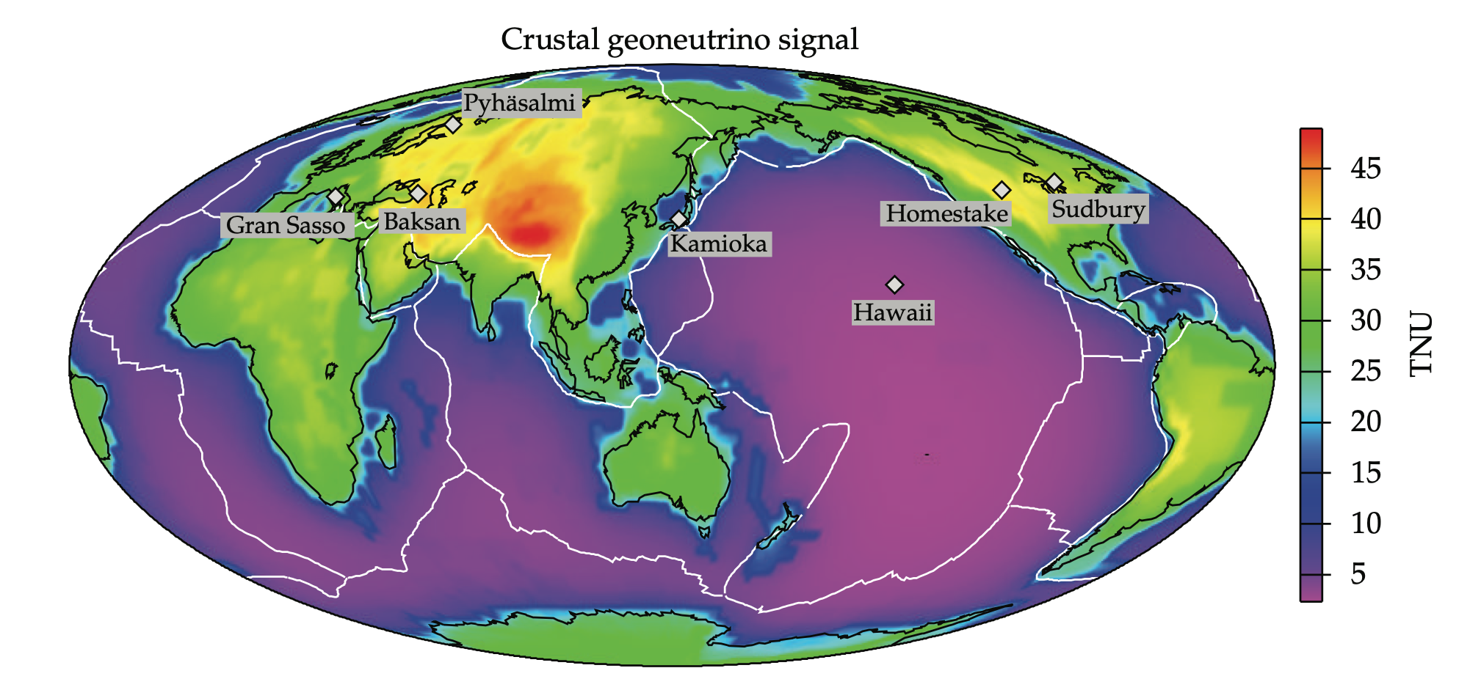
Expected Rates of Geoneutrinos
example of a model
calculation
Šrámek, McDonough, Learned (2012)
1 Terrestrial Neutrino Unit (TNU) = 1 event per 10³² proton targets per year
(assuming 100% efficient detection)
roughly 1 per kilotonne CH2 per year
14

Slide 15
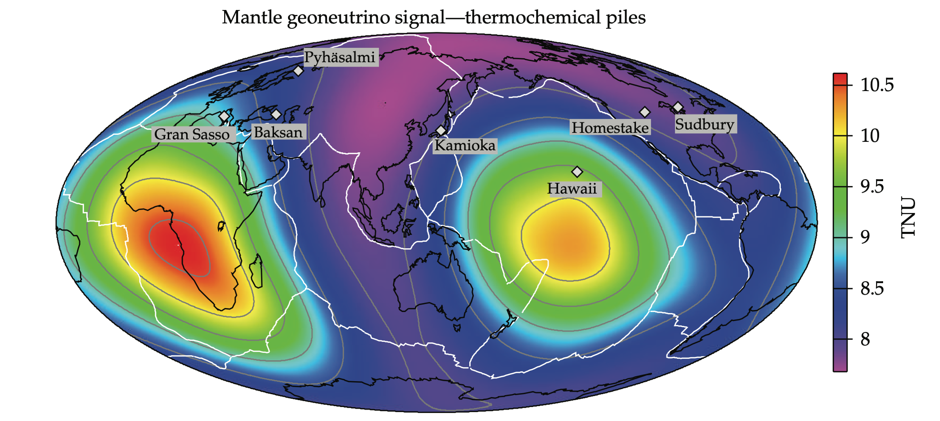
Mantle Composition Heterogeneity
example of a model
calculation
Šrámek, McDonough, Learned (2012)
“thermochemical piles” model responsible
for lateral variation in the flux (motivated by
Large Low Shear Velocity Provinces at the
base of the mantle)
15

Slide 16
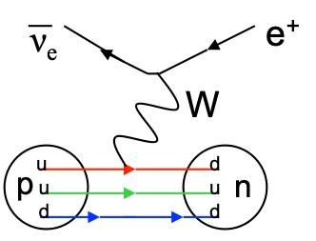
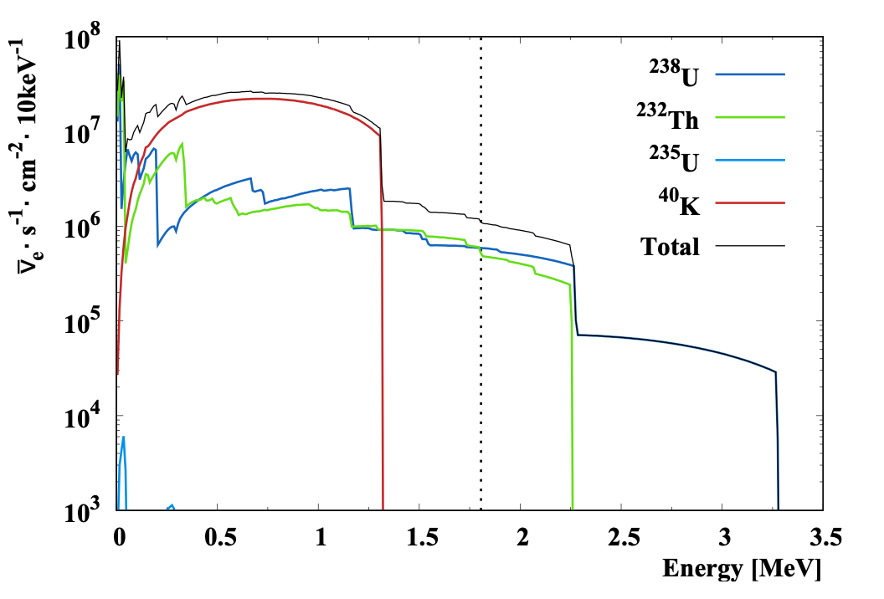
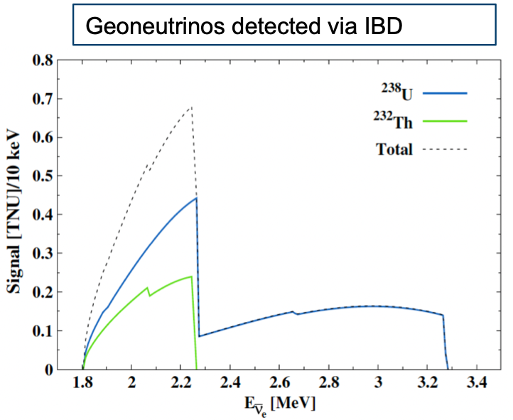
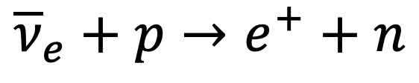
How to Detect Geoneutrinos
inverse beta decay (IBD):
  energy threshold Eν > 1.8 MeV
  liquid scintillator is ~CH₂ (protons)
    positron makes first scintillation
    neutron captures on H
      mean capture time ~200 μs
    delayed 2.2 MeV gamma ray from neutron capture makes second scintillation
$${\overline{ν}}_{e}+p→e^{+}+n$$
threshold
can’t detect ⁴⁰K geoneutrinos with this reaction

Slide 17
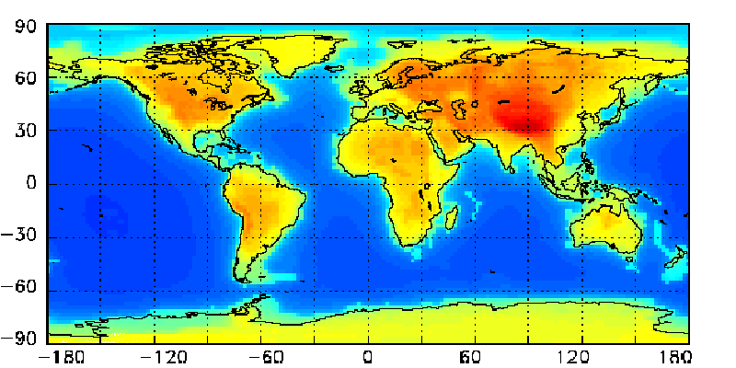
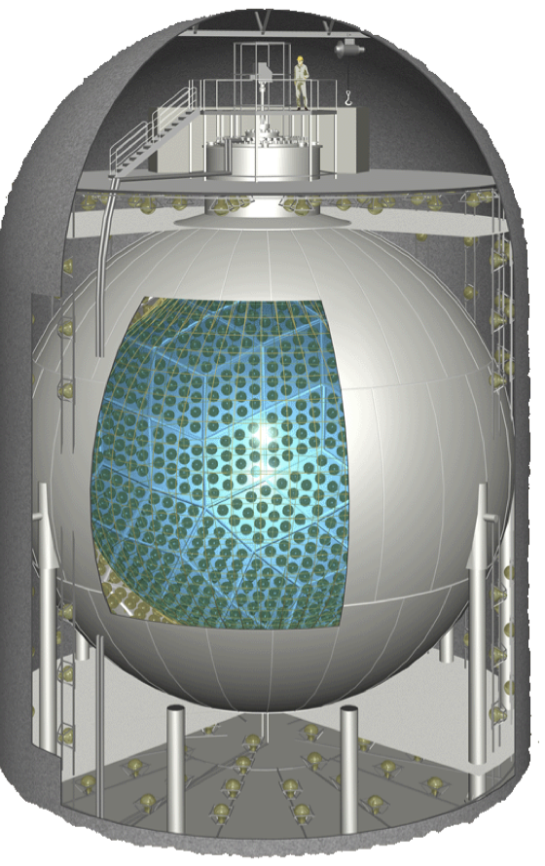
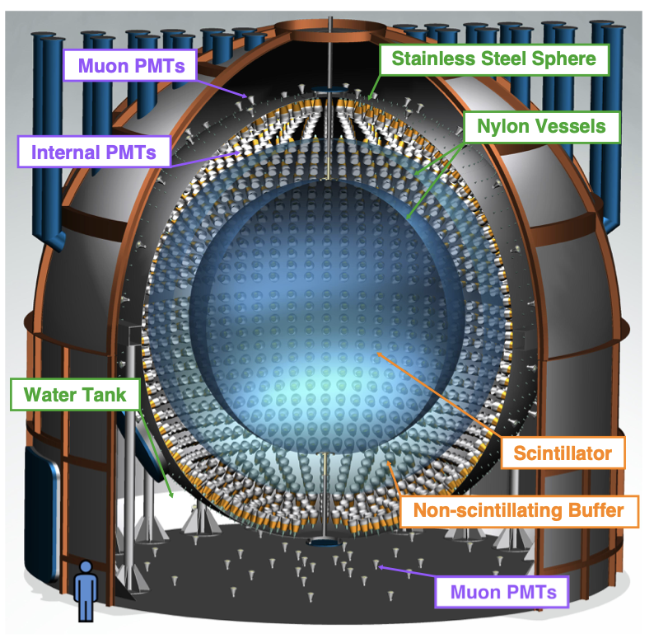
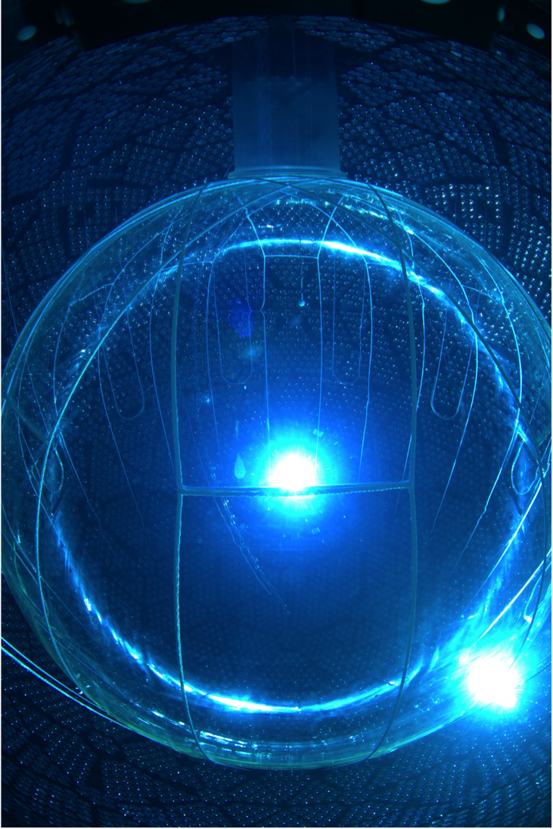
Geoneutrino Flux & Reactor Background
Geoneutrino Rate
depend on location
from Fiorentini, Mantovani, et al.
KamLAND
near Kamioka, Japan
JUNO
near Jiangmen, China
SNO+
near Sudbury, Canada
Borexino
near L’Aquila, Italy

Slide 18
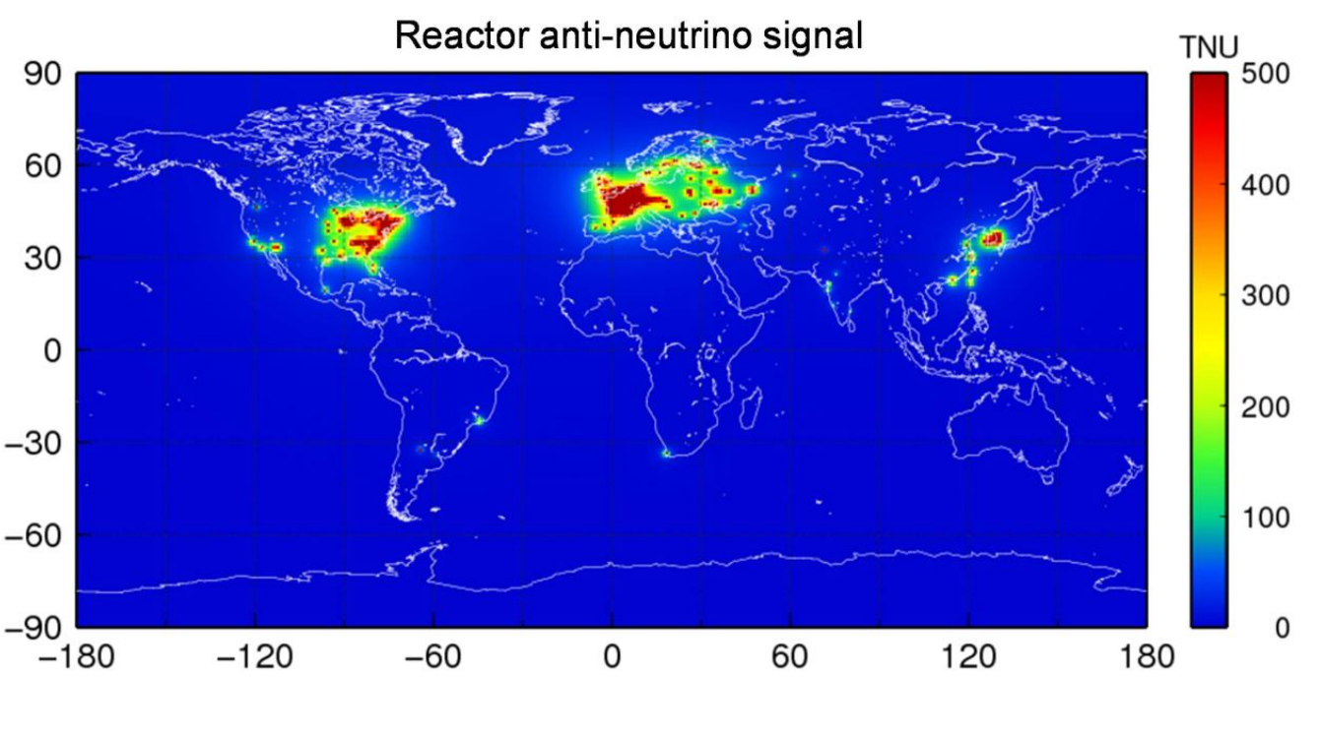
Geoneutrino Flux & Reactor Background
depend on location
KamLAND
near Kamioka, Japan
nuclear reactor
background
JUNO
near Jiangmen, China
from Ricci et al.
SNO+
near Sudbury, Canada
Borexino
near L’Aquila, Italy

Slide 19
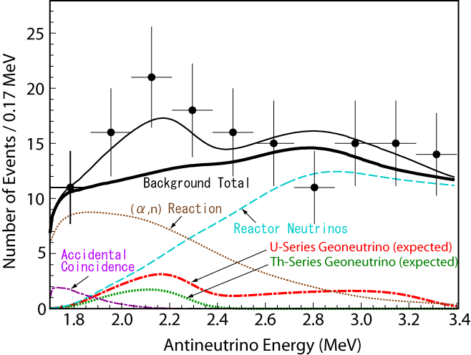
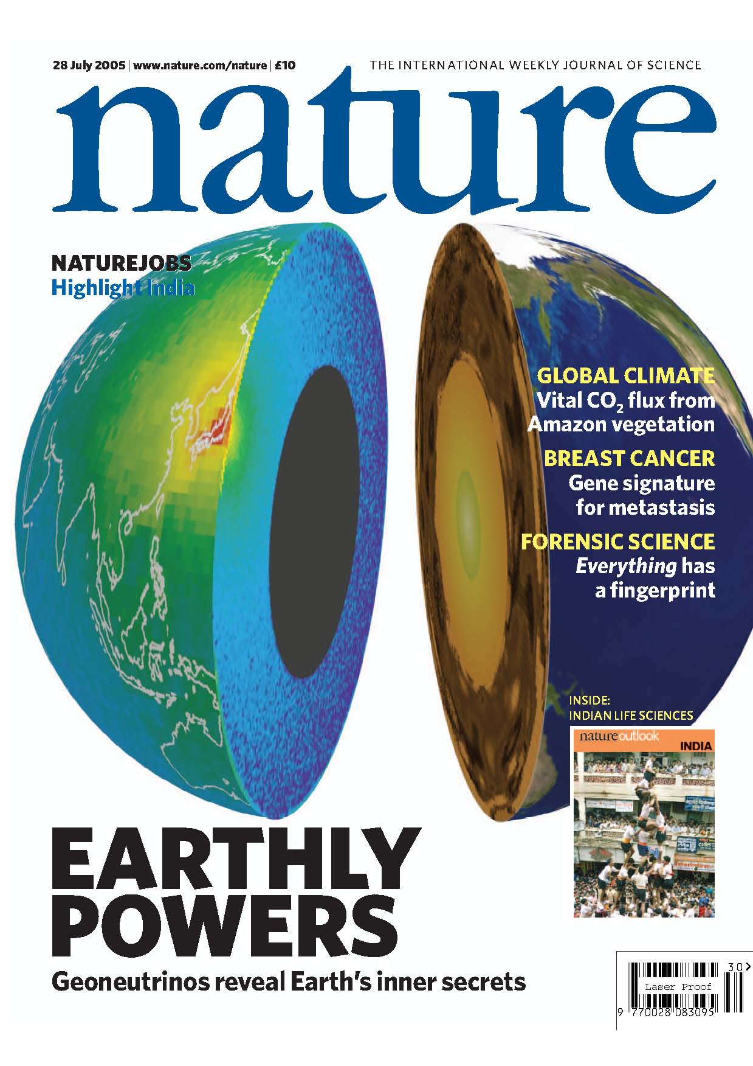
KamLAND First Detection in 2005
Expected Geoneutrinos
U-Series： 14.9
Th-Series： 4.0
Backgrounds
Reactor： 82.3±7.2
(α,n)： 42.4±11.1
Accidental： 2.38±0.01
BG total： 127.4±13.3
Observed： 152
reactor neutrinos
geo-ν
Number of Geoneutrinos:
25
＋19
－18
“expected” geoneutrinos means from BSE models

Slide 20
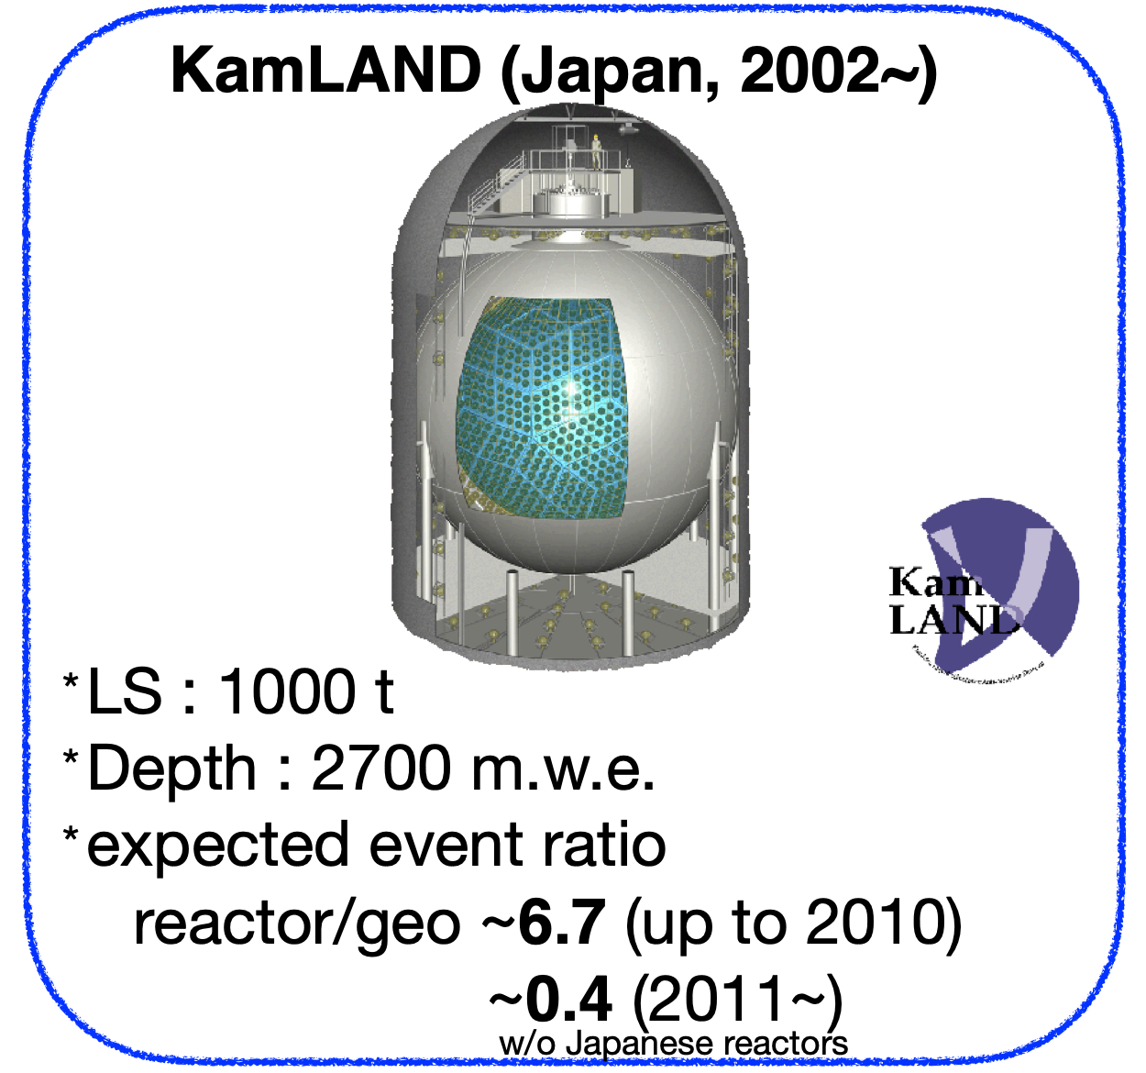
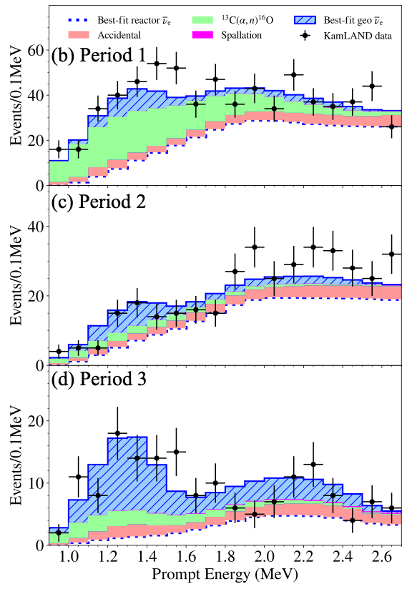
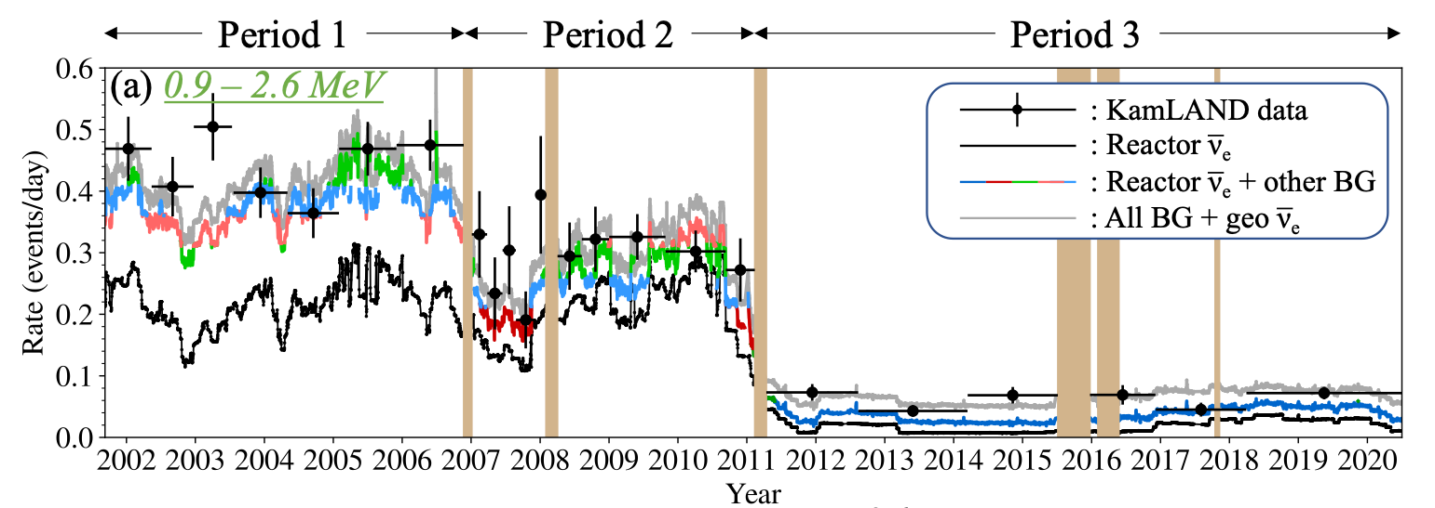
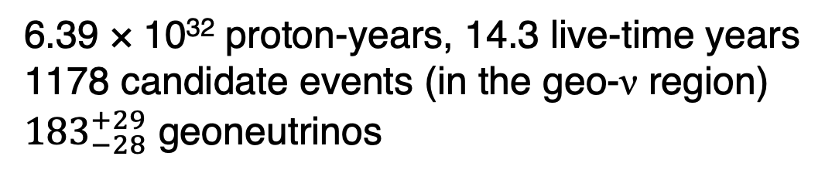
KamLAND Latest Geoneutrino Result
ended 2024 to
upgrade to
KamLAND2
6.39 × 10³² proton-years, 14.3 live-time years
1178 candidate events (in the geo-ν region)
${183}_{−28}^{+29}$ geoneutrinos
S. Abe et al., Geophys. Res. Lett. 49, e2022GL099566 (2022)

Slide 21
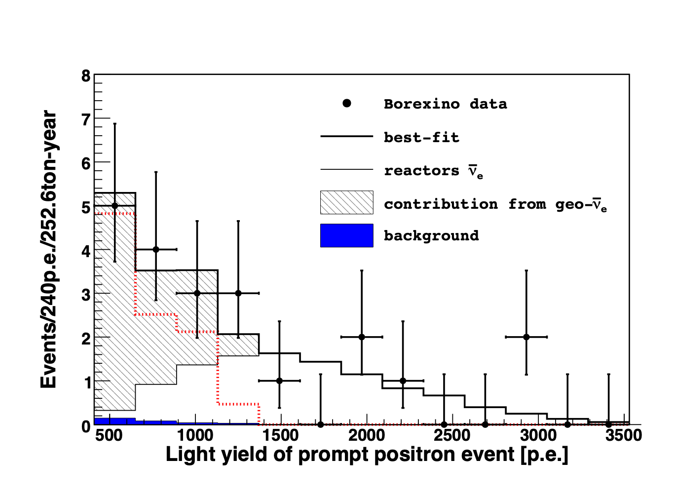
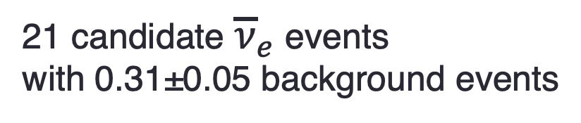
Borexino First Detection in 2010
21 candidate ${\overline{ν}}_{e}$ events
with 0.31±0.05 background events

Slide 22
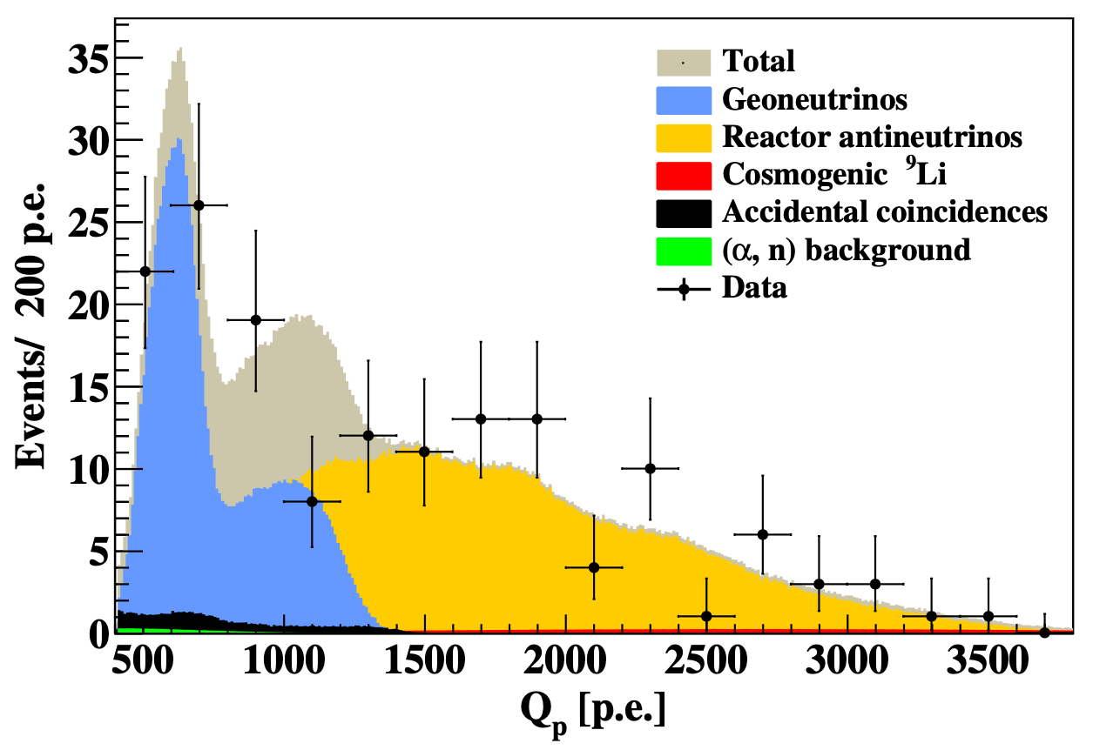
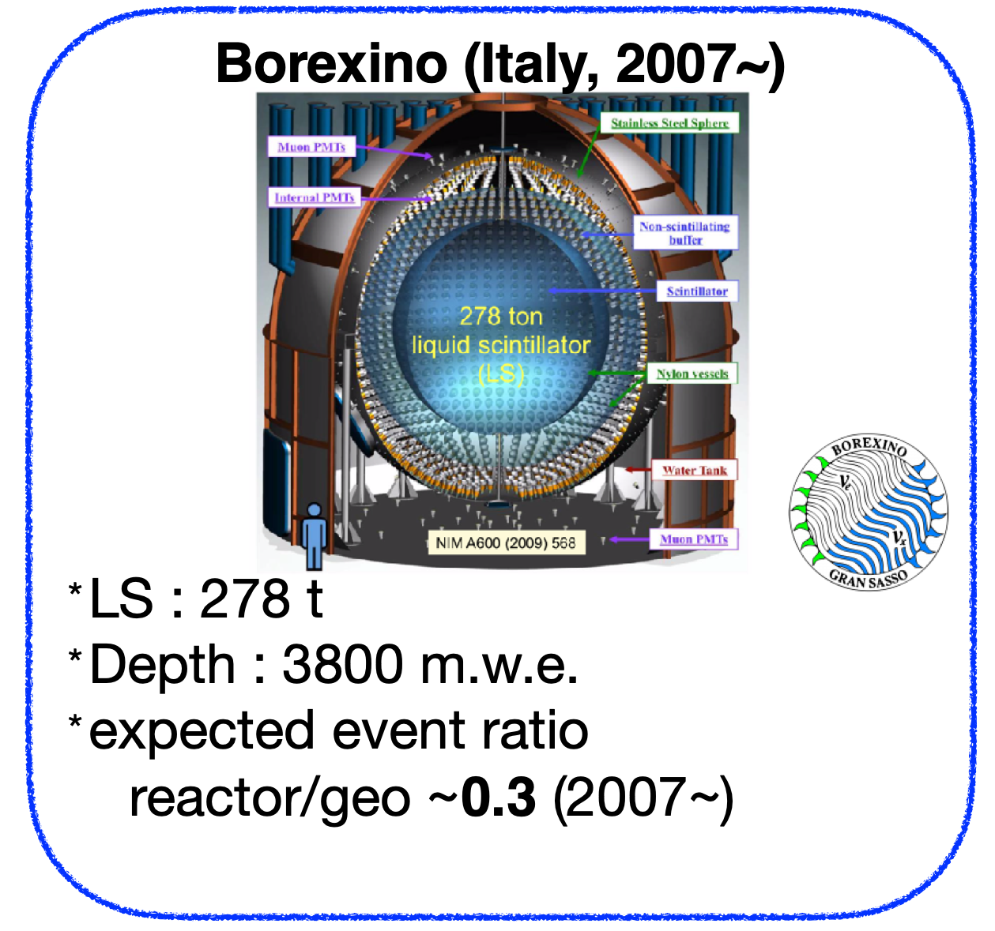
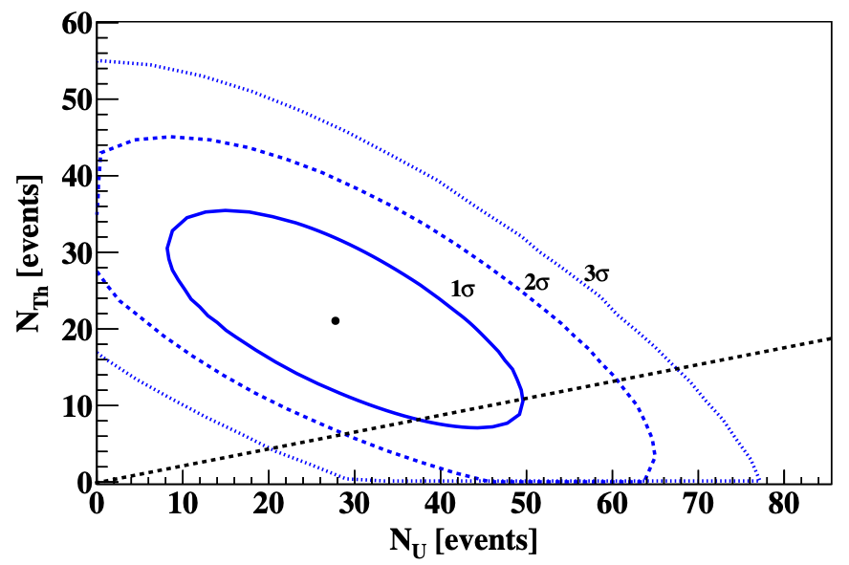
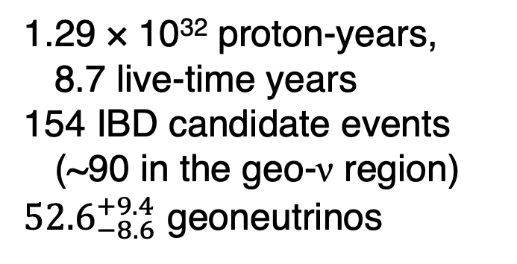
Borexino Final Geoneutrino Result
ended 2021
decommissioned
1.29 × 10³² proton-years,
8.7 live-time years
154 IBD candidate events
(~90 in the geo-ν region)
${52.6}_{−8.6}^{+9.4}$ geoneutrinos
M. Agostini et al., PRD 101, 012009 (2020)

Slide 23
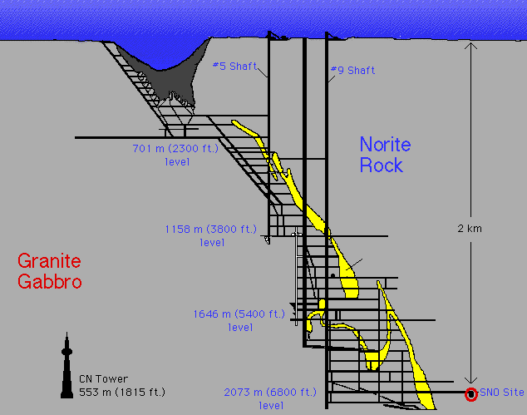

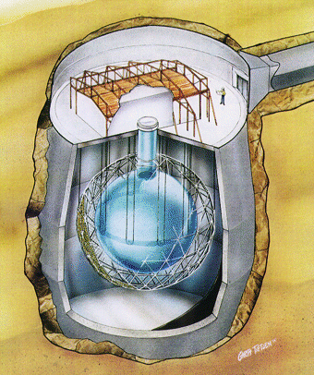
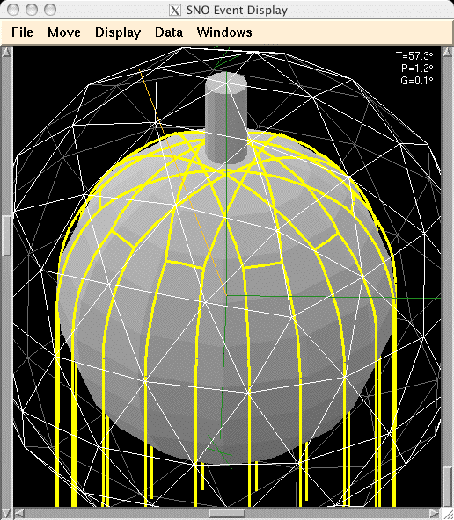
Sudbury
Neutrino Observatory
780 tonnes liquid
scintillator
1000 tonnes D₂O
12 m diameter Acrylic Vessel
18 m diameter support structure; 9500 PMTs
(~54% photocathode coverage)
1700 tonnes inner shielding H₂O
5300 tonnes outer shielding H₂O
Urylon liner radon seal
depth: 2092 m (~6010 m.w.e.) ~70 muons/day
hold-down
rope net

Slide 24
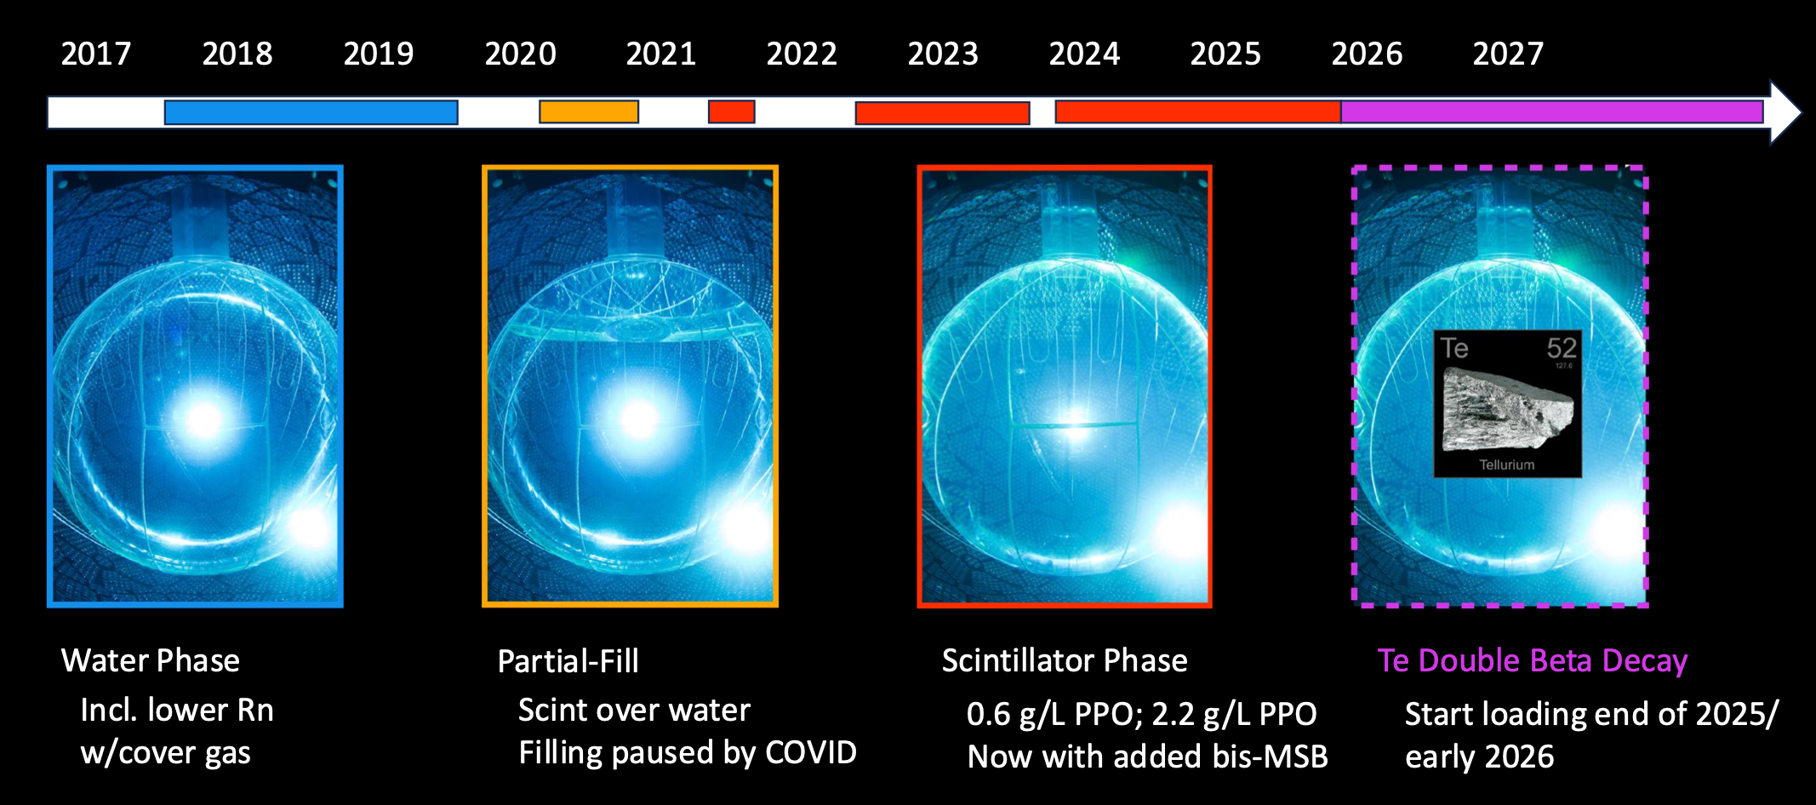

SNO+ Data-taking Timeline
`
World-leading limits for invisible nucleon decay
First observation of reactor neutrinos from a distance, using only pure water
Lowest background and threshold for solar neutrino detection with water Cherenkov
Start loading in 2027
First event-by-event directionality in a liquid scintillator detector (with solar neutrinos)
First observation of CC $ν_{e}$ on ¹³C for solar neutrinos – only the second real-time observation of solar neutrinos using a charged-current reaction, after SNO

Slide 25

SNO+ Scintillator Phase
Antineutrino Results
Reactor and Geo

Slide 26

Reactor Antineutrinos in SNO+
60% of the flux at SNO+ comes from the Ontario CANDU PHWR reactors

Slide 27

Reactor antineutrino flux expectation/calculation from tracking reactor power output
Ontario CANDU reactors operational status uses the hourly electrical output provided by IESO
For US reactors, publicly available daily thermal power from the US Nuclear Regulatory Commission
World’s nuclear power reactors operational status monitored using the PRIS database (IAEA) – monthly averages
We cross-check the hourly/daily data with the monthly averages from the IAEA database
CANDU reactors are “continuously” refuelled – the ²³⁵U:²³⁹Pu:²³⁸U:²⁴¹Pu “fission fractions” are steady-state values (approximately)
PHWR thus have slightly different neutrino energy spectrum than other reactor neutrino experiments

Slide 28



SNO+ Newest Antineutrino Result
PRL 137, 101807 (2026)
1.46 kilotonne-years (live) of
SNO+ Scintillator Phase data, with the LAB+PPO dataset and +bis-MSB dataset analyzed separately (due to different detector performance)
combined together in simultaneous fit with correlations included
Number of IBD and background events
Geoneutrinos U and Th total rate
      ${48}_{−12}^{+14}$ TNU
U/Th ratio constrained by expectation
from chondritic Earth models

Slide 29





Backgrounds from $(α,n)$ Events
prompt spectrum after time-residual classifier cut
$(α,n)$ backgrounds
reduced

Slide 30


SNO+ Geology Interpretation
$${48}_{−12}^{+14}$$
TNU
SNO+ prefers
medium-high values
for radiogenic heat

Slide 31


Local Geology
Far Field Crust
Deep Earth (mantle)
for SNO+
crust
mantle
total
oceanic

Slide 32



SNO+ Local Geology from Huang et al.

Slide 33







Slide 34


Signal from the Deep Earth
the mantle
Use local geology to calculate the contribution
to the total geoneutrino signal
- the difference between measured total and local prediction represents the mantle
SNO+ expected rate [TNU] from local geology, the entire Earth’s crust, and the CLM (continental lithospheric mantle) = Lithosphere

Slide 35


KamLAND Geology Interpretation
KamLAND
prefers Low-Q and
Mid-Q mantle;
disfavours High-Q
at 99.76% CL
(homogeneous
mantle; Th/U = 3.9)
crustal contribution
S. Abe et al., Geophys. Res. Lett. 49, e2022GL099566 (2022)

Slide 36



Borexino Geology Interpretation
Using LOC from M. Coltorti et al.
and FFL from Y. Huang et al.
and subtracting, Borexino finds
non-zero mantle contribution at
99.0% CL
Mantle signal: ${21.2}_{−9.1}^{+9.6}$ TNU
High-Q favoured
by Borexino
Borexino prefers
High-Q model; large
radiogenic contribution
to mantle “geo dynamics”
M. Agostini et al., PRD 101, 012009 (2020)

Slide 37

Global Fit – Combined Interpretation
KamLAND - Low-Q
Borexino - High-Q
SNO+ - Mid-High Q
JUNO preliminary
(unpublished) - Very High Q

Slide 38




JUNO First Detection in 2026
  as presented at Neutrino 2026
JUNO (China, 2025~)
LS : 20 kt
Depth : 1800 m.w.e.
expected event ratio
  reactor/geo ~9

Slide 39



Future Prospects
New experiments being built/proposed:
Jinping – 500-ton detector with the lowest reactor neutrino background
Ocean Bottom Detector – project to deploy a geoneutrino detector at an ocean-bottom site, far from continental crust
  to measure the mantle signal
Directionality: to help distinguish signal from the crust and mantle
w/slow scintillator and Cherenkov light
w/Li-doping for e⁺ n vertex resolution
⁴⁰K geoneutrinos: of major interest in geoscience
w/elastic scattering
w/Cu-doping in LiquidO
A. Cabrera, M. Chen, F. Mantovani, A. Serafini, V. Strati et al., Commun. Phys. 9, 95 (2026)

Slide 40


Summary
Today we shined the spotlight on
geoneutrinos
SNO+ result:
Geoneutrino flux at SNO+ ${48}_{−12}^{+14}$ TNU
JUNO upcoming - enormous statistics with reactor neutrinos as a “background"
Combined analysis:
KL, BX, SNO+, JUNO soon - will test
Earth models and distribution of HPEs

