Slide 1
Lattice imperfections and numerical simulation in the J-PARC 3-GeV RCS
Hiroyuki Harada
J-PARC/JAEA
“Beam Dynamics meets Magnets” Workshop
2-4 December, 2013

Slide 2
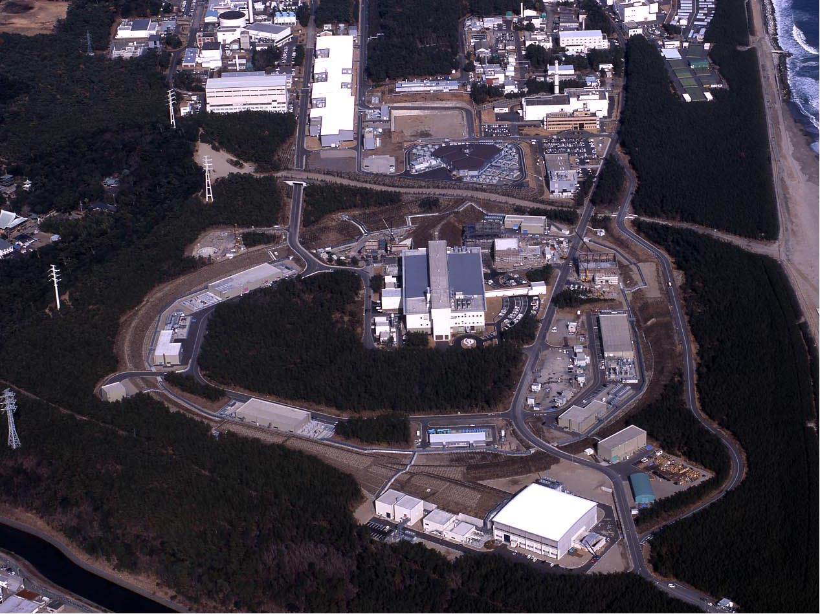
J-PARC
(JAEA & KEK)
400 MeV H⁻ Linac [181 MeV at present]
3 GeV Rapid Cycling Synchrotron (RCS)
Neutrino Beam Line to Kamioka (NU)
1 MW
50 GeV Main Ring Synchrotron (MR) [30 GeV at present]
Materials & Life Science Facility (MLF)
0.75 MW
JFY 2006 / 2007
JFY 2008
Hadron Experimental Hall (HD)
JFY 2009

Slide 3
Outline
Introduction of the 3GeV RCS
Lattice imperfections
Comparison between experiments and simulations
Measures of the lattice imperfections
Summary

Slide 4
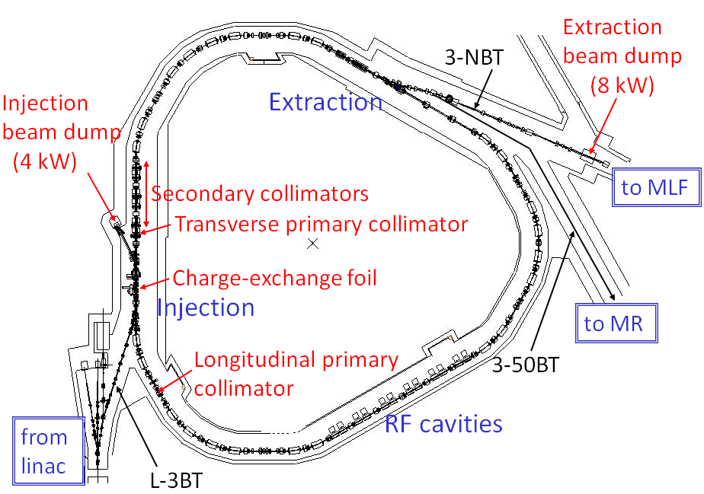
Design parameters and layout of the 3GeV RCS
Pulse dipole magnet
to switch the beam destination
Circumference | 348.333 m
Super-periodicity | 3
Injection | Charge-exchange, Multi-turn
Injection period | 0.5 ms (235/305 turns)
Injection energy | 181 MeV ⇒ 400 MeV
Extraction energy | 3 GeV
Repetition rate | 25 Hz
Harmonic number | 2
Number of bunches | 2
Particles per pulse | 2.5e13 - 5e13 ⇒ 8.3e13
Output beam power | 300-600 kW ⇒ 1 MW
Transition gamma | 9.14 GeV
Number of dipoles | 24
quadrupoles | 60 (7 families)
sextupoles | 18 (3 families)
steerings | 52
RF cavities | 12 (11 at present)
H⁻
Linac upgrade
Output energy upgrade by adding an ACS linac section
in 2013 summer-autumn maintenance period
181 MeV ⇒ 400 MeV
Intensity upgrade by replacing IS and RFQ
in 2014 summer maintenance period
Peak current 30 mA ⇒ 50 mA
We will aim at the design output beam power of 1 MW
after upgrading the linac.

Slide 5
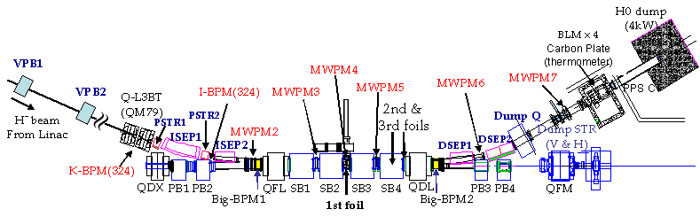
RCS Injection System
H⁻
ISEP1,2
3rd foil
Injection scheme
Chopped beam (fac.=0.56)
H－charge exchange
235 multi-turns (181MeV)
Painting injection
QFL
2nd foil
QDL
MWPM3
MWPM5
To beam dump
MWPM4
H⁺
x
H⁻
Beginning of painting
H⁻
s
H⁰
End of painting
H⁰
PB1,2
PB3,4
Circulating
beam
1st foil
H⁺
SB1
SB2
SB3
SB4
Painting injection by using of the PB1-4 and VPB1-2 in order to
  - depress/control the beam density
  - decrease number of foil hitting

Slide 6
Horizontal Painting Injection Process
3rd foil
H⁻
QFL
2nd foil
QDL
To beam dump
MWPM3
MWPM4
MWPM5
1st foil
H⁺
x
ISEP1,2
H⁻
s
H⁰
PB1,2
PB3,4
Circulating beam
Circulating beam
x’[mrad]
H⁻
SB1
SB2
SB3
SB4
current
SB
0
93
124.1
x[mm]
PB
-4.4
Injection Beam
Painting Area
time
Injection period(500μsec)

Slide 7
Horizontal Painting Injection Process
3rd foil
H⁻
QFL
2nd foil
QDL
To beam dump
MWPM3
MWPM4
MWPM5
1st foil
H⁺
x
ISEP1,2
H⁻
s
H⁰
PB1,2
PB3,4
Circulating beam
Circulating beam
x’[mrad]
H⁻
SB1
SB2
SB3
SB4
current
SB
0
93
124.1
x[mm]
PB
-4.4
Injection Beam
Painting Area
time
Injection period(500μsec)

Slide 8
Horizontal Painting Injection Process
3rd foil
H⁻
QFL
2nd foil
QDL
To beam dump
MWPM3
MWPM4
MWPM5
1st foil
H⁺
x
ISEP1,2
H⁻
s
H⁰
PB1,2
PB3,4
Circulating beam
Circulating beam
x’[mrad]
H⁻
SB1
SB2
SB3
SB4
current
SB
0
93
124.1
x[mm]
PB
-4.4
Injection Beam
Painting Area
Injection period(500μsec)
time

Slide 9
Vertical Painting Injection process
y‘
y
s
MWPM3
MWPM4
MWPM5
VPB1
VPB2
y
H⁺
H⁻
1st foil

Slide 10
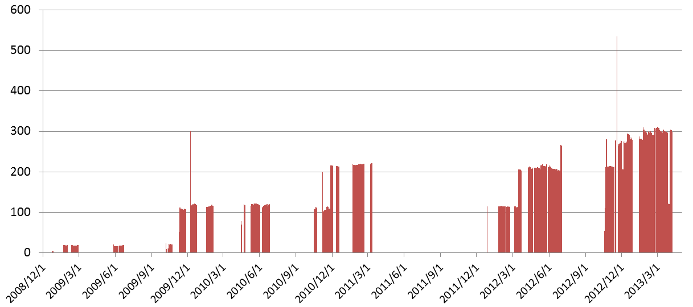
History of the RCS output beam power
Beam commissioning of the linac ; November 2006~
Beam commissioning of the RCS ; October 2007~
Startup of the MLF user operation ; December 2008~
Summer
shutdown
Summer
shutdown
Summer
shutdown
540-kW demo.
Recovery from damages
caused by East Japan earthquake
300-kW demo.
E_{inj}=181 MeV
300 kW
Output power to MLF (kW)
210 kW
210 kW
120 kW
4 kW
20 kW
The beam power ramp-up of RCS has steadily proceeded following;
- Progression in beam tuning and numerical simulation
- Hardware improvements
- Careful monitoring of the trend of residual activation levels.
RCS is stably providing 300 kW beam for users.

Slide 11
Contents
Introduction of the 3GeV RCS
Lattice imperfections
Comparison between experiments and simulations
Measures of the lattice imperfections
Summary

Slide 12
Numerical simulation setup
Simpsons (PIC particle tracking code developed by Dr. Shinji Machida)
Imperfections included:
Time independent imperfections
- Measured main and multipole field components for all the main magnets:
BM (K_{0~6}), QM (K_{1, 5, 9}), and SM (K_{2, 8}) obtained from field measurements
- Alignment errors (Δx, Δy, Δs, Δθ) after the earthquake
Time dependent imperfections
- Edge focus of the injection bump magnets:
K₁ estimated from measured optical functions
- Static leakage fields from the extraction beam line:
K_{0,1} and SK_{0,1} estimated from measured COD and optical functions
- BM-QM field tracking errors
estimated from measured tune variation over acceleration
- 1-kHz BM ripple
estimated from measured orbit variation
- 100-kHz ripple induced by injection bump magnets
estimated from turn-by-turn BPM data
Foil scattering:
Coulomb & nuclear scattering angle distribution calculated with GEANT
Time-dependent imperfections
can be included easily,
because “Simpsons” takes “time”
as an independent variable.
We are improving calculation model step-by-step following
the progression of beam experiment in collaboration with Dr. S. Machida(STFC/RAL),
discussing space-charge effect and its combined effects with machine imperfections.

Slide 13
Numerical simulation setup
Simpsons (PIC particle tracking code developed by Dr. Shinji Machida)
Imperfections included:
Time independent imperfections
- Measured main and multipole field components for all the main magnets:
BM (K_{0~6}), QM (K_{1, 5, 9}), and SM (K_{2, 8}) obtained from field measurements
- Alignment errors (Δx, Δy, Δs, Δθ) after the earthquake
Time dependent imperfections
- Edge focus of the injection bump magnets:
K₁ estimated from measured optical functions
- Static leakage fields from the extraction beam line:
K_{0,1} and SK_{0,1} estimated from measured COD and optical functions
- BM-QM field tracking errors
estimated from measured tune variation over acceleration
- 1-kHz BM ripple
estimated from measured orbit variation
- 100-kHz ripple induced by injection bump magnets
estimated from turn-by-turn BPM data
Foil scattering:
Coulomb & nuclear scattering angle distribution calculated with GEANT

Slide 14
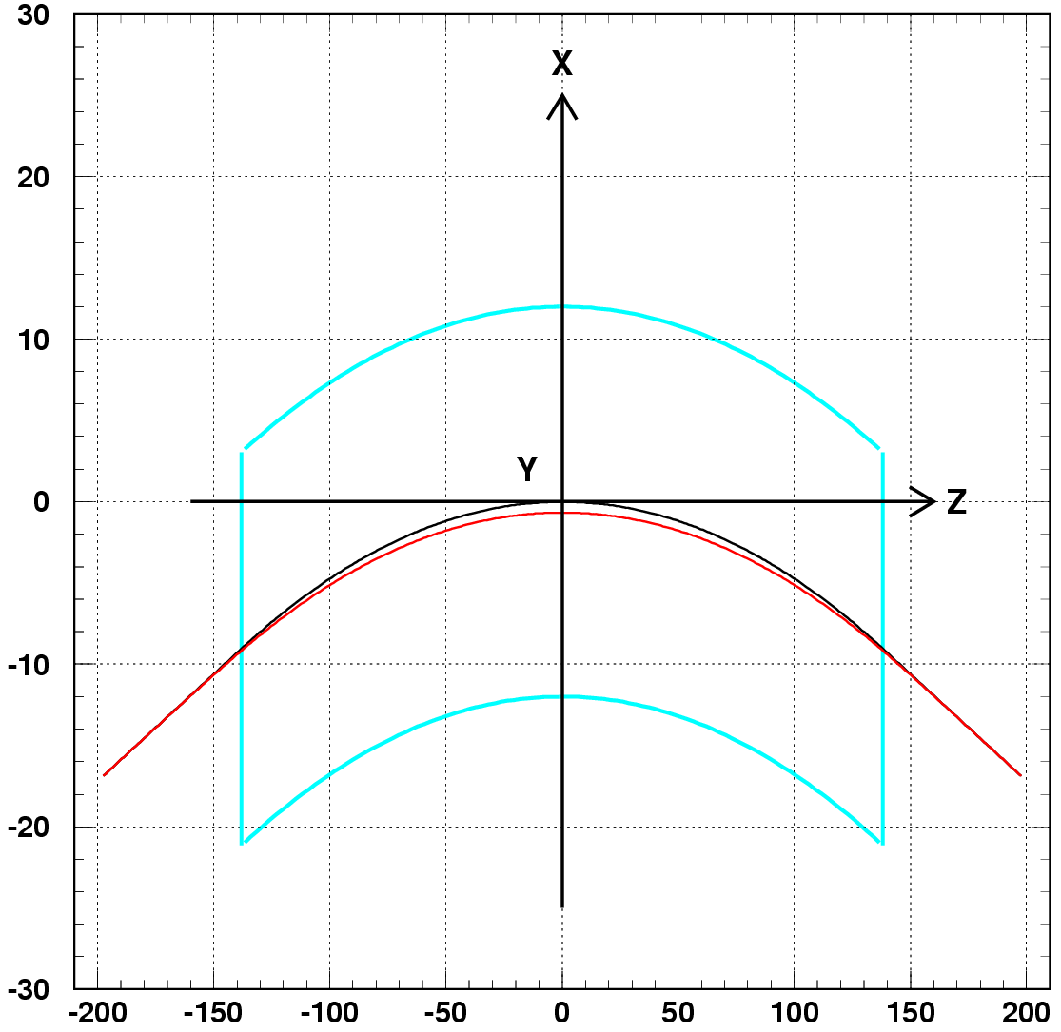
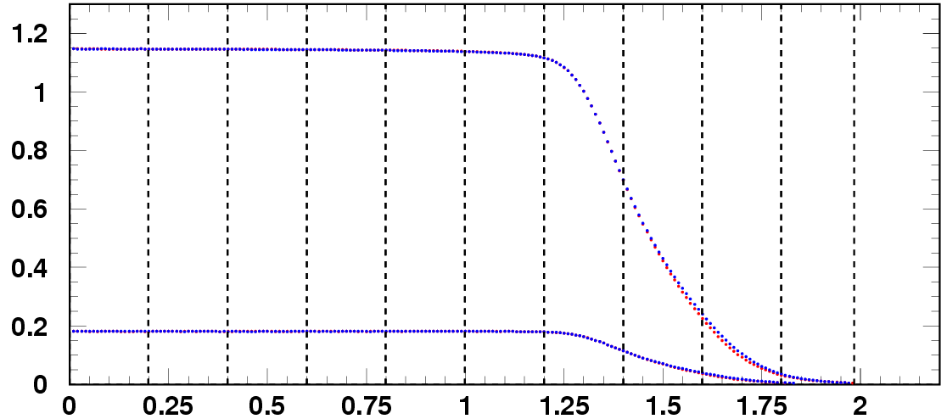
BM field measurement
Field measurement coordinate (x, y, s)
Mapping data of 12431 points
on the medium plane:
x= －0.15 ~ 0.15 m,
y= 0,
s= －2 ~ 2 m,
step = 0.01 m
(cm)
BM
~6.7mm
By vs. s (x=0, y=0)
s=0
s
x
B_{y} (T)
3GeV
y
181MeV
(cm)
s (m)
－entr. － exit

Slide 15
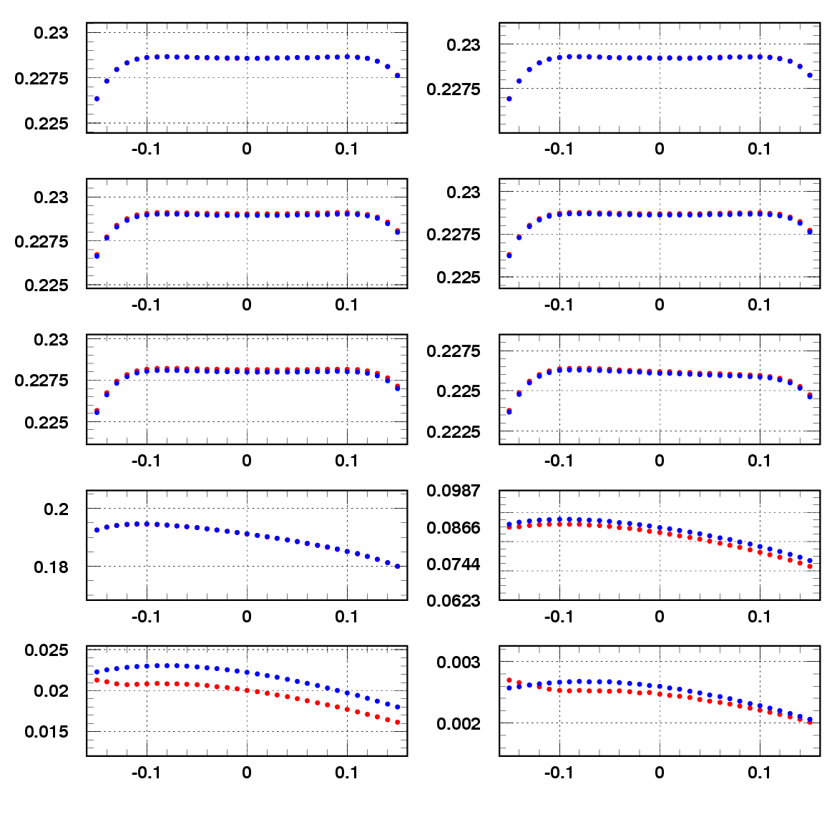
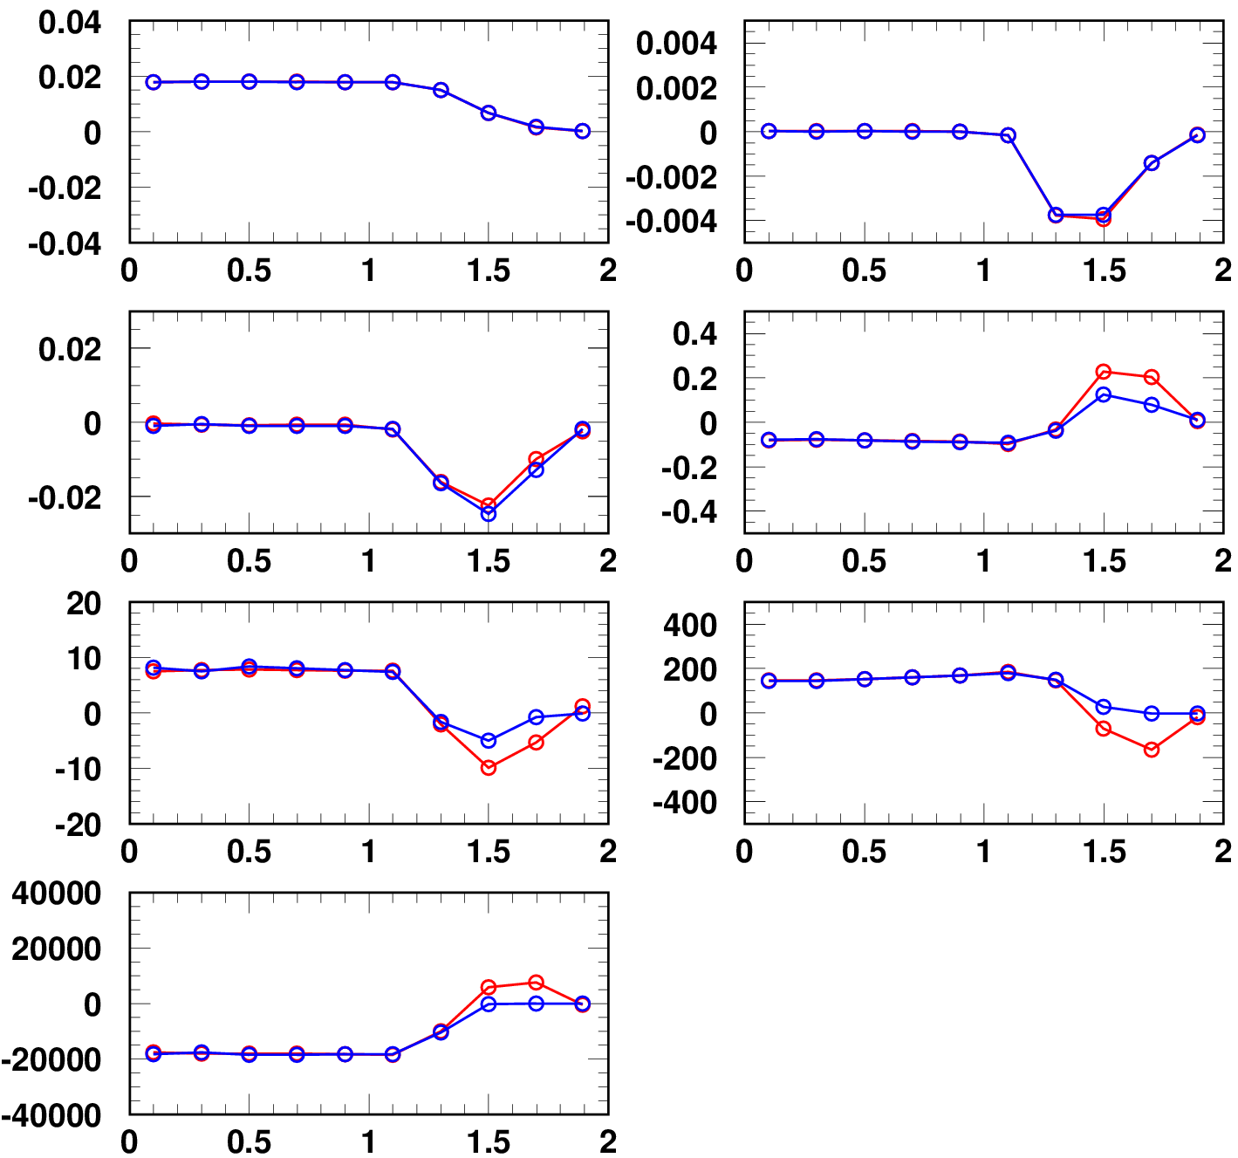
B_{y}L vs. x distribution
3GeV
B_{y} (T)
B_{y}L distribution for x direction in 10 points.
Multipole expansion by Polynomial fitting up to 6 order (saturated χ²) .
Multipole components exist in the magnet edge.
Ⅰ
Ⅱ
Ⅲ
Ⅳ
Ⅴ
Ⅵ
Ⅶ
Ⅷ
Ⅸ
Ⅹ
181MeV
s (m)
@3 GeV
Ⅰ
Ⅱ
B_{y}L (Tm)
K₀
K₁ (m⁻¹)
Ⅲ
Ⅳ
Ⅴ
Ⅵ
K₂ (m⁻²)
K₃ (m⁻³)
Ⅶ
Ⅷ
K₄ (m⁻⁴)
K₅ (m⁻⁵)
Ⅸ
Ⅹ
s (m)
K₆ (m⁻⁶)
－entr. － exit
－entr. － exit
x (m)
s (m)

Slide 16
Multipole field components
BM
x
y
s
Multipoles
K0 | (2.6180±0.0003)x10⁻¹
K1 (m-1) | (-2.023±0.049)x10⁻²
K2 (m-2) | (-1.006±0.100)x10⁻¹
K3 (m-3) | (3.635±1.003)x10⁻¹
K4 (m-4) | (-1.332±0.140)x10⁺¹
K5 (m-5) | (2.340±0.176)x10⁺²
K6 (m-6) | (-6.370±0.314)x10⁺⁴
B_{y}L (Tm)
x (m)
Errors when assuming
the field measurement accuracy of ~1 x 10⁻⁴
Multipole components of all main magnets have been estimated from the similar method of field measurement.
The estimated components have been added into accelerator model of numerical simulation.

Slide 17
Numerical simulation setup
Simpsons (PIC particle tracking code developed by Dr. Shinji Machida)
Imperfections included:
Time independent imperfections
- Measured main and multipole field components for all the main magnets:
BM (K_{0~6}), QM (K_{1, 5, 9}), and SM (K_{2, 8}) obtained from field measurements
- Alignment errors (Δx, Δy, Δs, Δθ) after the earthquake
Time dependent imperfections
- Edge focus of the injection bump magnets:
K₁ estimated from measured optical functions
- Static leakage fields from the extraction beam line:
K_{0,1} and SK_{0,1} estimated from measured COD and optical functions
- BM-QM field tracking errors
estimated from measured tune variation over acceleration
- 1-kHz BM ripple
estimated from measured orbit variation
- 100-kHz ripple induced by injection bump magnets
estimated from turn-by-turn BPM data
Foil scattering:
Coulomb & nuclear scattering angle distribution calculated with GEANT

Slide 18
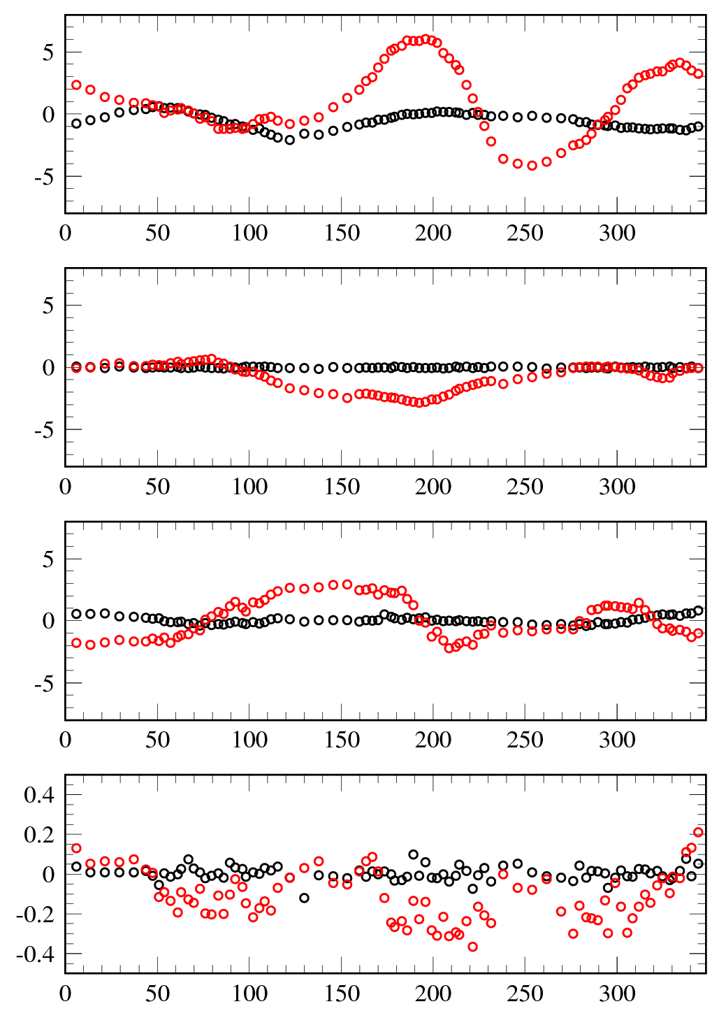
RCS alignment errors (position & rotation)
after the earthquake
N. Tani
Ins.
(Inj.)
Arc
Ins.
(Ext.)
Arc
Ins.
(RF)
Arc
Position errors for horizontal & vertical plane
out
Δx : - 4mm ～ +6mm
Δx (mm)
Δy : - 3mm ～ +1mm
inner
cause the COD (Δx=±5mm, Δy=±2mm)
reduce the physical aperture for the beam
⇒ correctable by the steering magnets
up
Δy (mm)
down
forth
Position errors for longitudinal plane
Δs (mm)
Δs : - 3mm ～ +3mm
cause the phase advance distortion
back
out
Rotation errors for transverse plane
Δθ (mrad)
Δθ : - 0.4mrad ～ +0.2mrad
enhance the linear coupling resonance
inner
s (m)

Slide 19
Numerical simulation setup
Simpsons (PIC particle tracking code developed by Dr. Shinji Machida)
Imperfections included:
Time independent imperfections
- Measured main and multipole field components for all the main magnets:
BM (K_{0~6}), QM (K_{1, 5, 9}), and SM (K_{2, 8}) obtained from field measurements
- Alignment errors (Δx, Δy, Δs, Δθ) after the earthquake
Time dependent imperfections
- Edge focus of the injection bump magnets:
K₁ estimated from measured optical functions
- Static leakage fields from the extraction beam line:
K_{0,1} and SK_{0,1} estimated from measured COD and optical functions
- BM-QM field tracking errors
estimated from measured tune variation over acceleration
- 1-kHz BM ripple
estimated from measured orbit variation
- 100-kHz ripple induced by injection bump magnets
estimated from turn-by-turn BPM data
Foil scattering:
Coulomb & nuclear scattering angle distribution calculated with GEANT

Slide 20
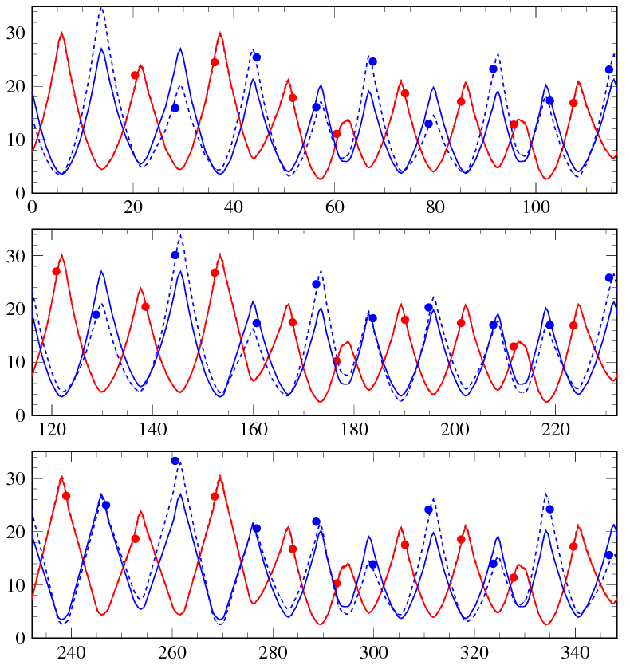
Beam-based measurements
of lattice imperfections in the RCS - I -
Edge focus of the injection-bump magnets
(0.5 ms flattop + 0.5 ms fall time)
Injection or bit bump
~58 mrad
Result of beta modulation measurements
Beta modulation caused by the edge focus;
- makes a distortion of
the lattice super-periodicity
- drives random lattice resonances.
Horizontal beta function
Vertical beta function
β_{x} , β_{y} (m)
● measurement (injection bump ; ON)
calculation (injection bump ; ON)
calculation (injection bump ; OFF)
Edge focus
estimated; K₁~-0.003335m⁻¹
s (m)

Slide 21
Numerical simulation setup
Simpsons (PIC particle tracking code developed by Dr. Shinji Machida)
Imperfections included:
Time independent imperfections
- Measured main and multipole field components for all the main magnets:
BM (K_{0~6}), QM (K_{1, 5, 9}), and SM (K_{2, 8}) obtained from field measurements
- Alignment errors (Δx, Δy, Δs, Δθ) after the earthquake
Time dependent imperfections
- Edge focus of the injection bump magnets:
K₁ estimated from measured optical functions
- Static leakage fields from the extraction beam line:
K_{0,1} and SK_{0,1} estimated from measured COD and optical functions
- BM-QM field tracking errors
estimated from measured tune variation over acceleration
- 1-kHz BM ripple
estimated from measured orbit variation
- 100-kHz ripple induced by injection bump magnets
estimated from turn-by-turn BPM data
Foil scattering:
Coulomb & nuclear scattering angle distribution calculated with GEANT

Slide 22
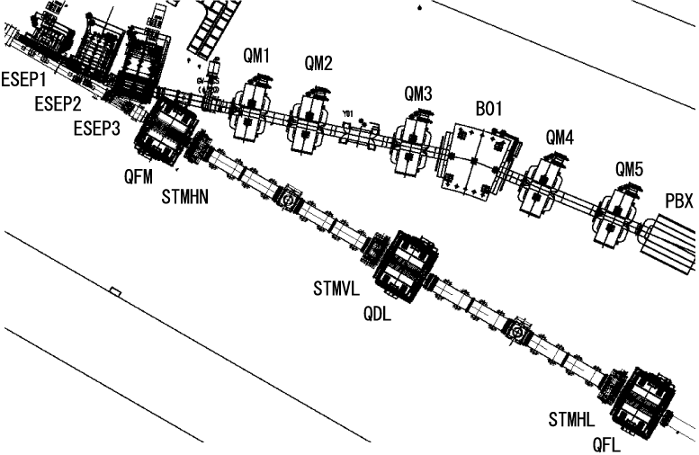
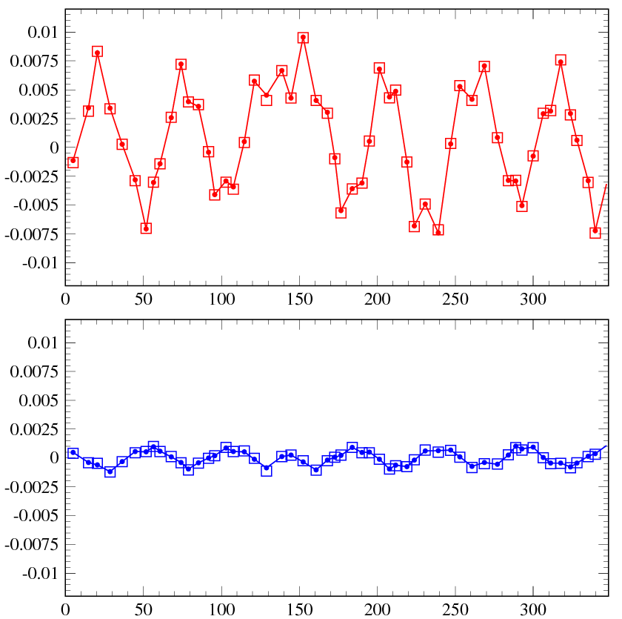
Beam-based measurements
of lattice imperfections in the RCS - II -
Leakage fields from the extraction beam line DC magnets;
- evaluation of dipole and normal quadrupole components
COD caused by the leakage fields
Extraction beam line DC magnets
Δx (m)
±10 mm
□ - calculation
Dipole component
estimated;
-1.14 mrad (hor.)
-0.12 mrad (ver.)
RCS ring
● - measurement
Leakage field includes;
・ Dipole component;
- makes COD
(correctable by steering magnets)
・ Normal quadrupole component;
- makes a distortion of the lattice
super-periodicity
- drives random lattice resonances
・ Skew quadrupole component;
- causes linear coupling
Δy (m)
±1.5 mm
□ - calculation
● - measurement
s (m)
Normal quadrupole component estimated
from the optics measurements; 0.0048 m⁻¹

Slide 23
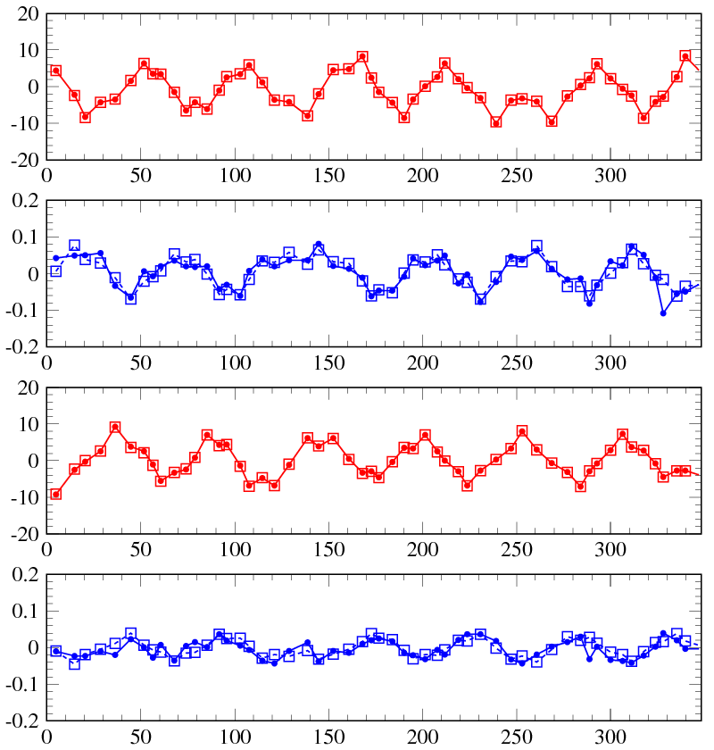
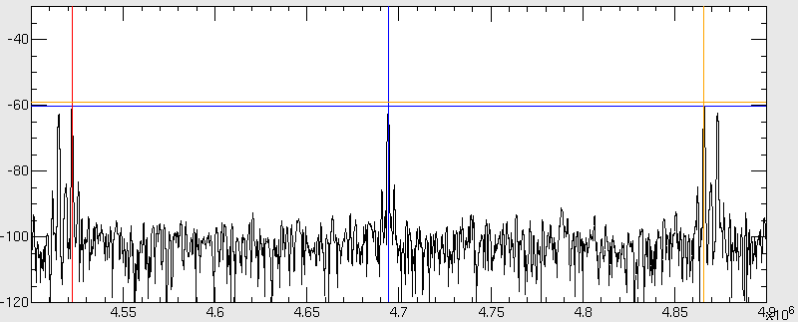
Beam-based measurements
of lattice imperfections in the RCS - II -
Leakage fields from the extraction beam line DC magnets;
- evaluation of skew quadrupole component
Orbit leak (Δy) to the vertical plane
by a horizontal single kick
Systematic measurement of
two normal mode betatron tunes (ν±)
near a linear coupling resonance
Kick
Δx (mm)
□ - calculation
● - measurement
Δy (mm)
ν±
FT spectrum of BPM signal
Kick
f_{rev}
Δx (mm)
Δy (mm)
(Hz)
s (m)
Skew quadrupole component estimated;
-0.00112 m⁻¹

Slide 24
Numerical simulation setup
Simpsons (PIC particle tracking code developed by Dr. Shinji Machida)
Imperfections included:
Time independent imperfections
- Measured main and multipole field components for all the main magnets:
BM (K_{0~6}), QM (K_{1, 5, 9}), and SM (K_{2, 8}) obtained from field measurements
- Alignment errors (Δx, Δy, Δs, Δθ) after the earthquake
Time dependent imperfections
- Edge focus of the injection bump magnets:
K₁ estimated from measured optical functions
- Static leakage fields from the extraction beam line:
K_{0,1} and SK_{0,1} estimated from measured COD and optical functions
- BM-QM field tracking errors
estimated from measured tune variation over acceleration
- 1-kHz BM ripple
estimated from measured orbit variation
- 100-kHz ripple induced by injection bump magnets
estimated from turn-by-turn BPM data
Foil scattering:
Coulomb & nuclear scattering angle distribution calculated with GEANT

Slide 25
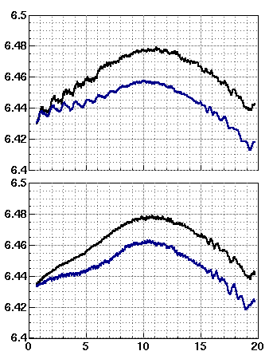
BM-QM field tracking error in acceleration mode
Operating point = (6.42, 6.42)
BM-QM field tracking error
Measured hor. tune
Injection
(0ms)
Extraction
(20ms)
BM field pattern
( no sine-curve)
QM field pattern
(sine-curve)
Measured ver. tune
BM-QM field tracking error causes
- tune excursion during acceleration
- emittance growth or beam loss
Time (ms)
Measured tune w/o manipulation
It is important to
- understand the tracking error
- control the tune during acceleration
- reproduce the error and tune excursion in simulation
Measured tune w/ manipulation
(QFM top 98% and QDL top 99%)

Slide 26
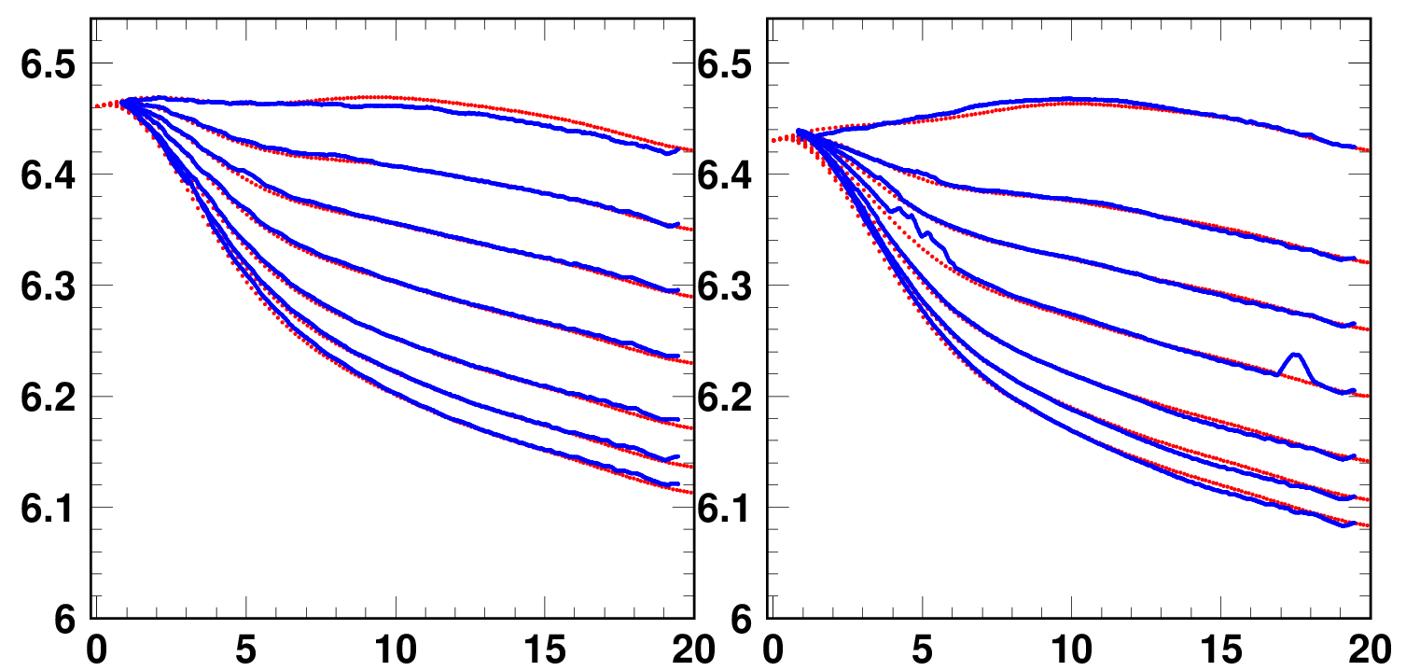
Reconstruction of BM-QM tracking error
in the simulation
The measured tune patterns were well reconstructed in our simulation.
Tune during acceleration process was well controlled by changing QMs top current.
Horizontal
Vertical
Tune
Measured tune
Calculated tune
Measured tune
Calculated tune
Time (ms)

Slide 27
Numerical simulation setup
Simpsons (PIC particle tracking code developed by Dr. Shinji Machida)
Imperfections included:
Time independent imperfections
- Measured main and multipole field components for all the main magnets:
BM (K_{0~6}), QM (K_{1, 5, 9}), and SM (K_{2, 8}) obtained from field measurements
- Alignment errors (Δx, Δy, Δs, Δθ) after the earthquake
Time dependent imperfections
- Edge focus of the injection bump magnets:
K₁ estimated from measured optical functions
- Static leakage fields from the extraction beam line:
K_{0,1} and SK_{0,1} estimated from measured COD and optical functions
- BM-QM field tracking errors
estimated from measured tune variation over acceleration
- 1-kHz BM ripple
estimated from measured orbit variation
- 100-kHz ripple induced by injection bump magnets
estimated from turn-by-turn BPM data
Foil scattering:
Coulomb & nuclear scattering angle distribution calculated with GEANT

Slide 28
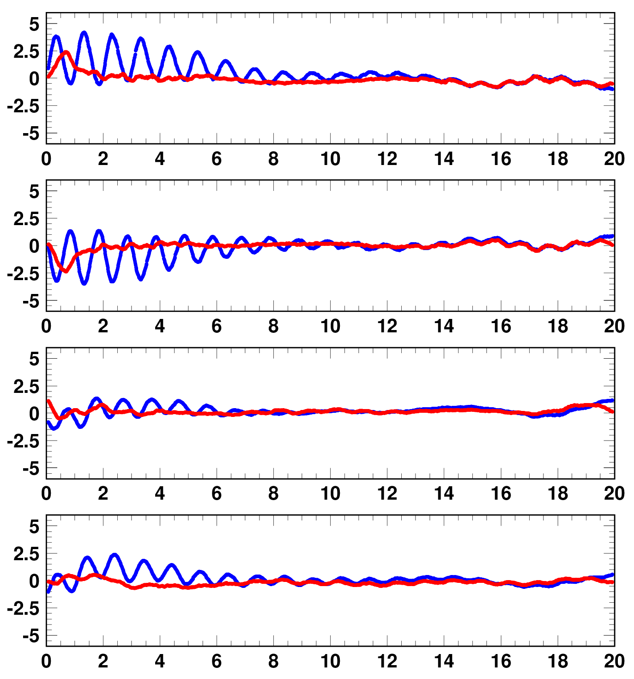
COD caused by 1-kHz BM ripple and COD correction
COD time dependence
@ AC mode
w/o 1kHz COD cor.
w/ 1kHz COD cor.
BPM0101
COD by 1-kHz BM ripple makes
- reduction of collimator physical aperture
- deformation of injection painting function
- tune fluctuation from COD and sextupole
components (K1=K2Δx)
BPM0301
Horizontal COD (mm)
BPM0701
Successful to correct the 1-kHz COD fluctuation from BM ripple by steering magnets.
Remain CODs were added into the simulation.
BPM1501
Time (ms)

Slide 29
Numerical simulation setup
Simpsons (PIC particle tracking code developed by Dr. Shinji Machida)
Imperfections included:
Time independent imperfections
- Measured main and multipole field components for all the main magnets:
BM (K_{0~6}), QM (K_{1, 5, 9}), and SM (K_{2, 8}) obtained from field measurements
- Alignment errors (Δx, Δy, Δs, Δθ) after the earthquake
Time dependent imperfections
- Edge focus of the injection bump magnets:
K₁ estimated from measured optical functions
- Static leakage fields from the extraction beam line:
K_{0,1} and SK_{0,1} estimated from measured COD and optical functions
- BM-QM field tracking errors
estimated from measured tune variation over acceleration
- 1-kHz BM ripple
estimated from measured orbit variation
- 100-kHz ripple induced by injection bump magnets
estimated from turn-by-turn BPM data
Foil scattering:
Coulomb & nuclear scattering angle distribution calculated with GEANT

Slide 30
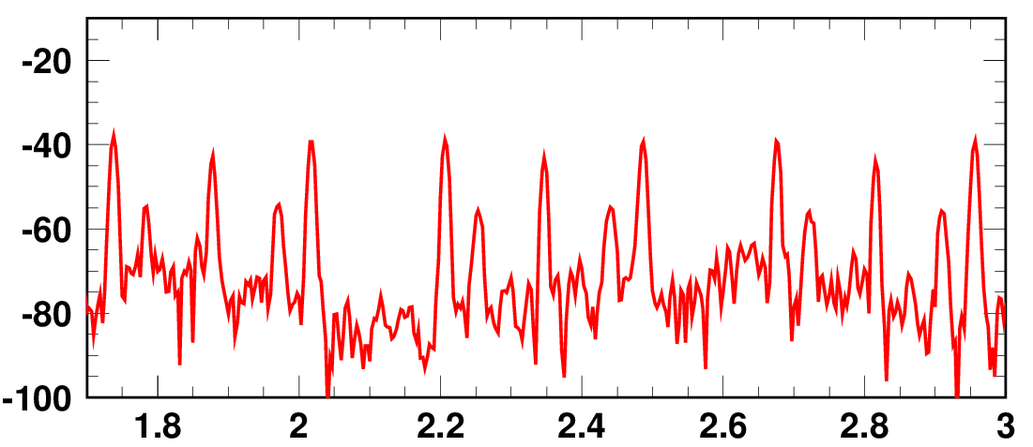
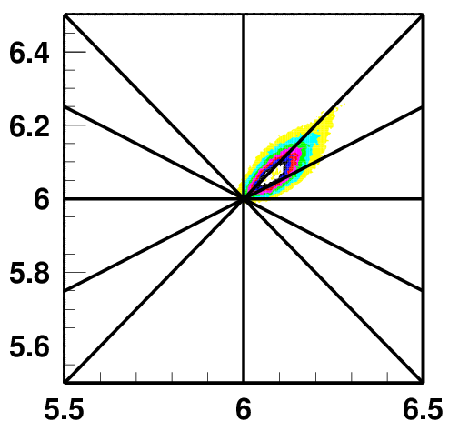
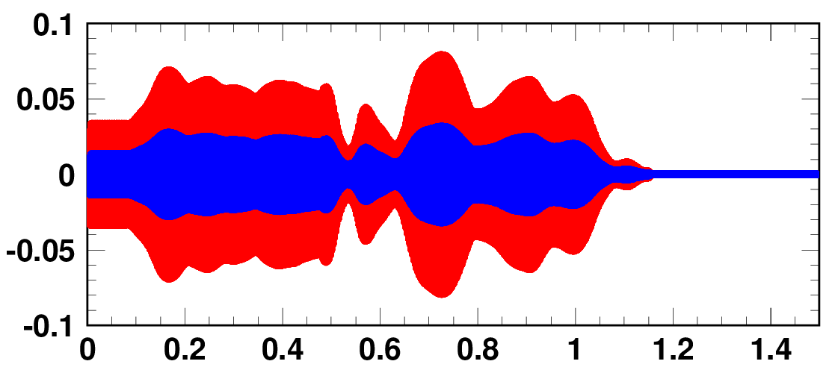
100-kHz dipole field ripple
induced by injection bump field
FFT spectrum of BPM signal when bump ON
β side-band
Peak
f_{rev} x 5
Horizontal
Side-band peak
excited by 100-kHz ripple
induced by injection bump field
Power (dB)
Tune footprint calculated at the end of beam injection
(6.45,6.42)
ν_{x}
0.2
Frequency (MHz)
0.2
Time structure of 100-kHz dipole field ripple
Flattop
Fall time
of injection bump
Horizontal
Vertical
Kick angle of ripple (mrad)
ν_{y}
This fast ripple excites additional
betatron resonances at 0.2
during injection (first ~1 ms)
and affects the beam.
~100 kHz
Time (ms)

Slide 31
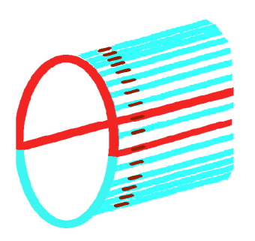
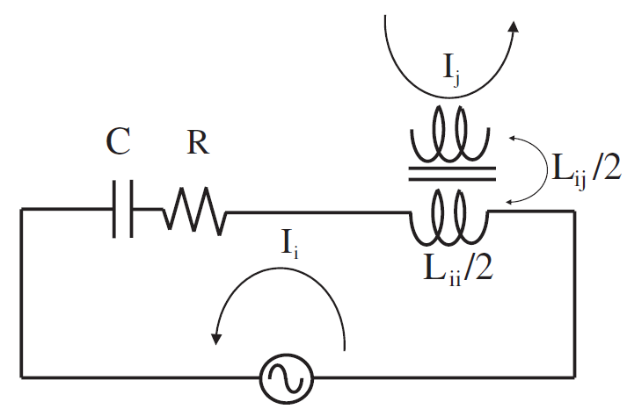
Source of 100-kHz dipole field ripple
Schematic drawing of the rf-shielded ceramics chamber
installed in the injection bump magnets
Y. Shobuda et al, PRST-AB 12, 032401 (2009)
Capacitor
RF shield strip
(Cu)
Resonant current in the rf shield loop
induced by dB/dt of the injection bump field
If the rf shield keep a symmetric configuration,
the ripple field can be canceled out through
the four injection bump magnets (- + + -).
But now the symmetric condition is destroyed
because a part of capacitors is now removed;
some capacitors burned out
in turning on the injection bump field
because of the lack of withstand voltage.
Such asymmetric configurations of the rf shield
spoil the cancelation and the remaining
field ripple component affects the beam.
Flange
Equivalent circuit of the RF shield

Slide 32
Numerical simulation setup
Simpsons (PIC particle tracking code developed by Dr. Shinji Machida)
Imperfections included:
Time independent imperfections
- Measured main and multipole field components for all the main magnets:
BM (K_{0~6}), QM (K_{1, 5, 9}), and SM (K_{2, 8}) obtained from field measurements
- Alignment errors (Δx, Δy, Δs, Δθ) after the earthquake
Time dependent imperfections
- Edge focus of the injection bump magnets:
K₁ estimated from measured optical functions
- Static leakage fields from the extraction beam line:
K_{0,1} and SK_{0,1} estimated from measured COD and optical functions
- BM-QM field tracking errors
estimated from measured tune variation over acceleration
- 1-kHz BM ripple
estimated from measured orbit variation
- 100-kHz ripple induced by injection bump magnets
estimated from turn-by-turn BPM data
Foil scattering:
Coulomb & nuclear scattering angle distribution calculated with GEANT

Slide 33
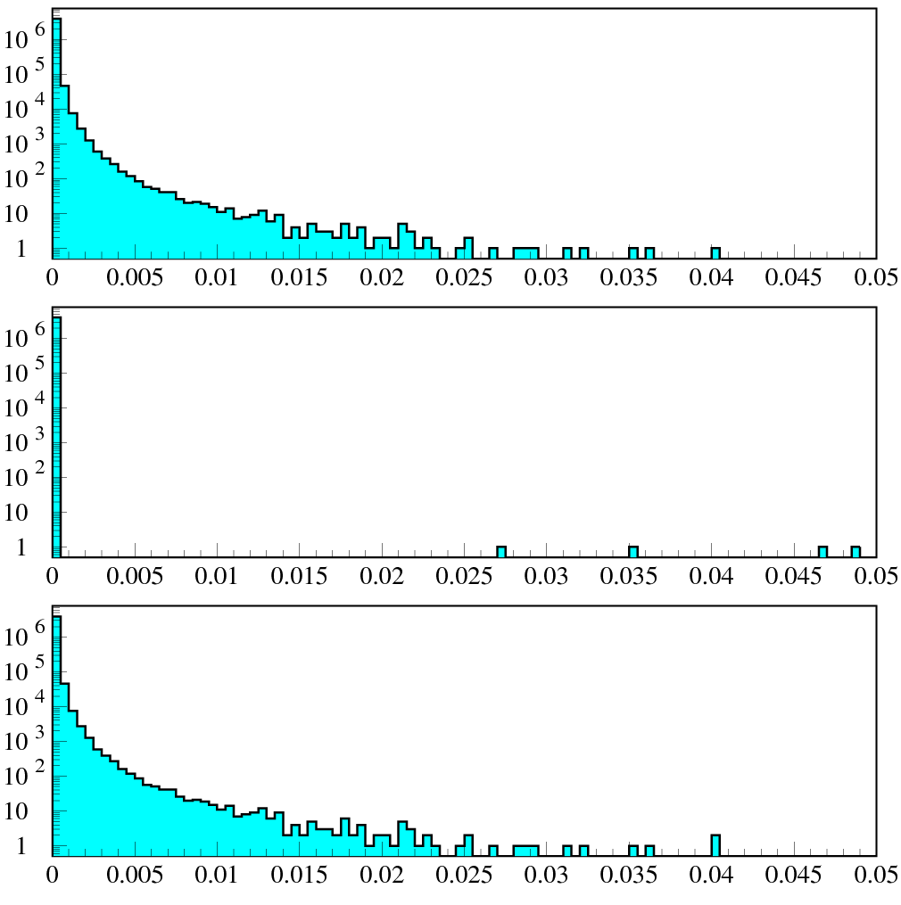
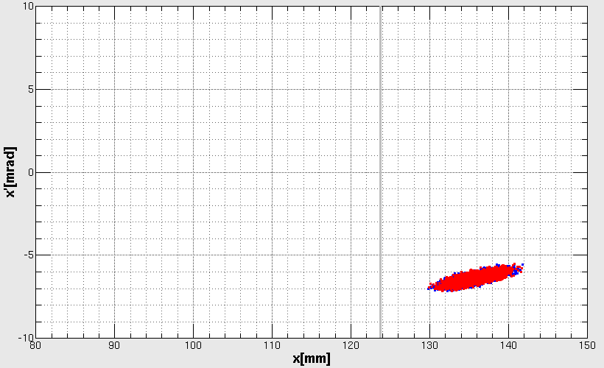
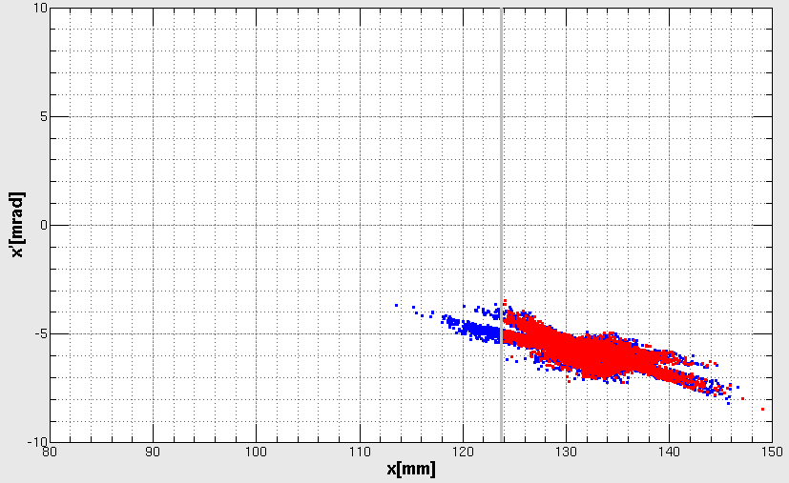
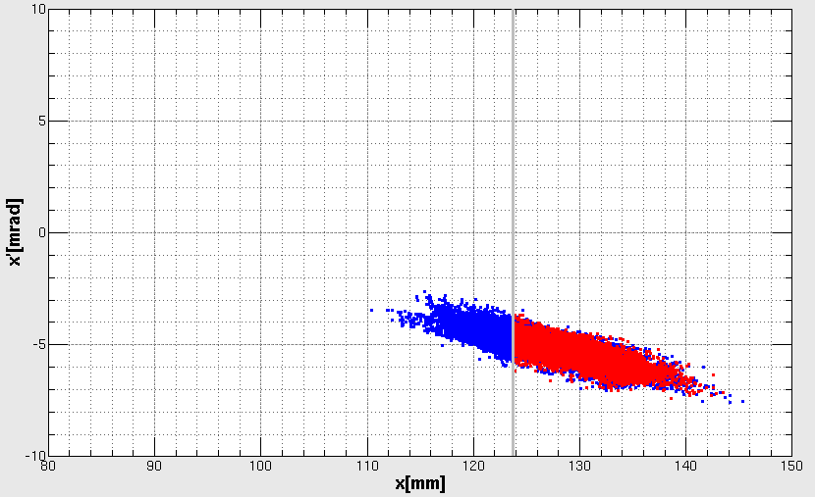
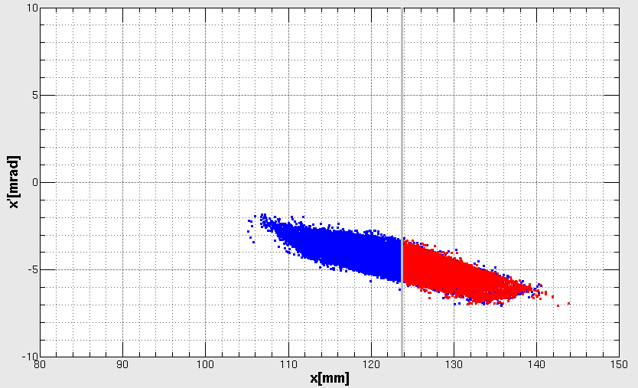
Foil Scattering
Scattering distribution by GEANT simulator (foil thickness : 300μg/cm²)
Horizontal phase space @ foil (simulation)
No hit particles, hit particles
Multiple Coulomb scattering
1 turn
Foil
10 turns
Foil
Nuclear scattering
20 turns
Foil
30 turns
Foil
Coulomb & nuclear scattering
By H. Hotchi
rad
Hit particles (red in plots) at the foil are identified.
Hit particles are given the scattering angle calculated by GEANT simulator.
Notes:
33

Slide 34
Contents
Introduction of the 3GeV RCS
Lattice imperfections
Comparison between experiments and simulations
Measures of the lattice imperfections
Summary

Slide 35
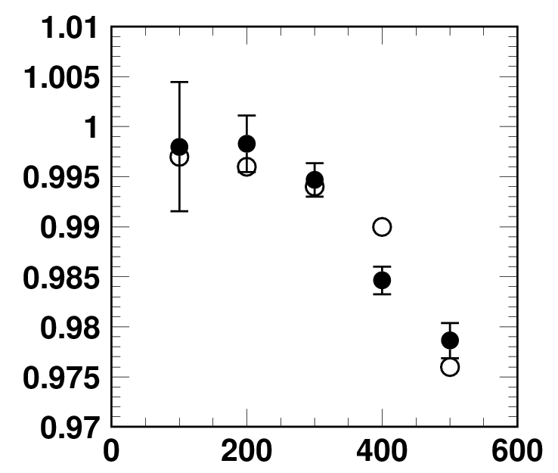
Measurement vs Simulation:
intensity dependence of beam loss
Painting parameter :
- 100π transverse painting
- Full longitudinal painting
Beam survival :
ratio of output intensity (DCCT)
to input intensity (SCT76)
539 kW (Li pulse 500 μs)
● Measurements
○ Simulations
(Preliminary)
433 kW (Li pulse 400 μs)
325 kW (Li pulse 300 μs)
433 kW
217 kW (Li pulse 200 μs)
104 kW (Li pulse 100 μs)
Beam survival
539 kW
217 kW
326 kW
Intensity dependence of the measured beam survival is similar globally with that of simulations.
104 kW
Li pulse length (μs)

Slide 36
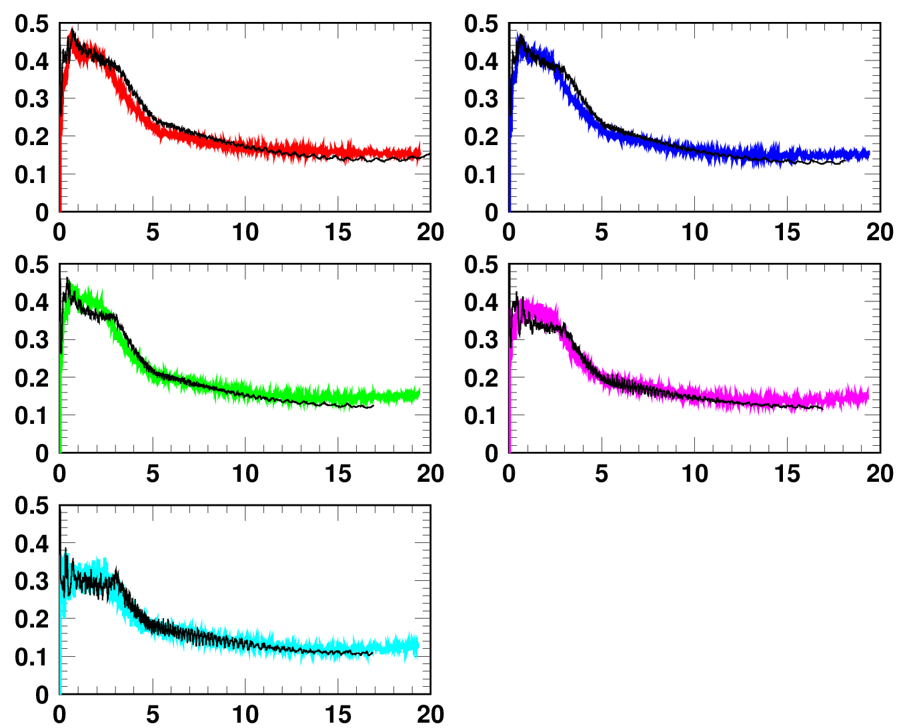
Measurement vs Simulation:
bunching factor from injection to extraction
― Simulations
539 kW (500 μs)
433 kW (400 μs)
326 kW (300 μs)
217 kW (200 μs)
Bunching factor
Time (ms)
104 kW (100 μs)
Time structure of measured bunching factor for each intense is in good agreement with simulated results.
Time (ms)

Slide 37
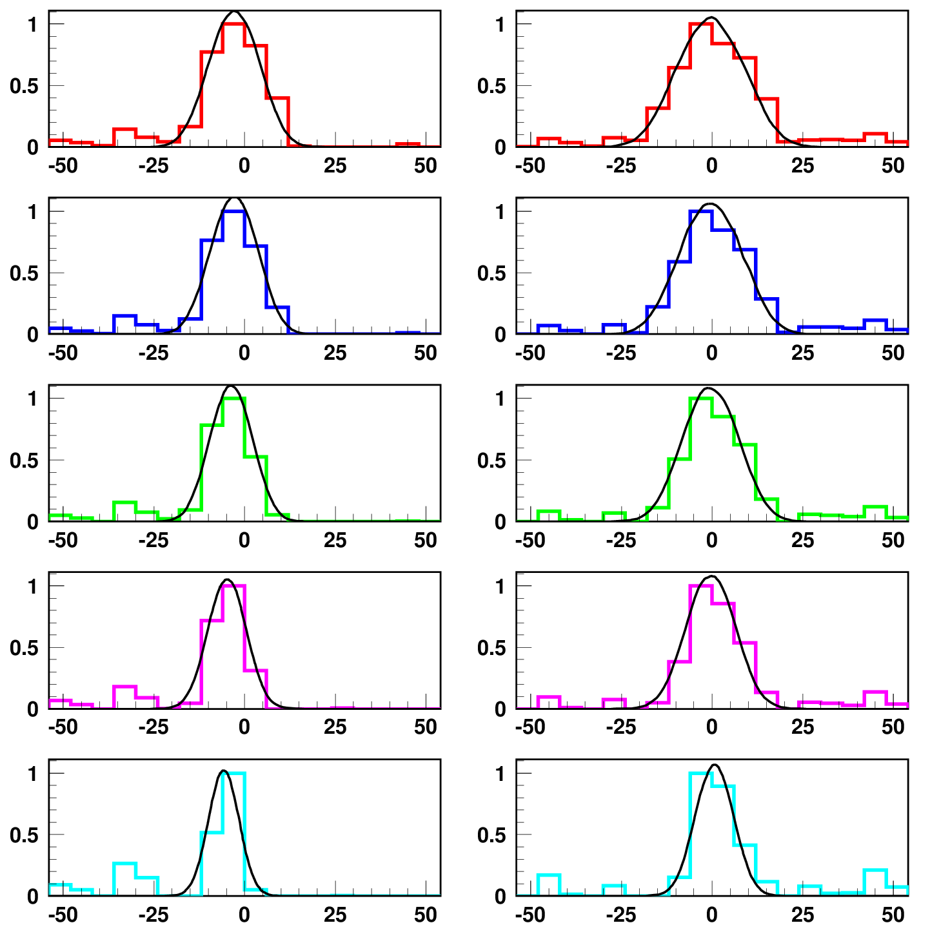
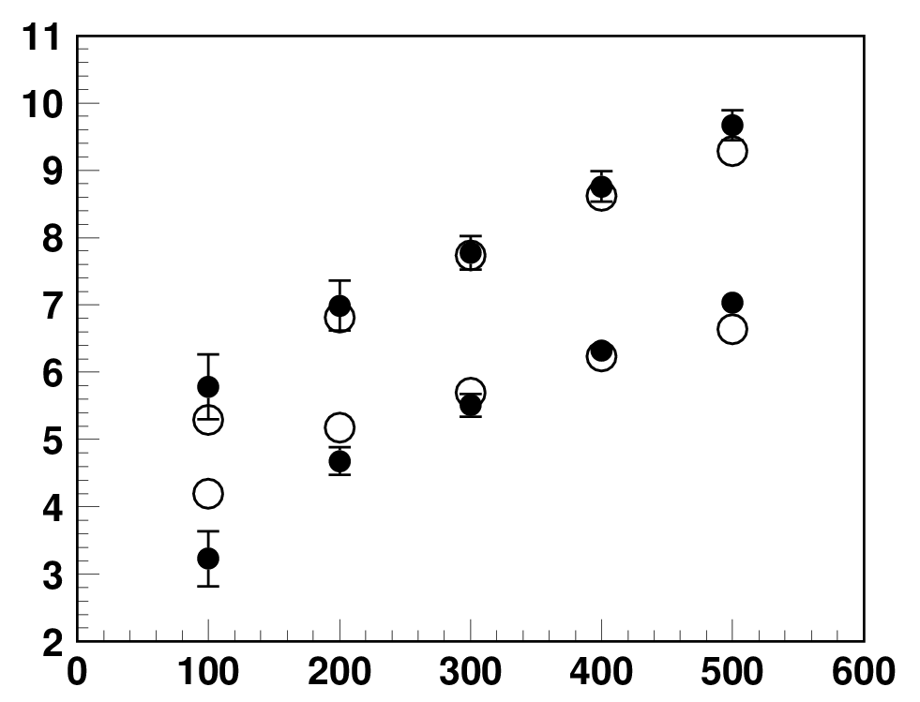
Measurement vs Simulation:
extraction beam profile at 3 GeV
MWPM @ extraction beam line
Horizontal
Vertical
Intensity dependence of RMS beam width
539 kW (500 μs)
― Simulations
(preliminary)
● Measurements
○ Simulations(preliminary)
433 kW (400 μs)
Charge density (Arb.)
Vertical
326 kW (300 μs)
RMS width (mm)
217 kW (200 μs)
Horizontal
104 kW (100 μs)
Li pulse length (ms)
Position (mm)
Our numerical simulation well globally reproduced
the experimental results up to 540 kW intensity beam.

Slide 38
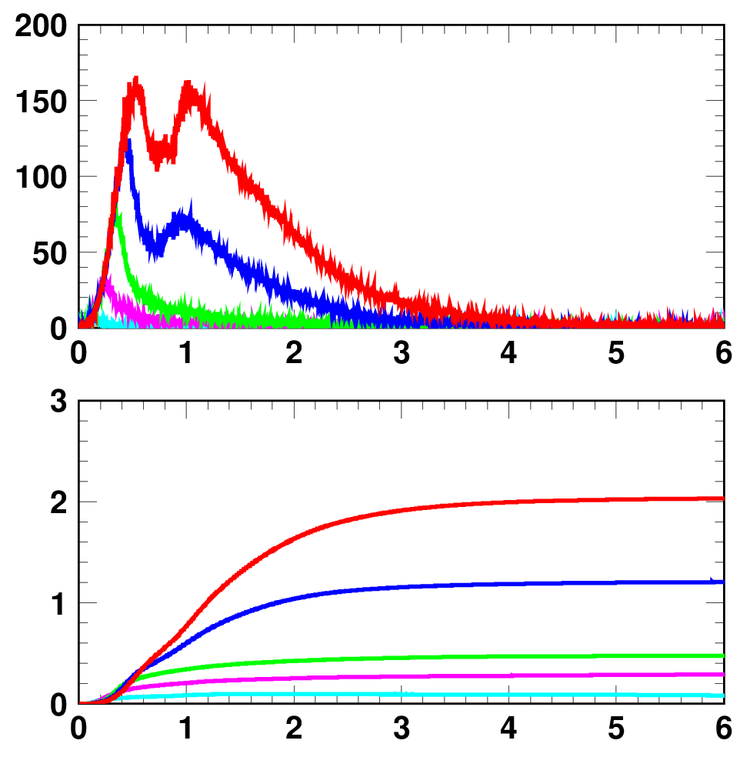
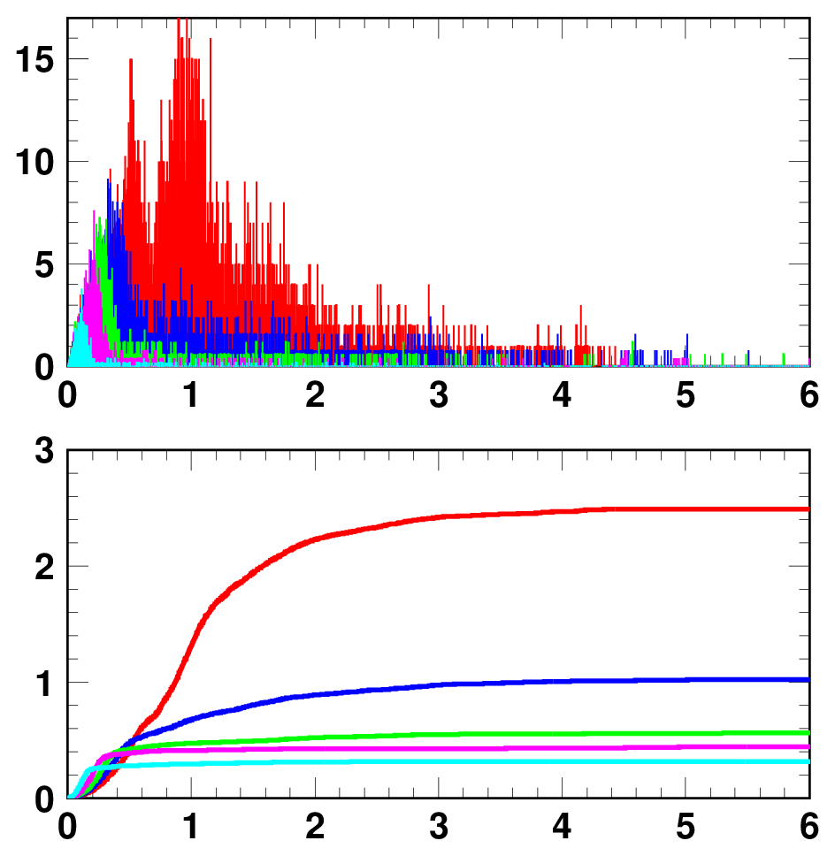
Time structure of beam loss
Scintillation type BLM @ Collimator
Simulations
(A)
539 kW (500 μs)
(A)
(B)
433 kW (400 μs)
(B)
326 kW (300 μs)
Preliminary
SBLM signal (Arb.)
217 kW (200 μs)
# of lost particles/turn
104 kW (100 μs)
2%
Beam loss (%)
Beam loss (%)
0.7 ms :
End of foil scattering
Time (ms)
0.7 ms :
End of foil scattering
Time (ms)
The beam loss appears only for the first 4 ms in the low energy region:
Beam loss of (A) Foil scattering during charge-exchange (H⁻ to proton) injection
Beam loss of (B) 100-kHz dipole field ripple induced by injection bump field

Slide 39
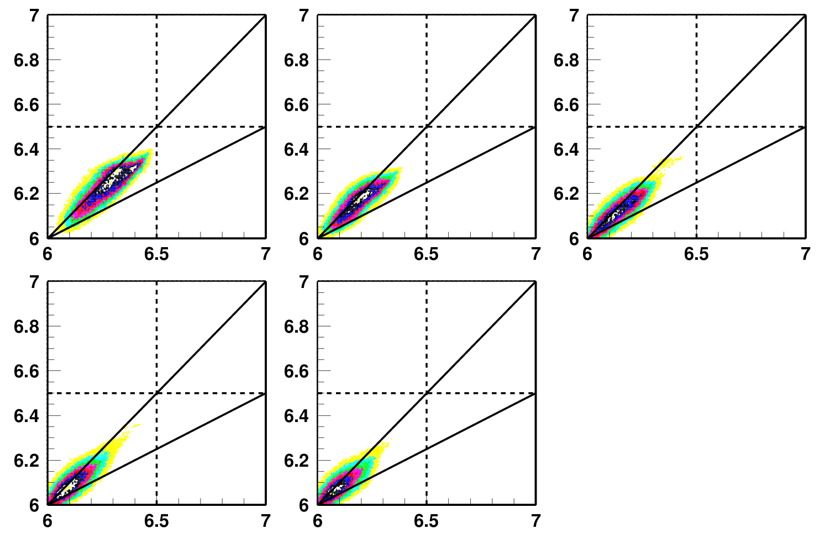
Effect of 100-kHz dipole field ripple
Tune footprint calculated at the end of injection
ν_{x}
104 kW (100 μs)
217 kW (200 μs)
326 kW (300 μs)
Present
operating point
0.2 (100 kHz/f_{rev}
at injection)
0.2
0.2
0.2
0.2
0.2
Core on 0.2 lines
433 kW (400 μs)
539 kW (500 μs)
100-kHz ripple makes additional
betatron resonances at 0.2
for the first 1 ms period.
A part of beam particles reaches to
0.2 lines due to space-charge
tune depression,
where the effect of ripple builds up,
leading to emittance growth.
0.2
0.2
0.2
0.2
Tail on 0.2 lines
ν_{y}
The situation for higher intensity beams is more critical in terms of halo/tail formation and its resultant beam loss, because the 100-kHz ripple directly affects a tail part of the beam.
The simulation studies for understanding the mechanism are under working!

Slide 40
Contents
Introduction of the 3GeV RCS
Lattice imperfections
Comparison between experiments and simulations
Measures of the lattice imperfections
Summary

Slide 41
Imperfections and measures
Time independent imperfections
- Measured main and multipole field components for all the main magnets:
  * No measures
- Alignment errors (Δx, Δy, Δs, Δq) after the earthquake
* Realignment in 2013 summer-autumn maintenance period
Time dependent imperfections
- Edge focus of the injection bump magnets:
- Static leakage fields from the extraction beam line:
  * Installation of 6 quadruple correctors for keeping the superperiodicity in 2013 summer-autumn maintenance period
  * Installation of additional shield at the extraction line in 2012 and success of leakage fields reduction (K₀:50%, K₁:40%, SK₁:75%)
- BM-QM field tracking errors
  * Adjustment of tune manipulation for emittance growth reduction
- 1-kHz BM ripple
  * Ripple reduction by low-path filter and COD correction by steering magnets
- 100-kHz ripple induced by injection bump magnets
  * Installation of new ceramics chamber with modified rf-shield structure in 2013 summer-autumn
Foil scattering:
  * Adjustment of foil position and transverse painting function

Slide 42
Summary
Lattice imperfections were also measured/estimated from field measurements and beam experiment.
The simulation input were created in the beam experiment.
Our numerical simulation well globally reproduced the experimental results.
Source of beam loss and emittance growth are discussed based on the realistic numerical simulation.
We will aim at the design output beam power of 1MW after upgrading the linac.

Slide 43
Back up

Slide 44
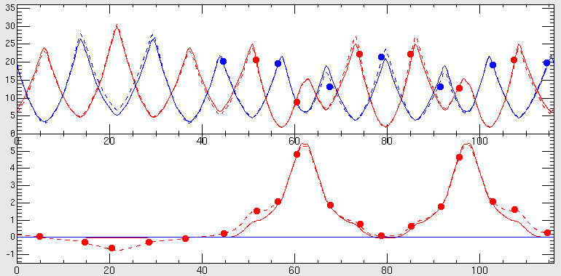
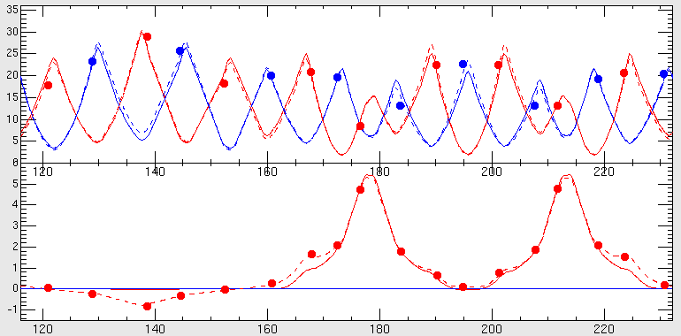
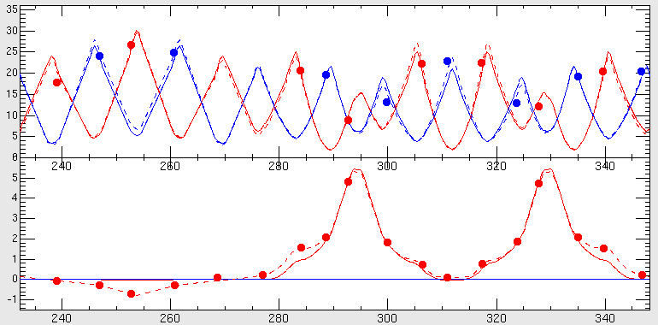
Optics Measurement
β_{x}, β_{y}(m)
Betatron tunes : Measured by Fourier transform analysis of detected transverse beam oscillation
Injection + Arc
η_{x}(m)
Tune set : (6.640, 6.250)
Tune measured : (6.672, 6.240)
@ Day-1
Dispersion functions : Measured by looking at a rf-frequency dependence of the closed orbit
Extraction + Arc
Beta functions : Estimated from a response of the closed orbit for a dipole kick (STM) :
RF + Arc
The measured optics can be reasonably well-reconstructed in our accelerator model
s(m)
Measured
Designed
Reconstructed

Slide 45
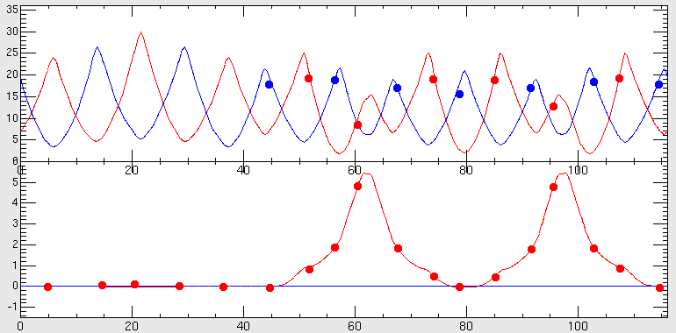
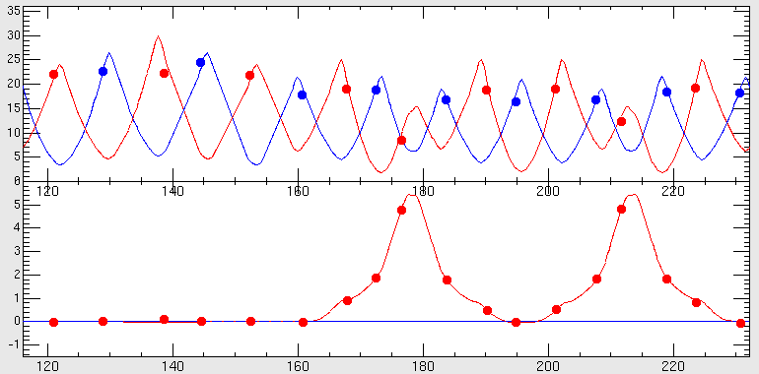
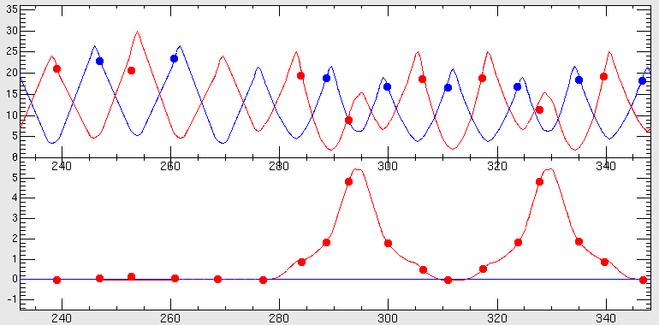
Optics Correction
- Based accelerator model
β_{x}, β_{y}(m)
Injection + Arc
“Fudge factor”: the difference of the set and reconstructed quadrupole strength with 7 families in our accelerator model
η_{x}(m)
Extraction + Arc
The optics parameters (beta functions, betatron tunes and dispersion functions) were well corrected to the design value with no iteration by our accelerator model
RF + Arc
s(m)
Measured
Designed

Slide 46
Ring Optics
Insertion
Arc
○ measured values
― calculated values
β_{x}, β_{y}(m)
(ν_{x},ν_{y})=(6.38,6.45)
on 2008/05/26
η_{x}(m)
s(m)
Insertion
Arc
β_{x}, β_{y}(m)
(ν_{x},ν_{y})=(6.40,6.42)
on 2009/11/02
η_{x}(m)
s(m)
We can control the ring optics by our accelerator model and discuss the various lattice imperfections in the real machine based on the accelerator model.

Slide 47
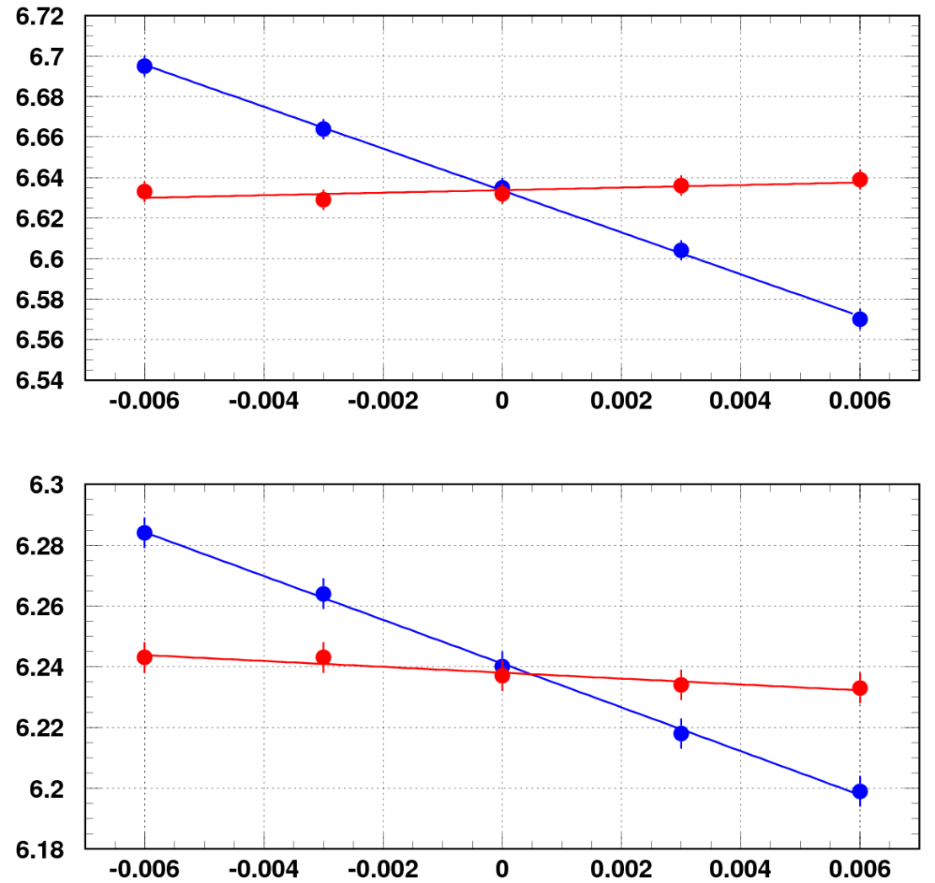
Chromaticity measurement & correction
After the optics correction, we measured the chromaticity
and tried the chromatic correction with 3 families of sextupole magnets.
ν_{x}
-10.3
Calculated chromaticity:
ξ_{x}=-8.5, ξ_{y}=-8.1
in assuming
the simple linear optics model.
ξ_{x}=-10.4, ξ_{y}=-6.8
if including
the multipole field components
of BMs & QMs measured from the
magnetic field measurements
(especially,
the 6-pole component of BM).
w/o corr.
-0.63
w/ corr.
ν_{y}
-7.2
0.97
The 6-pole component of BM from the field measurement were confirmed by chromaticity measurement in beam experiment.
Δp/p₀

Slide 48
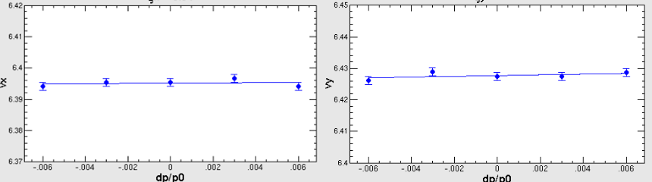
Chromatic correction
Measured the chromaticity w/ the sextupole magnets for the chromatic correction
Chromaticity (Hor.) w/ correction
Chromaticity (Ver.) w/ correction
From the basic tuning of the ring,
  COD correction (i.e., dipole components)
  Optics tuning (i.e., quadrupole components)
  Chromatic correction (i.e., sextupole componets)

Slide 49
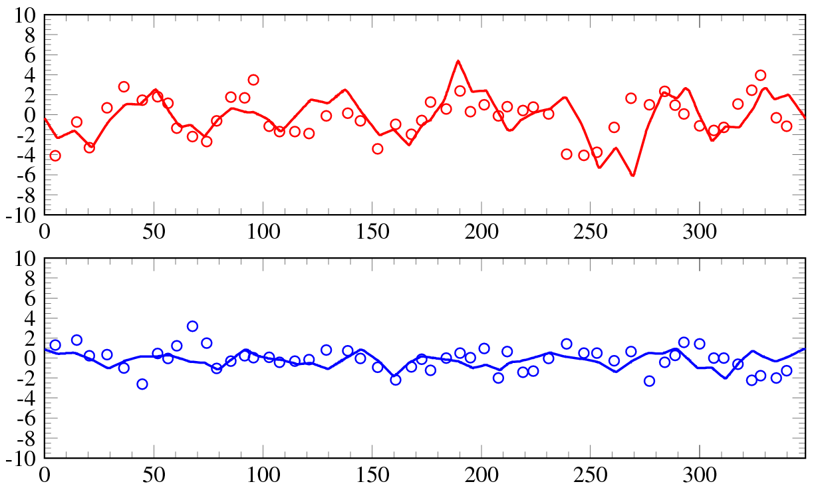
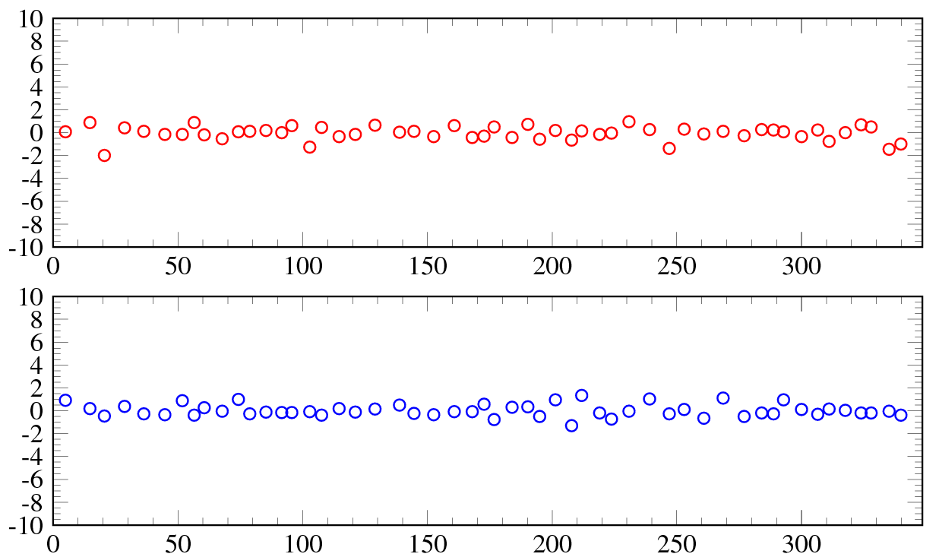
Difference of the COD from the alignment errors
Horizontal
H. Hotchi
Δx (mm)
Calculated the COD caused by new
alignment position errors.
Set the latest parameters of steering
magnets and measured the COD.
Vertical
Δy (mm)
s (m)
Horizontal
- COD after the correction
Corrected the COD within the previous accuracy.
The effect for the beam loss is small if the beam passes through the center of magnets.
Δx (mm)
Vertical
Δy (mm)
s (m)
○ measured values ― calculated values

Slide 50
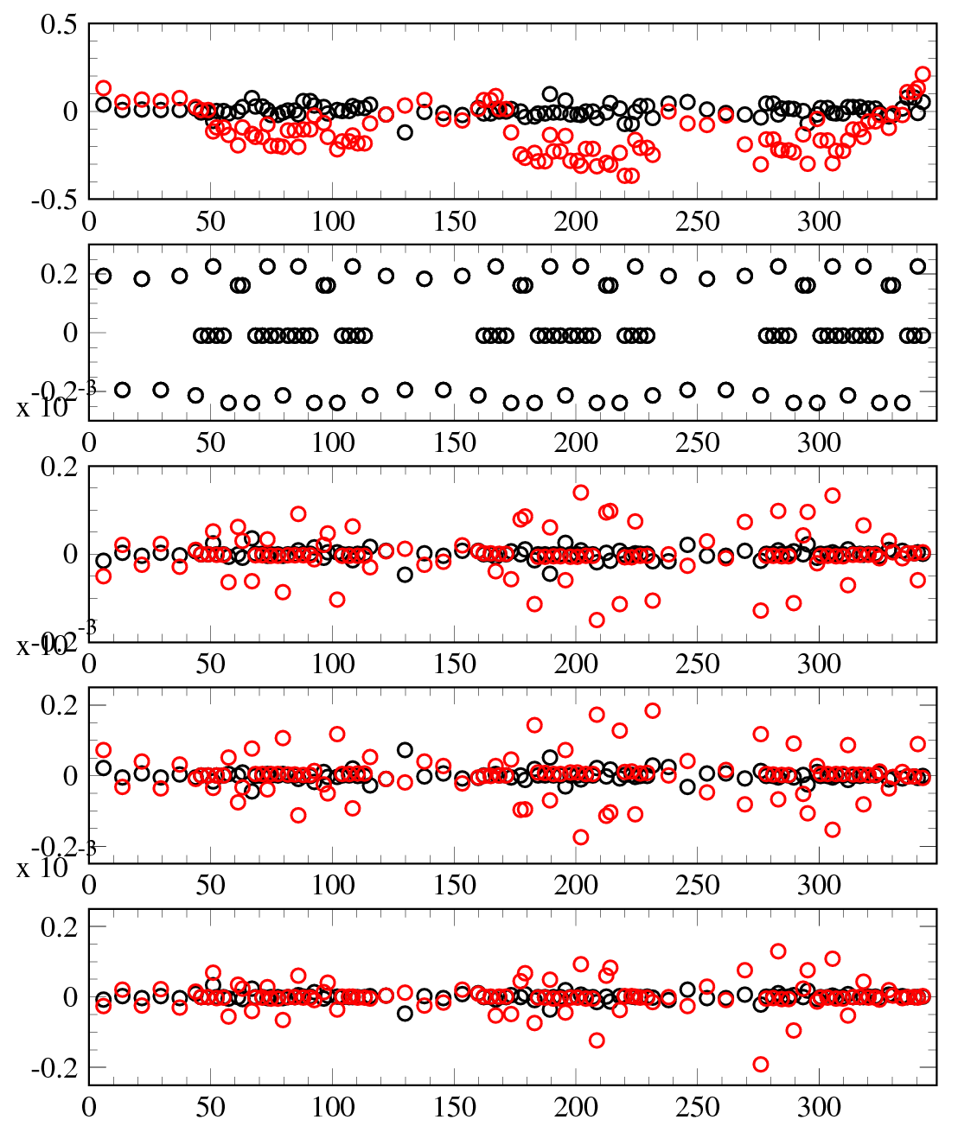
Estimation of the effect to beam caused by rotation errors
Operating Point =(6.42,6.42)
Black dots – before earthquake
Red dots – after earthquake
H. Hotchi
Linier Coupling of ν_{x} – ν_{y}
Rotation
Errors
(mrad)
K₁ (m⁻¹)
Quadrupole
Components
Skew-Quad.
Components
SK₁ (m⁻¹)
(before earthquake)
(after earthquake)
Real part of
G_{1,-1,0}
Re(G_{1,-1,0})
Skew components of leakage fields from extraction DC magnets
Im(G_{1,-1,0})
Imaginary part
of G_{1,-1,0}
s (m)

Slide 51
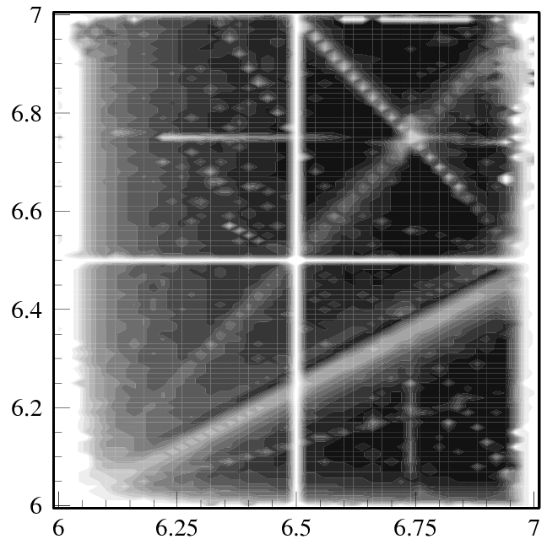
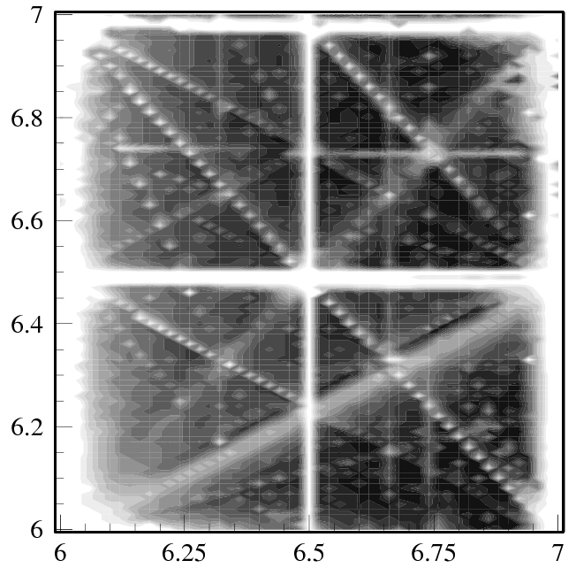
Tune diagram
Without the measured
“edge focus & leak fields”
With the measured
“edge focus & leak fields”
ν_{y}
: Operating points (6.45,6.42)
for high intensity beam
Edge focus and leakage field;
enhance
- linear coupling resonance,
- 3-rd order random resonances,
make
- strong limit for tunability.
ν_{x}
ν_{x}
In order to get more stable and flexible tune space,
we plan to
- install additional magnetic shields
for reducing the leakage field (in 2012 Summer shutdown)
- introduce quadrupole correctors
for compensating the edge focus effect (in 2013 Summer-Autumn shutdown)
Our understanding of the basic lattice properties
was deepen through such a series of beam dynamics measurements.

Slide 52
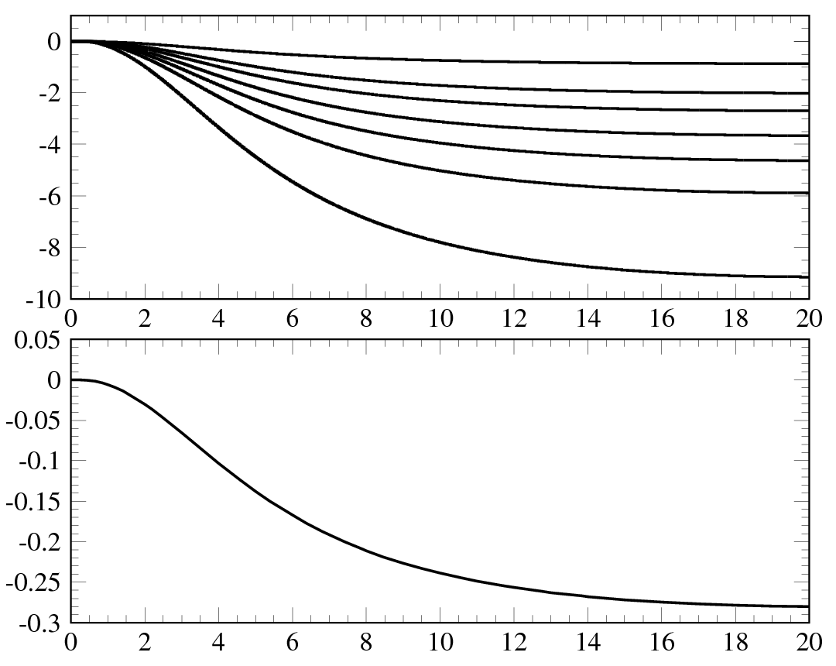
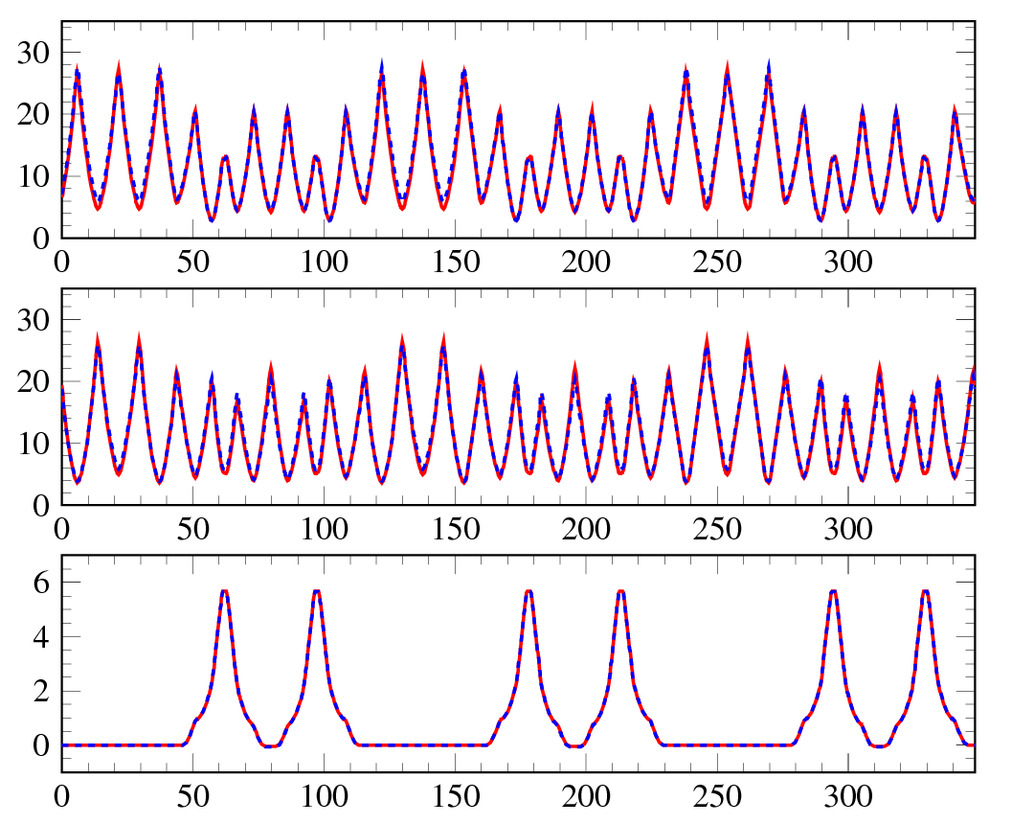
Tune manipulation during accelerating process
It is important to have the tune manipulation process during acceleration in order to reduce the beam loss and halo for higher output beam power
QFX
βx (m)
QFN
ΔGL/GL (%)
QDX
QDN
QDL
QFL
QFM
βy (m)
Δν
Δν_{x,y}= -0.28
ηx (m)
at 0 ms at 20 ms
Time (ms)
s (m)
We have found the quadrupole parameters to manipulate the tune with very low modulations of beta and dispersion functions

Slide 53
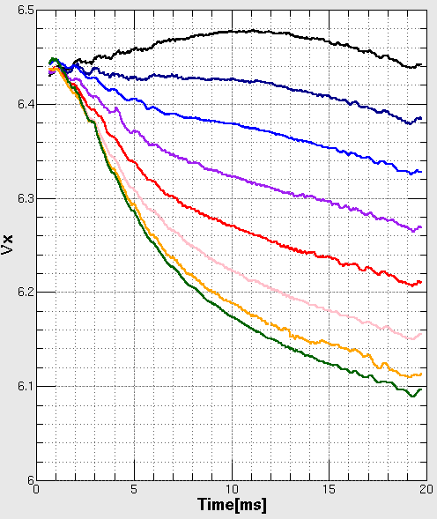


Tune manipulation test
(1) Δν=−0.00
(GL/GL₀)_{TOP}
QFX
(2) Δν=−0.05
QFN
QDL
(3) Δν=−0.10
QDN
(4) Δν=−0.15
QFL
QDX
(5) Δν=−0.20
QFM
(6) Δν=−0.25
(7) Δν=−0.28
(8) Δν=−0.30
Next step :
  Achieve fine manipulation of tunes
  Minimize the beam halo against tunes
Δν
Δν

Slide 54

Transverse painting injection
Transverse painting makes use of a controlled phase space offset
between the centroid of the injection beam and the ring closed orbit
to get a uniform particle distribution of the circulating beam
after the multi-turn injection.
Horizontal painting
by a horizontal closed orbit
variation during injection
(1)
Vertical painting
by a vertical injection
angle change during injection
Painting emittance mainly
applied in this beam study;
(3)
(2)
ε_{tp}= 50&100 π mm mrad
(1)&(2); correlated painting
(1)&(3); anti-correlated painting

Slide 55


Longitudinal painting injection
Longitudinal painting makes use of a controlled momentum offset
to the rf bucket in combination with superposing a second harmonic rf voltage
to get a uniform bunch distribution after the multi-turn injection.
Momentum offset injection
Phase sweep of 2nd harmonic rf
V₂/V₁=0 (fundamental rf only)
V₂/V₁=80%
Φ₂=-100°@t=0
Φ₂=-50°
Φ₂=0°@t=0.5ms
V_{rf}=V₁sinΦ-V₂sin{2(Φ-Φ_{s})+Φ₂}
Δp/p=0, -0.1, -0.2%
Uniform bunch distribution is formed through
emittance dilution by the synchrotron motion
in a flat and wide rf bucket potential
given by superposing a second harmonic rf.
The second harmonic phase sweep method enables to control the bunch distribution through a dynamic change of the rf bucket potential.

Slide 56


Longitudinal beam distribution
at the end of injection
Data ID 1
－Measurement (WCM)
－Simulation
Δp/p(%)
Charge density (Arb.)
B_{f}=(I_{average}/I_{peak})=0.25
φ (deg)
φ (deg)
Data ID 2
Data ID | ε_{tp} (π mm mrad) | V₂/V₁ (%) | φ₂ (deg) | Δp/p (%)
1 | -
2 | - | 80 | -100 | -0.0
3 | - | 80 | -100 | -0.1
4 | - | 80 | -100 | -0.2
5 | 50 | 80 | -100 | -0.2
6 | 100 | 80 | -100 | -0.2
Δp/p(%)
Charge density (Arb.)
B_{f}=0.38
φ (deg)
φ (deg)
Data ID 3
Δp/p(%)
Charge density (Arb.)
B_{f}=0.42
The uniformity of the longitudinal
beam distribution gradually improves
as the longitudinal painting progresses.
φ (deg)
φ (deg)
Data ID 4
Δp/p(%)
Charge density (Arb.)
B_{f}=0.45
φ (deg)
φ (deg)

Slide 57

Beam survival for high intensity beam studies
(output intensity/input intensity)
Injection beam;
181 MeV/20 mA/0.5 ms/0.56 chopper beam-on duty
⇒3.5E13/pulse, corresponding to 420 kW output at 25 Hz
Best beam survival;
>99 %
○ - Measurement
＊ - Numerical simulation
Painting injection parameters
Transverse
painting
Longitudinal
painting
No
paint
Longitudinal
+
Transverse
paint
Data ID | ε_{tp} (π mm mrad) | V₂/V₁ (%) | φ₂ (deg) | Δp/p (%)
1 | - | - | - | -
2 | - | 80 | -100 | -0.0
3 | - | 80 | -100 | -0.1
4 | - | 80 | -100 | -0.2
5 | 50 | 80 | -100 | -0.2
6 | 100 | 80 | -100 | -0.2
Beam survival
Longitudinal
paint
83%
Data ID
Beam power (kW)
Highest output;
~420 kW-eq.
Data ID

Slide 58

Time structure of the beam loss
(Acceleration time
from injection to extraction; 20 ms)
Data ID
2
Measurement;
Scintillation-type BLM signals for the first 6 ms
measured in the collimator section for data ID 2-6.
3
BLM signal (Arb.)
4
6
Data ID | ε_{tp} (π mm mrad) | V₂/V₁ (%) | φ₂ (deg) | Δp/p (%)
1 | -
2 | - | 80 | -100 | -0.0
3 | - | 80 | -100 | -0.1
4 | - | 80 | -100 | -0.2
5 | 50 | 80 | -100 | -0.2
6 | 100 | 80 | -100 | -0.2
Time (ms)
Number of lost
macro-particles/turn
Simulation
Time (ms)
Measurement (BLM)
Simulation
It was confirmed in this experiment
the present painting injection
- mitigates the space charge effect
through charge density control,
- leads to
significant beam loss reduction.
Integrals
(Beam loss rate)
by longitudinal
painting
by transverse
painting
Time (ms)

Slide 59



Estimation of SK₁ in the leakage fields
FFT spectrum of BPM signal near the ν_{x}−ν_{y}=0
Betatron motion near ν_{x}-ν_{y}=0
ν±
f_{rev}
(Hz)
ν±
ESEP & 3NBT excited at 181 MeV
ν_{y}
ν_{x}+ν_{y}=13
2ν_{x}=13
2ν_{y}=13
ν_{x}-2ν_{y}=-6
ν±
excited at 3 GeV
ν_{x}-ν_{y}=0
ν_{x}
ν_{y} set

Slide 60
Measured intrinsic nonlinear
& imperfection fields
* Tune (6.38,6.45)
 | K₀ SK₀ | K₁ SK₁ | K₂ | K₃ | K₄ | K₅ | K₆ | K₇ | K₈ | K₉
BM | 2.618E-01 | -2.023E-02 | -1.006E-01 | 3.635E-01 | -1.332E+01 | 2.340E+02 | -6.370E+04 | - | - | -
QFL | - | 1.943E-01 | - | - | - | - | - | - | - | -
QDL | - | -1.951E-01 | - | - | - | - | - | - | - | -
QFM | - | 1.952E-01 | - | - | - | 1.233E+02 | - | - | - | 5.666E+08
QDX | - | -2.170E-01 | - | - | - | -4.874E+02 | - | - | - | -1.460E+09
QFN | - | -2.199E-01 | - | - | - | 4.939E+02 | - | - | - | 1.480E+09
QDN | - | -2.377E-01 | - | - | - | -5.340E+02 | - | - | - | -1.600E+09
QFX | - | 1.610E-01 | 6.336E-04 | 1.667E-01 | - | 1.815E+02 | - | 5.612E+04 | - | 5.014E+08
SDA | - | - | -2.806E-01 | - | - | - | - | - | -6.887E+05 | -
SFA | - | - | 3.826E-01 | - | - | - | - | - | 9.391E+05 | -
SDB | - | - | -2.806E-01 | - | - | - | - | - | -6.887E+05 | -
STM | 1.000E-03 | 6.882E-05 | 5.028E-04 | 5.547E-03 | 6.903E-01 | - | - | - | - | -
Edge focus | - | -3.335E-03 | - | - | - | - | - | - | - | -
Leak field | -1.136E-03 -1.193E-04 | 4.763E-03 -1.115E-03 | - | - | - | - | - | - | - | -

Slide 61

Foil-related beam loss (2010)
15 mA/0.2 ms/560 ns/2 bunches/25 Hz/120kW output
Foil thickness ; 200 μg/cm²
The number of foil hits can be reduced
- by the transverse painting
- by optimizing the foil position
24.3 (# of foil hits)
BLM(int.)
@H0 branch
BLM signal/foil hits
22.8
13.8
11.0
8.8
BLM(int.)
@QFM entrance
Δx
Δx=7 mm
Δy=10 mm
Δy
Current foil size
110(H)x40(V) mm²
Δx=9 mm
Linac beam ~7x7 mm²
H&V anti-paint (150π mm mrad)
H paint (150π mm mrad), Δx=15 mm, Δy=20 mm

