Slide 1
J-PARC Main Ring Optics, Space Charge, Alignment
2013/12/3
Beam Dynamics meets Magnets
Igarashi (KEK)

Slide 2
Contents
Overview of J-PARC Main Ring
Magnetic field measurements
Alignment
Implementation to the beam tracking simulation
Comparison between the beam measurement and simulation
Coherent oscillation and damping with the octupole magnets

Slide 3
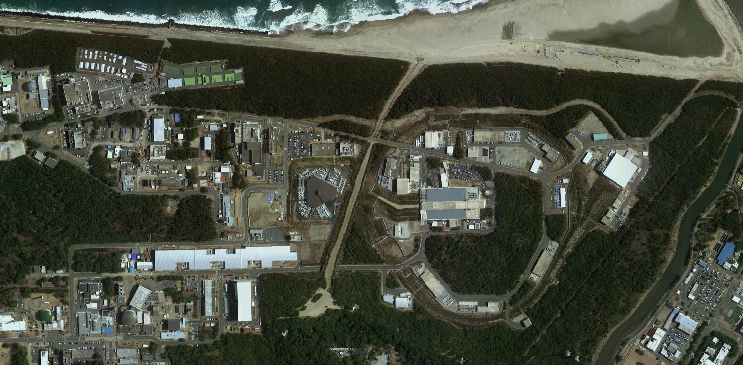
Japan Proton Accelerator Research Complex
(J-PARC)
High Intensity Proton Accelerators
Facilities to use the secondary beams
Operated by Japan Atomic Energy Agency (JAEA) and High Energy Accelerator Research Organization (KEK)
LINAC (181 MeV → 400 MeV)
Rapid Cycling Synchrotron (RCS) (3 GeV)
  Material and Life science Facility (MLF)
Main Ring (MR) (30 GeV)
  Neutrino Facility
  Hadron Hall
MR
Hadron Hall
RCS
LINAC
MLF
Neutrino

Slide 4
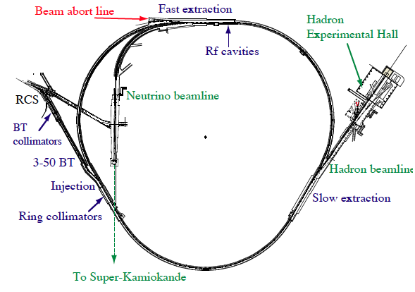
MR Design Features
To achieve the beam power of 750 kW
Large Aperture
Beam Loss Localization
Imaginary Transition γ lattice
The first beam in MR
  Injection 2008 May
  Acceleration and extraction 2008 Dec.
Circumference 1567.5 m
Three-fold symmetry
Injection Energy 3GeV
Extraction Energy 30 GeV (50 GeV)
Power achieved so far 240 kW

Slide 5
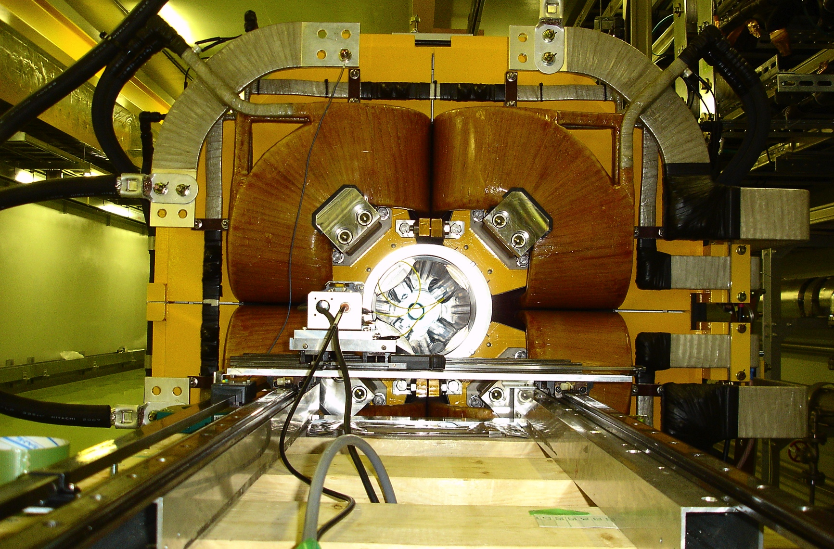
Large Aperture
Main Magnets :
96 Bending Magnets
216 Quadrupole Mangets
72 Sextupole Magnets
Aperture ≥ 81π mmmrad
Quadrupole magnet bore diameter ≥ 130 mm

Slide 6
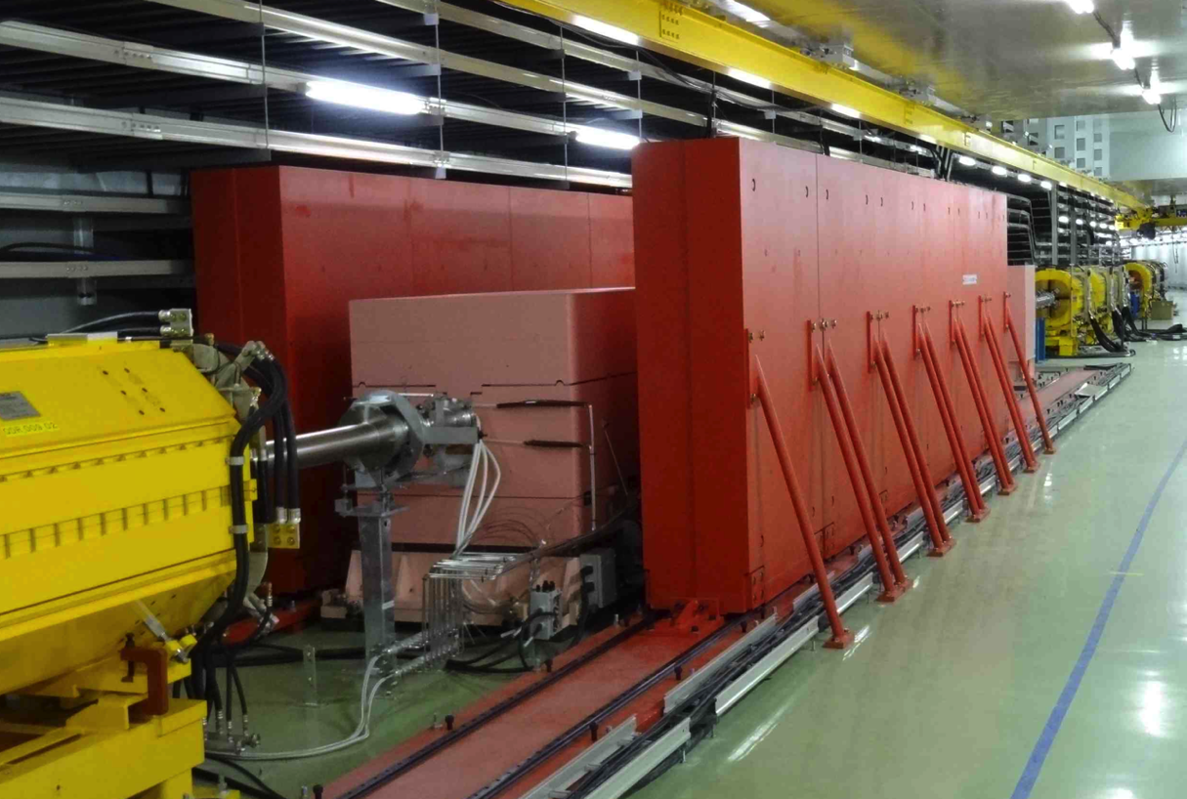
Beam Loss Localization
Collimator system is being upgraded in 2011 ~ 2013.
Power capacity: 0.45 kW → 3.5 kW.

Slide 7
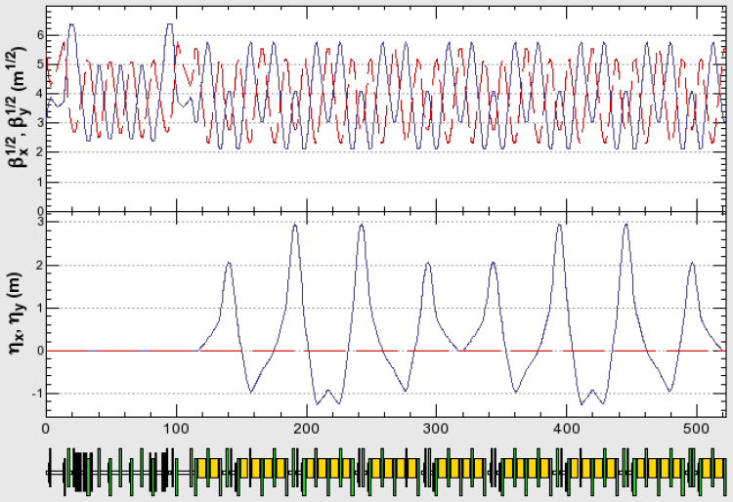
MR Optics
Imaginary Transition γ lattice designed by Machida-san
  for phase stability of RF acceleration
MR Beta and Dispersion, 1/3 of MR
Straight section
Arc section

Slide 8
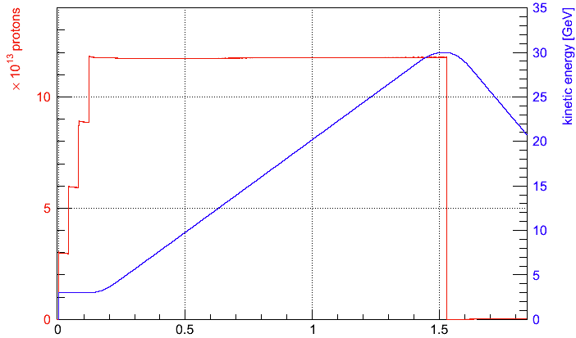
Typical Operation Status for Fast Extraction
Power : 225 kW
Repetition : 2.48 sec
4 batch (8 bunch) injection during the period of 0.13 s
1.5e13 protons per bunch (ppb) × 8 @ Injection
1.17e14 ppp @ P3 (end of acceleration)
Loss during the injection period : 400 W
Loss in the beginning of acceleration (0.12 s) : 150 W
Loss power is within the MR collimator limit of 2 kW.
Loss at 3-50BT : 70 W, < 3-50BT collimator limit of 2 kW
Time (s)
Acceleration
Extraction
Injection
Recovery
0.01 + 0.13 s
1.4 s
0.94 s

Slide 9
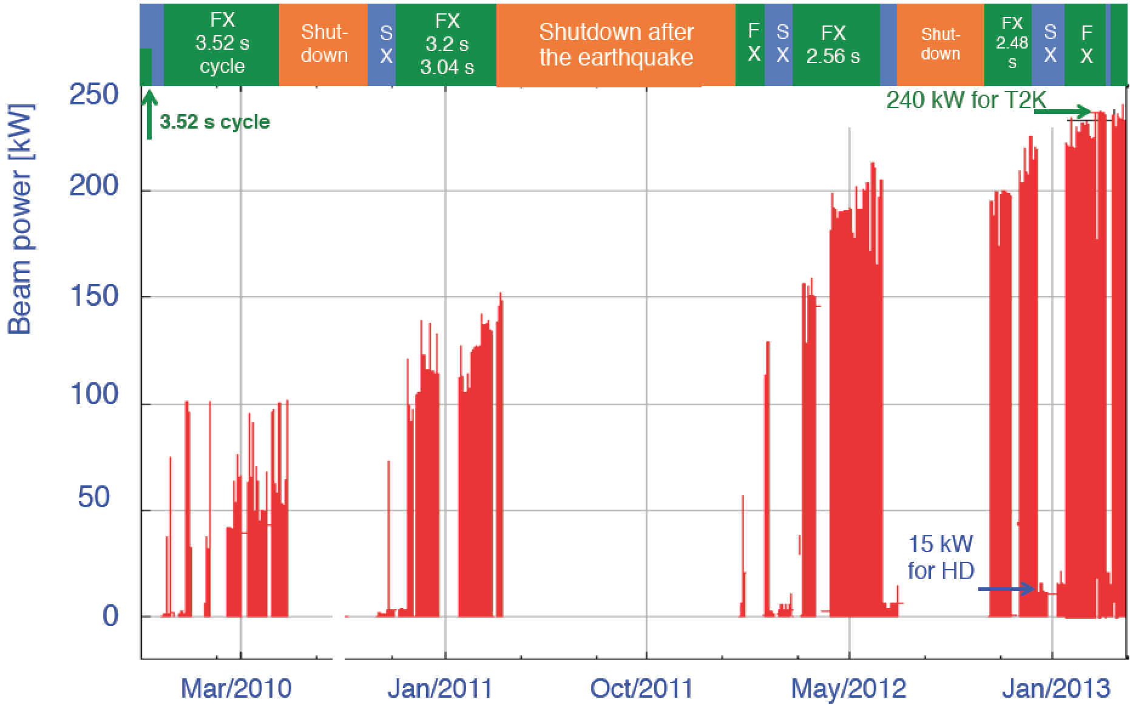
MR Operation History from January 2010 to March 2013
The Beam power of 240 kW has been achieved for the neutrino oscillation experiment T2K.
The Target power is 750 kW.

Slide 10
MR Top Energy 30 GeV
Original Plan was to achieve 750 kW with 50 GeV operation.
  The number of protons should be twice.
50 GeV Operation has disadvantage.
  Magnet Saturation > 30 GeV
  Power Consumption
    P(50 GeV) = 2 P(40 GeV) = 4 P(30 GeV)
Bending Magnet
Magnetic Field B(T)
Magnet Power Consumption
(relative to 50 GeV)
I (A)

Slide 11
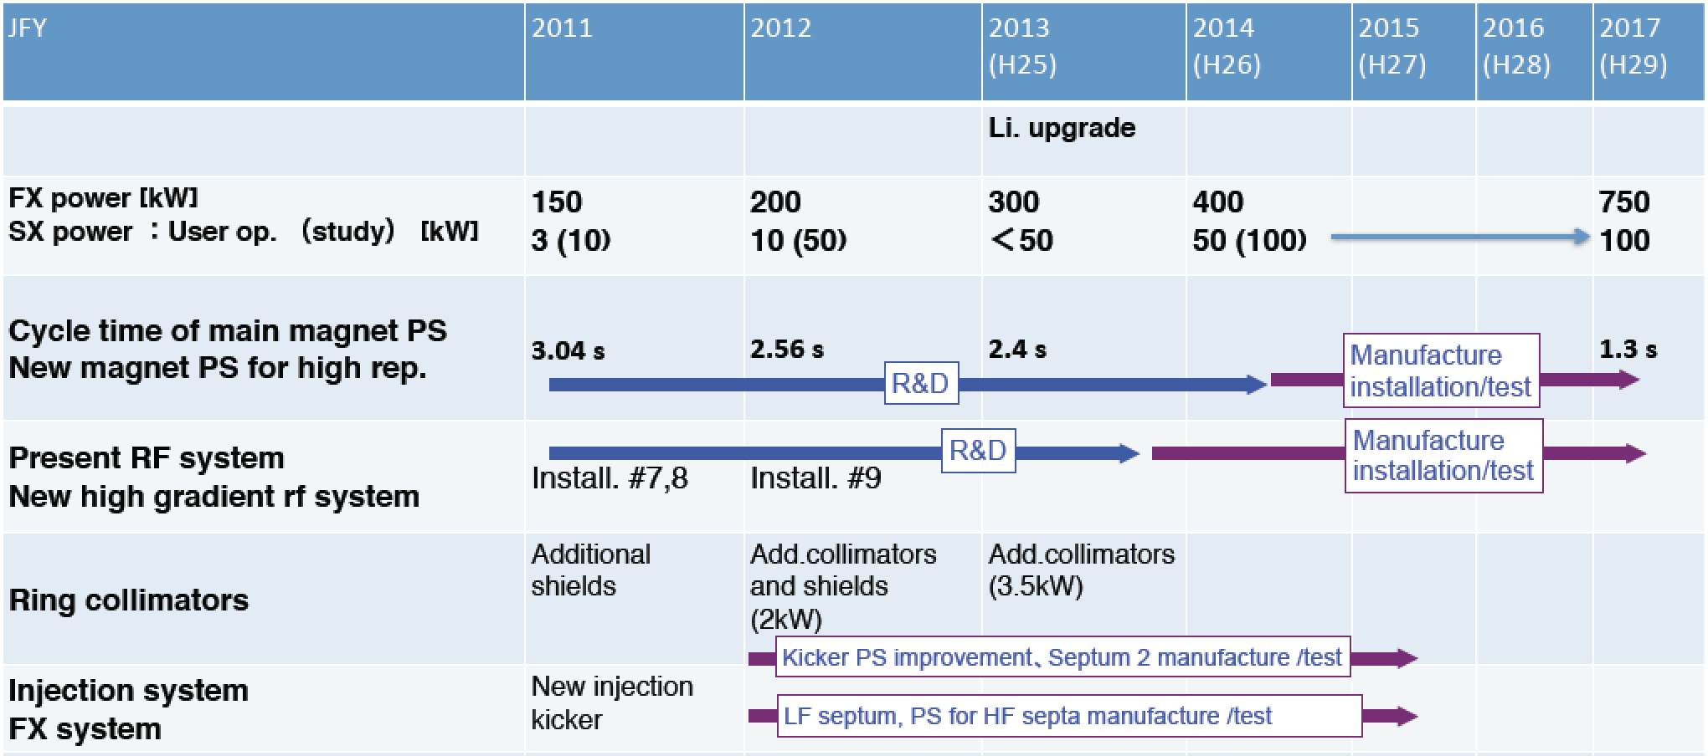
Mid Term Plan
High repetition rate scheme is been chosen to achieve 750 kW.
Repetition cycle will be 1.3 s.
Magnet Power Supplies and RF cavities will be replaced.
Collimators have been updated from 2 kW to 3.5 kW in this JFY.
Injection kicker power supplies are being improved and septum will be replaced for high repetition rate.
Ion Source
Upgrade

Slide 12
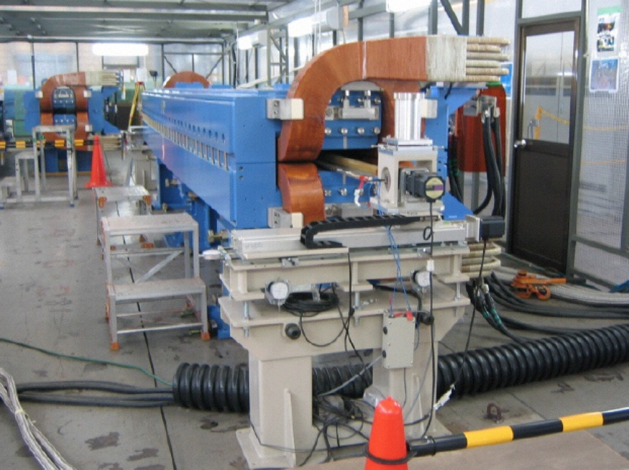
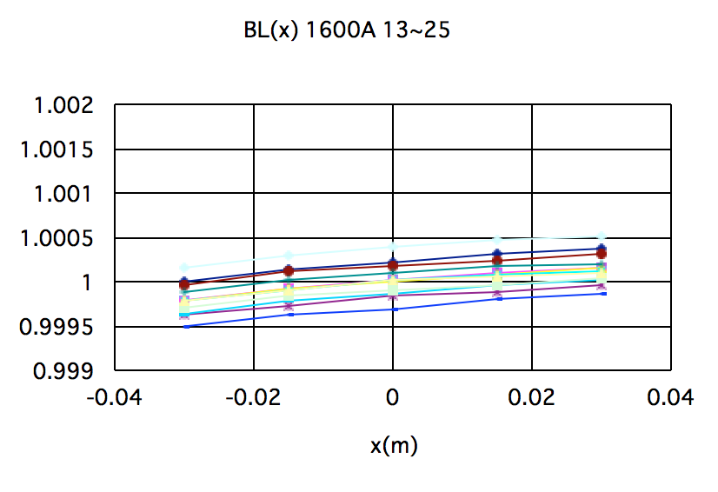
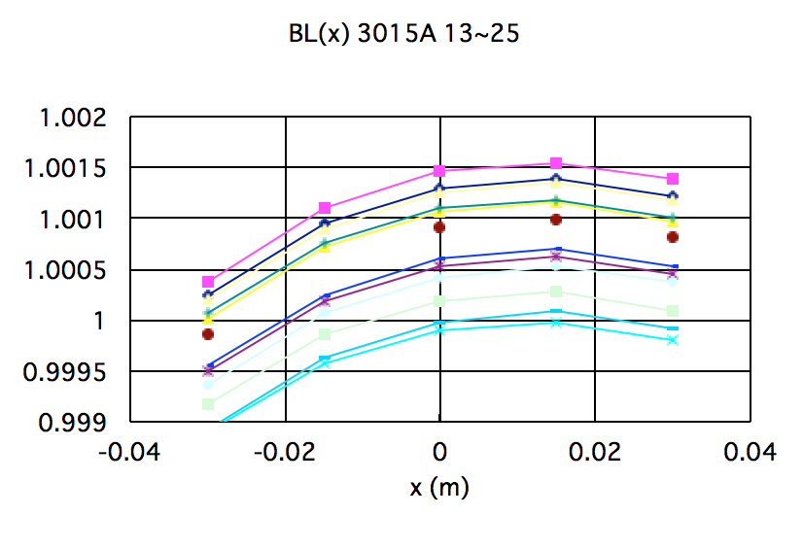
Bending Magnet Multipole
Measurements
Bending Magnet
96 Magnets
Field Uniformity Target < 5e-4
Flip coil Measurement
  Radius 19.09 mm
  Length 7 m
  x: -30 mm, -15 mm, 0 mm, +15 mm, + 30 mm
Parameters included in the tracking simulation SAD and SCTR
  Variation of dipole component
  Quadrupole component
  Sextupole component
Installation positions were decided to minimize COD.
12 magnets 1600 A 30 GeV
BL(x)/BL_ref
x (m)
12 magnets 3015 A 50 GeV
BM 96 magnets K0=(1/Bρ)(ByL) | RMS of dipole component (30 GeV) | Average amplitude of quadrupole (30 GeV) | Average amplitude of sextupole (30 GeV)
0.0654 radian | 1.2e-5 radian | -3.5e-4 m⁻¹ | -7.5e-3 m⁻²
x (m)

Slide 13
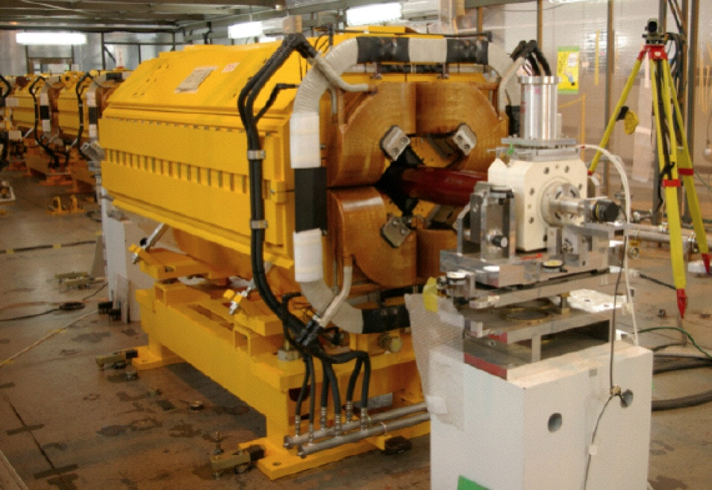
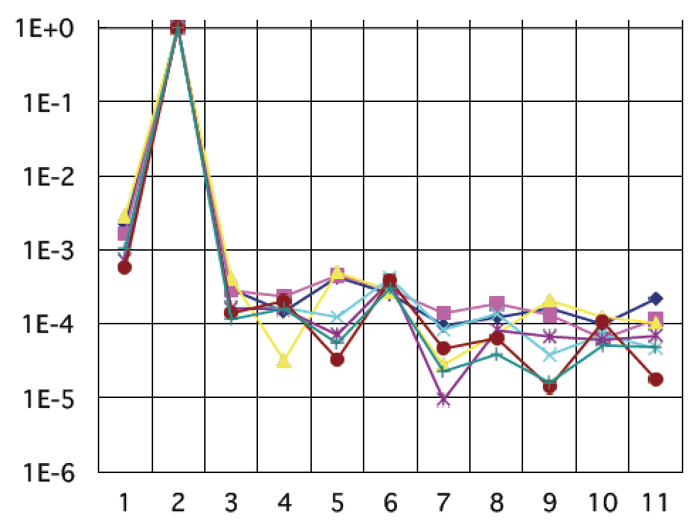
QM SM Multipole
Measurements
QM: 11 families, 216 magnets
SM: 3 families, 72 magnets
Field Uniformity Target < 1e-3
Harmonic Coil
  Radial coil: Radius 59.5 mm, Length 2 m
  Tangential coil: Opening angle 90°, Radius 59.8 mm, Length 3 m
Parameters included in the tracking simulation SAD and SCTR
  Variation of main component
  The first allowed multipole component
Installation positions were decided to minimize the related resonance amplitudes.
RMS of the K1 (K2) distribution
Q family | Number of magnets | σ30GeV
QFP | 6 | 1.1E-4
QFS,QFX | 6+48 | 3.8E-4
QFT | 6 | 2.1E-4
QFN | 48 | 2.2E-4
QDX | 27 | 1.5E-4
QDS | 6 | 1.1E-4
QFR | 9 | 2.8E-4
QDN,QDR | 48+6 | 2.8E-4
QDT | 6 | 1.5E-4
Sextupole | 72 | 8.9e-4
QM Reference mag. 7 time measurements
Relative Amplitude
Multipole component

Slide 14
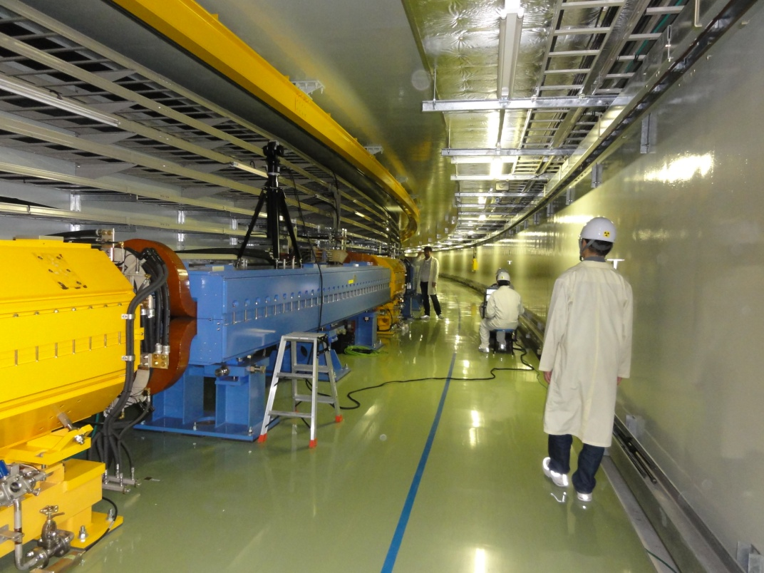
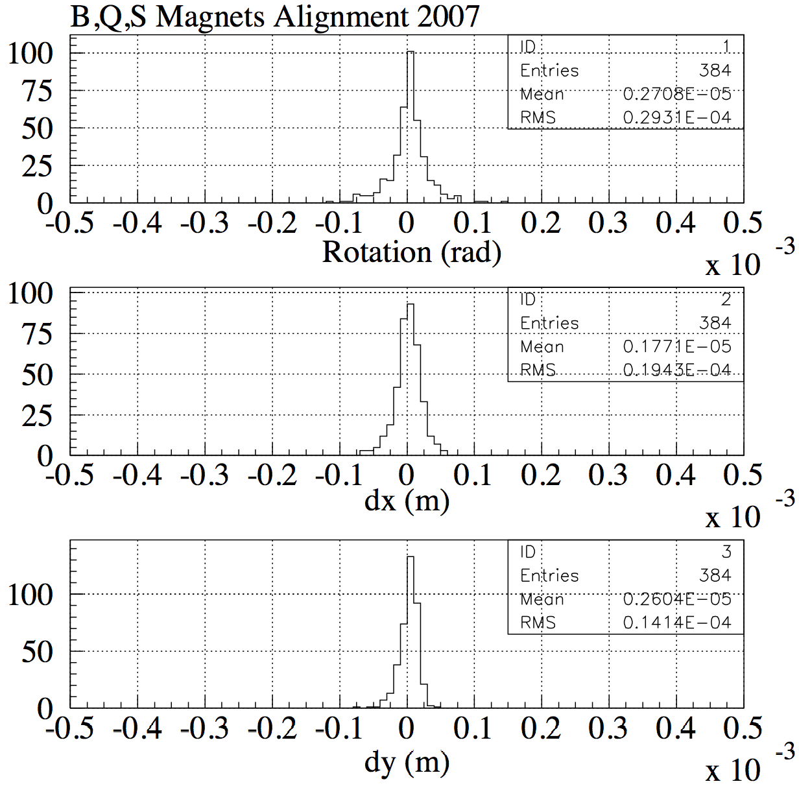
Magnet Alignment
Magnet alignment has been done in
  2007
  2011 (realigned after the earthquake of March 11 2011)
  2012 (survey)
  2013 (survey)
Alignment Target
  Rotation < 0.1 mrad
  Dx < 0.1 mm
  Dy < 0.1 mm
The target has mostly been achieved.
Alignment data were compiled for the 2007 results for the tracking simulation SAD and SCTR.
Data generated with random number of Gaussian distribution with certain deviations have also been tried for the tracking simulation.

Slide 15
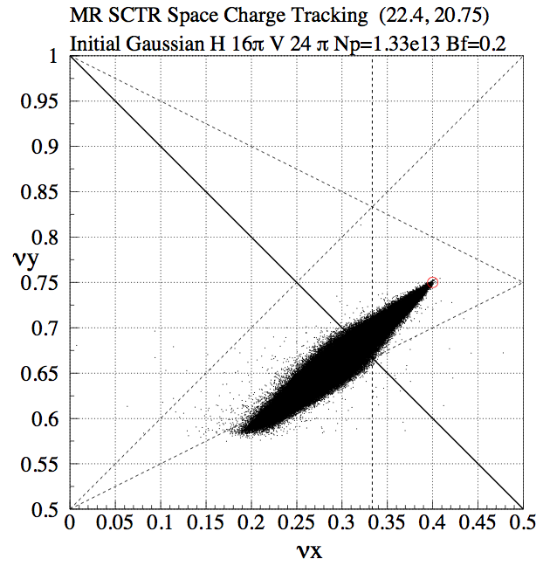
Incoherent Tune Shift for MR Power ~200 kW and Resonances
1.33e13 ppb
Ex 16 πmmmrad (2σ) (from the profile measurement)
Ey 24 πmmmrad (2σ) (from the measurement with the intensity of 1.18e13 ppb)
Bunching Factor 0.2
Tune Shift = 0.2
Resonances
Linear Coupling
  νx+νy=43
  Rotation of Q magnets and Vertical orbit at sextupole magnets
3rd order
  3νx=67
  νx+2νy=64
  νx-2νy=-19
  Variation of sextupole magnets
4th order
  2νx-2νy=3
  Octupole magnets
2νx-2νy=3
21
νy=21
νx-2νy=-19
νx+2νy=64
20.5
2νy=41
22
22.5
νx=22
3νx=67
2νx=45
νx+νy=43

Slide 16
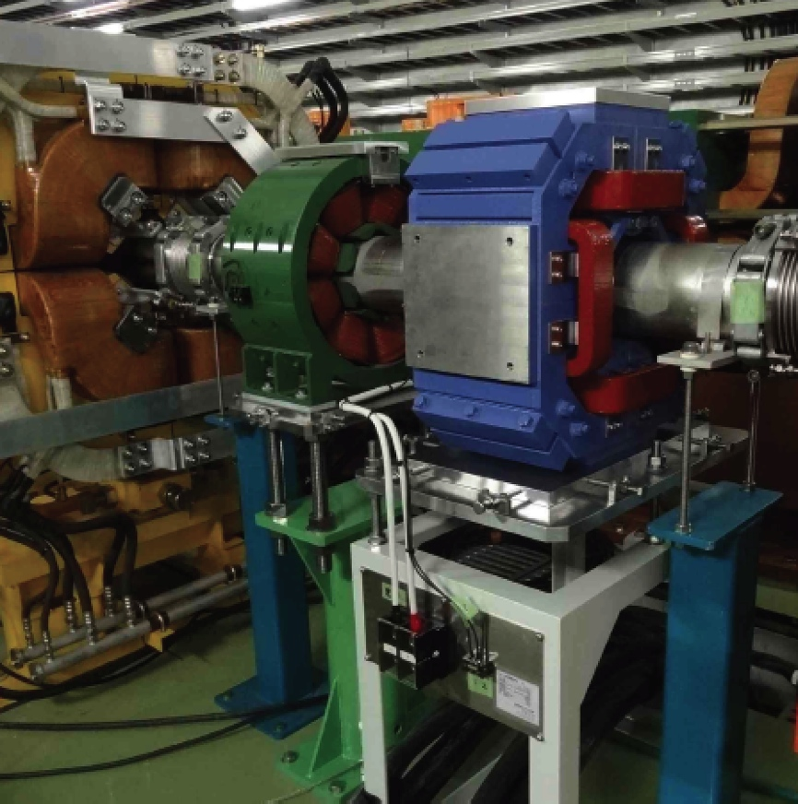
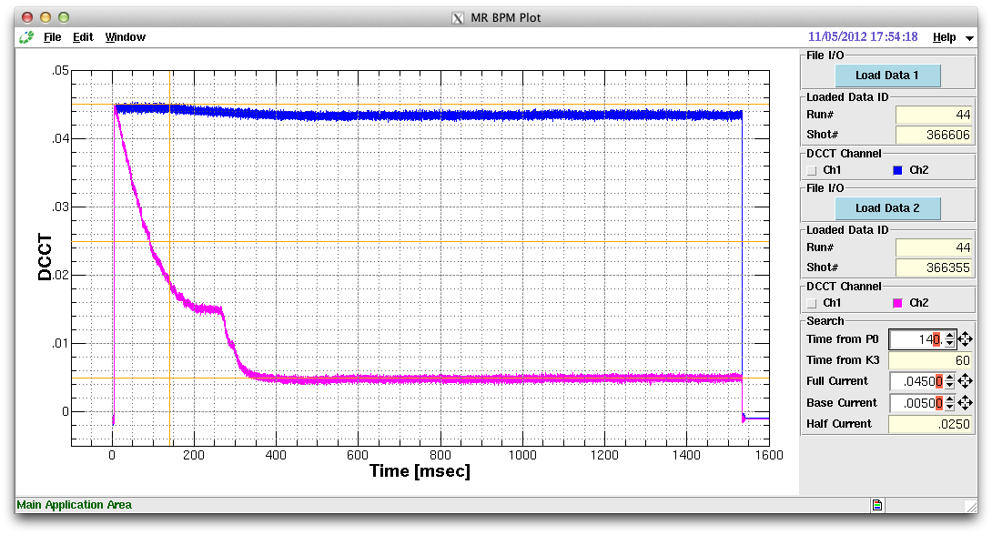
Sum Resonance Correction with Skew Q’s
MR tune: (νx, νy) = (22.275, 20.685)
νx + νy ≅ 43
Beam Intensity 4e11 ppb
Chromaticity: ξx = ξy = -6
MR mode: Accl (Abort)
Beam Intensity
Skew Q On
Skew Q Off
SQ address | Injection | Flat Top
001, 016 | +1.25A | +6.79A
145, 160 | +0.20A | +4.70A
Injection
Acceleration

Slide 17
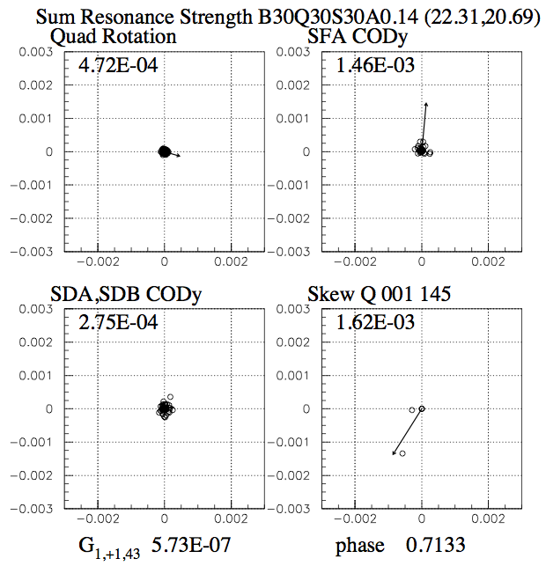
Sum Resonance νx+νy=43
Beam Measurement
The following skew Q settings improve the beam survival.
  SQ001, 016: sk1 = 7.11e-4 m-1
  SQ145, 160: sk1 = 1.14e-4 m-1
The sum resonance amplitude is then
  G1,+1,43=1.6e-3
Calculation with Survey and Field Measurements
The resonance amplitude is estimated to be smaller with the alignment results.
  G1,+1,43=3.6e-4
Calculation to reproduce the Beam Measurement
The resonance amplitude was reproduced with SAD simulation,
  Magnet position offsets : random Gaussian of σ = 0.14 mm
  Magnet rotation errors : random Gaussian of σ = 0.14 mmmrad.
The following skew Q settings cancels the resonance in SAD simulation,
  SQ001: sk1 = -1.08e-4 m-1
  SQ145: sk1 = 5.4e-4 m-1
The resonance amplitude is less than 1e-6 after the correction.
Sum Resonance Amplitude to reproduce
the Beam Meausrement at (22.31, 20.69)

Slide 18
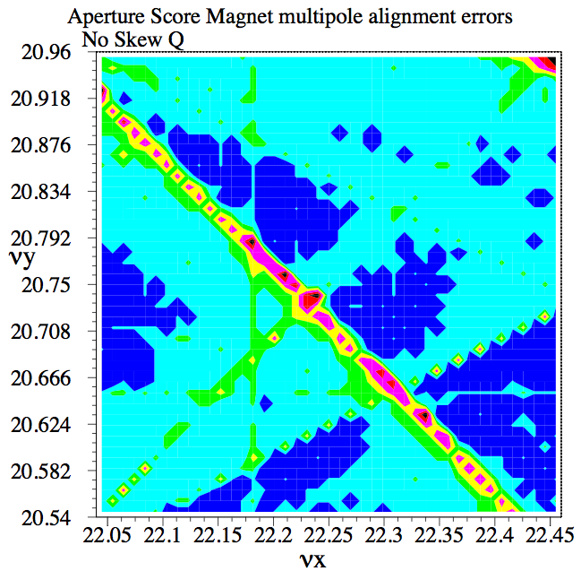
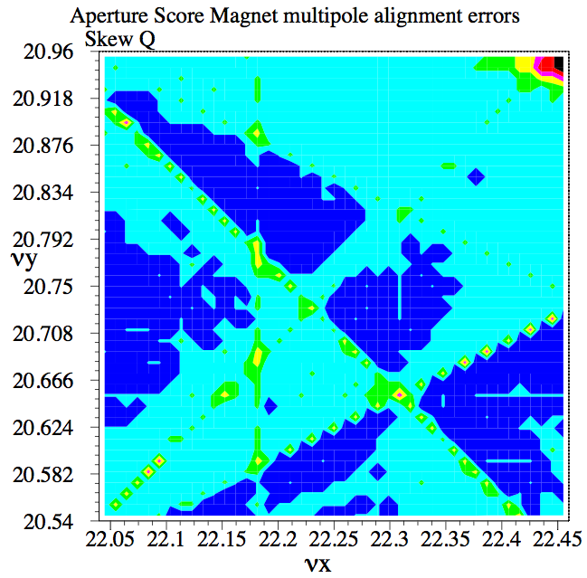
Aperture Survey in Tune Space
Initial test particles
Aperture was studied using SAD simulation with errors.
10 particles with ex = ey = 8.1π, 16.2π, … , 81π mmmrad
After 1000 turns the number of survived particles with 81π cut was calculated as the score.
The score was plotted In the horizontal tune range of 22.04 ~ 22.46 and vertical tune range of 20.54 ~ 20.96.
81π
ey
ex
81π
Score
9
■
8
■
7
■
6
■
5
■
4
■
<3
■

Slide 19



Space Charge Tracking Simulation SCTR
Program with the Particle in Cell method developed by Ohmi-san
The potential solver is based on FACR (Fourier Analysis and Cyclic Reduction) algorithm.
Typically ~200,000 macro particles and 128 × 128 of 1 mm grid.
The boundary is square perfect conducting wall.
Potential is assumed to be proportional to the line density of the beam.
Transverse potential is given by solving two-dimensional Poisson equation.
Space charge is grad of the potential.
Δs < β(s) =4~30 m for J-PARC MR → Δs ~ 1.5 m.
Ring Lattice and optics come from SAD.
REF: K. Ohmi et al., proceedings of PAC07, 3318 (2007).
K. Ohmi et. al., Proceedings HB2010, 425.

Slide 20
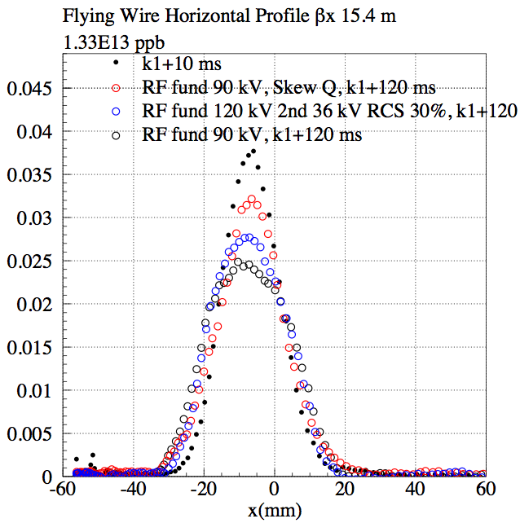
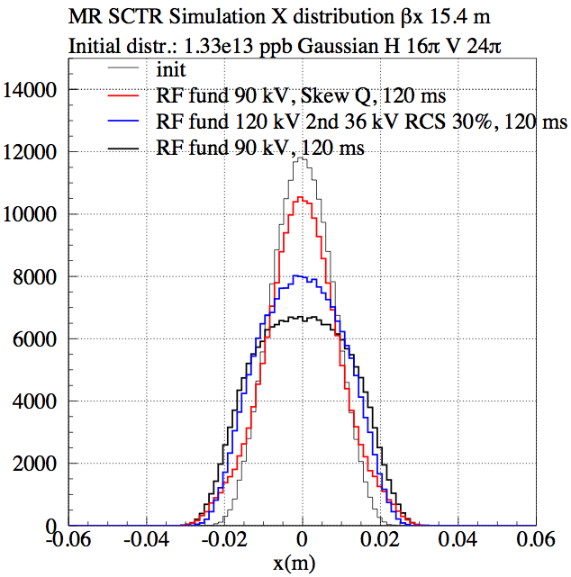
Horizontal Beam Profiles
(Measurement and Simulation)
2.7e13 ppp (2 bunch injection)
Flying Wire measurements at K1+10 ms and K1+120 ms.
SCTR simulation with initial distribution of 16π mmmrad of Horizontal 2σ emittance and 24π for Vertical 2σ emittance.

Slide 21
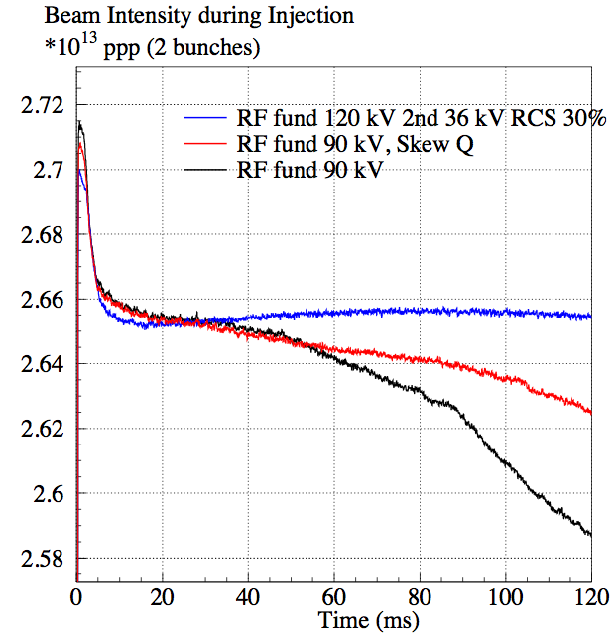
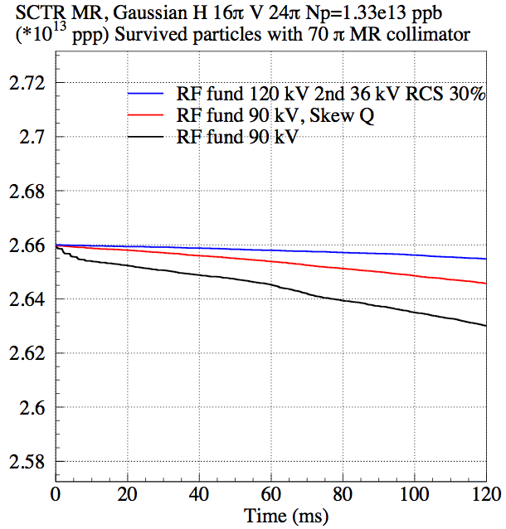
Beam Intensity (Measurement and Simulation)
DCCT measurement during the injection period of 130 ms
2 bunch injection
SCTR simulation with initial distribution of 16π mmmrad of Horizontal 2σ emittance and 24π for Vertical 2σ emittance.

Slide 22
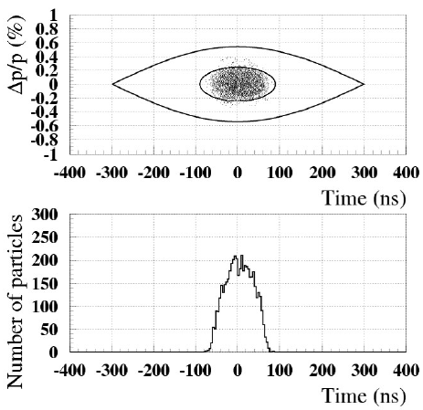
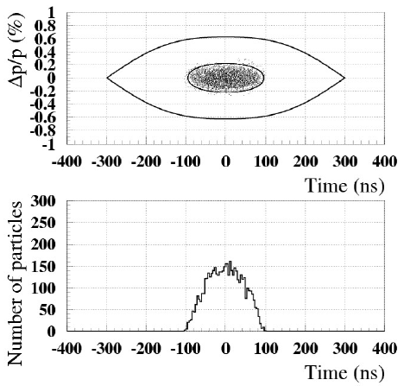
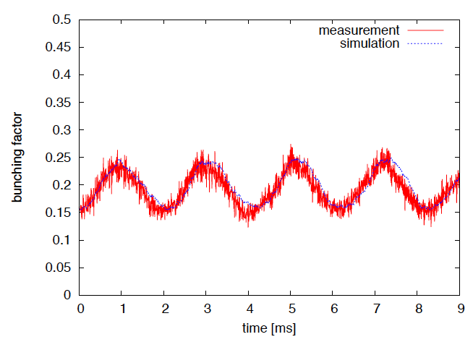
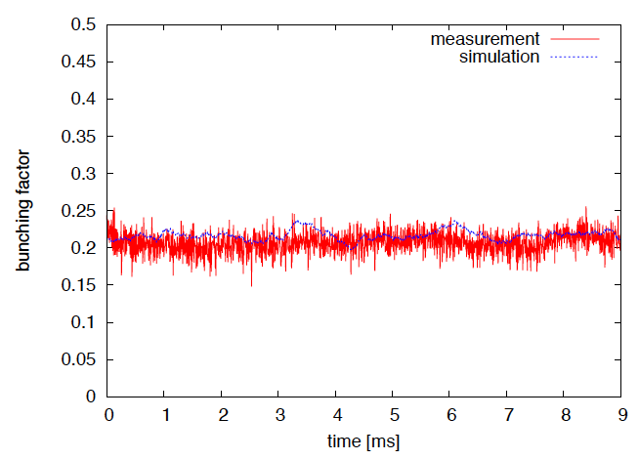
Longitudinal Distribution Measurement
Bunching Factor have been improved with the 2nd harmonic RF.
  MR fundamental 90 kV; RCS fund. only
  MR fund. 120 kV, 2nd 36 kV; RCS fund. & 2nd (30 %)
RF fund. 90 kV
RF fund. 120 kV, 2nd 36 kV
BF = 0.15 ~ 0.25
BF ~ 0.2

Slide 23
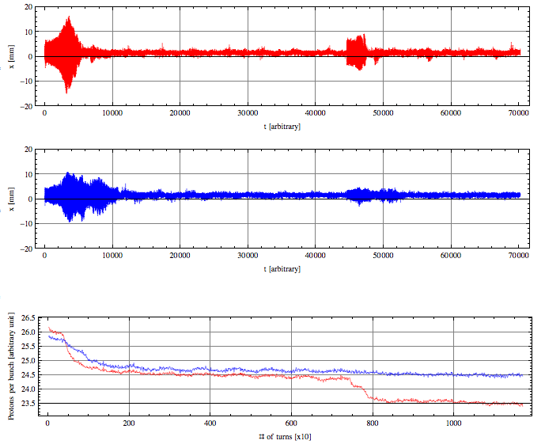
Beam Loss right after the Injection
Coherent Oscillation was observed right after the injection.
It is initiated by the injection error.
The impedance source may be resistive wall.
Front bunch
X (mm)
X
by Position Monitor
N_{B}~ 1.67x10¹³ ppp
2 bunches
ξ_{x}~−7.5
ξ_{y}~−7.0 (−25%)
Beam Intensity
by Fast Current Transformer
Time (arbitrary)
Rear bunch
X (mm)
K1
Time (arbitrary)
K2
Rear bunch
Bunch area, average of 10 turns
Intensity
Front bunch
Turns (× 10)

Slide 24
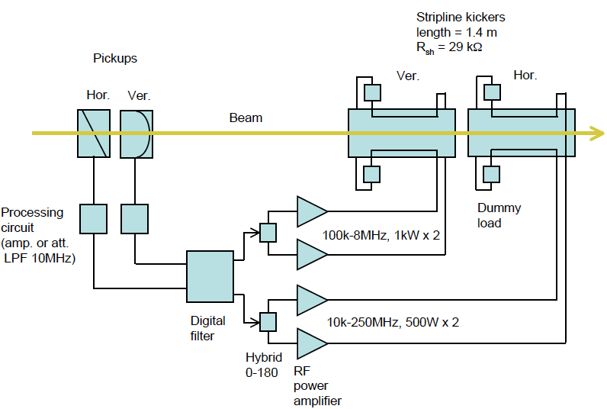
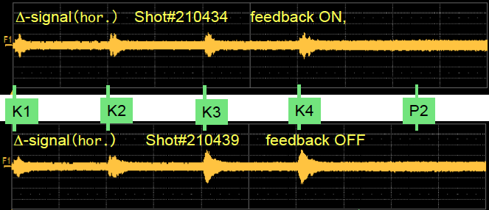
Bunch by Bunch Feedback
Coherent Oscillation is damped with the bunch by bunch feedback system.
Beam loss is reduced to be half.
NB ~ 7.3e13 ppb
8 bunches
Power ~ 115 kW
Intra bunch feedback will be implemented.
X Position
(arbitrary)
X Position
(arbitrary)
40 ms

Slide 25
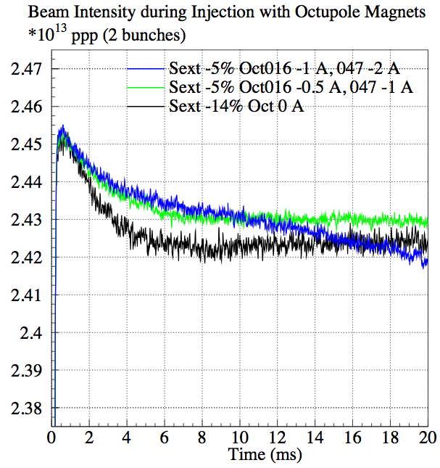
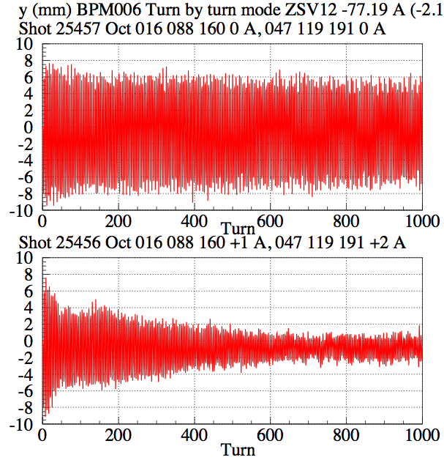
Octupole Mangets for Coherent Oscillation Damping
Coherent oscillation damping was observed with octupole magnets.
Beam loss right after the beam injection (~ 5 ms) was improved.
Dynamic aperture was reduced and beam loss during the injection period was increased.
Careful current adjustment may recover the dynamic aperture.
5 ms

Slide 26
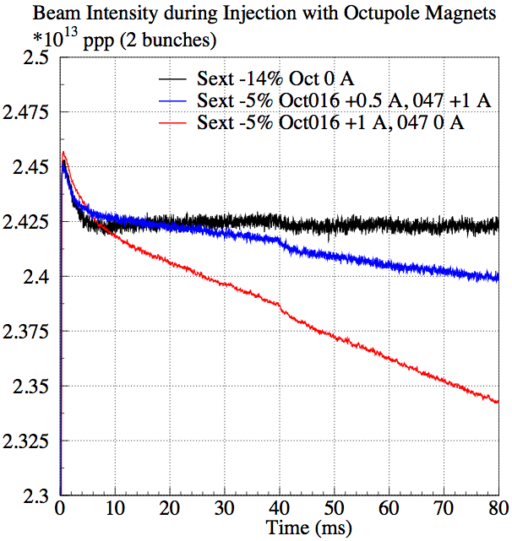
Octupole Magnets for Coherent Oscillation Damping (Side Effect)
Three octupole magnets were installed in 2011.
Three other magnets have been installed in 2012 to cancel the structure resonance of 2νx-2νy=3, 4νx=90.
Improvement of beam loss was observed with 6 magnets.
We have a plan to make octupole magnets for pulse excitation (~ 5 ms) to minimize the aperture reduction effect.
016, 088, 160 (2011)
047, 119, 191 (2012)

Slide 27
Summary
The beam power of 240 kW has been achieved in J-PARC MR with the scheme of
  large aperture,
  beam collimator and
  imaginary transition γ lattice.
The beam profile and beam loss measurement during the injection period (after 5 ms from the injection) are reproduced with the space charge tracking program SCTR.
The Beam loss right after the injection (~ 5 ms) is caused by the horizontal coherent oscillation triggered by the injection error.
  Suppression with the bunch by bunch feedback
  Octupole magnets
The target beam power of 750 kW is to be achieved with the high repetition rate scenario.

