Slide 1
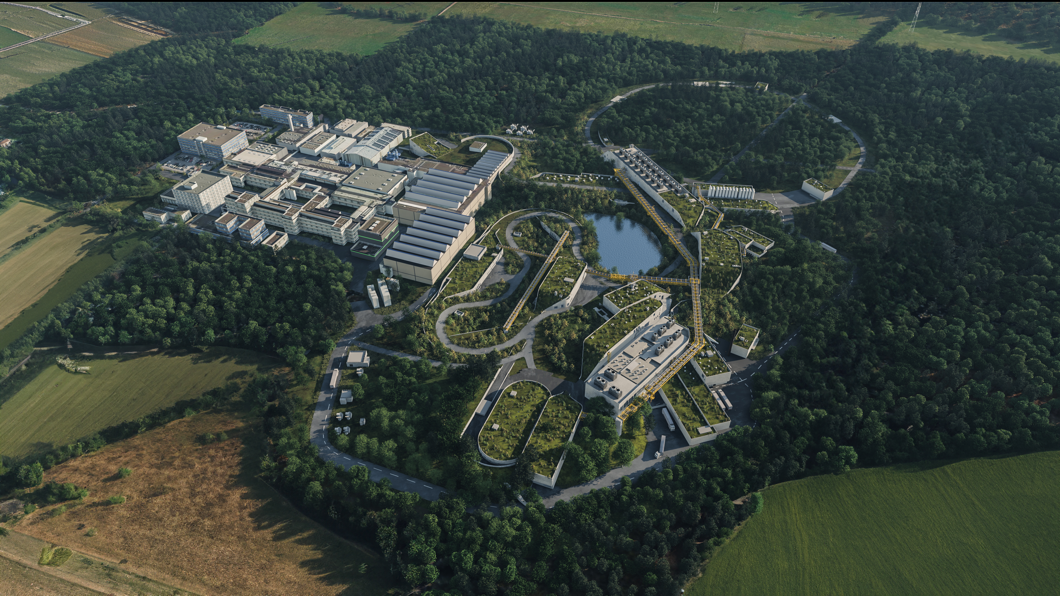
Welcome to the first MATHIPE meeting!
GSI-FAIR, Darmstadt, 22-23 February 2026

Slide 2
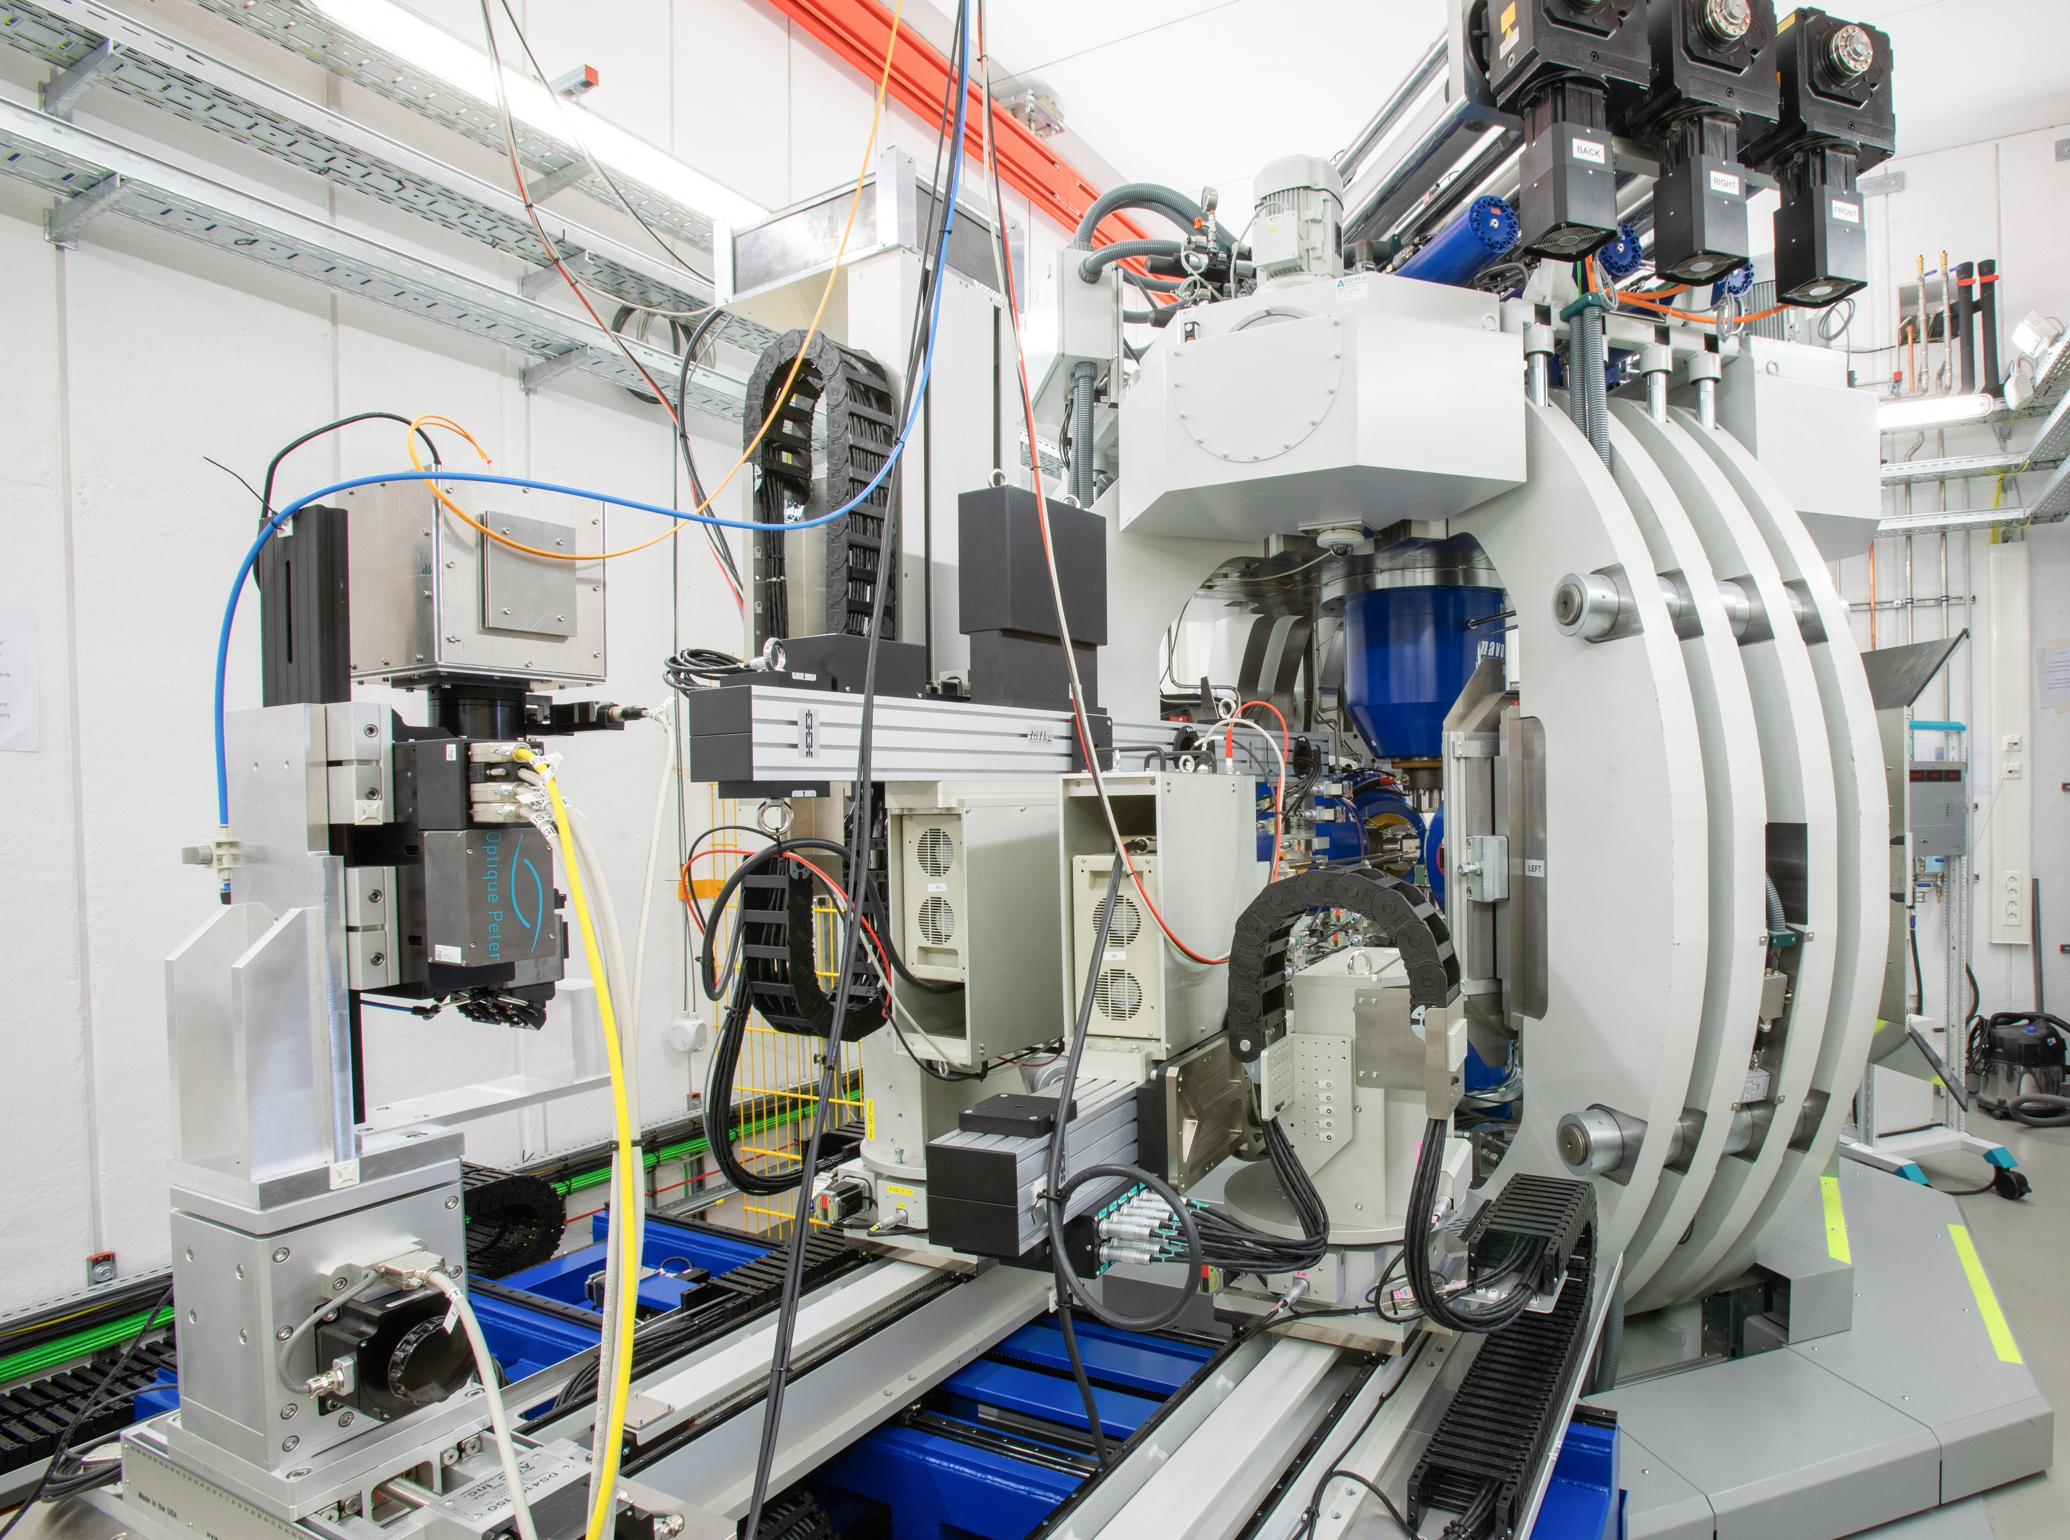
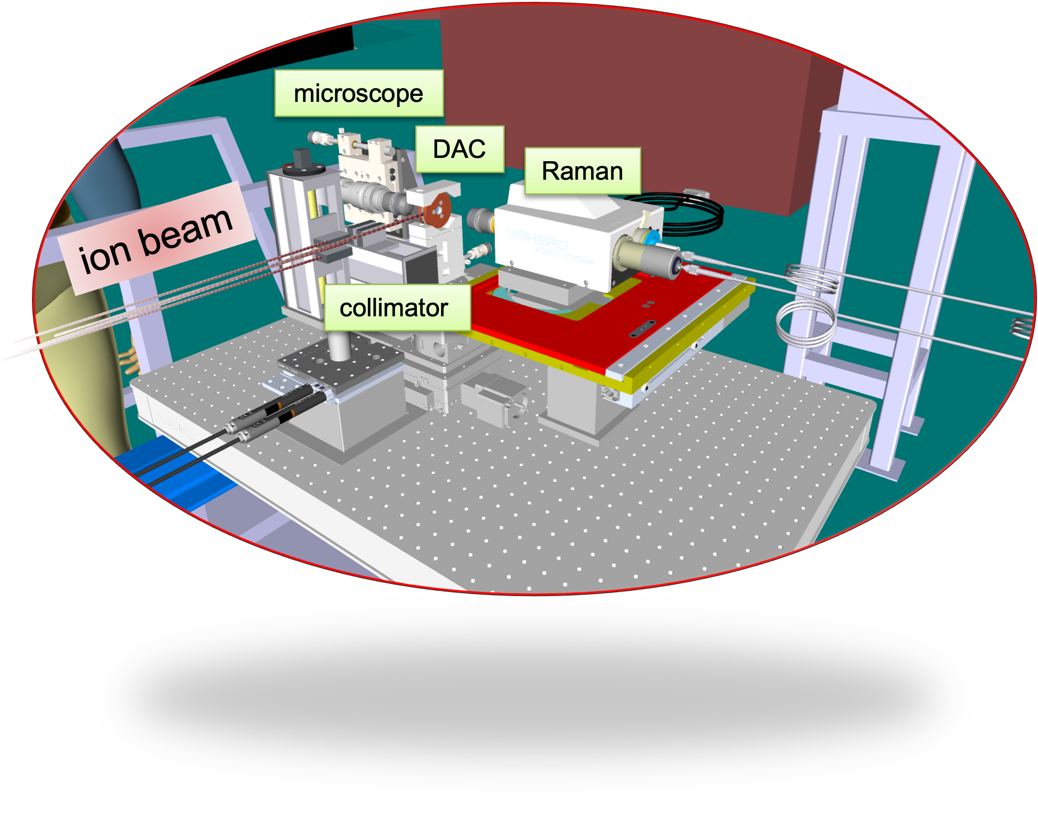
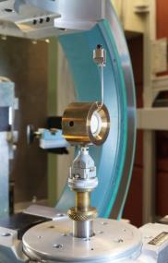





MATerials under High Pressure (MATHIPE)
Discovery of new materials and exploration of their properties and phase equilibria under extreme conditions (high pressure and temperature) synergetically exploiting the unique photon, neutrons and ion facilities of the participating Helmholtz Centers.
Large-volume press at P61B
Extreme conditions beamline P02.2
Ion irradiation under high pressure
SIS18, GSI
Custom-made cells for correlative neutron and X-ray analysis
PETRA III, DESY
Neue Materialien
5 Helmholtz centers, 2 programs
Quantenmaterialien
DESY: K. Glazyrin, R. Farla, S. Bhat, C. Strohm (MML-RT2 /FT photons)
GSI: M.E. Toimil-Molares, I. Tzifas (MML-RT2 /FT ions)
FZJ: K. Friese, A. Grzechnik (MML-RT2 /FT neutrons)
GFZ: S. Speziale (Erde und Umwelt) [In kind]
KIT: Y.-L. Mathis, B. Gasharova (MT) [Collaboration]
Photonen, Neutronen und
Ionen
Energiematerialien
Geomaterialien
Extreme Bedingungen
Hochdrucksynthese
Metastabile Phasen
Notes:
THE MATHIPE project aims to synergistically exploit the unique photon, neutron, and ion facilities of the participating centres to investigate materials under simultaneous extreme conditions of high pressure and temperatures (HPT). The overarching goal of MATHIPE will be the discovery of new materials and exploration of their properties and phase equilibria under these extreme conditions using X-rays, neutrons and ion-beam techniques. The correlative characterization of novel (meta)stable high-pressure phases will give impulses for the development of novel materials, including materials for energy storage, magnetism, quantum- and nano-technologies and will provide experimental data for data-based materials design. Recoverable phases to ambient conditions will be synthesised in large volume presses in bulk quantities for further characterisation (e.g. microstructure, band-gap, hardness, chemical composition, electron spin state and magnetic properties). HPT formation conditions of economically relevant geological materials will also be explored, which additionally aid our understanding of surface and deep-Earth processes. The complementary expertise of MATHIPE in physics, chemistry, geosciences, crystallography, material sciences, and particle-matter interaction, combined with the diverse enabling technologies at our large-scale infrastructures, provides a robust foundation for the proposed research and maximizes collaborative efforts among participating facilities.

Slide 3
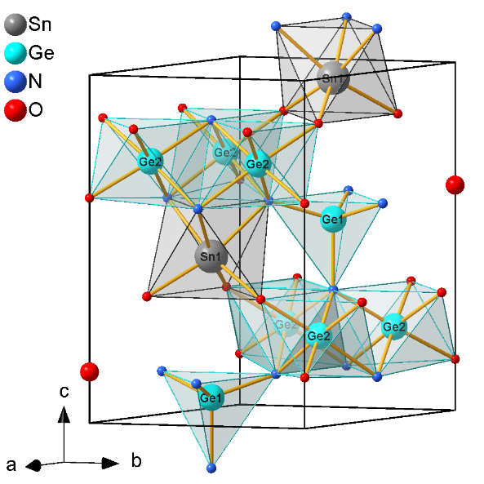
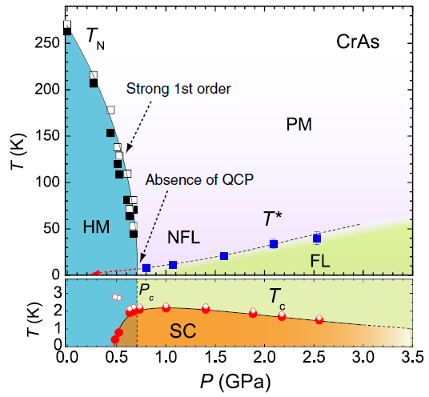
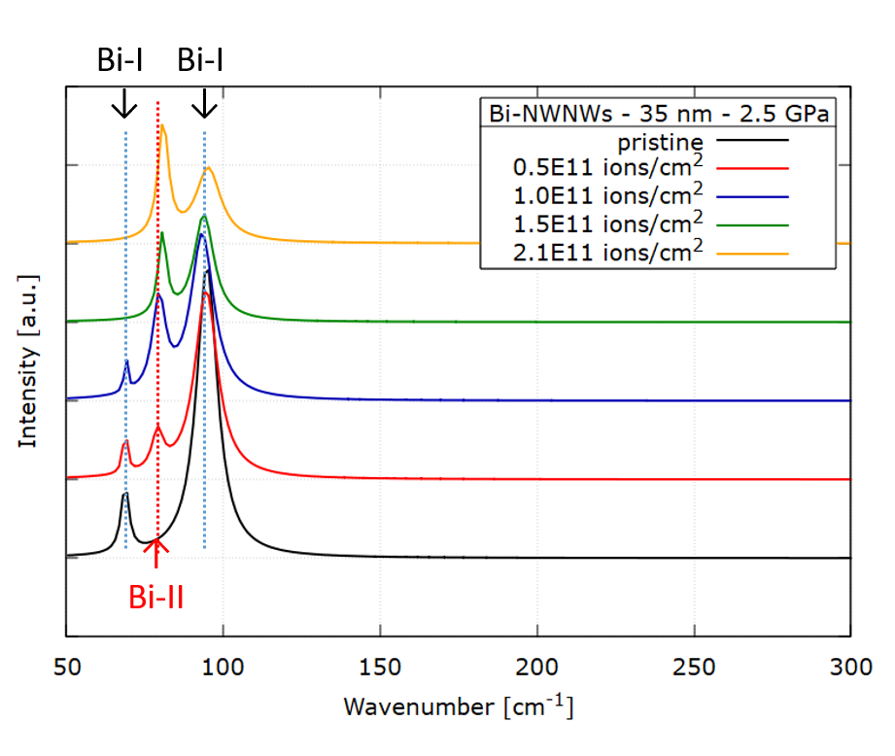
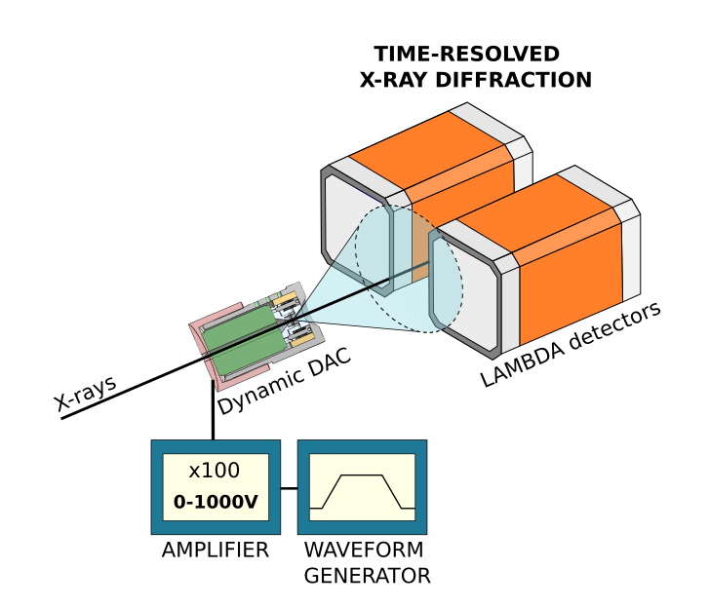
MATerials under High Pressure (MATHIPE)
Discovery of new materials and exploration of their properties and phase equilibria under extreme conditions (high pressure and temperature) synergetically exploiting the unique photon, neutrons and ion facilities of the participating Helmholtz Centers.
WP1 (DESY, FZJ, GSI)
Synthesis and identification of novel (meta)stable material phases in high pressure devices predicted by e.g. ab initio methods
WP2 (FZJ, DESY, GSI, KIT, GFZ)
Correlative characterization of high-pressure phases of quantum materials, energy materials and nanomaterials at photon, neutron and ion large-scale facilities
P. Golle-Leidreiter et al. . Acta Cryst. (2024) B80
W. Wu et al., Nat. Commun. 5, 5508 (2014)
WP3 (GSI, DESY, FZJ)
Ion-induced synthesis of new materials under extreme conditions and exploration and identification of new stable phases using HPT in-situ neutron and X-ray scattering
WP4 (DESY-HIBEF at EU.XFEL, DESY, GSI, FZJ)
Investigating thermodynamic pathways under extreme conditions at various time scales
X-ray scattering with pulsed-field magnet
Notes:
Structure of the project
Investigations will be performed in 4 work packages…

