Slide 1
CRYRING Machine Experiments
W. Geithner, Z. Andelkovic, S. Fedotova, F. Herfurth, N. Kotovsky, C. Krantz, C. Mohr, N. Stallkamp, S. Trotsenko , G. Vorobyev

Slide 2
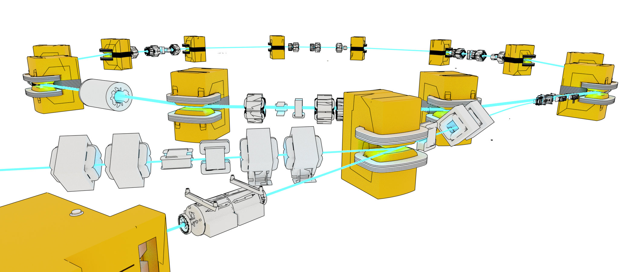
Machine Experiments 2025
CRY-AP-255: Multi turn injection optimization
CRY-AP-256: Schottky detection using BPMs
CRY-AP-257: Testing the ML and MC optimization routines of DeviceAutomator on injected ion beam
CRY-AP-258: Working point (tune) and chromaticity measurements using DeviceAutomator
CRY-AP-259: Test cooling with expansion 10 „only“
CRY-AP-260: Deceleration from max to min and/or orbit control
CRY-AP-261: Stacking „in between bunches“ using the B2B RF synchro
CRY-AP-262: Stacking using the E-Cooler
CRY-AP-263: Continue working on direct route SIS18 YR : use kicker to inject into YR and measure attainable intensity

Slide 3
Machine Experiments 2025
CRY-AP-255: Multi turn injection optimization
motorized drive for septa plates and bumper plates installed and used for the first time
optimized injection for a number of ion beams, however, still developments needed towards actual understanding
CRY-AP-256: Schottky detection using BPMs
BPM Schottky type signal stronger (due to higher amplification) but also more noise : thinkable of using in place of the dedicated long Schottky pickup
Improved amplification (charge-sensitive versus voltage-sensitive) yields a much better Schottky signal even for weak and slow beams (Thanks to BEA!)
CRY-AP-259: Test cooling with expansion 10 „only“
Done. Seems possible, however, sort of defeats the point of CRYRING@ESR
CRY-AP-260: Deceleration from max to min and/or orbit control
First tests done, however, orbit control still needs investigation (software response time).
CRY-AP-257: Testing the ML and MC optimization routines of DeviceAutomator on injected ion beam
CRY-AP-258: Working point (tune) and chromaticity measurements using DeviceAutomator
next
next

Slide 4
DeviceAutomator Recent Activities
Wolfgang Geithner, M. Boschert (H_DA), Z. Andelkovic, F. Herfurth,
J. Ködel, N. Stallkamp, S. Trotsenko, D. Zisis

Slide 5
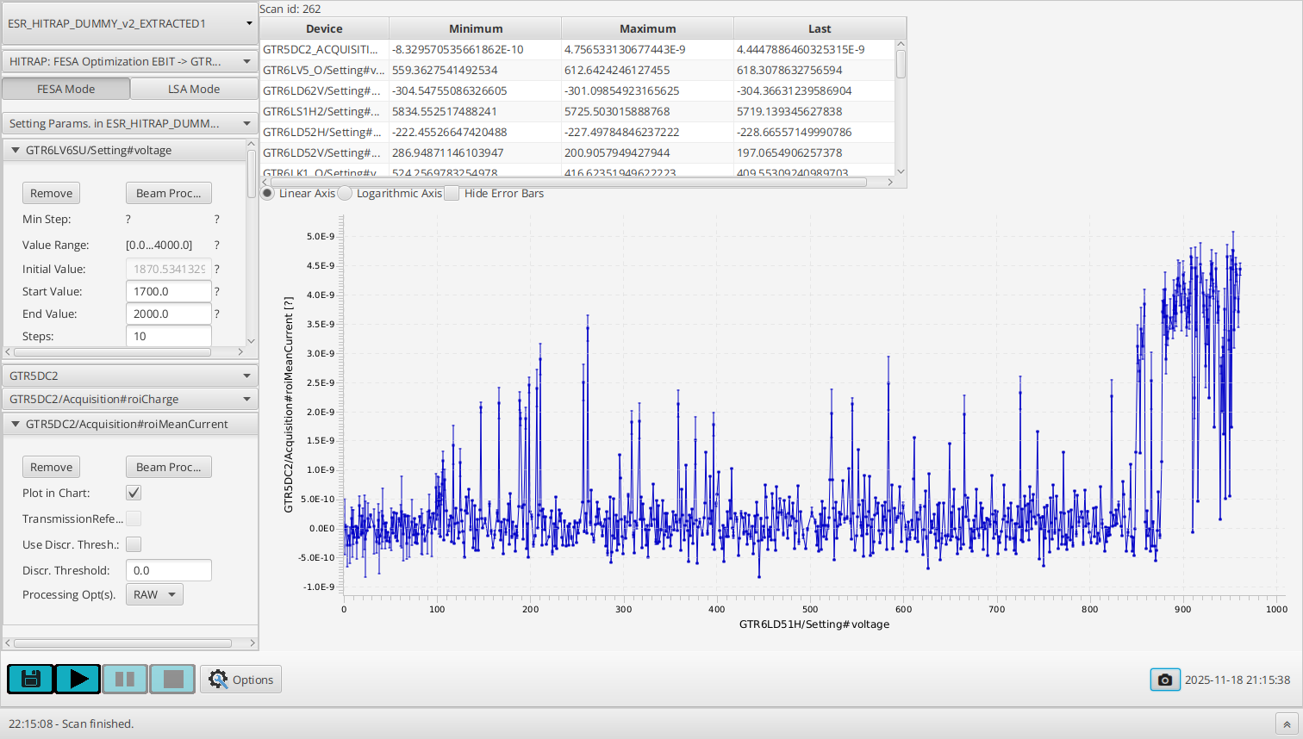
DeviceAutomator Main Features
JAVA based Application accessible via Application Launcher
Goal: Automated parameter setting and coordinated readout of beam diagnostics
Native integration into FAIR Control System
Configuration GUI for scan set-up
„Scan Templates“ for pre-defined scenarios
Scan algorithms:
Bruteforce: parameter stepping at constant step width
Genetic optimizer: based on Genetic algorithm
Bayesian optimizer: based on Bayesian algorithm
Random walk: algorithm perfoming small random walk around local optimum
Database for configuration and scan data persistence
Limited to scalar LSA/FESA parameters in the FAIR CS

Slide 6
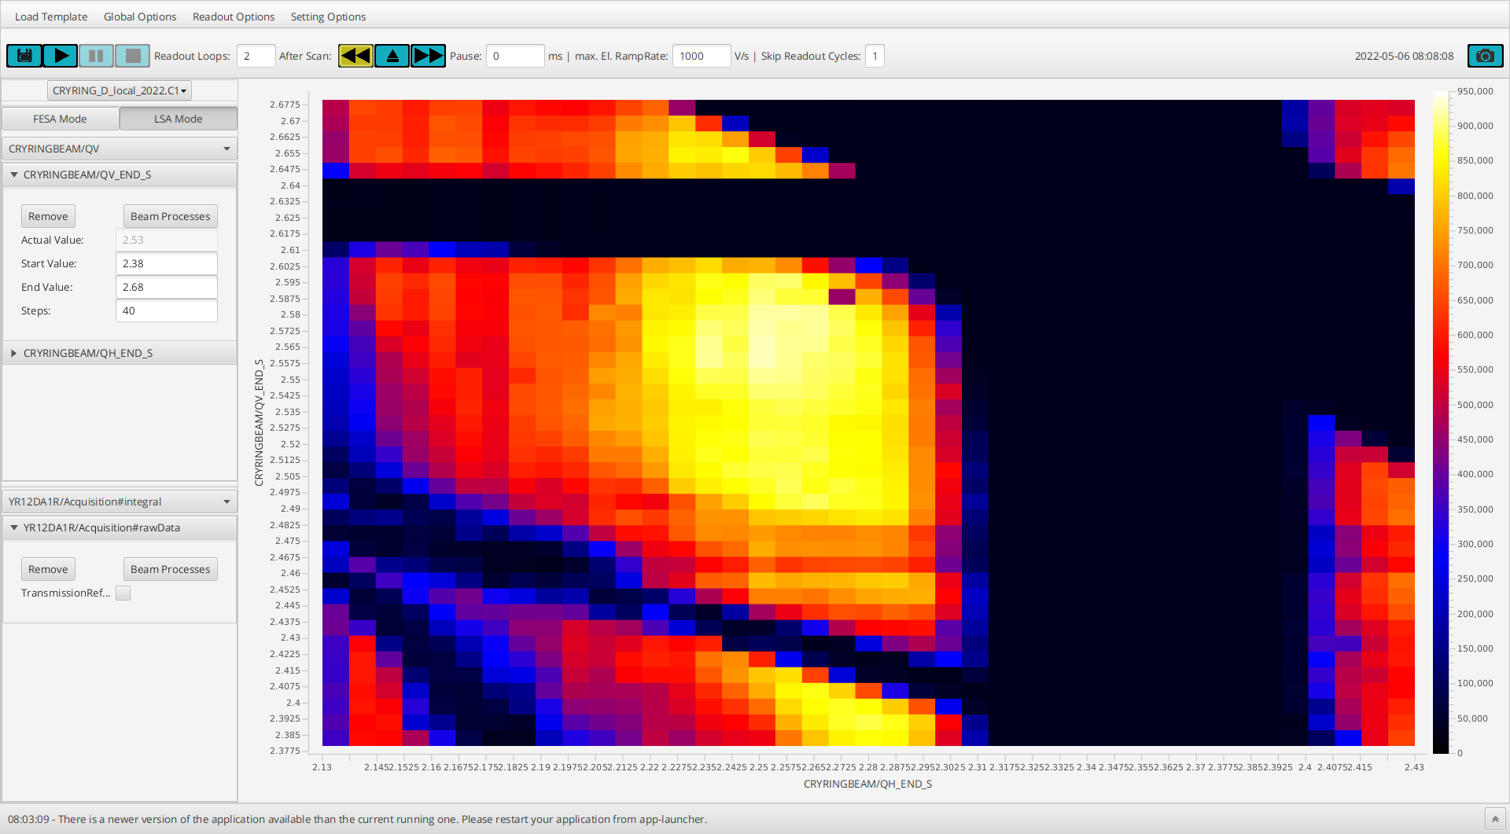
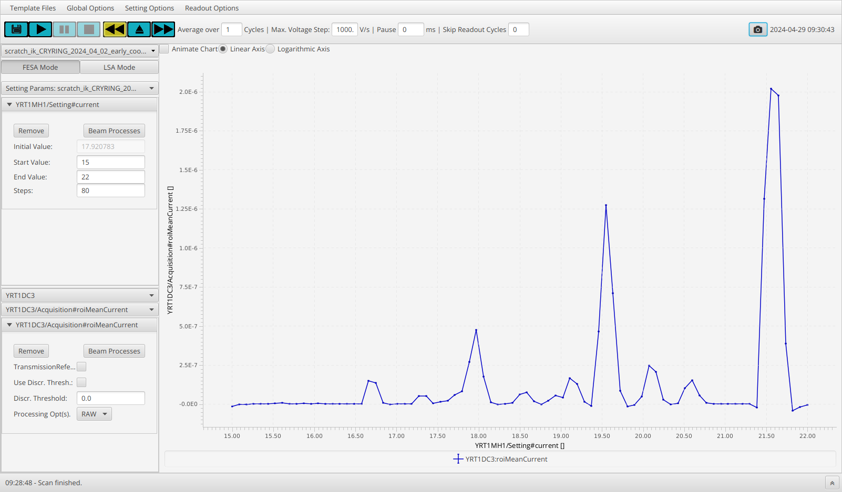
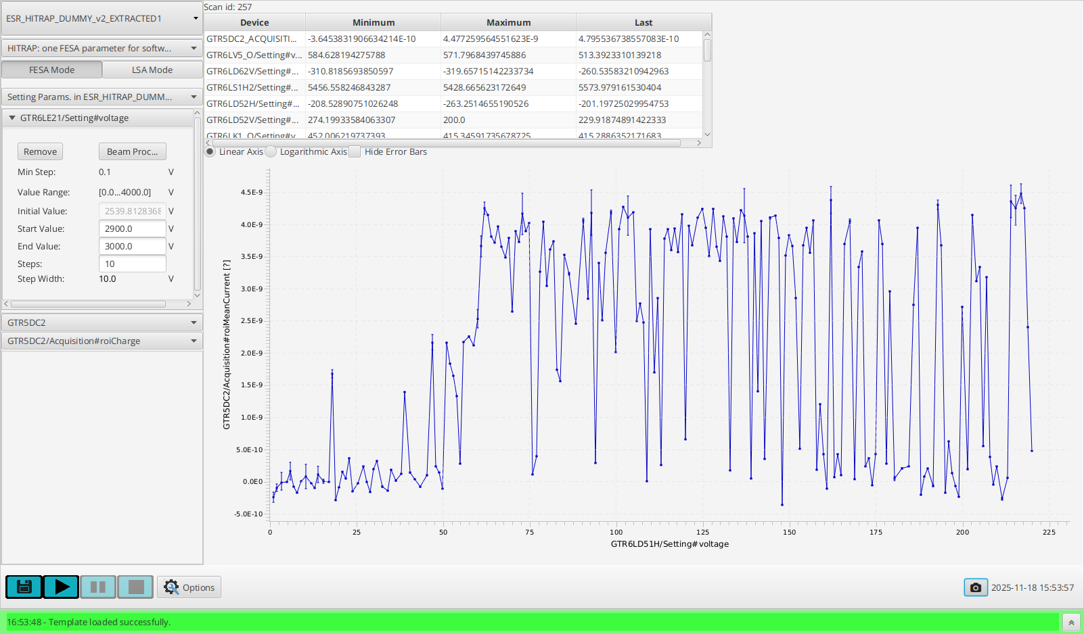
DeviceAutomator at CRYRING & HITRAP
CRYRING:
Mass spectrum recording
Injector/-ion optimization
Tune diagram mapping (CRY-AP-258)
HITRAP
Support for manual beamline optimization
Deceleration optimization
11/2025:
Focus on optimizers: performance & possible productive use (CRY-AP-257)
Bayesian optimization, 24 parameters
Notes:
Frank already showed this slide to show the various use cases where we in the DECELERATOR team use DeviceAutomator.
In this talk I cannot cover the whole range of application we use DeviceAutomator, but I will focus on some new features and recent tests we performed at the HITRAP beamline.

Slide 7
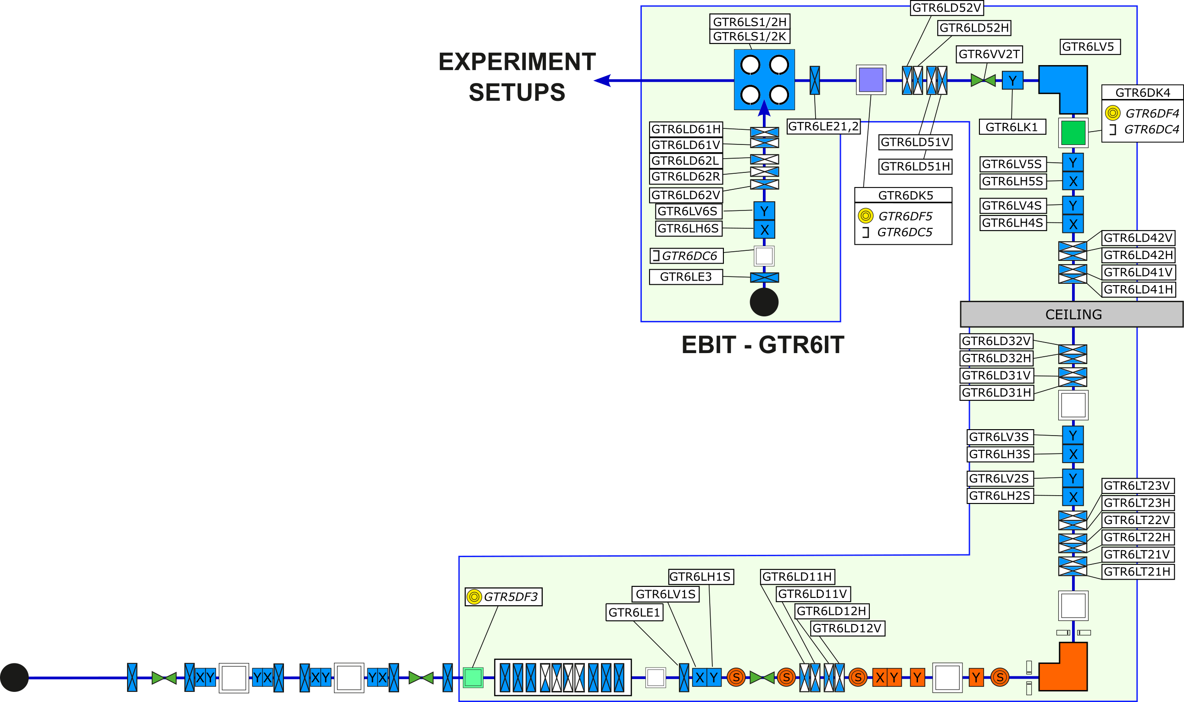
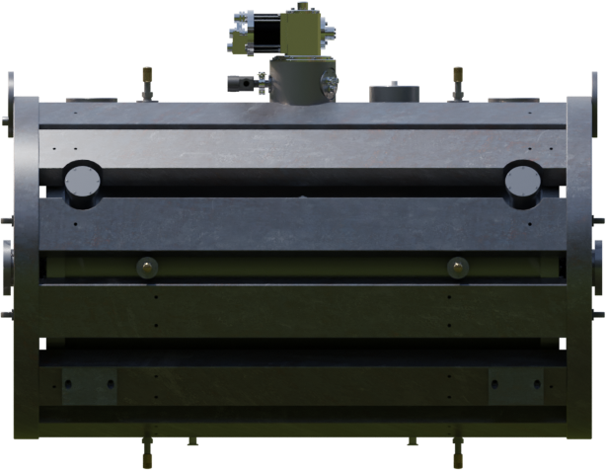
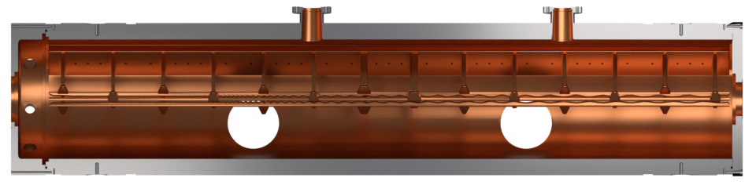
Beamline Optimization: Challenge
How to find good beamline settings in 58 parameter space and ~ 1000 steps per parameter?
→ Bruteforce with 1 Hz ~ 3 * 10¹⁶⁶ years
EBIT-ion source
Cooler-trap
58
RFQ-decelerator
Notes:
Now I want to change to the actual measurents / machine experiments we performed on the HITRAP beamline.
The beamline used for testing comprises
the HITRAP EBIT ion source
up to 58 electrostatic elements
3 detector positions
The main challenge for any beamline setup is how to get efficiently to good settings for 58 parameters?
To give an idea what this means if one scanned each of the 58 parameters stepwise in ranges of 1000 V and 100 Volts with 1 V or 0.1 Volts granularity:
the parameter space has a size 1000 to the 58.
this means with a stepping frequency of 1 Hz one had to scan 10^166 years…
→ we need to coe up with something different.

Slide 8
Very Short Introduction into Optimizer Algorithms in DevAuto
Genetic Algorithm
Based on random values combined with „evolutionary“ selection of good values
No internal model
External JAVA library „Jenetics“
DevAuto implementation takes into account power supply stepping resolution
Since 2018 used in Device-Automator
Bayesian Algorithm
Compiles internal model of „most promising“ function gains for value generation
DevAuto uses external JAVA library developed in a Master project at H_DA (informatics department)
Power supply resolution not considered in the code
Available since 09/2025
Notes:
Currently, two large range / general purpose optimizers are available in Device-Automator:
one based on Genetic algorithm paradigm
one besed on the Bayesian algorithm paradigm.
… currently I am investigating a BOBYQA algorithm implementation.
Given the time restrictions, I cannot go into the details of these algorithms, so some keydifferences between the Genetic and the Bayesian algorithm used in Device-Automator
→ SLIDE

Slide 9
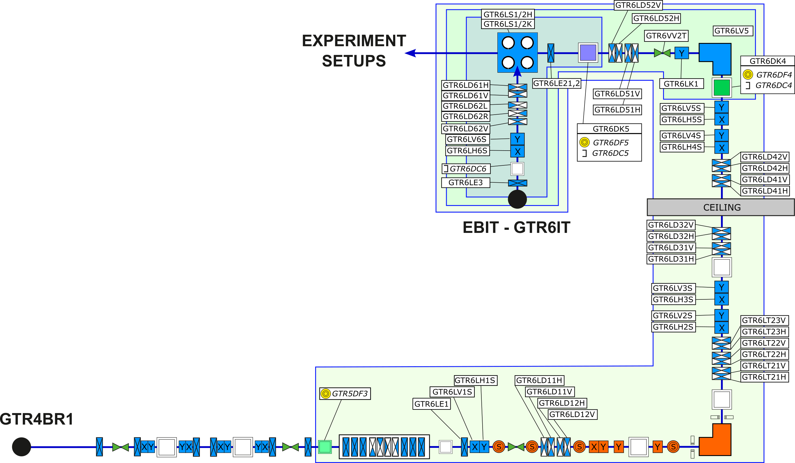
Experiments at HITRAP – Goals & Environment
Integration-test of transition to FAIR CS
Prepare Bayesian optimizer for standard operation
Compare performance of Genetic and Bayesian optimizer – convergence speed, quality of convergence
Collect experience with optimizers
Check beamline for unexpected behavior
⁴⁰Ar¹⁶⁺ beam from local EBIT ion source
Optimization of 16, 24, 58 parameters, single objective
Parameter ranges ~20% full range
16
24
EBIT-ion source
Cooler-trap
58
RFQ-decelerator
(from ESR)

Slide 10
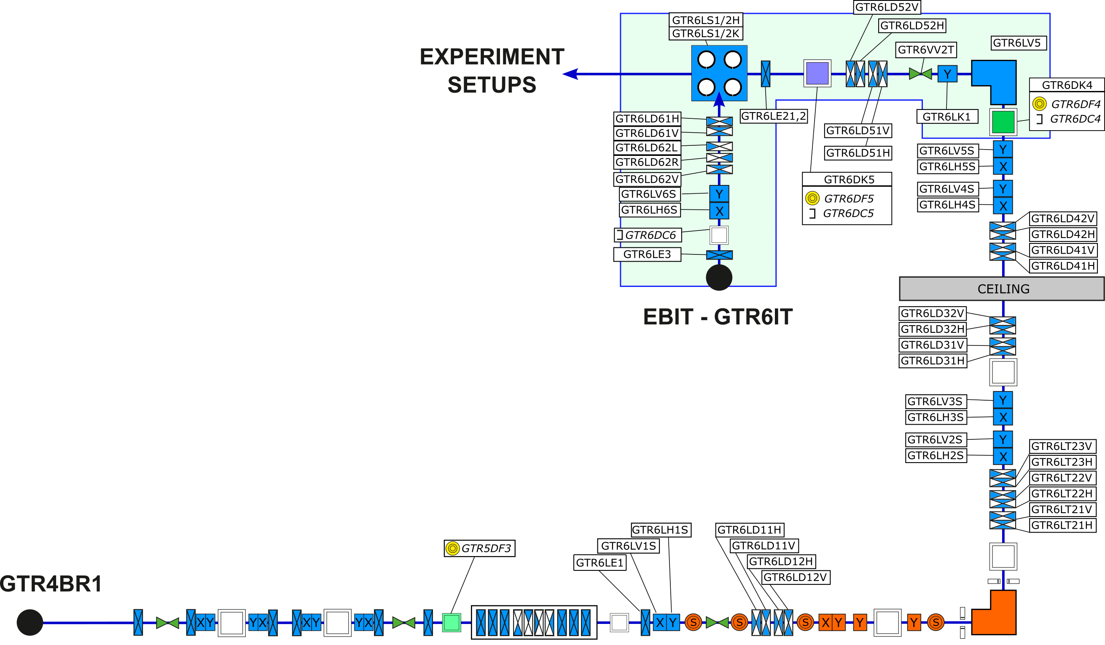
Experiments at HITRAP: EBIT → GTR6DC4
24 parameters
4 Bayesian runs
3 Genetic runs for comparison
24
EBIT-ion source
Cooler-trap
RFQ-decelerator

Slide 11
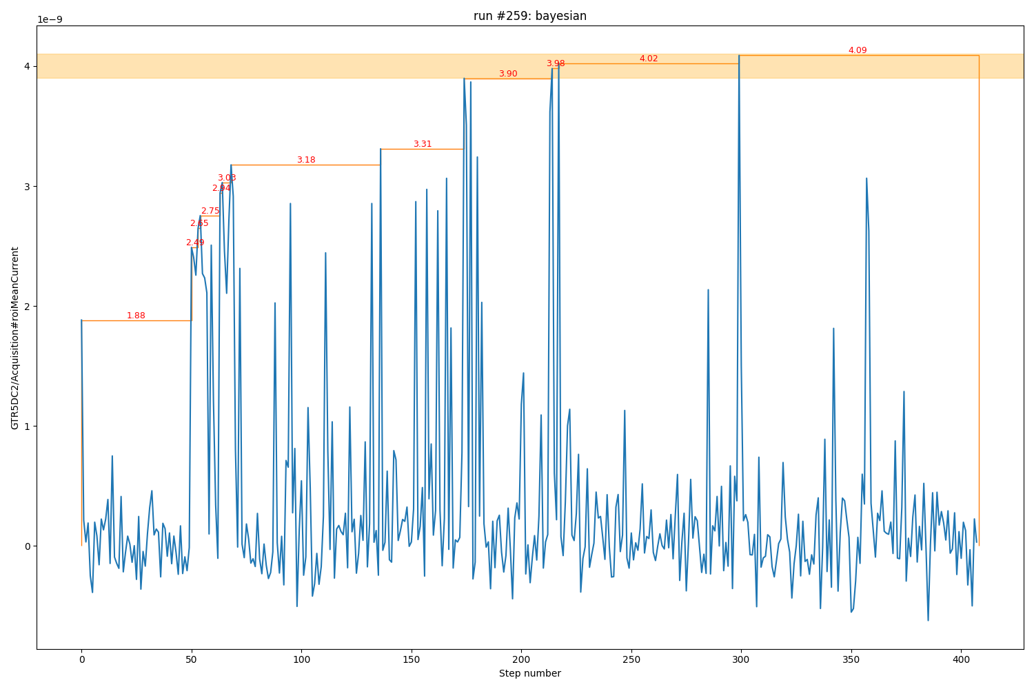
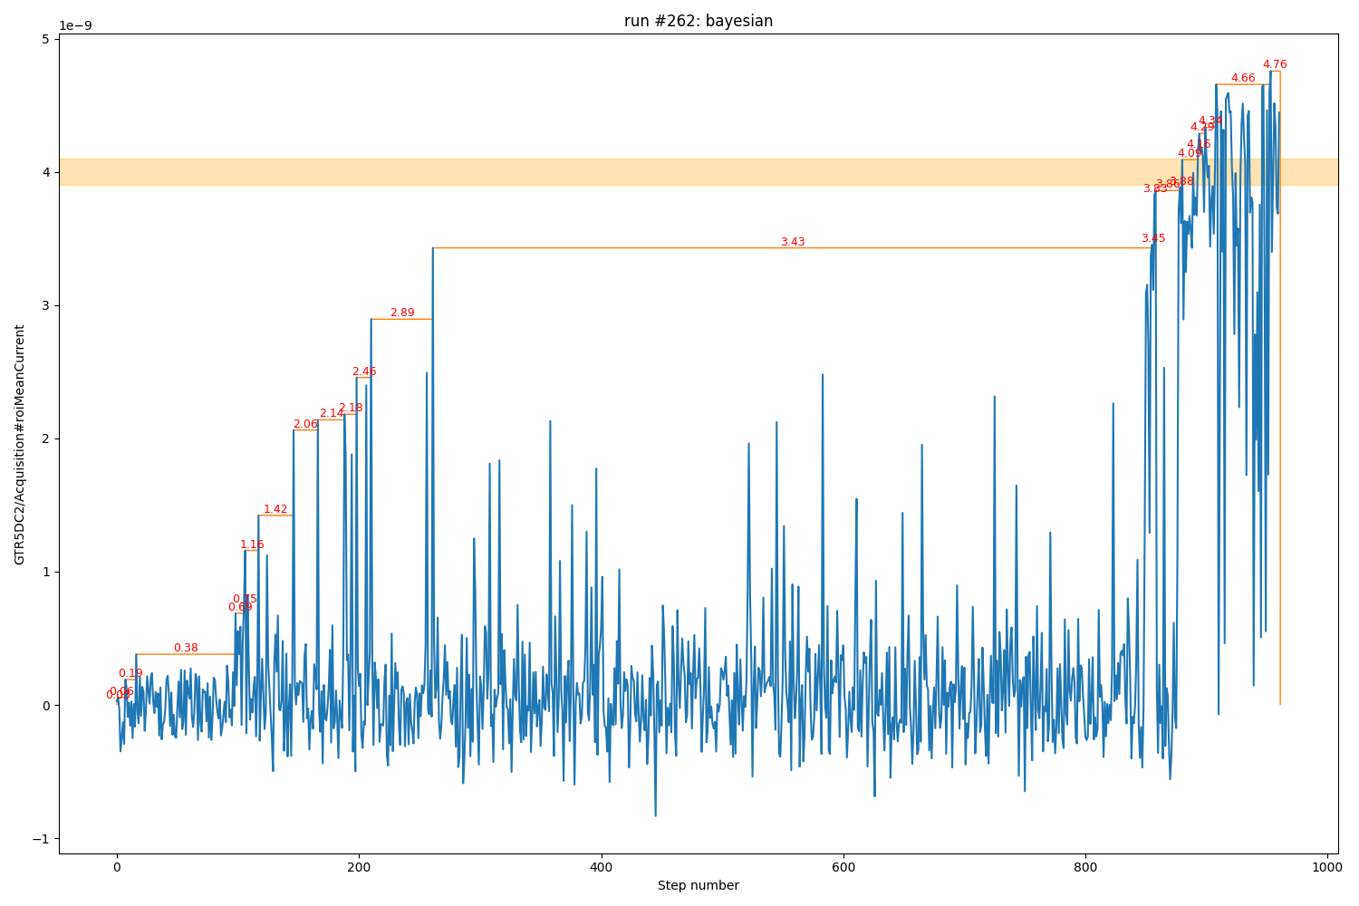
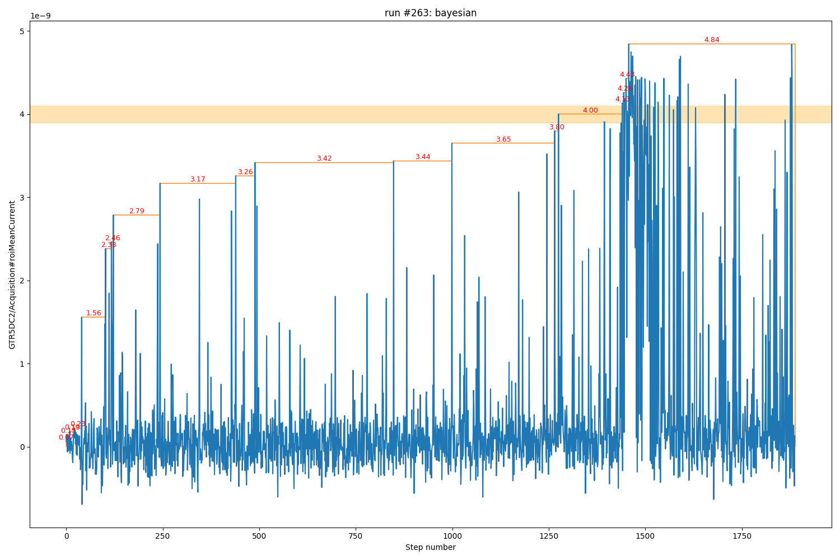
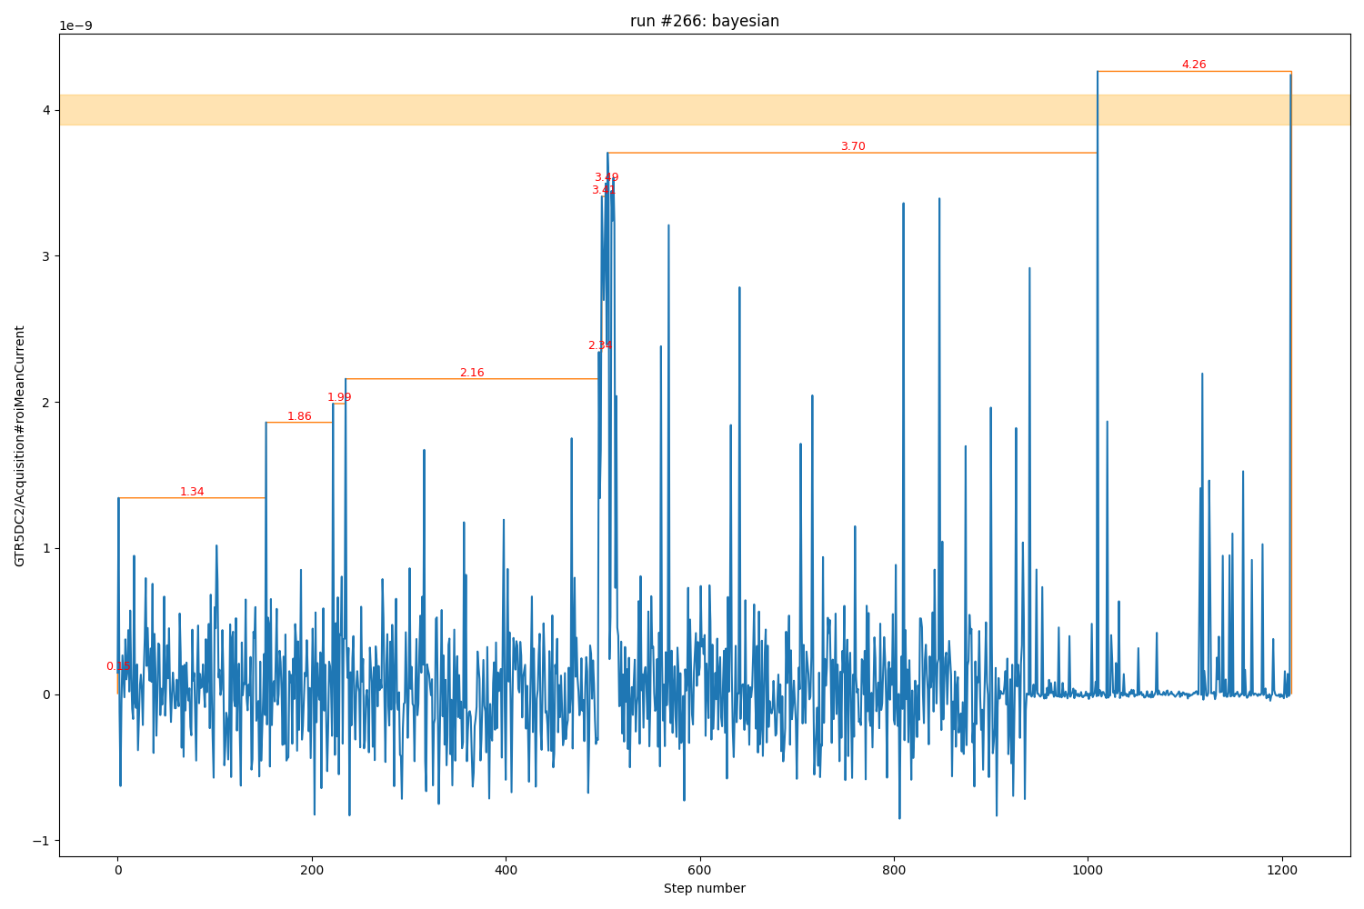
Algorithm tests: Bayesian EBIT -> GTR6DC4
Mean ROI mean maximum current: 4.5 nA ~ 115% operator value
Mean steps to maximum value: 1140
Mediocre signals reached after ~350-400 steps
Sensitive to signal-width vs. parameter-range
LogExpectedImprovement requires re-scaling of objective signals to O(1)
Internal model impacts performance after ~ 500 steps
stopped early

Slide 12
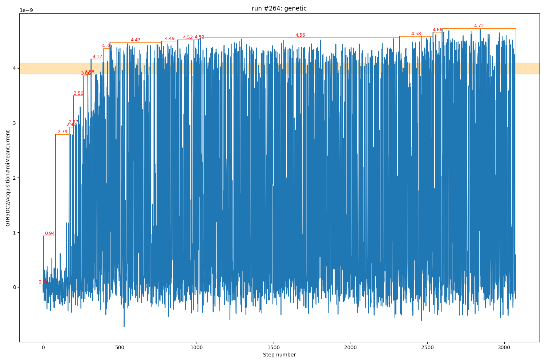
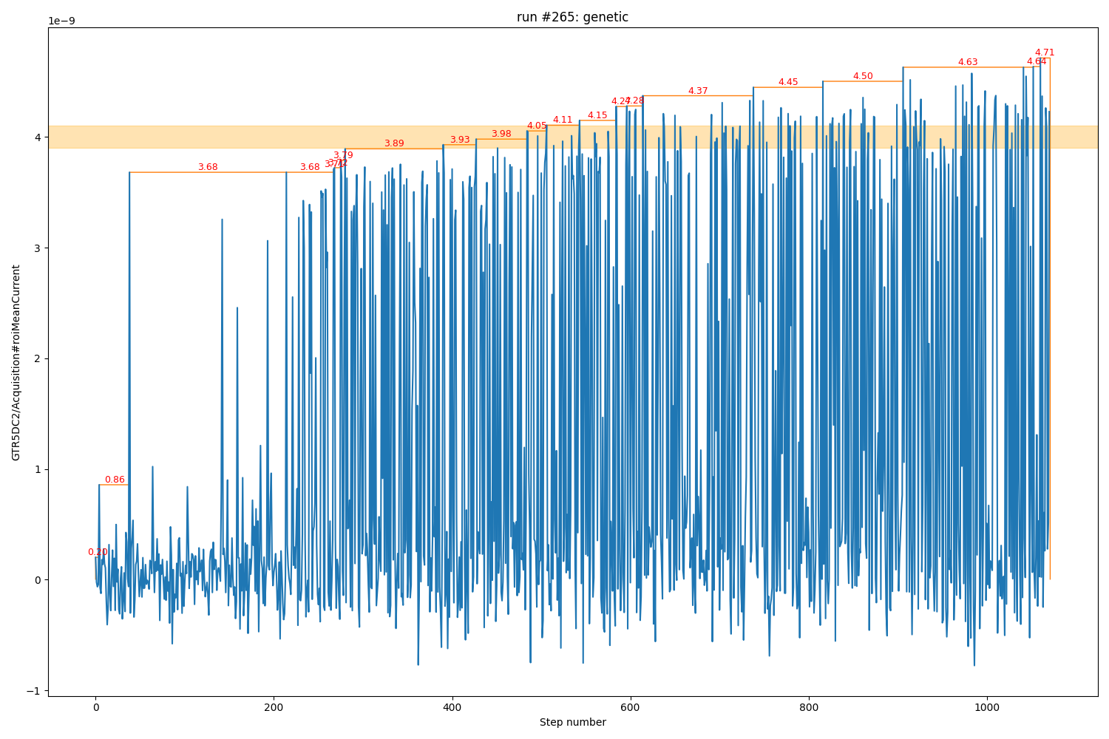
Algorithm tests: Genetic EBIT -> GTR6DC4
Average maximum value: 4.7 nA
Average steps to maximum value: ~1000 steps
Usable, mediocre signal is reached after averaged 366 steps
Independent from internal model → not (so) sensitive to signal width
More „random“ than Bayesian (advantageous and disadvantageous)

Slide 13
Algorithm tests: Bayesian EBIT -> GTR5DC2
58 parameters
3 Genetic runs
Bayesian runs were tested but did not converge (too large parameter space)
EBIT-ion source
Cooler-trap
58
RFQ-decelerator

Slide 14
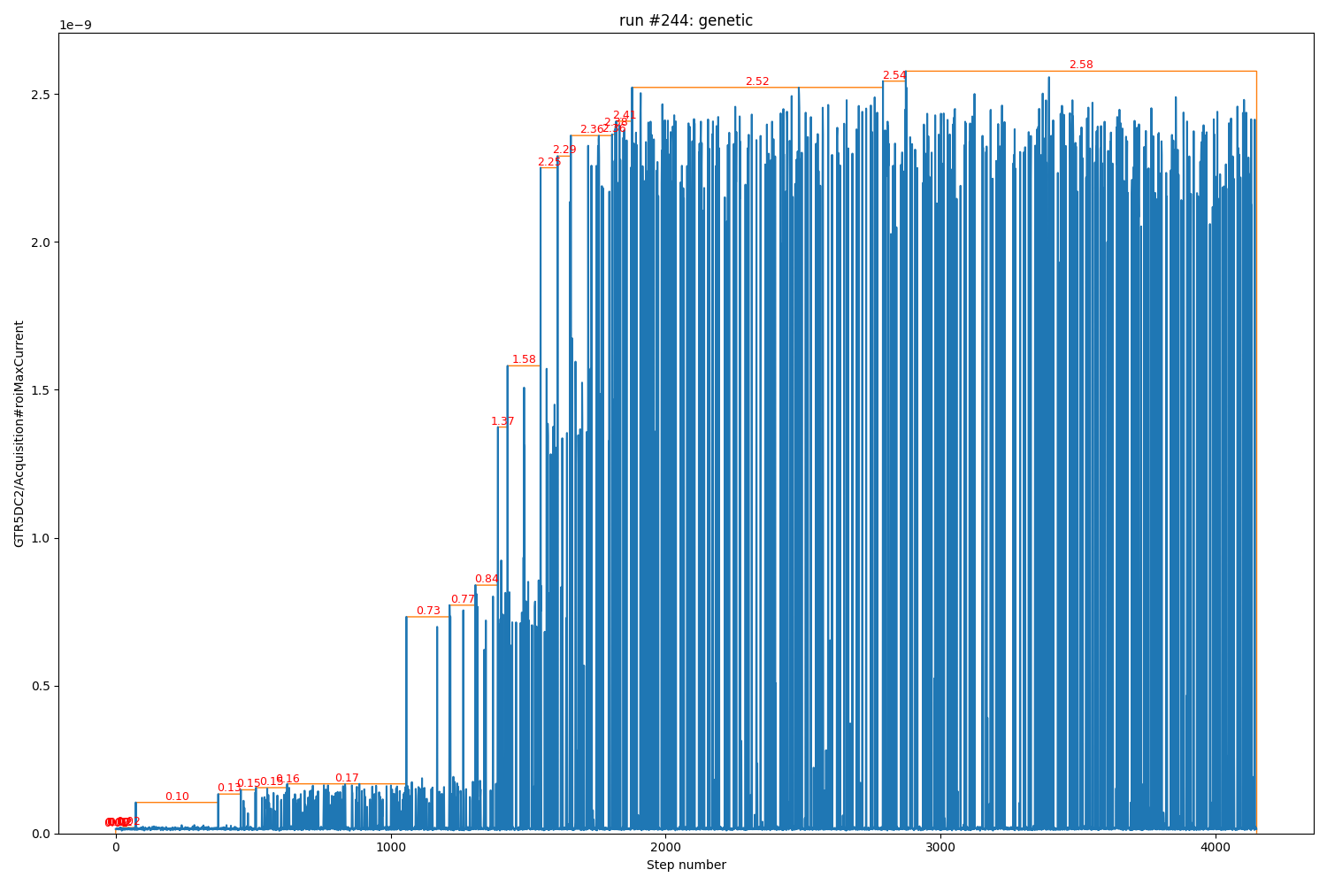
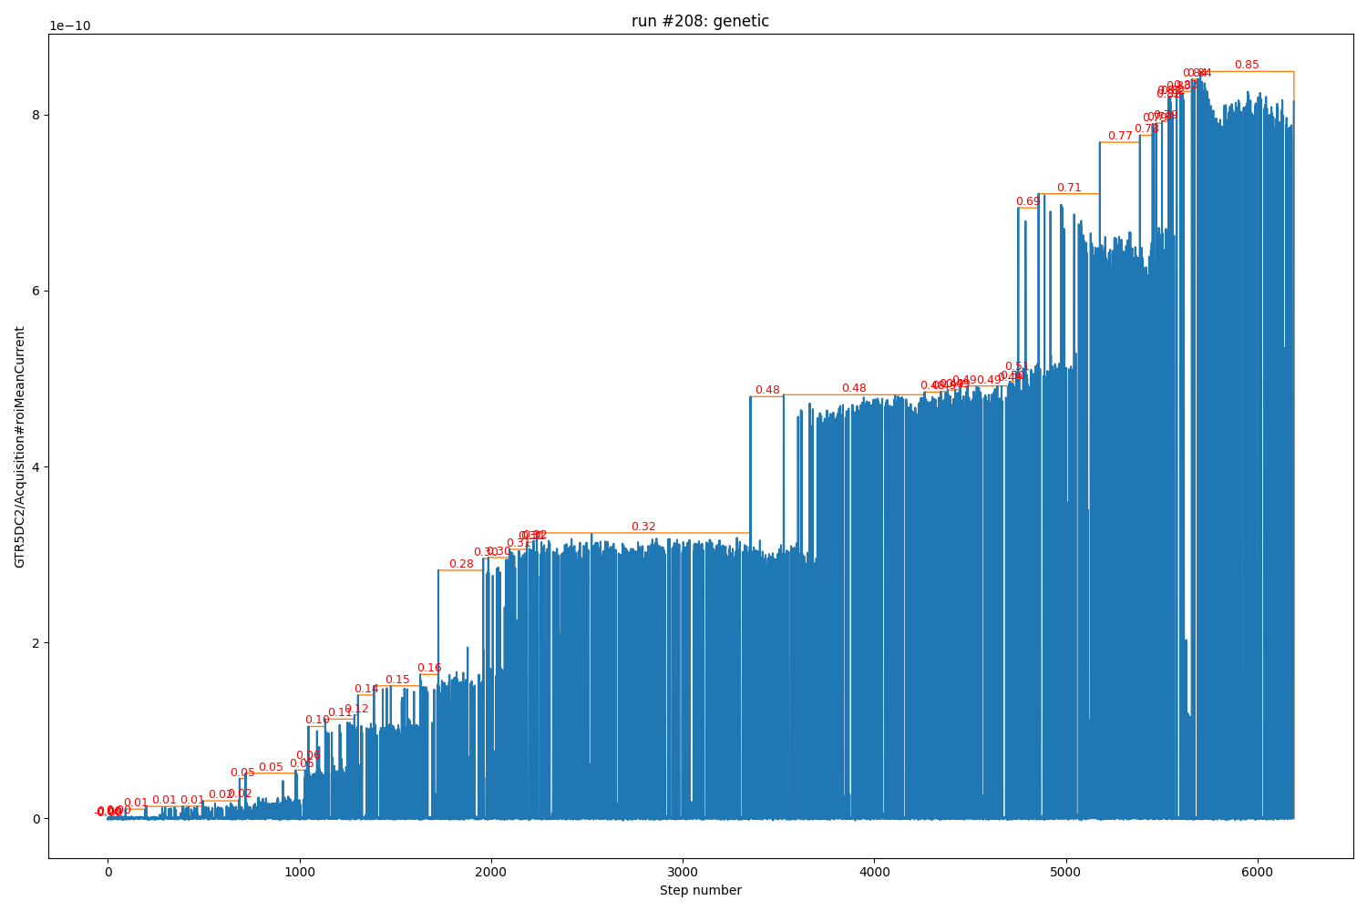
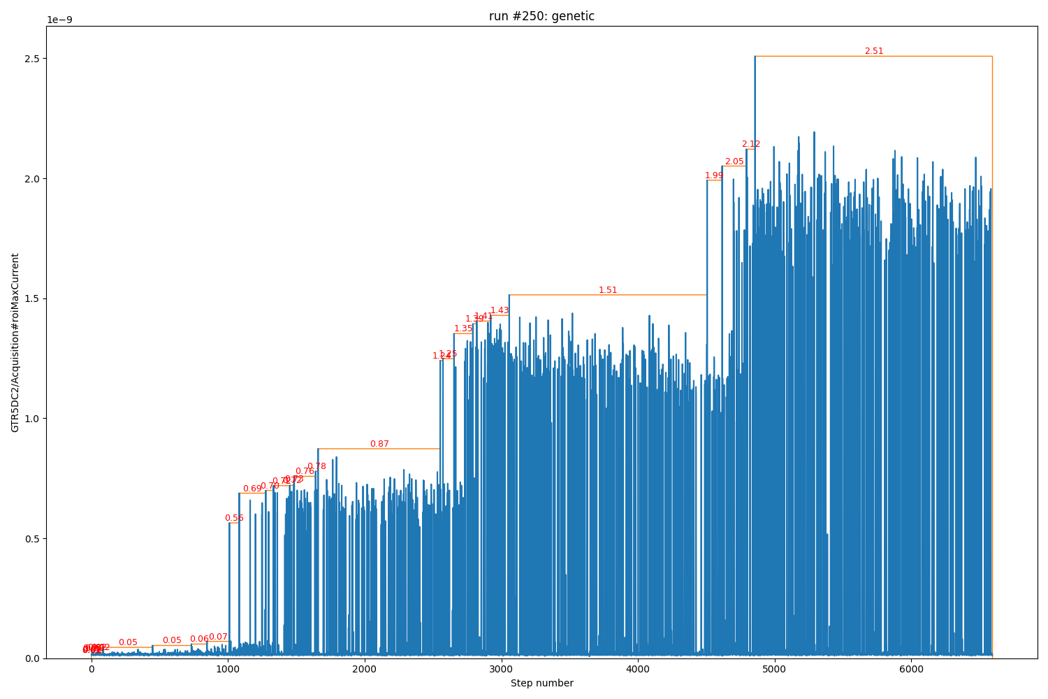
Algorithm tests: EBIT -> GTR5DC2 Genetic
Scan performed over up to 18h
Intensity reached outperformed human operator
ROI mean current
ROI max current

Slide 15
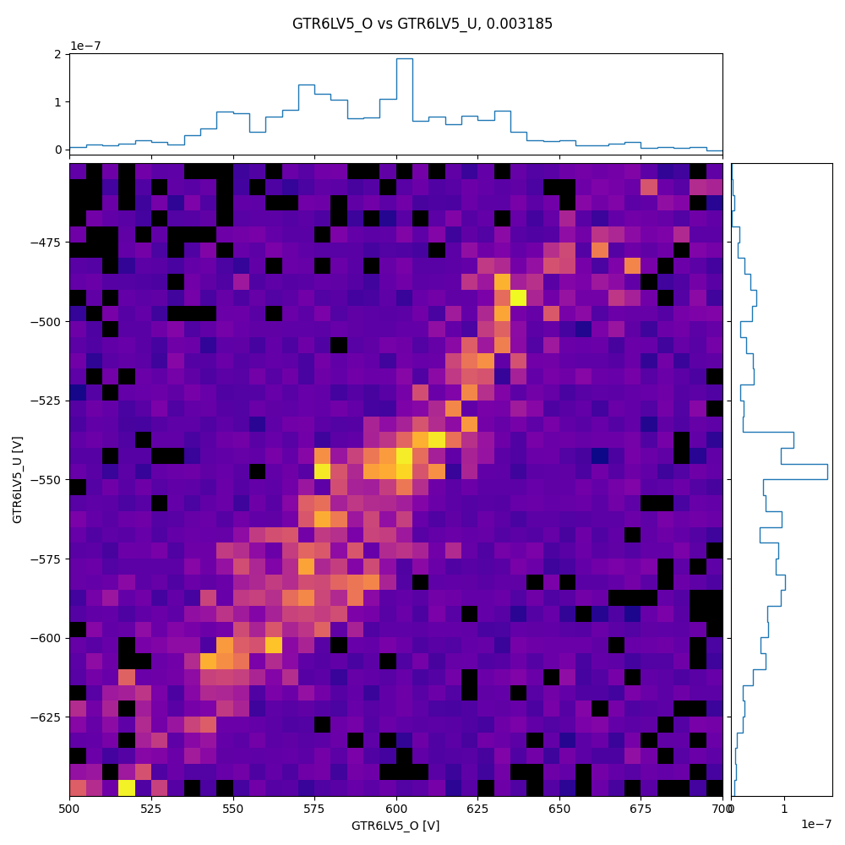
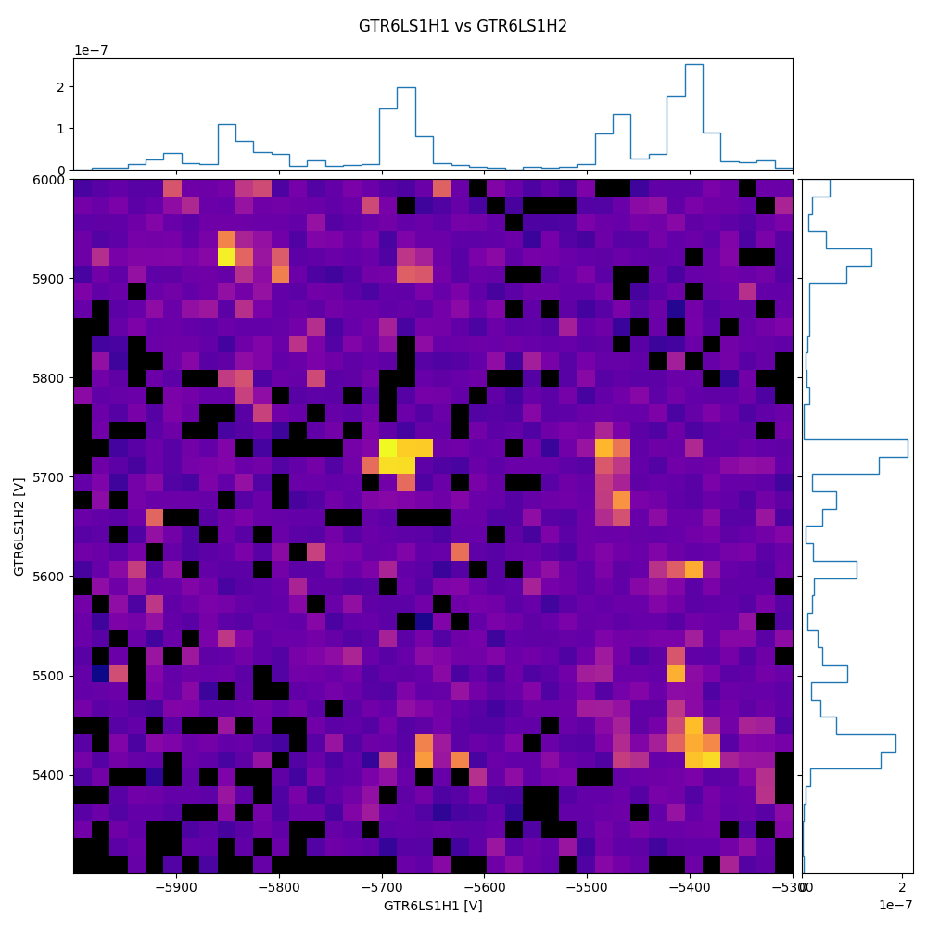
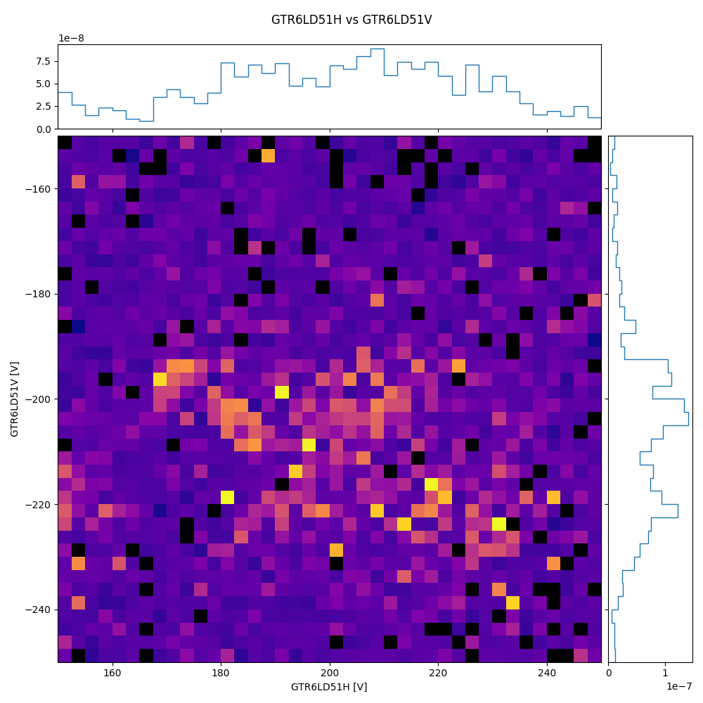
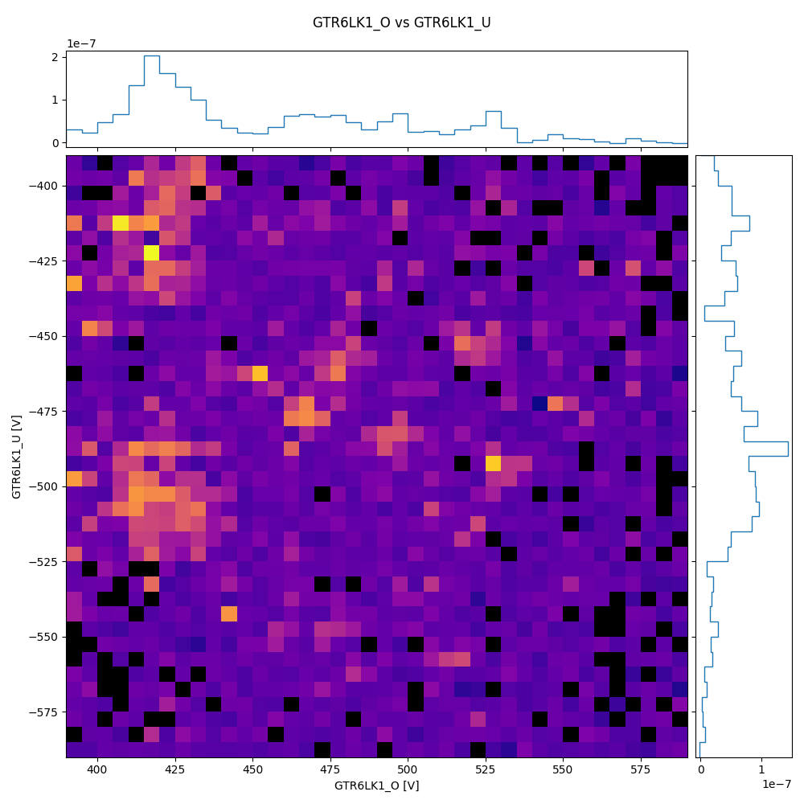
EBIT → GTR6DC4: Insights from Collected Data
24

Slide 16
Conclusions from Optimizer-Tests
Optimizers do not outperform human experts
„Good“ optimizer use cases / scenarios:
exploration of unkown (sub)system / beamline settings
increase of available time for machine setup
tool supporting unexperienced personnel
parallel setup of machines
limited search spaces
Genetic algorithm is better for large search spaces, Bayesian for well known spaces
Aspect | Genetic | Bayesian
Reliabiliy of optimum | Good | Good
Scan space: parameters and/or ranges | Better for large spaces | Better for narrower ranges
Scan Time | Rather random | Faster for narrower ranges
Objective range | Independent of objective range | Works better if objective is re-scaled e.g. 1.23E-9 → 1.23
Influence of algorithm on stepping speed | Negligible, constant | Increasing, significant for steps > 1000

Slide 17
BACKUP

Slide 18
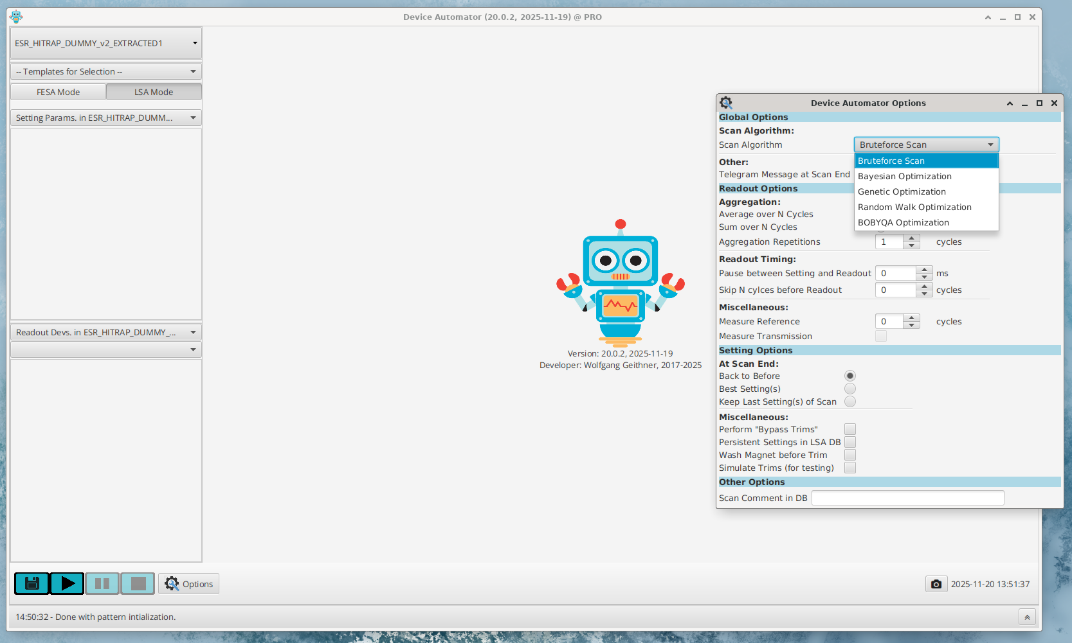
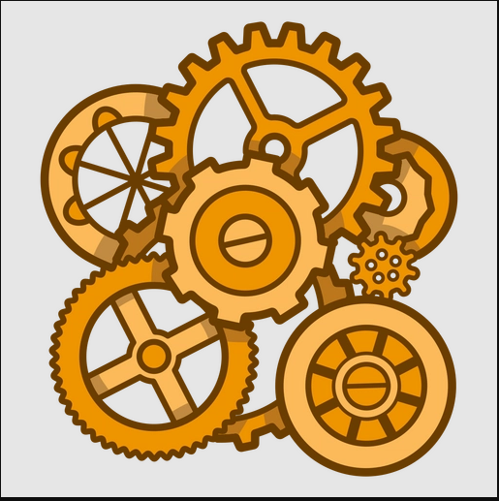
DeviceAutomator – a bit of Architecture
chains,
patterns,
parameters,
…
ranges data
FESA REST API
LSA Settings
config, templates
DEVAUTO REST API
run data
config data
templates
run data
DEVAUTO
Oracle DB
LSA Layer
FESA settings
FESA
settings
JAPC Layer
BI acquisition data
extraction,
analysis, …
FESA Layer
Notes:
This is a very rough sketch of the Device-Automator architecture and bulding blocks.
Here, I show the UI in ist newest version, which is not yet rolled out. The UI allows users to set up scans, parameter to be scanned, beam processes to be used per parameter an so forth.
In the UI data from beam instruments is visualized as the scan progresses
To the right I put a screenshot of scan options. The user can set options for
General: algorithms for generating values
BI readout:
readout repetitions,
delay between setting and readout,
…
Setting values:
Behavior at ending a scan (go to last, best, before value)
Perform bypass trims
Simulate trim for testing
…
Below the UI there is a „business“/service layer realizing the integration into the FAIR CS. Specifically
Orchestration of the scan process
Setting scalar LSA parameter values
Setting scalar JAPC-FESA parameter values
Subscription and readout of BI data
Device-Automator uses as well the FESA REST API to collect supporting data for the program
In the lastest version we implemented as well a Device-Automator specific Oracle database. In this this database configuration data is stored (parameter ranges, scan templates, …) and where coordinated data sets of each scan step is stored for later analysis.
All the data to be shown in this talk is stored in this database…

Slide 19
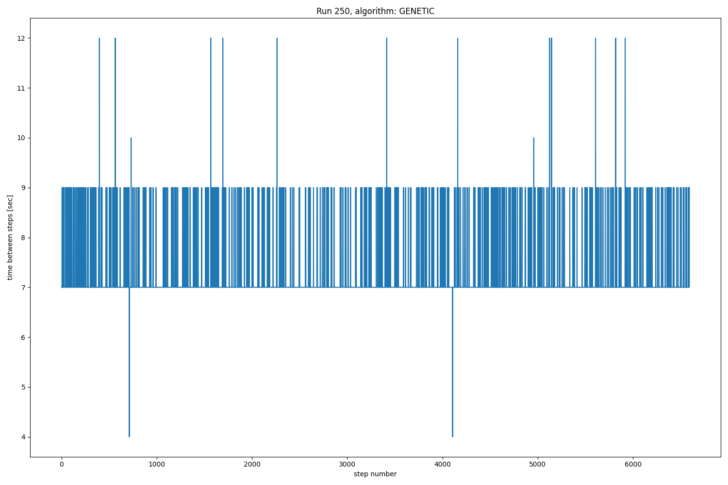
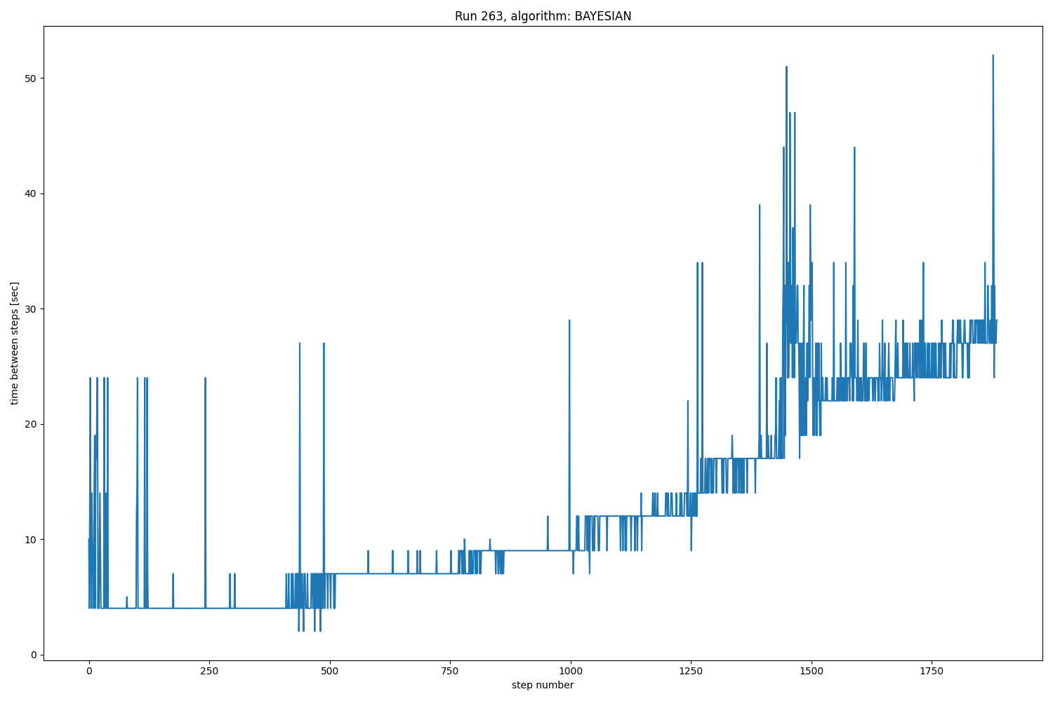
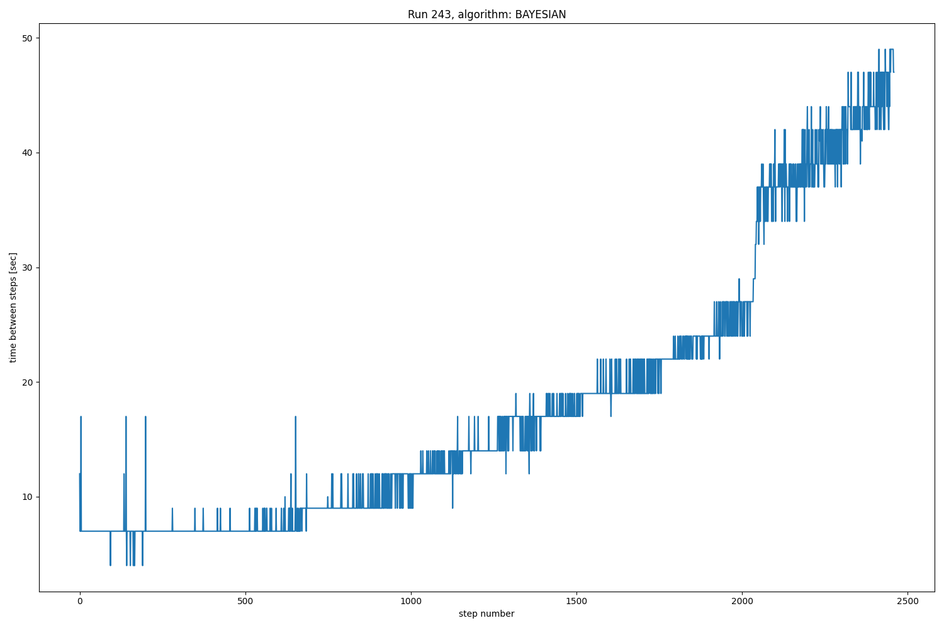
Bayesian Runs: Algorithm Performance Limits
Genetic algorithm does not do internal calculations → constant step-to-step periodicity
Bayesian algorithm slows down due to internal model calculations
Bayesian, 24 params
Genetic, 58 params
Bayesian, 58 params

Slide 20
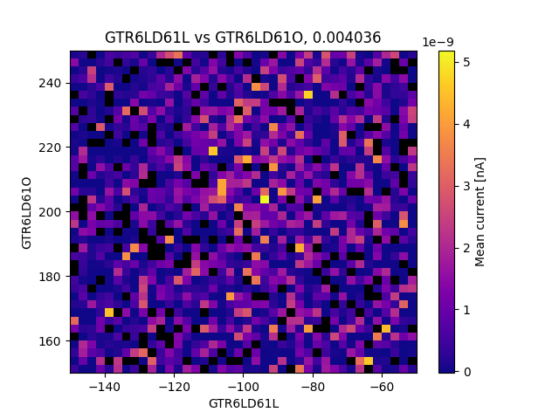
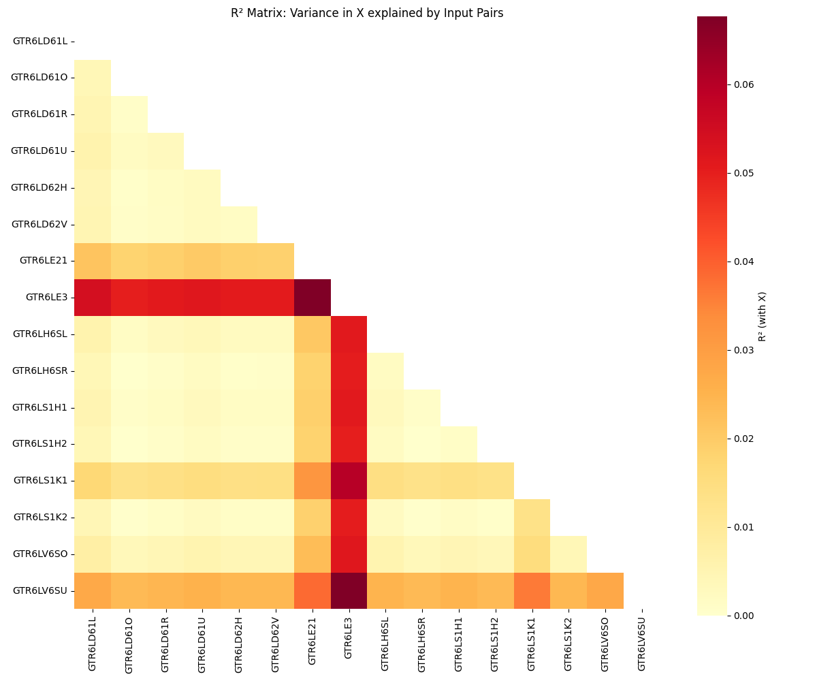
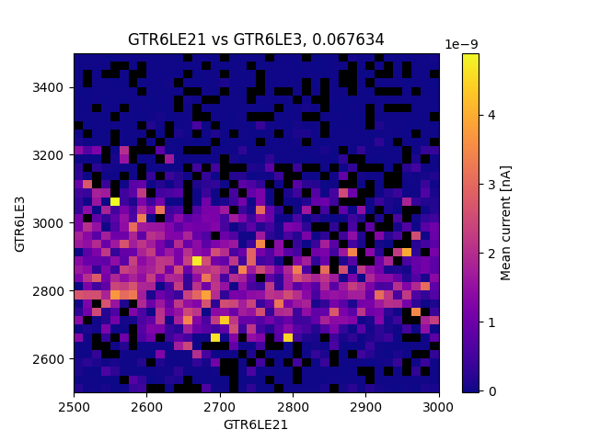
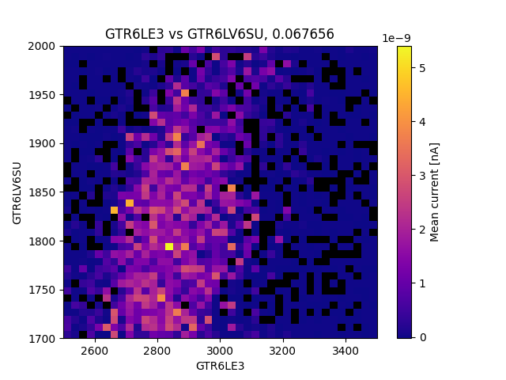
Tool for Mapping Parameter Ranges / Sensitivity
Work in progress…

