Slide 1
FRS Machine Run
12th July 2025:
Method testing for S-FRS:
Ion-Optical Optimization
Quadrupole axes measurements
D. Kallendorf, Z. Brencic, J. Wirtz, M. Bajzek, S. Appel, P. Madysa, J. H. Hetzel, H. Weick, S. Pietri, E. Kazantseva

Slide 2
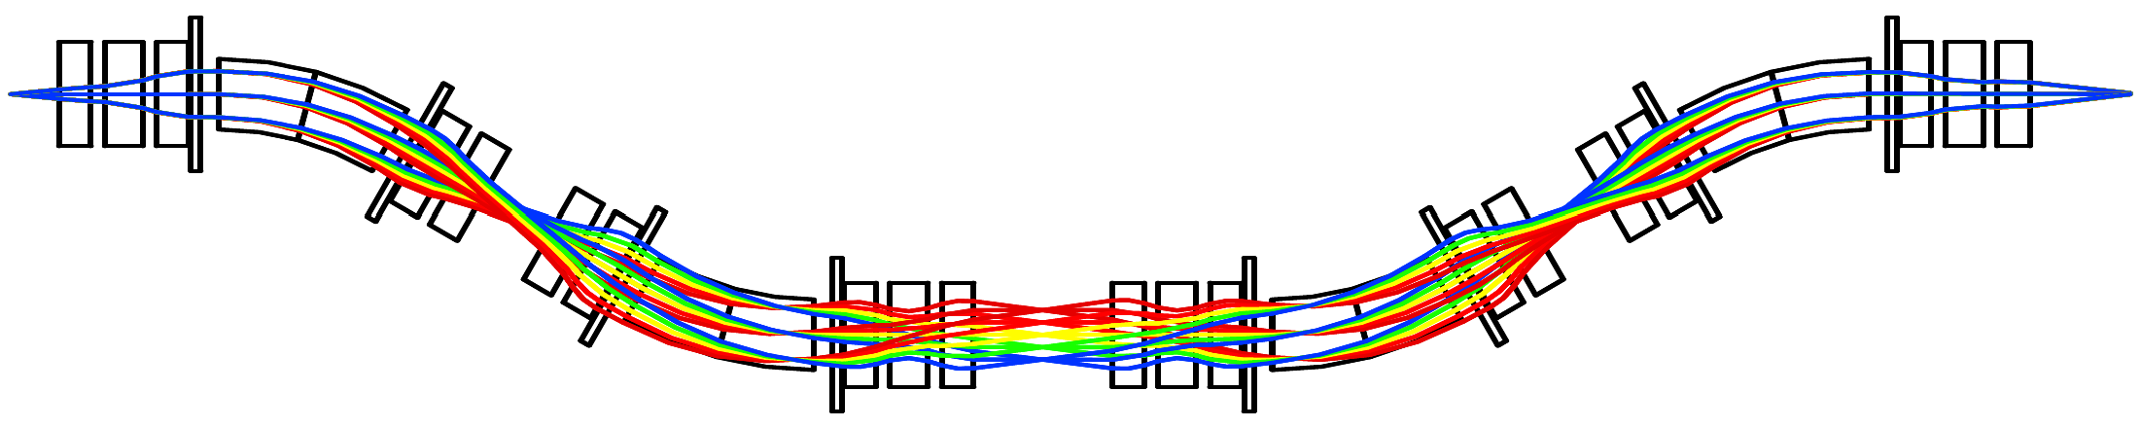
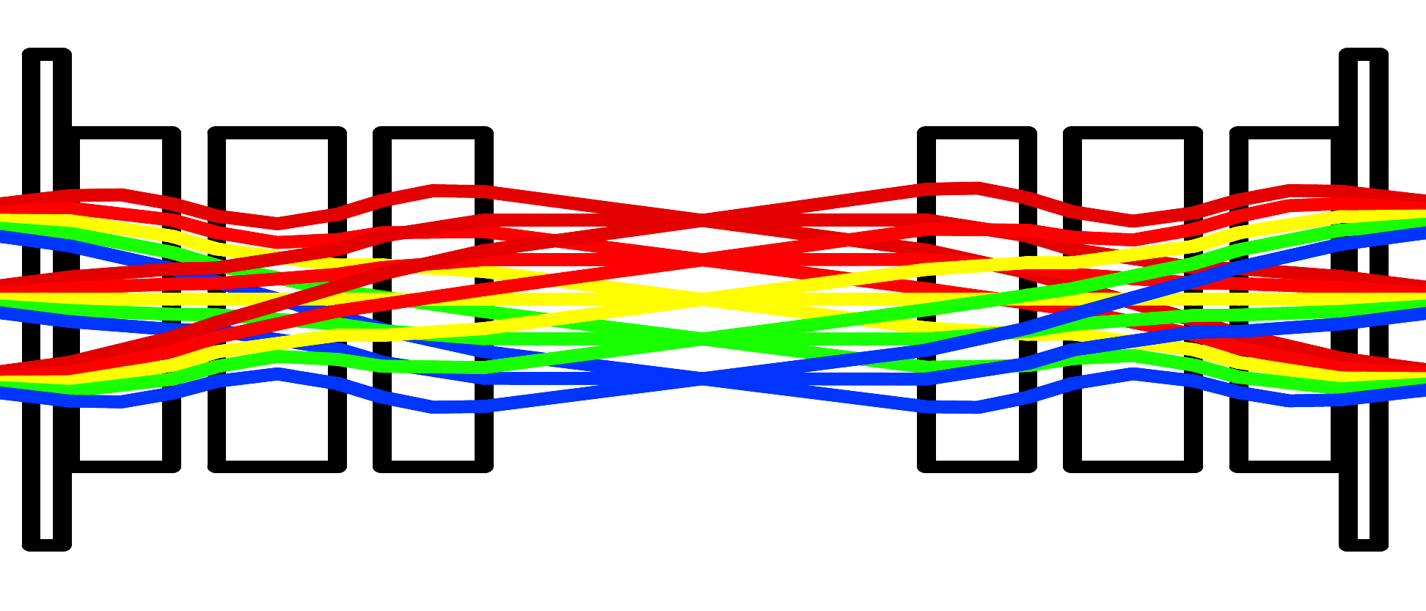
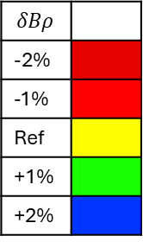
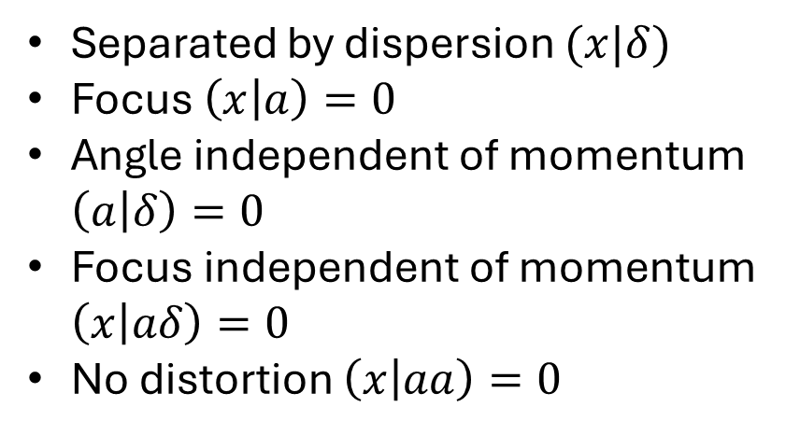
Reminder: Fragment Separator FRS
S2
$$δBρ$$
-2%
-1%
Ref
+1%
+2%
Separated by dispersion $(x|δ)$
Focus $\left(x | a\right)=0$
Angle independent of momentum $\left(a | δ\right)=0$
Focus independent of momentum $\left(x | aδ\right)=0$
No distortion $\left(x | aa\right)=0$

Slide 3
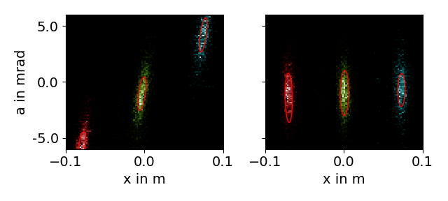
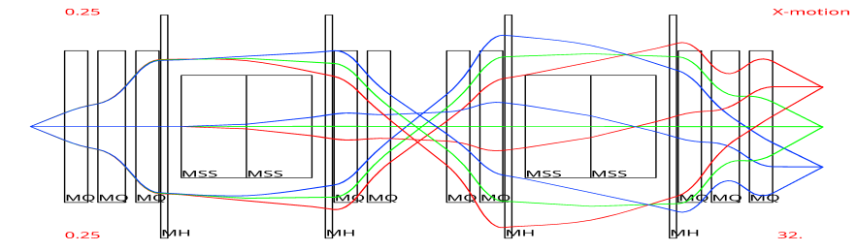




Experimental Setup: Expected case
Diagnostic Mode:
Use target to generate charge states
of primary beam
Beam: 650MeV/u U, TA: 113mg Be + Sci1
TPCs (experimental DAQ)
measure phase space
$${\text{U}}^{92+}$$
$${\text{U}}^{91+}$$
$${\text{U}}^{90+}$$
$${\text{U}}^{91+}$$

Slide 4
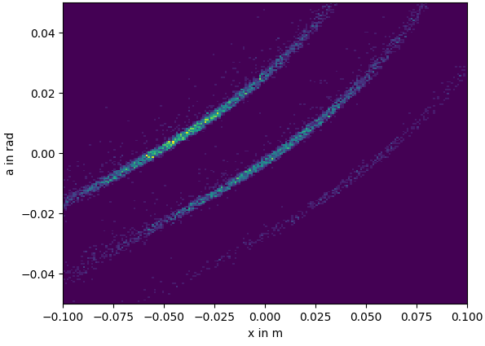
What you might see instead:
Bad S2 phase space (simulation)
Consequences:
No x-separation of spots
Emittance growth
Reason:
Imperfect model
Solution
Optimization based on detector data
Improve machine knowledge

Slide 5
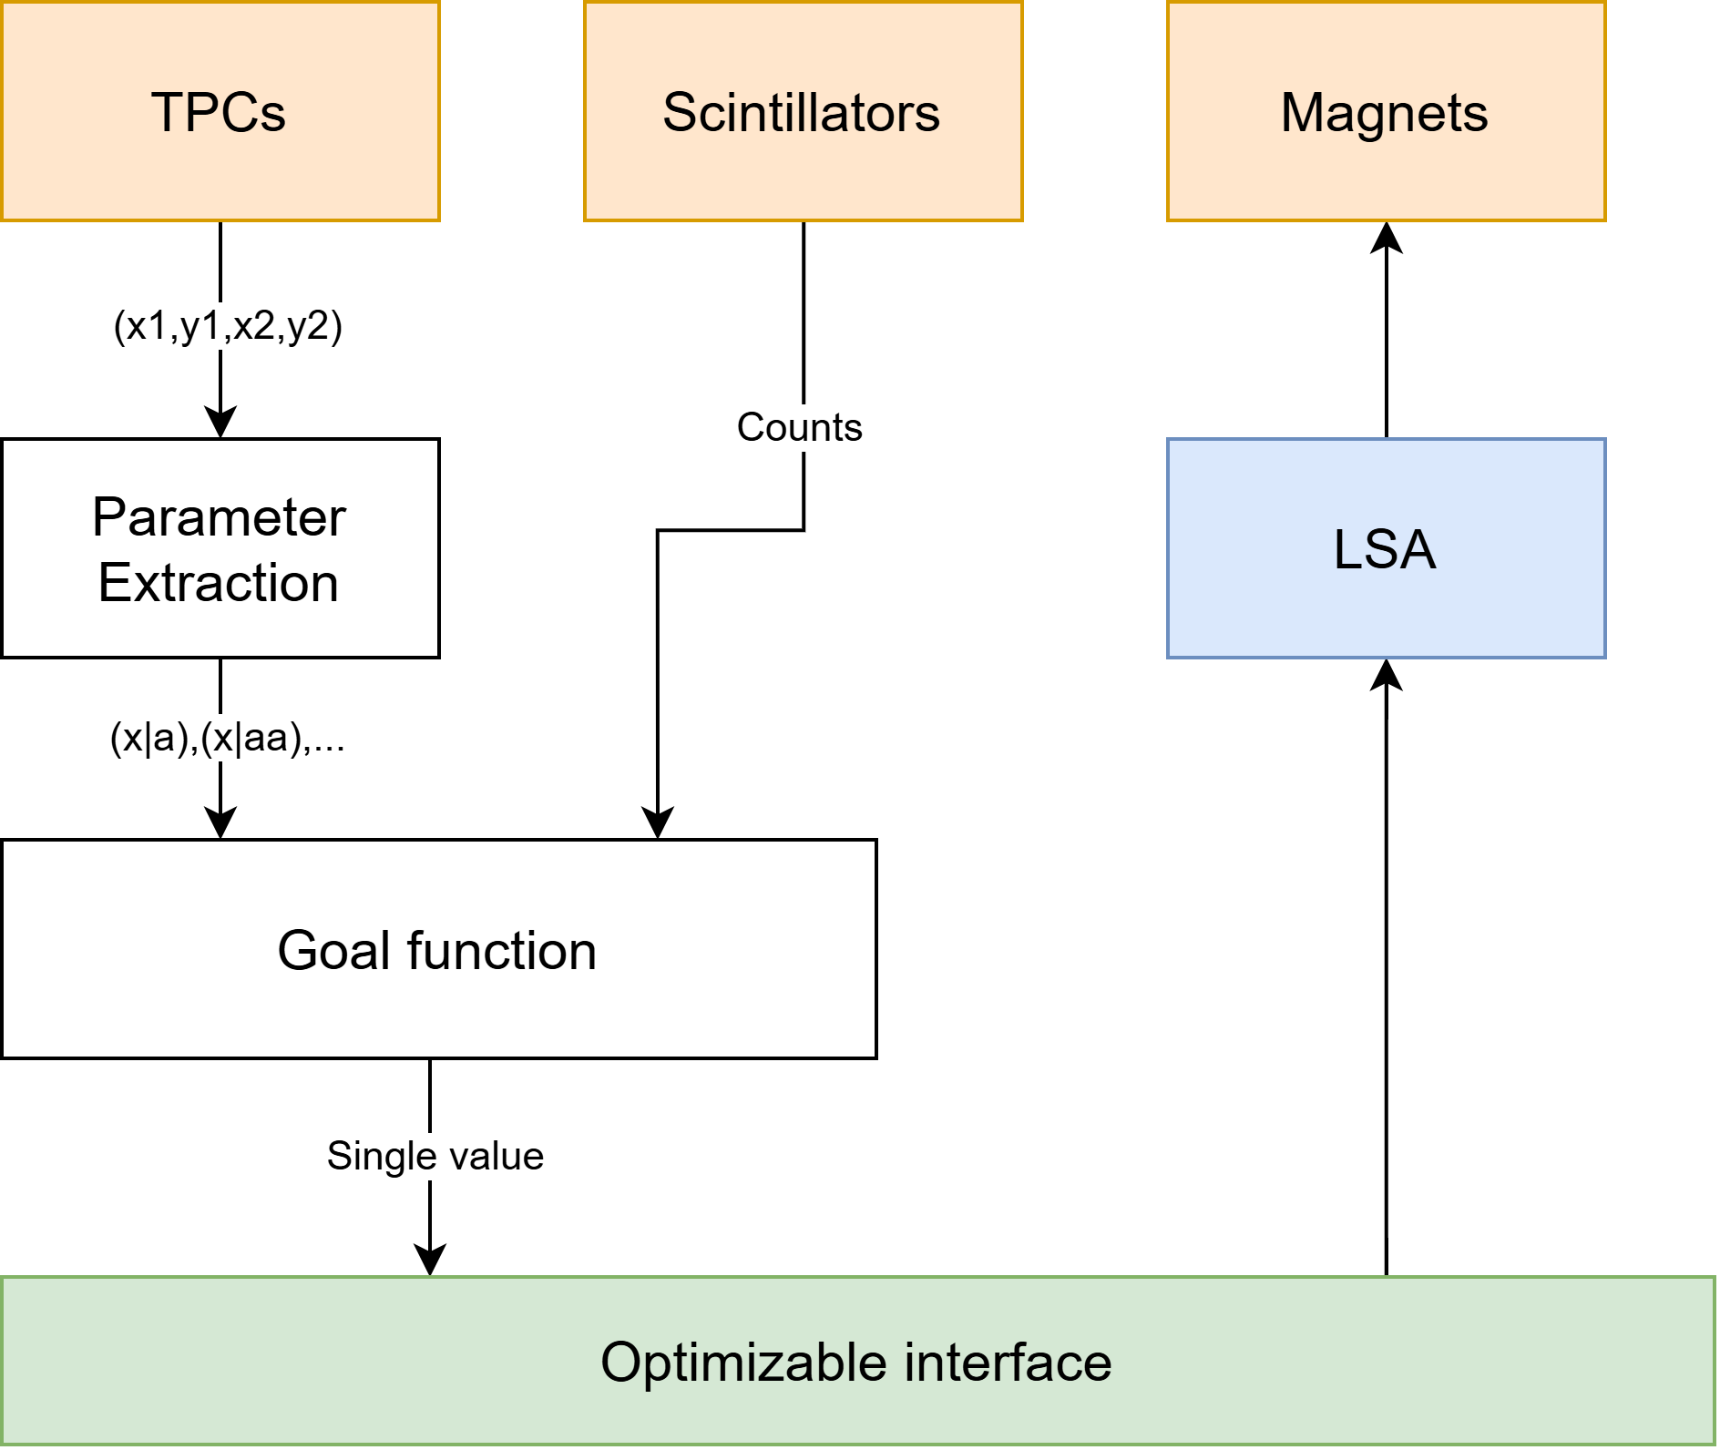
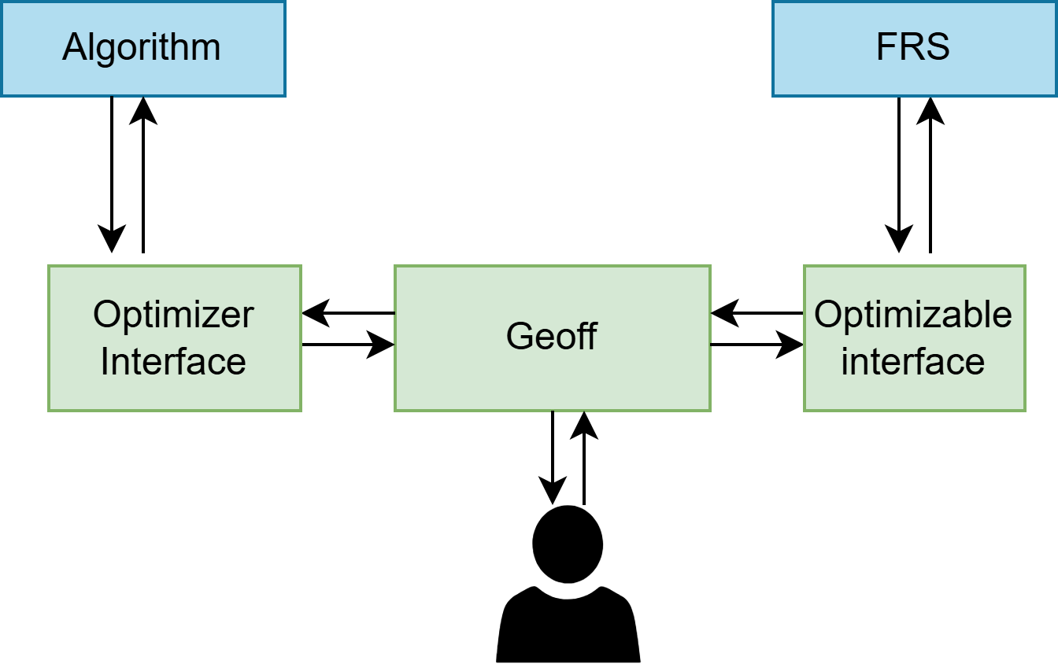
Optimization

Slide 6
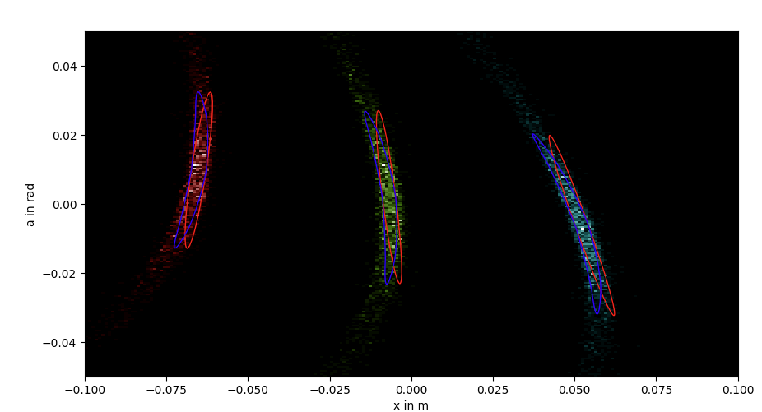
Parameter Extraction
Clustering
Identify linear distortions (red)
→Quadrupoles
Identify non-linear distortions (blue)
→ Sextupoles

Slide 7
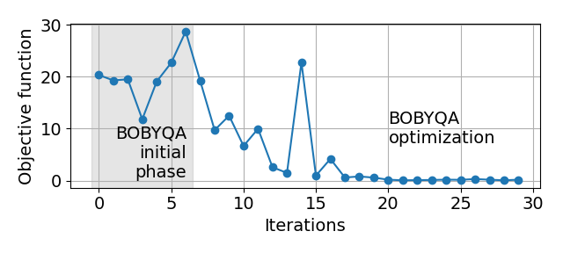






Results
Ion-Optical Optimization
Python FRS magnet control ✔
Python FRS-DAQ readout ✔
Numerical online optimization
at the dispersive focal plane ✔
Automatic evaluation of
multiple charge-state spots ✔
Optimization of momentum
dependent component ✔
Include transmission X
Optimization of sextupoles X
$${\text{U}}^{91+}$$
$${\text{U}}^{92+}$$
$${\text{U}}^{91+}$$
$${\text{U}}^{90+}$$
$${\text{U}}^{90+}$$
$${\text{U}}^{92+}$$

Slide 8
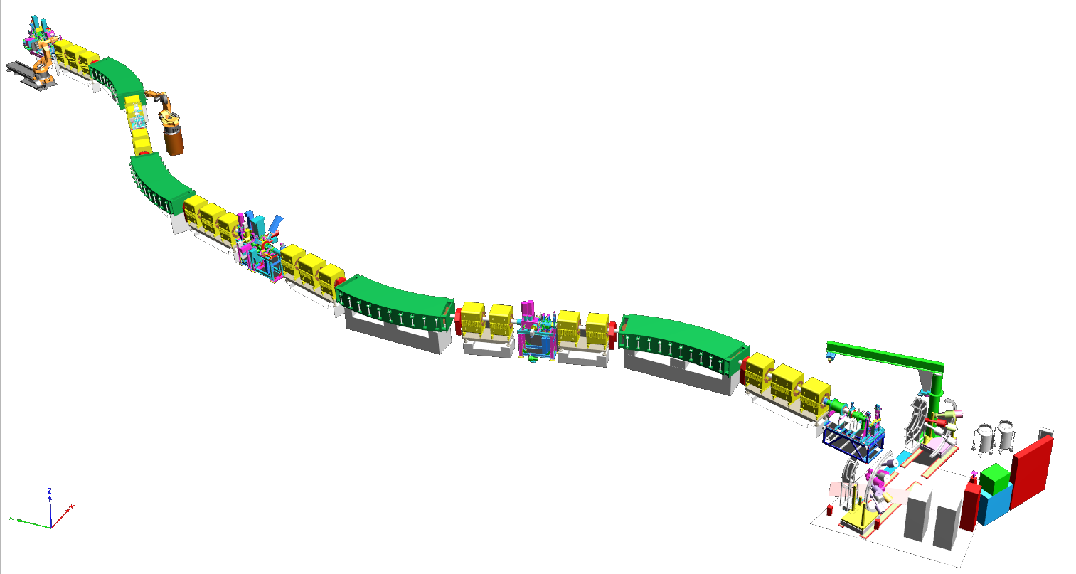
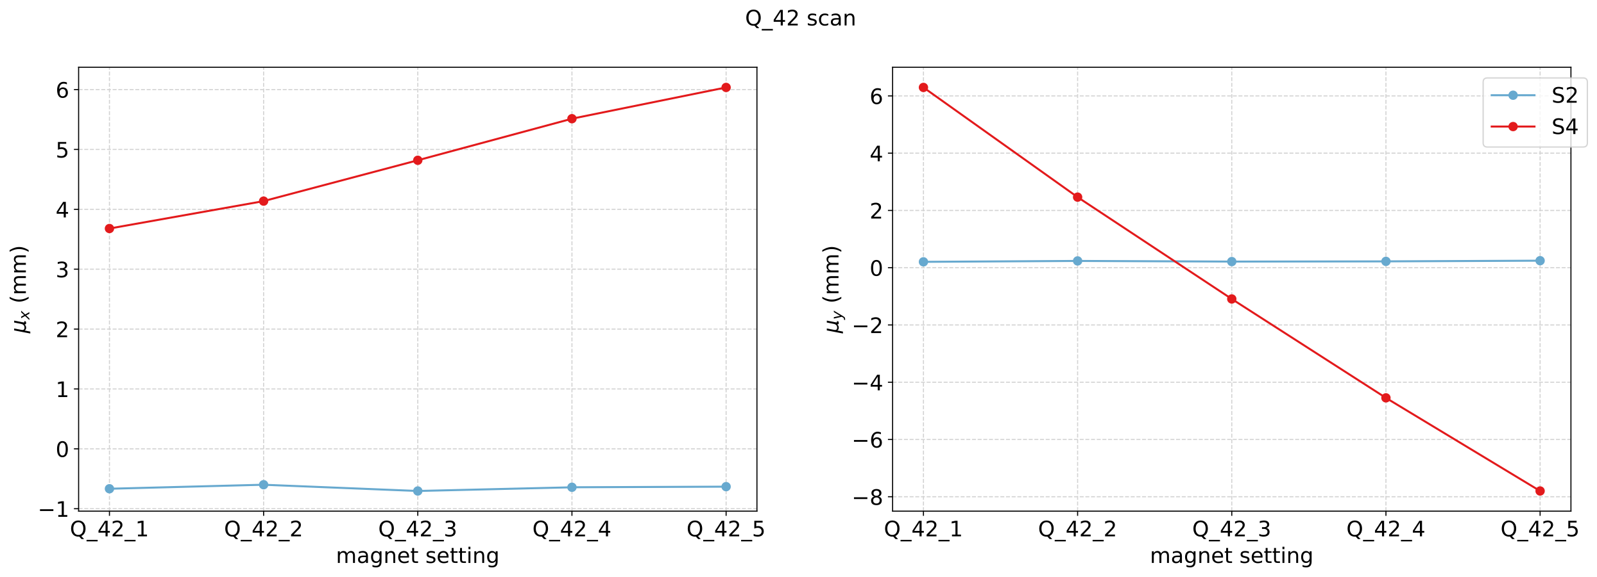
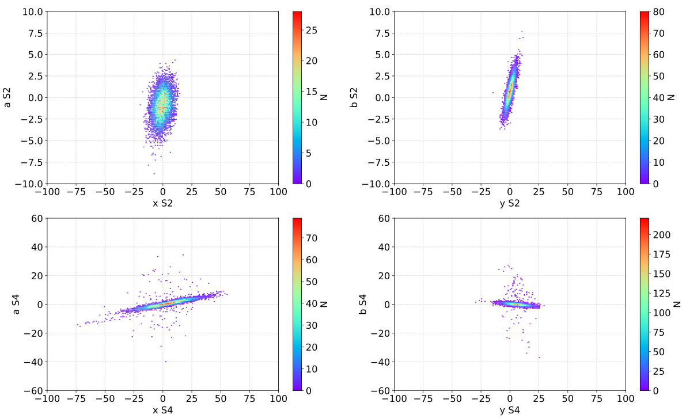
FRS Misalignments measurements
Goal: deduce quadrupole misalignments by quadrupole scan
Procedure: turn off as many magnets as possible, turn on quadrupoles one by one, vary K1L, measure phase space at S2 and S4 to reconstruct misalignments
pjlsa was used to set up magnets automatically
Result evaluation is in progress (PhD student Z. Brencic)
S3
S2
Q32
Q42
D3
Q31
D4
S4
Q41
Q43

Slide 9
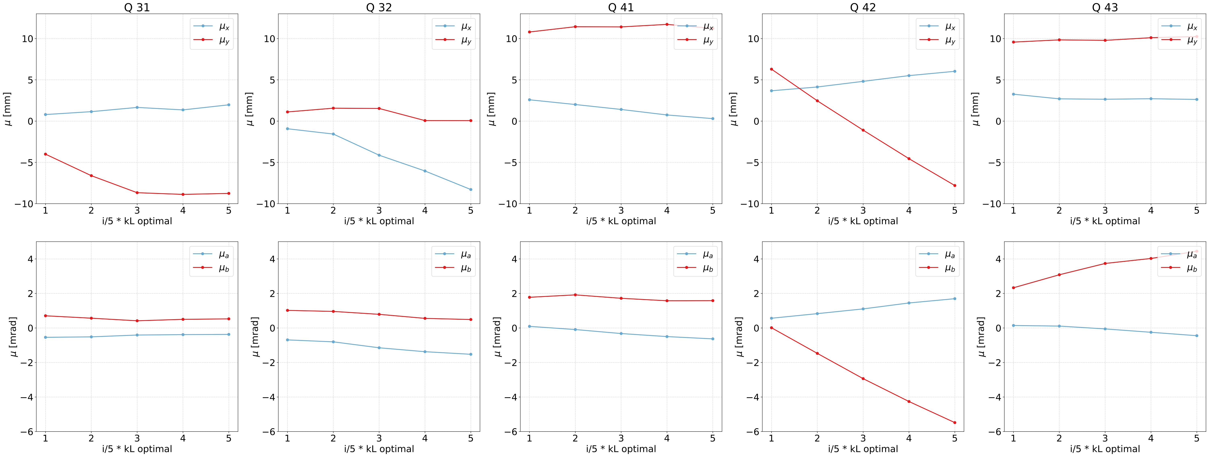
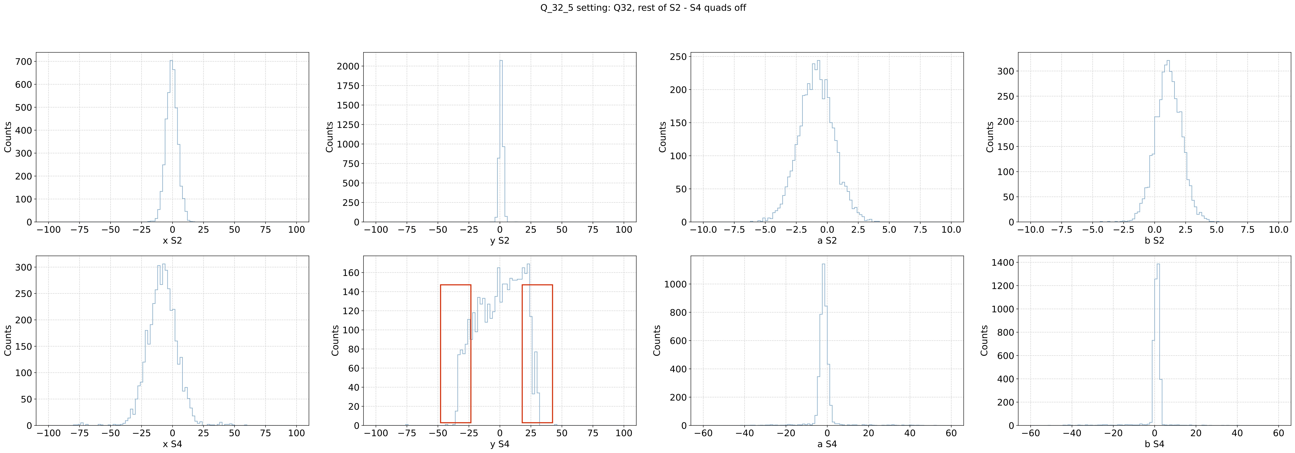
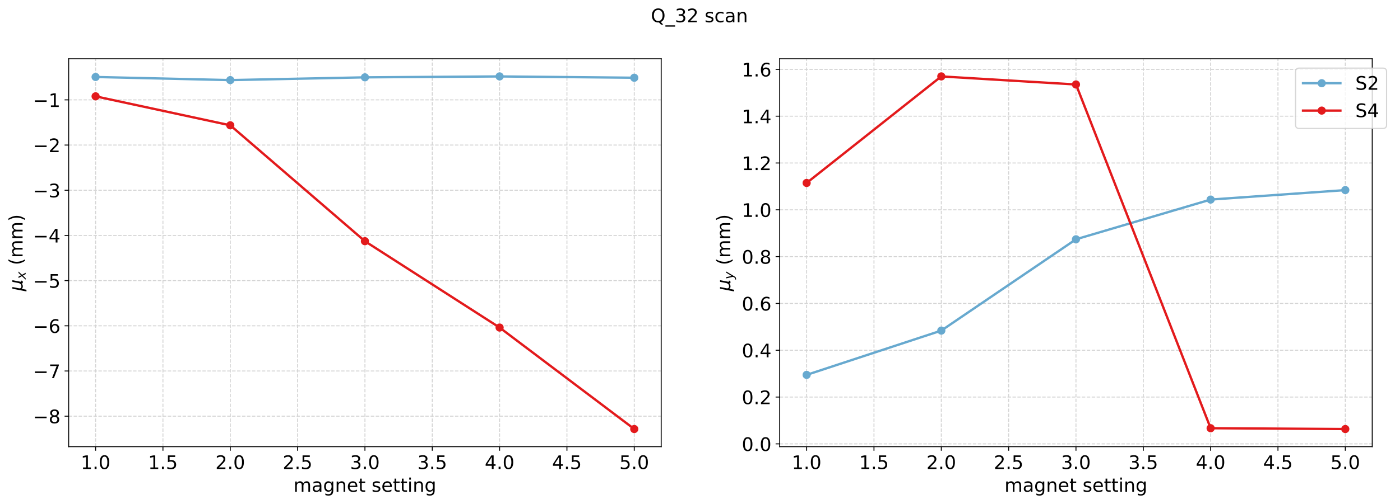
FRS Misalignment measurements
Trigger at S4 sci led to cutting part of beam → need more thorough analysis to reconstruct misalignments of Q31 and Q32
2 approaches to test:
  evaluate only mean beam position/angle changes
  single particle dynamics

