Slide 1
Automation of GSI key beam manipulations with AI methods
Sabrina Appel (APH)
(Team: APH, Super-FRS, CERN, TUDa, PLUS Salzburg)

Slide 2

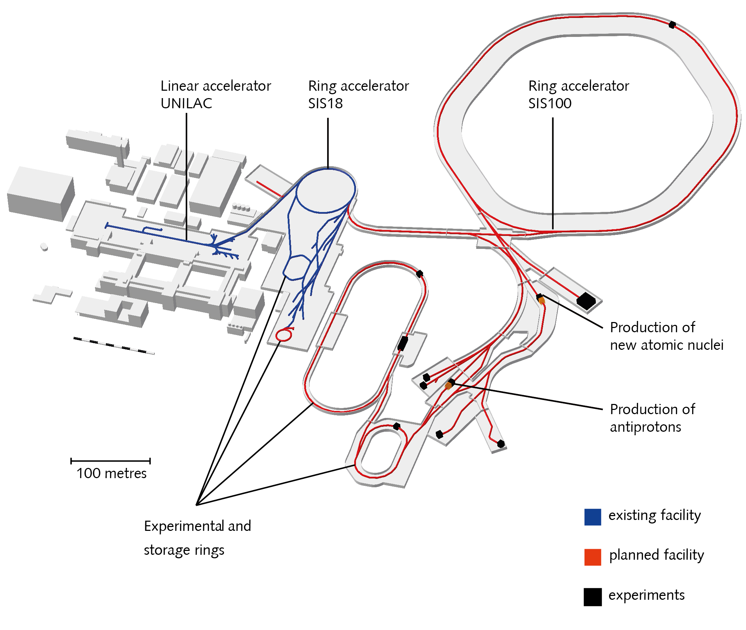
FAIR/GSI
Goal: Tools for automating key beam manipulations to support control room operators.
Automation and optimization with Python:
Beam steering and focusing (TK, X2)
Multi-turn injection loss minimization (SIS18)
Closed-orbit correction for non-standard optics (SIS18)
Slow extraction loss minimization (SIS18)
Beam steering and focusing (FRS/S-FRS)
Methods of interests of automation:
Numerical + Bayesian optimization (BO)
Physics-information or Multi-Fidelity BO
Multi-Objective optimization with BO
Data-driven model predictive control (MPC) and reinforcement learning (RL)
EURO-LABS finances scientific staff member + 2 staff member from APH
Several TUDa Master and PhD students (with TUDa funding)
One Master student from Paris Lodron Universität Salzburg
Collaboration with CCPS, TUDa and CERN
S. Appel - APH
2
Notes:
Methods of interests of automation:
Numerical + Bayesian optimization (BO)
Uses only measurements; needs sufficient iterations
Physics-information or Multi-Fidelity BO
Combines data and simulation; fewer iterations
Multi-Objective optimization with BO
Optimizes competing goals; explores trade-offs
Data-driven model predictive control (MPC) and reinforcement learning (RL)
Learns control via interaction; model-based variants reduce data needs
Efficient at runtime after learning system behavior

Slide 3
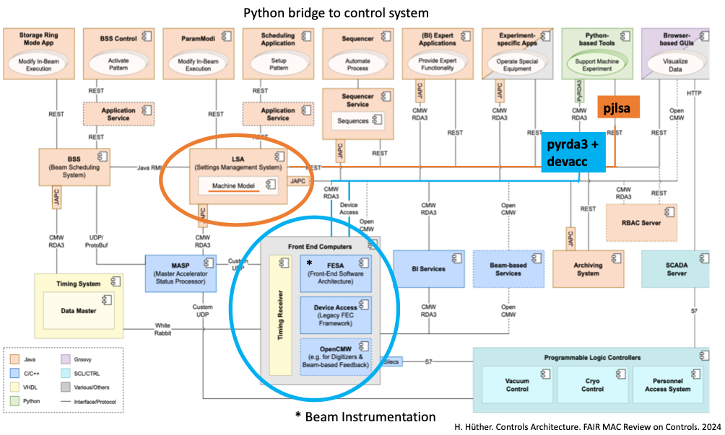
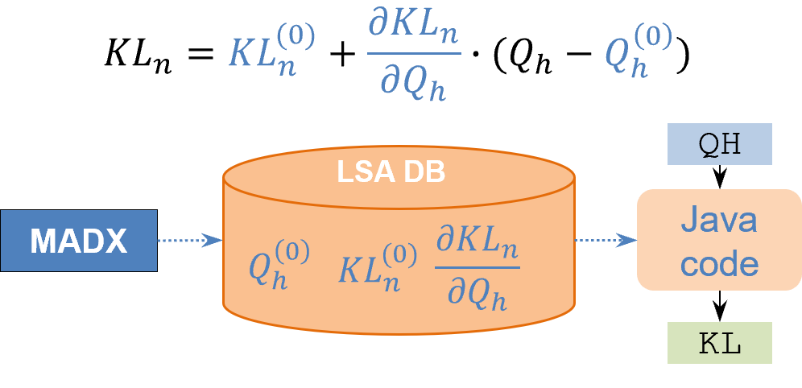
GSI: Python Bridge
One key ingredient: Python bridge to GSI Control System (software and hardware)
¹https://wiki.gsi.de/BEPHY/PythonBridge,
²https://git.gsi.de/scripting-tools/pjlsa_gsipro,
³https://www-acc.gsi.de/wiki/FESA/PythonCmwRda,
⁴https://gitlab.cern.ch/acc-co/devops/python/prototypes/pyda
Ported existing CERN solution to GSI
Python bridge will be maintained by APH (new software engineer, starting today) + “GSI Acc-Py“
pjlsa
pyrda3
LSA
FESA
(BEA)
The Python access to FESA is most meaningfully used for retrieving data from beam diagnostic devices, while changes to settings (e.g., for magnets) should be handled via LSA.
D. Ondreka. MT, 2025
(ACO/SYS)

Slide 4
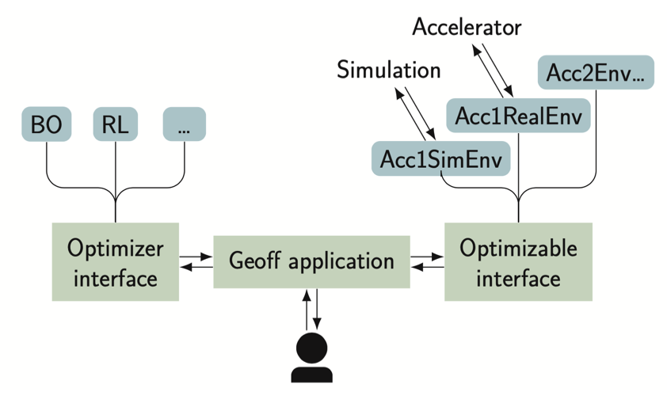
GeOFF at GSI
Additional ingredient: Generic Optimization Frontend & Framework (GeOFF) GeOFF is a widely used framework for deploying automation at CERN
Python-based framework
lists, configures and runs optimization problems
standardized interfaces and adapters for various packages via Common Optimization Interfaces
Optimization problems formulated as environment (classes) (allow optimization of very complex problems)
Class contains logic for live plotting, data logging, and communication with LSA, FESA and the Device Access system
Quick adaptation of code and on-the-fly during shifts: This is made easy due to flexibility of the framework.
GeOFF Development/Distribution/Maintenance (P. Madysa, APH, EU funded)
Madysa, Appel et al. arXiv, 2506.03796
https://doi.org/10.1016/j.softx.2025.102335

Slide 5
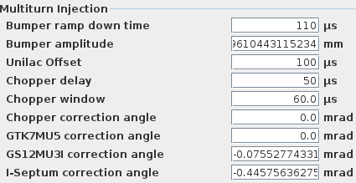
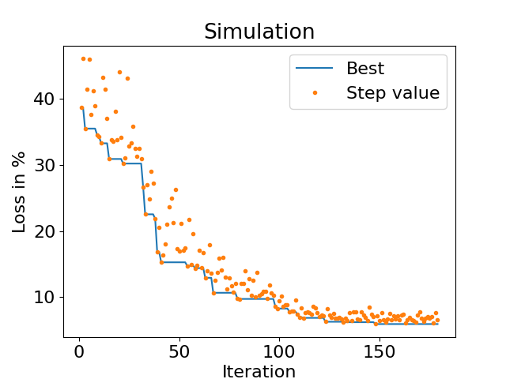
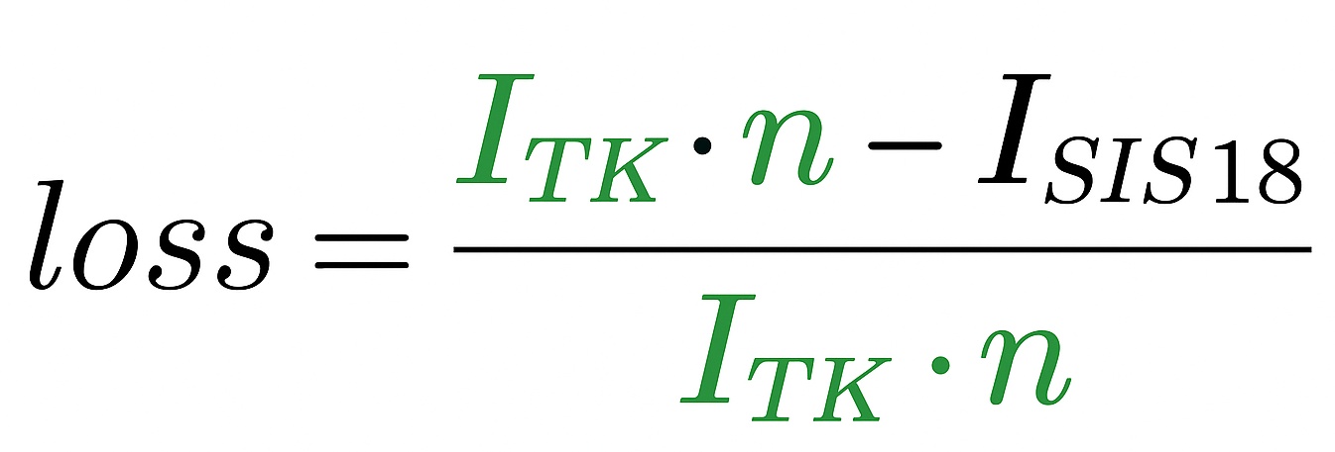
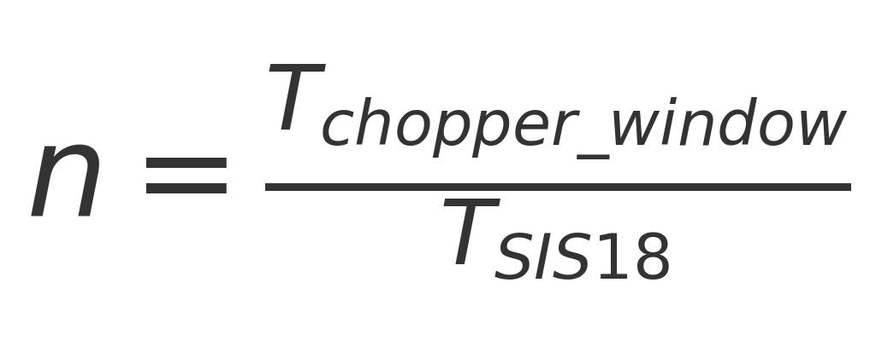
Automation of MIT adjustment and optimization
Usually is MTI optimized manually with varying success
Idea: Automated optimization of MTI
with numerical optimizer (BOBYQA) + ML
by using GeOFF and python bridge
Aim: low loss injection over many turns
Bounds and constraints for parameters can be included
Variables controlled by the numerical optimizer
1
2
3
4
5
+ 4 TK Steers (+ 2 Quads)

Slide 6
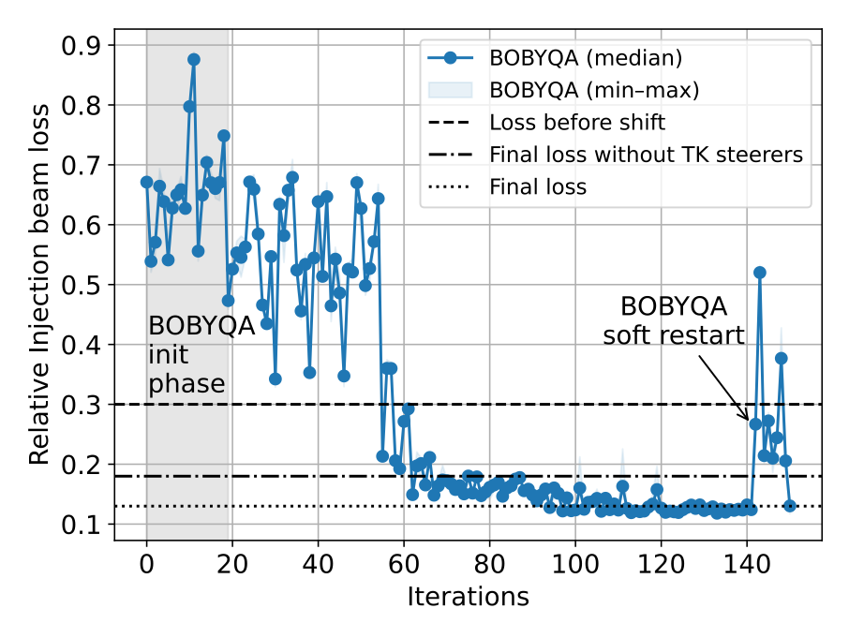
Automation of Multi-Turn Injection
Usually, MTI is optimized manually, with varying success
Using nine optimization parameters.
150 iterations required, which took about 30 minutes. (depending on cycle time, LSA reaction time, and averaging)
1 iteration = median of 3 evaluations (to reduce variance)
gray area = initialization phase of algorithm.
Loss could be reduced from 30 % to 12 %
successful use of numerical optimizer BOBYQA
CON: algorithm's internal model not reusable
(correction of loss calculation to earlier publications)
S. Appel, P. Madysa,

Slide 7
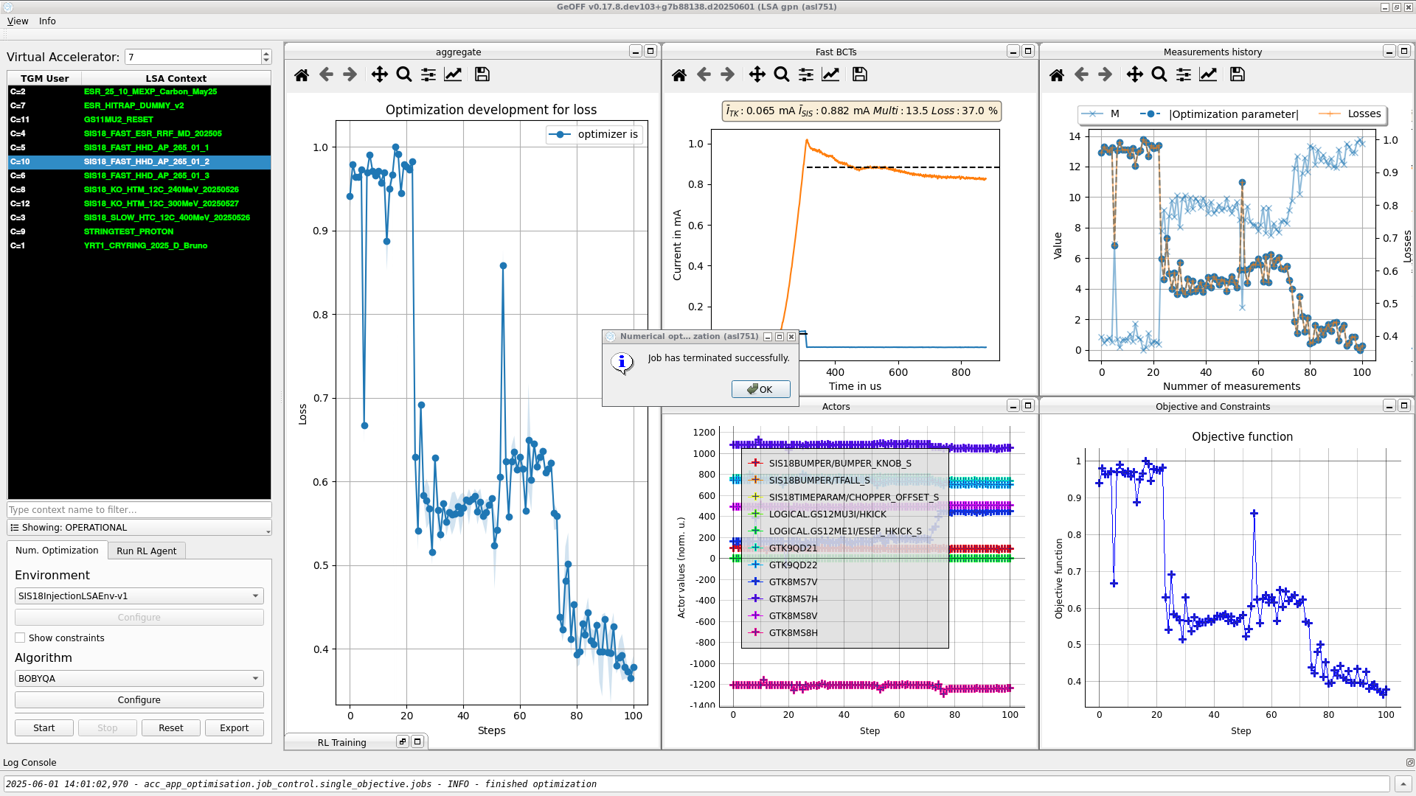
GeOFF GUI at GSI (1. June 2025)
Machine learning and numerical automation via intuitive GUI for operators
GUI – Easy to Use
Optimization context fully described by environment
Custom live plotting
Tested multiple options for usability
Workflow
Select:
LSA context
Problem environment (e.g., SIS injection)
Algorithm
Configure if needed
Start/Stop optimization
P. Madysa , L. Dingeldein, S. Appel

Slide 8
Bayesian optimization: Simulation results
various BO kernels and acquisition functions studied
combine multiple answers to make BO more general
Hedging algorithm prefers most exploitative answer
Comparison of different acquisition functions
S. Appel, P. Madysa, C. Reinwald

Slide 9
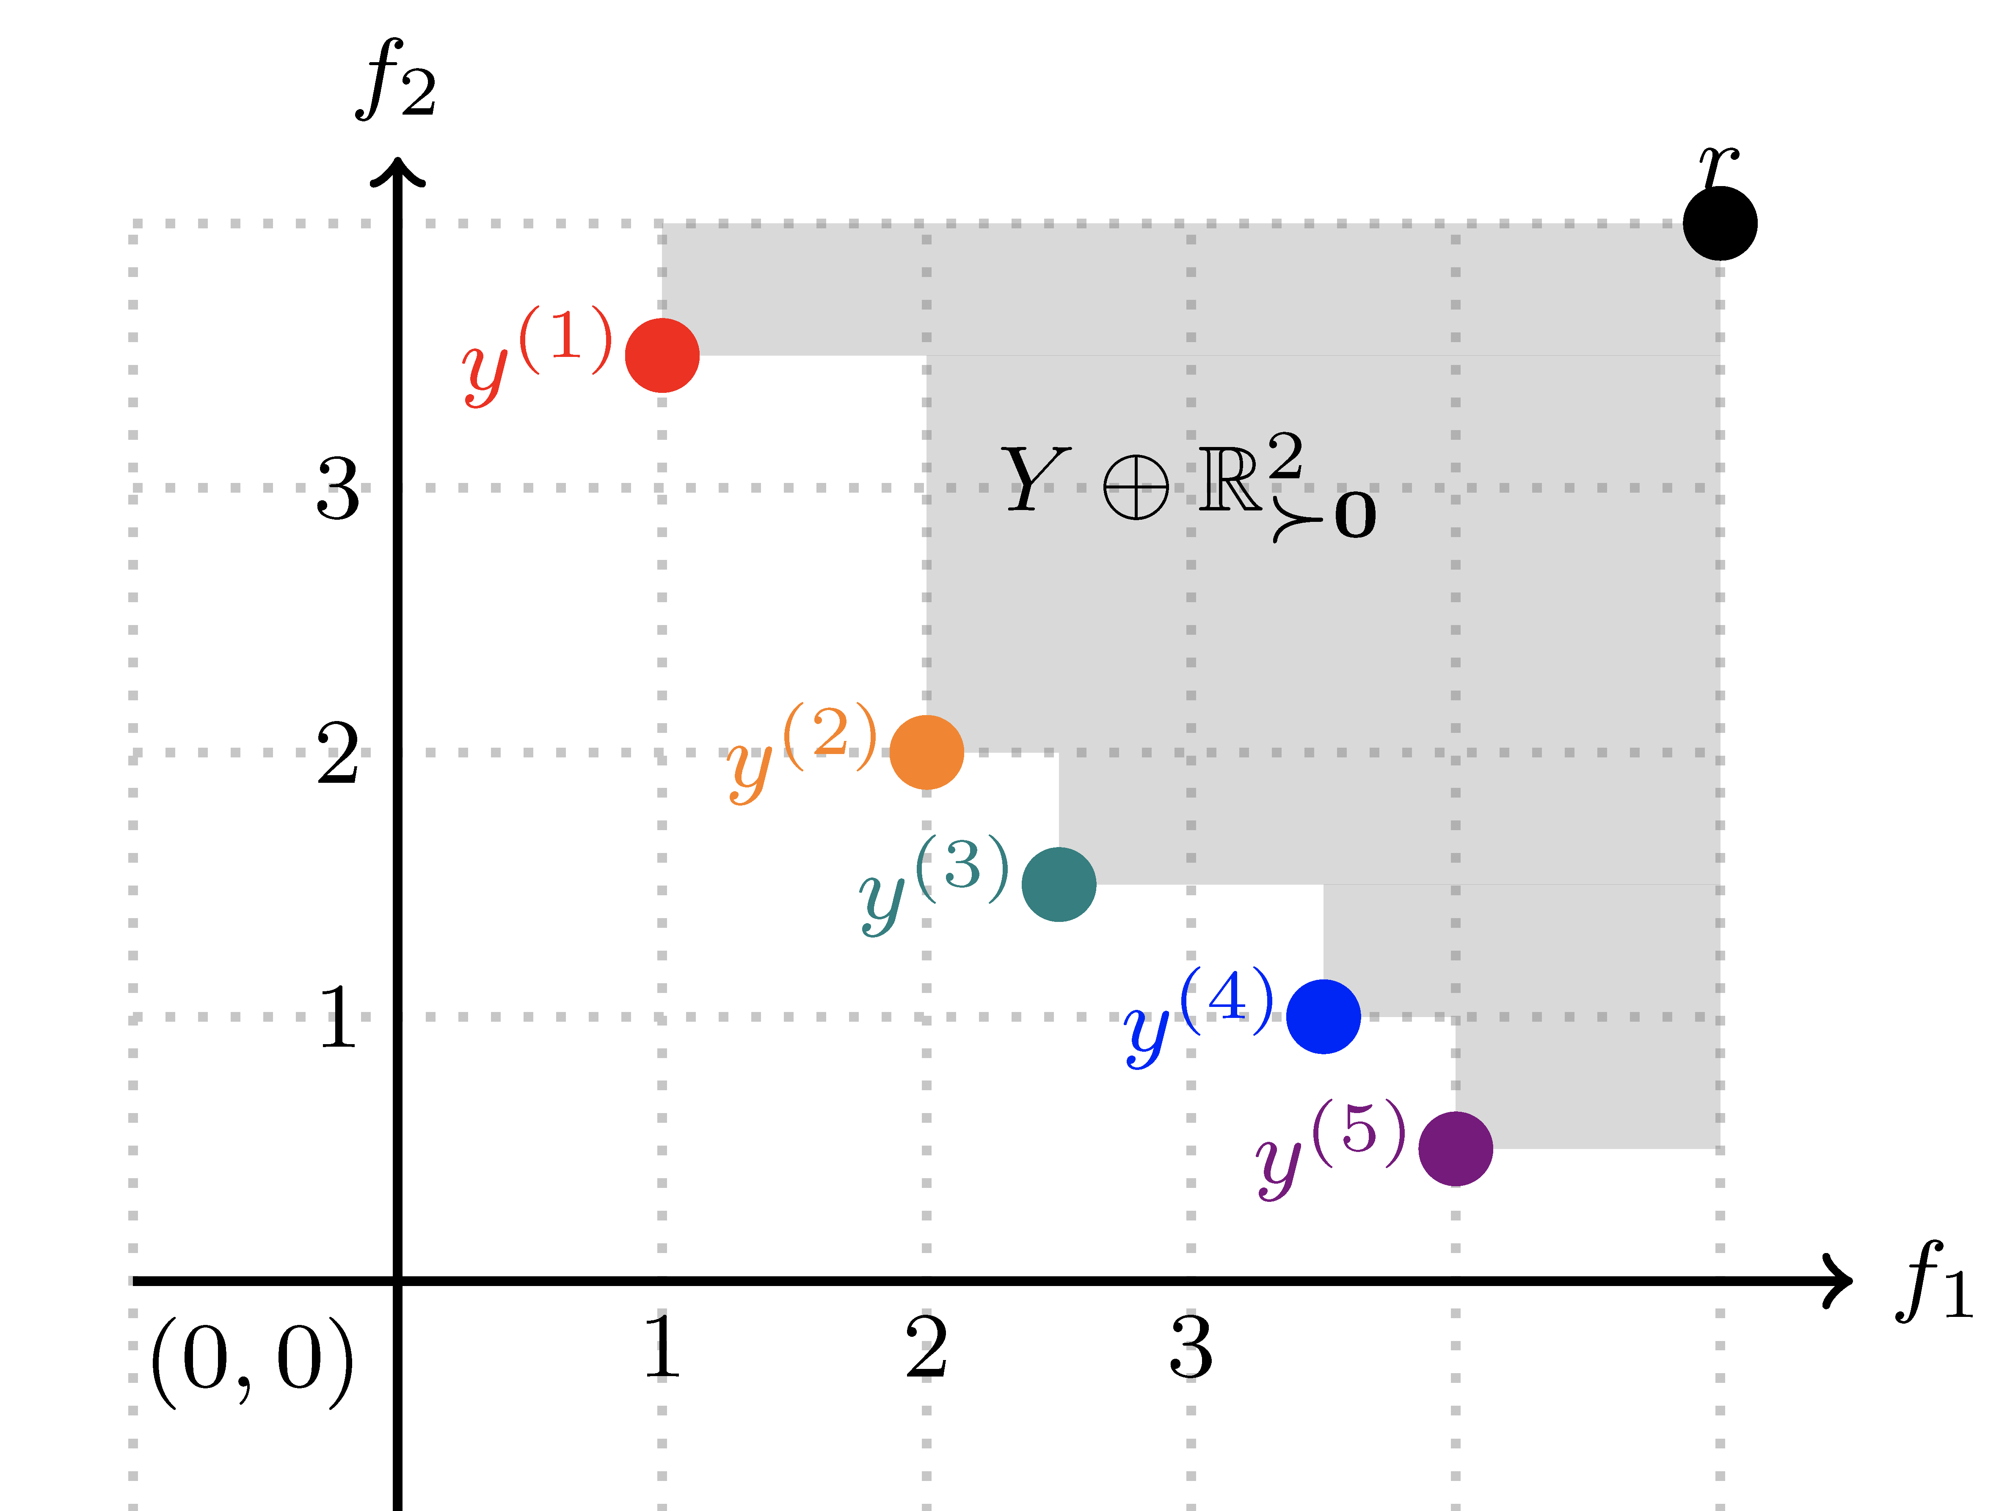
Multi Objective Bayesian Optimization
https://ax.dev/tutorials/multiobjective_optimization.html
Competing goals: maximize number of injections, minimize loss
dependence of gain factor on loss
BO with hypervolume-based optimization drives efficient PA-front improvement
Achieves similar or better results in a fraction of the time of genetic algorithms
Prior art (up to 10 hours):
Simulation with genetic algorithms
Measurements with MOBO
Optimization of injector beam line is missing
S. Appel, P. Madysa

Slide 10

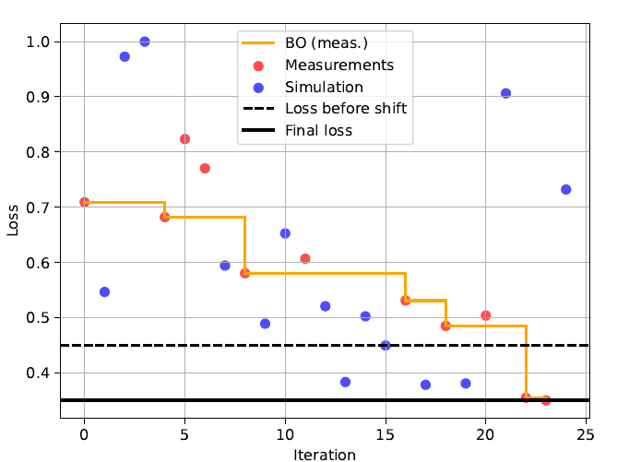
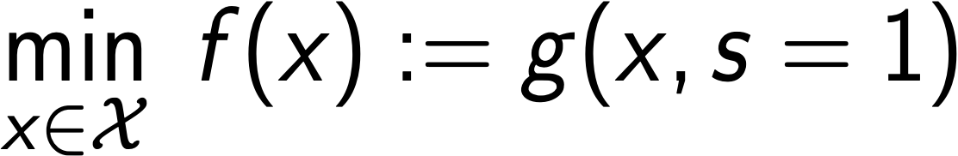
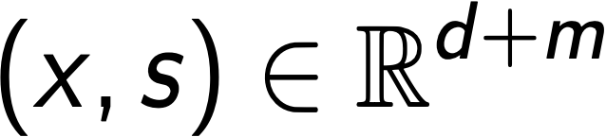
Multi-Fidelity Bayesian Optimization
Towards to a Digital Twin
reduces costly machine interactions
measurements for validating predictions.
useful when machine evaluation is time-consuming
MFBO combines
low-fidelity simulations (fast but approximate, s <1) and
high-fidelity experiments (accurate but expensive, s=1).
to optimize black box functions via BO
Parameters space
Fidelity space
x
s
Method
Optimization problem:
Joint Gaussian Process model over
GP model
Acquisition funciton
s<1
s=1
Simulation
Machine
experiment
S. Appel, P. Madysa, H. Alsmeier, R. Findeisen, S. Hirt, E. Lenz, M. Pfefferkorn

Slide 11
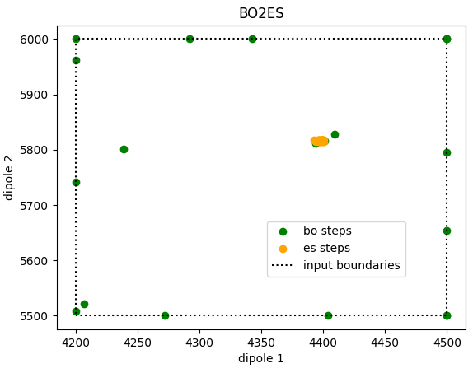
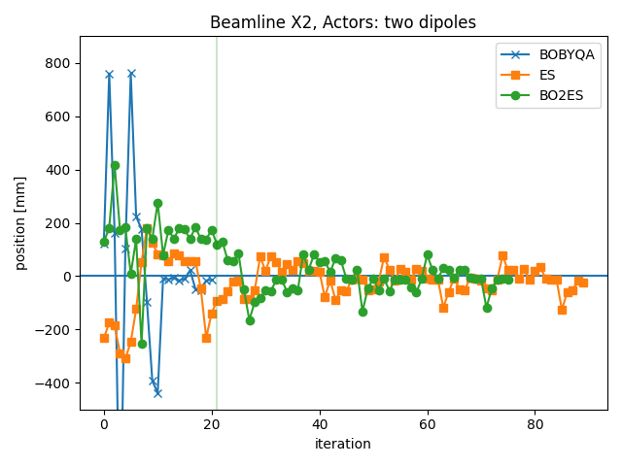
X2 beam line optimization
cooperation with CCPS lab of TU Darmstadt
custom algorithms implemented by domain experts without prior knowledge
here: combination of BO & Extremum Seeking

Slide 12
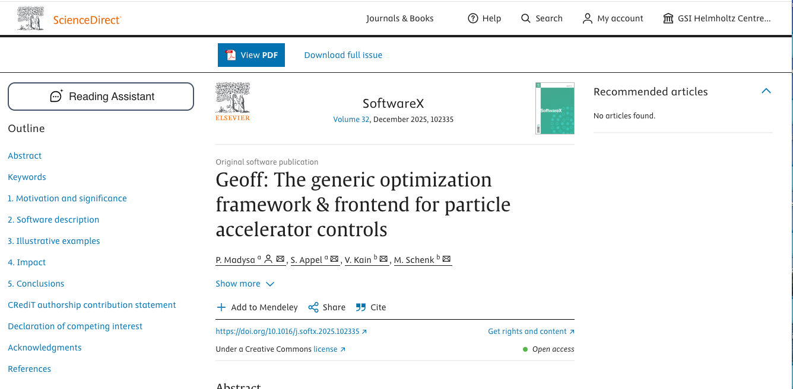
Summary and Outlook
Geoff Development, Project URLs
Geoff enables rapid, automated tuning
Open-source framework for accelerator
Recent paper in SoftwareX
https://gitlab.cern.ch/geoff
https://github.com/geoff-project
https://cernml.docs.cern.ch
Advanced Techniques
SIS18 injection losses reduced 45\% → 15\%
Multi-objective BO
Multi-fidelity BO → Towards to a digital twin
Outlook
Using Geoff for PUMA experiment at CERN (TUDA)
Possible use also at KIT and GANIL (EU)
Super-FRS and SIS100 commissioning methods
Acknowledgements
Supported by EURO-LABS (EU Horizon programme)
Collaboration with CERN, TUDa, PLUS Salzburg

Slide 13

Geoff Paper Published in SoftwareX
https://doi.org/10.1016/j.softx.2025.102335
Team: S. Appel, P. Madysa, V. Kain, M. Schenk

Slide 14
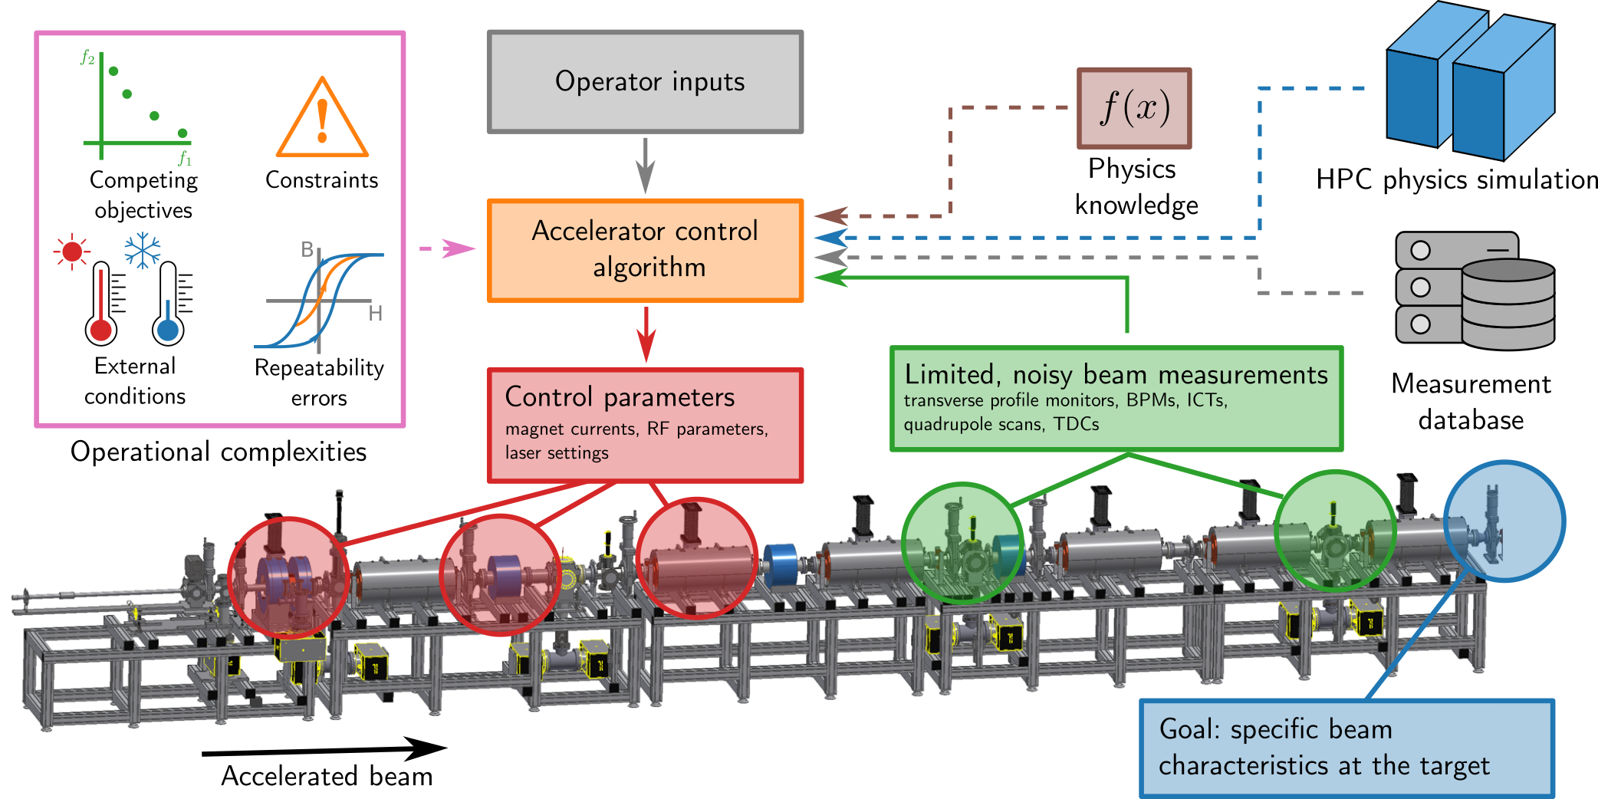
Introduction:
Automation:
Acceleration of manual tuning (which can take days)
→ mathematical optimization → AI
Accelerator optimization:
Performed live on the machine using mathematical optimizers and AI.
Tuning of a large number of parameters with limited online measurements, while incorporating prior knowledge from previous measurements, physical simulations, and domain expertise.
R- Roussel et al., Phys. Rev. Accel. Beams 27, 084801 (2024)
Real time
During cycle
RF control
Milliseconds
Control
Cycle by cycle
Noise control
Seconds/Minutes
Accelerator adjusting
Today: partly manually
SIS18 + FRS adjustment
hours up to days
Accelerator surrogates and ML:
From simple regression models to artificial neural networks
Training from real machine or/and simulation data
Goal: Fast, invertible models for analysis/optimization
1-2 interaction
‘Model-based ML’
on FPGAs
< 100 interaction
‘Model-based ML’
Extremum Seeking
> 1e6 interaction
Evolution/numerical optimization
Challenges: Long setup times, safety constraints, external conditions, and feedback systems.

Slide 15
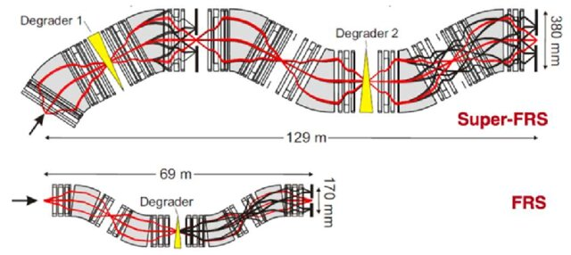
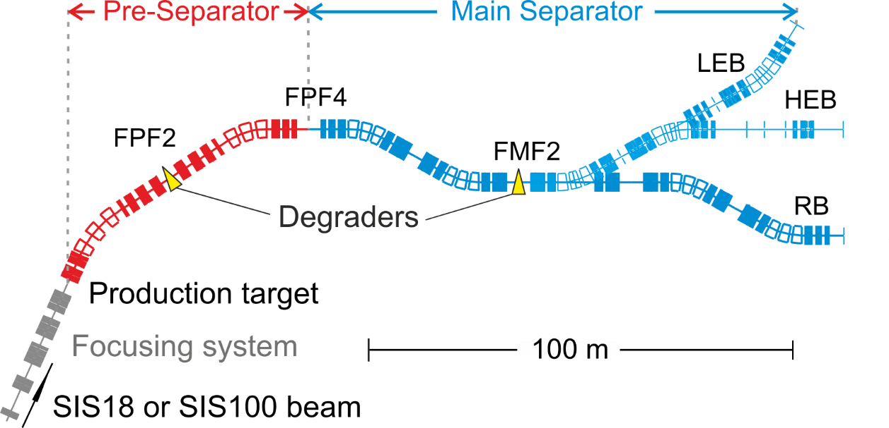
FRS (FRagment Separator) and Super-FRS
Automation of operational tasks essential for Super-FRS
Production and investigation of nuclear structure of exotic nuclei.
characteristics of the high-resolution magnetic spectrometer FRS, exotic nuclei can be produced, separated, identified and eventually stored in a storage ring
Super-FRS increas of acceptance and complexity (about 4 times more magnets), Gain factors of 1000 (¹²C) and 7500 (¹³²Sn) can be reached.
Super-FRS layout:

Slide 16
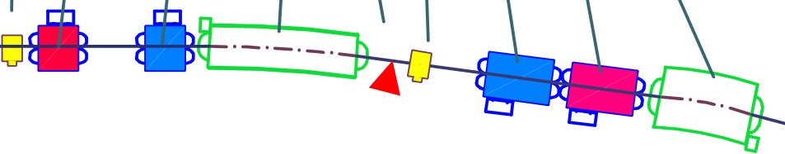
FRS: Automated online steering
As a first step toward a possible full automation, we started with beam steering.
Objective Functions: Offset or distance to the beam target using to two grids in front of the target
steerer
dipol
Ver. Foucs quad
grids
target
Hor. foucs quad
Proof of principle:
All the required systems for automation have been verified.
Online beam steering in 50 iteration and took 18 minutes.

Slide 17
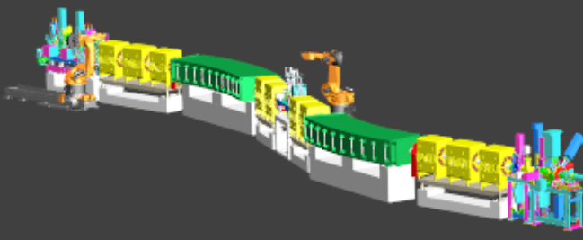
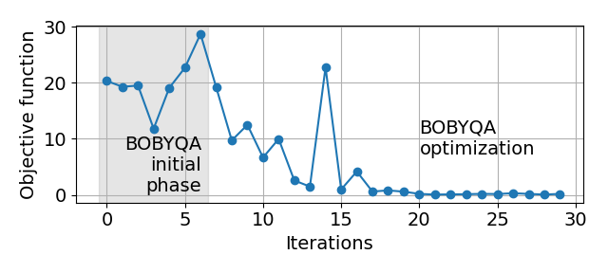
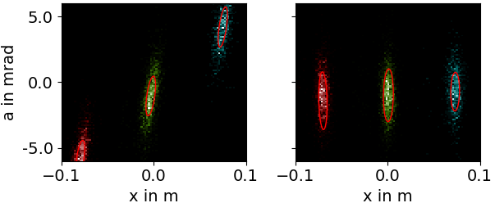
FRS 1st order: tune quadrupoles
Proof of principle at FRS:
Steer beams at the target
Tune quadrupoles to focus the beam (central spot upright)
Numerical optimization (BOBYQA)
TPC Data analysis
with unsupervised clustering
or more sophisticated (inner and outer spots)
Automated measurement of misalignments (method validation for Super-FRS commissioning)
Tune sextupoles to remove focal plane tilt and “banana”-deformation
Schematic illustration of FRS Dispersive Focus area
Change quadrupole strengths
Evaluation of beam spot slope

Slide 18
Optimization of separator optics with primary beam
Individual particle tracking detectors + charge states:
-> Lots of information from x-x’ spectra at dispersive focal plane
TPC Data analysis
2024
Central spot (2024):
x-Twiss parameters
Non-dispersive 1st order x-transfer matrix
Charge states after target (outer spots, 2025):
Dispersive transfer matrix elements of 1st and 2nd order
Goal: Bring the spectra as close as possible to desired 1st order parameters
Using charge states = more deduced optical properties (Difficult for humans to interpret and optimize)
U⁹²⁺
U⁹¹⁺
U⁹⁰⁺
Dispersion
Different distance:
focus tilt
Different heights
Different tilt,
a_center ≠ 0:
Twiss parameters → 1st order transfer matrix
2nd order deformations → sextupole errors
2025
Team: S. Appel, M. Bajzek, E. Kazantseva, P. Madysa, S. Pietri, H. Weick, D. Kallendorf

