Slide 1
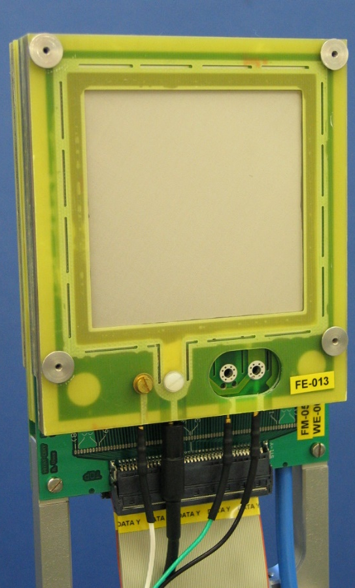
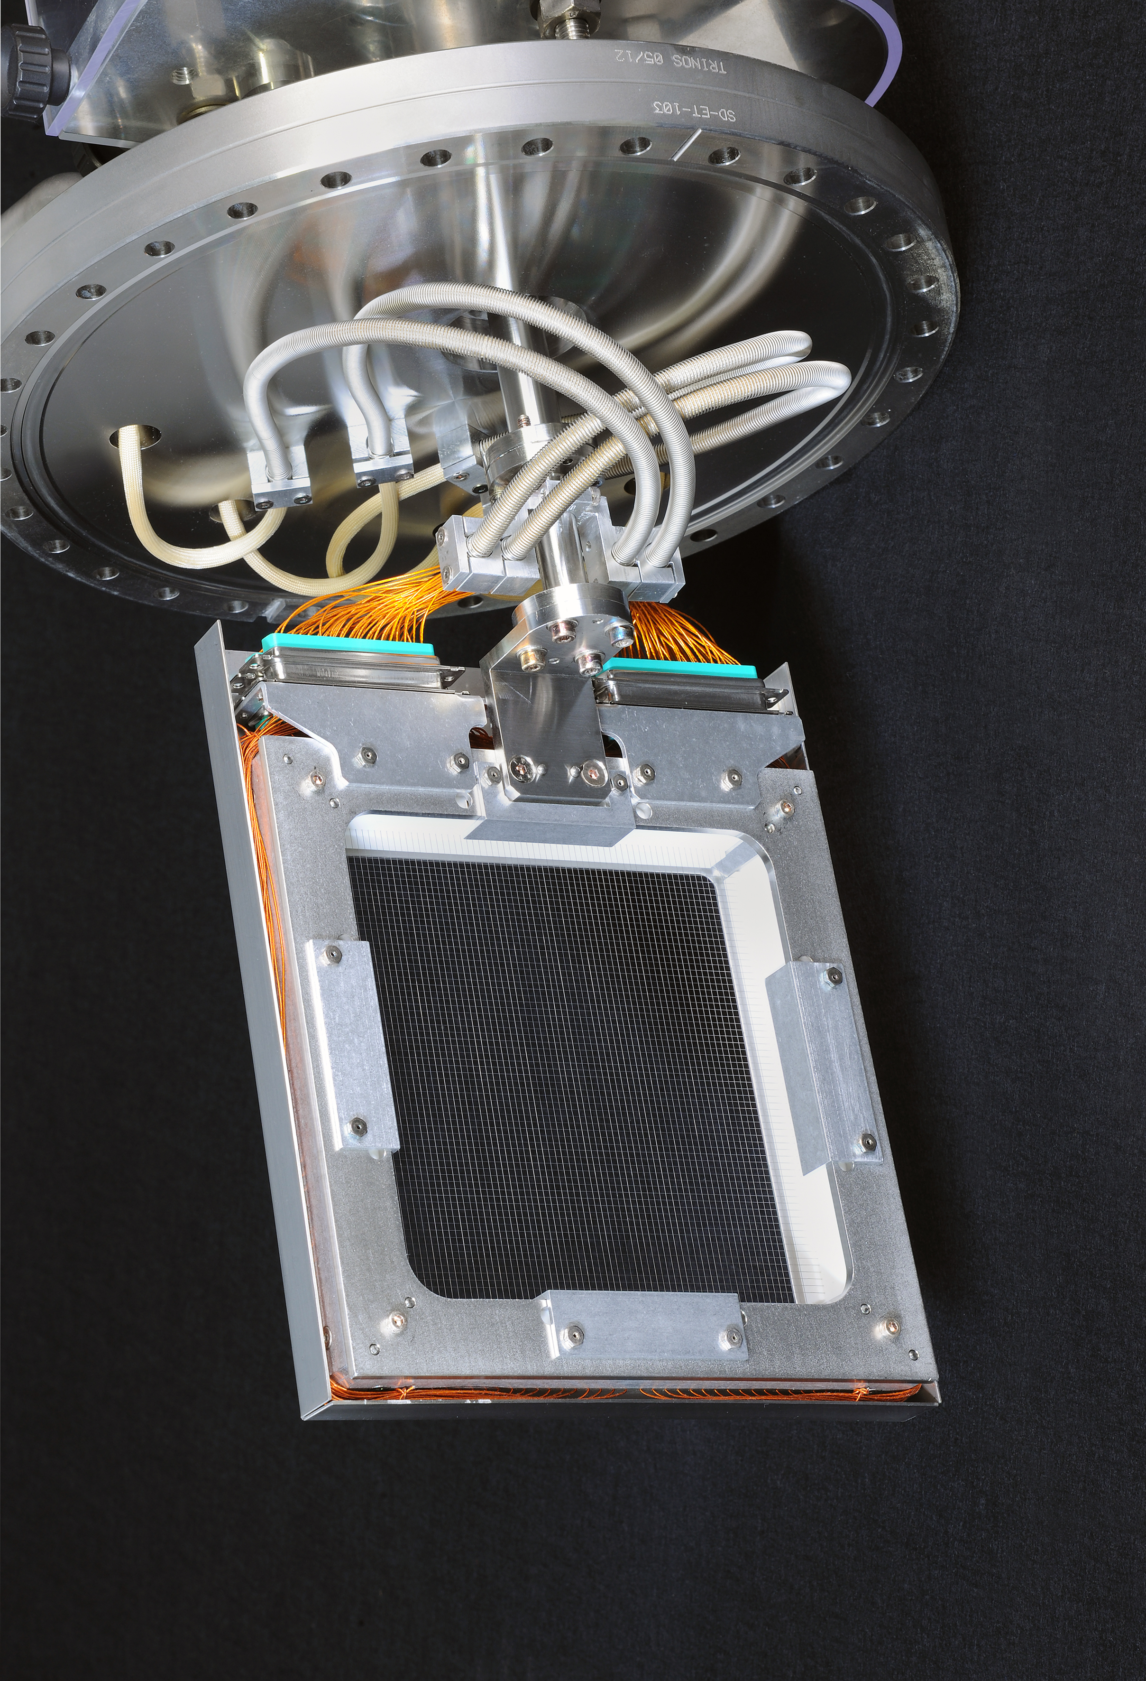
Beam Experiment No. 248: Slow extraction SEM-Grid test
Spokesperson: A. Reiter, S. Löchner, P. Wieczworek
GSI HEST – Machine Experiments 2025
A. Reiter, S. Löchner & EEL Dept.
1st Dec. 2025
Use case:
Beam extraction monitoring
at higher intensities, i.e. intensities where MWPC detectors saturate
Can we measure without
working gas and
use a SEM-grid as signal source?

Slide 2
HTP Setup 2021/2022:
Data Acquisition – MWPC
2 m
~75 m
GHTP
HTP
Atom-Hütte
4x
10 m
2x 64 wires
100 mm active area
Low: 100 µA = 2.50 pC/count
High: 10 µA = 0.25 pC/count
IC
coaxial cable (~80 m)
1x Poland
(optional)
Reference detectors for monitoring
IC: GHTPDI1I
SEM: GHTPDI1S
with 1 kHz readout in Lassie DAQ system
via IFC3 (current-to-frequ. converter)
Quelle: POLAND Aufbau und Verbindungsuebersicht.pdf

Slide 3
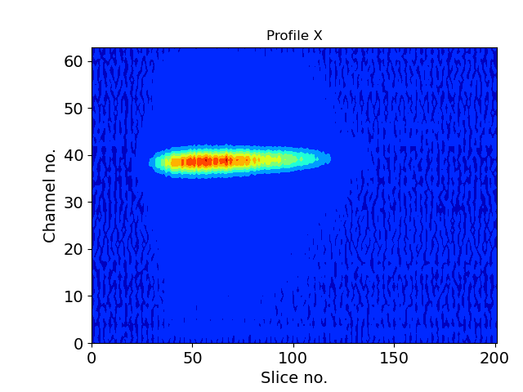
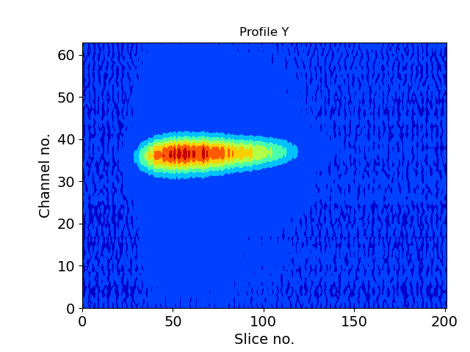
Poland Measurement with MWPC in 2021
Time-Resolved Profiles – Contour Plot
Horizontal profile X
Vertical profile Y
7.5 ms / slice
Typ. measurement range with
existing GSI integrator electronics

Slide 4
HTP Setup 2025:
Data Acquisition – Intermediate setup
2 m
~75 m
GHTP
HTP
Atom-Hütte
SEM-grid
Awags
4x
10 m
AWAGS chip: Amplifier With Adaptive Gain Setting
Publication in Journal of Instrumentation: P. Wieczorek et al., 2022 JINST 17 C06010
MBS DAQ PC
(optional)
Intermediate solution:
Analogue signal transfer between Awags and digitisation in Poland electronics
Final solution:
Direct digitisation of Awags signal with Poland electronics only for communication.

Slide 5
GHTPDG2
Test Measurements 2025
Beam:
  U-238, 200 MeV/u, N = [3e7 , 8e8 ], spill length ~400 ms (with spill feedback)
  U-238, 900 MeV/u, N ~1.2e7
Aim: “Overlap” measurement between data only measured with the pure POLAND readout system or measured with the AWAGS preamplifier in combination with the POLAND system.

Slide 6
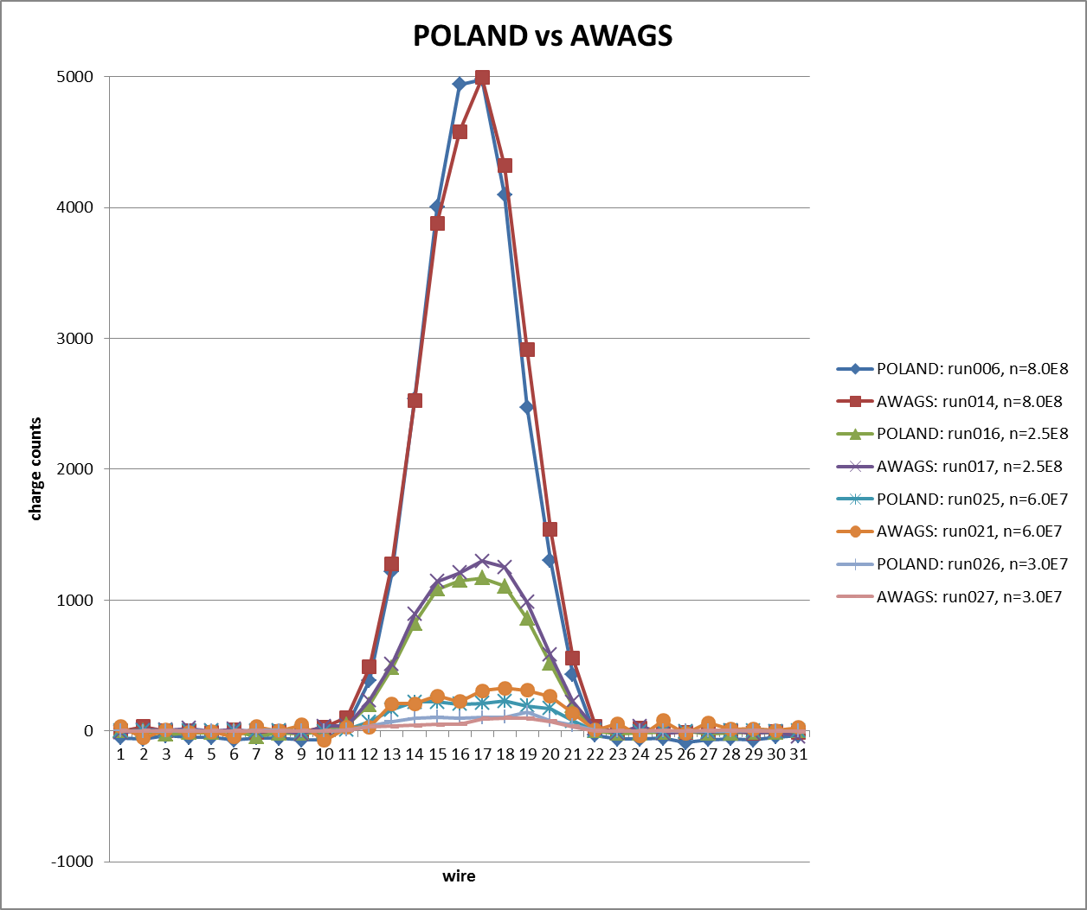
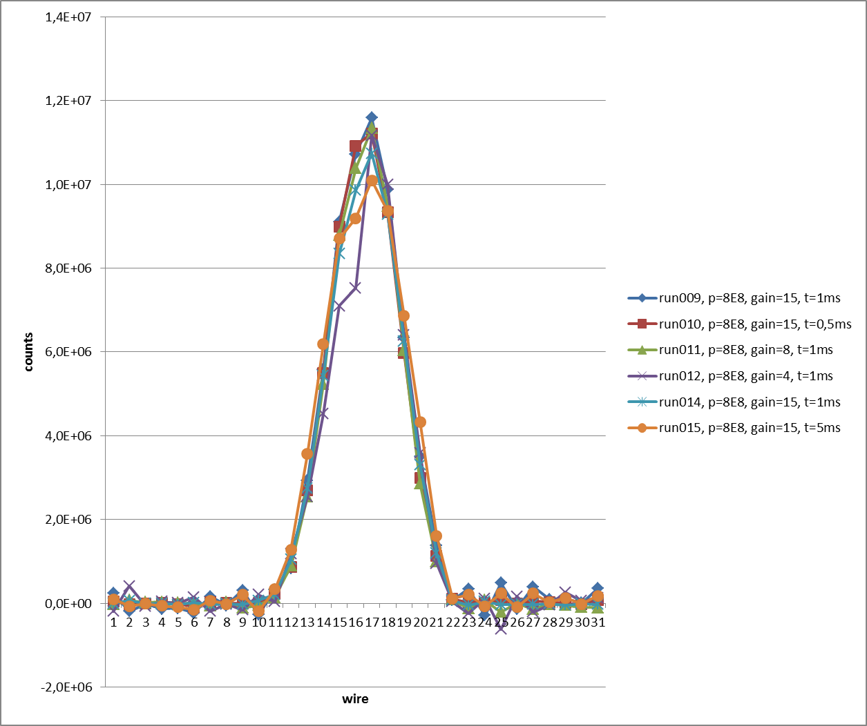
„Result“ 200 MeV/u U-238 beam
Overlap and comparison of Poland & Awags
Absolute value of colleted charge in agreement with theoretical estimate:
  Yield ~ 500 e-/ion, coverage factor ~ 0.1
  N=1E9 => Q = 8 nC
  Profile integral ~ 27.000 counts (250 fC/count) => Q = 6.75 nC
Profile shapes in reasonable comparison
Noise issues required careful subtraction
Profiles for different intensities
N = [3E7 , 8E8]
Gain-normalised profiles@8E8 U-238

Slide 7
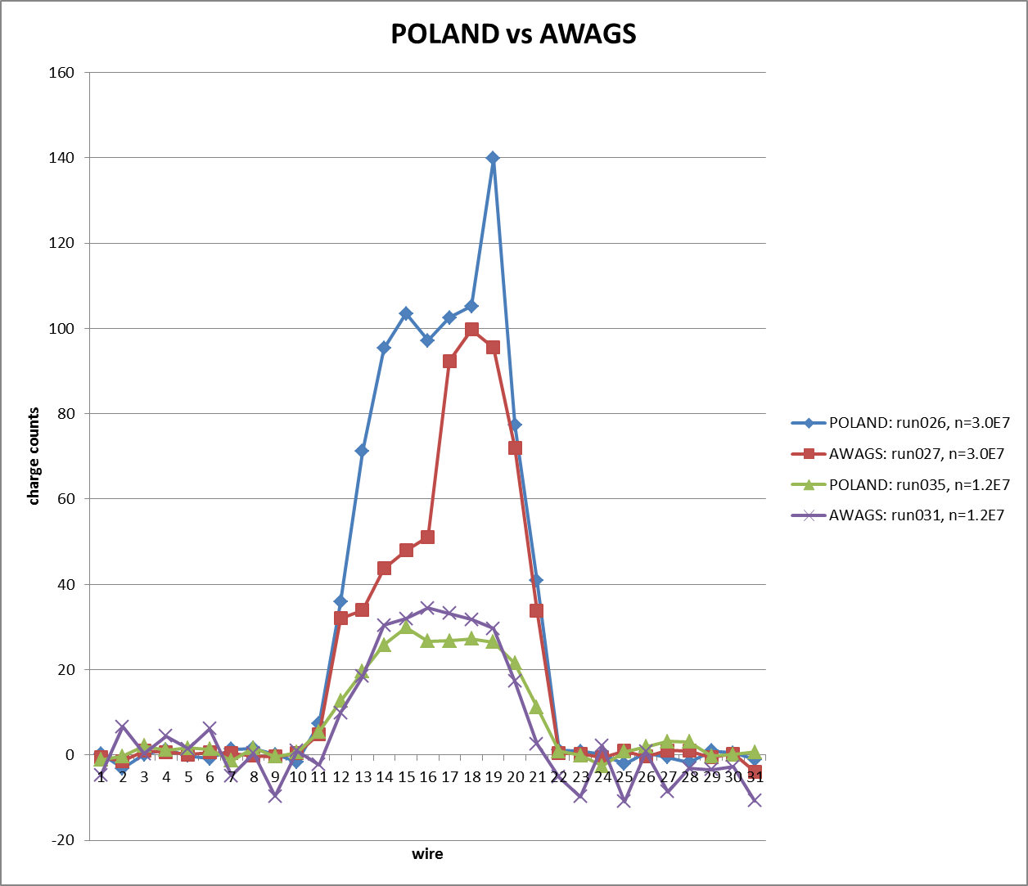
„Result“ 900 MeV/u U-238 beam; N ~ [1 – 3]E7
Overlap and comparison of Poland & Awags
Absolute value of colleted charge in agreement with theoretical estimate:
  Yield ~ 500 e-/ion, coverage factor ~ 0.1
  N=1.2E7 => Q = 80 pC
  Profile integral ~ 240 counts (250 fC/count) => Q = 60 pC
Comparison only partially ok. Some effects in Awags due to long cables.
Need more data and improved analysis.

Slide 8
Summary
Poland/Awags Readout System
Results:
  Awags in „roll mode“ (multiple measurements with fast resets) is suitable for slow extraction measurements
  Low gain operation with longer integration time (1 ms) better than High gain with shorter integration time. Sufficient for slow extraction.
  HTP measurement yields data set that can be scaled to other beam conditions for prediction of signal strength
Next steps:
  Integration of Awags boards as optional modules into existing Poland electronics
  Integration of Awags parameters in FESA class software
  February 2026: dedicated test system for laboratory tests
  Production of hardware for FAIR detectors (HEBT, SIS100, SFRS)

