Slide 1
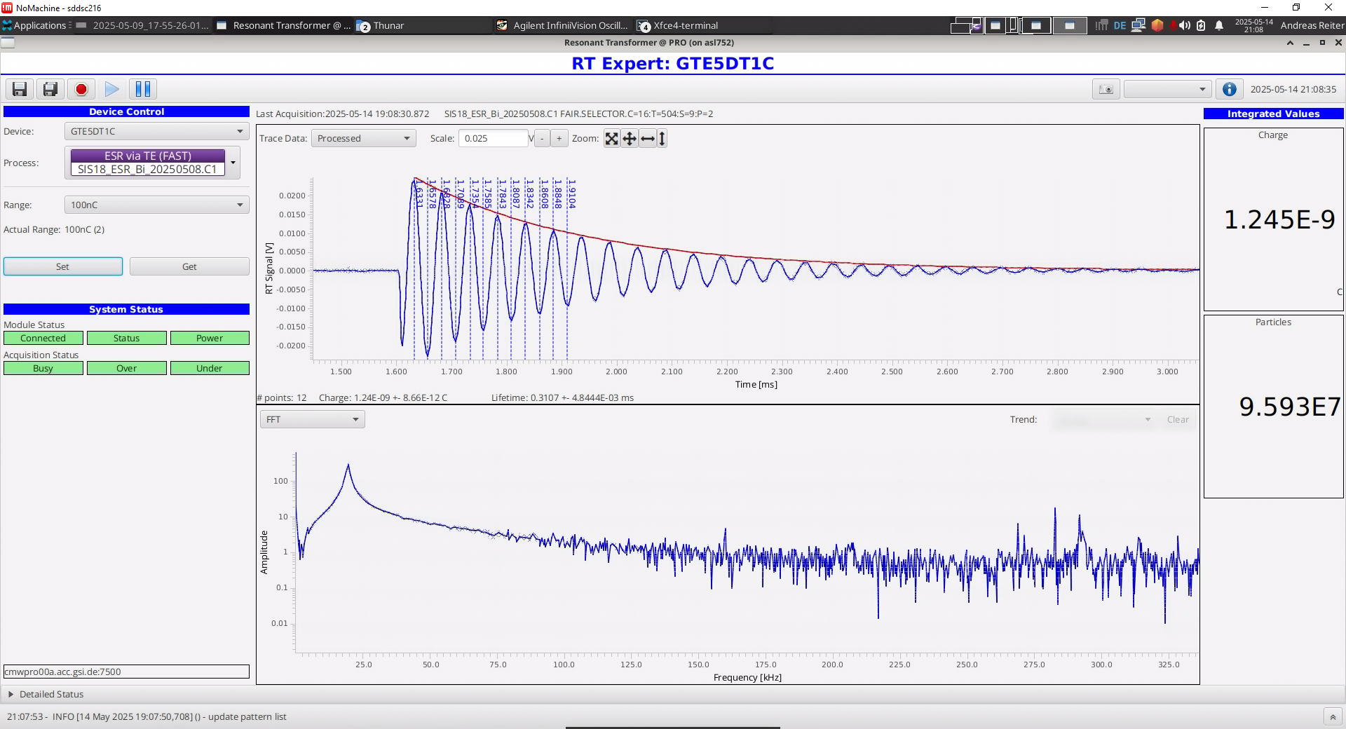
Beam Experiment No. 250: HEBT Resonant Transformer tests
Spokesperson: A. Reiter, M. Witthaus, H. Bräuning
Existing DAQ:
  Old, outdated and unreliable
  Delivers only charge value based on peak detector voltage
  No signal acquisition; unknown data quality
New DAQ system:
  FAIR hardware: new head amplifier; 4 chan-nel connector box; µTCA ADC and CPU
  FAIR software: FESA class
Test detectors:
  GTE5DT1C (ESR injection; GSI RT)
  GHTPDT1C (HTP; new FAIR RT)
Test beam times:
  Parallel to SIS18 – ESR transfer
  Dedicated shift: HTP, 8th July 2025
Results:
  DAQ system including software with stable operation and good signal quality
  Added noise/distortion (10 – 100 kHz) during some experiments due to magnet power supplies, etc.
Detector response to ~1 nc beam charge:
Damped 21 kHz oscillation („resonant“ trafo) of 2 Volt amplitude
Online display of FFT spectrum or trend of charge values for selected beam
oscillation
frequency
Next steps:
  Detailed analysis of data
  Production of hardware for FAIR and GSI detectors (head amplifiers, connector boxes)
  Upgrade of GTE1DT1C, GHHTDT6C, GHHDDT1C in 2026 for FCC operation

Slide 2
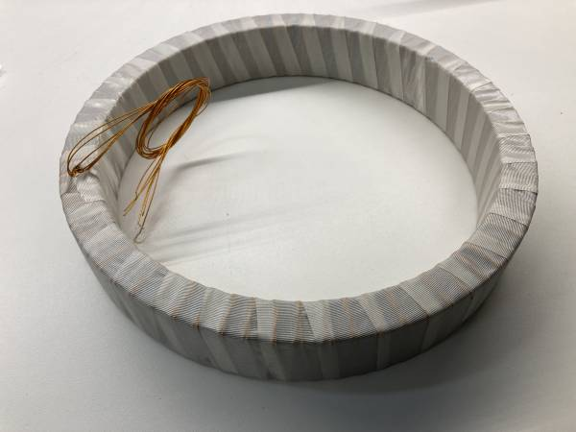
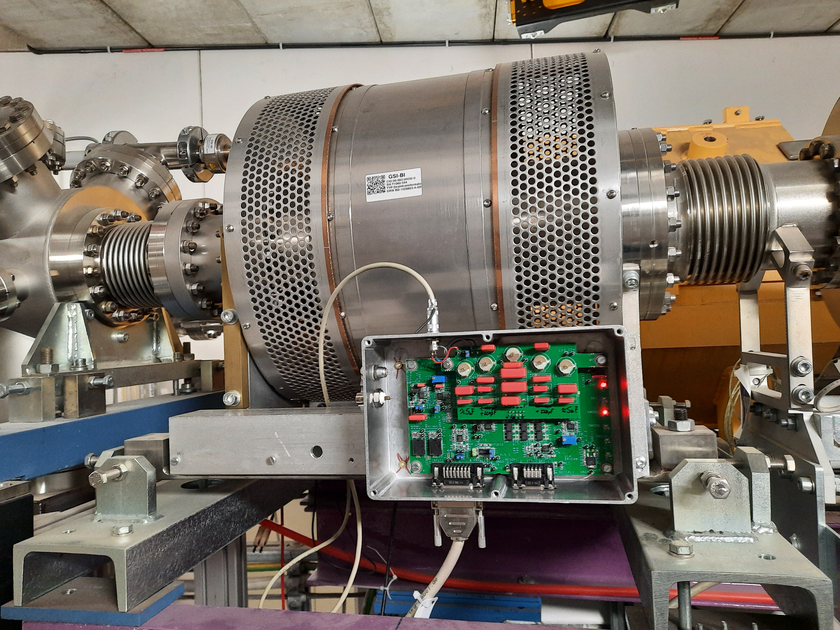
HEBT Resonant Transformer tests in HTP TE5 beam line
GSI HEST – Machine Experiments 2025
A. Reiter, M. Witthaus, H. Bräuning
1st Dec. 2025
Use case:
Beam Transmission Monitoring
  SIS/HEBT injection/extraction efficiency
  HEBT transmission efficiency

Slide 3
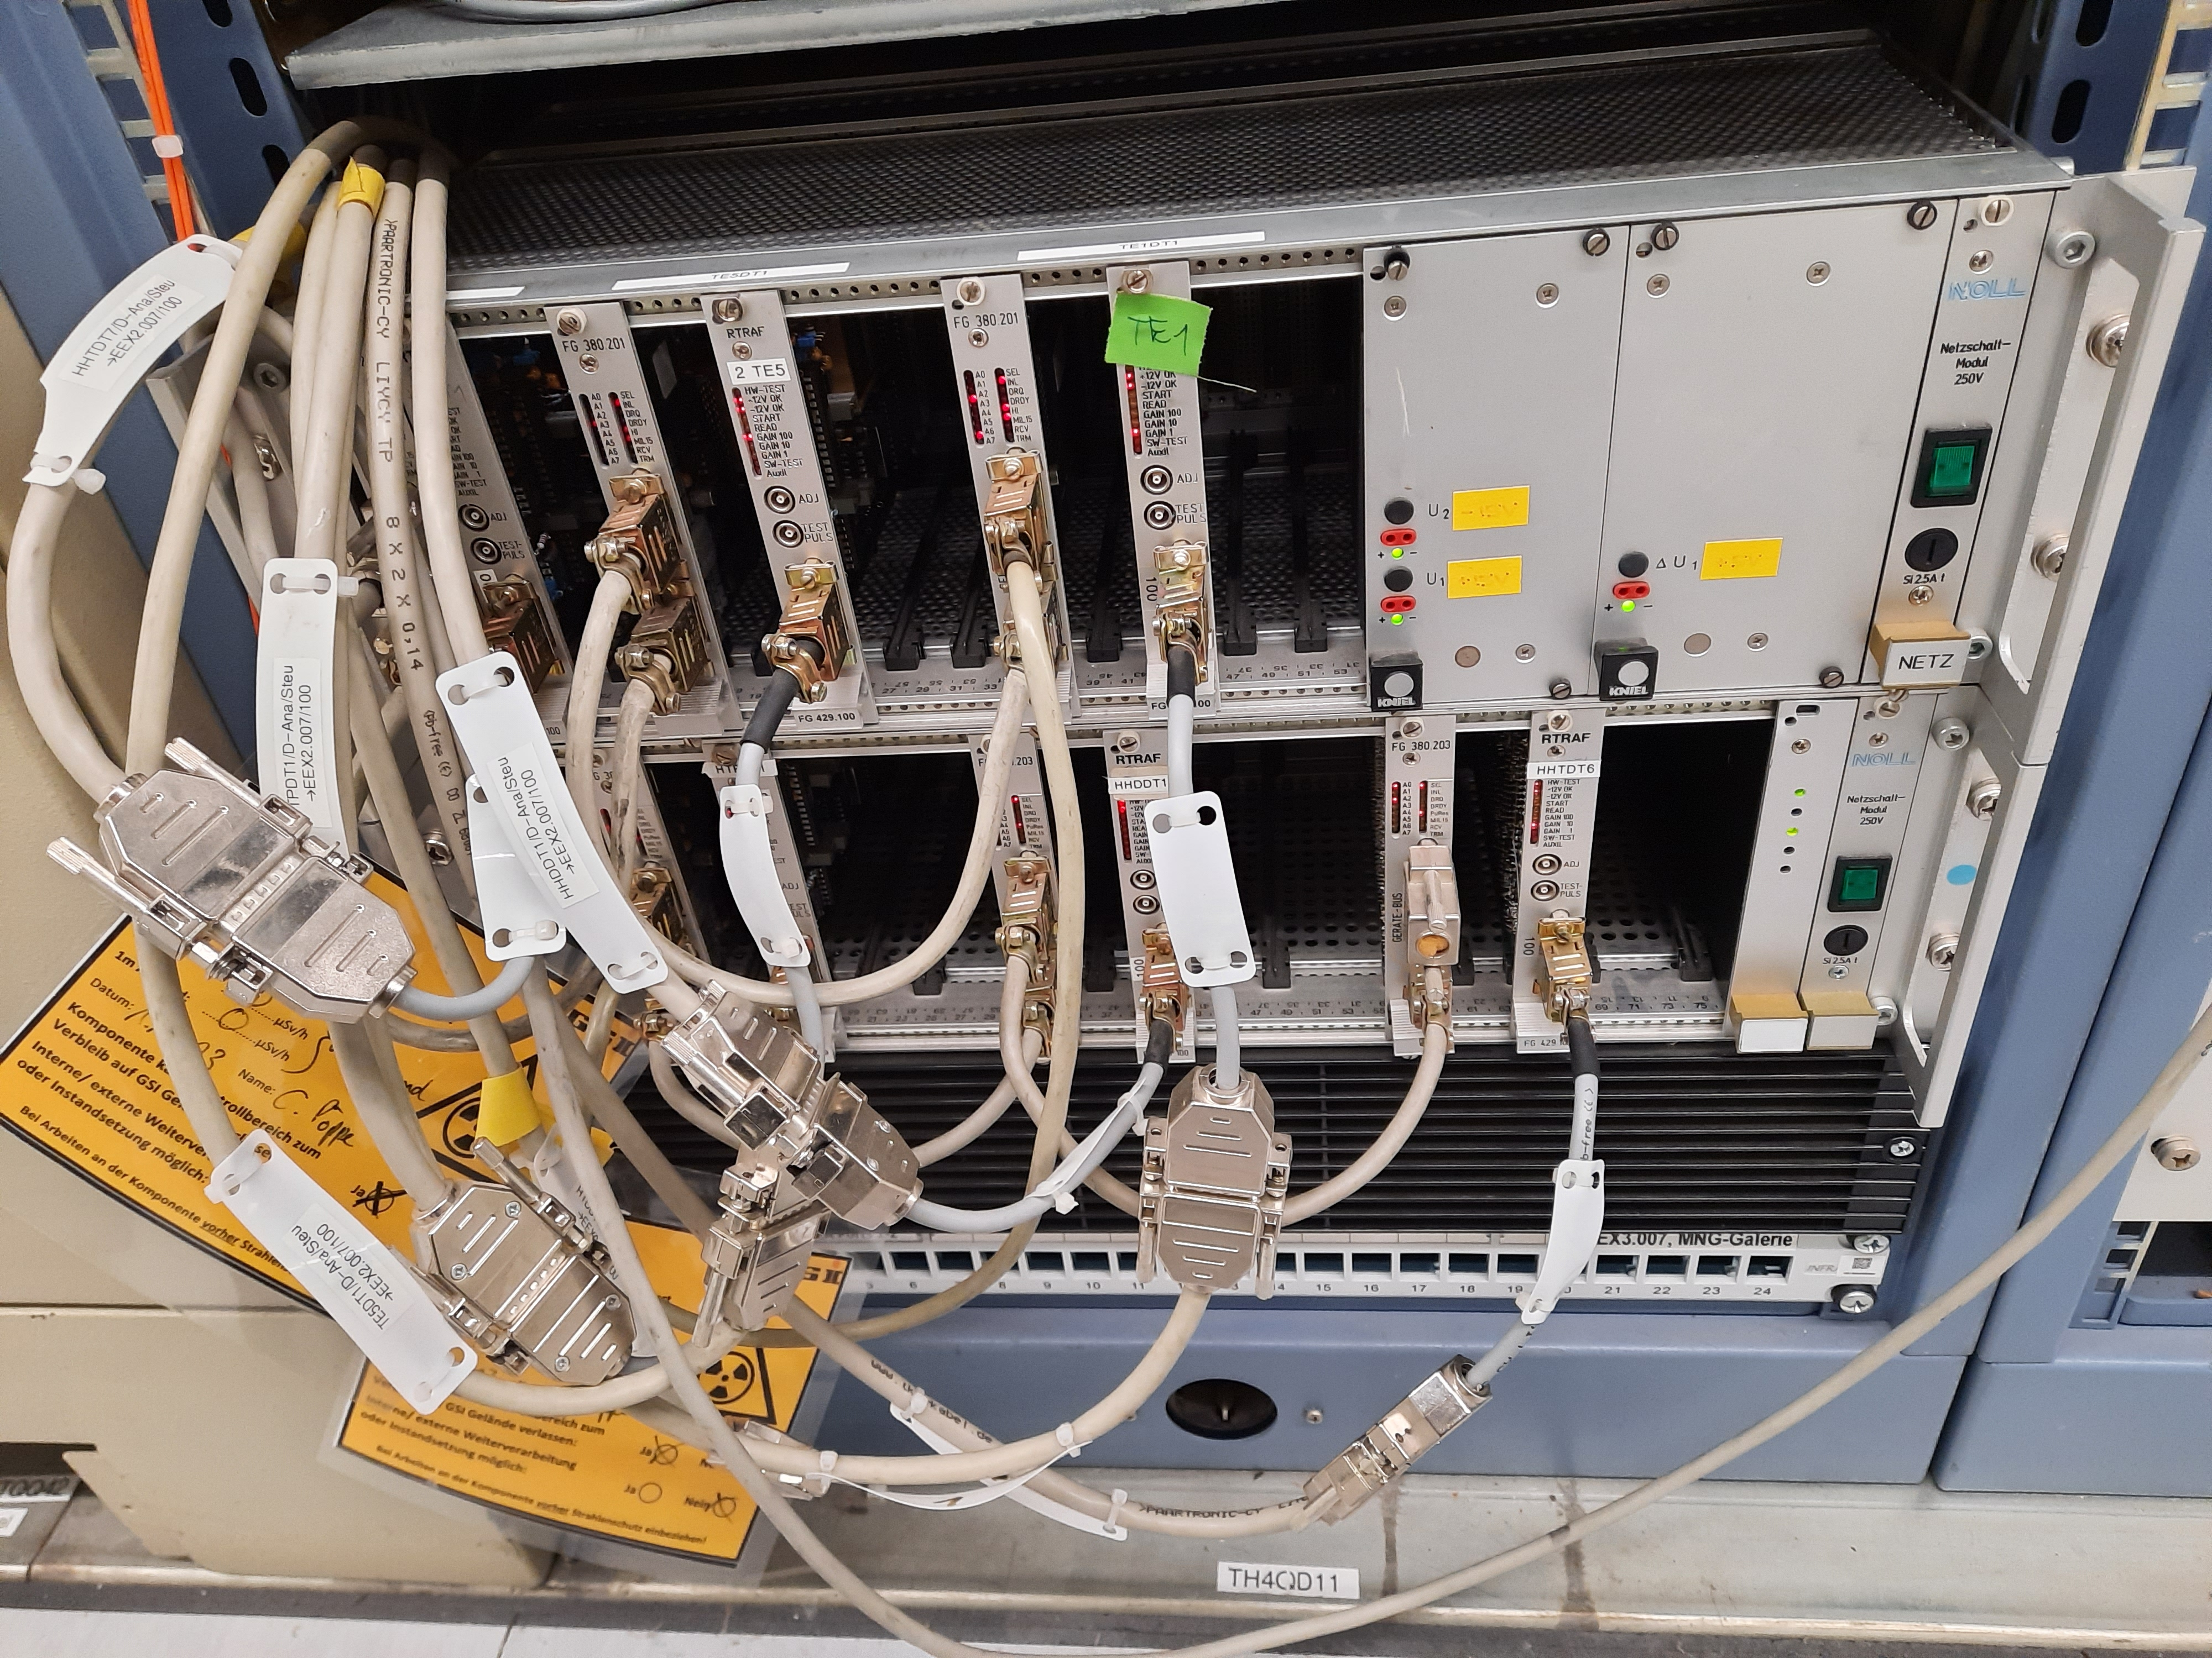
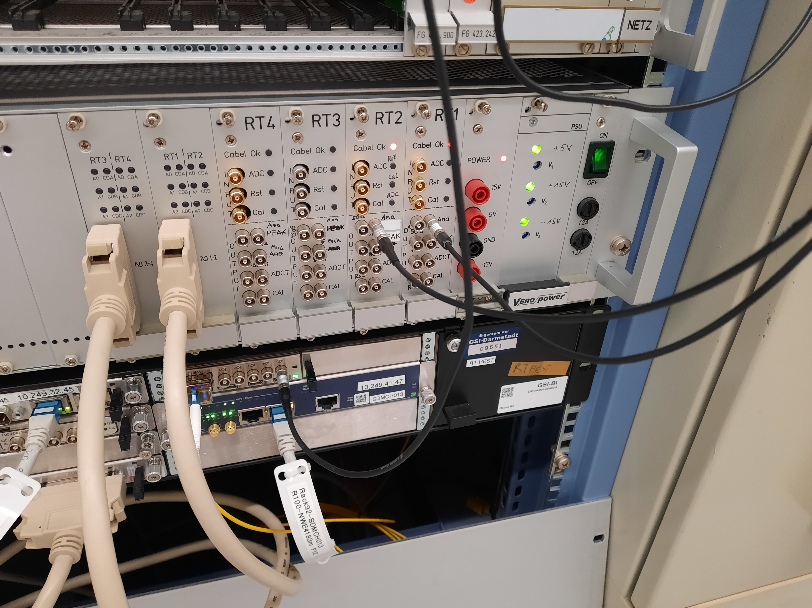
Motivation
Existing GSI DAQ
  Old, outdated and unreliable
  Delivers only digital charge value based on peak detector in front-end amplifier;
  No monitoring outputs
  No raw signal acquisition; unknown data quality
New amplifier & DAQ system acc. to FAIR standard
  New head amplifier: 5 ranges (1 nC – 10 µC), full scale output = +/- 2 V
  External calibration hardware (injection in dedicated windings)
  4 channel connector box
  µTCA crate with CPU, 100 MSa/s 14 bit ADC (+/-5 V, 0.5 V, 50 mV), IO-board, FTRN timing receiver
  Software: FESA class with standard interfaces (LSA, saft-lib, etc.)
  FAIR: ES(6 RTs), FS(8), FS+(0), FS++(4), MSVC(8)
30 years

Slide 4
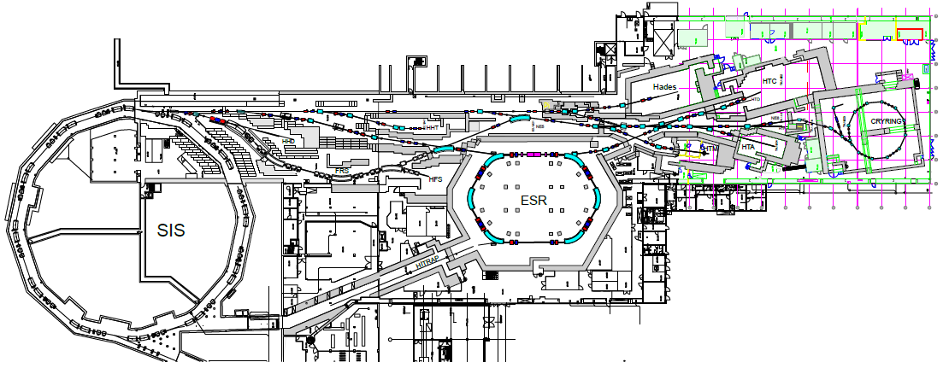
Trafos FCT & RT @GSI HEST
Status 2025
Resonant Trafo (RT)
Fast Current Trafo (FCT)
Ring FCTs
GTE5DT1C
Nomenclature
GTE1DT1C
GTE5DT1C
GHTPDT1C
GHHDDT1C
GHHTDT6C
Nomenclature
GTE1DT1FP
GTE5DT1FP
GHTPDT1FP
GHHTDT7FP

Slide 5
GTE5DT1C
Commissioning measurements 2025
Measurement programme
  Noise level (with/without beam, i.e. machine cycle)
  System response
  Range check
  Minimum detectable signal

Slide 6
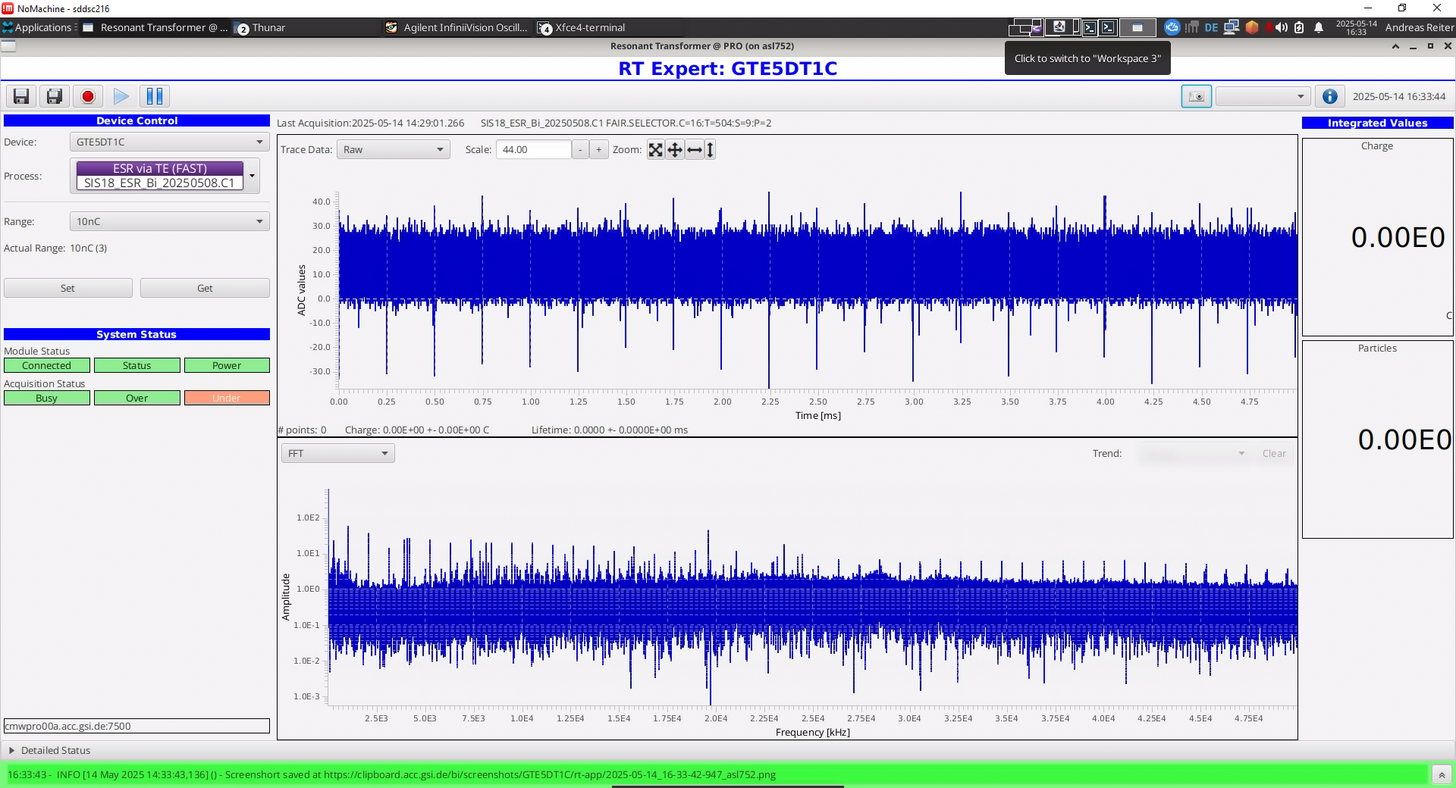
1. Noise level
No beam – ADC data & FFT, R = 10 nC
ADC input:
30 MHz analoge bandwidth
+/- 5 Volt at 14 bit
1 ADC unit = 0.6 mV
Full ADC bandwidth:
Noise level ~ 18 mVpp
Some 4 kHz distortion from hardware power supply
Added noise/distortion during some experiments due to magnet power supplies, etc. (10 – 100 kHz)

Slide 7
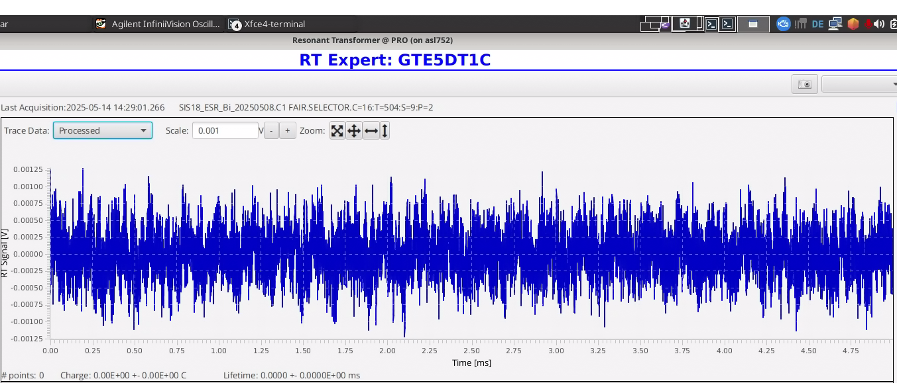
1. Noise level
No beam – Processed data, R = 10 nC
Data processing involves conversion to voltage signal and frequency filter
DC offset eliminated in FFT
Frequency filter: cut at 1 MHz in FFT
Result 1: effective noise level (under ideal conditions)
  V = +/- 1 mV
  Vpp = 2 mV

Slide 8
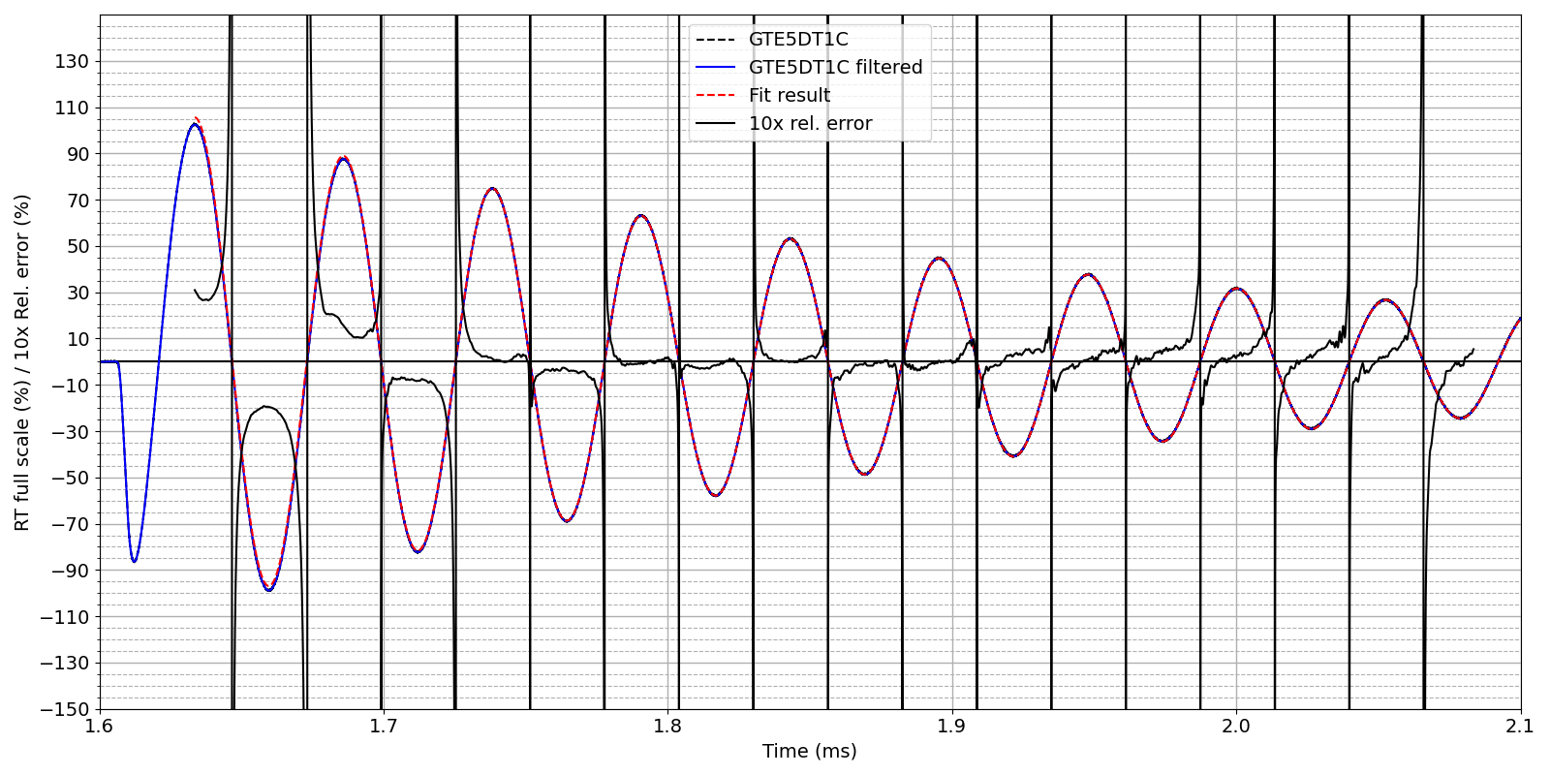
2. System Response
RT oscillation – comparison to theoretical RLC model
RT response to beam excitation is a damped oscillation at ~ 20 kHz and decay time constant given by inductance L and total loss R.
Some ~3% deviation at start of RT response (1st period). Measured response in good agreement with theory.
Result 2: Measurement system (RT sensor, amplifier, cable transmission, connector box, ADC) seems to work correctly.

Slide 9
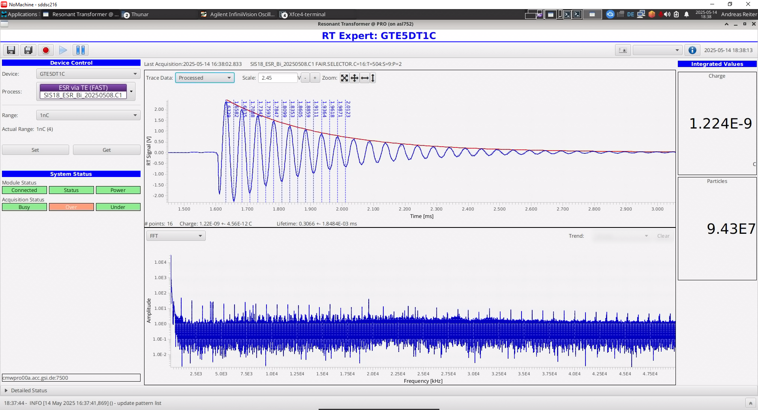
3. Range check
1 nC beam, R = 1 nC
Expected amplitude ~ 2.0 V
Software analyses several maxima and minima to calculate total charge
Processed data: DC excluded and upper limit 1 MHz
Amplitudes are extracted from a P2 fit around the maximum position
Max. no. of extrema used: 30
If signal falls below a threshold, the peak search is stopped.
The resulting amplitude envelope is shown as red line on top of the processed data.

Slide 10
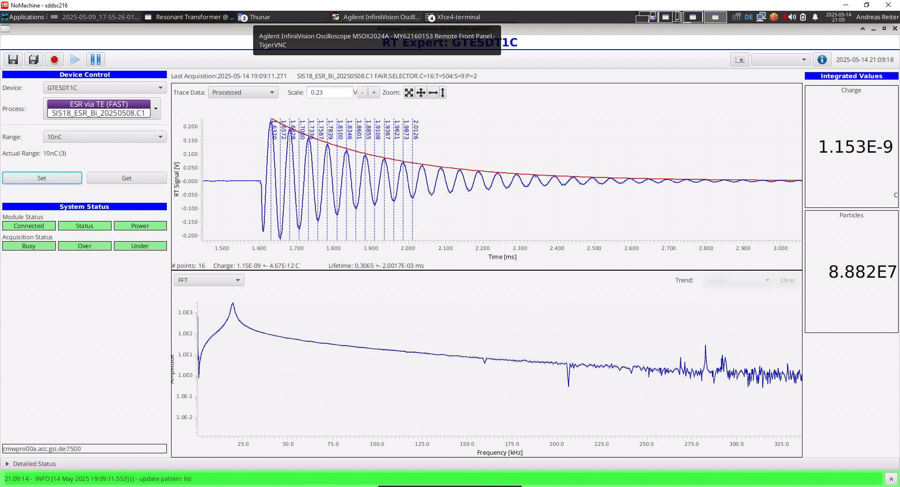
3. Range check
1 nC beam, R = 10 nC
Expected amplitude ~ 0.2 V

Slide 11
3. Range check
1 nC beam, R = 100 nC
Expected amplitude ~ 0.02 V
= 20 mV

Slide 12
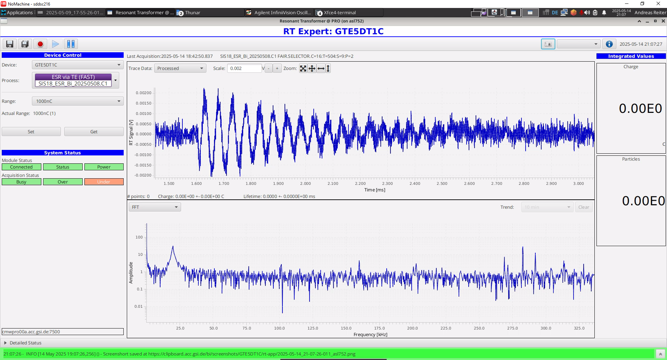
3. Range check
1 nC beam, R = 1000 nC
Expected amplitude ~ 0.002 V
= 2 mV

Slide 13
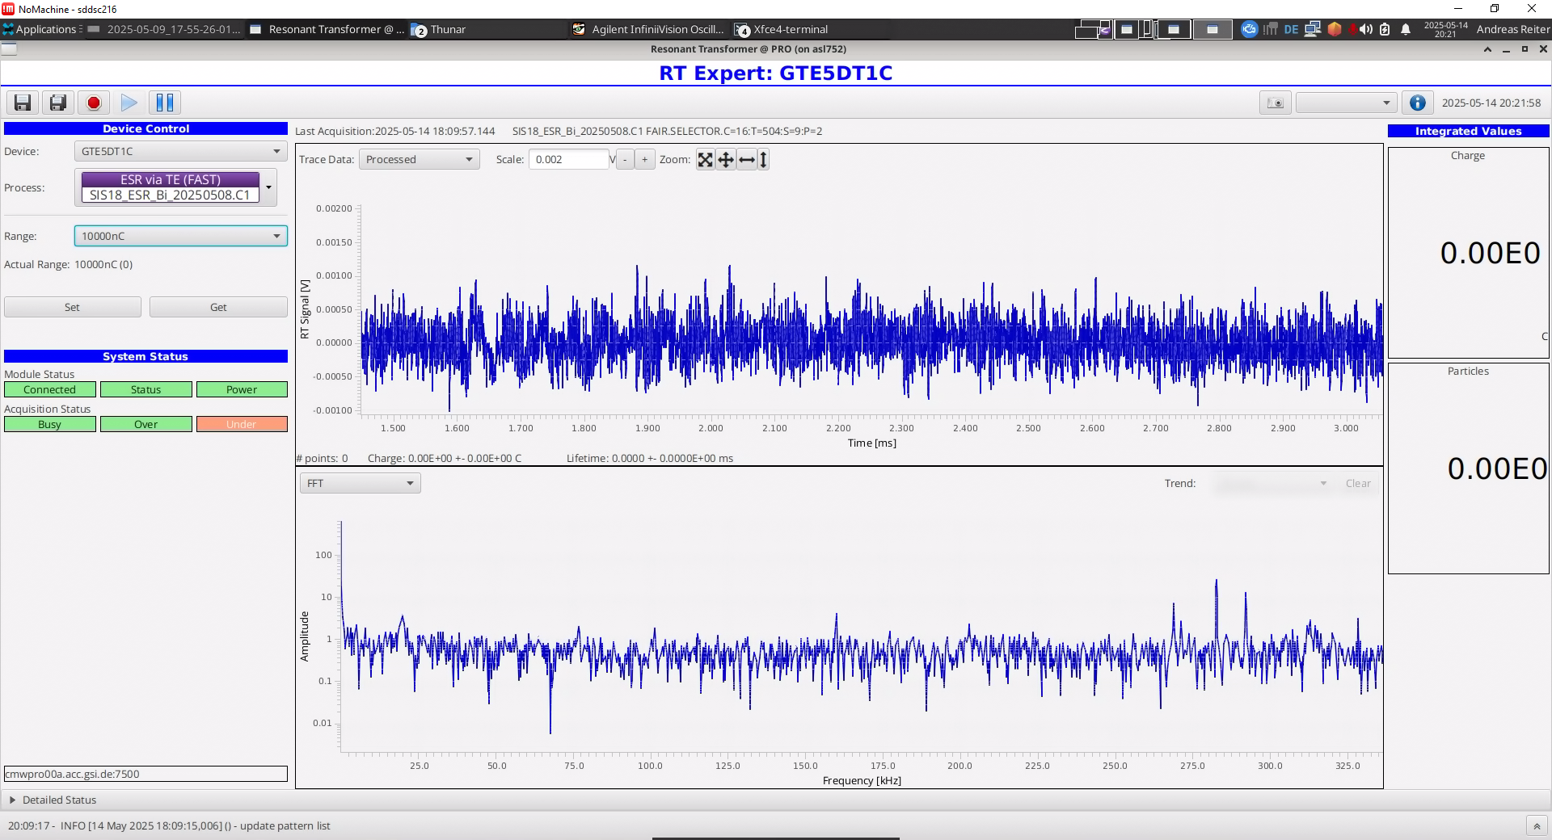
3. Range check
1 nC beam, R = 10.000 nC
Expected amplitude ~ 0.0002 V
= 0.2 mV
No observable ADC signal
Tiny peak around RT oscillation frequency

Slide 14
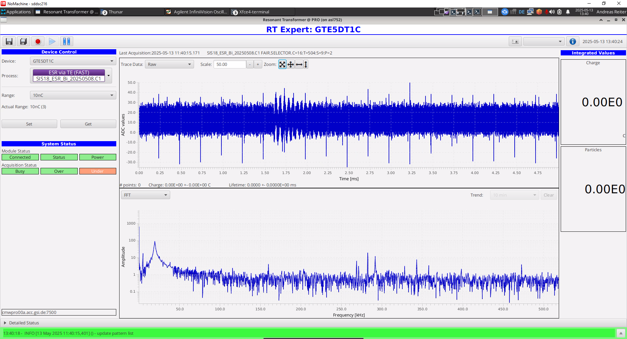
4. Minimum detectable signal
ADC spectrum – raw data (5 ms), R = 10 nC
ADC spectrum shows a weak oscillation and some 5 kHz noise
FFT spectrum up to 500 kHz

Slide 15
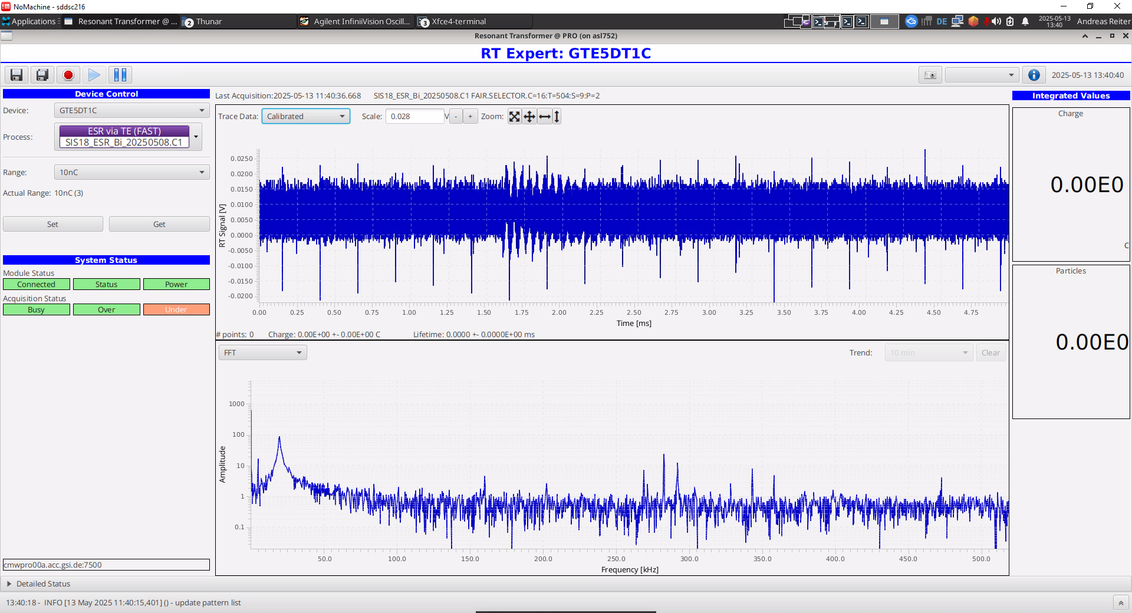
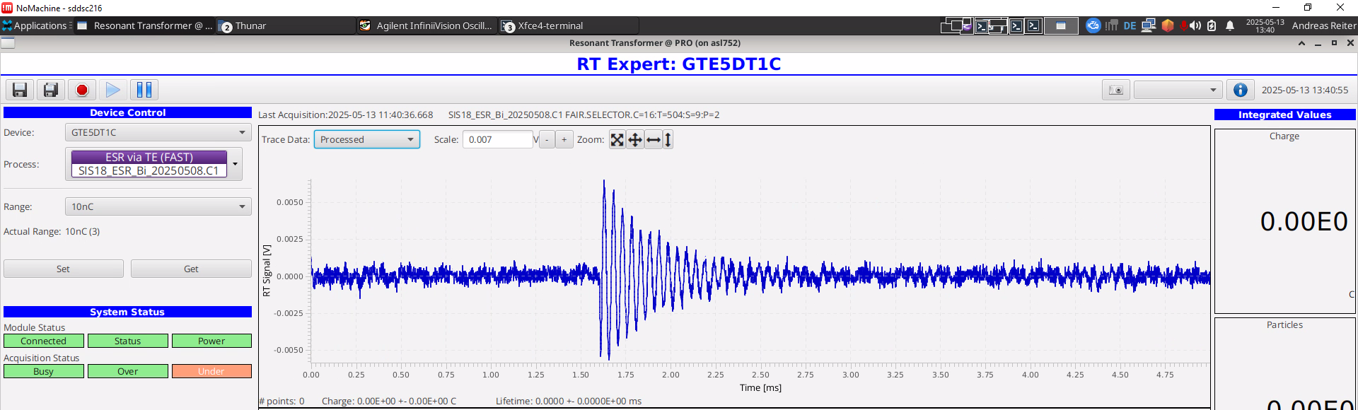
4. Minimum detectable signal
ADC spectrum – processed data (5 ms), R = 10 nC
Voltage signal
Processed data after filtering

Slide 16
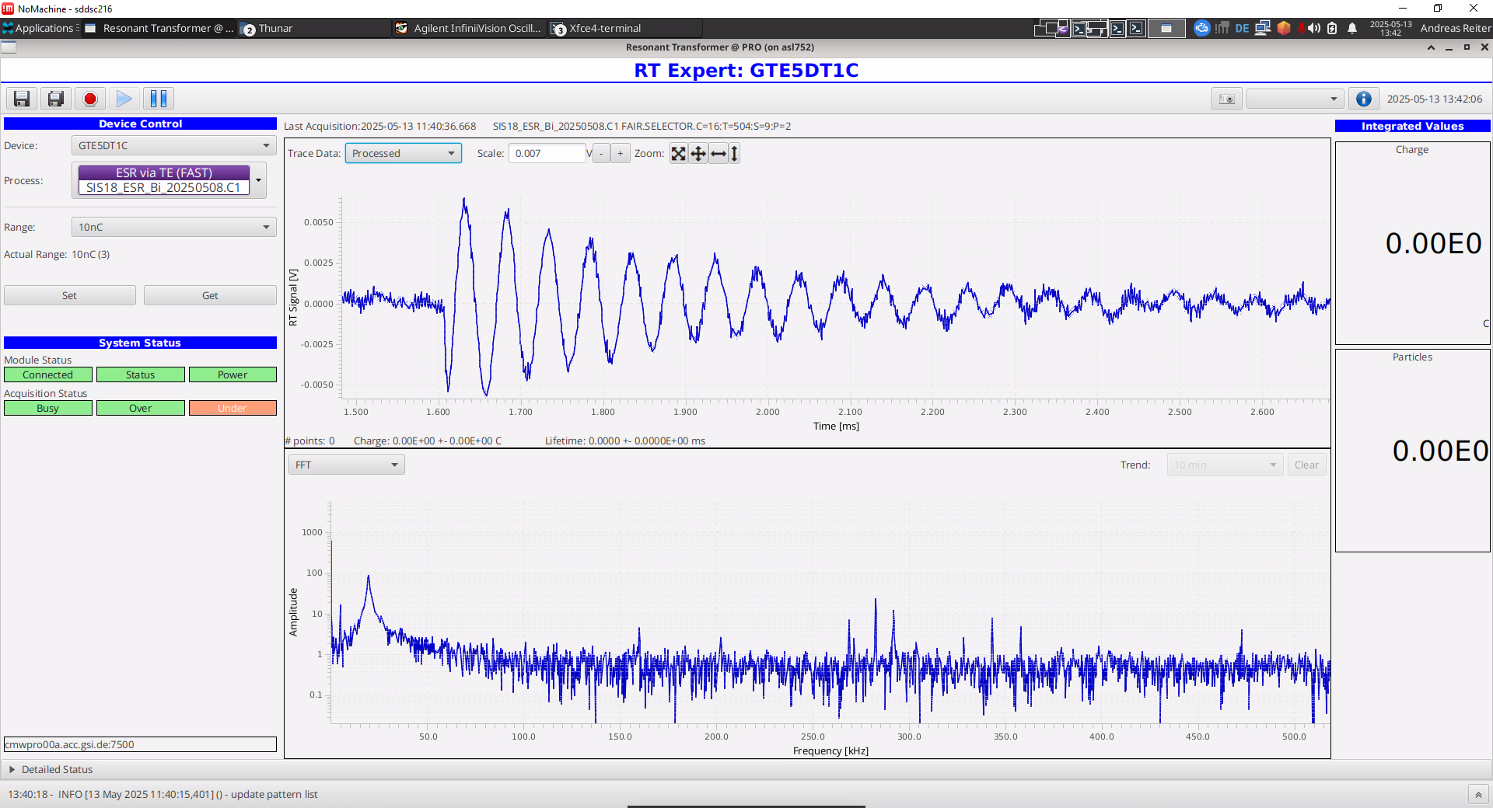
4. Minimum detectable signal
Processed data – t = [1.6, 2.7] ms, R = 10 nC
Oscillation of 5 mV amplitude is clearly detectable
S/N ~ 4 (S = amp, N = Vpp)
Result 4: Estimate for minimum signal:
~2 mV ~1E-3 full scale
~10 pC for 10 nC range

Slide 17
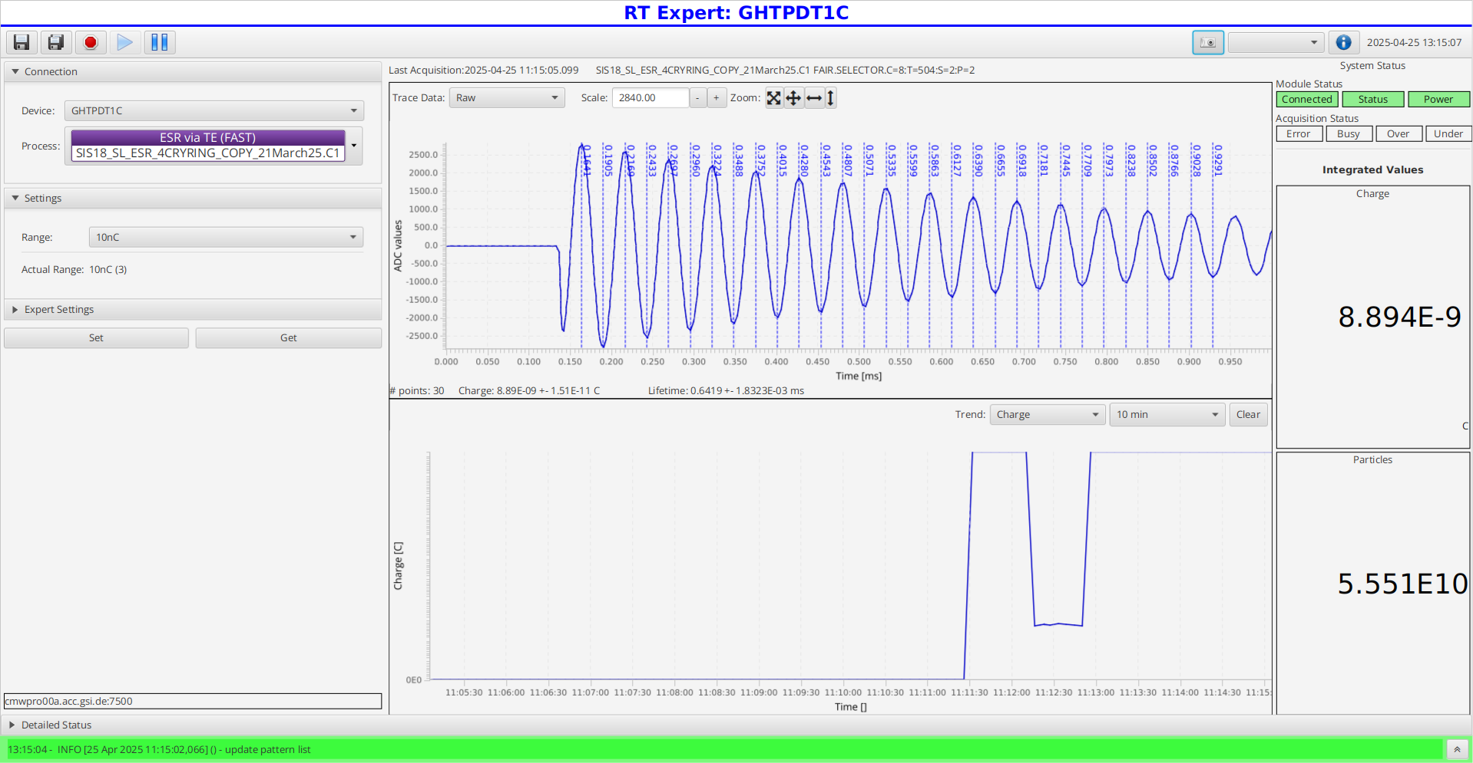
Summary
RT Development
Results:
  We did measure in HTP as well!
  Development of new FAIR hardware is completed.
  Stable operation of new DAQ system with FESA software
  Signal quality under favorable conditions is very good, but can be hampered by distortions caused by magnet power supplies, etc.
  Charge calculation in software offers flexibility to counteract unwanted effects.
Next steps:
  Production of hardware for FAIR and GSI detectors
  Upgrade of GTE1DT1C, GHHTDT6C, GHHDDT1C in 2026 for FCC operation

