Slide 1
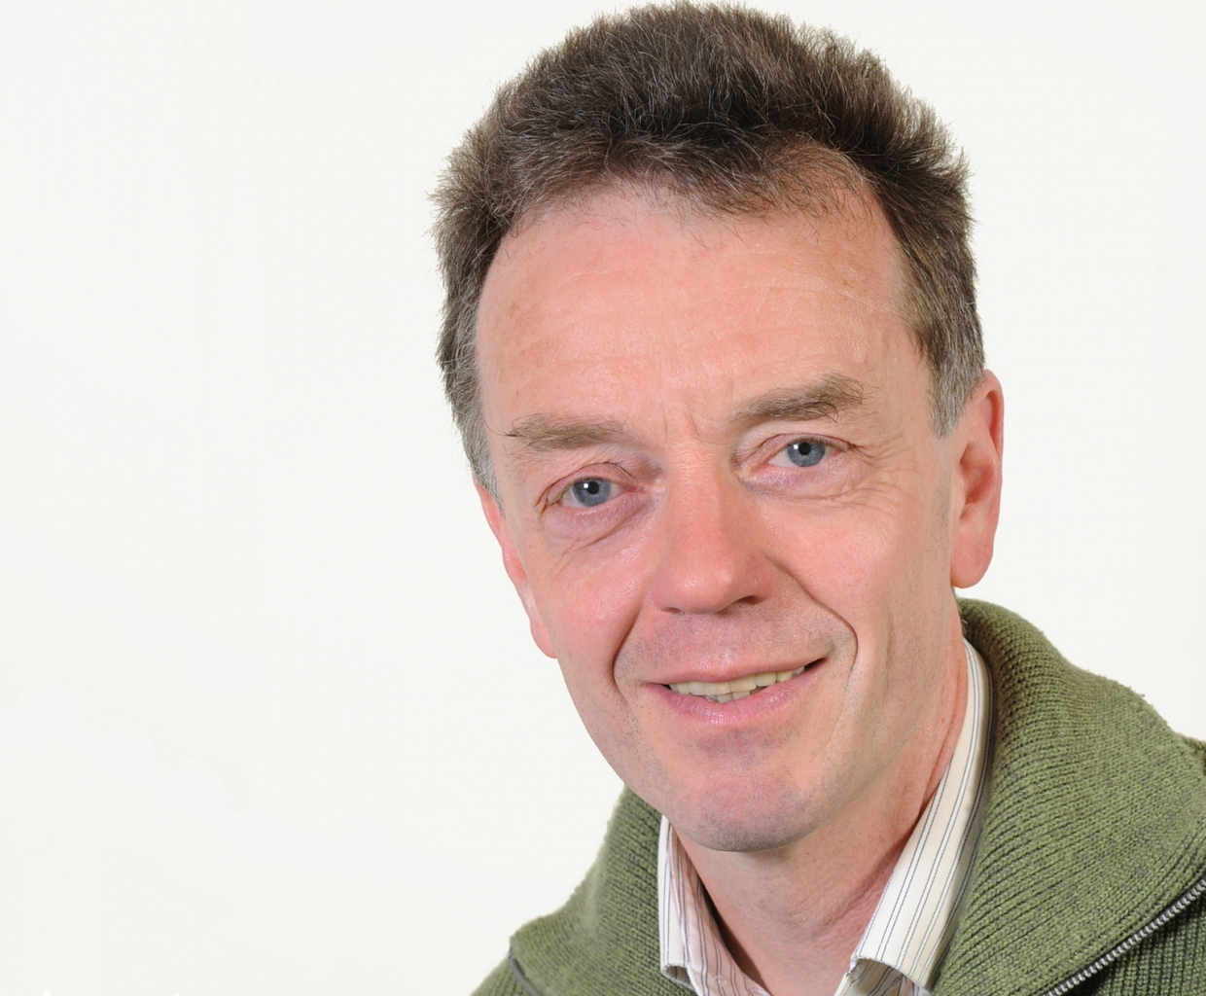
Collisions of Co-Circulating Heavy-Ion Beams in the ESR
Low-energy collisions near the Coulomb barrier between two highly charged heavy nuclei, co-circulating in a storage ring,
offer a unique environment for studying phenomena that are inaccessible in fixed-target experiments:
The formation of superheavy quasi-molecular states with total nuclear charge exceeding Z_{cr.}​ ∼ 173, which can lead to
spontaneous vacuum decay via electron-positron pair production.
Quasi-molecular electron transfer between highly-charged ions, such as during
collisions of H-like ²³⁸U⁹¹⁺ with bare ²³⁸U⁹²⁺
2 ways to get collision:
Co-circulating beams on separate orbits, with slightly different momenta,
intersecting at a designated point using a special ion-optical setting,
proposed by B. Franzke 40 years ago.
Merged beams co-moving along the same closed orbit but with different velocities —
an experiment envisioned for many years by M. Steck and only made possible in 2025.
S.Litvinov for the ESR team, December 1st, 2025

Slide 2
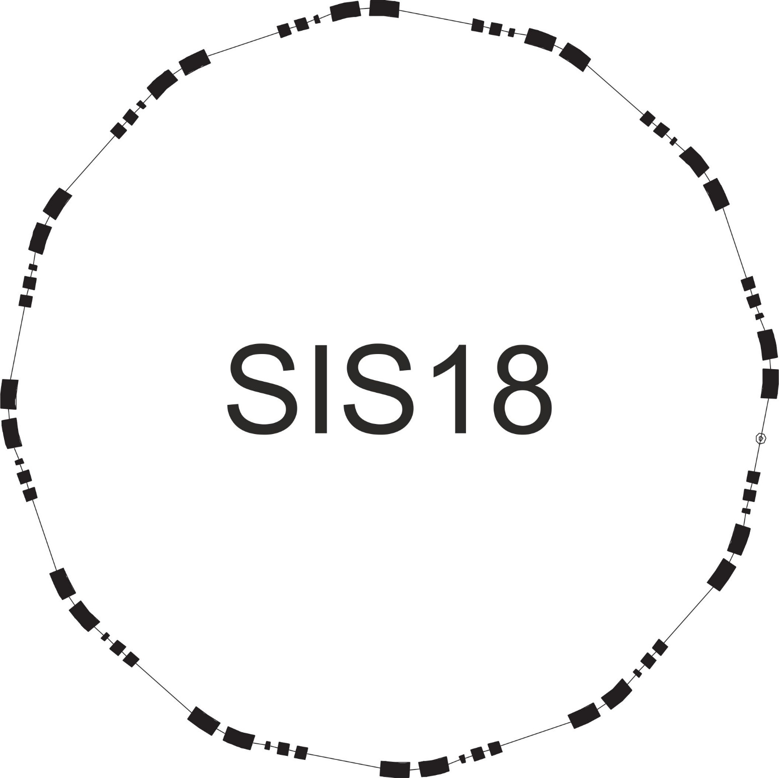
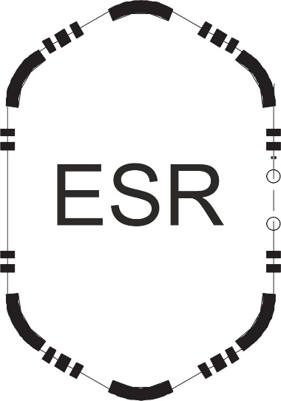
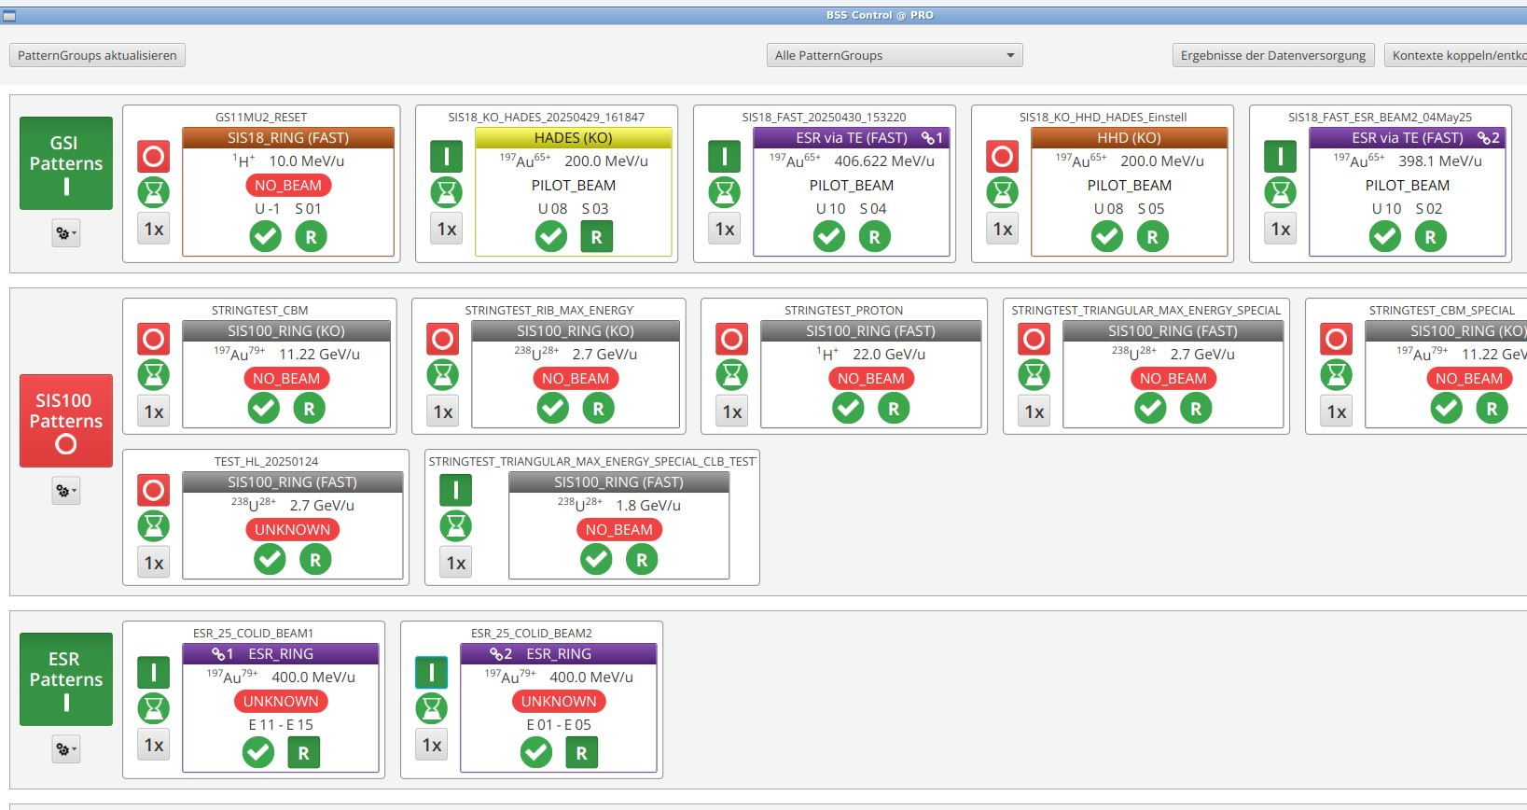
Experimental Concept (Gold example)
E_{SIS18} = 406.6 MeV/u (for ¹⁹⁷Au⁷⁹⁺)
Bρ_{ESR} = const (¹⁹⁷Au⁷⁹⁺)
100 mg Cu stripper
¹⁹⁷Au⁶⁵⁺
¹⁹⁷Au⁷⁸⁺
or
¹⁹⁷Au⁷⁹⁺
Bρ = const (¹⁹⁷Au⁷⁹⁺)
E_{SIS18} = 398.1 MeV/u (for ¹⁹⁷Au⁷⁸⁺)
Two identical ESR and SIS18 patterns were prepared, forming two
SIS18-ESR chains.
SIS18 energy of the first chain was set to inject and store bare ¹⁹⁷Au⁷⁹⁺ ions in the ESR.
SIS18 energy of the second chain was set to store H-like ¹⁹⁷Au⁷⁸⁺ ions, keeping the magnetic rigidity Bρ^{TE-ESR} = const
(corresponding to ¹⁹⁷Au⁷⁹⁺) downstream of the stripper.
After preparing the beam setup with the individual chains, the two SIS18-ESR chains were operated sequentially.
To inject and store both beams in sequence, a feature of Storage Ring Mode was used.

Slide 3
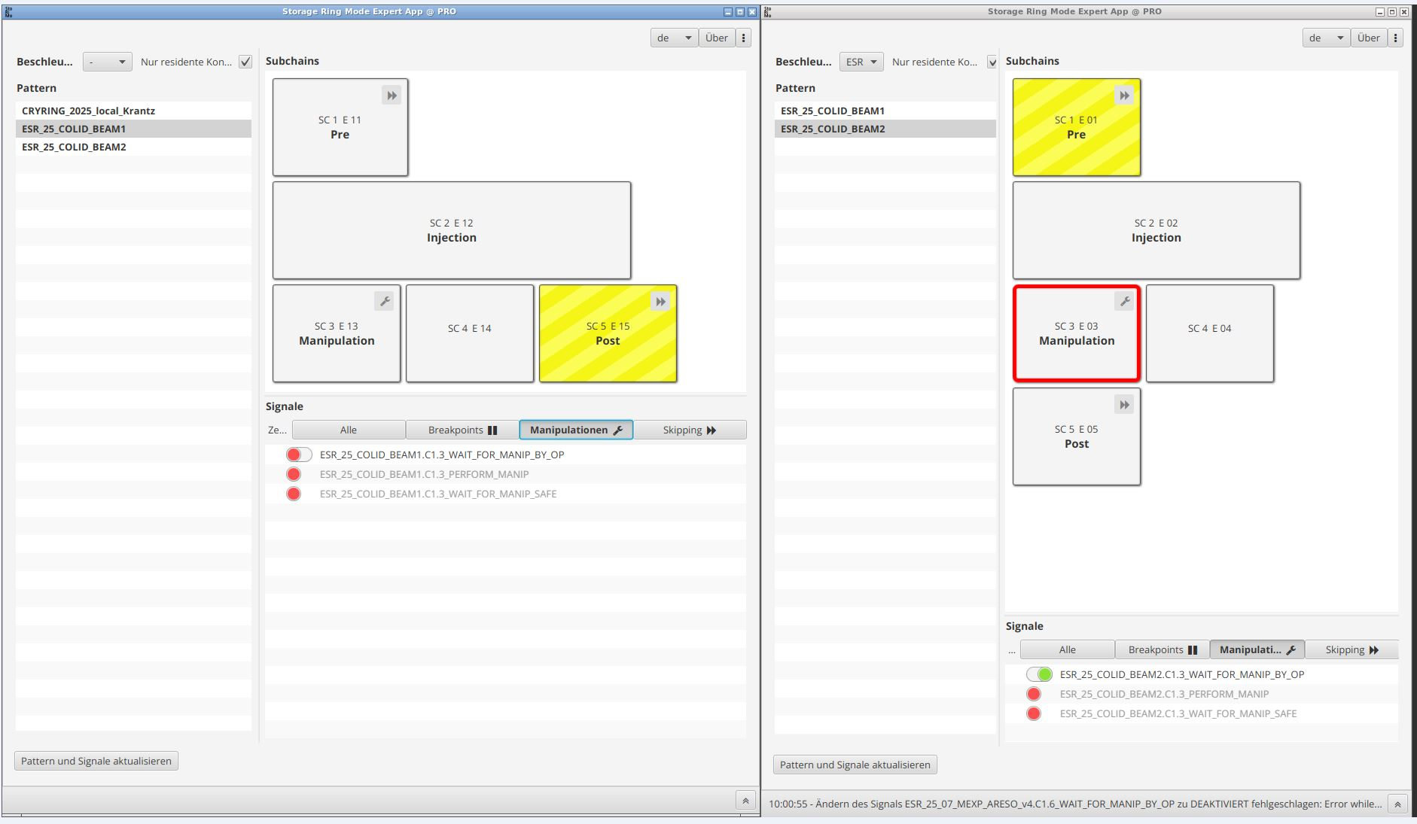
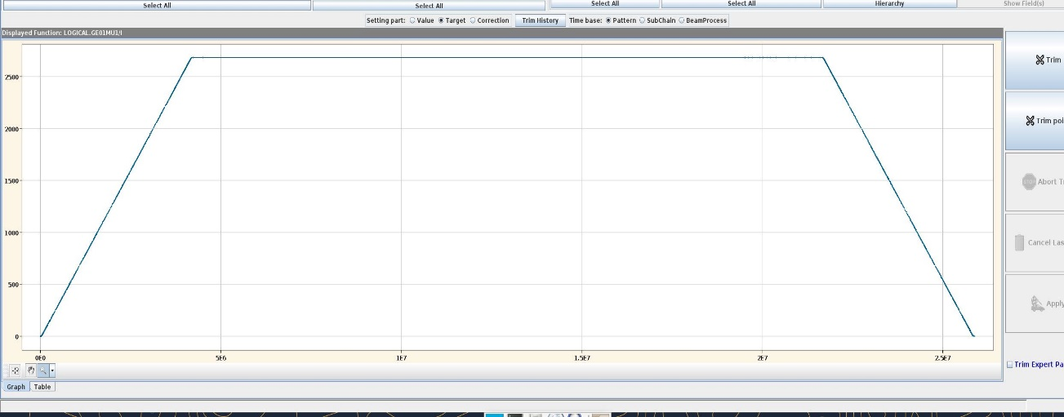
Running 2 ESR together
The Pre- and Post- beam processes are responsible for
ramping the ESR up to the injection level and back down.
By skipping the Pre- and Post- of the ESR cycle while
one beam is already stored in the ring, the second beam
can be stored together with the first.
ESR 1
ESR 2
Pre
Post
Pre
Post
ESR 1
ESR 2

Slide 4
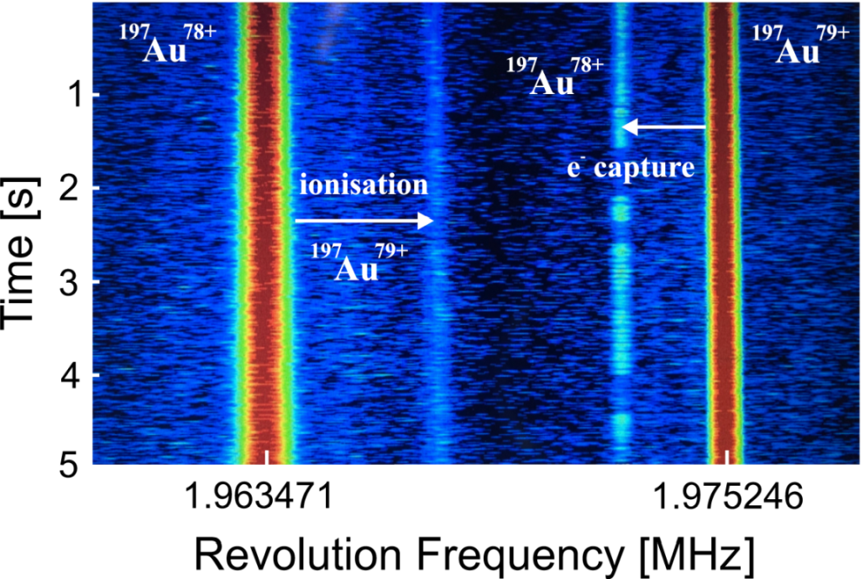
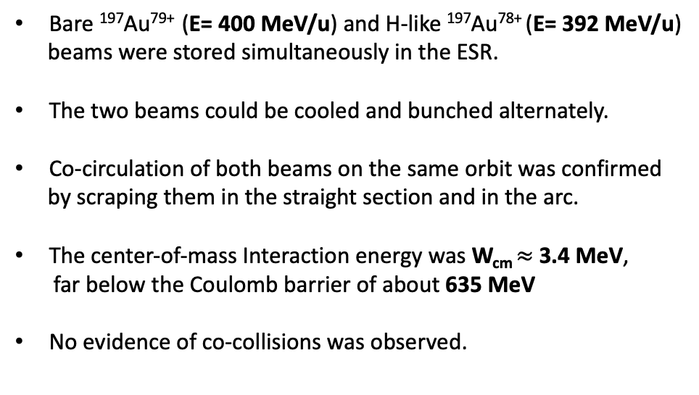
Experiment (Gold)
Bare ¹⁹⁷Au⁷⁹⁺ (E= 400 MeV/u) and H-like ¹⁹⁷Au⁷⁸⁺ (E= 392 MeV/u)
beams were stored simultaneously in the ESR.
The two beams could be cooled and bunched alternately.
Co-circulation of both beams on the same orbit was confirmed
by scraping them in the straight section and in the arc.
The center-of-mass Interaction energy was W_{cm} $≈$3.4 MeV,
far below the Coulomb barrier of about 635 MeV
No evidence of co-collisions was observed.
¹⁹⁷Au⁷⁸⁺
¹⁹⁷Au⁷⁹⁺
* The experiment was performed during the night of 4 May 2025.

Slide 5
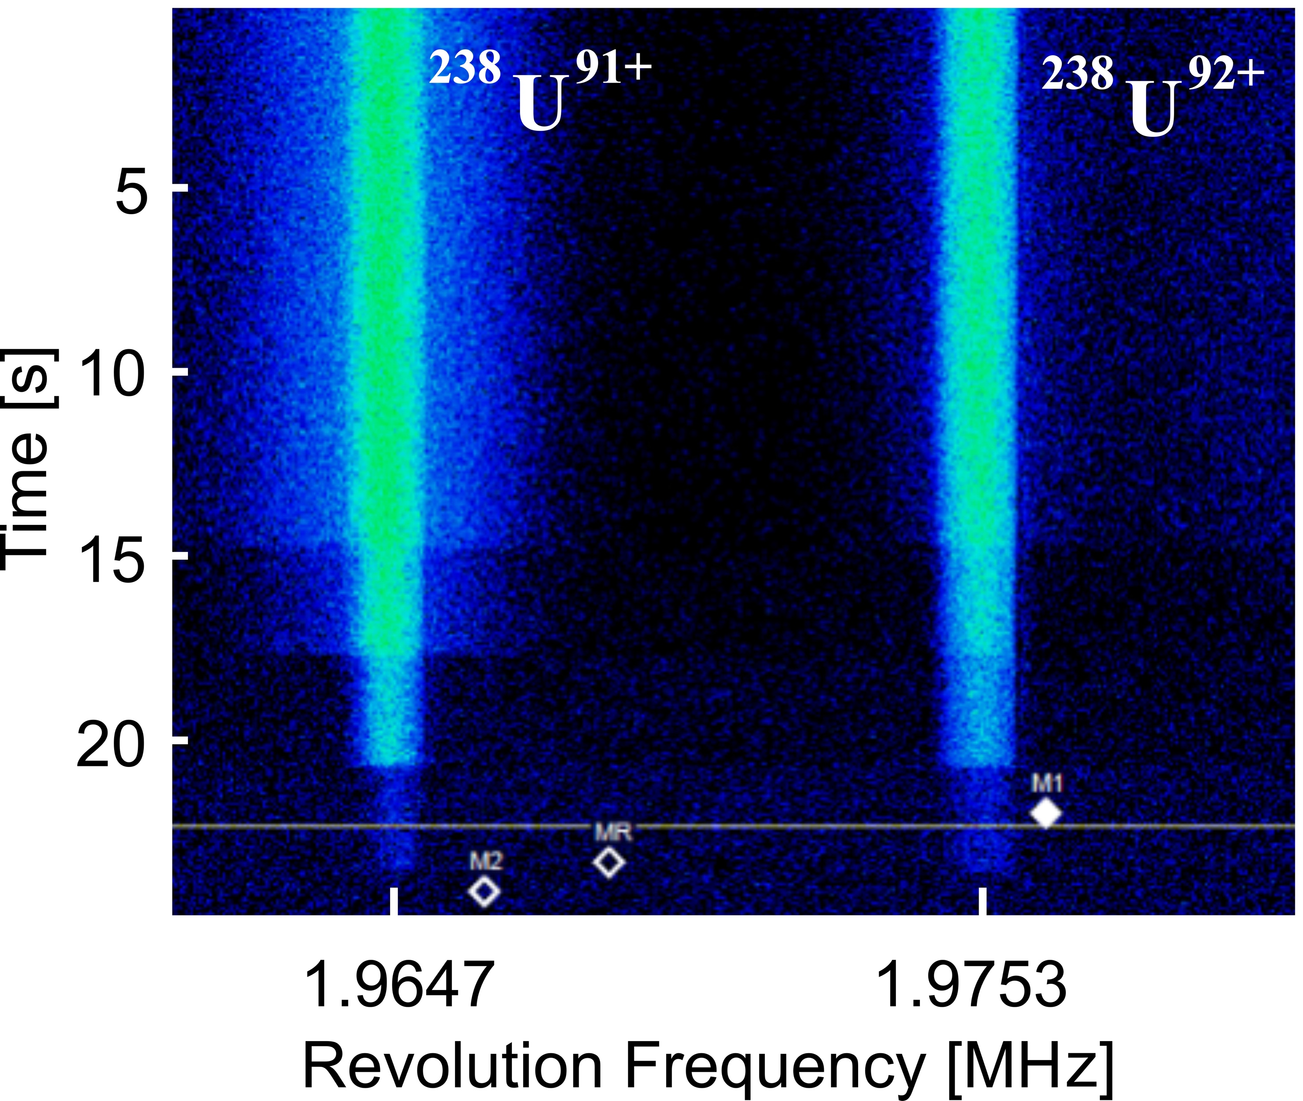
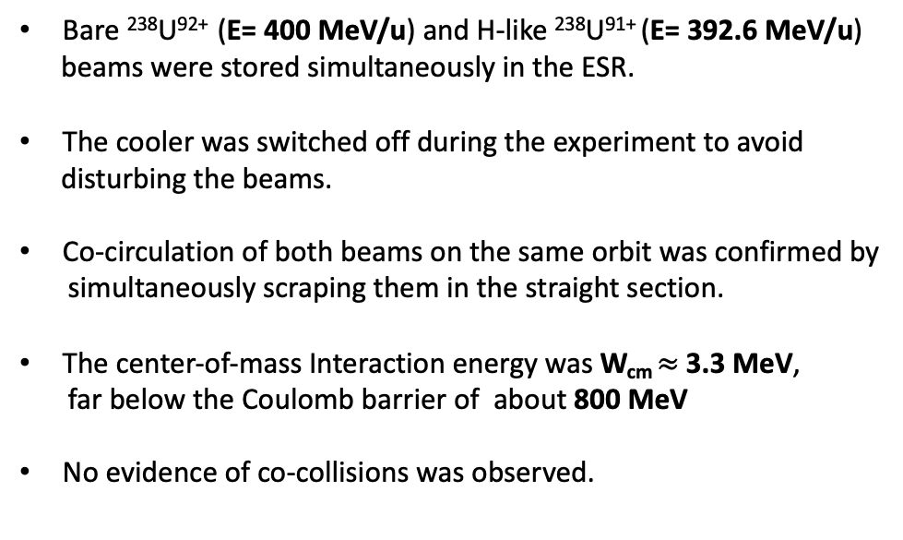
Experiment (Uranium)
E_{SIS18} = 407.4 MeV/u (for ²³⁸U⁹²⁺)
100 mg Cu stripper
or
Bρ_{ESR} = const (²³⁸U⁹²⁺)
²³⁸U⁷³⁺
²³⁸U⁹¹⁺
²³⁸U⁹²⁺
Bρ = const (²³⁸U⁹²⁺)
E_{SIS18} = 400.1 MeV/u (for ²³⁸U⁹¹⁺)
Bare ²³⁸U⁹²⁺ (E= 400 MeV/u) and H-like ²³⁸U⁹¹⁺ (E= 392.6 MeV/u)
beams were stored simultaneously in the ESR.
The cooler was switched off during the experiment to avoid
disturbing the beams.
Co-circulation of both beams on the same orbit was confirmed by
simultaneously scraping them in the straight section.
The center-of-mass Interaction energy was W_{cm} $≈$3.3 MeV,
far below the Coulomb barrier of about 800 MeV
No evidence of co-collisions was observed.
¹⁹⁷Au⁷⁸⁺
¹⁹⁷Au⁷⁹⁺
* The experiment was performed during the evening of 15 June 2025.

Slide 6
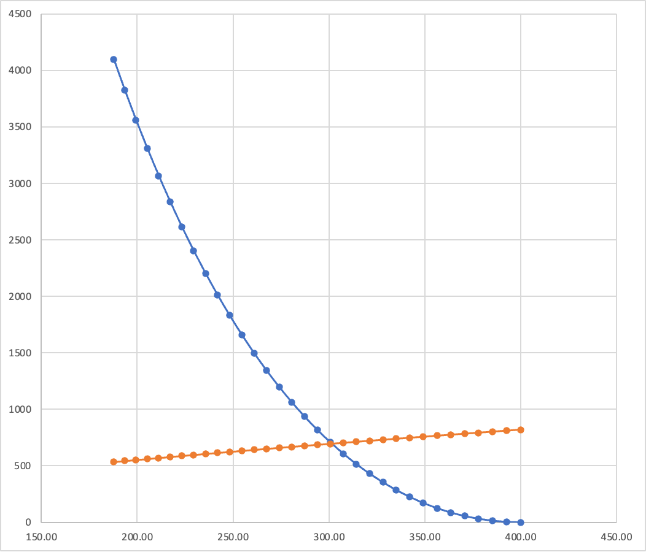
Beyond the U⁹²⁺ / U⁹¹⁺ Combination
With the fixed energy of the first beam U⁹²⁺ at E₁ = 396 MeV/u,
it is energetically preferable to choose U⁷⁸⁺ for the second beam, with E₂ = 298 MeV/u, so that both beams can co-circulate on the
same orbit (same Bρ). In this case W_{cm} exceeds the Coulomb barrier
only slightly, with W_{cm} − V_{c} ≈ 10 MeV.
A choice of U⁷³⁺ extracted directly from SIS18 without
additional stripping would also be possible, but in that case
W_{cm} would be significantly higher than Vc.
The new achromatic optics of the ESR (D_{x} = 0 in the straight
section) can be applied in the experiment to increase the
collision probability.
Independent control of the beams using separate RF cavities,
together with a dedicated ESR optics setting, could allow both beams
to co-collide at a chosen interaction point, where the necessary detectors
could be installed.
E₁(U⁹²⁺) = 396 MeV/u
W_{cm}
W_{cm} [MeV], V_{C} [MeV]
V_{C}
¹⁹⁷Au⁷⁸⁺
Q=78
e⁻ capture
Q=92
Q=60
¹⁹⁷Au⁷⁹⁺
ionization
E₂ [MeV/u]
¹⁹⁷Au⁷⁸⁺
¹⁹⁷Au⁷⁹⁺

