Slide 1
ESR Machine Experiments 2025 Barrier Bucket Stacking Beam Optics Studies
B. Lorentz, Maschinenexperimente 2025, 01.12.2025

Slide 2
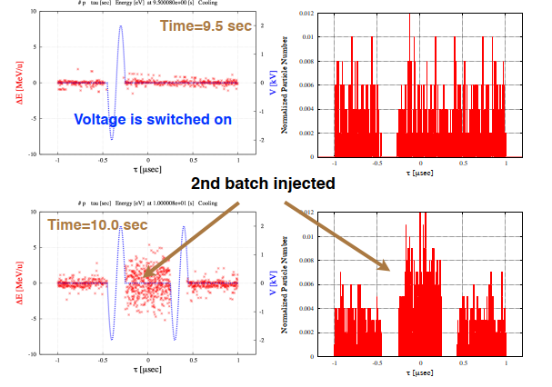
Barrier Bucket Stacking

Slide 3
Barrier Bucket Stacking
Original proposal: ‚Experimentally verify the moving barrier bucket stacking‘
During preperation for experiment we switched to ‚Testing of Stacking
with fixed barrier bucket‘
reason: not enough space for the stacked beam:
barrier bucket frequency presently restricted to 5 MHz-> 200 ns
we need two of them: 400 ns
minimum length of inj. kicker flattop: 100 ns makes 500 ns
stoch. cooling only available at 400 MeV, 2 MHz -> 500 ns

Slide 4
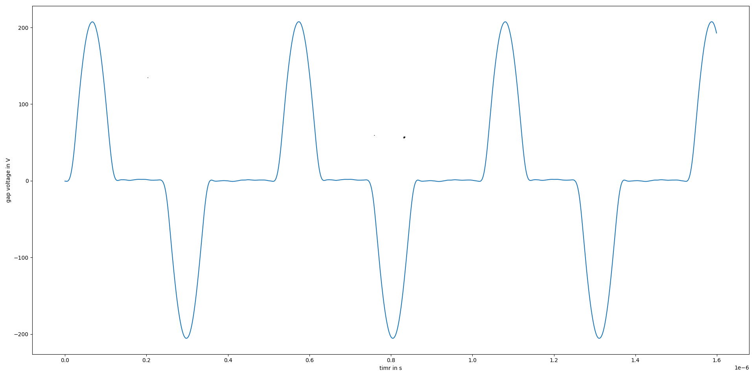
Barrier Bucket Stacking
Thanks to the RHF people for preparing an adequate BB signal with one of the BB cavities on short notice (Measurement at Beginning of Experiment)

Slide 5
Barrier Bucket Stacking
The three types of Stochastic Cooling:
Palmer Cooling: all three planes independently, long. Cooling via Dispersion at Pickup and Kicker, fast, this is what we always use for stacking
TOF Cooling, lower acceptance, higher final momentum spread, slower
Notch Filter Cooling: lower acceptance, lower final momentum spread, slower
According to simulation, Palmer Cooling is the best choice, so we started out with that
Unfortunately: we couldn‘t reach longitudinal cooling with the standard setup procedure.
There was intensiv search for any hardware failure, but nothing could be found (because
most likely there was none, two weeks later it worked as it should for Bi beam, not
understood, may be caused by the low charge and mass of the available carbon beam)
So we did the measurements with TOF cooling, and even Notch Filter Cooling worked.

Slide 6
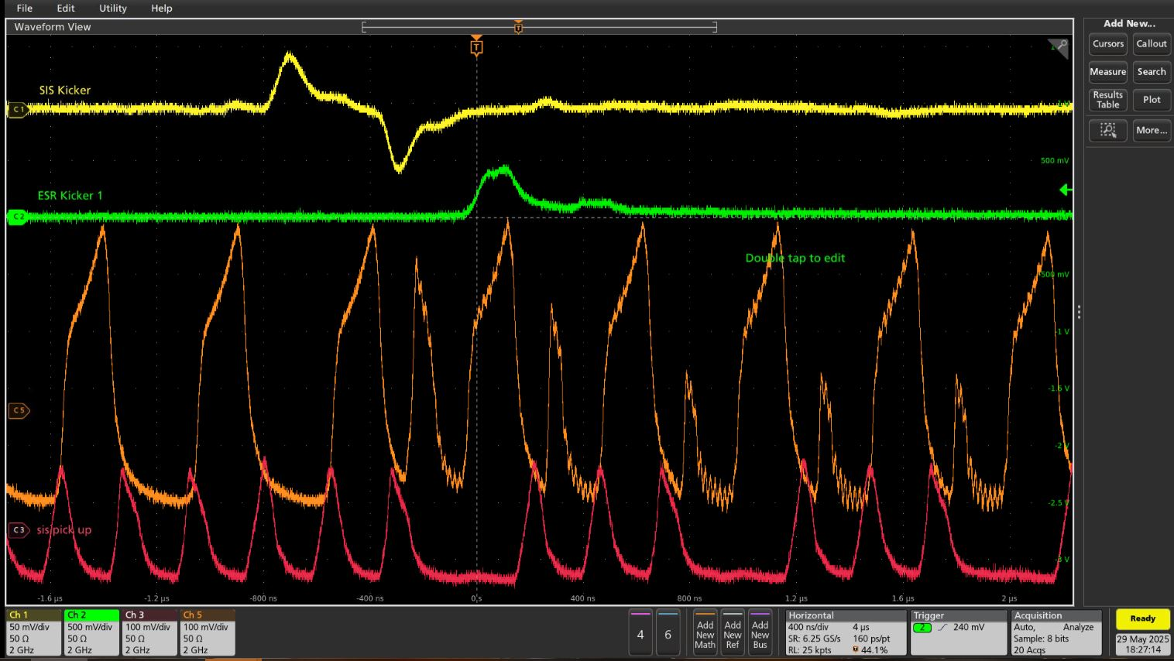
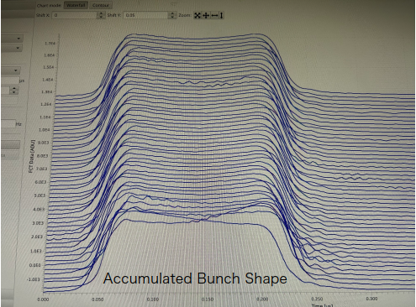
Barrier Bucket Stacking
A selection of results

Slide 7
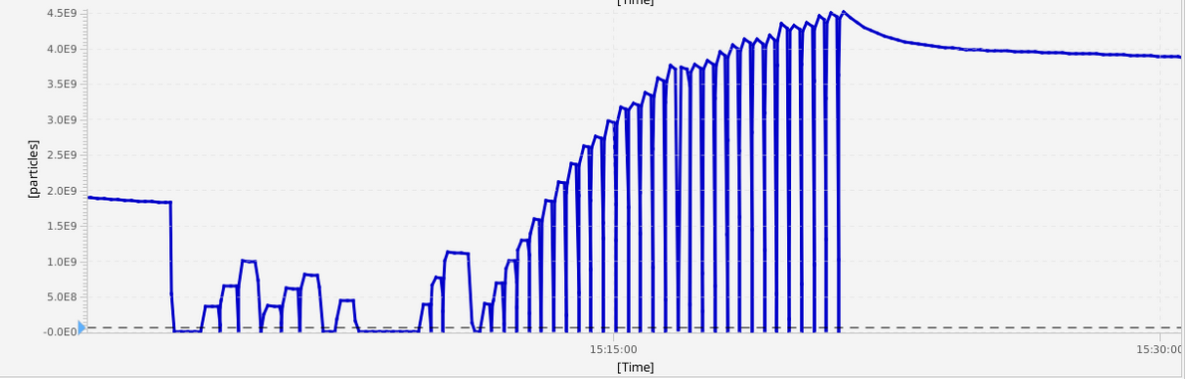
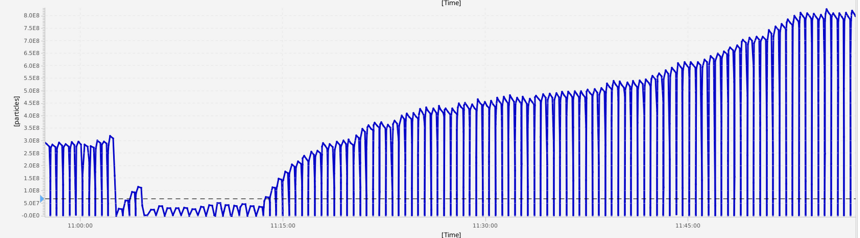
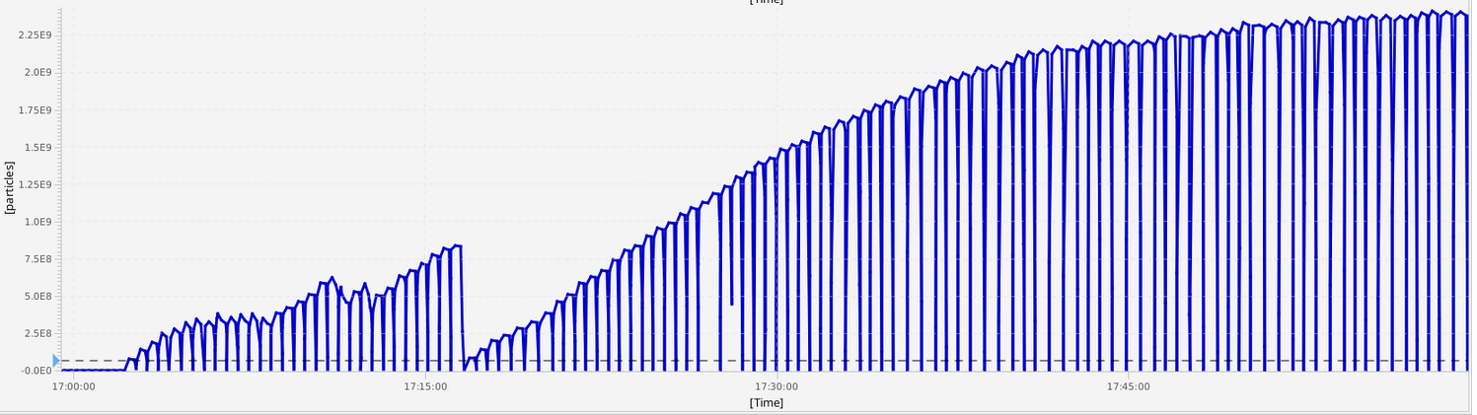
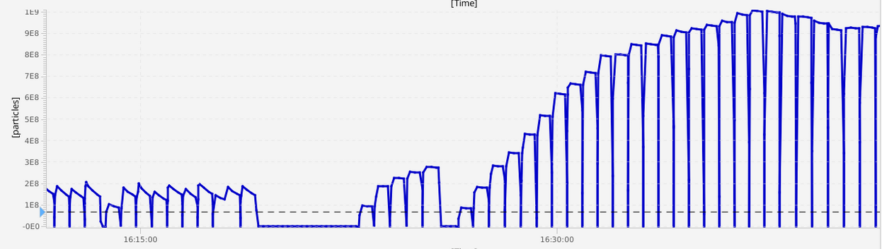
Barrier Bucket Stacking
Highest Intensity (5E9) reached with
e-cooling (500 mA) and BB (50V)
TOF cooling, adjustment of gain, Intensity increase by factor 15 increase
e-cooling and BB, Intensity increase by factor 20
Efficiency goes down over time as predicted by simulation
H=1 & e-cooling, works as well, maybe less efficient,
but settings not optimized here (one of the last runs)

Slide 8
Barrier Bucket Stacking
Summary:
All observations agree well with predictions of simulations
Electron cooling works well, but is slow (similar efficiency for longer cooling times)
TOF cooling doesnt work as well, probably because of too much noise in the system
Notch Filter Cooling was tried, but only slightly better than the TOF cooling.
Palmer Cooling is inevitable (fast, large acceptance, acceptable final momentum spread)
Still open question: especially the question of efficiency for moving barrier bucket
stacking with Palmer Cooling (is expected to be higher than with electron cooling)
Once BB frequency can be higher, this could be a further study. (and Palmer Cooling
should work, maybe better with a more frequently used, heavier ion with higher charge state)

Slide 9
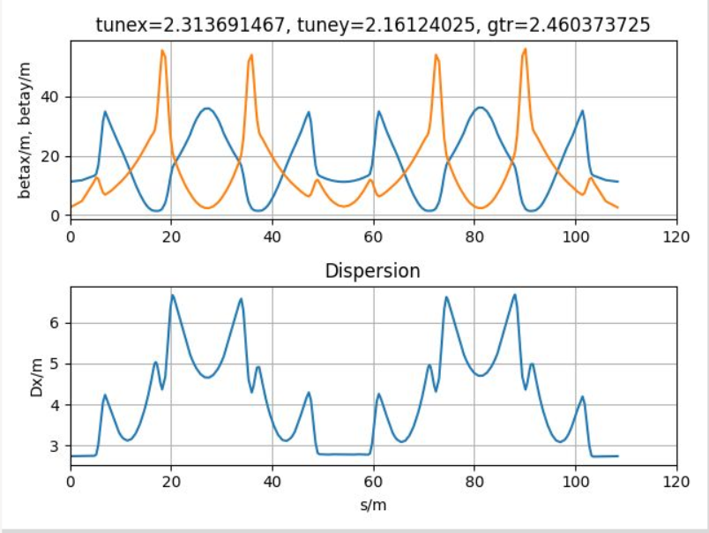
Beam Optics
Standard optics settings
always used for the ESR
It has significant dispersion
in the straight sections,
that means also at the
electron cooler
There is no real reason.

Slide 10
Beam Optics
Consequence of Dispersion at the electron cooler:
via the Dispersion some coupling of longitudinal cooling into the horizontal plane is introduced, the cooling force is redistributed and can
improve transverse cooling.
This is not needed and also not intentional.
But in turn it means: best longitudinal cooling is achieved with Dispersion zero
Transvers emmittance is with typically below 2 mrad sufficiently small anyway. The longitudinal dp/p is of large importance for the performance, so improving it is a good choice.

Slide 11
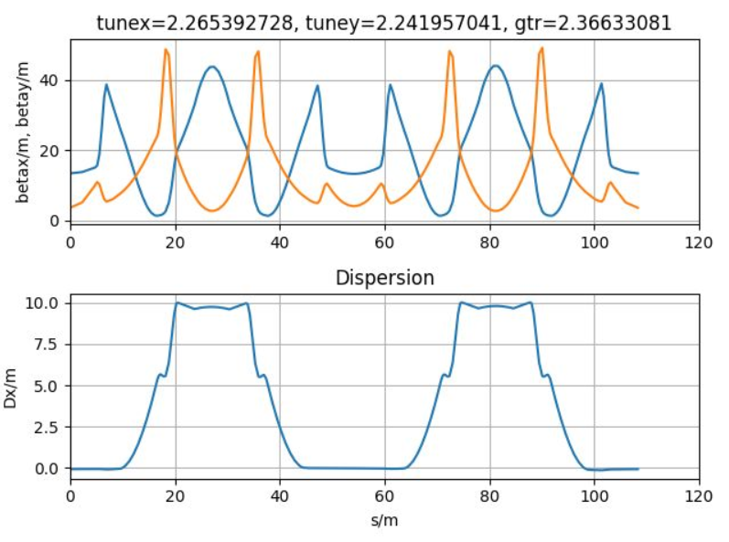
Beam Optics
With Change of one quad family (out
of five), dispersion will be zero in
the straight section (cooler, target)
Tunes need to be corrected
Standard tune knob changes all (!?)
families.
Instead now its done with only
2 families, Dispersion setting
and tune settings are made
independent

Slide 12
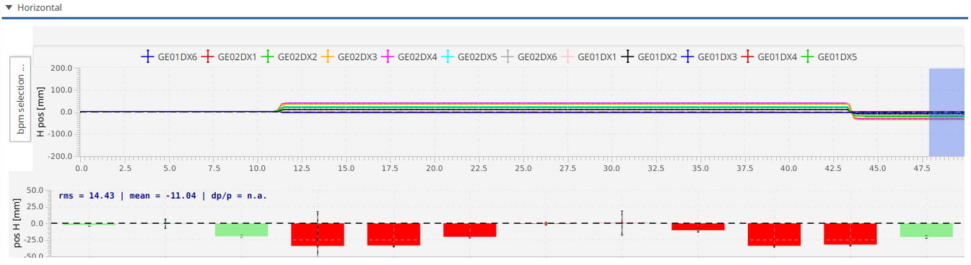
Beam Optics
Second try: Dispersion in straight practically zero (in Manipulation, so Injection not effected
the bar plot is here the difference between the reference orbit, and a dp orbit
=> dispersion

Slide 13
Beam Optics
Next step was to apply it already at injection, injection intensity
was practically unchanged
defined this as an alternative optics in LSA
towards the end of this years beamtime we checked again, and it works (we even saw
overcompensation, so dispersion not exactly zero but with changed sign)
(we even used it for one of the physics experiments at the end of this years block)
For the future this will be the standard optics for ESR!!
To be flexible we think to put a button for ‚Dispersion in Straight‘ in LSA in the future, as
there may be reasons to use the old settings, the zero dispersion, or even a different
sign for dispersion

Slide 14
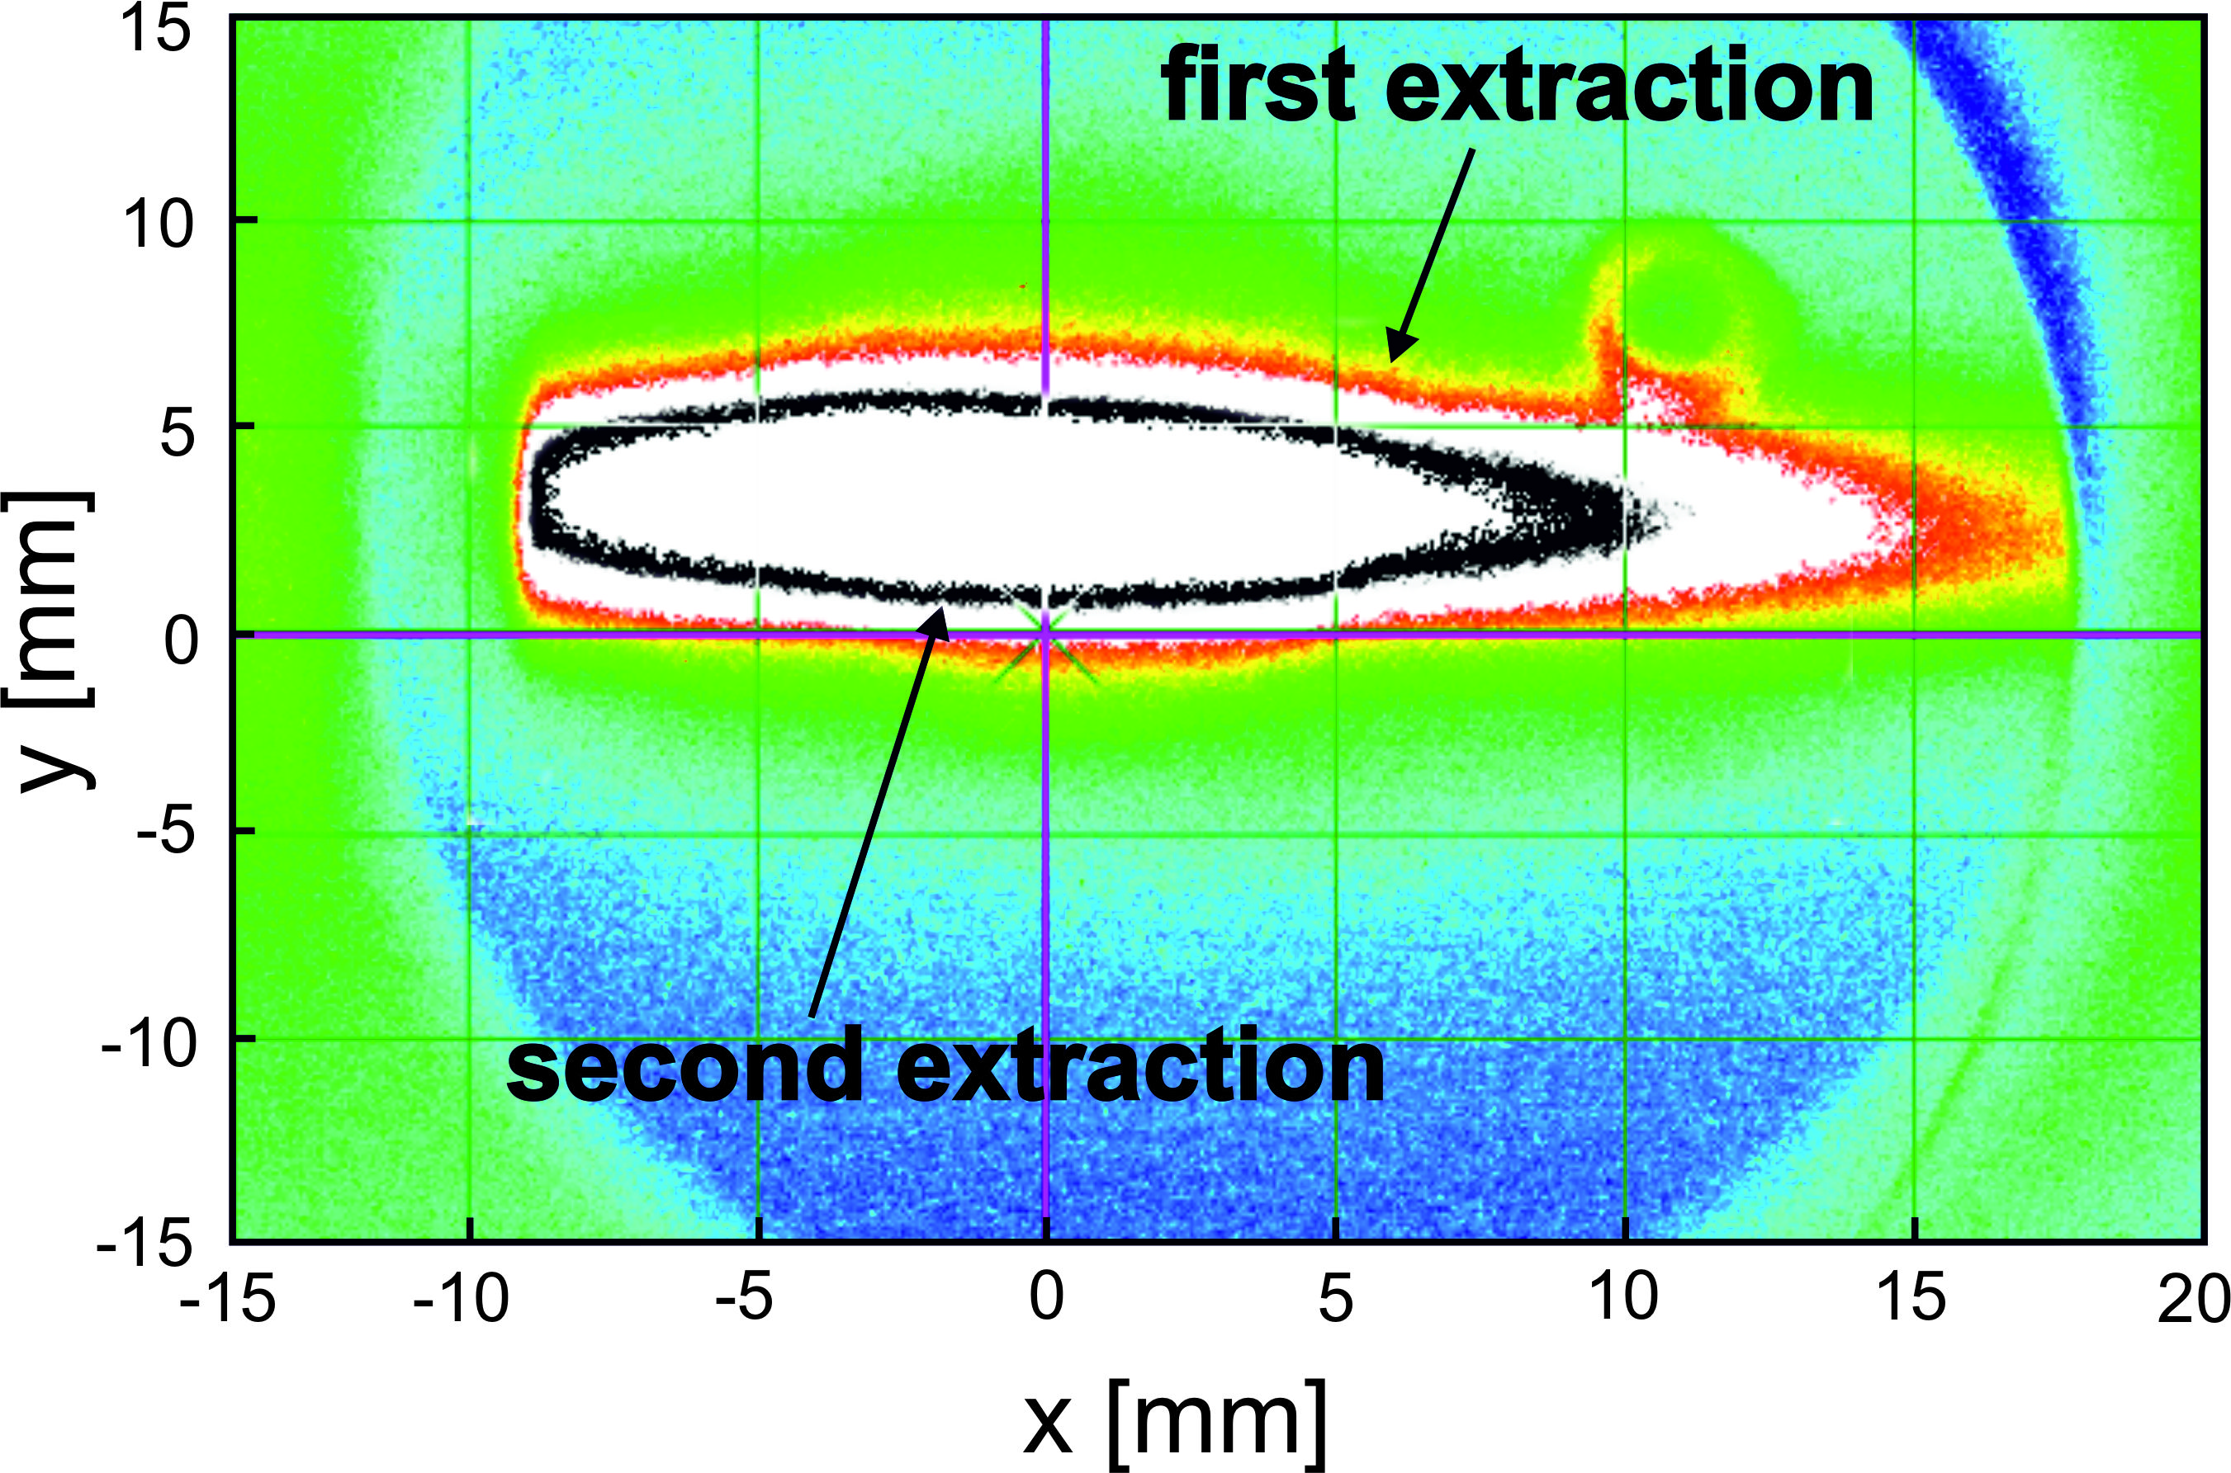
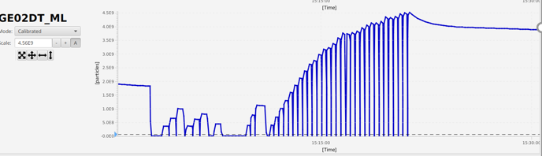
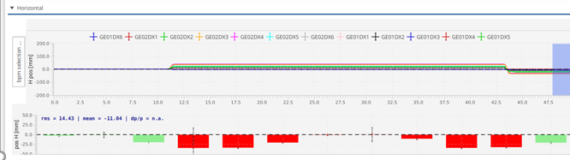
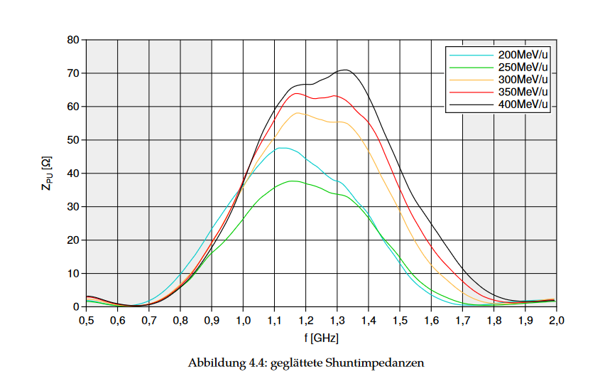
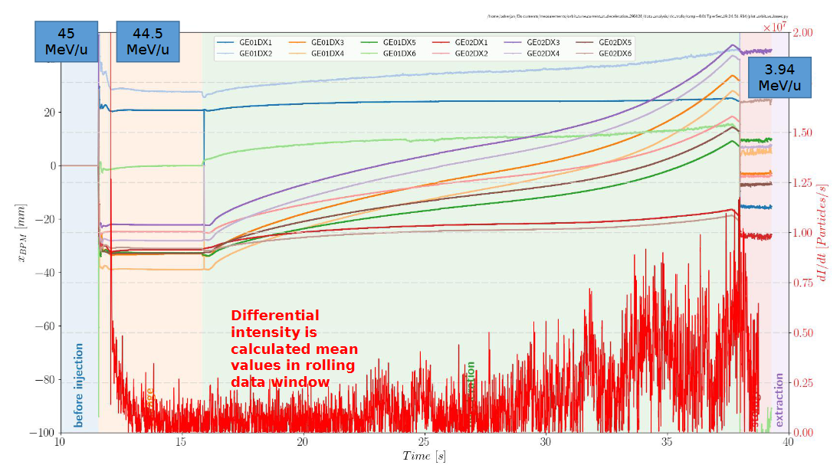
Machine Experiments at ESR in 2025
Co-colliding beams,
storage of two different ions , opening up the way to new experiments (demonstrated for Au78+,79+ and U91+, 92+)
Stacking with fixed Barrier Bucket
of importance especially for future FAIR storage rings
Multiple extraction
possible improvement for HITRAP commissiong and operation
intensity increase from 5e8 upto 4e9 for 12C6+
first screen after ESR in direction HITAP
Beam Optics studies
optimized optics for e-cooling and experiments
Stochastic Cooling
possible extension of energy range
in the future
Investigation of Deceleration
Possible improvement of efficiency in the future
D=0 in straight
dispersion around the ESR
shunt impedance 250-400 MeV/u
orbit during decelarition

Slide 15
The team:
B.Lorentz, M.Steck, S.Litvinov, R.Hess, R.Joseph, C.Crantz, A.Sherjan,
STOCO: C.Peschke, T.Katayama
Thank you for your attention

Slide 16
Barrier Bucket Stacking
As a consequence of the study, we already used the H=1 stacking with stochastic
cooling (Palmer) successfully for a physics experiment.
Easier to setup than the so far used Stacking with stochastic cooling, and electron
cooling on two different orbits.
And faster, as no orbit displacement is required.

Slide 17
Barrier Bucket Stacking
Highest Intensity reached with
e-cooling (500 mA) and BB (50V)
H=1 & electron cooling, works as well, maybe less efficient,
but settings not optimized here (one of the last runs)
e-cooling and BB, Intensity increase by factor 20
Efficiency goes down over time as predicted by simulation
TOF cooling, adjustment of gain increases
factor 15 increase

Slide 18
Barrier Bucket Stacking
Highest Intensity reached with e-cooling (500 mA) and BB (50V)

Slide 19
E-Cooling Barrier Bucket Stacking
Intensity increase by factor 20
Efficiency goes down over time as predicted by simulation

Slide 20
Barrier Bucket Stacking
TOF cooling, adjustment of gain increases efficiency when saturating
final intensity still lower than with e-cooling, but still factor 15 increase
(Palmer Cooling should be better...)

Slide 21
Barrier Bucket Stacking
H=1 and electron cooling, works as well, maybe less efficient,
but settings not optimized here (one of the last runs)

Slide 22
Beam Optics
There are more benefits of Dispersion zero in straight
We often change the momentum of the stored ion beam (e.g. for chromaticity
measurement) by changing the energy of the electron beam, i.e. the cooler
voltage. Frequently we were limited in the possible energy change, as the ion
beam moved horizontally out of the electron beam.
For internal target experiments, the overlap of ion beam and Gas Jet is also
effected by changing momentum witth non zero dispersion
Same for scraping,
or detector positioning
...

Slide 23
Beam Optics
There are more benefits of Dispersion zero in straight
We often change the momentum of the stored ion beam (e.g. for chromaticity
measurement) by changing the energy of the electron beam, i.e. the cooler
voltage. Frequently we were limited in the possible energy change, as the ion
beam moved horizontally out of the electron beam.
For internal target experiments, the overlap of ion beam and Gas Jet is also
effected by changing momentum witth non zero dispersion
Same for scraping,
or detector positioning
...

Slide 24
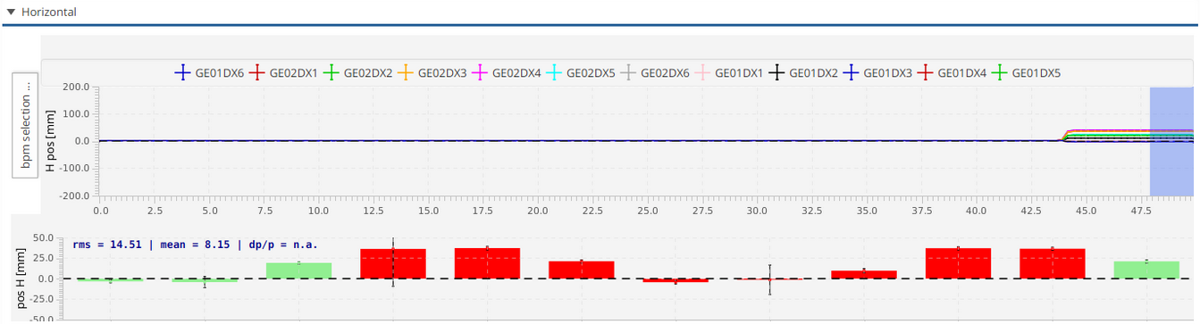
Beam Optics
First try (in Manipulation, so injection unchanged)
the bar plot is here the difference between the referenz orbit, and an dp orbit
=> dispersion

