Slide 1
Machine Development Experiments
Ring RF
Exp. 242, 267, 269
D. Lens, RRF
01.12.2025

Slide 2
Overview of Ring RF MDE in 2025
Nr. | Machine | Coordinator | Title
240 | SIS18 | K. Groß | Micro spill cavity
241 | SIS18 | B. Zipfel | Beam phase control
242 | SIS18 | D. Lens | Bunch compression
243 | SIS18 | K. Groß | Batch compression
244 | SIS18 | M. Hardieck | Longitudinal Feedback (PhD thesis C. Reinwald, TU Darmstadt)
267 | SIS18 & ESR | D. Beck | Phase shifting with Bunch2Bucket SIS18 → ESR
268 | ESR | B. Zipfel | Beam Phase Control
269 | ESR | M. Frey, K. Groß | Stacking with ESR Barrier Bucket
as usual: support from numerous colleagues and groups (sorry they cannot be mentioned here)

Slide 3
ESR Barrier-Bucket:
Stacking With Moving Barriers coordinators: M. Frey, K. Groß

Slide 4
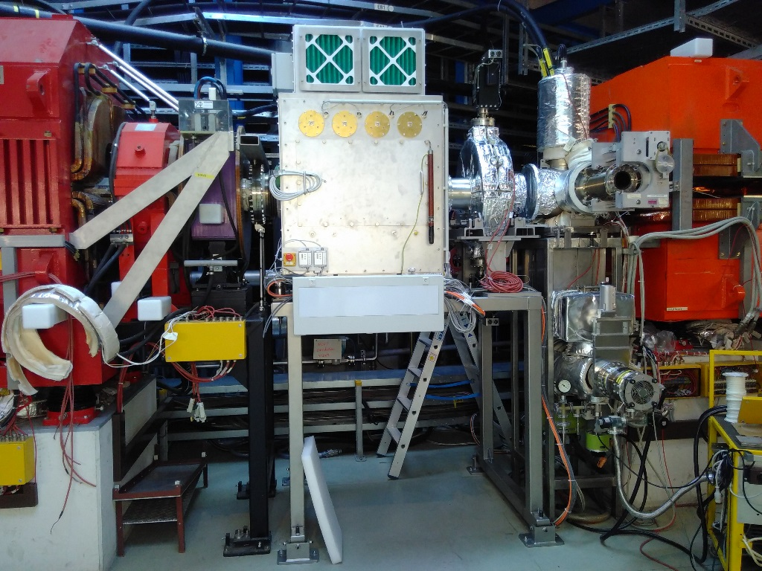
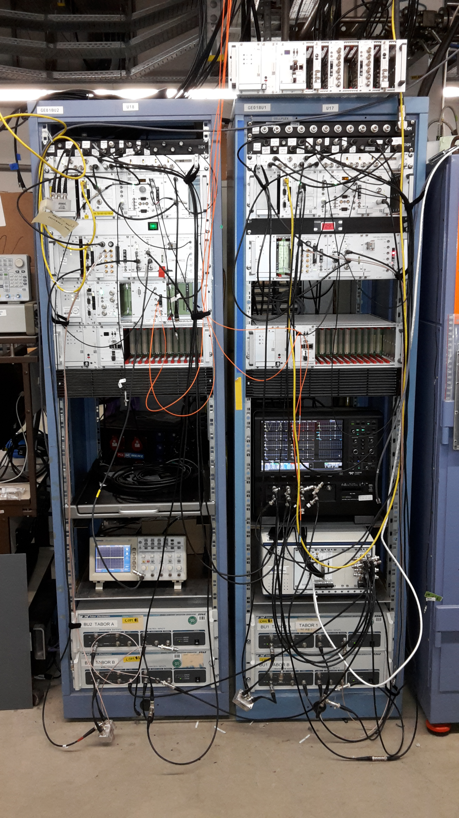
ESR Barrier Bucket cavity systems
Barrier Bucket cavities E01BU1 and E01BU2:
Broadband cavities combined in one housing (ESR tunnel)
Semiconductor power amplifiers (close to the cavities)
Low-Level Radio Frequency electronics, 5 racks (BG.1.016)
Photos: RRF/M. Frey

Slide 5
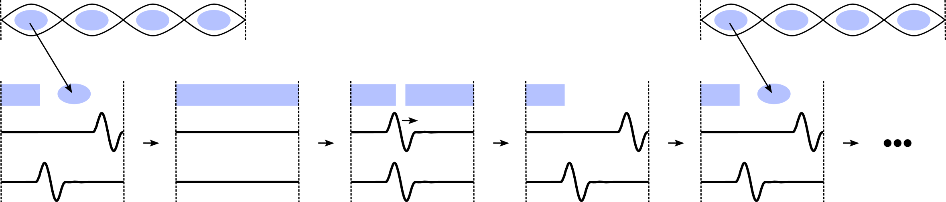
Principle of stacking with moving barriers
SIS18
only 1 bunch extracted (low intensity, with approval of machine coordinators)
B2B transfer (phase shifting in SIS18)
long. phase space
E01BU2
E01BU1
ESR
gap voltages
1) injection of new beam
2) barriers ramped down, coasting beam (cooling on)
3) barriers ramped up, then shifting …
4) … 1 barrier in phase to make space for …
5) … the new injection

Slide 6
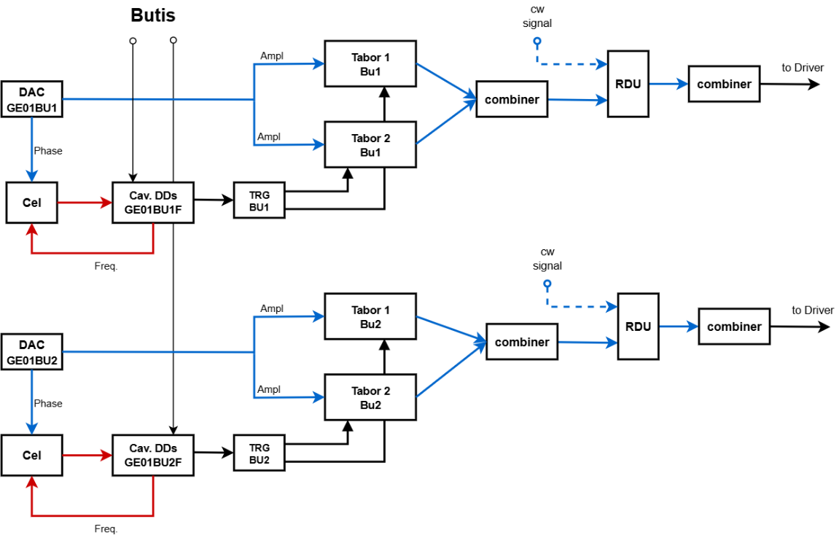
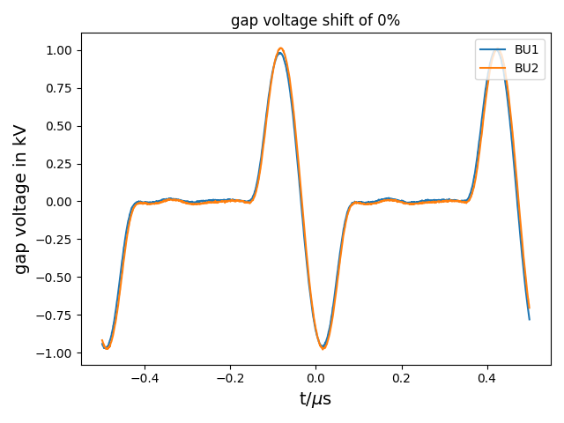
Barrier-Bucket signal generation
ESR BB project leader: M. Frey
each cavity has own LLRF for CW & pulsed operation
calculation methods for pre-distorted signal generation (based on measured cavity transfer function) were developed @ TUDa (accelerator technology group, H. Klingbeil)
software implementation: D. Penza
phase calibration of single-sine pulses with respect to ESR Group DDS signal (h=1)
currently fixed BB pulse (single-sine) duration of 200 ns
up to 1 kV per cavity
repetition frequency between 0.9 … 2 MHz

Slide 7
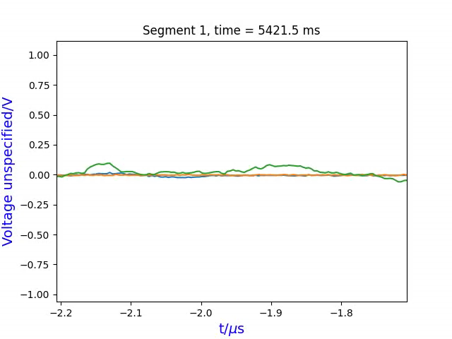
Ramping and phase shifting of barriers with beam
¹²C⁶⁺ at 400 MeV/u (May 28th, 2025)
Gap voltage E01BU1
Gap voltage E01BU2
FCT signal
offset in phase relation between cavities and FCT due to installation (ring) positions
preliminary analysis; observation of beam losses at each injection (not yet analyzed in detail)

Slide 8
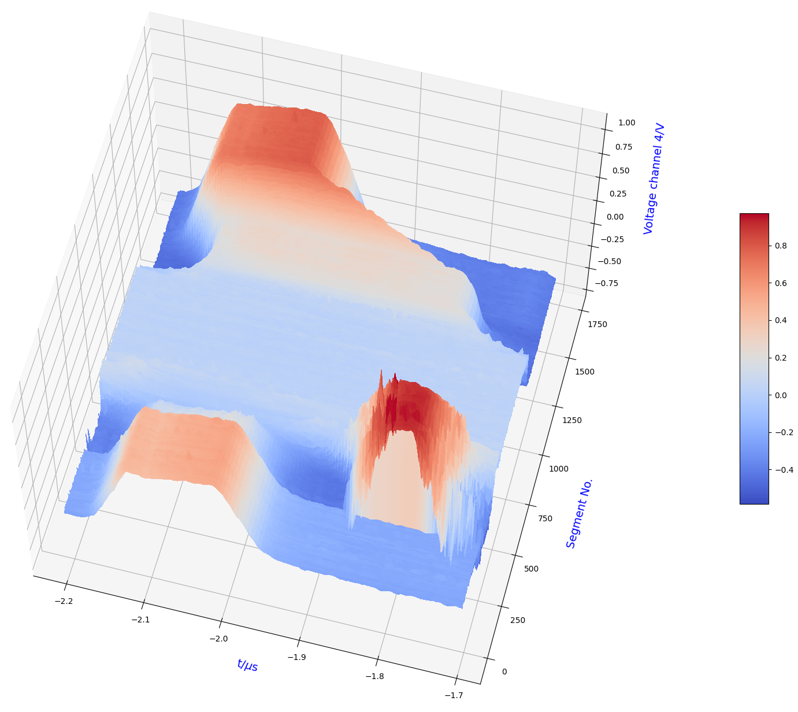
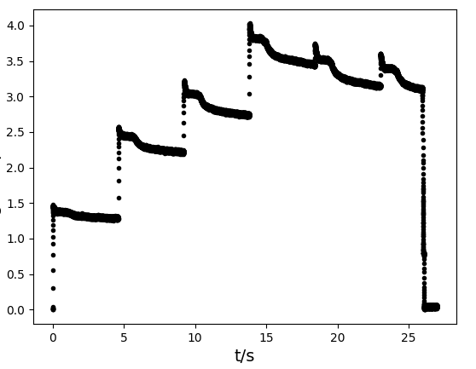
Stacking with ¹²C⁶⁺ at 400 MeV/u (May 28th, 2025)
5) one barrier moved in phase to make space for new injection
pattern and machine settings realized by S. Litvinov, B. Lorentz, …
stacking (proof of principle, not optimized) using B2B phase shift method in SIS18 (configured by D. Beck):
4) barriers ramping up
ESR FCT
ESR DC beam current
3) barriers ramped down: coasting beam
1) stored beam
analog DC trafo signal: Thanks to BEA (O. Chorniy)
2) injection of new beam

Slide 9
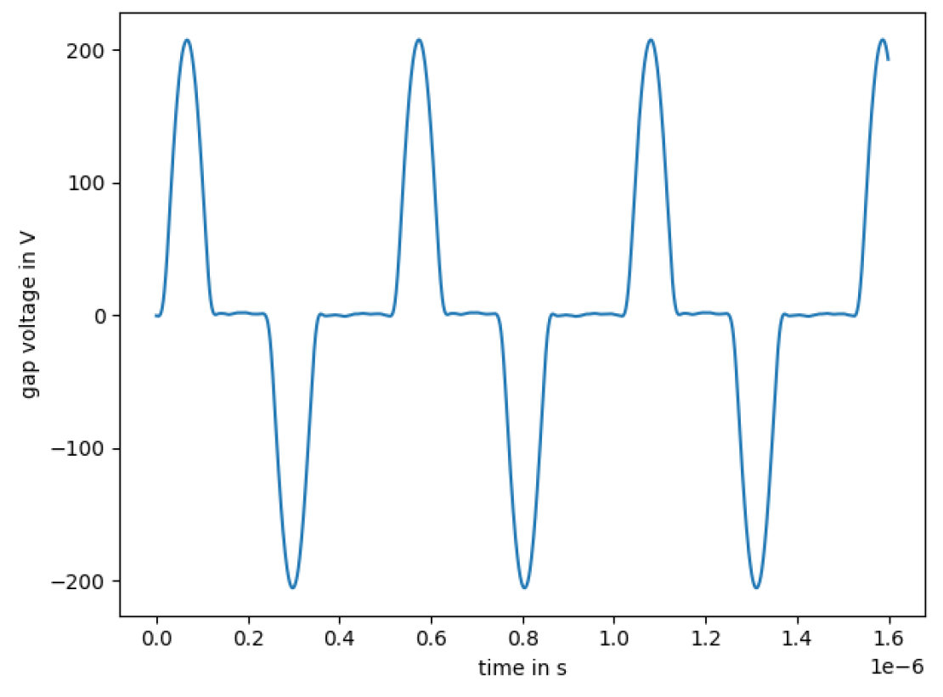
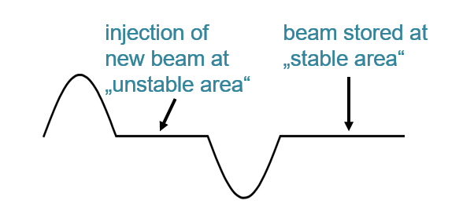
Signal generation for stacking with fixed barriers
Special signal preparation by RRF for subsequent MDE by T. Katayama et al., experiment with stacking:
→ see talk by B. Lorentz
Generation of two separate half-waves with one cavity, special implementation by D. Penza
Manual setup, currently not available/planned for standard operation
Measured gap voltage of E01BU2 (averaged, n=1000)

Slide 10
Conclusion and outlook
Result:
Successful stacking with moving barriers fully controlled by the central control system (target values: amplitude, phase, frequency)
Beam losses occurred at each injection; reason not yet analyzed in detail
Special thanks to:
ESR: B. Lorentz, M. Steck, S. Litvinov, T. Katayama, … (many more)
Bunch-to-bucket transfer with phase shifting: D. Beck (see also separate talk)
Next steps:
Remaining control system integration and LSA model implementation:
- Switching between CW and BB mode via RF switch events (from ParamModi instead of DeviceControl)
- Improvements for long and stable operation (e.g. automatic switching off function generators when not needed, automatic calibration procedure, …)

Slide 11
SIS18 Bunch Compression:
Phase Synchronisation Studies coordinator: D. Lens
D. Lens (RRF)
01.12.2025
11

Slide 12
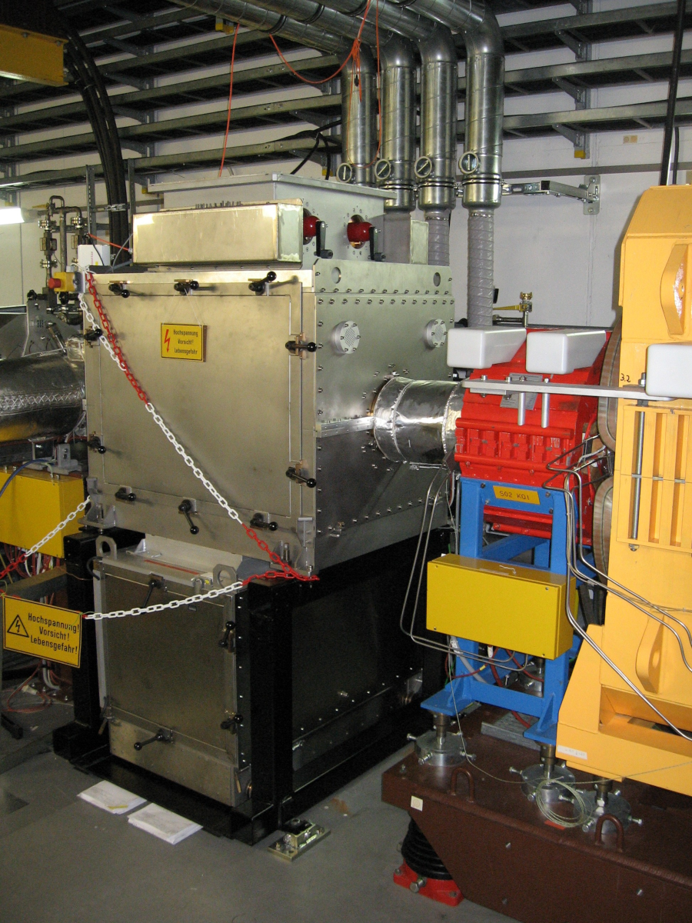
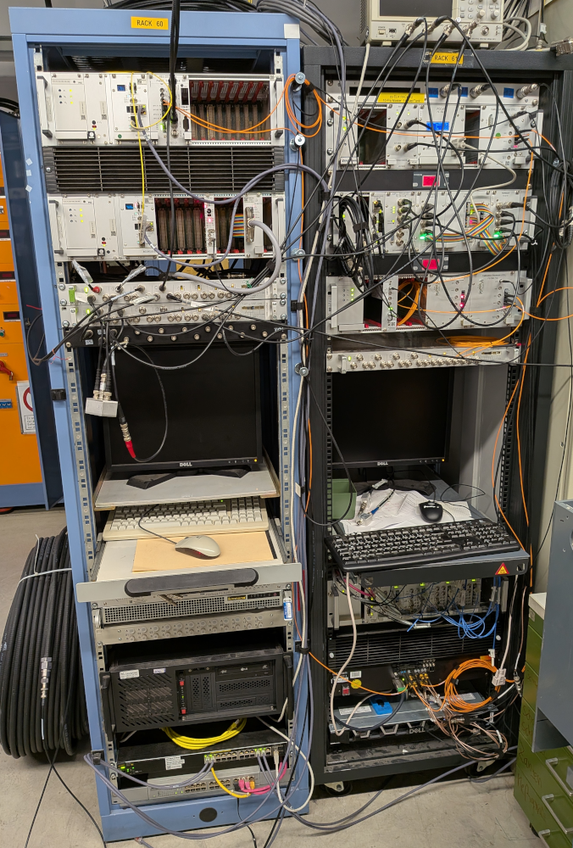
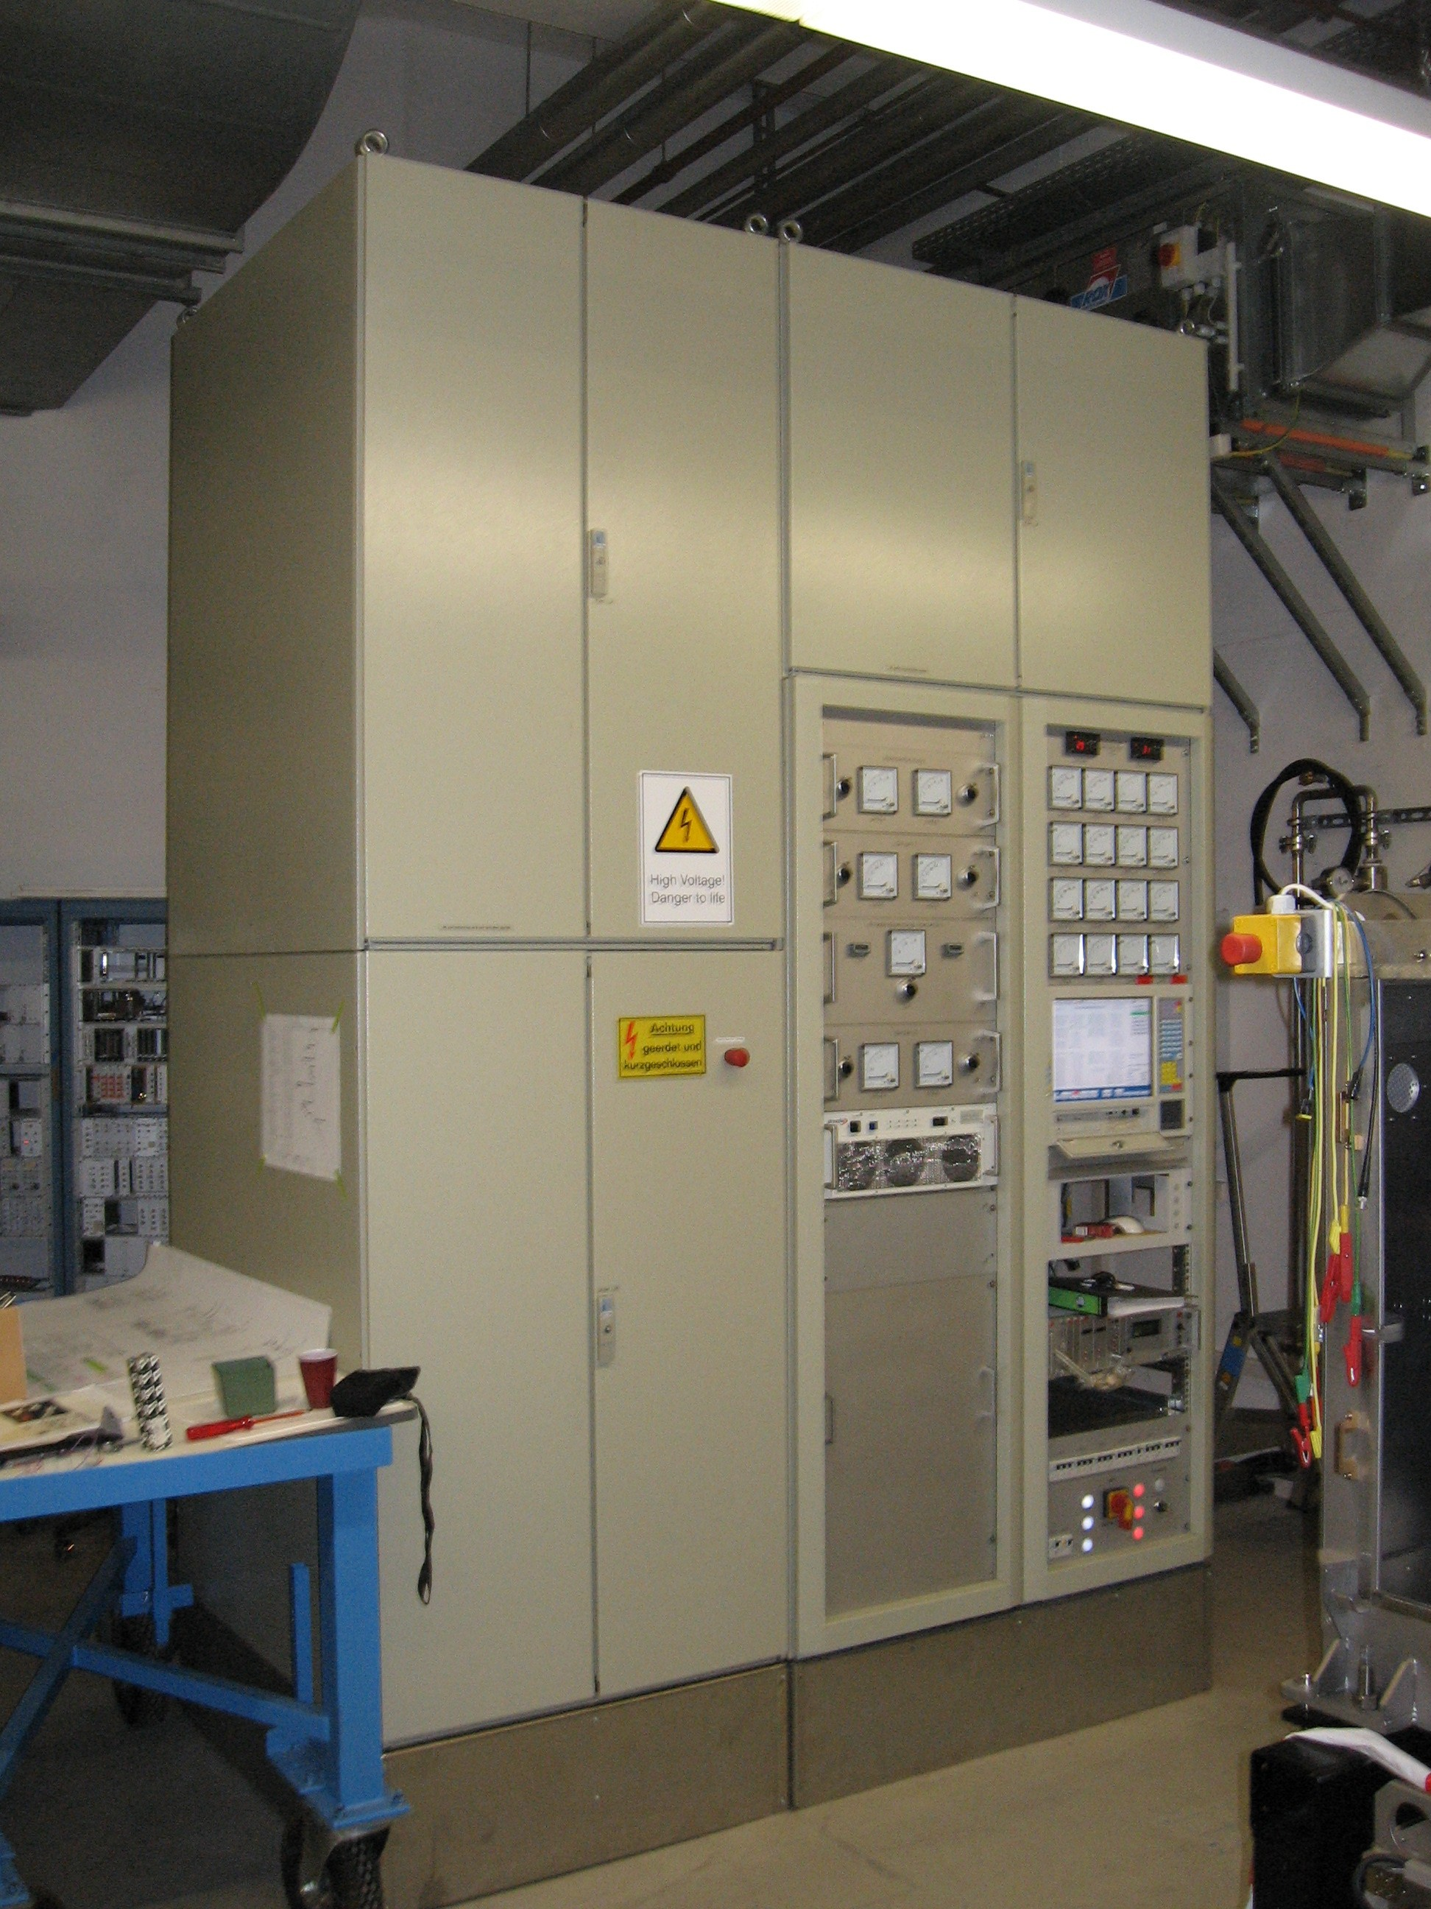
SIS18 Bunch Compressor system
Cavity & amplifier
SIS18 tunnel
RRF supply room (BG.1.016)
LLRF (cavity synchronization, control system interface, …)
power supply unit incl. PLC & stepper motor control

Slide 13
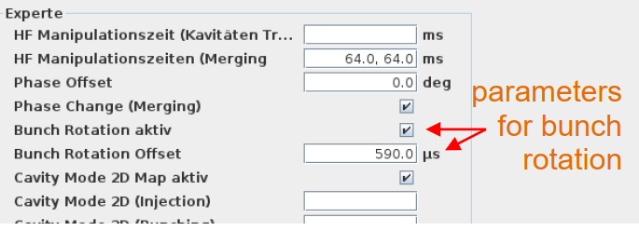
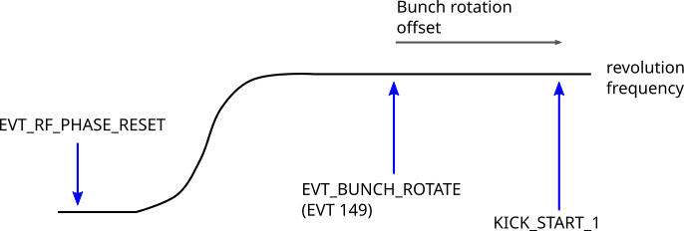
Current status of S02BB1
status, on/off/reset from DeviceControl (PLC integrated in CCS)
implemented data supply:
  frequency
  harmonic number
  phase
  switching on/off timing event for activation of bunch rotation for a beam cycle
  time between start of rotation and extraction
settings that currently have to be done with expert support (RRF):
  changing resonance frequency: stepper motor control, via network; still needs expert knowledge
  target amplitude
Cavity (phase) synchronisation partly feedforward (advantage: fast; disadvantage: phase drift during pulse, needs very long delay cables)

Slide 14
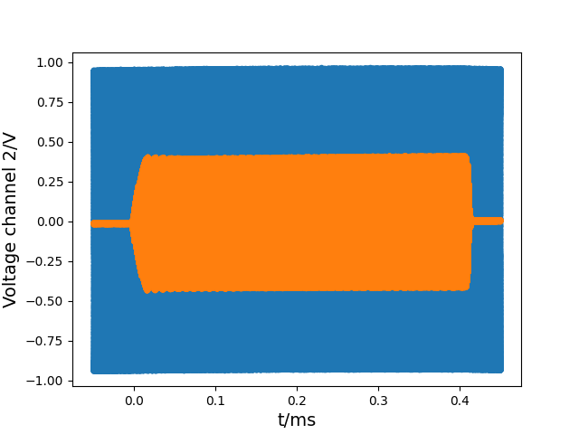
Current status of S02BB1
status, on/off/reset from DeviceControl (PLC integrated in CCS)
implemented data supply:
  frequency
  harmonic number
  phase
  switching on/off timing event for activation of bunch rotation for a beam cycle
  time between start of rotation and extraction
settings that currently have to be done with expert support (RRF):
  changing resonance frequency: stepper motor control, via network; still needs expert knowledge
  target amplitude
Cavity (phase) synchronisation partly feedforward (advantage: fast; disadvantage: phase drift during pulse, needs very long delay cables)
RF voltage S02BB1 (1:40.000)
extraction
pulse start (EVT 149 + delay)

Slide 15
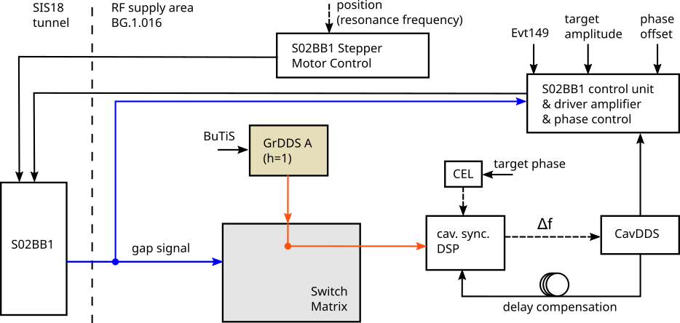
Cavity synchronization scheme
Requirements for S02BB1:
amplitude rise time < 30 µs
phase synchronization settling time significantly faster than for other (CW) RF systems
Synchronization scheme before MDE/beam time:
combination of feedforward & analog phase control
problem: phase drifts during pulse

Slide 16
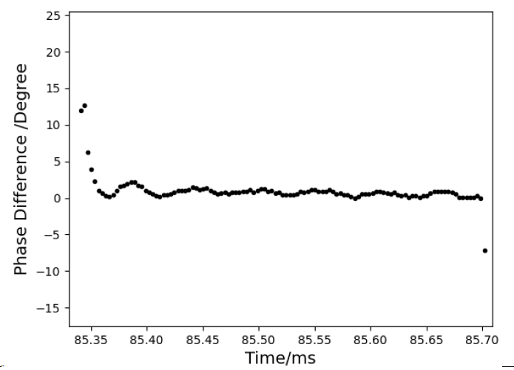
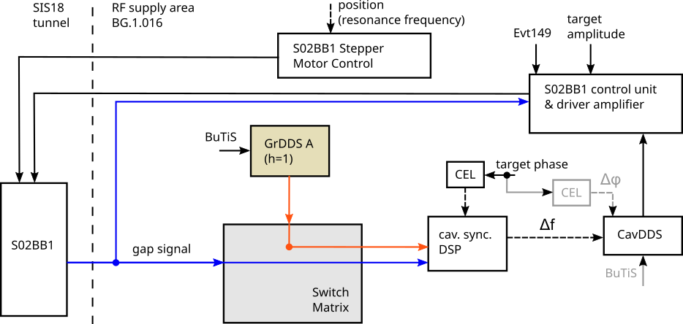

Cavity synchronization scheme
Requirements for S02BB1:
amplitude rise time < 30 µs
phase synchronization settling time significantly faster than for other (CW) RF systems
Synchronization scheme before MDE/beam time:
combination of feedforward & analog phase control
problem: phase drifts during pulse
Test of new scheme:
synchronization directly on gap voltage
new DSP hardware, PID control
BuTiS-clocks and feedforward for Cavity DDS
Measured gap phase (shutdown)
$$50μs$$

Slide 17
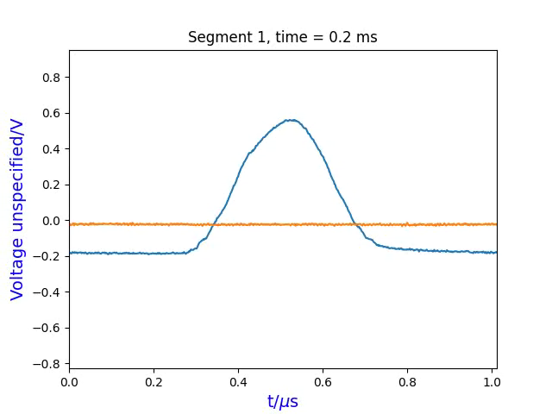
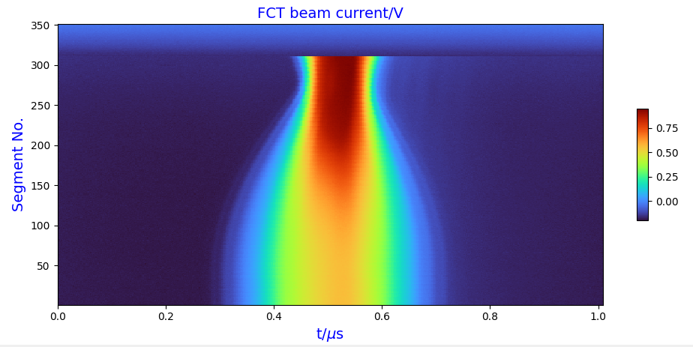
Compression (during PPH beam time)
compression of one SIS18 bunch (400 MeV/u, U⁷³⁺)
extraction
(here, shortly after maximum compression)

Slide 18
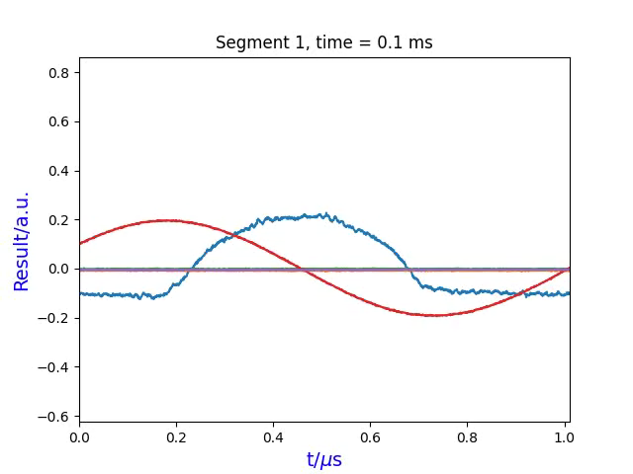


Compression with MA cavities (300 MeV/u, U⁷³⁺)
reduced voltage of S02BB1 (16 kV) due to problem with „remote“ operation of system (solved after MDE)
observed FWHM: before compression: ≈ 400 ns
highest compression: ≈ 125 ns
idealized estimation:
demonstration of multi-cavity compression
but: so far only proof-of-principle:
  manual setup for pulsed operation of MA cavities
  special setting of phase detection module (AGC)
  worst case for synchronization: BE3/5 pulse starting from 0 V (phase feedback slower than amplitude feedback)
Remaining topics if needed in standard operation:
  partly upgrade of MA systems LLRF (incl. solution for AGC)
  control system integration
  choice of RF voltages before pulse (> feedback threshold)
  momentum acceptance limits (extraction/transfer line)?
FCT signal (measured signal x 10)
Gap voltage S02BB1 (1:40.000), max. 16 kV
Gap voltage S07BE3 (1:20.000), max. 11 kV
Gap voltage S07BE4 (1:20.000), 4 kV
Gap voltage S07BE5 (1:20.000), max. 7.7 kV
(phase relations depend on installation positions)
$$\frac{1}{3.2}$$
$$\sqrt{\frac{\left(11+4+7.7+16\right)}{4}}≈3.1$$

Slide 19
Conclusion & outlook
Result:
S02BB1 integrated in DeviceControl and ParamModi
successful proof of principle of new synchronization scheme (also important for SIS100 BC), has to be further tested and optimized during shutdown
Problems during MDE and beam time:
issue with analog amplitude feedback, limited voltage to less than 20 kV during MDE; has been solved, to be tested during shutdown
partly unstable operation due to unacceptable high ambient temperature in BG.1.016 → insufficient cooling issue has been addressed/escalated
Outlook and tasks:
implementation (mainly FESA) of resonance frequency tuning via CCS (without expert knowledge)
reducing down-time due to over-heating (cooling upgrade of BG.1.016 necessary!)
further machine development experiments needed for achieving standard operation without RRF support
Please contact RRF in advance in case SIS18 Bunch Compressor is desired for operation

