Slide 1
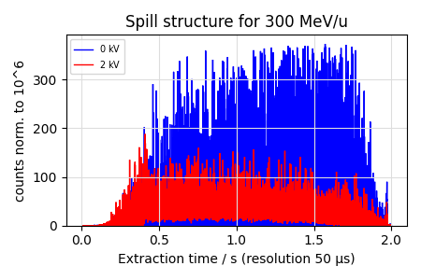
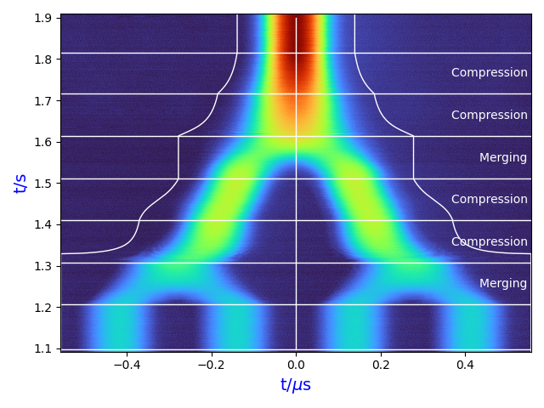
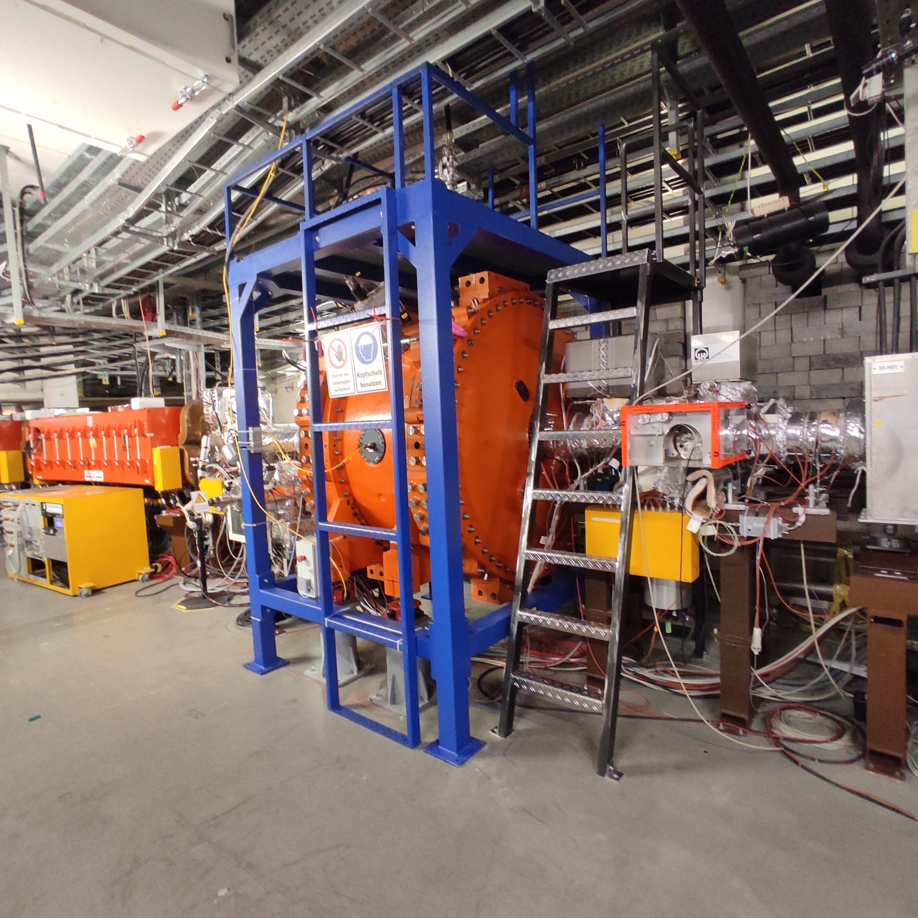
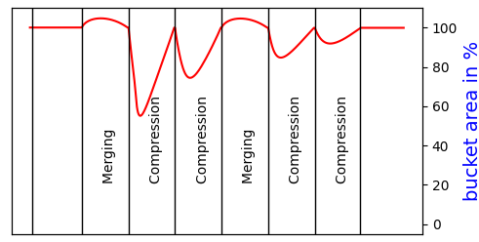
Exp. 240
SIS18 Micro Spill Cavity and
Exp. 243
Batch Compression
Maschine Experiments 2025 K.Groß. RRF 01.12.2025

Slide 2
Overview
Ring RF MDE in 2025
Nr. | Machine | Coordinator | Title
240 | SIS18 | K. Groß | Micro spill cavity
241 | SIS18 | B. Zipfel | Beam phase control
242 | SIS18 | D. Lens | Bunch compression
243 | SIS18 | K. Groß | Batch compression
244 | SIS18 | M. Hardieck | Longitudinal Feedback (PhD thesis C. Reinwald, TU Darmstadt)
267 | SIS18 & ESR | D. Beck | Phase shifting with Bunch2Bucket SIS18 → ESR
268 | ESR | B. Zipfel | Beam Phase Control
269 | ESR | M. Frey, K. Groß | Stacking with ESR Barrier Bucket
as usual: support from numerous colleagues and groups (sorry they cannot be mentioned here)

Slide 3
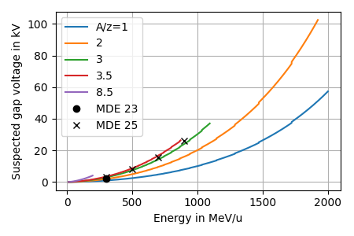
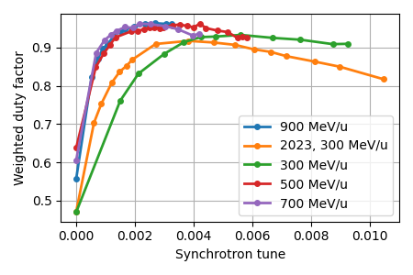
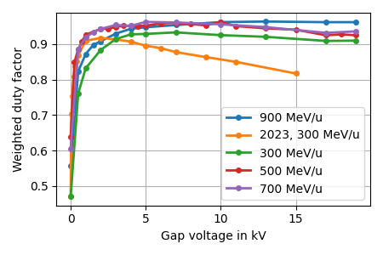

Micro Spill Cavity
Overview
Experiments
Nov. 29th ’23, ¹⁴N⁷⁺, 300 MeV/u
→ opt. $2$ kV, $Q_{syn}≈0.0038$
July 13th ’25, ²³⁸U⁷³⁺, 300, 500, 700 & 900 MeV/u
  → “expected” energy dependence not found → low voltages sufficient

Slide 4
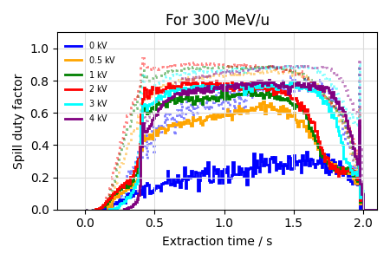
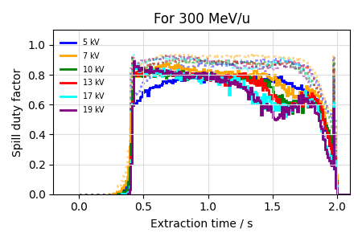
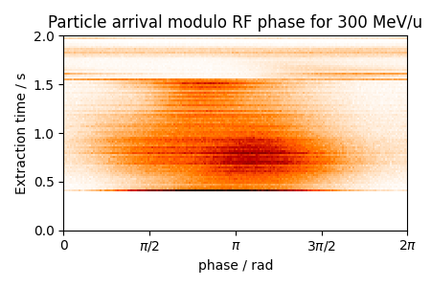
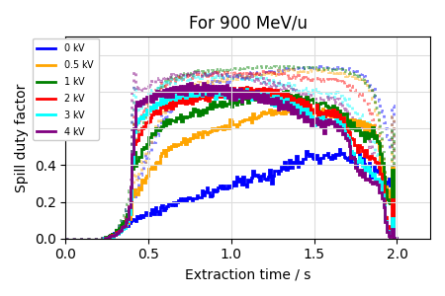
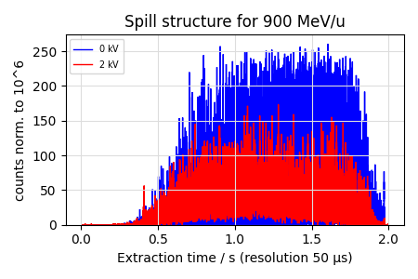
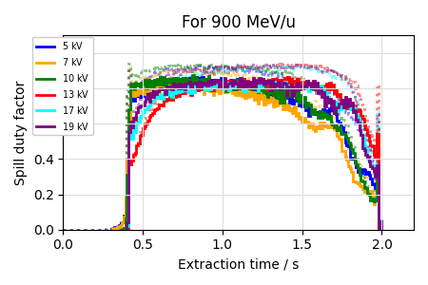
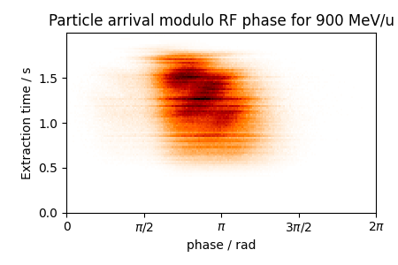
Micro Spill Cavity
Experiment July 13th ’25
Low voltages for spill improvement
see OP school:
https://indico.gsi.de/event/23330/
High voltages for beam dyn. studies
see SX 2025: https://indico.bnl.gov/event/27693/contributions/112722/

Slide 5
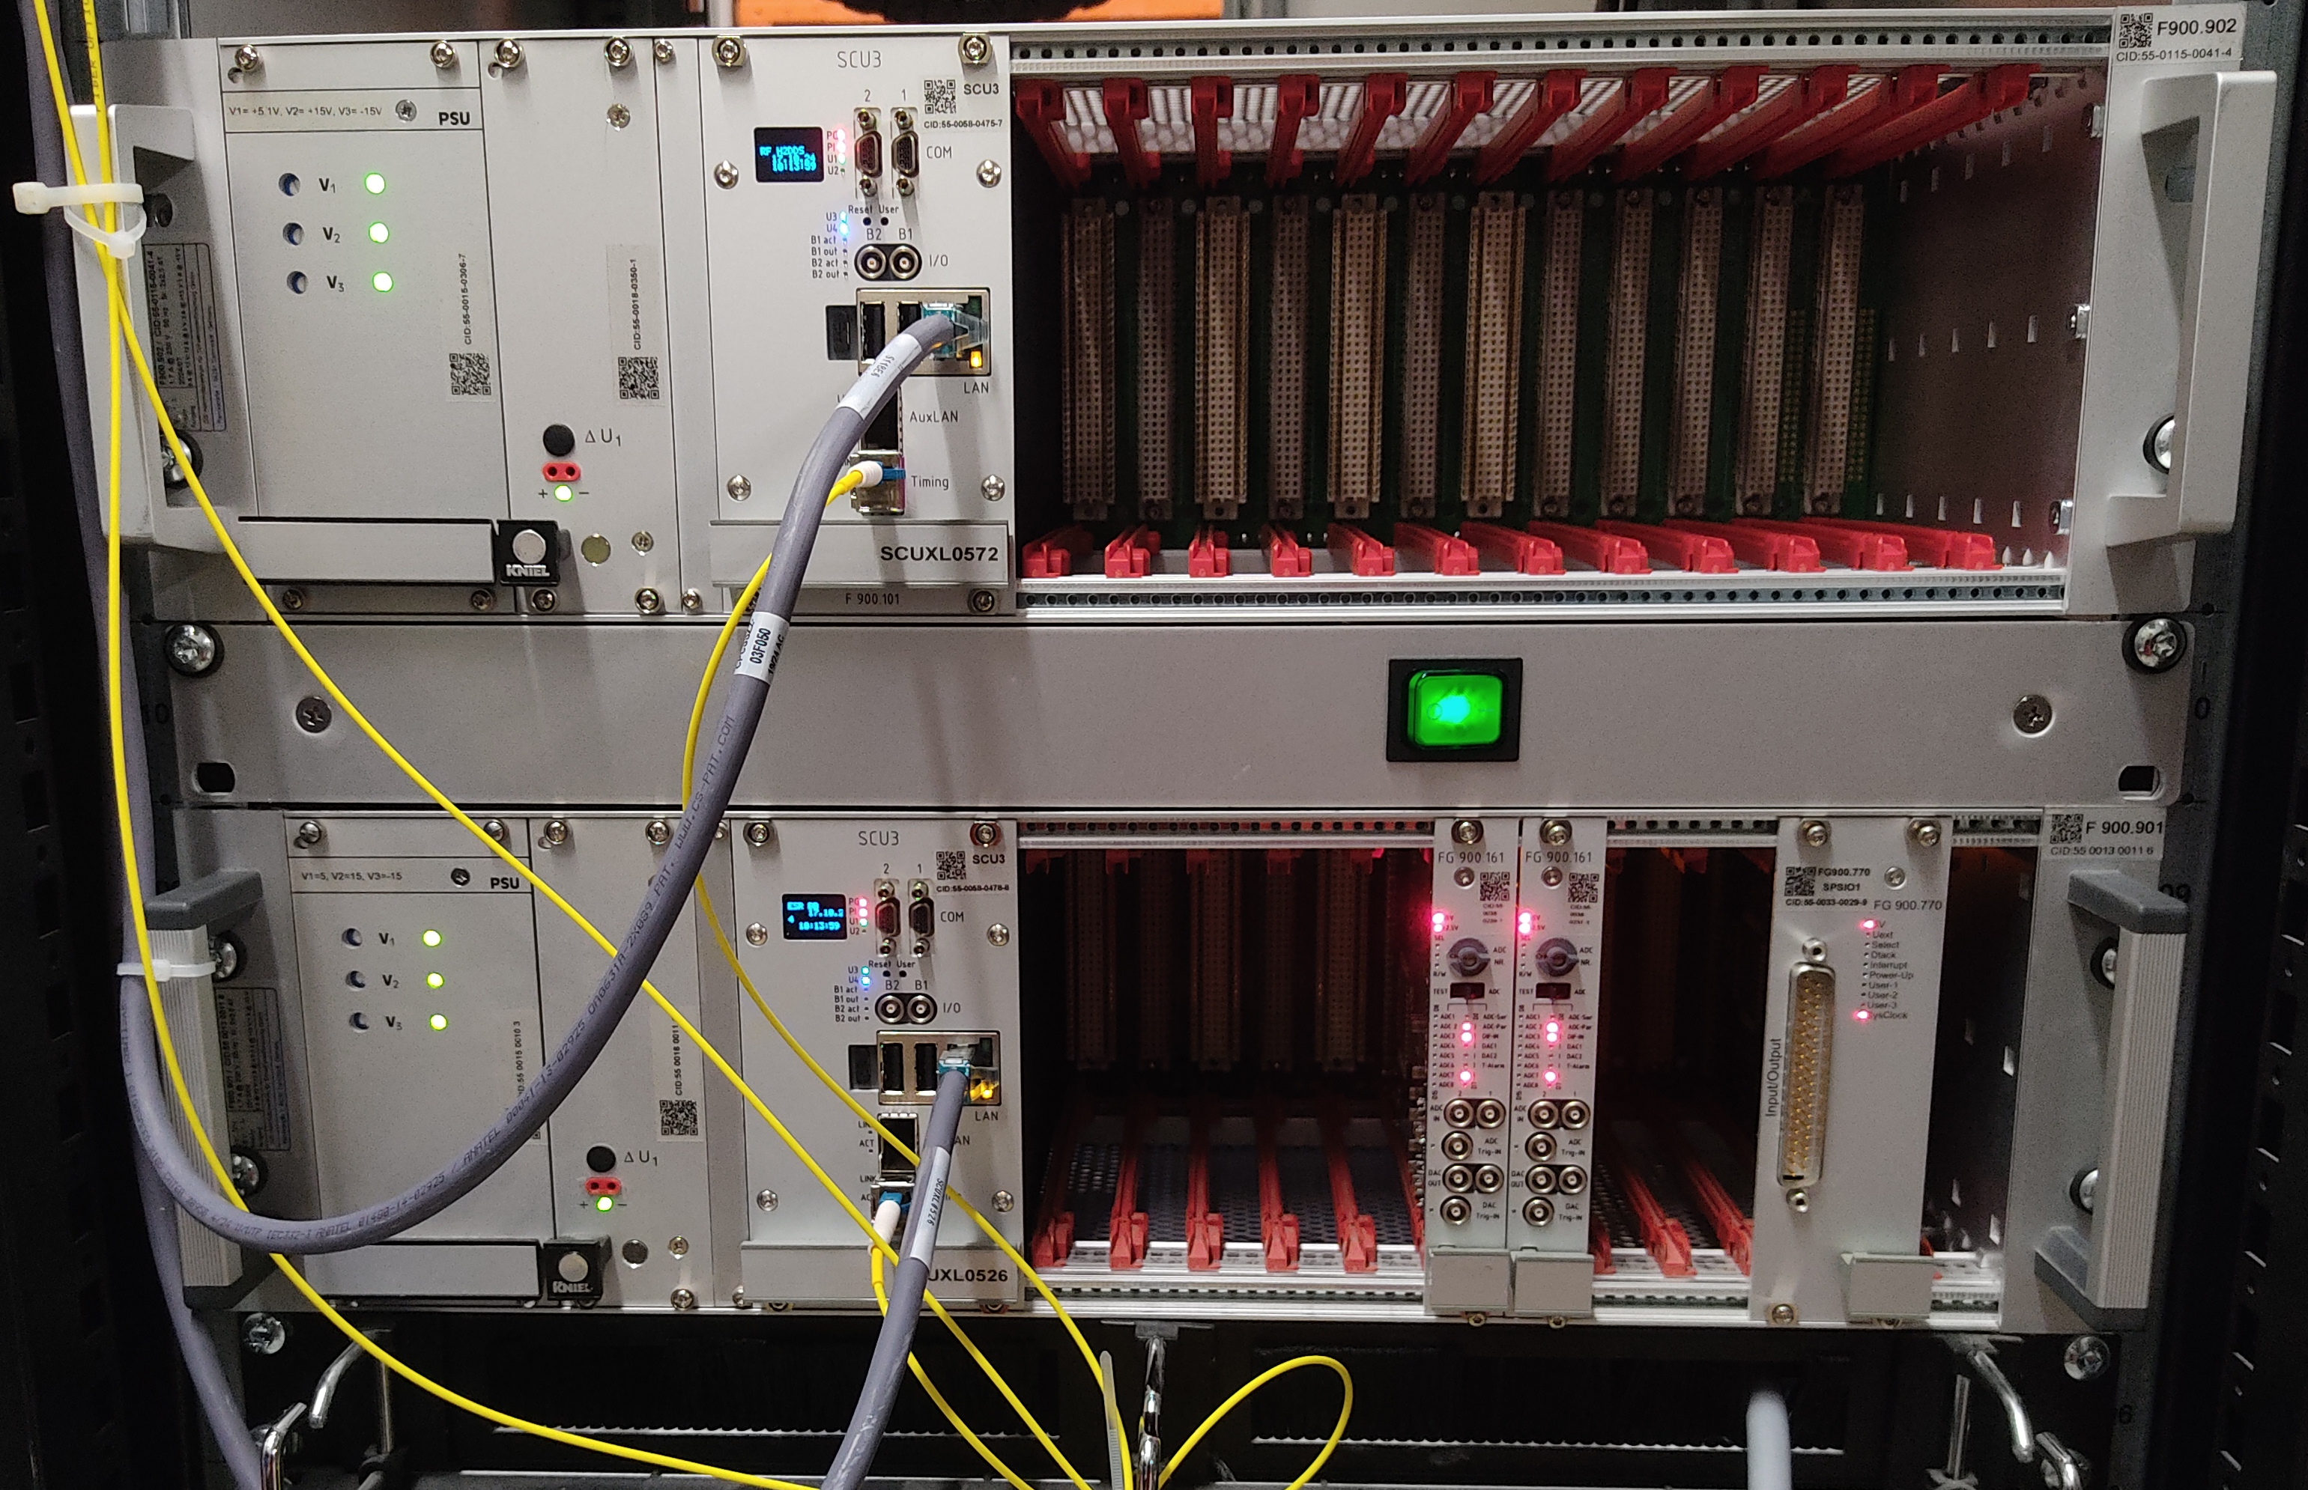
Micro Spill Cavity
Summary and Outlook
Summary
Reproducible reduction of spill peaks by factor 2
Low gap voltage 1.5 to 2 kV sufficient for all energies
More than 5 kV not recommended
Thanks to P. Forck and J. Yang for their support and interest!
Outlook
Integration into control system
Operation to gain user experience
Future experiments (< 2 kV)
  Limit for high current operation
  Influence on (/ controllability of) macro spill structure
SCU
ADDAC
SCU
SPS-IO

Slide 6
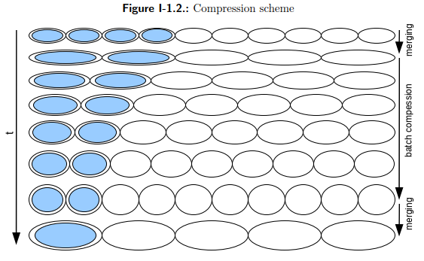
Batch Compression
Background
Batch Compression defined
for SIS100 Proton Cycle
in „SIS100 Cycles“
Aim of experiment
  First Batch Compression
  @ GSI
  Test case for SIS100
  Not relevant for operation
  @ SIS18 (due to limitations)
July 9th ’25 night shift, ²³⁸U⁷³⁺

Slide 7
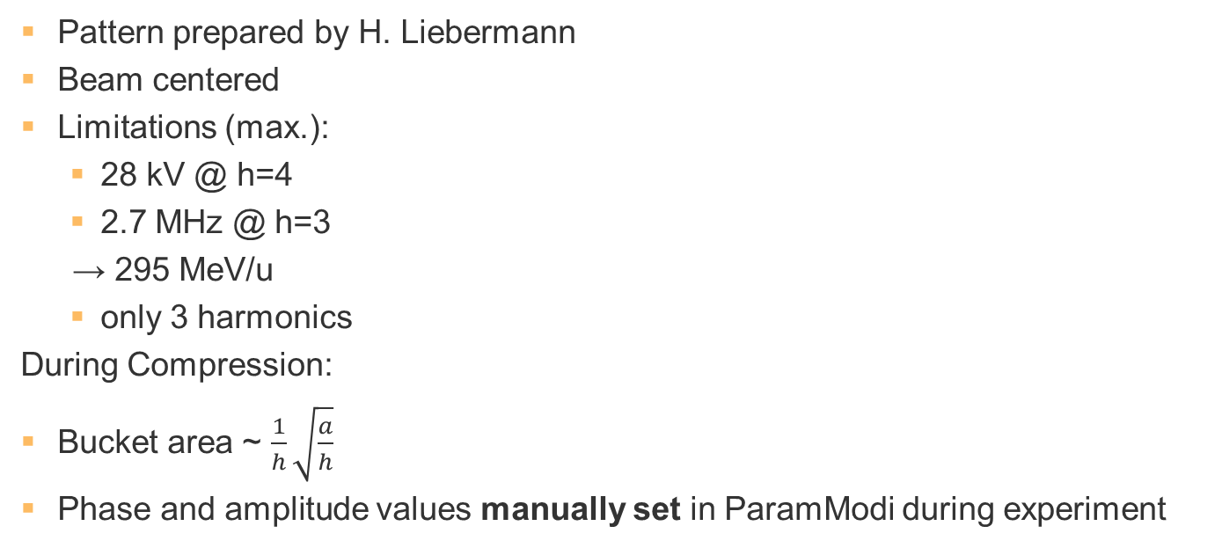
Batch Compression
Preparation
Pattern prepared by H. Liebermann
Beam centered
Limitations (max.):
  28 kV @ h=4
  2.7 MHz @ h=3
→ 295 MeV/u
  only 3 harmonics
During Compression:
Bucket area ~ $\frac{1}{h}\sqrt{\frac{a}{h}}$
Phase and amplitude values manually set in ParamModi during experiment
Batch Compression
Merging
Batch Compression
Merging

Slide 8
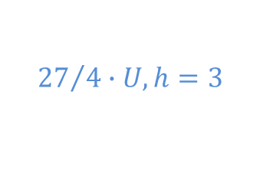



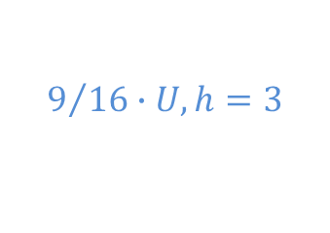
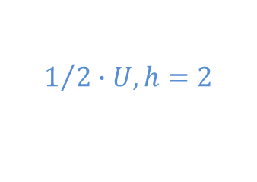

Batch Compression
Preparation
Pattern prepared by H. Liebermann
Beam centered
Limitations (max.):
  28 kV @ h=4
  2.7 MHz @ h=3
→ 295 MeV/u
  only 3 harmonics
During Compression:
Bucket area ~ $\frac{1}{h}\sqrt{\frac{a}{h}}$
Phase and amplitude values manually set in ParamModi during experiment
$$16∙U, h=4$$
Batch Compression
$${27}/4∙U, h=3$$
$$2∙U, h=2$$
Merging
$$4∙U, h=4$$
Batch Compression
$$9/{16}∙U, h=3$$
$$1/2∙U, h=2$$
Merging
$$a=U, h=4$$

Slide 9
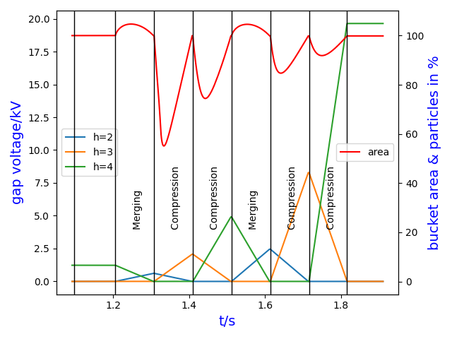
Batch Compression
Amplitude Optimization and Bucket Area
Voltage ratios as shown & lin. ramps
Problem: bucket area decreases
Part of experiment preparation
Only short test in experiment

Slide 10
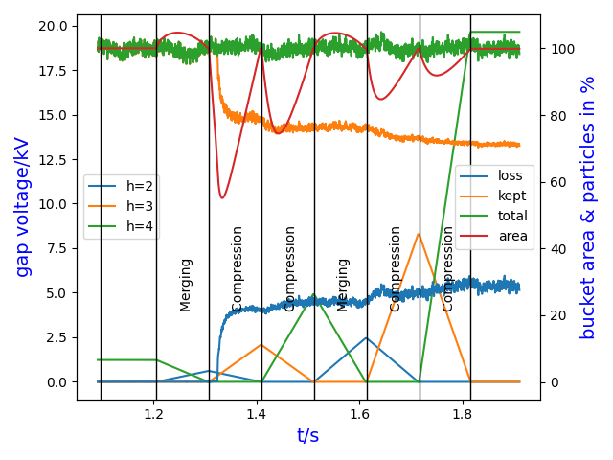
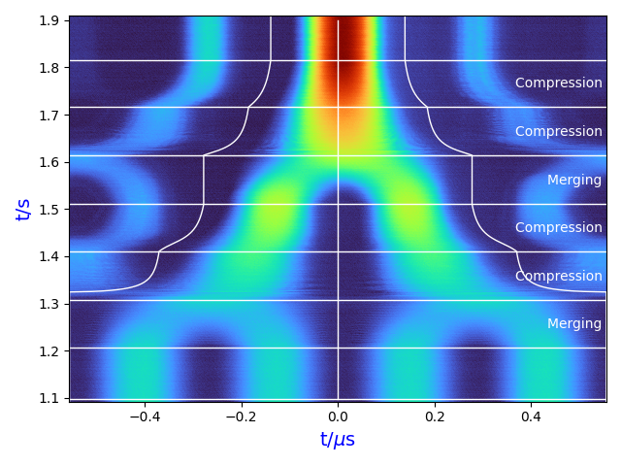
Batch Compression
Amplitude Optimization and Bucket Area
Voltage ratios as shown & lin. ramps
Problem: bucket area decreases
Part of experiment preparation
Only short test in experiment

Slide 11
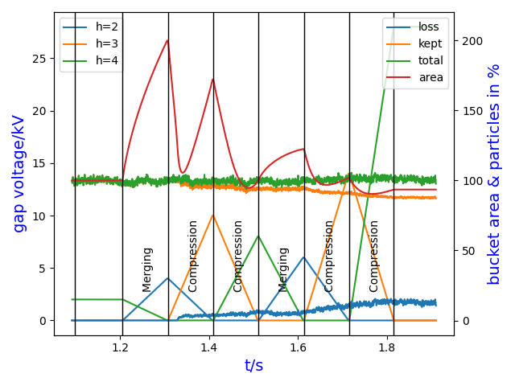
Batch Compression
Amplitude Optimization and Bucket Area
Simple solution: increase amplitudes
Optimization by simulations ongoing
Successful batch compression
← Various amplitudes tested

Slide 12
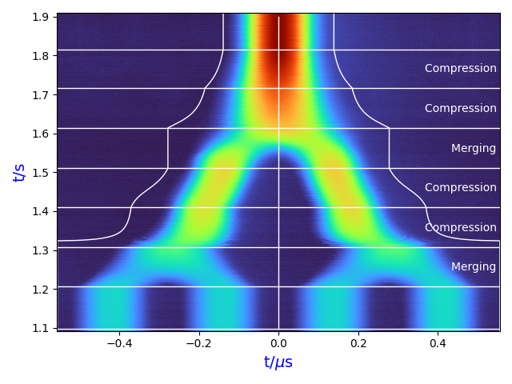

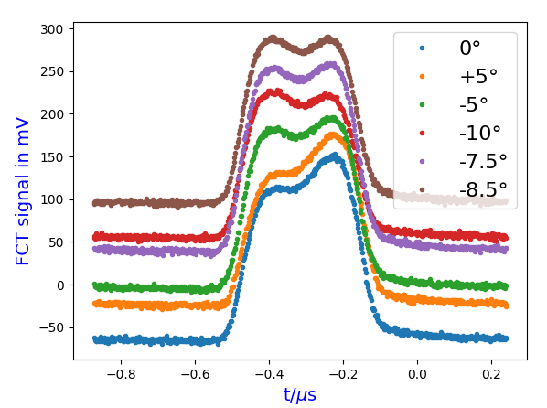
Batch Compression
Cavity Phase Optimization
Bunch merging (h=4 → h=2) was analyzed online during the experiment
for manual phase correction in ParamModi
Theoretical phases
Optimum: -8.5° @ BE5 (h=2)
Detailed evaluation also shows a small mismatch of BE3/4 (h=3)
Result similar to earlier merging experiments. Further experiments needed!

Slide 13
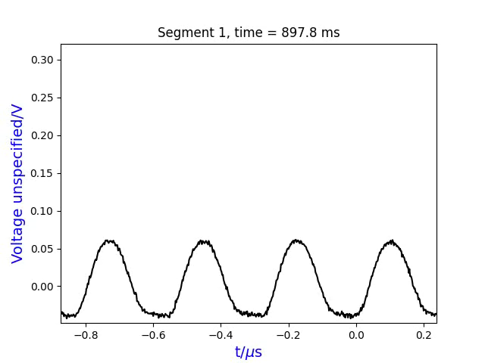
Batch Compression
Visualization

Slide 14
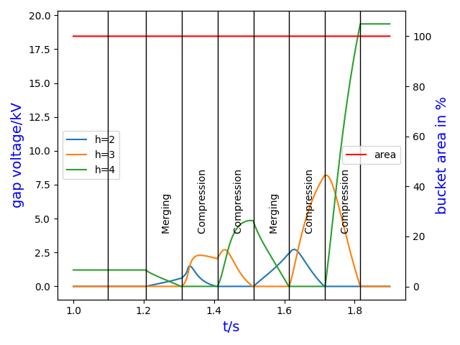
Batch Compression
Summary and Outlook
Summary
First batch compression
@ SIS18 successful
on July 9th ’25
All ferrite and MA cavities
worked well together
Outlook
Investigation of remaining phase error
@ different energies
Various schemes for Batch Compression
to be analyzed for SIS100 cycles

Slide 15
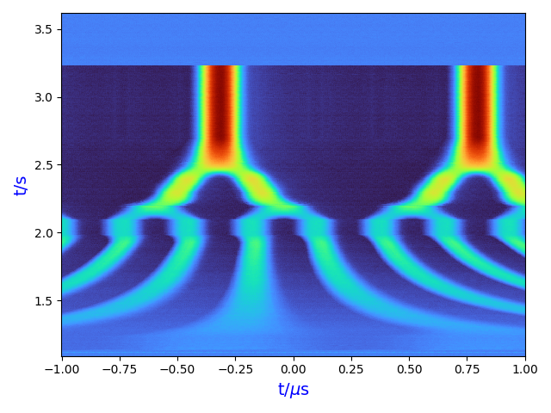
The End
Thanks for your attention!
Special thanks to K. Grigoryev
for providing reliable planning and flexibility
Questions?
Known jitter for the EVT_START_CYCLE (#32):
→ 18.7 ms measured
Reduced by new “deterministic” scheduling?

Slide 16
Used measurements
Slide 1: from slides 4 and 12
Slide 3: all from ’23 & ’25 with correct spill length (trigger)
Slide 4: as indicated on slide & 19 kV
Slide 10: # 2
Slide 11: # 33
Slide 12: # 13, # 18, # 13-18
Slide 13: # 33

