Slide 1
Dosimetry with Uranium beams
E. Kozlova, A. Sokolov, S. Kundumattathil Mohanan, T. Radon, E. Mustafin

Slide 2
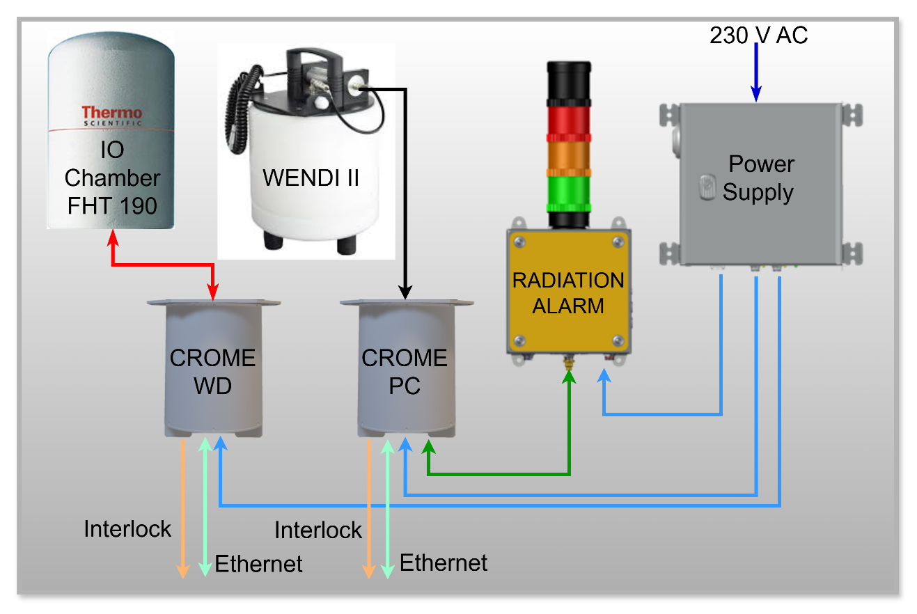
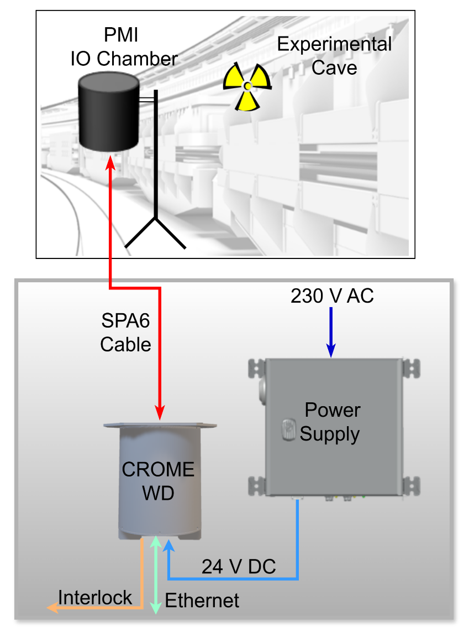
CERN Radiation Monitoring Electronics (CROME) @ FAIR
Measuring Station
Controlled Area
Limit: 3 uSv/h
Surveyed Area
Limit: 0.5 uSv/h
Part of Personal Access System (PAS)
Dose Monitoring
PMI + CROME – were tested during Machine Studies in 2024 and approved themselfs to be the perfect candidates for dose measurements at FAIR facility

Slide 3
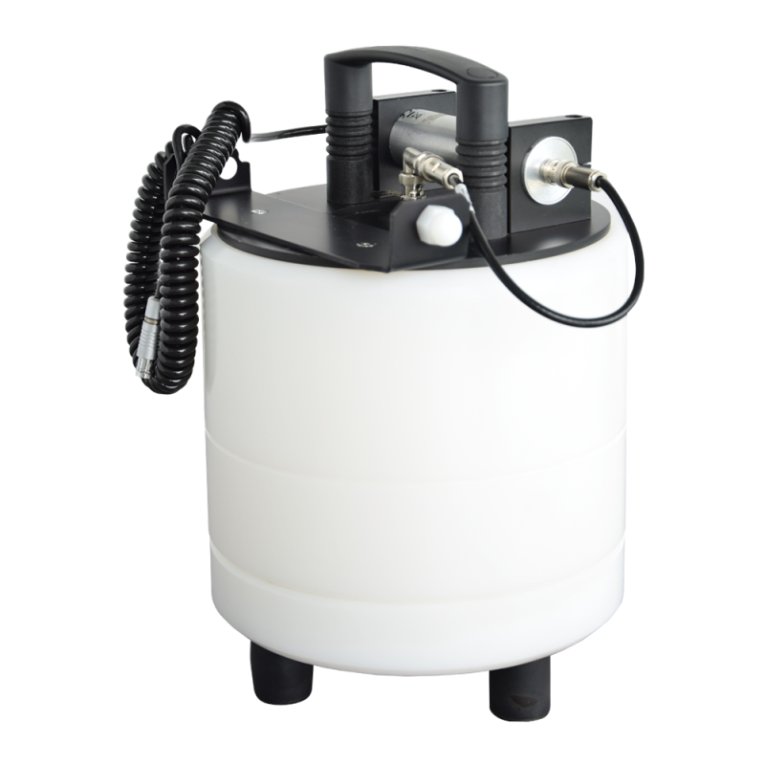
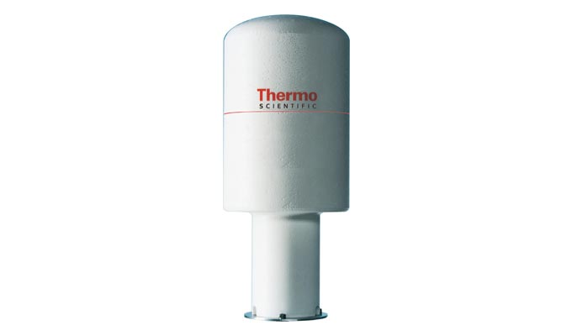
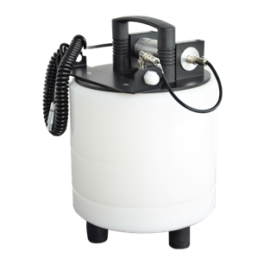
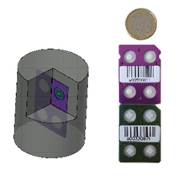
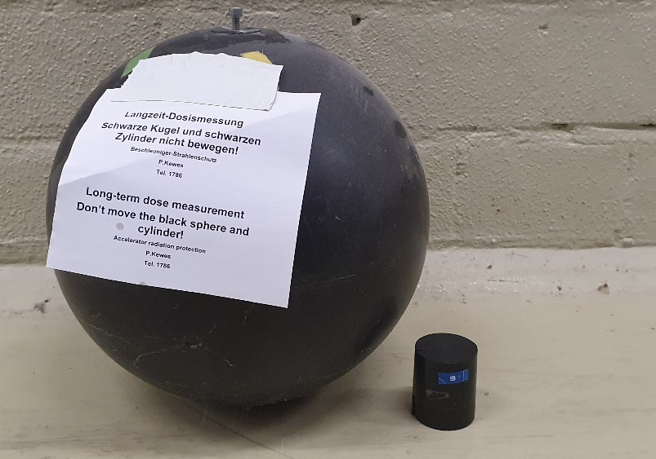
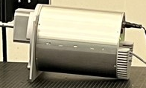
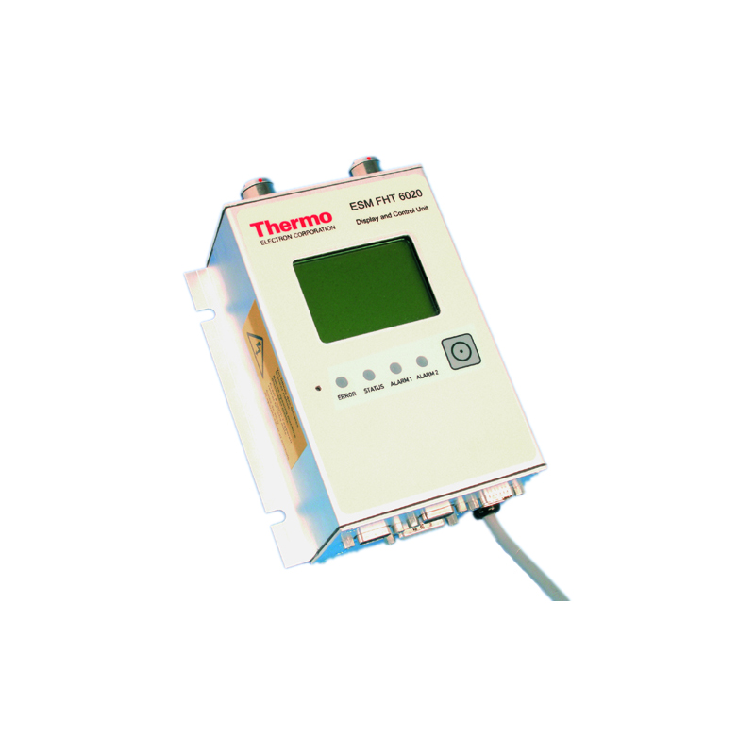
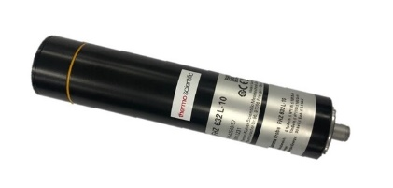
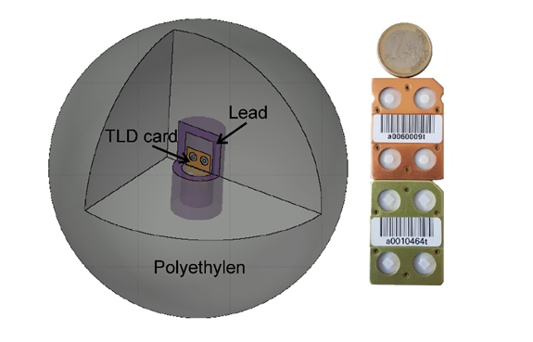
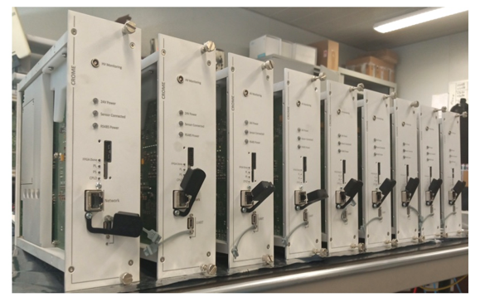
Dosimeters and Electronics
Thermo Fisher‘s active dosimeter
GSI‘s passive dosimeters
FHT
192
FHT
192
WENDI II
WENDI II
FHZ 632L-H10
FHT6020
CROME PC
CROME R
FHT
190
FHZ 632L-H10
CROME PC

Slide 4
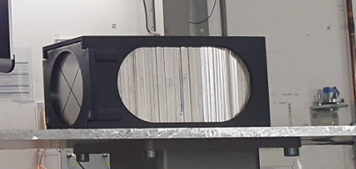
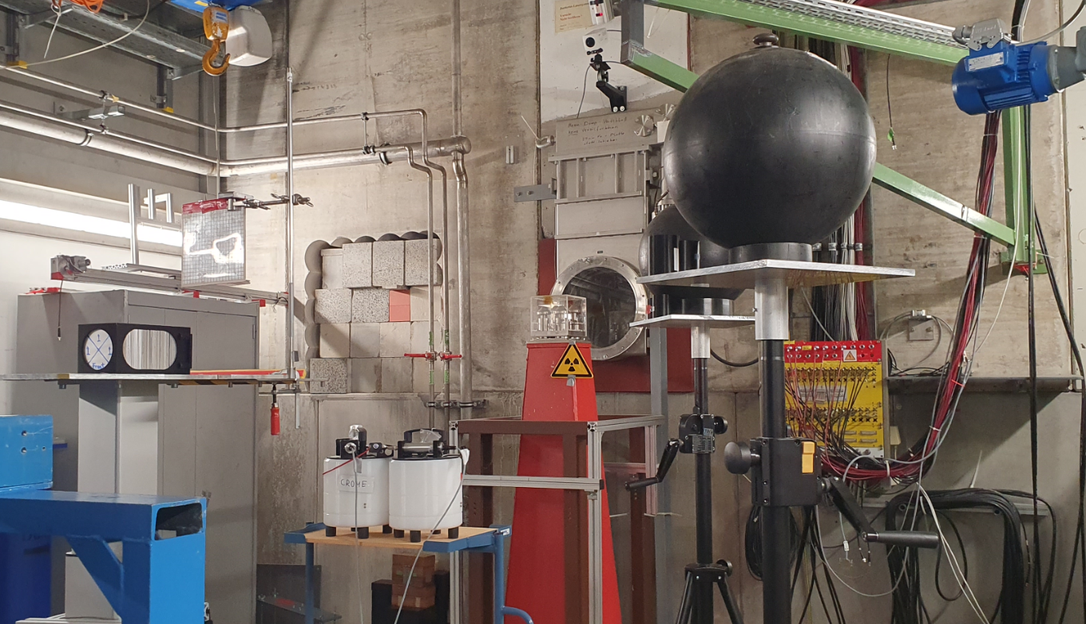
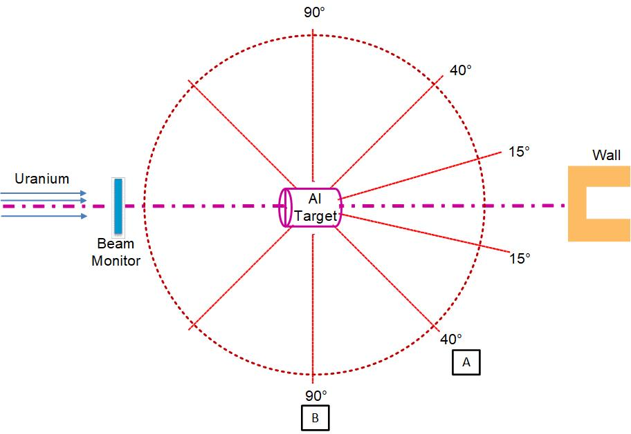
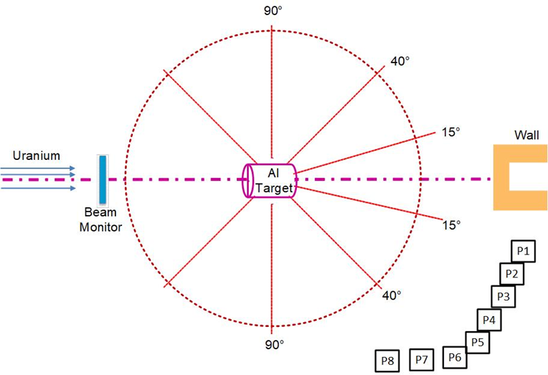
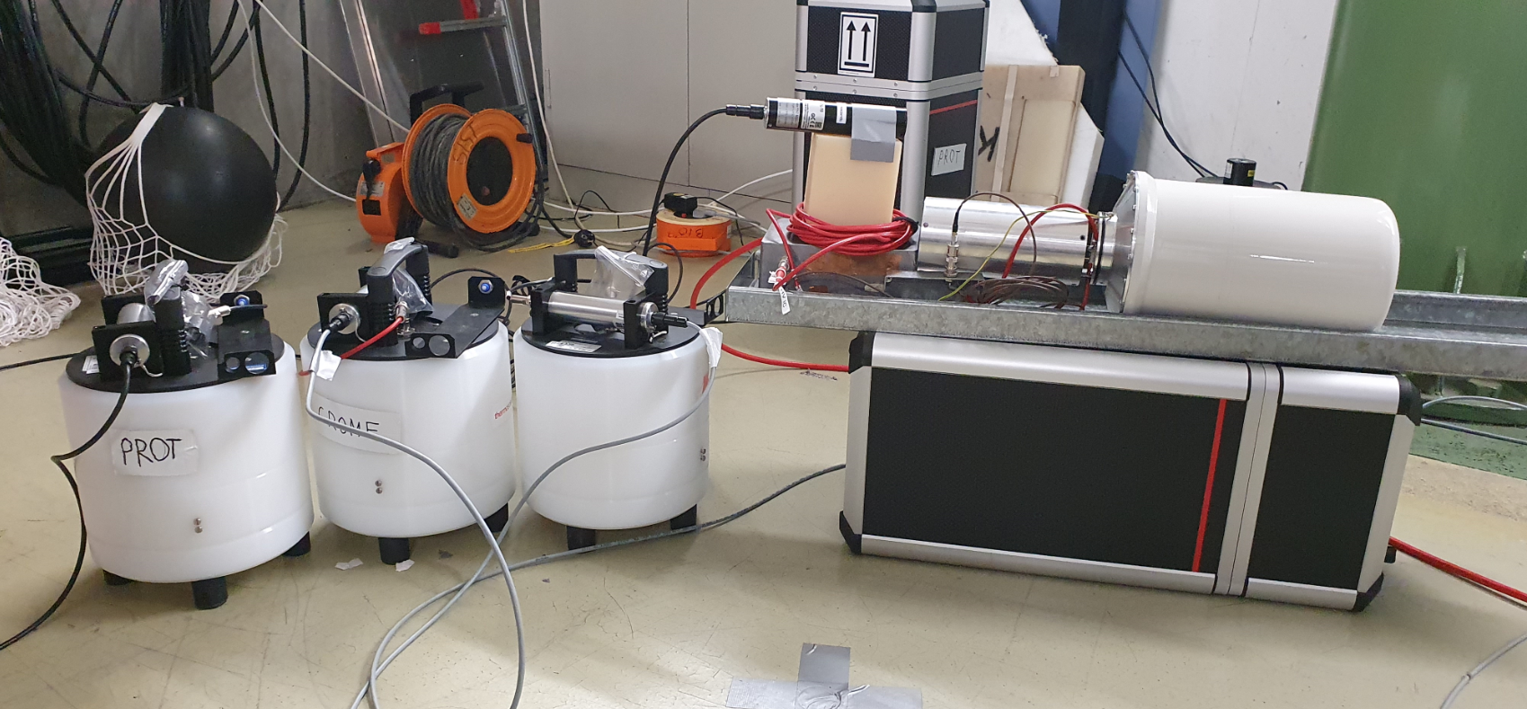
Experimental Setup
Al-Target 10x10x21.1 cm³
Set of 114 plates
GSI-Sphere
90°
40°
Target
WENDI II
990 MeV/u
1
2
´cc
C
D
SEETRAM
FHZ 632
FHT 190
WENDI II
FHT 192
U⁺⁷³@ 990 MeV/u slow extracted beam.
The transmission from SIS to Cave A was about 17%.

Slide 5
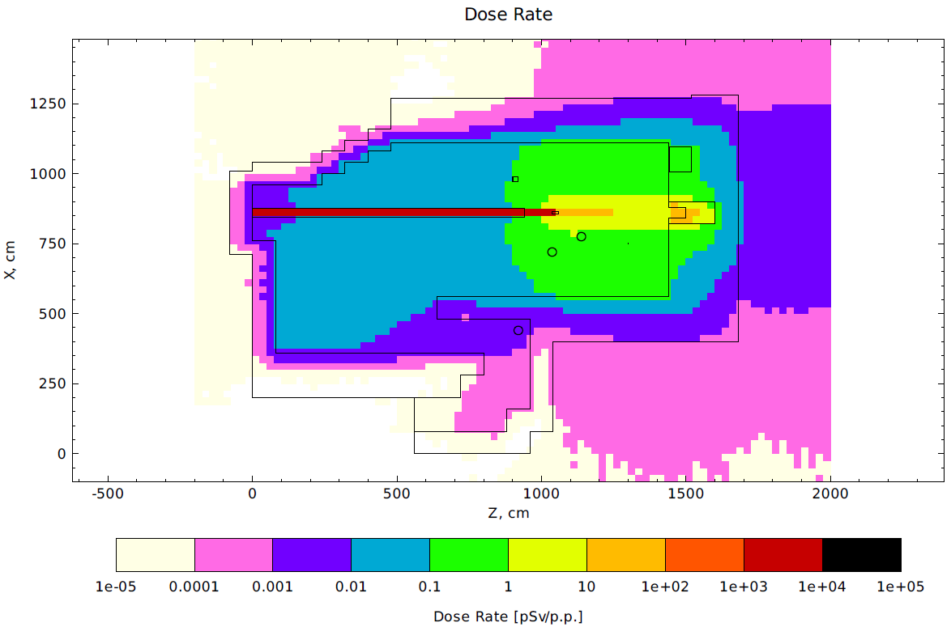
Dose rates/FLUKA Simulations
Total ambient dose
Neutron ambient dose

Slide 6
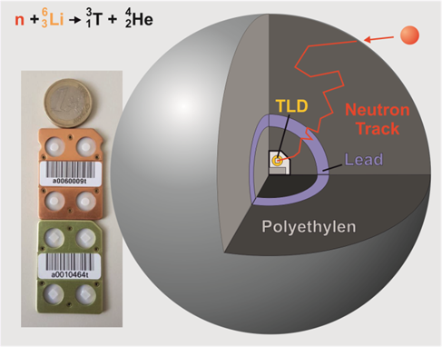
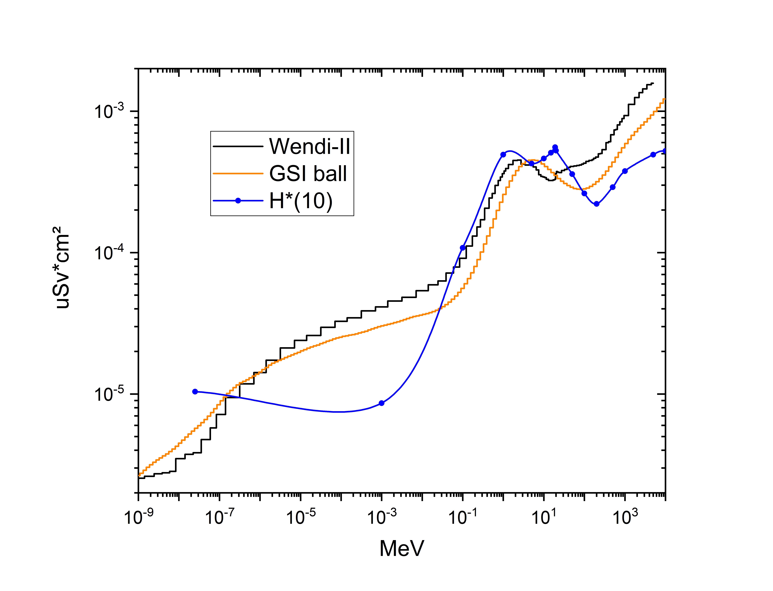
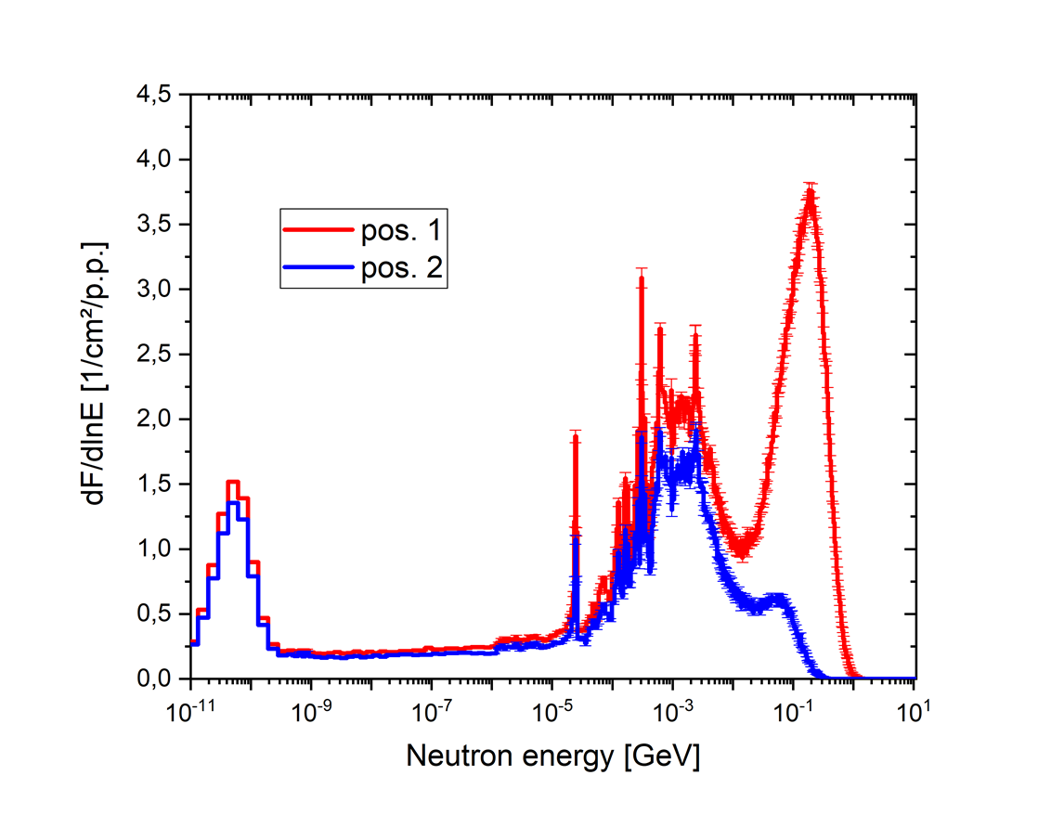
Neutron Detectors
GSI‘s passive neutron dosimeter
Response functions and neutron
fluence-to-ambient dose conversion
coefficients
Neutron Spectra/FLUKA Simulations
Wendi-II active dosimeter
40°
90°

Slide 7
Dose Measurements and Results

Slide 8
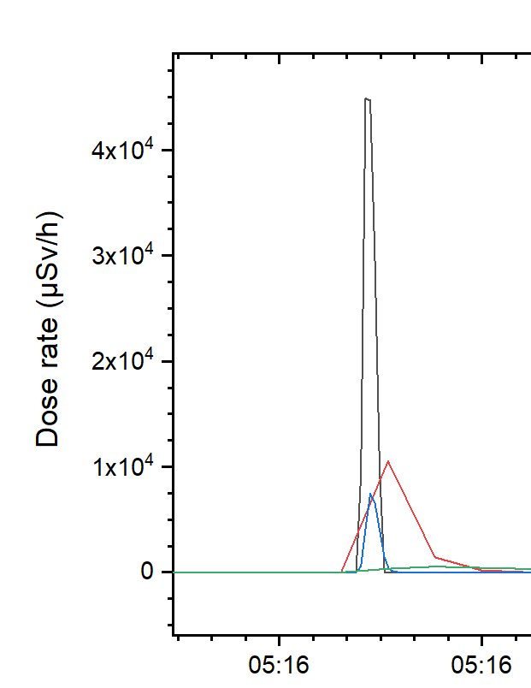
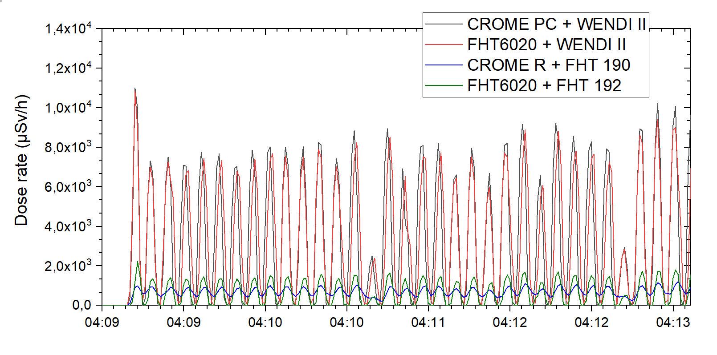
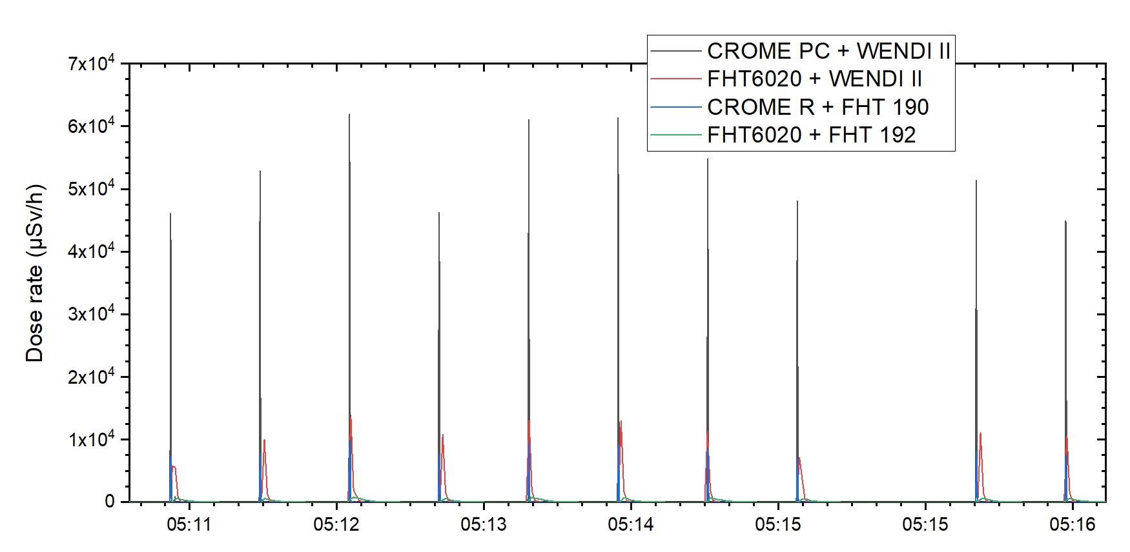
Dose Measurements and Results
5 s spill length 2 s off
Total dose:
CROME PC + WENDI II = 38 µSv
FHT6020 + WENDI II = 37 µSv
CROME R + FHT 190 = 7,7 µSv
FHT6020 + FHT 192 = 8,1 µSv
0.5 s spill length 30 s off
Total dose:
CROME PC + WENDI II = 758 µSv
FHT6020 + WENDI II = 713 µSv
CROME R + FHT 190 = 136 µSv
FHT6020 + FHT 192 = 147 µSv

Slide 9
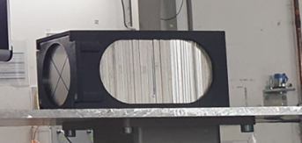
Depth profiles of some residual nuclides produced in the activated Al target
Five different gamma detectors were used to measure the gamma spectra of the foils
E. Mustafin

Slide 10
Summary
Different dosimeters were tested in „classical GSI“ radiation field from 990 MeV/u uranium beam hitting the Al-target, different spill lengths and intensities were used. The irradiation was done with slow extracted beam.
The measured with different devices dose rates were compared between each other
Additional comparison of the measurements was done with the FLUKA simulation results
The Wendi-II - neutron dosimeter, FHT190/FHT192 – ion chamber, FHZ 632L-10 – proportional counter tube and new CROME Prototype showed reliable results and approved themselfs to be the perfect candidates for dose measurements at FAIR facility
The next step is to qualify the various combinations of detectors and electronics at pulsed radiation fields produced with a fast extracted beam. In this case, all possible scenarios will be covered and the measuring detector systems will be fully characterized.
Thank you very much for your attention and support during the experiment, and for providing us with the beam!

