Slide 1
Machine experiment, 275
Influence of amplitude dependent tune shift (ADTS) on the slow extraction process, 2025-07-11
Björn Gålnander, David Ondreka.
SYS, SIS18/SIS100, 2025-01-03

Slide 2
Objective
Influence of amplitude dependent tune shift (ADTS) on the slow extraction process
  No octupole magnets in SIS18
  Exciting the sextupole magnets relatively strongly, in order to achieve second order ADTS
KO-extraction
Extraction efficiency compared with tracking simulations

Slide 3
Sextupoles in SIS18
Two sextupole families in SIS18 Sextupoles GS##KS1 and GS##KS3.
in odd sectors, 6 magnets each:
GS##KS1C, hor corr, and resonant extraction
  betax, betay, Dx = 29.5, 7.45, 3.14 m
GS##KS3C, vert corr
  betax, betay, Dx = 9.05, 22.3, 1.72 m
  (values at extraction, doublet optics, tau=1.0)
Natural chromaticity chx, chy = -6.6, -4.1
at extraction, tau=1.0, Qx, Qy, = 4.32, 3.29

Slide 4
Amplitude dependent tune shift (nonlinear detuning)
Chromaticity correction with sextupoles
Amplitude-dependent tune shift (ADTS)
  octupoles (only Jx term)
  sextupoles in second order (only Jx term)
see Lee, Wiedemann…
Notes:
octupole tune shift proportional to octupole strengt k3 and length and number
sextupole tune shift second order, proportional to strenght squared (and number)

Slide 5
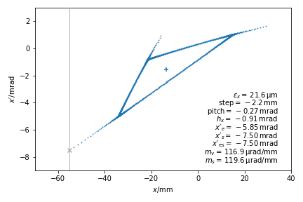
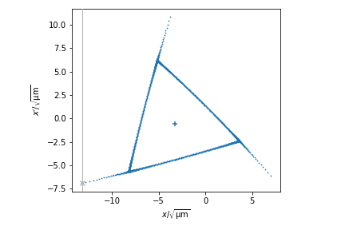
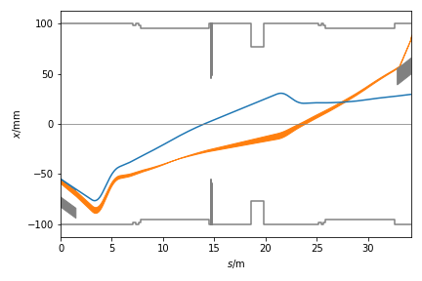
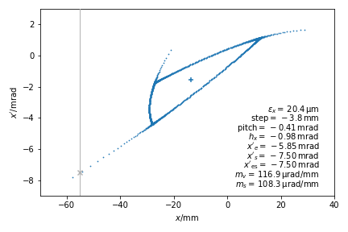
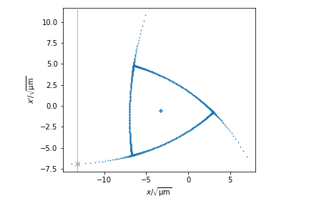
ADTS from sextupoles, effect on separatrix
dqh = 0.0022
samp = 0.03 1/m2
sphi = 64
choff KS1C= 0.0 1/m2
cvoff KS3C = 0.0 1/m2
chx, chy = -6.6, -4.8
dnuxdjx = 52
dqh = 0.0028
samp = 0.03
sphi = 23
choff = 0.25
cvoff = -0.654
chx, chy = 0.0, 3.3
dnuxdjx = 89
dipole k2L = 0.04 1/m2
no quad fringe fields
Notes:
Separatrix, phase space for two different cases one without and one with chromaticity sextupoles added.
the position and angle of the septum is indicated in the plots (line
Applying sextupole corrections for chromaticity also induces adts, and this must be compensated by rotating the phase space, the phase of the resonant sextupoles, s phi.
And this was the idea of the measurements to observe transmission and find optimum

Slide 6
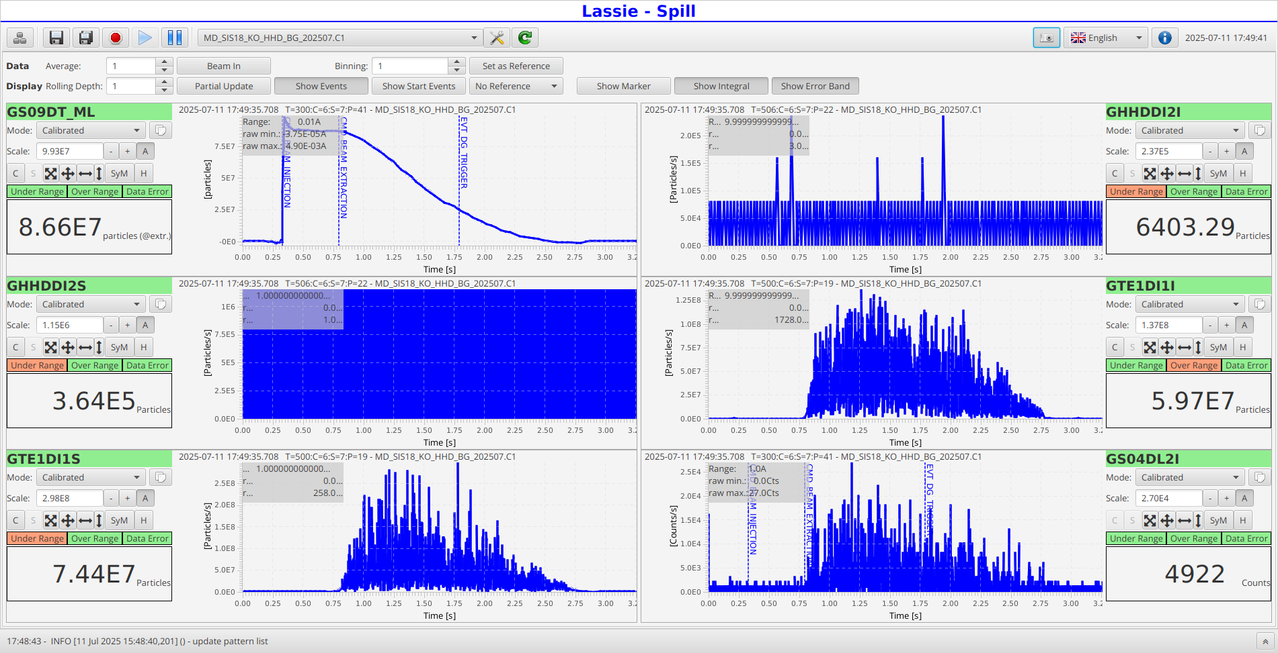
Diagnostics
Notes:
Observing beam current DCCT, counter TE1, Ionisation chamber and SEETRAM
(note over range and under range)
Also observing loss rates at the BLMs in sector 4.

Slide 7
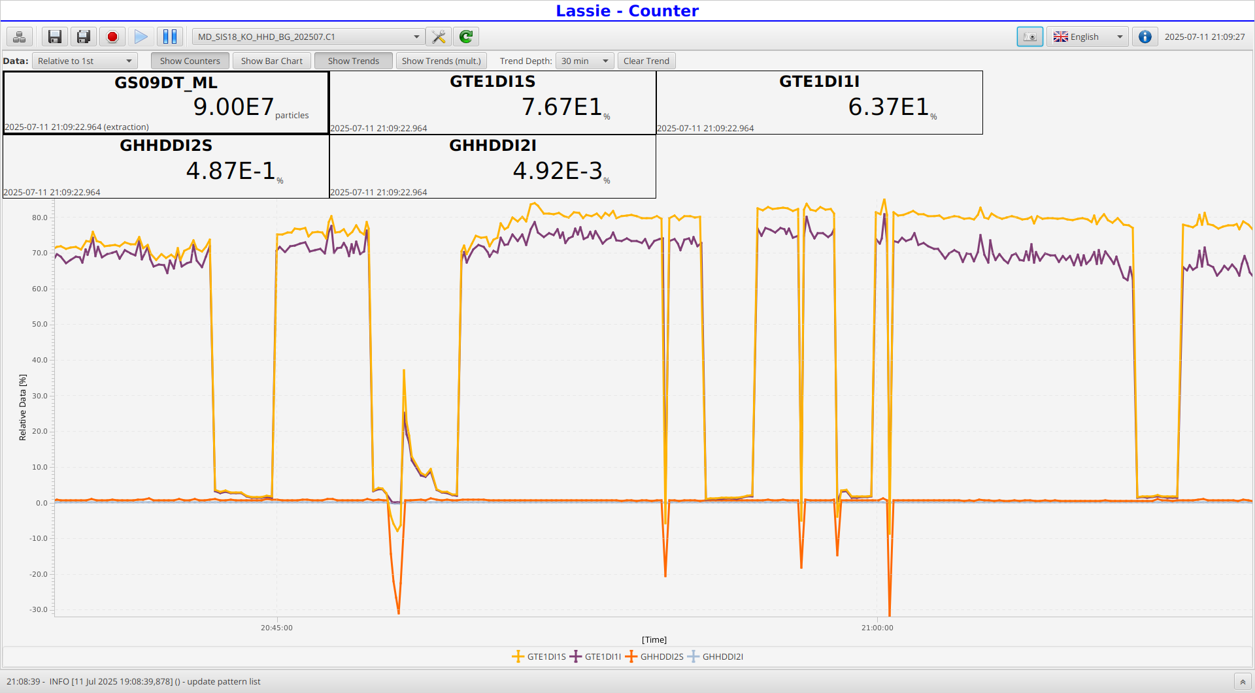
Transmission
particle count relative to flattop DCCT
sphi modified to optimise transmission
-- align separatrix with ES angle
Notes:
Plot of TE1 counter vs dcct at flat top.
80 % extraction efficiciency and 95% in simulations.
Calibration?

Slide 8
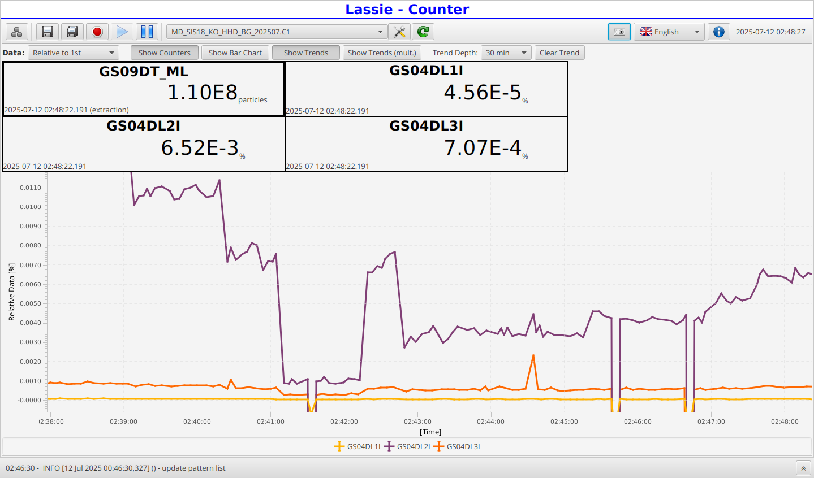
Losses at ES
Notes:
observation of BLMs in sector 4, losses minimised,
Trend following transmission, but generally minumum not at same sphi as transmission maximum.

Slide 9
Results
Adjusting sphi to minimse losses, for two different cases correcting chx = 0
Problem going to higher sextupole strengths…see below
choff KS1= 0.14 1/m2
cvoff KS3 = 0.0 1/m2
chx, chy = 0.0, -5.8
choff KS1= 0.082 1/m2
cvoff KS3 = 0.35 1/m2
chx, chy = 0.0, -13.3
Experiments | Experiments |  | Simulations
samp (1/m2) | sphi | dqh | sphi | dqh | dQx/dJx
0.02 | 50 | 0.0198 | -8 | 0.0027 | 67
0.03 | 40 | 0.0204 | 15 | 0.0034 | 84
0.05 | 70 | 0.0224 | 29 | 0.0048 | 139
0.07 | 70 | 0.0241 | 35 | 0.0062 | 222
Experiments | Experiments |  | Simulations
samp (1/m2) | sphi | dqh | sphi | dqh | dQx/dJx
0.02 | 50 | 0.0247 | 12 | 0.0029 | 20
0.05 | 60 | 0.0253 | 39 | 0.0052 | 65
0.07 | 60 | 0.0257 | 46 | 0.0067 | 98
following same trend in adjusting sphi for different samp, different adts,
but not matching experimental values, not fully understood

Slide 10
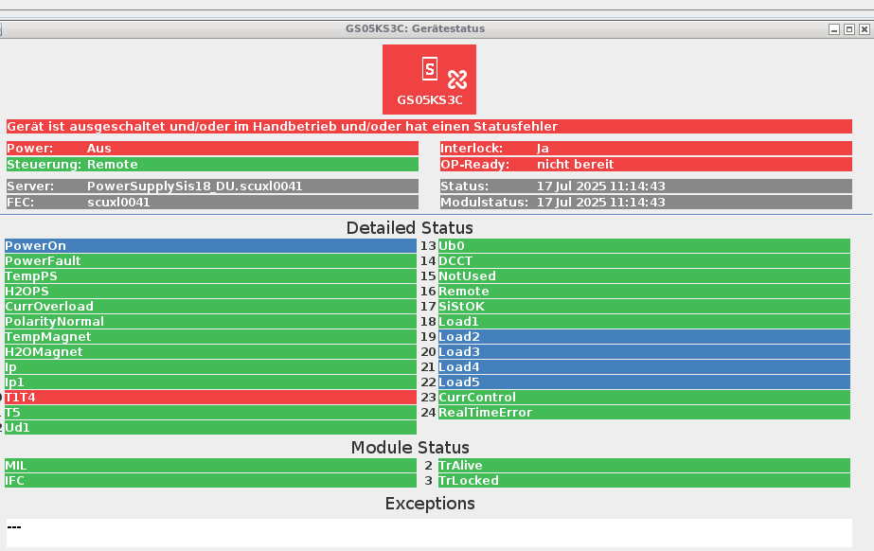
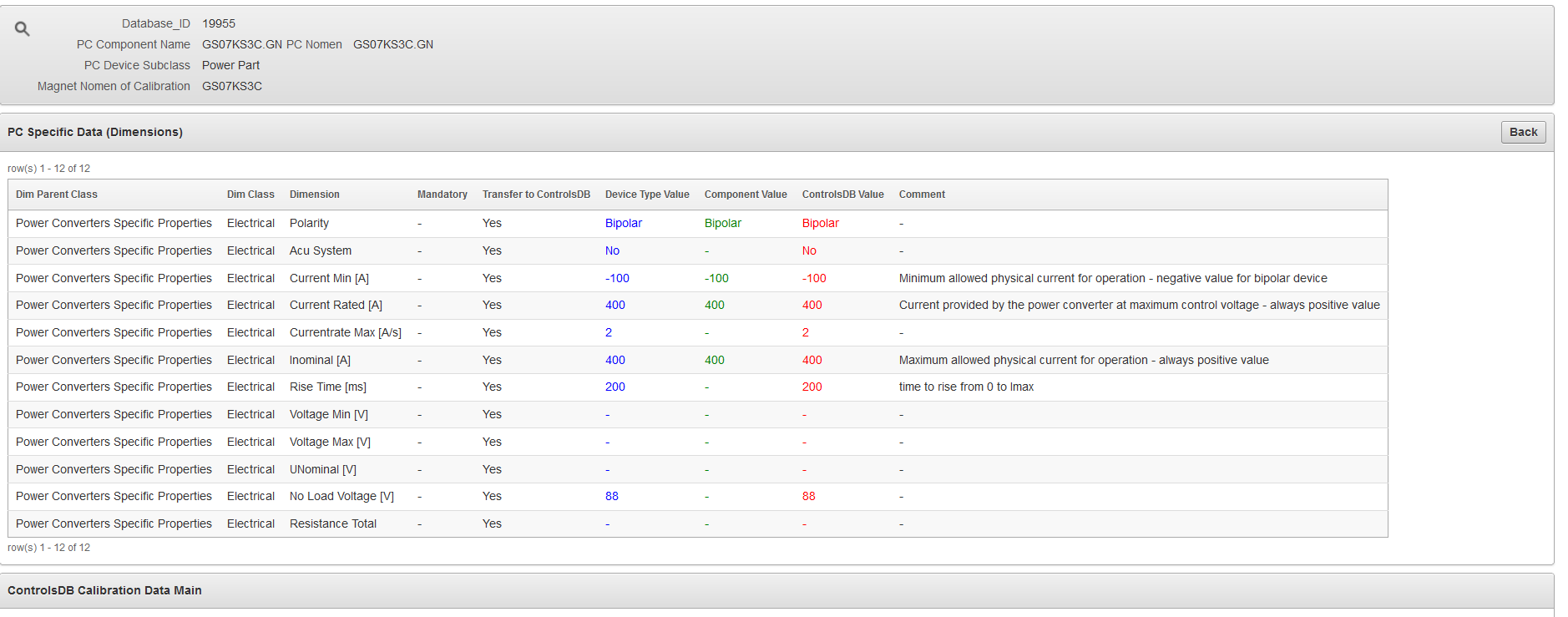
Sextupole power supplies limitation
Limits for sextupoles leading to PS fault, T1T4, when going to too high currents.
PS for sextupoles:
  LOGICAL.GS01KS1C/B2L LSA: MIN(-3.5633236) MAX(14.25359)
  For Brho = 12 Tm, max k2l = 14.2/12 = 1.2, min = -3.6/12 = 0.3
  LOGICAL.GS01KS3C/B2L LSA: MIN(-14.25359) MAX(3.5633236)
  For Brho = 12 Tm, max k2l = 0.3, min = -1.2
I = 28 * B2L
Limits, -100 – 400 A (KS03 have a negative sign for current.)
Problem time for ramping to max current, 200 ms
in KO ramping in pre_extraction BP 40 ms default.
  in slow extraction (qdr) 32 ms for ramping, in beginning of the slow extraction.
For max currents ramp time has to be prolonged. LSA model change would be helpful.
Realized and tested separately, 2025-07-17, together with EPS
olog ID 924091 https://olog.acc.gsi.de/olog/event/showEvent/924091
Notes:
Not a problem in everyday use when only compensating chromaticity

Slide 11
Summary
Studied amplitude dependent tune shift, ADTS, by using both sextupole families, KS1 and KS3.
Results show qualitativity expected results, but sextupole phase, sphi, settings to minimize losses not quantitatively matched in simulations.
Problems with power supply faults limited range of experimental parameters that could be tested.
Ramp time when ramping to max currents > 200 ms (now 40 ms default)
  For “normal” usage, chromaticity correction to chx = 0.0, this is not a problem.
  But a modification of the LSA model would be helpful.
Further studies with higher sextupole strengths for larger variation of ADTS needed.

Slide 12
Acknowledgements:
A. Pastushenko
H. Lieberman, for LSA, Paramodi support
B. Zipfel et al. exp 241 for beam-sharing
U. Clausen, W. Orlov, EPS for follow-up, error solving and testing

Slide 14
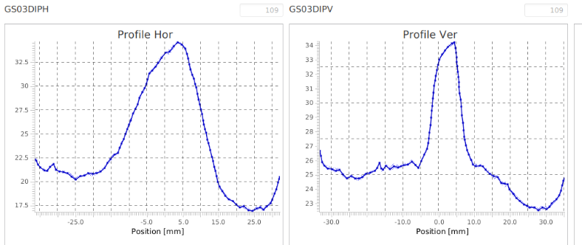
IPM flattop (evt 45), 2025-07-11, 21:37
U73+ 500 MeV/u
Beam size +- 15 mm
  betax = 13.25
  em_x = 15^2/13.24 = 17 mm mrad
  implies, em_x = 24 mm mrad at 350 MeV/u

Slide 15
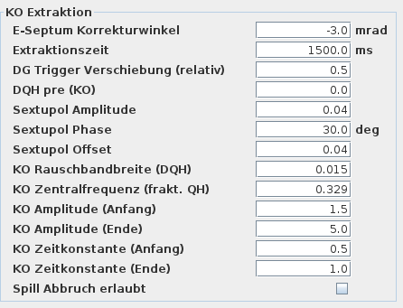
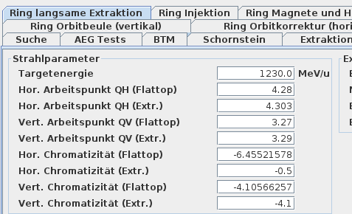
Sextupoles with chromaticity correction, KO
Either setting chromaticity, both K1 and K3
Or, an offset, only correcting K1,

