Slide 1
Dual Isotope Beams from SIS18
D. Ondreka, SYS
Machine Experiments 2025
01.12.2025

Slide 2
Outline
Motivation
Dual isotope cycle
  Idea and requirements
  Implementation
  Experiment
Summary and outlook

Slide 3
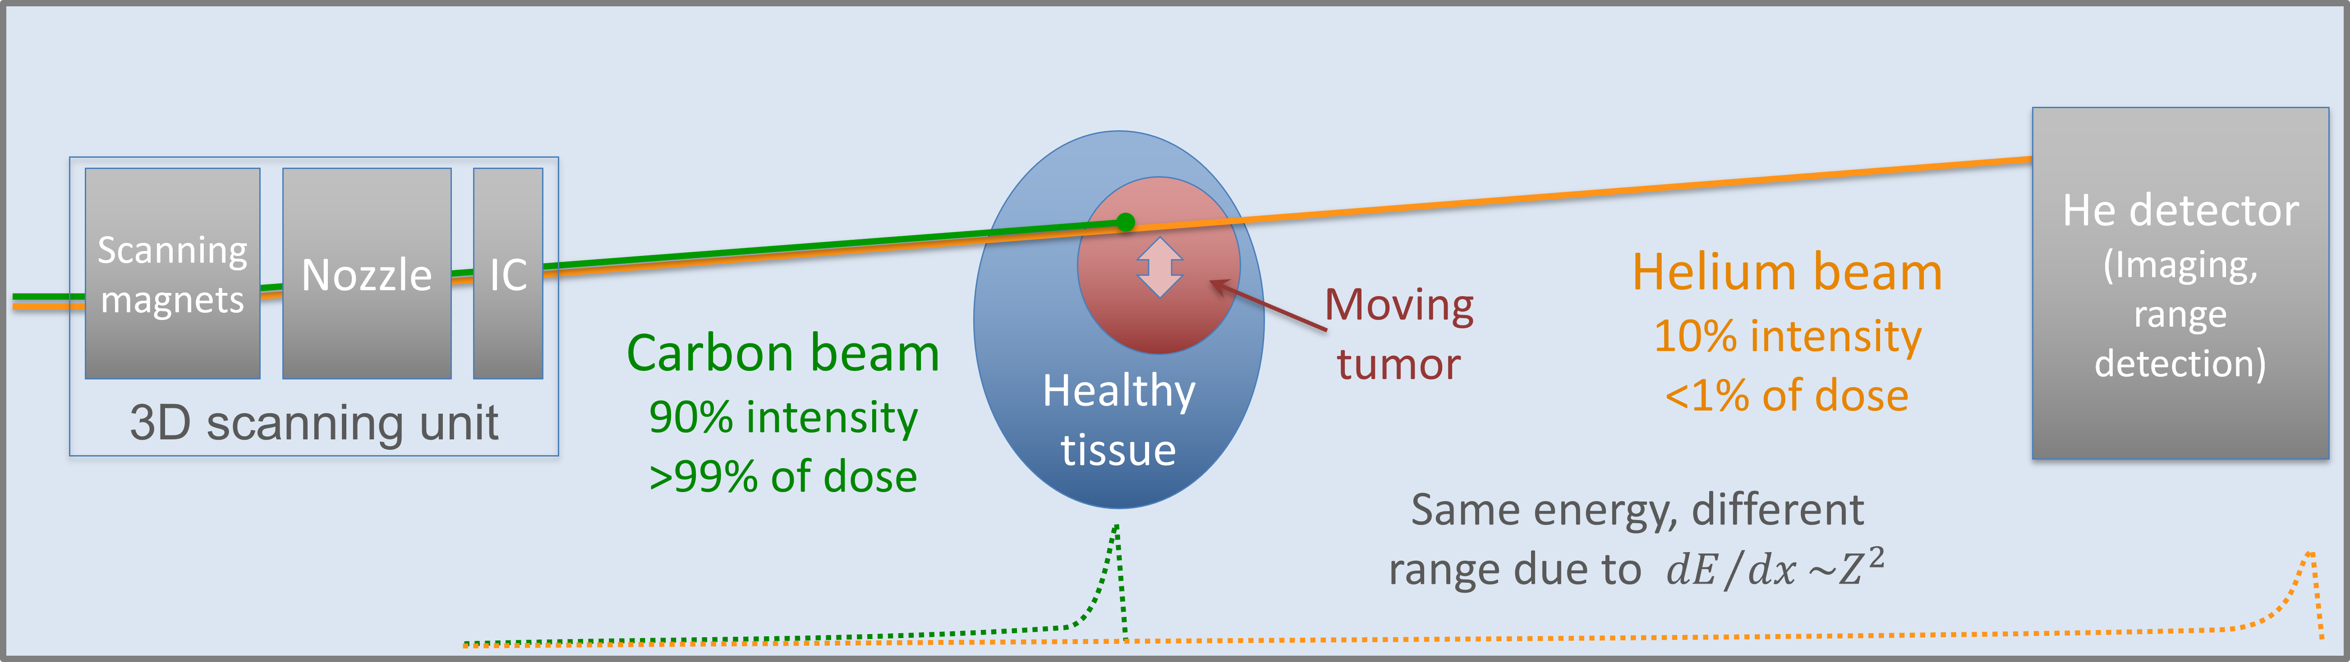
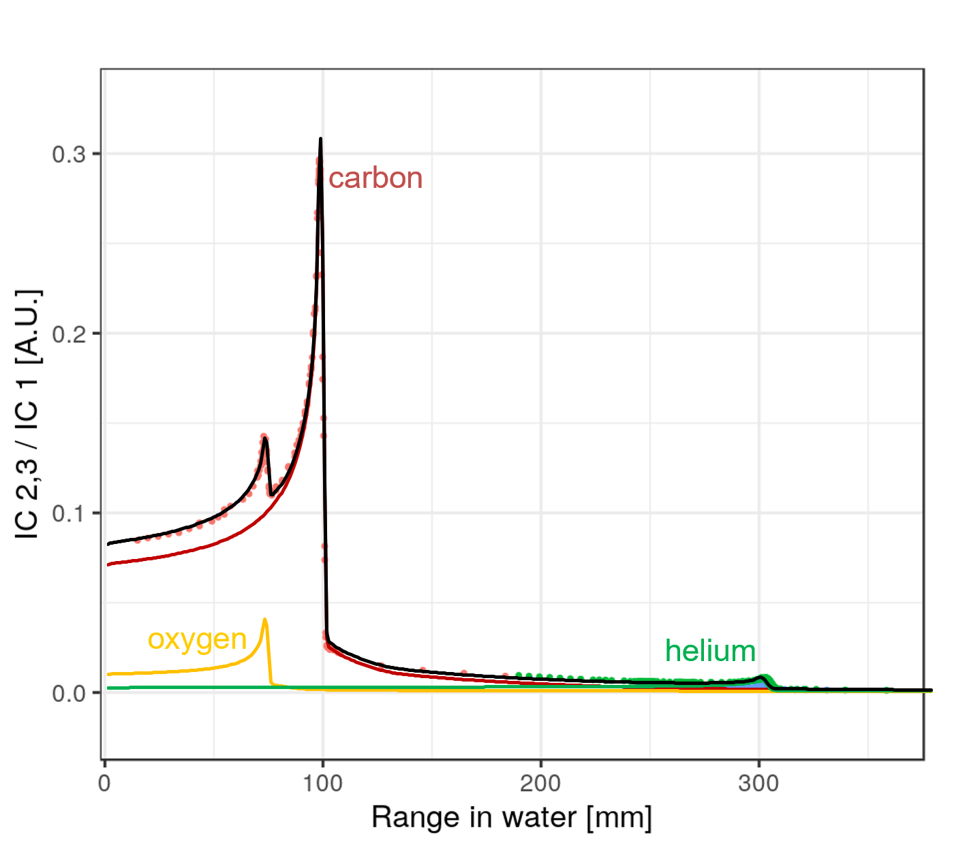
Motivation
Dual Isotope Beam: | “Acceleration and extraction of two ion species with different A/Q in the same synchrotron cycle”
Why dual isotope beams?
Mixed beams for range-monitoring in ion therapy
  Carbon for treatment, helium for range detection
  C⁶⁺/³He²⁺ one way to provide contamination free beam
Further possible applications
  Plasma physics: heating and probing with two species
  Fragment separator: small fraction of ‘reference ion’
  Precise energy calibration of primary beam
Interesting accelerator physics challenge
Courtesy L. Volz

Slide 4
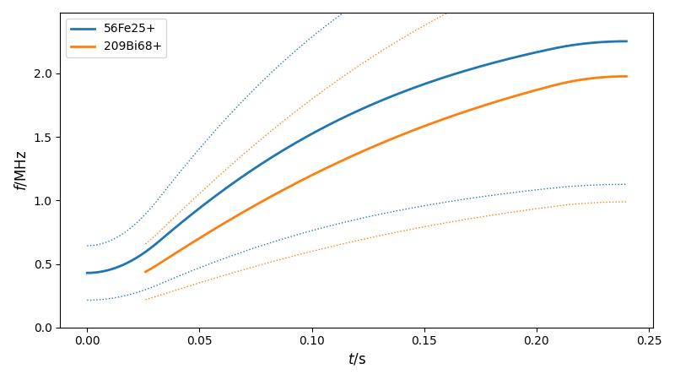
Dual Isotope Cycle: Idea
Different ions can be accelerated in same field
  Differ only in energy and revolution frequencies
  Two independent cavities would in principle suffice
Basic expectations about mutual influence
  No net voltage of ‘foreign’ RF if harmonics don’t cross
  Interactions between ions negligible for low intensities
Facility satisfies all prerequisites
  UNILAC can provide two ion species at a time
  SIS18 cavities can run independently without feedback
  Just need to program the correct set values!
Challenges for the control system
  Cycle with two injections of two different ions
  RF set values for two ion species in single cycle
Common
Acceleration
Injection 2
Acceleration 1
Injection 1
time

Slide 5
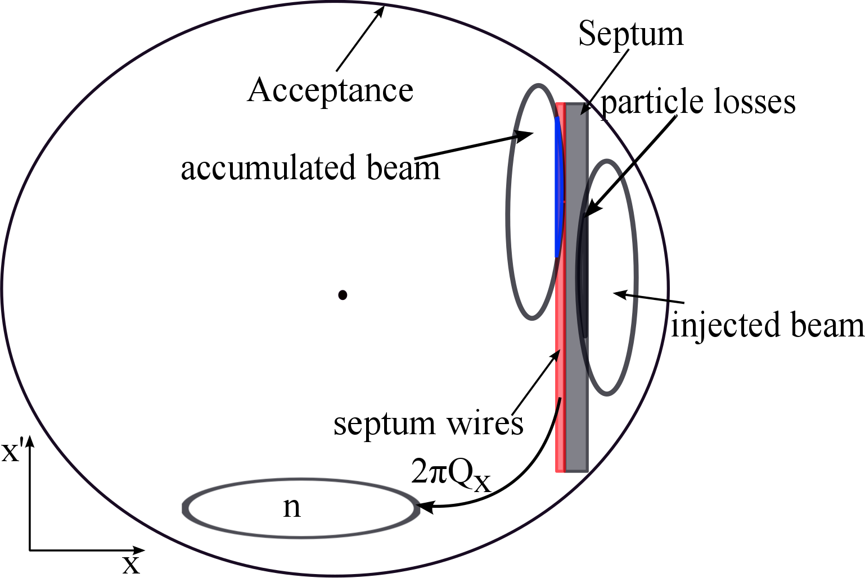
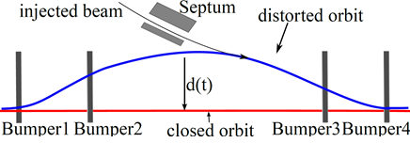
Double MTI
injection 1
injection 2
bump amplitude
Multi-turn injection (MTI) from UNILAC
  Accumulation of beam in hor. phase space
  Four bumpers affecting dynamic bump
Two beams nested in phase space
  Smaller bump for second injection needed
Further optimizations possible
  Dispersive separation: inner and outer orbit
  Electron cooling to merge beams in phase space
time
damping by
acceleration
clipping on
injection 2
x’
injection 1
injection 2
x

Slide 6
Extension of RF Model
Generic hierarchy for circular accelerators
  Central role of magnetic rigidity BRHO
    Derived from beam and cycle parameters
  Hierarchy separated into magnet and RF parts
    Magnets depend on BRHO and tune, chroma, …
    RF depends on BRHO and bucket size, harmonic, …
  No interdependencies below BRHO
BEAM/E
BEAM/AOQ
BEAM2/E
BEAM2/AOQ
BEAM/QH
BEAM/QV
BEAM/BRHO
BEAM/H
BEAM2/H
SIS18: extension for dual isotope beams
  Add input parameters for second ion
    Modify BRHO calculation for second injection
    Use first ion as reference for BRHO
  Add copy of RF hierarchy for second ion
    Calculate RF parameters once for each ion
    Sent cavity set values to selected cavity per ion
Extension almost transparent
  Need only switch of RF synchronization manually
QUAD/KL
BEAM/GAMMA
BEAM2/GAMMA
QUAD/BL
BEAM/FREV
BEAM2/FREV
QUAD/Set#current
CAVITY/Set#frf
CAVITY2/Set#frf

Slide 7
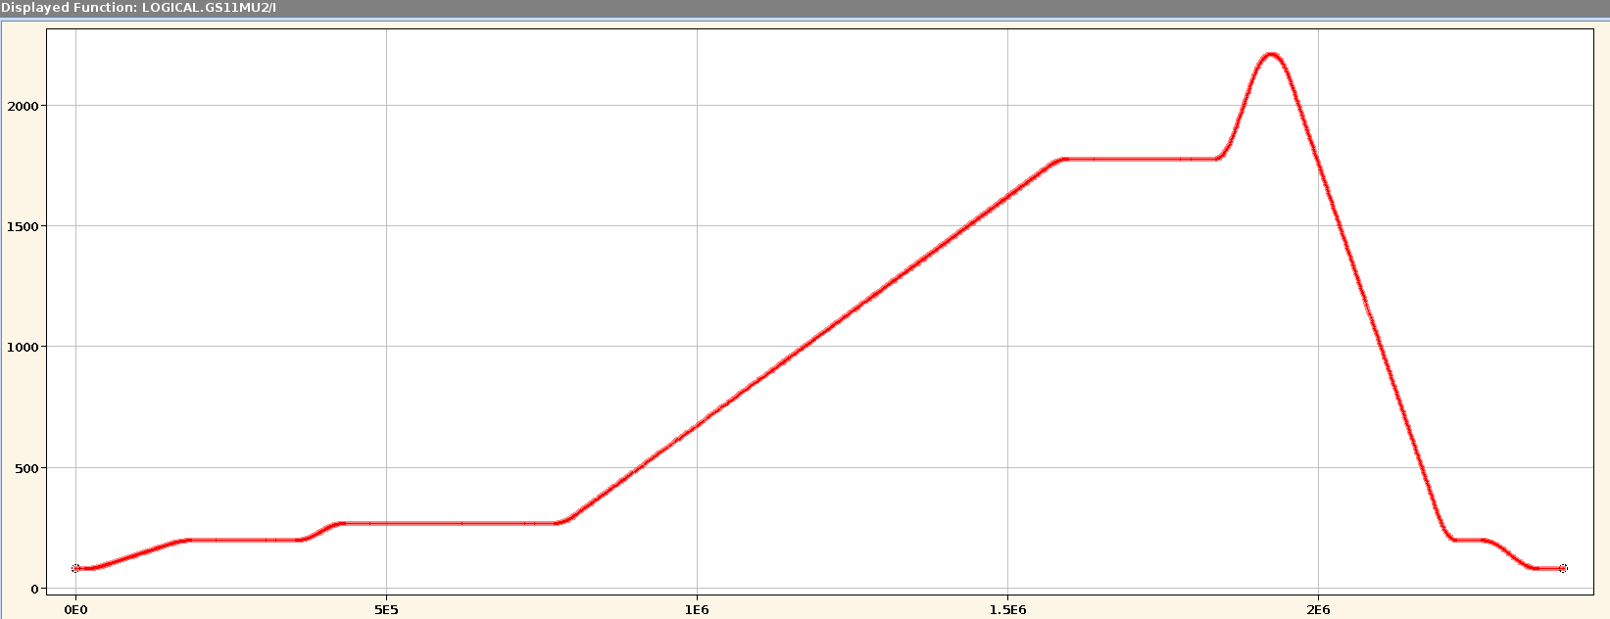
Cycle: Structure
Technically composed of several sub-cycles
  Necessary for injections of two ion species
  Causes artifacts in current measurements
Beam Parameters
Ion | ⁵⁶Fe²⁵⁺ | ²⁰⁹Bi⁶⁸⁺
E (Inj. 1) [Mev/u] | 11.36 | –
E (Inj. 2) [Mev/u] | 20.90 | 11.14
E (Extr.) [Mev/u] | 673.4 | 400.0
Fe sub-cycle
Fe + Bi sub-cycle
Chimney
Extraction
Simultaneous
acceleration
Dipole current [A]
Accel. Fe
Inj. Bi
Inj. Fe
time [μs]

Slide 8
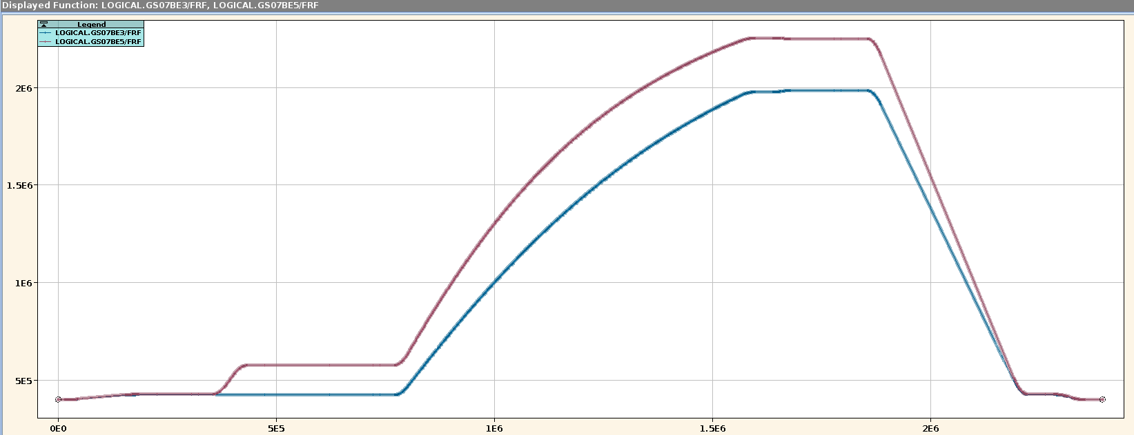
Cycle: RF
One MA cavity for each ion species, operated at h=2
Cavity for first ion operated as usual (synchronized with master DDS)
Cavity for second ion disconnected from master DDS (unsynchronized)
Fe sub-cycle
Fe + Bi sub-cycle
RF frequency [Hz]
time [μs]

Slide 9
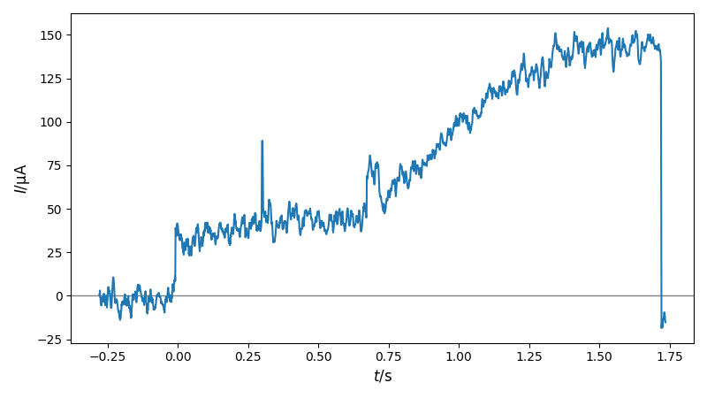
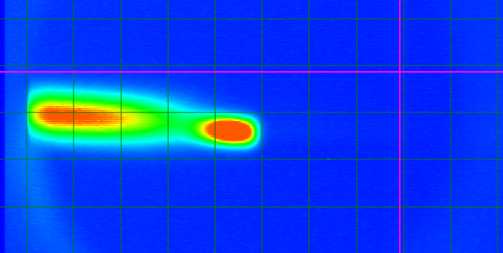
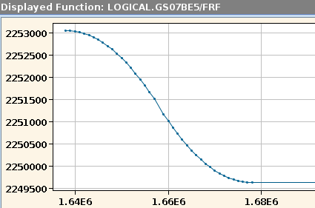
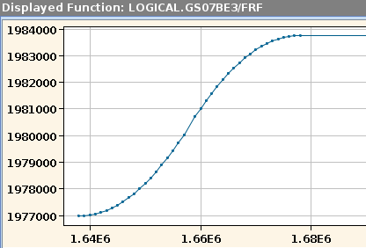
Experiment: Results
Simultaneous acceleration successful
    About 1 – 2∙10⁷ particles per species
    Transmission estimated to around 70%
How to demonstrate there are two beams?
  Dispersive separation with RF frequency shifts
  Fe and Bi moved to inner and outer orbit
  Fast extraction using kicker magnets
  Observation of beam spots on screen
Current on DCT during cycle
Injection Bi
Injection Fe
Beam spots on screen at magnetic septum
Bi
Fe
Frequency offsets for Fe (left) and Bi (right)
RF frequency [Hz]
time [μs]
time [μs]
radially outward
radially inward

Slide 10
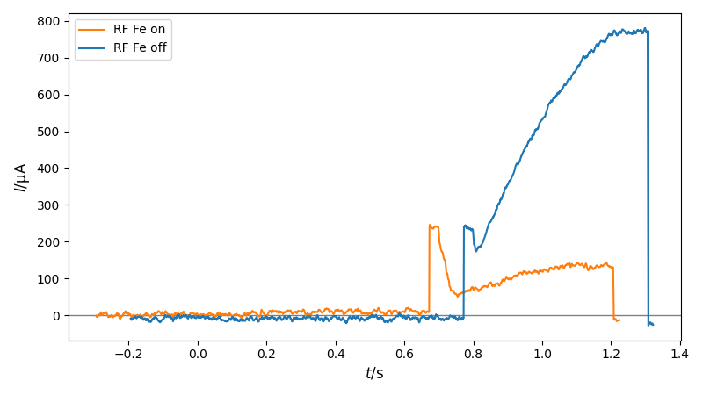
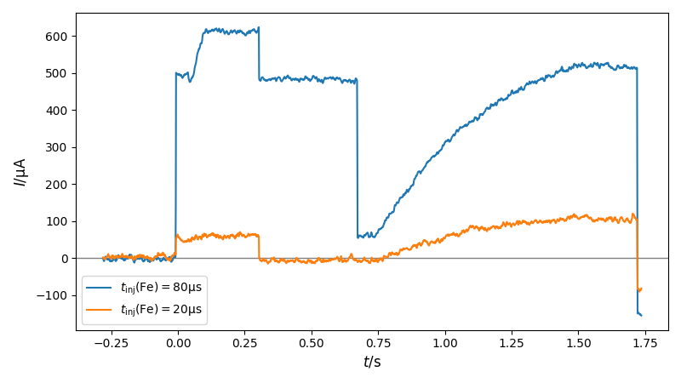
Experiment: Challenges
Strong influence of second RF observed
  Initially larges losses
Mitigation measures
  Reduced ramping speed
  Smaller horizontal beam size
    Short injection pulses (Fe: 20μs, Bi: 5μs)
    Leads to small intensities
Performance difficult to quantify
  Measurements with DCT have artifacts
    Spurious current drop and zero line offset
    Caused by sub-cycle structure
  Need to repeat measurements
Effect of RF for Fe on Bi (no Fe injected)
Injection Bi
Artifacts in current measurement
Injection Fe
Injection Bi

Slide 11
Summary and Outlook
Simultaneous acceleration of Fe and Bi in SIS18 demonstrated
  Manageable effort due to flexibility in RF system and machine model
  Significant influence of ‘foreign’ RF observed
  Mitigated by decreasing horizontal emittance at expense of intensity
Next steps
  Repetition of experiment with improved instrumentation
    Systematic measurements for clarifying and quantifying loss mechanisms
    Elimination of DCT artifacts, frequency selective measurements
    Application of electron cooling to minimize emittance
  Simulation of process and benchmarking with experiment
    Influence of ‘foreign’ cavity and loss mechanisms
    Non-trivial, because standard tools not adapted to this use-case

Slide 12
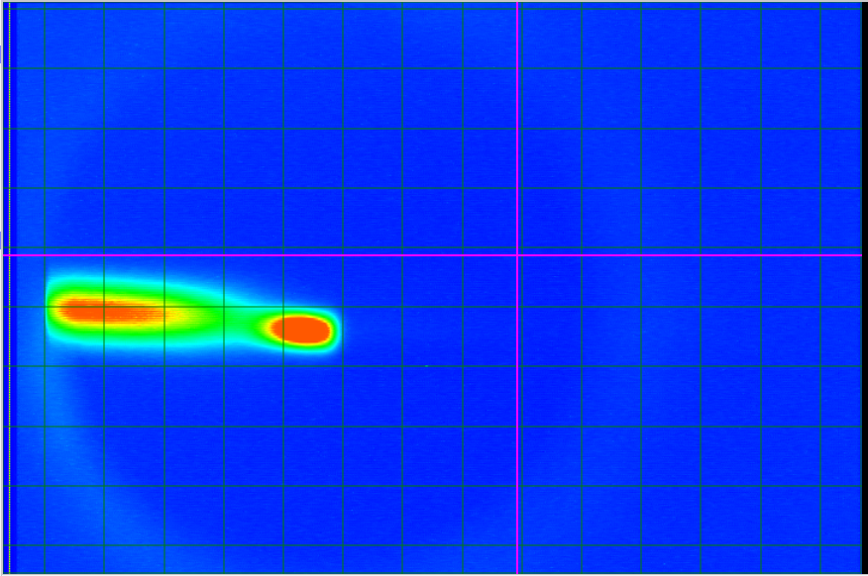
Thanks for your attention!
Special thanks go to Holger Liebermann, who implemented the RF model extensions, and the ring RF group for their support!

