Slide 1
Studies with U²⁸⁺
Ultimate Intensities & Cryoinserts
L.Bozyk

Slide 2
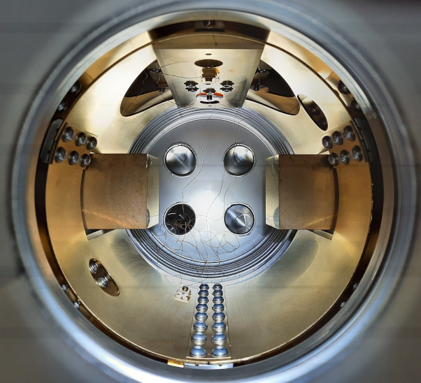
Content
U28+
  Intensities
  Liefetime
Cryoinserts
  Collimator currents
  Transmission
  Intensities
Simulation
  Improvements
Summary & Outlook

Slide 3
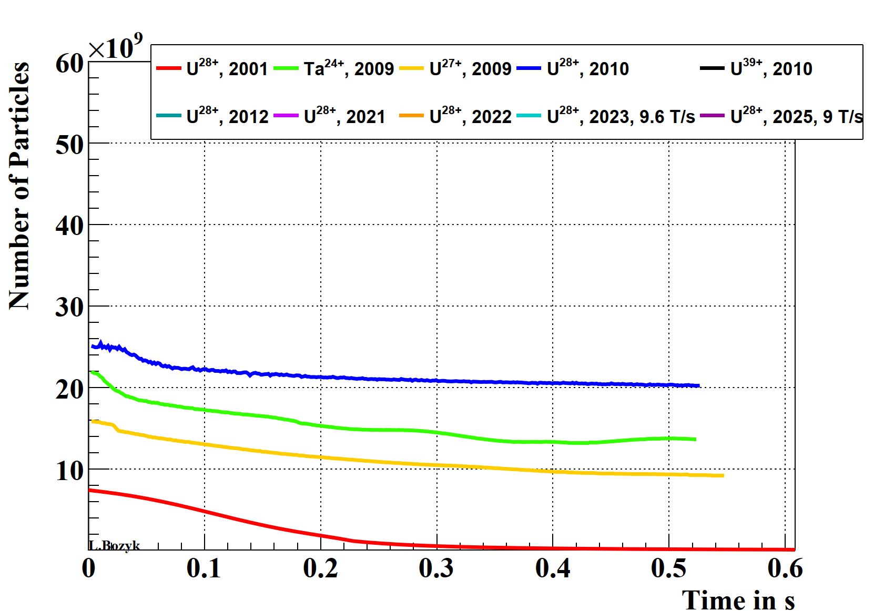
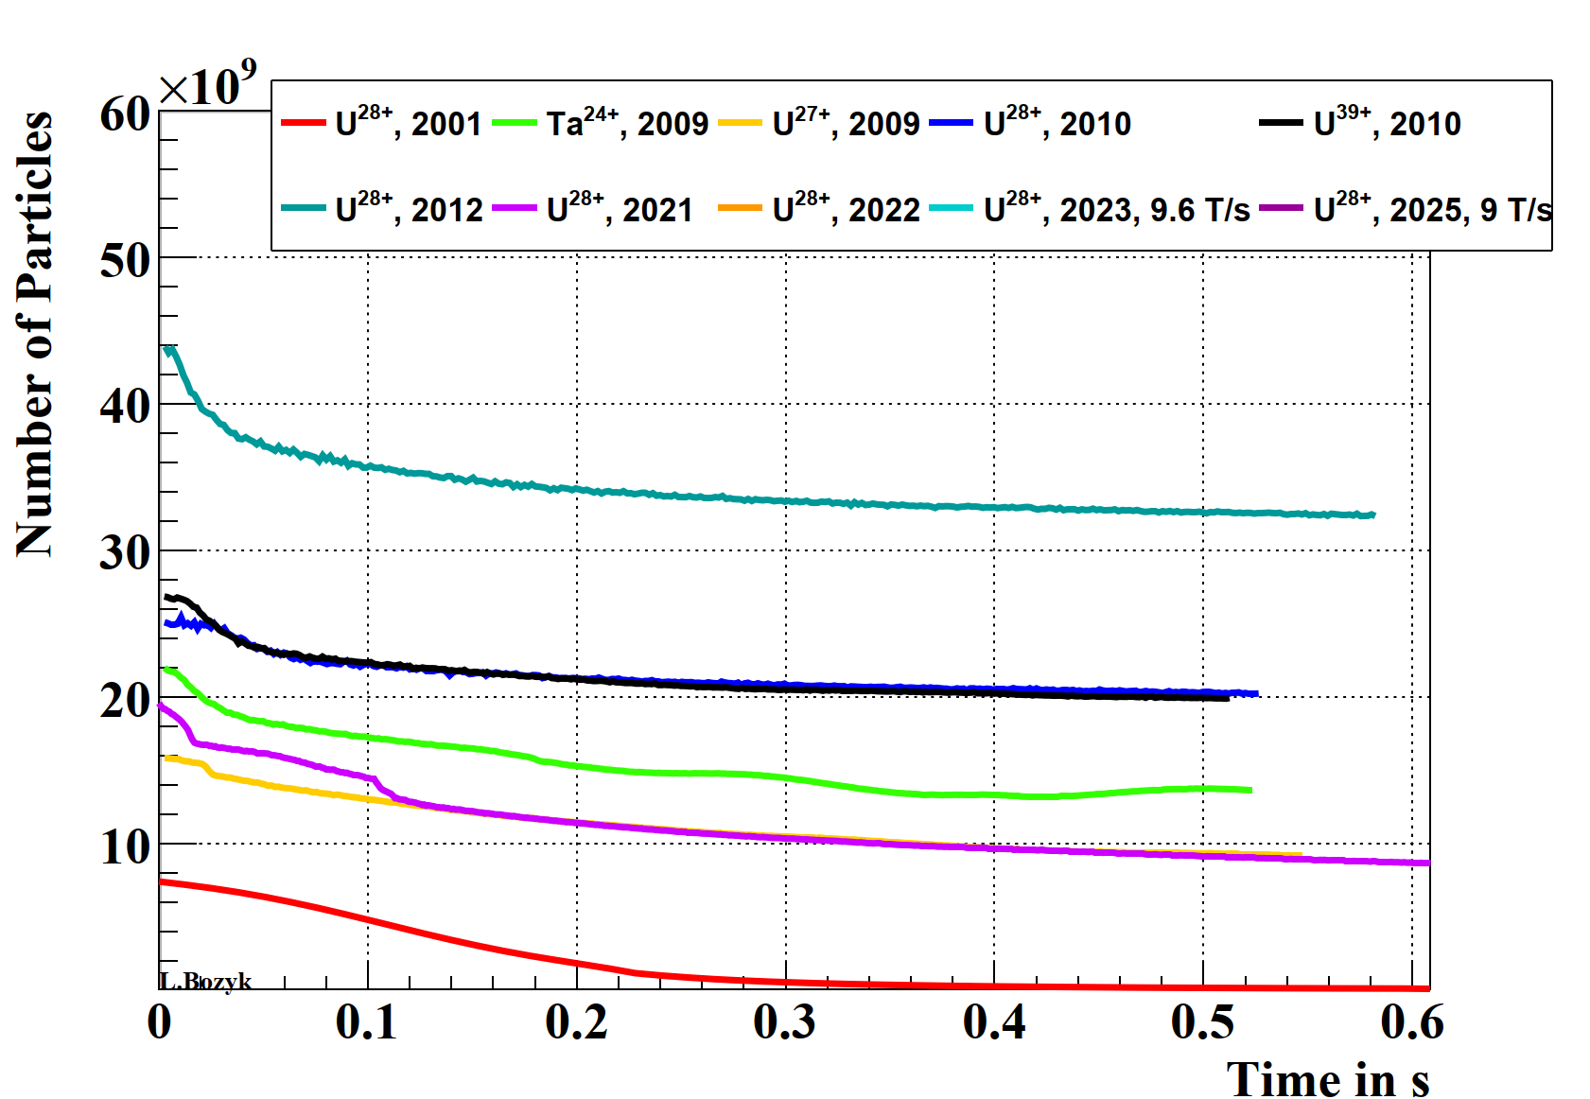
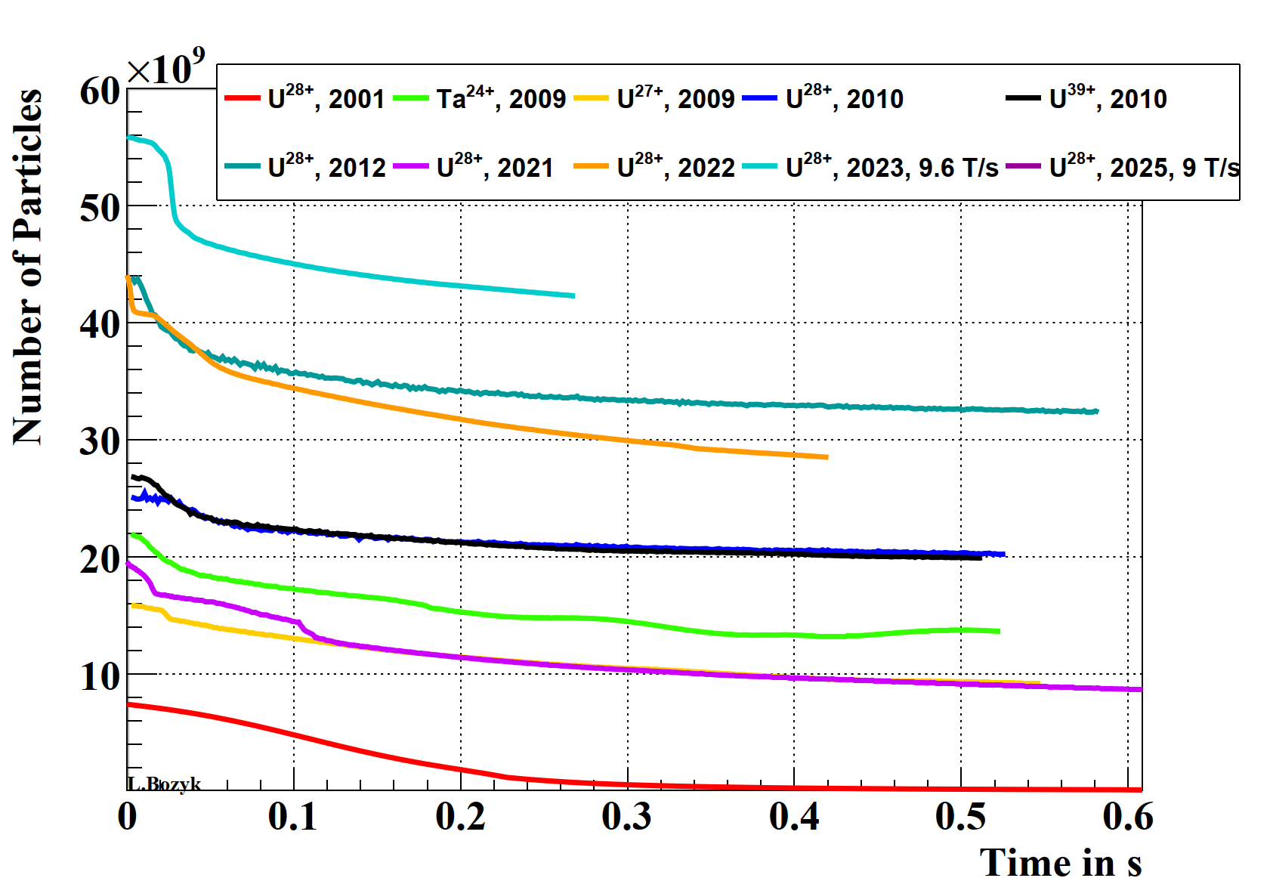
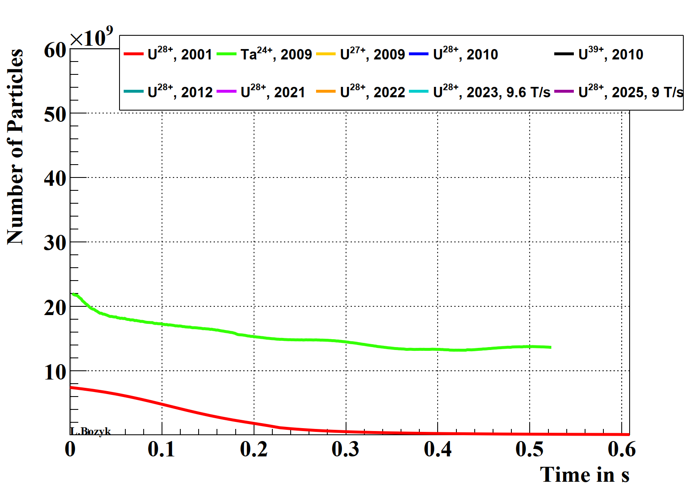
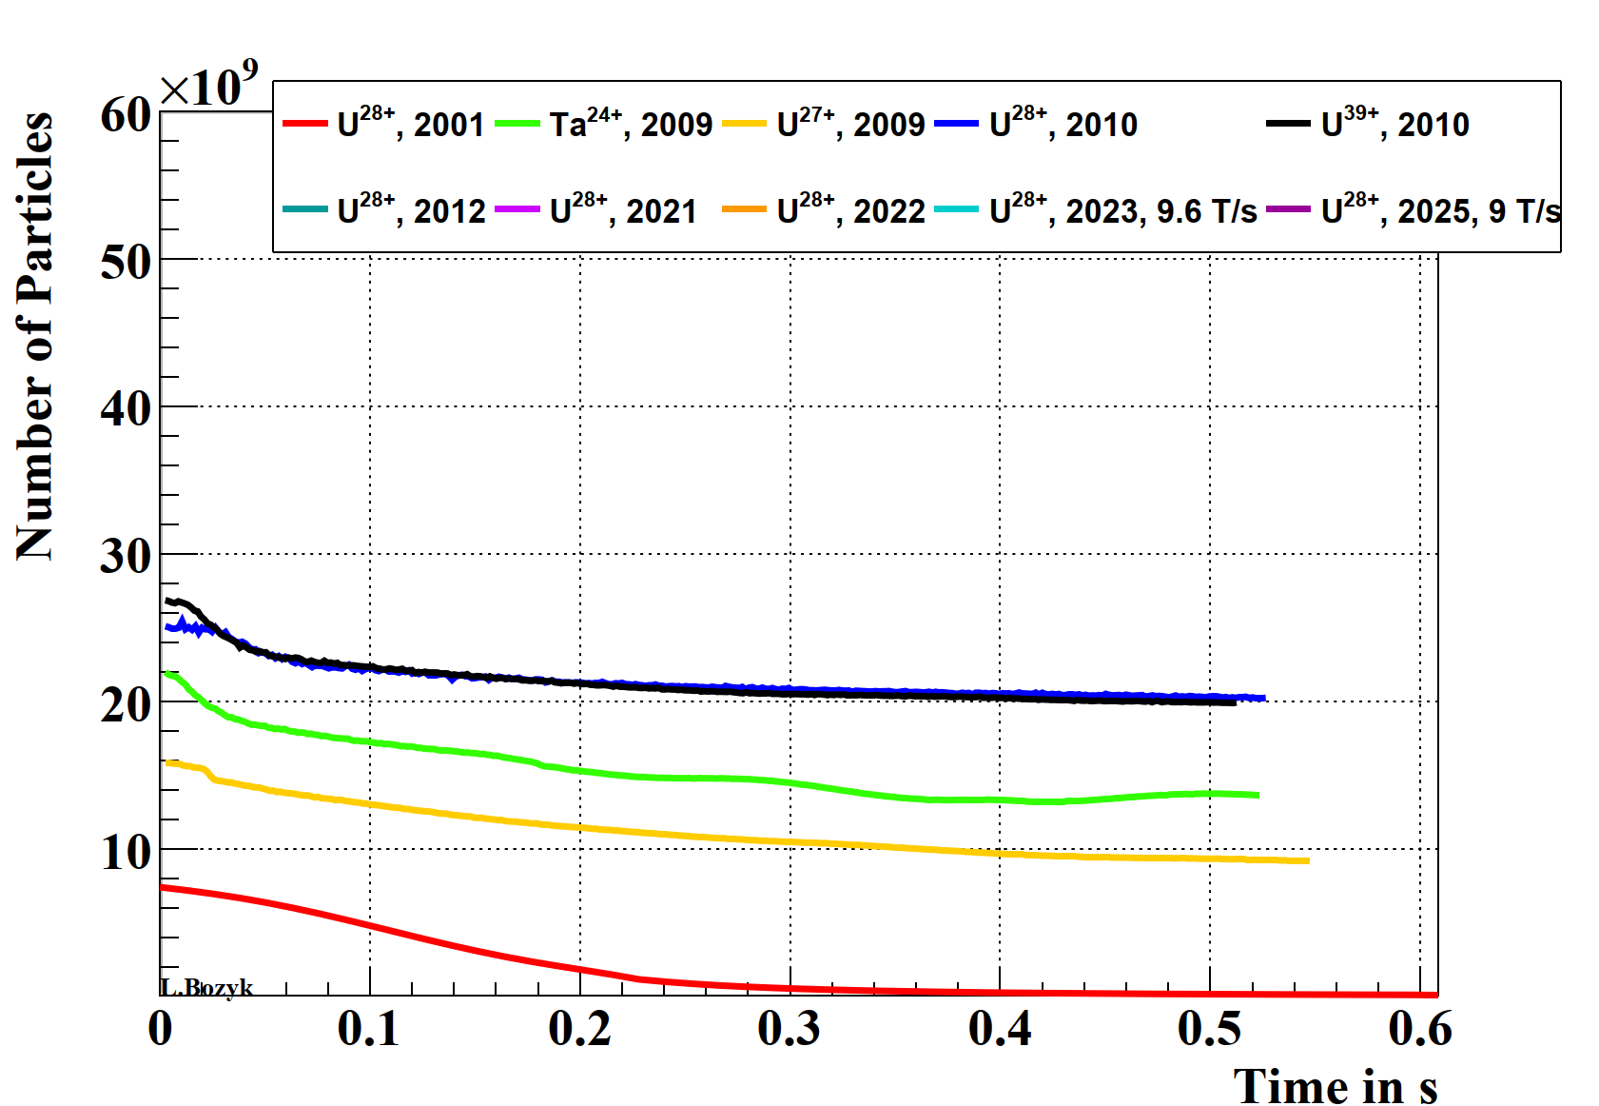
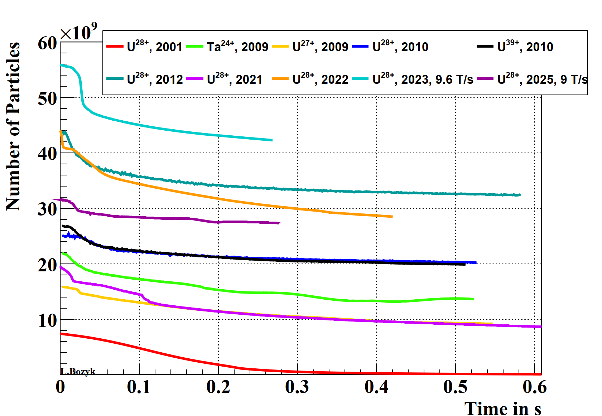
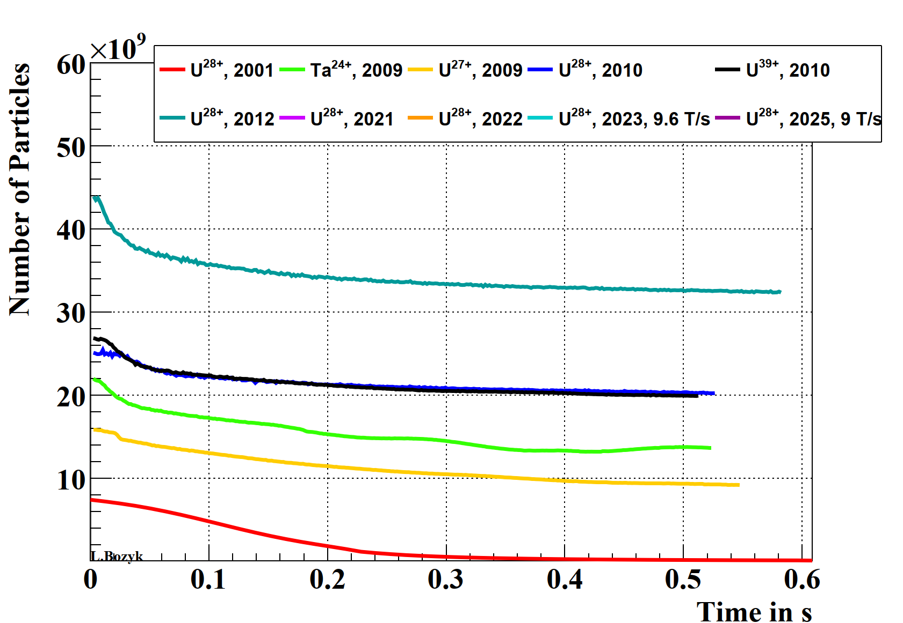
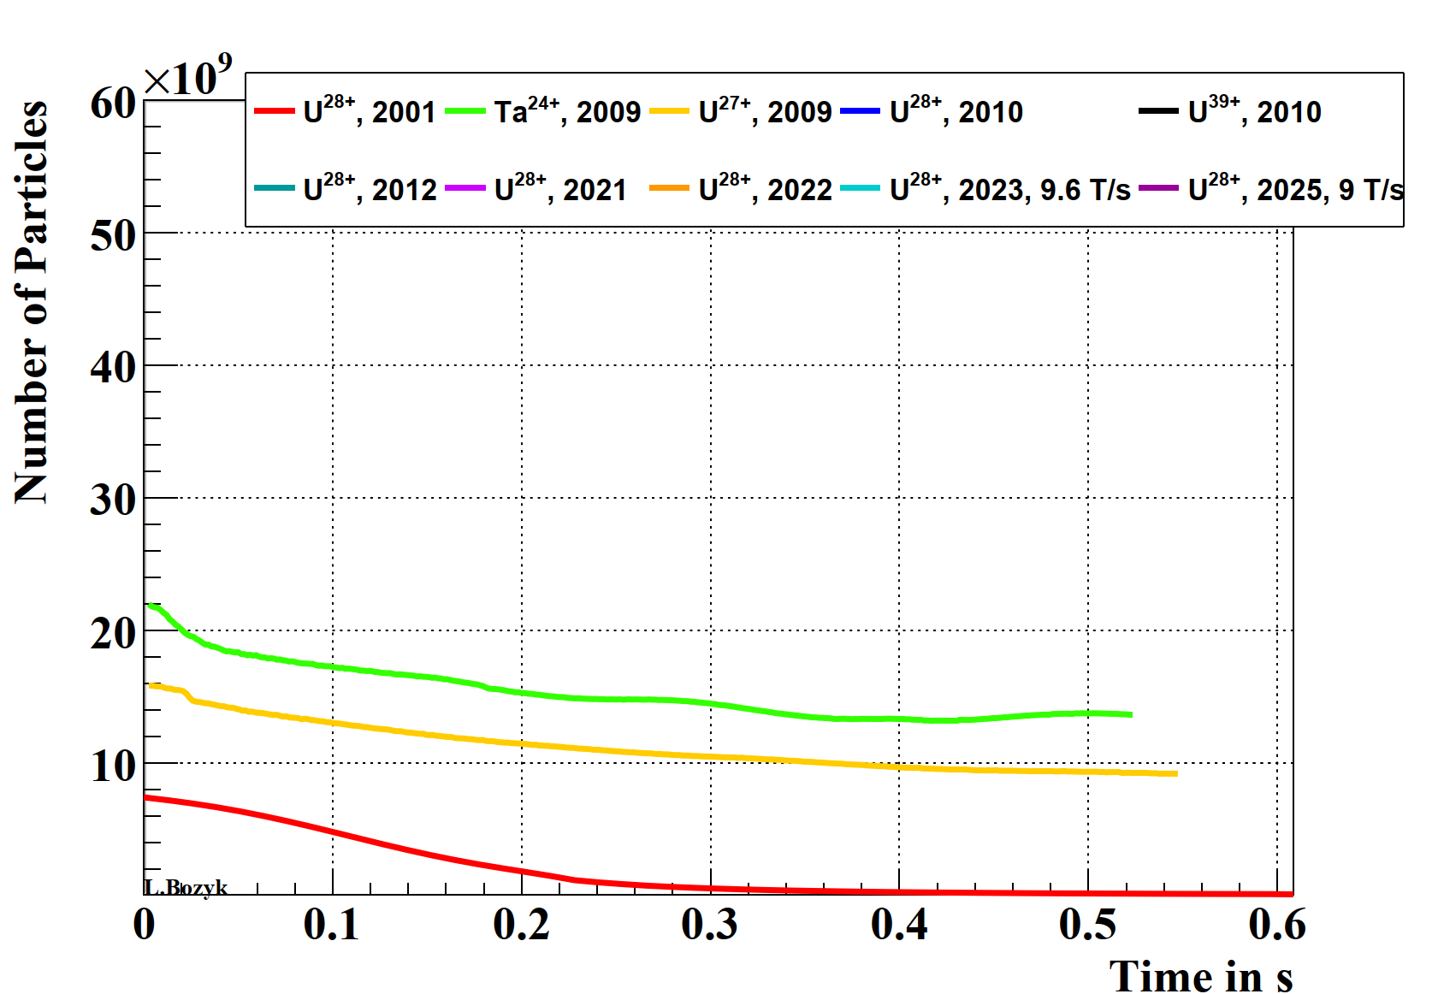
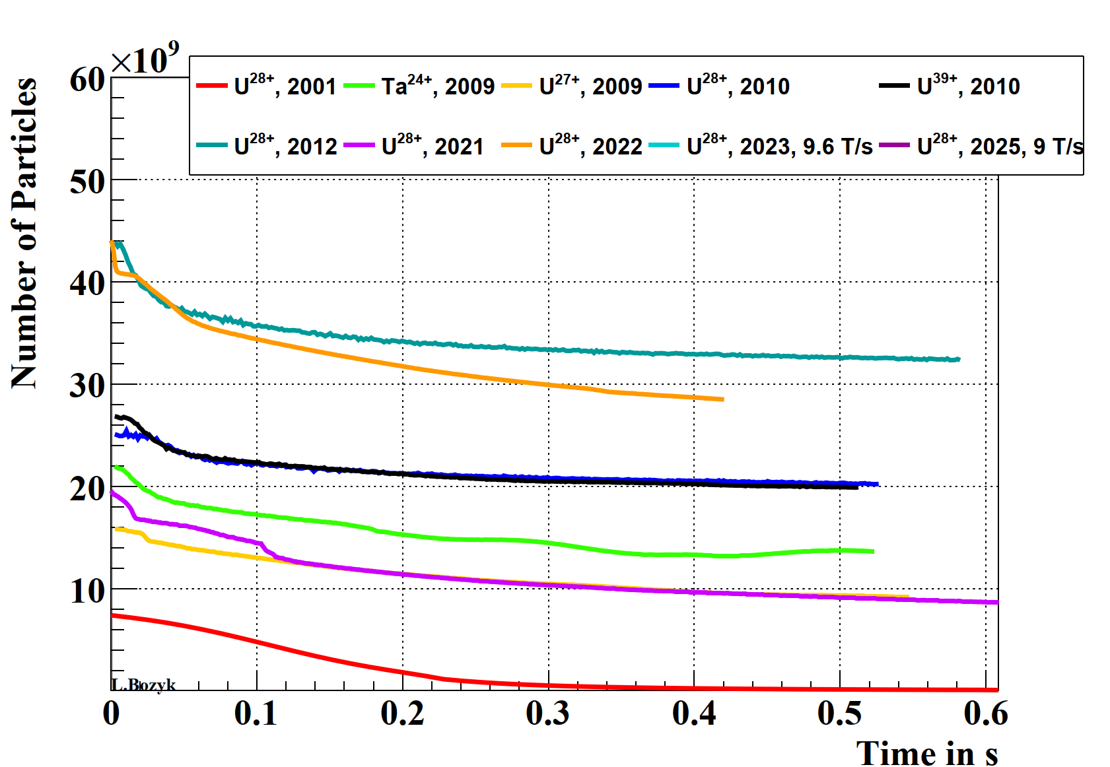
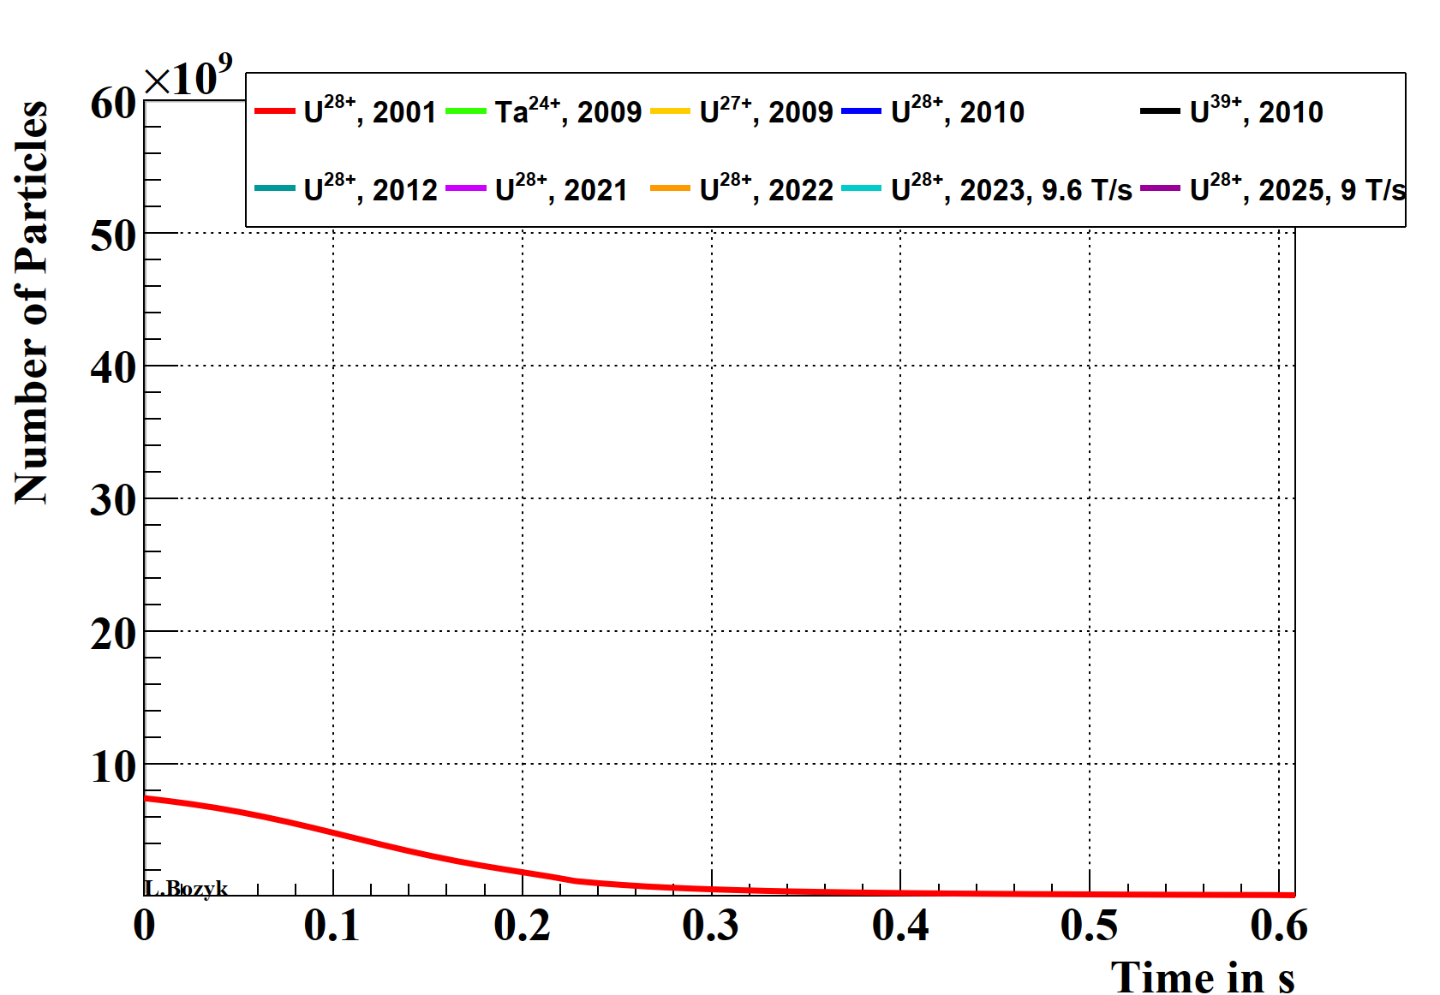
Maximum Intensity U²⁸⁺

Slide 4
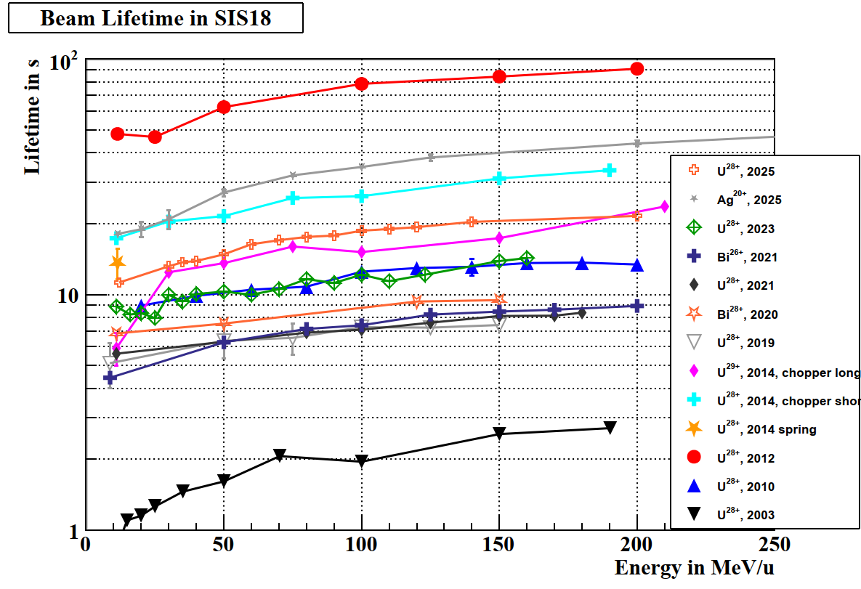
Beam Lifetime

Slide 5
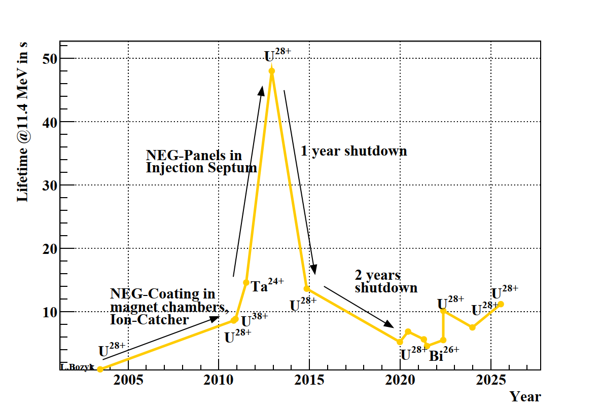
Evolution of Beam Lifetime

Slide 6
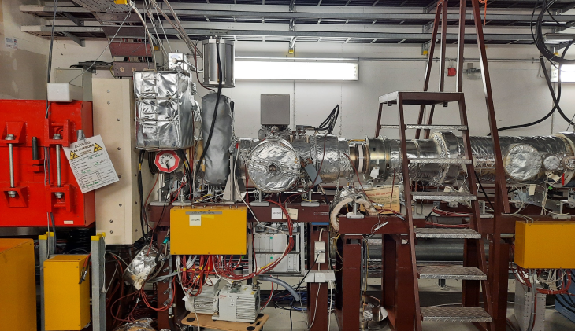
Cryoinserts-Results
Lifetime, incl. disruption
Collimator currents
during beam storage
Beam-intensity

Slide 7
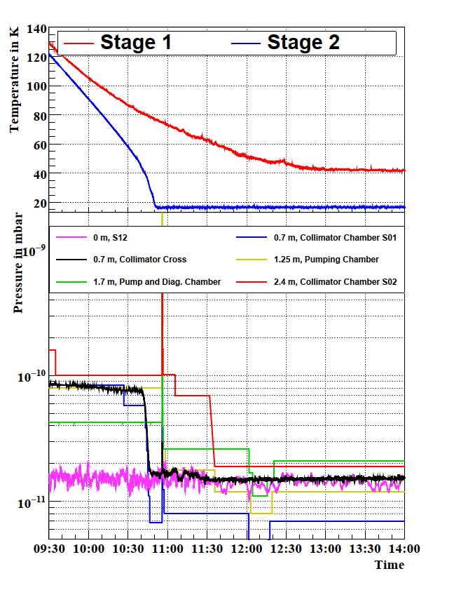
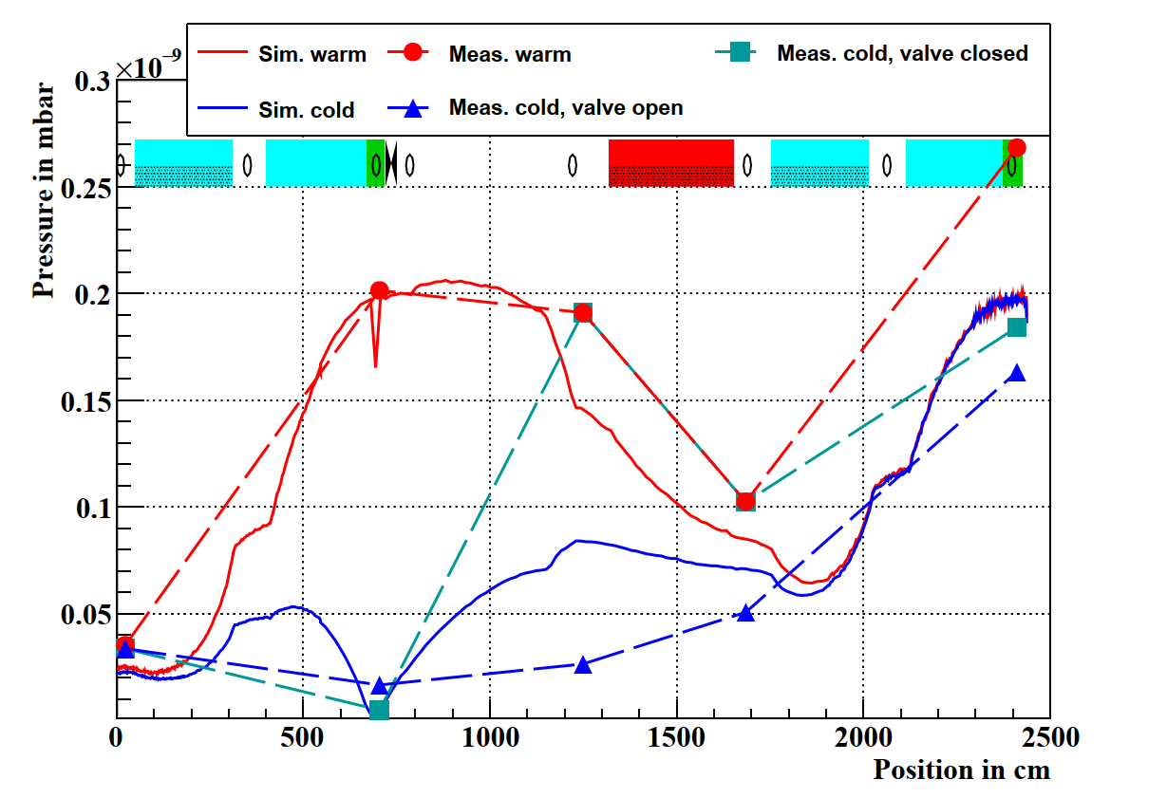
Cryoinserts in SIS18 – Static Vacuum
L. Bozyk and P. Spiller, “Cryogenic inserts in the room temperature synchrotron SIS18 at GSI”, presented at the IPAC'25, Taipei, Taiwan, Jun. 2025, THPS058

Slide 8
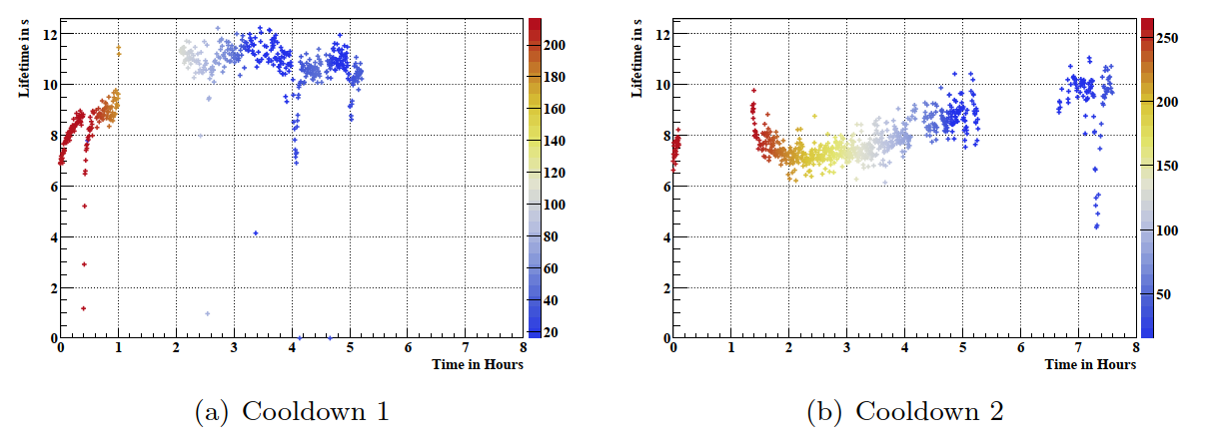
Lifetime @ 11.4 MeV during cooldown
Lifetime was measured alternating to high intensity storage cycles
Cooldown 2 had ~3 times the intensity of cooldown 1, therefore lower lifetimes were measured

Slide 9
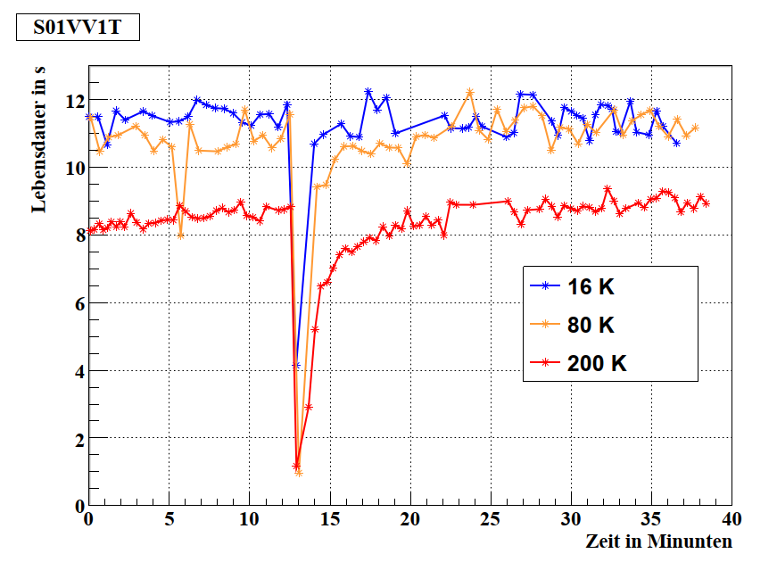
Livetime during Valve-movement
S01VV1T: Valve directly next to cryoinserts
Valve movement creates pressure bump
Time for pumpdown of pressure bump decreases with decreasing temperature

Slide 10
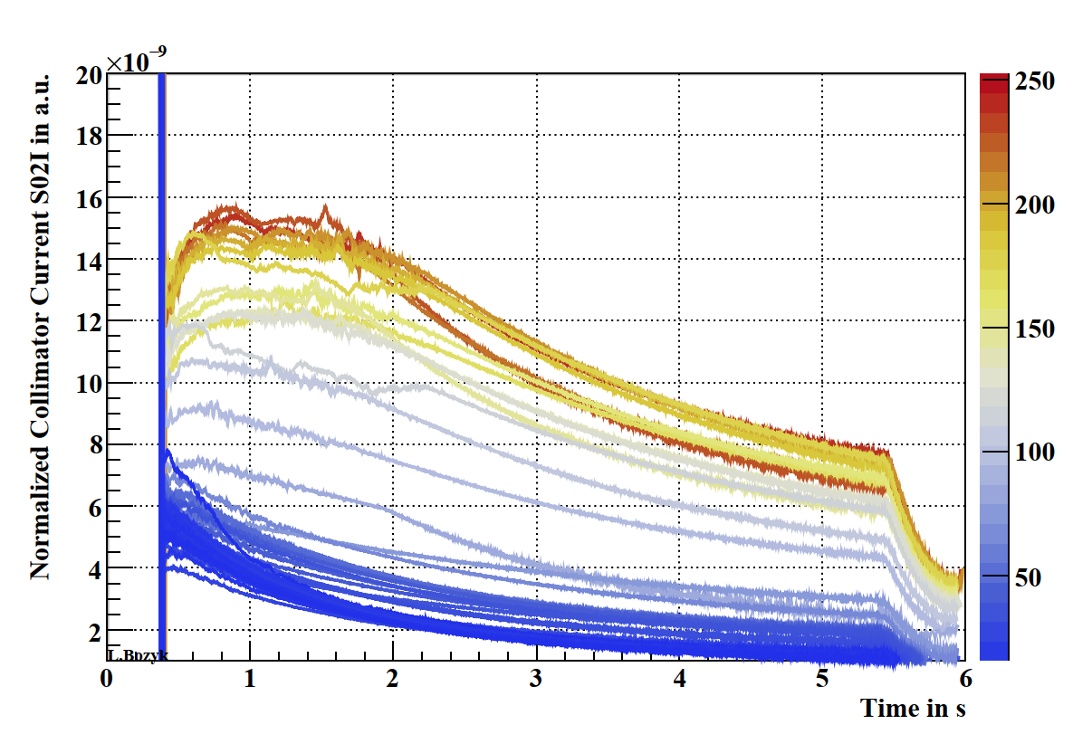
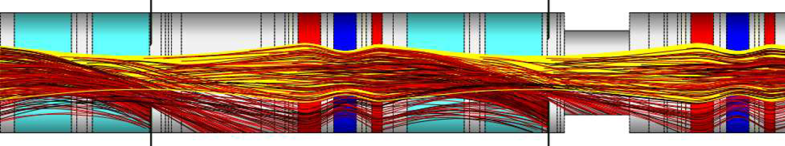
Ionization loss behind Cryoinserts
S01
S02
All collimators can measure incident ions
Collimator-current in S02 normalized to actual beam intensity is proportional to rest gas pressure in S01
Color represents temperature of cryoinserts
Decrease of charge exchange with falling temperature visible
Cryoinserts
Measurement

Slide 11
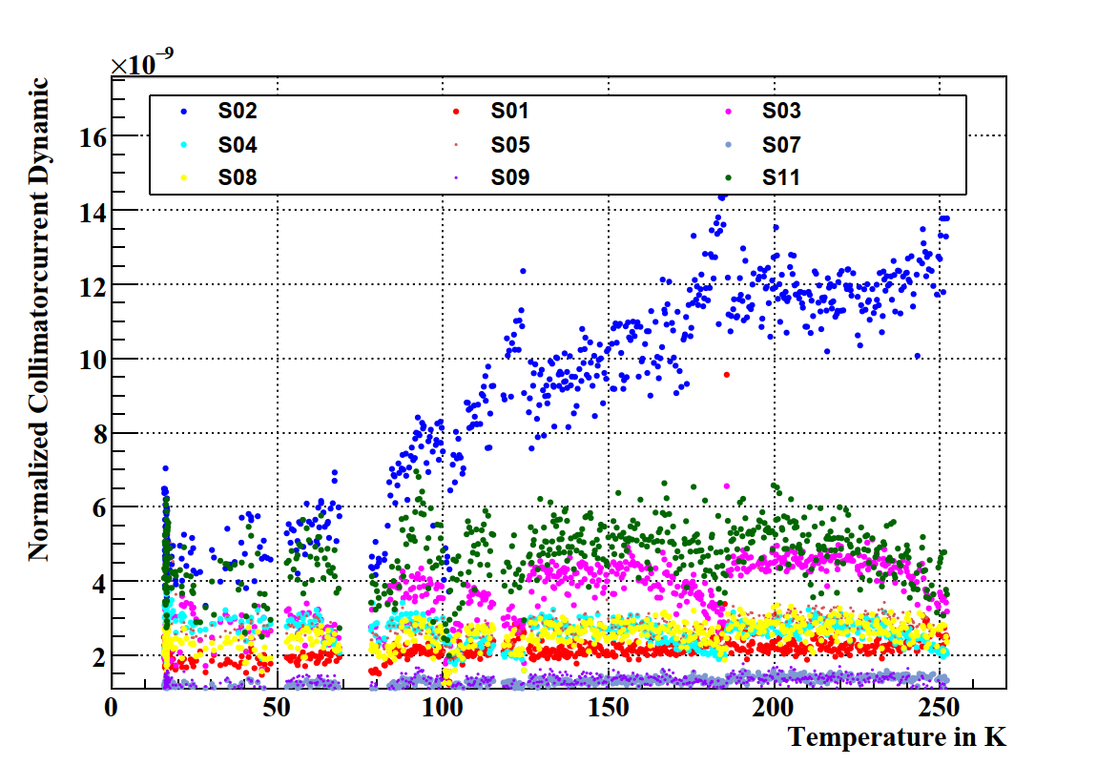
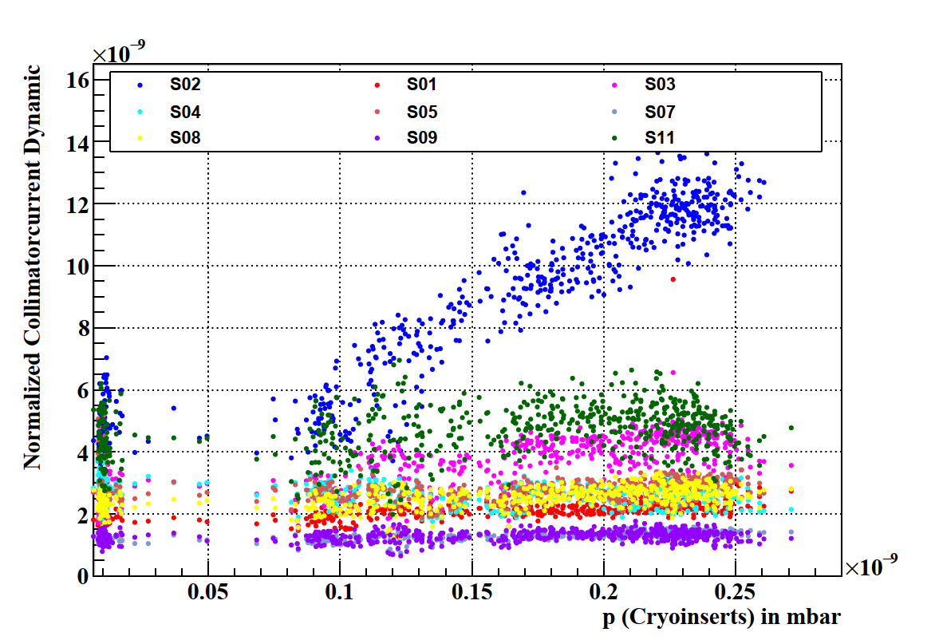
Normalized Ionization Dynamics
Normalize Dynamic = {(Max. value) – (Min. value)} / initial beam intensity

Slide 12
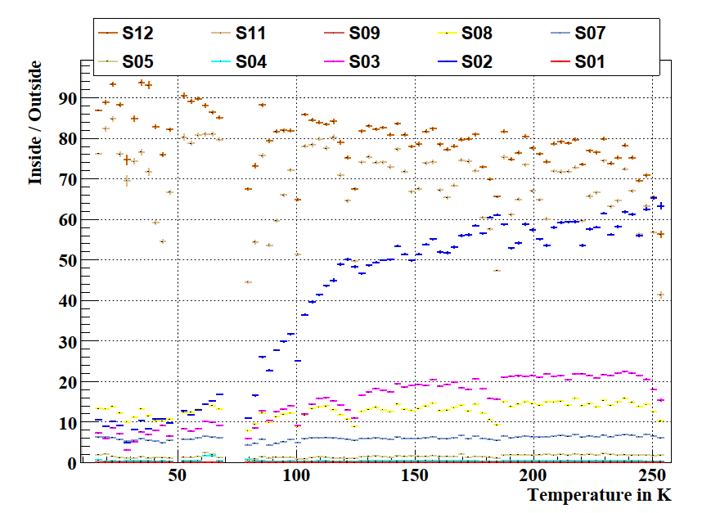
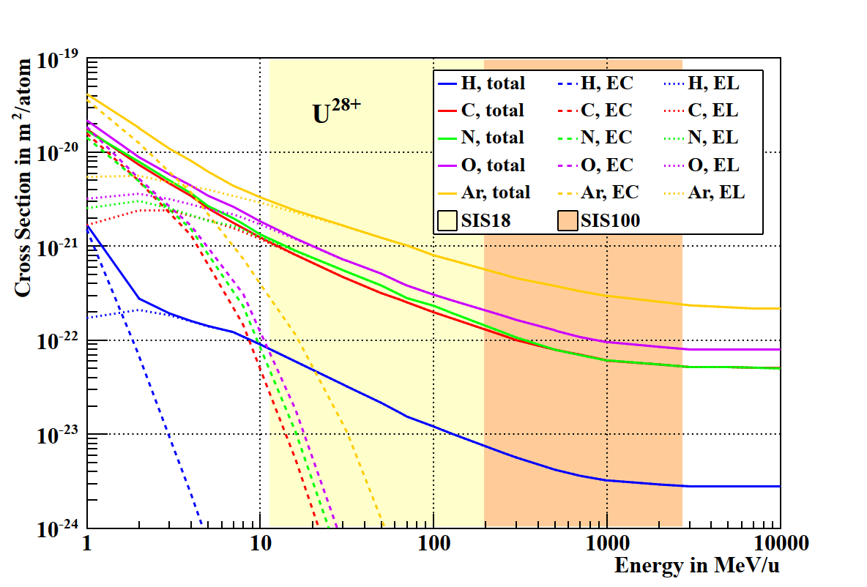
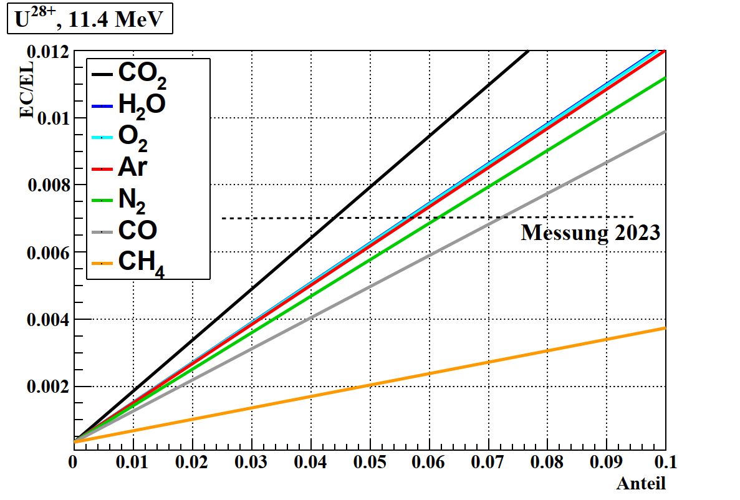
Ratio between Electron Capture and Electron Loss
SIS18 is equipped with collimators on both sides
Electron Loss: Inside
Electron Capture: Outside
Different processes
of atomic physics
Ratio depends on residual gas composition

Slide 13
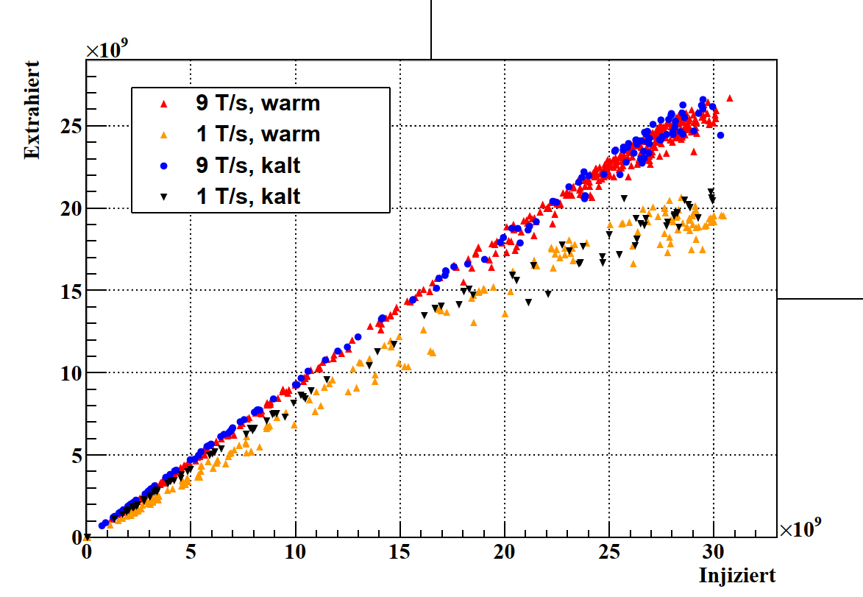
Extracted vs. Injected Numbers of Particles
Due to dynamic vacuum effects the number of extracted particles does not scale linear with the number of injected particles
Less ramping rate means higher nonlinearity
Cold cryoinserts slightly increase the total intensity
1e10 ppp is not enough for this analysis, therefore intensity optimization was necessary during beam time

Slide 14
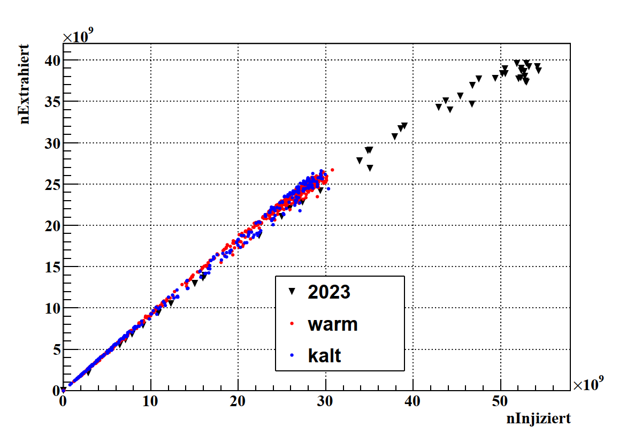
Extracted vs. Injected Numbers of Particles
Comparison with record intensity from 2023
Ramping rate: 9 T/s
This year, the machine settings and overall vacuum was slightly better than 2023

Slide 15
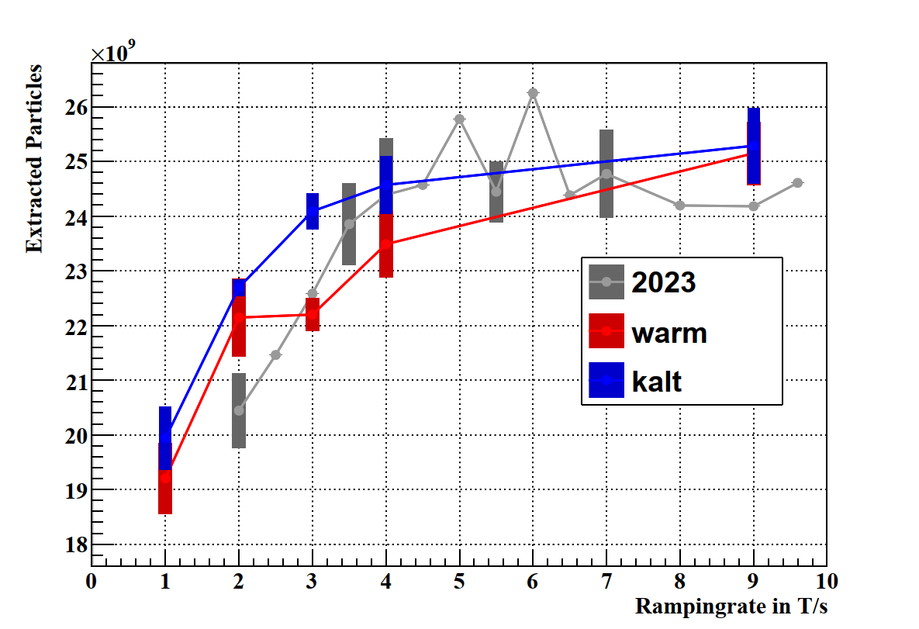
Influence of Ramping Rate
Dependency of number of extracted particles on the ramping rate
Cold cryoinserts slightly improve the transmission
Comparison with 2023 data (restricted to 2025 intensities) again show better performance this year

Slide 16
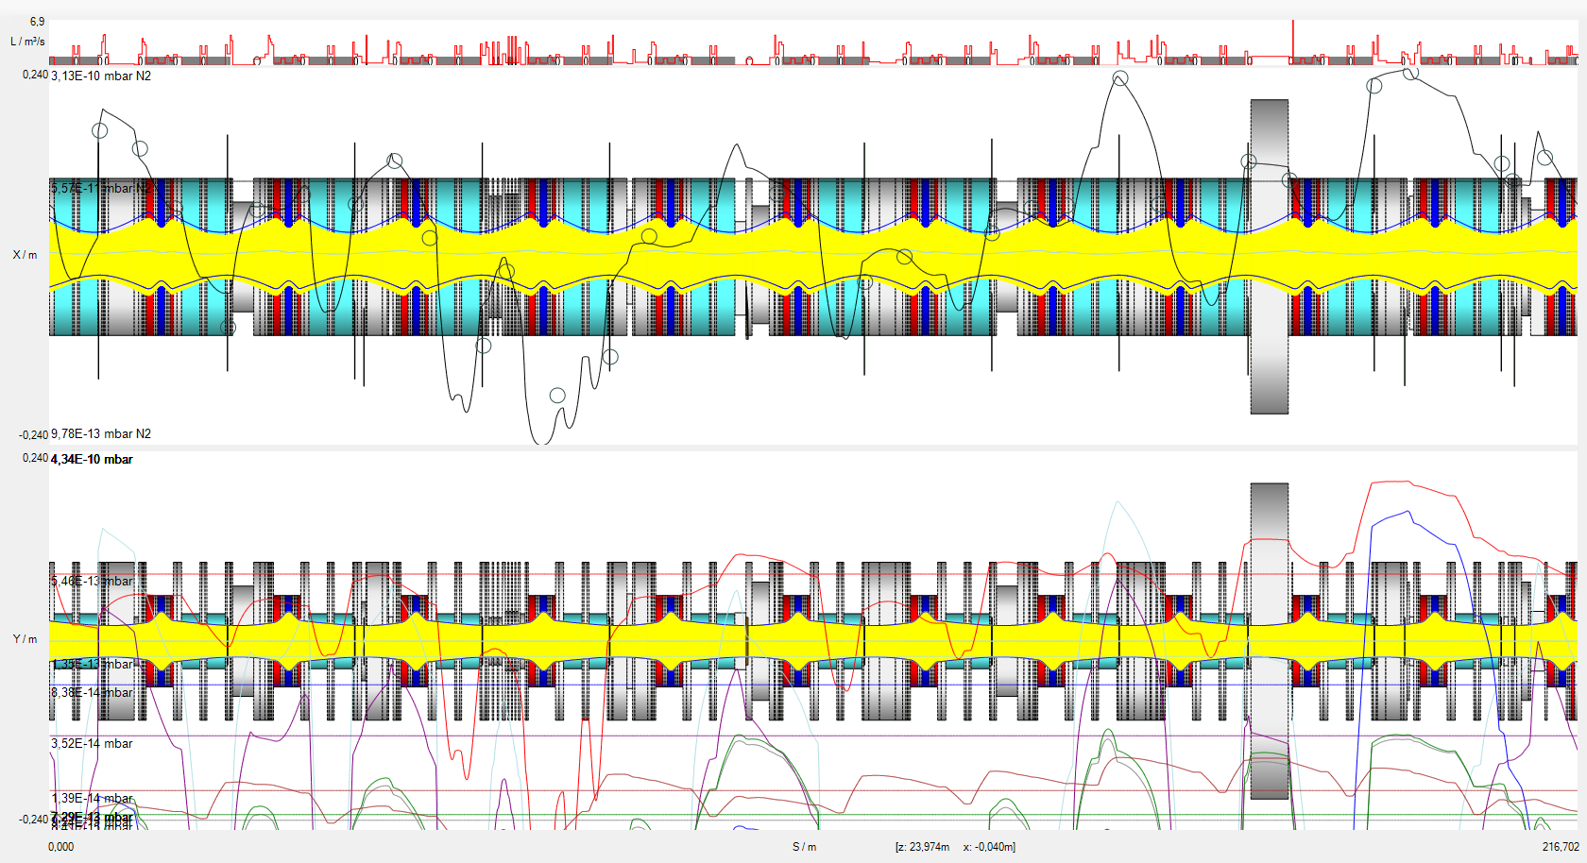
Outlook: Simulation
New adaptions
in StrahlSim:
Display Measured values
Calculate N2-equivalent
Add leak list
Ageing of NEG-surfaces
→ Reproduce measured values

Slide 17
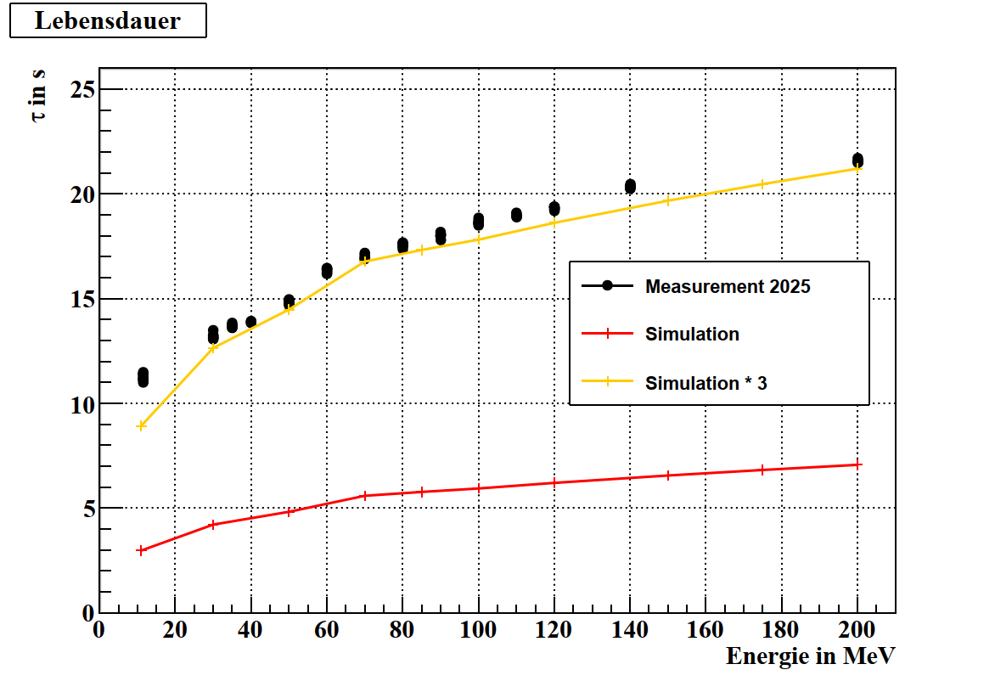
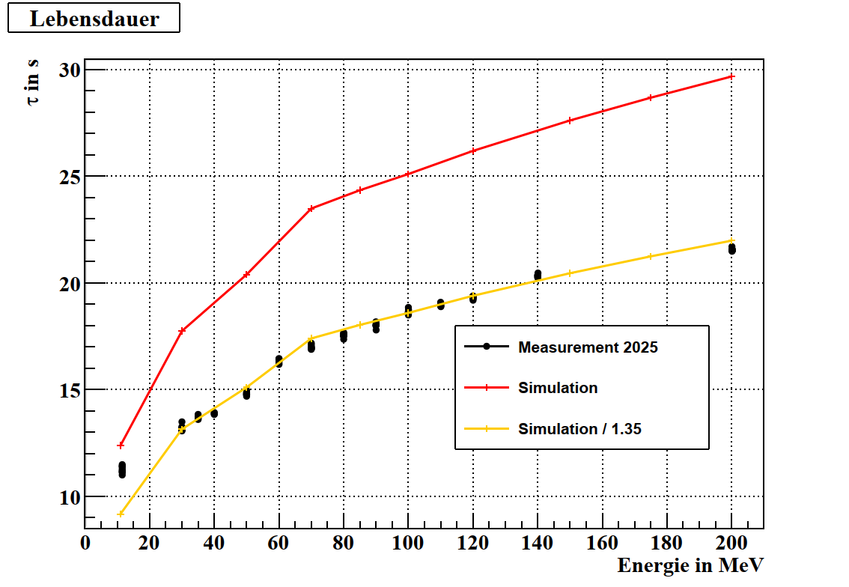
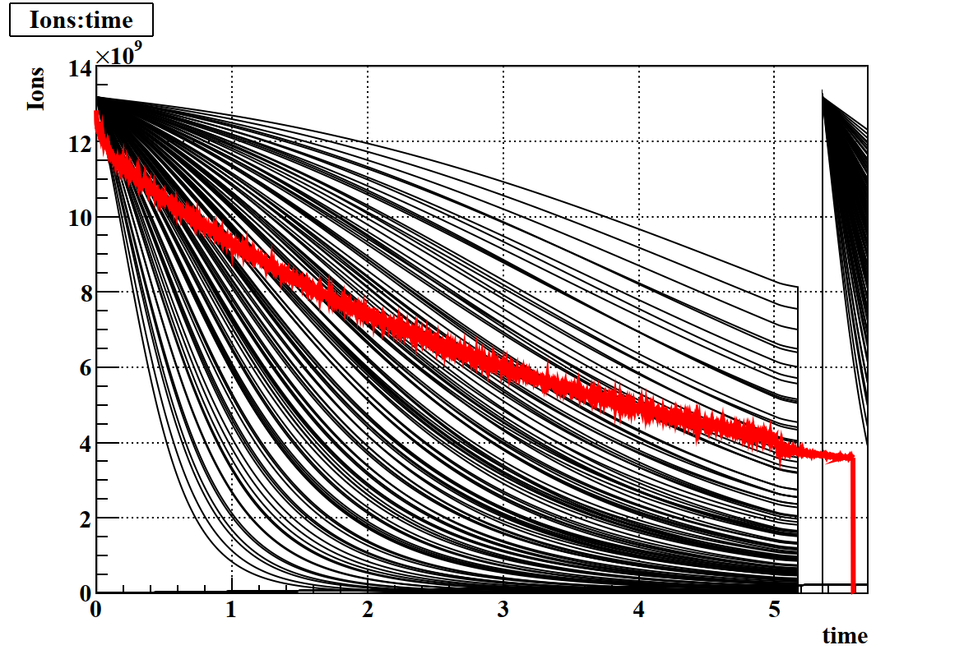
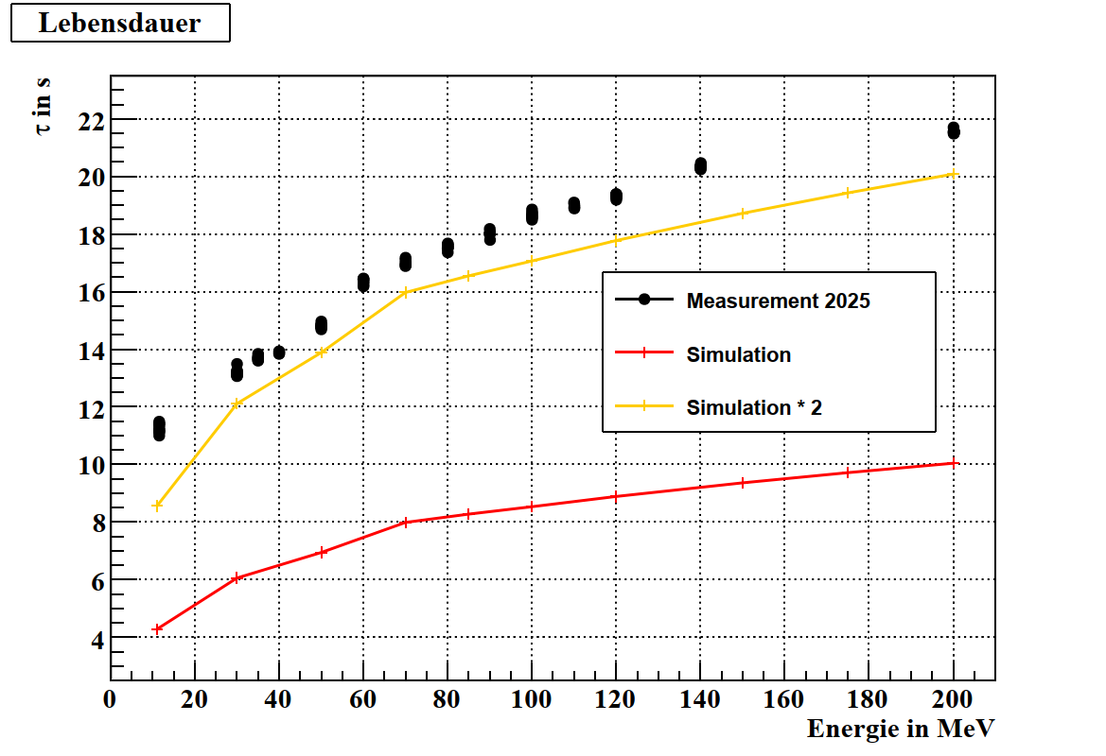
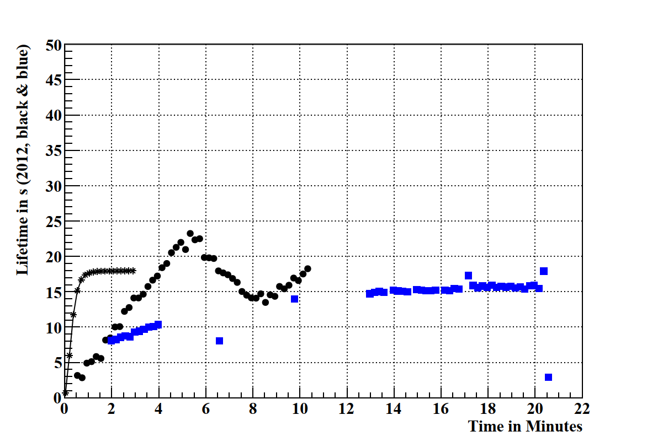
Outlook: Simulation of Lifetime and Stored Beams
Goal: Detailed
Simulation of
- Stored bams
- Cryoinsert-cooldown

Slide 18
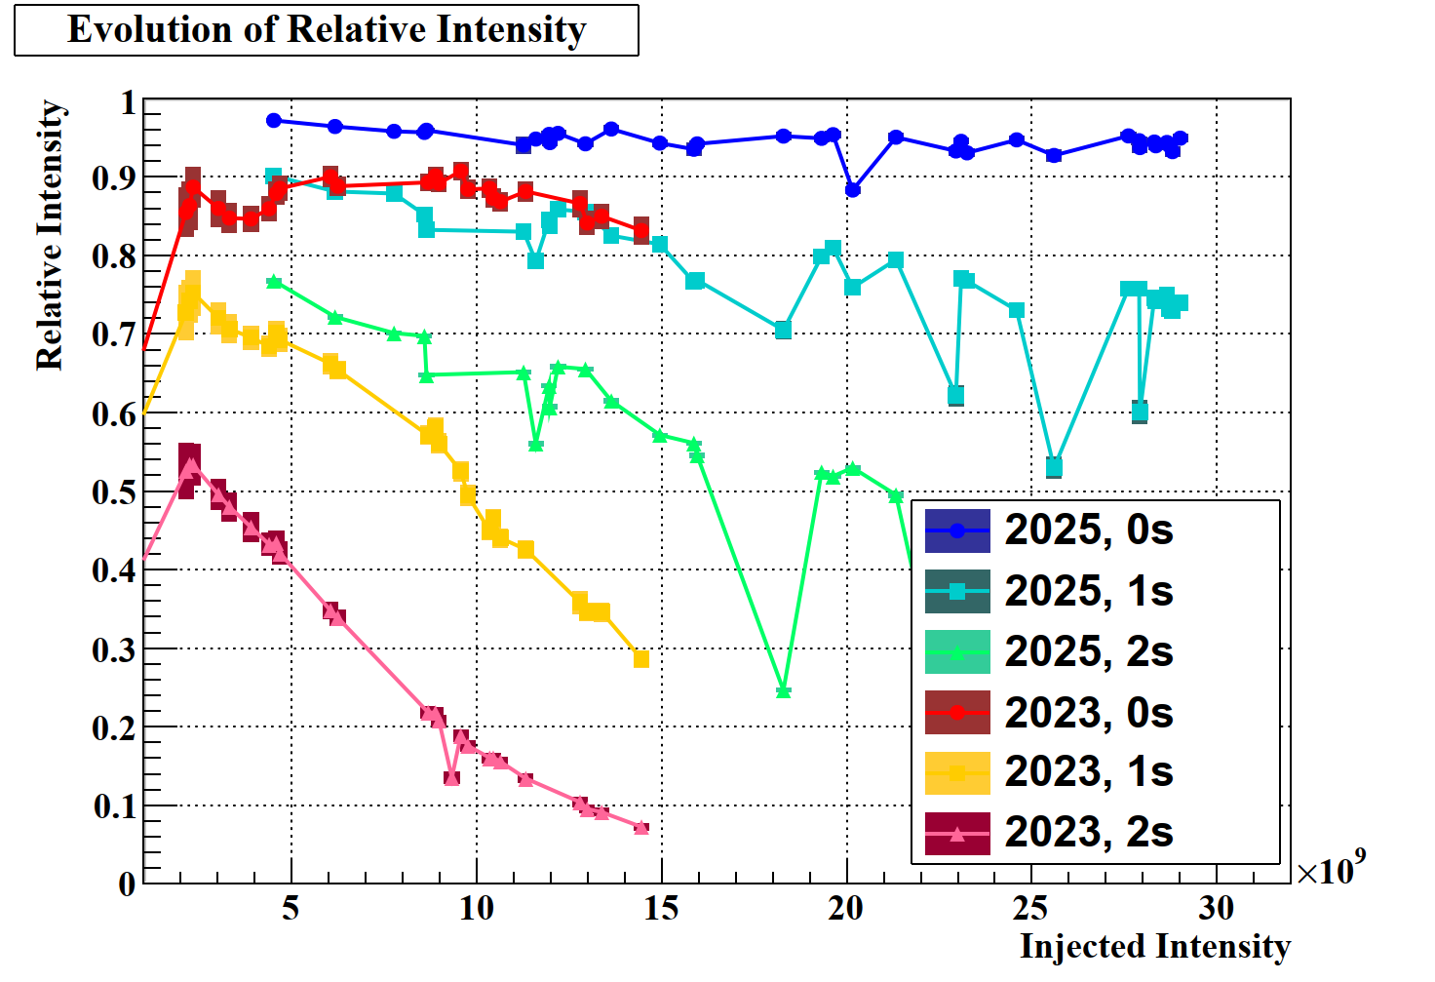
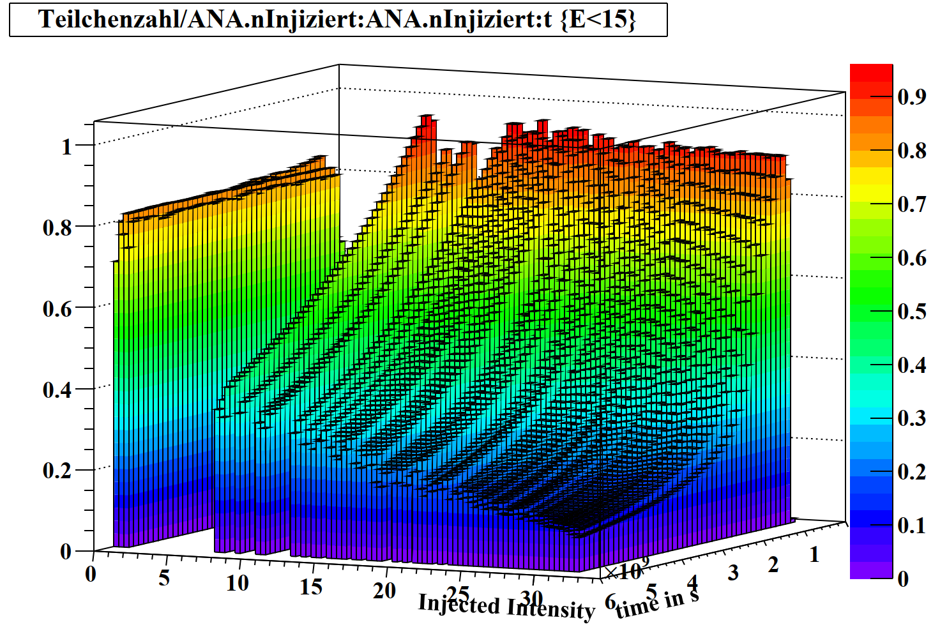
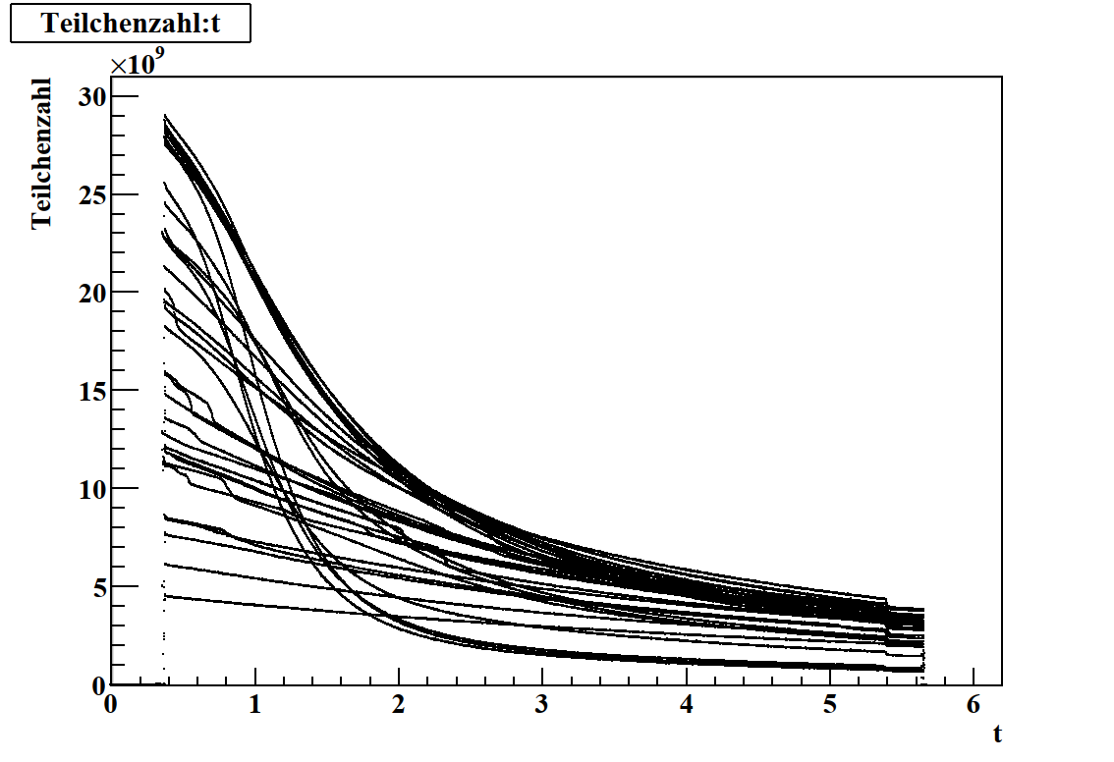
Intensity Beakdown induced by Dynamic Vacuum

Slide 19
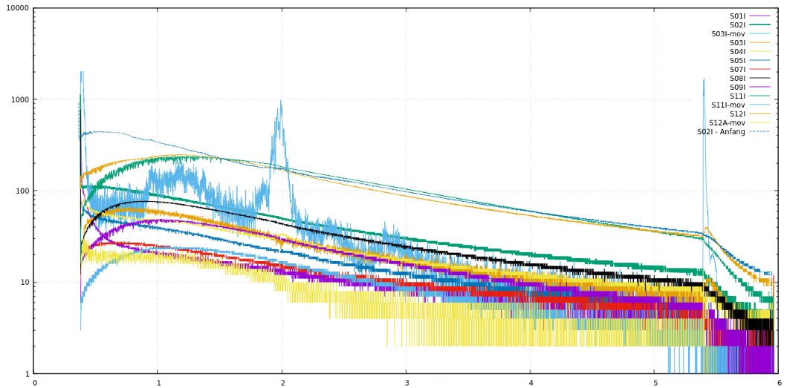
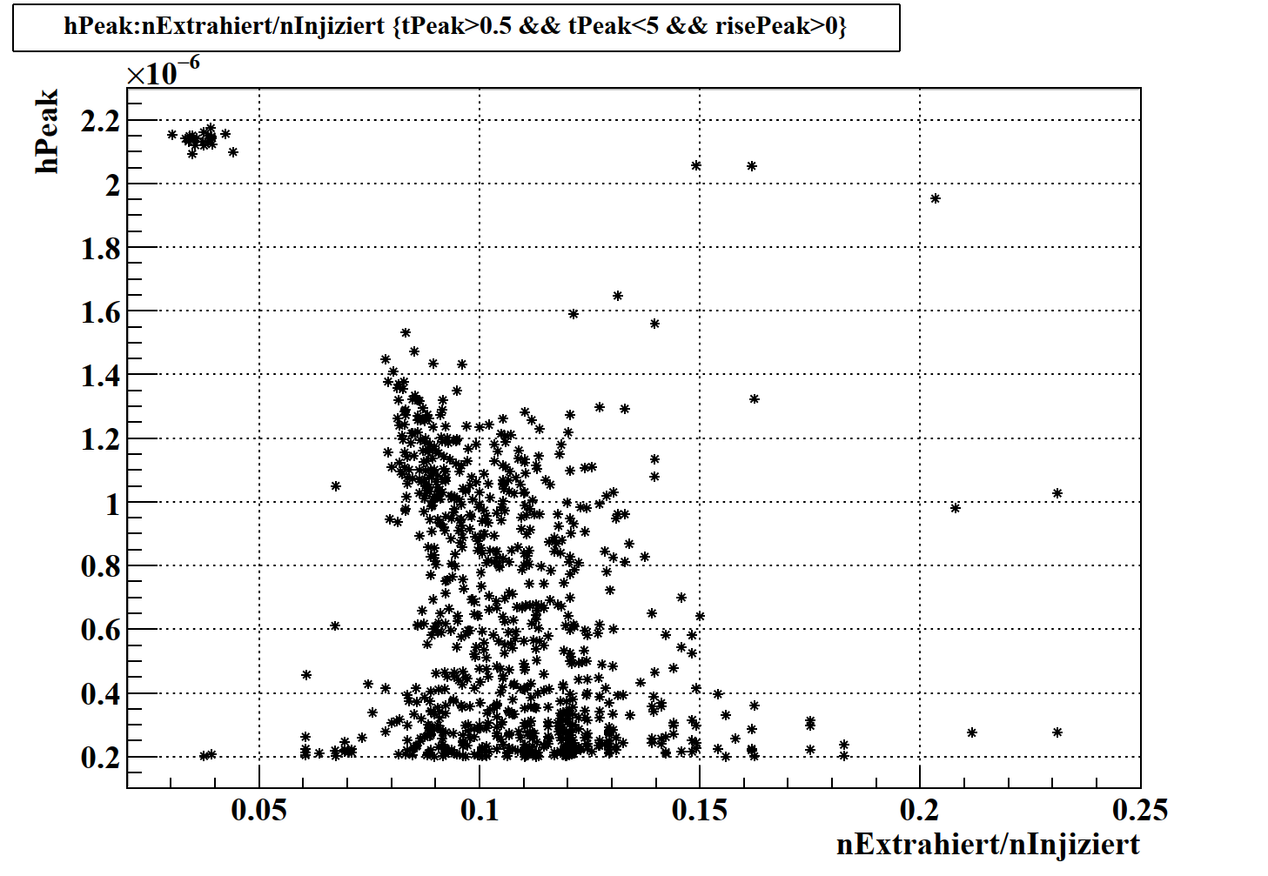
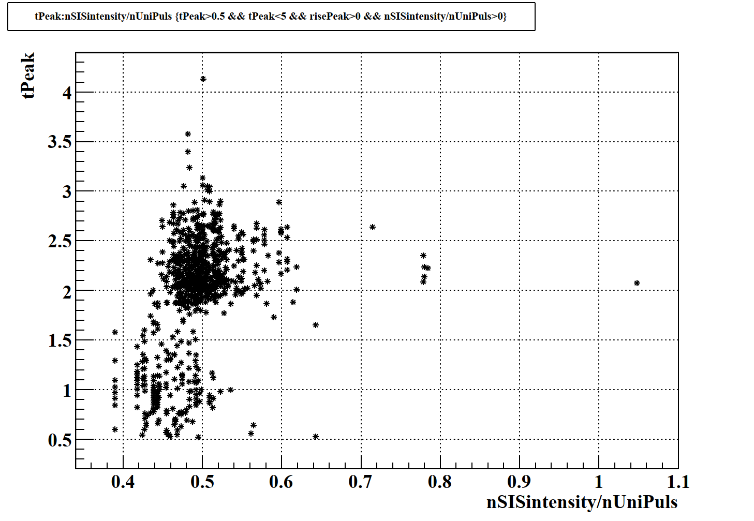
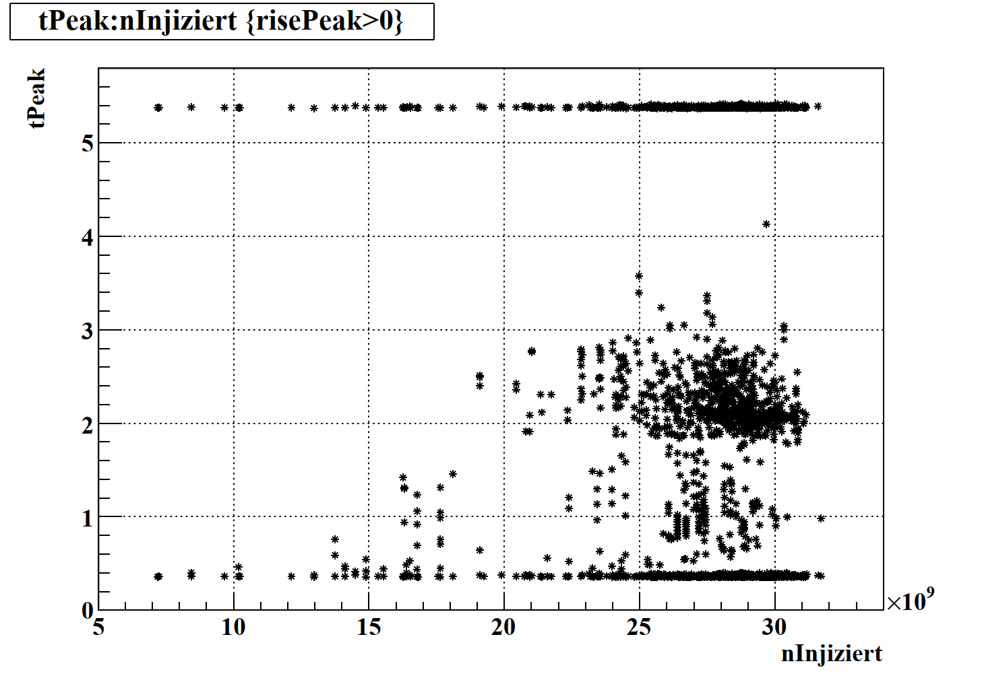
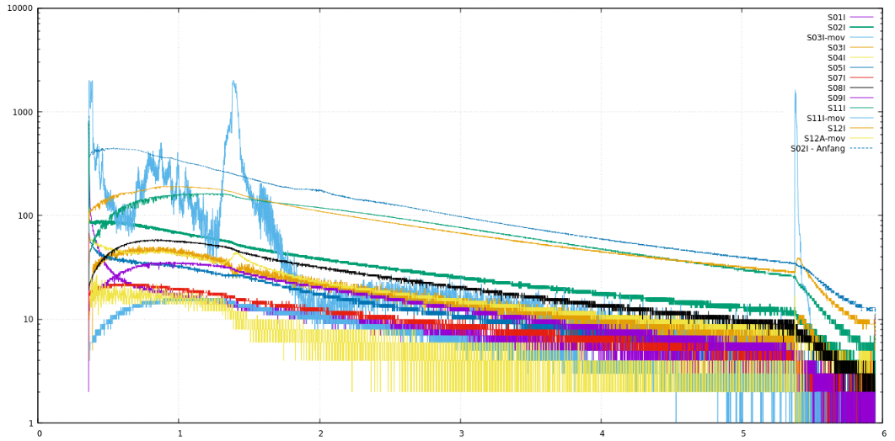
Spontaneous Losses during Storage?!

Slide 20
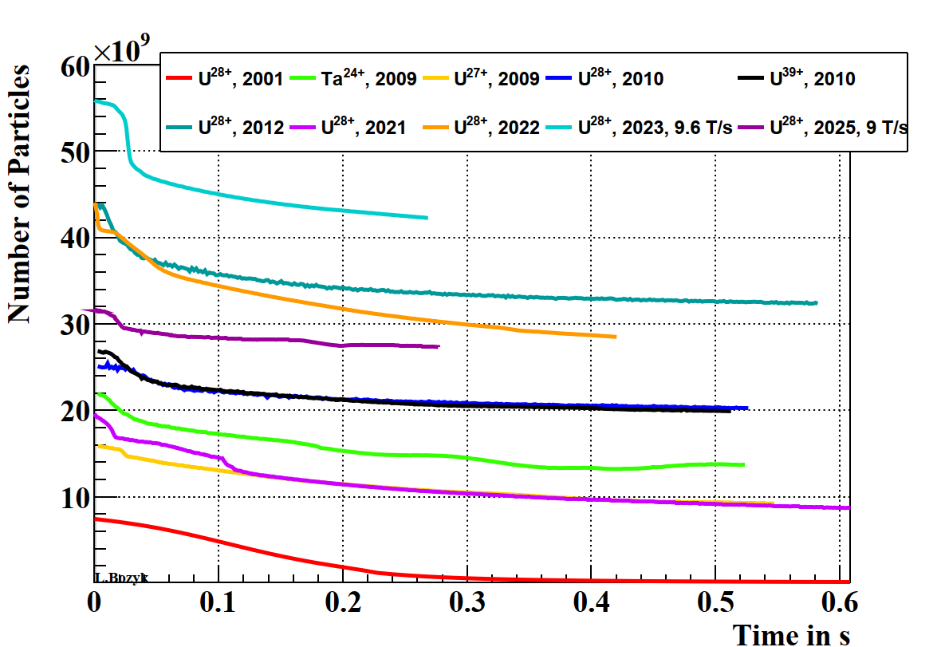
Summary

