Slide 1
Machine Experiments 2025 UNILAC pulsed gas stripper
P. Gerhard, L. Groening, M. Maier
PSU

Slide 2
Topics
Goals:
create database for specification of final gas control station: explore gas pressure range especially at low pressures and resulting charge state spectra for H₂ and especially N₂ for light, medium and heavy ions ⇒ several ions needed, extensive parameter space
Measurements:
setup beam of light/medium/heavy ion to gas stripper.
acquire stripping efficiencies for most abundant charge states as function of gas pressure, cover full pressure range available, for N₂ only. For H₂ we did not get the needed beamtime using different ion species. U stripping data with H₂ already available.
Analysis:
evolution of stripping efficiencies for most abundant charge states vs. pressure (target density)

Slide 3
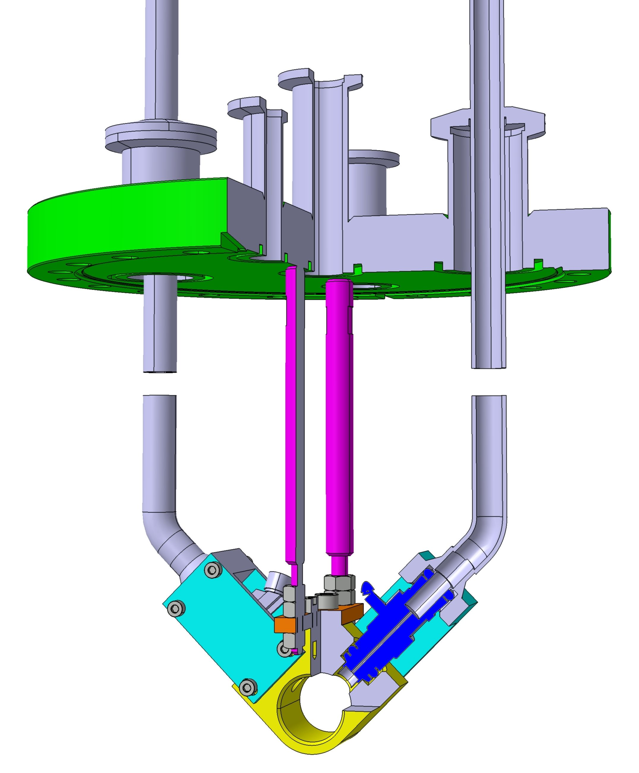
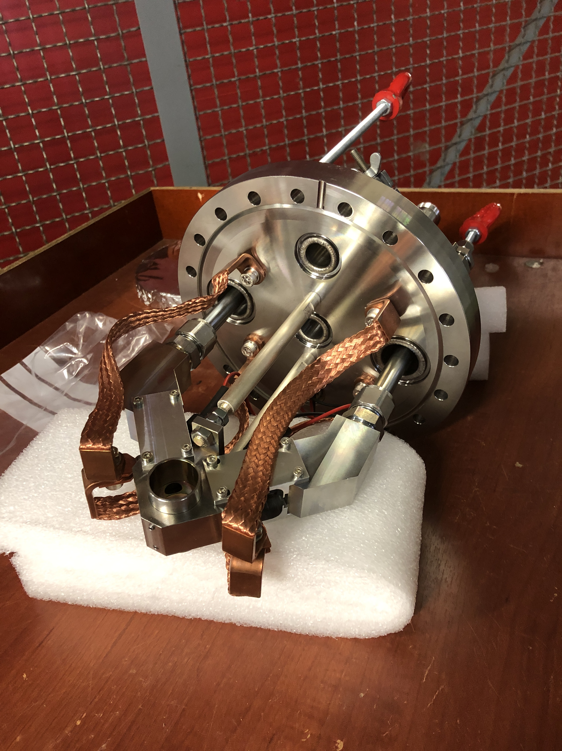
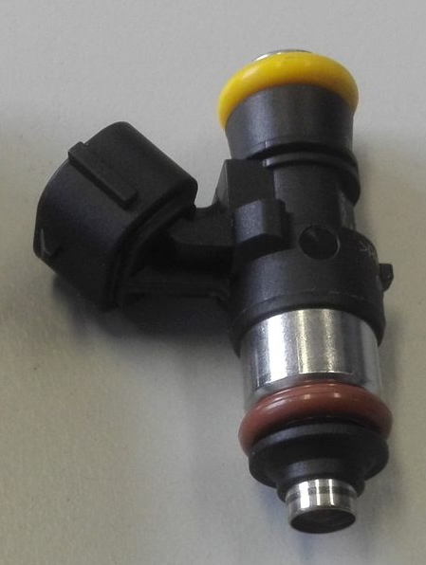
UNILAC Pulsed Gas Stripper

Slide 4
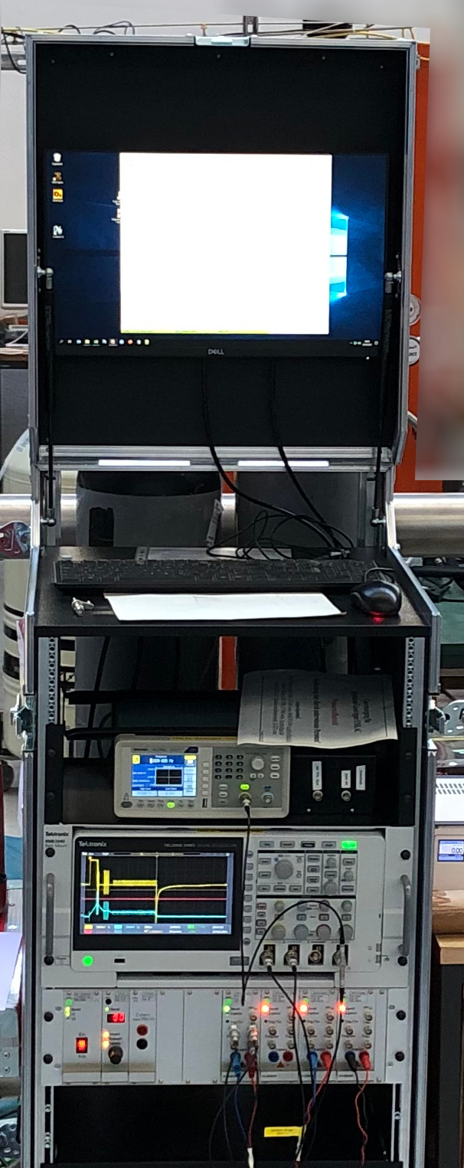
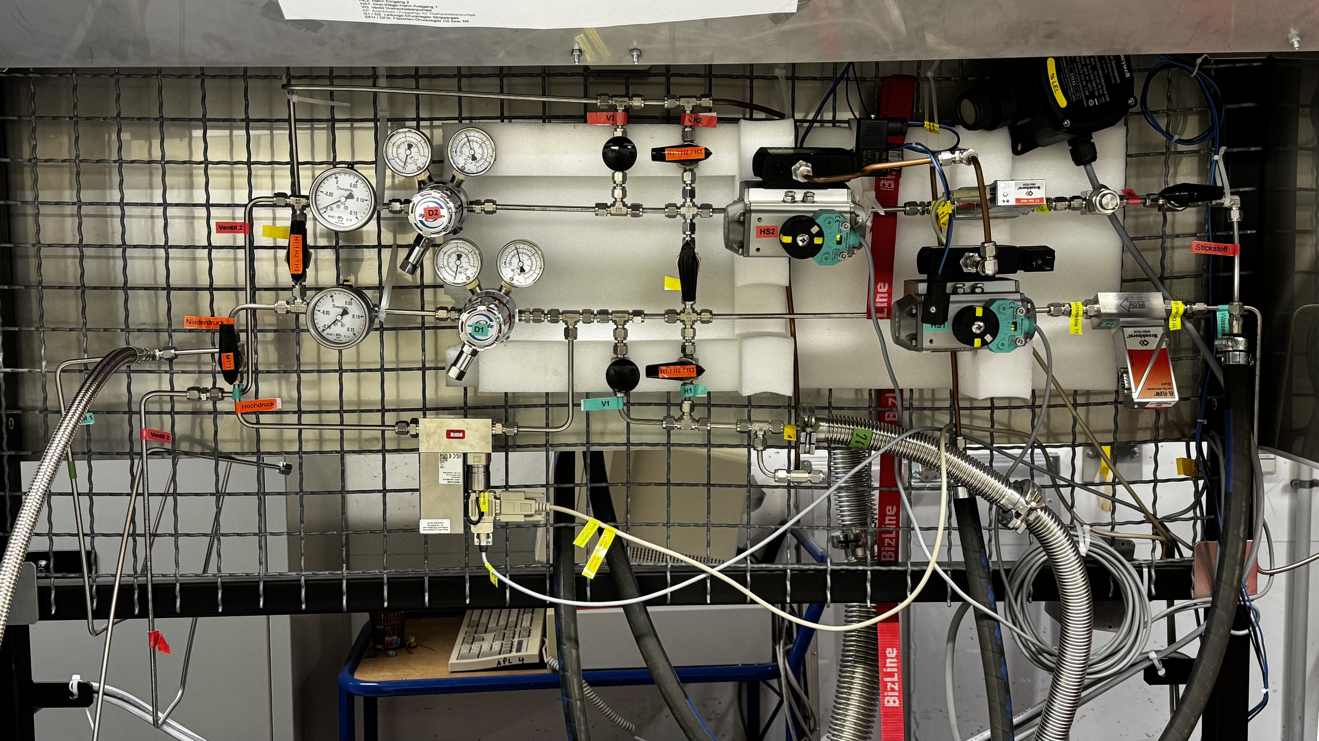
Preparation for beam time
Upgraded development setup
low pressure
regulators
upgrade 2024
safety cut-off valves with
H₂ supply
split purge line
and bypass line
⇒ flexible use of
2 injection valves
upgrade 2024
Flowmeter
N₂ from supply line
upgrade 2024
PC ⇒ local / remote control
electronic pressure controller
electronic pressure regulator (0,1 - 6 bar(a))
improvement 2025
oscilloscope ⇒ timing
injection valve controller

Slide 5
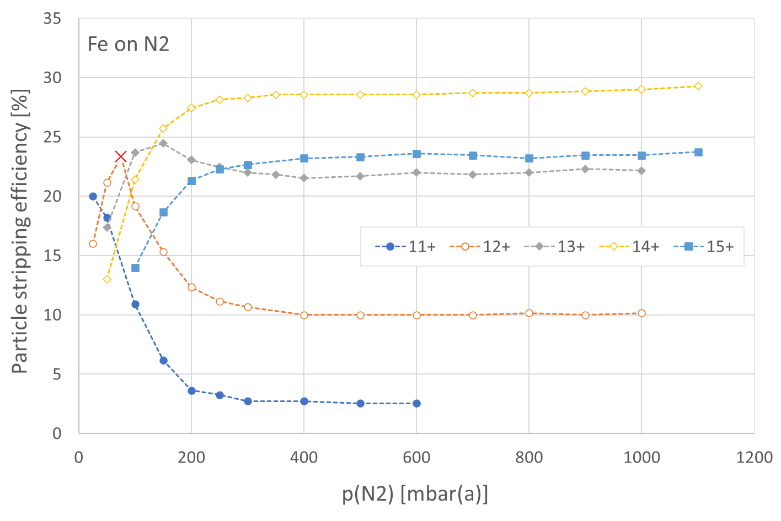
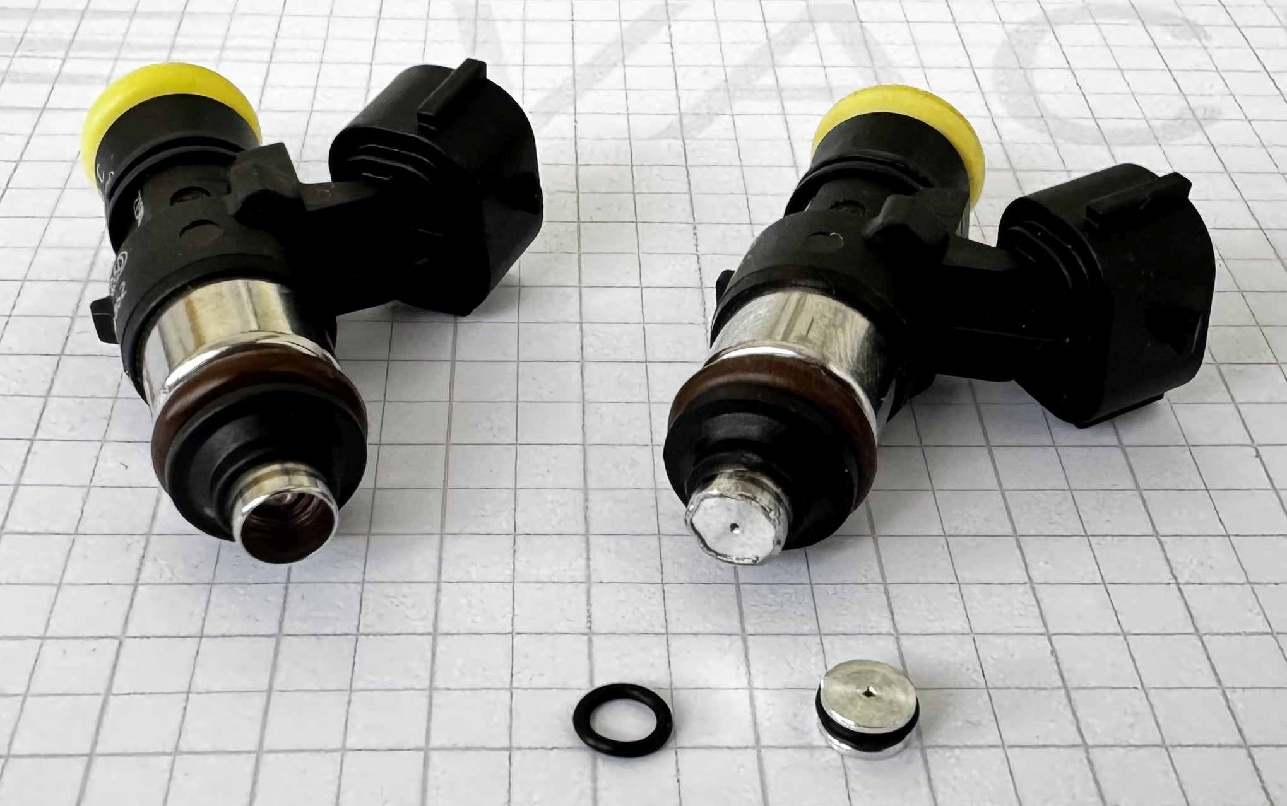
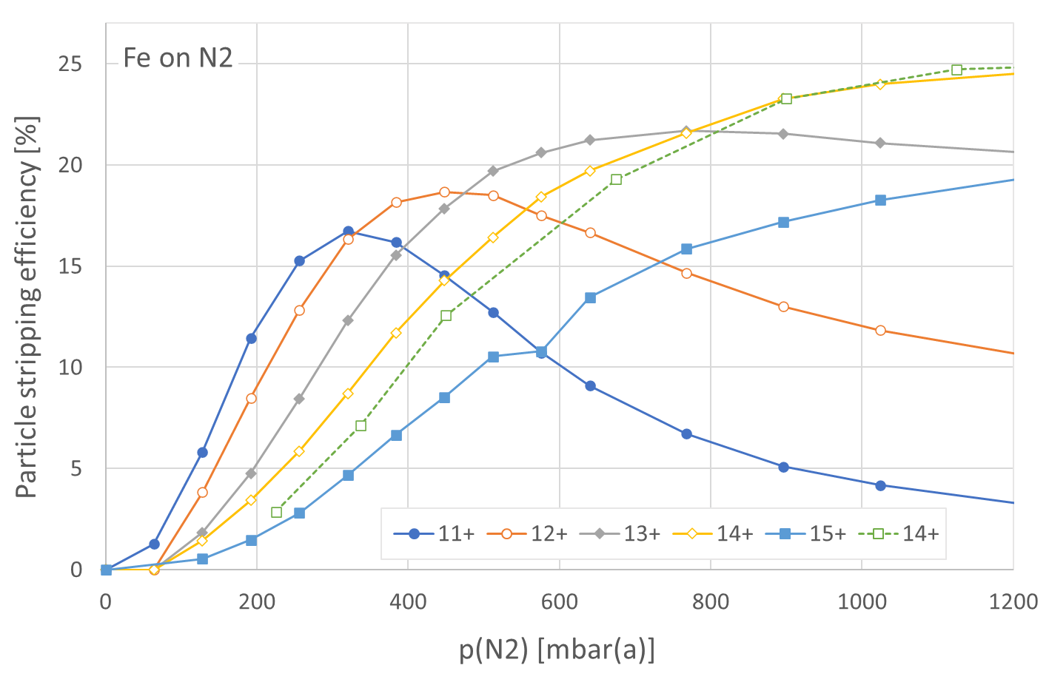
UNILAC Gasstripper: Modified Injection Valves
Valves failed after 20% of expected service life – due to very low gas pressure?
Restrict gasflow by orifice in valve outlet ⇒ increase system pressure by factor of 4.5
Stripping not affected ✓
Additional benefit: Facilitates pressure control
without orifice
(original)
⇓
with orifice
Valve with orifice ∅0.6 mm
Original
valve

Slide 6
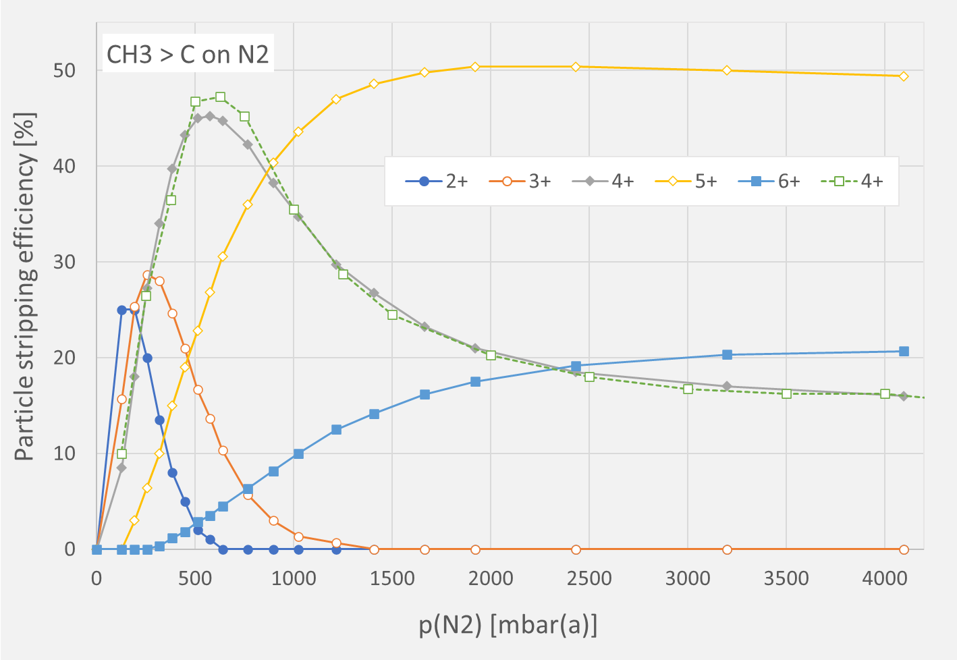
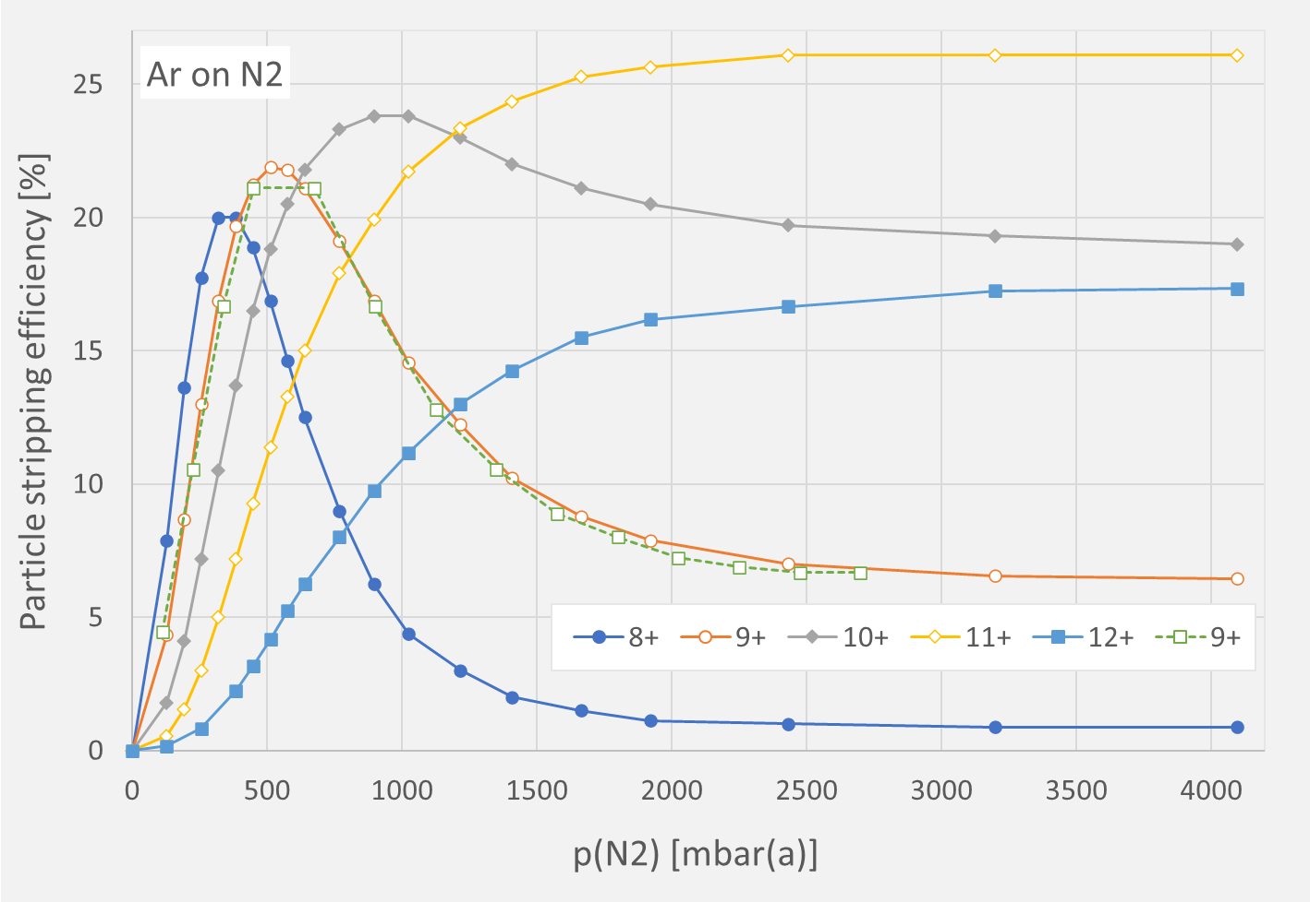
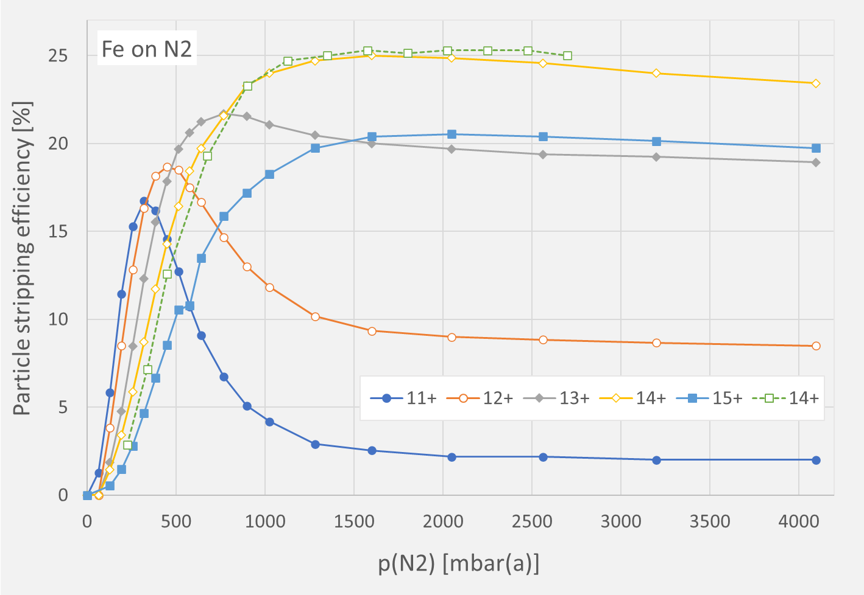
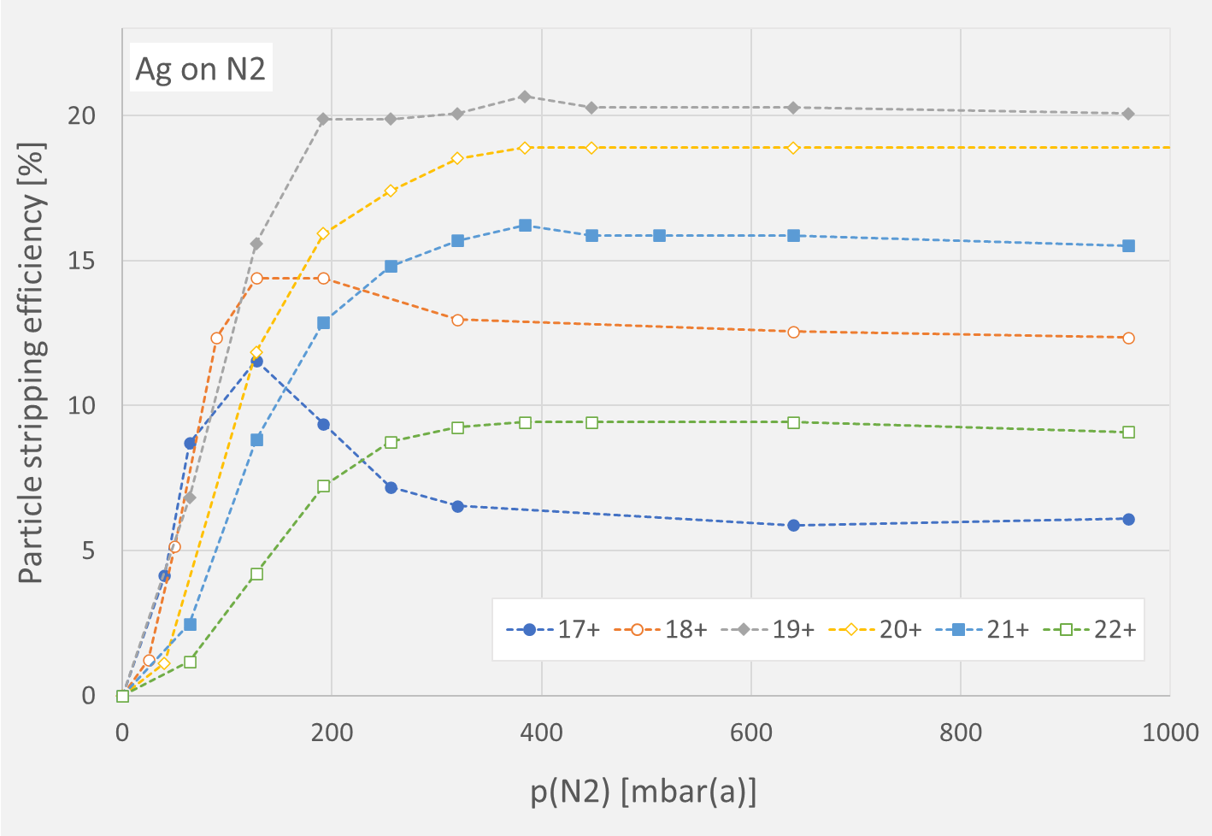
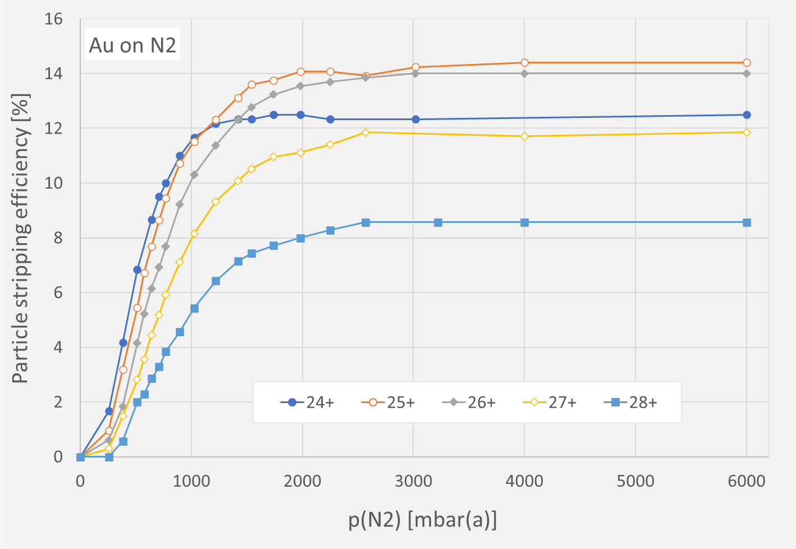
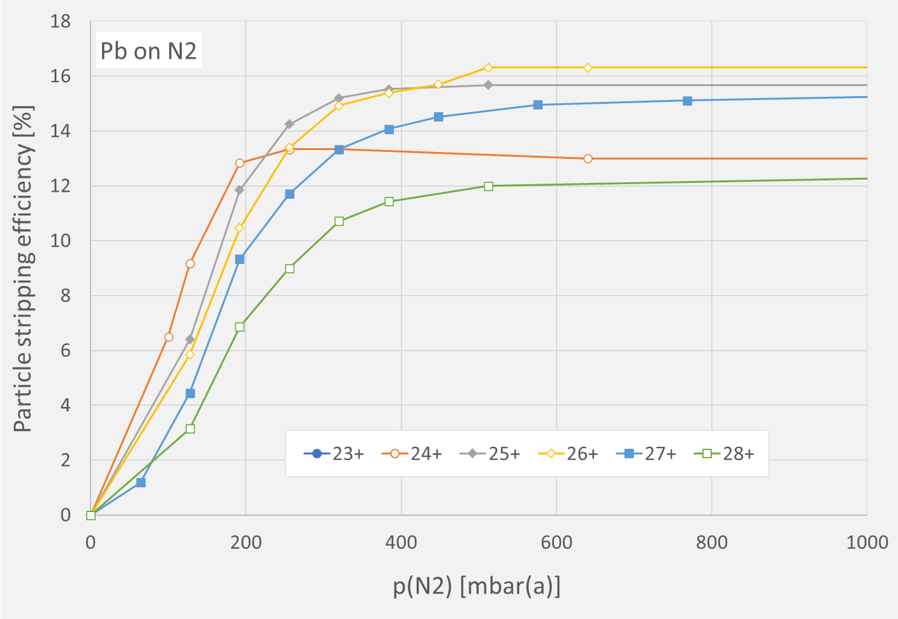
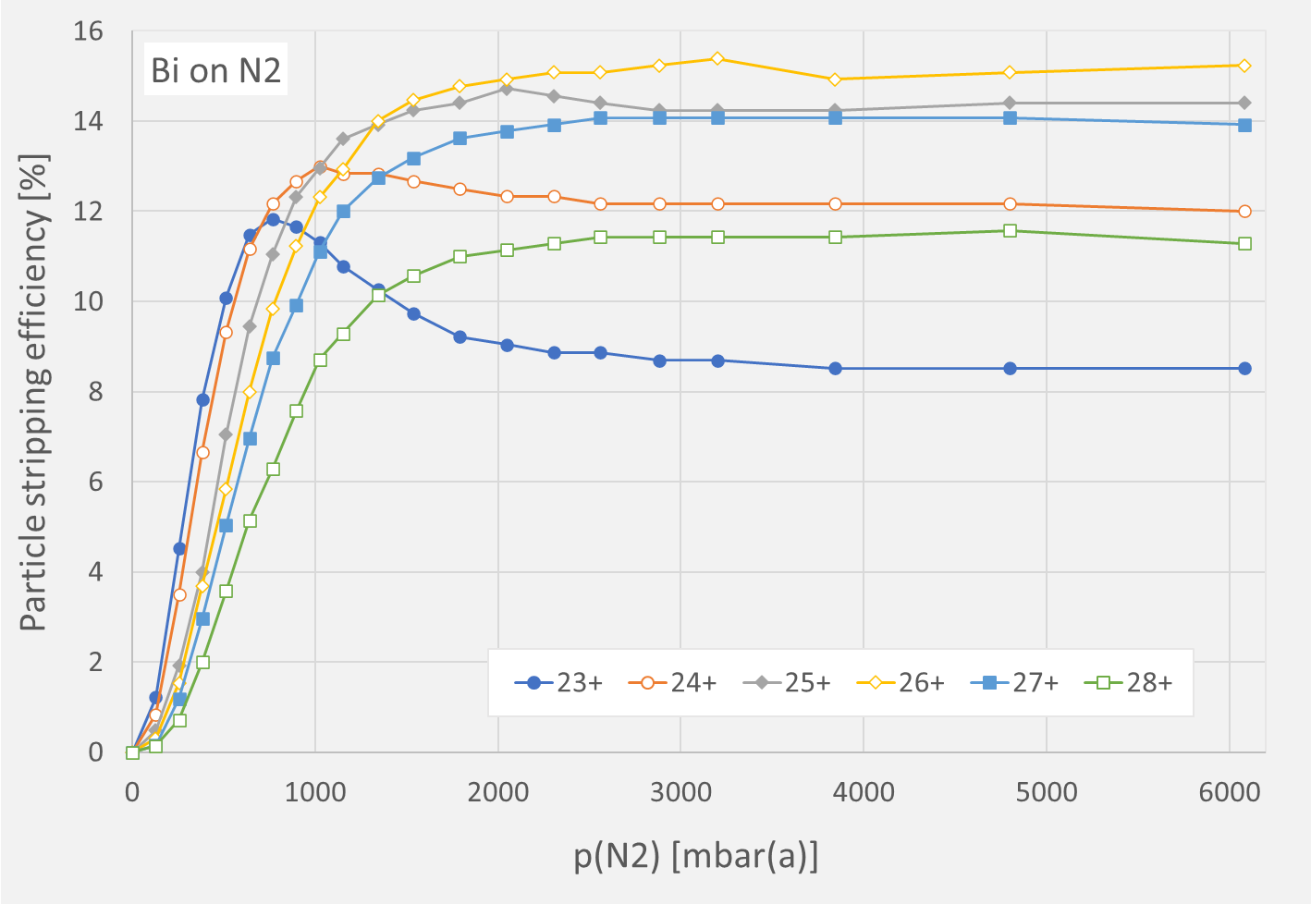
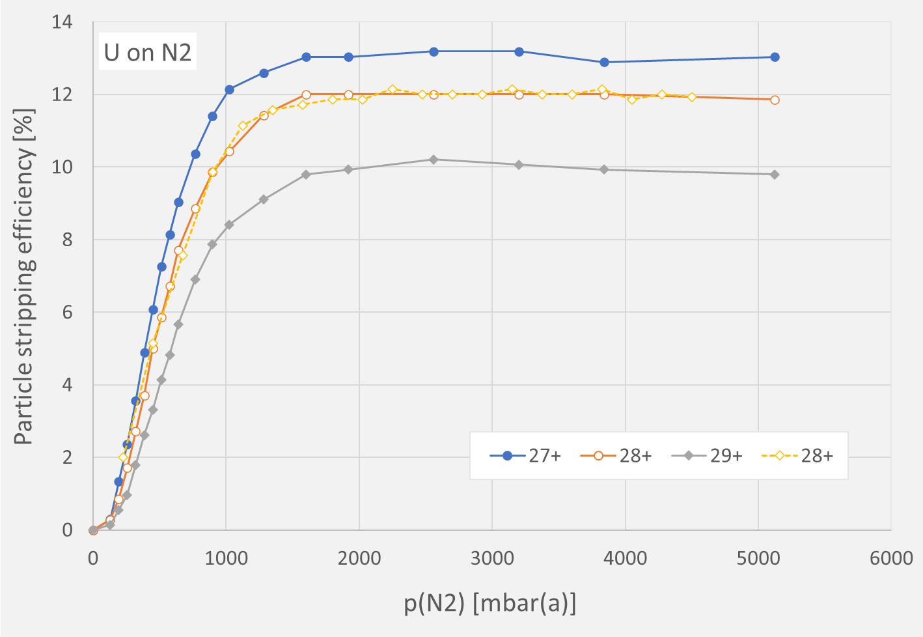
UNILAC Gasstripper: Registration of New Ion Species
Stripping data below were taken during the whole beamtime for ion species stripped with the pulsed gas stripper (with modified valve) for the first time (Kr not shown)

Slide 7
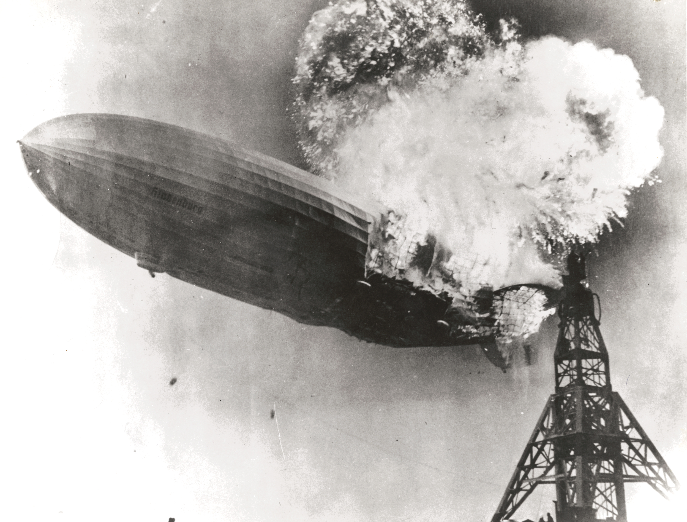
Thank you!
... and thanks to all the colleagues, who supported this project especially during the beamtime (PSU dept., vacuum, beam diagnostics, operations, ...)

