Slide 1
Beam tests on the Advanced Demonstrator

Slide 2
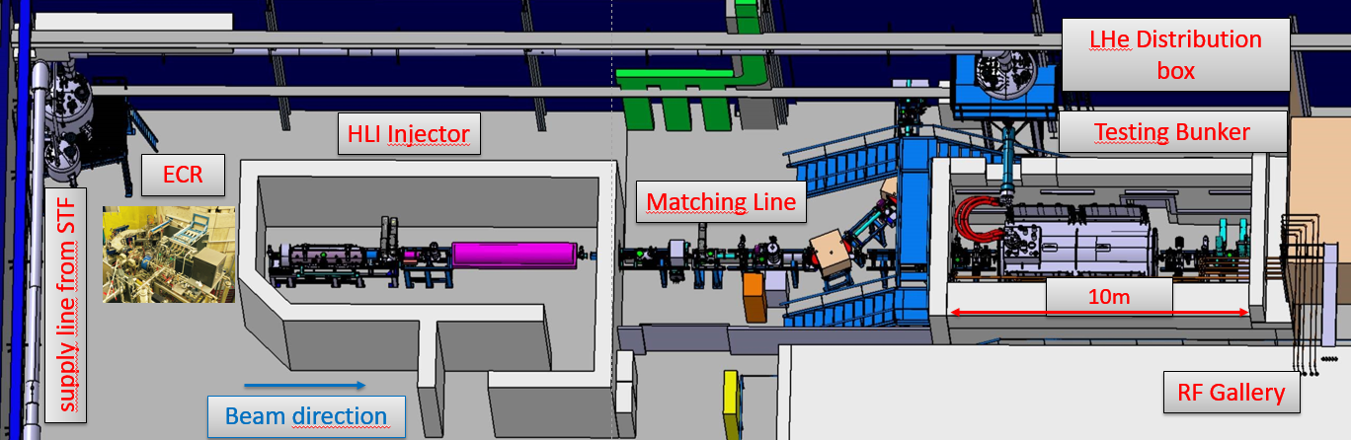
Test area @GSI for cryogenic accelerator modules
The first cryomodule from HELIAC has been in experimental operation since December 2023
Design energy has been achieved and transmission is at approximately 90%
Detailed knowledge of the longitudinal and transverse phase space is required to better adapt the HLI beam to the cryomodule

Slide 3
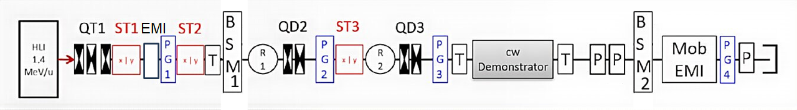
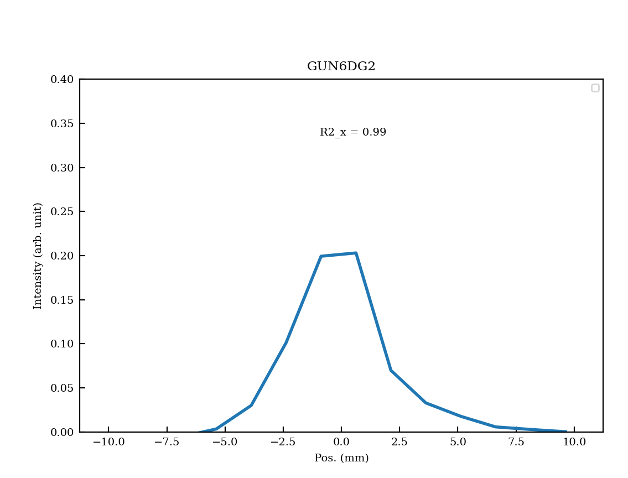
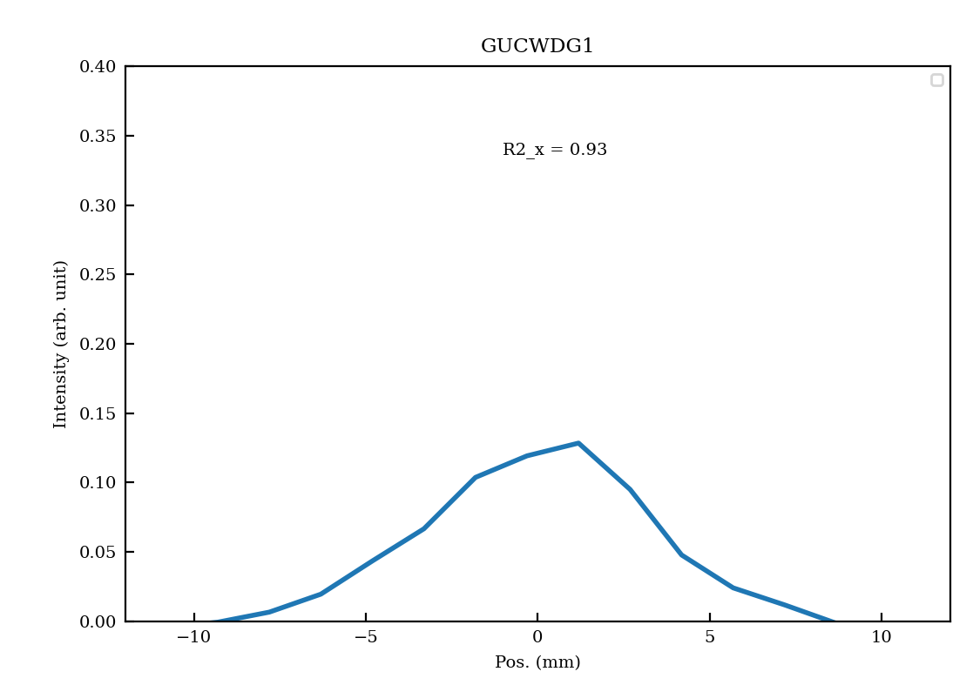
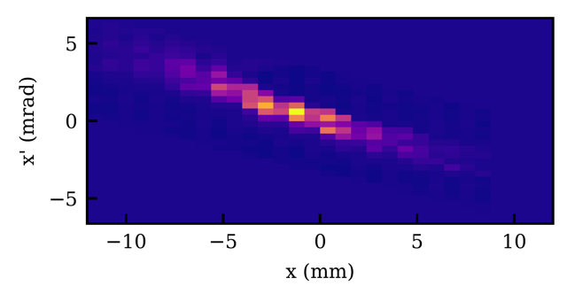
Beam guidance: Transverse measurement setup
PG2
PG3
Intensity (a.u.)
100% Transmission between HLI and EMI
-10
0
10
-10
0
10
Pos (mm)
Goal: reconstruction of the 4D particle distribution at the HLI exit
The slit grid measurement system provides only projections of x-x' and y-y'. The assignment of particles x-x' to measurements y-y' is missing (i.e. the correlation is missing)
The x-y and x'-y' data is missing. Profile grids I(x) and I(y) are required to check the constructed particle distribution

Slide 4

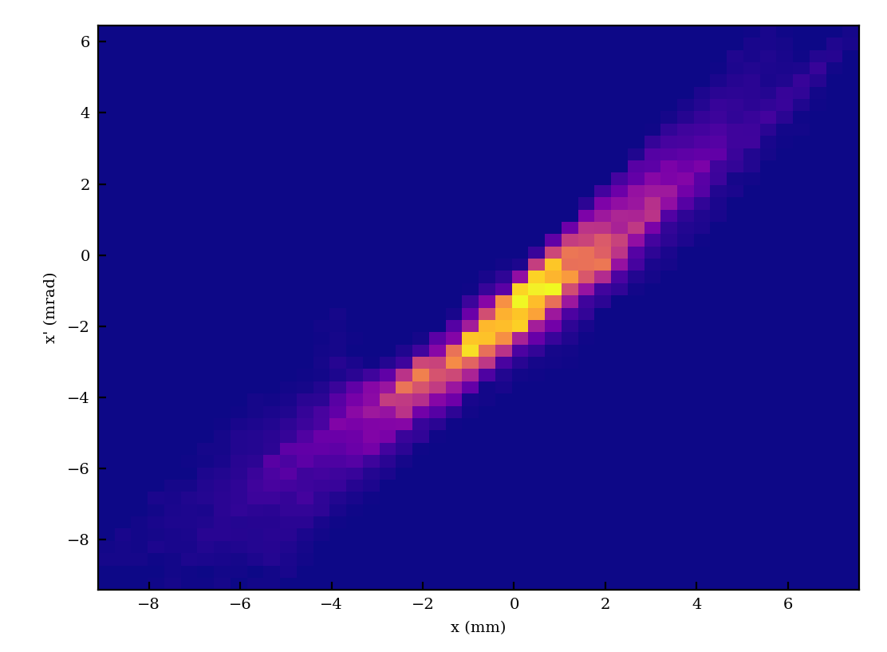
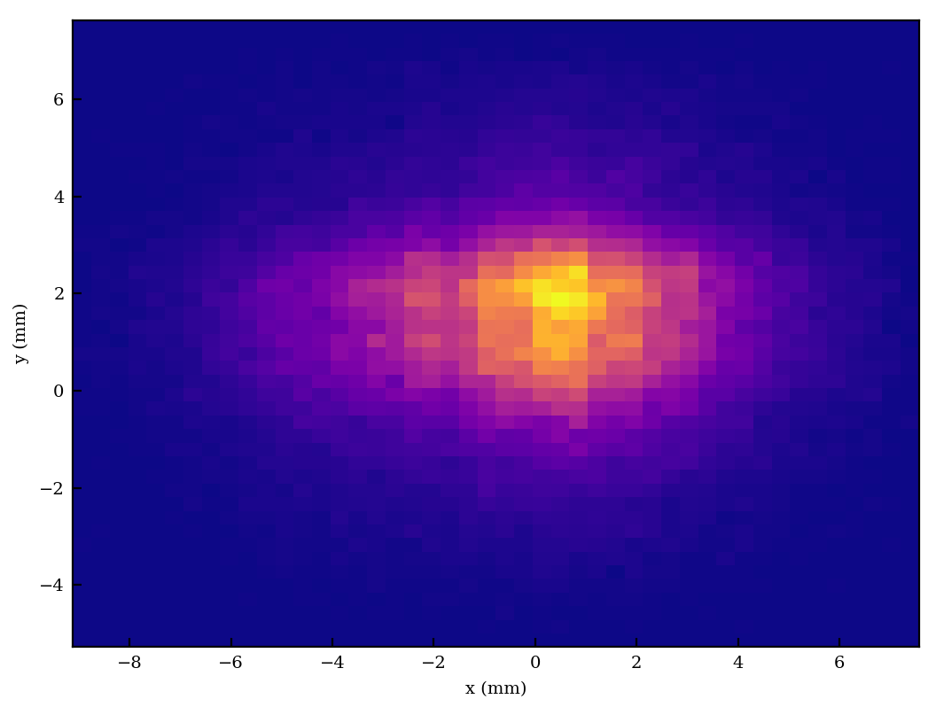
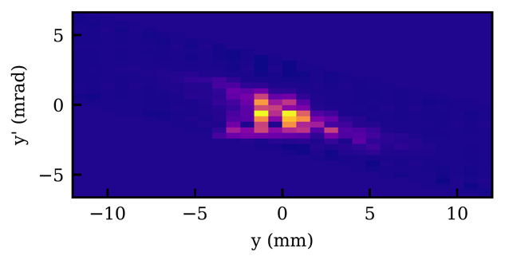
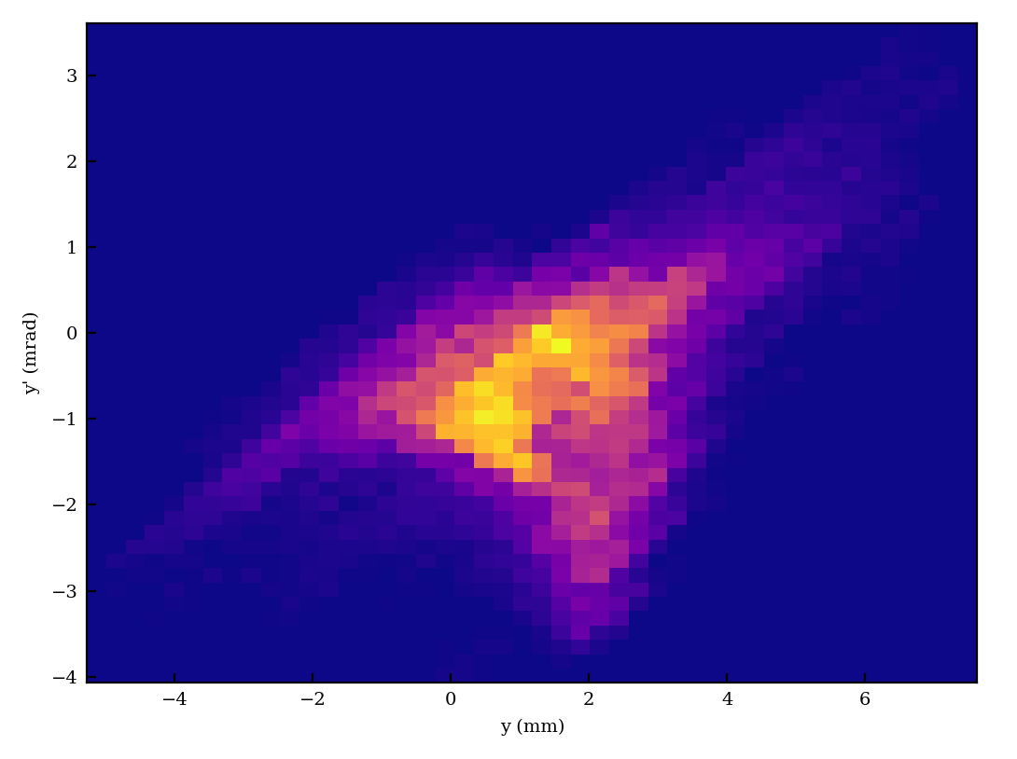
Reconstruction: Transversal
5
0
x’(mrad)
5
-5
y (mm)
-5
0
5
0
5
y’(mrad)
0
-5
-5
-5
0
5
-5
0
5
x (mm)
x/y (mm)
Measured at EMI
Backtracked to HLI
Combined 4D distribution

Slide 5
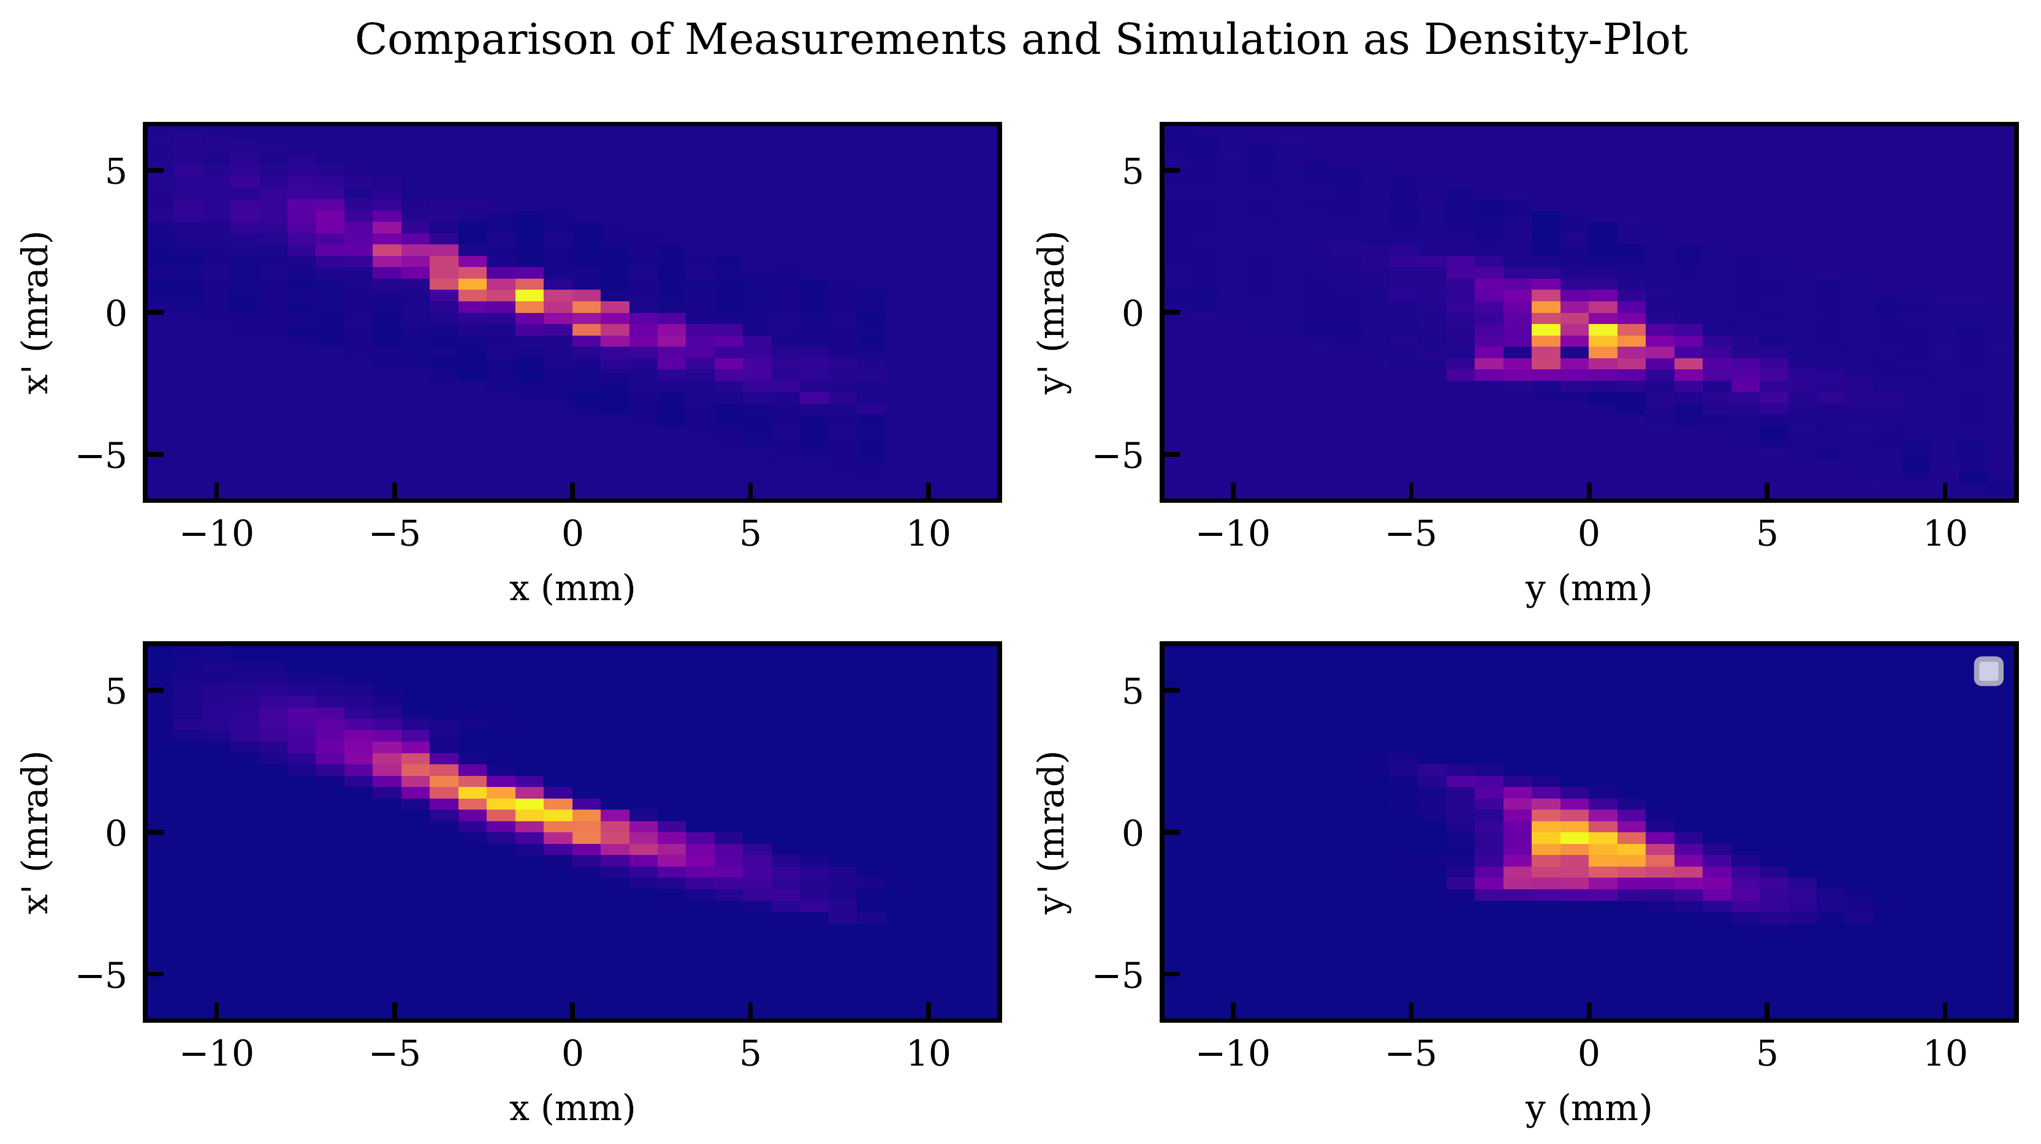
Reconstruction: Transversal
Measurement
Simulation

Slide 6
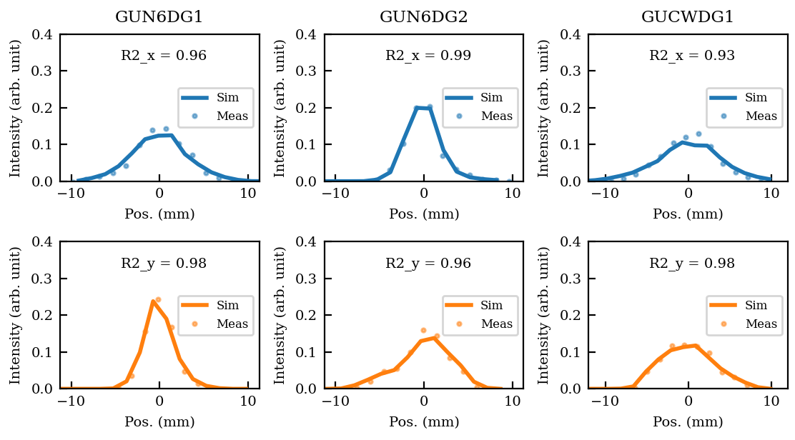
Reconstruction: Transversal
PG1
PG2
PG3
Beamline quadrupoles settings were changed to observe agreement between simulation and measurement
High agreement in transverse plane

Slide 7
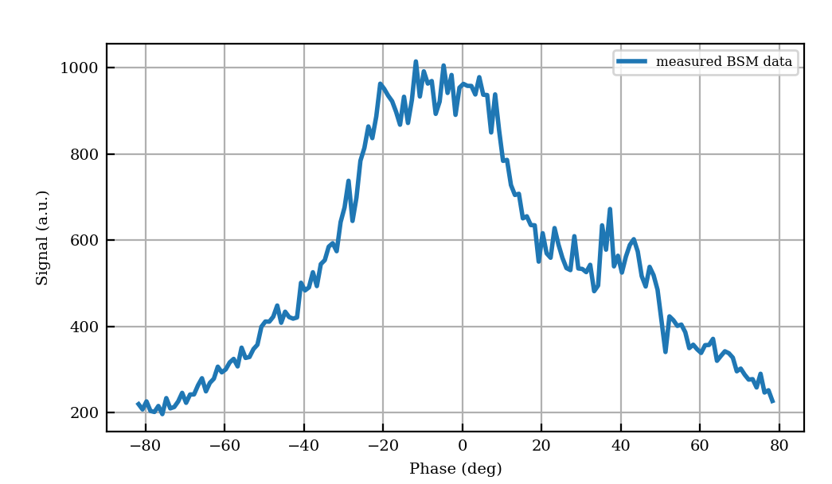
Beam guidance: Longitudinal measurement setup
Goal: reconstruction of the 2D particle distribution at the HLI output
The BSM provides only projections of the bunch onto the time axis. Intensity: I(t)
Rebunchers R1 & R2 allow transformation of the bunch
Measurement at the location of BSM2 for different buncher (R1 & R2)
BSM1 controls the measurement

Slide 8
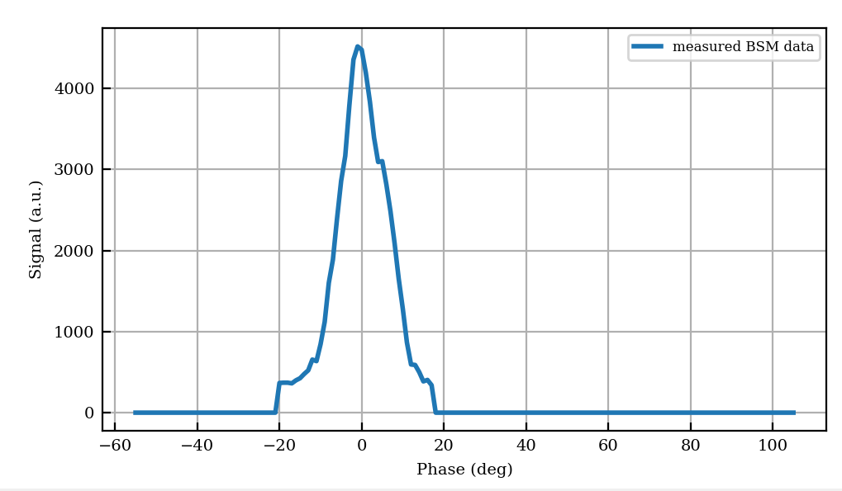
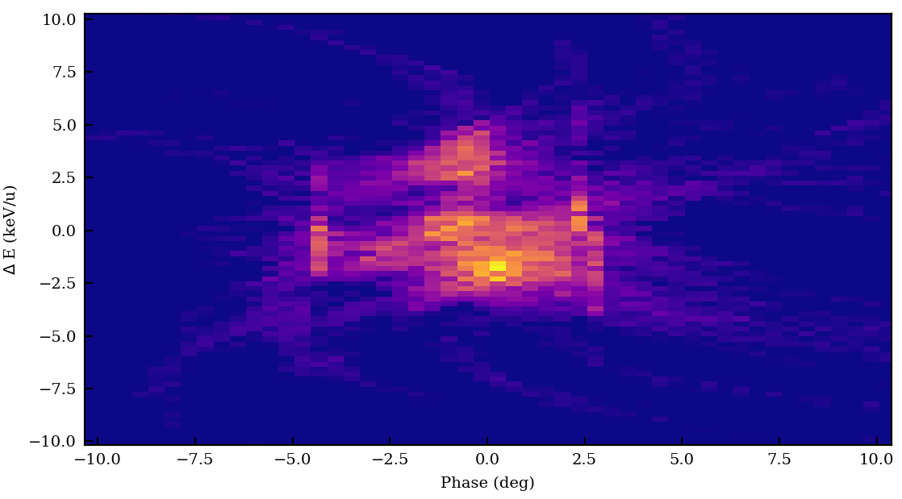

Reconstruction: Longitudinal
E (keV/u)
$$∆$$
Phase (deg)
Tomographic reconstruction, Around 40 measurements

Slide 9
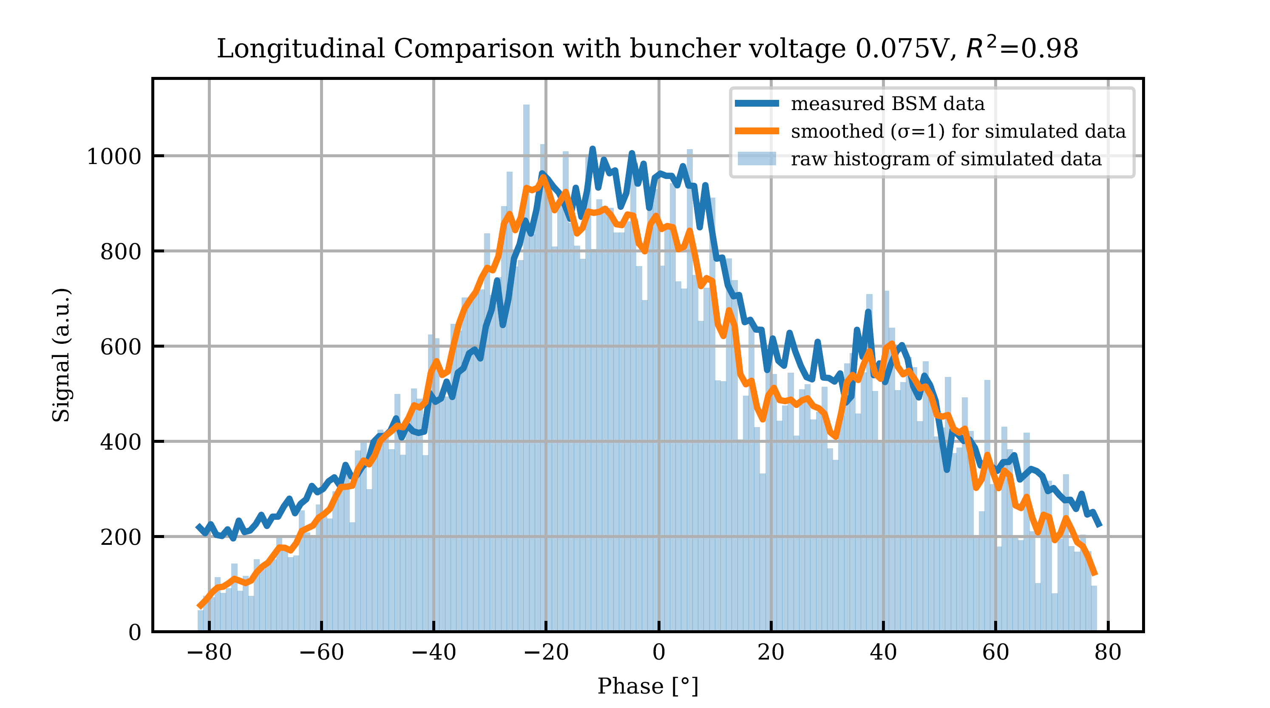
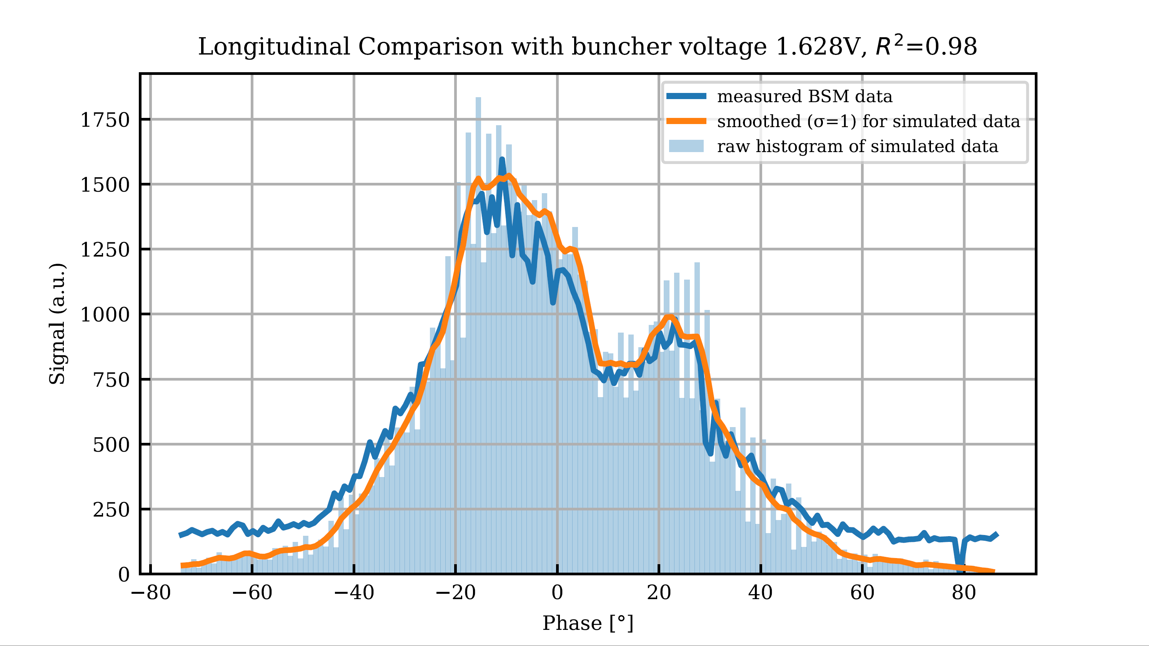
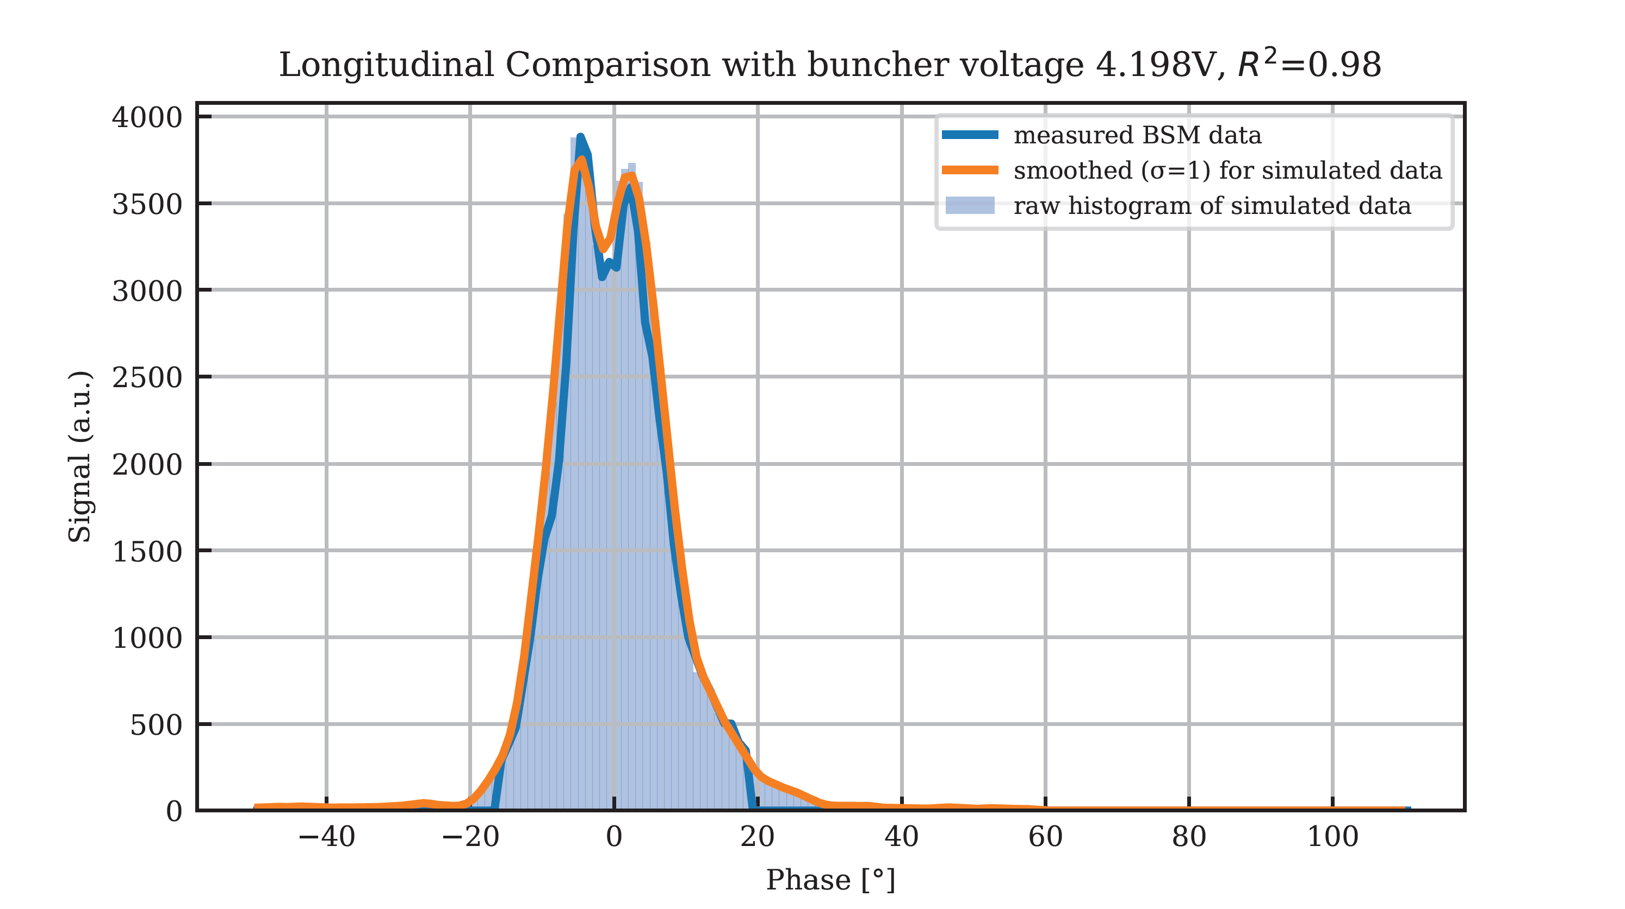
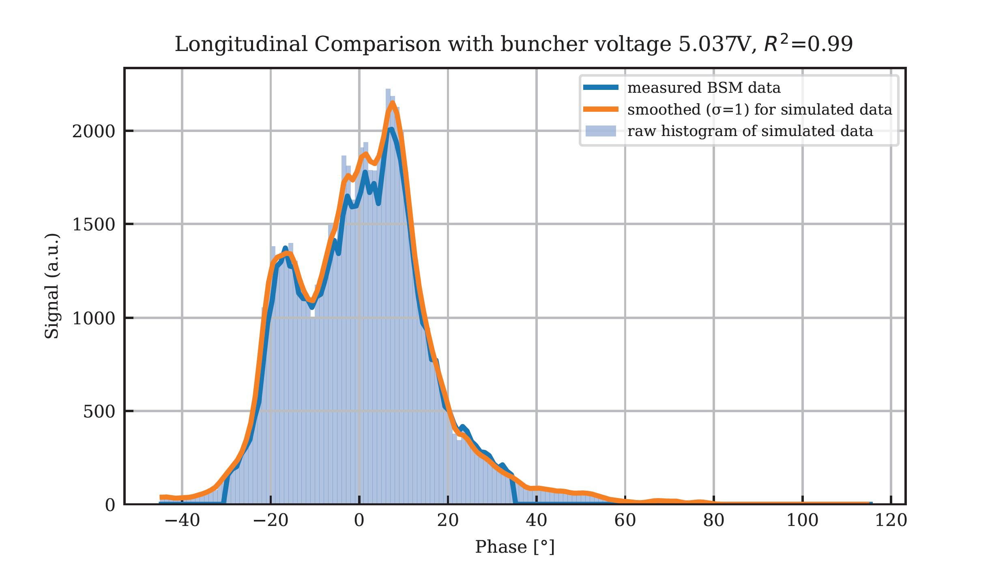

Reconstruction: Longitudinal
$$\overline{R^{2}}=0.98$$

Slide 10


Reconstruction: Longitudinal
It is evident that two beams exhibit disparate energy levels
Approximately 30% of the beams demonstrate an energy deviation that exceeds 1.6 keV/u
The discrepancy in the beam cores is approximately 4 keV/u
This corresponds to a phase difference of 16 degrees at BSM1
E (keV/u)
$$≈4 keV/u$$
$$∆$$
Phase (deg)

Slide 11
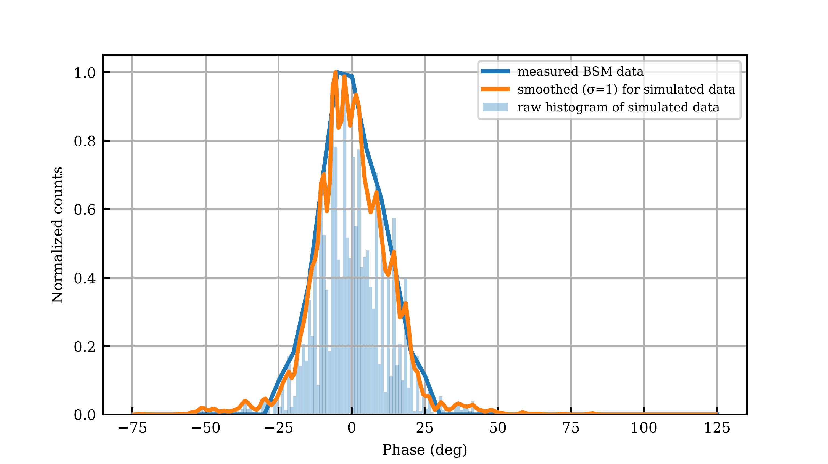
Reconstruction: Longitudinal
$$R^{2}=0.97$$
Comparison between simulation and BSM1 measurement
High agreement in longitudinal plane

Slide 12
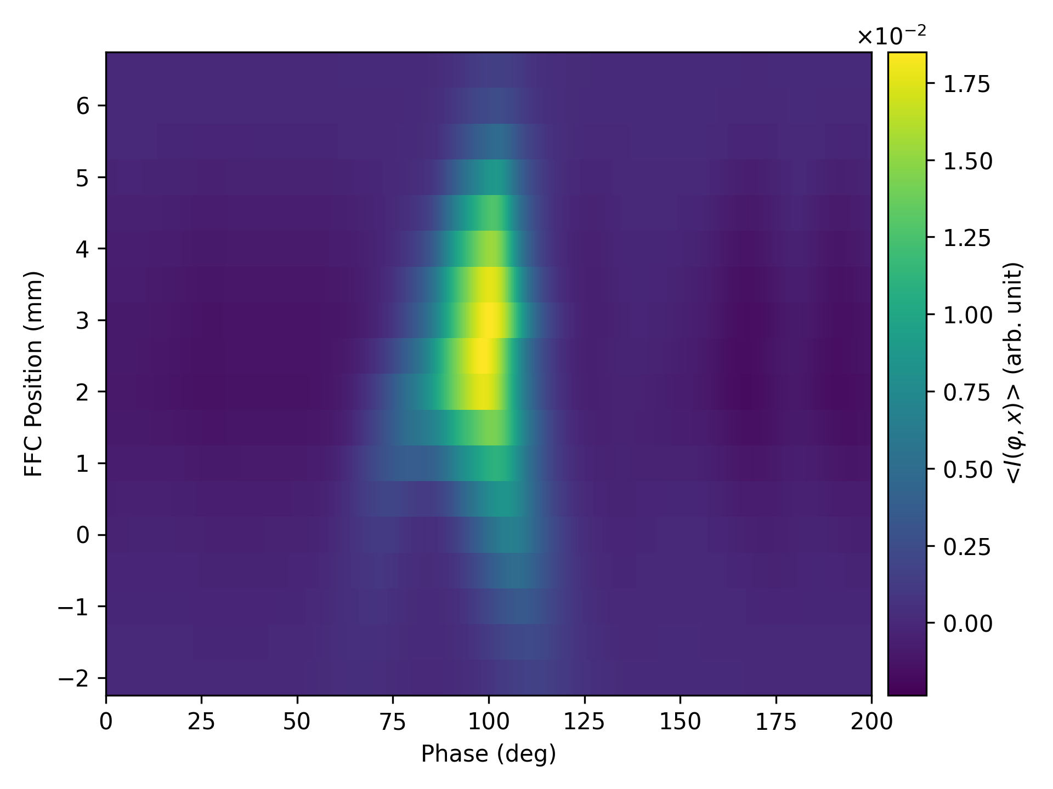
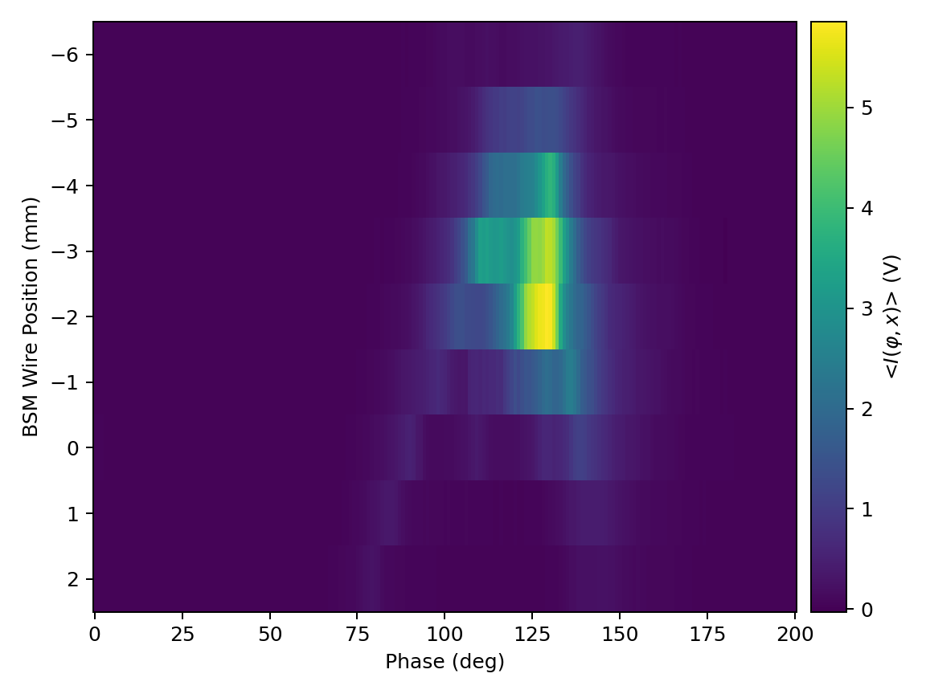
Transverse-Longitudinale Correlation
FFC measurement for different wire positions
BSM 1 measurement for different wire positions

Slide 13
Summary & Outlook
Summary:
Measured transverse and longitudinal particle distribution
Reconstructed 6D particle distribution
Reconstructed distribution is experimentally validated
Numerical model of beamline is validated
Outlook:
The search for settings for "UN6/GUCW" beamline which provides 100% transmission through CM1

Slide 14
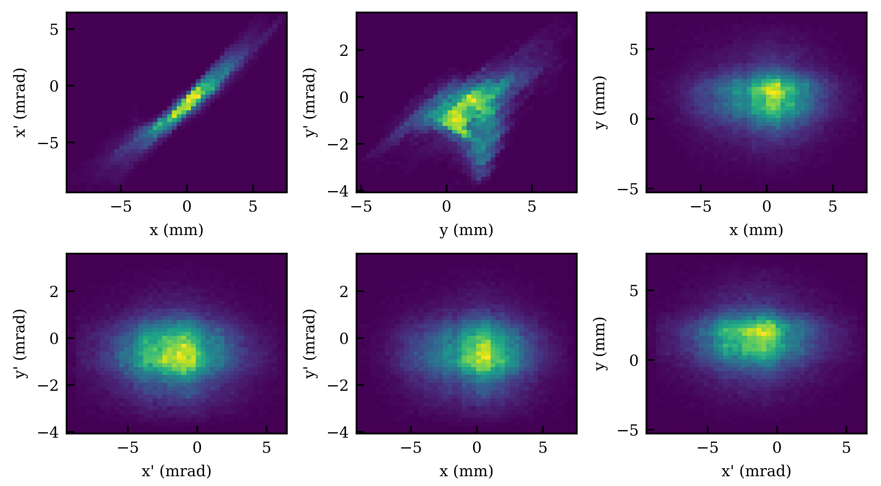
Transverse Particle Distribution
Reconstructed transverse 2D particle projections
Pascal Häckel
Transverse Distribution
25

Slide 15
Transverse Particle Distribution
Reconstructed distribution shows:
Beam is not centered
Beam is inserted oblique
Beam is divergent and elliptic in horizontal plane
Unexpected, non elliptic shape in vertical plane
Unmeasured projections show symmetric and circular shape as expected
Reconstructed transverse 2D particle projections
Pascal Häckel
Transverse Distribution
26

Slide 16
Transverse Validation
Measurement
Simulation
Comparison of phase-space measurement and simulation
Pascal Häckel
Transverse Validation
27

Slide 17
Transverse Validation
Comparison shows:
Similar shape in both planes
Similar intensity at center
Same offset of center
Distribution is filled and without holes
Measurement
Simulation
Comparison of phase-space measurement and simulation
Pascal Häckel
Transverse Validation
28

Slide 18
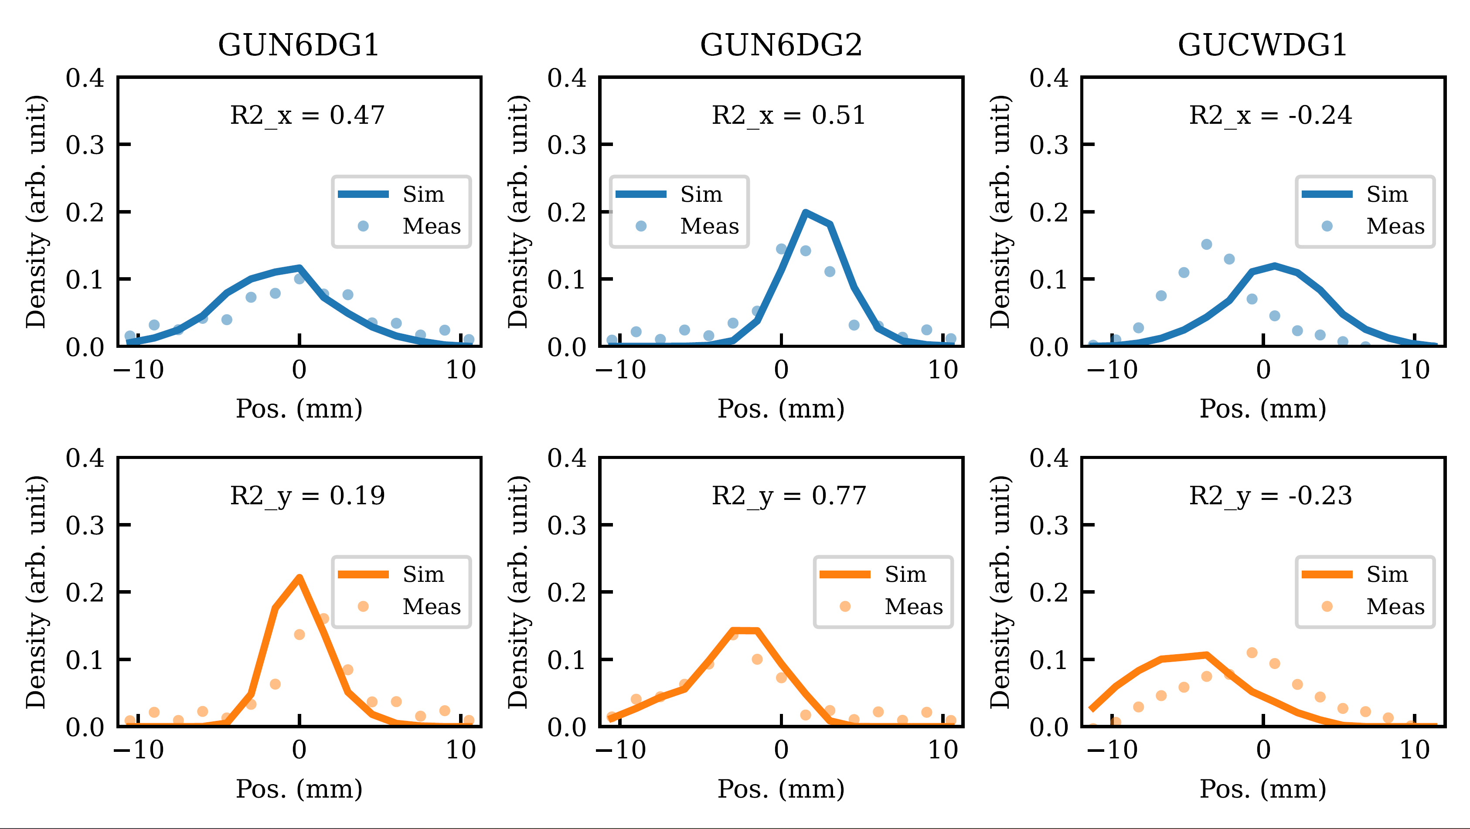
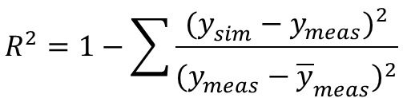
Transverse Simulation
$$R^{2}=1−\sum{\frac{{(y_{sim}^{}−y_{meas}^{})}^{2}}{{(y_{meas}^{}−{\overline{y}}_{meas}^{})}^{2}}}$$
Coefficient of determination
Comparison of simulated and measured profile grids (blue: hor, orange: ver).
Pascal Häckel
Transverse Simulation
29

Slide 19
Transverse Simulation
Beam Alignment Problems:
Wrong steering in simulation
Expected reason is hysteresis of steering magnets.
Data needs to be centered for comparison
Comparison of simulated and measured profile grids (blue: hor, orange: ver).
Pascal Häckel
Transverse Simulation
30

Slide 20
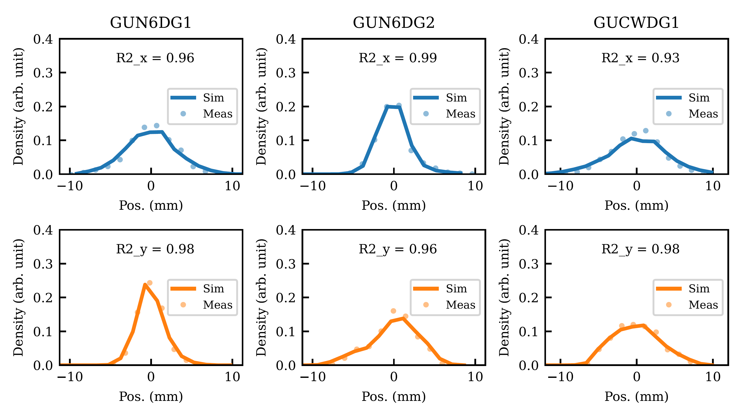
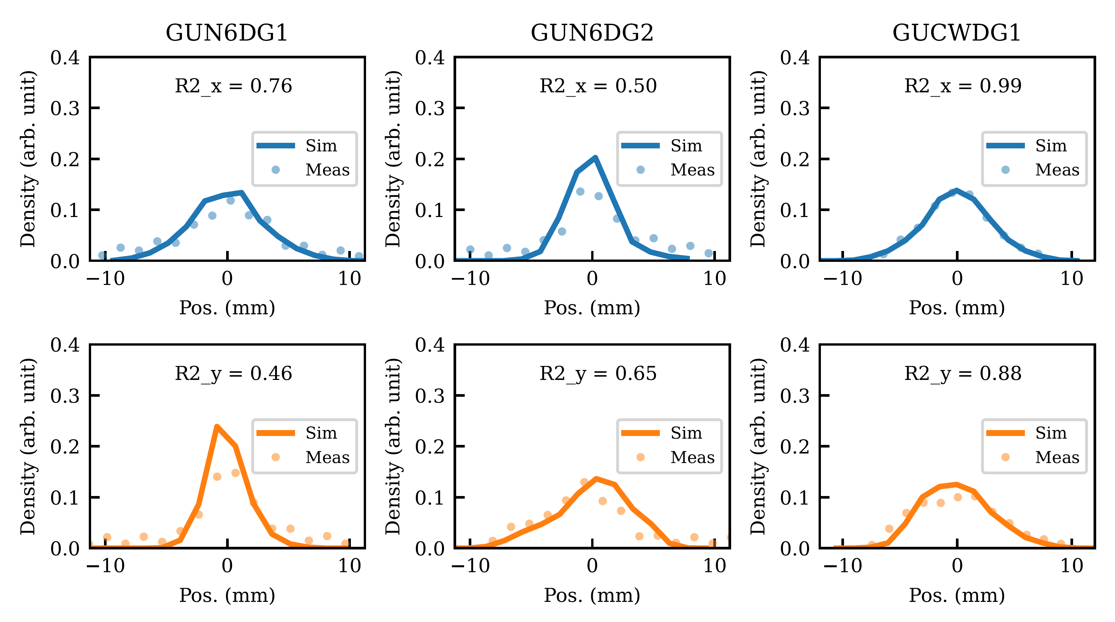

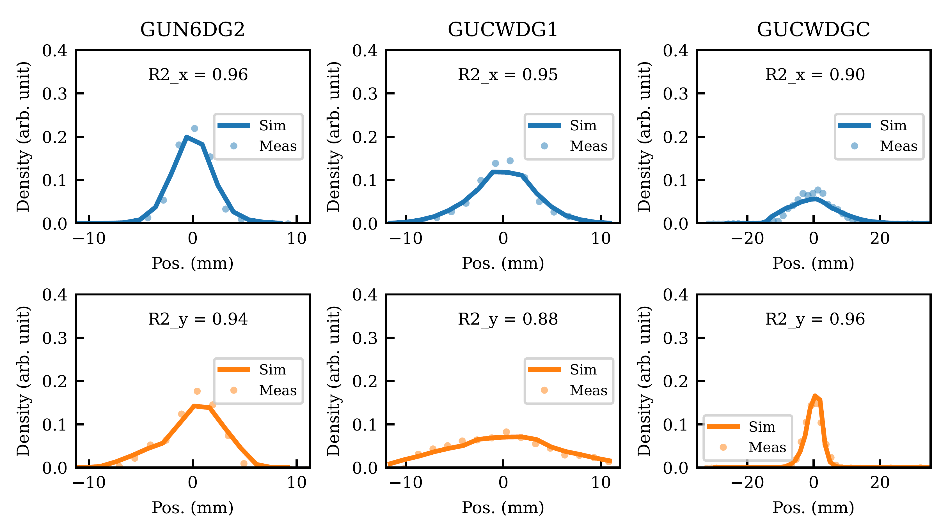
Transverse Simulation
1
2
3
4
Pascal Häckel
Transverse Simulation
31

Slide 21
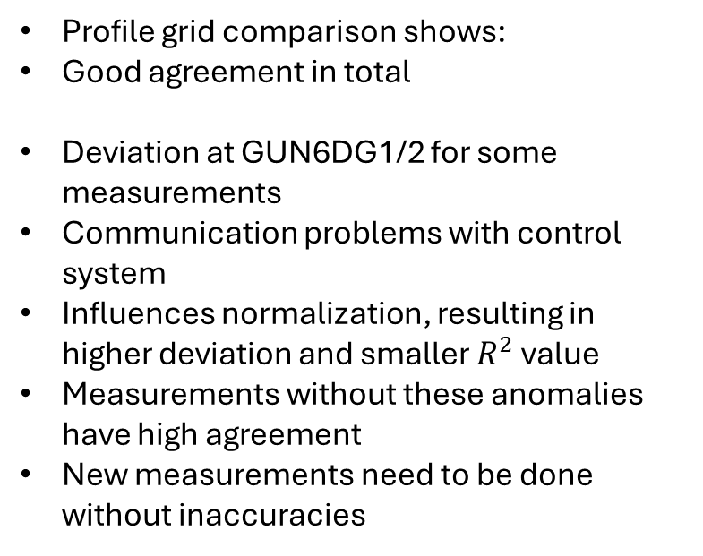
Transverse Simulation
Profile grid comparison shows:
Good agreement in total
Deviation at GUN6DG1/2 for some measurements
Communication problems with control system
Influences normalization, resulting in higher deviation and smaller $R^{2}$ value
Measurements without these anomalies have high agreement
New measurements need to be done without inaccuracies
Pascal Häckel
Transverse Simulation
32

Slide 22
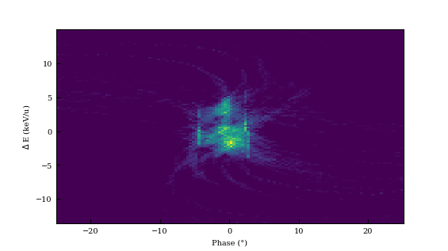
Longitudinal Validation
Reconstructed longitudinal phase-space
Pascal Häckel
Longitudinal Validation
33

Slide 23
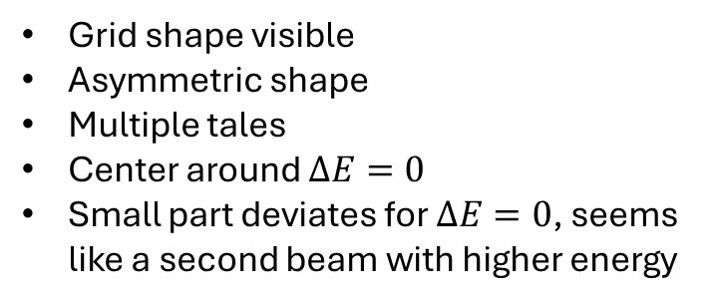
Longitudinal Distribution
Grid shape visible
Asymmetric shape
Multiple tales
Center around $∆E=0$
Small part deviates for $∆E=0$, seems like a second beam with higher energy
Reconstructed longitudinal phase-space
Pascal Häckel
Longitudinal Distribution
34

Slide 24
Longitudinal Validation
Pascal Häckel
Longitudinal Validation
1/X

Slide 25

Longitudinal Validation
$$\overline{R^{2}}=0.98$$
Pascal Häckel
Longitudinal Validation
35

