Slide 1
Super-FRS controls and slow controls and the like
Stephane Pietri, SFC

Slide 2
Control system vs experimental system
Machine (SIS18, UNILAC, HEST) ➔ accelerator control system, detectors integrated in it, ACC network, FESA/LSA world
Experiments ➔ experimental area, for NUSTAR NDAQ (MBS/Drasi etc..), ad hoc slow control
Quiz: FRS (between both of them)?

Slide 3
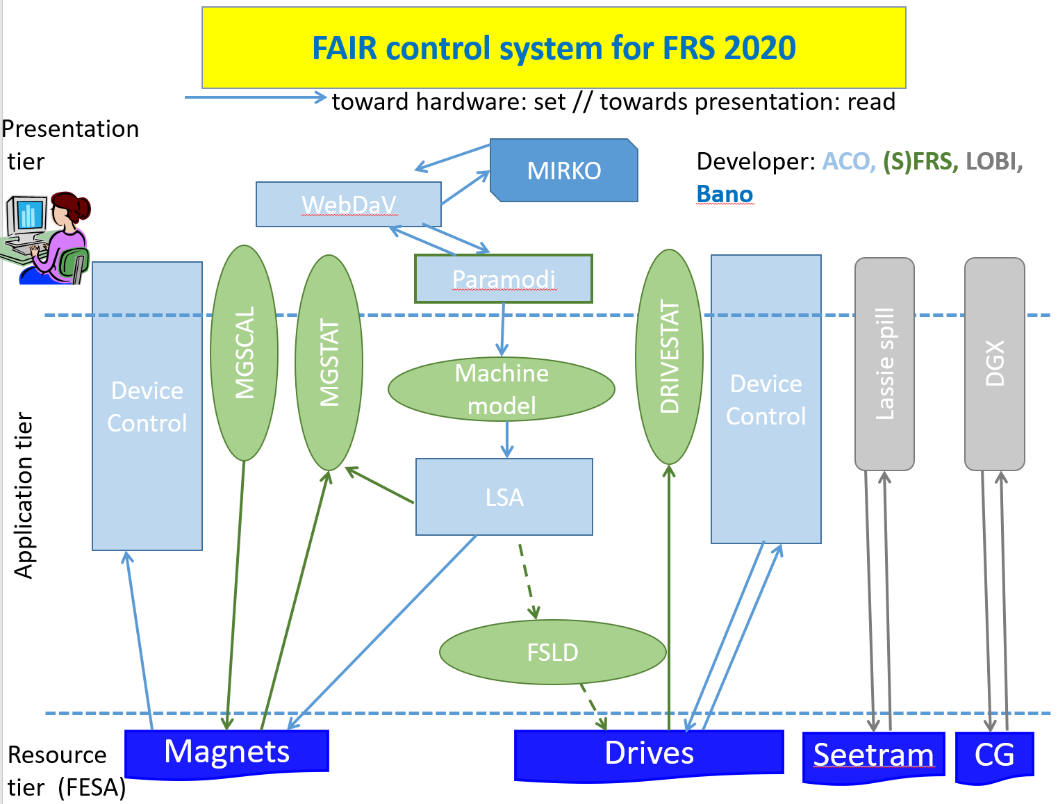
FRS ACC control side
LOBI == BEA

Slide 4
Super-FRS
SFRS control system: based on LSA/FESA from CERN, controls “machine”
  interface to equipment (magnets/drive) using standard FAIR solutions (BEA, ACO, EPS..)
  machine model (LSA), high level operation of spectrometer
  anything that change the Brho in spectrometer should be controlled/read out
NUSTAR DAQ
  needed for event-event readout and correlations, same standard for NUSTAR
  defined for NUSTAR and Super-FRS (Haik, Stephane,…)
  assures ID of SFRS is use
NUSTAR DAQ slow control
  EPICS based (aggregation of detector/experiment slow control)
  highly flexible
  collaboration/group responsibility
➔sometimes device readout by NDAQ but drive in/out by control system

Slide 5
Three cases
Facility control ➔ ad hoc solution with interface to ACO
  Facility gas control, temperature in room etc… (provided by FSB/ACO)
Control System (machine control)
  everything machine (same solution as SIS100, HEBT etc..), magnets, drives, vacuum etc..
  rule of thumb@ SFRS: will your actuator change Brho -> if yes actuator in control system
  is it a BEA detector ➔ application in ACC network (PSP 2.4.6.3.1.1)
Slow control
  everything that controls/linked to “Experimental detectors”, providing event by event ID (DAQ in PSP 2.4.6.3.1.2)
  flow control for detector, HV control, temperature sensors for detectors, electronic control
  ➔ we (Ahmed) provide an aggregation of the information in EPICS

Slide 6
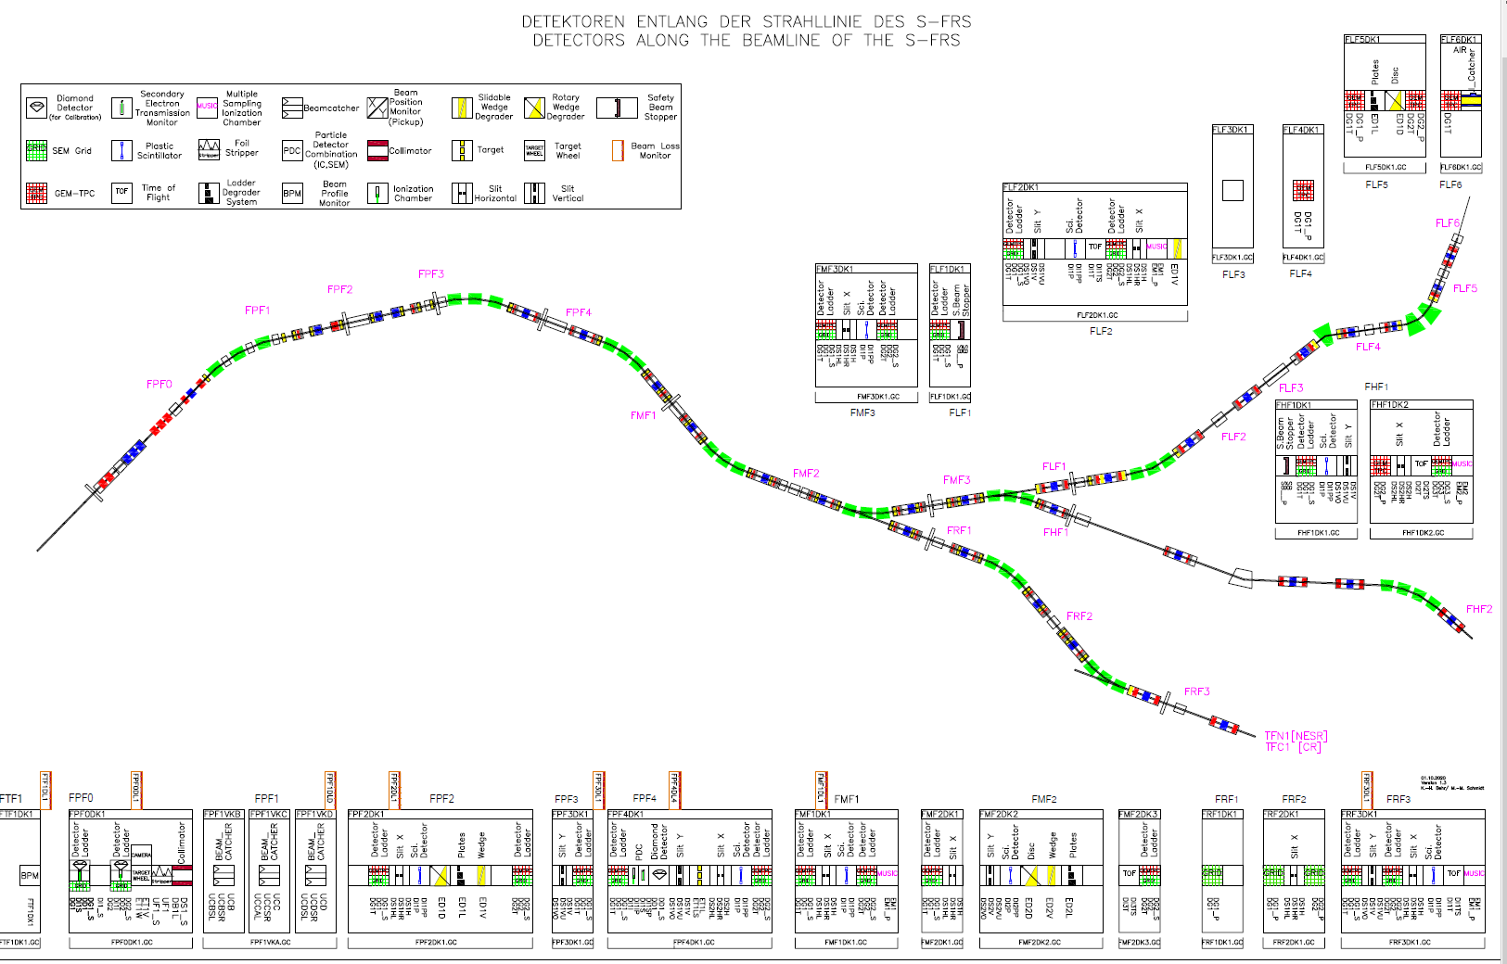
Super-FRS detectors: readout experimental DAQ
Super-FRS detector supply (HV, gas etc..) EPICS (?)
Drives in SFRS control system

