Slide 1
Super-FRS DAQ and commissioning needs
Stephane Pietri, SFC

Slide 2
Goal of the workshop - clarifications
Diversity is our strength! We come from different trades/physics back ground

Slide 3
Goal of the workshop - clarifications
Diversity is our strength! We come from different trades/physics back ground
Chacun chez soi et les poules seront bien gardées.
French proverb
German equivalent proverb
Schuster, bleib bei deinem Leisten
(we should trust each other on our expertises and respect interfaces)

Slide 4
Goal of the workshop - clarifications
Diversity is our strength! We come from different trades/physics back ground
Chacun chez soi et les poules seront bien gardées.
French proverb
A mal nommer les choses on ajoute du malheur au monde
German equivalent proverb
Schuster, bleib bei deinem Leisten
(we should trust each other on our expertises and respect interfaces)
Albert Camus
To name things wrongly is to add to the world’s misery.
Dinge falsch zu benennen heißt, das Unglück in der Welt zu vergrößern
(we should agree on terms, despite former definition we used to have)

Slide 5
Super-FRS DAQ and commissioning needs
Stephane Pietri, SFC

Slide 6
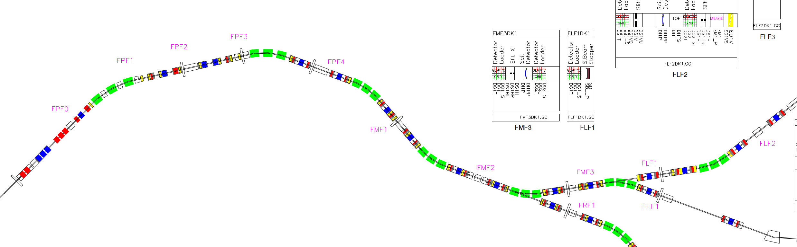
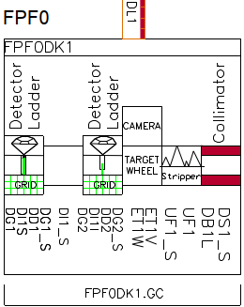
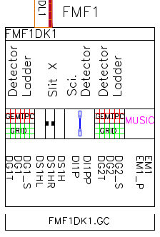

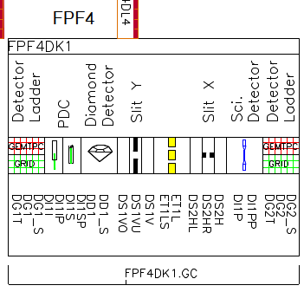
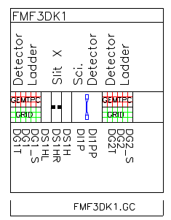
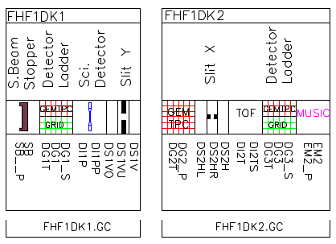
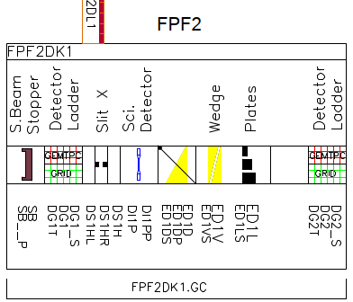
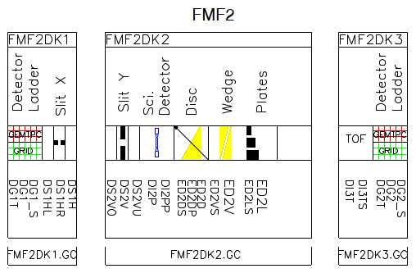
Super-FRS 2027 - ES
All this for: separate and identify ions in event by event modes!
FMF1
FMF3
FHF1
@FHF2 : 2 Fiber detectors
+ one isomer station

Slide 7
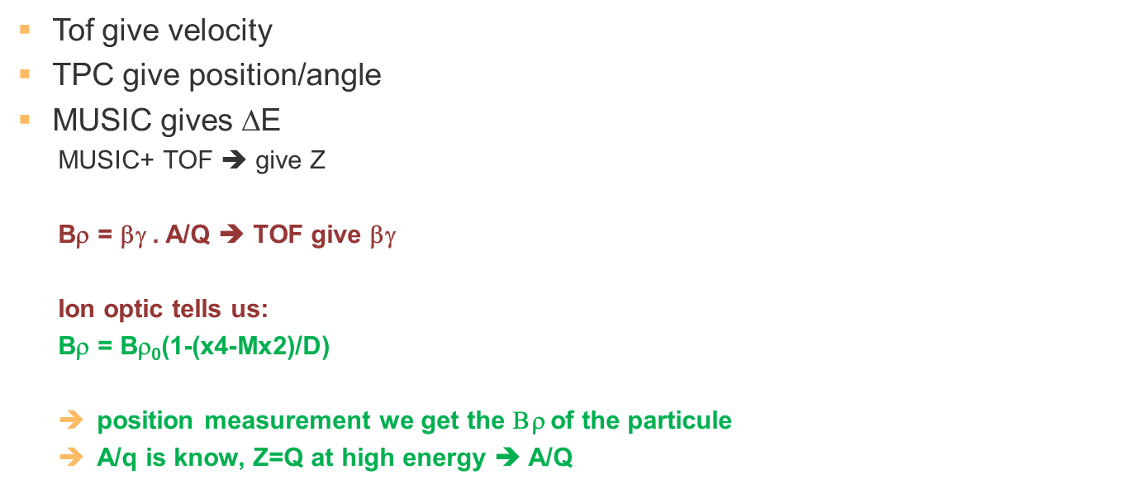
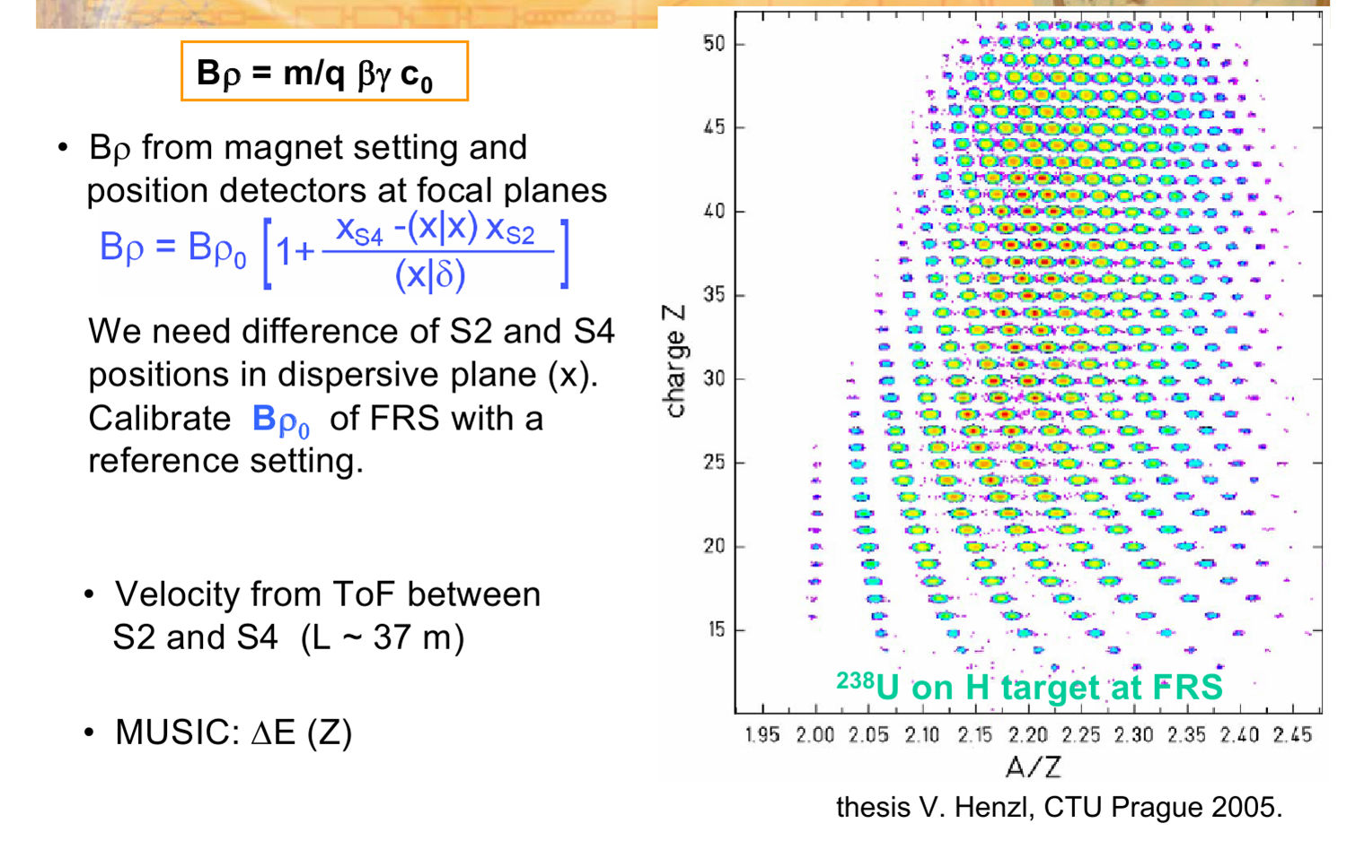
Final goal of detector suit and DAQ – to identify

Slide 8
Goal – to identify
Need to correlate, event by event detector data online and send to experiments

Slide 9
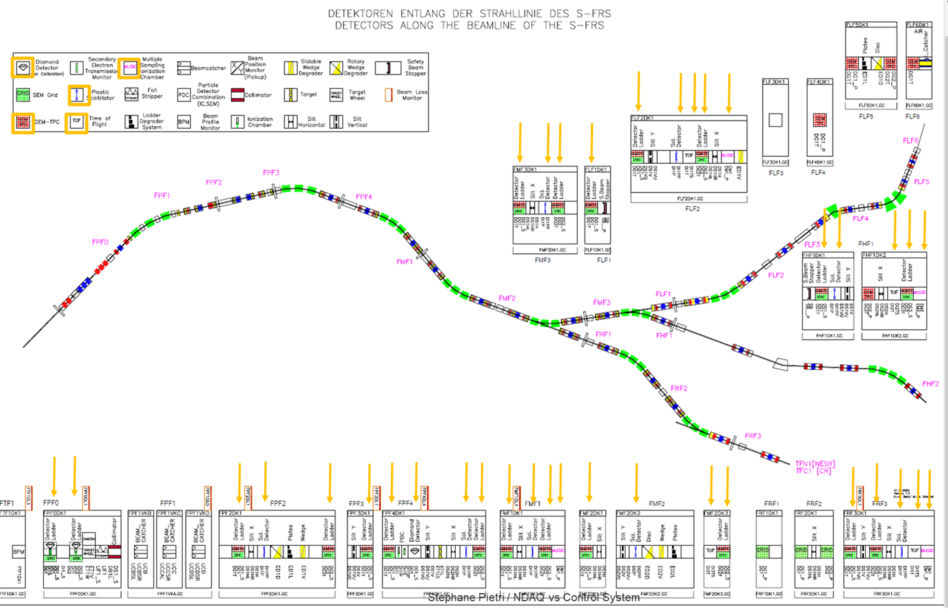

Experimental DAQ (PSP 2.4.6.3.1.2) – WPL S.P.
Goal: Super-FRS DAQ a sub-branch of the NUSTAR DAQ
NUSTAR DAQ coordinator Haik Simon

Slide 10
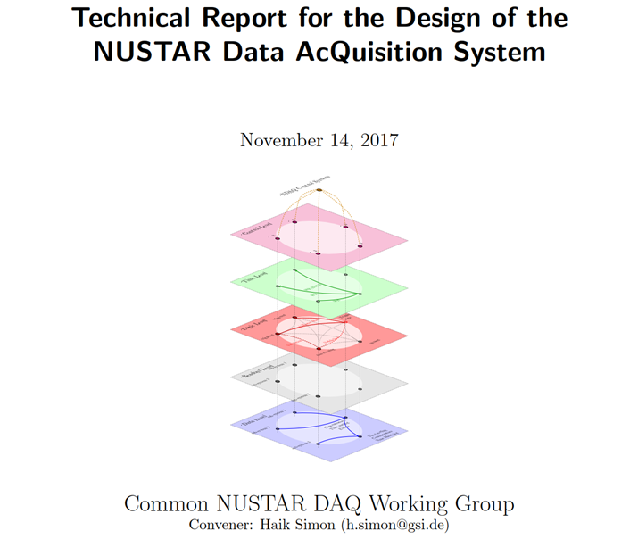
NUSTAR DAQ – TDR 2017

Slide 11
A node
A node : basic unit to build data acquisition configuration
  a node has control, timing, logic, readout and data levels (see next slide)
  example of nodes:
    A single VME crate with an MVLC, a VETAR and a TRIVA
    A PC with PCI readout (PEXARIA, TRIXOR etc…)
    ….

Slide 12
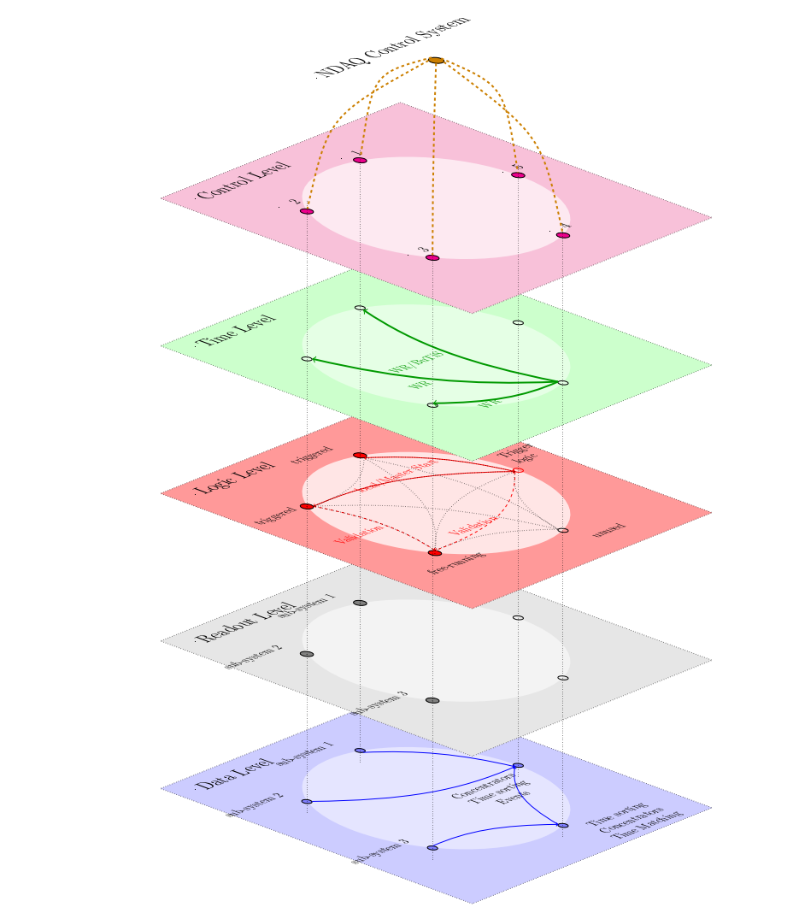
NUSTAR DAQ concept - nodes
Control level
Time level
Logic level
Readout level
Data level
the is the way to talk to the node
synchronization, timing, clocks and time stamps
trigger, period of interest (POI), coincidence etc..
readout of electronic to prepare for data sending
how to merge data stream, build/order events

Slide 13
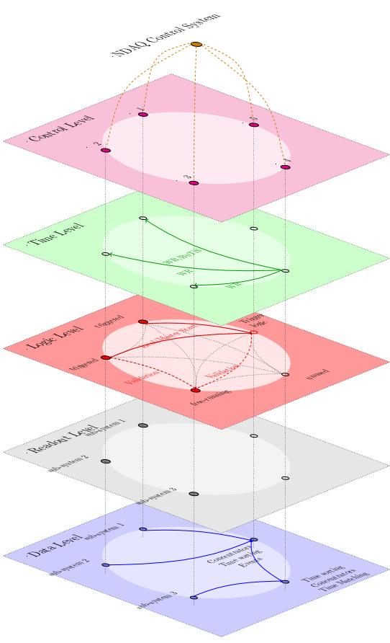
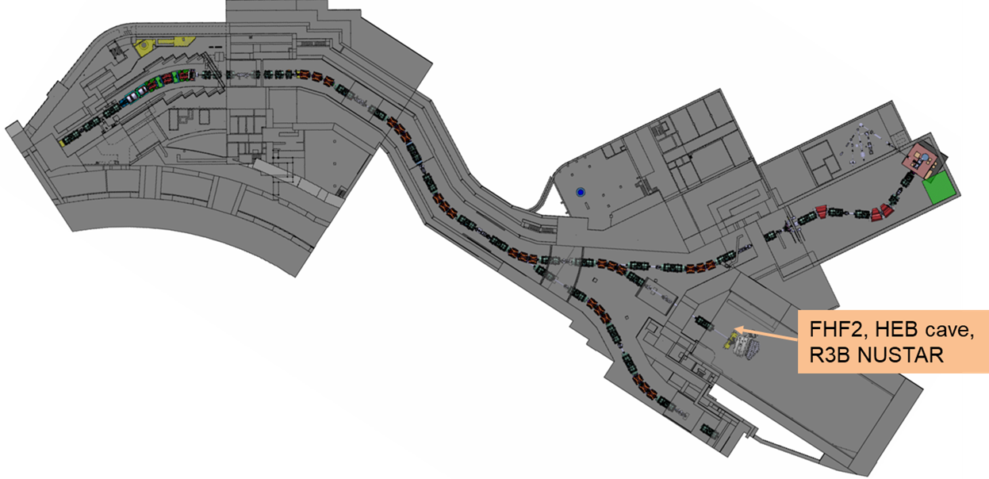
Idea behind NDAQ TDR – easy to reconfigure
24 m
DAQ nodes
NUSTAR@SFRS: 19 locations
NUSTAR@FRS : 5 locations
(one location can have several nodes)
@SFRS access will be longer (magnets)
and distances will be longer to walk ➔ 15 min at FRS is
45 min at SFRS

Slide 14
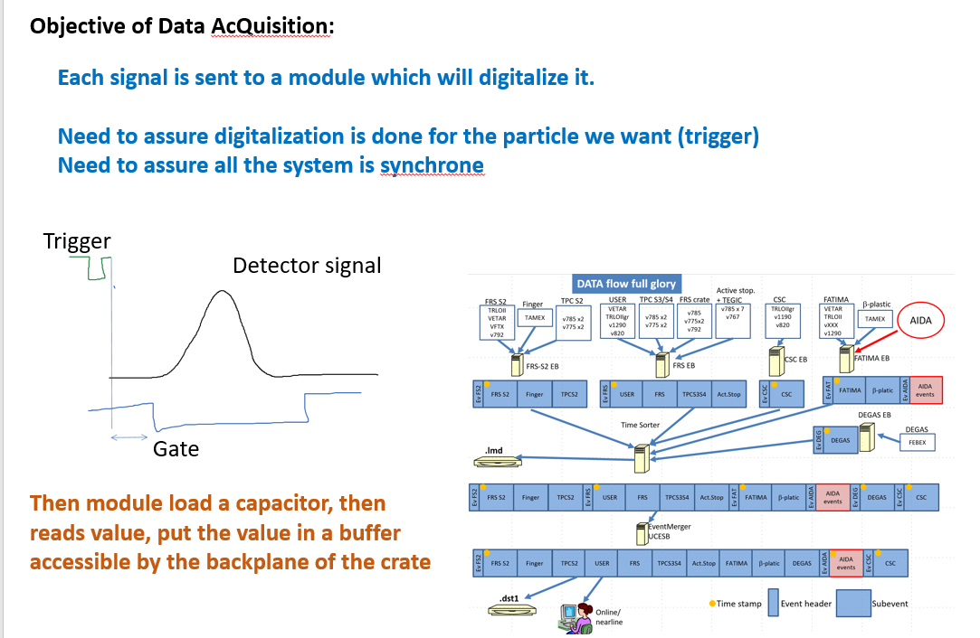
Examples from FRS
3 locations
5 nodes
1 node: S2
1 node messhute
3 node S4

Slide 15
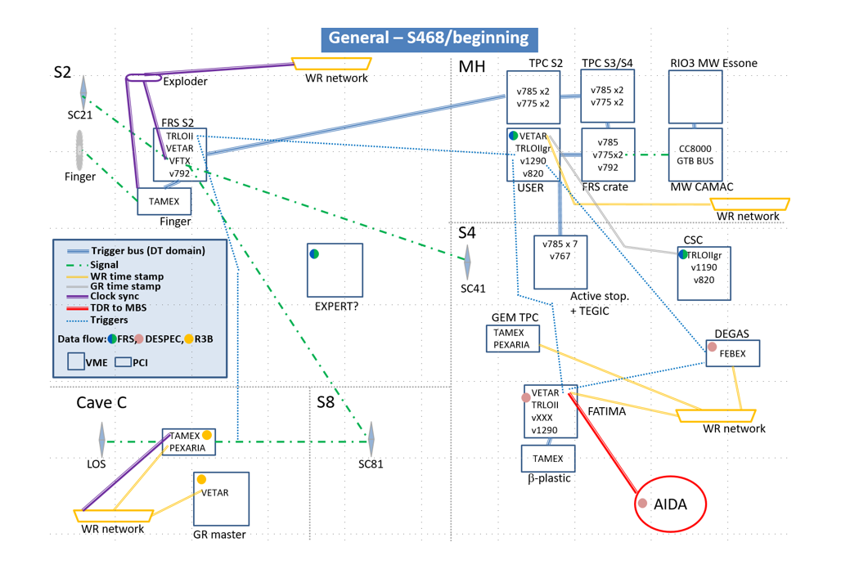
Example of DAQ for experiment and FRS with R3B
DAQ 2020

Slide 16
NUSTAR DAQ
Control level
  Each node can have several processors, configuration shall be scalable (and version controlled) ➔ it can not be 1 GUI per module
Readout
  LMD format file, POI or second level reduction if needed (in case of full readout system)
  monitor back pressure if any
Data flow
  locally Event Building (Drasi or MBS ) for same dead time domain
  time sorter configuration
  use Drasi or MBS
Notion of “data stitching” ➔ build physics event out of time ordered data

Slide 17
Examples from FRS
3 locations
5 nodes
1 node: S2
1 node messhute
3 node S4

Slide 18
Logic and timing
Logic:
  NDAQ request to be able to send and receive trigger ➔ Signal Exchange Point

Slide 19
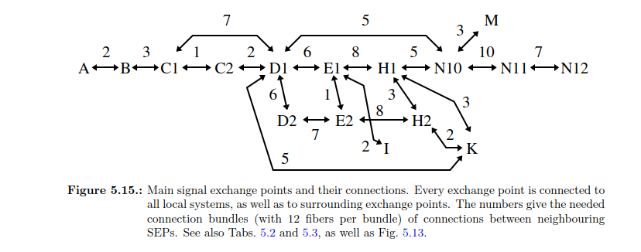
Idea of “signal exchange point”
Permit to send/receive signals from one focal plane to the next
NDAQ TDR, Nov. 2016, p56 Swedish in-kind contribution

Slide 20
Logic and timing
Logic:
  NDAQ request to be able to send and receive trigger Signal Exchange Point
Timing:
  clock synchronization (BuTiS? or WR based)
  Time stamping
  Suggestion for time measurement between focal plane
    time locked clock,
      focal plane A measurement with respect to clock
      focal plane B same,
  (works with VFTX, used at R3B for example)
  In DAQ TDR ➔ require BuTiS, today we do it with WR, enough?

Slide 21
Generic concept, examples of implementation
Control level
Time level
Logic level
Readout level
Data level
this shall be “script configurable” not “only GUI”
ex: MVLC for MUSIC, not doable if 10 systems
this can be WR or Heimtime or BuTiS
need discussion to make sure we can have the options we need
solution exist in MBS or Drasi, not a problem

Slide 22
Conclusion DAQ Super-FRS- question to you
Does the system needs BuTiS or can we remove it from requirement (cables etc..)
How readout is made, how data reduction happens (trigger, POI?)
Can detector send trigger, can its electronic receive trigger
Which timing module, protocol is needed (Heimtime, WR, BuTiS?)

Slide 23
Super-FRS DAQ and commissioning needs
Stephane Pietri, SFC

Slide 24
Commissioning – DAQ and detector need and operation
Super-FRS commissioning start in 2027 (some activities in fall 2026)
Beam commissioning October 2027
Most of commissioning activities from spring 2027
A LOT OF WORK in 2027
➔ need clear planning

Slide 25
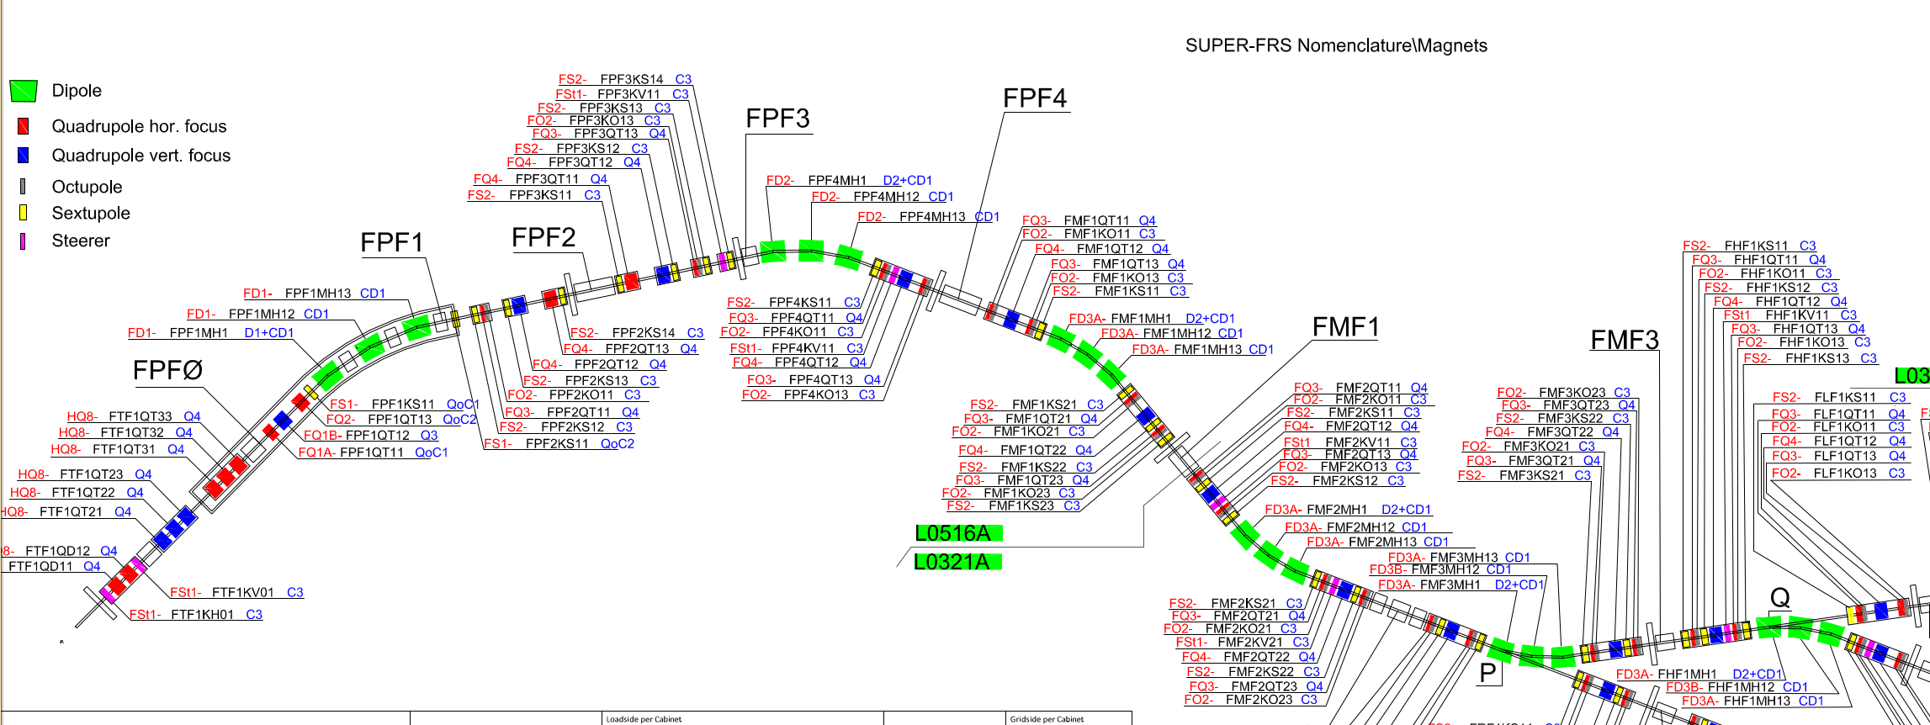
Magnets – size and constrain
Need large magnets to accept as much in momentum (40 cm openings)
This means inductance quite high (good for machine protection…)
This means need more order correction – quite a variety of multiplet

Slide 26
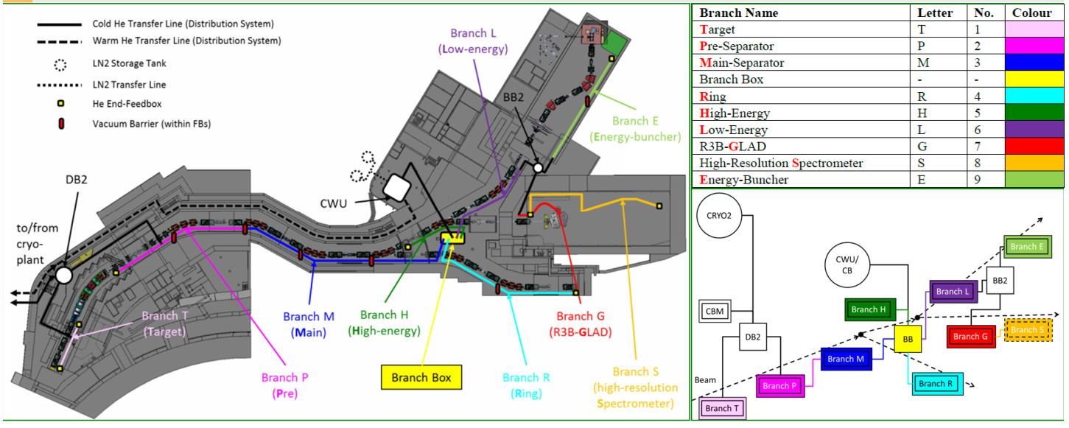
Complexity due to cryogenics
Cryogenics distribution not based on functional sections
Local cryogenics: depends on general cryogenics and deliveries
Phase 2 commissioning Super Conducting Magnets after local cryogenics commissioning
Dependency:
➔Magnet commissioning
phase 2 after cool down
per section
but P/M/H cooled
down at once

Slide 27
Commissioning – detector case
phase 2 ➔ local DAQ test
phase 3.1 ➔ integrated DAQ test between focal planes
phase 3.2 ➔ test if can couple to NUSTAR (optional)
phase 4 ➔ beam commissioning
most SFRS detectors have no data if no particle! Pulser test are of limited use to test DAQ configurations and to test online analysis

Slide 28
Beam commissioning
Limited time ➔ need to hunt all sources of inefficiency, make easy to use
4 typical cases
  detector characterization :
    self trigger of the detector
    trigger with detector from the same focal plane
  Ion Optical Commissioning (focal plane per focal plane)
    most of the time one trigger at focal plane N for all detector in focal plane N
    few cases of beam reaching N+2 and we need information of detectors at N
  Separator commissioning
    complex trigger (main trigger at FHF1, reduced trigger in FMF2 and FPF4 for example, FHF2 detector readout)
    need some flexibility
  Isomer tagging configuration
    add a small isomer tagger at FHF2, same trigger or ROI

Slide 29
Beam commissioning - requirement
Must have
  Ability to switch trigger between detectors at or other focal plane
  Possibility to merge data, and reduce data based on trigger
  Same timing, and data merging
  No ground loops
Nice to have
  operate same dead time domain per focal plane
  send dead time between focal plane
Those requirement are a lighter version from the DAQ TDR descriptions

Slide 30
Note on commissioning operation
3 cases:
  the detector is being commissioned : detector expert shall be present
  the detector is not being used for this measurement : detector expert shall not be present
  the detector has been commissioned and is being used for other measurements
    the operation of the detector is a secret : detector expert shall be present,
                OR
    clear operation manual, and Super-FRS commissioning crew can be trained to assure basic operation ➔ detector expert needed only in case of major failure
Example: BEA detectors at FRS, any FRS crew, in 10 minutes training, can operate CG at target
  ➔ this require clear integration in DAQ, data analysis, slow control (see this afternoon talks)

Slide 31
My view
I can use Windows and I am not an system operating expert
An operator in HKR is not an expert in magnets, ion optics, vacuum, application development BUT he has the tools to operate the SIS18@GSI or LHC@CERN
Applications, analysis, detectors, magnets, shall be able to operate with trained crews who are not experts in everything.
This require clear interfaces, instruction manuals (all is defined in M12 from PMO)

