Slide 1
Data Supply
Operator School 2025
D. Ondreka, SYS
31.10.2025

Slide 2

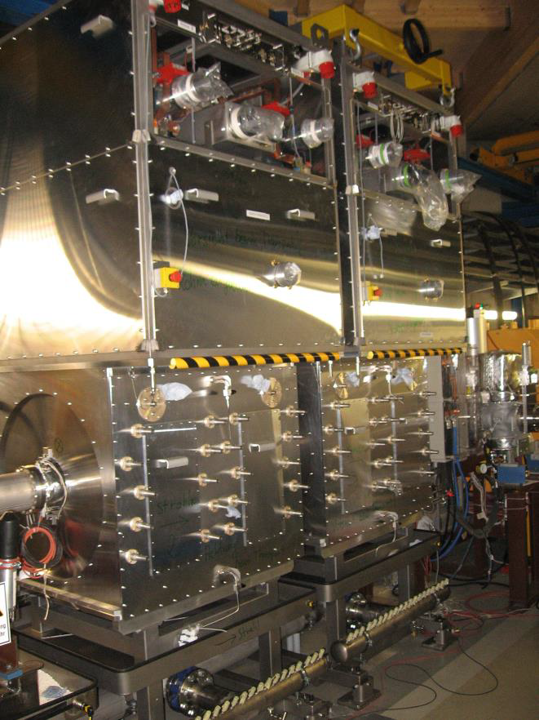
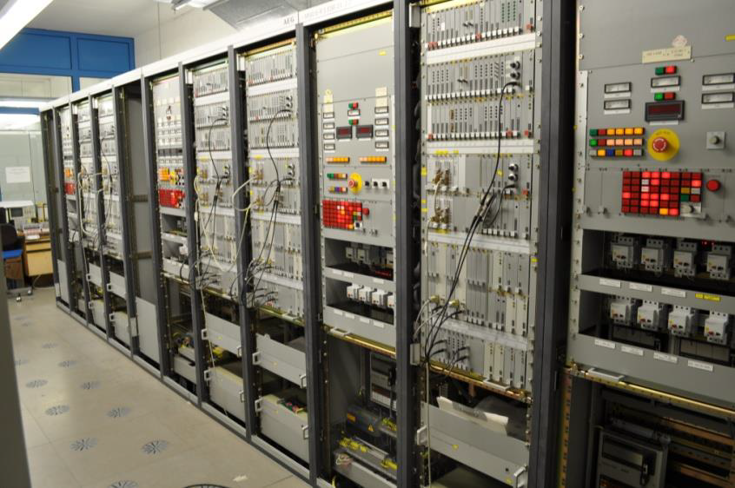
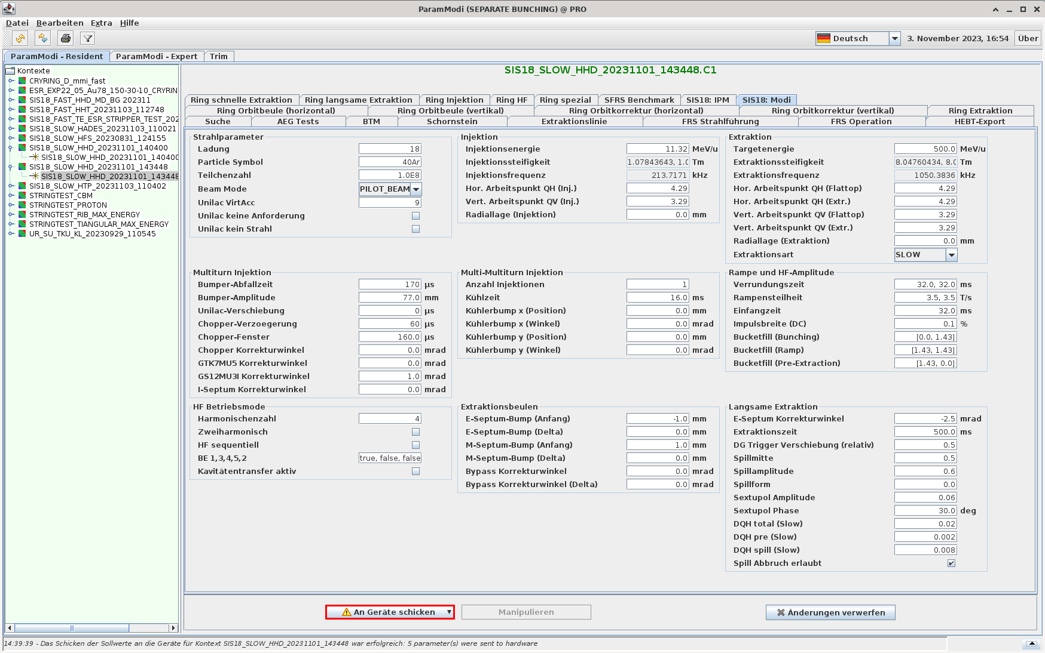

Have you ever asked yourself…
How does the control system know
  how an accelerator is supposed to work?
  what a synchrotron cycle is?
  which knobs are needed to tune a machine?
  the properties of all devices?
If I change a parameter in ParamModi:
  What happens behind the scenes?
  How can I know which devices are affected?
  What is a parameter anyway?
  How can I inspect old and new values?
?

Slide 3
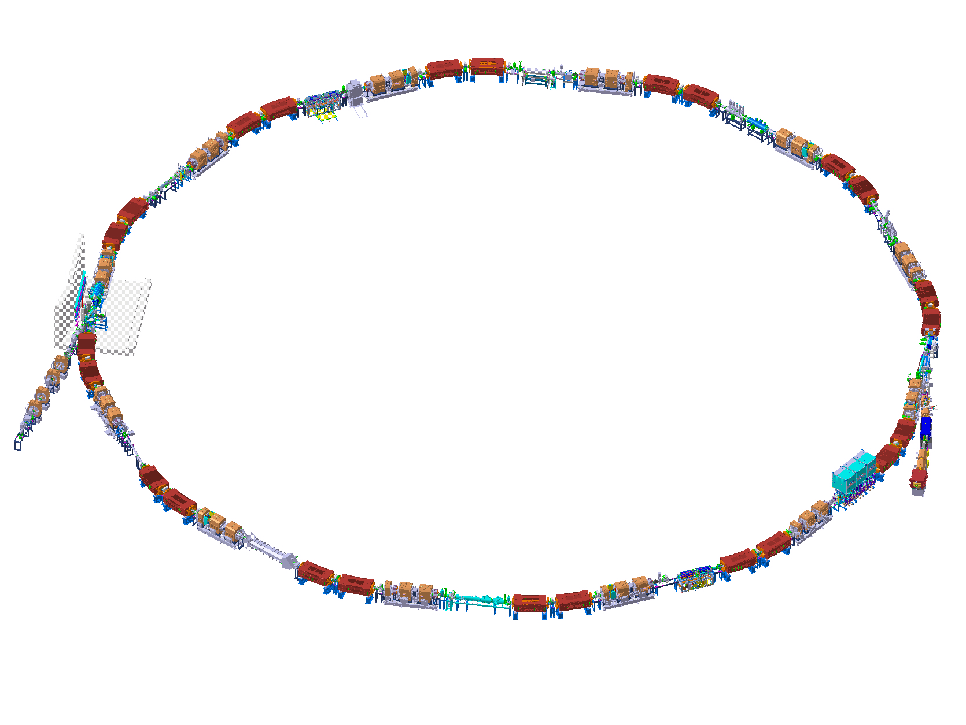
What is ‘Data Supply’?
Accelerator can only work if
  all devices have consistent set values
  the timing system provides the right events
  required beam parameters can be specified
  required operation modes can be selected
  the right knobs for tuning are available
That’s what ‘Data Supply’ is about!
Core feature: machine model
  Abstraction in terms of physics parameters
  Relations to hardware set values
  Representation of operation modes
SIS18 Model Statistics
#Devices | ~150
#Parameters | ~1500
#Input Parameters | ~200
#Hardware Parameters | ~350
#Rules | ~1700

Slide 4
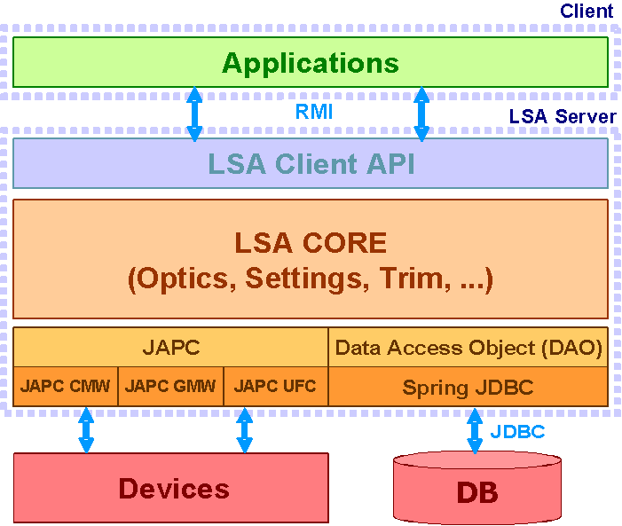



Machine modeling using LSA
LSA: Framework for accelerator modeling
  Invented by CERN, co-developed by CERN/GSI
Data-driven system with 3-tier architecture
  LSA-DB: storage for input and output data
  LSA-Server: calculations and data access
  Applications: management of data
Generic structures for modeling
  Tables for machine specific data (e.g. optics)
  Tables for device data (e.g. calibrations, limits)
  Object model for description of accelerators
  Interface for definition of physics algorithms
Change injection tunes
Physics
Function from scalar
Calculate tune ramp
Optics data
Calculate quadrupole strengths
Calibration data
Calculate quadrupole current
Hardware
Proper format
Calculate set value
Algo-
rithms
Data

Slide 5
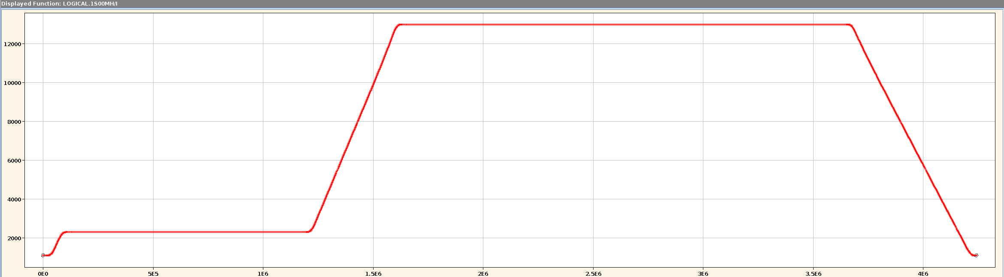




LSA in a nutshell
Spatial partitioning of facility
  Particle transfers (=timing groups)
  Accelerator zones
Accelerator represented via parameters
  Linked to logical or physical devices
  Organized in hierarchy from physics to hardware
Cycles organized in contexts
  Basic unit: beam process for particle transfer
  Grouping into chains and sub-chains
Values represented as settings
  Value of parameter in beam process
  HW settings get sent to devices (set-values)
Calculations implemented as rules
  Java code mostly written by physics experts
  Calculate child from parents and data in LSA-DB
SIS18BEAM/QH
SIS18BEAM/BRHO
SIS18BEAM/QV
Physics
LOGICAL.GS01QS1F/KL
LOGICAL.GS01QS2D/KL
LOGICAL.GS01QS1F/BL
LOGICAL.GS01QS2D/BL
Hardware
GS01QS1F/Setting#current
GS01QS2D/Setting#current
INIT
RESET
INJECTION
RAMP
EXTRACTION
Setting of tune parameter
Parameter | SIS18BEAM/QH
Beam process | P.SIS18.RING_INJECTION
Value | Constant function = 4.28
$${KL}_{n}={KL}_{n}^{(0)}+\frac{{∂KL}_{n}}{{∂Q}_{h}}∙(Q_{h}−Q_{h}^{\left(0\right)})$$
LSA DB
QH
MADX
$$\frac{{∂KL}_{n}}{{∂Q}_{h}}$$
Java code
$$Q_{h}^{\left(0\right)}$$
$${KL}_{n}^{(0)}$$
KL

Slide 6
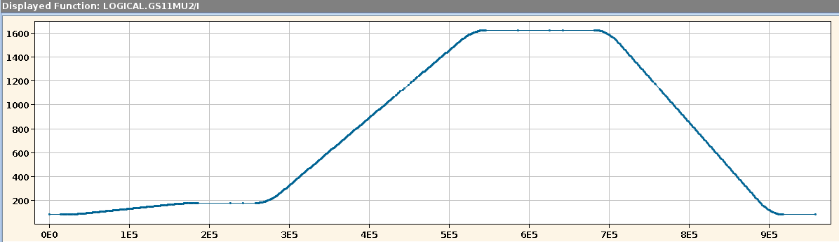
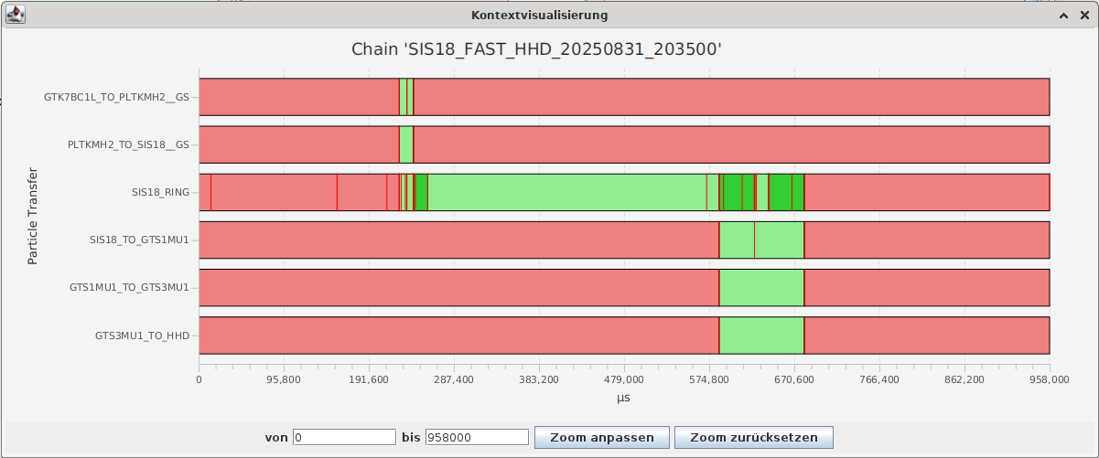
SIS18 Cycle
Cycle represented as chain
  Comprises several particle transfers
    Ring, cooler, beamline sections
  Partitioned into in beam processes
    Types and number depend on particle transfer
  Display with chain viewer
    ParamModi: context menu on chain name
    Displays timing events also
SIS18 dipole current and beam processes
BP boundary
BEAM_IN
Timing event
BEAM_OUT

Slide 7
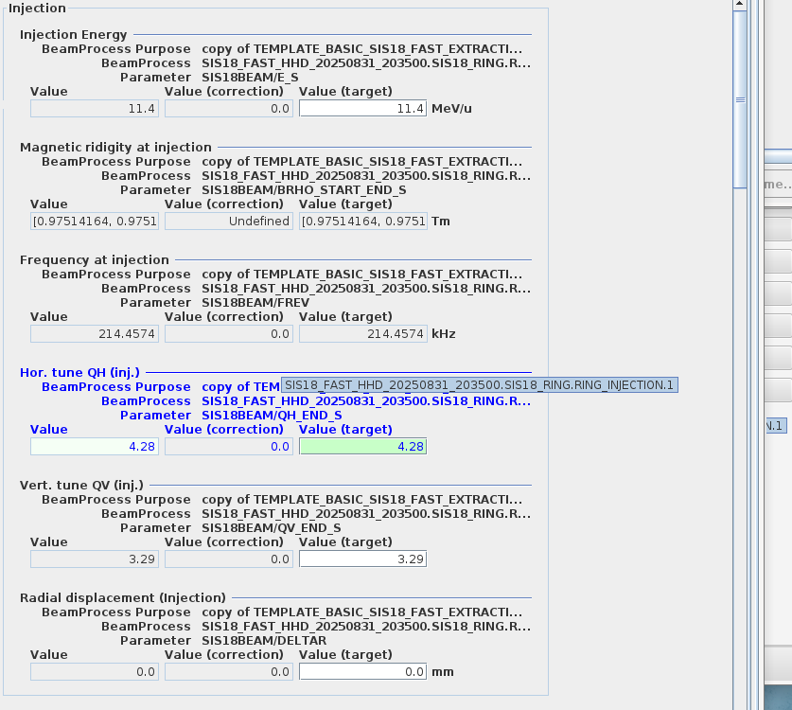
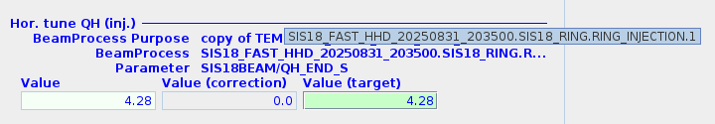
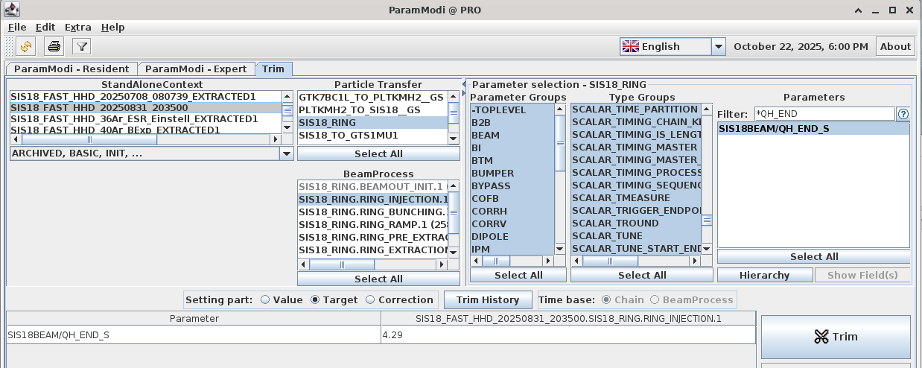
Hierarchy and Trim: An Example
What happens if we change injection tune?
  ParamModi sends changed value to LSA-server
  LSA-server calculates new values along hierarchy
  Let’s join it on the journey!
How do I know the parameter?
  Go to ‘Expert Mode’ (Menu ‘Extras’)
  Find the input field by its label ‘Hor. tune QH (Inj.)’
    Linked to parameter ‘SIS18BEAM/QH_END_S’
    Linked to injection beam process
Open hierarchy viewer on trim tab
  Select parameter and click ‘Hierarchy’
  How to find parameter?
    Select all ‘Parameter Groups’
    Select all ‘Type Groups’
    Use ‘Filter’ field, e.g. ‘*QH_END’
ParamModi: Expert Mode (SIS18: Modi/Injection)
ParamModi: open hierarchy on trim tab

Slide 8
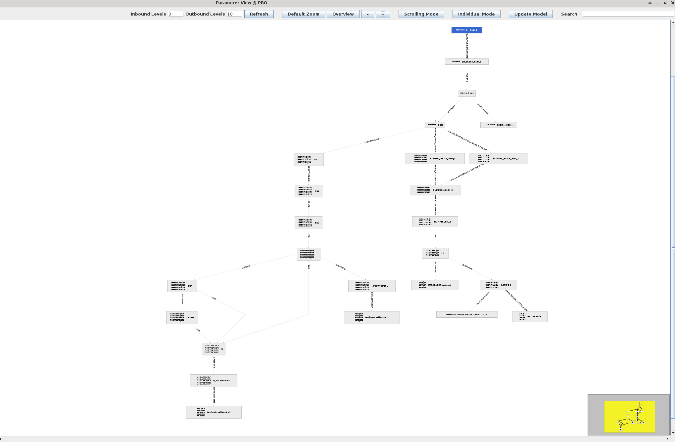
Tune Trim: Hierarchy
Tunes:
Scalar to Functions
Quadrupoles
Bumpers

Slide 9
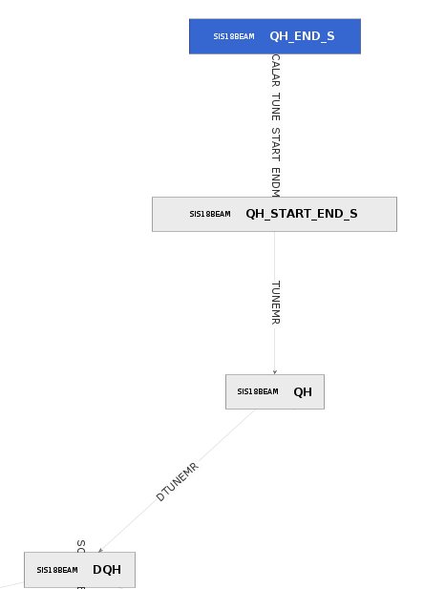
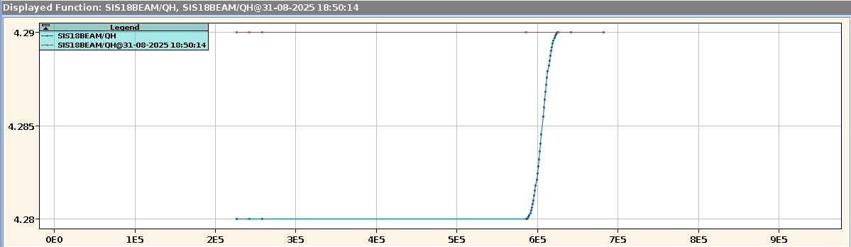
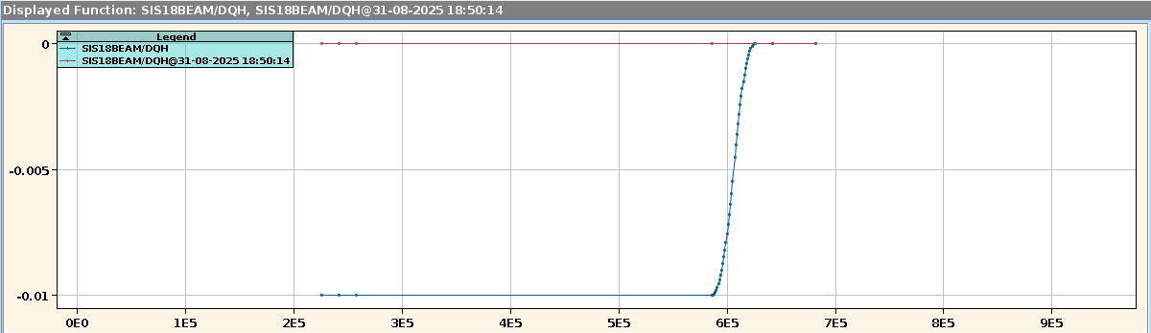
Tune Trim: Scalar to Functions
Scalar input must be converted to function
  Tune function required when there is beam
  Tunes constant during ramp → change in PRE
Input value for QH at injection
Values for QH at beam process boundaries
INIT
INIT
INJ
INJ
BUN
BUN
RAMP
RAMP
PRE
PRE
EXT
EXT
POST
POST
RESET
RESET
Function for QH from injection to extraction
BUN
RAMP
PRE
POST
INJ
EXT
Function of difference DQH to theory tune (QH = 4.29)
BUN
RAMP
PRE
POST
INJ
EXT

Slide 10
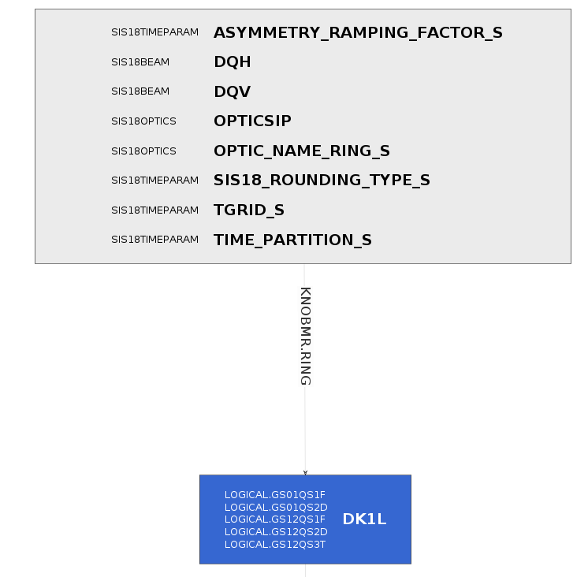
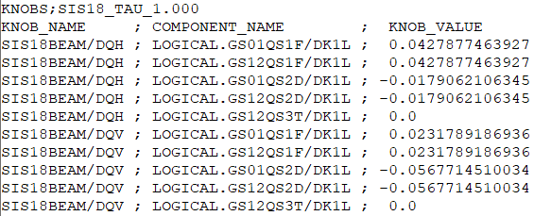
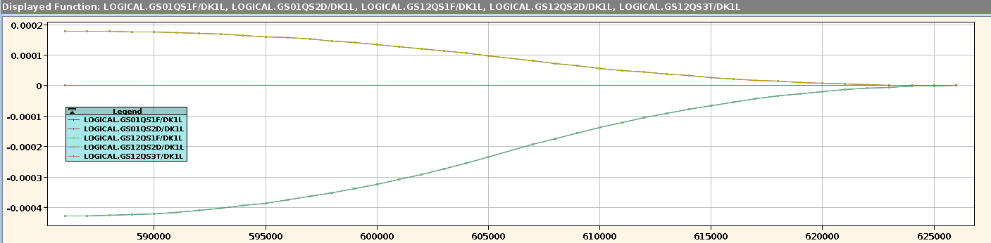




Tune Trim: Quadrupole Strengths
Accelerator physics comes in:
  Quadrupole strengths depend on both tunes
  Generally requires ion optical simulations
  Linear approximation used in model
$${KL}_{n}={KL}_{n}^{(0)}+\frac{{∂KL}_{n}}{{∂Q}_{h}}∙(Q_{h}−Q_{h}^{\left(0\right)})$$
LSA DB
QH
MADX
$$\frac{{∂KL}_{n}}{{∂Q}_{h}}$$
Java code
$$Q_{h}^{\left(0\right)}$$
$${KL}_{n}^{(0)}$$
KL
Coefficients for linear approximation of strength change
Quadrupole strength changes in beam process PRE_EXTRACTION

Slide 11
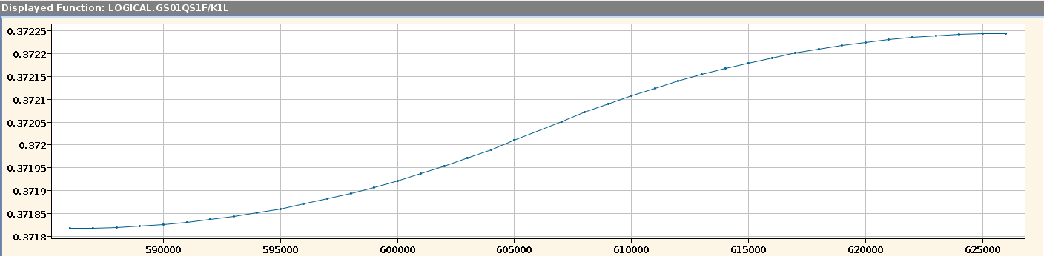
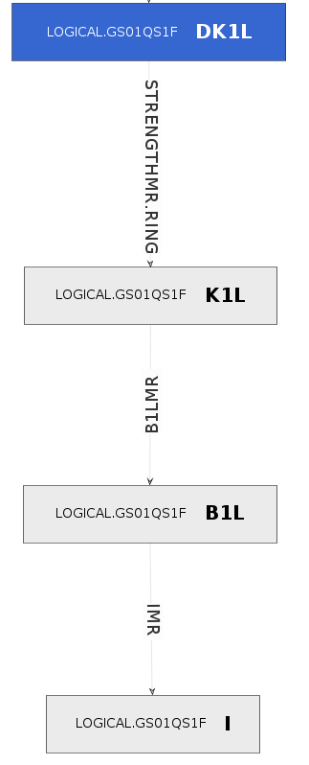
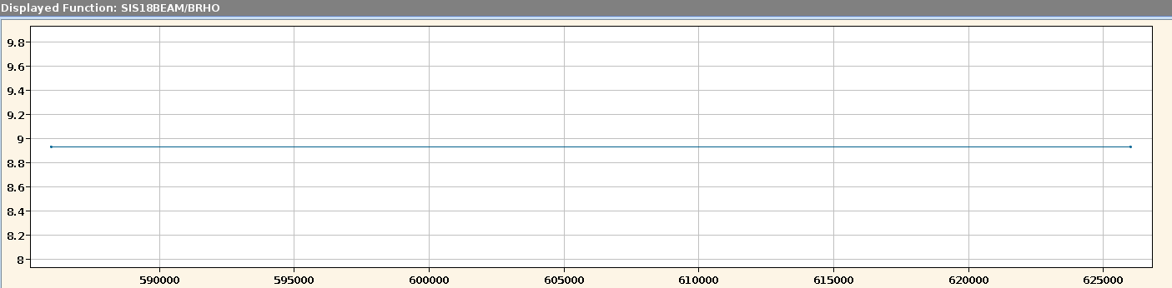
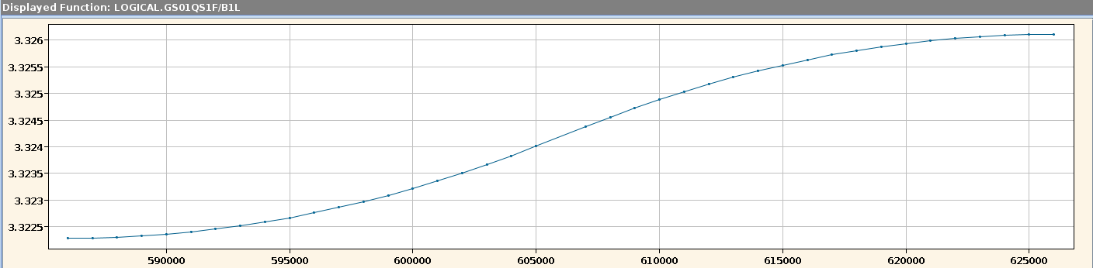
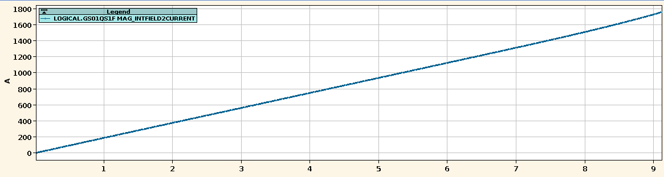
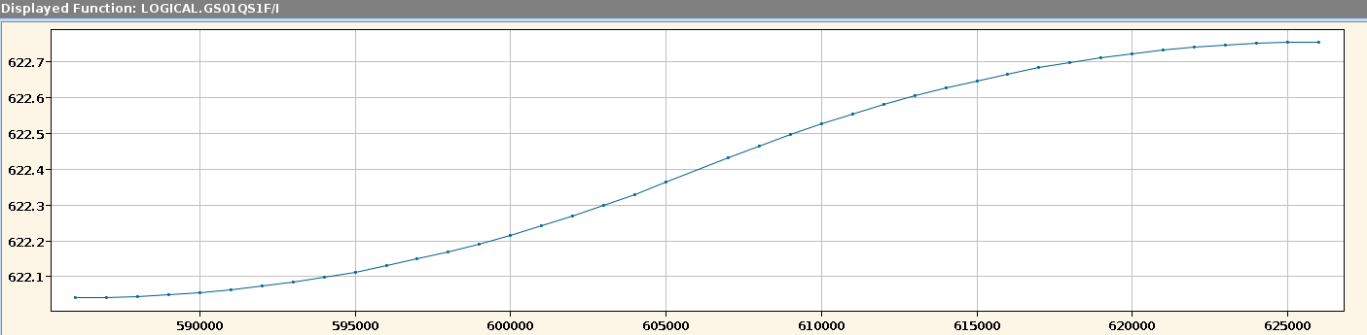
Tune Trim: Strength to Current
Independent calculations per quadrupole
  Integral field: strength x rigidity
  Current: calibration curve look-up
Strength (K1L): DK1L + theory strength
Rigidity (BRHO)
x BRHO
Integral field (B1L)
Calibration curve
Calibration look-up
Quadrupole current (I)

Slide 12
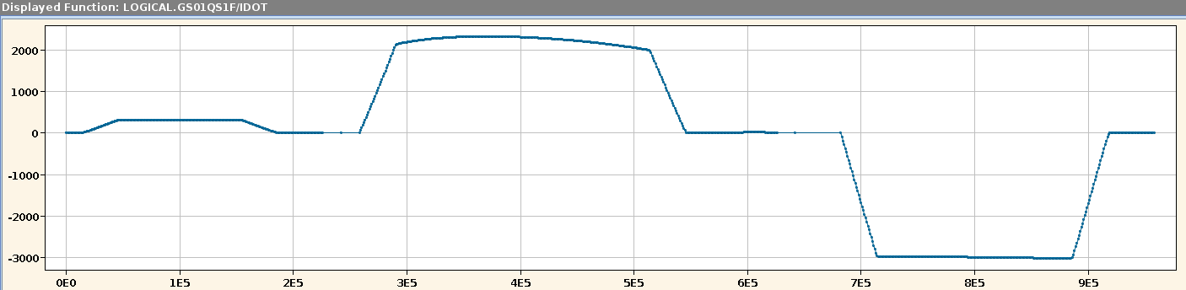
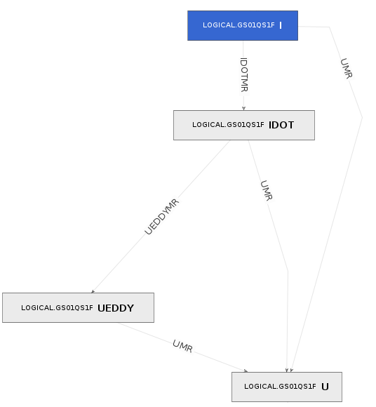
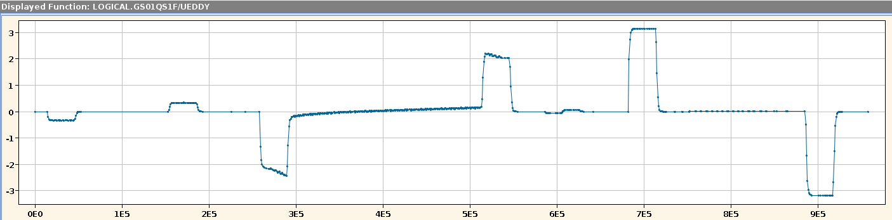
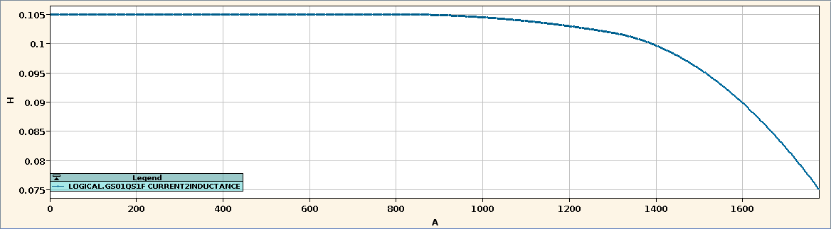
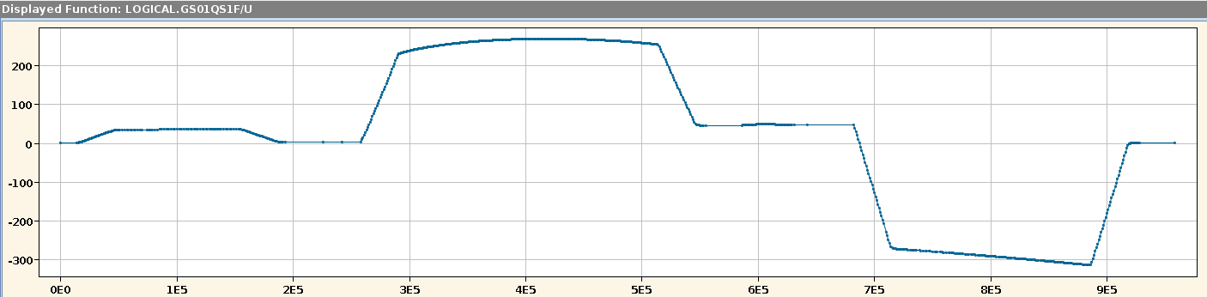
Tune Trim: Current to Voltage
Power converters need current and voltage
  Inductive contribution from current change
  Eddy current contribution
Current change (IDOT): numerical differentiation
Eddy current model
Eddy current contribution to voltage (UEDDY)
Inductance curve
U = R∙I + L(I) ∙dI/dt + U_{eddy}
Load voltage prediction (U)

Slide 13
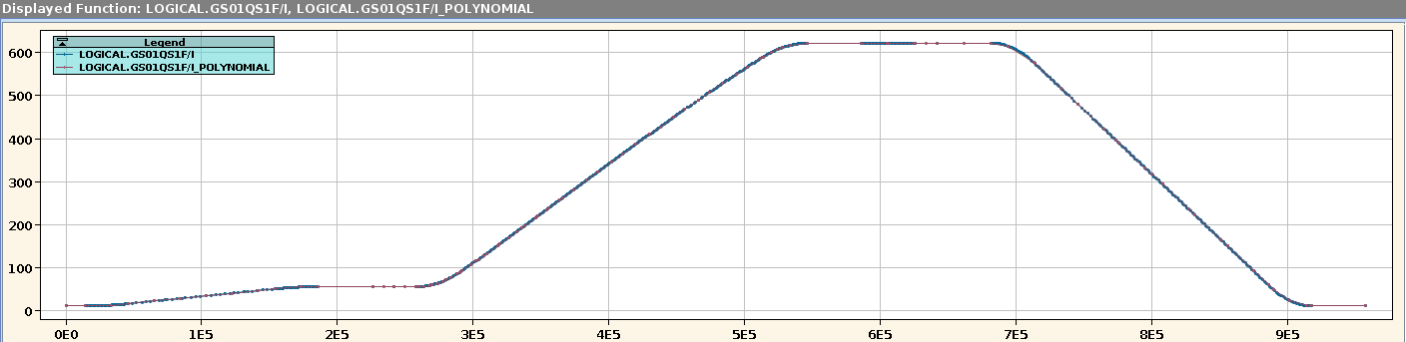
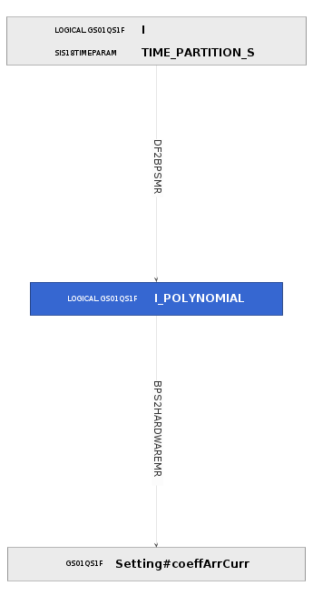
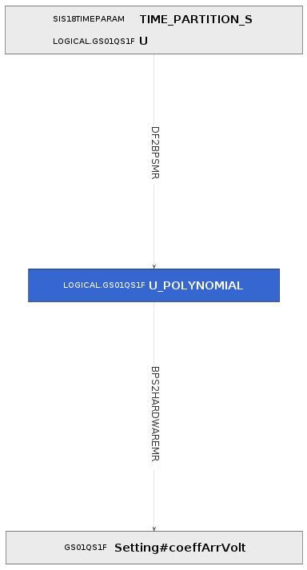
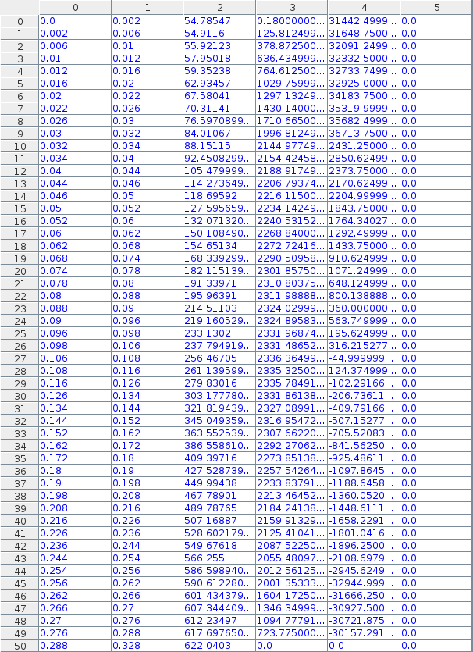
Tune Trim: Set Values
Ramped SCUs need quadratic polynomials
  Polynomial fit of values on time grid
  Extraction of coefficients into set value parameters
  Sent to SCU for resident chains
Current polynomial (I_POLYNOMIAL) and current (I)
Current set value Setting#coeffArrCurr (RAMP)

Slide 14
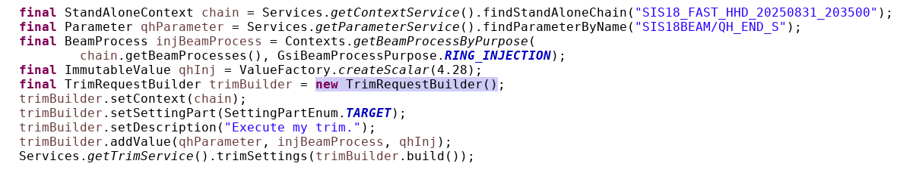
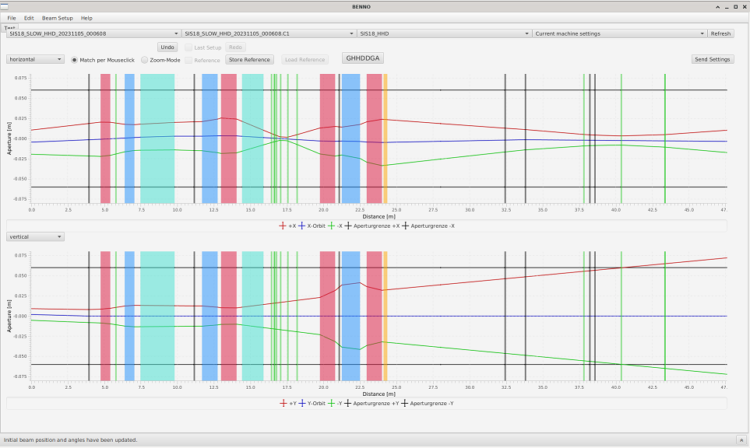
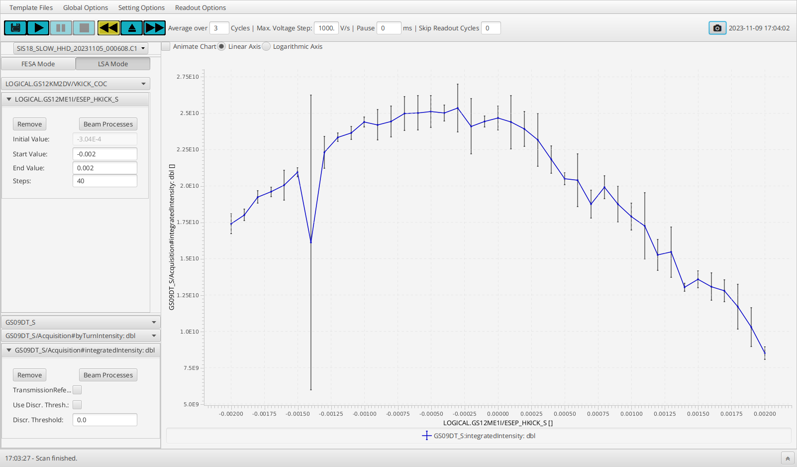
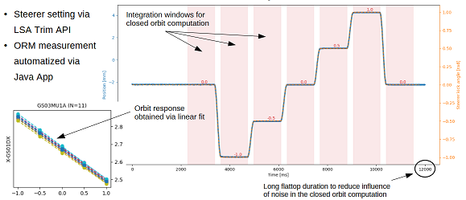
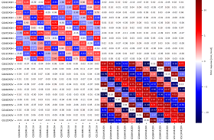
Model: Interface to Machine
Model provides general access to settings
  Modifications not limited to ParamModi
  Programmatic access to all levels of the hierarchy
  Modification of time functions possible
Applications using model in routine operation
  Benno Application (C. Heßler/OPE):
  beamline steering and focusing
  Device Automator (W. Geithner/DEC):
  parameter scanning
Interfaces used for machine experiments
  Java API: standard used by CS applications
  Python bridge: experimental (→ S. Appel/APH)
Java code for executing the tune trim just discussed
Benno Application
Device Automator Application
LOCO-based ORM measurement
(Java app, steerer function trims)
Courtesy of
D. Vilsmeier

Slide 15
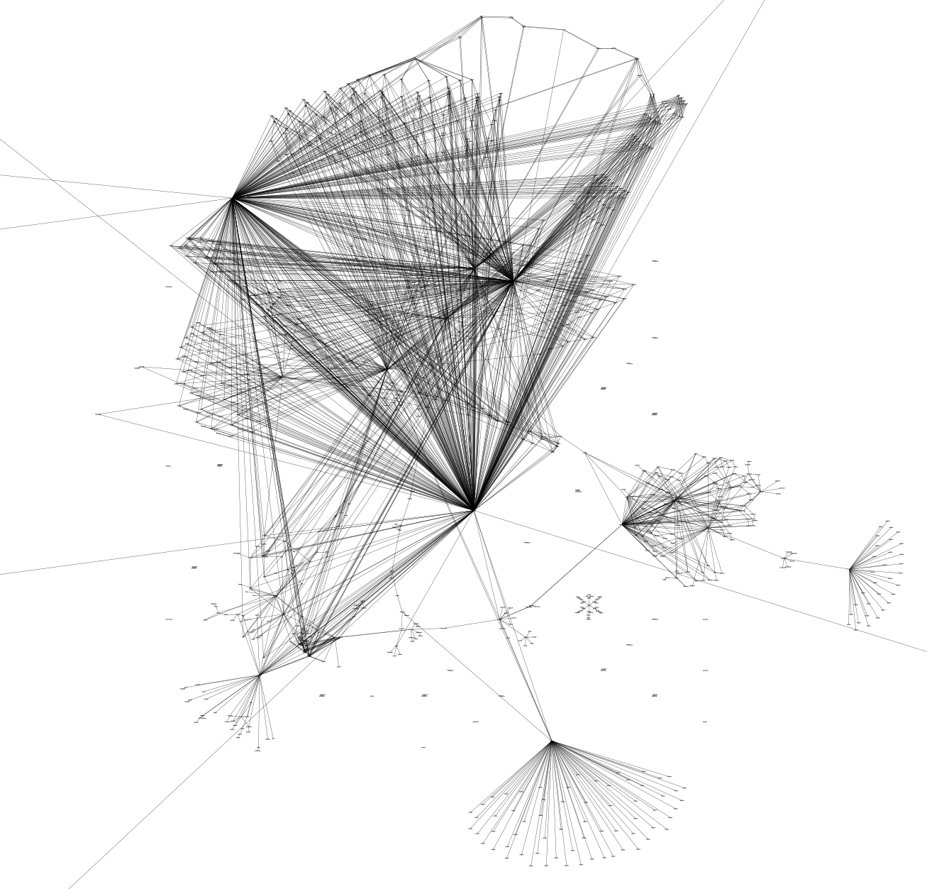
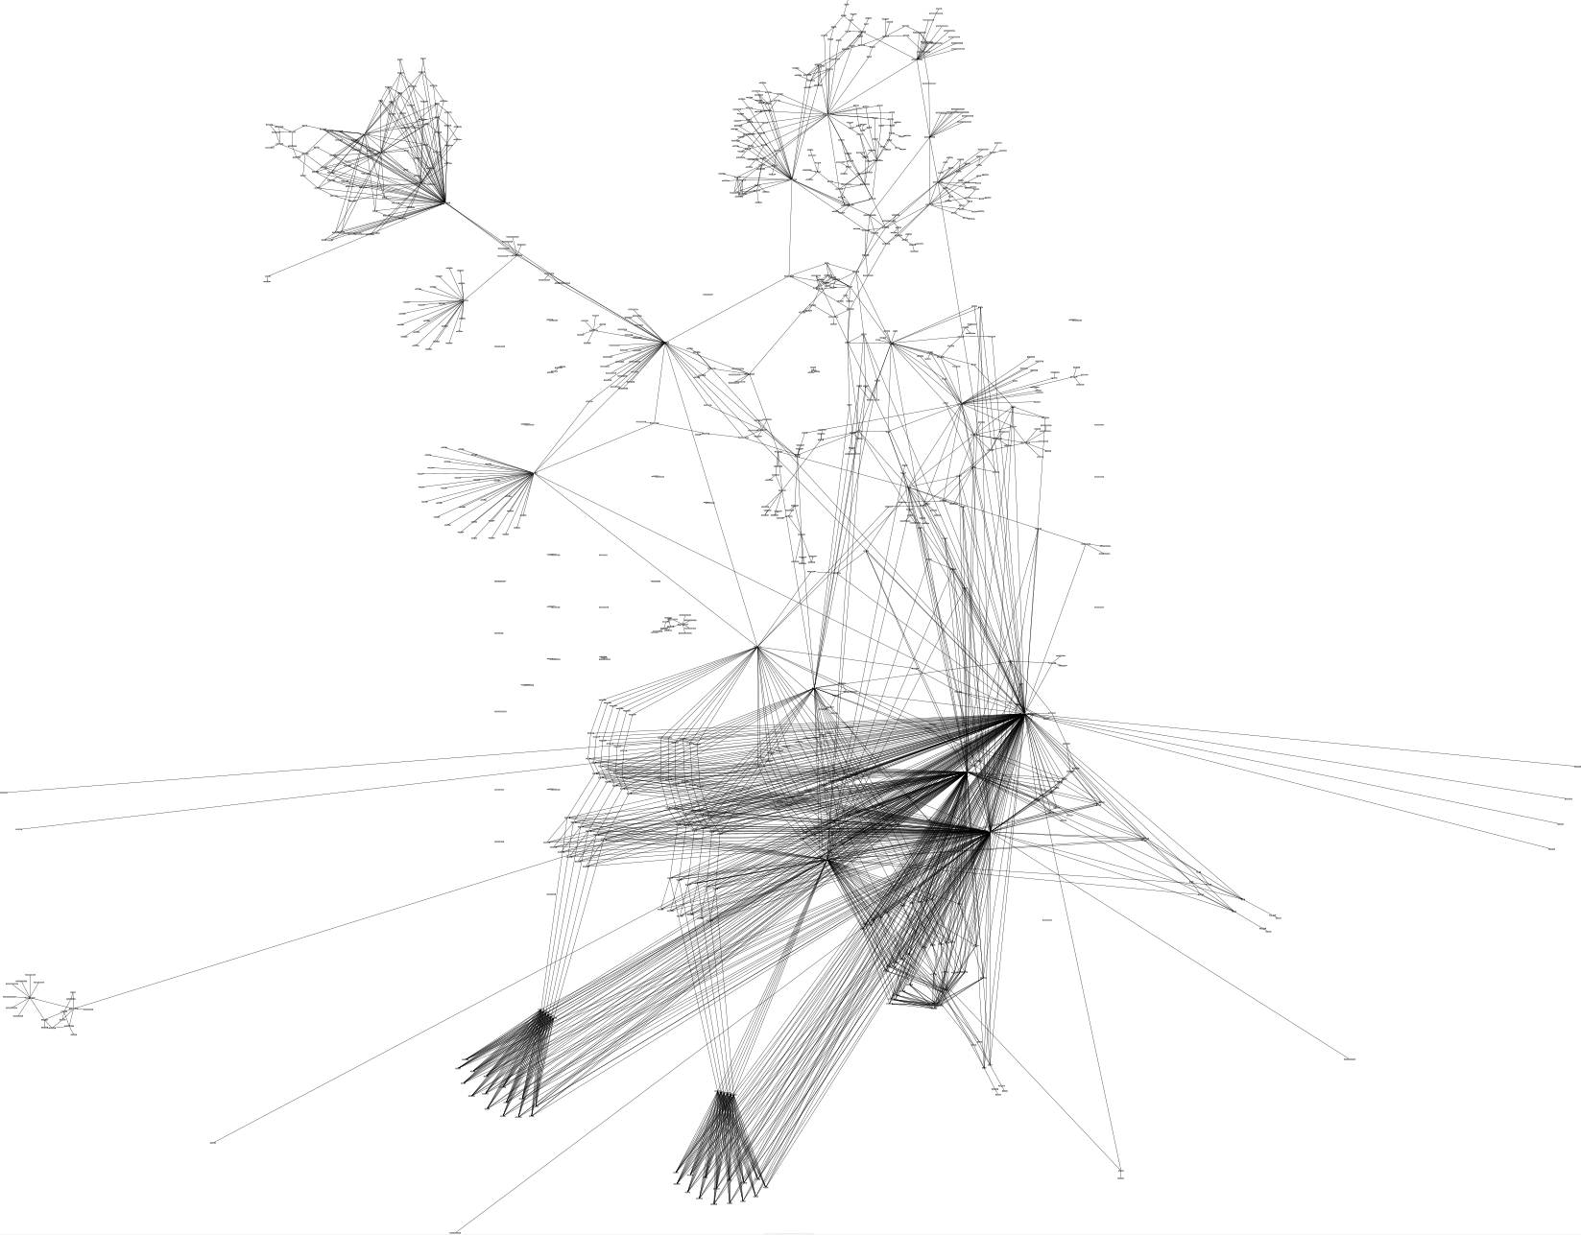
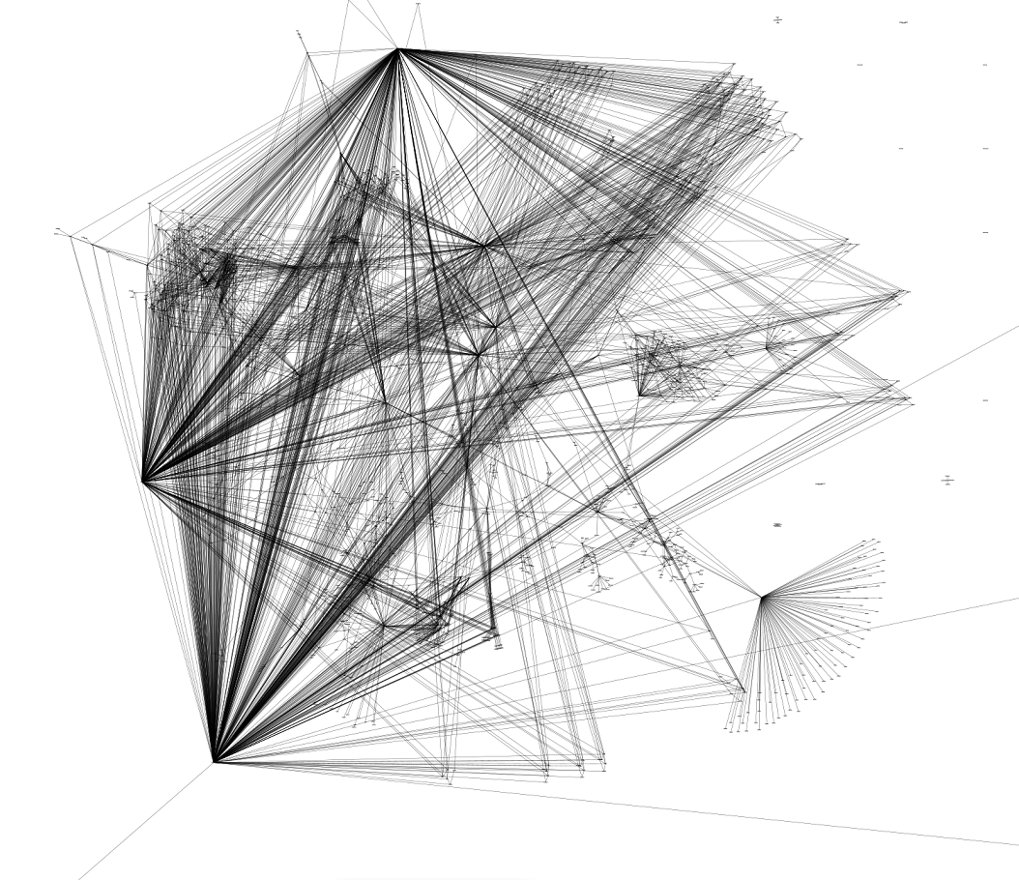
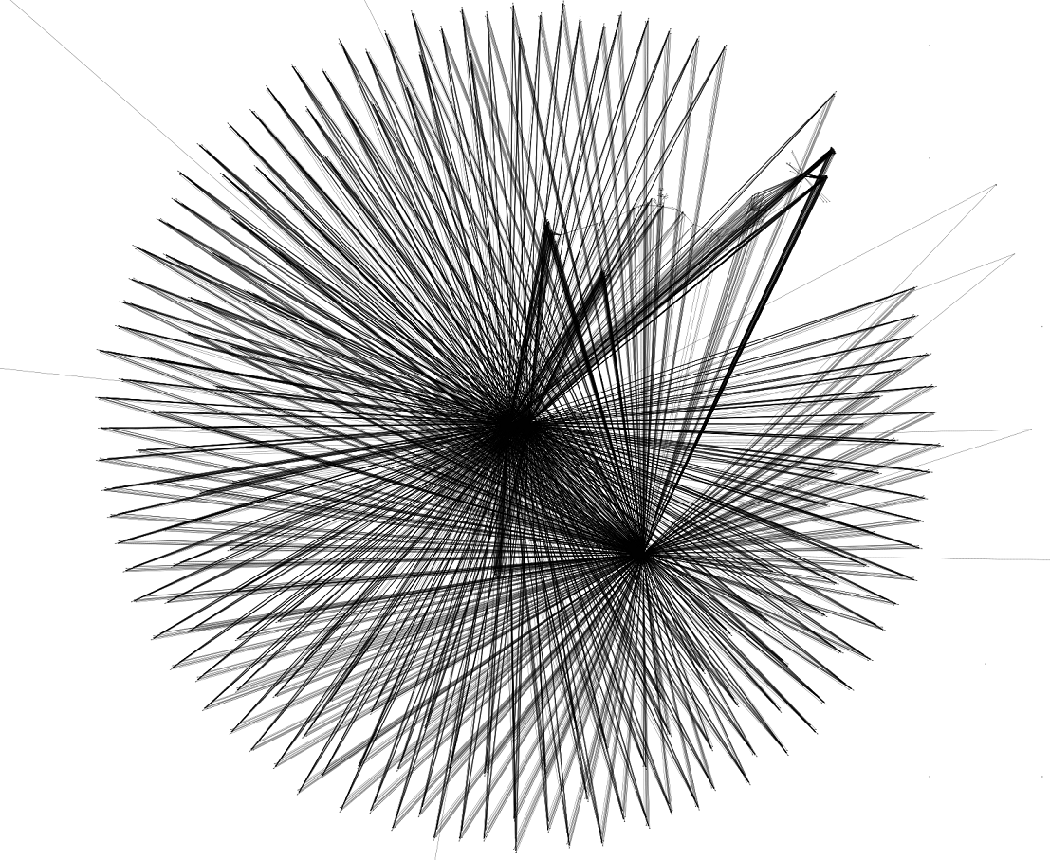
Thank you for your attention!
Special thanks go to the great FAIR Data Supply team: Peter Gerhard, Holger Liebermann, Ingrid Kraus, Sergey Litvinov, Michael Kelnhofer, Christoph Hessler, Raphael Müller, Andreas Schaller, Jonas Pforr, Jutta Fitzek, Hanno Hüther, and others
CRYRING
ESR
SIS100
SIS18
Looks like accelerator modeling is an art…
Courtesy A. Schaller

