Slide 1
Bunch Struktur Messungen am UNILAC --- Status Report ---
Operator-School, 30.10.2025
Beam Instrumentation Abteilung:
Peter Forck, Stephan Klaproth, Timo Milosic, Thomas Sieber, Rahul Singh
LINAC Abteilung:
Maksym Miski-Oglu, Uwe Scheeler, Nimue Schmidt,
Winfried Barth, Simon Lauber et al.

Slide 2
Gliederung
Messungen longitudinal Parameter:
Beispiele zur Simulation des longitudinaler Phasenraums
Generelles zur Bunch-Länger Messung am UNILAC
Monitor 1: Bunch Shape Monitor (BSM) von russischen Institut INR
Monitor 2: Fast Faraday Cup (FFC); Design vom amerikanischen Fermilab
Erste Ansätze zur Bestimmung des longitudinalen Emittanz
Vergleich von BSM und FFC
Zusammenfassung und Ausblick

Slide 3

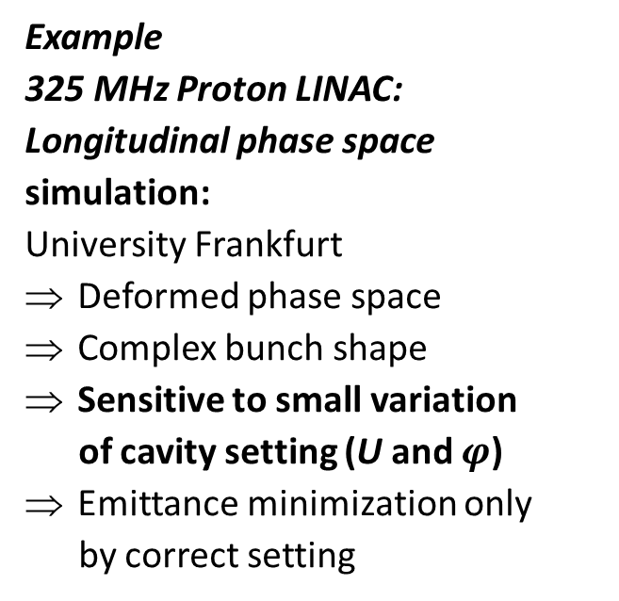


Bunch Shape by KONUS Beam Dynamics
Bunch shapes are very non-Gaussian
Reason: Acceleration on maximum of rf-wave to enable maximum energy gain
by KONUS beam dynamics at CH-cavities (KoNuS = Kombinierte Null Grad Struktur)
$E=3$MeV ⇔ $β$=8%
E=$7$MeV ⇔ $β$=12%
$E=67$MeV ⇔ $β$=37%
Example
325 MHz Proton LINAC:
Longitudinal phase space
simulation:
University Frankfurt
Deformed phase space
Complex bunch shape
Sensitive to small variation
of cavity setting (U and $φ$)
Emittance minimization only
by correct setting
Phase ϕ:
span 90⁰
= 0.77 ns
Phase ϕ:
span 40⁰
= 0.34 ns
Phase ϕ:
span 20⁰
= 0.17 ns

Slide 4
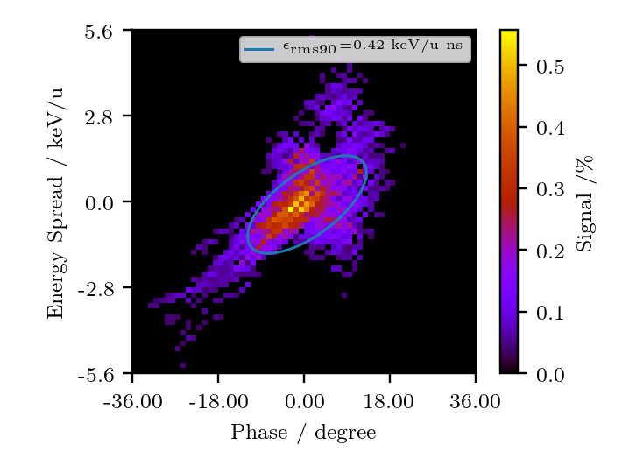
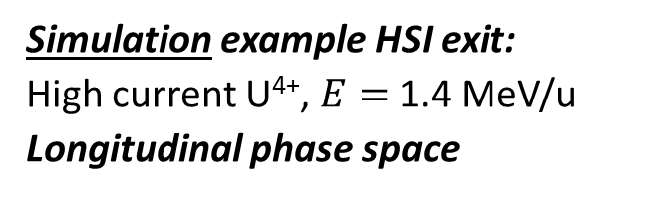


Bunch Shape by KONUS Beam Dynamics
Bunch shapes are very non-Gaussian
Reason: Acceleration on maximum of rf-wave to enable maximum energy gain
by KONUS beam dynamics at IH-cavities (KoNuS = Kombinierte Null Grad Struktur)
Simulation example HSI exit:
High current U⁴⁺, $E=$ 1.4 MeV/u
Longitudinal phase space
Measurement example HLI at UN6:
Low current, $E=$1.4 MeV/u
Measurement: Tomographic reconstruction
0.9
0.45
$\frac{∆E}{E}$ span 0.8 %
Energy spread ΔE/E [%]
0
-0.45
-0.9
0
-18
-9
9
18
Phase ϕ [degree]
Phase ϕ span 36⁰ = 2.8 ns @36 MHz
Phase ϕ span 72⁰ = 1.85 ns
W. Barth, S. Yaramishev et al. LINAC’06
S. Lauber et al., IPAC’19 & Phys. Rev. Accel. Beams, 23, 114201 (2020)

Slide 5
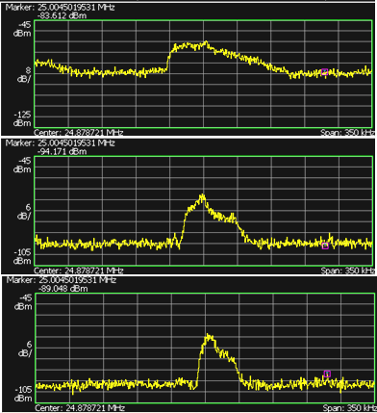
Longitudinal Schottky for Momentum Spread Δp/p₀ Analysis
Momentum spread Δ p/p₀ after multi-turn injection
& de-bunching of t < 1ms duration
to stay within momentum acceptance during acceleration
Method: Variation of buncher voltage
i.e. rotation in longitudinal phase space
minimizing of momentum spread Δ p/p₀
Example: 10¹⁰ U²⁸⁺ at 11.4 MeV/u
injection plateau 150 ms, η = 0.94
Longitudinal Schottky at harmonics h = 117
Momentum spread variation:
Δp/p ≈ (0.6... 2.5) ⋅10⁻³ (1σ)
bunched
Δp/p ≈ 2.5 ⋅10⁻³
LINAC bunches at injection:
De-bunching after some ms:
from LINAC
long. phase space
long. phase space
f_{center} = 24.9 MHz
35 kHz
de-bunching
8 dB
δ = Δp/ p
δ = Δp/ p
Schottky
only drift
Δp/p ≈ 1.3 ⋅10⁻³
time or phase
time or phase
6 dB
U_{left}
U_{sum}
However:
Schottky show only the
stable stored beam
not UNILAC beam Δp/p
Σ
U_{right}
de-bunched
Δp/p ≈ 0.6 ⋅10⁻³
Schottky
pickup
6 dB
Δf_{h} ∝ h⋅Δp
synchrotron
LINAC
buncher
injection
extraction

Slide 6
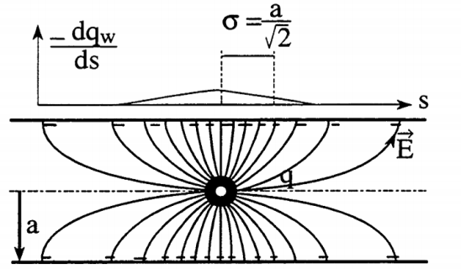
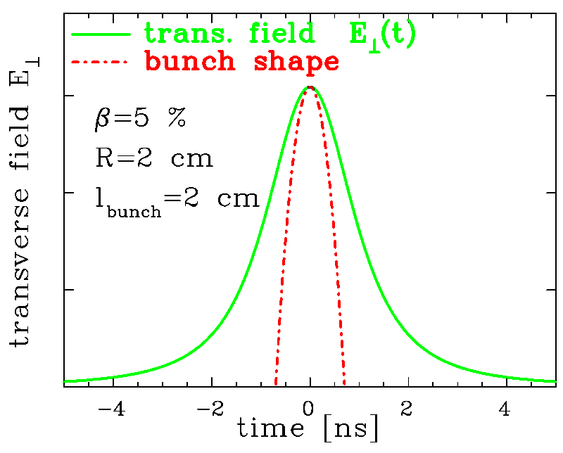
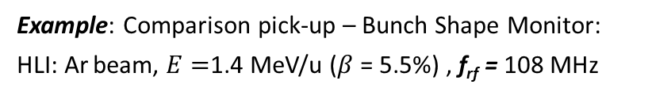
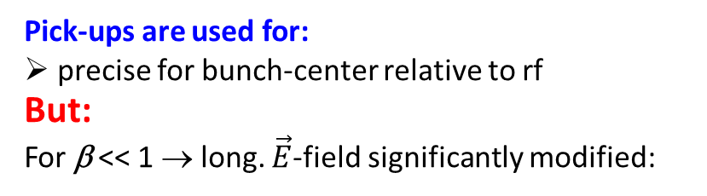
Bunch Structure at low E_{kin}: Not possible with Pick-Ups
Pick-ups are used for:
precise for bunch-center relative to rf
But:
For β << 1 → long. $\vec{E}$-field significantly modified:
Example: Comparison pick-up – Bunch Shape Monitor:
HLI: Ar beam, $E=$1.4 MeV/u ($β$ = 5.5%) , f_{rf} = 108 MHz
σ ≈ R / γ
R
ampl.
⇔ t_{bunch}=1.3 ns
1/ f_{rf} = 9.2 ns
⇒ the pick-up signal is insensitive
to bunch ’fine-structure’
source
Bunch Shape Monitor
Buncher
RFQ
LINAC
B.
BSM

Slide 7
Gliederung
Messungen longitudinal Parameter:
Beispiele zur Simulation des longitudinaler Phasenraums
Generelles zur Bunch-Länger Messung am UNILAC
Monitor 1: Bunch Shape Monitor (BSM) von russischen Institut INR
Monitor 2: Fast Faraday Cup (FFC); Design vom amerikanischen Fermilab
Erste Ansätze zur Bestimmung des longitudinalen Emittanz
Vergleich von BSM und FFC
Zusammenfassung und Ausblick

Slide 8
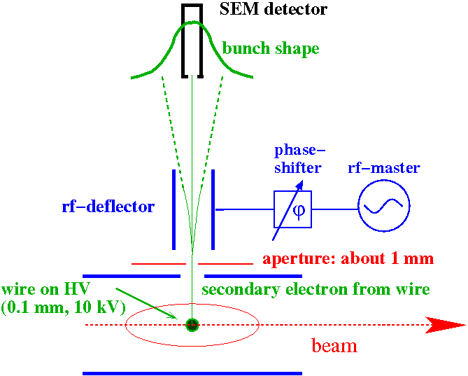

Bunch Structure using secondary Electrons for low E_{kin}Ions
Secondary e⁻ liberated from a wire carrying the time information.
→ Bunch Shape Monitor (BSM)
Working principle:
Insertion of a 0.1 mm wire at $U=$-10 kV
Emission of secondary e⁻ within $t≤10$ ps
→ accelerated toward an rf-deflector
rf-deflector as ’time-to-space’ converter
Detector behind a thin slit
Scanning method:
Shift of the phase ϕ for each macro-pulse
Resolution ≈ 10 ps ≈ 1º @ 280 MHz
SEM: Secondary Electron Multiplier

Slide 9
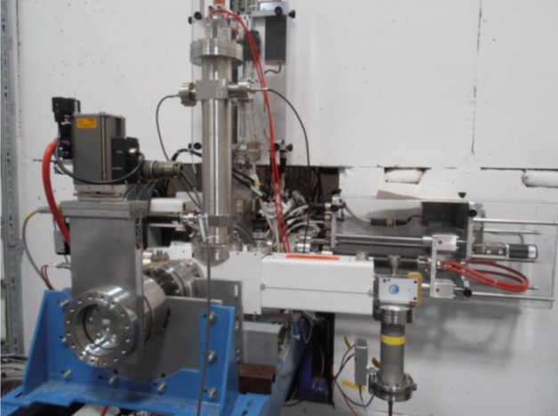
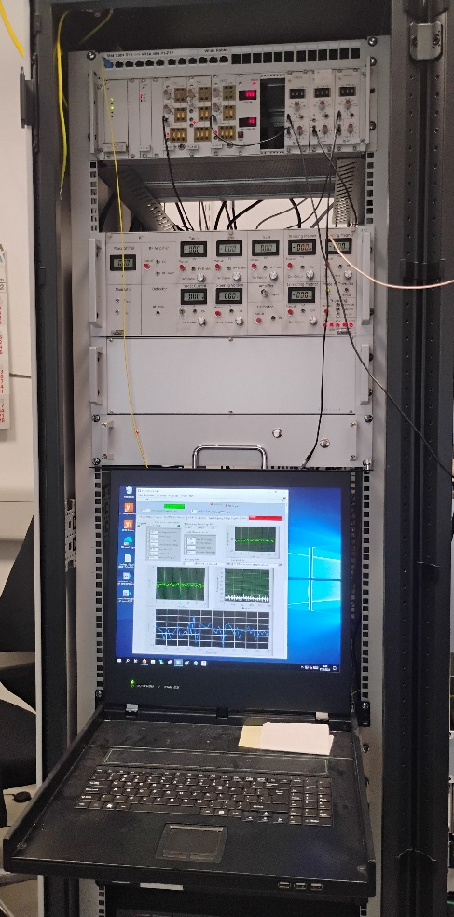
Realization of Bunch Shape Monitor at GSI
Installation of the three BSMs:
Presently: UN6 (HLI), X2, UCW (after cavities)
Planned: UT2, TK7, UCW (after cavities)
Installation at UCW:
Electronics
UNILAC BSM
lens HV /steerer
Installation at UCW
HELIAC (cwLINAC)
rf-pickup
rf-coupling
resonator housing
frequency tuner
viewing ports
target HV
CF63
µ metal
actuator
BEAM
magnets
~ 1m
e⁻ multiplier
Remark:
Insertion length in beam direction: 129 mm
Alignment with flange accuracy sufficient

Slide 10
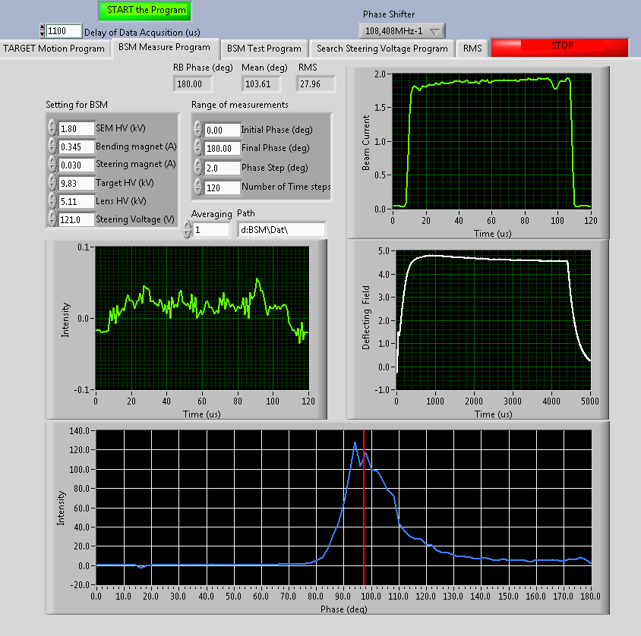
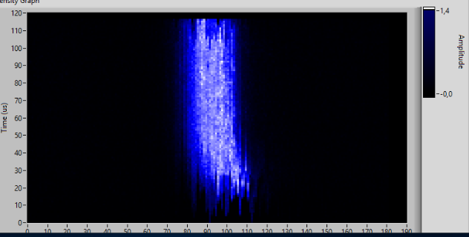


Bunch Shape Monitor: Graphical User Interface
Performant GUI:
Control of various monitor parameters
Bunch shape averaged over macro-pulse
Time resolved bunch with 1 µs steps
Control parameters
Scan range
Transformer
signal of
macro-pulse
Time [µs]
Phase $φ$[deg]
BSM signal of
macro-pulse
Control parameters
Bunch shape (entire macro-pulse)
10⁰@108MHz
=157 ps
Remarks:
BSM system responsible:
Thomas Sieber, Pere Forck (deputy)
Control parameters are fixed during measurements and are aligned by BEA members
Moreover, variation during macro-pulse → should be observed and interpreted !
Phase ϕ span 180⁰ = 4.6 ns

Slide 11
Gliederung
Messungen longitudinal Parameter:
Beispiele zur Simulation des longitudinaler Phasenraums
Generelles zur Bunch-Länger Messung am UNILAC
Monitor 1: Bunch Shape Monitor (BSM) von russischen Institut INR
Monitor 2: Fast Faraday Cup (FFC); Design vom amerikanischen Fermilab
Erste Ansätze zur Bestimmung des longitudinalen Emittanz
Vergleich von BSM und FFC
Zusammenfassung und Ausblick

Slide 12
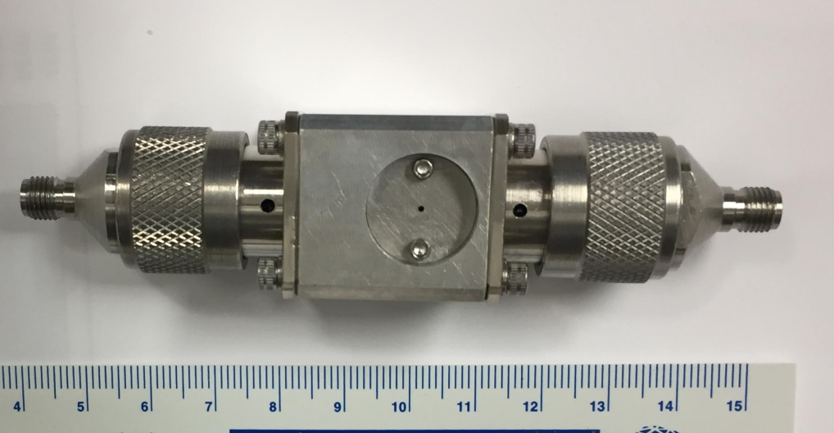
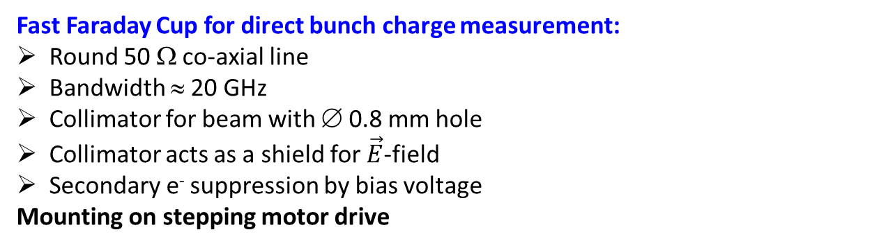
Fast Faraday Cup FFC for Bunch Shape Measurement
N- connector
Fast Faraday Cup for direct bunch charge measurement:
Round 50 Ω co-axial line
Bandwidth ≈ 20 GHz
Collimator for beam with ∅ 0.8 mm hole
Collimator acts as a shield for $\vec{E}$-field
Secondary e⁻ suppression by bias voltage
Mounting on stepping motor drive
∅0.8 hole for beam
N-connector
Electronics:
Commercial Bias-Tee (bandwidth 10 GHz)
Broadband amplifier
Fast oscilloscope with at least 8 GHz bandwidth
Time resolution:
61 ps for β = 5%
22 ps for β = 15%
Determined by:
Gap between inner&outer conductor
Electronics bandwidth
U_{bias}
Design at Fermilab (USA) by D. Sun & A. Shemyakin,
see J-P Camiero et al. Int. J. of Mod. Phys. A, vol. 34, no. 36, 2019

Slide 13
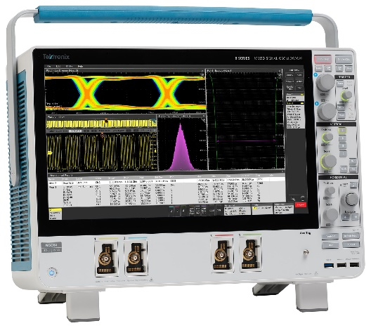
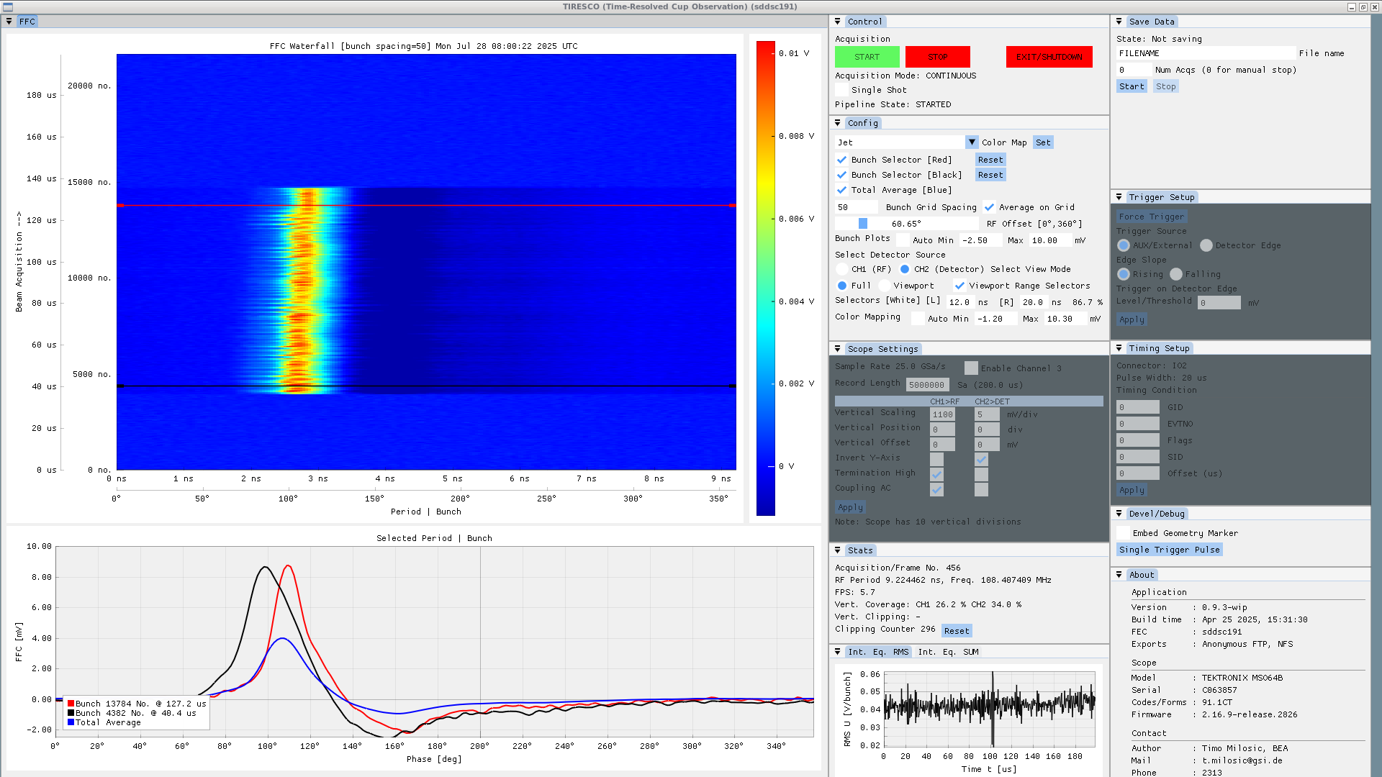
Fast Faraday Cup FFC: Graphical User Interface
FFC display with TIRESCO:
Readout of Tektronix scope MSO64B (6 GHz, 25 GS/s)
Bunch shape along macro pulse
Here: variation during macro-pulse
Average along macro pulse
Status:
Software by Timo Milosic
Almost finished
Bunch shape along macro-pulse
Phase ϕ span 360⁰ = 9.26 ns
Installation:
Presently:
UN6, UCW, US3, X2
Planned:
UN6, UCW, X2, US3, UT2, TK7
Broadband electronics and DAQ in preparation
Care: FFC might be destroyed by high beam power
Bunch shape
Integrated over macro-pulse
At time t₁ & t₂ during pulse

Slide 14
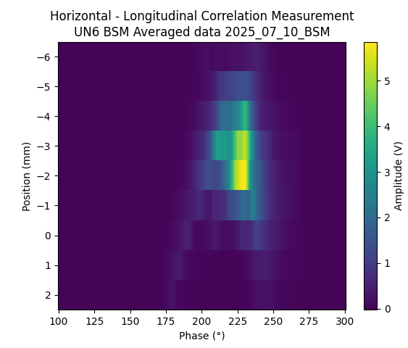
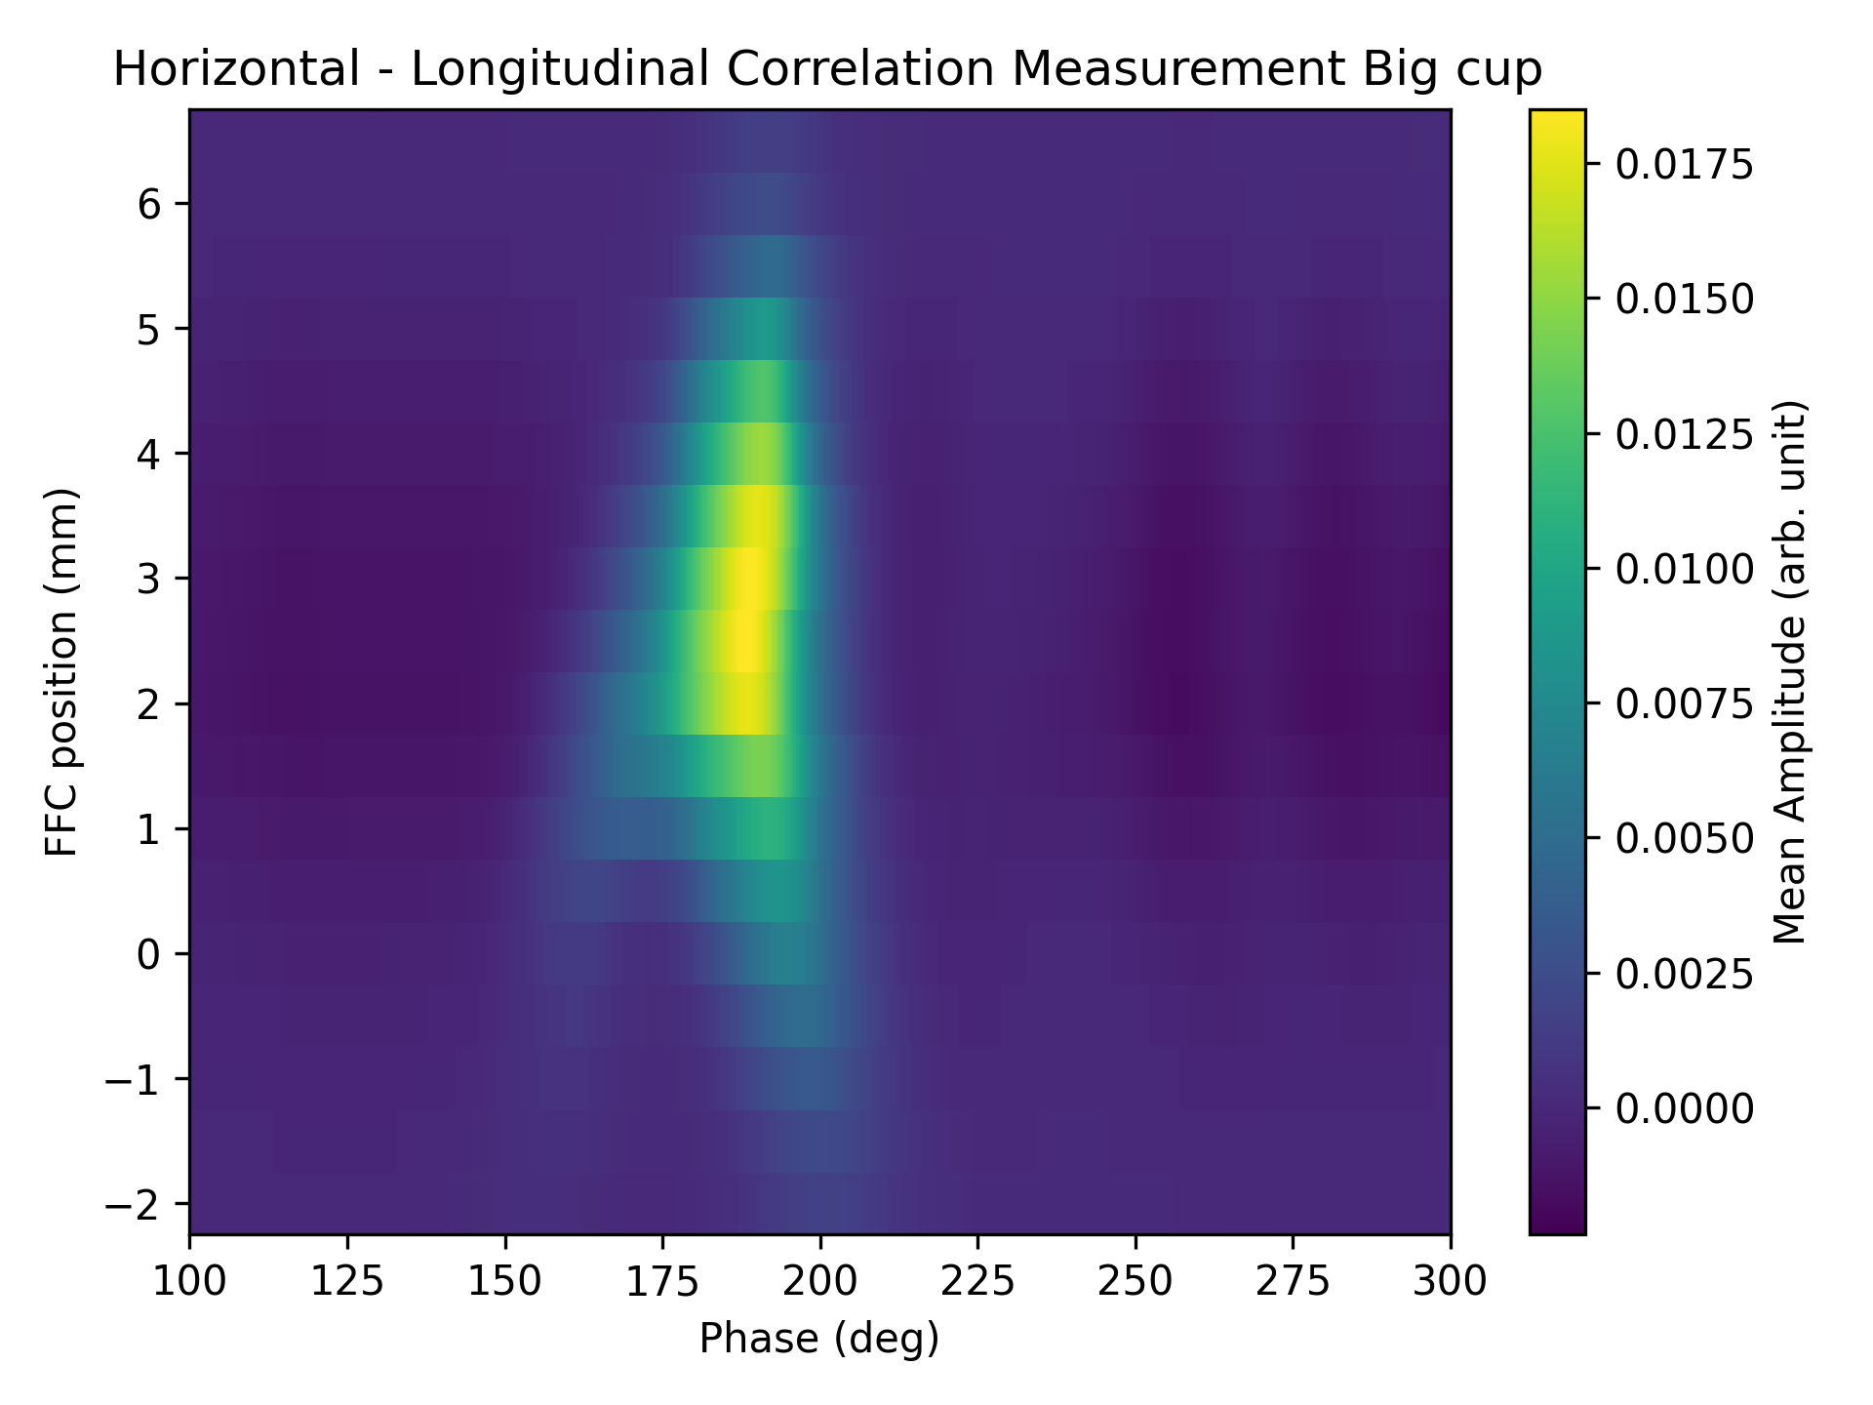
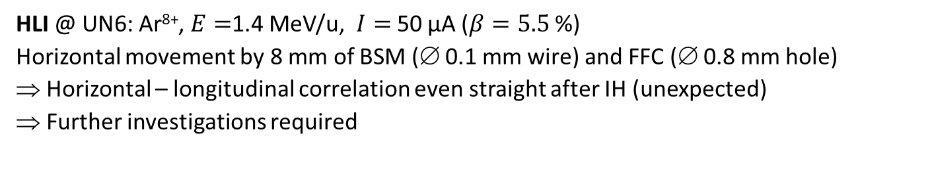
Comparison FFC and BSM, Bunch Shape Variation
HLI @ UN6: Ar⁸⁺, $E=$1.4 MeV/u, $I=$ 50 µA ($β=5.5$ %)
Horizontal movement by 8 mm of BSM (∅ 0.1 mm wire) and FFC (∅ 0.8 mm hole)
⇒ Horizontal – longitudinal correlation even straight after IH (unexpected)
⇒ Further investigations required
BSM
FFC
9 mm hori.
movement
Phase ϕ span 200⁰ = 5.14 ns
Phase ϕ span 200⁰ = 5.14 ns

Slide 15
Gliederung
Messungen longitudinal Parameter:
Beispiele zur Simulation des longitudinaler Phasenraums
Generelles zur Bunch-Länger Messung am UNILAC
Monitor 1: Bunch Shape Monitor (BSM) von russischen Institut INR
Monitor 2: Fast Faraday Cup (FFC); Design vom amerikanischen Fermilab
Erste Ansätze zur Bestimmung des longitudinalen Emittanz
Vergleich von BSM und FFC
Zusammenfassung und Ausblick

Slide 16
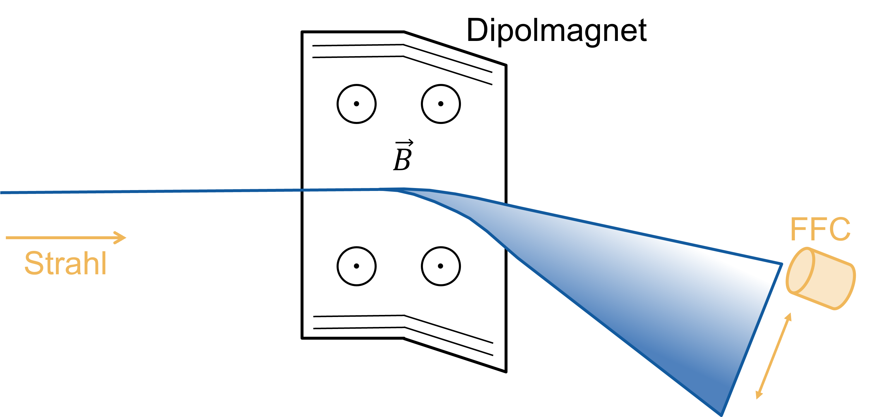
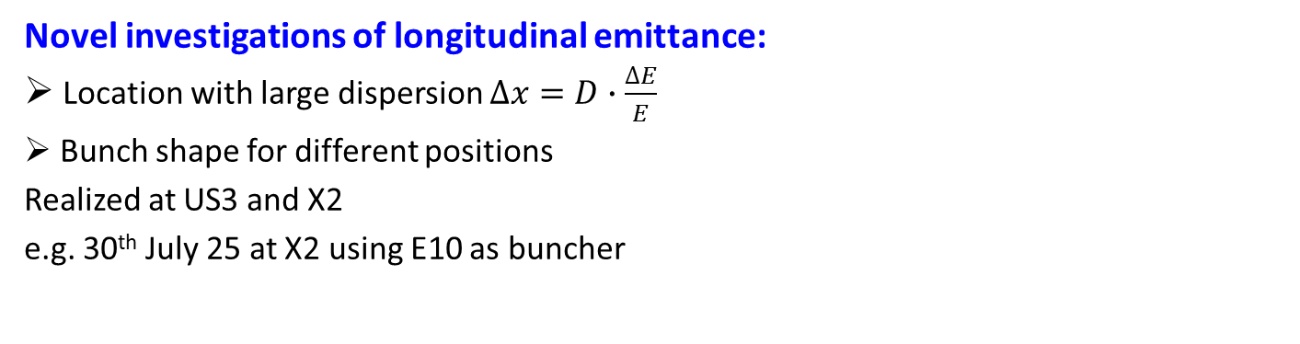
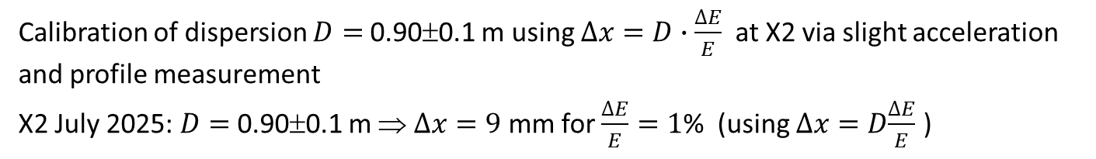
Idea for longitudinal Emittance Measurement
Novel investigations of longitudinal emittance:
Location with large dispersion $∆x=D∙\frac{∆E}{E}$
Bunch shape for different positions
Realized at US3 and X2
e.g. 30th July 25 at X2 using E10 as buncher
Calibration of dispersion $D=$0.90±0.1 m using $∆x=D∙\frac{∆E}{E}$ at X2 via slight acceleration and profile measurement
X2 July 2025: $D=$0.90±0.1 m ⇒ $∆x=9$ mm for $\frac{∆E}{E}=1$% (using $∆x=D\frac{∆E}{E}$ )
N. Schmidt et al, IBIC’25 & Master Thesis

Slide 17
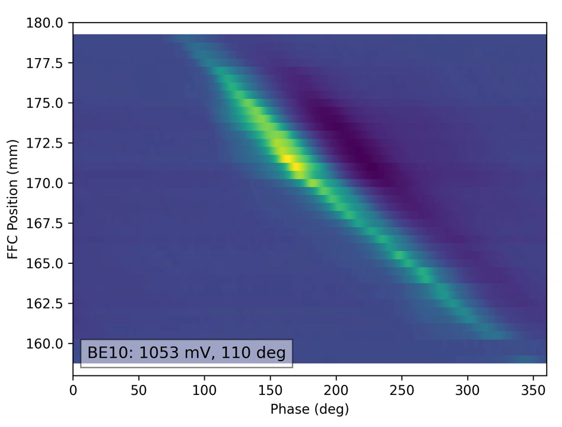
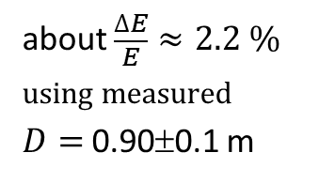
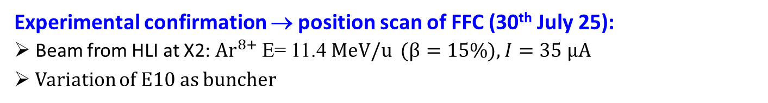
Idea for longitudinal Emittance Measurement
Experimental confirmation → position scan of FFC (30th July 25):
Beam from HLI at X2: $Ar^{8+}$E= 11.4 MeV/u ($β=15\%$), $I=35$ µA
Variation of E10 as buncher
about $\frac{∆E}{E}$ $≈2.2 \%$
using measured
$D=$0.90±0.1 m
Result:
Method is appropriate
Dispersion measurement by energy variation and SEM-grid detection
Strong deformation of longitudinal phase space
Evaluation is ongoing
Phase ϕ span 360⁰ = 9.25 ns

Slide 18
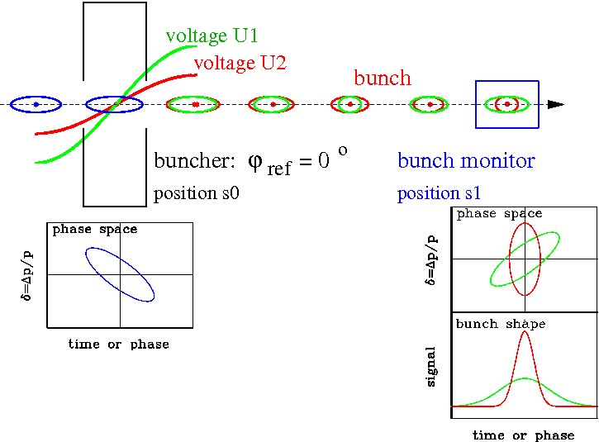
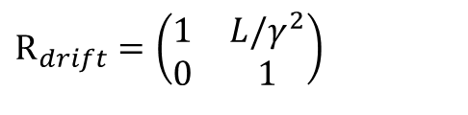
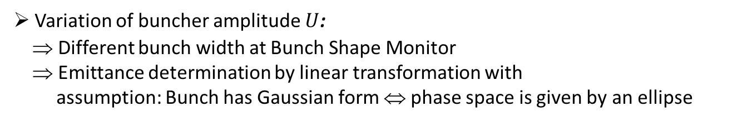

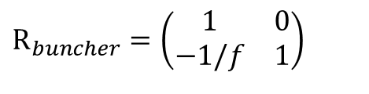
Long. Emittance by linear Transformation using a Buncher
Longitudinal focusing:
Variation of the bunch shape by a rf-buncher
→ components 5 and 6 from 6-dim phase-space
Transversal correspondence:
Quadrupole variation
➢ Transfer matrix of buncher & drift:
$$R_{buncher}=\left(\begin{matrix}1 & 0 \\ −1/f & 1\end{matrix}\right)$$
$${\text{R}}_{drift}=\left(\begin{matrix}1 & L/γ^{2} \\ 0 & 1\end{matrix}\right)$$
with focal length $\frac{1}{f}=\frac{2πf_{rf}}{Apv^{2}}⋅U$
➢ Variation of buncher amplitude $U$:
⇒ Different bunch width at Bunch Shape Monitor
⇒ Emittance determination by linear transformation with
assumption: Bunch has Gaussian form ⇔ phase space is given by an ellipse

Slide 19
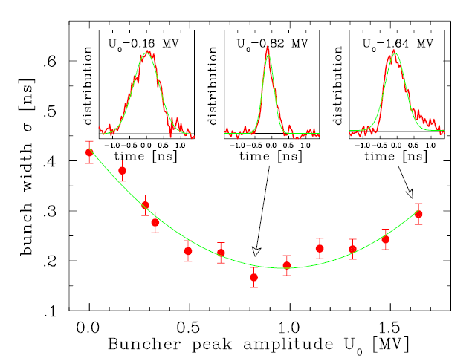
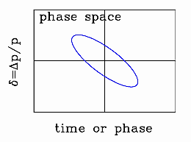
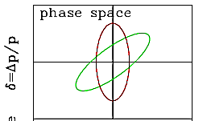

Result of a longitudinal Emittance Measurement
Example UNILAC-TK5: Voltage variation at E10 for 11.4 MeV/u Ni¹⁴⁺ beam, 31 m drift:
This example: The resolution is better
than 50 ps or 2º for 108 MHz
Typical bunch length at proton LINACs:
σ_{bunch} ≈ 0.1 to 0.5 ns
Determination of longitudinal emittance possible
However: Bunch has non-Gaussian shape!
Application for synchrotron injection:
Shaping of longitudinal phase space by buncher
i.e. long bunches ⇔ low momentum spread
to match to the synchrotron long acceptance
multi-turn
injection
p synchrotron
de-bunched
source
Bunch Shape Monitor
Buncher
BSM
RFQ
LINAC
B.
injection
extraction

Slide 20
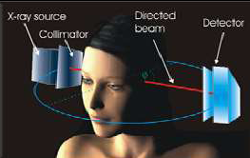
Longitudinal Emittance using tomographic Reconstruction
Tomography: Generation of a n-dim image
from many lower-dim projections
Medical application: 2-dim reconstruction using sufficient 1-dim projections
1st back-
projection
original object
Iterative projection
& back-projection
after sufficient
iterations
Filtered back projection:
Iterative process by redistributing
the 2-dim image and considering the
differences to the previous iteration step.

Slide 21
Longitudinal Profile & Emittance: Tomographic Reconstruction
Example GSI HLI: Voltage variation at buncher for 1.4 MeV/u Ar⁹⁺ beam
Measurement examples with BSM
for different buncher settings using ‘Non-Negative Least Square’ solver including space charge
Reconstruction at HLI output
Measurement
at BSM
$\frac{∆E}{E}$ span 0.8 %
Phase ϕ span 200⁰ = 5.1 ns
Result:
Non-regular phase-space distributions are recovered.
Phase ϕ span 72⁰ = 1.85 ns
source
Bunch Shape Monitor
Buncher
RFQ
LINAC
B.
BSM
S. Lauber et al., Phys. Rev. Accel. Beams, 23, 114201 (2020)

Slide 22
Gliederung
Messungen longitudinal Parameter:
Beispiele zur Simulation des longitudinaler Phasenraums
Generelles zur Bunch-Länger Messung am UNILAC
Monitor 1: Bunch Shape Monitor (BSM) von russischen Institut INR
Monitor 2: Fast Faraday Cup (FFC); Design vom amerikanischen Fermilab
Erste Ansätze zur Bestimmung des longitudinalen Emittanz
Vergleich von BSM und FFC
Zusammenfassung und Ausblick

Slide 23
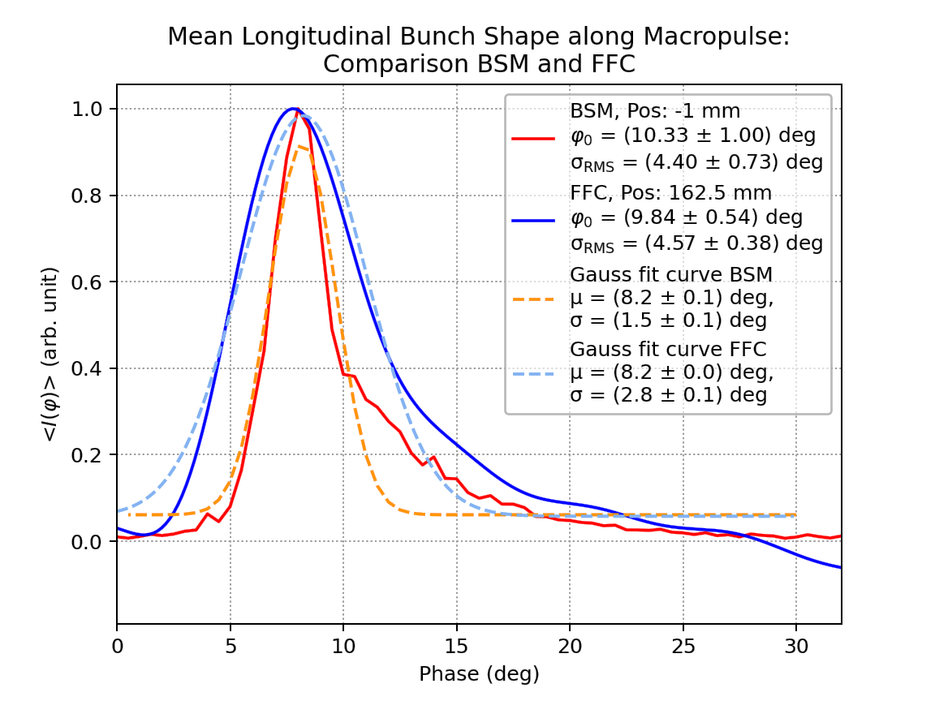
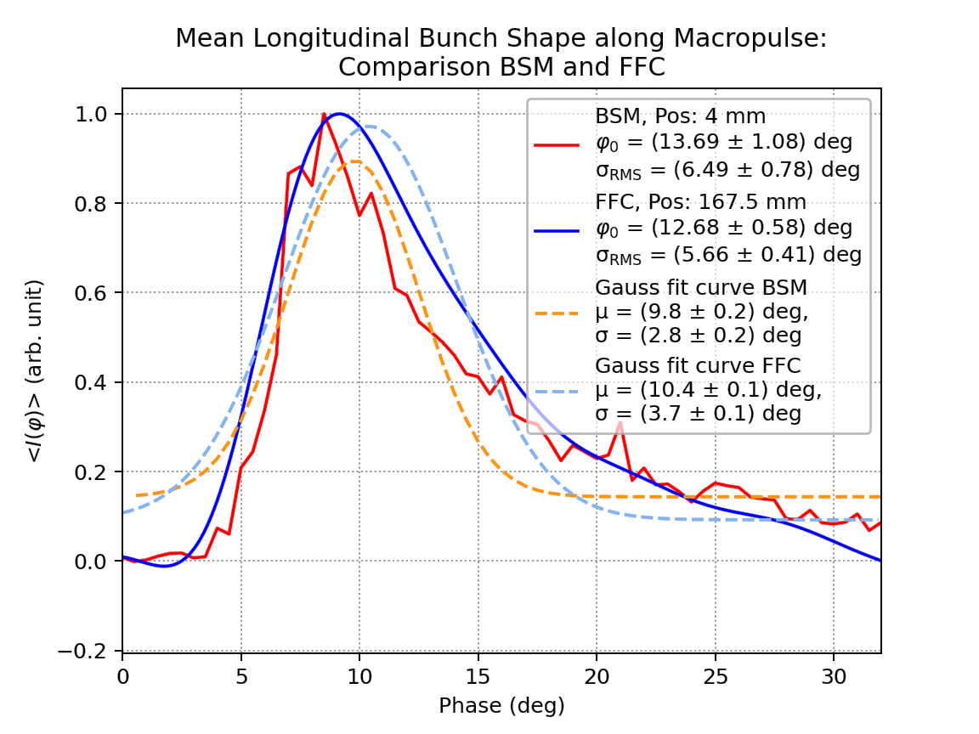
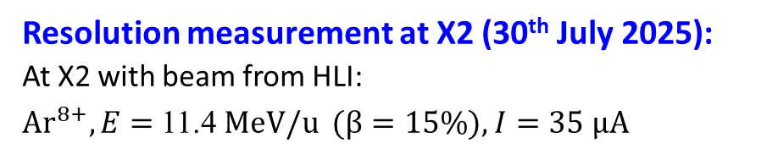
Comparison FFC and BSM
Resolution measurement at X2 (30th July 2025):
At X2 with beam from HLI:
$Ar^{8+}, E=$11.4 MeV/u ($β=15\%$), $I=35$ µA
FFC
Interpretation:
BSM & FFC can be used for measurement
BSM: - Better resolution (about ≈ 1⁰ = 25 ps)
- Long measurement time due to scan
FFC: - Less resolution (about ≈ 5⁰ = 125 ps)
depending on electronics & cable bandwidth
- Fast measurement within one macro-pulse
Applications:
FFC → Fast information during operation
BSM → Precise measurement
Goal: Tomographic reconstruction etc.
BSM
Centre of beam→ short bunch
Phase ϕ span 32⁰ = 0.82 ns
FFC
BSM
Side of beam → long bunch
Phase ϕ span 32⁰ = 0.82 ns

Slide 24
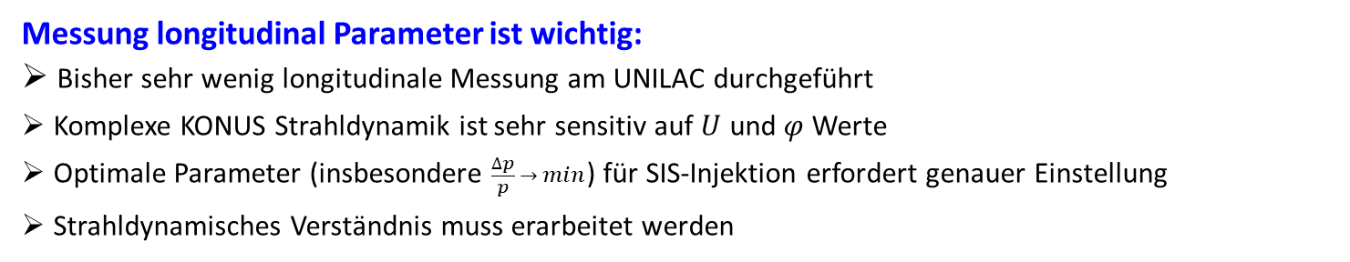
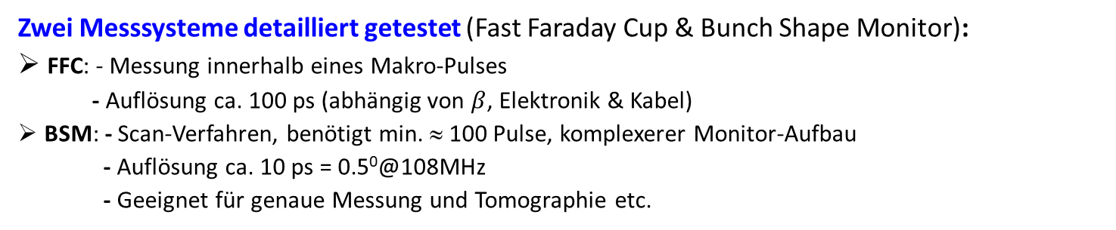
Zusammenfassung und Ausblick
Messung longitudinal Parameter ist wichtig:
Bisher sehr wenig longitudinale Messung am UNILAC durchgeführt
Komplexe KONUS Strahldynamik ist sehr sensitiv auf $U$ und $φ$ Werte
Optimale Parameter (insbesondere $\frac{∆p}{p} → min$) für SIS-Injektion erfordert genauer Einstellung
Strahldynamisches Verständnis muss erarbeitet werden
Zwei Messsysteme detailliert getestet (Fast Faraday Cup & Bunch Shape Monitor):
FFC: - Messung innerhalb eines Makro-Pulses
- Auflösung ca. 100 ps (abhängig von $β$, Elektronik & Kabel)
BSM: - Scan-Verfahren, benötigt min. ≈ 100 Pulse, komplexerer Monitor-Aufbau
- Auflösung ca. 10 ps = 0.5⁰@108MHz
- Geeignet für genaue Messung und Tomographie etc.
Einbau:
FFC: UN6, UCW, US3, UT2, TK7oder 8, X2
BSM: 3 Monitore vorhanden;
bisher: UN6, UCW, X2; zukünftig: UCW, UT2, TK7 oder 8 (parallel zu FFC)
Tests durch LINAC- und BEA-Team in 2026 bei Engineering Runs & Operation bei Bedarf
Bemerkung: Variationen über den Makro-Puls detektiert; dies ist auch bei den Phasensonden sichtbar
(passender GUI wird hoffentlich installiert) ⇒ bitte im Operating beobachten.
Vielen Dank für die Aufmerksamkeit. Gibt es Fragen & Bemerkungen?

Slide 25
Back-up slides

Slide 26
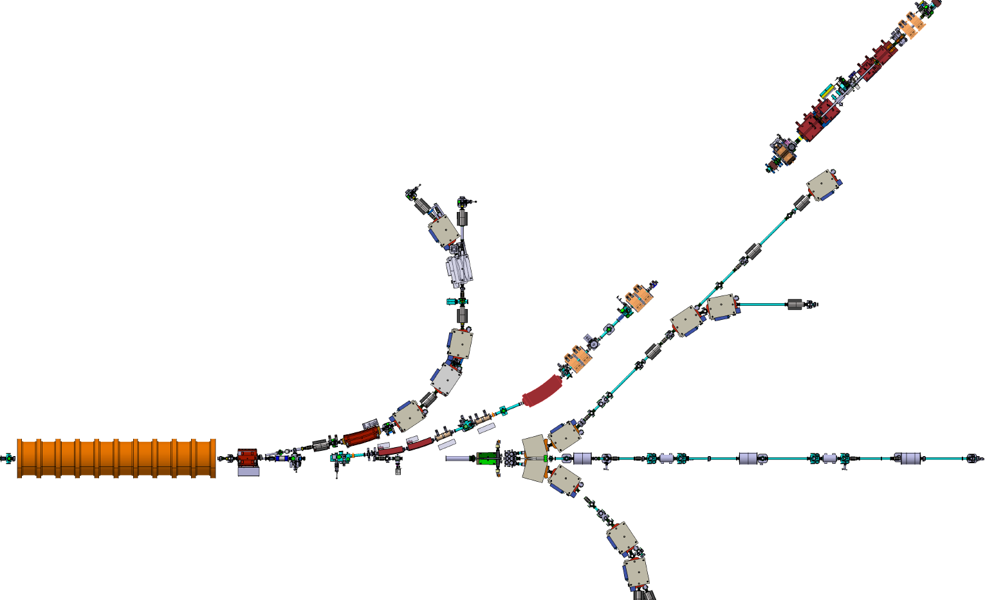
BSM at GSI, current situation:
3 BSM at GSI: UNILAC- (2017, 108, 216, 325 MHz); cw- (2020, 108 MHz), pLinac- (2020, 325 MHz)
UNILAC and cw-BSM frequently (and currently) in operation at HLI/HELIAC
Recommendation 22/23 (MAC / Technical Integtration Team) to investigate UNILAC longitudinal beam properties (BSM +FFC) → meeting LIN + BEA → install two BSM in UNILAC+TK
pLinac BSM (after commissioning at HLI) modified to 216 MHz and tested in X2
Locations and measurements
Installation at UT1 (pLinac BSM) and TK8 (UNILAC BSM) to investigate beam behind UE1 and TK debuncher (SIS18 injection optimization)
Longitudinal emittance studies by reproduction technique
Investigate effect of bunch shift during macropulse in X2
Investigate position dependent bunch shape (including FFC measurement)
BSM 2 (+FFC)
108.408 MHz
TK8
UNILAC
Single gap
resonators
BSM 1 (+FFC)
216.816 MHz
UT1
To M- caves
Notes:
26

Slide 27
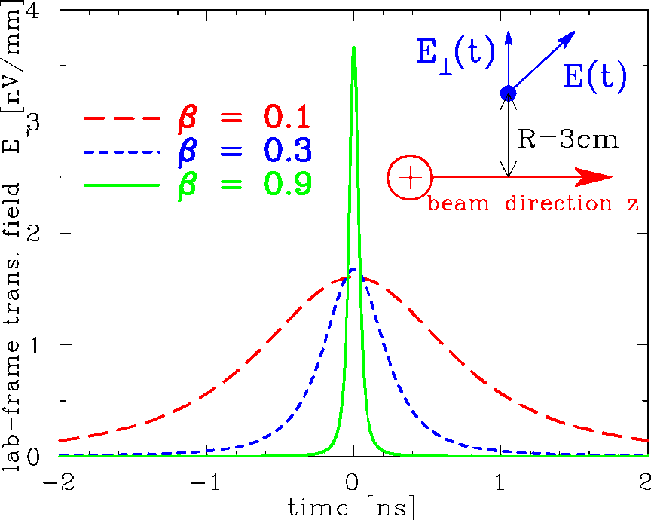
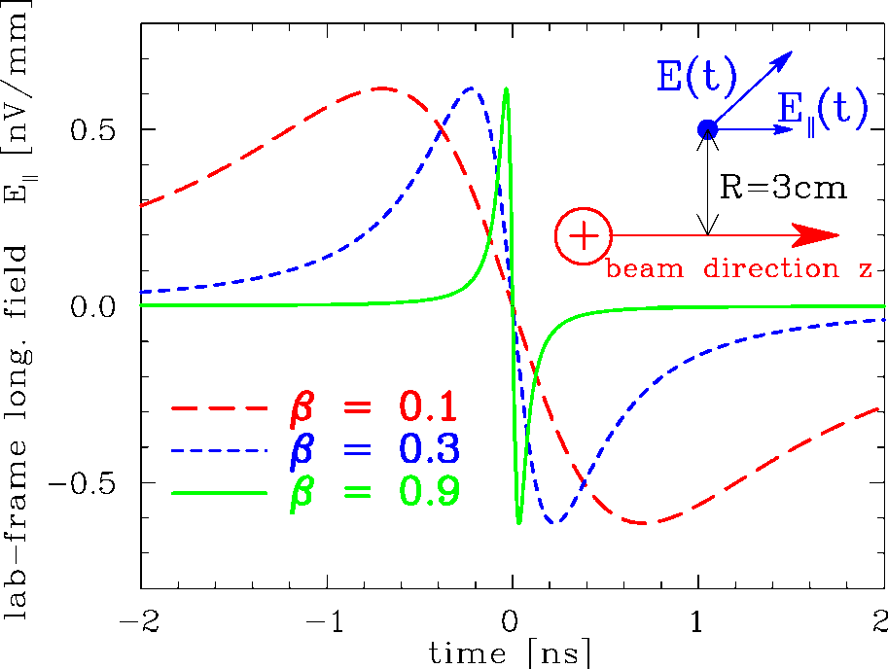
Low Velocity Effect: General Consideration
Lorentz transformation of single point-like charge:
Lorentz boost and transformation of time:
Trans. E⊥lab.-frame of a point charge:
Long. E|| lab.-frame of a point charge:

Slide 28
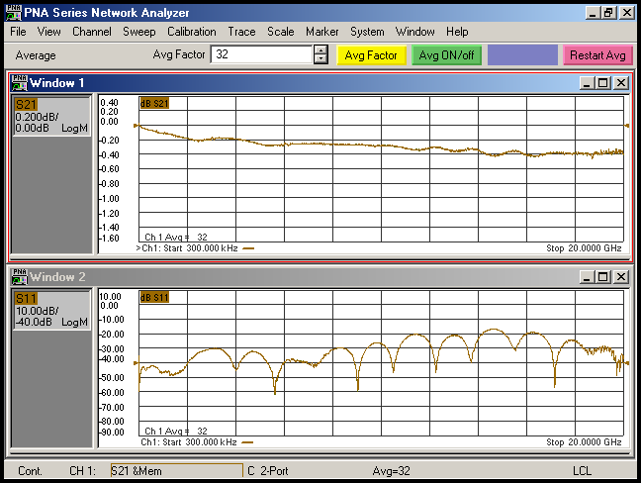
Fast Faraday Cup FFC Bandwidth
Fast Faraday Cup for direct bunch charge measurement:
Round 50 Ω co-axial line
Bandwidth ≈ 20 GHz
U_{bias}
Design at Fermilab (USA) by D. Sun & A. Shemyakin,
see J-P Camiero et al.
Int. J. of Mod. Phys. A, vol. 34, no. 36, 2019

Slide 29
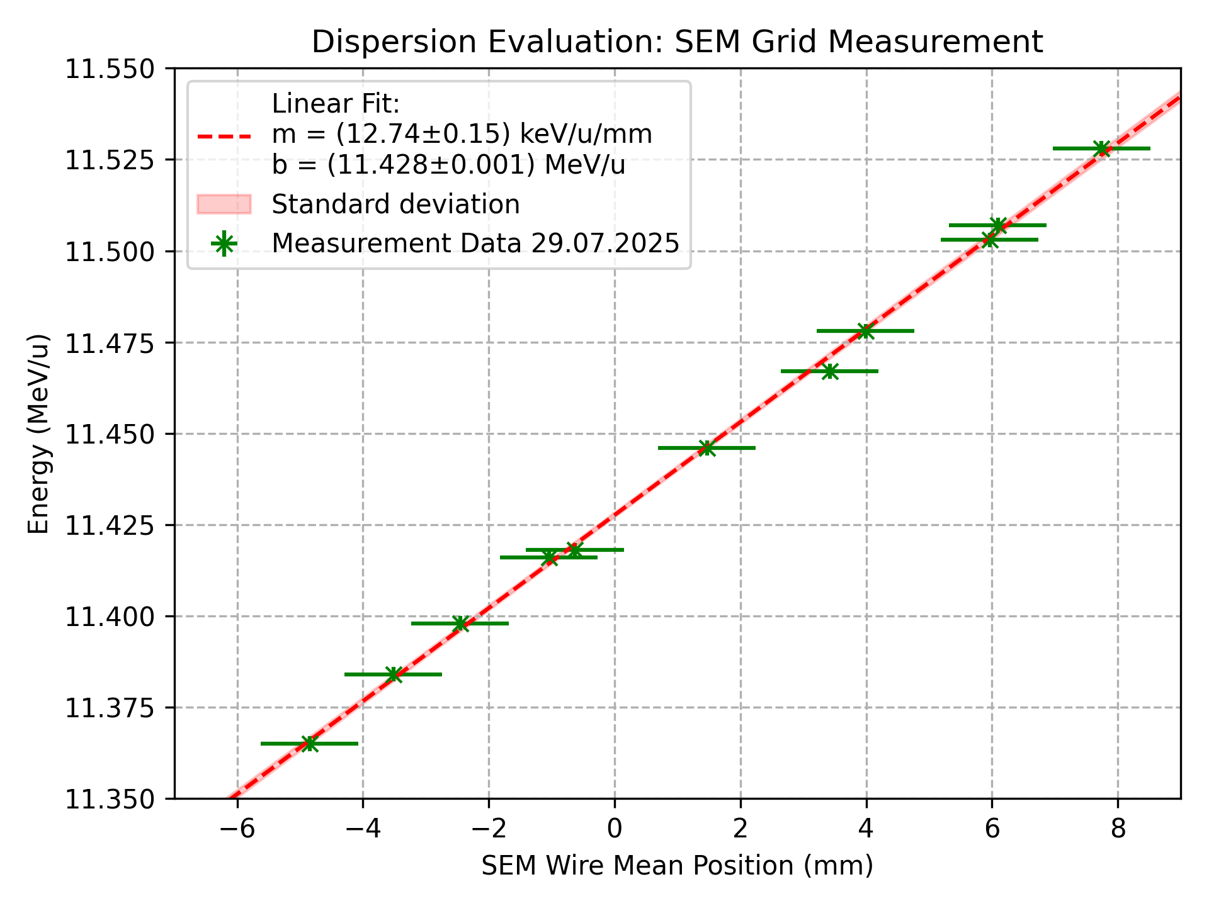
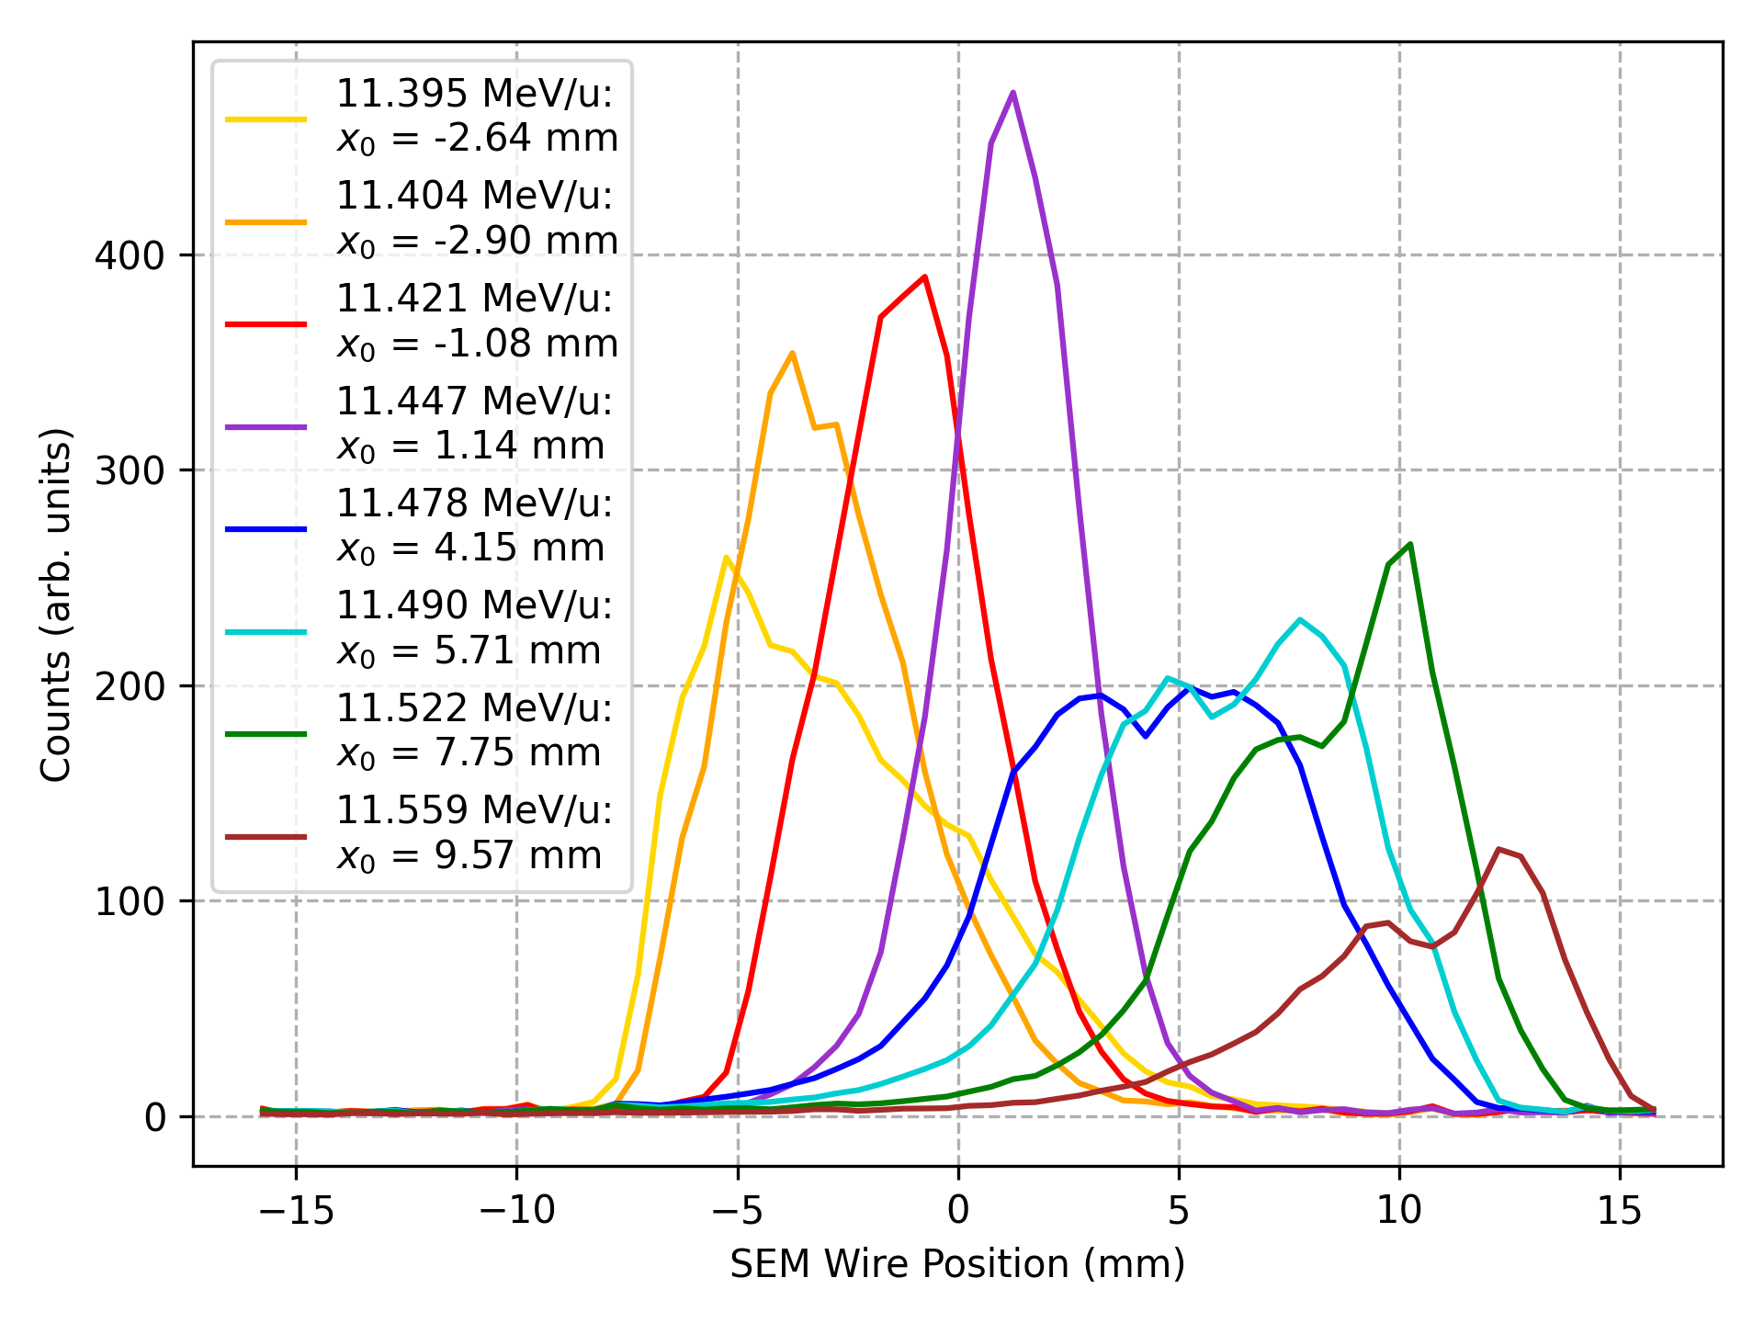
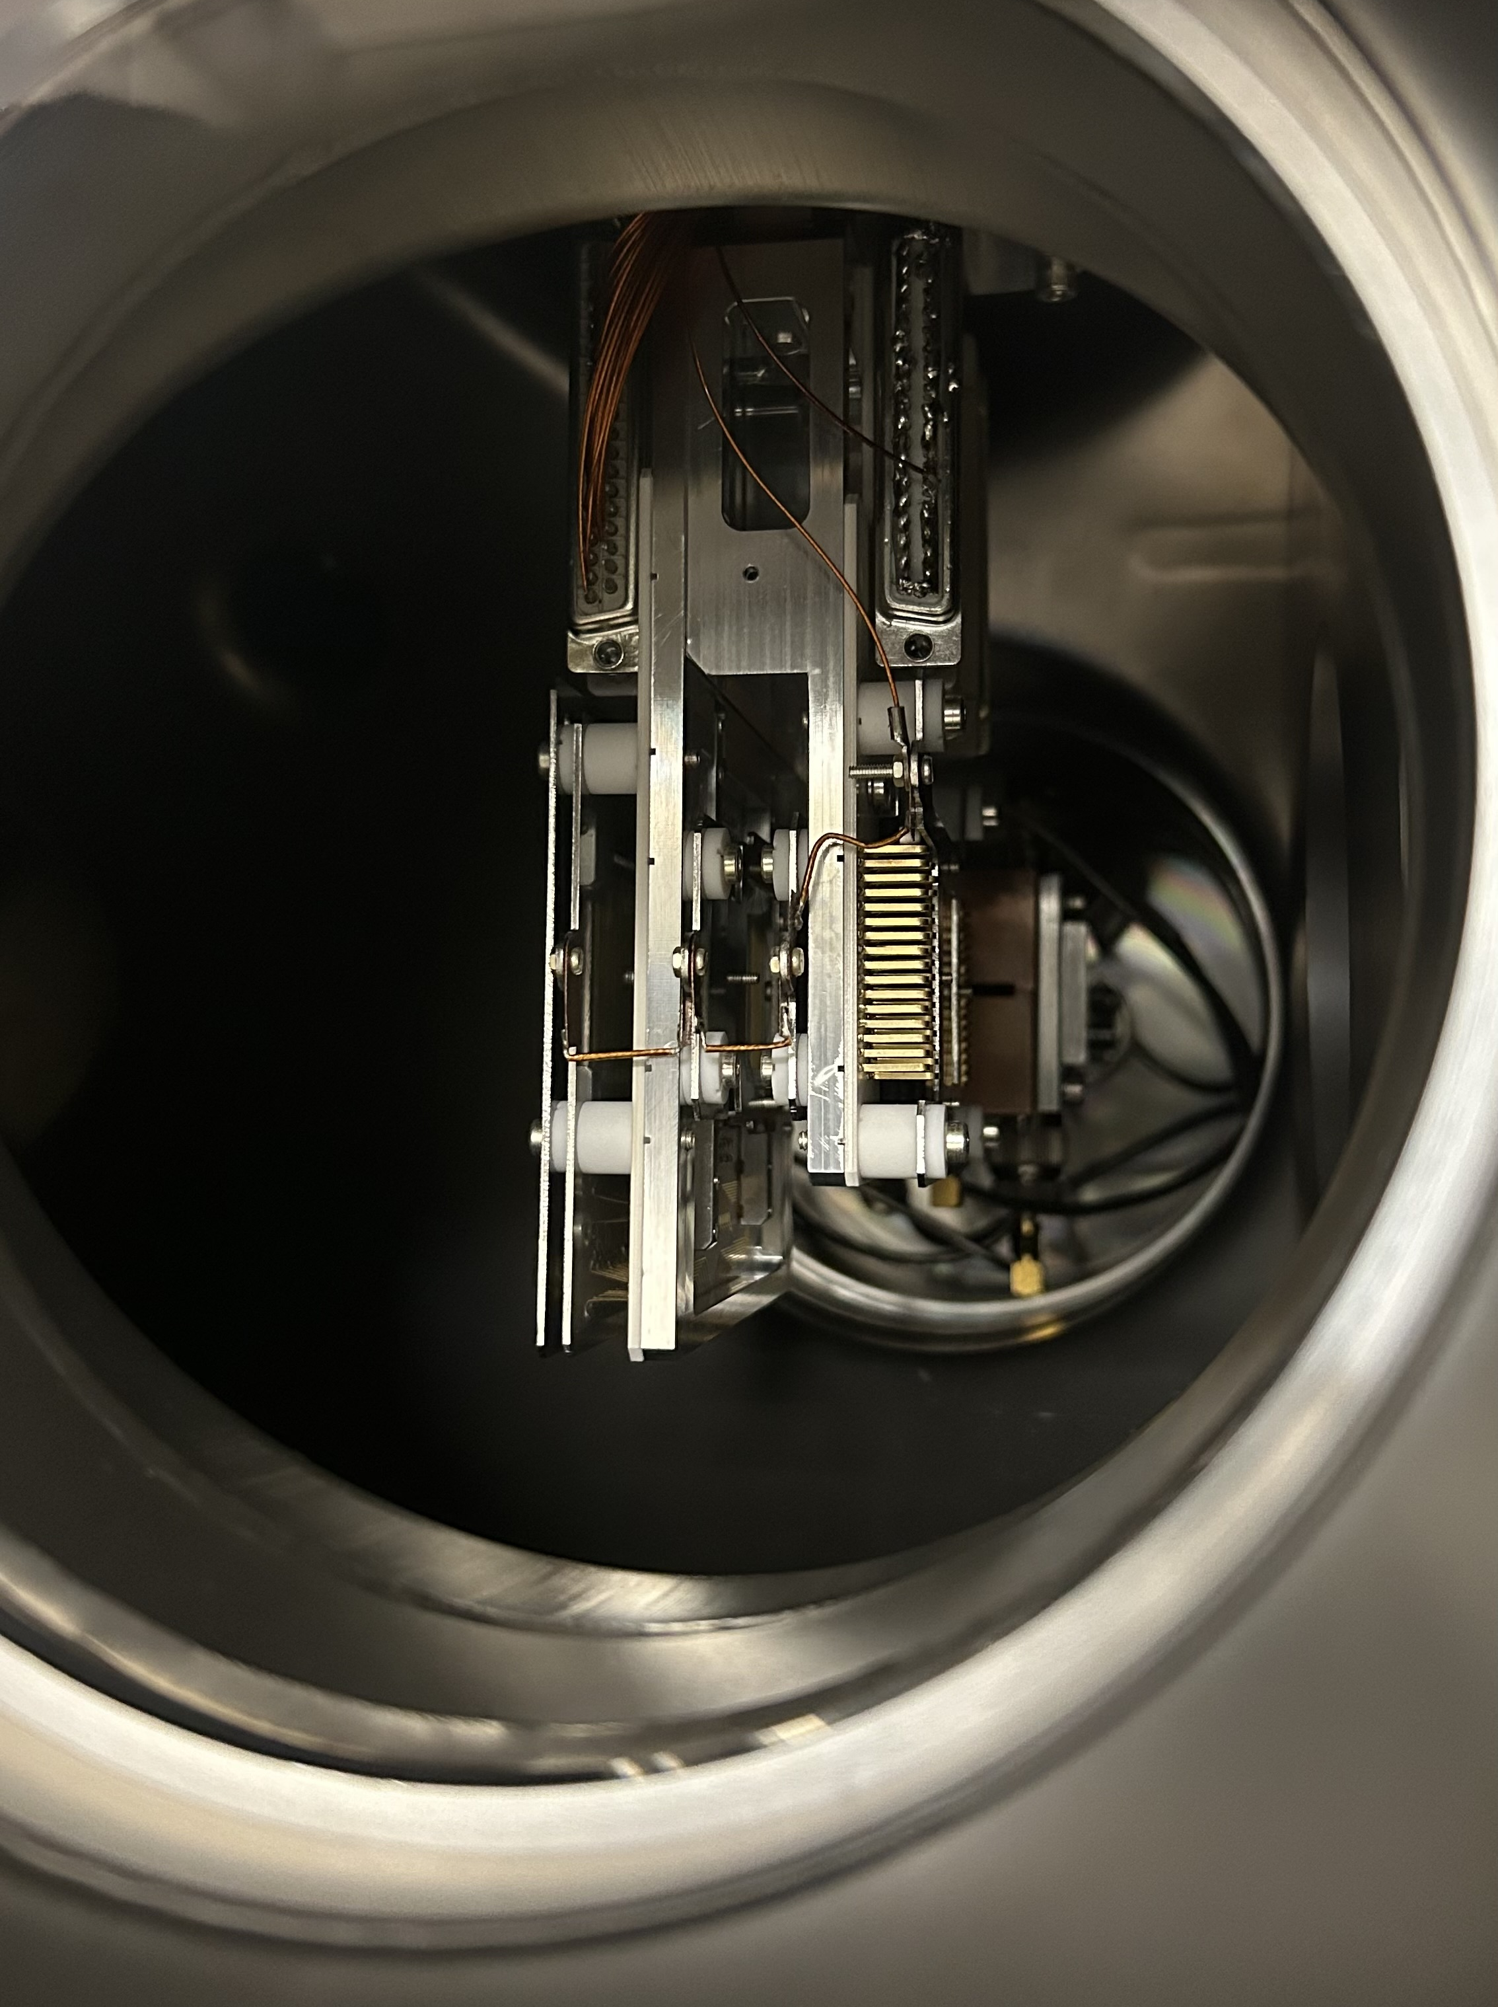

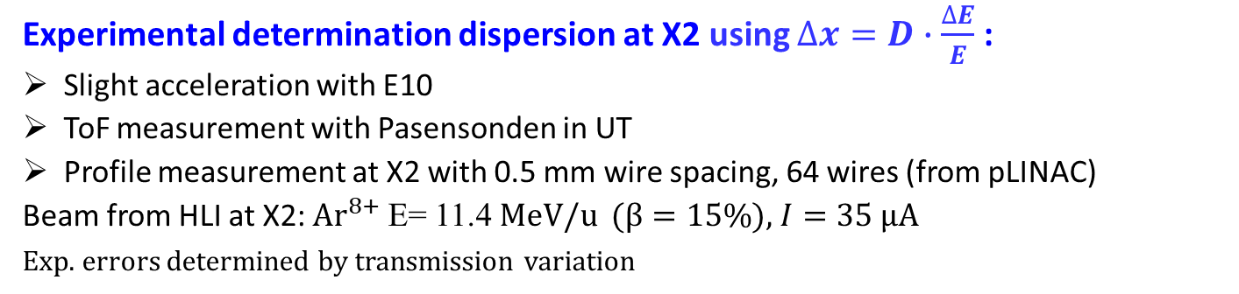
Measurement of Dispersion at X2
Experimental determination dispersion at X2 using $∆x=D∙\frac{∆E}{E}$ :
Slight acceleration with E10
ToF measurement with Pasensonden in UT
Profile measurement at X2 with 0.5 mm wire spacing, 64 wires (from pLINAC)
Beam from HLI at X2: $Ar^{8+}$E= 11.4 MeV/u ($β=15\%$), $I=35$ µA
Exp. errors determined by transmission variation
$D=$0.90±0.1 m
SEM-grid described at: Juan Herranz et al., IBIC‘22

Slide 30

Longitudinal Profile & Emittance: Tomographic Reconstruction
Example GSI LINAC: Voltage variation at buncher for 1.4 MeV/u Ar⁹⁺ beam
Arbitrary phase space shapes can be recovered by reconstruction techniques (within some uncertainty)
Phase space at buncher in discrete areas with m grid points ${\vec{X}}_{in}$ with intensities $I_{in}$ → called mapping
With particle tracking codes transferred to BSM $f_{i}\left({\vec{X}}_{in}\right)$ for different buncher setting $i$
Projection to time axis $A_{i}\left(φ, {\vec{X}}_{in}\right)$ for all buncher setting $i$ to form a vector $\vec{A}= {\left(A_{1}, A_{2}…A_{n}\right)}^{t}$
⇒ Can be interpreted as vector-matrix equation $\vec{A}=B ∙ \vec{X}$
Matrix $B$ of dimension (n x m) = length of all phases $\sum_{i=1}^{n}{φ_{i}}$ x number of grid points m
resolution for phases $φ$: 100 , number of measurement: $i=50$ ⇒ n = 5000
Best fit by minimizing $\left|B\vec{X}− {\vec{A}}_{meas}\right| →min$ for the best phase space distribution $\vec{X}$
by Non-Negative Least Square
(NNLS) method
source
Bunch Shape Monitor
Buncher
RFQ
LINAC
B.
BSM
S. Lauber et al., Phys. Rev. Accel. Beams, 23, 114201 (2020)
Phase φ

Slide 31
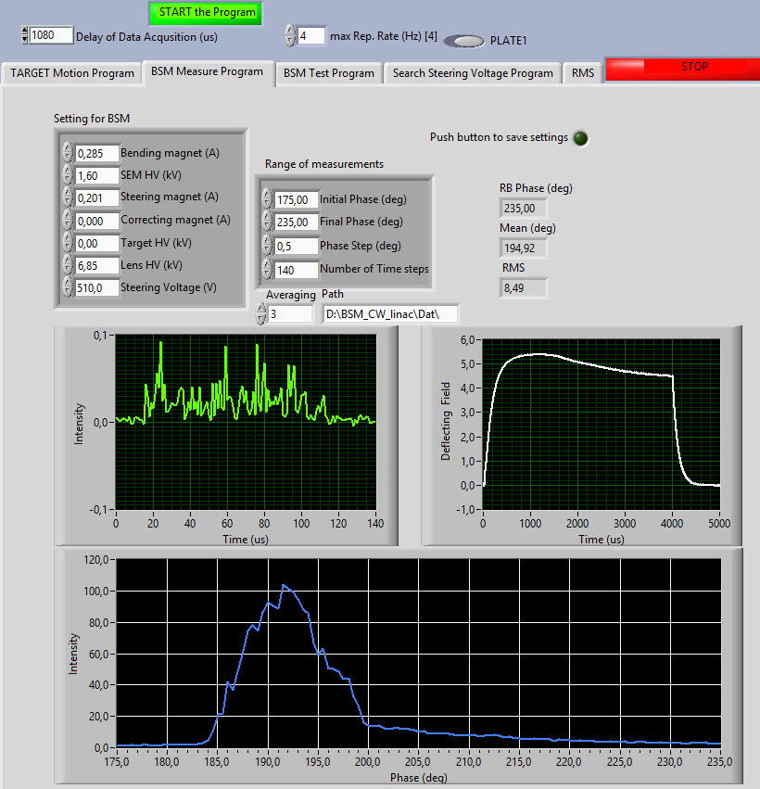
Bunch Shape Monitor: Graphical Unser Interface
Performant GUI:
Control of various monitor parameters
Bunch shape averaged over macro-pulse
Time resolved bunch with 1 µs steps
Control parameters
Scan range
Time [µs]
Phase $φ$[deg]
Signal of
macro-pulse
Control parameters
Bunch shape (entire macro-pulse)
5⁰ @ 108MHz=129 ps
Remarks:
BSM system responsible:
Thomas Sieber, Pere Forck (deputy)
Control parameters are fixed during
measurements and are aligned by BEA members
Phase ϕ span 60⁰ = 1.54 ns

Slide 32
Longitudinal Profile & Emittance: Algebraic Reconstruction
Example GSI HLI: Voltage variation at buncher for 1.4 MeV/u Ar⁹⁺ beam
Measurement examples with BSM
for different buncher settings:
Measurement at BSM
Example
Nr. 1
Measurement
at BSM 2
Example
Nr. 2
Phase ϕ span 200⁰ = 5.1 ns
Example
Nr. 3
Result: Non-regular phase-space distributions recovered
Test by changing Buncher 2 ⇒ trustful reconstruction
source
Buncher
Bunch Shape Monitor
RFQ
LINAC
B.1
B.2
BSM 2
S. Lauber et al., Phys. Rev. Accel. Beams, 23, 114201 (2020)

