Slide 1
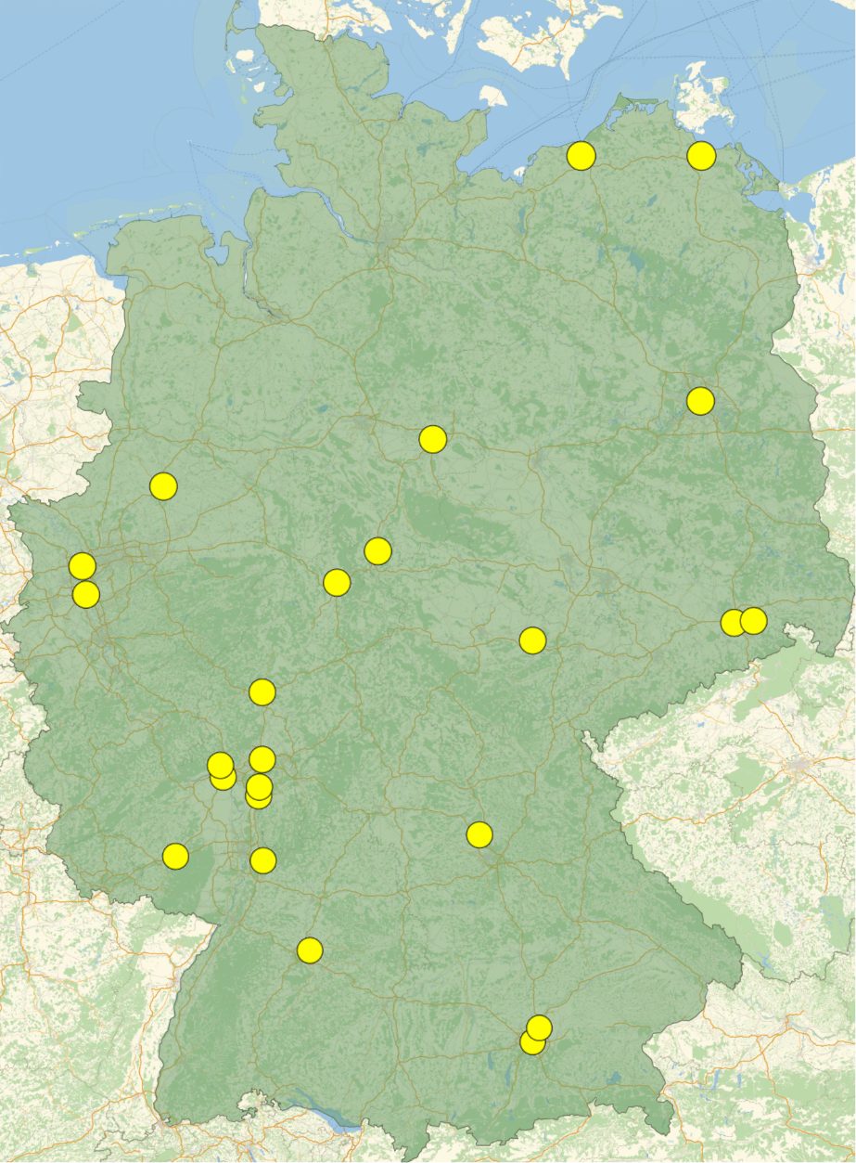











ErUM-FSP T05 “Aufbau von APPA bei FAIR”
Annual Meeting 2026
U Greifswald
U Rostock
Upcoming Events
2025 Intermediate Report
Funding Period 2027-2030
Outreach
Next Annual Meeting
AOB
HU Berlin
U Münster
TU Braunschweig
U Duisburg-Essen
U Göttingen
TU Dresden
U Düsseldorf
U Kassel
HI Jena
U Jena
HZDR
U Gießen / THM
HS Rhein-Main
U Frankfurt
U Mainz
HI Mainz
FAIR / GSI
TU Darmstadt
MPIK
U Erlangen-Nürnberg
TU Kaisers-
lautern
U Heidelberg
U Stuttgart
TU München
U München
not all universities applied for funding

Slide 2
Upcoming Events
26 – 30 January, 46th International Workshop on Physics of High Energy Density in Matter (Hirschegg/Germany)
01 February, Deadline for proposals using beams from the CRYRING local injector
18 – 19 February, BMFTR Strategy Meeting (Hamburg/Germany)
22 – 23 March, Workshop on Physics in the APPA Cave (GSI)
30 April, Deadline for report (Zwischenbericht) to BMFTR
07 – 11 September: 22nd (Huizhou/China)
11 – 13 September: 23rd Topical SPARC Workshop (Huizhou/China)
10 – 11 December: KHuK-Meeting (Bad Honnef/Germany)
21 – 22 January 2027: Next Annual Meeting of the ErUM-FSP APPA (GSI)

Slide 3
Report to BMBF “Zwischenbericht 2025”
Deadline: 30 April 2026
Individual reports, one per grant number (FKZ)
Report on activities in 2025
For instructions see
https://pt.desy.de/fuer_zuwendungsempfaenger/index_ger.html
Common report to be prepared by the FSP spokesperson
  I will ask for your input

Slide 4
BMBF Funding of German University Groups
ErUM-FSP T05 –
„Aufbau von APPA bei FAIR“
U Greifswald
U Rostock
HU Berlin
SPARC, HED@FAIR (2024-2027)
11 projects funded (31 asked for)
4.7 M€ (14 M€ asked for)
U Münster
TU Braunschweig
U Duisburg-Essen
U Göttingen
TU Dresden
U Düsseldorf
U Kassel
HI Jena
U Jena
HZDR
U Gießen / THM
HS Rhein-Main
U Frankfurt
U Mainz
HI Mainz
FAIR / GSI
TU Darmstadt
MPIK
U Erlangen-Nürnberg
TU Kaisers-
lautern
U Heidelberg
SPARC, HED@FAIR (2021-2024)
13 projects funded
7.5 M€
U Stuttgart
TU München
U München
Funds reduced by 24%!
not all universities applied for funding

Slide 5
BMBF Funding 2024-2025 for „Smallest Particles“
Total: 100 M€

Slide 6
Seven SPARC Projects in 2024-2027
Development and application of laser-based methods at HITRAP, CRYRING, and ESR
Technische Universität Darmstadt (Wilfried Nörterhäuser)
Development and application of laser-based methods at HITRAP, CRYRING, and ESR
Technische Universität Dresden (Ulrich Schramm, Michael Bußmann)
Electron-ion collision spectroscopy of highly-charged heavy ions at the FAIR storage rings
Justus-Liebig-Universität Gießen (Stefan Schippers)
Integration of a VUV-EUV photon spectrometer with VLS gratings at the gas target of CRYRING at FAIR Universität Kassel (Arno Ehresmann)
Adaption of an array of metallic magnetic calorimeters for the use at the CRYRING electron target
TH Mittelhessen (Saskia Kraft-Bermuth)
Theoretical excitation and recombination cross sections for experiments with highly-charged ions at ESR/CRYRING and FAIR
Friedrich-Schiller-Universität Jena (Stephan Fritzsche)
World-wide first energy dispersive x-ray spectrometer with photon acceptance up to 100 keV, with > 5000 resolving power, and with calibration on the ppm-level
Ruprecht-Karls-Universität Heidelberg (Christian Enss, Andreas Fleischmann)

Slide 7
Four HED@FAIR Projects in 2024-2027
Numerical and theoretical investigation of 'Super Charge' TNSA and its application for the nuclear and
plasma physics research at FAIR
Heinrich-Heine-Universität Düsseldorf (Alexander Pukhov)
Development of diagnostics and experimental possibilities for APPA@FAIR: Ultrafast pyrometry and
semi-dynamical proton microscopy
Goethe-Universität Frankfurt (Björn Winkler)
Development of diagnostics for plasma-physics experiments at FAIR
Friedrich-Schiller-Universität Jena (Malte Kaluza, Christian Spielmann)
Iono-akustische Messung der Energieverteilung von Ionen in strukturierten Feststoffen
Ludwig-Maximilians-Universität München (Jörg Schreiber)

Slide 8

SPARC Core-Invest via ErUM-FSP T05
PSP-Code | Component | Core Invest (k€, PB 2005) |  |  |  |  |  | University | Year of Completion
 |  | Total | 2015-2018 | 2018-2021 | 2021-2024 | 2024- 2027 | Still available
1.3.1.1.1.1 | Laser cooling 1 | 192 |  |  |  | 192 |  | Dresden | 2027
1.3.1.1.1.2 | Laser cooling 2 | 235 |  |  |  | 244 |  | Darmstadt | 2027
1.3.1.3.5.1.1 | Calorimeter 1 | 92 | 92 |  |  |  |  | Heidelberg | 2018
1.3.1.3.5.1.2 | Calorimeter Electronics | 87 |  |  |  |  | 87 | Heidelberg/Jena
1.3.1.3.10 | Lepton spectrometer | 99 |  |  |  |  | 99 | N.N. | obsolete
1.3.1.3.11.2 | XUV laser | 367 | 256 | 42 | 69 |  |  | Jena | 2024
1.3.1.3.12.3 | VUV/VIS spectrometer | 194 |  | 117 | 72 |  |  | Kassel | 2024
1.3.1.5.1.2 | 2D X-ray detectors | 29 |  |  |  |  | 29 | Lüneburg | obsolete
1.3.1.5.4.1 | X-ray optics | 19 | 19 |  |  |  |  | Jena | 2018
1.3.1.5.5 | Reaction microscope | 236 |  |  | 236 |  |  | Frankfurt | 2024
1.3.1.5.7.1 | Ion detectors 1 | 111 | 111 |  |  |  |  | Frankfurt | 2018
1.3.1.5.7.4 | Ion detectors 3 | 114 |  |  | 104 | 10 |  | Gießen | 2027
1.3.1.5.8.1 | Laser spectroscopy 1 | 148 | 148 |  |  |  |  | Darmstadt | 2018
1.3.1.5.8.2 | Laser spectroscopy 2 | 42 | 42 |  |  |  |  | Münster | 2018
1.3.1.5.9 | Electron target | 375 | 133 | 147 | 63 | 33 |  | Gießen | 2027
1.3.1.5.10.1 | Cooler voltage control | 32 | 20 | 12 |  |  |  | Gießen | 2019
1.3.1.5.10.3 | Laser view ports | 8 | 8 |  |  |  |  | Darmstadt | 2018
Sums | foreseen by BMBF: 2380 | 2380 | 829 | 318 | 544 | 471 | 215

Slide 9

HED@FAIR Core-Invest
PSP-Code | Component | Core Invest (k€, PB 2005) |  |  |  |  |  | University | Year of Completion
 |  | Total (for Day 1) | 2015 -2018 | 2018 - 2021 | 2021 - 2024 | 2024 - 2027 | Still available
1.3.2.2.1 | Target Chamber for Day-1 | 545 |  | 184 | 53 |  | 82 | Darmstadt | 2027
 |  |  |  | 88 | 81 |  |  | Frankfurt
 |  |  |  | 57 |  |  |  | Jena
1.3.2.3.1 | Detectors for Day-1 | 394 | 83 |  |  |  | 24 | Darmstadt | 2027
 |  |  | 56 |  | 56 | 22 |  | Frankfurt
 |  |  | 69 |  | 84 |  |  | Jena
1.3.2.4.1 | Diagnostic Laser for Day-1 | 359 | 235 |  |  |  | 18 | Darmstadt | 2027
 |  |  |  | 51 | 54 |  |  | Jena
Sums | foreseen by BMBF: 1300 | 1298 | 443 | 380 | 328 | 22 | 124

Slide 10
MATerials Science Core-Invest
PSP-Code | Component | Core Invest (k€, PB 2005) |  |  | University | Year of Completion
 |  | Total (for Day 1) | 2022-2024 | still available
1.3.5.3 | Multi-Purpose UHV Chamber | 198 |  | 198 | Darmstadt | 2028
1.3.5.4.1 | High-Pressure Equipment C01 | 222 | 232 |  | Jena | 2025
Sums | foreseen by BMBF: 420 | 420 | 232 | 188

Slide 11
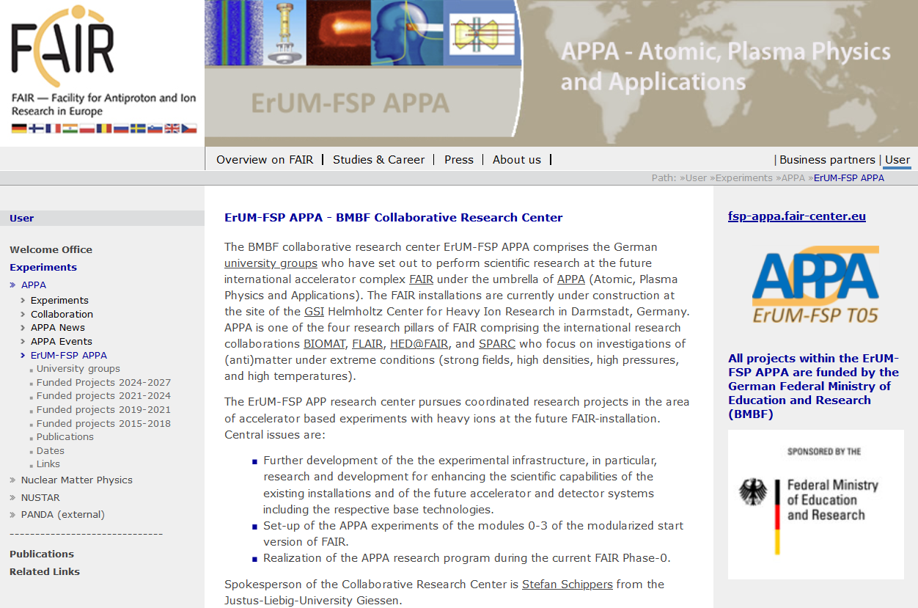
Outreach – FSP-APPA Website
Please provide a short description of your current project in English and German, preferably with one nice figure.
https://fsp-appa.fair-center.eu

Slide 12
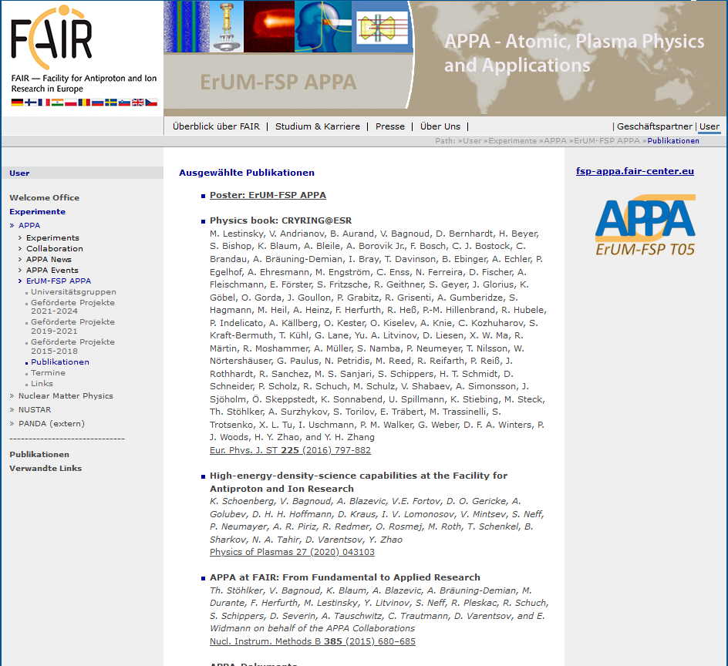
Outreach – FSP-APPA Poster

Slide 13
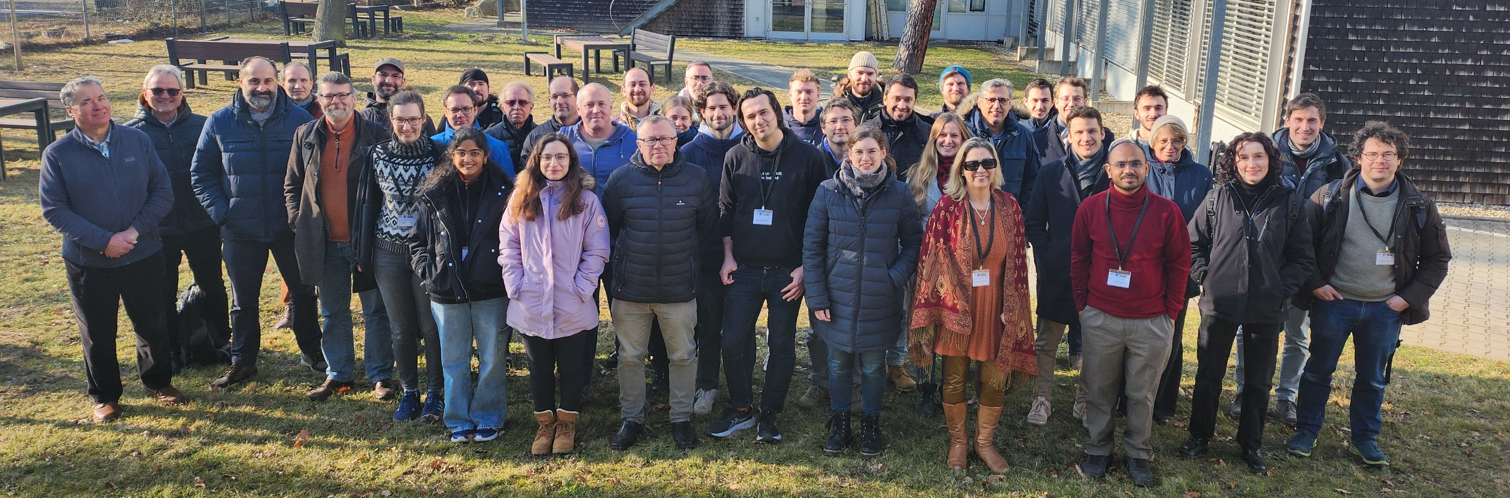
Next Annual Meeting 21./22. January 2027
Special thanks to Lea Wunderlich
Thank all of you for having come and contributed to this meeting!

