Slide 1



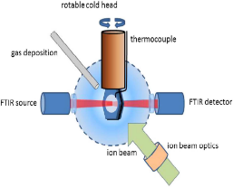
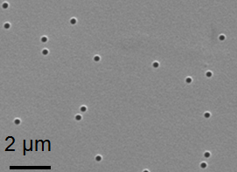
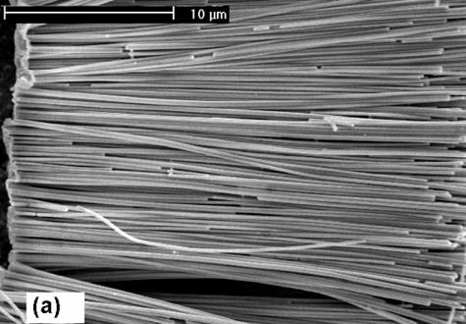
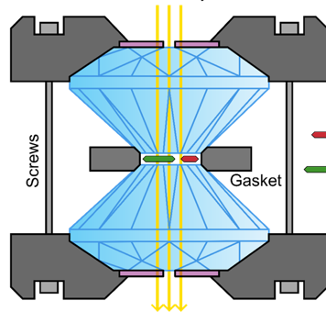




News from MATerials Research
M.E. Toimil-Molares
Materials Research Department
GSI Darmstadt
APPA ErUM Meeting 2026
µm thick cryogenic film
on IR transparent window
ion beam

Slide 2
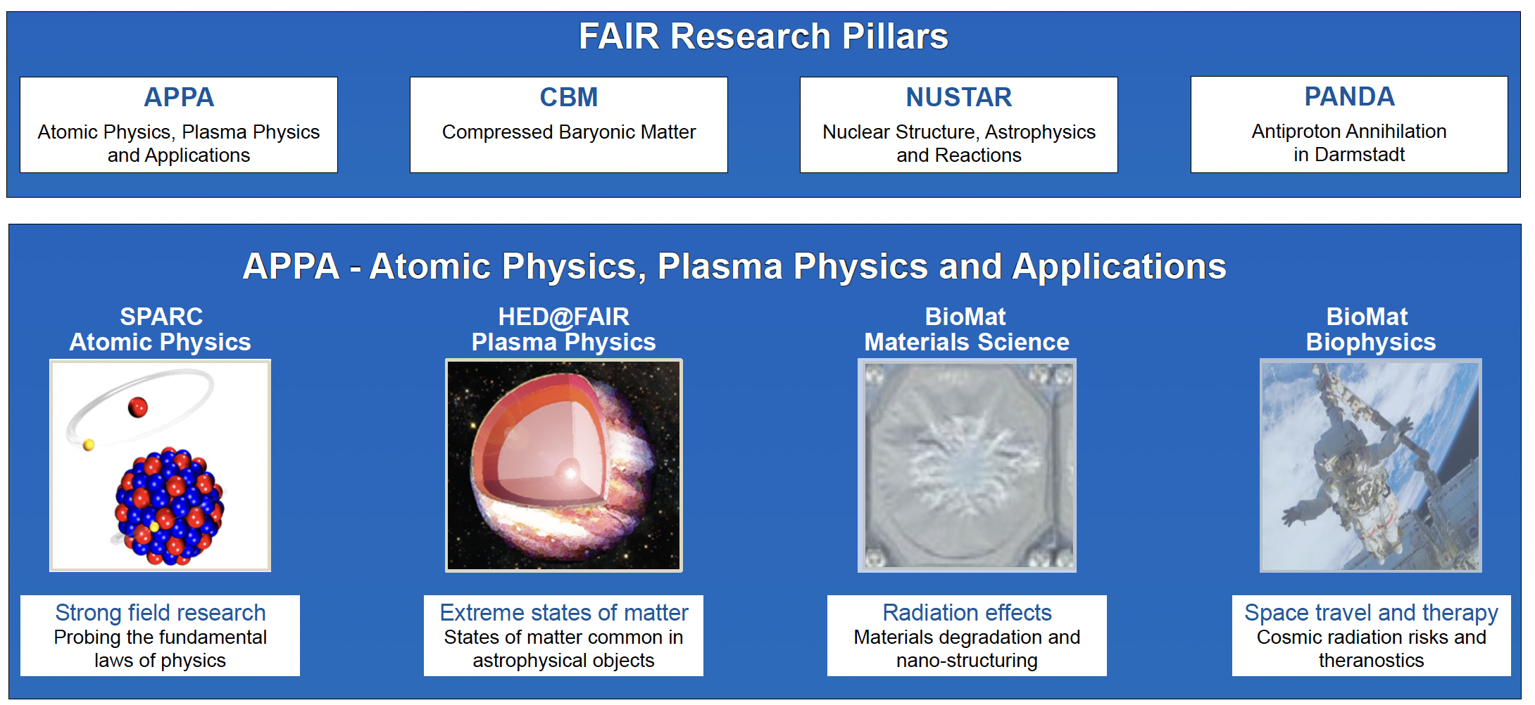
APPA ErUM Meeting January 2026 – Toimil-Molares

Slide 3
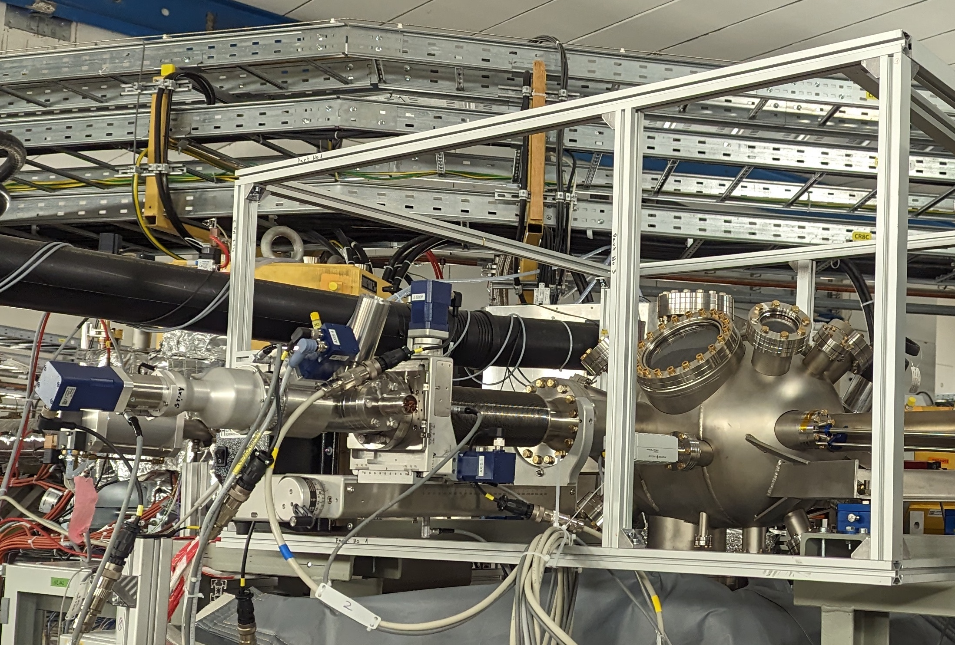
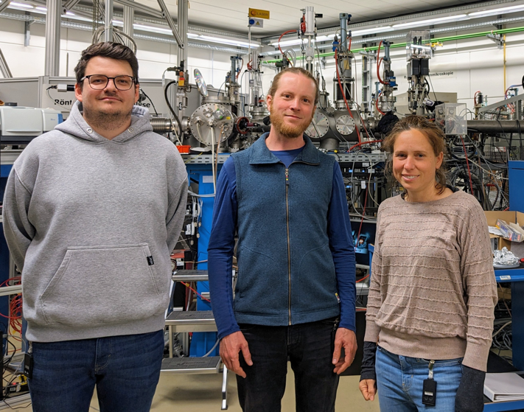
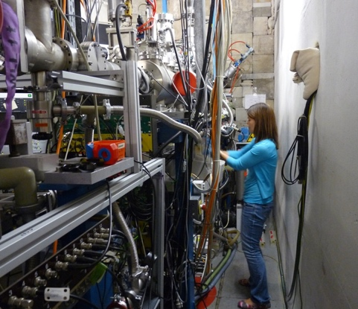
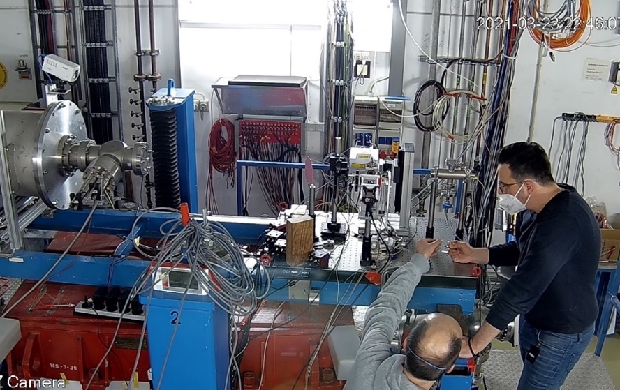

Successful 2025 beamtime campaign
CRYRING
MAT station
UNILAC
M-branch (M1,M2,M3)
UNILAC
X0
SIS18
Cave A
~40 user groups of the MAT collaboration served in 2025
~45 % of ~300 shifts granted for 2024/2025 performed (> 50 days of parallel operation)
Nanotechnology, radiation hardness, astrochemistry, materials under extreme conditions,…
Research requires: various ion species, ion energy, intensities, and dedicated equipment
Currently, six different beamlines for materials research under operation
APPA ErUM Meeting January 2026 – Toimil-Molares

Slide 4
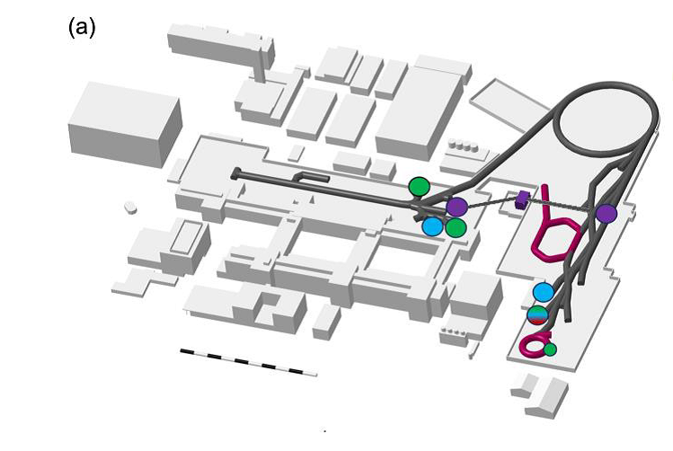
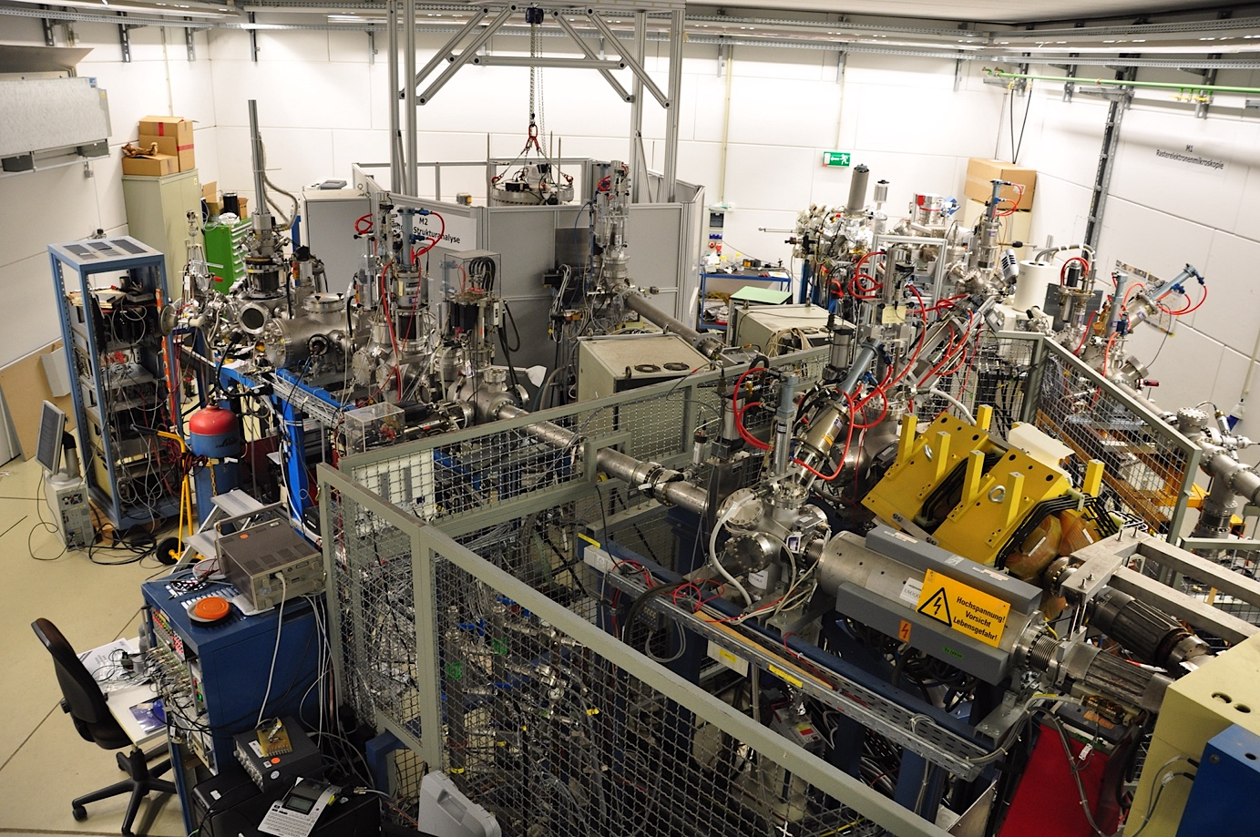
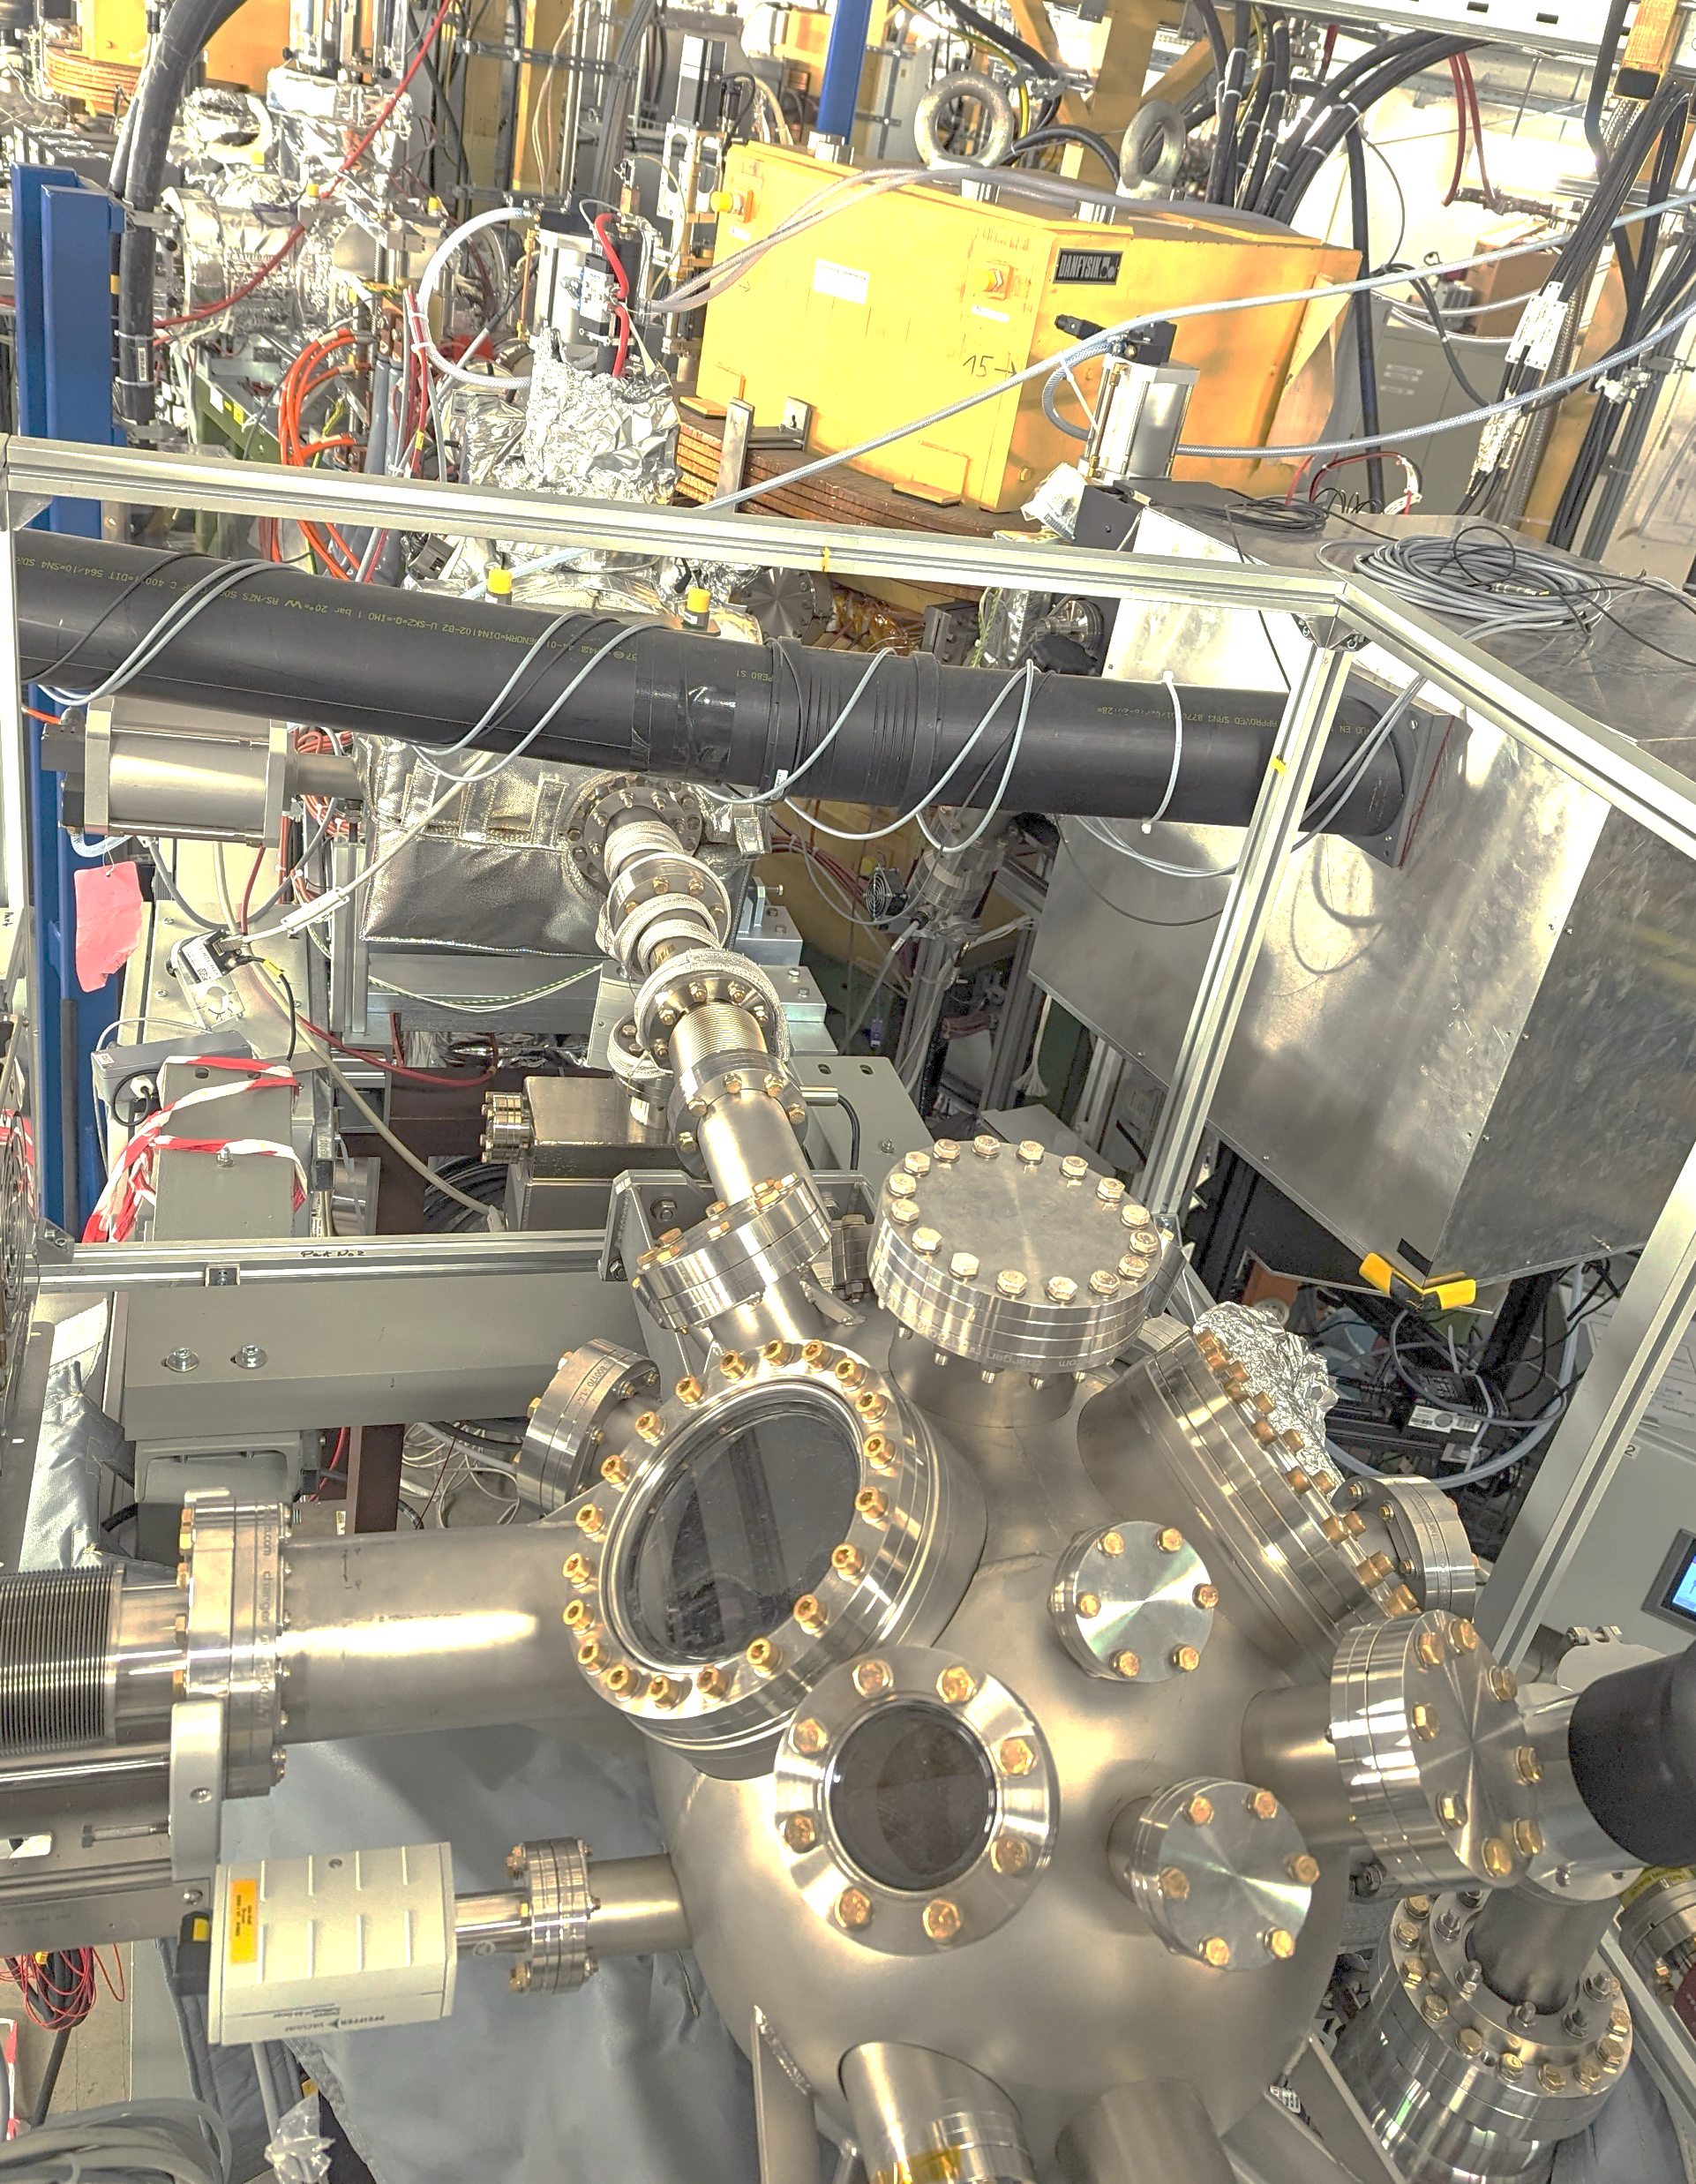
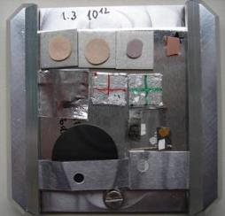
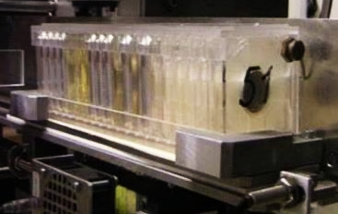
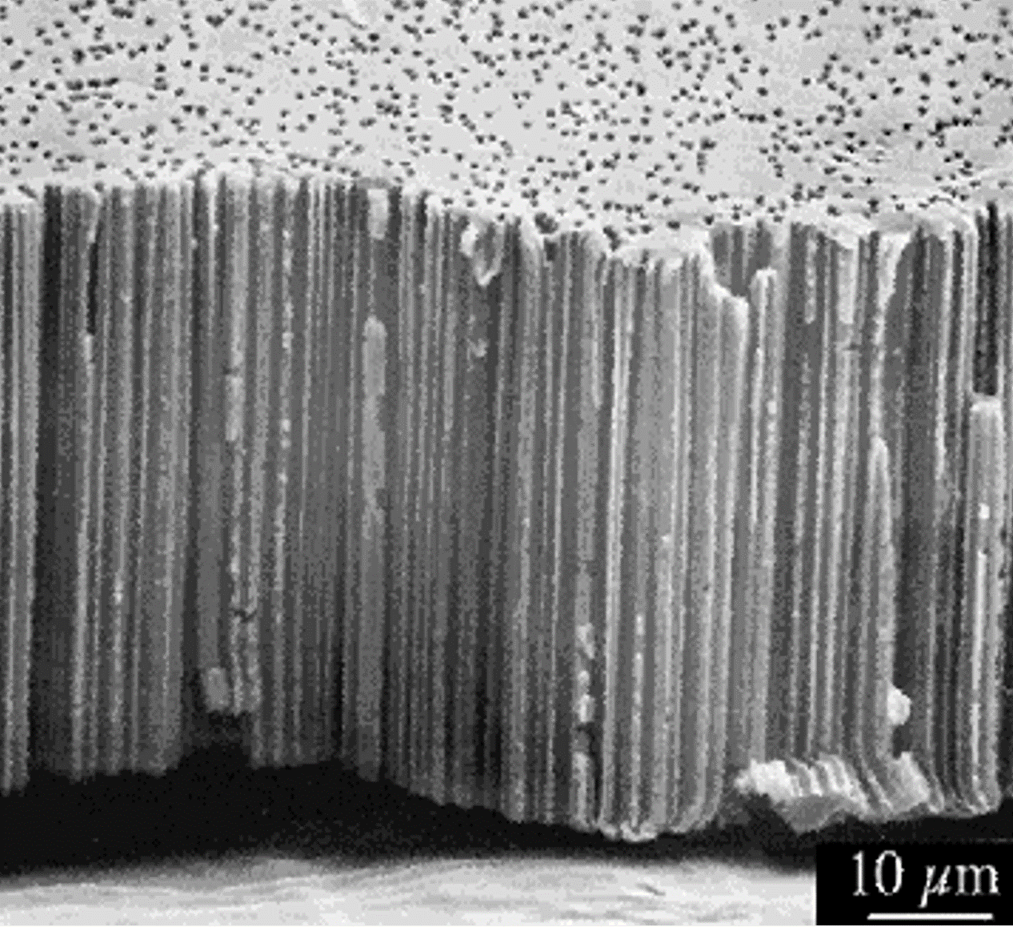


Materials Research User Facilities
UNILAC (up to 11 MeV/u)
Highest ion energy loss
Ion range up to 120 µm
M-branch
In–situ analysis
SIS-18
M3
M2
M1
UNILAC
X0 beamline
Sample exchange system
Heavy-ion microprobe
CRYRING MAT-station
with in-situ analysis
Highest ion charge states
at various kinetic energies
5 x 5 cm²
APPA ErUM Meeting January 2026 – Toimil-Molares

Slide 5
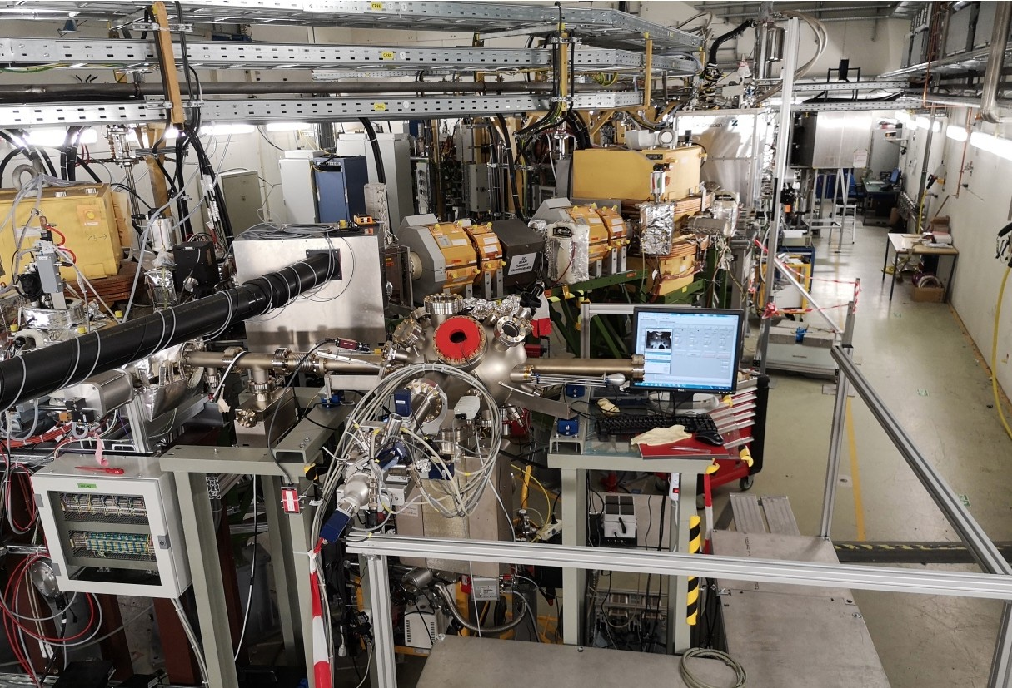
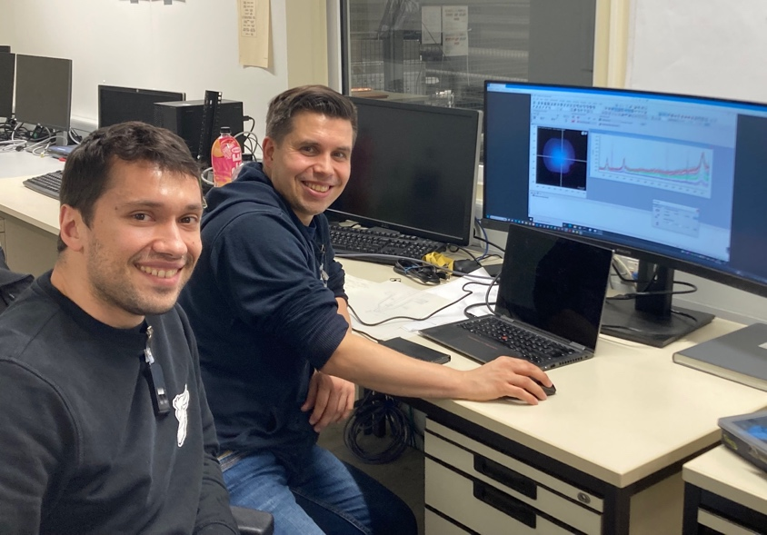
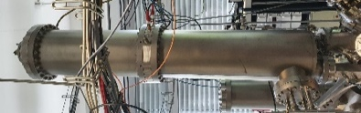
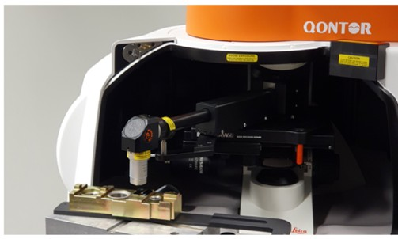

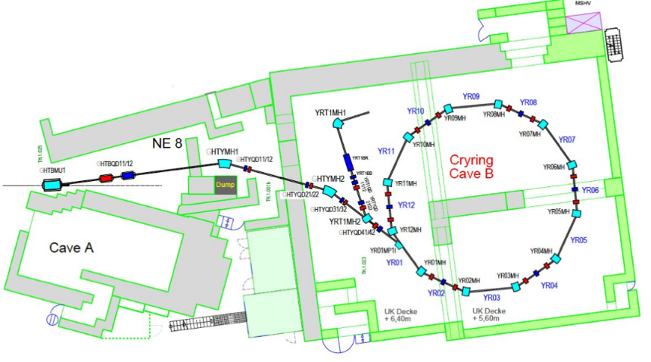
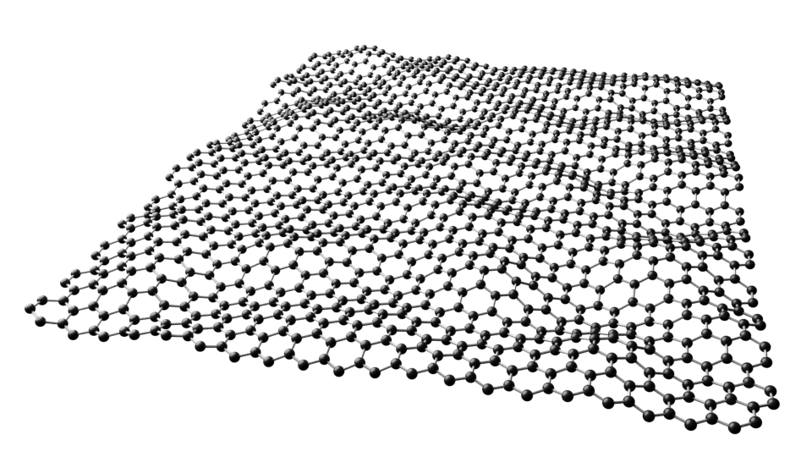
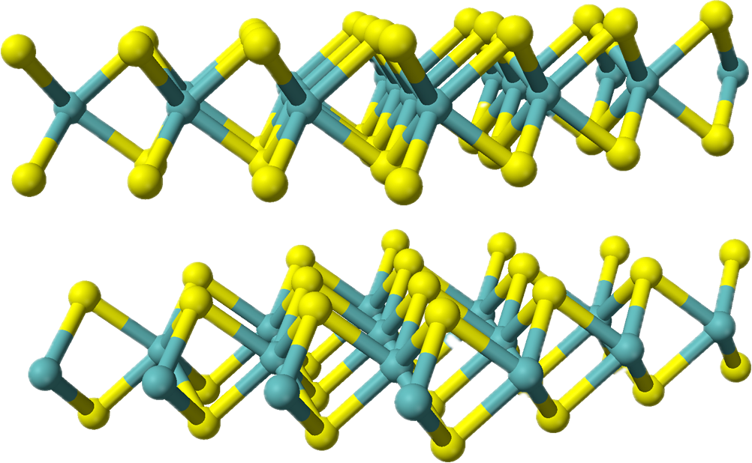
In-situ Raman at CRYRING MAT-Station
March 2025: First experimental beamtime!
MAT-Station
Graphene and MoS₂

Slide 6
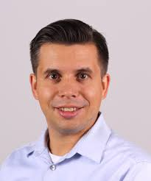
In-situ Raman at CRYRING MAT-Station
D: defect peak
G: graphene peak
4.7 MeV/u
Au ⁷⁵⁺
graphene
Complementary experiments at M1 and HITRAP
Talk tomorrow by Lars Breuer (Uni Duisburg)

Slide 7
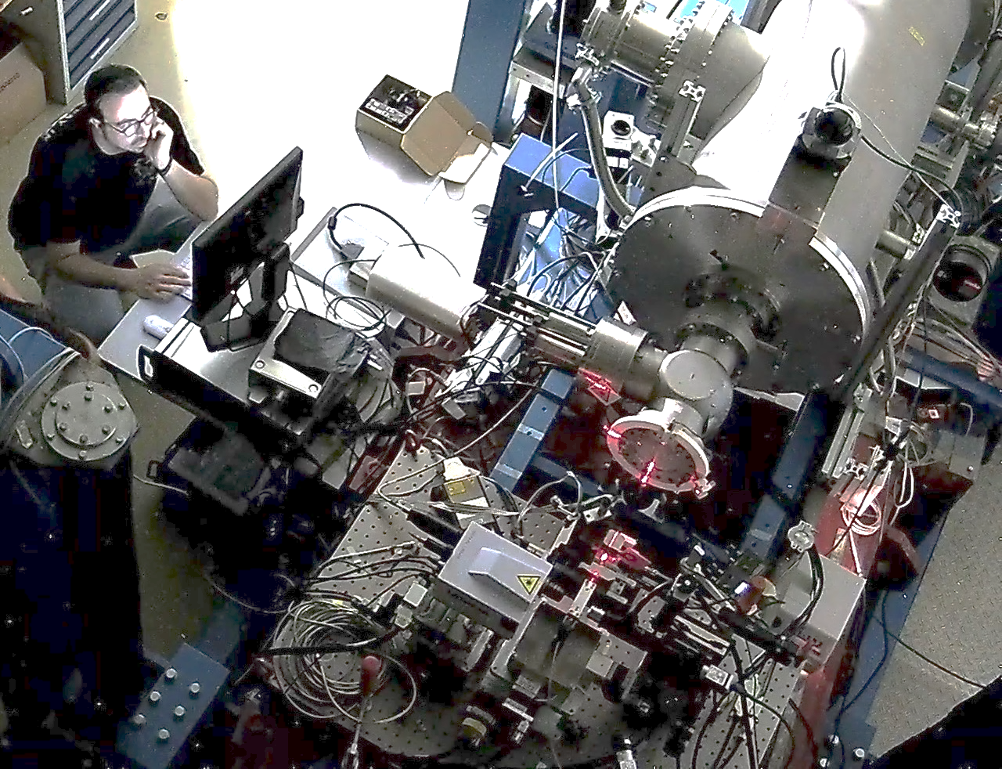
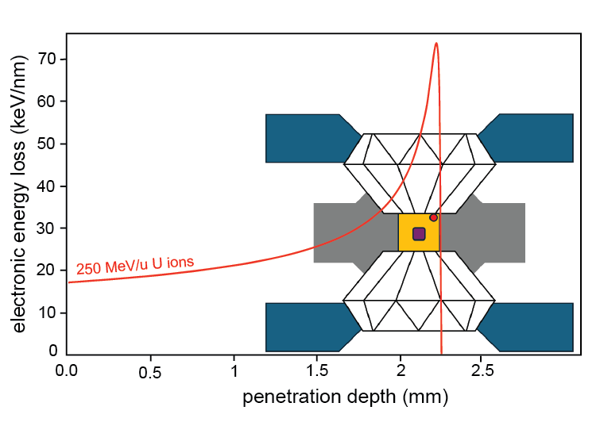
Materials Research User Facilities
UNILAC (up to 11 MeV/u)
Highest ion energy loss
Ion range up to 120 µm
SIS-18 (up to 1 GeV/u)
Largest ion ranges mm-cm
M-branch
In–situ analysis
Cave A
High pressure platform with in-situ Raman
SIS-18
M3
M2
M1
UNILAC
X0 beamline
Sample exchange system
Heavy-ion microprobe
CRYRING MAT-station
with in-situ analysis
Highest ion charge states
at various kinetic energies
5 x 5 cm²
APPA ErUM Meeting January 2026 – Toimil-Molares

Slide 8
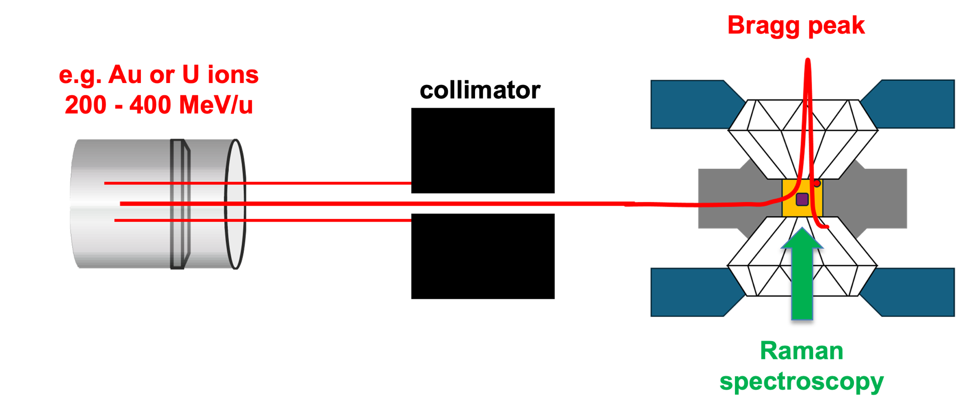
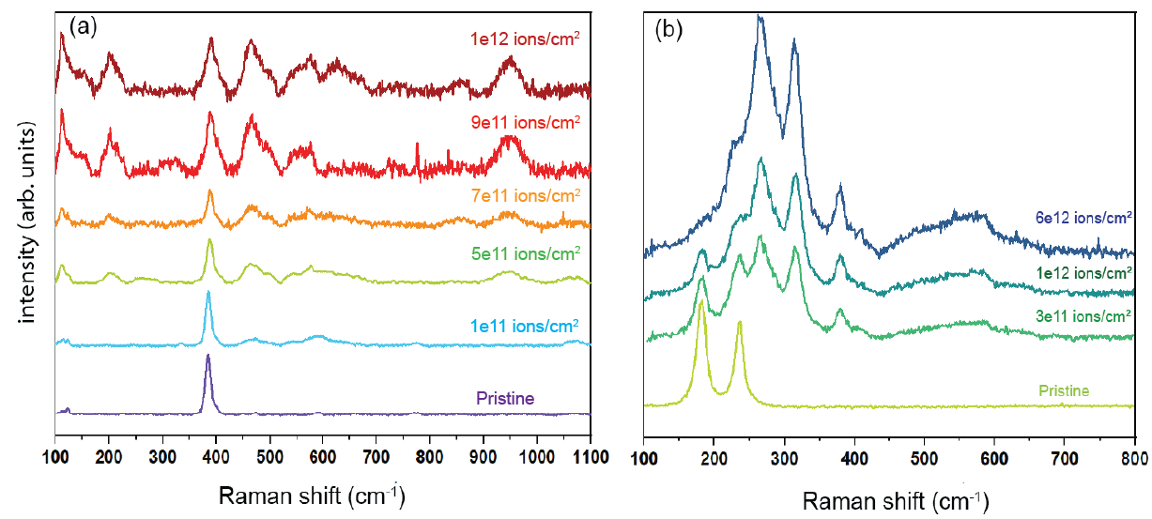








High-Pressure Irradiation Platform
Succesful beamtime in June 2025
First experimental results for various materials types
Gd₂O₃
NaN₃
New user groups for 2026/27
Talk tomorrow by I. Tzifas
Tzifas et al. Experimental platform for combining high pressure and swift heavy ion irradiations (submitted)
Liang et al. Structural and optical responses of molecular solids to swift heavy ion irradiation under high pressures (submitted)

Slide 9
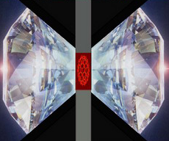

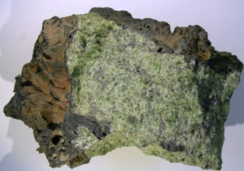


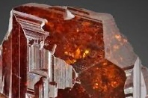
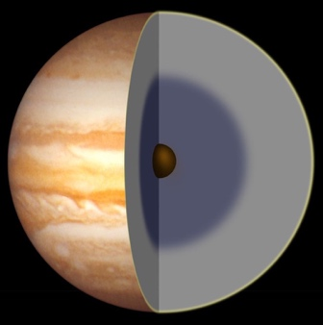
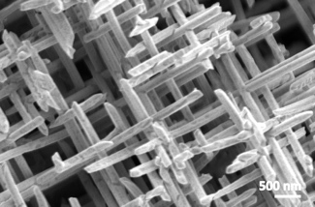
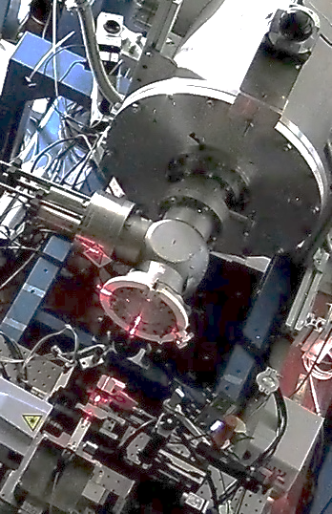
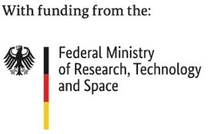

Exciting Upgrades
pressure
Extension of high-pressure research to low and high-temperatures
Materials of interest: ices, minerals, nanomaterials and molecular compounds
P
Research goals
Irradiation of space ices under pressure at cryogenic temperatures to understand physicochemical processes
Study response of rocky planet materials under irradiation, pressure and high temperatures and explore how extreme conditions affect structural and chemical changes
Elucidating the role of temperature and temperature rates in ion-induced phase transformations under high-pressure
Conduct temperature-dependent in-situ electrical measurements to correlate structural and electrical properties of novel material phases
ices
High T
minerals
Low T
gas giants
nanomaterials
Ions
Upgrade of facility funded by BMFTR ErUM-Pro (2025-2028) (B. Winkler, Goethe University)
APPA ErUM Meeting January 2026 – Toimil-Molares

Slide 10
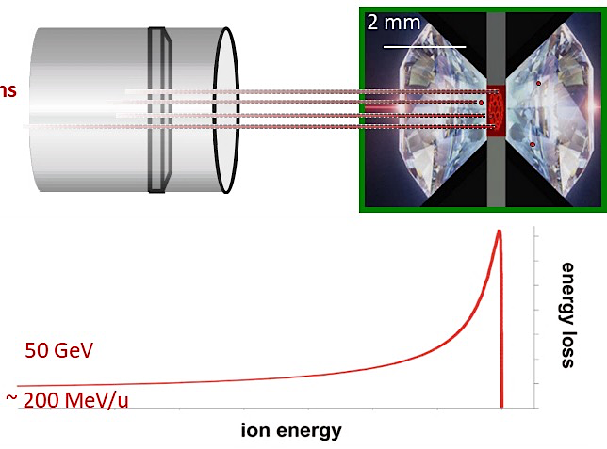

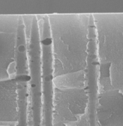
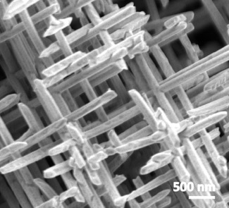

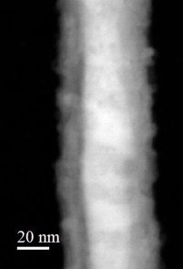
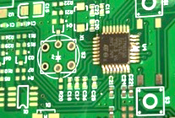
Materials Research
I. Ion-Track Nanotechnology
II. Heavy-Ion-induced modifications
III. Materials under Extreme Conditions
Functional Isoporous membranes
Functional materials
High-pressure irradiation
from
bulk
Single-nanochannel sensors
Space electronics
Radiation hardness of functional materials
Size-dependent properties of nanowires
to
nano
Nanomaterials
Nanowire assemblies
for energy applications
Molecules
ions
Pressures of up to ~50 GPa
Ion Irradiation
High Pressure
Energy loss
Temperature
Ion penetration range
APPA ErUM Meeting January 2026 – Toimil-Molares

Slide 11
Materials Research
I. Ion-Track Nanotechnology
II. Heavy-Ion-induced modifications
III. Materials under Extreme Conditions
Functional Isoporous membranes
Functional materials
High-pressure irradiation
from
bulk
Single-nanochannel sensors
Space electronics
Radiation hardness of functional materials
Size-dependent properties of nanowires
to
nano
Nanomaterials
Nanowire assemblies
for energy applications
Molecules
Talk by M. Dürr
ions
Pressures of up to ~50 GPa
Ion Irradiation
High Pressure
Energy loss
Temperature
Ion penetration range
APPA ErUM Meeting January 2026 – Toimil-Molares

Slide 12
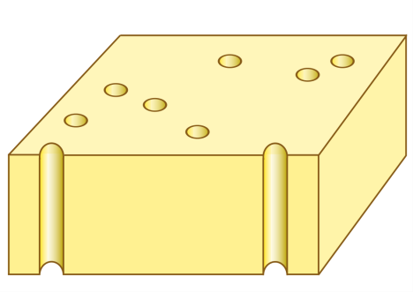
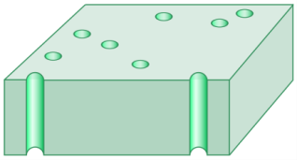
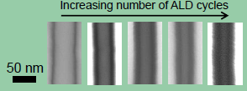
Irradiation Effects on Nanomaterials
Conformal coating by
atomic layer deposition
… yields nanotubes with tailored wall thickness

Slide 13
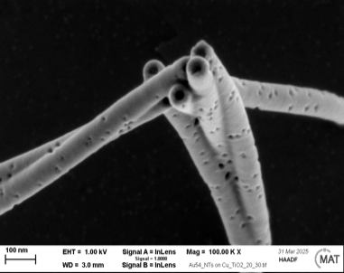
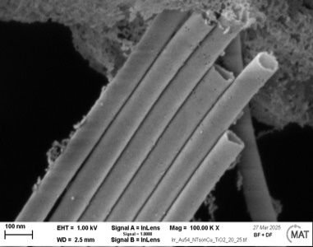
Irradiation Effects on Nanomaterials
Conformal coating by
atomic layer deposition
Study of size-effects on ion-material interaction
1.6 GeV Au ions
amorphous
crystalline
… yields nanotubes with tailored wall thickness
100 nm
40 nm

Slide 14

Irradiation Effects on Nanomaterials
Conformal coating by
atomic layer deposition
Study of size-effects on ion-material interaction
1.6 GeV Au ions
amorphous
crystalline
Talk tomorrow by Ina Schubert
… yields nanotubes with tailored wall thickness
Swift heavy ions to fabricate and to irradiate nanowires
Radiation effects as a function of size and crystalline structure
Relevant for use of nanomaterials in extreme radiation environments
100 nm
40 nm

Slide 15
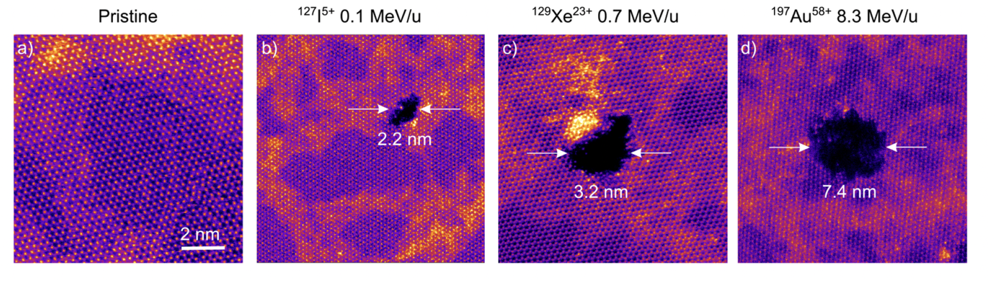
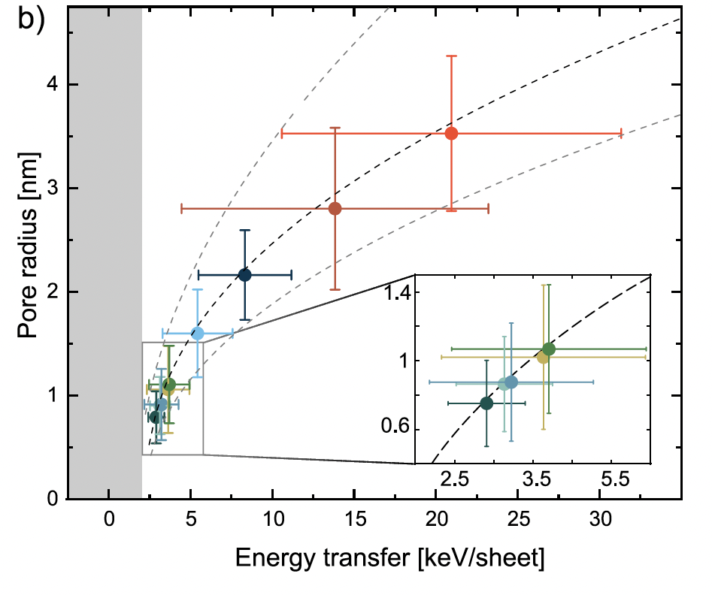
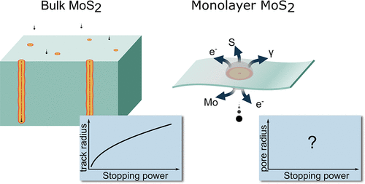
Nanopores in MoS₂ Monolayers
Y. Liebsch et al. ACS Appl. Mater. Interfaces (2026)
Ion-Matter interaction: bulk vs. nano
Nanopores with tailored diameter
Understanding
Controlling

Slide 16


New Projects
Integrated nanopore sensor platforms for single-molecule diagnostics based on track-etched nanopores
LOEWE MULTIDRUG Terapeutic Drug Monitoring (2026-2029): Intelligent sensor system to improve pediatric cancer care.
MULTIDRUG
TU-Darmstadt
Engineering
Sensing
Data analysis
Materials Science
Uni Frankfurt
Pharmacology
Pediatric oncology
Development of advanced materials and new setups devoted to fusion materials testing

Slide 17
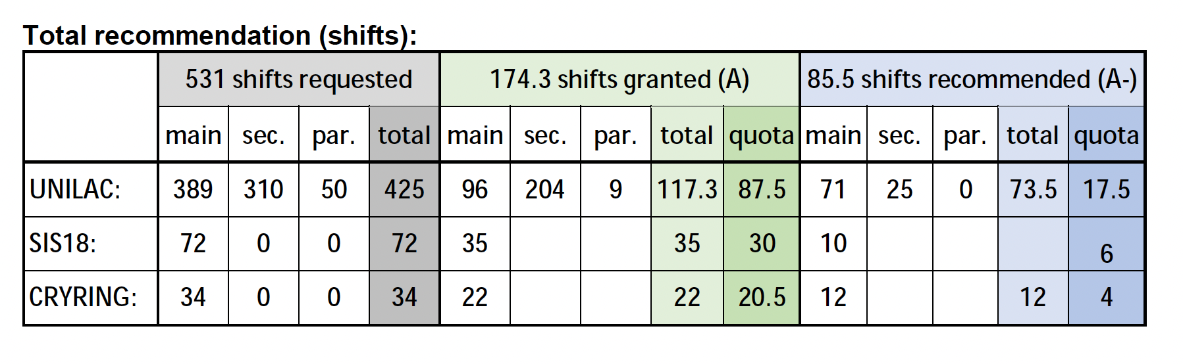
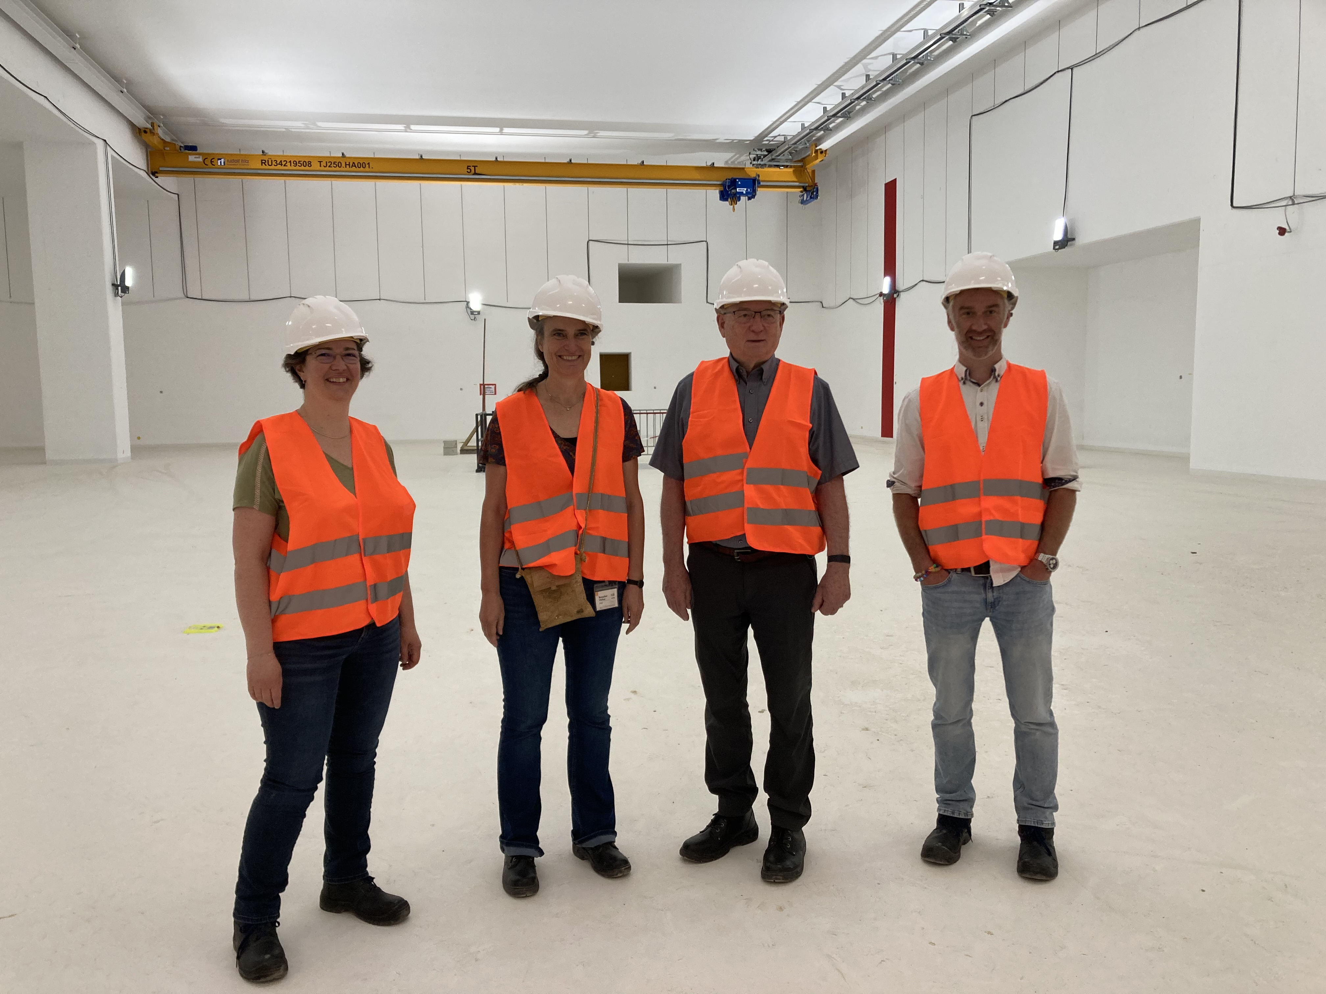
Meeting of the Mat-PAC
Members of Program Advisory Committee for Materials Science
Large overbooking factors:
UNILAC: 4.8
SIS-18: 2.8
Mat-Station @ CRYRING: 1.6
Number of proposals: 39
A (granted): 33
A- (recommended): 2
B: 4
APPA ErUM Meeting January 2026 – Toimil-Molares

Slide 18
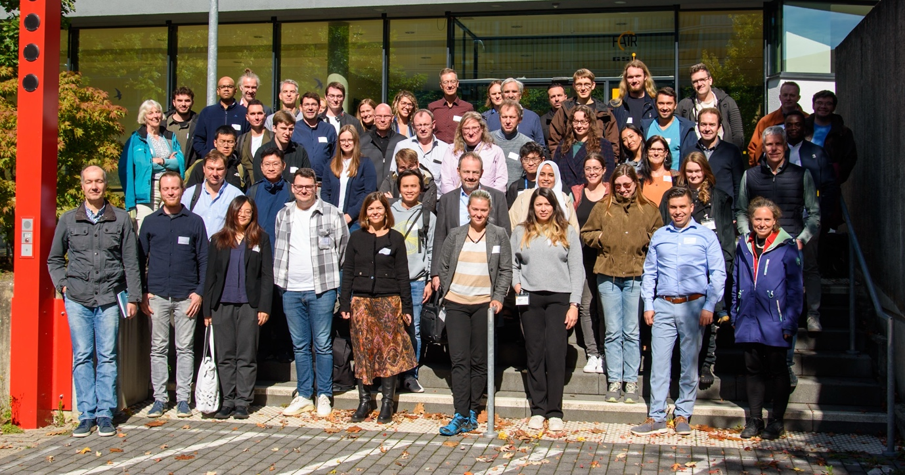
Annual Workshop of Ion and Particle Beams
GSI, September 22-24, 2025
Recent results from large-scale research infrastructures supported by the BMFTR ErUM program.
Developments in accelerator and beamline technologies.
Updates from key facilities at e.g., GSI-MAT, ISOLDE at CERN, IBC at HZDR, and the Tandem laboratory in Uppsala.
With participation of KFSI (Committee Research on Condensed Matter with Nuclear Probes and Ion Beams (KFSI)) and
Rebecca Redlin (PT-DESY)
26 scientific presentations
15 poster contributions
Strong focus on engaging early-career researchers
APPA ErUM Meeting January 2026 – Toimil-Molares

Slide 19


Upcoming Meetings
Workshop : Science Program and Technical preparations of the APPA Cave
GSI, March 12–13, 2026
MAT Collaboration Meeting
GSI, September 24-25, 2026
~200 members from around 30 countries
APPA ErUM Meeting January 2026 – Toimil-Molares

Slide 20















Thank you!
… and all our collaborators and funding agencies
APPA ErUM Meeting January 2026 – Toimil-Molares

Slide 23




Materials Research
Investigation and improvement of the radiation hardness of first-wall materials
(W and HEA nanostructured materials, ODS-steel, …) using in-situ analysis during ion irradiation
Collaboration with KIT, Focus Energy, Hermle, ZOZ, SCK-CEN, Uni Münster Funding : 1.7 M€ (for GSI)
Material development and characterization
Irradiation and in-situ analysis of fusion materials
High-entropy alloys, nanostructures
Neutron Sources
Bulk irradiation (~20 dpa/year)
Similar neutron spectrum
Higher costs
Long turnover times
High radioactivation
No in-situ/on-line diagnostics
Heavy-ion Irradiation
~100 μm penetration depth
Medium dose rates (dpa/d)
Controlled dose & temperature
In-situ sample analysis
Little radioactivation
Inhomogeneous damage distribution
New materials!
Interesting also for biomedical applications, extreme environments,...

Slide 24



Electrodeposition Process for Gold Nanowires
$${Au\left(CN\right)}_{2}^{−}+e^{−}↔Au\left(s\right)+2{CN}^{−}$$
Li, Mohan, et al. RSC advances 13.7 (2023): 4721-4728.

Slide 25


UNILAC – M-branch
X-ray diffraction
(XRD)
Scanning electron microscopy (SEM)
Secondary ion mass spectrometry (SIMS/SNMS)
Multi-purpose chamber with UV/VIS- Raman-, and IR-spectroscopy
Low- and high-temperature irradiations
M2
M1
M3

Slide 26
UNILAC – M-branch
X-ray diffraction
(XRD)
Scanning electron microscopy (SEM)
Secondary ion mass spectrometry (SIMS/SNMS)
Multi-purpose chamber with UV/VIS- Raman-, and IR-spectroscopy
Low- and high-temperature irradiations
M2
M1
M3
Ion-induced material modifications
Radiation hardness of materials
Astrochemistry,…
> 15 user national and international groups
Germany: TU-Darmstadt (Alff), Uni Jena (Ronning/Hafermann), Uni Gießen (Dürr), Uni Münster (Tomut), University of Applied Sciences Wiesbaden (Bender), Uni Duisburg (Schleberger/Breuer),…

Slide 27



Radiation hardness of nanomaterials
Ina Schubert
Swift heavy ions to fabricate and to irradiate nanowires
Radiation effects as a function of surface-to-volume ratio for various materials
Relevant for use of nanomaterials in extreme radiation environments
In preparation

Slide 28

High-Pressure Irradiation Platform
Polymerization of CO
Tzifas et al. Experimental platform for combining high pressure and swift heavy ion irradiations (submitted)
Liang et al. Structural and optical responses of molecular solids to swift heavy ion irradiation under high pressures (submitted)

