Slide 1
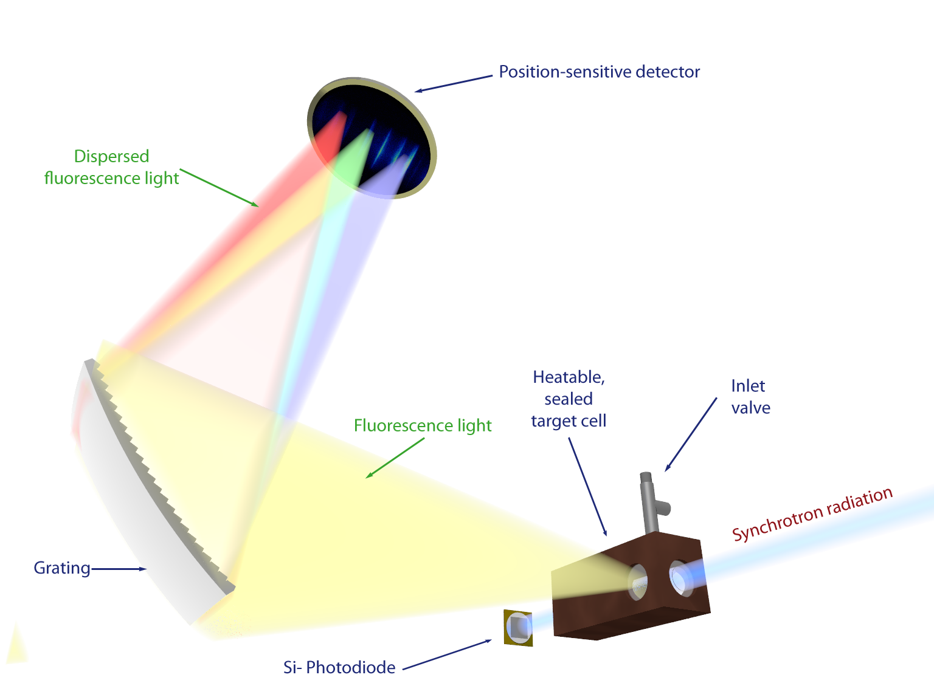




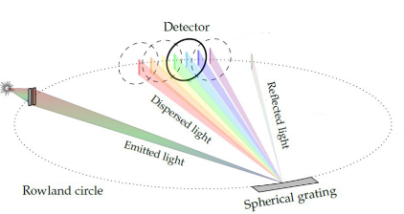
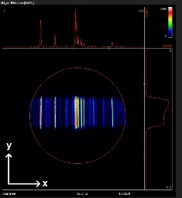
Current status of VUV-EUV VLS-grating photon spectrometer at CRYRing
Rohit Tyagi, J. Viehmann, A. Krone, A. Hans, A. Ehresmann
University of Kassel
23-01-2026

Slide 2
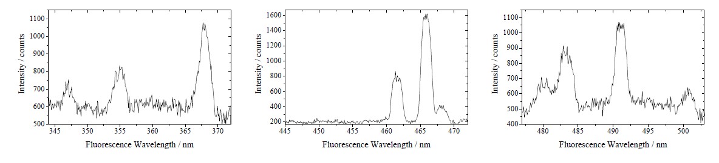
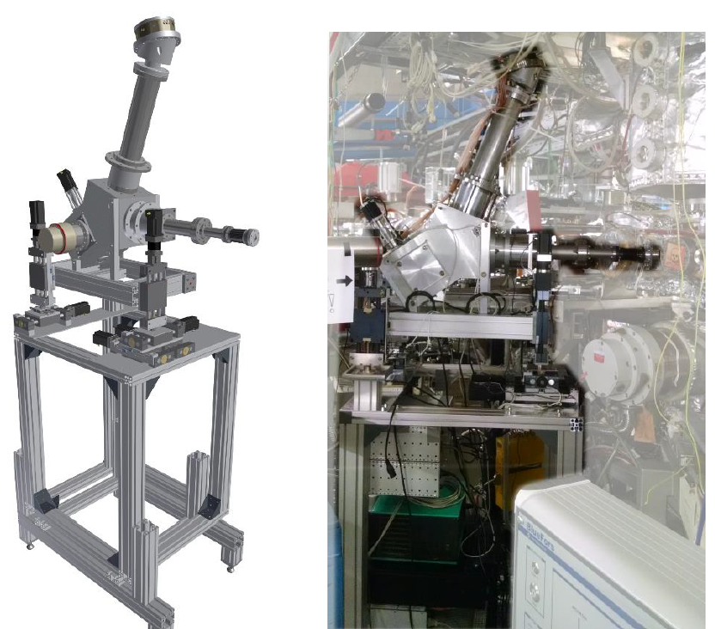
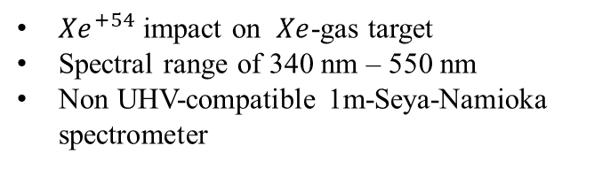
A first test experiment
${Xe}^{+54}$ impact on $Xe$-gas target
Spectral range of 340 nm – 550 nm
Non UHV-compatible 1m-Seya-Namioka spectrometer
Obstacles due to geometric constraints and requested vacuum conditions
Observation through window
Spectrometer not in focus to source volume
Result:
In spite of obstacles signal-to-noise ratio good → Worthwhile to build a EUV/VUV spectrometer
Reiß et al., Phys. Scr. T166, 014031 (2015)
2

Slide 3
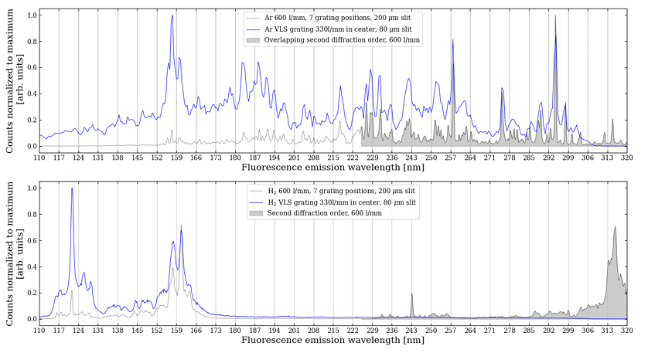
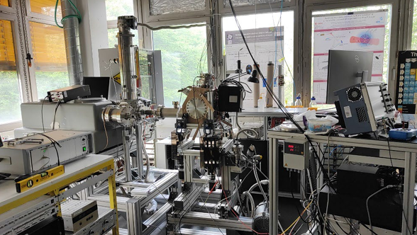
Why VLS ?
Ar and $H_{2}$fluorescence emission 2 keV electron impact
Aberration-corrected (defocus, coma, astigmatism) by design
Flat-field imaging allows 2D detectors enabling imaging spectrographs
More complex and costly fabrication of VLS gratings
Optimize for wavelength band requiring multiple gratings for wide coverage.
NIS (Normal incidence spectrometer) system the spectra must be recorded and appended at 7 different grating positions
VLS grating Full spectra can be taken in single shot
3

Slide 4

















Ion-Atom Collision
Excitation
/ $I$
$$I^{q+}+A→I^{q+}+A^{∗}$$
$$I^{+}$$
/ $I^{−}$
$$I^{q+}+A→I^{q+}+A^{+}+e^{−}$$
$$E_{P}^{f},{\vec{P}}_{P}^{f}$$
Pure Ionization
Transfer Processes
$$I^{q+}+A→I^{(q−k)+}+A^{m+}+\left(m−k\right) e^{−}$$
$$⊥$$
$$∥$$
Radiative
relaxation
$$I^{+}$$
$$E_{e}, {\vec{P}}_{e}$$
$$E_{P}^{i}, {\vec{P}}_{P}^{i}$$
UV/VUV
Spectroscopy
$$E_{R},{\vec{P}}_{e}$$
$$A^{+}$$
/ $A$
/ $A^{−}$

Slide 5

Motivation: (Single or multiple) electron transfer/ capture to/ by highly charged ions
Possibility (a): Surplus energy released by Capture fluorescence
Projectie
Target
Ne⁷⁺
Ne
Ne⁶⁺
Ne⁺
Projectile fluorescence (for NeVII in the range of 46.5 – 97.3 nm, for higher excited states above 198 nm)
E_{I+}
E_{I+}
4p
4p
3s
3s
2p
2p
2p
2p
2s
2s
2s
2s
Projectile
Target
Possibility (b): Surplus energy released by Correlative Excitation in target
Ne⁷⁺
Ne
Ne⁶⁺
Ne^{+*}
E_{I+}
E_{I+}
4p
4p
Target fluorescence
3s
3s
2p
2p
2p
2p
Measurable?
2s
2s
2s
2s

Slide 6
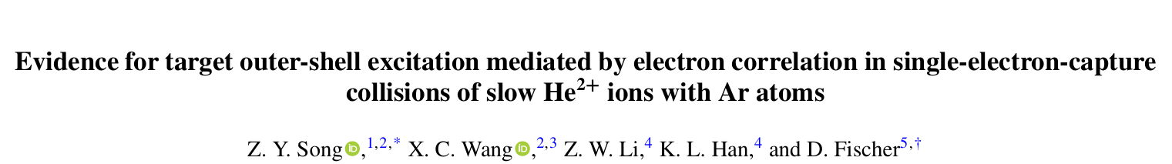
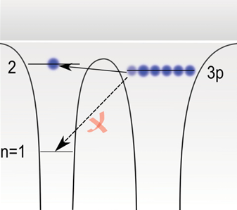
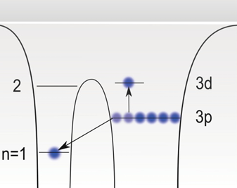
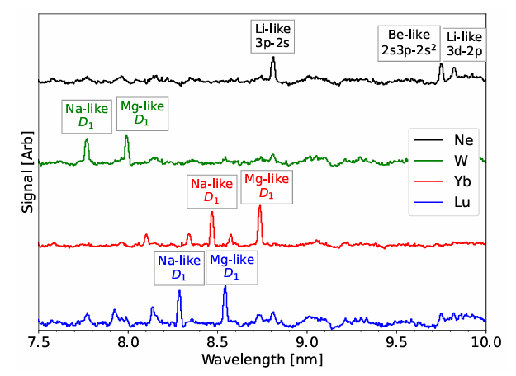
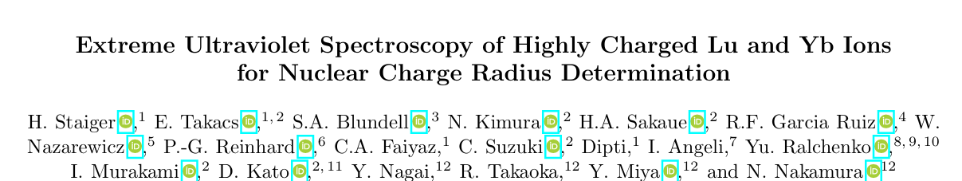
Cont..
The e-e interaction enables this capture channel to occur and another
valence electron will be excited due to the recoil force
PHYSICAL REVIEW A102,042820(2020)
Precision experiment for QED
www.arxiv.org/pdf/2511.20537 Nov 2025

Slide 7
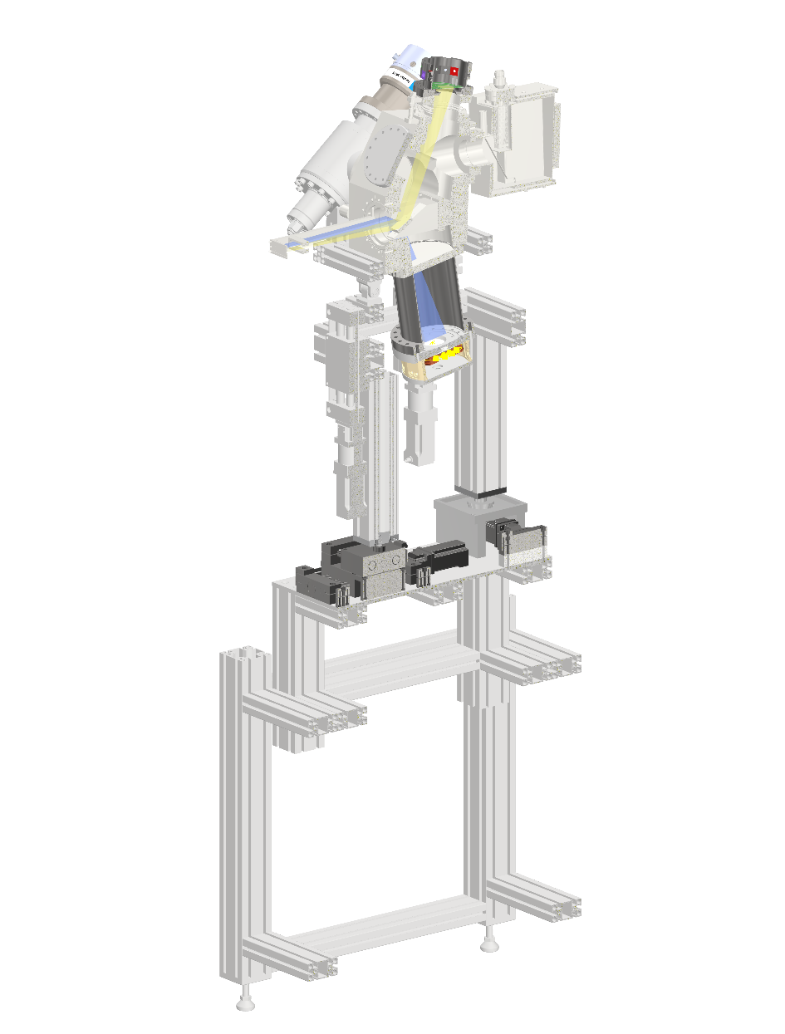
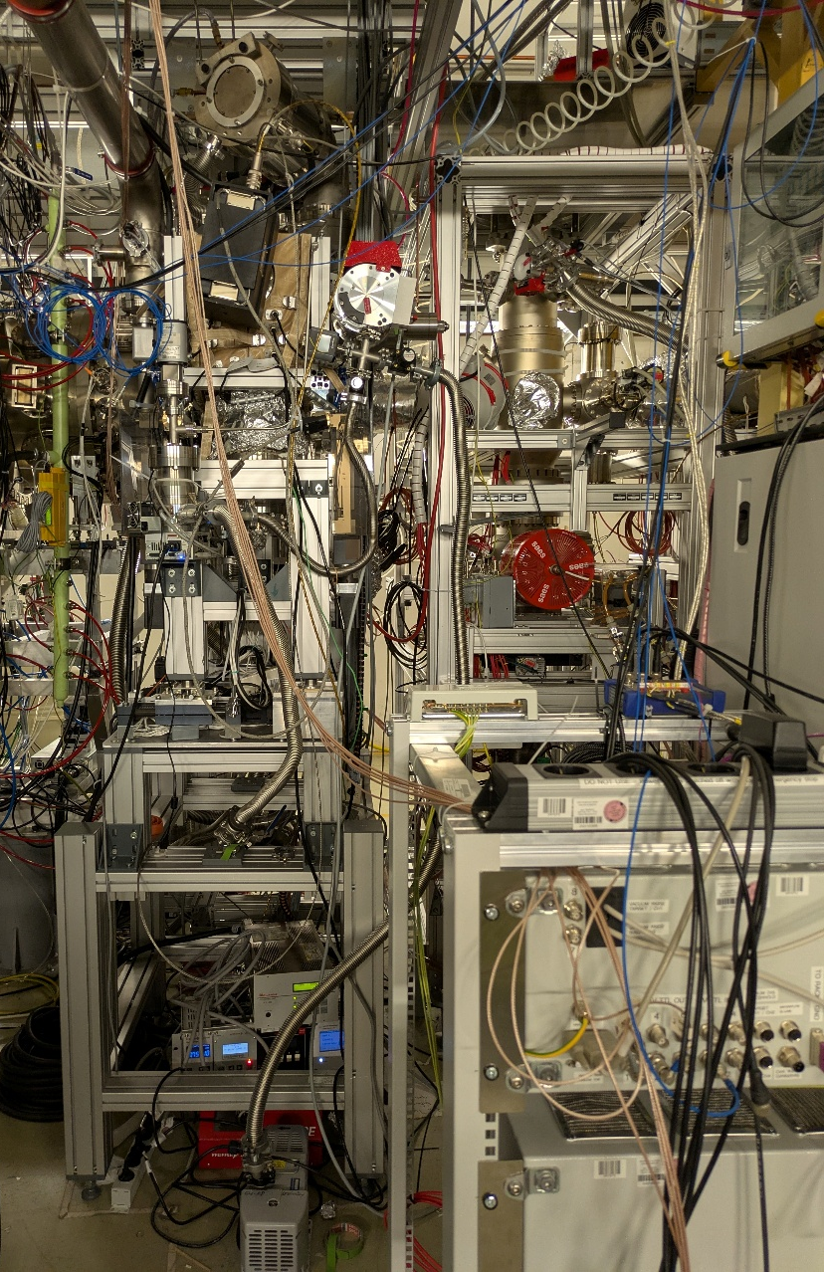
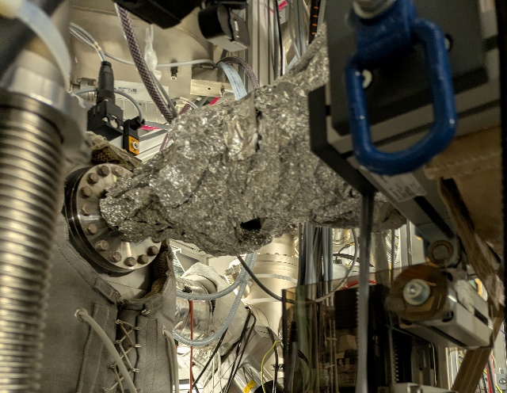
UV/VUV detection @ CryRing
10-120 nm, 100-300 nm
Position-sensitive photon detection unit no. 1, here EUV-detection unit
Pumping unit
Slit unit, if used in focus of the variable line spacing grating (35.8cm away from the grating center)
Position-sensitive photon detection unit no. 2, here VUV-detection unit
Remotely controllable adjustment stage

Slide 8
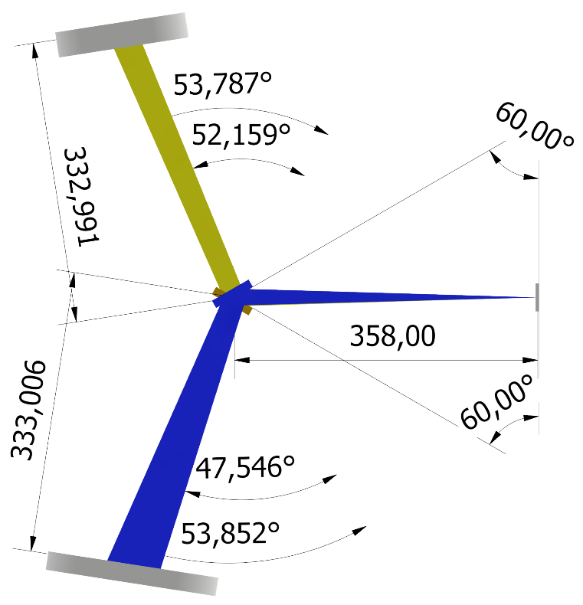
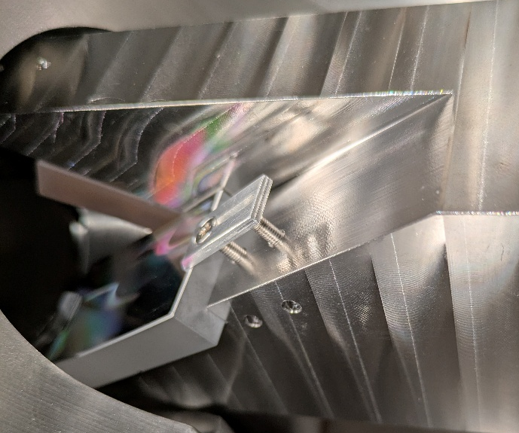
Grating and Detector positions and characteristics
EUV: 300 l/mm (avg) Al + MgF₂-coating focal length 35.8 cm 50 x 30 mm active area
VUV: 1300 l/mm (avg) Au coating focal length 35.8 cm 50 x 30 mm active area
Different use cases:
Grating (1) target fluorescence and grating (2) projectile fluorescence downstream of the target
Both grating-detector combinations are used together downstream of target area for projectile fluorescence
Alternate use of the grating-detector combinations by stage shift along ion beam for target fluorescence

Slide 9
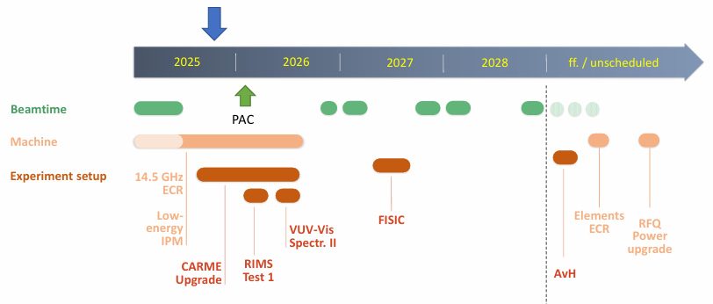
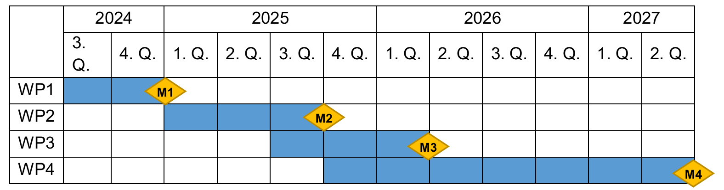
Work plan including milestones and status
Integration of spectrometer control and data acquisition systems into the GSI infra structure. Iteration to solve technical limitation
User operation
Beam time (Optimistic :))
Installation
Preliminary test

Slide 10
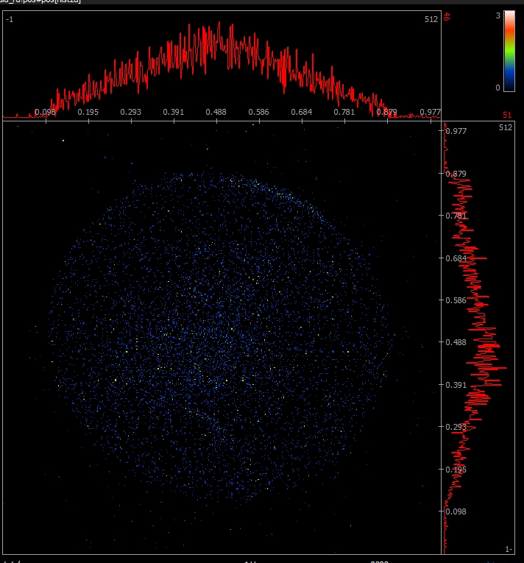
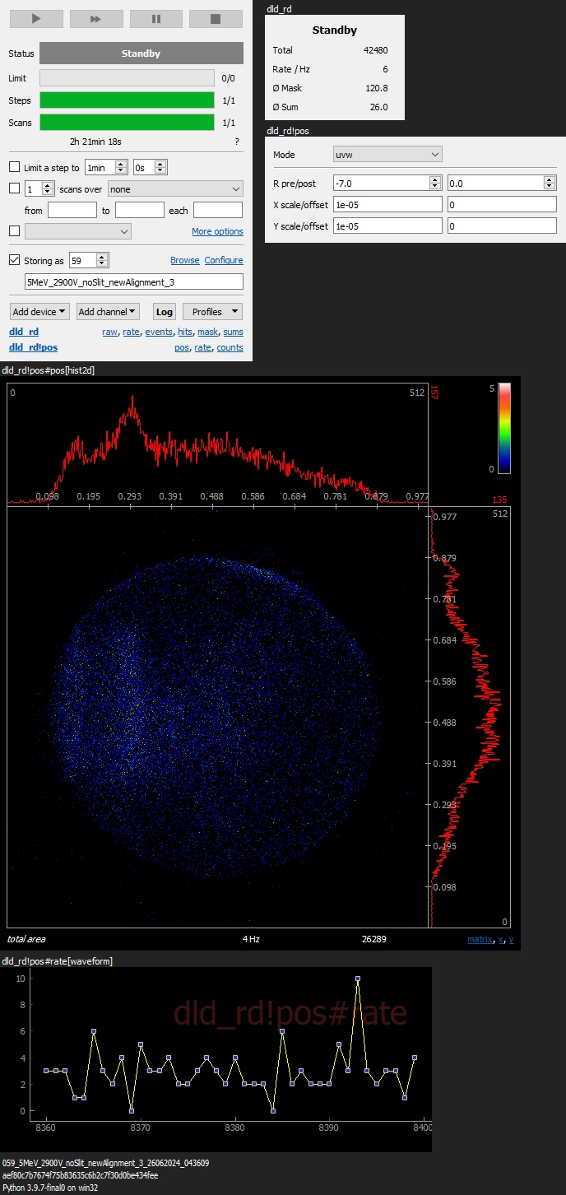
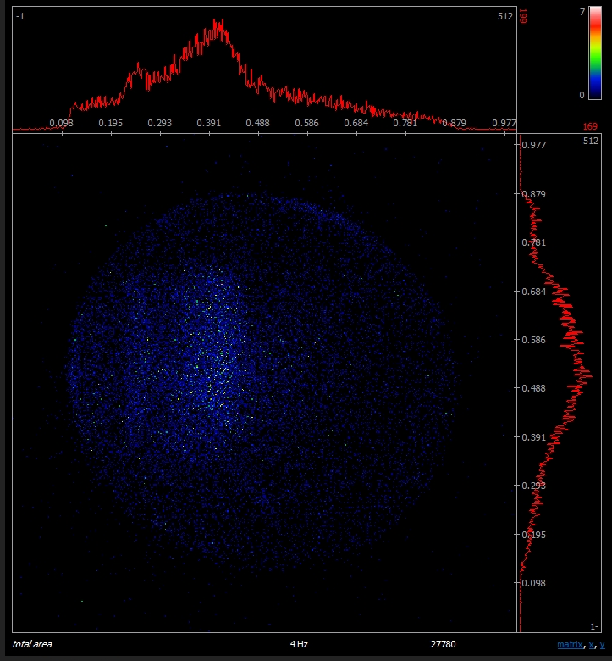
Facts and challenges from beamtime
Spectra measured without slit unit in about 45 min
Target: Kr/ Xe at 25bar, nozzle 25 microns, trumpet-shaped; projectile: Ne⁷⁺ @ 5MeV/u
background
Krypton
Xenon
Clear target-specific spectra detected → signal to noise even at this unfortunate spectrometer position is o.k.
10

Slide 11
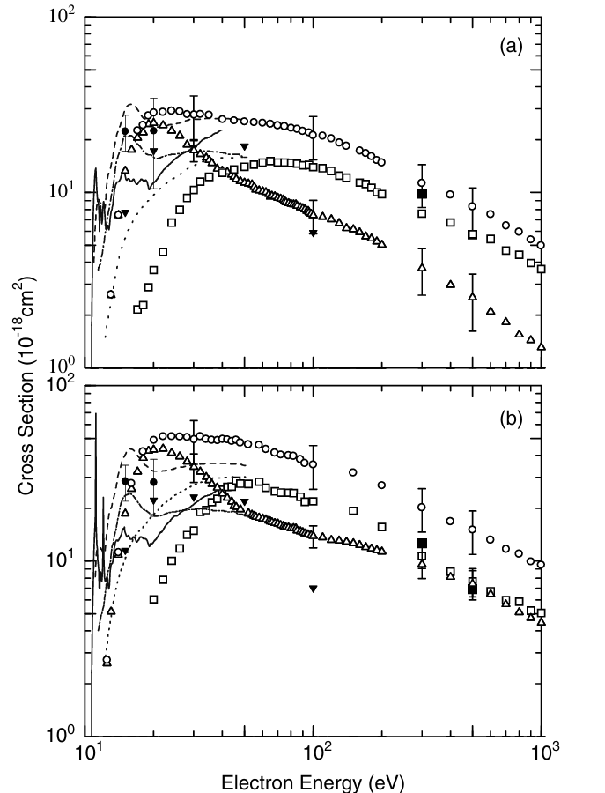
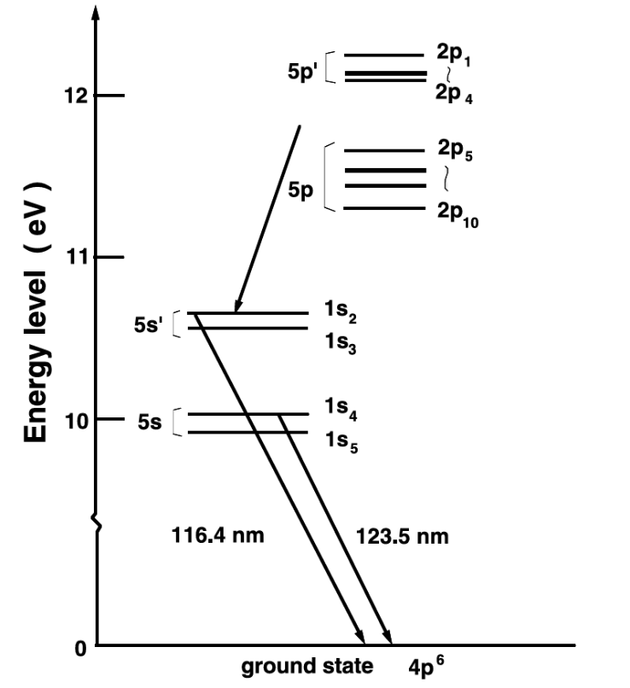
What are we looking for?
Kr (4p⁶5s⁰)
(116.4 nm)
5s4p⁵ → 4p⁶
(123.5 nm)
S Tsurubuchi et al 2003 J. Phys. B: At. Mol. Opt. Phys. 36 2629

Slide 12
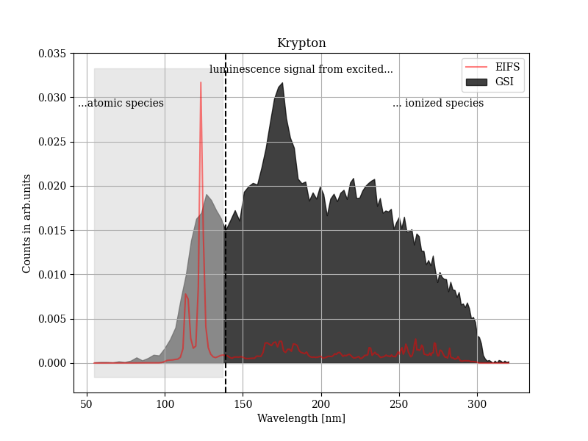
Cont..
Kr (4p⁶5s⁰)
Experimental run @ GSI
S Tsurubuchi et al 2003 J. Phys. B: At. Mol. Opt. Phys. 36 2629
Target: Kr/ Xe @ ~25bar, nozzle ~25microns, trumpet-shaped
Projectile: Ne7+ @ 5MeV/ion

Slide 13
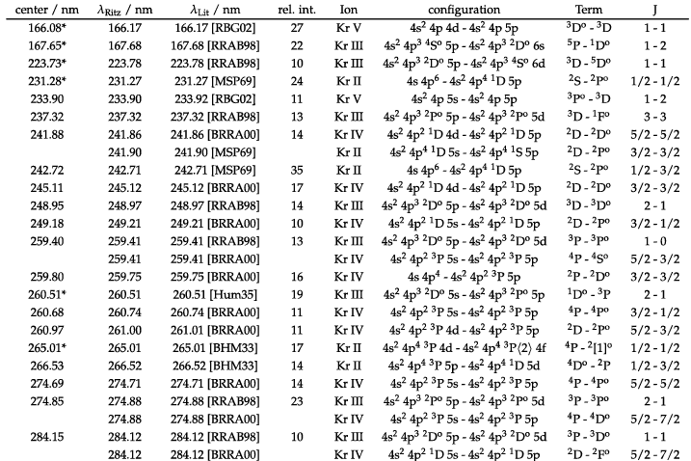
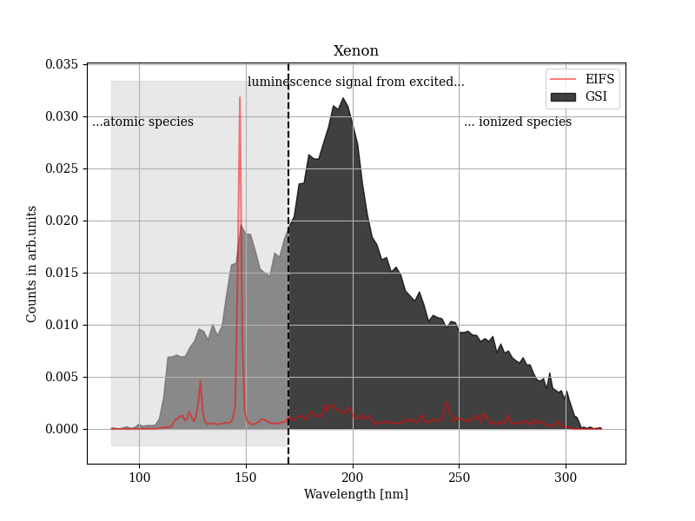
Kr ionic species lines
,
0.87
0.52
1.15
0.91
(Hartree unit)
1.93
1.5
32.7
129.6 nm
147.0 nm
Ne
Kr
Kr I
Xe I: 5p⁵(²P_{1/2})6s ²[1/2]₁ → 5p⁶ ¹S₀
Xe I: 5p⁵(²P_{3/2})6s ²[3/2]₁ → 5p⁶ ¹S₀
Roothaan-Hartree-Fock Atomic wave function by Clementi and Roetti

Slide 14
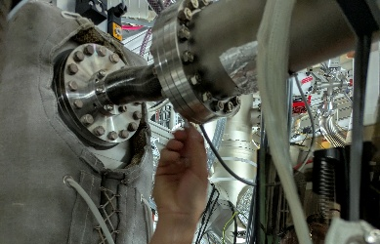
Previous set-up New set-up
Diagnostics and upgrade
Dectector
Dectector
Interaction
region
Interaction
region
Grating
Grating
slit
slit
400-450mm
50mm
Problem | Possible Cause
Very low signal | Distance between the grating and interaction region is large
Poor resolution | Slit needed to be removed, not in grating focus
Calibration | Spectra used might have slightly different conditions
Changes | Possible improvement
The distance between the grating and interaction region | More count rate
Use of slit or focused on interaction region | Might improve resolution
More gas density | More count rate
Projectile energy seems high for capture process
We should try for different projectile energy

Slide 15
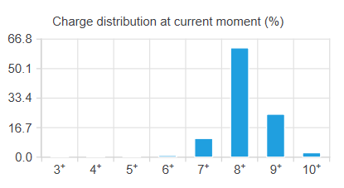
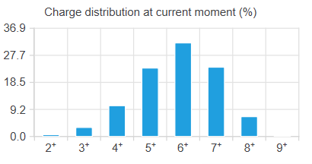
Projectile Ne⁷⁺ charge state distribution after collision
Kr Target density : 6.46 x${10}^{11}$atoms per ${cm}^{2}$
Projectile energy 5 MeV per u
Projectile energy 1 MeV per u
LISEcute++

Slide 16
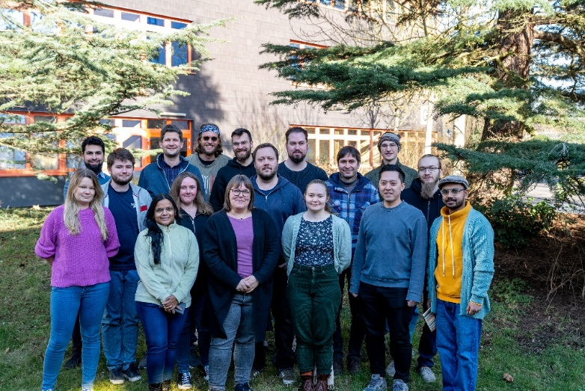

Current status and future plan for VLS spectrometer
Great support/ collaboration by
A. Gumberidze S. Hagmann E. O. Hanu
M. Lestinsky N. Petridis E. Menz U. Spillmann
Th. Stöhlker …
GSI
Summary
First detection of Kr- and Xe-target fluorescence after slow Ne⁷⁺ ion collision
Hints to fluorescence from target ions
There is room for improvement, but exciting, science seems very well feasible
We hope to obtain good signal to noise ratio in new configuration
A. Hans C. Küstner-Wetekam L. Marder
A. Krone D. Bloss C. Honisch N. Kiefer J. Viehmann …
Institute of physics U Kassel
धन्यवाद || Thank You
Danke ☺
P.-M. Hillenbrand
C. Brandau
S. Schippers
…
JLU Giessen
Monetary support by
is gratefully acknowledged

Slide 17
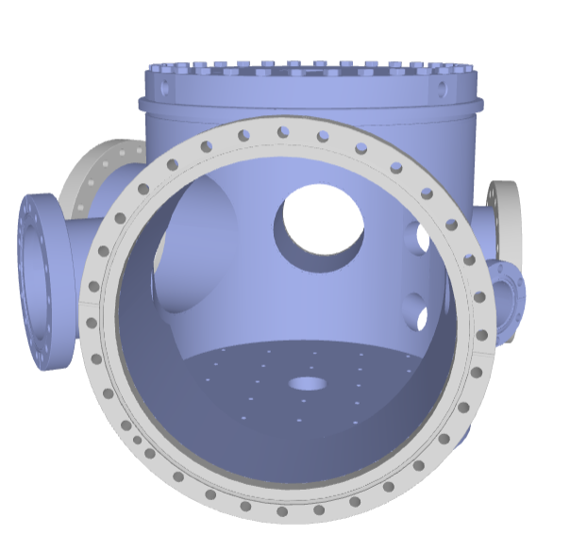
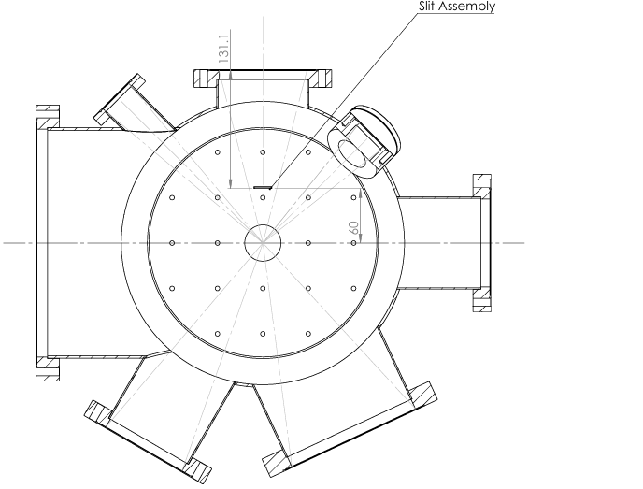
Special bellow: Total relax length not more than 70 mm
Idea: DN63 bellow both end with DN 100 Flange.
Grating:
100 mm
131 mm
55 mm
358 mm

Slide 18
E_{I+}
E_{I+}
4p
4p
3s
3s
2p
2p
2p
2p
2s
2s
2s
2s

Slide 19
