Slide 1
ESR
Machine Performance
During Beam Time 2025
Bernd Lorentz
for the ESR operating team
ErUM-FSP APPA, January 22 and 23, 2026

Slide 2
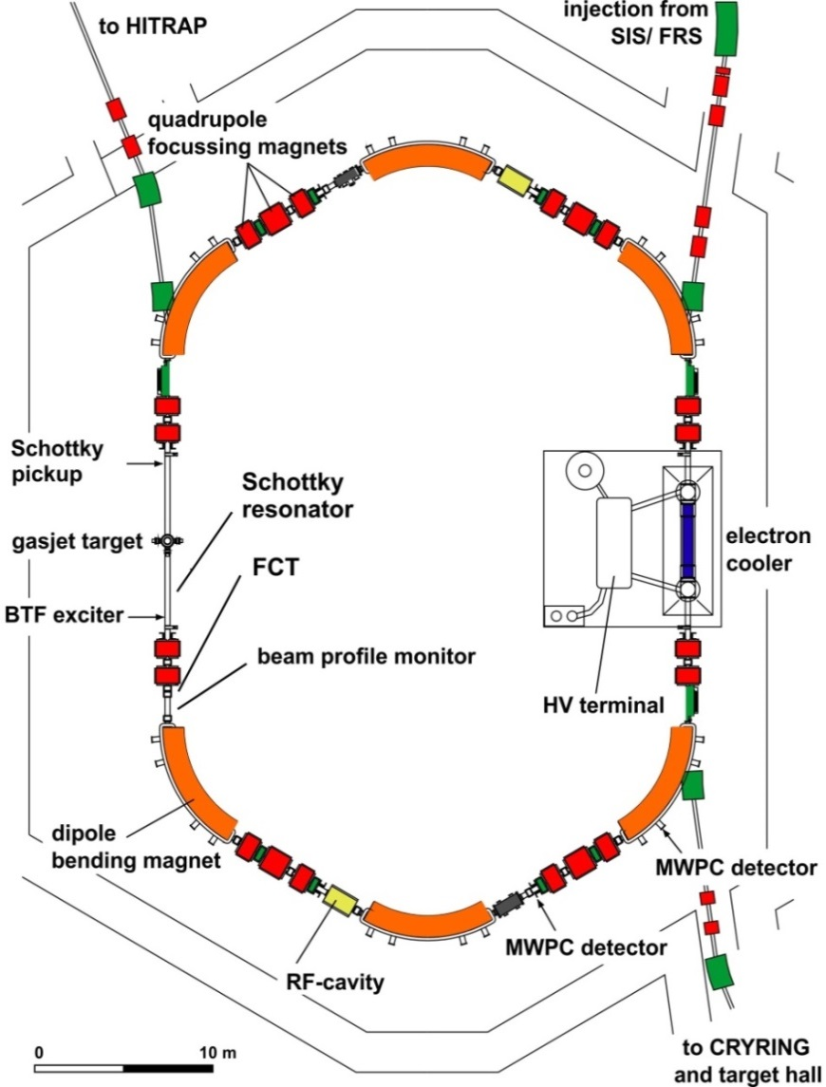
ESR operation modes (used in 2025)
injection of cooled beams from SIS18
storage of highly charged ions and secondary beams via TE or FRS
stochastic cooling (400 MeV/u)
electron cooling (3 - 420 MeV/u)
internal gas jet target
deceleration (minumum 3 MeV/u)
fast extraction to HITRAP or CRYRING
charge exchange extraction
accumulation
isochronous optics mode
schottky mass spectrometry of RIBs
slow resonance extraction

Slide 3
ESR operation in 2025
Chronological:
07.-24.02.: ¹⁰⁷Ag⁴⁵⁺ HITRAP commissioning
25.02-03.03.: ⁷⁸Kr³⁶⁺ ESR internal
09.03.-13.03.: ¹⁹⁷Au⁷⁹⁺ HITRAP experiment
18.03.-07.03.: ¹⁹⁷Au⁷⁹⁺ CryRing
08.03.-22.03.: ¹⁹⁷Au⁷⁹⁺ CryRing
03.04.-07.04.: ²⁰⁸Pb⁸²⁺/¹¹⁶Hf⁸²⁺ ESR internal, isochronous mode
28.04.-04.05.: ¹⁹⁷Au⁷⁹⁺ machine experiments
12.08.-18.05.: ²⁰⁹Bi⁸¹⁺ ESR internal
22.05.-01.06.: ¹²C⁶⁺ machine experiments
02.06.-11.06.: ⁴⁰Ar¹⁸⁺ machine experiments
19.06.-25.06.: ²³⁸U⁹²⁺/²²⁹Th⁸⁹⁺ ESR internal
30.06.-06.07.: ²³⁸U⁹¹⁺ CryRing
very
smooth
operation,
almost no
failures
a lot of failures
and retuning
(high temperatures,
cooling issues)

Slide 4
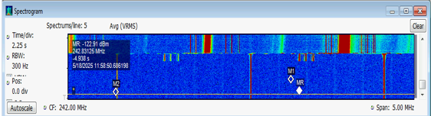
²⁰⁹Bi⁸¹⁺/²⁰⁸Bi⁸⁰⁺ ESR internal
²⁰⁹Bi⁶⁸⁺ from SIS18, stripped to ²⁰⁹Bi⁸¹⁺ in TE Stripper, stacking with stochastic and electron cooling
Deceleration (400 -> 374 MeV/u)
Switch to production target, Injection of ²⁰⁸Bi⁸¹⁺, breading ²⁰⁸Bi⁸⁰⁺ by charge exchange in e-Cooler
Deceleration of ²⁰⁸Bi⁸⁰⁺ (400 -> 374 MeV/u) and scraping
²⁰⁸Bi⁸⁰⁺
scrapers remove unwanted isotopes after deceleration

Slide 5
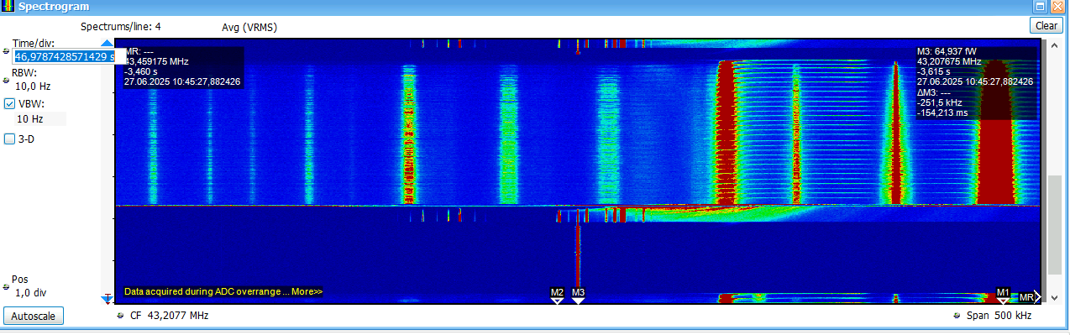
²³⁸U⁹²⁺/²²⁹Th⁸⁹⁺ ESR internal
refined procedure for purification of 229Th89+:
40xstacking with stoch. cooling and synchr. RF SIS18-ESR, electron cooling after accumulation
deceleration and debunching for scraping unwanted fragments,
rebunching of the 229Th89+ for laser excitation measurements
many failures during the whole time of this experiments over the whole accelerator chain (hot weather...)

Slide 6
Machine Experiments in 2025
For the first time ESR machine experiments were executed
in parallel to user operation at other places, leading to signigicant
improvement in available time.
(very usefull, I hope this can be continued in the future...)

Slide 7
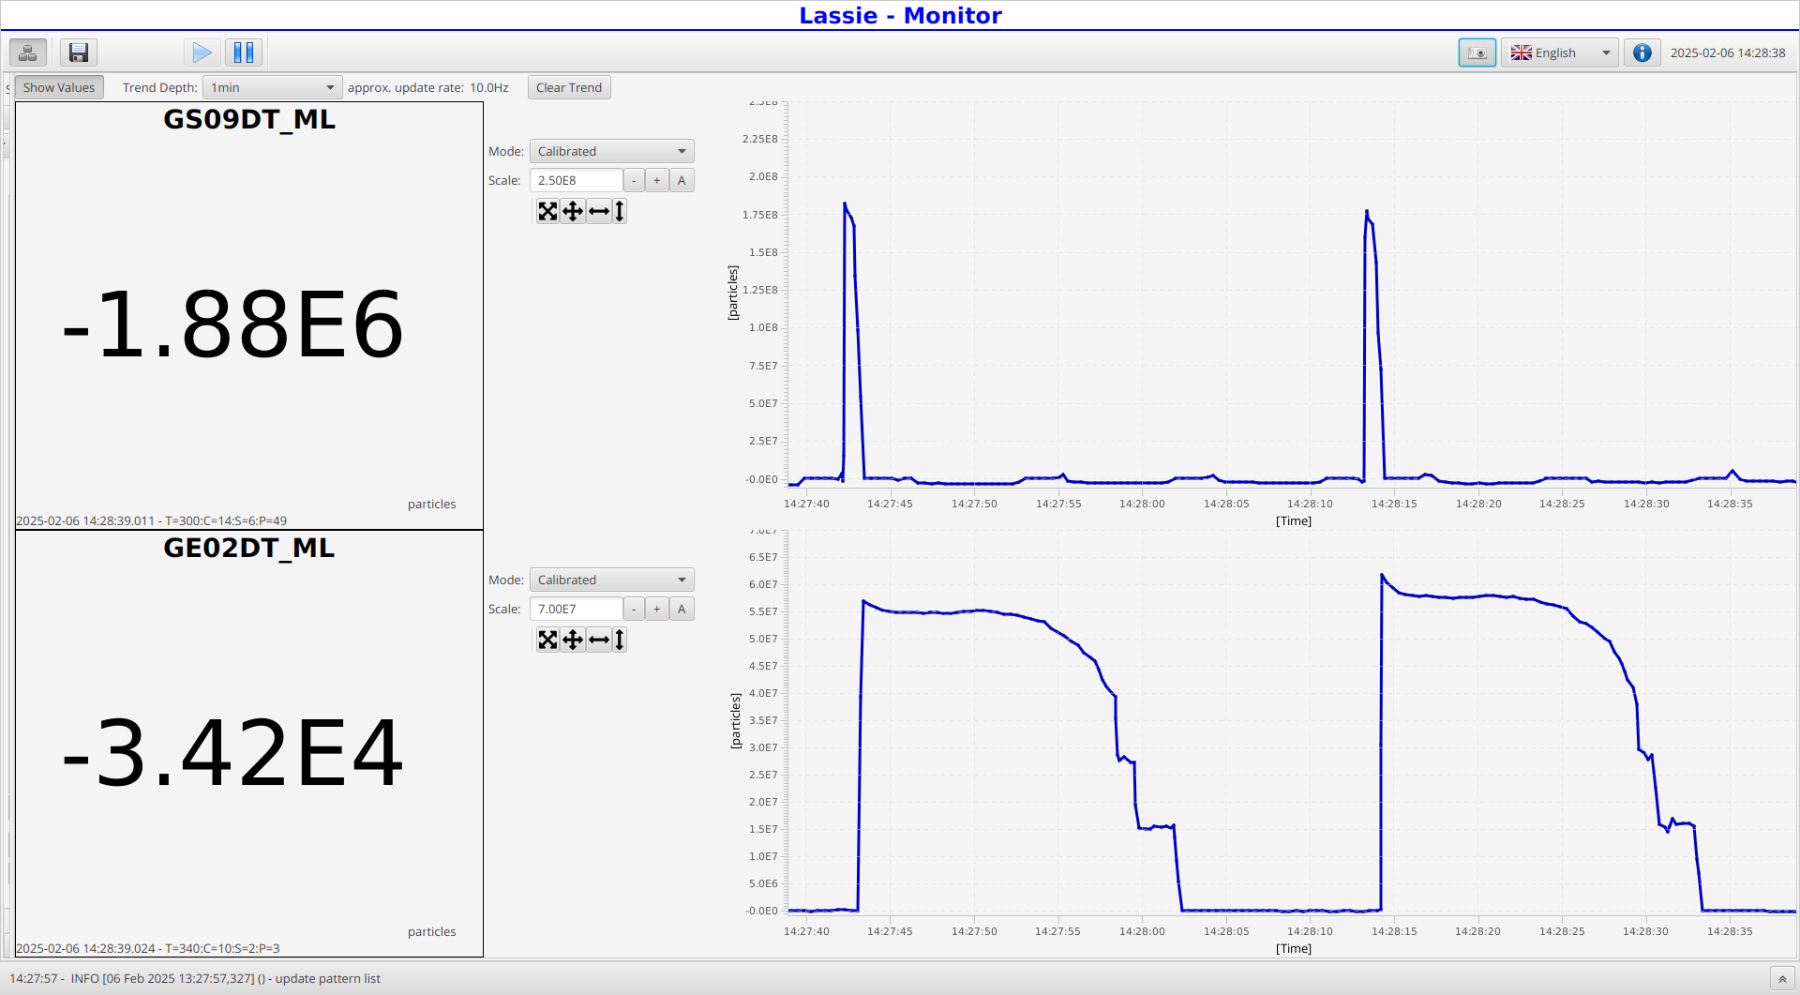
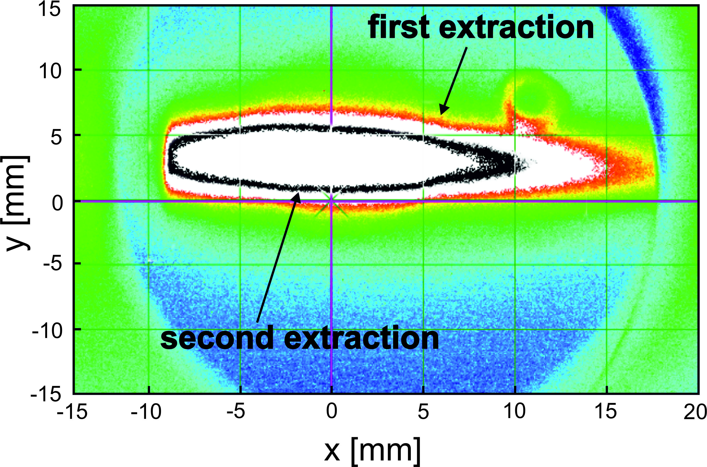
Multiple extractions for HITRAP
Bunching on 2nd harmonic, duplicate extraction subchain,
kick 1st bunch, readjust hf phase in second extr. subchain to kick the second bunch
first screen ESR to HITRAP
first extraction
second extraction
ESR intensity
option for more efficient HITRAP setup
could not directly be used by HITRAP, needs special pattern, controls setup
courtesy: S.Litvinov

Slide 8
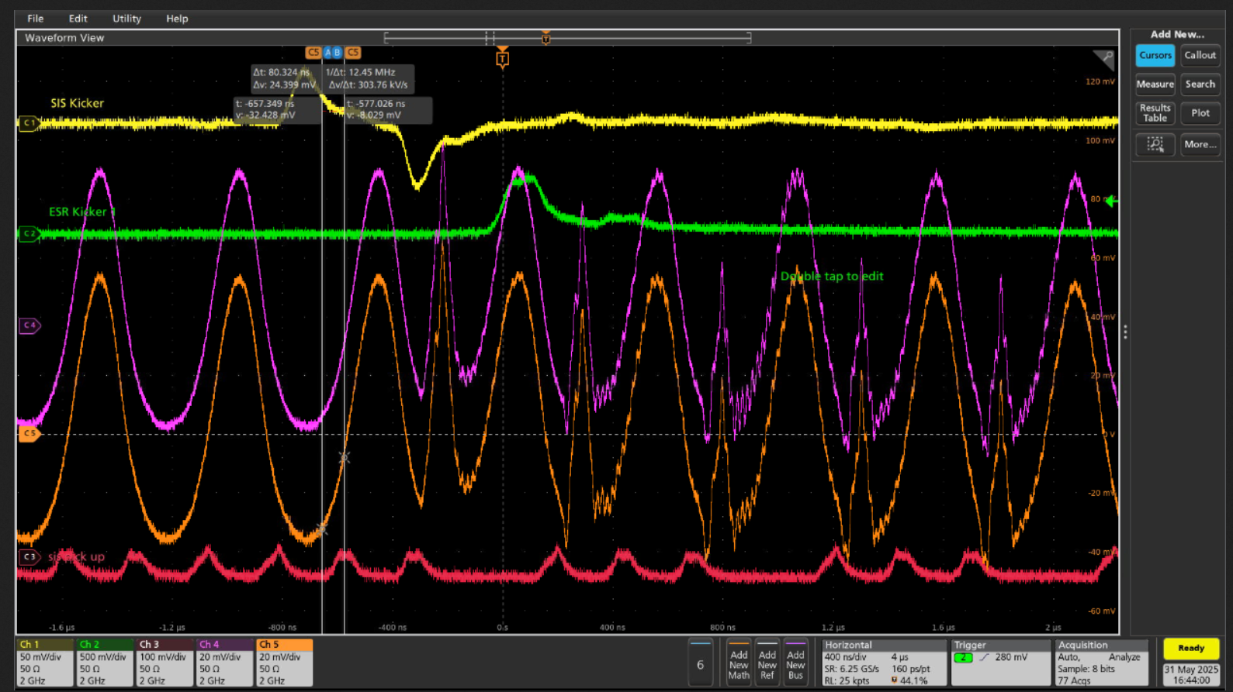
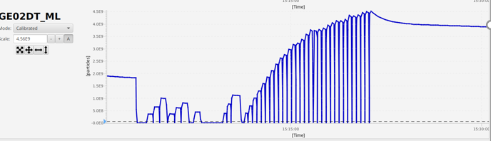
Stacking with fixed Barrier Bucket (or H=1)
of importance especially for future FAIR storage rings
but also can be more effective than the usually applied stacking with stochastic cooling on injection orbit and electron cooling on displaced orbit
Procedure: Synchronization between SIS HF and ESR HF allows injection into the unstable region of the bucket, the beam is then cooled into the stable bucket area
injected bunch
accumulated bunch
intensity increase from 5e8 upto 4e9 for 12C6+
SIS kicker
ESR kicker
ESR bunch
(2 bpm‘s)
SIS bunch
4th harmonicc

Slide 9
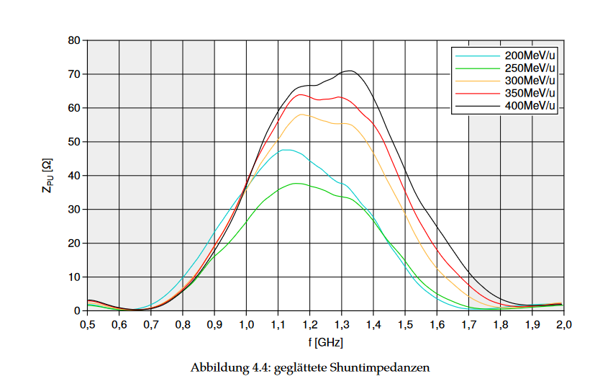
Stochastic Cooling
Possible extension of energy range in the future
measured shunt impedance at stochastic
pickups between 200-400 MeV/u
Study of real stochastic cooling at different
energies (which also involves the stochastic
kicker efficiency) will follow in the future
courtesy: C.Peschke

Slide 10
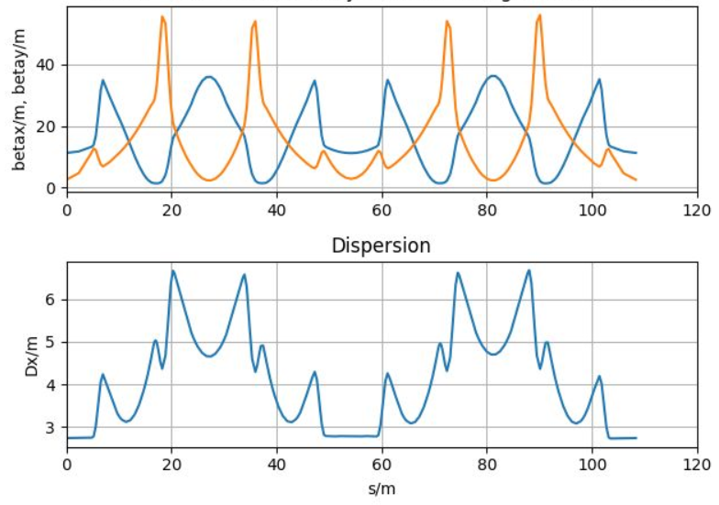
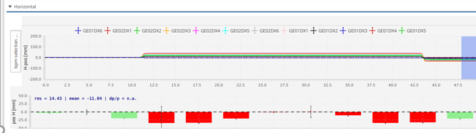
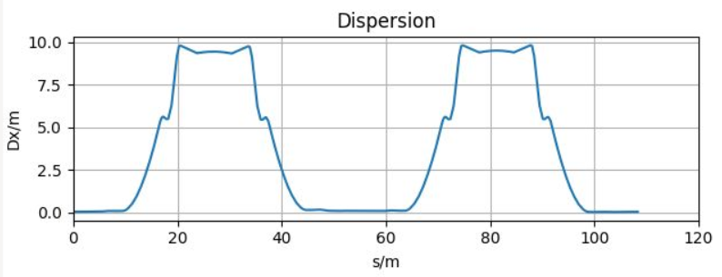
Beam Optics studies
old „standard optics“
difference orbit when changing
the momentum of the stored beam
by change of bunching frequency
=> dispersion around the ESR
This will be our
„new standard optics“
in the future
(button in LSA to
easily adjust D in
straight sections
will be prepared)
change of 1 quad family by 4 %,
tune adjustment with two different families
(beta function aprox. the same)
D=0 in straights

Slide 11
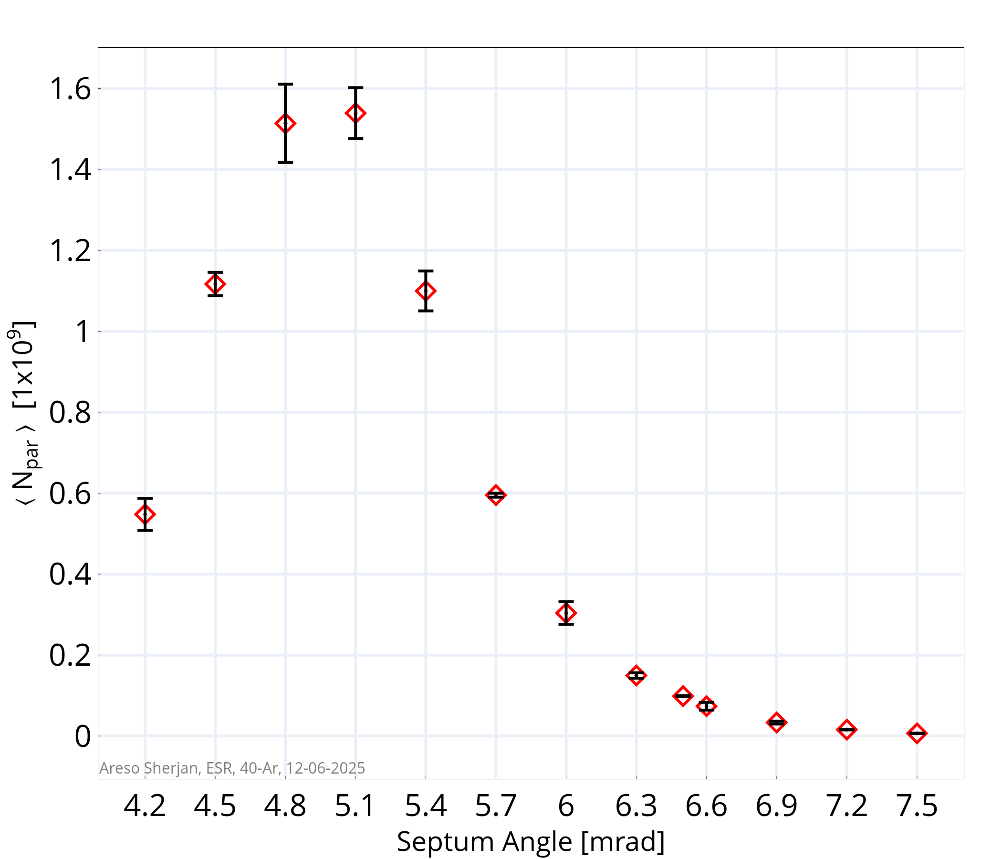
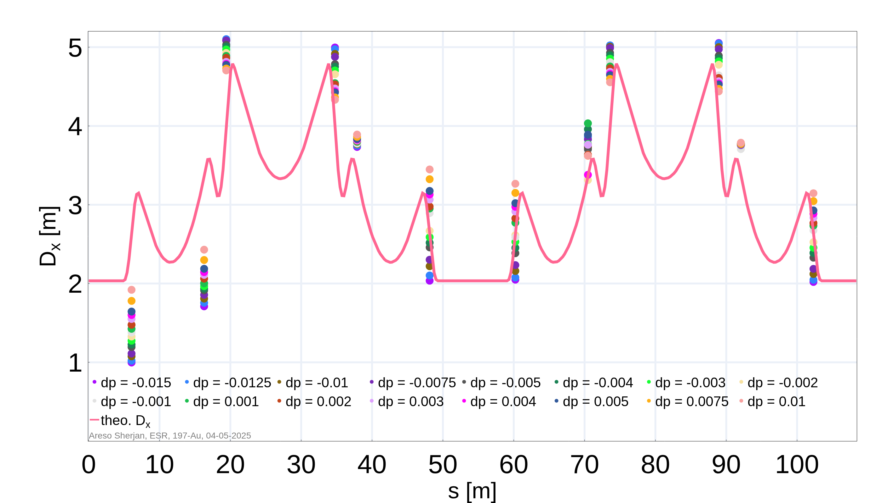
Investigation of Deceleration
Possible improvement of efficiency in the future
Optics Model for Deceleration Studies
Initial Setting:
N_{par} ~ 6 x 10⁶
Measurement Campaign at ESR May, June 2025
Areso Sherjan/ Giuliano Franchetti
Many thanks to O. Chorniy and T. Giacomini for the support.
courtesy: A.Sherjan

Slide 12
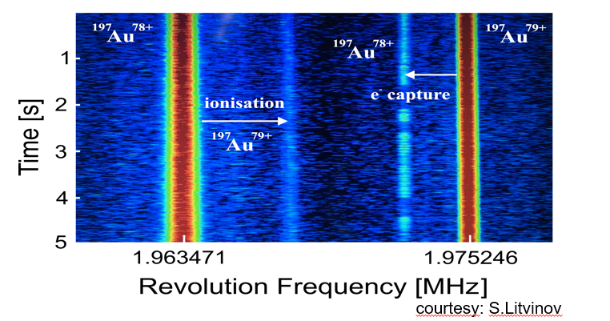
Co-colliding beams
storage of two different ions of the same rigidity, on identical orbit, opening up the way to new experiments (demonstrated for Au78+, 79+ and U91+, 92+, could also be applied to different ions with apropriately selected chargestates)
next steps:
bunch the two beams
cool the two beams
crossing of the two beams
at dedicated location

Slide 13
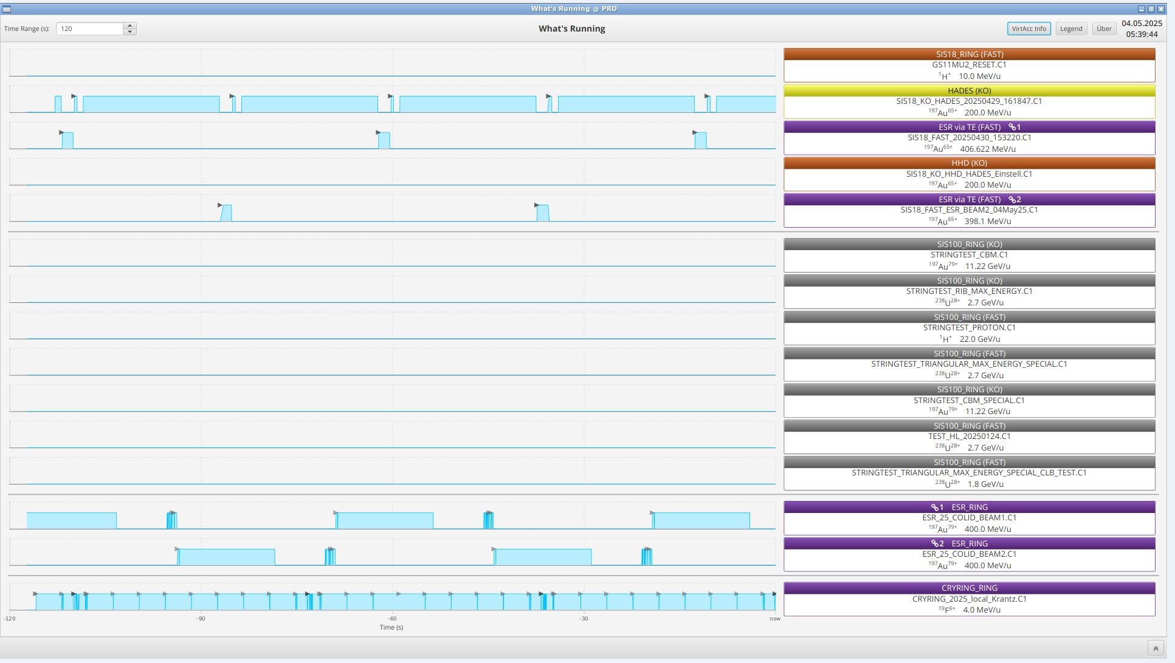
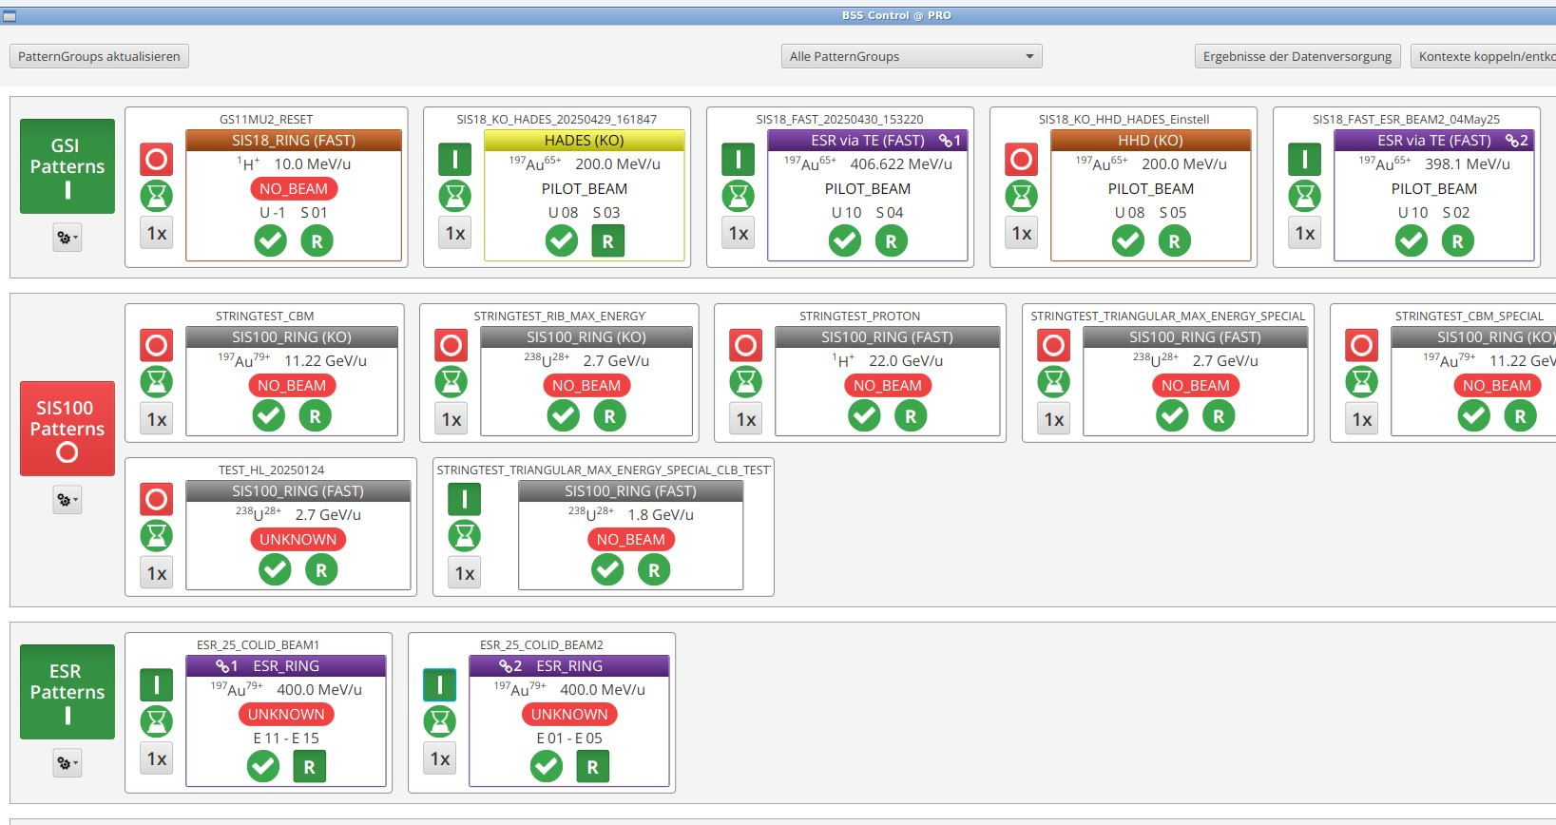
Two SIS18-ESR chains
Second chain
We run 2 chains one after each other.
First chain

Slide 14
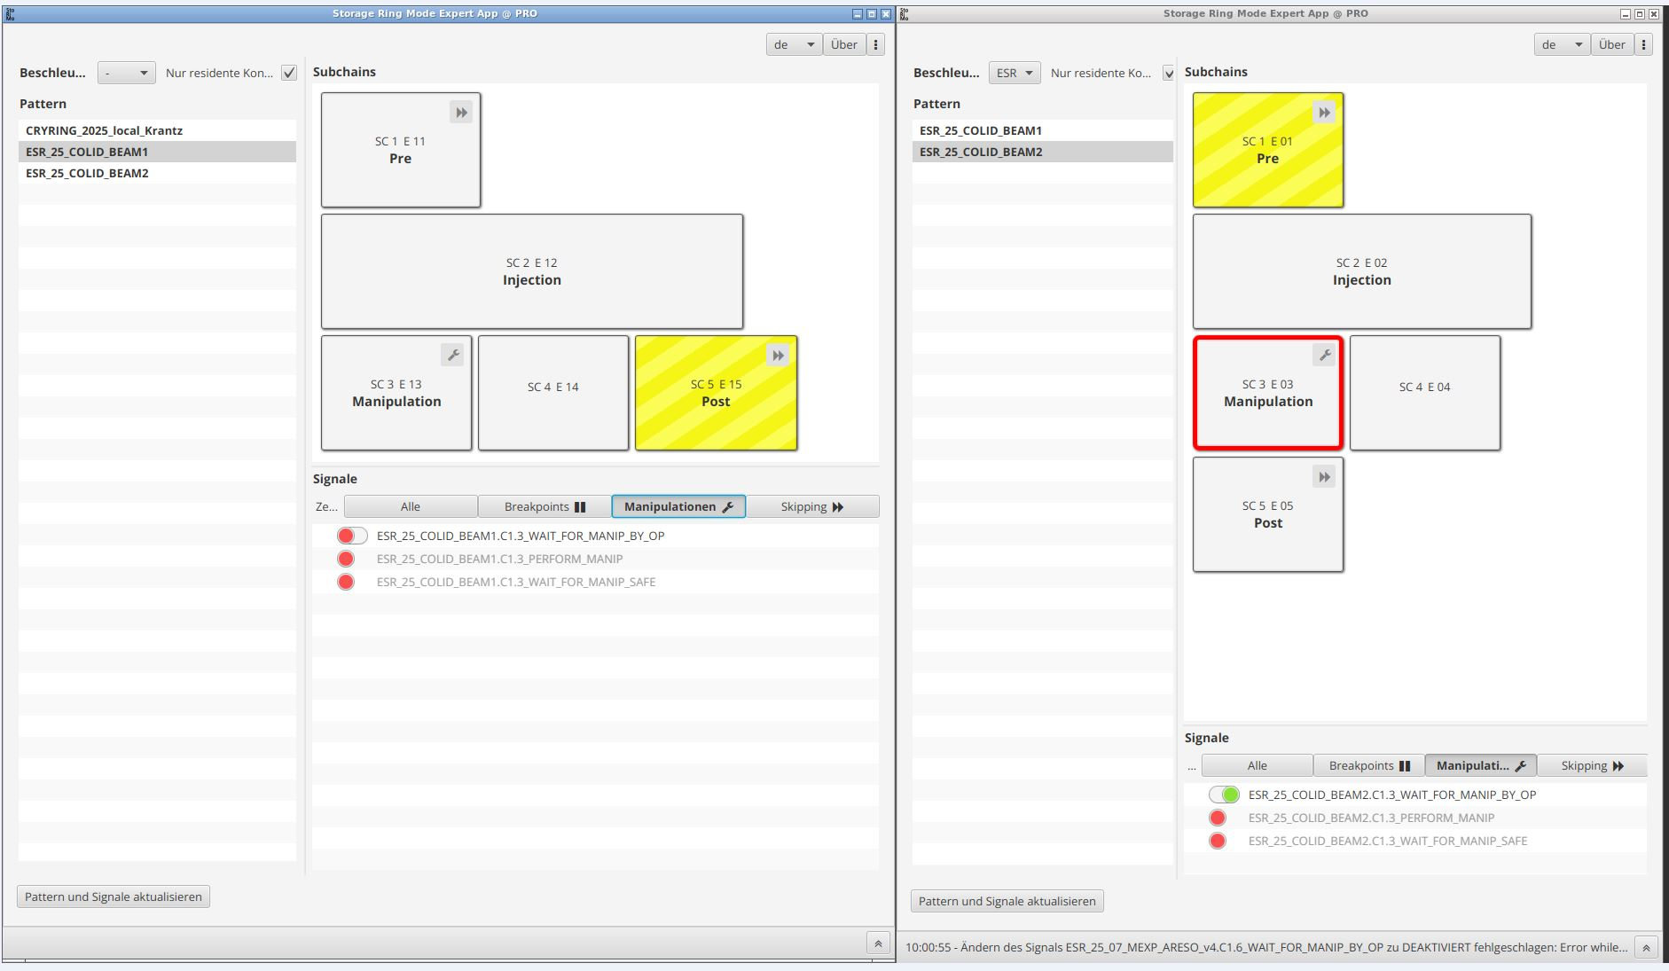
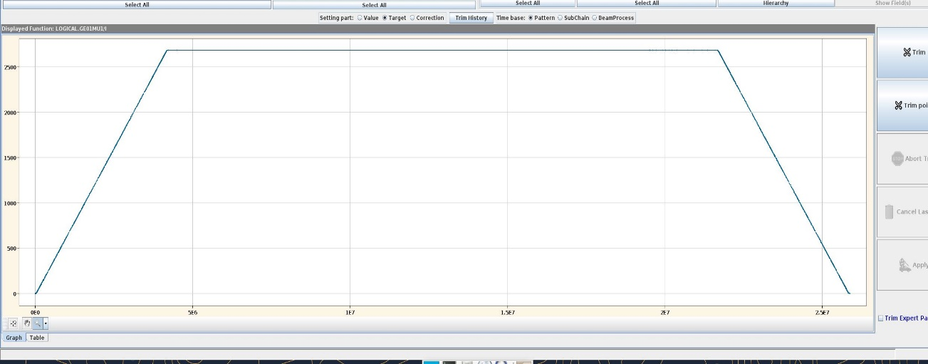
Running 2 ESR together
Pre
Post
Pre
Post
ESR 1
ESR 2

Slide 15
Summary
ESR operation in 2025 was successfull
only during the Thorium experiment a lot of problems were encountered
LSA and storage ring expert app offers a very flexible operation of the storage ring
  all experiment requirements can be satisfied
  it opens up the way to new developments (e.g. multiple extractions, storing different ions simultaneously)
the transition of ESR hardware to FAIR standards is not yet completed, the performance is therefore still restricted
monitoring the system and error diagnosis is not possible adequately due to the lack of actual values (istwert erfassung!) and archiving and should be given high priority!!!
Machine experiments in parallel to running physics experiments at SIS18 worked well, and should be continued

Slide 16
Outlook to 2026
Shutdown work 2025/2026
Repair of Extraction Septum in direction HITRAP (exchange of coil) (work in progress now)
Preparation work in the target region for upcoming experiments (postponned)
Work on the mechanics of pressurized air drives (exchange of aged parts)
(Strategy for longer term solution decided: Replacement with system similar to that at CryRing)
Exchange of MCP‘s of IPM (venting Southern Arc of ESR, after Dry Run)
^{regular maintanance work}
conversion of the recently acquired PTB Main e-cooler HV device for use with
faster ramp speed (delivery June/July 2026)
^{Dry Run in February 2026}

Slide 17
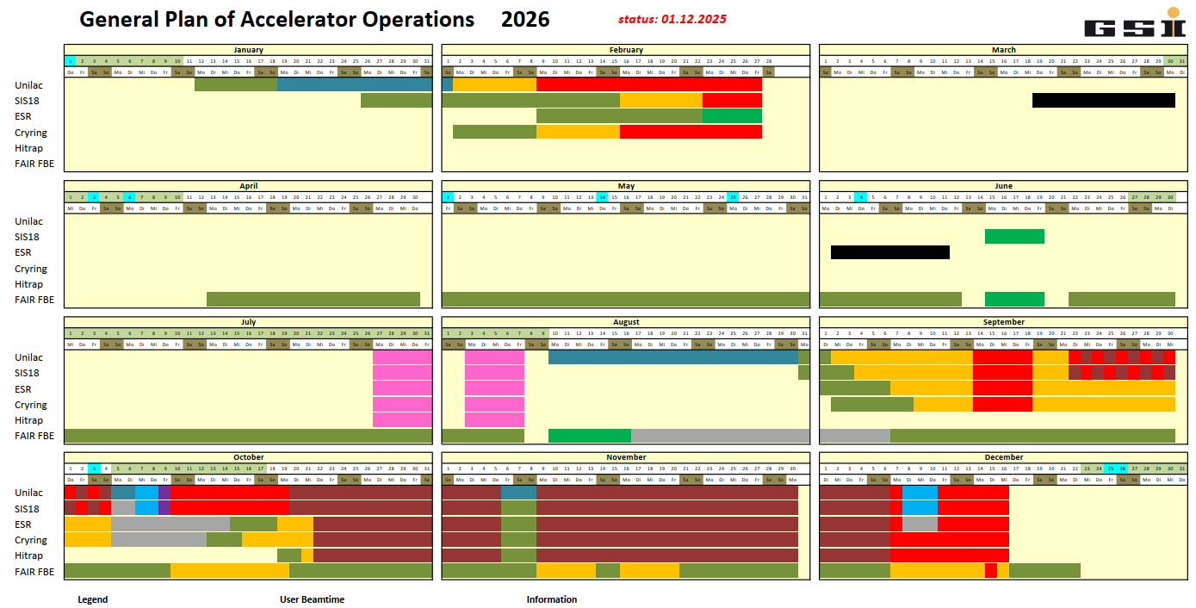

Slide 18
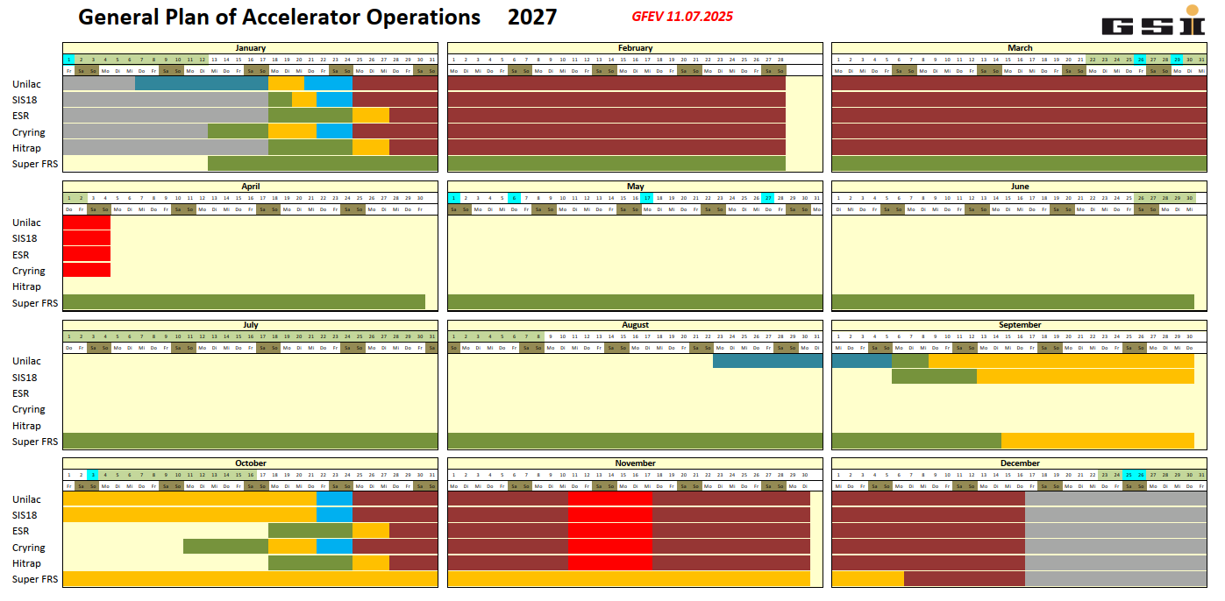

Slide 19
ESR will be ready for operation from FCC in Sept. 2026
Thank you for your attention

