Slide 1


Dielectronic Recombination (DR) of Highly Charged Ions: Comparative Study of Theory and Experiment
Houke Huang
Relativistic Quantum Dynamics of Ions and Beams @Prof. S. Fritzche
Annual Meeting of APPA
2026-02-23

Slide 2
Introduction
Theory of electron-ion recombination: Benchmark study @CSRm @Jena Atomic calculator
Nuclear effects:
Hyperfine-resolved DR resonances
Summary and outlook
Overview
Notes:
Here is the outline for the talk; I will mainly report recent progress on the benchmark study of Expt. and theo. of DR of of astrophysical relevance ions. Besides, a simulation study of hf-resolved DR resonance of interesting ions is given.

Slide 3
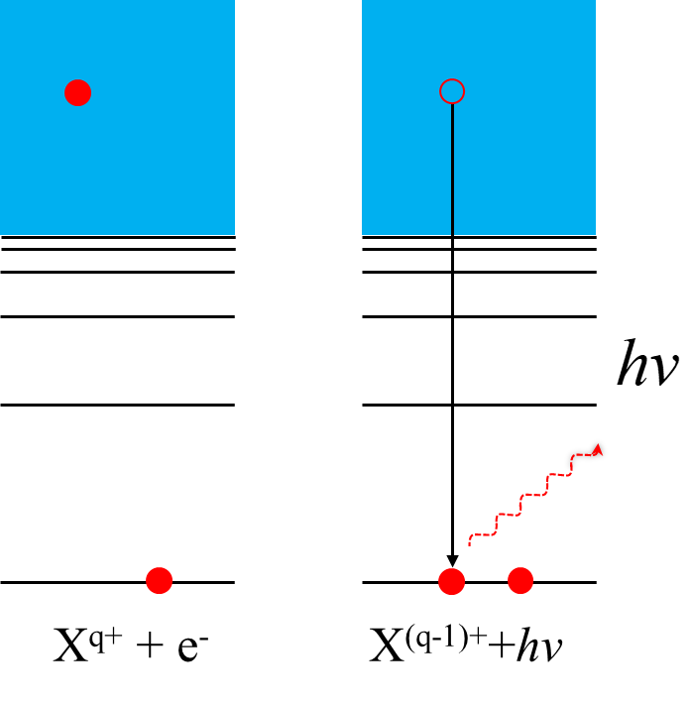
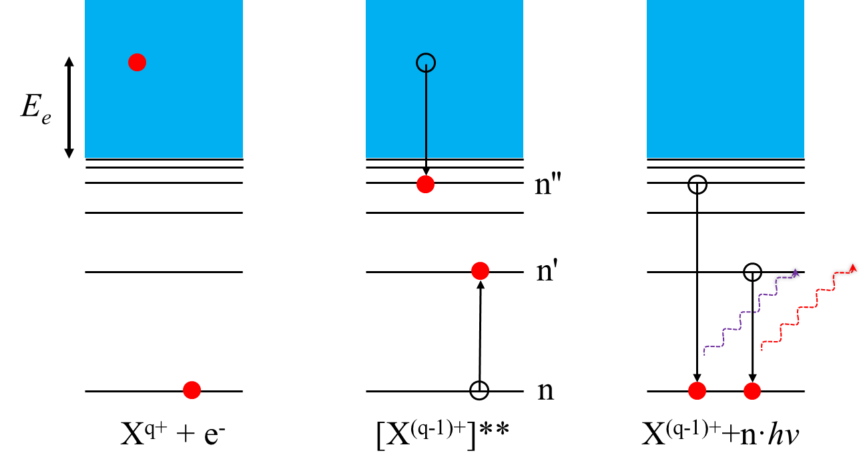
Electron-ion recombination process
E_{rel}
DR spectrum
E_{rel}
Rate coefficients
E_{Rydberg}
△E_{core}
[X^{(q-1)+}]**
Dielectronic capture
Radiative stabilization
(a)
(b)
(a)
(b)
(c)
Radiative recombination(RR)
Dielectronic recombination（DR）
Notes:
RR is a direct process where the target ion captures a free electron, and the excess energy is emitted as a photon.
On the contrary, DR is a two-step resonant process. Initially, an electron is captured resonantly from the continuum, resulting in the formation of a doubly excited ion in a lower charge state. This unstable state may either autoionize back to the initial continuum state or stabilize through radiative decay to a bound state below the first ionization threshold. The latter step completes the DR process.
Resonant condition
Scan … measured recombined ions to gain DR spectra.

Slide 4
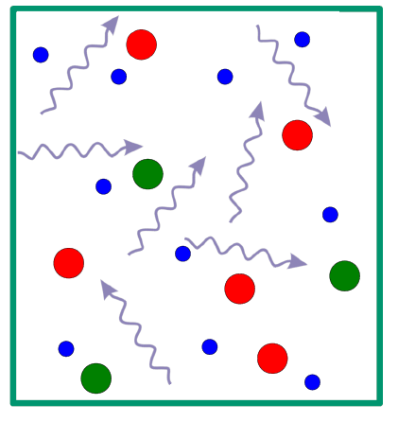
The role of DR@ Atomic data for modeling in plasmas
In order to model the spectra emitted from astrophysical plasmas, one needs “reliable” atomic data of:
Photoionization cross sections
Radiative recombination (RR) rate coefficients
Dielectronic recombination (DR) rate coefficients
Electron impact ionization (EII) rate coefficients
Charge transfer rate coefficients with H, He,…
Three body recombination
Other processes….
DR is widely recognized as playing a crucial role in determining ionization balance and level populations over a broad temperature range.
Reliable data? Benchmark!
D. Savin, JPCS 88 (2007) 012071; Nature Astronomy 2, 608–609 (2018)
Notes:
Generated by state-of-the art theories
But it is found that we need to benchmark theoretical DR data… using laboratory measurements … especially for many-electron ions … in order to provide reliable and accurate atomic data that meet the demands of high-resolution X-ray astrophysics

Slide 5




TSR @ MPIK in Heidelberg
Electron cooler + Electron target
TSR@MPIK,
Heidelberg
Stefan Schippers
Alfred Müller
Andreas Wolf
Daniel Savin
Kilgus et al., PRL 64, 737 (1990)
Schnell et al., PRL 91, 043001 (2003)
Schippers et al., PRL 98, 033001 (2007)
Lestinsky et al., PRL 100, 033001 (2008)
Schippers et al., NIMB 350, 61 (2015)
D. W. Savin receives the 2026 LAD Laboratory Astrophysics Prize: He led a 21-year project measuring dielectronic recombination, the dominant electron-ion recombination process for most atomic ions in astrophysical plasmas.
Notes:
In last decades, the TSR has provided benchmark experimental DR datasets for a wide range of ions in astrophysical plasmas, thereby significantly advancing the development of state-of-the-art DR theories.

Slide 6
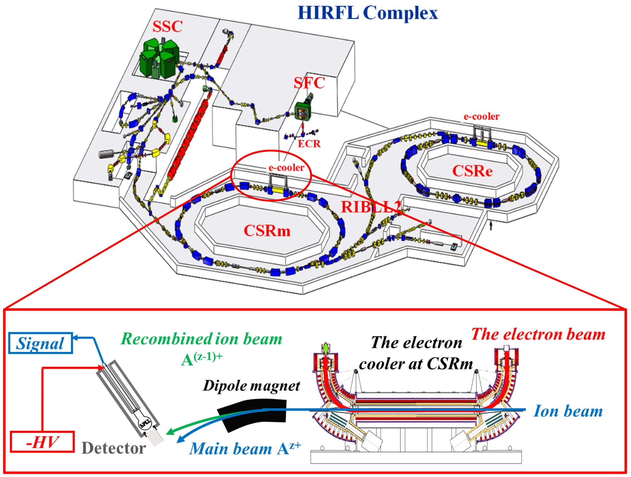
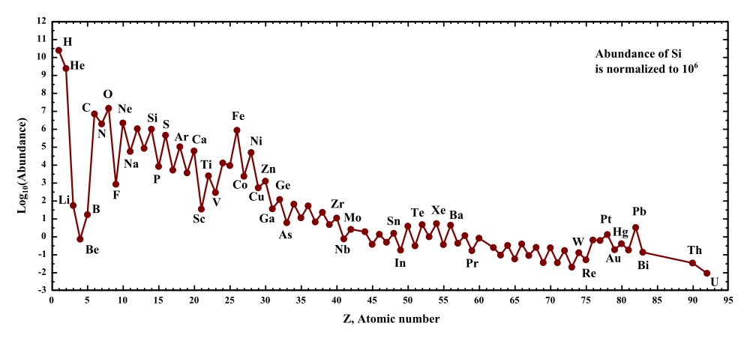
DR experiments at storage rings…
@IMP in Lanzhou
@TSR
All ions are equally important. ...
but some are more equal than others.
Ni : Number of stored ions in the ring;
n_{e} : Density of electrons at the merged section;
L : Interaction length;
C: Length for the circumference of CSRm;
β _{e} , β_{i} :Relativistic factor for electron and ion beam;
Ar^{12+,13+,14+, 15+}, Ca^{14+,16+,17+}, Fe^{15+, 17+},Ni¹⁹⁺,
Kr^{19+, 25+, 30+}, Sn³⁵⁺
Notes:
Abundant ions Fe
Fe15+

Slide 7
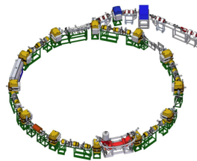


CRYRING @ MSL in Stockholm
CRYRING
@ GSI/FAIR
High energy resolution
formerly @ MSL
DeWitt et al., PRA 50, 1257 (1994)
Bartsch et al., PRL 79, 2233 (1997)
Mannervik et al., PRL 81, 313 (1998)
Lindroth et al., PRL 86, 5027 (2001)
Schuch et al., PRL 95, 183003 (2005)
Reinhold Schuch
Eva Lindroth
RMBPT theory

Slide 8
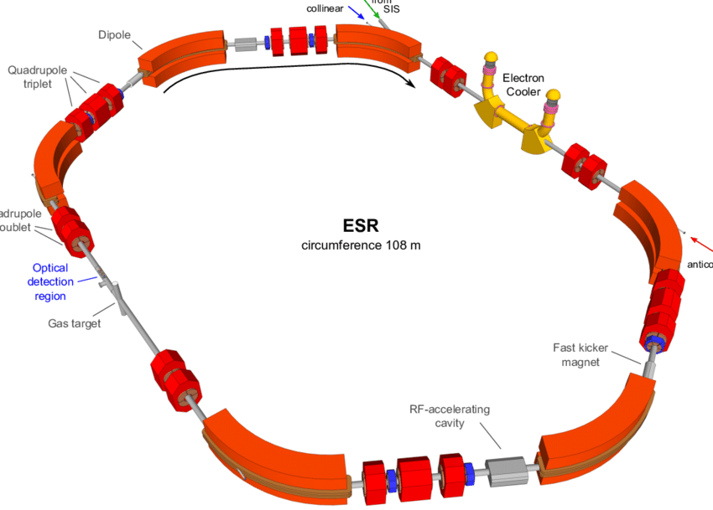
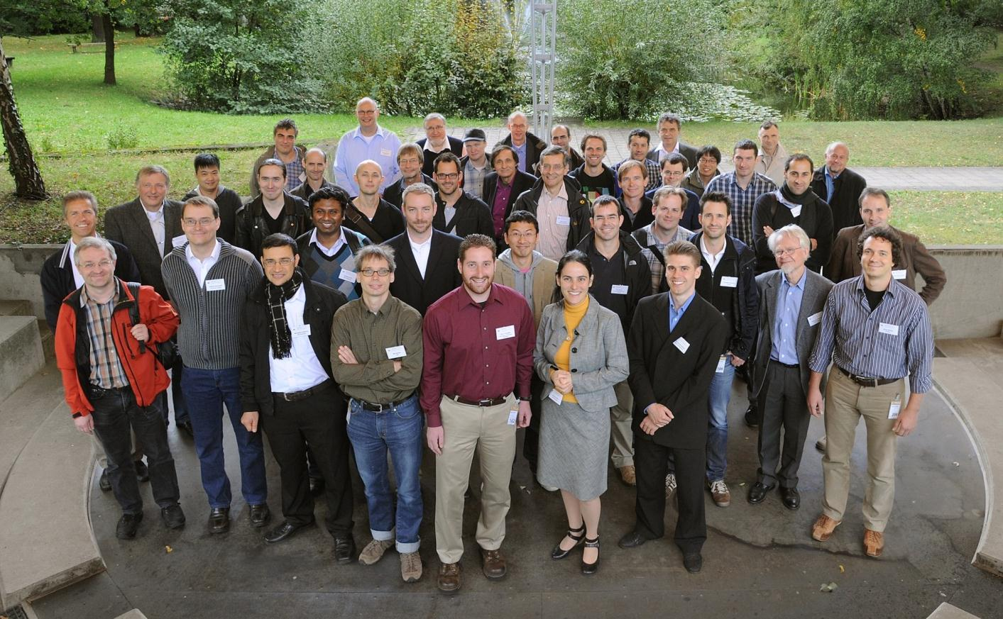
ESR @ GSI in Darmstadt
Heavy highly-charged ions
Carsten Brandau
ESR@GSI, Darmstadt
Spies et al., PRL 69, 2768 (1992)
Brandau et al., PRL 89, 053201 (2002)
Brandau et al., PRL 91, 073202 (2003)
Brandau et al., PRL 100, 073201 (2008)
Bernhardt et al., PRA 83, 020701 (2011)
Note: The CRYRING has been moved to GSI and combined with the ESR ： CRYRING@ESR
@Mirko Looshorn (Gießen, SPARC): Testing QED by Electron-Ion Collision Spectroscopy of Highly Charged Ions at CRYRING@ESR

Slide 9
Introduction
Theory of electron-ion recombination (Benchmark study @CSRm @Jena Atomic calculator)
Nuclear effects: Hyperfine-resolved
Summary and outlook
Overview

Slide 10
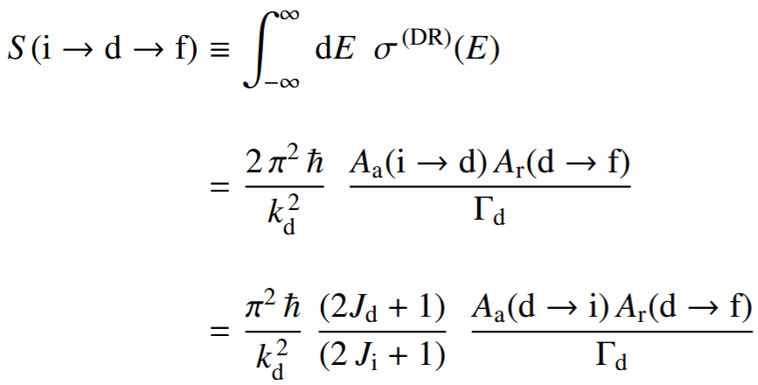
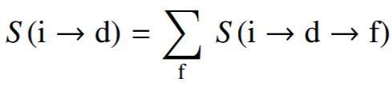

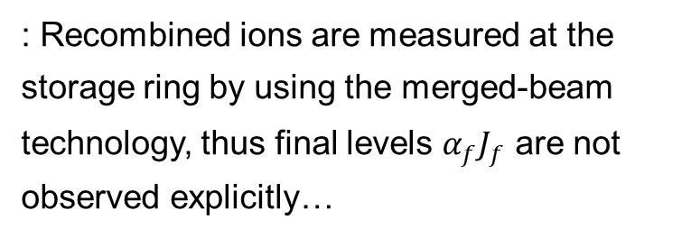
DR as a “half-scattering" process
DR as a two-step process: $A^{q+}(α_{i}J_{i})+e^{−}(εκ)→A^{\left(q−1\right)+∗}(α_{d}J_{d})⟶A^{\left(q−1\right)+\left(∗\right)}(α_{f}J_{f})+ℏω$
Independent process and isolated resonance approximation, partial DR strength for pathway $S(i→d→f)$and total DR strength for passage $S(i→d)$:
Distorted wave approximation: all continuum orbitals are generated in a local potential(Dirac-Hartree-Slater or others) of the ionic core, and without the explicit treatment of the exchange interaction.
: Recombined ions are measured at the storage ring by using the merged-beam technology, thus final levels $α_{f}J_{f}$ are not observed explicitly…
CPC 182,7 (2011); Rep. Prog. Phys. 60 691 (1997); A&A 656, A163 (2021)
Notes:
10

Slide 11

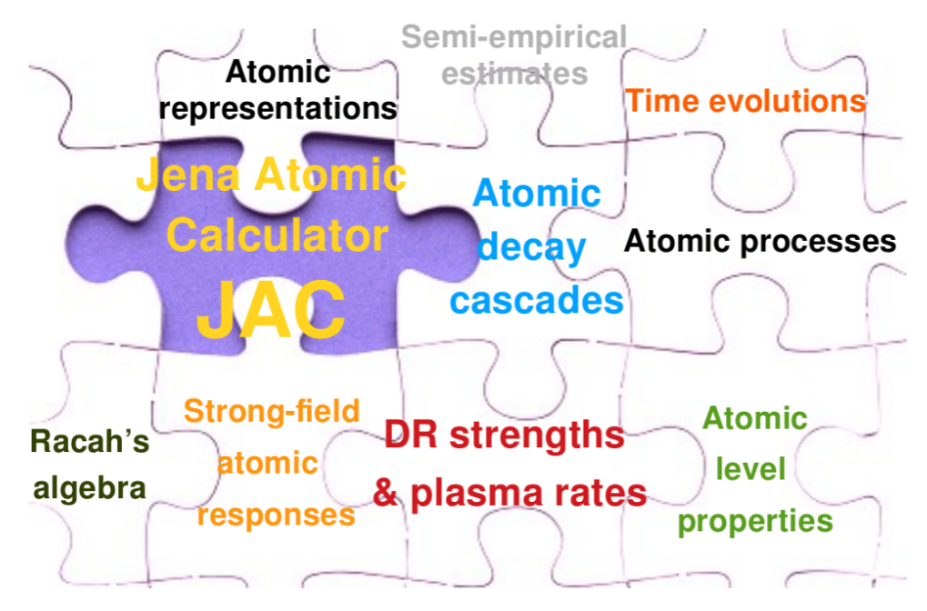

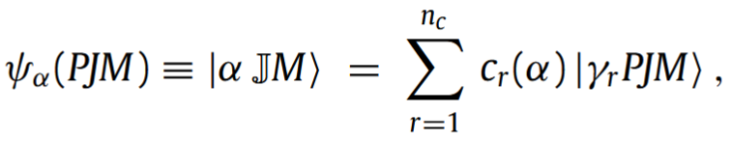
Building block: fine-structure levels
JAC@Multiconfiguration Dirac–Hartree–Fock (MCDHF) method
Dirac-Coulomb–Breit Hamiltonian
Atomic state function (ASF) is written within the MCDHF model as a linear combination of configuration state functions (CSF) with well-defined parity P, total angular momentum J, and its projection M:
Accurate atomic amplitude
The accuracy of any (atomic) computation also critically depends on the representation of atomic states and the explicit definition of the many-electron basis.
S.Fritzsche, Computer Physics Communications 240 (2019) 1–14
Notes:
11

Slide 12


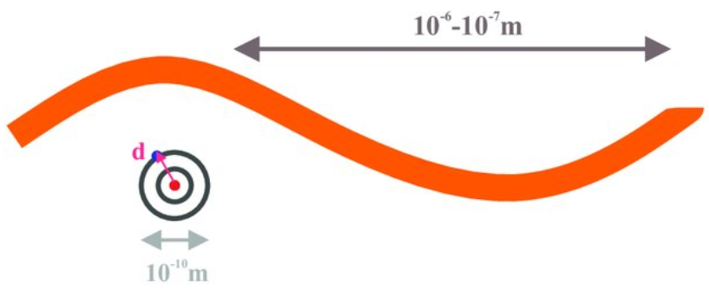

Building block: E1 transition rate
Electro-magnetic multipole transition amplitudes and probabilities
Quantum notation and amplitudes
A multipole M ≡ (L, p) ≡ (L, electric/magnetic) = E1, M1, E2, ... hereby contains all information about its multipolarity (angular momentum) L and type magnetic (p = 0) or electric (p = 1) , respectively.
E1-Dipole approximation ($λ≫a_{0}$): $D=−er$
electron-photo interaction
Notes:
12

Slide 13
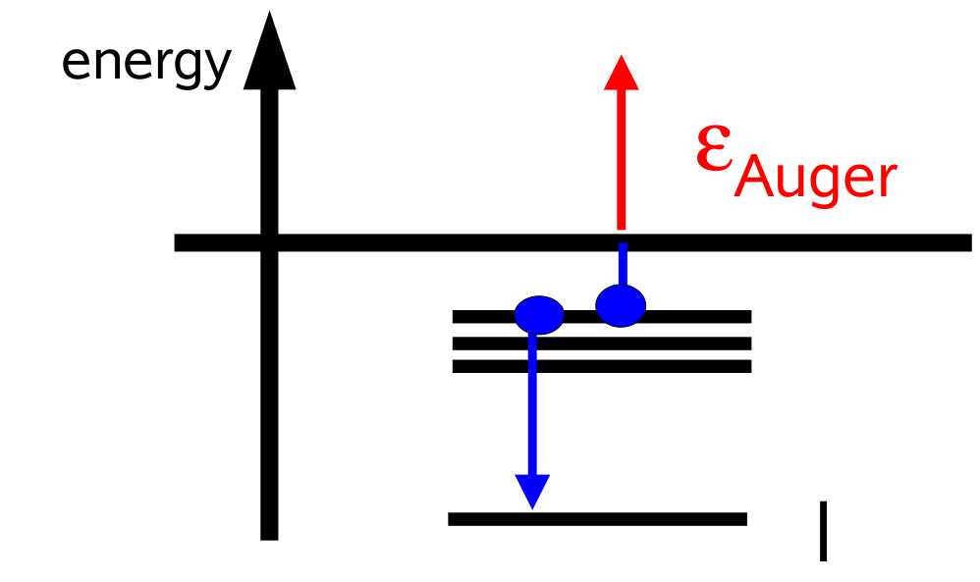


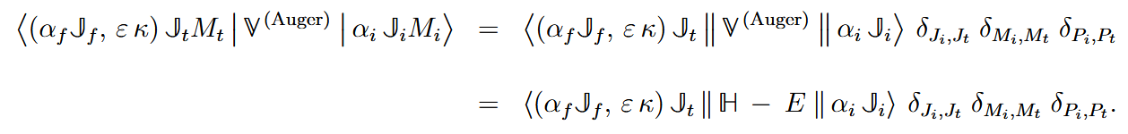

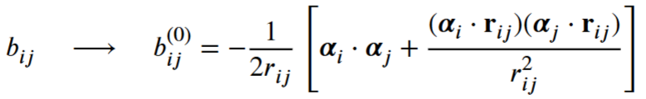

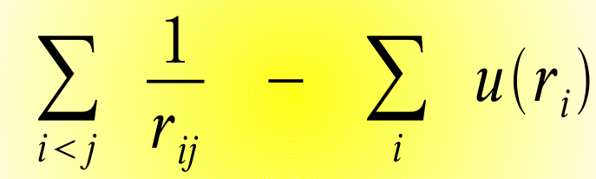
Building block: Auger rates
Auger electron emission (autoionization) of an atom or ion
Amplitude and rates
Wentzel’s ansatz: Autoionization is caused by electron-electron interactions, which cannot be considered in a one-particle picture.
electron-electron interaction
Fritzsche S. JAC: User Guide, Compendium & Theoretical Background.https://github.com/OpenJAC/JAC.jl; Unpublished (10.10.2025).
Notes:
Ideal tool to study e-e interaction!
13

Slide 14
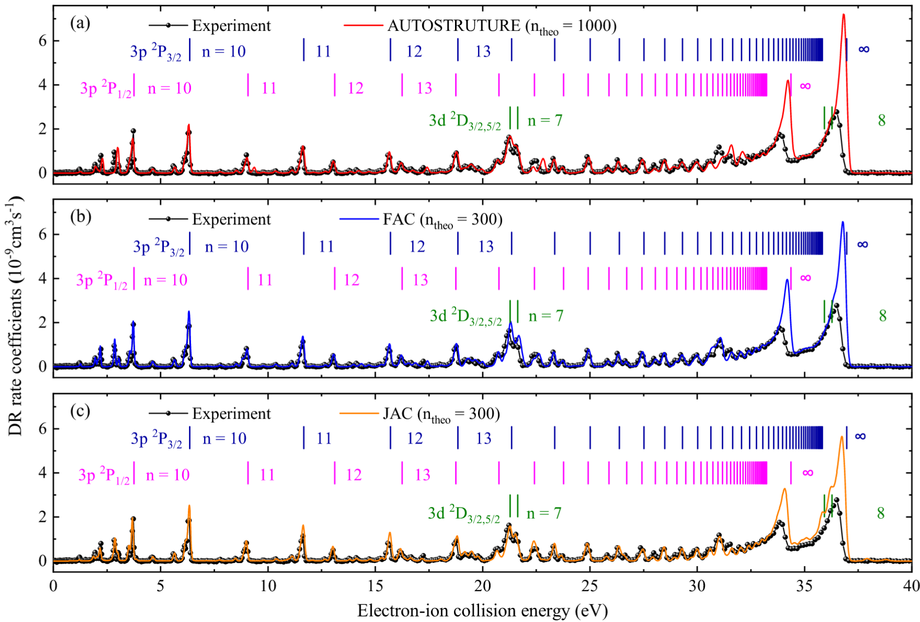
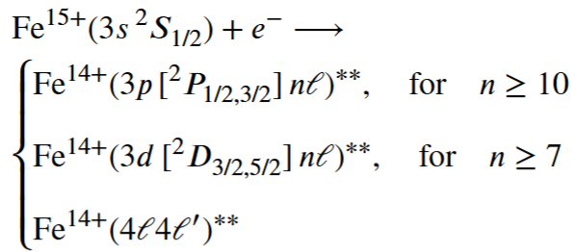
Benchmark: Na-like Fe¹⁵⁺@CSRm
DR Channels：
Rydberg formula：
Excellent agreement is observed between the experiment and three state-of-the-art theories (AS, FAC, and JAC) over the 0–40 eV energy range.
H.K. Huang, et al. APJS, 278:44 (2025)
Notes:
The measured DR rate coefficients in the energy range from 0 to 90 eV cover all of the DR resonances due to 3s → 3p and 3s → 3d (Δn = 0) transitions and part of the DR resonances from 3s → 4l (Δn = 1) core excitation.

Slide 15
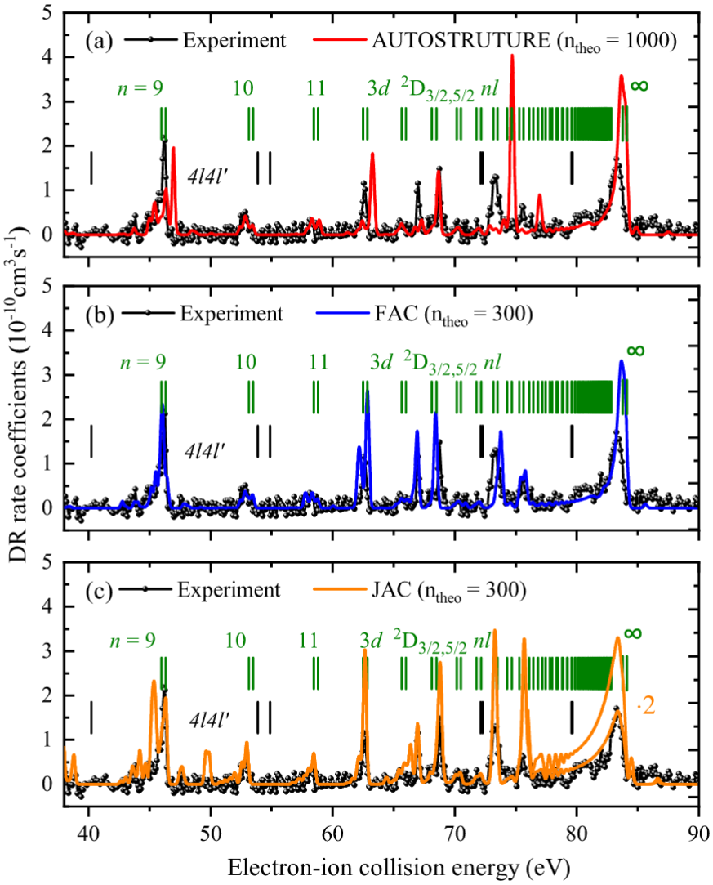
Benchmark: Na-like Fe¹⁵⁺@CSRm
In the energy range 40-90 eV:
contributing DR resonances
4l4l’ resonances
Despite being state-of-the-art, the AS, FAC, and JAC theoretical models show significant discrepancies with the experimental energies and strengths of the 4l4l′ resonances.
Indicating that strong electron correlation effects in the 4l4l′ resonance states poses a significant challenge to current theoretical models.
H.K. Huang, et al. APJS, 278:44 (2025)

Slide 16
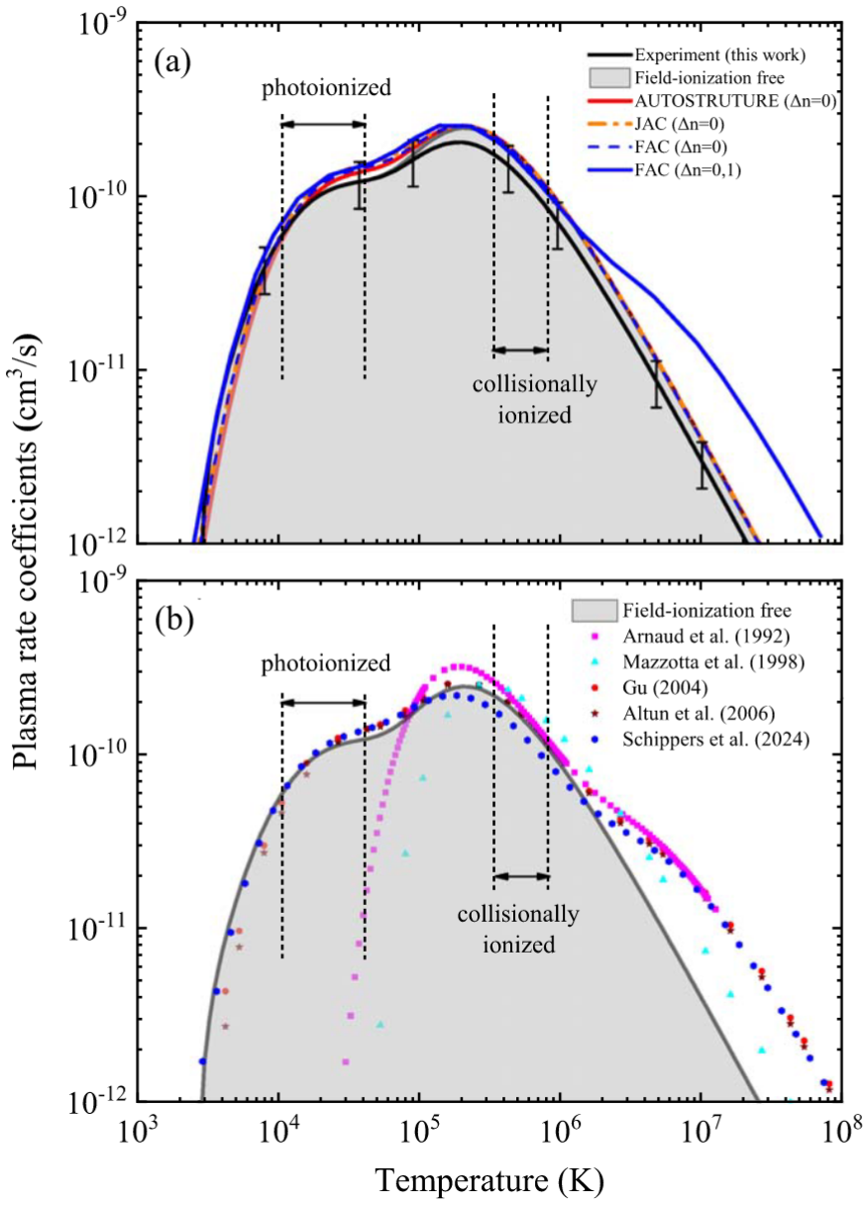
Astrophysical applications
Plasma rate coeff.
Maxwellian distribution
Electron-ion recombination rate coeff.
Notes:
Furthermore, temperature-dependent plasma recombination rate coefficients are derived from the measured DR rate coefficients over the temperature range of 103–108 K and are compared with previously available results in the literature.
The present results provide a benchmark data set for astrophysical modeling

Slide 17
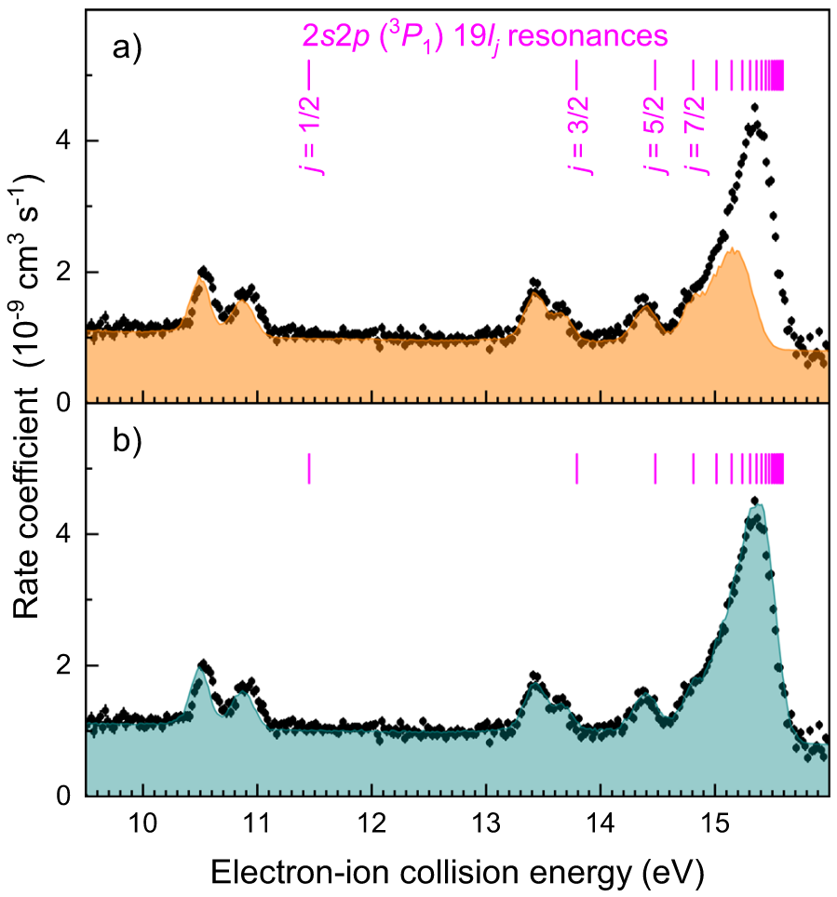
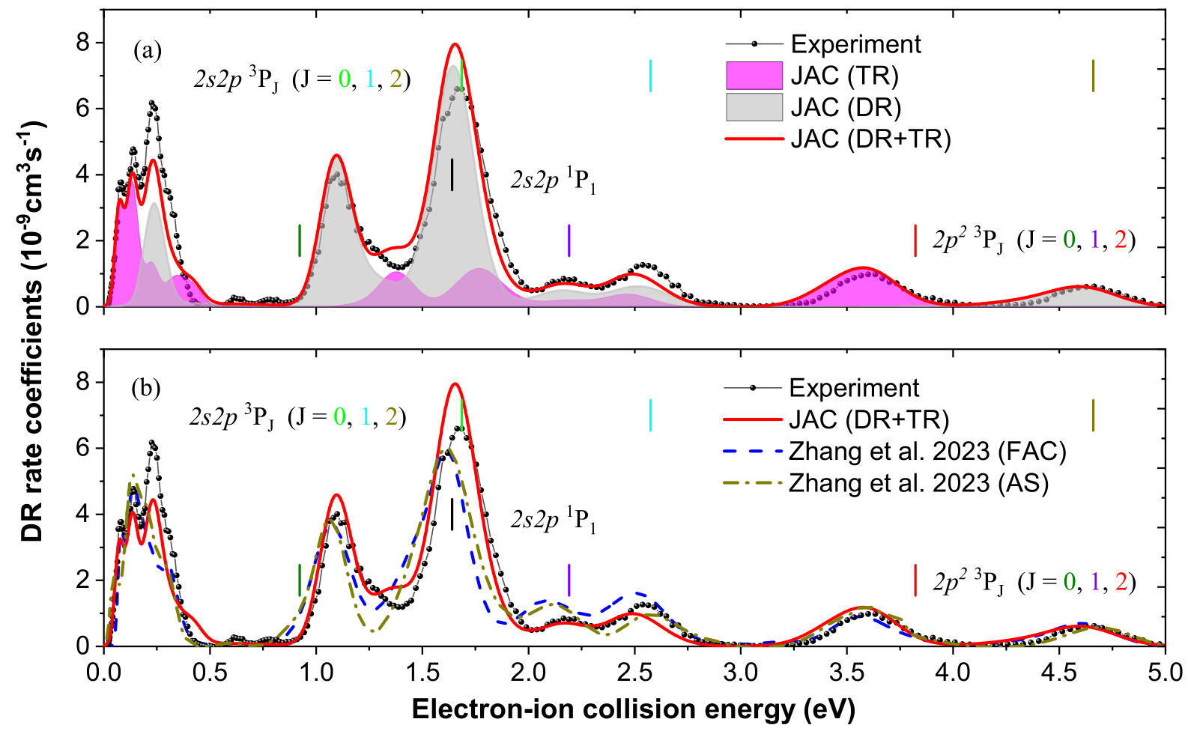
More benchmark studies of DR spectra for different ions suggest that JAC is a suitable tool for studying atomic processes in multiply and highly charged ions…
Be-like Ar¹⁴⁺ at CSRm
Be-like Pb⁷⁸⁺ ions at ESR@CRYRING
S. Fritzsche, H.K. Huang et al., EPJD(2025) 79 :22
S. Schippers, et al., PRL. 135, 113001(2025)
H.K. Huang, S. Fritzsche et al. , EPJD, 79(3), 18 (2025)

Slide 18
Introduction
Theory of electron-ion recombination
Nuclear effects: Hyperfine-resolved
Summary and outlook
Overview
Simulated hyperfine-resolved DR spectrum for Li-like Sc¹⁸⁺ and Bi⁸⁰⁺ ions.

Slide 19
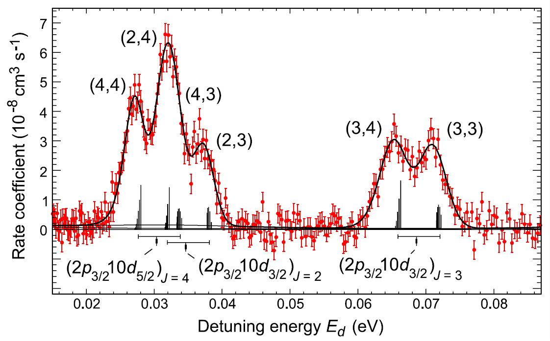
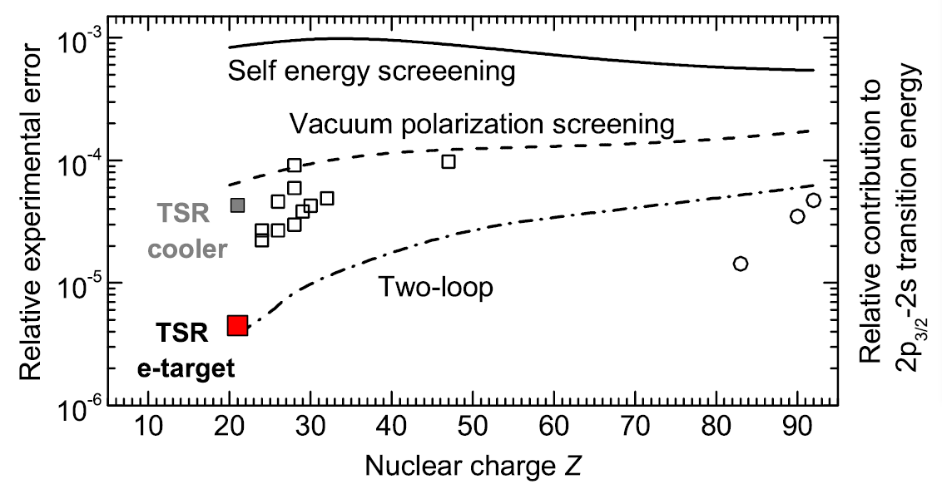
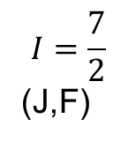
DR spectroscopy tool
TSR electron cooler S. Kieslich et al., PRA 70 (2004) 042714
$$I=\frac{7}{2}$$
(J,F)
hot cathode, thermionic emission
Sc¹⁸⁺
2p_{3/2}10l_{j}
resonances
photocathode, cooled with LN2
accuracy of resonance
energies on ppm level
HF-splitting
TSR electron target M. Lestinsky et al., PRL 100 (2008) 033001

Slide 20
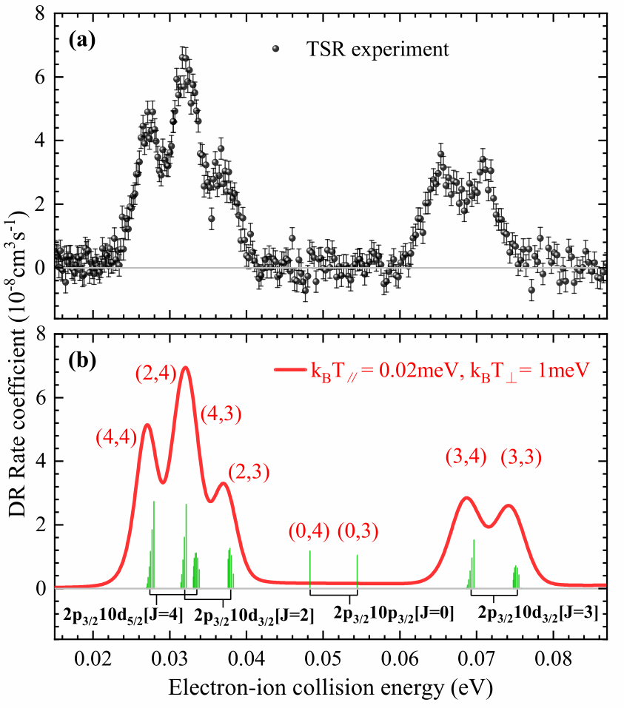
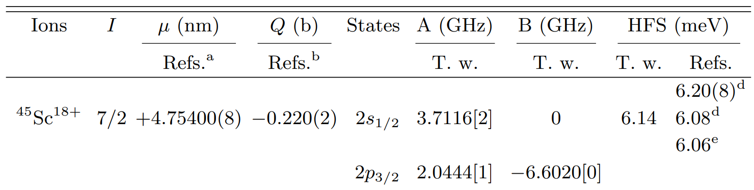
Li-like low-Z ions with long-lived upper hyperfine states
hfs
Good candidate:
DR resonances in the very low electron-ion collision energy range.
Relative long-lived upper hyperfine states (>40s), for the F = 3, 4 hyperfine states, thermal populations at 300 K are used (50%,50%)
⁴⁵Sc¹⁸⁺
JAC
(J,F)
Y. Yuan, H. K. Huang et al. Phys. Rev. A 113, 012815 (2026)

Slide 21
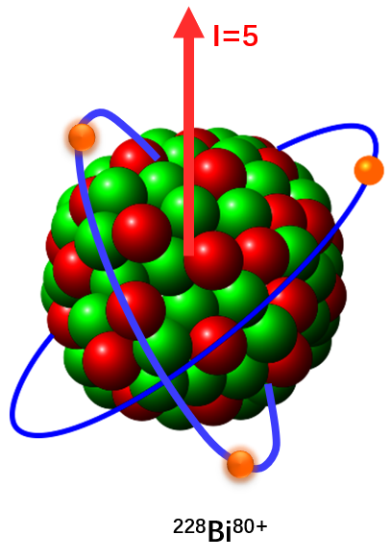
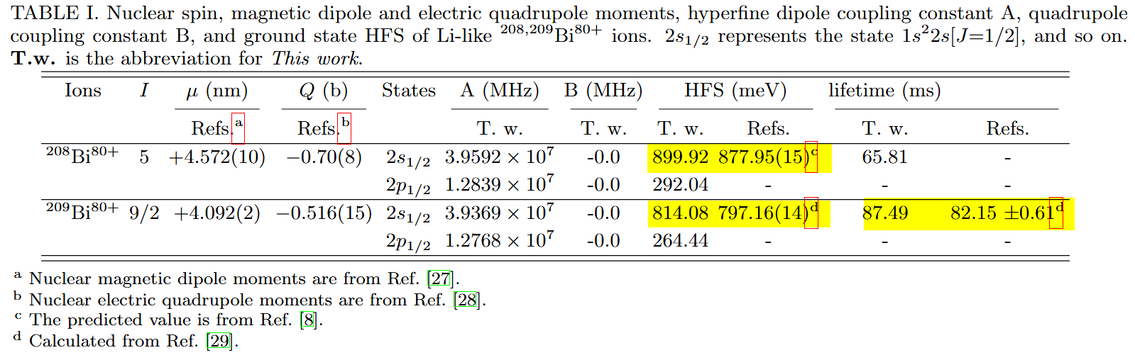

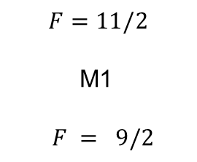
Transition energy and lifetime for HFS of ^{208,209}Bi⁸⁰⁺ ions
Dimitrios Zisis (Darmstadt, SPARC): Dielectronic Recombination-Assisted Laser Spectroscopy: A new Tool to Investigate the Hyperfine-Puzzle in Bi⁸⁰⁺]
Our MCDF calculations…
$$F=11/2$$
M1
$F = 9/2$
$$2s_{1/2}$$
A more realistic determination of the HFS values would not alter the qualitative nature of the final results of DR of Bi⁸⁰⁺ ions.
[8] M. Horst et al., Nat. Phys. 21, 1057 (2025); [27] N. Stone, Tech. Rep. 0794, IAEA Nuclear Data Section(2019).
[28] N. Stone, Tech. Rep. 0833, IAEA Nuclear Data Section(2021) ;[29] A. V. Volotka et al., Phys. Rev. Lett.108, 073001 (2012)
Notes:
We used the MCDF method to calculate the multi-electron wavefunction, employing the Fermi model for nuclear charge distribution, without considering the BW correction and QED effects.

Slide 22
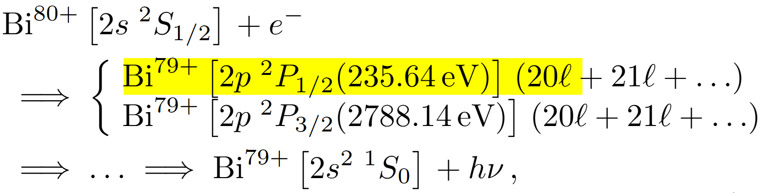
DR resonances of Bi⁸⁰⁺ with zero nuclear spin $(I=0)$
Dirac
Low-j: the blue vertical lines indicate the DR resonance energies and strengths corresponding to the 2p_{1/2}20s_{1/2}[J = 0, 1], 2p_{1/2}20p_{1/2}[J = 1], and 2p_{1/2}20p_{1/2}[J = 0] resonances.
High-j, hydrogen-like!
Notes:
19 possible total angular momentum values from j = 1/2 up to
$j = 20×2 − 1/2 = 39/2$.

Slide 23
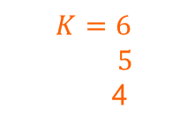


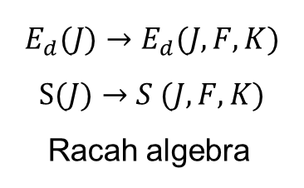






Hyperfine-resolved Rydberg DR resonances($I≠0$)
$$2p_{1/2}$$
$$F^{′}={11}/2$$
$9/2$
(a) (b)
$$E_{\left(nℓ_{j_{2}}\right)J}$$
(2p_{1/2}20p_{1/2})_{J=1}
$$K=6$$
$5$
4
$$E_{res}$$
$$F=11/2$$
$$E_{res}$$
$$2s_{1/2}$$
M1~60 ms
Laser exc. ~25%
$$F=9/2$$
$$E_{d}(J)→E_{d}(J,F,K)$$
$$S(J)→S (J,F,K)$$
Racah algebra
A. Wolf, et al., Hyperfine Interact 172:111–124 (2006)
Notes:
Take (2p_{1/2}20p_{1/2})_{J=1} as example: (I, J)K
Assume laser excites 25% population from the F=9/2 states to F=11/2 states
Double peak structures, distinct hf structures of resonances with K=4,5,6

Slide 24
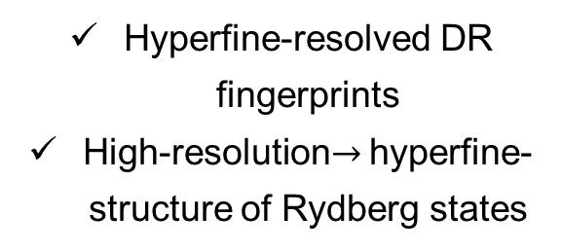
Hyperfine-resolved Rydberg DR resonances($I≠0$)
Hyperfine-resolved DR resonances in the low electron-ion collision energy range
Hyperfine-resolved DR fingerprints
High-resolution$→$ hyperfine-structure of Rydberg states

Slide 25
Summary and outlook
Benchmark study between experiment and theory
Astrophysics relevance ions: DR of many-electron ions still challenges the-state-of-art theories! The e-e correlation mainly is still the troublemaker.
Theoretical simulation of hyperfine-resolved DR spectrum (Funded by the GET−INvolved Programme of GSI GmbH)
Li-like Sc¹⁸⁺ & Bi⁸⁰⁺ ions
Outlook
1. DR theory (JAC) for low-charged astrophysical relevance ions
2. DR at FIAR-CRYRING@ESR
HIAF-SRing: electron cooler + electron target

Slide 26










Acknowledgments: DR International collaboration
IMPCAS, Lanzhou | Z.K. Huang, W.Q. Wen, H.B. Wang, Houke Huang, D.Y. Chen, X.L. Zhu, D.M. Zhao, L.J. Mao, J. Li, X.M. Ma, T.M. Tang, D.Y. Yin, Y.J. Yuan, J.C. Yang, X. Ma* ;
USTC, Hefei | S.X. Wang, X. Xu, W.L Ma, L.F. Zhu;
Uni. Fudan, Shanghai | K. Yao, C.Y. Chen;
GSI, Darmstadt | Stephen Fritzsche, Th. Stöhlker, C. Brandau, A. Gumberidze, Yu. Litvinov, M. Steck;
Uni. Giessen | A. Müller, S. Schippers;
BINP, Novosibirsk | V. V. Parkhomchuk, V. B. Reva;
IAPCM, Beijing | X.Y. Han, J.G. Wang;
NWNU, Lanzhou | L.Y. Xie, D.H. Zhang, C.Z. Dong, ;
Uni. Strathclyde, Glasgow | N.R. Badnell, Simon Preval;

Slide 27
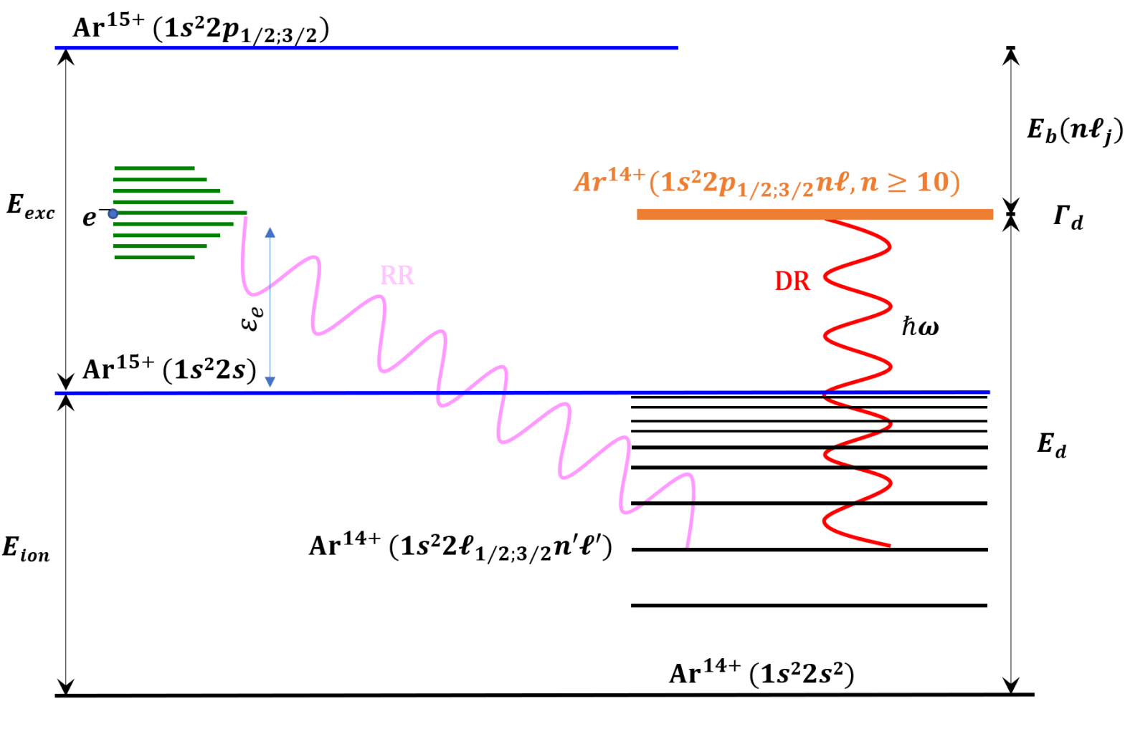
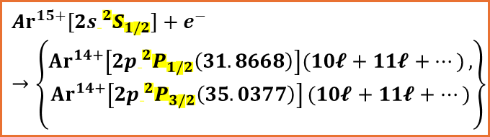
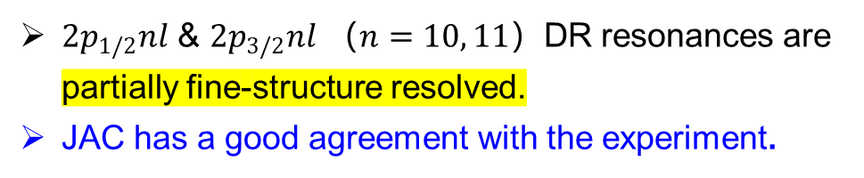

Benchmark: Li-like Ar¹⁵⁺@CSRm
A simple structure system, structure:
DR channel associated with core transition $∆n=0:$
$${Ar}^{15+}{[2s ^{2}S_{1/2}]}+e^{−}→\left\{\begin{matrix} \\ {Ar}^{14+}\left[2p ^{2}P_{1/2}\left(31.8668\right)\right](10𝓵+11𝓵+…), \\ {Ar}^{14+}\left[2p ^{2}P_{3/2}\left(35.0377\right)\right](10𝓵+11𝓵+…) \\ \end{matrix}\right\}$$
$2p_{1/2}nl$ & $2p_{3/2}nl$ （$n=10, 11$）DR resonances are partially fine-structure resolved.
JAC has a good agreement with the experiment.
Notes:
The fast-moving ions experience a motional electric field due to the dipole magnet
The Rydberg electron with n>n_cut will be kicked of from the recombined ions

Slide 28
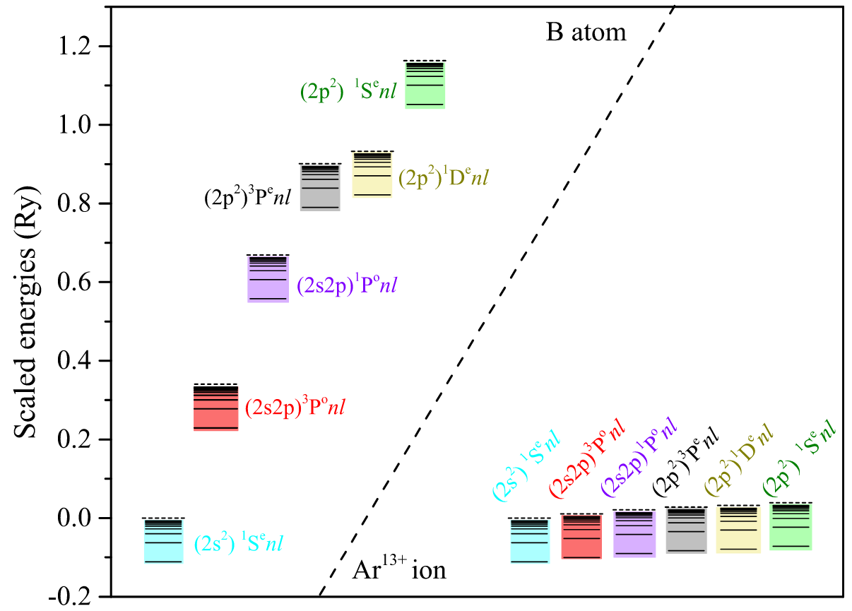
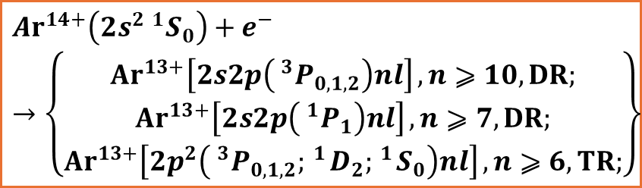
The challenge for the state-of-the-art DR calculations
Challenge of Many-electron ions :
Z=5
Z=18
Phy. Rev. A 101, 032508 (2020)
$${Ar}^{14+}\left(2s^{2} ^{1}S_{0}\right)+e^{−}→\left\{\begin{matrix} \\ {Ar}^{13+}\left[2s2p\left( ^{3}P_{0,1,2}\right)nl\right],n⩾10,DR; \\ {Ar}^{13+}\left[2s2p\left( ^{1}P_{1}\right)nl\right],n⩾7,DR; \\ {Ar}^{13+}\left[2p^{2}\left( ^{3}P_{0,1,2}; ^{1}D_{2}; ^{1}S_{0}\right)nl\right],n⩾6,TR;\end{matrix}\right\}$$
Strong e-e correlation effect: tri-electronic recombination process, TR
Houke Huang, et al. , EPJD, 79(3), 18 (2025)

Slide 29
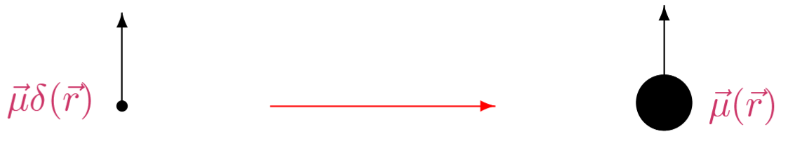
Tests of QED in HCIs via hfs
Problem: Theoretical uncertainty is dominated by nuclear magnetization distribution (Bohr-Weisskopf effect, BW).
Solution (Shabaev et al., 2001):
Consider the specific difference between ground-state hyperfine splittings of Li-like and H-like ions, for the same nucleus:
Δ′E=ΔE(2s)−ξΔE(1s)
Parameter ξ= 0.16886 is chosen to cancel the BW effect and can be calculated with high precision.
Theoretical Progress:
Volotka et al. improved the two-photon exchange corrections for Li-like Bi (Z=83), achieving a relative uncertainty of ~10⁻⁴ in the specific difference.
Precision measurements of H-like and Li-like Bi at the 10⁻⁶ level enable probing many-body QED effects at a few percent level.

Slide 30
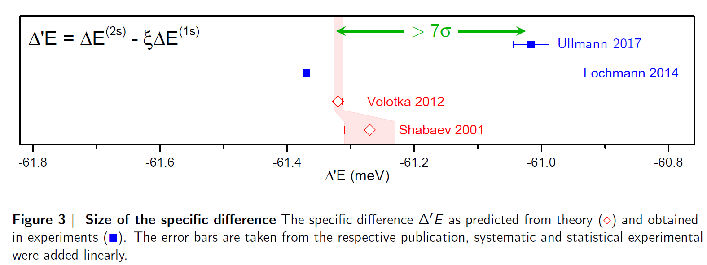
Tests of QED in HCIs via hfs
Collinear laser spectroscopy at storage rings ESR, GSI
²⁰⁹Bi Measurements [Ullmann et al., 2017]
Measured specific difference for ²⁰⁹Bi⁸²⁺ (H-like) and ²⁰⁹Bi⁸⁰⁺ (Li-like)
ξ = 0.16886 used to cancel BW correction
Results:
Discrepancy: 7σ, the largest reported in strong-field QED test (Hyperfine Puzzle in Bi ions)
²⁰⁸Bi Measurements
[M. Horst et al., Nat. Phys. 21, 1057 (2025)]
Hfs of ^{209, 208}Bi⁸²⁺ (H-like)
Results: Good agrement with
Skripnikov, L. V. et al. New nuclear magnetic moment of ²⁰⁹Bi: resolving the bismuth hyperfine puzzle. Phys. Rev. Lett. 120, 093001 (2018): μ(²⁰⁹Bi) _new = 4.092(2)μ_{N}
Outlook: Li-like ²⁰⁸Bi⁸⁰⁺ ions? Laser spectroscopy and DR tool? 22nd SPARC Topical Workshop [S. Rodolfo et al., Dielectronic Recombination-Assisted Laser Spectroscopy: A new Tool to Investigate the Hyperfine-Puzzle in Bi⁸⁰⁺]
Bohr–Weisskopf correction + precise experimental data on the nuclear magnetic moments?

Slide 31
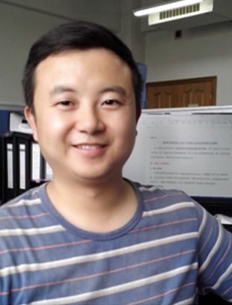

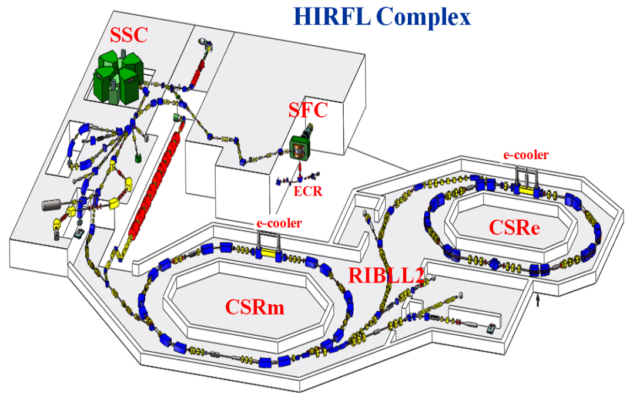
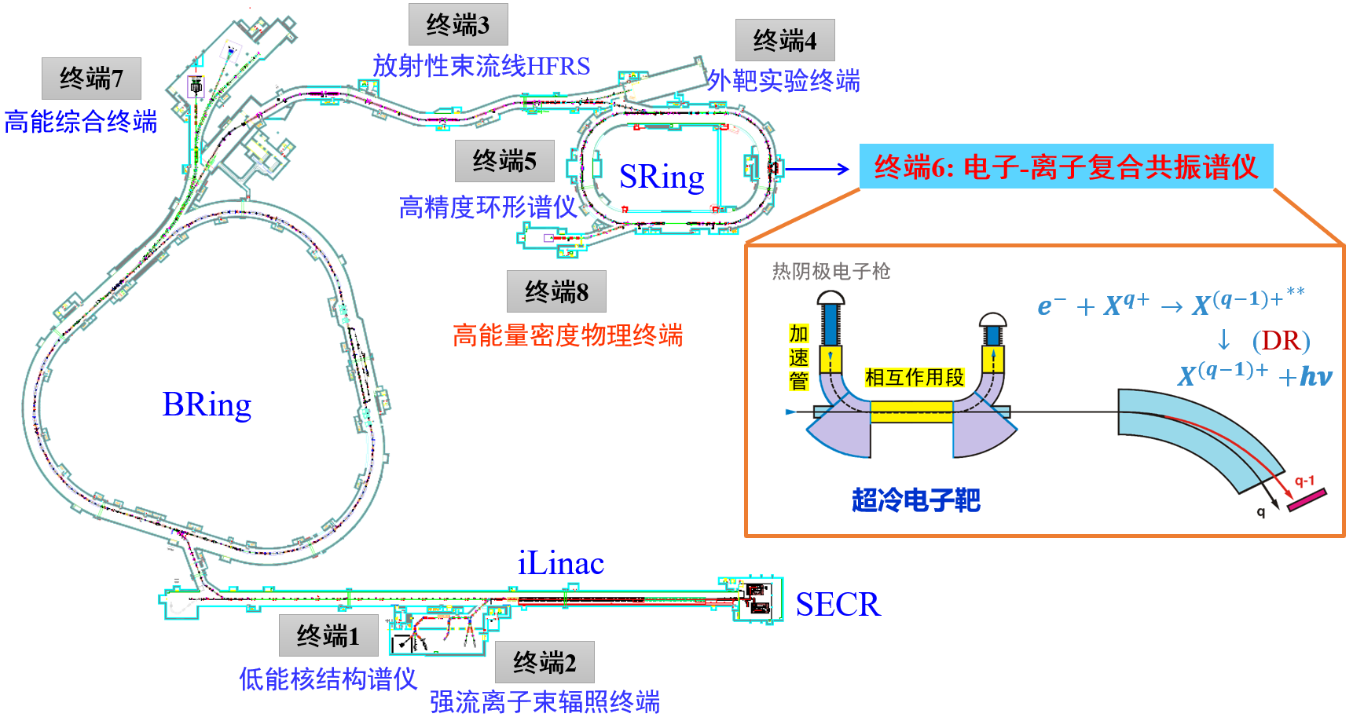






CSRm, CSRe @IMP in Lanzhou: electron-cooler HIAF-SRing @IMP in Huizhou: electron-cooler + electron target
DR
W.Q. Wen
Prof.
X. Ma
Prof.
Zhong Kui Huang
Associate. Prof.
Han Bin Wang
Associate. Prof.
Dong Yang Chen
Postdoc
Houke Huang
PhD (2021-2025)
Meng Yu Wang
Master(2025-)
Yang Yuan
Master(2025-)

Slide 32


Electron cooler
Electron target

