Slide 1


Testing strong-field QED by Electron-Ion Collision Spectroscopy of Highly Charged Ions at CRYRING@ESR
Mirko Looshorn
(mirko-dieter.looshorn@physik.uni-giessen.de)
Atom- und Molekülphysik
I. Physikalisches Institut

Slide 2
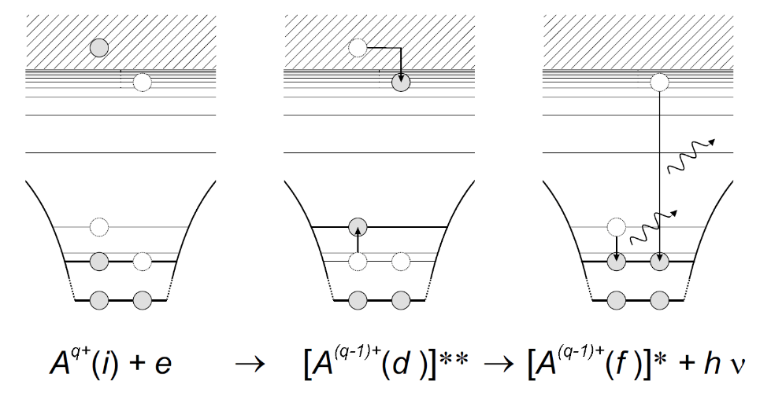
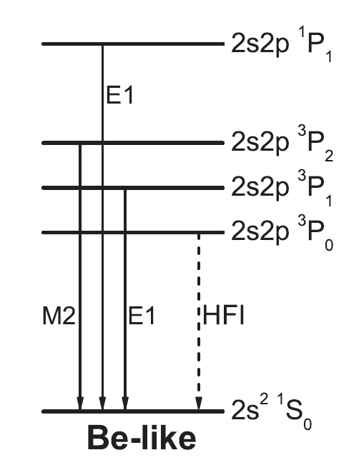
Dielectronic Recombination (DR) of Be-like Ions
DR collision spectroscopy
successful spectroscopic tool
test of QED in strong fields
investigations of nuclear properties via isotope shift
lifetime studies
measurement of input data for plasma modelling and astrophysics (e.g.: Ne²⁺, Ne³⁺, O²⁺)
time inverse Auger process
resonant capture of free electron
→ double-excited state of ion
E_{rel} + E_{bind} = E_{exc}
de-excitation by photon emission
Excitation from ground state in Be-like systems:
2s² ¹S₀ → 2s2p (³P₁) nl_{j} series for n ≥ 19
2s² ¹S₀ → 2s2p (³P₀) nl_{j} series for n ≥ 20
2s² ¹S₀ → 2s2p (¹P₁) nl_{j} series for n ≥ 6
S. Schippers et al., PRL 135, 113001 (2025)

Slide 3


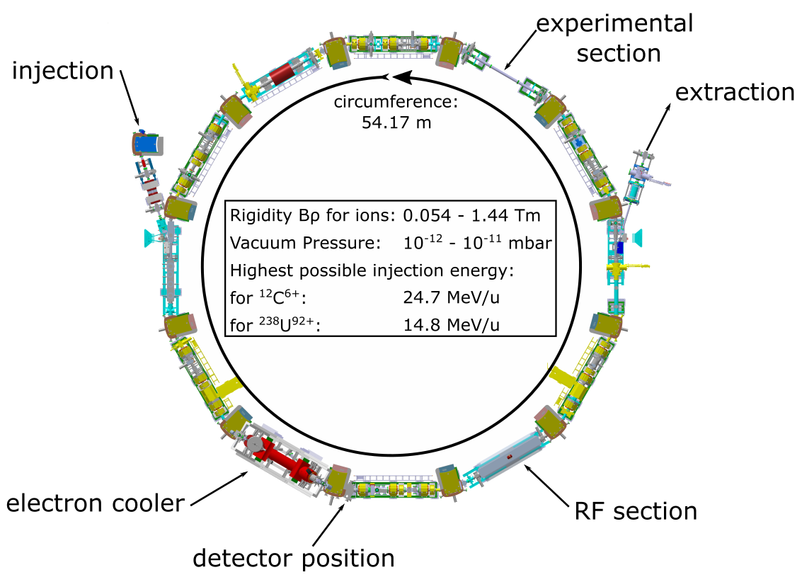
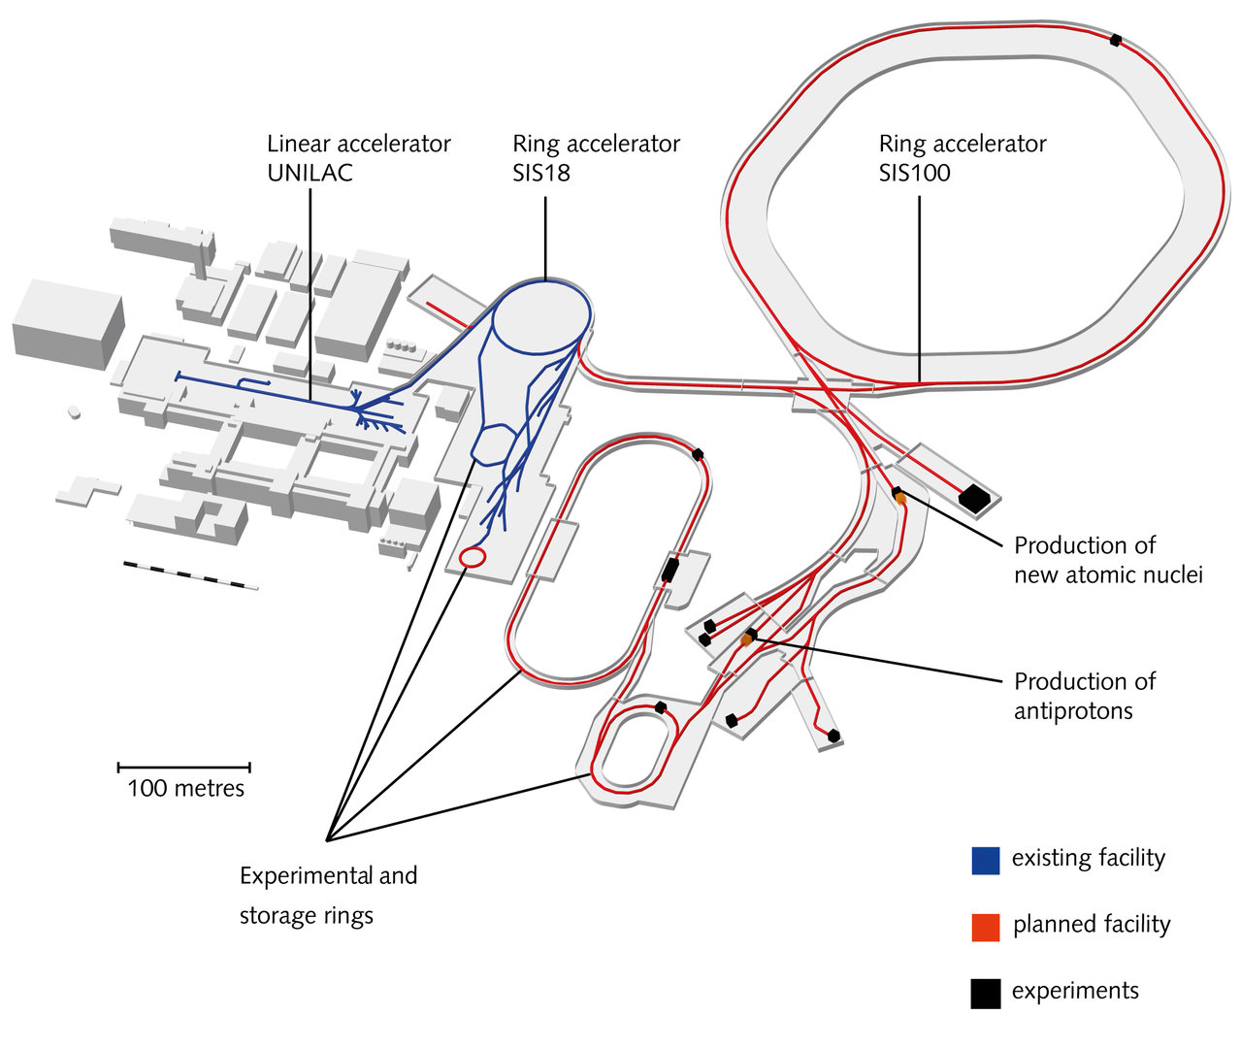
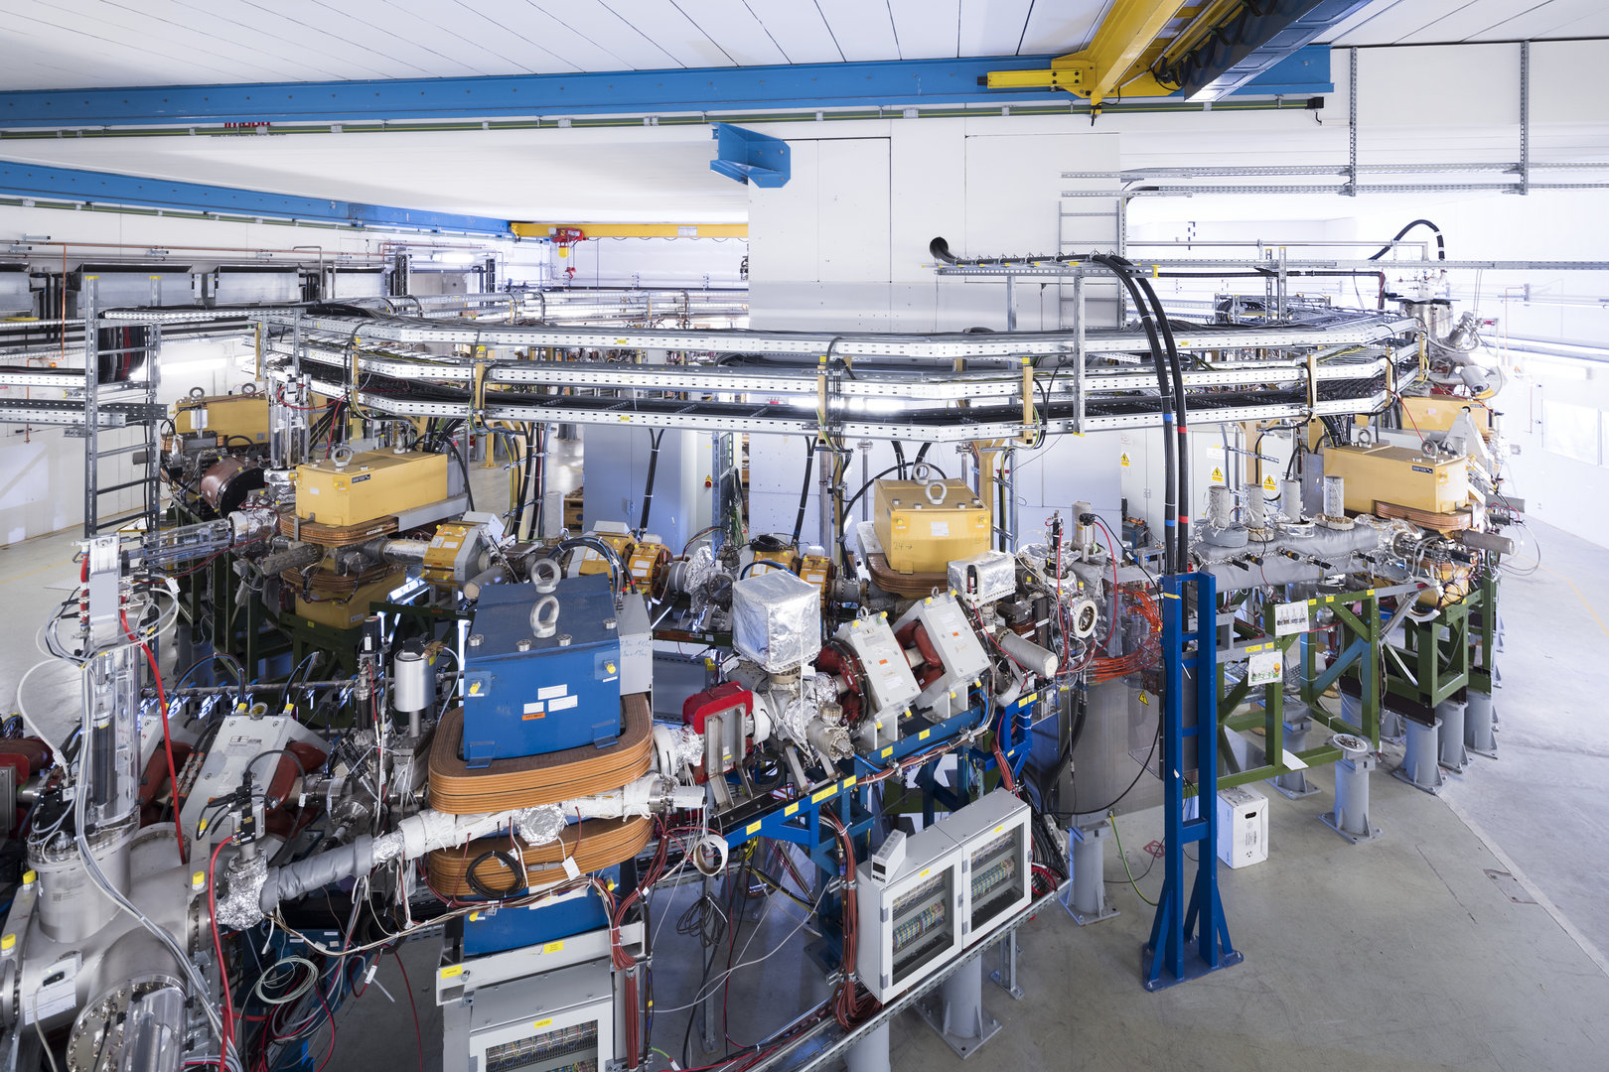
Heavy-Ion Storage Rings
UNILAC
→ SIS18
→ ESR
→ CRYRING
ESR:
Deceleration and cooling
Up to 2x10⁷ ions
SIS18:
Generation of the desired charge state q (Pb⁷⁸⁺, Au⁷⁵⁺)
Up to 1x10⁹ ions
CRYRING:
Ion beam energy: ~12 MeV/u
Ion beam lifetime: > 30 s
Up to 7x10⁶ ions
Detector count rate: up to 260 kHz
Be-like ions
J. Hosan / GSI Helmholtzzentrum GmbH
Mirko Looshorn
ErUM-FSP APPA 2026, Darmstadt

Slide 4
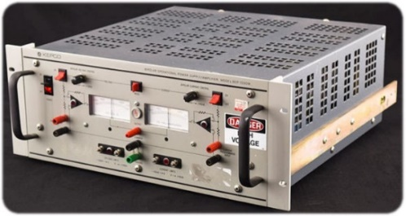
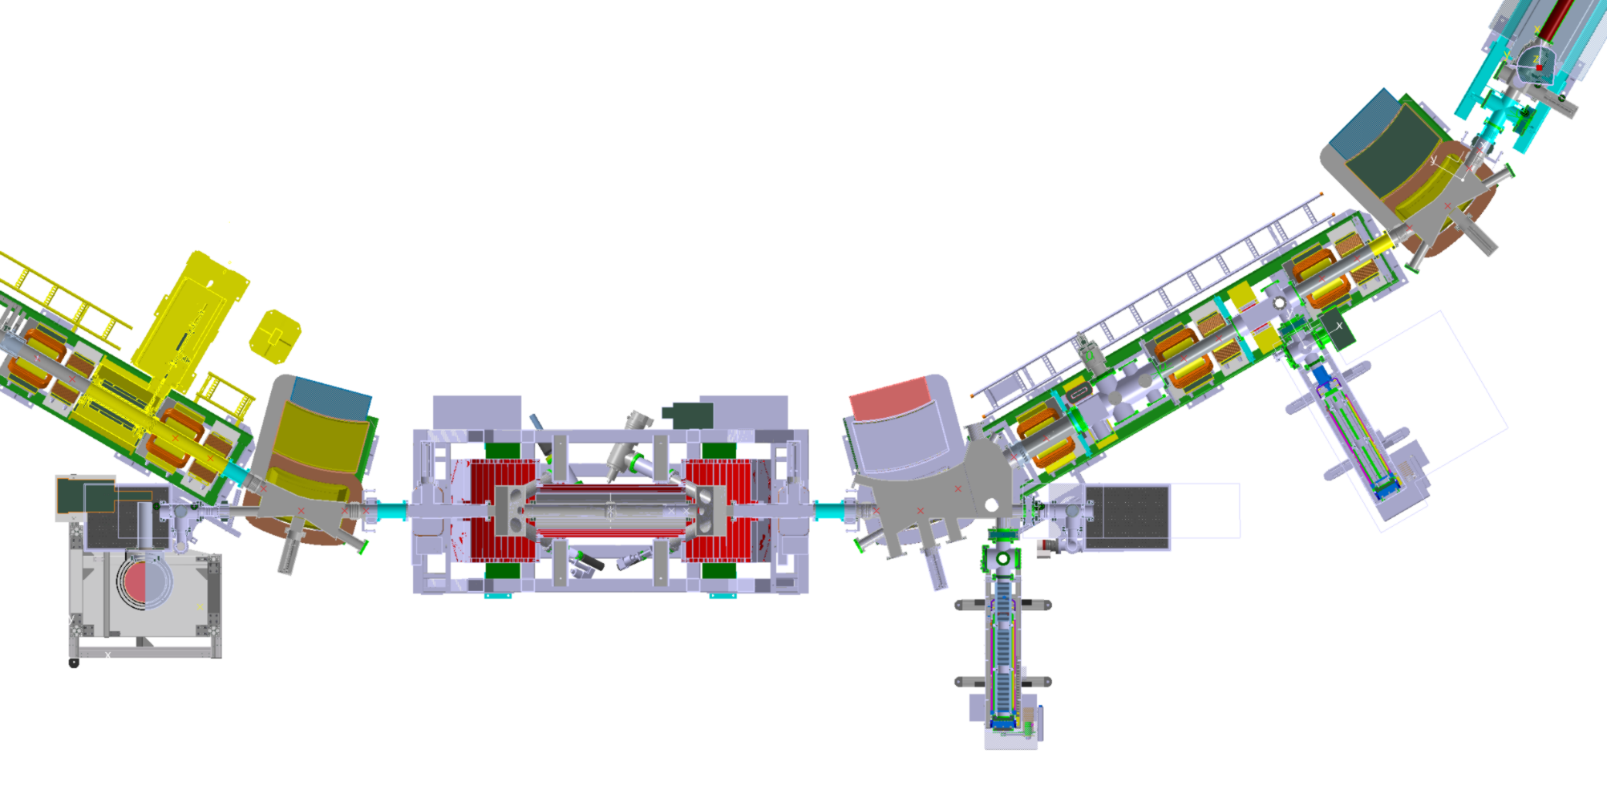
Experimental Setup at the CRYRING cooler
KEPCO
HV amplifier for fast changes of the cooler cathode voltage
Channeltron detector
q > 30
used for Pb⁷⁸⁺ (2021) and Au⁷⁵⁺ beamtime (2024)
Scintillation detector
q < 20
used for O²⁺/F⁶⁺ (2025) and S³⁺ beamtime (2024)
controlled by raspi and microcontrollers via local network with fiber optics
fairly independent from accelerator control (just uses trigger signals)
Electron cooler
High purity germanium x-ray detector
C. Brandau et al., Chin. Phys C 49, 064001 (2025)
Mirko Looshorn
ErUM-FSP APPA 2026, Darmstadt

Slide 5
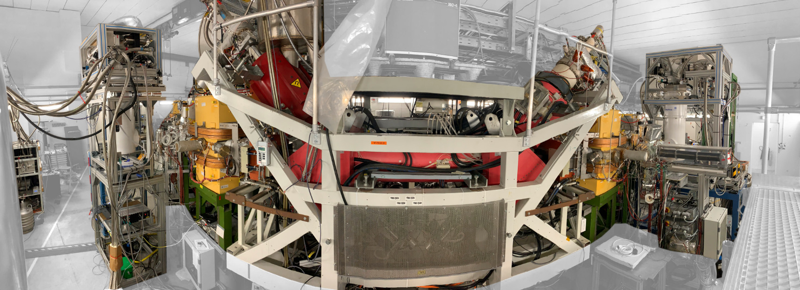
Merged-beams Setup
Au⁷⁵⁺ + e⁻ → Au⁷⁴⁺ + photons
Mirko Looshorn
ErUM-FSP APPA 2026, Darmstadt

Slide 6
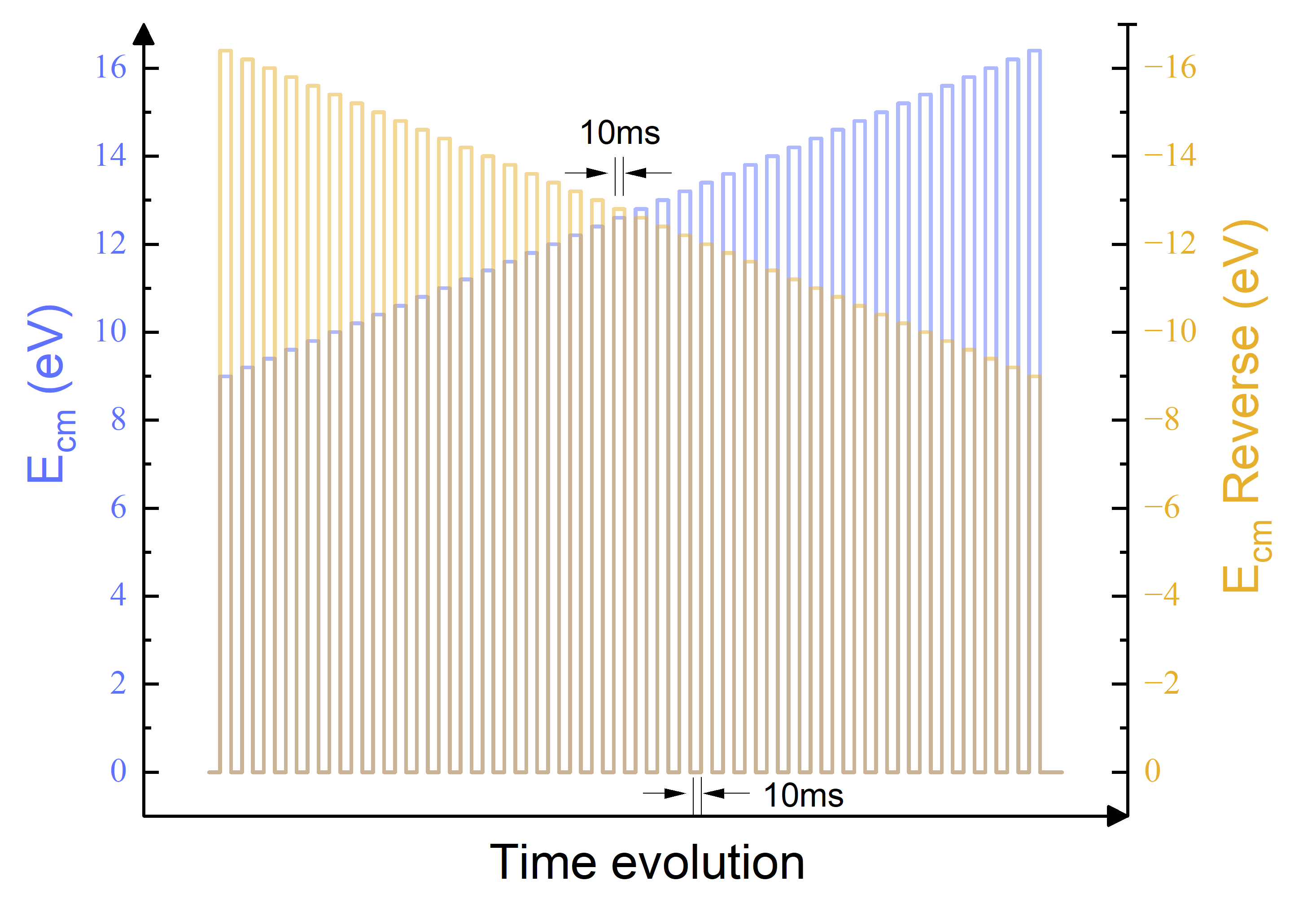
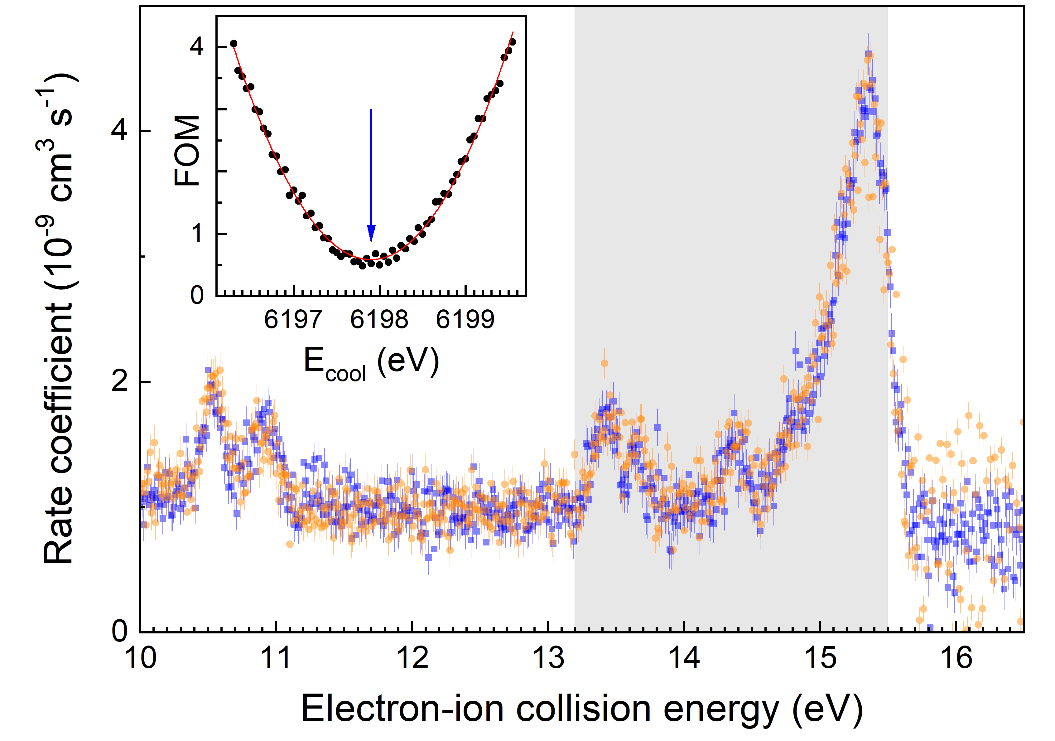
Predefined Scanning Sequence
E_{cm} (eV)
S. Schippers et al., PRL 135, 113001 (2025)
Mirko Looshorn
ErUM-FSP APPA 2026, Darmstadt

Slide 7
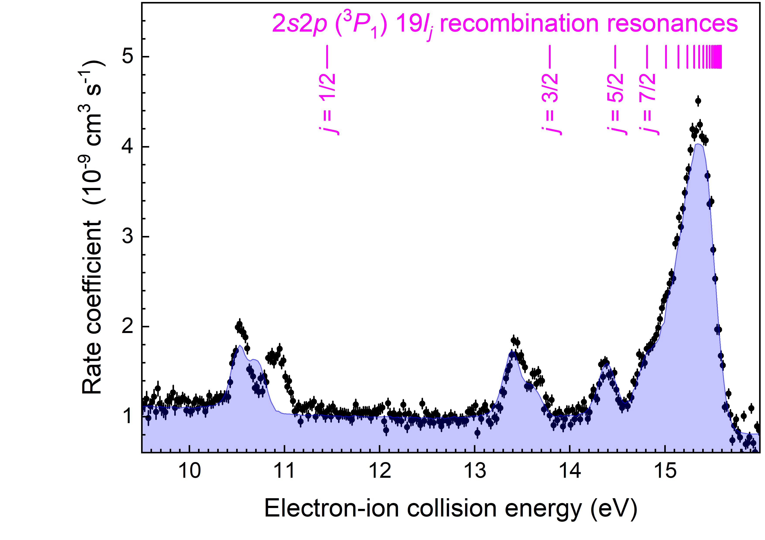
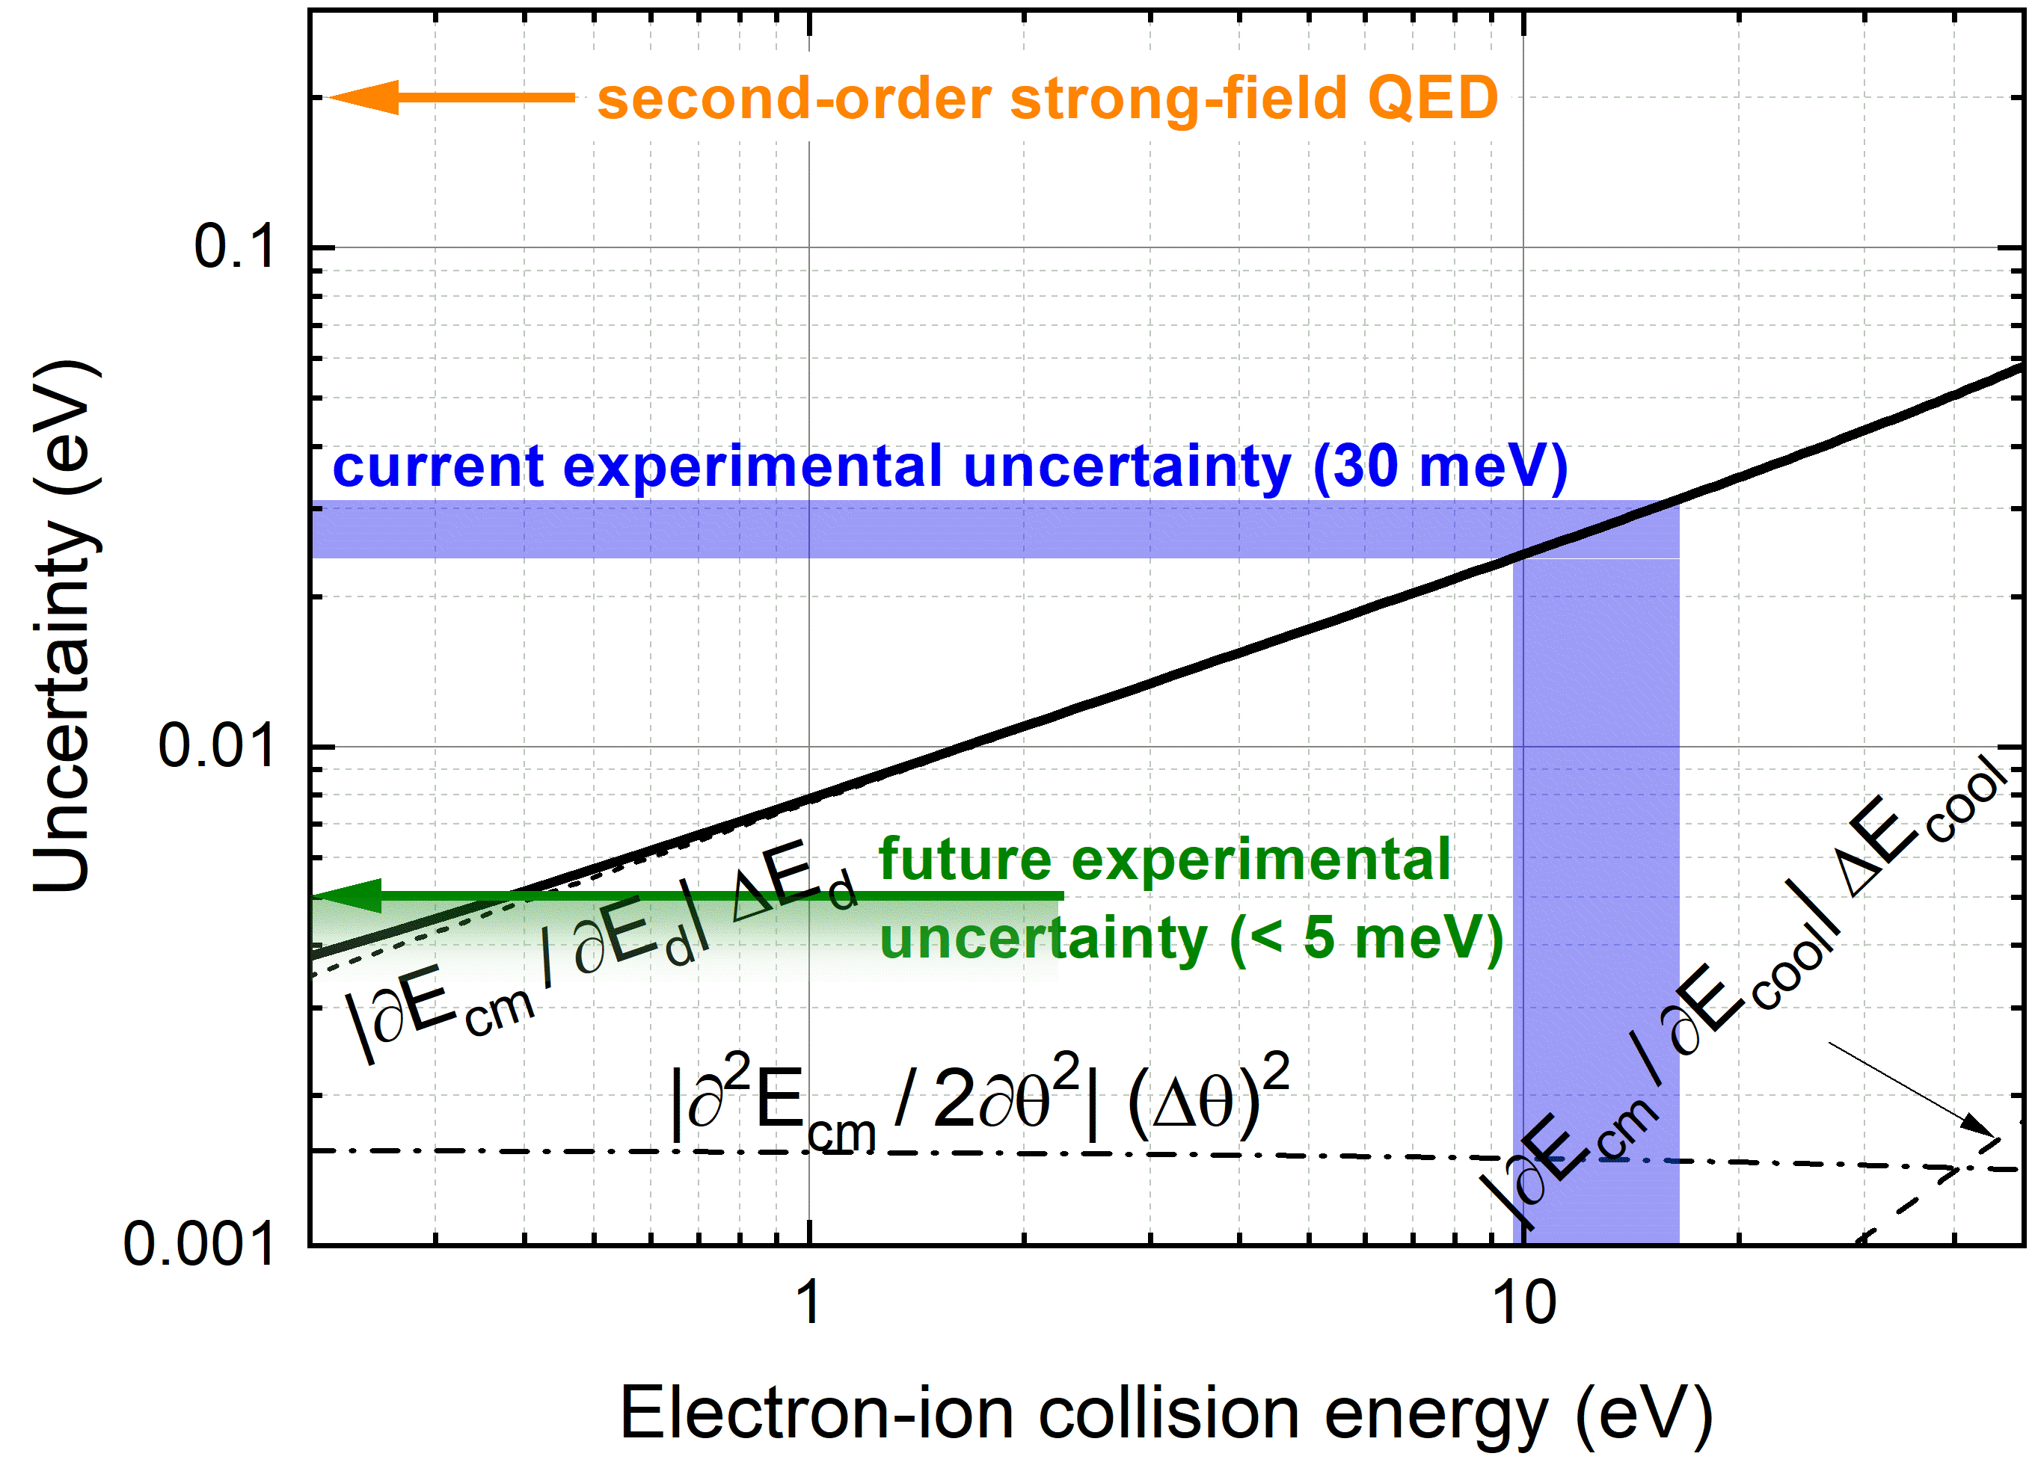
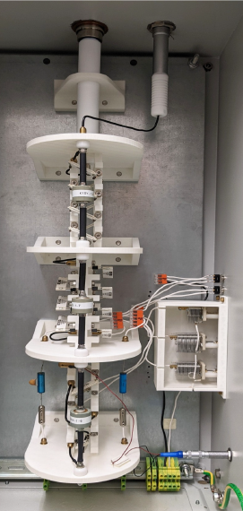
Final Result of the Pb⁷⁸⁺ Experiment
Record low experimental uncertainty
thanks to the ultra-cold electron beam
Decelerated Be-like Pb⁷⁸⁺ ions from the ESR
FC20
2s² → 2s2p³P₁ excitation energy
Experiment: 244.937(30) eV
Theory: 244.942(52) eV
Related theoretical work: A. Malyshev et al., PRA 110, 062824 (2024)
S. Schippers et al., PRL 135, 113001 (2025)
Mirko Looshorn
ErUM-FSP APPA 2026, Darmstadt

Slide 8
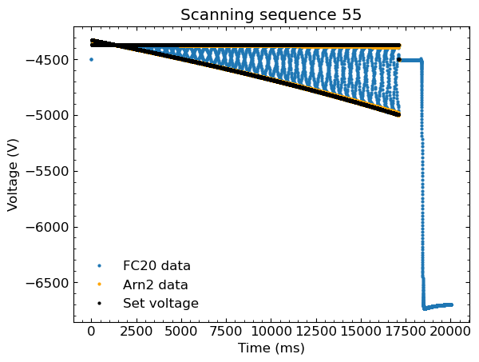
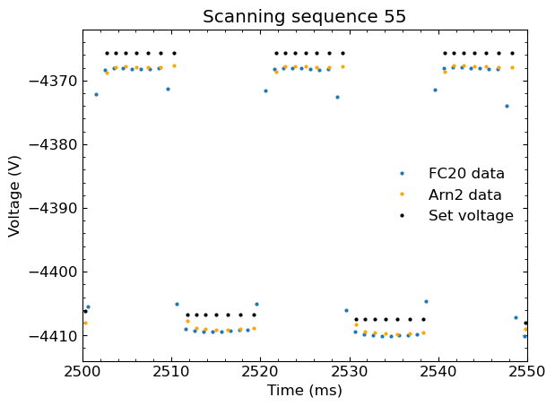

Integration of FC20 for the Au⁷⁵⁺ Experiment
T. Dirkes V. Hannen, K. Ueberholz,
C. Weinheimer
FC20
Scale factor measurement 6.3.2024: scale factor = 1027.7698+/-0.0004
Ramp parameter: E_{cm}, E_{rel} = [-260,-125]eV, E_{ref} = 250eV, Meas-Ref
FC20: Münster HV divider
10⁻⁵ rel. uncertainty
Arnold: Giessen HV divider
10⁻⁴ rel. uncertainty
Scale factor measurement 18.3.2024 scale factor = 1027.7694+/-0.0004
Mirko Looshorn
ErUM-FSP APPA 2026, Darmstadt

Slide 9
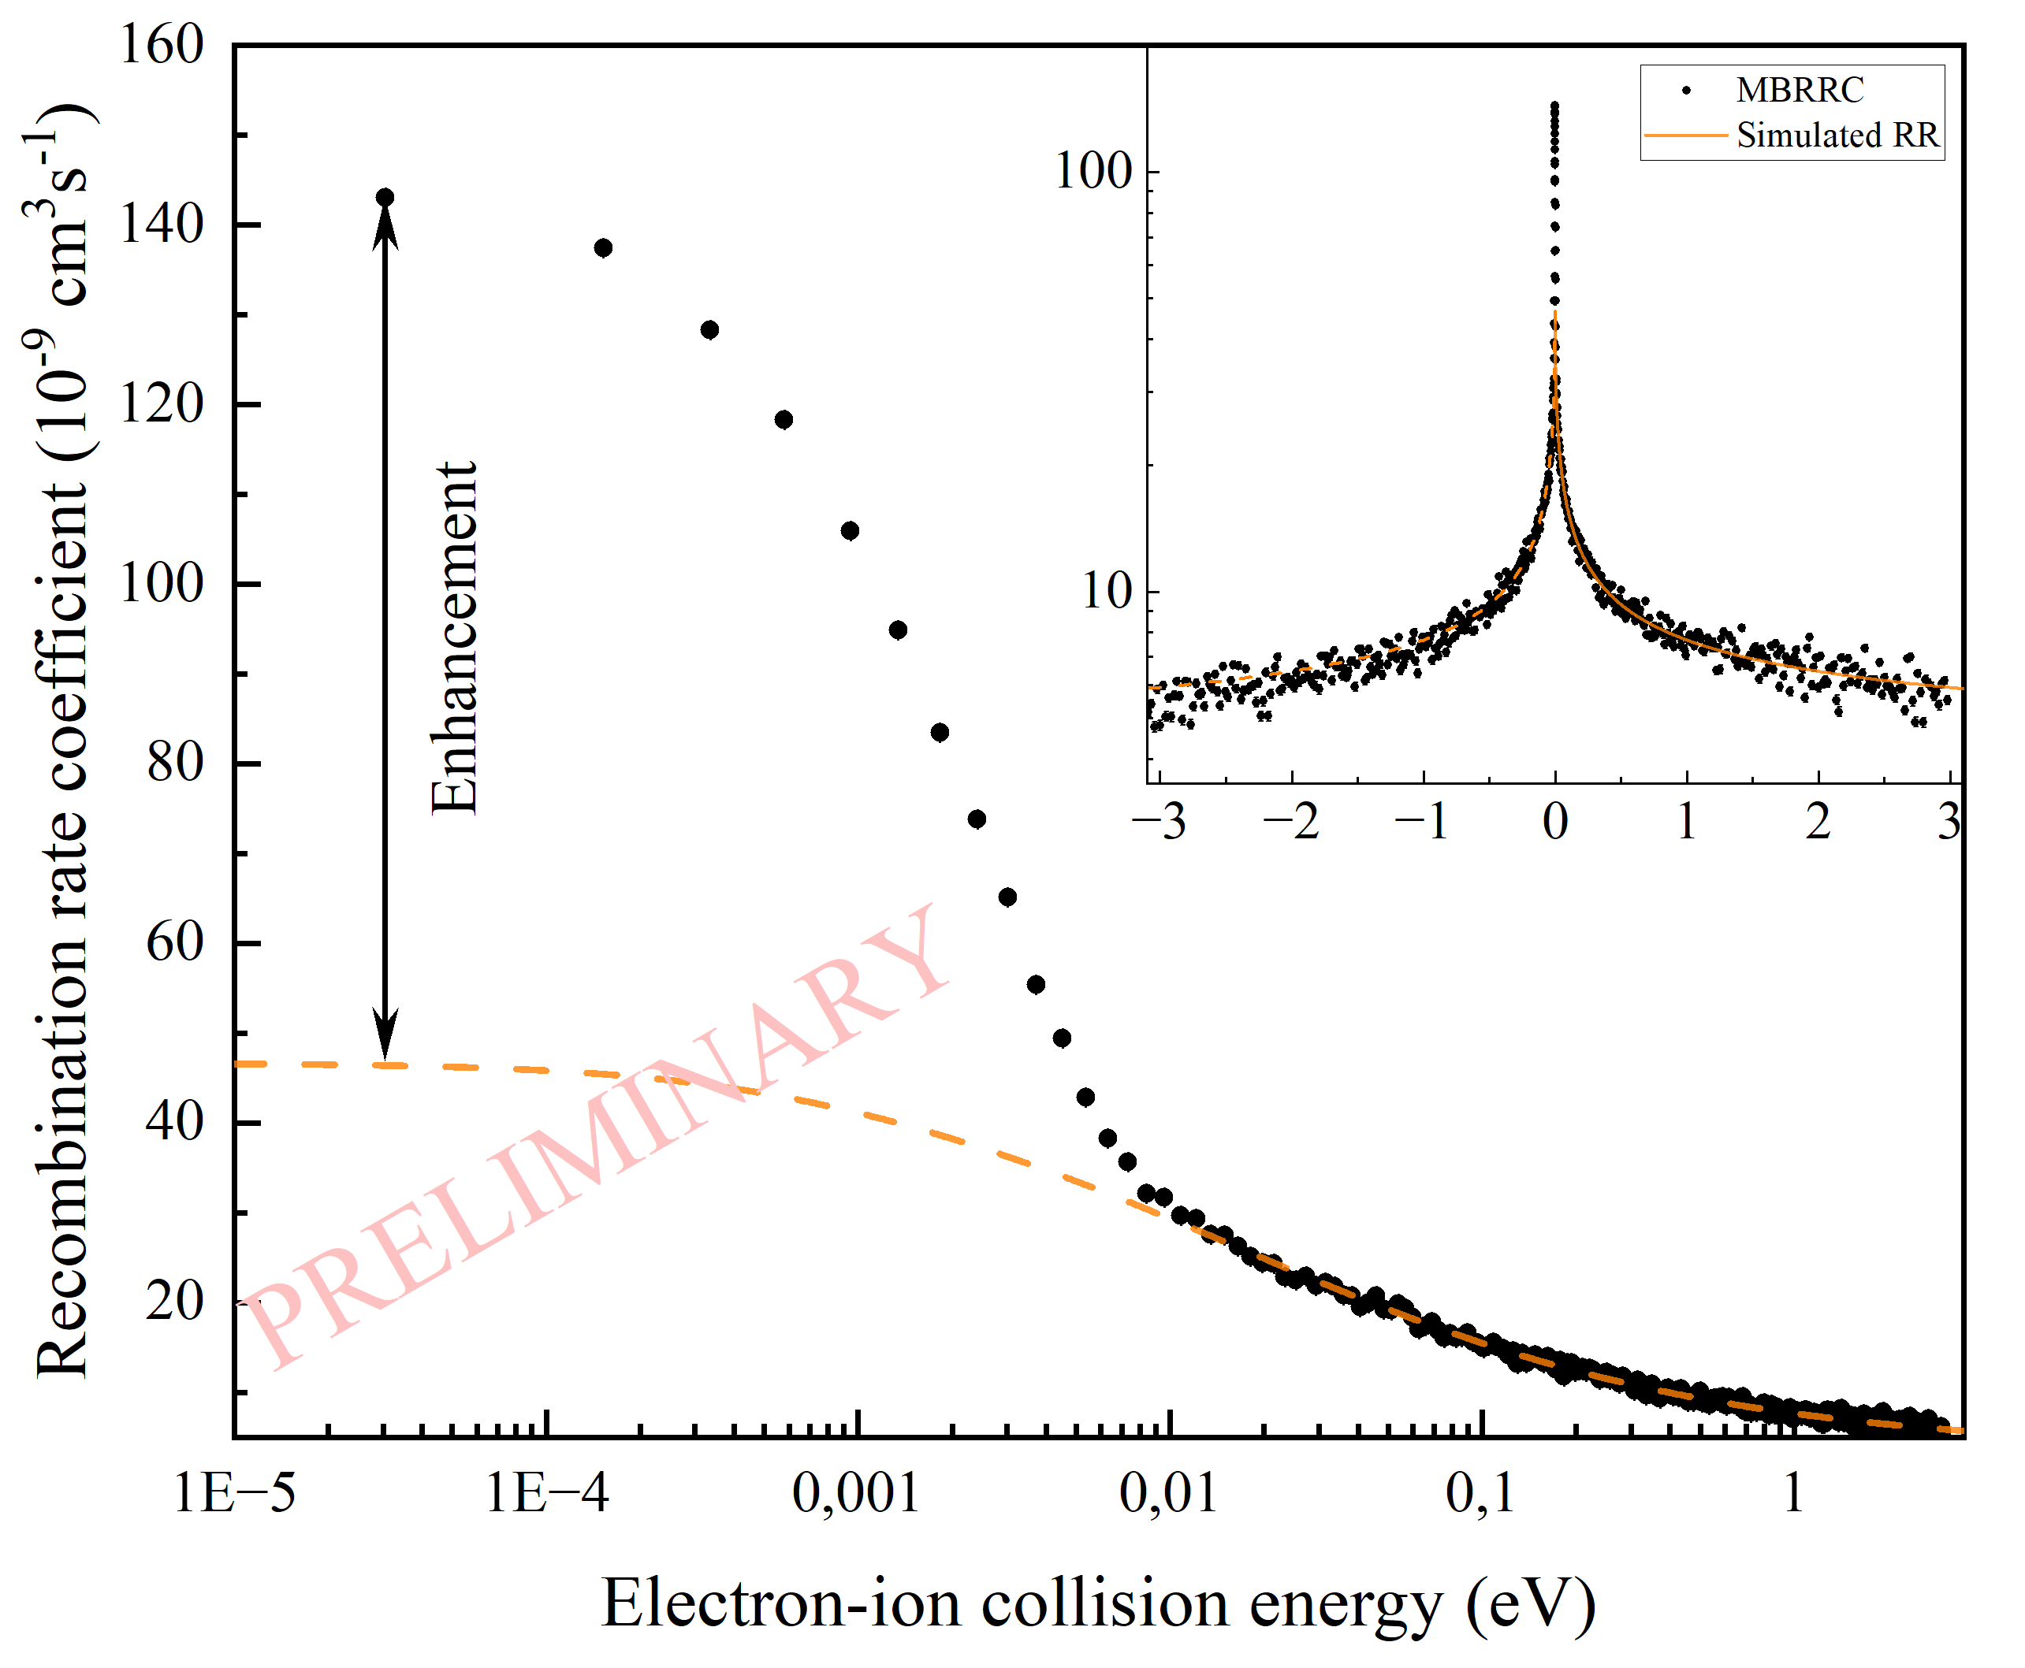
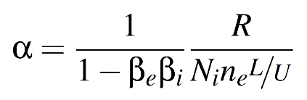
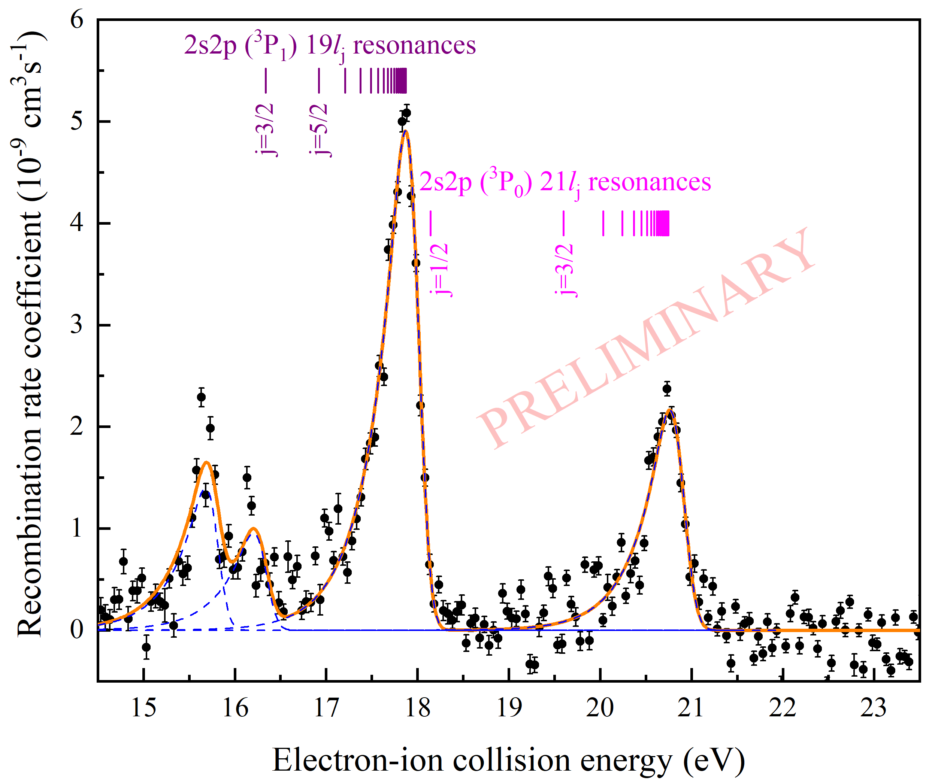
Preliminary Results of the Au⁷⁵⁺ Experiment
Recombination rate coefficient:
R … count rate (with substracted background signal)
N_{i} … number of stored ions (from fit of ion current signal)
n_{e} … electron density
L … length of interaction region
U … ring circumference
Mirko Looshorn
ErUM-FSP APPA 2026, Darmstadt

Slide 10
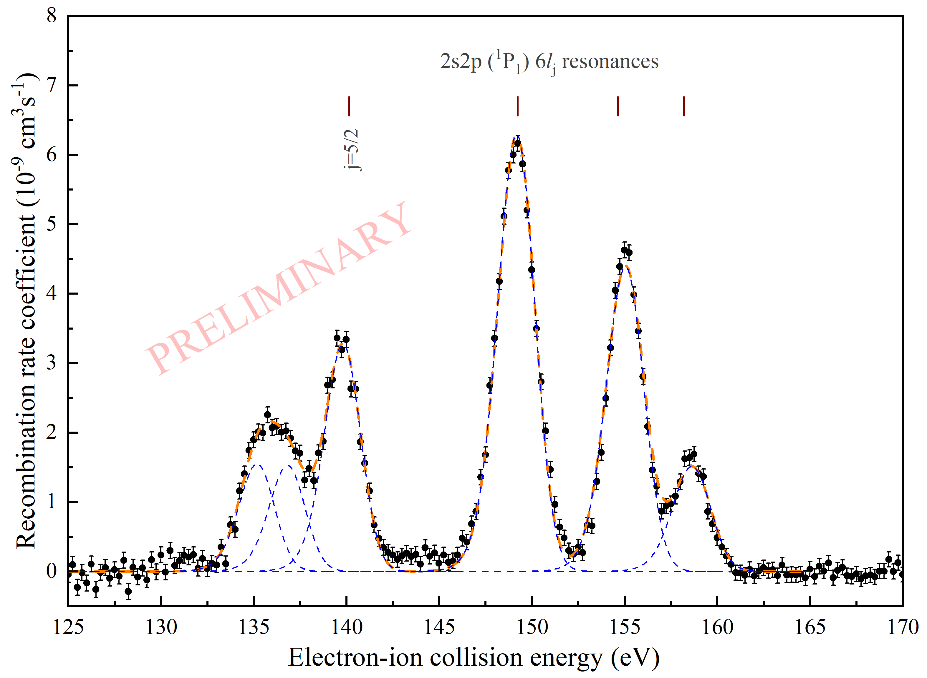
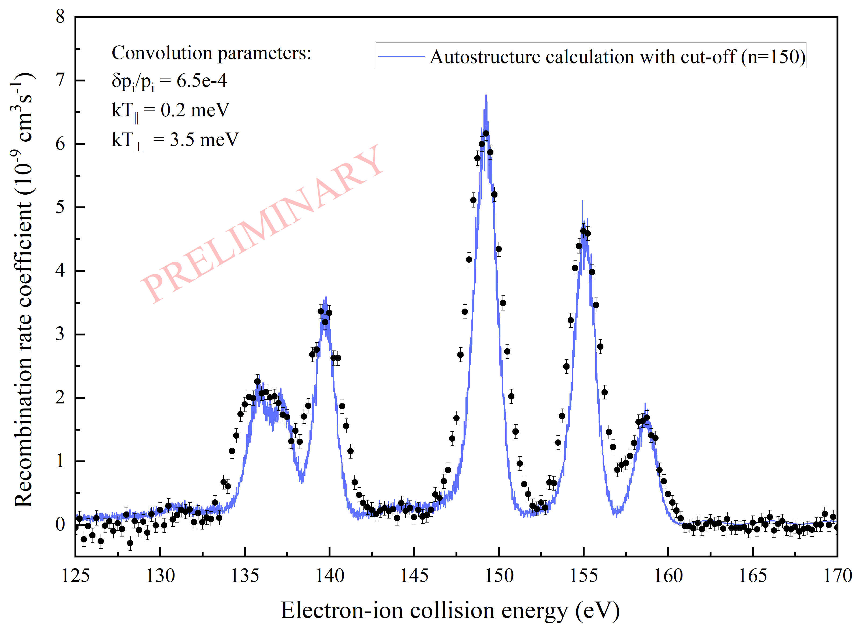
Preliminary Results of the Au⁷⁵⁺ Experiment
Mirko Looshorn
ErUM-FSP APPA 2026, Darmstadt

Slide 11
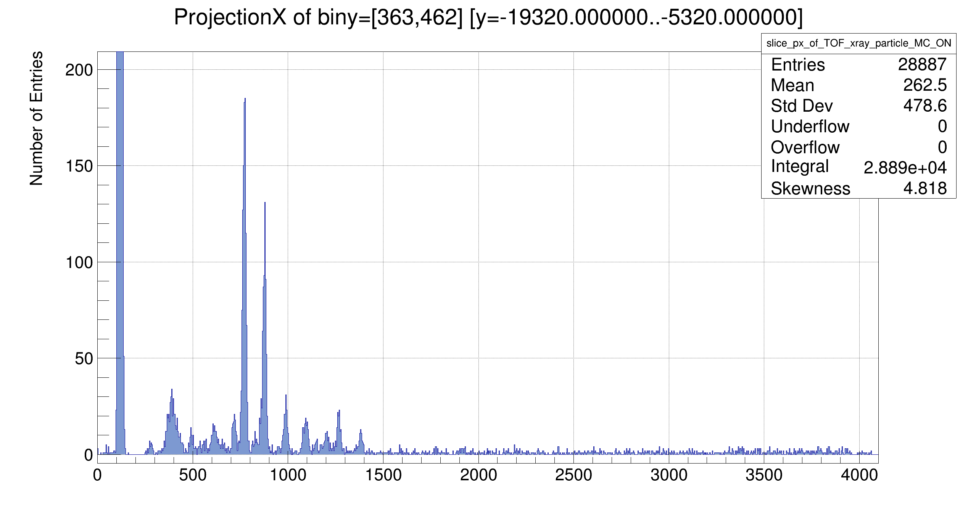
Preliminary Results of the Au⁷⁵⁺ Experiment
X-rays detected during Au⁷⁵⁺ experiment
Balmer
X-ray spectrum from an alpha source (²⁴¹Am) was used for calibration
Peak positions for L-RR are determined by the ionization energy of B-like Au (~21.92 keV)
L-RR
j=1/2
j=3/2
59,5keV
Mirko Looshorn
ErUM-FSP APPA 2026, Darmstadt

Slide 12
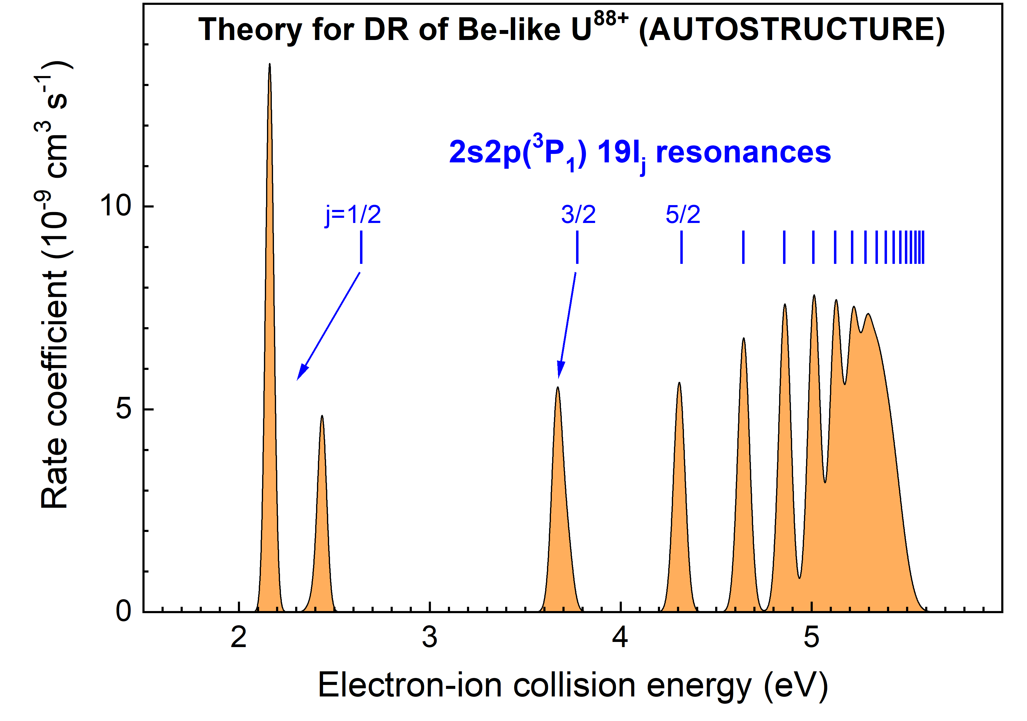
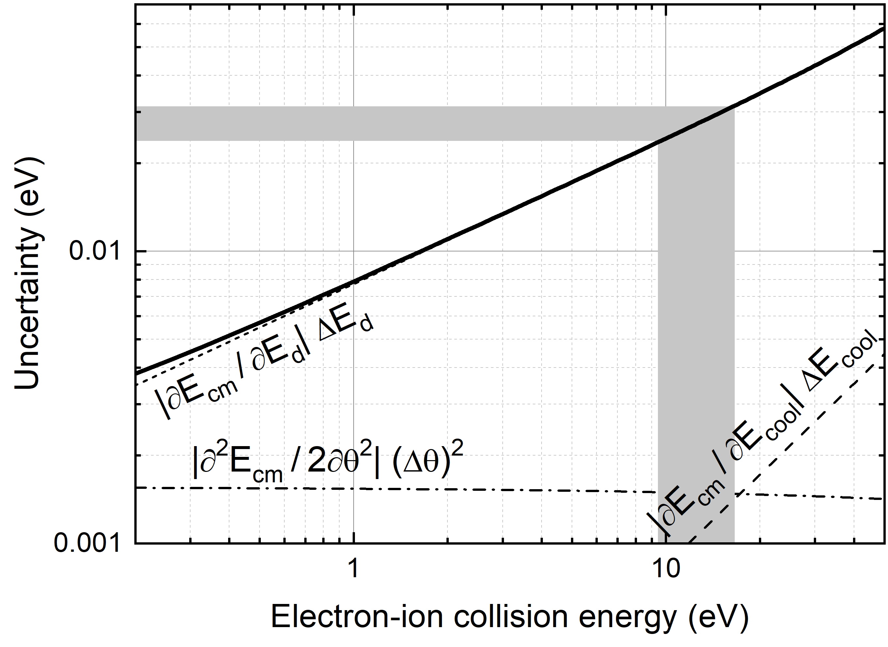
Follow-up Proposal: DR of Be-like U⁸⁸⁺
At low energies, the experimental resolving power is largest, and the experimental uncertainty is lowest.
Low-energy resonances calculated using AUTOSTRUCTRUE
Mirko Looshorn
ErUM-FSP APPA 2026, Darmstadt

Slide 13
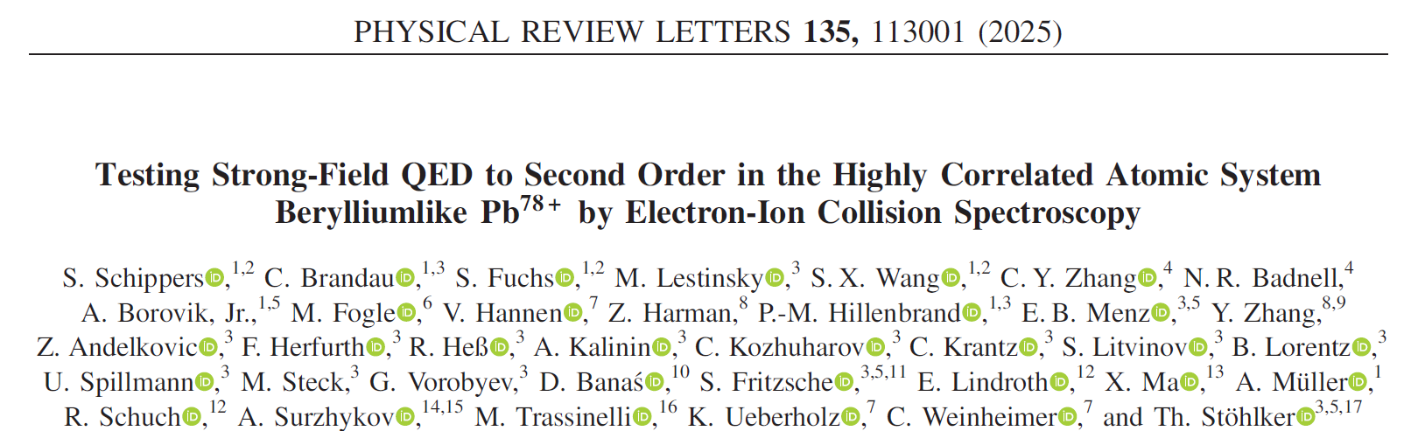
Summary
High resolution DR collision spectroscopy: successful spectroscopic tool for testing QED in strong fields
Published work on resonant electron-ion recombination of berylliumlike Pb⁷⁸⁺ ions (S. Schippers et al., PRL 135, 113001 (2025))
DR collision spectroscopy of Be-like ¹⁹⁷Au⁷⁵⁺ ions at 12 MeV/u in CRYRING@ESR
Second experiment using the full GSI accelerator chain after E131 / First with integrated FC20
Peak positions and peak strengths must be compared with theoretical calculations
Beam temperatures must be obtained from a Monte Carlo approach
Mirko Looshorn
ErUM-FSP APPA 2026, Darmstadt

Slide 14
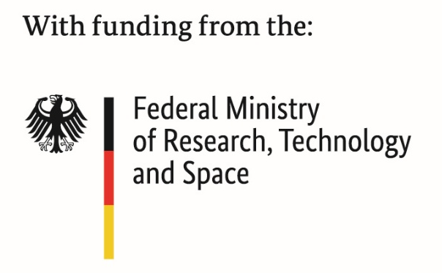



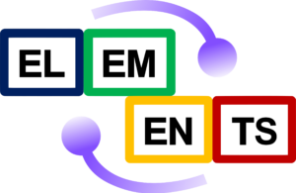
Thanks TO ALL COLLABORATORS
S. Schippers ^{1,2}, C. Brandau³, S. Fuchs^{1,2}, M. Fogle⁴, J. Glorius³, E. O. Hanu^{3,5,6}, V. Hannen⁷, F. Herfurth³, P.-M. Hillenbrand³, C. Krantz³, M Lestinsky³, E. B. Menz^{3,8}, R. Schuch⁹, U. Spillmann³, M. Tatsch¹, K. Ueberholz⁷, S.-X. Wang^{1,2}, T. Stöhlker^{3,5,10}
N. R. Badnell¹¹, A. Borovik Jr.^{1,5}, Z. Harman¹², C. Y. Zhang¹¹, Y. Zhang^{12,13}, Z. Andelkovic³, R. Heß³, A. Kalinin³, C. Kozhuharov³, S. Litvinov^{3,8}, B. Lorentz³, M. Steck³, G. Vorobyev³, D. Banas¹⁴, S. Fritzsche ^{3,5,10}, E. Lindroth⁹, X. Ma¹⁵, A. Müller¹, A. Surzhykov^{16,17}, M. Trassinelli¹⁸ and C. Weinheimer⁷
¹JLU Gießen, ²HFHF, ³GSI, ⁴Auburn University, ⁵HI Jena, ⁶Goethe University Frankfurt, ⁷WWU Münster, ⁸Universität zu Köln, ⁹Stockholm University, ¹⁰FSU Jena, ¹¹University of Strathclyde, ¹²MPIK Heidelberg, ¹³Xian Jiantong University, ¹⁴JKU Kielce, ¹⁵IMPCAS Lanzhou, ¹⁶PTB Braunschweig, ¹⁷TU Braunschweig, ¹⁸UMPC Paris

Slide 15
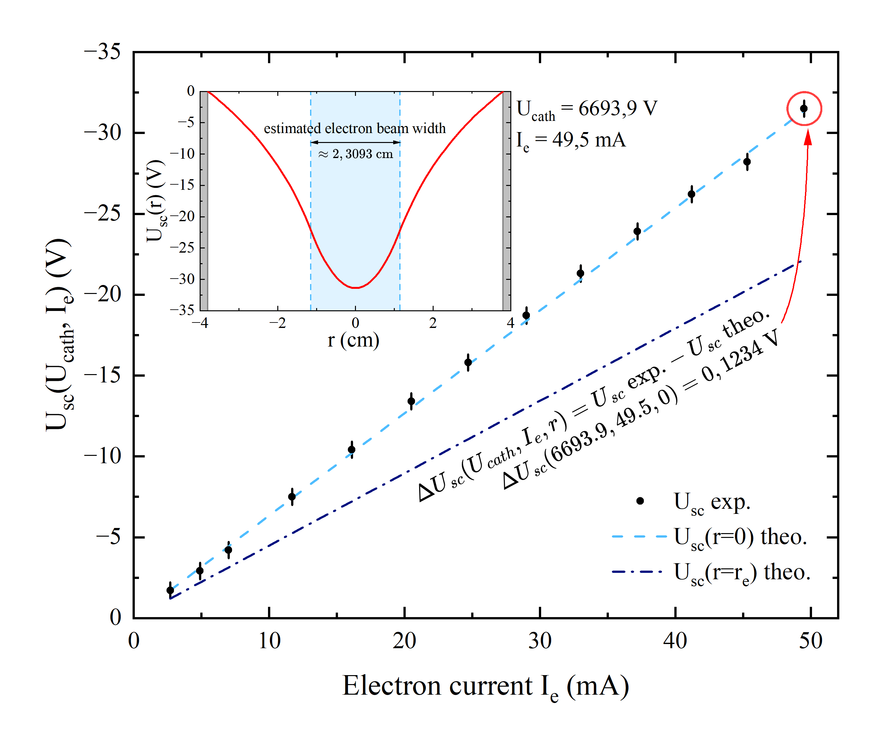
Preliminary Results of the Au⁷⁵⁺ Experiment
Iset_mA | Iread_mA | Ierr_mA | Uset_V | Uread_V | Uerr_V | scpot_V | scerr_V | theocen_V | theoedge_V
55 | 49.5 | 0.2 | 6695 | 6693.9 | 0.5 | 31.51 | 0.5099019513593 | 31.38 | 22.11
50 | 45.3 | 0.2 | 6692.5 | 6691.1 | 0.5 | 28.71 | 0.5099019513593 | 28.72 | 20.23
45 | 41.2 | 0.2 | 6690 | 6688.6 | 0.5 | 26.21 | 0.5099019513593 | 26.12 | 18.40
40 | 37.2 | 0.2 | 6687.5 | 6686.3 | 0.5 | 23.91 | 0.5099019513593 | 23.59 | 16.61
35 | 33.0 | 0.2 | 6685 | 6683.7 | 0.5 | 21.31 | 0.5099019513593 | 20.93 | 14.74
30 | 29.0 | 0.2 | 6682.3 | 6681.1 | 0.5 | 18.71 | 0.5099019513593 | 18.39 | 12.95
25 | 24.7 | 0.2 | 6679.6 | 6678.2 | 0.5 | 15.81 | 0.5099019513593 | 15.66 | 11.03
20 | 20.5 | 0.2 | 6677.0 | 6675.8 | 0.5 | 13.41 | 0.5099019513593 | 13.00 | 9.16
15 | 16.1 | 0.2 | 6674.0 | 6672.8 | 0.5 | 10.41 | 0.5099019513593 | 10.21 | 7.19
10 | 11.7 | 0.2 | 6671.0 | 6669.9 | 0.5 | 7.51 | 0.5099019513593 | 7.42 | 5.23
5 | 7.0 | 0.2 | 6667.8 | 6666.6 | 0.5 | 4.21 | 0.5099019513593 | 4.44 | 3.13
3 | 4.9 | 0.2 | 6666.5 | 6665.3 | 0.5 | 2.91 | 0.5099019513593 | 3.11 | 2.19
1 | 2.7 | 0.2 | 6665.4 | 6664.1 | 0.5 | 1.71 | 0.5099019513593 | 1.71 | 1.21
As far as we know
Best agreement of experiment and
theory at the CRYRING cooler
Mirko Looshorn
ErUM-FSP APPA 2026, Darmstadt

