Slide 1
Discussion Power Abuse AGBR

Slide 2




Data PA Survey 2025
SHARED STORIES (103 total, 72 with consent for use)
The perpetrator:
1. has Dark Personality traits:
Machiavellianism
Narcissism
Psychopathy
2. lacks supervision skills/motivation
3. does not respect contracts
"Sexism and Gaslighting: When I addressed a sexist comment made in a public setting, I tried to handle it privately to avoid escalation. However, instead of reflection, he became defensive, excused his behavior, and shifted the blame to me, suggesting that feeling harassed is a personal choice. He manipulated the situation by framing my complaint as an attempt to control him and threatened to make the issue public to discredit me. He openly admitted he might repeat such behavior, claiming he "cannot promise it won’t happen again," which left me feeling powerless and disrespected. […]"
"The PI of my lab had absolutely unrealistic expectations and didn't really know what he was talking about. All faults were always on his employees but never his even when he told people what to do. He was claiming to be able to do everything better and faster but didn't show it and didn't teach me anything, everytime he tried he failed miserably. […]"
"According to our head of department it is normal to work everyday more than the normal 8 hours and also on the weekends, and if you don't do so, you should think if a PhD is really something for you or not, because you will never be able to get your PhD if it doesn't consume your life."
10th General Assembly, October 2025

Slide 3
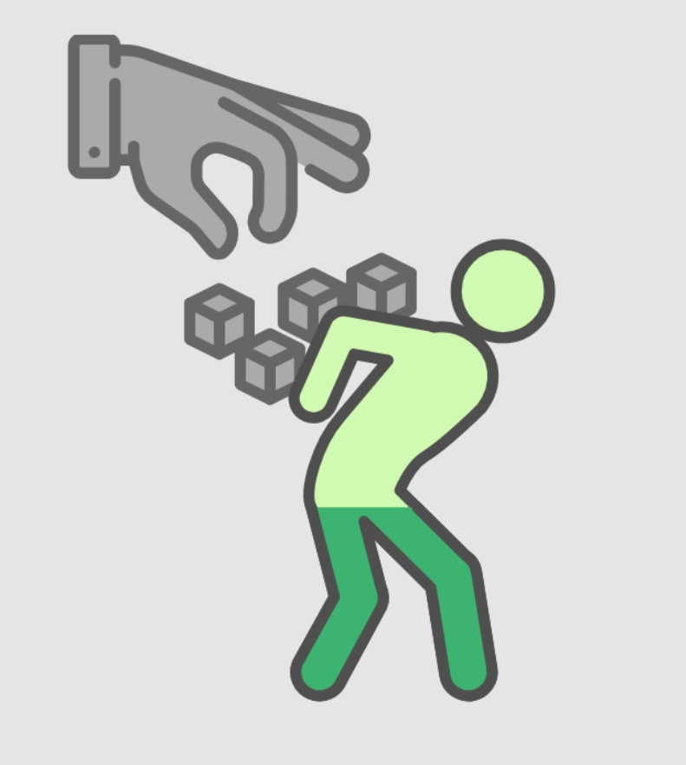
Data PA Survey 2025
SHARED STORIES (103 total, 72 with consent for use)
b. The DRs are (consequently):
Overworked
Afraid/anxious
Marginalized
Intimidated
Helpless
Stressed
Depressed
Physically ill
"Public Humiliation and Rule by Fear: In meetings, he publicly humiliated me in front of multiple male supervisors, putting me on the spot with complex technical tasks without prior warning, knowing I was unprepared. When I struggled, he escalated the humiliation by leaving me alone at the board, increasing my anxiety and distress. Afterward, he continued to undermine me during my talk by asking aggressive and belittling questions in front of the audience, damaging my professional credibility. My attempts to prepare for the next meeting were dismissed, as he set even higher expectations without guidance. Seeking help from other supervisors was futile, as they distanced themselves and provided no support. The relentless pressure and public humiliation led to severe stress, ultimately causing me to fall physically ill from anxiety."
10th General Assembly, October 2025

Slide 4
Data PA Survey 2025
SHARED STORIES (103 total, 72 with consent for use)
c. The support structures fail due to:
The anonymity impasse
The powerlessness impasse
The "action paralysis" impasse
"A colleague confided in me that after they began the process of reporting an incident, they were informed that in order to investigate the matter with the perpetrator, they could no longer remain anonymous. They were given the option to remain anonymous and drop the issue, or reveal to their supervisor that they (the victim) were filing an official complaint."
"[…] She has repeatedly stated that she won't let me get a PhD. Now this has come to fruition because she has refused to sign my supervision agreement or sign off on my project and has not allowed me to enroll in the university. I have taken these concerns to the omnsbudpersons and the works council, who have been supportive but unable to force her to do anything. Currently I am still employed in the lab but I am searching for a new PhD position in a different institute and I will lose the previous 2 years of work on my PhD.
"After repeatedly overstepping my boundaries and having conversations that were way too personal, my PhD supervisor (top of his field) started to touch me inappropriately. […] Multiple times. I was so ashamed and traumatized that I couldn't talk to anyone in 1,5 years. Now I'm really struggling to not leave academia because official institutions (Early Career Coordinater, Ombuds Person) told me there is nothing they can do for me and no one they can refer me to. After developing so much courage to speak to them and feeling so lost right now, it is incredibly hard to live on. But I still refuse to be pushed out, wondering what I'm doing here."
10th General Assembly, October 2025

Slide 5
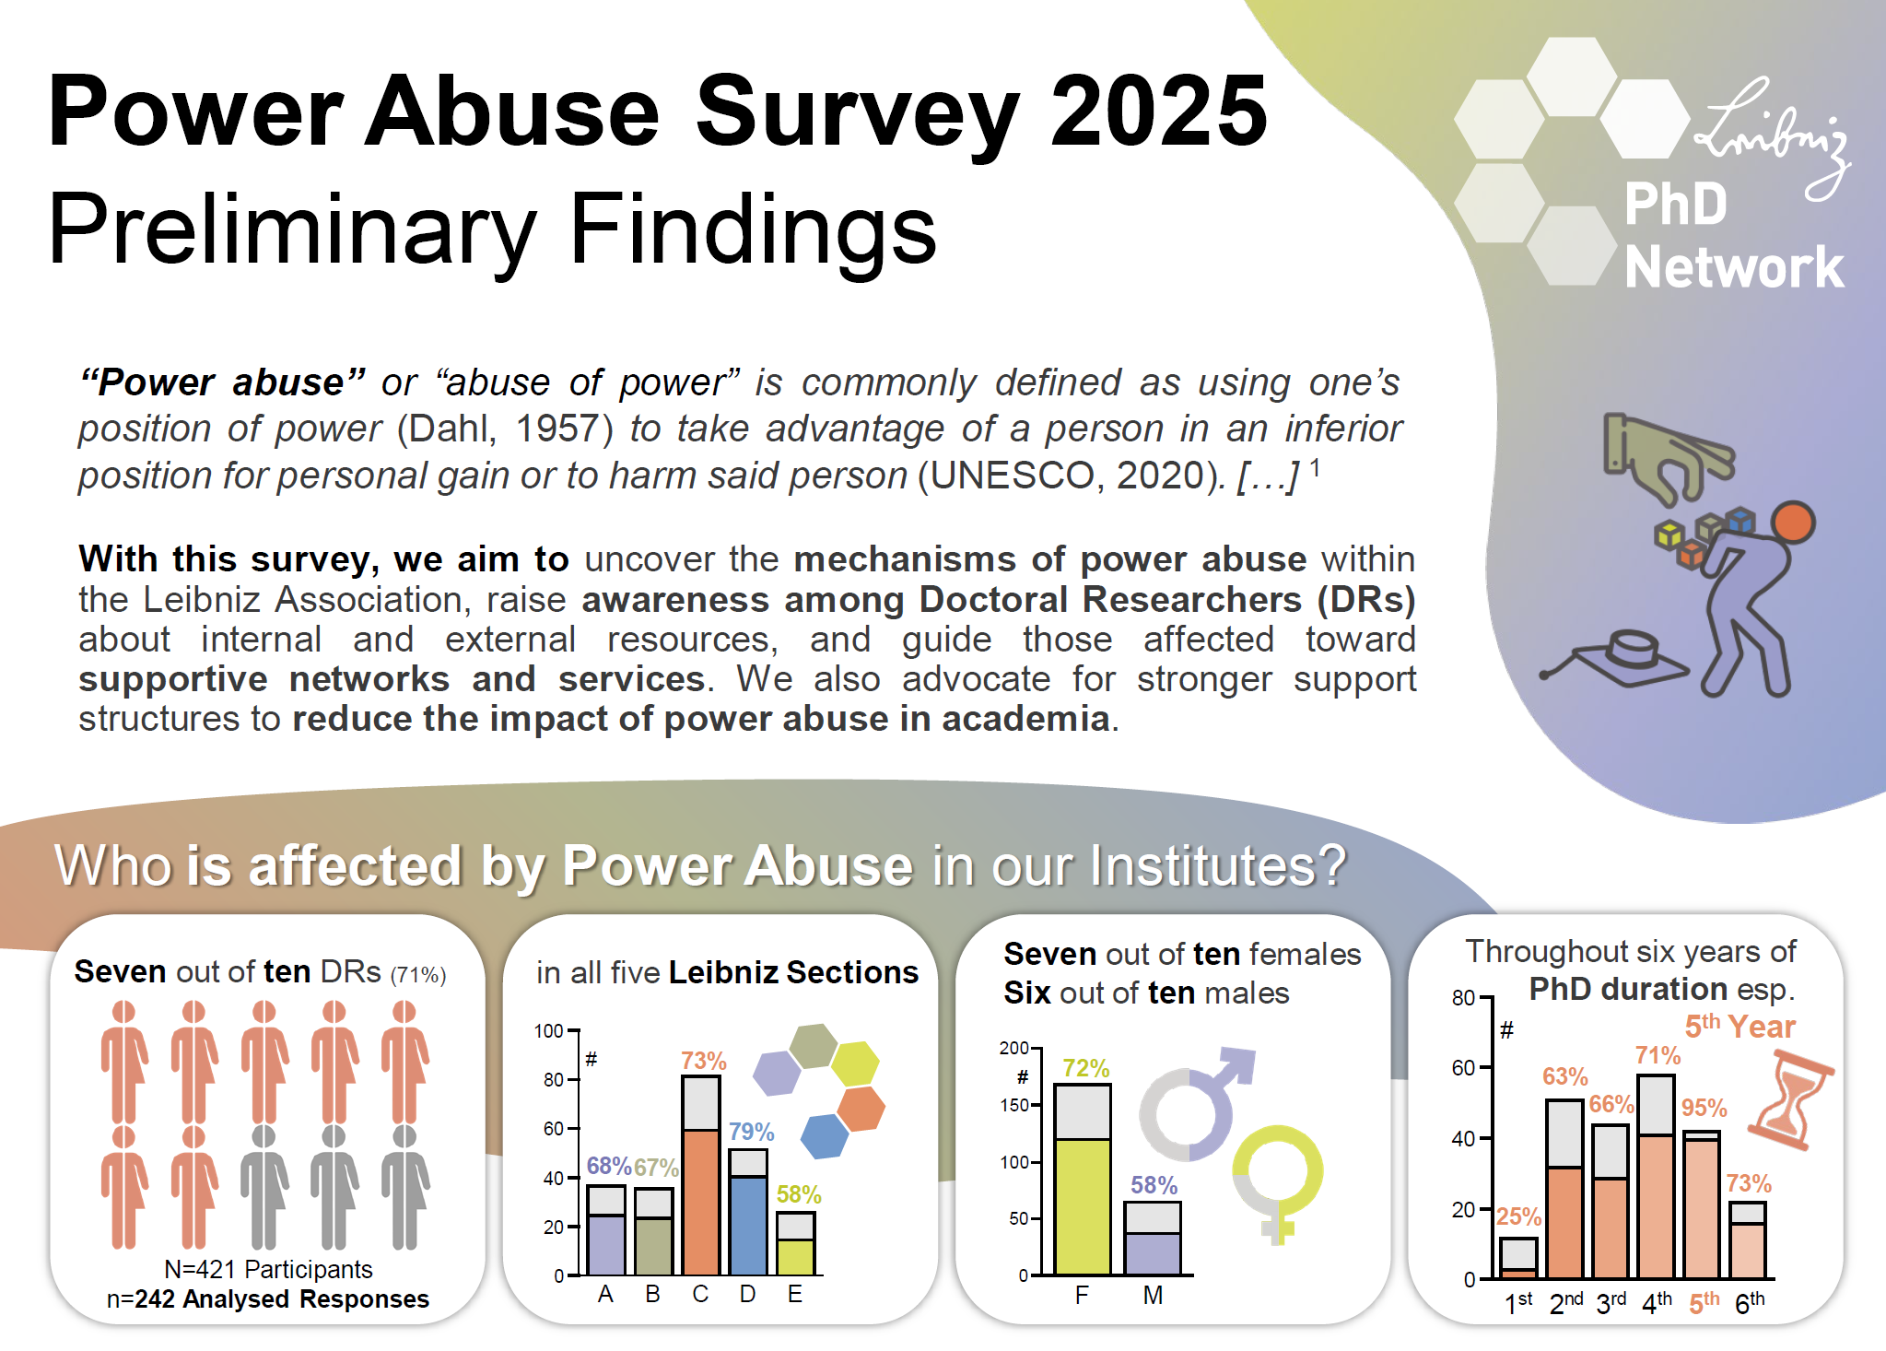

Slide 6
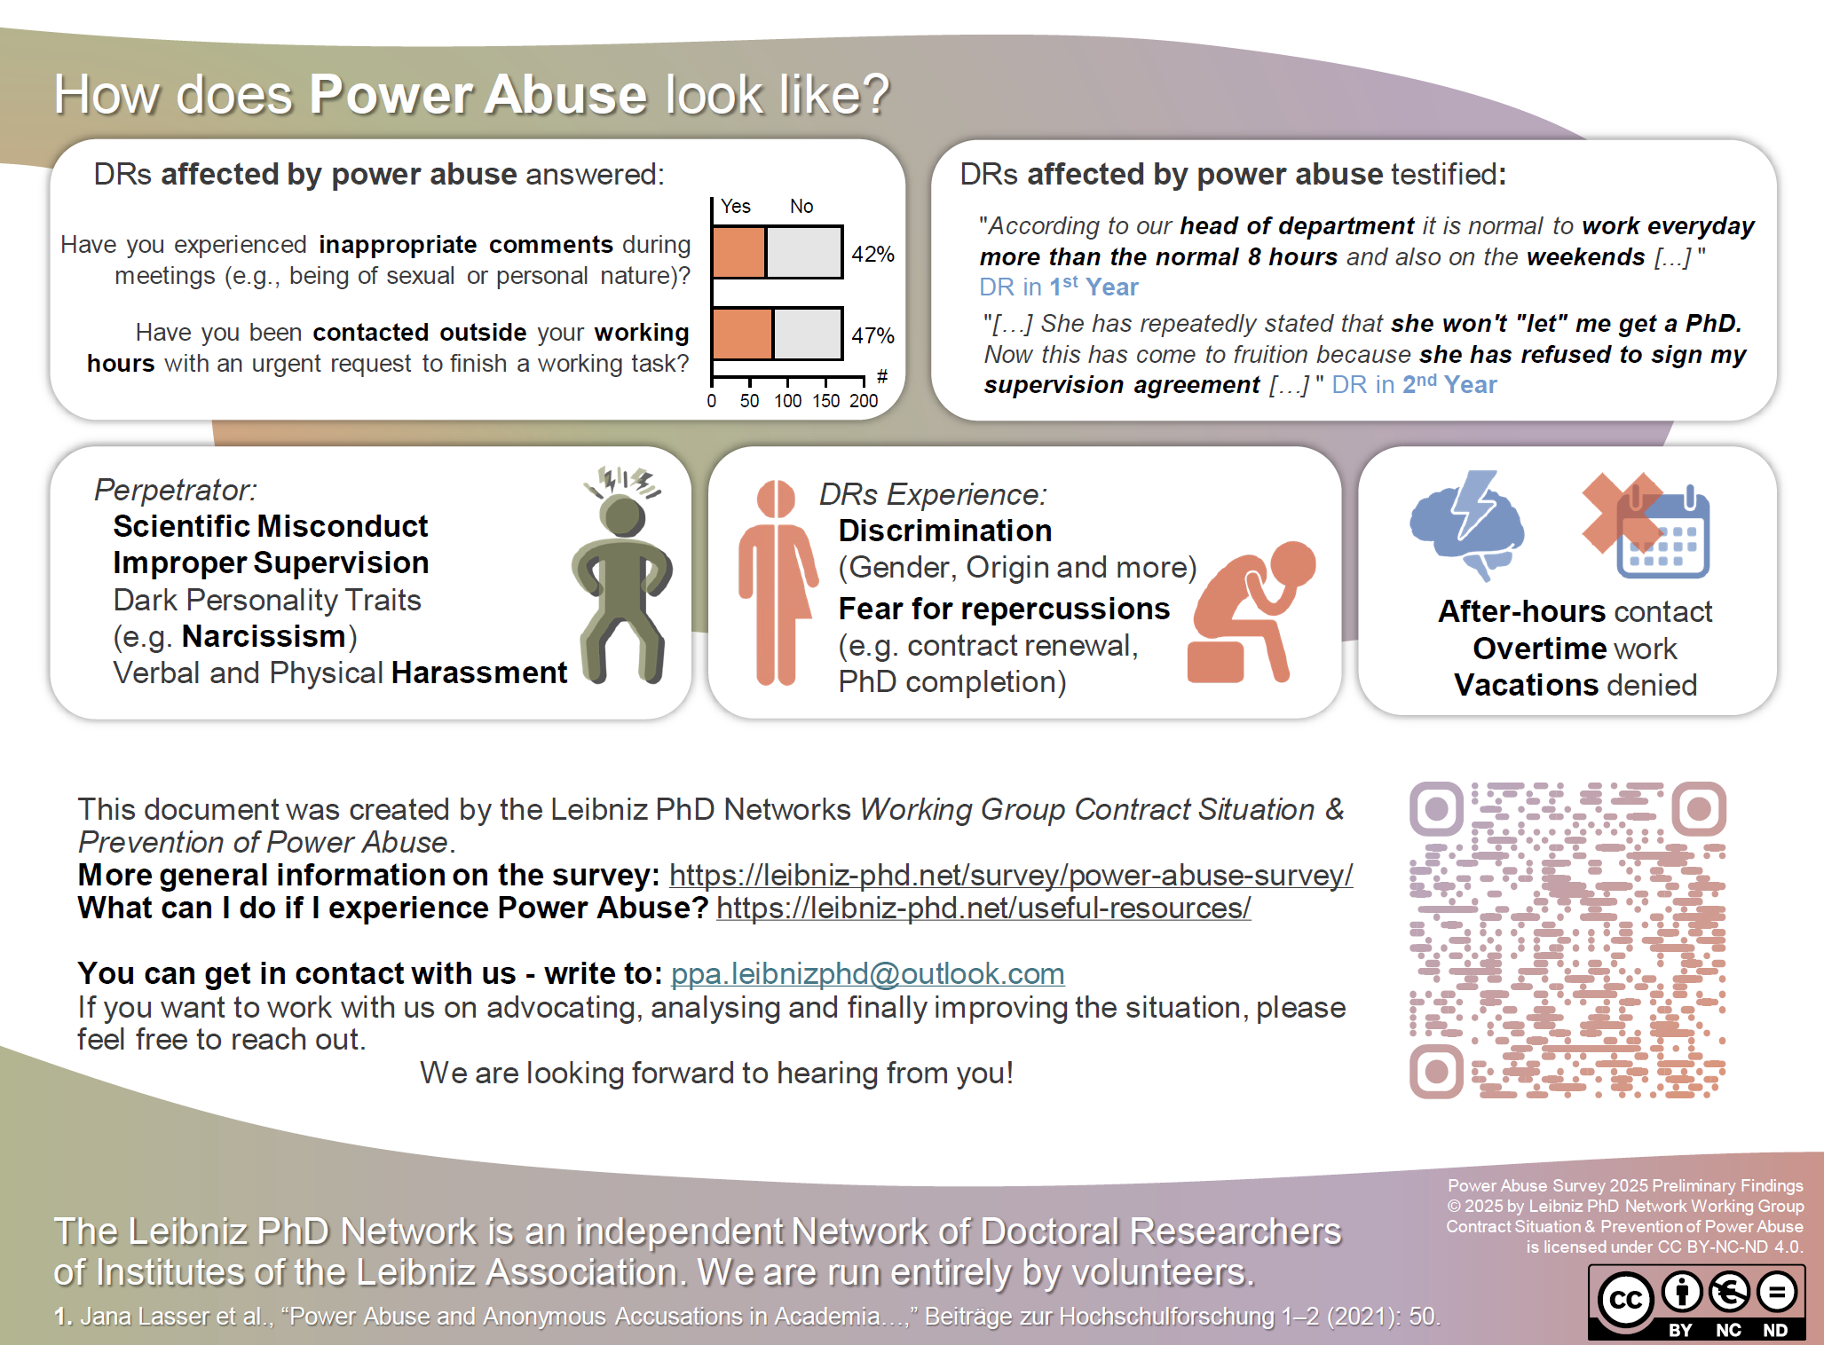

Slide 7
Recent / Future / Upcoming Actions and Aims
Talks with the LA board unfruitful
Talks with PPA advocates (2 professors) very productive: complete support
Conference attendance
Scientific Publication
We are looking for loyal supporters

