Slide 1
Archiving System
Status OCT 2025

Slide 2
Main Goals of the System
Collect and store the data produced by different accelerator components (devices)
Provide interfaces to query the data

Slide 3
Current State
Current State
The System is deployed and running for about 5 years now
Several adjustments and improvements since the start of operation
Grafana and DAVE can be used to query the data from the database
Up to now - only “Best effort operation”, due of lack of resources
Current ingestions rate: about 70 - 150 GB/day (gross) of data
Limitations and known issues
50 TB of net disc space is available at the present stage
Opensearch database tends to OOM failures, presumably due of overload with requests
Limited analyzing functionalities

Slide 4
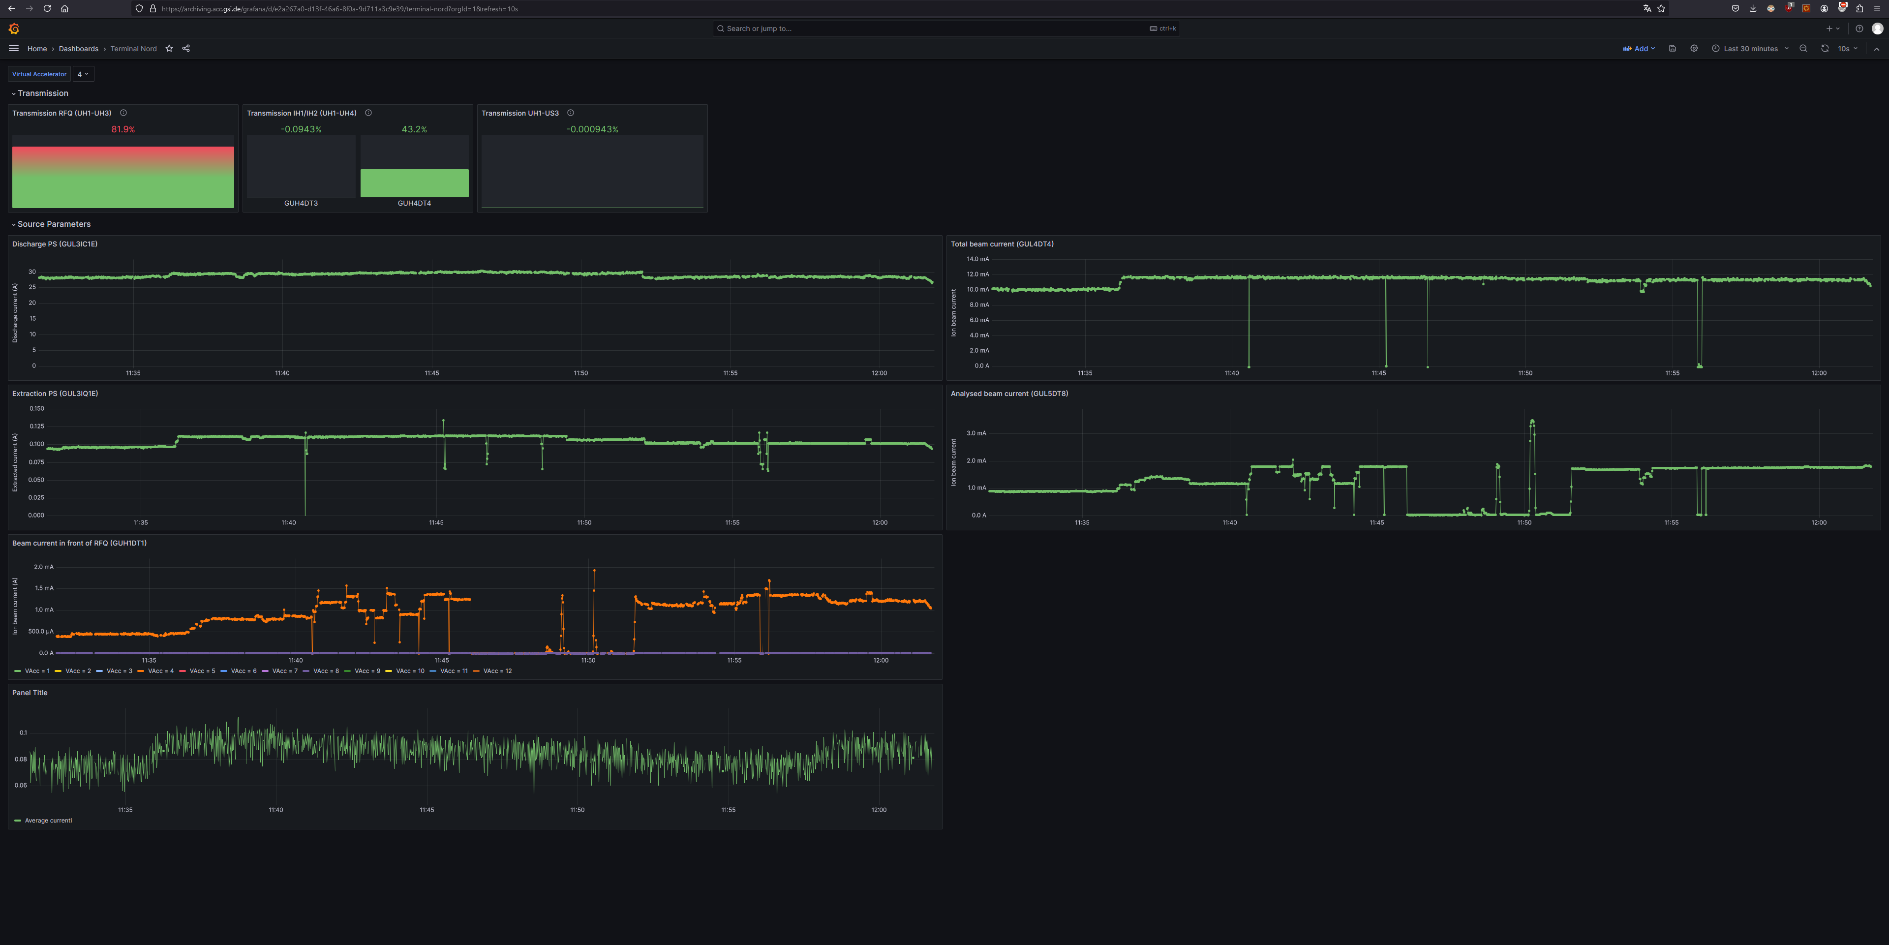
Grafana

Slide 5
2025 Developments
Developments in 2025
New Developer joined the team on 1.3.2025
Additional In-Kind (S2 Innovation) developer is also available
Main focus: address known limitations in scalability and performance on big data
A workshop with major stakeholders was held to determine the actual use cases and needs for the system
As the result the system is being reworked and optimized to handle the required scale, minimize technical debt, improve stability and maintainability

Slide 6
Why we need a reworking
Current System:
Main architectural Idea: flexible database centric storage
Opensearch as database backbone
Store data in same formats as it is received originally
Use complex reduction algorithms to reduce data amount over time
Limitations:
Scaling the database is challenging, often costly and cannot be easily achieved by adding more hard drives
A database is optimized for search queries rather than for bulk data retrieval
Analytical capabilities are limited by database features
Format flexibility costs performance and is complicated to manage

Slide 7
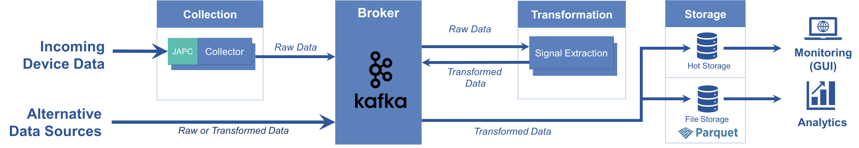
Next Generation Archiving
NeXt ARchiving (NXAR):
Main architectural Ideas:
Normalize (transform) incoming data to a basic time-series format
Store the data in Apache Parquet files on disk
Use a time-series database as hot storage and monitoring (Grafana)
Data Flow:

Slide 8
Next Generation Archiving
NeXt ARchiving (NXAR):
Benefits
Apache Parquet allows an easy integration with modern analytical, ML and AI tools
Scaling disk storage is (relatively) easy
Files allow an easy handling like storing them on tape or external HDD
A possibility to store them on CIT’s Lustre is in discussion (preferred approach today)
Normalized data format:
Allows generic algorithms for reduction analysis etc.
Data storage flexibility for hot storage
In addition:
Less technical complexity
Better technical integration with existing ACC tooling like monitoring and logging
Simpler integration with other data sources (WinCC OA, OPC UA)

Slide 9
Roadmap
Roadmap 2026:
Working prototype by the end of 2025
March 2026
Configuration data is migrated to NXAR
All user side components are adapted (proxy, extractor)
June 2026
Web GUI for basic operations is ready
Basic context data from LSA is available in the new system
Summer 2026
Data from the current system is exported to Parquet files
August 2026 (Beamtime)
Using existing Opensearch cluster, but storing the data in new format
Existing Grafana Dashboards are migrated
Writing parquet files to Lustre (if achievable by that time)

Slide 10
Roadmap
Roadmap for 2027 and beyond:
Introduction of a powerful tool set to analyze and query the data e.g. Jupyter Notebook (or similar)
Extending the available context information e.g. LSA Trim Settings, Timing Data etc.
Integration with OPC UA and WinCC OA data
Introduction of a new time-series DB for hot storage and monitoring

Slide 11
Q & A
?

Slide 12
ICALEPS 2025 Paper
V.Rapp et al., From terabytes to petabyte: scaling of the archiving system for FAIR
DOI: 10.18429/JACoW-ICALEPCS2025-TUPD109
Link: https://epics.anl.gov/icalepcs-2025/doi/jacow-icalepcs2025-tupd109/index.html

