Slide 1




Momentum-fragmented hyperons in cold neutron stars
arXiv:2507.07556
Hristijan Kochankovski
Àngels Ramos
Laura Tolos
EMMI Workshop: 5th Workshop Anti-Matter, Hyper-Matter and Exotica Production at the LHC, Salerno, Italy
10-14.10.2025

Slide 2
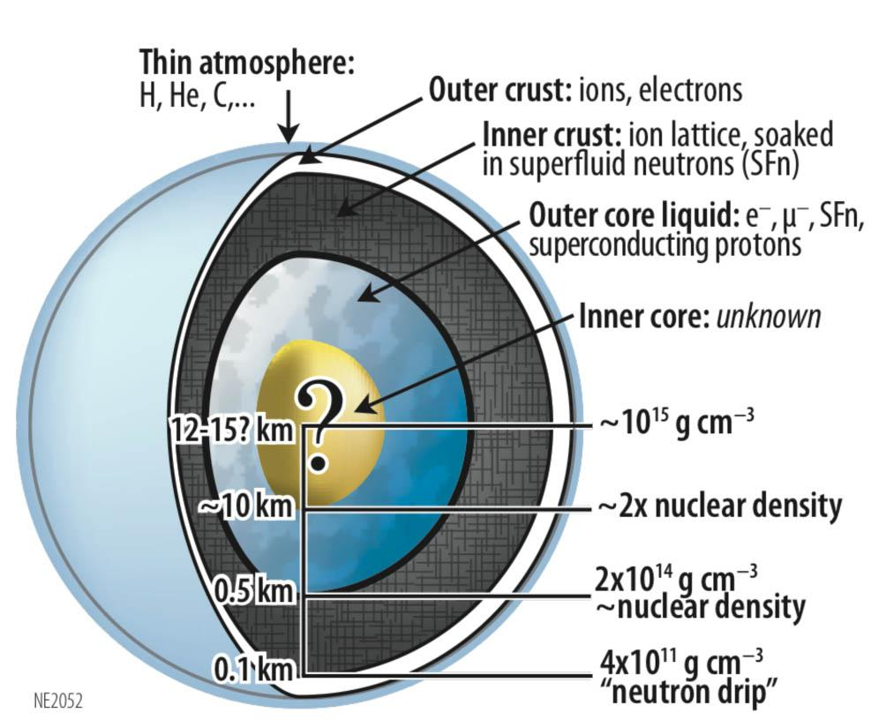
Introduction
AB INITIO
PHENOMENOLOGY
Brueckner–Hartree–
Fock
RMF methods
Variational approach
Skyrme potentials
Self-consistent Green Function
Quark-meson coupling method
Gendreau et al., SPIE, 2012
Notes:
The composition of the core of cold isolated neutron stars has been an open question for several years. Due to the uncertainty of the interaction at high densities, the composition of the dense matter is still model dependent, with some models predicting that hyperons, baryons with strange quarks can appear in the matter. Theoretically, the EoS of dense matter has been devoleped using Ab initio methods and phenomenological methods. For hypernuclear matter, the RMF method has been extensively used.

Slide 3
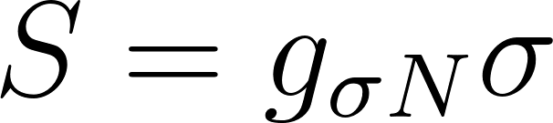
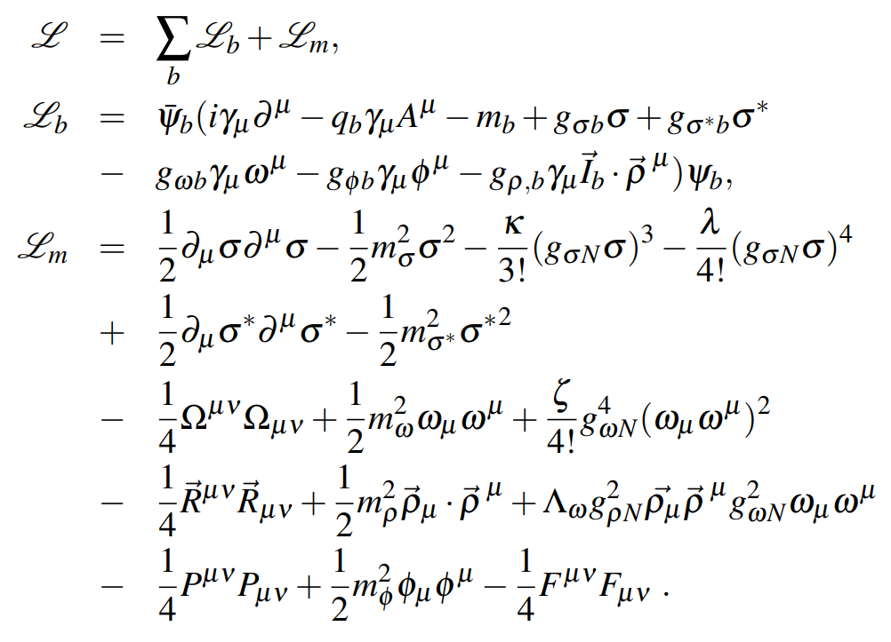
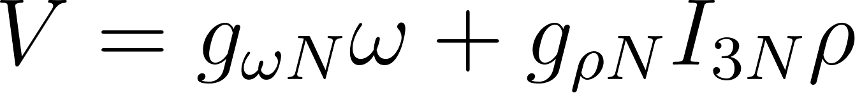
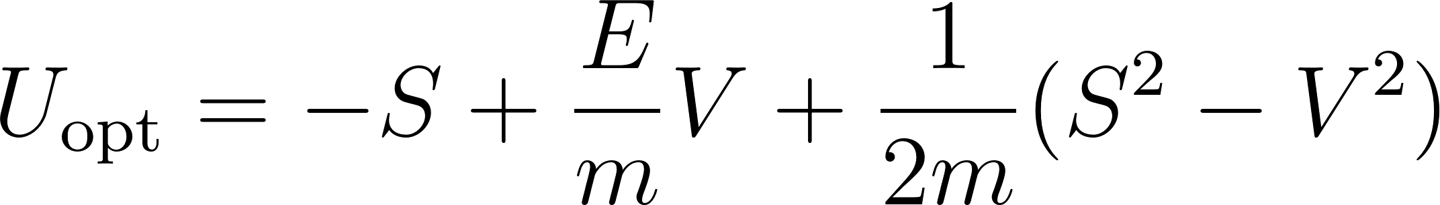
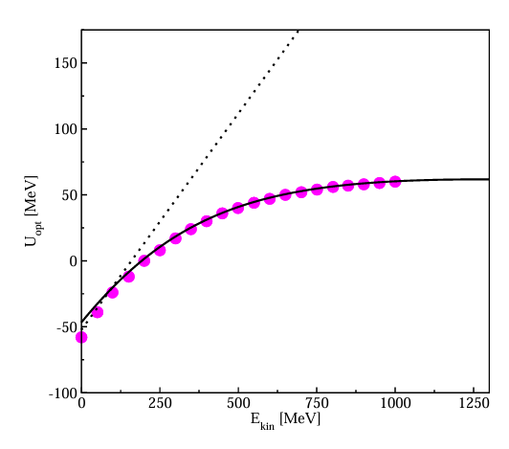
Relativistic mean field framework
RMF framework
Gaitanos et al, Nuc. Phys. A, 2013
Dirac phenomenology
Notes:
In the RMF method the interaction between baryons is mediated by the exchange of virtual mesons. Starting point of the theoretical framework is the lagrangian that has baryon term and meson term which depend on some parameters like masses of mesons and coupling constants that are tuned in a way for the model to be consistent with data from finite nuclei and nuclear matter parameters. However, the usual RMF methods yield scalar and vector potentials that are momentum and energy independent. Hence, they predict optical potentials that increase almost linearly with the energy of the nucleons. This is contrast with the results obtained from the dirac phenomenology, where a saturation of the increase is observed at very high energies
Dirac phenomenology – scattering from heavy nuclei

Slide 4
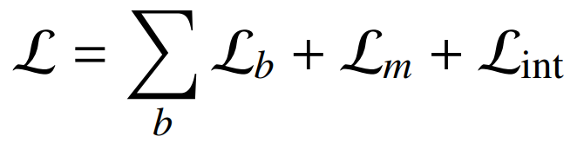
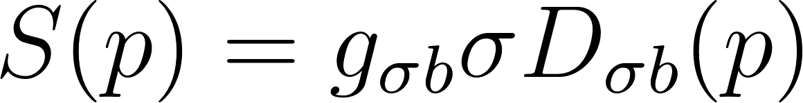
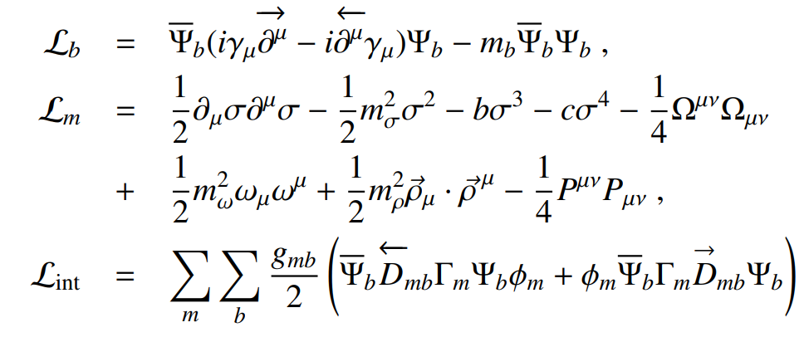
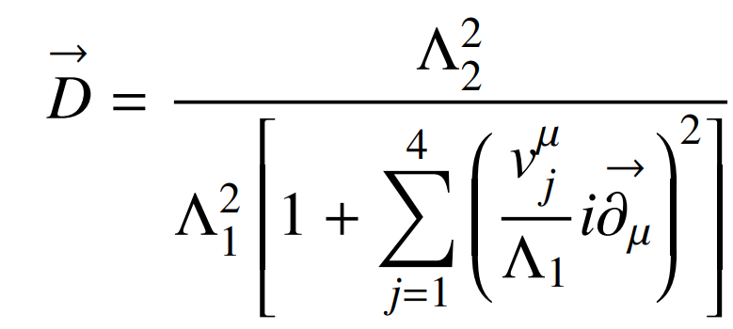
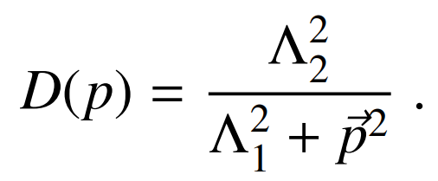
Non-Linear Derivative (NLD) model
Introducing a non-linear derivative operator
Momentum-dependent meson self-energies
NLD model
Gaitanos et al, Nuc. Phys. A, 2013
Nuclear matter
Dirac phenomenology
For an introduction to the model, see:
S. Typel, Phys. Rev., 2005; T. Gaitanos et al, Nucl. Phys. A, 2012; T. Gaitanos et al, Nuc. Phys. A, 2013 …
Notes:
A way to resolve this issue is to add an additional operator in the lagrangian, that for infinite nuclear or hypernuclear matter reduces to a momentum dependent cut-off that softens the interaction at higher momenta. By introducing the operator D an explicit momentum dependence is introduced to the meson self energies. In this way the optical potential in symmetric matter can be consistent with the phenomenology extracted from scattering events.

Slide 5
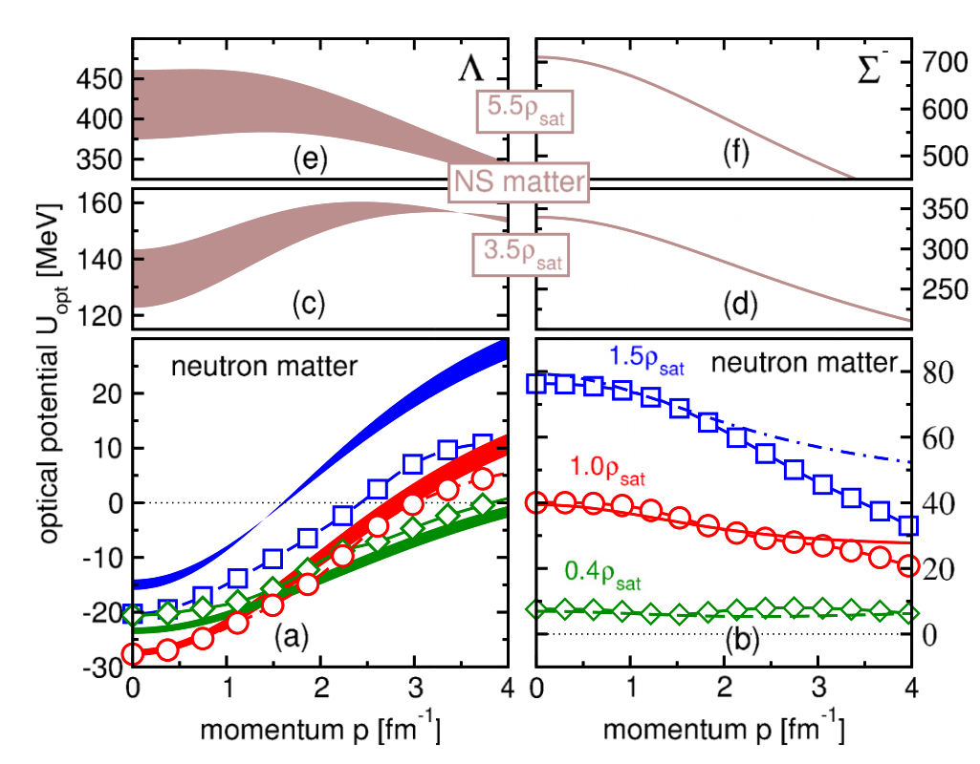

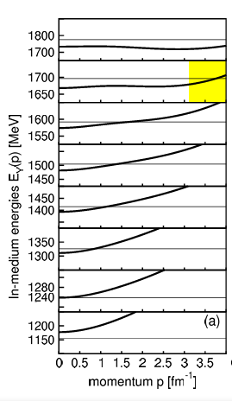
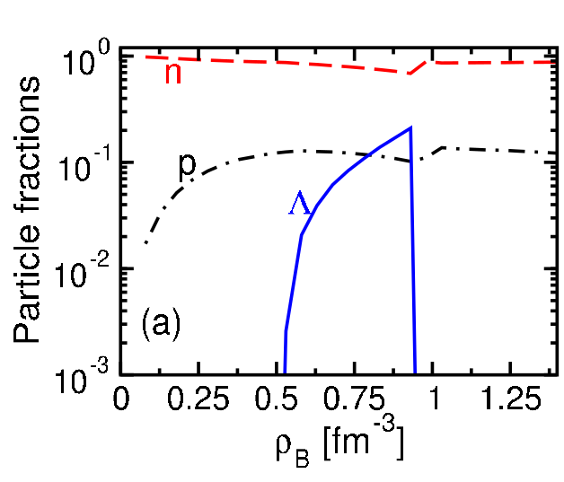
NLD model and hyperons
The model was recently extended to take into account hyperons in matter
Surprising results—hyperons disappear from matter when a soft momentum dependence is present.
thin line —
A. Chorozidou et al, PRC, 2024
fitted to the results from χBHF—S. Petschauer et al., EPJ A, 2016
Notes:
Very recently, the model has been extended to incorporate the lambda and sigma minus hyperon in the matter. In this case the momentum dependent part of the interaction was tuned according to the results obtained for the two hyperonic species in Cjhiral Brueckner Hartree Fock framework. In the graphs here the lines and the bands belong to the best fit of the optical potential of the hyperons in pure neutron matter for various densities labeled in different colours. The symbols represent the calculations from the ChiralBHF method. In the results obtained for the composition of the matter a surprising feature can be observed – the Lamba hyperon disappeared from the matter when a soft momentum dependence was present, even when the energy of the specie for a large set of momenta lied bellow the threshold line given by the neutron chemical potential.

Slide 6
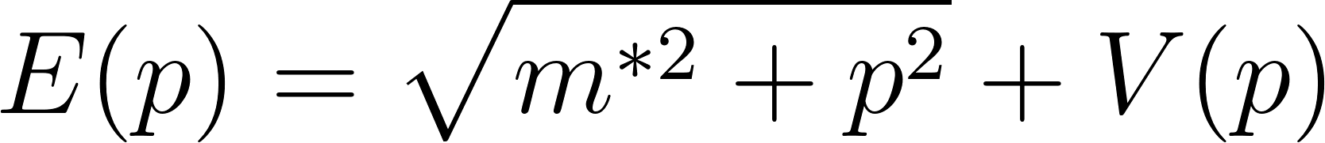
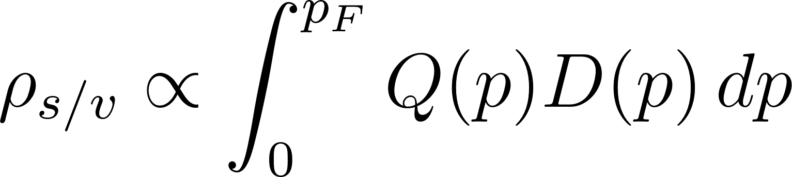
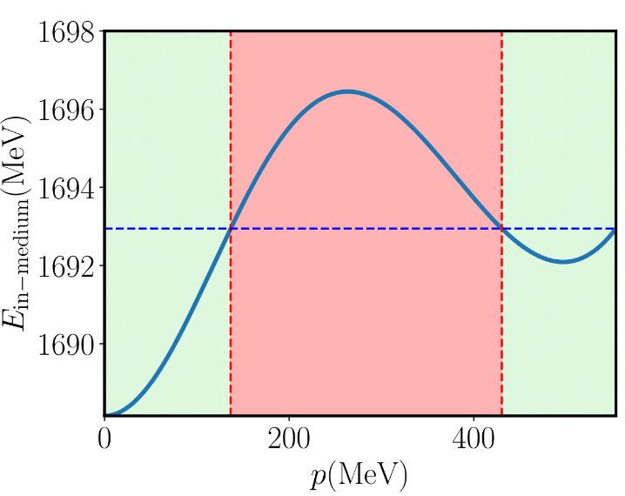

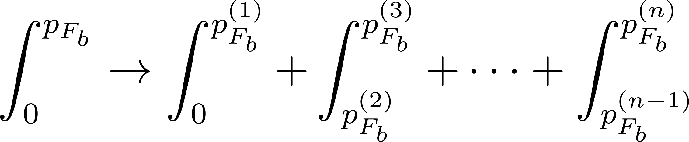
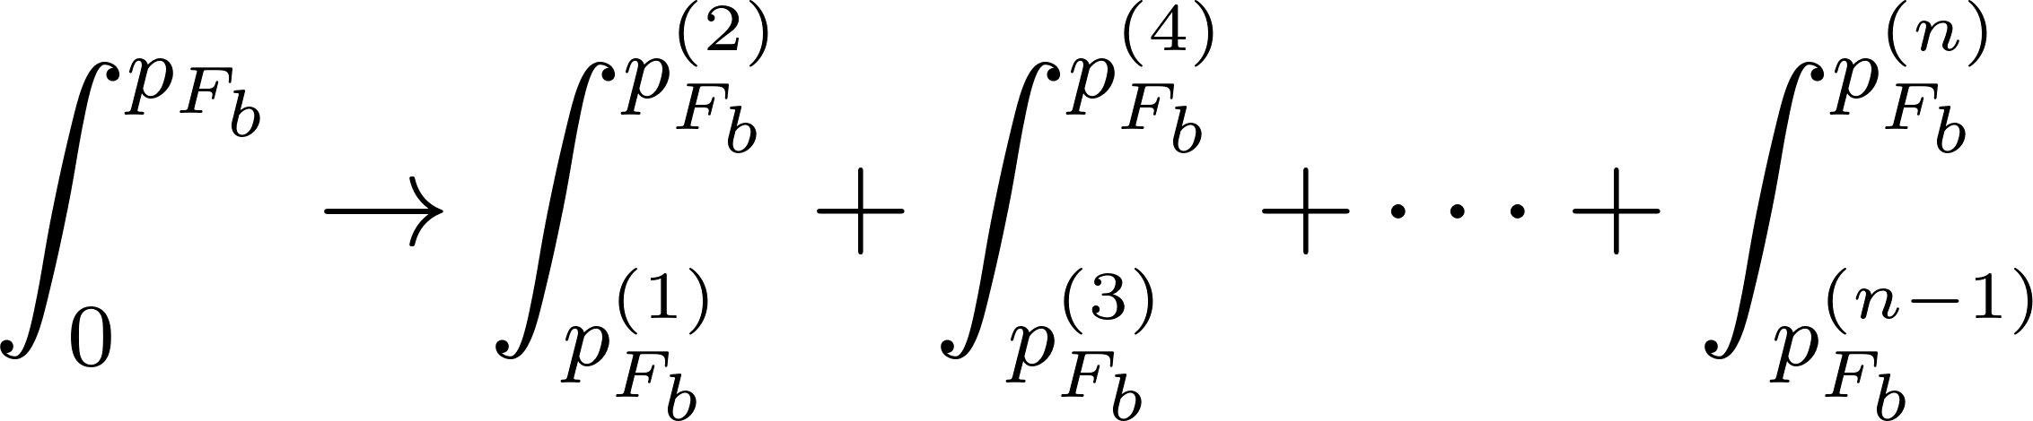
Non-monotonic behavior of the in-medium energy
Due to the soft momentum dependence, the in-medium energy of hyperons can have several crossings with the Fermi energy
The non-monotonic behavior of the in-medium energy requires a change of the theoretical formalism
populated
populated
The number of crossing is odd
forbidden
The number of crossing is even
Notes:
That is why we decided to review the EoS of the NLD model. The interesting results is that due to the momentum dependence, the energy of the specie can be non-monotonic function with respect to the momentum. For example, the Lambda energy of the matter can have the following form like on the graph. That can lead to cases where the energy of the lambda hyperon crosses the neutron chemical potential line three times. That means that another region has been opened at higher momenta that can been populated too. The momentum states are not continuously filled anymore. This requires a change in the theoretical formalism. The scalar and vector densities that before were integrated from 0 to the highest momenta, now should be fragmented, to not include the contribution from the more energetic particles with lower momenta from the fermi one.

Slide 7

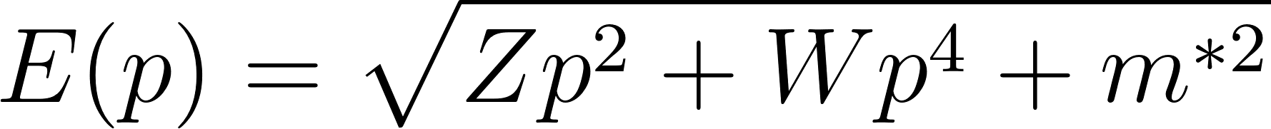
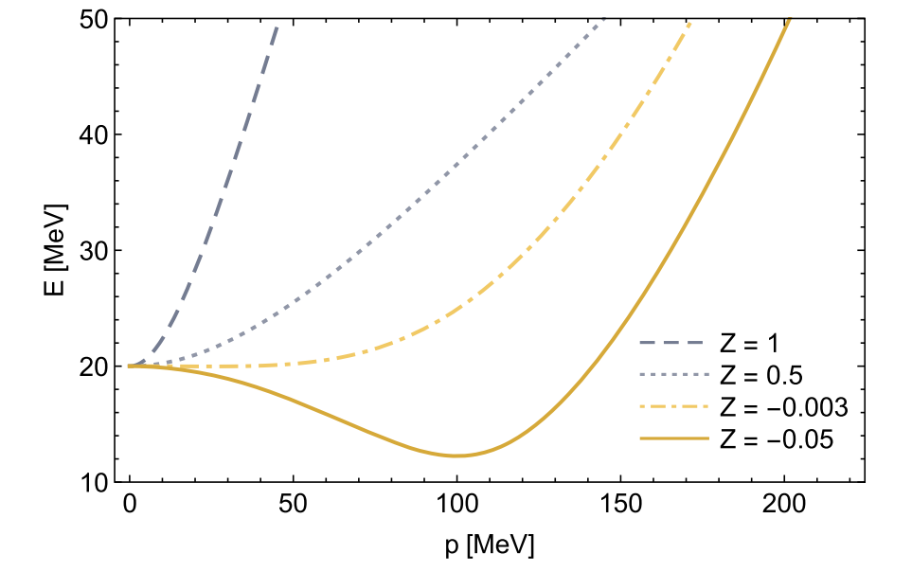


Momentum-fragmented hyperons
The Fermi sphere is fragmented and has an onion-like structure ⟶ momentum-fragmented hyperons
R. D. Pisarski et al., PRL, 2021
F. Rennecke et al., PRD, 2023
Notes:
As we said, the momentum-states are not continuously filled. The filled and empty states can alternate in the momentum space, leading to a fermi sphere that is fragmented, acquiring an onion-like structure. Due to the shape of the Fermi sphere in that case, the hyperons that populate this type of Fermi sphere will be called momentum-fragmented hyperons. In some recent articles it was mentioned that a similar situation could be possible in heavy ion collisions. In those cases, for particles that have a minimum of the energy at non-vanishing momentum an enhance in the production is predicted at finite momenta. This region is called moat region. However, since in those cases a spatially modulation also exists we will keep using the term momentum-fragmentation for the hyperons appearing with a fragmented fermi sea.

Slide 8

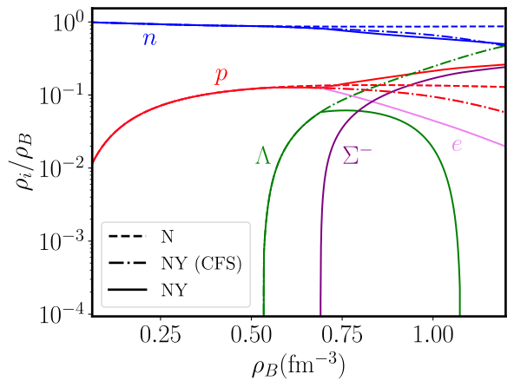

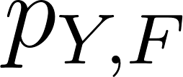
Results - composition and
Three sets of calculations:
i) N—nucleonic matter only
ii) NY (CFS)—hypernuclear matter but solving the equations as in usual RMF methods:
Threshold for appearance:
Disregards the momentum-fragmented hyperons and assumes that all states are filled up to
iii) NY—full consistent calculations, taking into account the momentum-fragmented hyperons
Notes:
In the following slides I will present the main results that we have obtained about the composition of the particles and the in-medium energy of the hyperons. In order to dissantagle the different effects that come from the introduction of hyperons and the proper treatment of the fermi seas, three distinct calculations are performed. In the first ones, labeled with dashed lines, only nucleonic matter is taken into account. The second set of calculations, labeled with dashed-dotted lines considers hypernuclear matter and the RMF equations are solved as in usual RMF methods. That means that as a threshold for appearance of any species, the energy of the zero-momentum hyperon is considered ant the fermi seas are treated as to be continuously filled. The third sets of calculations are labeled with solid lines and in those calculations the momentum-fragmentation of the fermi seas is consistently taken into account.

Slide 9

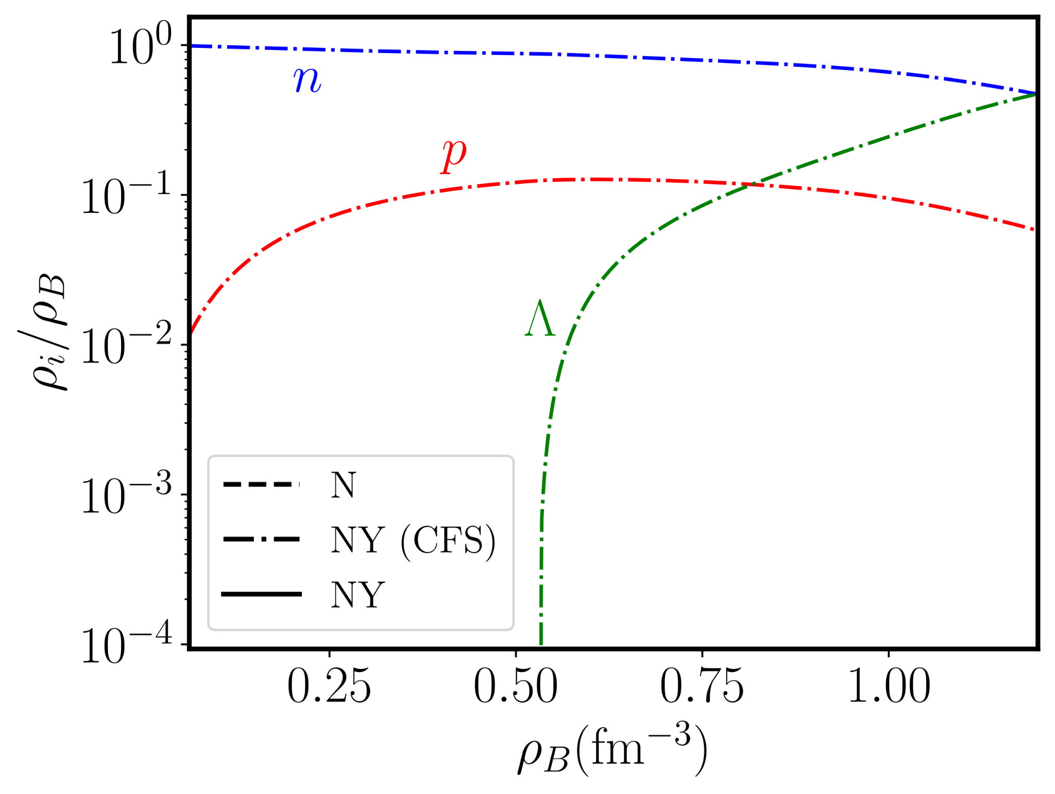
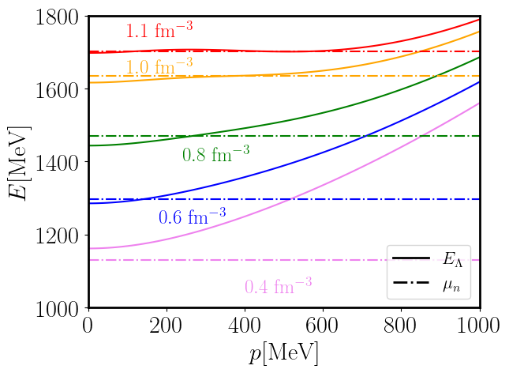
Results - composition and
NY (CFS)
in-medium energy
Notes:
Let’s first start with the calculations where the fermi spheres are not properly treated. To better understand the composition plot, we will compare it with the in-medium relation of the lambda hyperon, for few different densities, each labeled with different colors. With dashed lines, the chemical potential of the neutron, in beta-equilibrium, at those densities, is also shown.

Slide 10

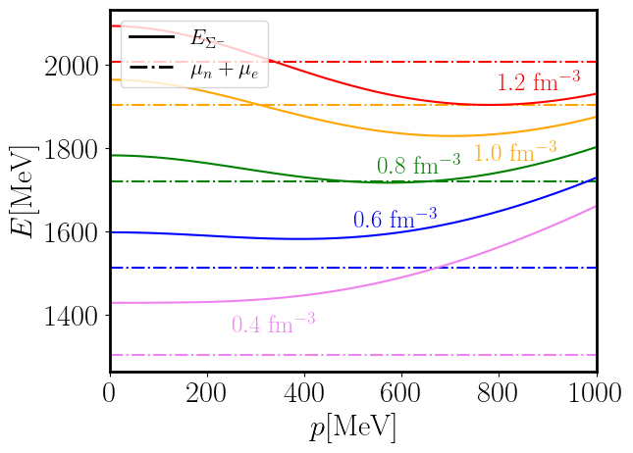
Results - composition and
NY (CFS)
in-medium energy
Notes:
One may wonder why the negative sigma minus hyperon did not appear in the matter. To better understand, let’s look at the in medium energy of the sigma as a function of the momentum for a few different densities.

Slide 11
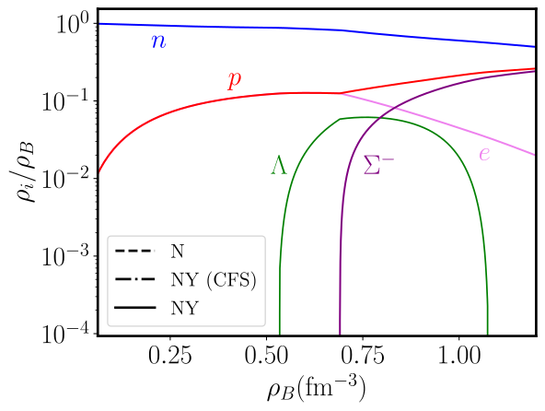
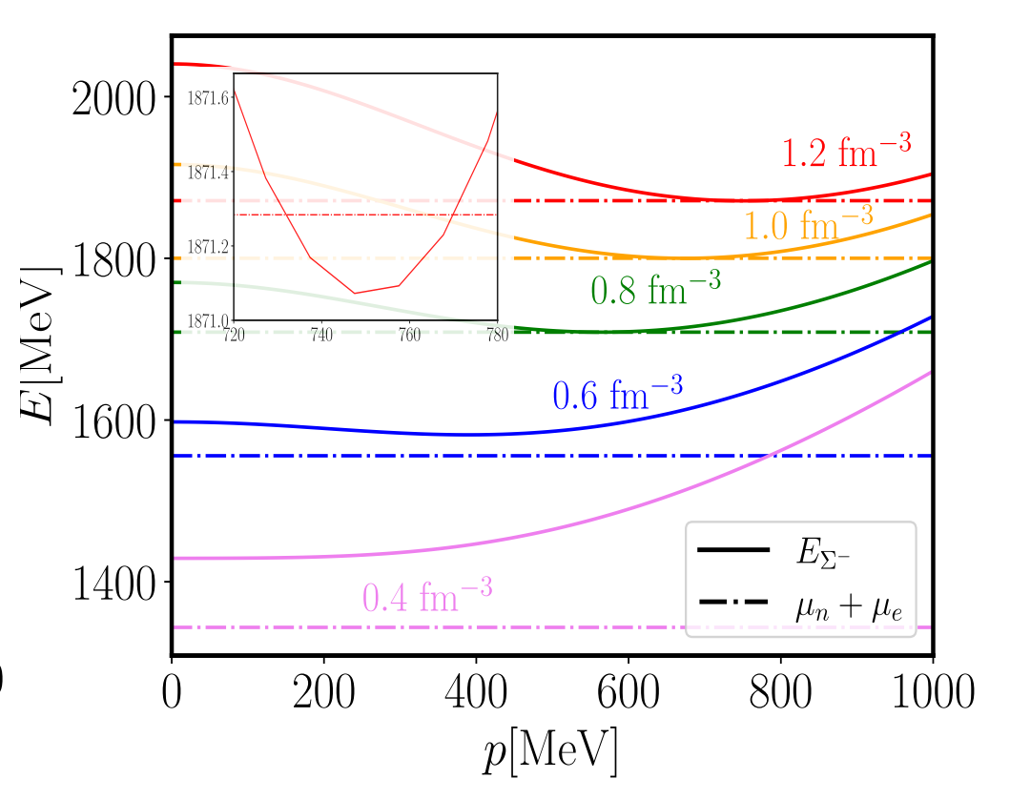
Results - composition and
NY – consistent calculations
in-medium energy

Slide 12
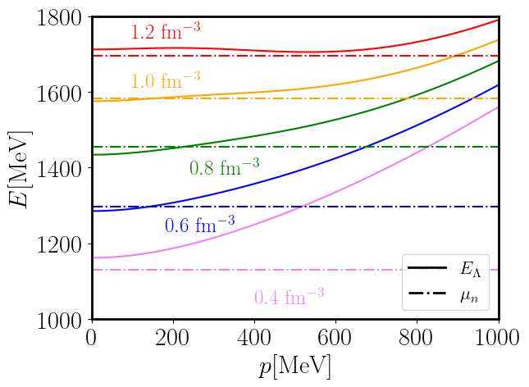
Results - composition and
NY – consistent calculations
in-medium energy
Notes:
Treating properly the momentum-fragmented region, if present, significantly changes the composition of matter.

Slide 13
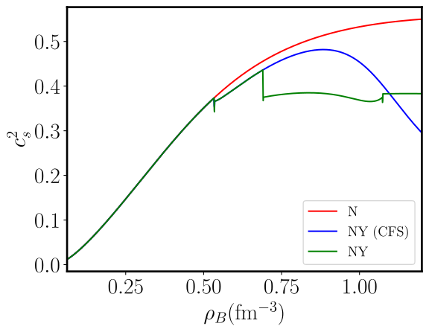
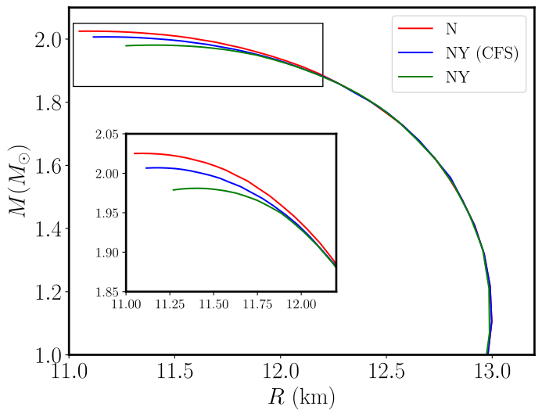
Results - composition and
The speed of sound remains almost constant for a wide range of densities
The mass radius curves are insensitive to the different matter composition
Notes:
Exlain the kinks of the curve. Label the appearance of the species . In spite of having a very different composition and speed of sound the m(R) is not that sensitive.

Slide 14
Conclusions
We reviewed the EoS of hypernuclear matter using the NLD model that introduces an explicit momentum-dependent potentials by introducing a cut-off operator. The cut-off operator softens the interaction between the baryons at high momenta.
The softening effect can alter the otherwise monotonic behavior of the energy of the baryonic species as a function of the momentum.
The minimum energy of the hyperons can be achieved at a finite momentum, allowing states to be populated even when regions of lower momenta are empty. We call those particles momentum-fragmented hyperons.
The presence of momentum-fragmented hyperons can prevent an increase in the speed of sound, but the mass-radius relation is not significantly changed with respect to the cases where they are not taken into account.
The methodology of the momentum-fragmented region can be applied to any model with momentum-dependent potentials.

Slide 15
Thank you for your attention!

Slide 16
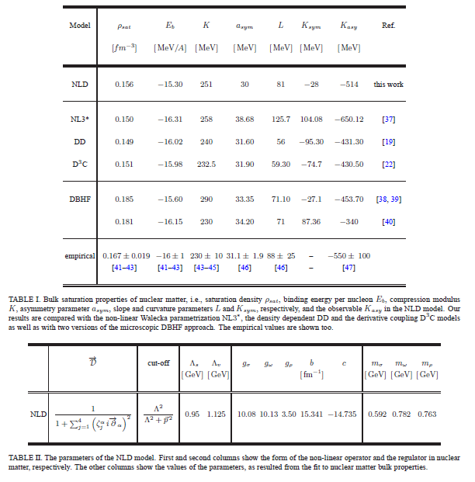

Slide 17
