Slide 1


MVD updates
    Thermal properties improvement
    Cooling circuit test (Torino)
    Integration (Jülich)
G. Giraudo
GSI-Darmstadt 24-06-2013

Slide 2
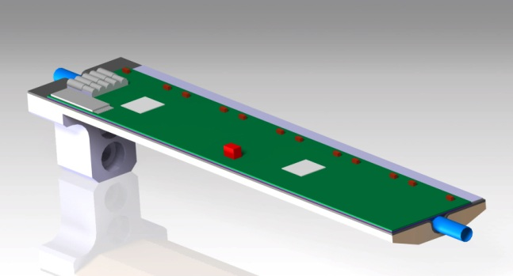
Updates for stave – Improvements for thermal properties
Changes:
  carbon foam → carbon paper
  carbon foam → Rohacell 31 IG
Thermagraph FGS
Properties | Unit | Data
Thickness | mm | 0.03
Density | g/cm³ | 1.6
Thermal Conductivity Through Plane | W/m·K | 1500
Thermal Conductivity Through Thickness | W/m·K | 15
Poco Foam/HTC
Properties | Unit | Data
Thickness | mm | <25.4
Density | g/cm³ | 0.6/0.9
Thermal Conductivity Through Plane | W/m·K | 135/245
Thermal Conductivity Through Thickness | W/m·K | 45/70
REFERENCE:
http://www.amecthermasol.co.uk
G. Giraudo
GSI-Darmstadt 24-06-2013

Slide 3
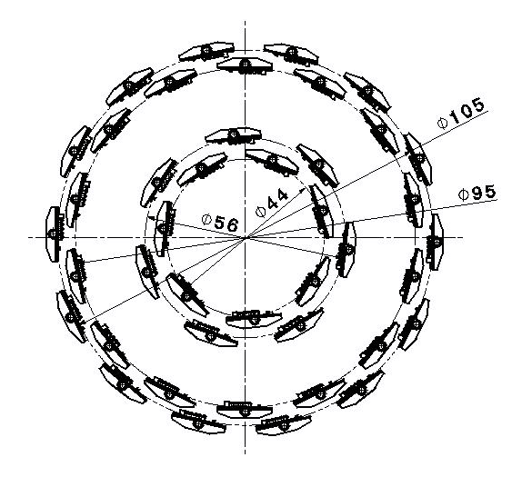
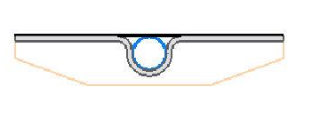
Position and detectors distribution of Layer 1 & Layer 2 UNCHANGED
Thermal filler
Carbon Paper
Rohacell
G. Giraudo
GSI-Darmstadt 24-06-2013

Slide 4
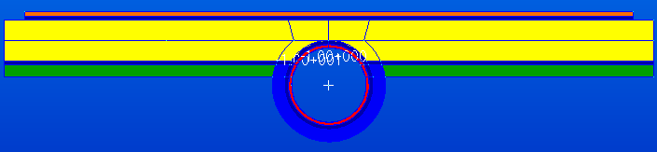
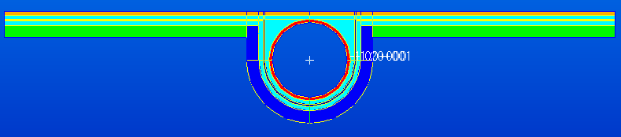
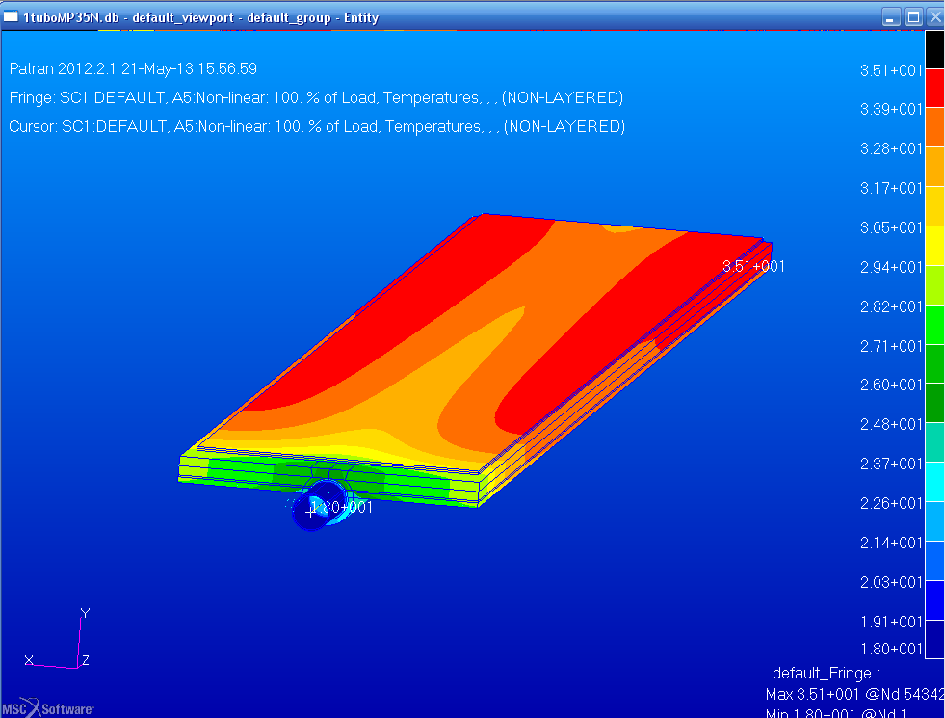
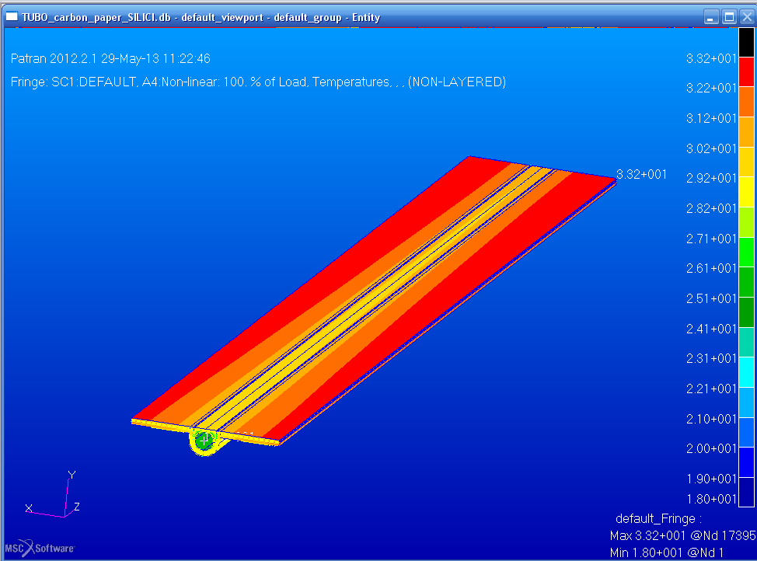
CARBON FOAM PROJECT
CARBON PAPER PROJECT
Carbon Foam
Si=0,1mm
Glue=0,1mm
CF=1mm
Glue=0,1mm
Ω=0,3mm
Glue=0,1mm
MP35N=0,08mm
Si=0,1mm
Glue=0,1mm
MP35N=0,08mm
Glue=0,1mm
CP=0,05mm
Glue=0,1mm
Ω=0,3mm
Carbon Paper
TEST ARE NEEDED
Tmax=35°C
Tmax=33°C
ADVANTAGES: CF plane workable
DRAWBACK: CF gluing uniformity
ADVANTAGES: minor Temperature; less material
DRAWBACK: plane precision

Slide 5
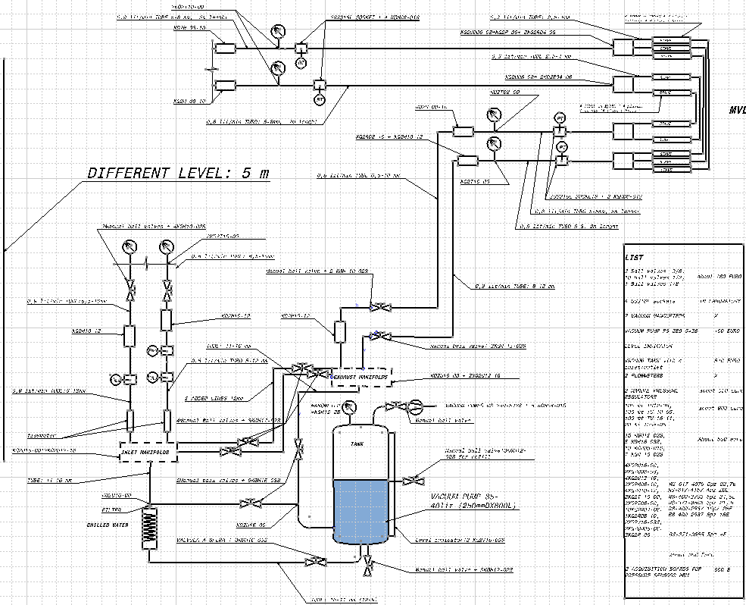
Hydraulic circuit test – 2 lines
First step – not remote controlled
G. Giraudo
GSI-Darmstadt 24-06-2013

Slide 6
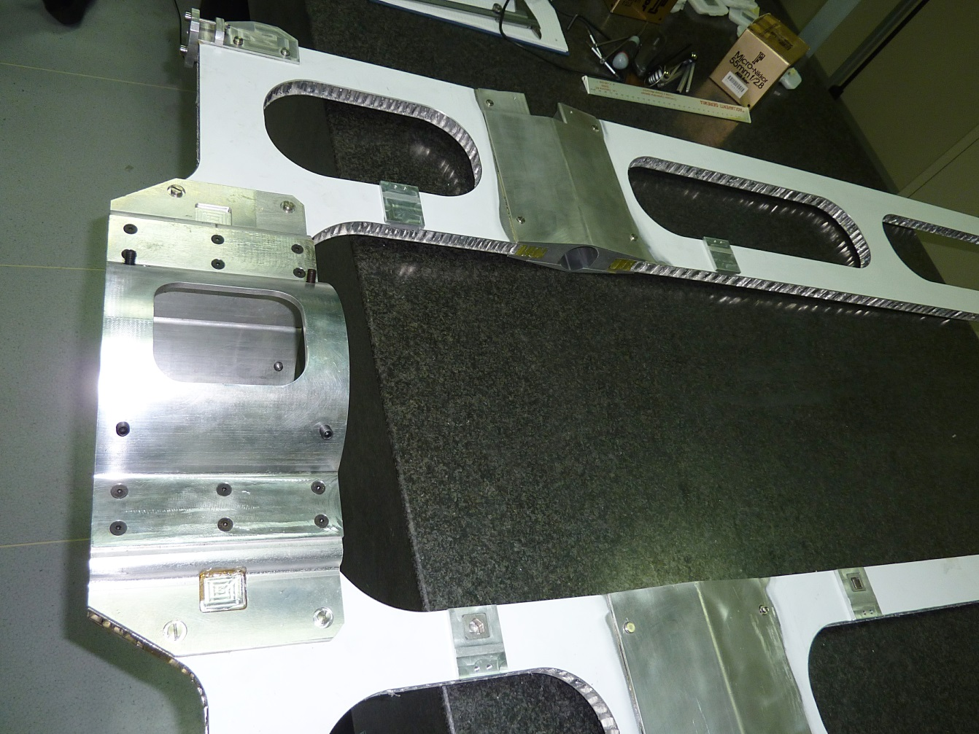
Central frame (Prototype) completed in Frascati last 15thMay
Bosses for MVD suspension added
Ready to be sent in Jülich a.s.a.p.
G. Giraudo
GSI-Darmstadt 24-06-2013

Slide 7
G. Giraudo
GSI-Darmstadt 24-06-2013

