Slide 1
Reconstructing Radiator Plates for the Barrel DIRC
Marko Zühlsdorf^{1,2}
¹GSI Helmholtzzentrum für Schwerionenforschung GmbH, Darmstadt
²Goethe-Universität Frankfurt

Slide 2
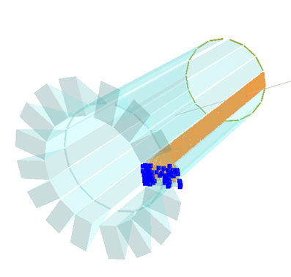
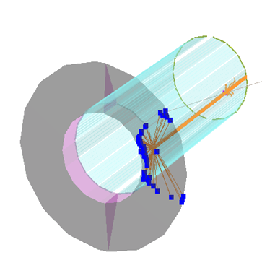
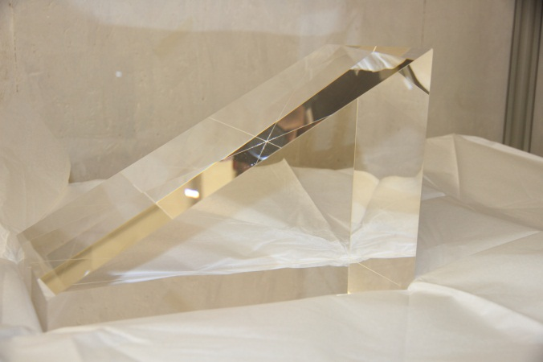
DIRC Design Options
use 1 wide plate Instead of 5 bars per segment
fewer pieces to be polished
requirements for optical quality of side surfaces less severe due to fewer side reflections
significant cost reduction
What about PID performance?
Synthetic fused silica instead of mineral oil as material for expansion volume
one prism per DIRC segment
better optical properties than oil
30 cm

Slide 3
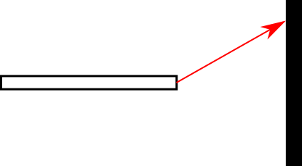
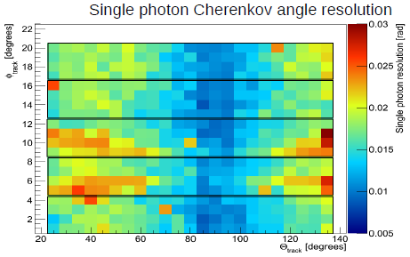
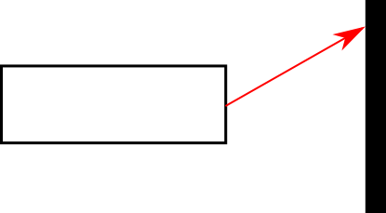
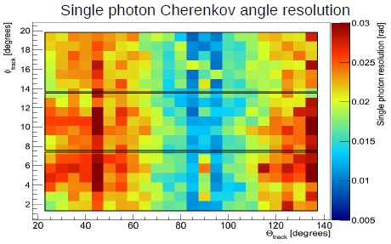
Reconstruction via Look-Up-Table
Maria (PANDA CM, Dec12):
x
radiator
top view
detection plane
z
Reconstruction gets harder with wider radiator as width contribution to θ_{C}-resolution is not negligible anymore

Slide 4
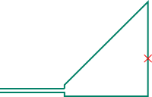
Geometrical Reconstruction
DIRC Observables:
photon hit coordinates (x and y)
hit time
BaBar-DIRC type reconstruction takes bar exit as point source and uses look-up-tables where photon angles in 2 dimensions are stored to reconstruct Cherenkov angle
When using a wide plate a point source assumption is valid only in the ‘side’-projection where radiator thickness is the same for bar and plate
Idea: factorized reconstruction
Use look-up-table for side-projection (BaBar type)
Fully reconstruct propagation path in top-projection
side-view
y
radiator
expansion volume (EV)
top-view
x

Slide 5
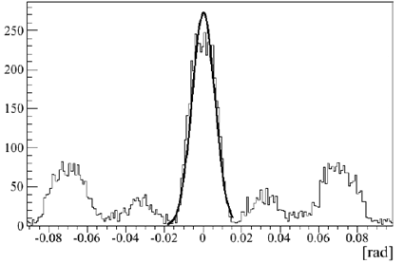
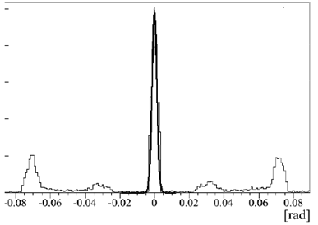
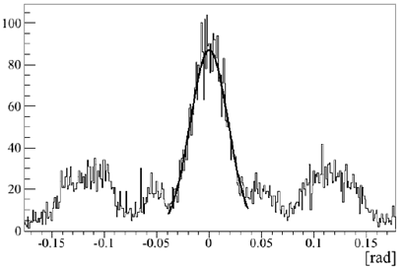
Reconstruction – ‘side’-projection
γ
γ [°]
read out plane
thin plate (2 mm)
no pixels
thin plate (2 mm)
reconstructed angle - true MC angle
σ ≈ 1.4 mrad
σ ≈ 6 mrad
Thickness: 17mm
Pixel size: 6.5mm
σ ≈ 18 mrad
γ_{Rec}-γ_{MC}
γ_{Rec}-γ_{MC}
Reconstruction behaves as expected when changing DIRC parameters
γ_{Rec}-γ_{MC}

Slide 6
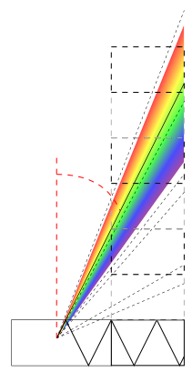
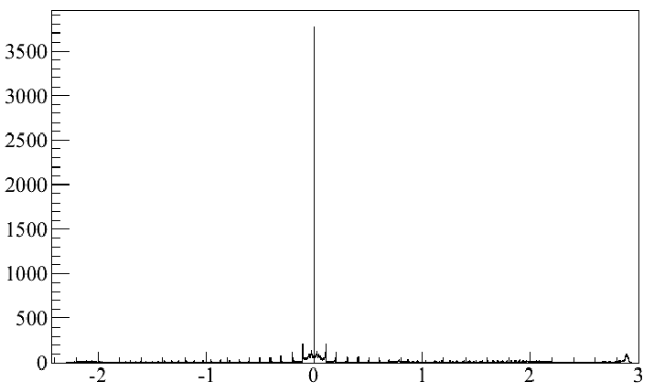
Reconstruction – ‘top’-projection
Possible paths in wavelength range are treated as ambiguities
EV
z₀
T
$$α=\arcsin\left(\frac{z0}{T∙c_{n}∙\sin{γ}}\right)$$
Idea:
Plates give fewer side reflections compared to narrow bars
Fully reconstruct photon path in top-projection
Needed:
z-position of plate hit (z₀)
tracking
photon hit time (T)
fast timing
photon propagation velocity (group velocity c_{n})
and angle in side-projection ($γ$)
previously reconstructed
no pixels
perfect z₀
α_{Rec}-α_{MC}
$$α$$
[rad]

Slide 7
Geometrical Reconstruction - results
Muons, 35° θ_{Track}, 2 GeV/c
plate thickness: 17 mm
wavelength range: 300-700 nm
pixel size: 6.5 mm
θ_{C} [rad]
peak visible at the right position
large number of ambiguities gives a poor signal/background ratio
bad single photon Cherenkov angle resolution

Slide 8
Geometrical Reconstruction - results
17 mm
300-700 nm
6.5 mm
2 mm
300-700 nm
6.5 mm
2 mm
300-700 nm
0 mm
θ_{C} [rad]
θ_{C} [rad]
θ_{C} [rad]
2 mm
398-402 nm
0 mm
Just by cutting deep into the photon wavelength band one can get a good resolution.
The photon yield per track gets too small.
θ_{C} [rad]

Slide 9
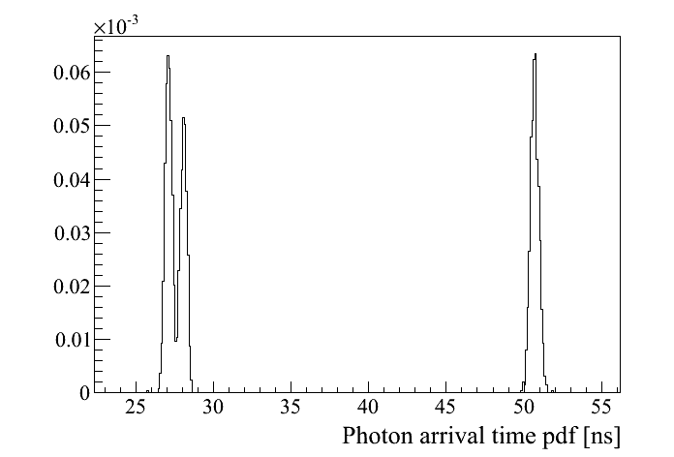
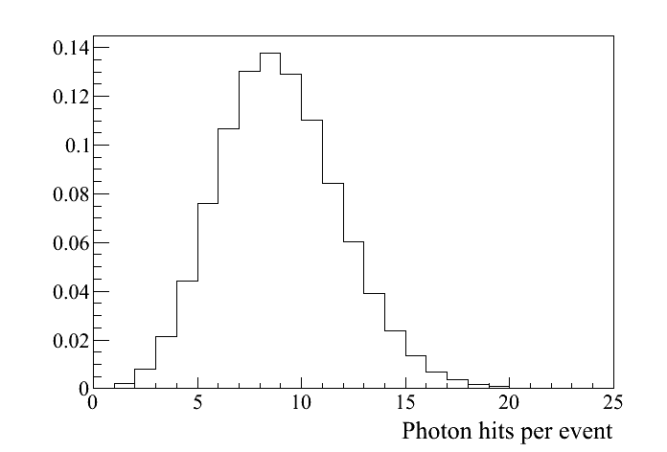
Alternative: Time based likelihood test
Now consider 1 event (with N hits):
take pdf-values for corresponding pixels
and multiply them
$$LH=\prod_{N}{pdf\left(xi,yi,ti;H\right)×P_{N_{0}}(N)}$$
$$\text{log}LH=\sum_{N}{\text{log}[pdf\left(xi,yi,ti;H\right)]+{\text{log}P}_{N_{0}}(N)}$$
photodetector plane
Instead of geometrical θ_{c}-reconstruction:
Likelihoods based on the hit time probability distribution per pixel are calculated and compared for different particle hypotheses.
A ‘typical’ hit pattern in X-Y
(with some cuts to keep it simple)
Y
Each pixel has a specific hit time distribution (for a certain hypothesis H).
If normalized they can be considered as propability density functions.
$P_{N_{0}}(N)$: Poissonian of mean $N0$ to obtain $N$ hits
MCP- PMT
X
MC: 400 000 identical particles
with identical event parameters

Slide 10
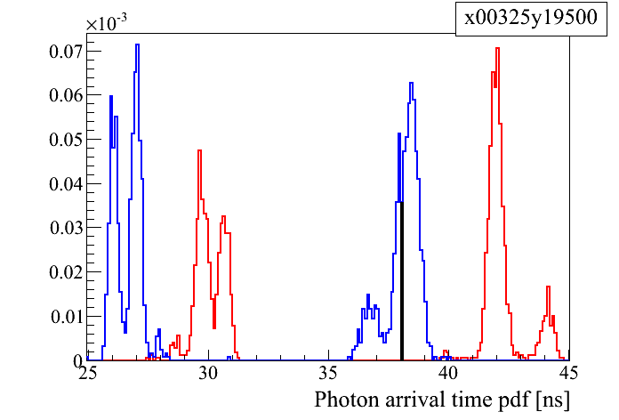
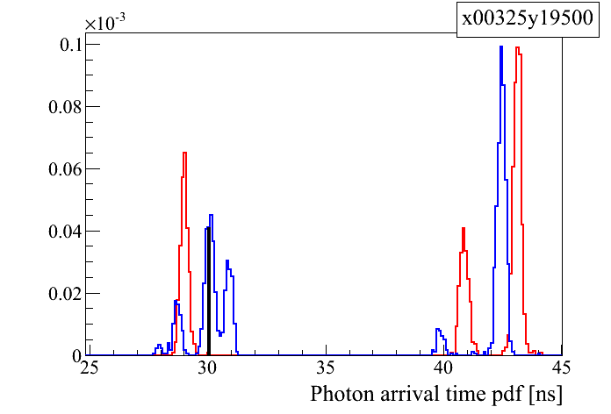
Time based likelihood test: Example
1 GeV/c
3 GeV/c
Blue: Kaon hypothesis
Red: Pion hypothesis
loop over all hits and multiply pdf values
take the likelihood ratio for two competing hypotheses
apply cut value to accept or reject hypothesis

Slide 11
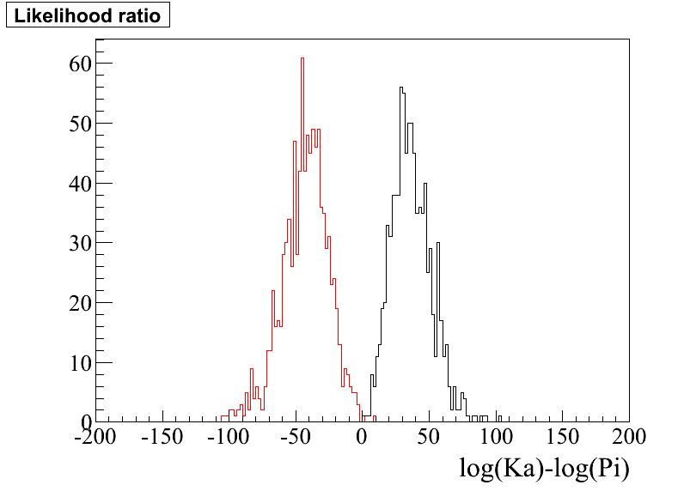
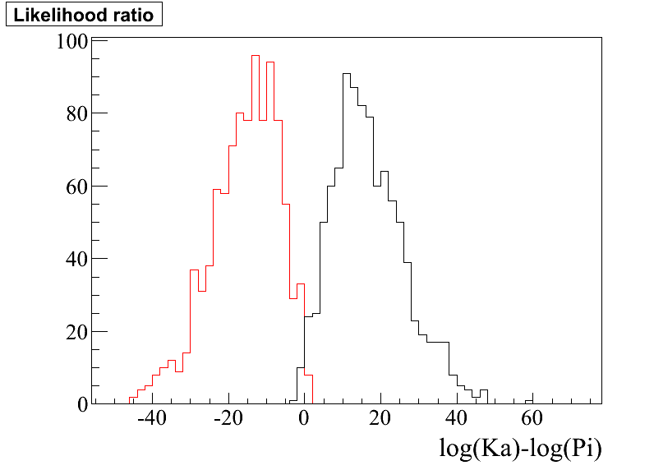
Time based likelihood test
thin plate (2mm)
no B-field
1000 particles tested (π⁺, K⁺)
θ_{Track} = 35°
1 GeV/c
3 GeV/c
π⁺
K⁺
π⁺
K⁺

Slide 12
Time based likelihood test
thick plate (17mm)
B-field
1000 particles tested (π⁺, K⁺)
θ_{Track} = 35°
1 GeV/c
3.5 GeV/c
π⁺
K⁺
π⁺
K⁺

Slide 13
Time based likelihood test
thick plate (17mm)
B-field
1000 particles tested (π⁺, K⁺)
θ_{Track} = 22°
1 GeV/c
3 GeV/c
π⁺
K⁺
π⁺
K⁺

Slide 14
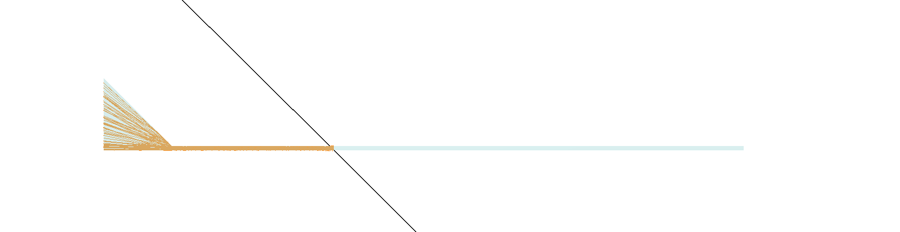
Time based likelihood test
thick plate (17mm)
B-field
1000 particles tested (π⁺, K⁺)
θ_{Track} = 135°
1 GeV/c
π⁺
K⁺

Slide 15
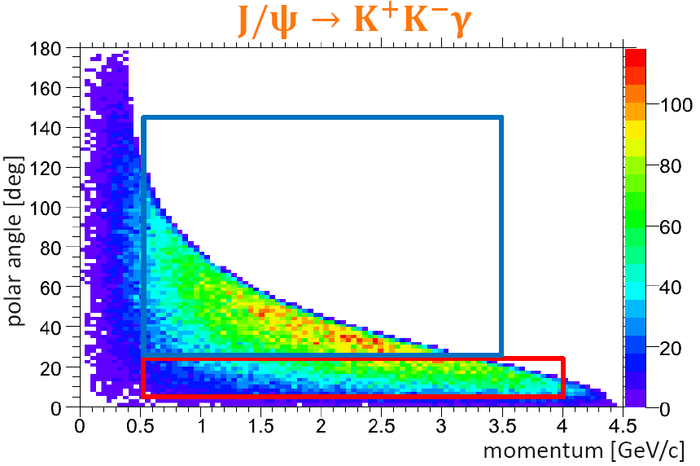
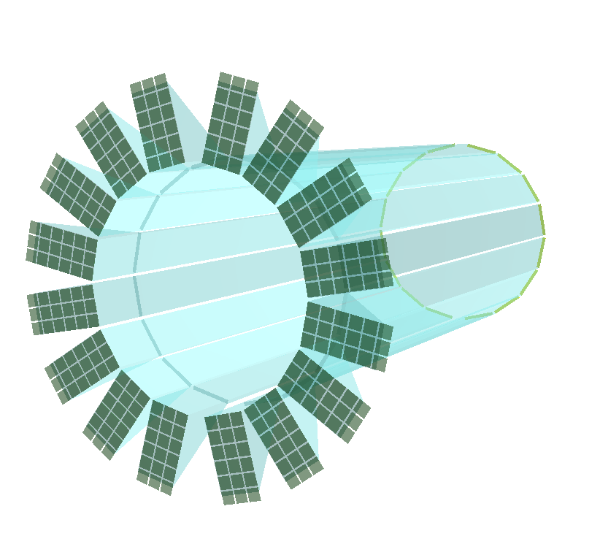
Summary
A design based on radiator plates instead of narrow bars would significantly reduce the cost of the Barrel DIRC.
A geometrical reconstruction approach was developed and seems to be not powerful enough due to lots of combinatorial background from ambiguities.
A likelihood based approach shows good results for simple geometries for ‘crucial’ phase space points.
Outlook
More realistic geometries will be implemented (including photo sensors, focusing, etc.).
Reco methods will be applied to beam data from 2012.
An analytical approach to calculate pdfs has to be found as there are too much points in parameter space to be covered by MC.

Slide 16
Summary
A design based on radiator plates instead of narrow bars would significantly reduce the cost of the Barrel DIRC.
A geometrical reconstruction approach was developed and seems to be not powerful enough due to lots of combinatorial background from ambiguities.
A likelihood based approach shows good results at simple geometries for ‘crucial’ phase space points.
Outlook
More realistic geometries will be implemented (including photo sensors, focusing, etc.).
Reco methods will be applied to beam data from 2012.
An analytical approach to calculate pdfs has to be found as there are too much points in parameter space to be covered by MC.
PD
plate top view
x
t
Y. Arita, N-lab, 9 March, 2013, QFPU Final International Forum
Thank you!

Slide 17
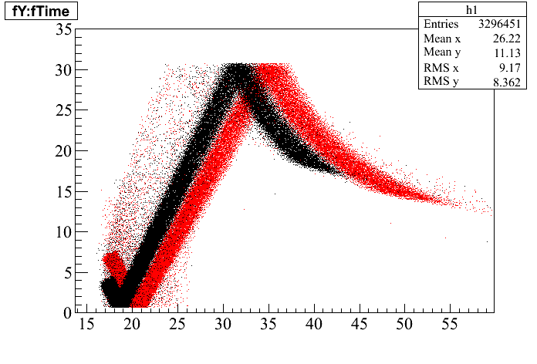
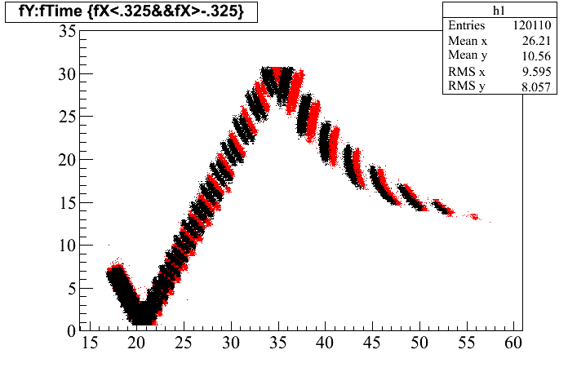
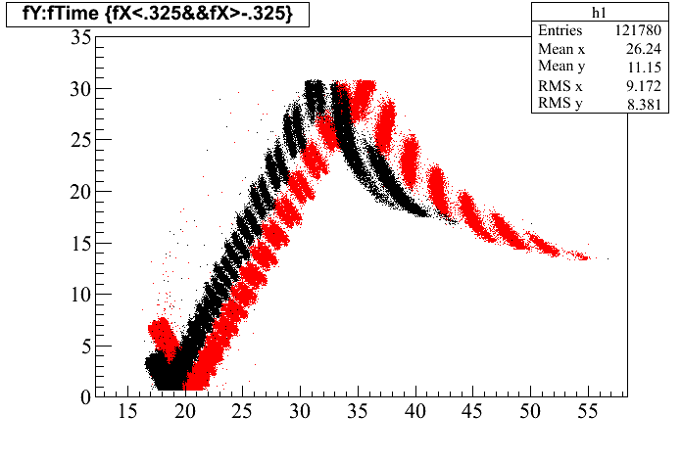
Y
Y
1 GeV/c
3 GeV/c
t
t
Y
cut on middle pixel column
t

Slide 18
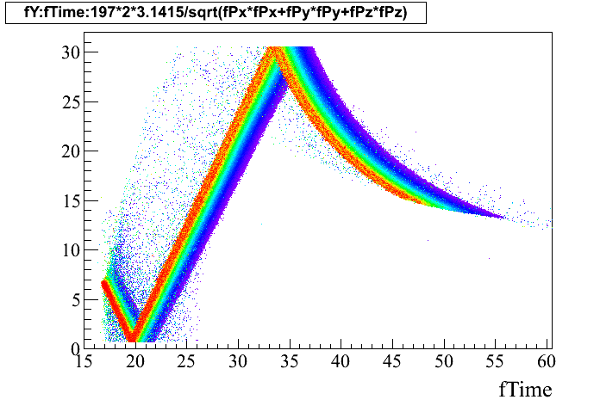
Y
Photon colors

