Slide 1
Plans and preparations for the testbeam in Mainz
Christoph Rosner
PANDA Collaboration Meeting, GSI 25.06.2013
Notes:
On behalf of mainz barrel dirc group

Slide 2
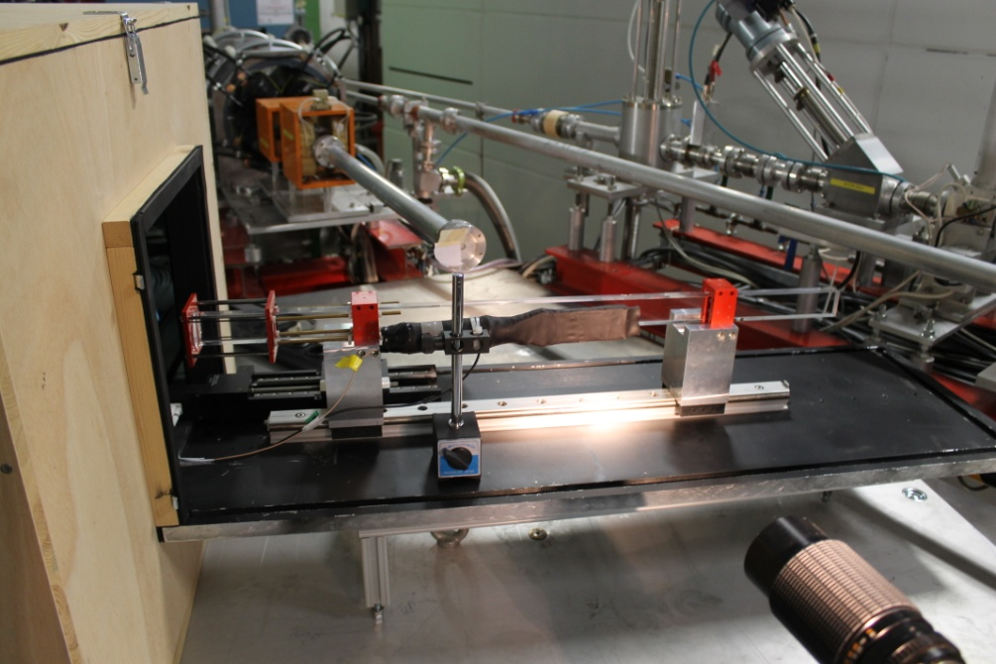
Setup
Beampipe
Bar
Lens system
Scintillator
Readout electronic
Expansion
volume
Two testbeams in july:
11. 7. – 14. 7. 2013
25. 7. – 30. 7. 2013
Place: MAMI B, X1
e⁻ beam at 855 MeV/c
1 mm radius, 0.1 mrad divergence
Notes:
Setup from last years testbeam, explain parts

Slide 3
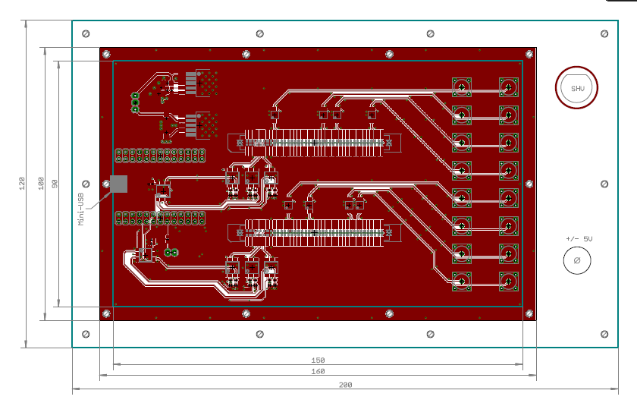
Changes to the Setup
New backplate with 6 feedthrough boards for our readout cables
DC Motor to adjust
airgap between fish-
tank and lens
2 scintillators for
coincidence trigger
5 MCPs to read out Cherenkov pattern, 3 on one side, 2 on the other
Notes:
New backpart of wooden box, feedthrough: 2 connectors for flat ribbon cables, lemo outputs, to the left nino daq programming, shv and pm 5v.

Slide 4
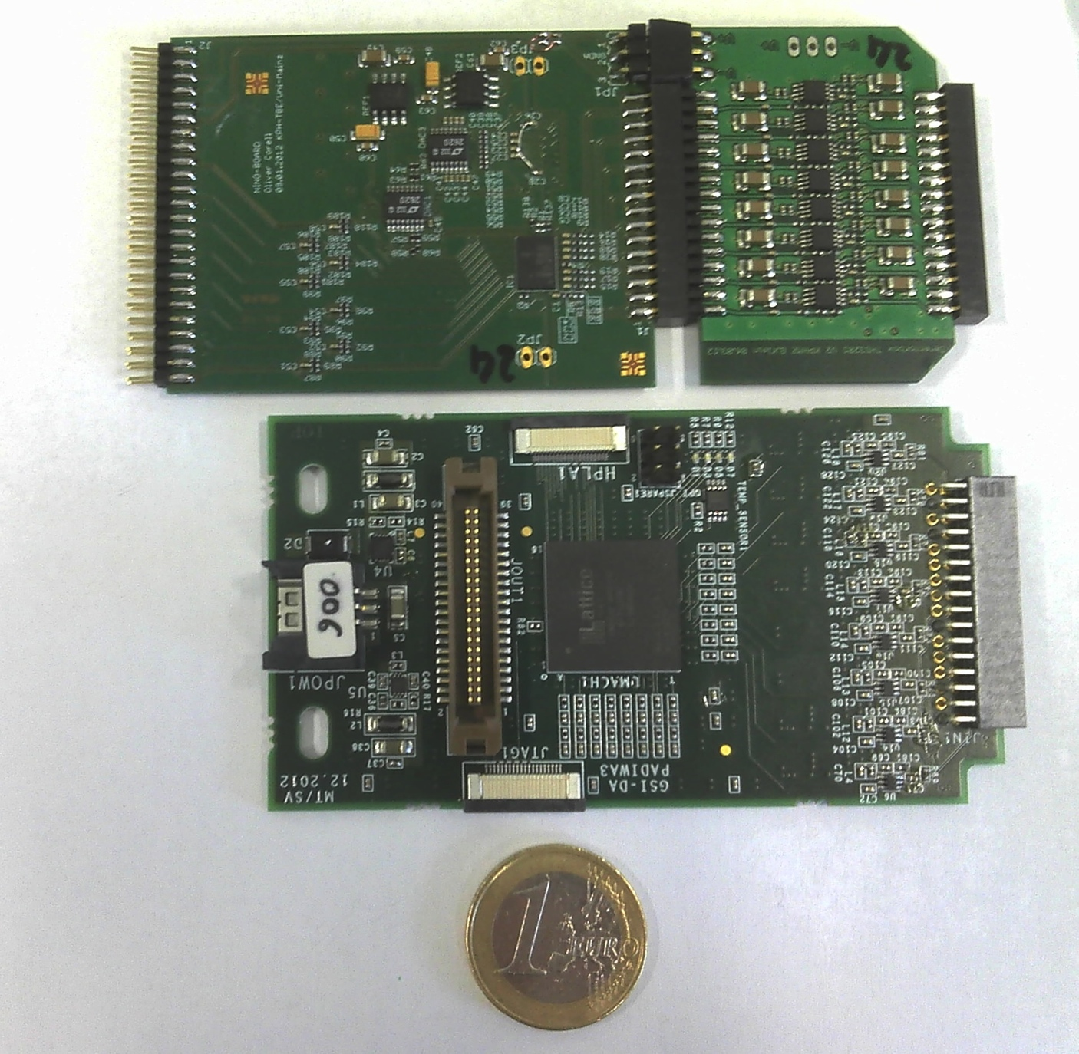
Goals for the testbeam
Test new padiwa boards:
Based on FPGA
Still ToT design, no direct measurement of charge
1 MCP read out with Padiwa, 4 with NINO boards
NINO board
Padiwa board
Notes:
Old nino: pre amplifier board with 8-10 gain, then nino discriminator board, padiwa: integrated pre amplifier

Slide 5
Goals for the testbeam
Test new TDC design for TRB boards
32 MCP channels per TDC
2 MCP can be read out per TRB
Achieve a good time resolution with our setup (<100 ps) by doing timewalk correction etc., best case: observe chromatic effect
Notes:
New tdc design by cahit and michael traxler

Slide 6
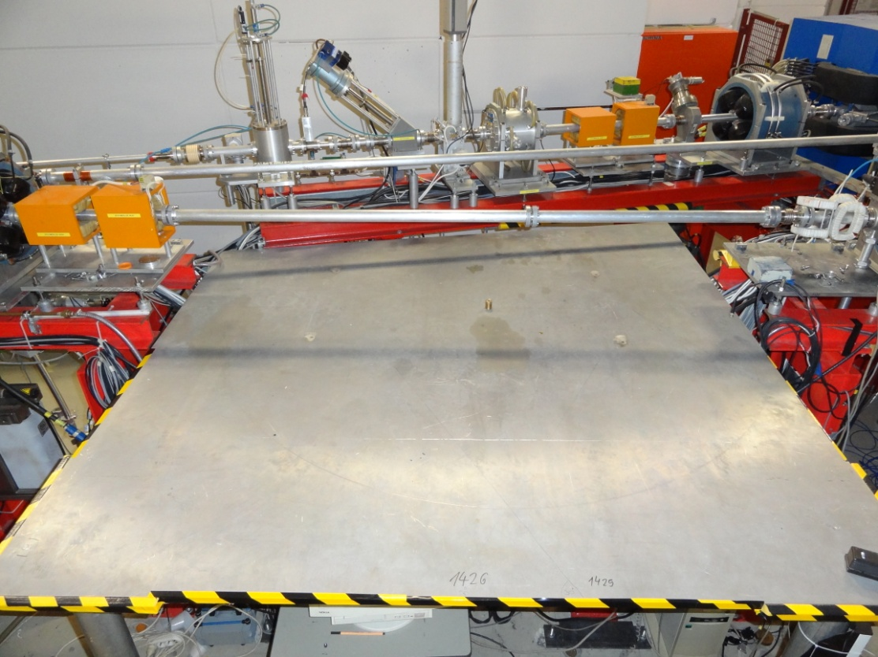
Measurement plan
Take data at different angles to:
See Cherenkov pattern move
„switch on/off“ reflected part
Measure
30° → 0° → 30° to see systematic effects
2 – 3 different angles for actual data
Notes:
Whole setup will be mounted on turnable aluminium plate with „wheels“, put onto center

Slide 7
Measurement plan
Angle for total reflection:
(refraction index n₁ ~ 1.47)
Θ₁ = sin⁻¹(1/n₁) = 42.9°
Cherenkov angle:
Θ_{c} = cos⁻¹(1/n₁) = 47.1°
reflected part vanishes for angles >
47.1° – 42.9° = 4.2°
Reflected part delayed ~2-3 ns

Slide 8
Chromatic effect
Cherenkov spectrum is continuous, refraction index of fused silica depends on wavelength
Results in different Cherenkov angle → different arrival time of the photons
For a range of 300 nm – 632.8 nm:
Θ_{c1} – Θ_{c2} = cos⁻¹(1/1.488) - cos⁻¹(1/1.457) =19.3 mrad
→ σ = 19.3 mrad / = 5.6 mrad
Expected variation from multiple scattering:
mrad, → same order of magnitude
Possible solution: silicon strip

Slide 9
Preparations
Most of the prototype is ready for beam, some parts (new backpart of the wooden box, feedthrough panels) still in the workshop
Lens system and optics have been tested
Electronics have been tested with our laser (black box)
TRBs are working (thanks to Cahit)
To be tested: silicon strip detector, Padiwa boards
To be borrowed: mirror… thanks

Slide 10
Thank you

