Slide 1
Laser accelerated protons
- a candidate for WDM imaging @ FAIR
I. Hofmann, TU-Darmstadt /GSI
EMMI workshop HEDPD@FAIR
Sept. 30 – Oct. 2, 2013
Introduction
Proton optics: Solenoid or doublet/triplet?
Alternatives: Micro-focusing
Scaling discussion
Conclusions
Acknowledgment: H. Al-Omari, S. Busold, D. Schumacher, LIGHT collaboration

Slide 2
Background
Dense plasma physics program @ FAIR APPA cave
  Laplas
  WDM
PHELIX
  as driver for dense plasmas
  as diagnostics
LIGHT @ PHELIX → 10-20 MeV
  Focusing, energy selection, bunch rotation ...
  Applications: bio-medical, dense plasmas ...
Recent developments with lasers & acceleration
  BOA and other mechanisms → 50-100 MeV
Mega-Gauss magnetic fields by lasers
ARD & Helmholtz Beamline

Slide 3
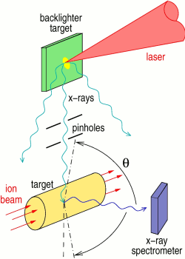
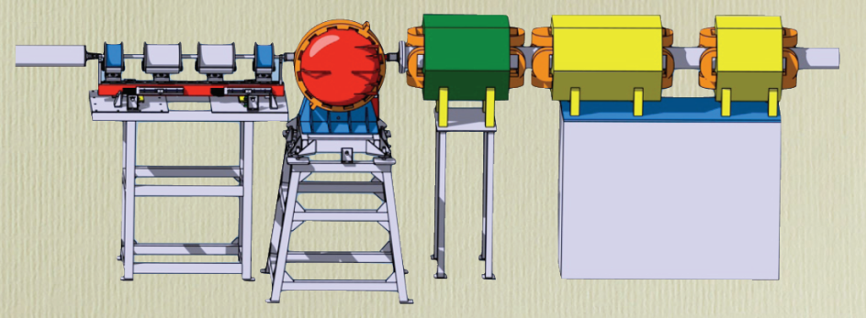
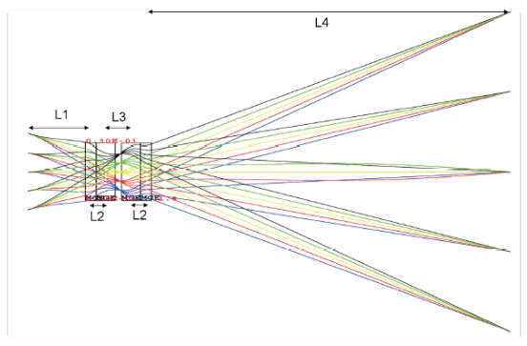
Dense plasmas (WDM) @ FAIR in APPA cave (Atomic, Plasma Physics and Application)
Laser proton imaging (50-100 MeV or more)
- a complementary approach to:
X-ray backscattering (PHELIX) for WDM 4.5 GeV SIS18-proton radiography (PRIOR)
x-ray transparent targets thick targets – high spatial resolution (microscope)
Scheme of the implementation of the X-ray scattering diagnostic of heavy ion beam generated Warm Dense Matter targets

Slide 4
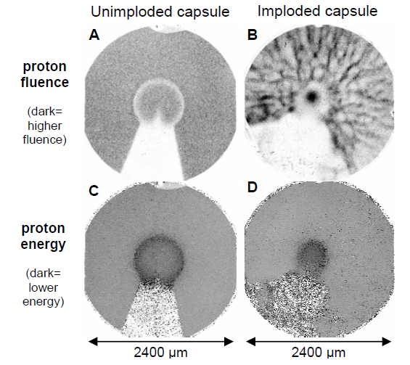
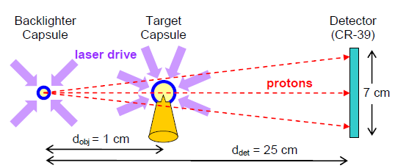
Imaging example (Rochester Ω−laser)
3 10⁸ 15 MeV p from fusion in D₂-³He-filled capsule
J.R. Rygg et al., Proton radiography of inertial fusion implosions, Science 2009
Notes:
protons from fusion reaction in left capsule – 15 MeV 0.1 ns capsule itself is 430 microm (kleinere Kugel) 3x10^8 protons with 3%dE/E

Slide 5
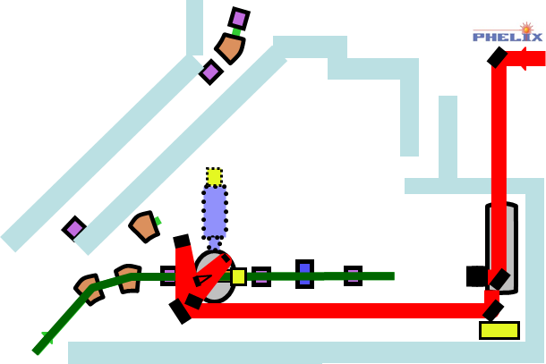
Laser proton imaging currently discussed in context of ARD @ GSI and beyond
RF cavity for
bunch rotation
~ 1 MV 108 MHz
ΔE/E: 0.05→ 0.005
LIGHT@GSI
current: LIGHT "test-bed" ~ 10 MeV
collection: solenoid
laser
2-3 m
Proton imaging beam line (~70 MeV p - schematic)
~ 7 m (~ β)
FD
laser
< 1 ns
focusing device determines
efficiency of collection
energy selection
beam quality (→imaging resolution)
solenoid – triplet – other options?
diagnostics
RF debuncher
~ 3.5 MV
108 MHz (?)
WDM-target
Notes:
weisser Kreis: original size – red laser beams later ... protons in Rochester experiment are from fusion

Slide 6
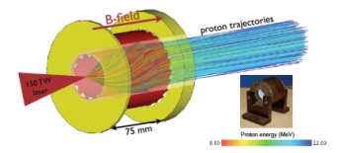
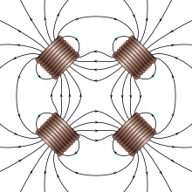
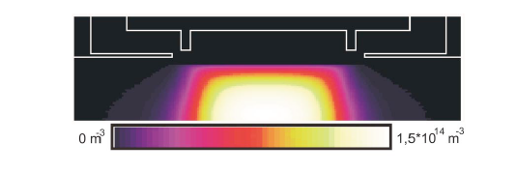
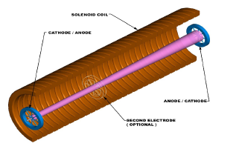
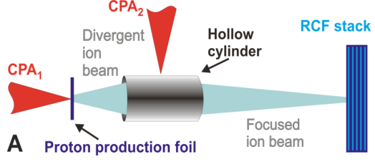
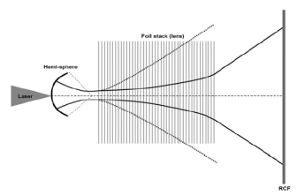
Focusing options – from conventional to advanced
what are the criteria?
Solenoids: focusing only in "second order" – pulsed?
Quadrupoles: first defocusing magnet "bad"
  acceptance problem?
Gabor lens: high voltage
Plasma lens: pulsed discharge
Micro-lens: plasma driven by laser
1-turn coils for electrons – to be discussed later!
Foil stack –magnetic focusing proposed by LBL
J. Pozimski, O. Meusel, 2005
solenoid: guide field
Toncian et al. 2006

Slide 7
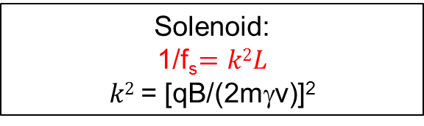
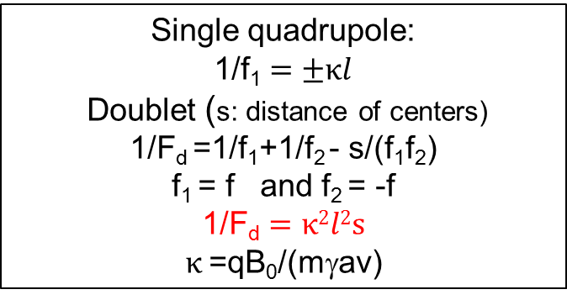


Comparison solenoid-quadrupoles
common knowledge: "solenoids are good at low energy /injectors / for round beams"
– where is the transition to quadrupoles?
I. Hofmann, Performance of solenoids versus quadrupoles in focusing and energy selection of laser accelerated protons, PRST-AB 16, 2013
Comparable systems using thin lens approximation (see Martin Reiser's book p. 102ff):
same overall length of lens system
same maximum B
point-to-parallel focusing
thin-lens-approximation
other criteria may be not less important -ignore
Single quadrupole:
1/f₁$=±κl$
Doublet (s: distance of centers)
1/F_{d} =1/f₁+1/f₂ - s/(f₁f₂)
f₁ = f and ­f₂ = -f
1/F$\text{d}=κ2l2s$
$κ$=qB₀/(mγav)
Solenoid:
1/f_{s}$=k2L$
$k2$= [qB/(2mγv)]²
$$L$$
$$l$$
s

Slide 8

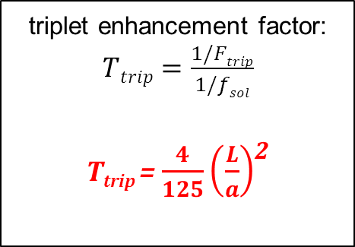
Scaling law for triplet vs. solenoid focusing
→ excellent confirmation of thin lens approximation by simulation
triplet enhancement factor: $Ttrip=\frac{1/Ftrip}{1/fsol}$
T_{trip} = $\frac{4}{125}\left(\frac{L}{a}\right)$²
x'~1/$\sqrt{βγ}$
→ for L/a > 5 triplet focusing superior to solenoid focusing
at same field strength!
pulsed
or sc

Slide 9
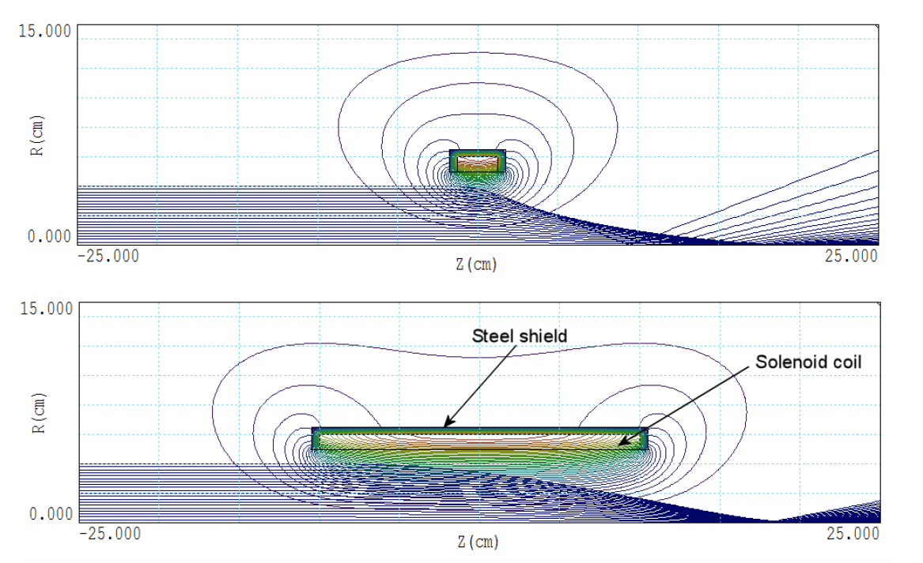
Why is it so?
source: S. Humphries, 2012
spherical aberration
x' ~ x + α x³
for short lens
edge-field B_{r} needed to get rotation → focusing by B_{z}
Long solenoid: less spherical aberration, but less efficient !
Spherical aberration an issue @ LIGHT: unable to focus into RF cavity ~ 3 m as L/a only ~ 5 !

Slide 10
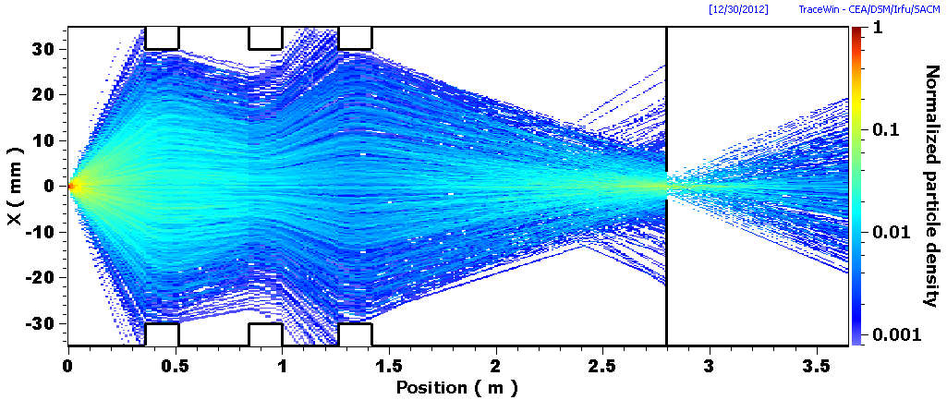
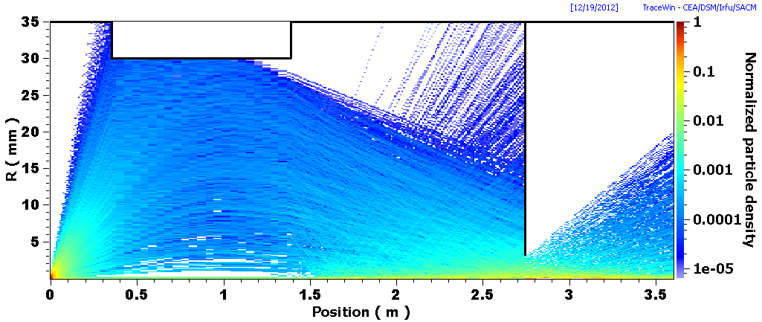
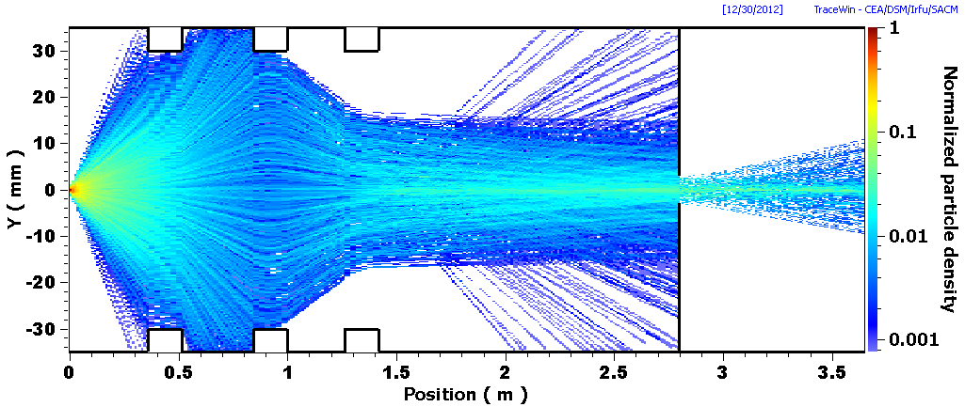
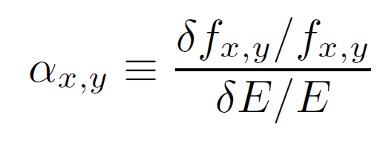
Full tracking & energy selection
using initial distribution from Rad-Press-Accel-model by Yan et al.
triplet
solenoid
Dependence of focal length on energy:
I.Hofmann. J. Meyer-ter-Vehn, X. Yan, H. AlOmari, NIM 2012
solenoid: α_{x,y} ~ 2
triplet: α_{x}~1, α_{y} ~4
~ (α_{x}α_{y})^{1/2}
(x: initial defocusing)
"splitting" no problem!
Rad-Press-Accel -simulation

Slide 11
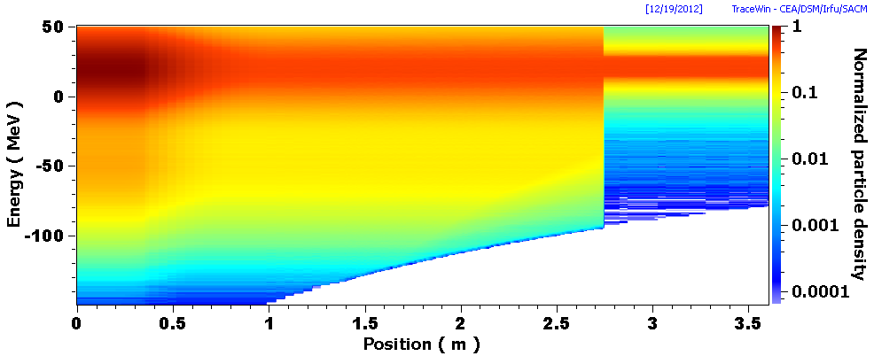
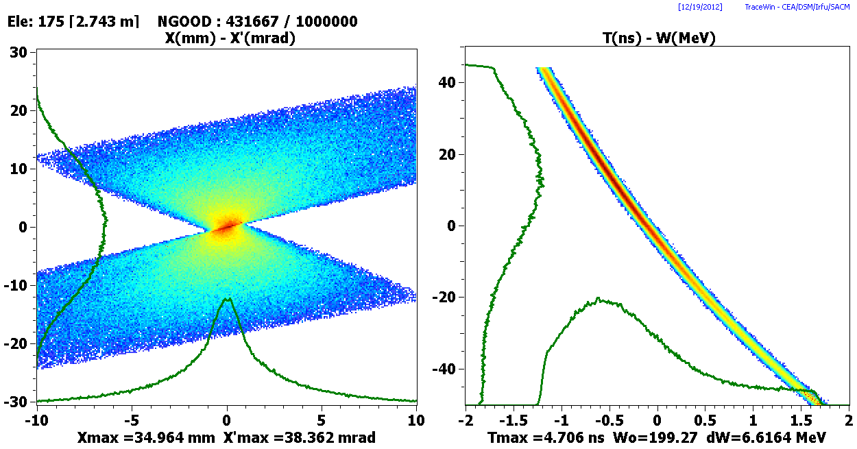
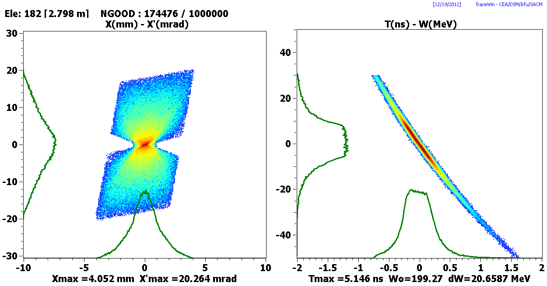
Energy selection for solenoid and origin of chromatic emittance – energy-dependent focusing
3 mm aperture
initial distribution
final selected distribution

Slide 12
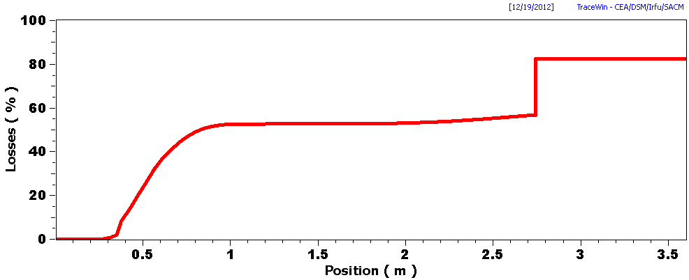
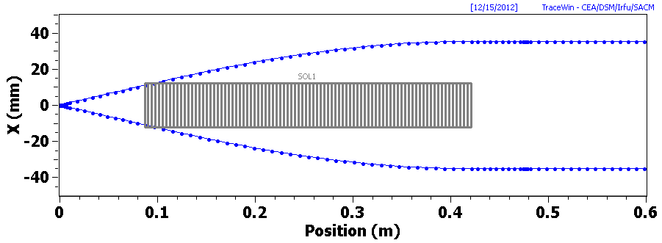
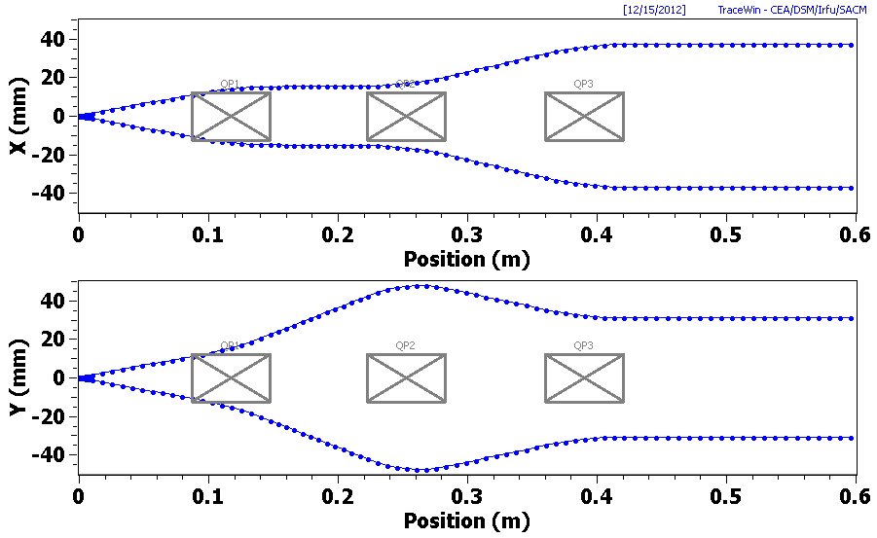
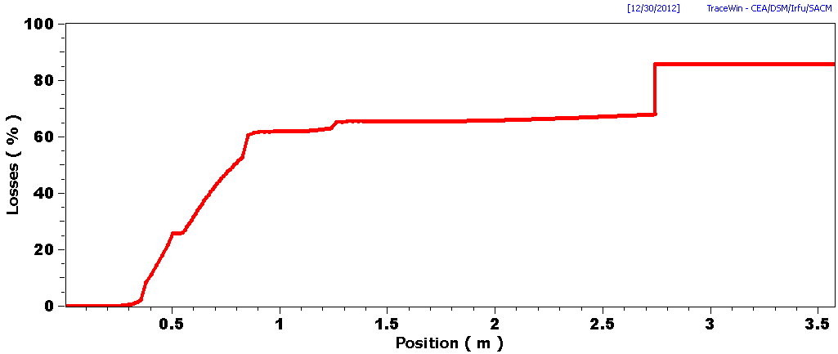
Transmission study equivalent solenoid – triplet
using Rad-Press-Acc-simulation input by Yan
Transmission ~ 25% lower (only!) for triplet than for equivalent solenoid
  immediately after lens (35% for triplet – 47% for solenoid)
  after energy selection ~ same ratio cont'd
  protons > 50 mr are lost on 30 mm aperture
→ triplet (electromagnetic) clearly superior for energies > 10 MeV
  energy variation by current
47% transmission
loss %
solenoid
35% transmission
triplet

Slide 13
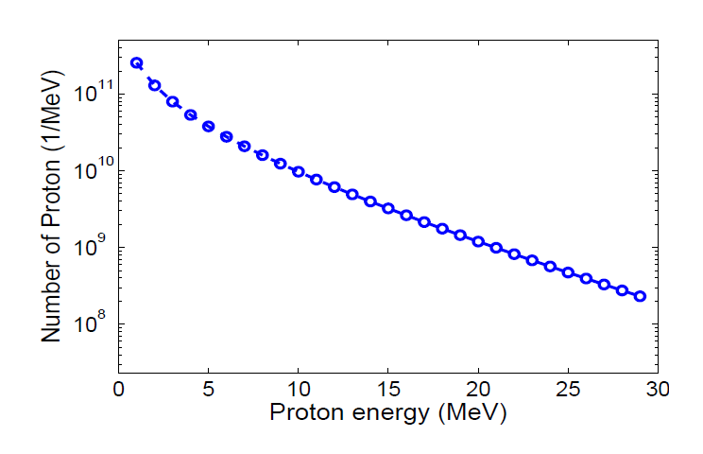
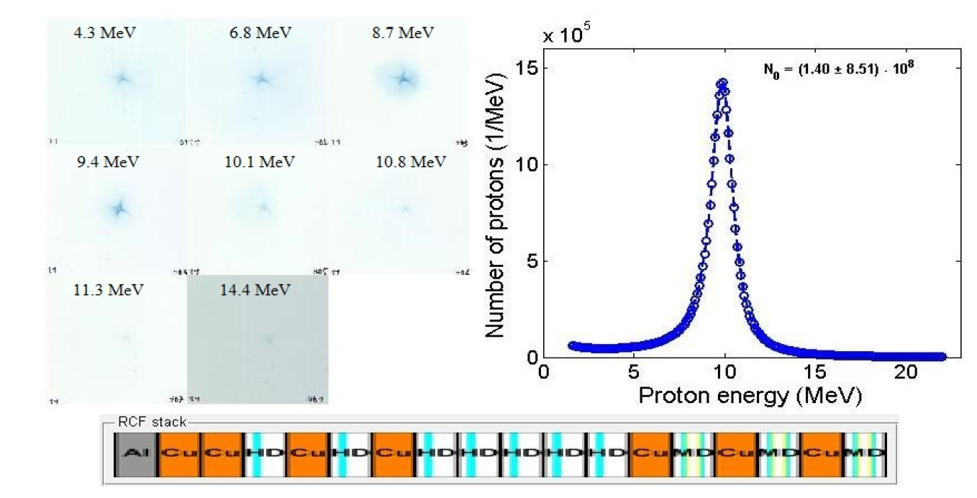
Experimental verification of chromatic energy selection @ PHELIX in June 2013
incoming spectrum
transmission spectrum through 5 mm radius on RCF stack at 10 MeV focal plane of solenoid

Slide 14
Are "conventional" lenses the optimum solution to focus laser protons on small WDM targets?
We are familiar with them
they are reliable (especially if non-pulsed)
"predictable" beam quality
"large" dimensions (for higher energies)
sacrifice short initial pulse length
beam quality degraded by aberrations

Slide 15
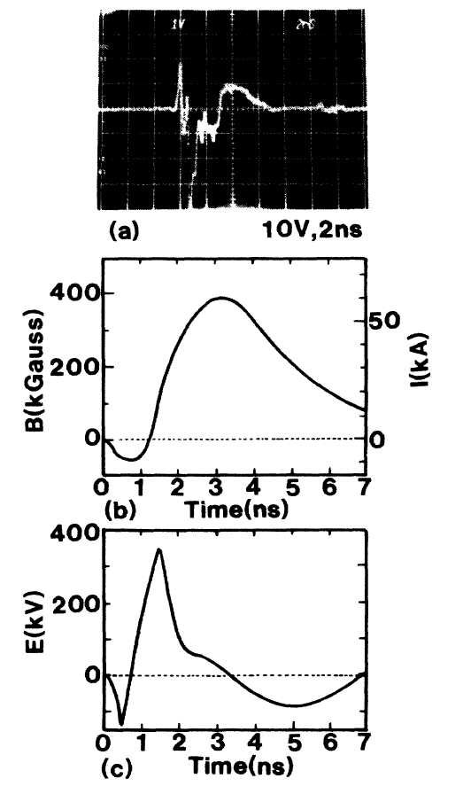
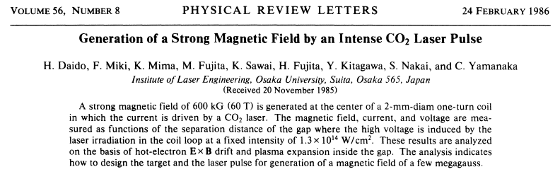
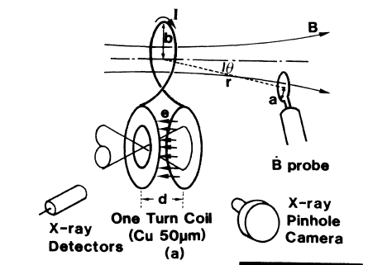
Lasers can generate huge currents and B-fields in ns time scales
and 1-turn (or few turn) capacitor-coils -
intended for laboratory astrophysics experiments etc.
laser also fast switch!!!
plasma created on right disk
> 10 keV electrons ahead of expanding plasma
charge up annular left disk
discharges over loop
10¹⁴ W/cm²

Slide 16
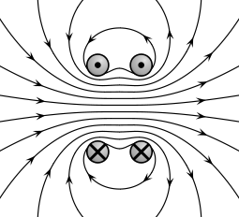
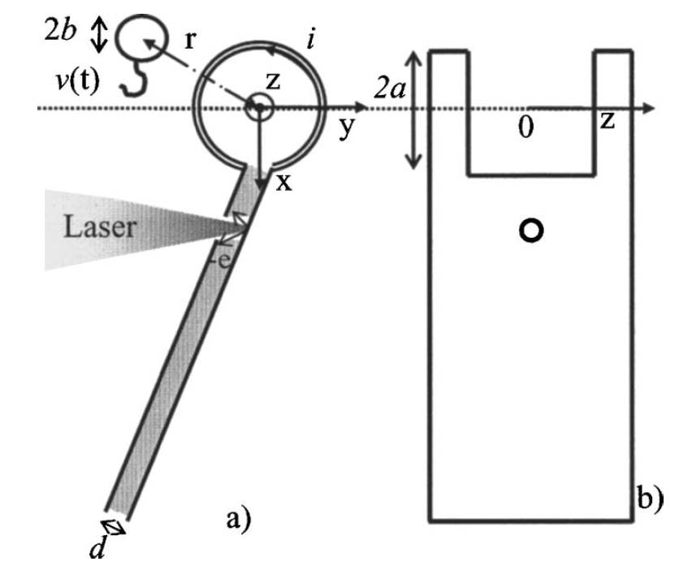
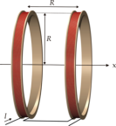
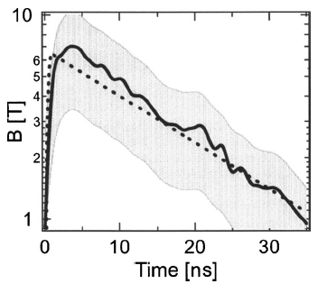
1.25 mm radius Helmholtz coil driven to 7 T
with 1 ns 300 J Vulcan Laser (RAL), Courtois et al. J. Appl. Phys., 2005
Optimization to higher B-fields!!!

Slide 17
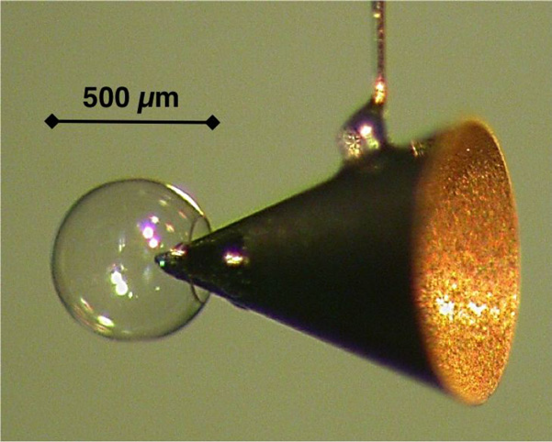
Interest revived with "fast ignition" in inertial fusion
to guide MeV electrons into pellet core → fusion ignition
plastic capsule (with D)
compressed by shocks from ns laser beams
"ignite" compressed sphere
need 5 keV heating
laser cannot penetrate
but fast electrons <2 MeV
produced from 10 ps Petawatt laser beams into cone
Difficulties in the fast-ignition scheme
‘unstoppable’ electrons
diverging electron beam (>90º)
cure divergence by MGauss B-field
Gekko, Osaka, Japan

Slide 18
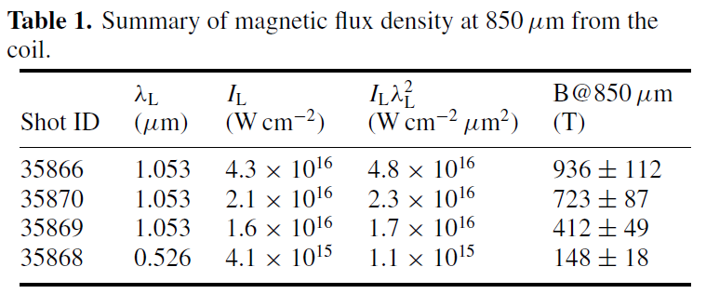
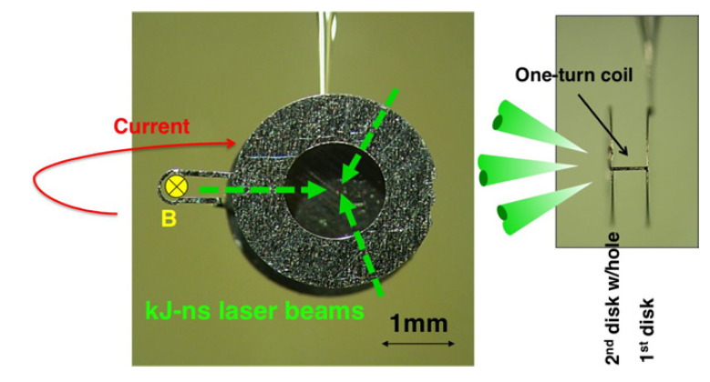
GEKKO XII laser facility
Fujioka et al. Plasma Phys. Contr. Fusion, 2012
"fast ignition" inertial fusion & laboratory astrophysics

Slide 19
Chromatic effect of – arbitrary – focusing lenses
for very small intrinsic emittance as in laser case
Simple scaling for "chromatic emittance"
– relevant behind a lens (even if source emittance is ~ zero):
(more accurate expression involves an integral)
ϕ
δϕ
ϕ
A
s
pulse length proportional to distance s
Chromatic effect increases linearly with A – purely geometrical effect !
Can we minimize size of optics to
achieve smaller chromatic emittance for same ΔE/E (5-10%)
keep short pulse length (< or << ns) for fast processes (material science, dense plasmas)
→ micro-focusing of p scaled down by factor 10 or more is attractive advanced option

Slide 20
Challenges of reducing size of focusing
solenoid, doublet/triplet, ...
size scaled down by factor "x" (10 ... 100)
radius and length shrinking → acceptance invariant
p pulse length ~ x⁻¹ +
space charge effect ~ x -- *)
effective emittance ~ x⁻¹ +
B_{max} ~ x (due to L shrinking) --
drive current ~ x⁰ o
size ~ x⁻¹ --
stored energy ~ x⁻¹ +
heat load ~ x² --
mechanical stress --
*) assuming de-neutralization within lens
take advantage of "nearly" point source
match better to small-size target experiment (imaging)

Slide 21
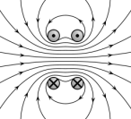
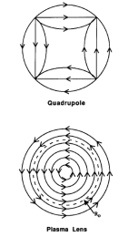
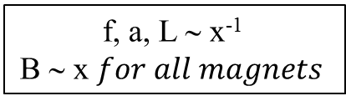
Scaling of fields and currents
for focal length, aperture, length decreased by factor x
f, a, L ∼ x⁻¹
B ∼ x $for all magnets$
current needed to drive:
Helmholtz coil : B_{solenoid} [T]=3.6 I[A]/a[m]10⁻⁶
Quadrupole : B_{pole-tip} [T]=2.5 I[A]/a[m]10⁻⁶
Plasma channel : B_{edge} [T]=2.0 I[A]/a[m]10⁻⁶
→ I is independent of scale-down factor x
stored energy: W=1/2 L I²
L ~ x⁻¹→W~x⁻¹
need small L for fast pulsing time

Slide 22
Concluding remarks
Laser protons > 50 MeV for imaging of WDM @ FAIR a promising diagnostics alternative
Electromagnetic triplet superior to solenoid above a few MeV
Micro-focusing coils driven by laser – challenging alternative
Micro coils: should reach better match to small and fast WDM targets
Need further study and optimization

Slide 23
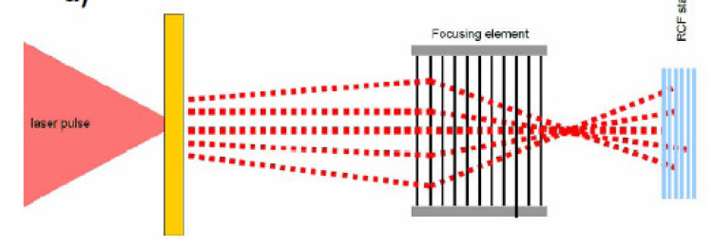
Still another option: foil stack self-focusing
Magnetic self-focusing by foil stack (LBNL – P. Ni et al.) – space charge repulsion screened by stack
  proton current and energy dependent – optimum at lower energy?
  needs pre-focusing
  how well does it really work?
40 mm long stack: 1000 foils 0.5 μm – 40 μm gaps
need tight initial convergence (non-planar target)
stack effective 500 μm thickness close to range
at higher energies current goes down – rigidity up
experiment @PHELIX with "indication"
P. Ni et al. Laser and Particle Beams, 2012

Slide 24
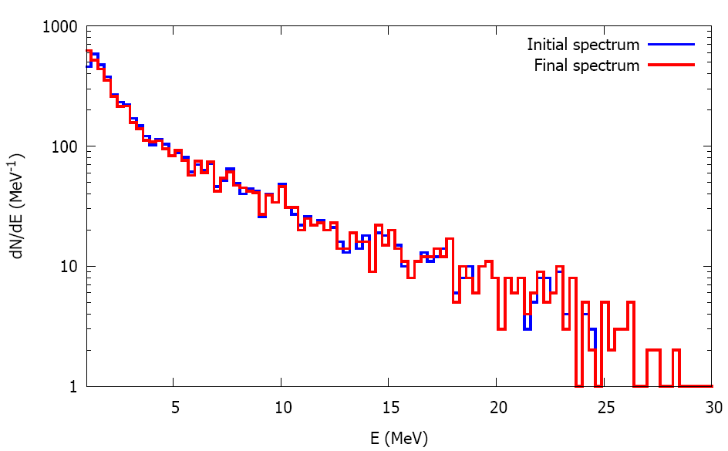
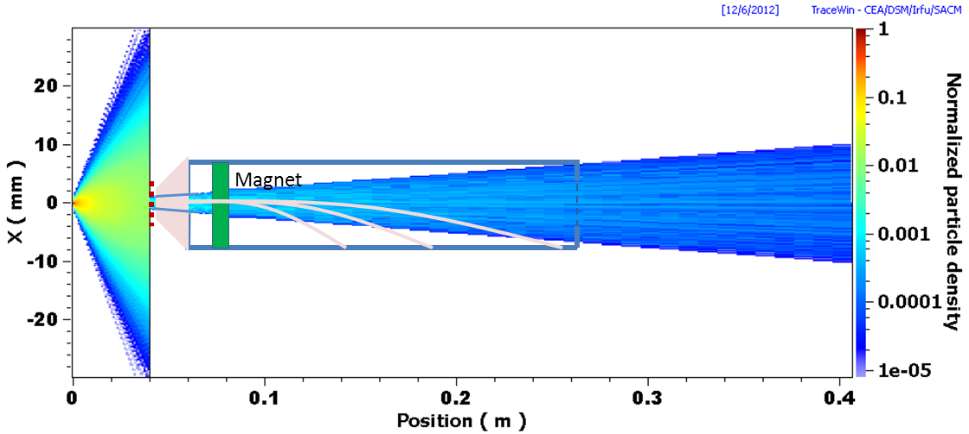
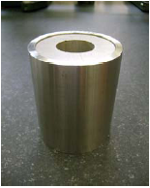
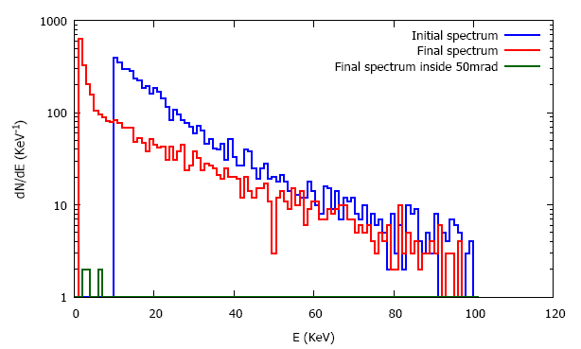
Space charge effect in lens:
Approved PHELIX-Experiment to test physics of foil for controlled de-neutralization
De-neutralization of laser accelerated protons by a secondary foil target
H. Al-Omari (U Frankfurt), A. Blazevic (GSI), C. Brabetz (U Frankfurt), S. Busold (TUD), O. Deppert (TUD), I. Hofmann (HI-Jena), M. Roth (TUD), D. Schumacher (GSI), S. Sinigardi and T. Turchetti (U Bologna)
PMQ → line focus + foil in one half space

