Slide 1
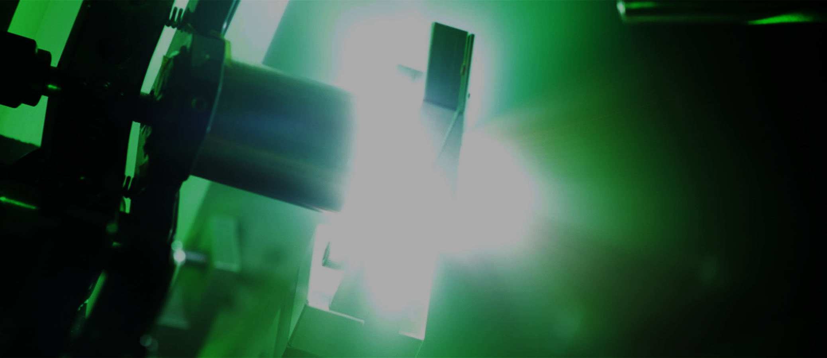
Laser-accelerated ions
in the break-out-afterburner regime
Simulations, Applications and Diagnostics
Oliver Deppert¹, A. Schreiber¹, S. Busold¹, C. Brabetz³, K. Philipp¹, A. Kleinschmidt¹, D. Schumacher²,
F. Wagner¹, S. Bedacht¹, P. Mulser¹, A. Blazevic², M. Schollmeier⁴, D. Jung⁵, and Markus Roth^{1,2}
¹Technical University of Darmstadt, Germany; ²GSI - Helmholtz Centre of Heavy Ion Research, Darmstadt, Germany
³Goethe University Frankfurt, Germany; ⁴Sandia National Laboratories, New Mexico, USA; ⁵Los Alamos National Laboratory, New Mexico USA
02 October 2013 | Oliver Deppert | EMMI HEDM workshop 2013 | Plasma physics workgroup TU Darmstadt | 1
Notes:
23.01.11
|
| 1

Slide 2
Motivation
Probing WDM with charged
particles
Development of „future“
accelerators
LIGHT
Bright and coherent
high-harmonics for
gamma-radiography
High energy short pulse laser-system for FAIR
LAPLACE
Directed neutron
beams for HEDM
neutron radiography
Explore new laser-driven
acceleration schemes
Development of charged particle diagnostics
02 October 2013 | Oliver Deppert | EMMI HEDM workshop 2013 | Plasma physics workgroup TU Darmstadt | 2
Notes:
23.01.11
|
| 2

Slide 3
Topics
Overview - BOA in a nutshell…
Theoretical background…
Relativistic transparency
Buneman instability
Simulation results…
Cryogenic hydrogen vs. plastic targets
Characterisation of BOA ions - experimental point of view…
Advanced multi-channel RIS and Quenching
State of the art magnetic spectrometer – iWASP
Scientific case - generation of a bright and directed neutron beam
02 October 2013 | Oliver Deppert | EMMI HEDM workshop 2013 | Plasma physics workgroup TU Darmstadt | 3
Notes:
23.01.11
|
| 3

Slide 4
Overview
BOA in a nutshell…
courtesy of D. Jung. LANL
Yin. et al., GeV laser ion acceleration from ultrathin targets: The laser break-out-afterburner, Laser and Particle Beams, 2006
TNSA phase: Target opaque to laser light
=> “Heating“ => initial density decreases
=> Higher inertia of rel. electrons => critical density increases
Intermediate phase: Laser propagates “behind” classical critical density => Volume-Heating
BOA phase: Target relativistic transparent
=> Laser interacts with electrons in under-dense plasma
=> Buneman-Instability: Energy transfer from electrons to ions
=> But: Electrons still gain energy in laser field
=> Indirect coupling between laser-energy and ion-momentum
Yin et al., Break-out afterburner ion acceleration in the longer laser pulse length regime, Physics of Plasmas, 2011
02 October 2013 | Oliver Deppert | EMMI HEDM workshop 2013 | Plasma physics workgroup TU Darmstadt | 4
Notes:
23.01.11
|
| 4

Slide 5
Relativistic transparency
Very thin targets…
Find steady solution for very thin plasma foils (delta-dirac like profile)
$n_{e}\left(x\right)=$ $n_{0}lδ(x)$
monochromatic pure transverse fields, Ansatz of plane, standing waves, circular polarised
Current is localised at x=0 => magnetic field discontinuous (like “perfect” mirror)
Ansatz of surface current at discontinuity: $i\left(t\right)=J(t)∙l$
Electric field and vector-potential are continuous : $J\left(t\right)=−en_{0}v=$ $−\frac{en_{0}p}{m_{e}γ}=−\frac{e²n_{0}A(0,t)}{m_{e}γc}$
Split solution: Incoming/reflective and transmitting part; substitution with common transmission- and reflection-coefficients
Find boundary condition for threshold of transparency, if R=0
$$a_{0}≅π\frac{n_{0}}{n_{c}}\frac{l}{λ}$$
A. Macchi, A superintense Laser-Plasma Interaction Theory Primer, 2013
02 October 2013 | Oliver Deppert | EMMI HEDM workshop 2013 | Plasma physics workgroup TU Darmstadt | 5
Notes:
Now we have a electron-density distribution….we like to estimate the Intensity threshold, when the target becomes transparent…
Just want to show the „way“ the analytical estimation goes, the details can be found in
Andrea Macchi: A superintense Laser-Plasma Interaction Theory Primer, 2013
#################################################
IMPORTANT:
Linear relation between a0 (respectivly the intensity) and surface-density n0*l
=> so, it‘s quite easy to estimate and scale target thickness for different materials
Solution for Transparency threshold restrictive, analytically valid for
l<<l_s=c/w_p (smaller than skin-depth)
But numerical simualtions show, estimation holds even for:
l<=lambda
#################################################
But: how good is the estimation, are their any further limitations?
=> Check analytical expression by PIC-Simulations….
23.01.11
|
| 5

Slide 6
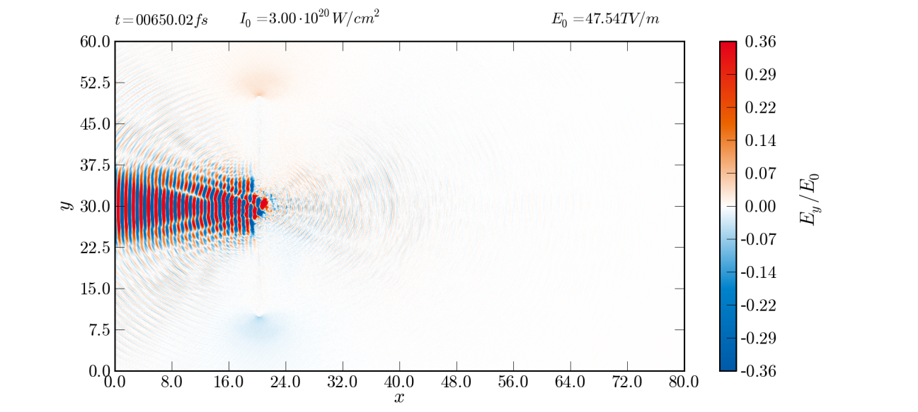
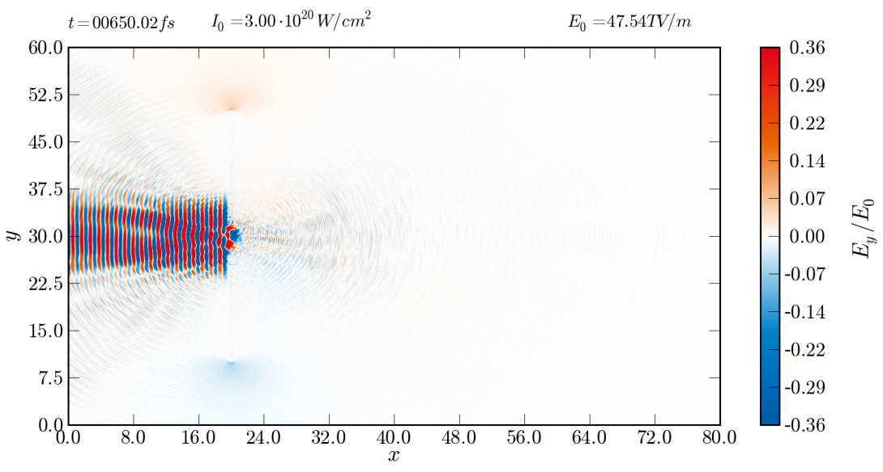
Relativistic transparency
Particle-In-Cell Simulations…
Laser-intensity: $I_{0}=3∙{10}^{20}\frac{W}{cm^{2}}→a_{0}≈15$
Now: Linear polarised light in PIC => does estimation hold ?
Transparency Threshold:
$n_{e,0}=\text{5.26}{∙10}^{22}/cm^{3}$ (cryogenic hydrogen) $n_{e,0}=\text{28}\text{.}51{∙10}^{22}/cm^{3}$ (PMP, C₆H₁₂)
$→l≈100 nm$ $→l≈18 nm$
$$a_{0}≅π\frac{n_{0}}{n_{c}}\frac{l}{λ}$$
x 5.4
600 nm hydrogen
100 nm PMP
Absolute value contradicts analytical estimation, but scaling fits very well !
Reason: Linear polarisation in contrast to circular assumption => more electron heating/expansion
02 October 2013 | Oliver Deppert | EMMI HEDM workshop 2013 | Plasma physics workgroup TU Darmstadt | 6
Notes:
Target @ 20µm, I0 at left boundary at t=750fs
=> I_max @ Target at 816fs
=> @ 650fs => I=0.86*I_0
=> a0(650fs)= eher 14…
23.01.11
|
| 6

Slide 7
Theoretical background
Buneman instability – just a hypothesis…
Beam-plasma instability => Kind of two-stream instability
During rel. transparent phase => Electrons gain large forward drift
“Fast” electrons flow past “slow” ions => Excitation of this instability
Phase speed of instability matches drift-speed of ions => Resonant acceleration
Strong longitudinal electric-field => co-moves with ions
Transfers electron forward momentum to ion momentum
Loss in electron momentum compensated by acceleration in laser field
Preservation of instability
Efficient, indirect coupling of laser energy to ion momentum
$$1−\frac{ω_{pe}^{2}\sin^{2}{θ}}{γ_{e}(ω−kc\cos{θ)²}}−\frac{ω_{pi}^{2}}{{\left(ω−kv_{i}\right)}^{2}}=0$$
Albright et al., Relativistic Buneman instability in the laser breakout afterburner, Phys. Plasmas, 2007
02 October 2013 | Oliver Deppert | EMMI HEDM workshop 2013 | Plasma physics workgroup TU Darmstadt | 7
Notes:
Highly relativitic drifts => gamma>>1
Theta=angle between electron drift speed and wave vector k of instability (along laser polarisation)
Assumptions: finite drift speed of ions v_i
w_pe and w_ie = classical electron/ion plasma-frequency
Dispersion relation of „relativistic“ Buneman instability
At the moment „just“ hypothesis, no clear evidience that buneman instability is realy the driving mechanism behind BOA
Argumentation goes like this: we assume, that buneman is the reason for BOA; we take a look into the Dispersion relation of rel. Buneman
We go insinde the PIC code and „search“ for parameters like ion drift speed, angle between electron velocity vector and laser propagation, the electron-gamma and for the denisty of ions and electrons
Than we subistiute into rel. Dispersion relation and search for their roots
=> Possible to calculate the instability frequency real(omega) and their growth-rate im(omega)
We can find a broad range of unstable modes for „certain“ PIC parameters with a growth-time in the oder of 10s of femtoseconds
Linear phase of instability rapidly envolves to a turbulent and non-linear phase
Leads to a localized, strong electric field which co-moves with the ion population
Problem: do we really have a evidence for Buneman?
=> we need to first identify some observables to really make sure, that Buneman is the driving mechanism, before we place any numbers into the dispersion relation!
23.01.11
|
| 7

Slide 8
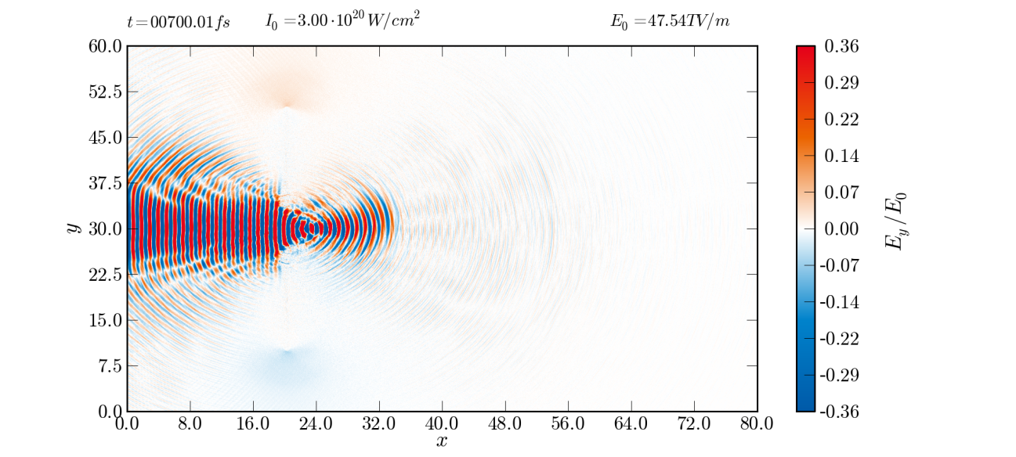
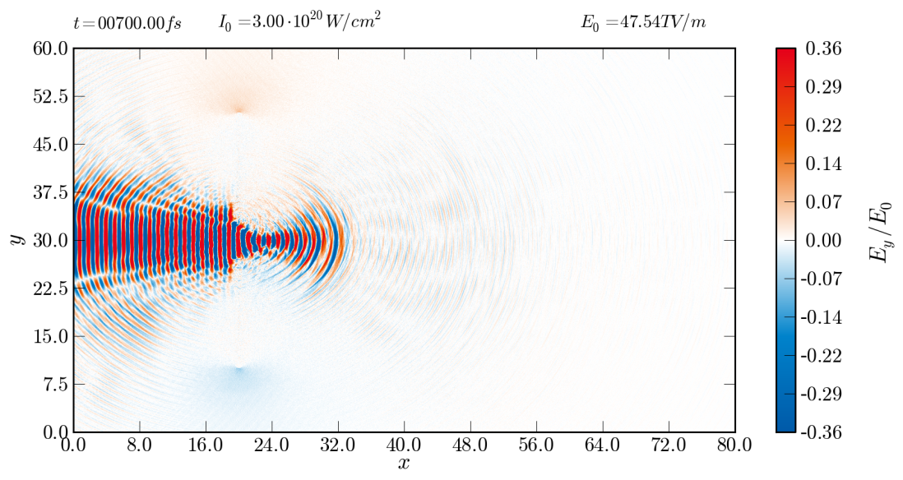
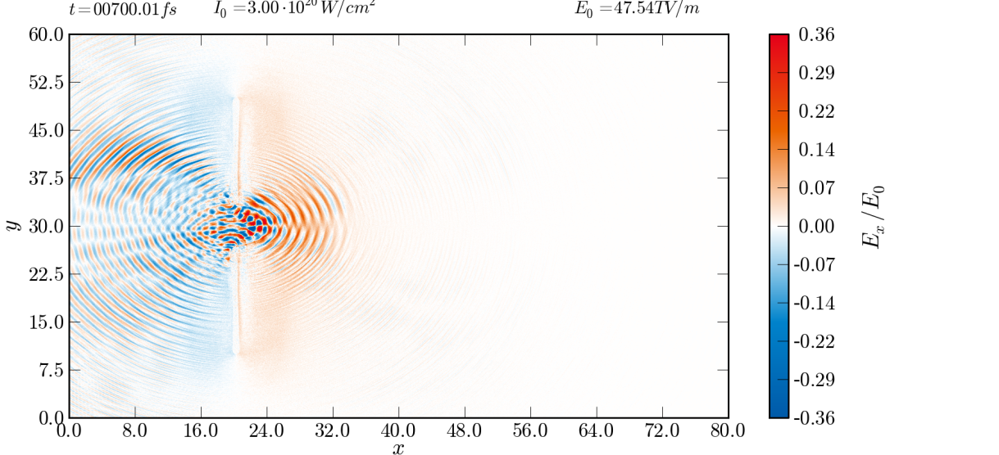
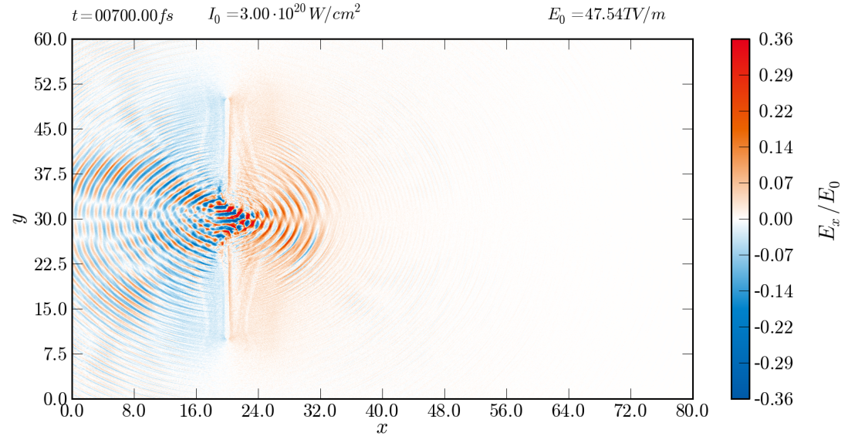
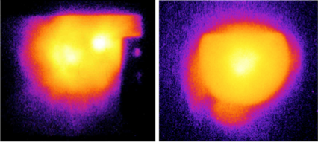
Simulation results
cryogenic hydrogen vs. PMP
600 nm hydrogen
100 nm PMP
transverse E-field
transverse E-field
BOA
TNSA
longitudinal E-field
longitudinal E-field
02 October 2013 | Oliver Deppert | EMMI HEDM workshop 2013 | Plasma physics workgroup TU Darmstadt | 8
Notes:
23.01.11
|
| 8

Slide 9
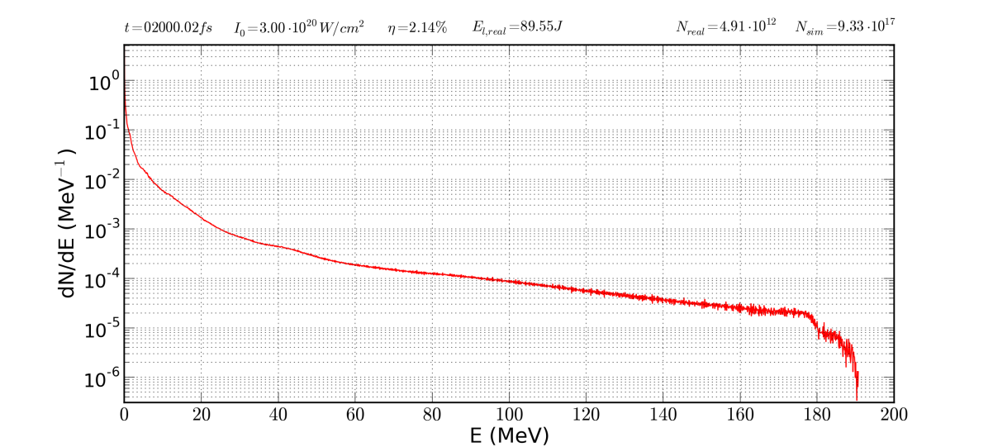
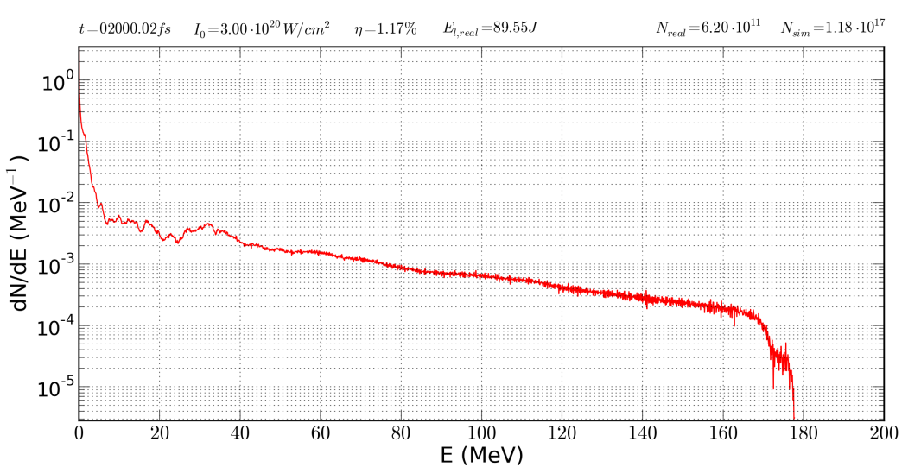
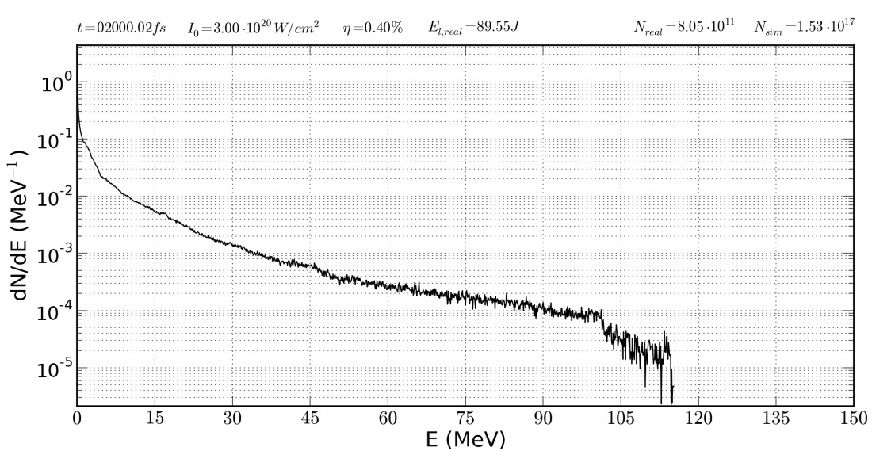
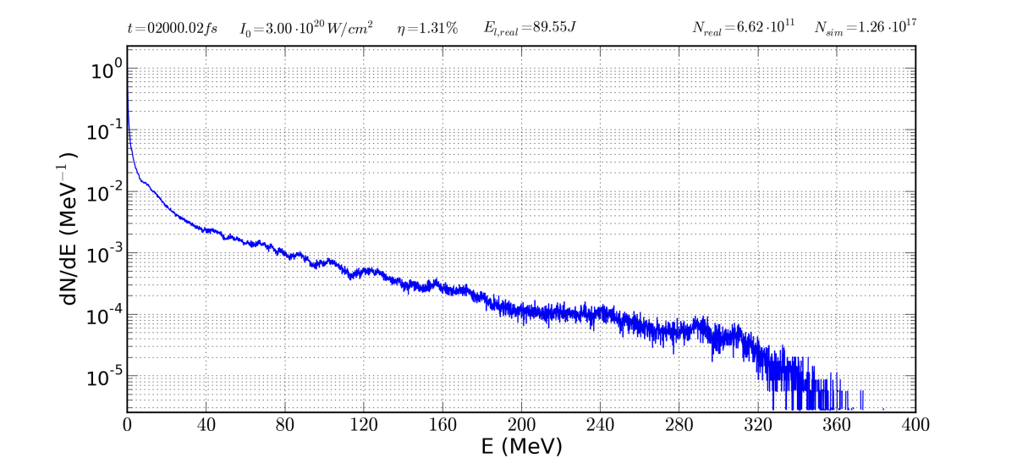
Simulation results
cryogenic hydrogen vs. PMP
600 nm hydrogen
protons
η = 2.14%
100 nm PMP
protons
η = 1.17%
100 nm PMP (65% doped)
deuterons
η = 0.40%
100 nm PMP
carbon
η = 1.31%
02 October 2013 | Oliver Deppert | EMMI HEDM workshop 2013 | Plasma physics workgroup TU Darmstadt | 9
Notes:
23.01.11
|
| 9

Slide 10
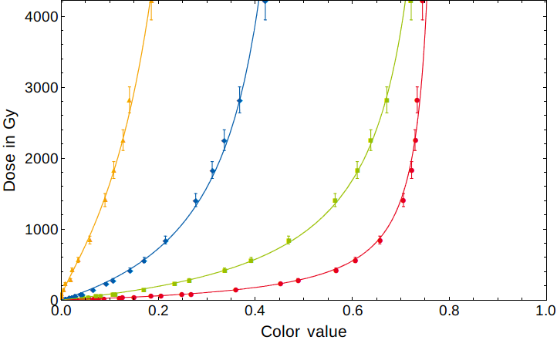
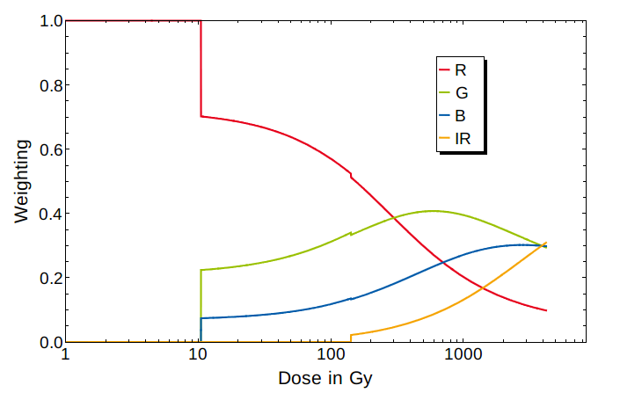
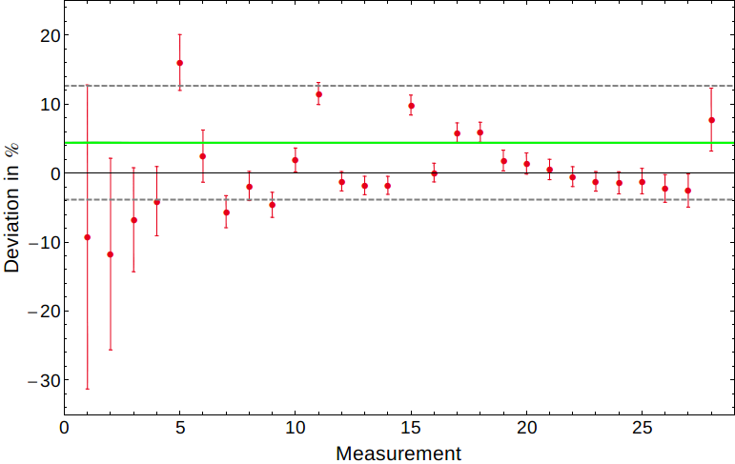
Characterisation
RCF multi-channel spectroscopy
Multi-channel (RGB+IR) calibration
Large dose range; dose uncertainty < 5 %
HD, HD-V2, MD-V2 and EBT3
Weighted fits: Dose/color value uncertainties
Channel weighting: Dynamic range/slope of calibration curve
HD-V2
HD-V2
+σ
-σ
02 October 2013 | Oliver Deppert | EMMI HEDM workshop 2013 | Plasma physics workgroup TU Darmstadt | 10
Notes:
23.01.11
|
| 10

Slide 11
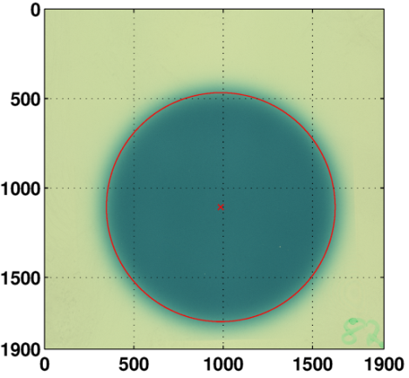
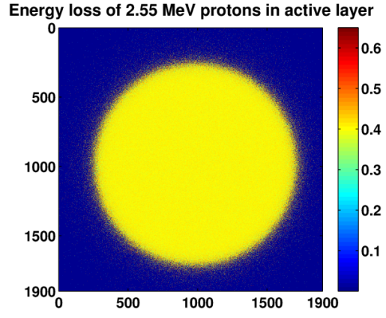
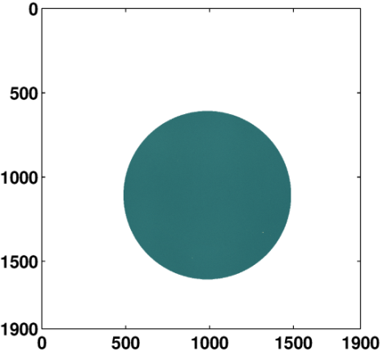
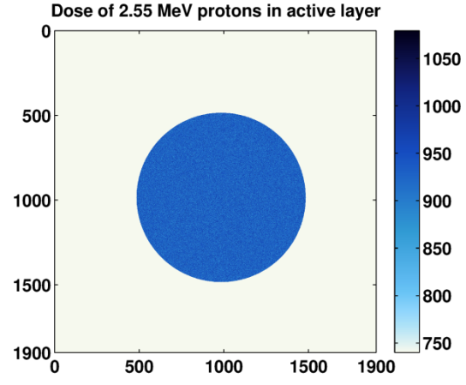
RCF multi-channel spectroscopy
Quenching effect
Measured dose is significant lower than GEANT4 simulation suggests
Reduced response function of active layer close to Bragg-Peak
Experiment
GEANT4
air
Sensitive detector:
5x5 cm²; 1968x1968 segments 5x10⁷ protons
Active layer HD-V2, d = 8 µm
Each segment measures
accumulated energy loss
number of protons
D = (594.2 ±8.5) Gy
D = (929.24 ±0.04) Gy
p
64%
IC
02 October 2013 | Oliver Deppert | EMMI HEDM workshop 2013 | Plasma physics workgroup TU Darmstadt | 11
Notes:
23.01.11
|
| 11

Slide 12
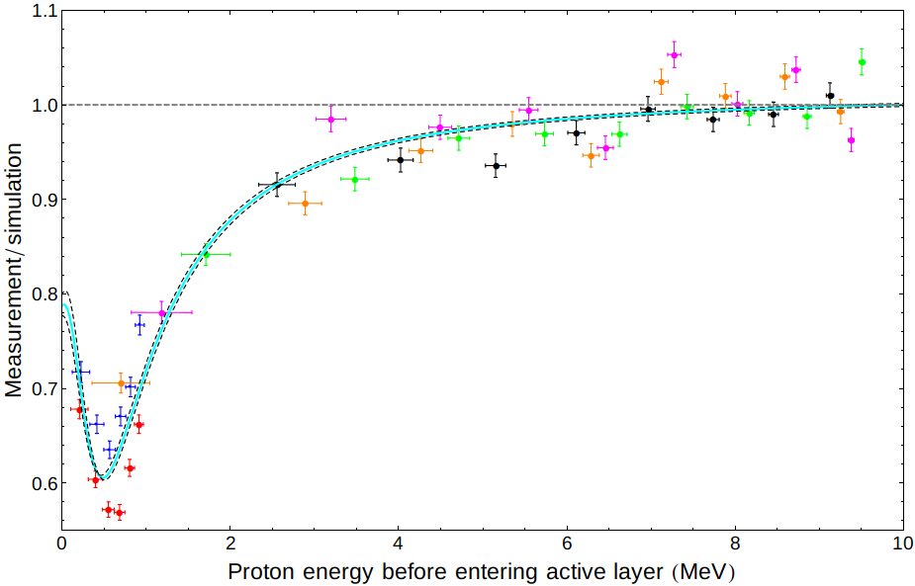
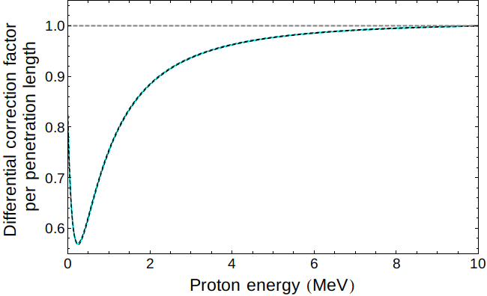
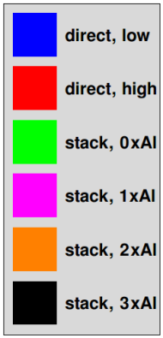
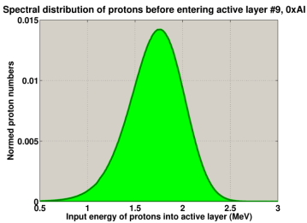
RCF multi-channel spectroscopy
Quenching effect
Two complementary Bragg-scanning methods: Direct scan and stack-scan
RCF “efficiency” follows Bragg-slope
Differential approach: Localized problem (saturation along ionisation-path)
De-convolve
Differential solution “de-convolves” from active layer thickness
Differential model “self-similar” to “integrated”; derivative
02 October 2013 | Oliver Deppert | EMMI HEDM workshop 2013 | Plasma physics workgroup TU Darmstadt | 12
Notes:
23.01.11
|
| 12

Slide 13
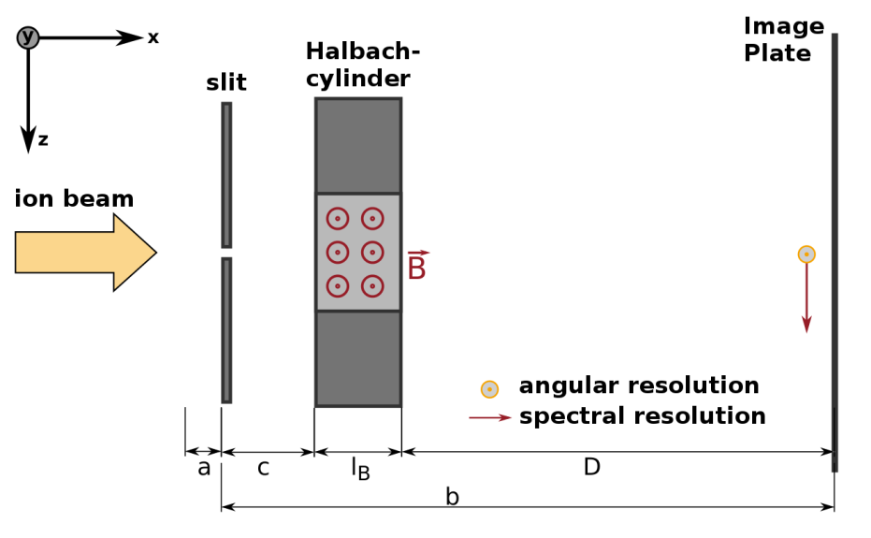
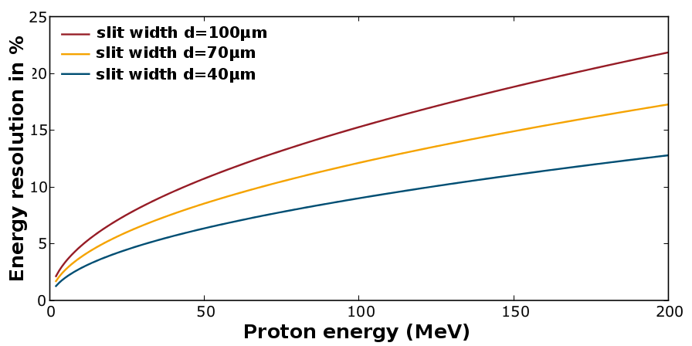
Magnetic spectrometer
Ion wide angle spectrometer (iWASP)
First design by D. Jung (LANL)
Angular-resolved spectral measurement => better estimation of conversion-efficiency
Optimisation: Better energy resolution at higher ion energies (Poster Katrin Philipp)
State of the art Halbach design => Stronger (1.4T) and more homogenous magnetic field
∆E/E ~ 8% at 70 MeV (D=30cm) ∆E/E ~ 4% at 70 MeV (D=60cm)
∆E/E ~ 13% at 200 MeV (D=30cm) ∆E/E ~ 6% at 200 MeV (D=60cm)
02 October 2013 | Oliver Deppert | EMMI HEDM workshop 2013 | Plasma physics workgroup TU Darmstadt | 13
Notes:
23.01.11
|
| 13

Slide 14
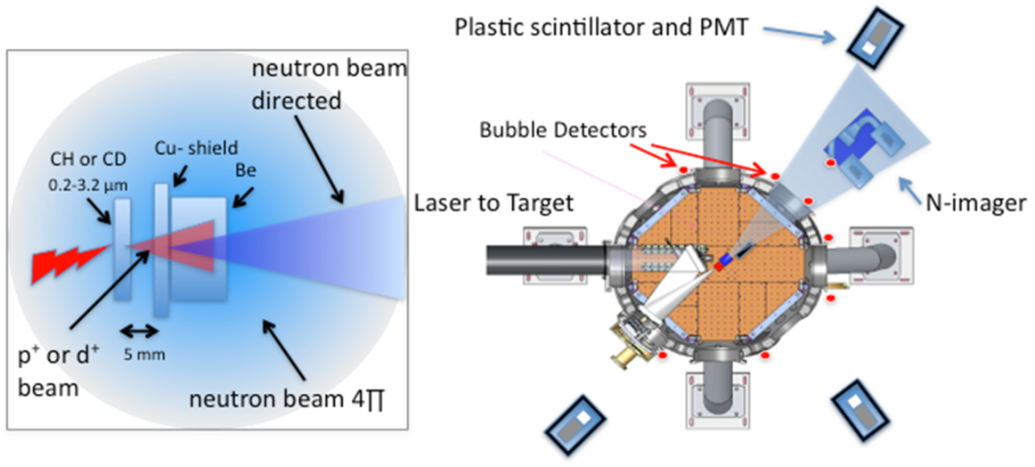
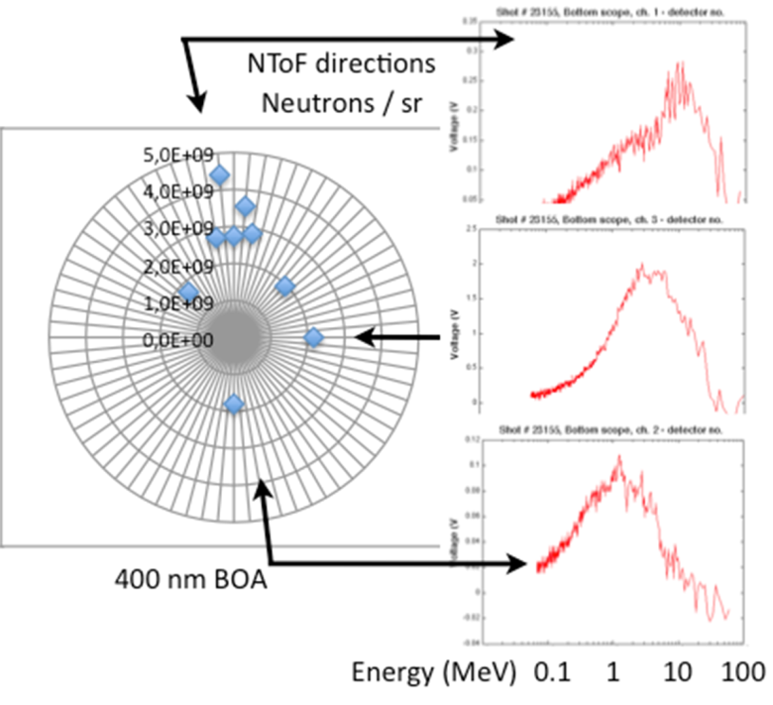
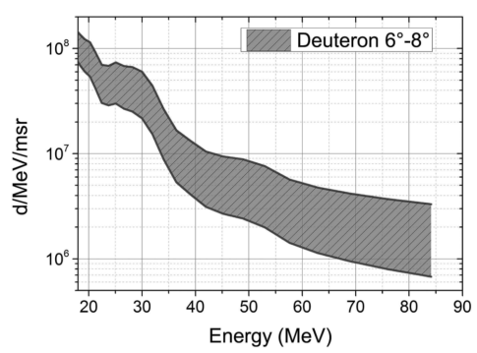
Scientific case
Generation of a directed neutron beam
Deuteron beam by BOA-mechanism
Interaction of deuterons with Be-converter
Break-up reaction leads to “directed” neutrons
Spectral and angular characterisation (Poster Annika Kleinschmidt)
02 October 2013 | Oliver Deppert | EMMI HEDM workshop 2013 | Plasma physics workgroup TU Darmstadt | 14
Notes:
Numerical case=>Optimise the experiment
-Optimization of BOA for various target geometries by self-consistent particle-in-cell calculations
higher ion energies and better conversion efficencies => find optimum BOA configuration
Efficient acceleration of deuterons as projectile for “fast” neutron generation process
-Optimisation of interaction with secondary converter material
Find best material for converter; maybe layer/stacked design of different absorber materials
Numerical monte-carlo modelling with MCNPX and Talys-coupled databases => only posibility to “model” deuteron-break up reaction
At least a phenomenological model exist in nuclear data code Talys => but many “free” parameters, cross-section for relevant materials like Be aren’t well known
(Geant4 isn’t capable to do this)
23.01.11
|
| 14

