Slide 1
EMMI 2013.09.30-10.02 @gsi
Energy Partition, γ-ray Emission, and Radiation Reaction
in the near-QED Regime of Laser-plasma Interactions
Liangliang Ji, Alexander Pukhov
Heinrich-Heine-Universität Düsseldorf, Germany
I. Yu. Kostyukov
Russian Academy of Sciences, Russia
K. U. Akli
The Ohio State University, USA

Slide 2
Contents
Introduction
Energy absorption channels
High-density carbon target
Low-density hydrogen target
γ-photon emission
Angular distribution
Radiation trapping
Summary

Slide 3
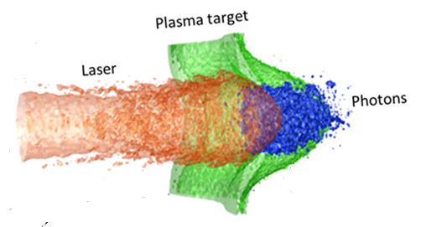
Laser-plasma interaction in the near QED regime
ELI,
iZEST, iCAN,
XCELS
> 10²³W/cm²
Ion
Laser field
Laser field
e⁺
γ-photon
e⁻
γ-photon
……
e⁻
γ-photon
Radiation reaction
(RR)

Slide 4
Laser-plasma interaction in the near QED regime
ELI,
iZEST, iCAN,
XCELS
Ion
> 10²³W/cm²
γ
e⁻
γ
γ
e⁺
Radiation reaction
(RR)

Slide 5
How much energy goes to
photons and positrons?
With RR effect, how is the laser energy distributed
between different species?

Slide 6
We need 3D Simulations
Laser-plasma interaction is an essentially multi-dimensional problem
Target deformation
Instabilities
Filament
Pinching effect
…
VLPL code, including a QED model , to describe RR effect and electron-positron creation
E. N. Nerush et al., Phys. Rev. Lett. 106, 035001 (2011).

Slide 7
Simulation parameters
Laser:
Duration: 54 fs
Spot size: r₀ = 4 μm
Intensity:
3×10²¹ —4×10²⁴ W/cm²
Thick target:
Carbon target
n_{e}=300n_{c}
Solid Hydrogen
n_{e}=32n_{c}
Linearly-polarized
(LP)
Circularly-polarized
(CP)
Energy absorption channels
Photon emission
Power laws
…..

Slide 8
Energy absorption channels
vs.
Laser amplitude
Conversion efficiency

Slide 9
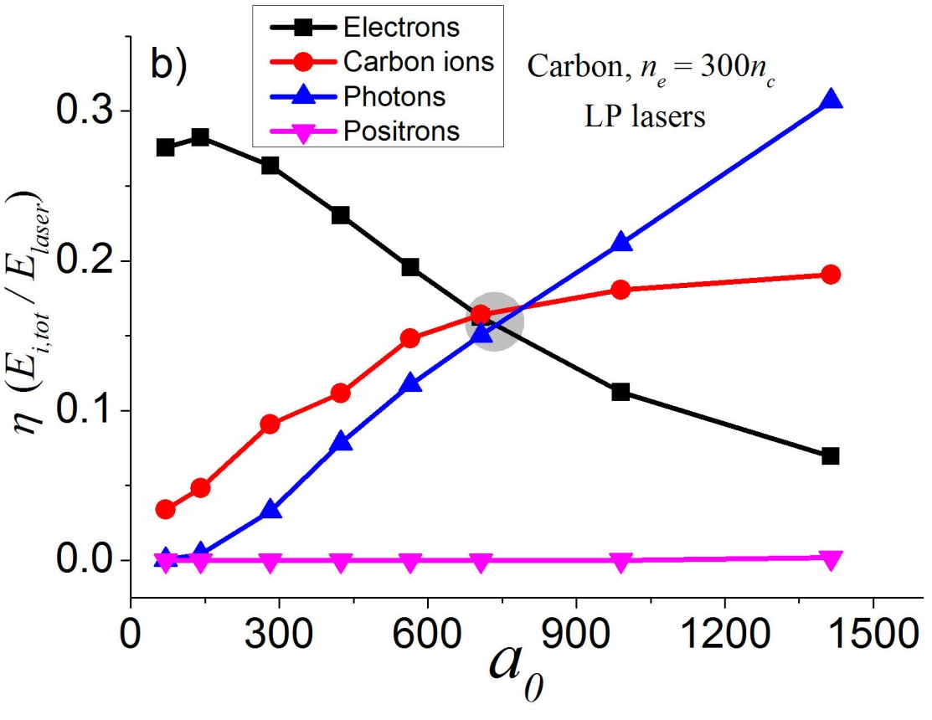
Carbon target. Energy absorption channels
CP lasers
LP lasers
1.2×10²⁴W/cm²
1.7×10²⁴W/cm²
η_{electron} drops
η_{photon} rises
η_{ion} saturates, η_{photon} < 1- η_{ion}

Slide 10
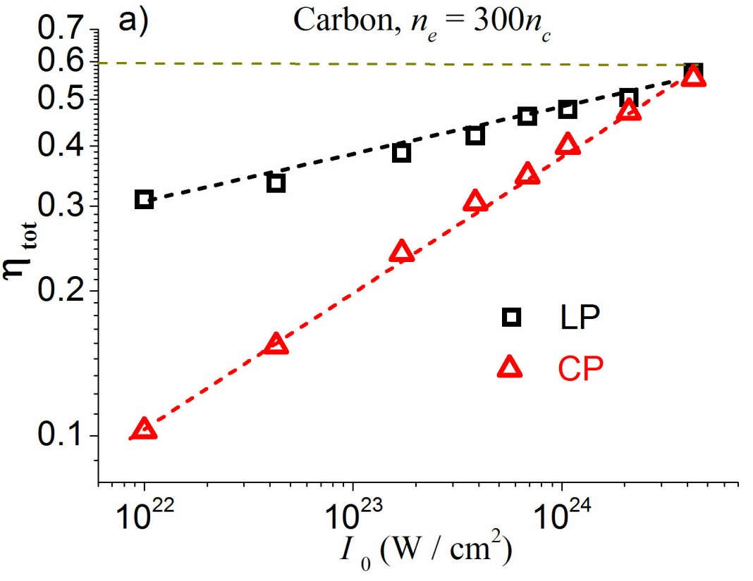
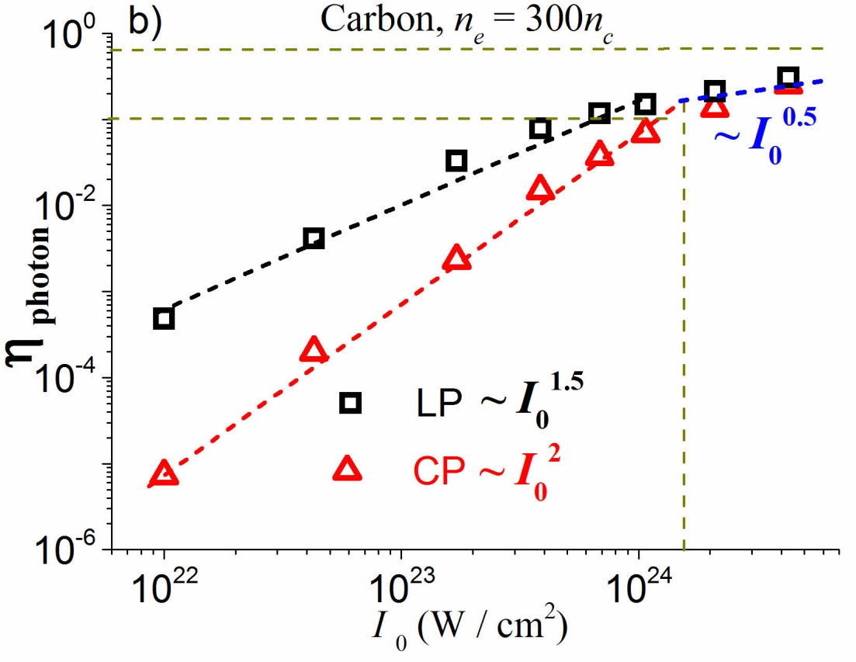
Carbon target. Power laws
η_{photon}
η _{LP} > η _{CP}
Power-laws converge at I₀ > 10²⁴ W/cm²
η _{tot, c} ~ 60%
η _{photon, c} ~ 10%

Slide 11
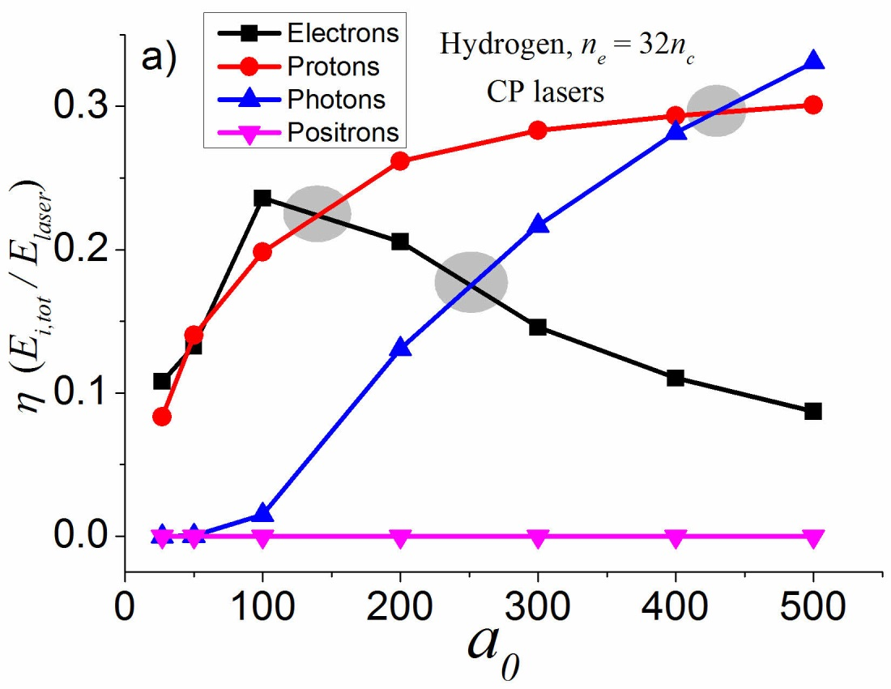
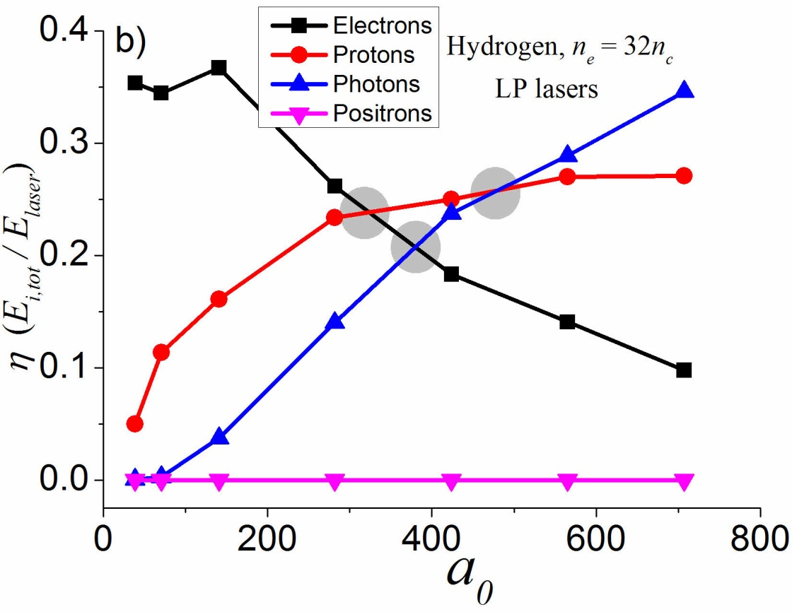
Solid hydrogen target. Energy absorption channels
CP lasers
LP lasers
2.8×10²³ W/cm²
3×10²³ W/cm²

Slide 12
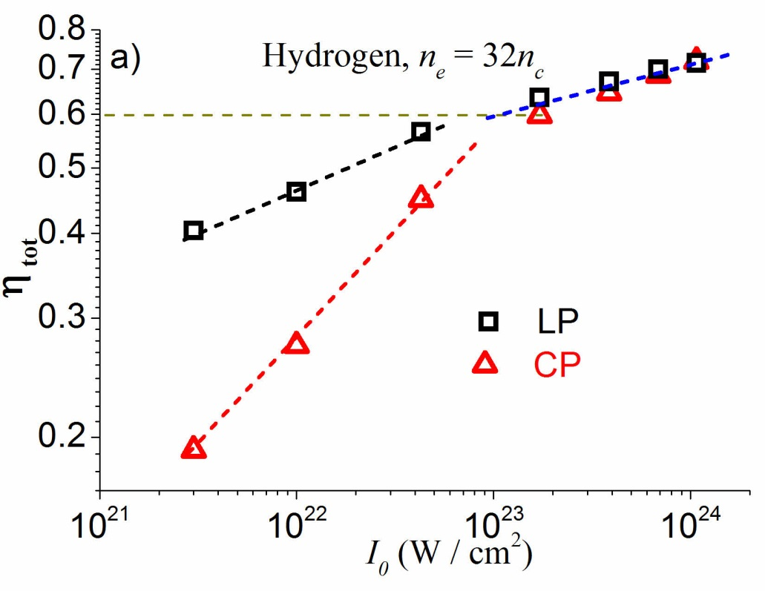
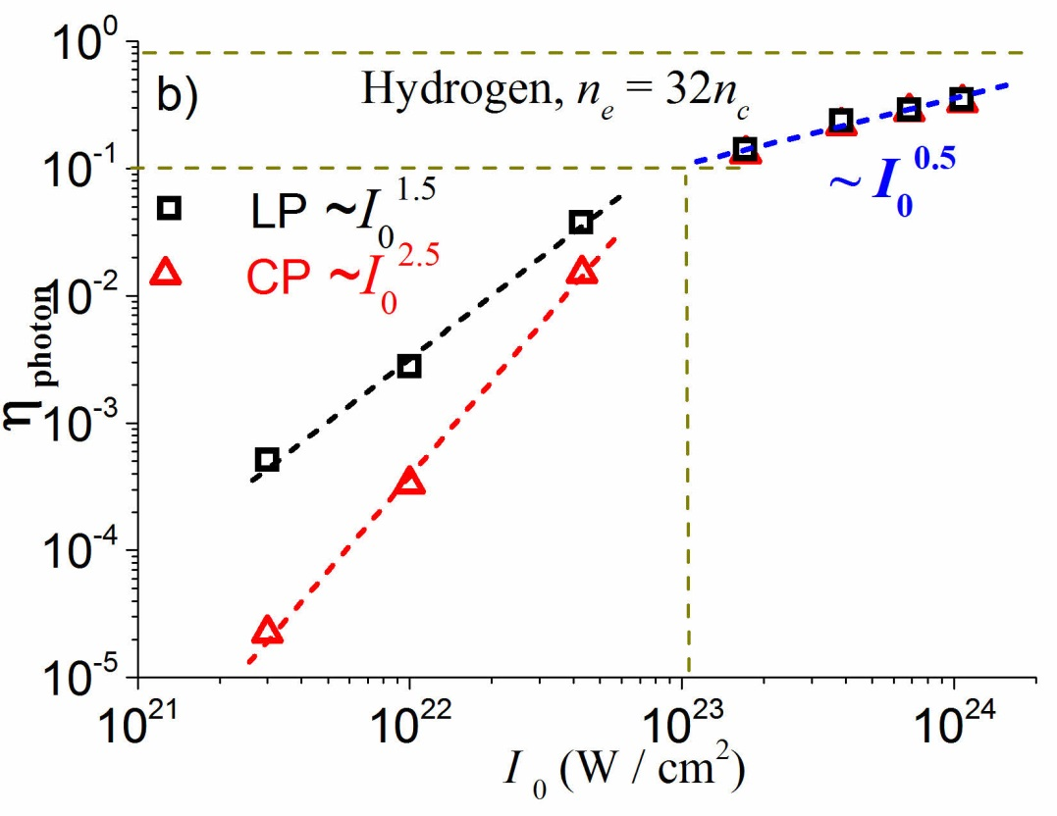
Solid hydrogen target. Power laws
η_{photon}
Power-laws converge at I₀ > 10²³ W/cm²
η _{tot, c} ~ 60%
η _{photon, c} ~ 10%

Slide 13
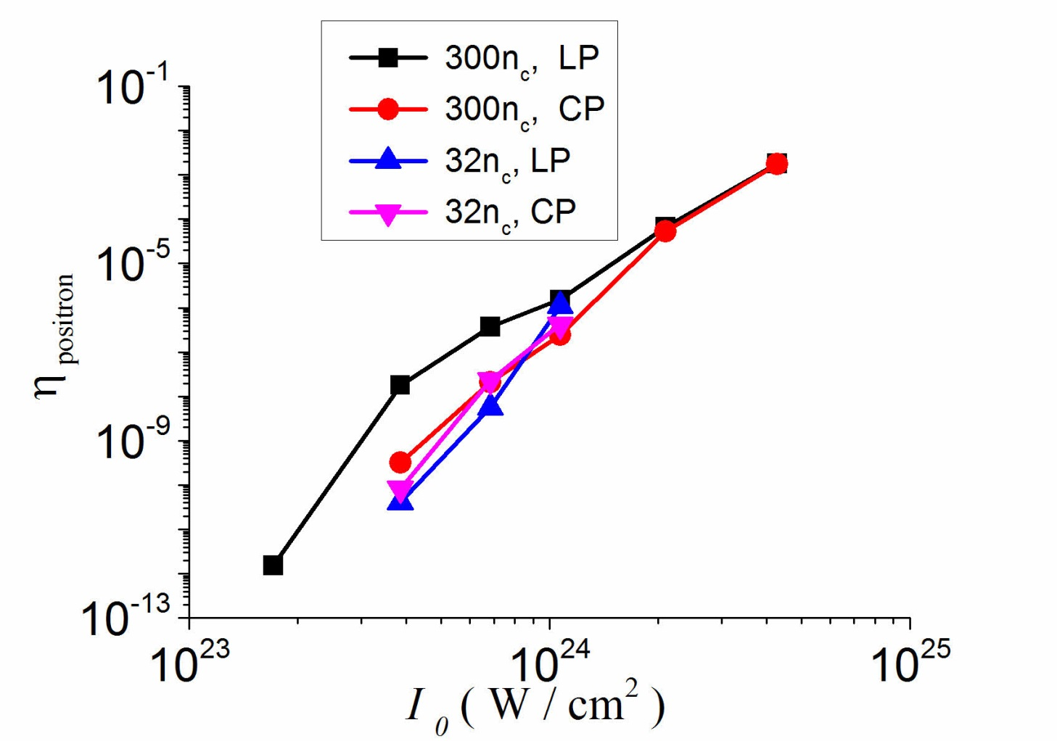
Energy amount for positrons
Small conversion efficiency when
I₀ < 10²⁵ W/cm²

Slide 14
Laser-plasma interaction in the near-QED regime is an efficient
γ-ray source
η _{photon, max} ~ 35%

Slide 15
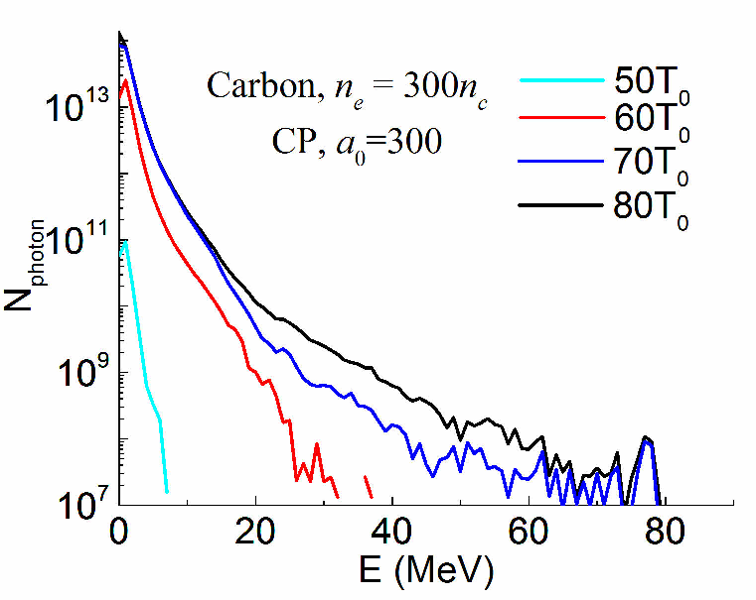
Photon spectra
Tens-of-MeV photons with efficiency over 30%

Slide 16
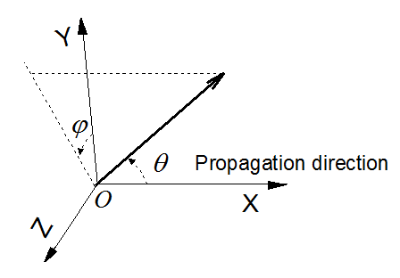
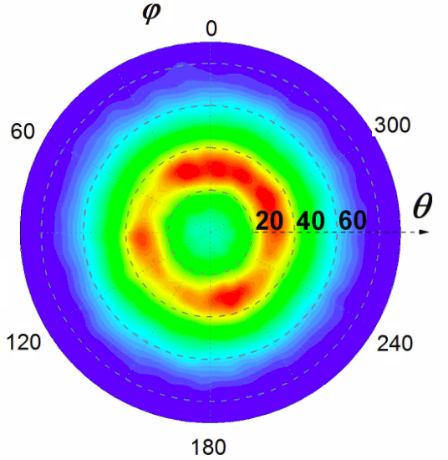
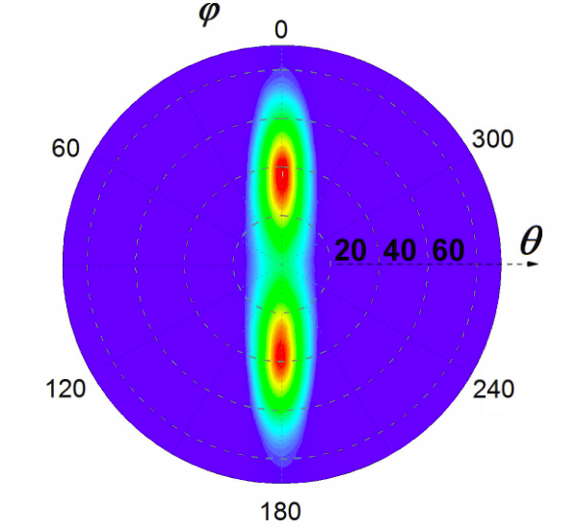
Angular distribution
CP laser
LP laser
Angular distribution of the emitted photon beam is defined by
that of the incident laser

Slide 17
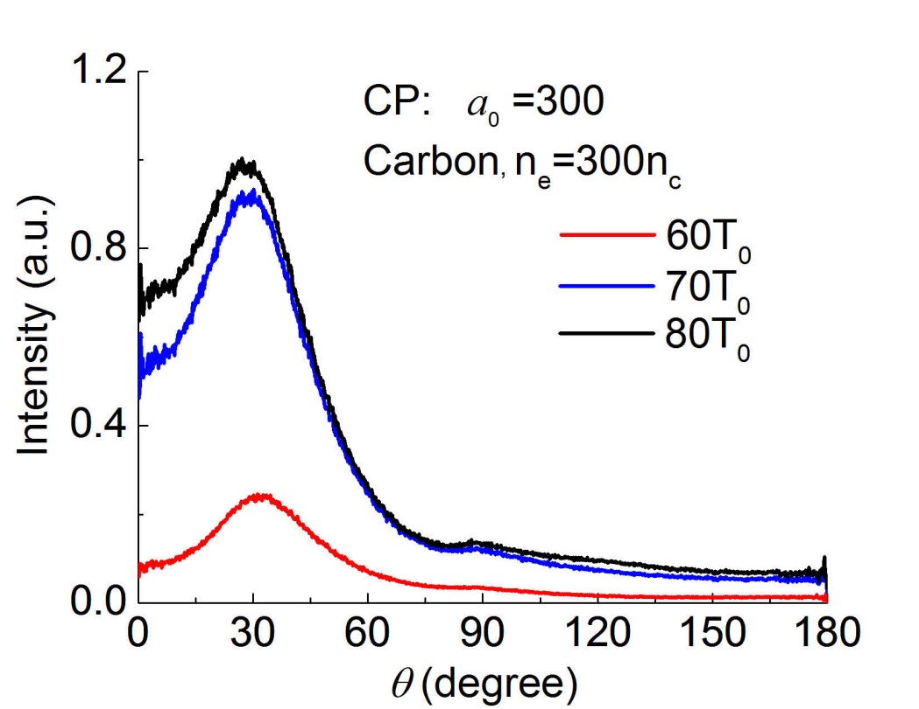
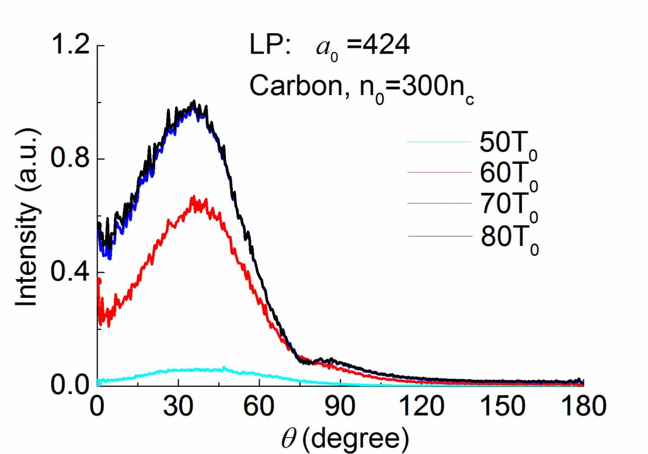
Angular distribution-dependence on θ
CP lasers
LP lasers
Peak at around θ=30⁰
Peak around θ=35⁰

Slide 18
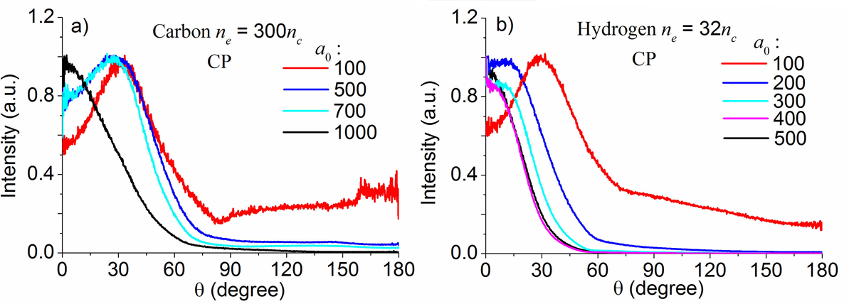
θ-distribution vs. laser amplitude ----CP lasers
Carbon target
Hydrogen target
Peak divergence angle ~ 30⁰
Centralized!
Peak along propagating direction

Slide 19
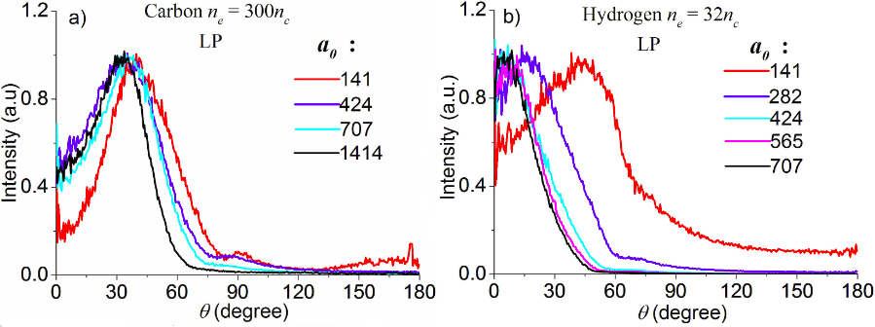
θ-distribution vs. laser amplitude -------LP lasers
Carbon target
Hydrogen target
Peak divergence angle > 30⁰
Centralized!
Peak along propagating direction

Slide 20
Two distinctive regions are identified
η _{tot} : 0 -60%
η _{photon} : 10⁻⁵ -10⁻¹
Stronger power-laws, η _{photon} ~ I₀^{1.5-2.5}
Larger divergence angle for photons
???
η _{tot} : > 60%
η _{photon} : > 10⁻¹
Power-laws converge
Photon beams become more collimated

Slide 21
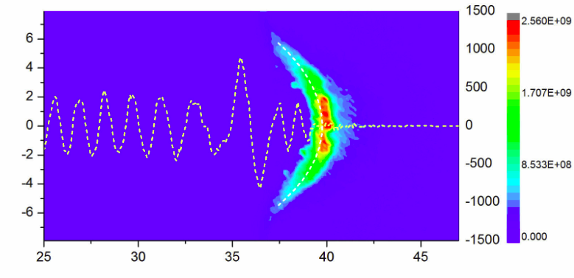
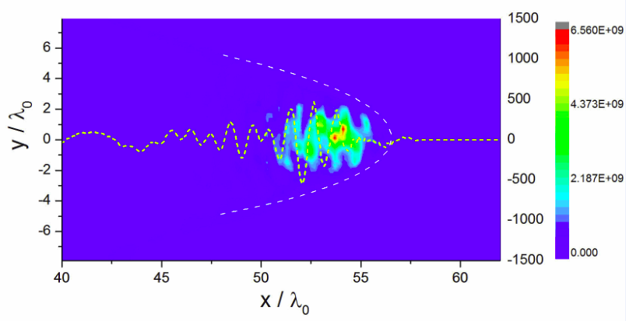
Relativistic transparent region
Opaque
a₀=424, n_{e}=300n_{c}
Lower efficiency
Large divergence angle
Relativistic transparent
a₀=424, n_{e}=32n_{c}
High efficiency
More collimated ?

Slide 22
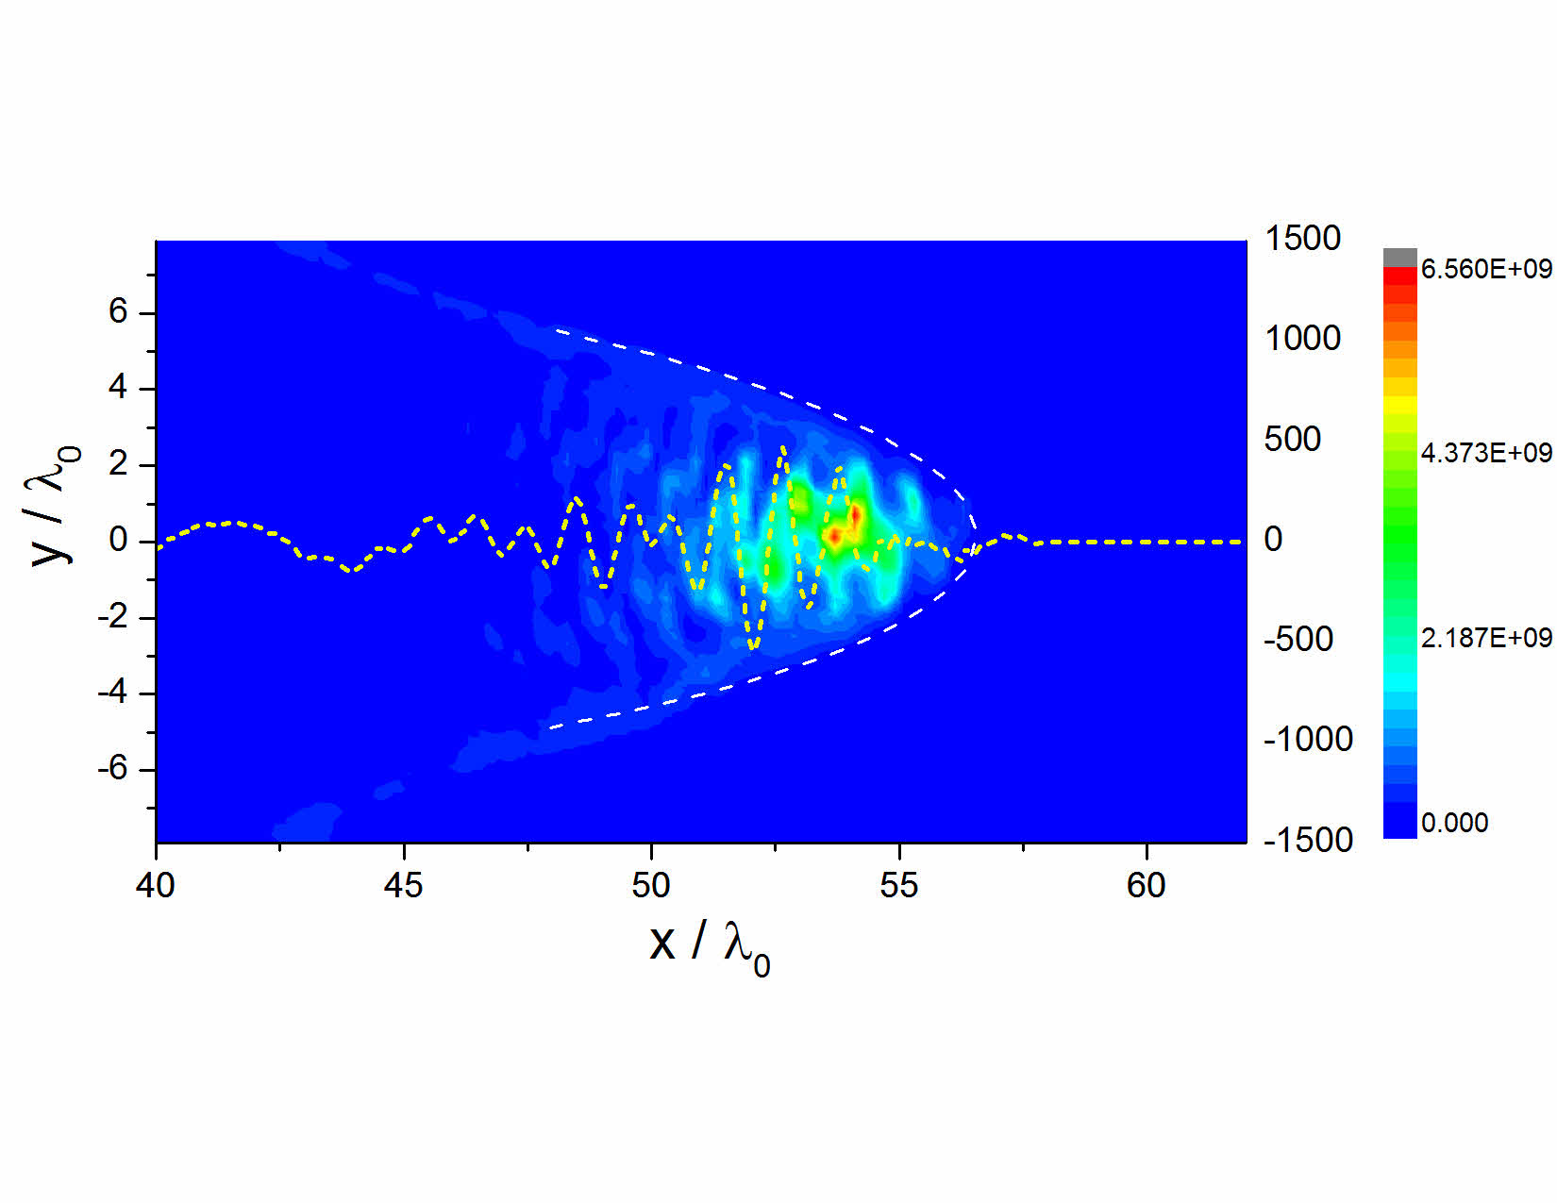
Radiation trapping
Electrons are trapped due to
Radiation Reaction!

Slide 23
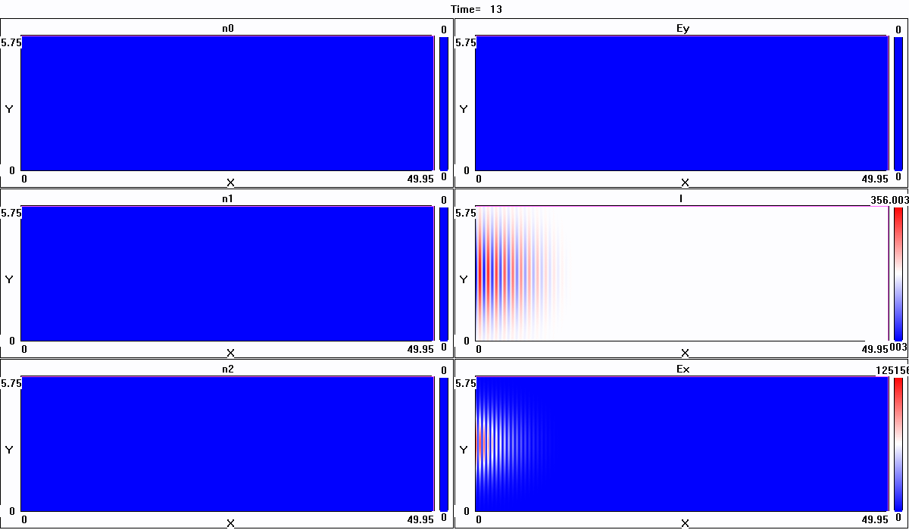
Without RR
Electrons
Positrons
LP, a₀ =500
Hydrogen n_{e}=20n_{c}
Protons
Laser field E_{y}
γ-photons
Laser intensity

Slide 24
With RR
Electrons
Positrons
Protons
Laser field E_{y}
γ-photons
Laser intensity

Slide 25
Radiation trapping threshold
Electron oscillation amplitude
Radiation reaction force
Threshold laser amplitude
Pinching effect may reduce the threshold of radiation trapping

Slide 26
Summary
3D simulations reveal the energy channels and photon emission in the near QED regime.
Two interaction regions are distinguished: the opaque region and relativistic transparent region.
Radiation trapping of electrons is discovered.

Slide 27
Thank you for your attention!
------End------

