Slide 1


Nucleus-electron cloud coupling in plasmas: the case of ⁸⁴Rb.
EMMI Workshop on high energy density plasma diagnostics at FAIR: Novel laser based photon and particle sources
D. Denis-Petit¹, V. Bagnoud³⁴, I. Bessières¹, T. Bonnet¹, M. Comet¹²,F. Dorchies⁵, A. Frank³⁴, F. Gobet¹, G. Gosselin², F. Hannachi¹, V. Méot², P. Morel², J-Ch. Pain², O. Peyrusse⁵, M. Tarisien¹, M. Versteegen¹, MM. Aléonard¹
¹Univ. Bordeaux, CNRS-IN2P3, CENBG, F-33175 Gradignan, France
²CEA/DIF BP12, F-91680 Bruyères-le-Châtel, France
³GSI Helmholtzzentrum für Schwerionenforschung GmbH, 64291 Darmstadt, Germany
⁴Helmholtz Institute Jena, 07743 Jena, Germany
⁵ Univ. Bordeaux, CNRS, CEA, CELIA, 33400 Talence, France.
With the support of:

Slide 2
Nuclear physics in plasmas
Plasmas: allow to study the nucleus in extreme conditions
Nuclear properties can be modified according to the nucleus environment
  Charge state (ionization degree) of the atom
M
¹²⁵Te 1st excited state at 35 keV
γ
L
Q | T_{1/2} (ns)
0 (neutral) | 1.49
48⁺ | 11 ± 2
Internal Conversion
in shell K blocked
e⁻
K
Nucleus
Atom
F. Attallah et al. Phys. Rev. Lett. 75,1715
  Apparition of new excitation / de-excitation processes
    λ is modified (G. Gosselin et al. Phys. Rev. C, 76,044611)

Slide 3
Nuclear excitations in plasmas
In hot and dense plasmas ➢different excitation processes
  direct excitation processes
    Photoexcitation
    Inelastic electron scattering
  indirect excitation processes (nucleus-its electron cloud coupling)
    Nuclear Excitation by Electron Transition (NEET)
    Nuclear Excitation by Electron Capture (NEEC)

Slide 4
NEET in ⁸⁴Rb plasma
⁸⁴Rb: unstable isotope
  must be produced in nuclear reactions. Two states remain populated after the reaction:
    The ground state (J^{π}=2⁻,T_{1/2}=32.82d)
    The isomeric state (J^{π}=6⁻,T_{1/2}=20.6mn)
Nuclear isomeric state depopulation processes
  In a neutral isolated atom: « direct decay », γ at 215, 248 and 463 keV, T_{1/2}=20.6m
  In plasmas: excitation to the 5⁻ state possible ?
    De-excitation via the 5⁻ state: γ at 218 and 248 keV in coincidence → T_{1/2} modified
NEET: can be the dominant excitation process in plasmas in particular plasma conditions
  Resonance between atomic and nuclear transitions with same multipolarity (M1)
  Key nuclear data:
  6⁻→5⁻ transition energy
E_{nuclear}(keV)
5⁻
9 ns
466.6
6⁻
20.6 m
463.6
3⁻
0.31 ns
248.1
[1] F.G. Kondev, Nuclear Data Sheets 110, 2815 (2009)
2⁻
32.82 d
0
Partial level scheme of ⁸⁴Rb nucleus [1]

Slide 5
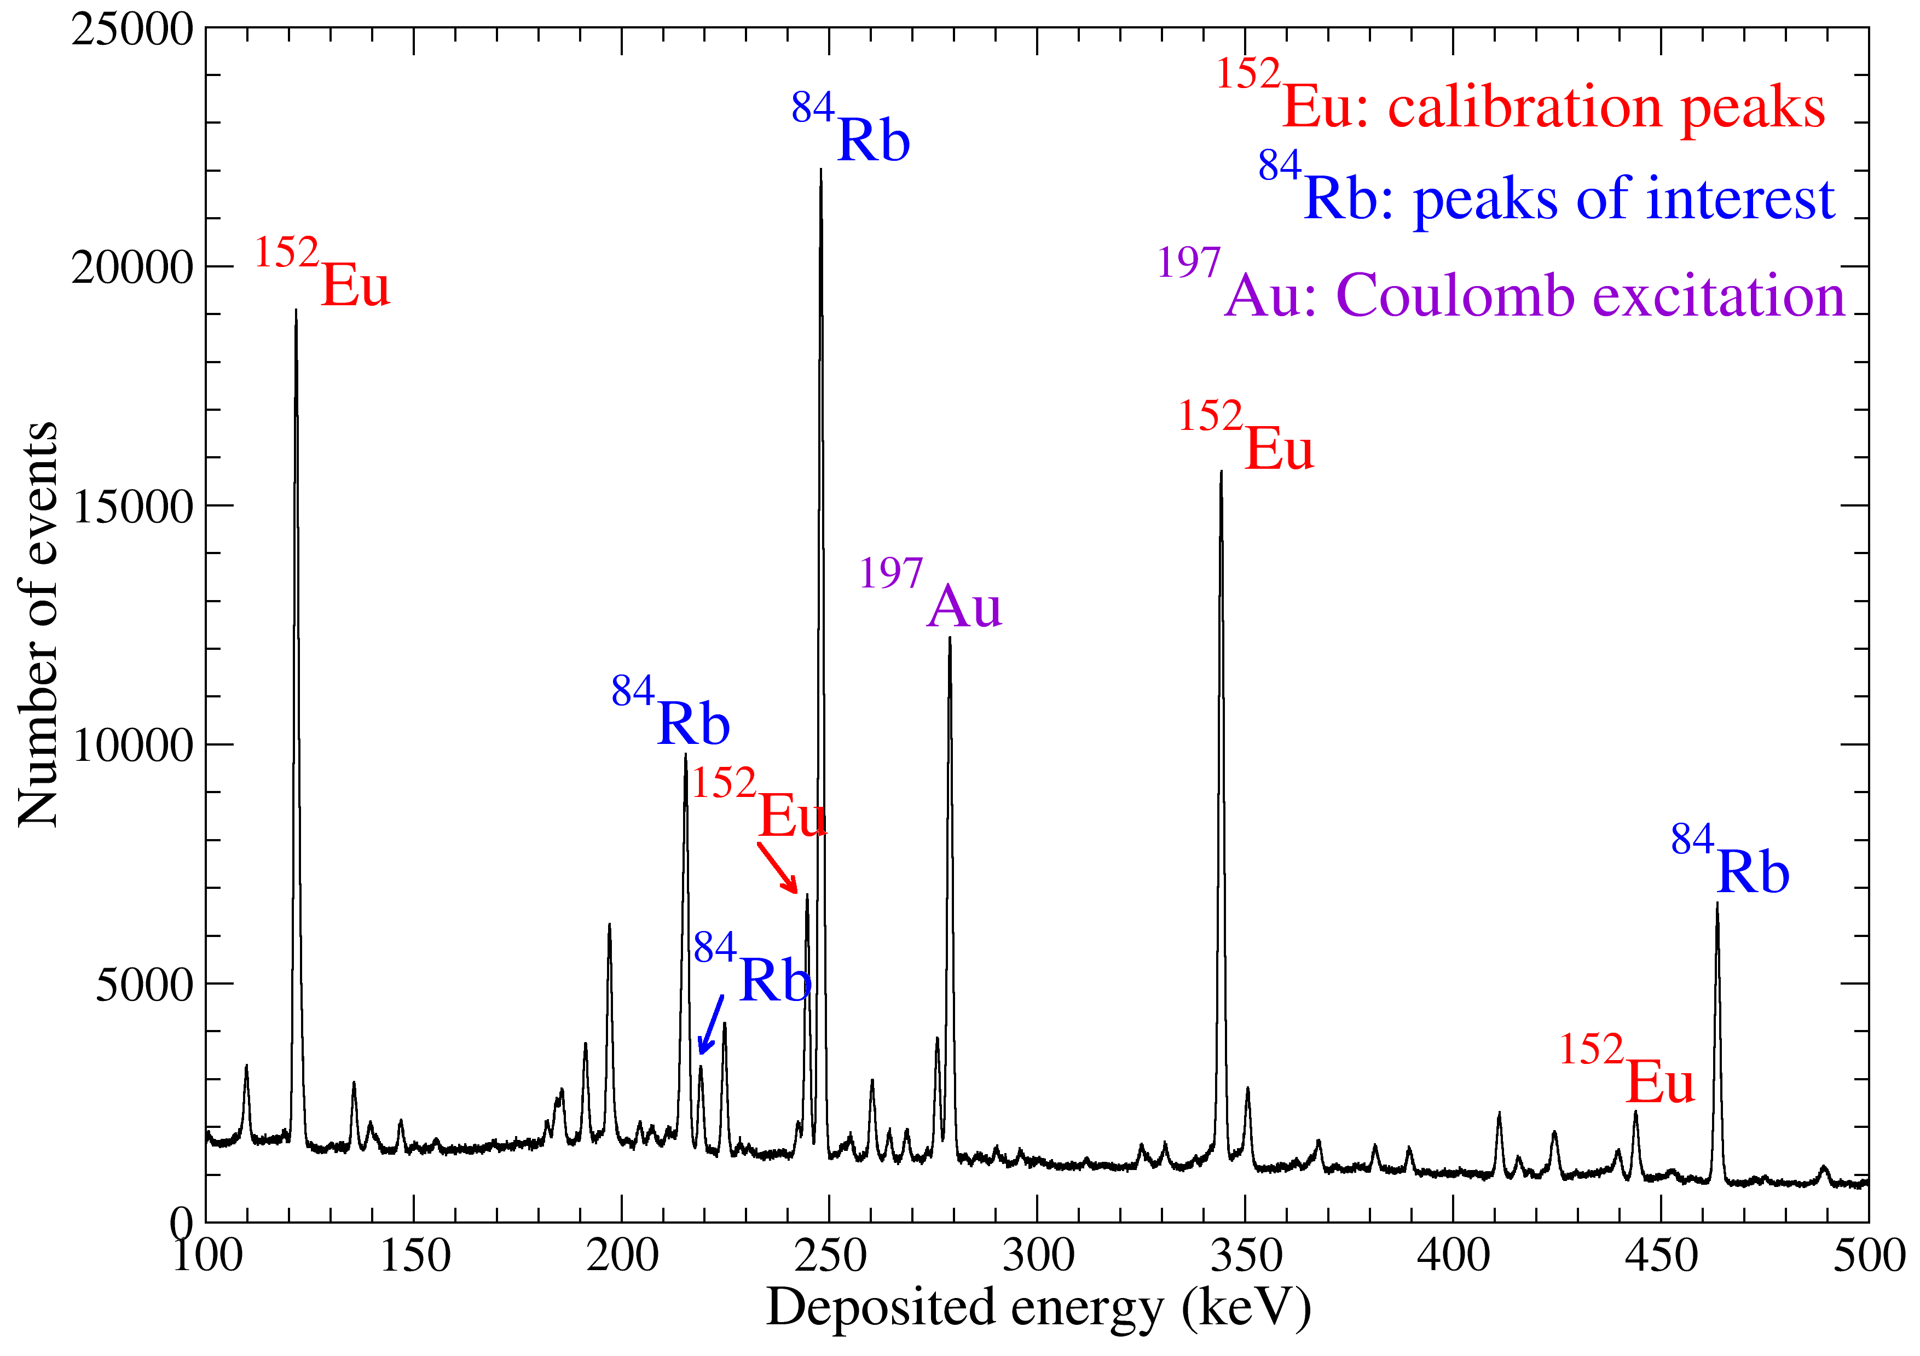
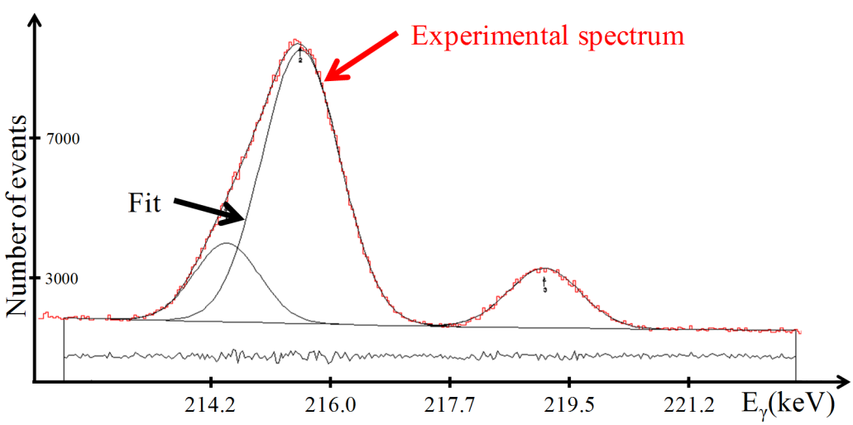
Nuclear transition energy measurement
Values given in the nuclear tables are not enough accurate
  Measurement of the ⁸⁴Rb γ spectrum below 500 keV
Measurements
  Decay of the 5⁻ not measurable offline
    Specific facility: ORGAM at TANDEM/ALTO
    accelerator (IPN Orsay)
  Production via ⁷⁶Ge(¹¹B,3n)⁸⁴Rb reaction. ¹¹B at 30MeV
  Calibration source and target counted simultaneously
  Peak centroid determined by fitting (Radware code)
Transition | Nudat[1] | Our measurements
5⁻ → 3⁻ | 218.3 ± 0.2 keV | 219.107 ± 0.009 keV
6⁻ → 3⁻ | 215.61 ± 0.10 keV | 215.603 ± 0.002 keV
5⁻ → 6⁻ | 2.69 ± 0.23 keV (γ) 3.05 ± 0.18 keV (levels) 3.4 keV (suggested) | 3.504 ± 0.010 keV
Transition | Nudat[1]
5⁻ → 3⁻ | 218.3 ± 0.2 keV
6⁻ → 3⁻ | 215.61 ± 0.10 keV
5⁻ → 6⁻ | 2.69 ± 0.23 keV (γ) 3.05 ± 0.18 keV (levels) 3.4 keV (suggested)
This measurement fixes the search for atomic transitions suitable for NEET

Slide 6
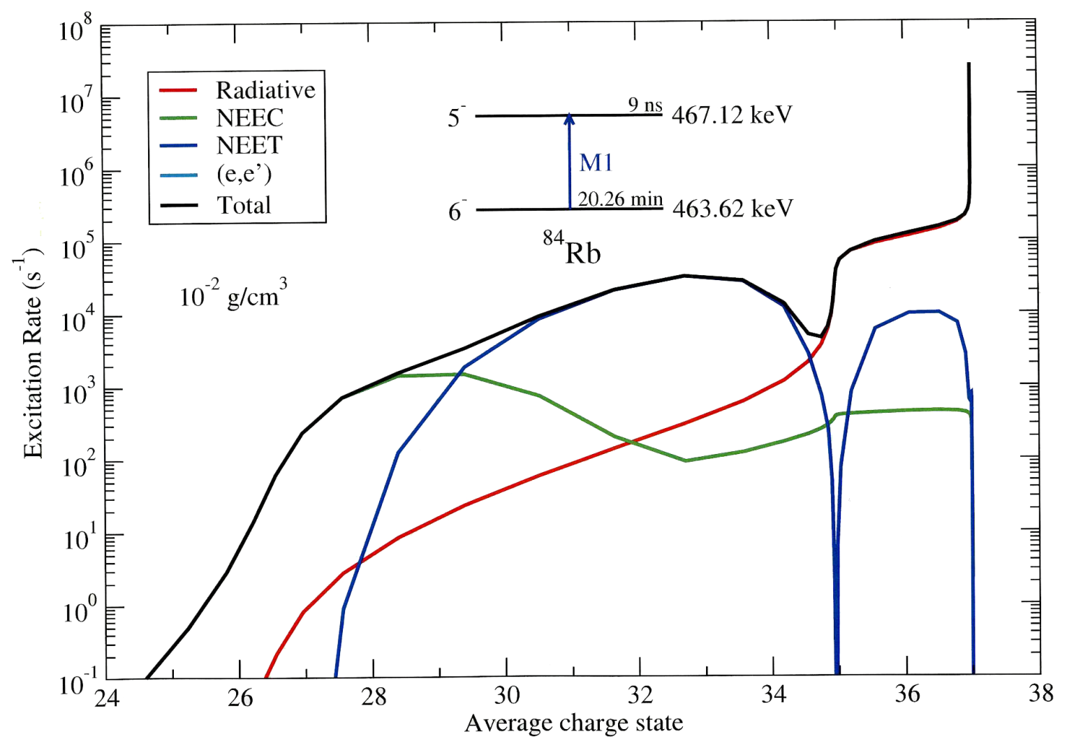
Plasma conditions suitable for the NEET
To calculate nuclear excitation rate by NEET and NEEC: need a description of the atom
  Relativistic Average Atom Model under the Local Thermodynamic Equilibrium Hypothesis (LTE)
    Atoms of the plasma are described by one average atom
    Plasma temperature and density taken into account
To be dominant, NEET requires specific plasma properties
NEET is dominant for Rb plasma
with charge states: 30⁺→34⁺
G. Gosselin et al. Private Communication

Slide 7
NEET experiment in ⁸⁴Rb plasma
Experimentally: accelerator combined with a high energy laser (UNILAC+PHELIX at GSI)
  Production of the isomeric state ^{84m}Rb
    Ion accelerator →UNILAC
    Reaction: ⁷⁶Ge(¹²C,p+3n)⁸⁴Rb
  Creation of a ⁸⁴Rb plasma suitable for NEET process
    High energy laser →PHELIX
    Charge states ≥30⁺
  Evidence of the excitation: detection of the γ-rays at 219 keV
Are the plasma conditions available at
PHELIX suitable for NEET ?
E_{nuclear}(keV)
5⁻
9 ns
467.12
PHELIX Beam
6⁻
20.6 m
463.62
219.11
3⁻
0.31 ns
248.01
¹²C UNILAC Beam
⁷⁶Ge Target
248.01
2⁻
32.82 d
0
Partial level scheme of ⁸⁴Rb

Slide 8
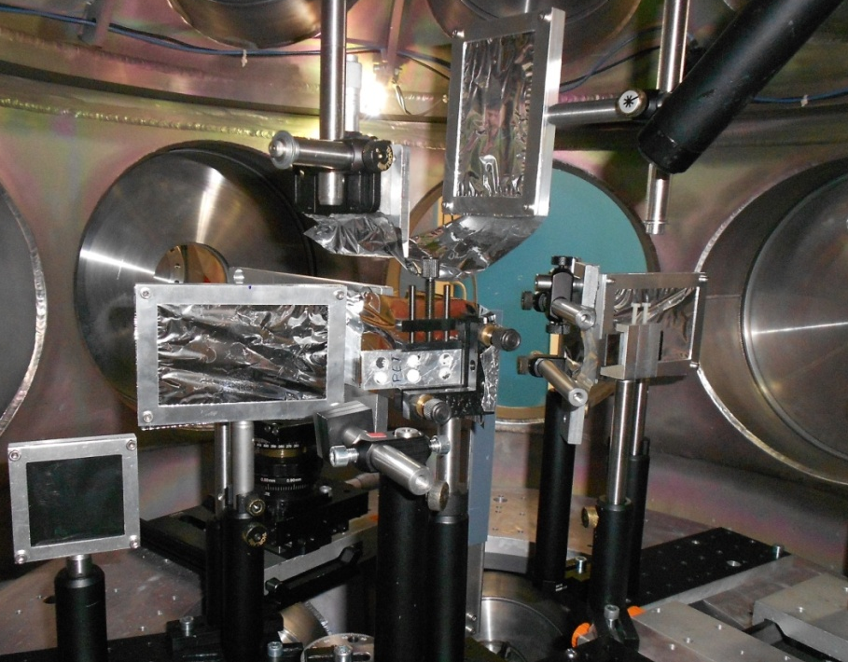
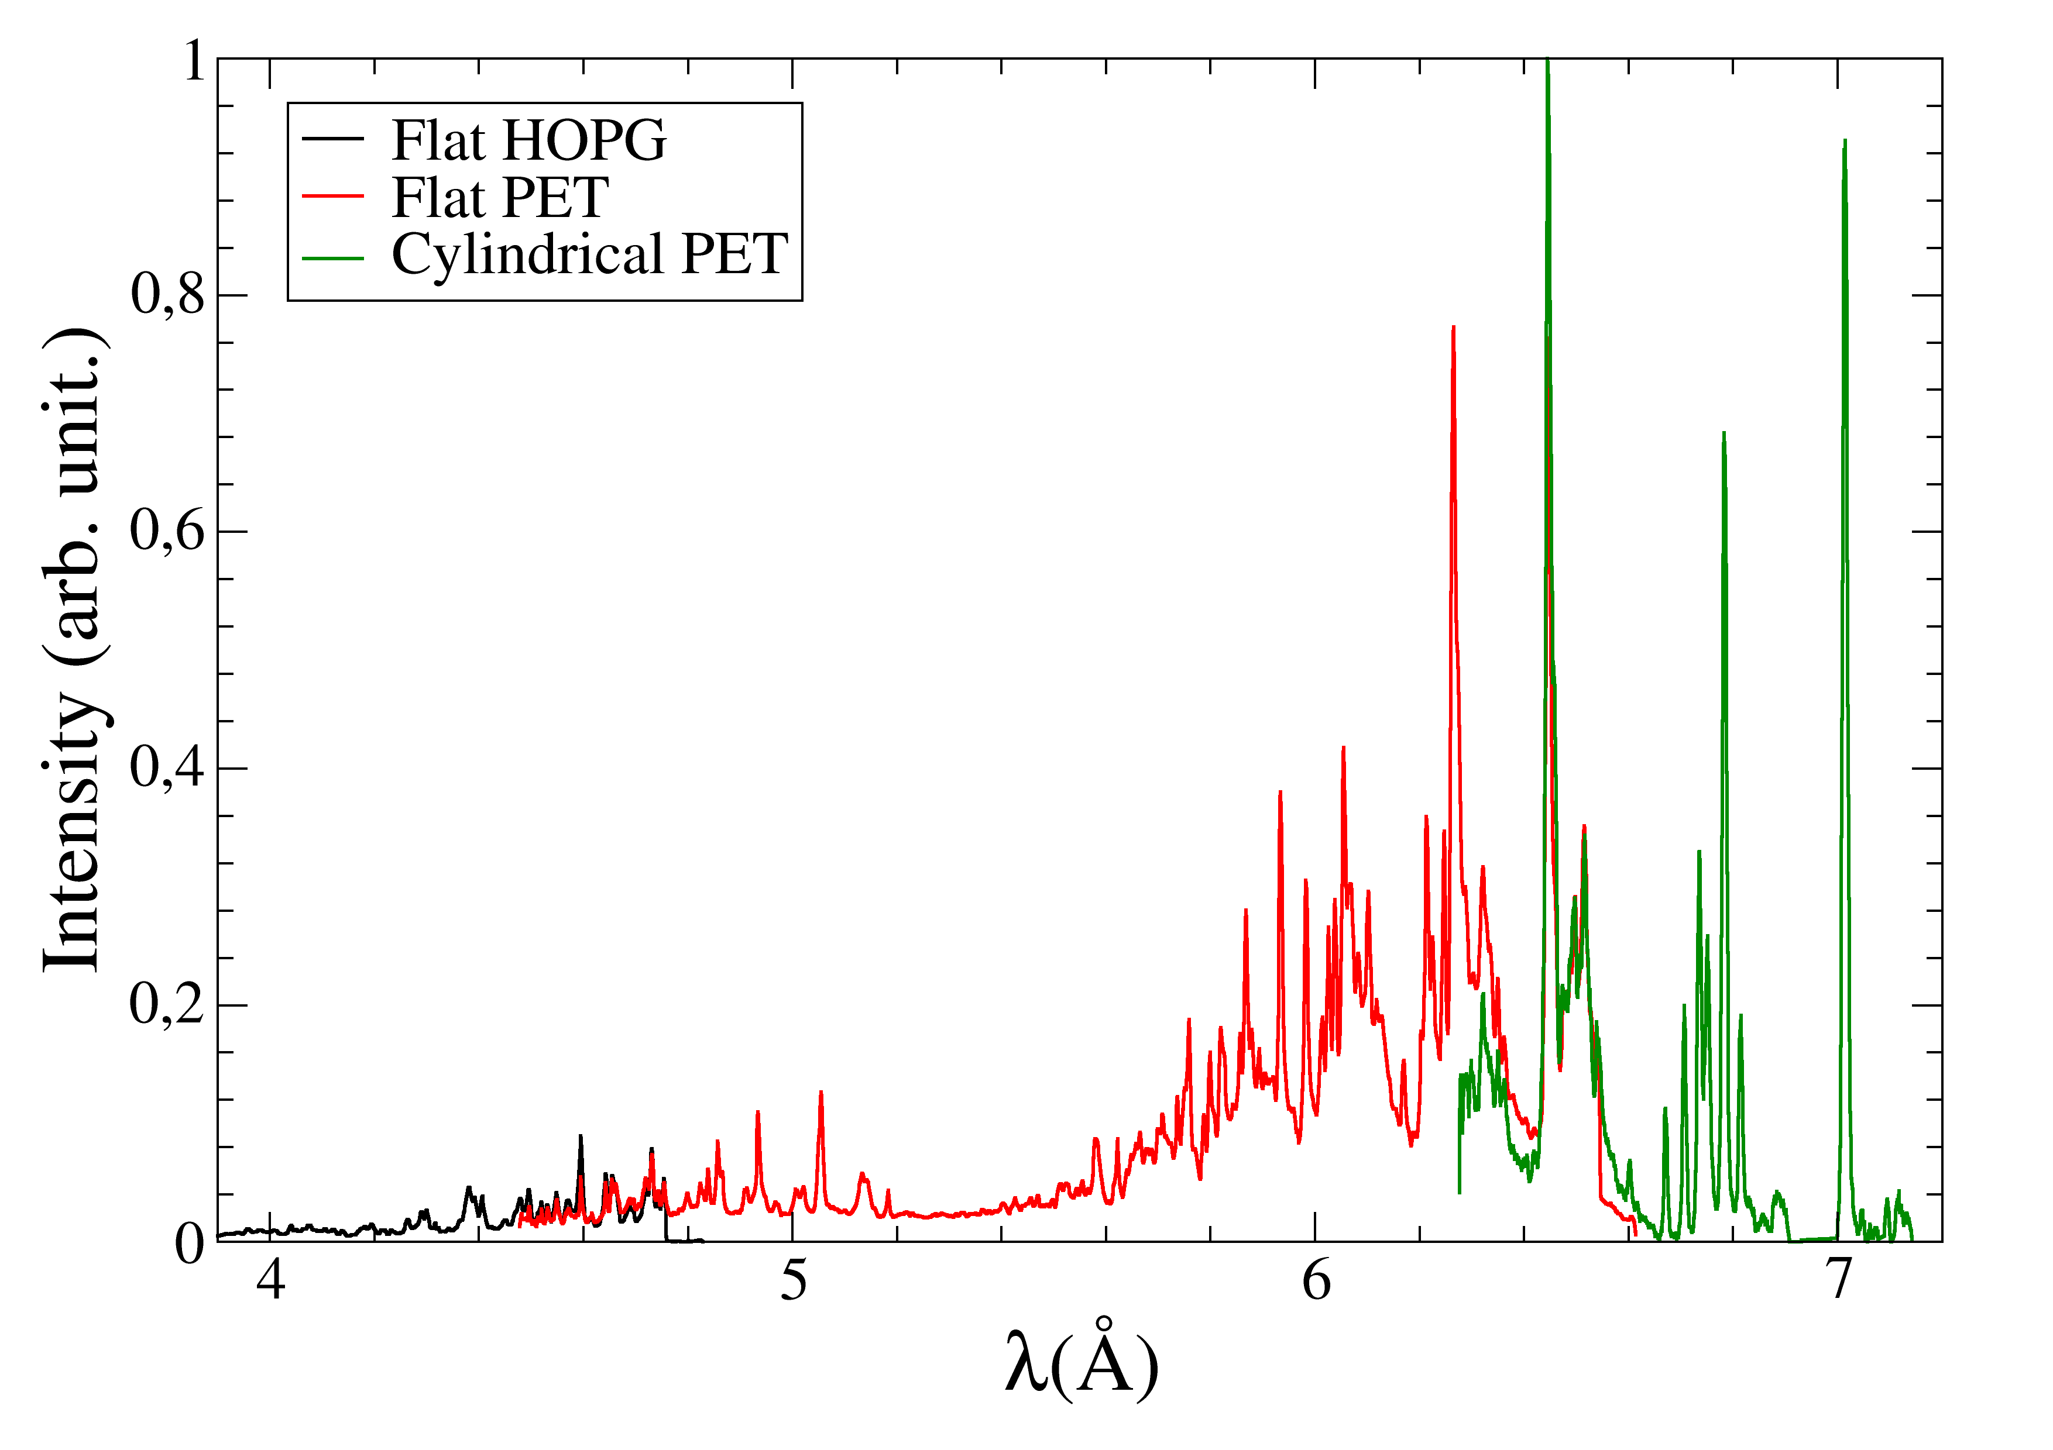
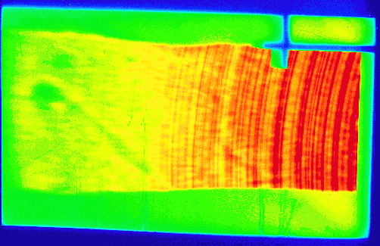
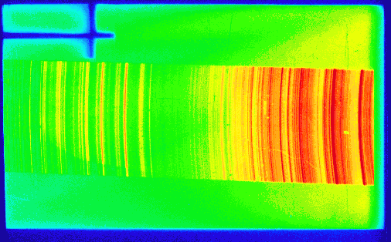
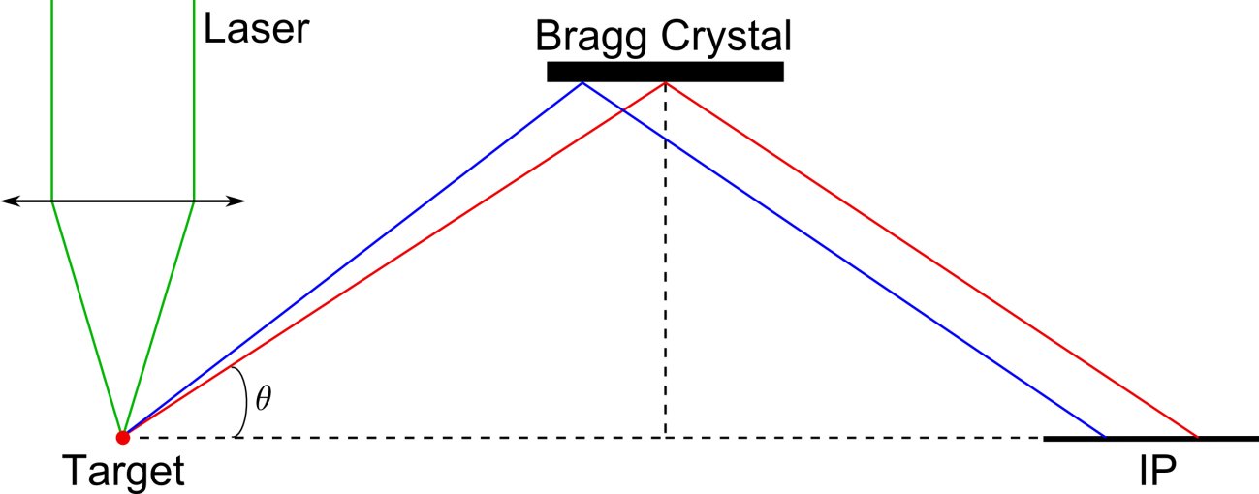
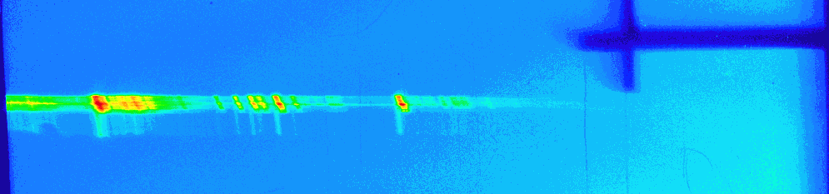
Measurement of the X-spectrum from a Rb plasma
Goals:
  Determine plasma conditions available with PHELIX:
    Plasma temperature
    Charge state distribution
  Check the validity of atomic calculations
Experimental setup:
  PHELIX beam (527nm at 2ω, 2.10¹⁴W/cm²)
  Bragg crystals + Image Plate (IP)
Cylindrical PET
Conditions suitable
for the NEET ??
PHELIX Beam
Flat PET
Flat HOPG
Flat HOPG
Flat PET
Cylindrical PET
3.1 keV
Bragg relation:
1.8 keV
k: interference order

Slide 9
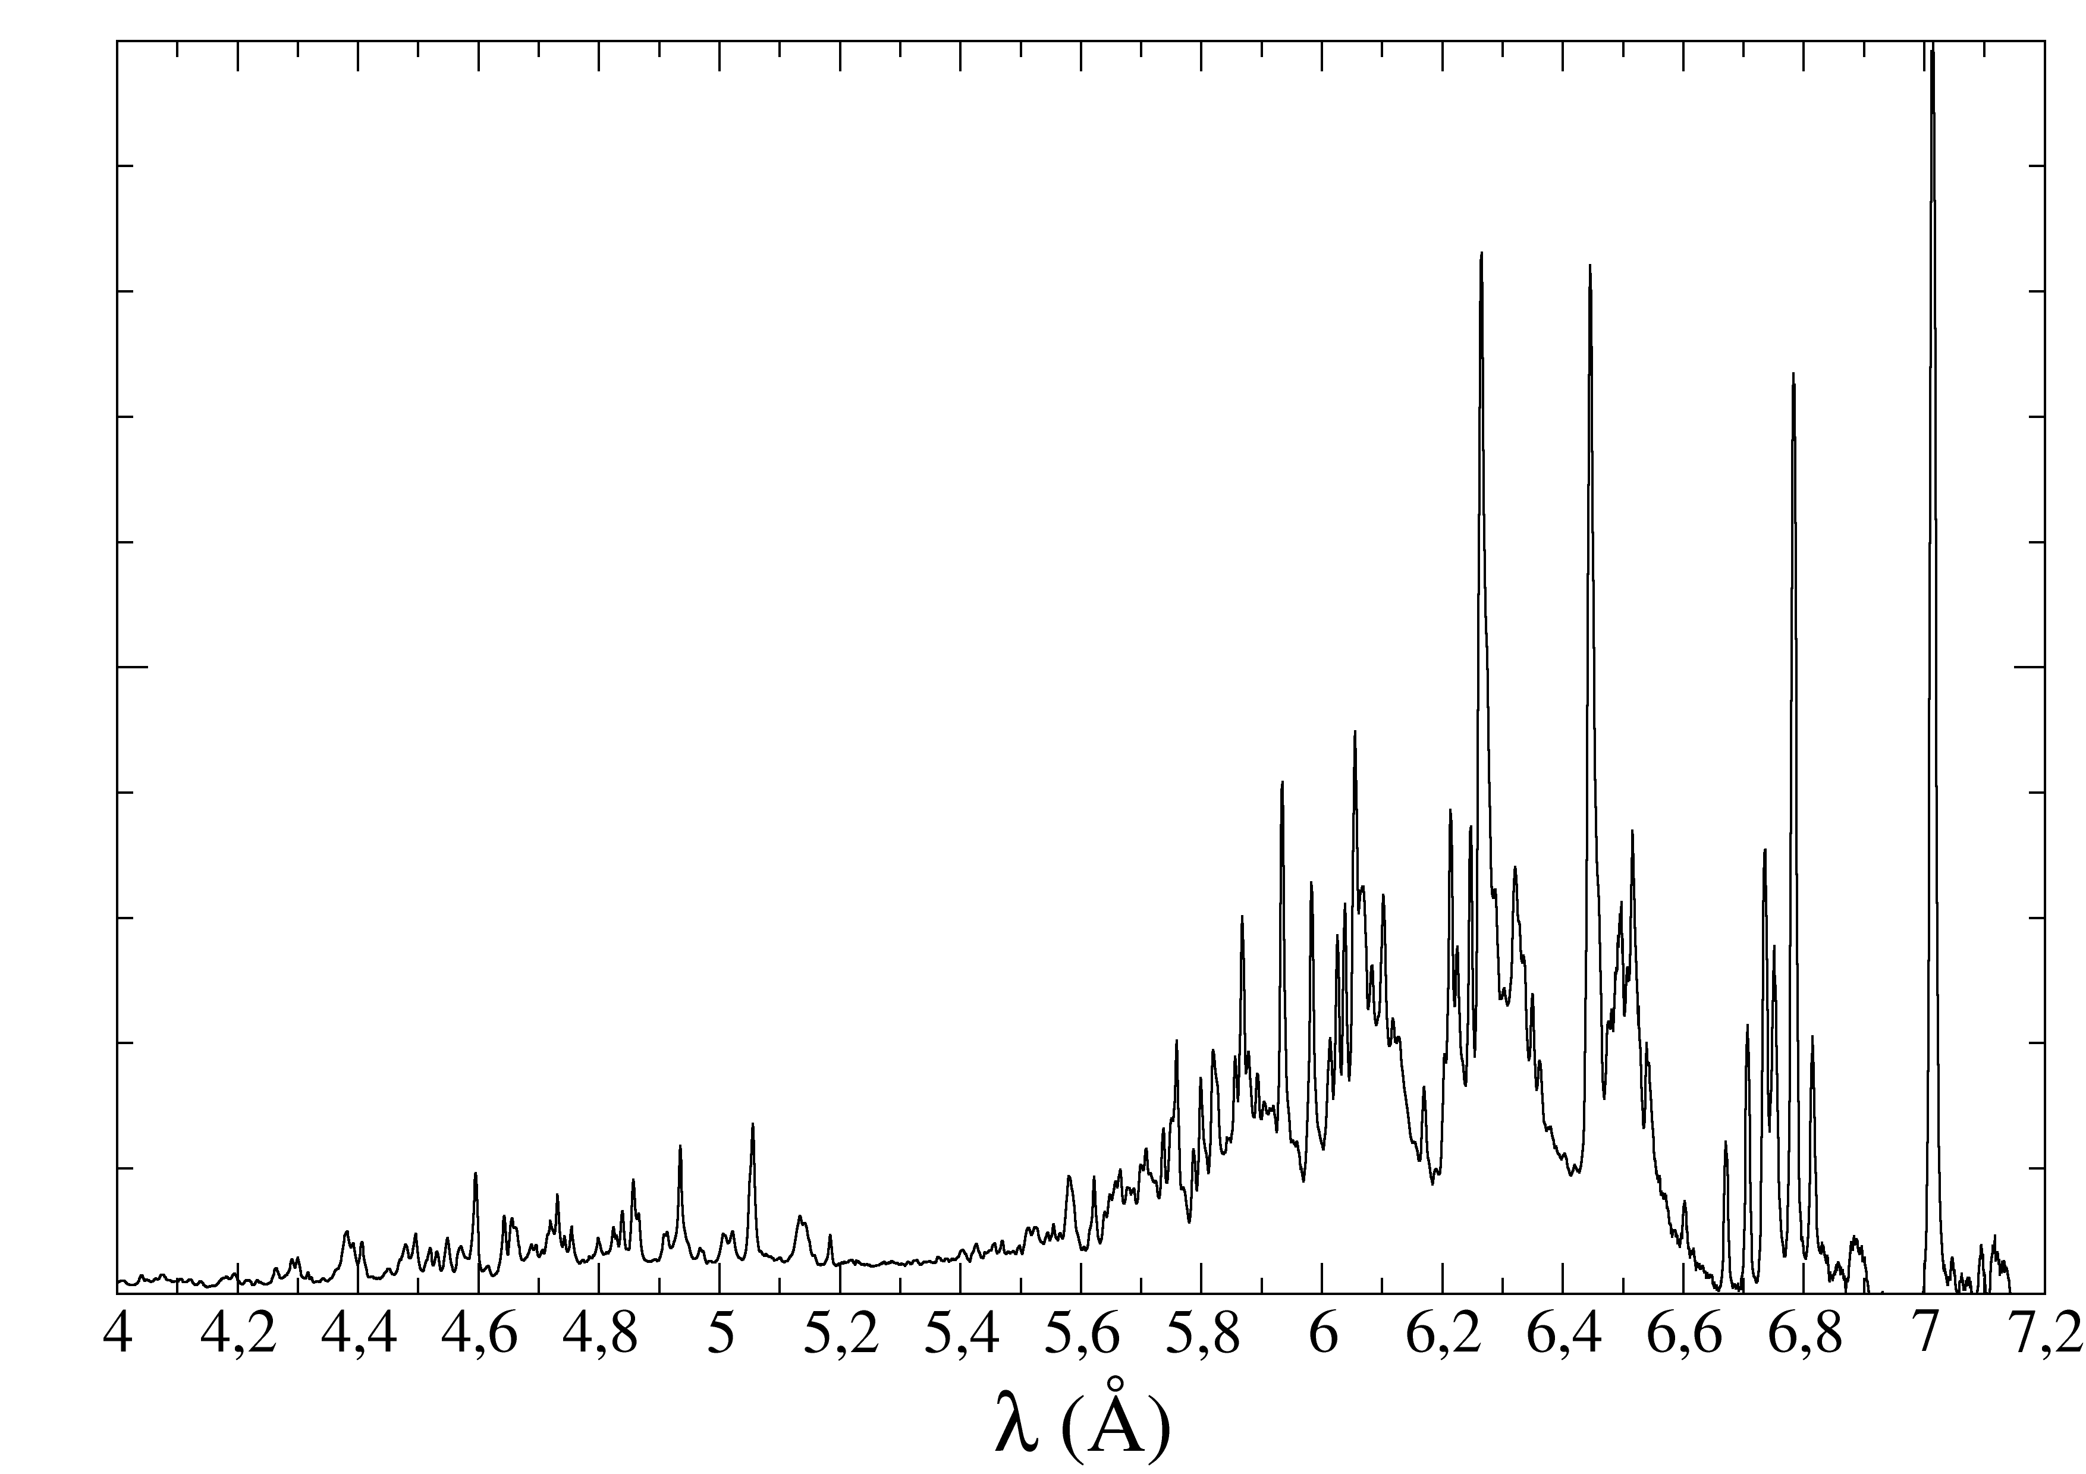
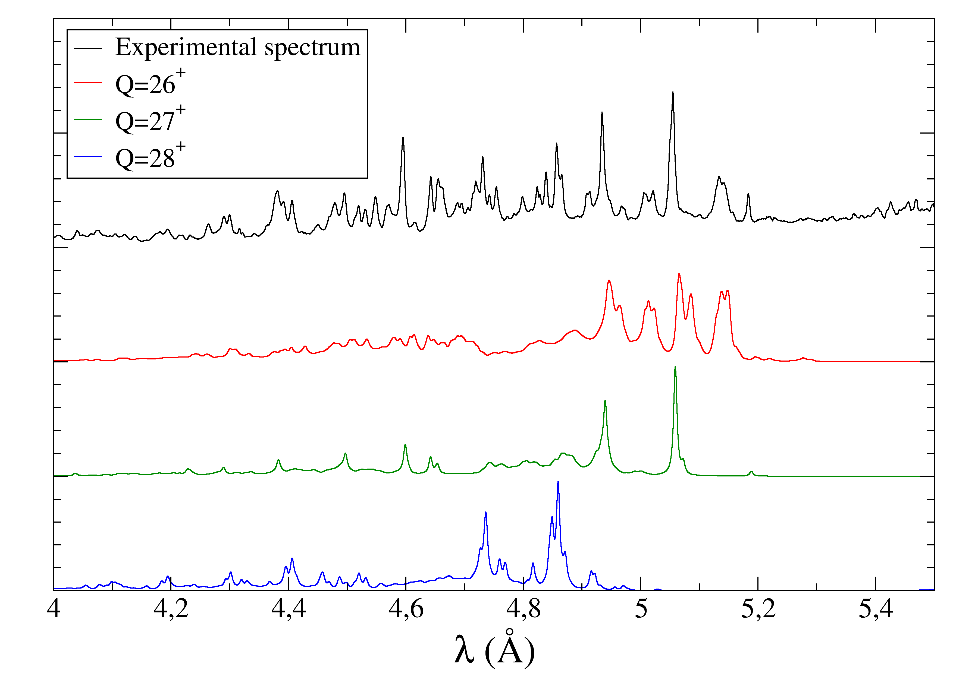
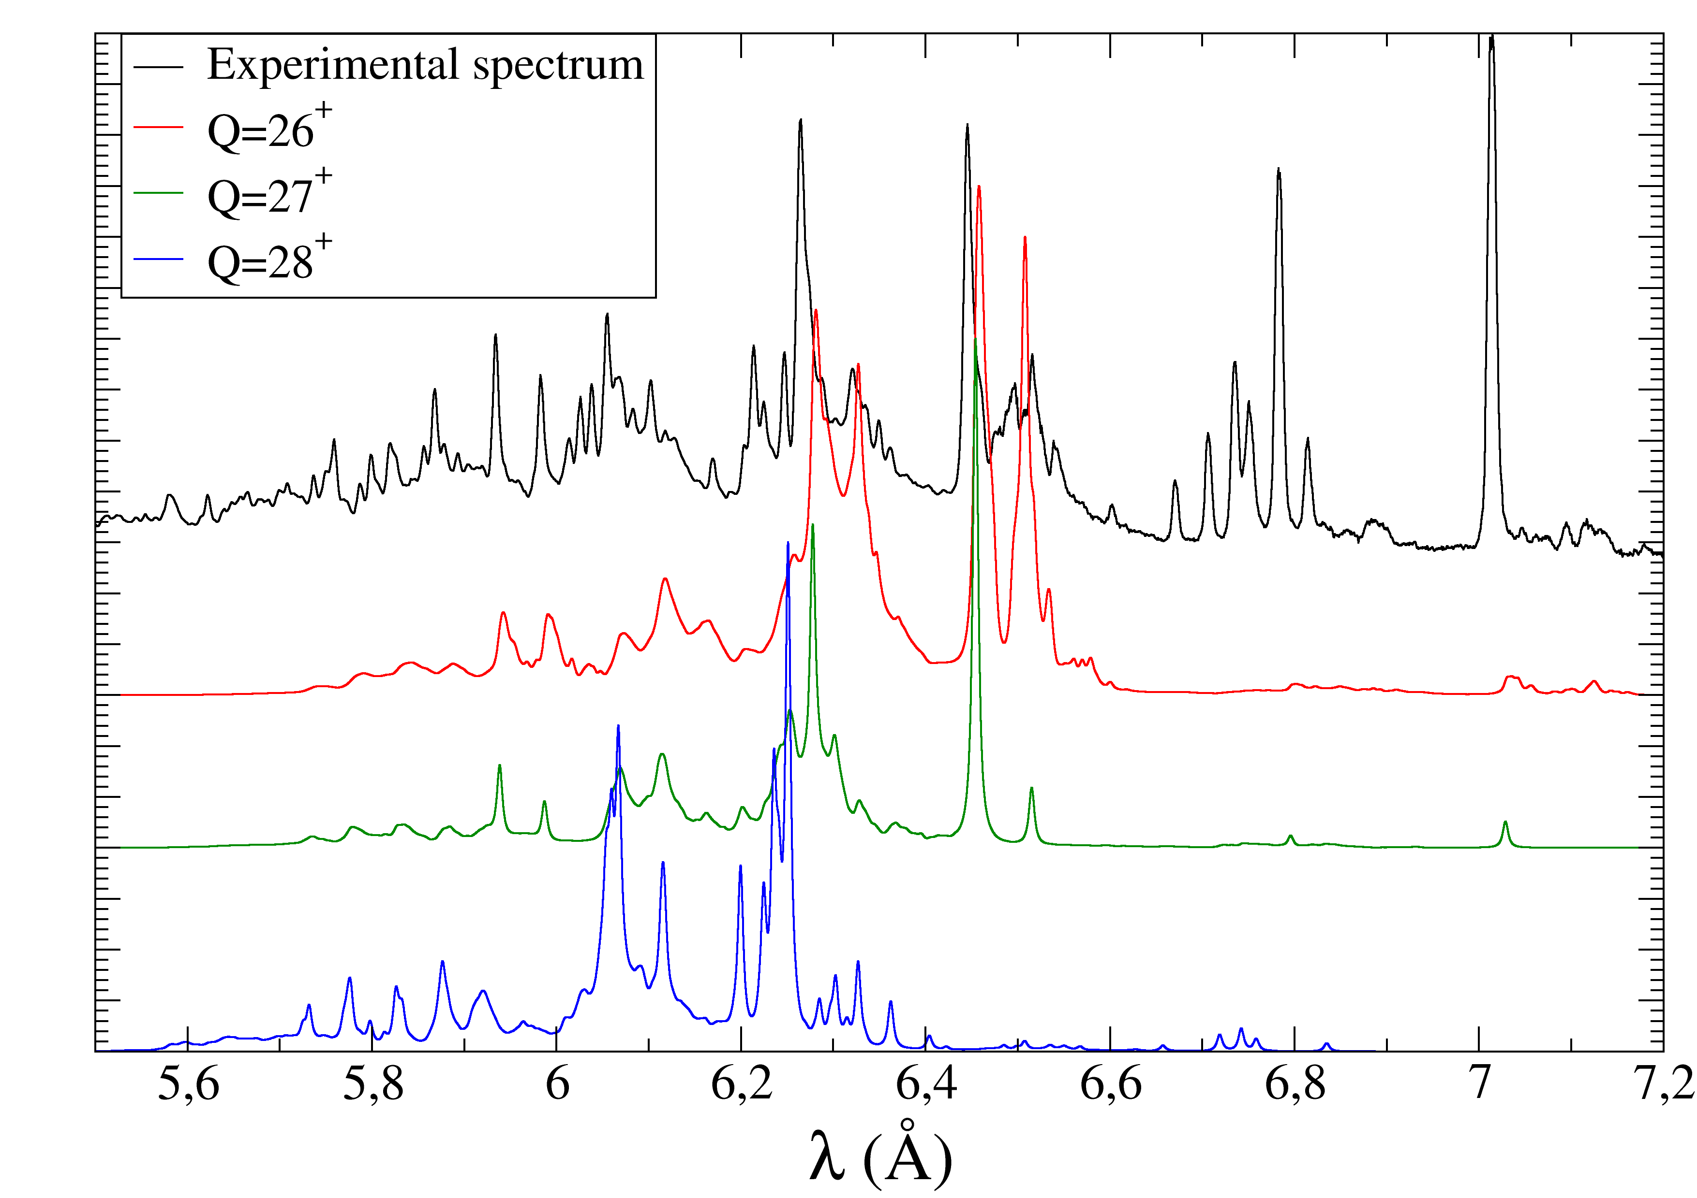
Comparison with theoretical spectra
  Detailed Multi Configuration Dirac-Fock (MCDF) calculations
  Most probable electronic configurations taken into account
  E1 transitions M,N,O,P→L, with K shell full
  Weighting with a partition function: LTE temperature of 400 eV
  Line broadening taking into account the experimental resolution
Main lines can be identified with Q=26⁺, 27⁺ and 28⁺
Q=27⁺ is dominant
Identification compatible with earlier published data [2,3,4]
Validation of our atomic code
[2] H. Godon et al., J. Phys. B. 12, 881 (1979)
[3] R. J. Hutcheon et al., Phys. Scr. 21, 89 (1980)
[4] S. Elliott et al., Phys. Rev. A. 47, 1403 (1993)

Slide 10
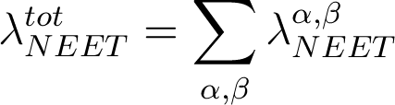
NEET rate beyond the Average Atom Model
Average Atom Model: simplest method to calculate the NEET excitation rate
  One atomic configuration with non-integer orbital populations
MCDF detailed atomic calculations
  More precise description: calculations for all the electronic configurations
The total NEET rate →sum over all the electron transitions:
For one transition from the initial atomic orbital α to the final atomic orbital β:
Widths of the
atomic states i,f
Sum over the
final states
Atom-nucleus
matrix element
Occupations of the orbitals α and β
Energy mismatch
Sum over the
charge state
distribution
Degeneracy of
the final orbital β
Weighted sum over
the initial states
Experimentally determined

Slide 11
Conclusion and perspectives
Nuclear transition energy precisely determined
Measurements at PHELIX
  First measurement of the ⁸⁵Rb X-ray spectrum on a large wavelength range (3.9-7.3 Å)
  X-ray spectra of Ge: solid and aerogel target →higher charge states with the aerogel target ?
  Test of multi-pulses shot: more X-rays but not higher charge states
MCDF atomic calculations at LTE to compare experimental and theoretical spectra
  Validation of the atomic code (E1) → M1 calculations launched to calculate the NEET rate with detailed atomic configurations
  Big lines in the spectrum: apparent charge state distribution centered on the 27⁺
  Remaining structures: non-LTE calculations planned (higher charge states ?)

Slide 12
Thank you for your attention !

Slide 13
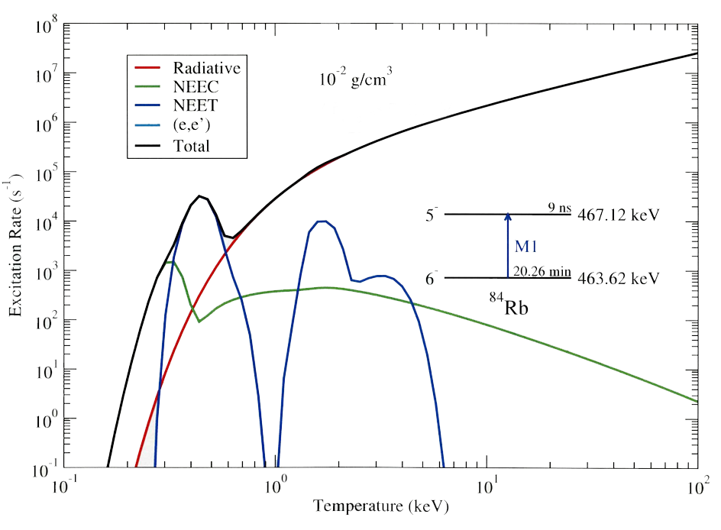
Plasma conditions suitable for the NEET
To calculate nuclear excitation rate by NEET and NEEC: need a description of the atom
  Relativistic Average Atom Model under the Local Thermodynamic Equilibrium Hypothesis (LTE)
    Atoms of the plasma are described by one average atom
    Plasma temperature and density taken into account
NEET requires particular plasma properties to be dominant
NEET is dominant for plasma temperatures between 300 and 600 eV (LTE)
⇒ Resonance between nuclear and atomic transitions for charge state 30⁺→34⁺
G. Gosselin et al. Private Communication

Slide 14
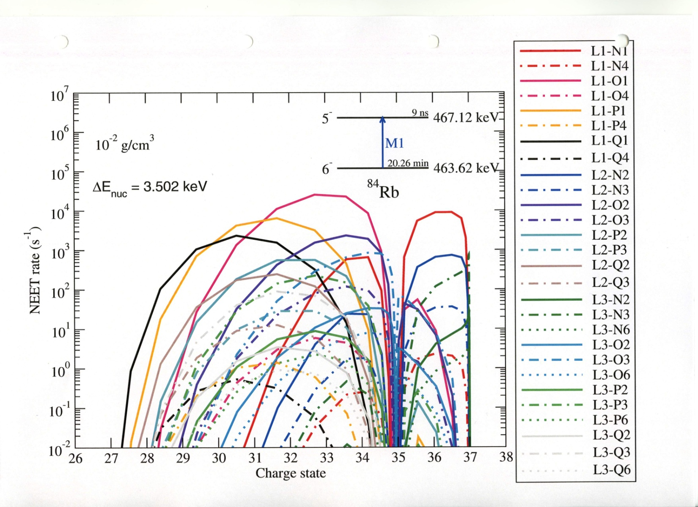
NEET rate (1)

Slide 15
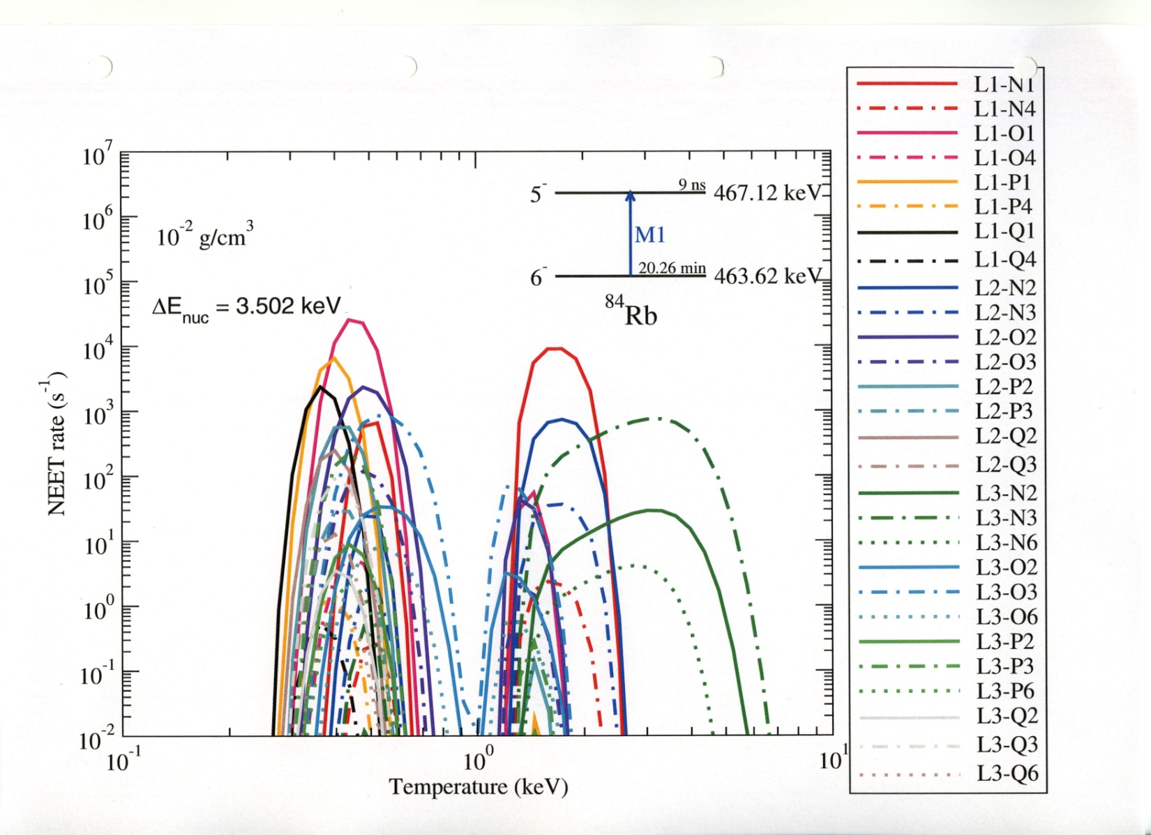
NEET rate (2)

Slide 16
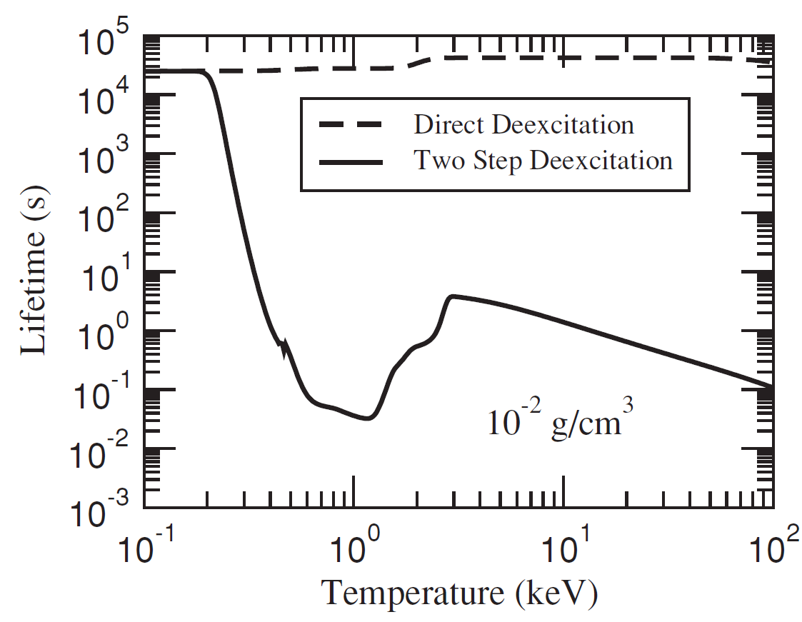
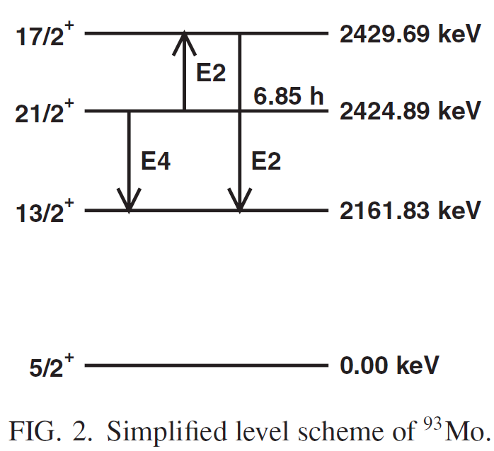
Lifetime modification

Slide 17
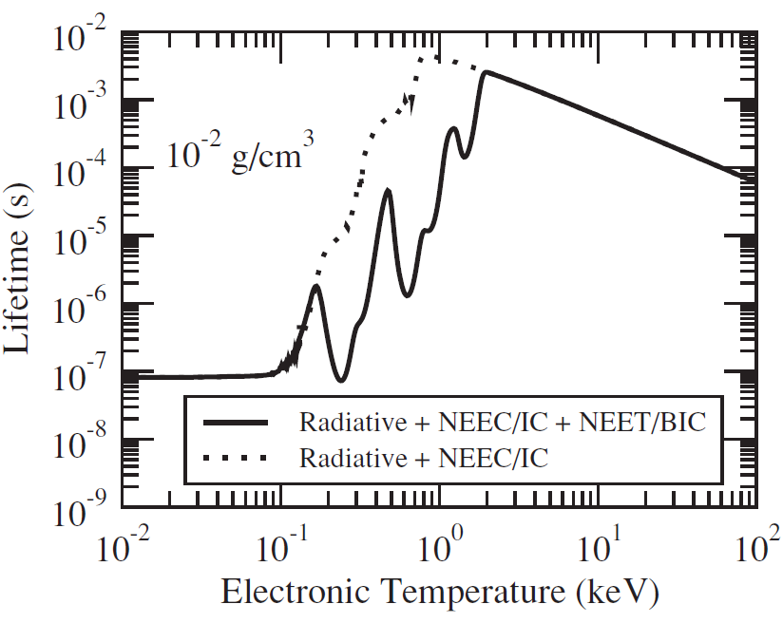
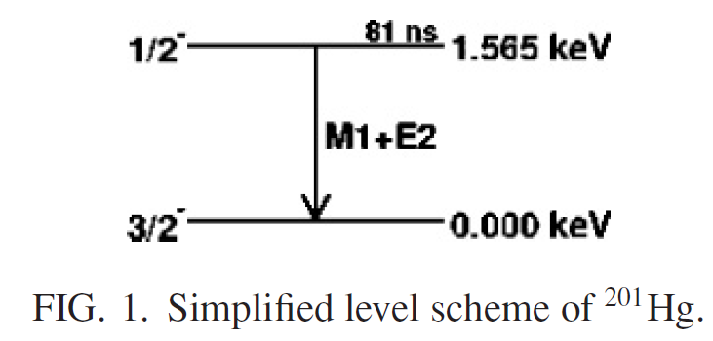
Lifetime modification

Slide 18
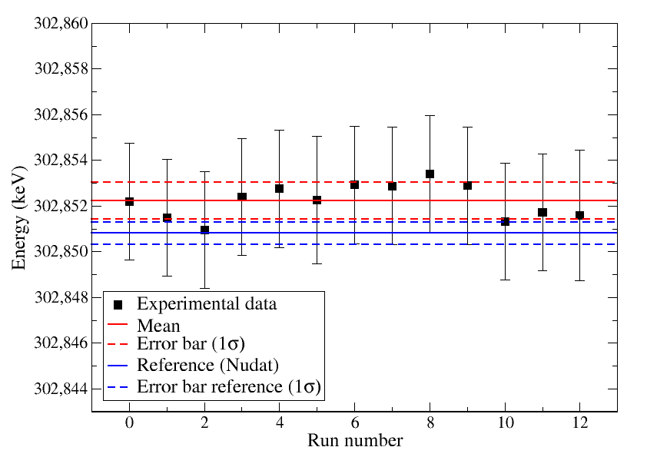
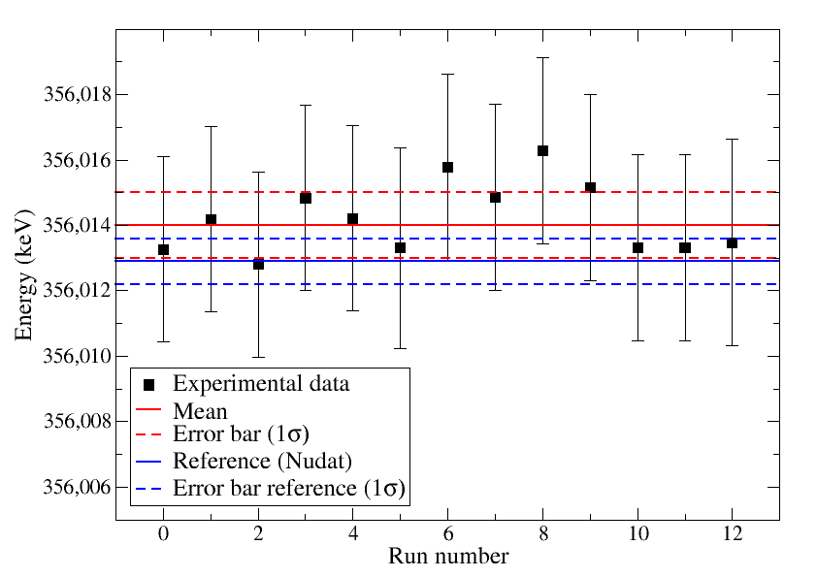
Nuclear transition energy measurement (1)

Slide 19
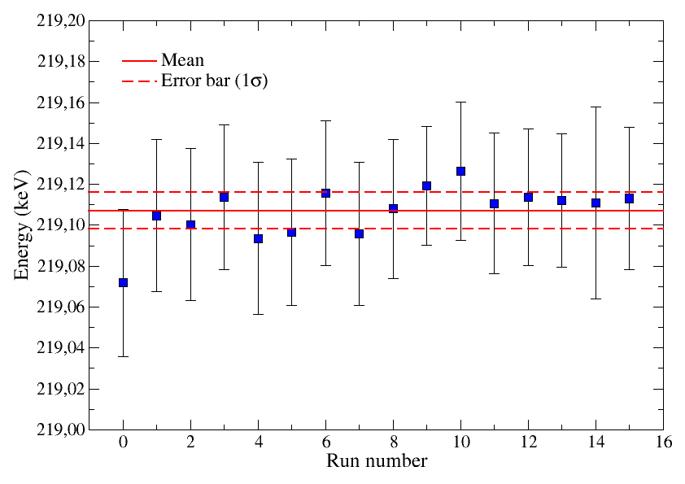
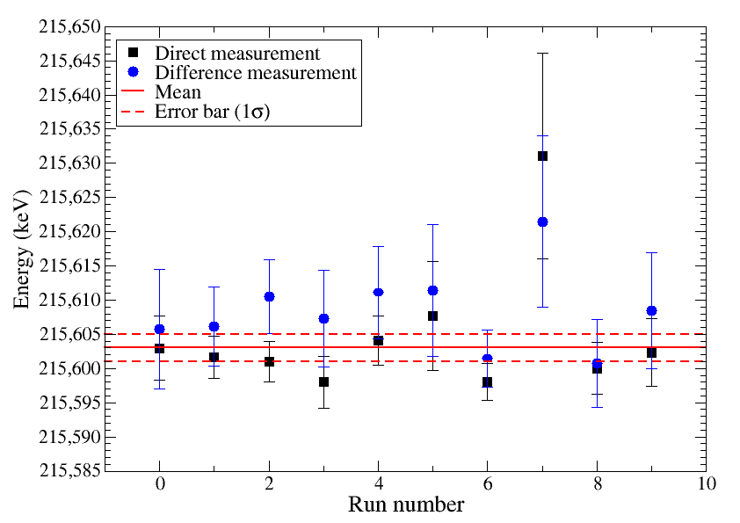
Nuclear transition energy measurement (2)
Experimental spectrum
Fit

Slide 20
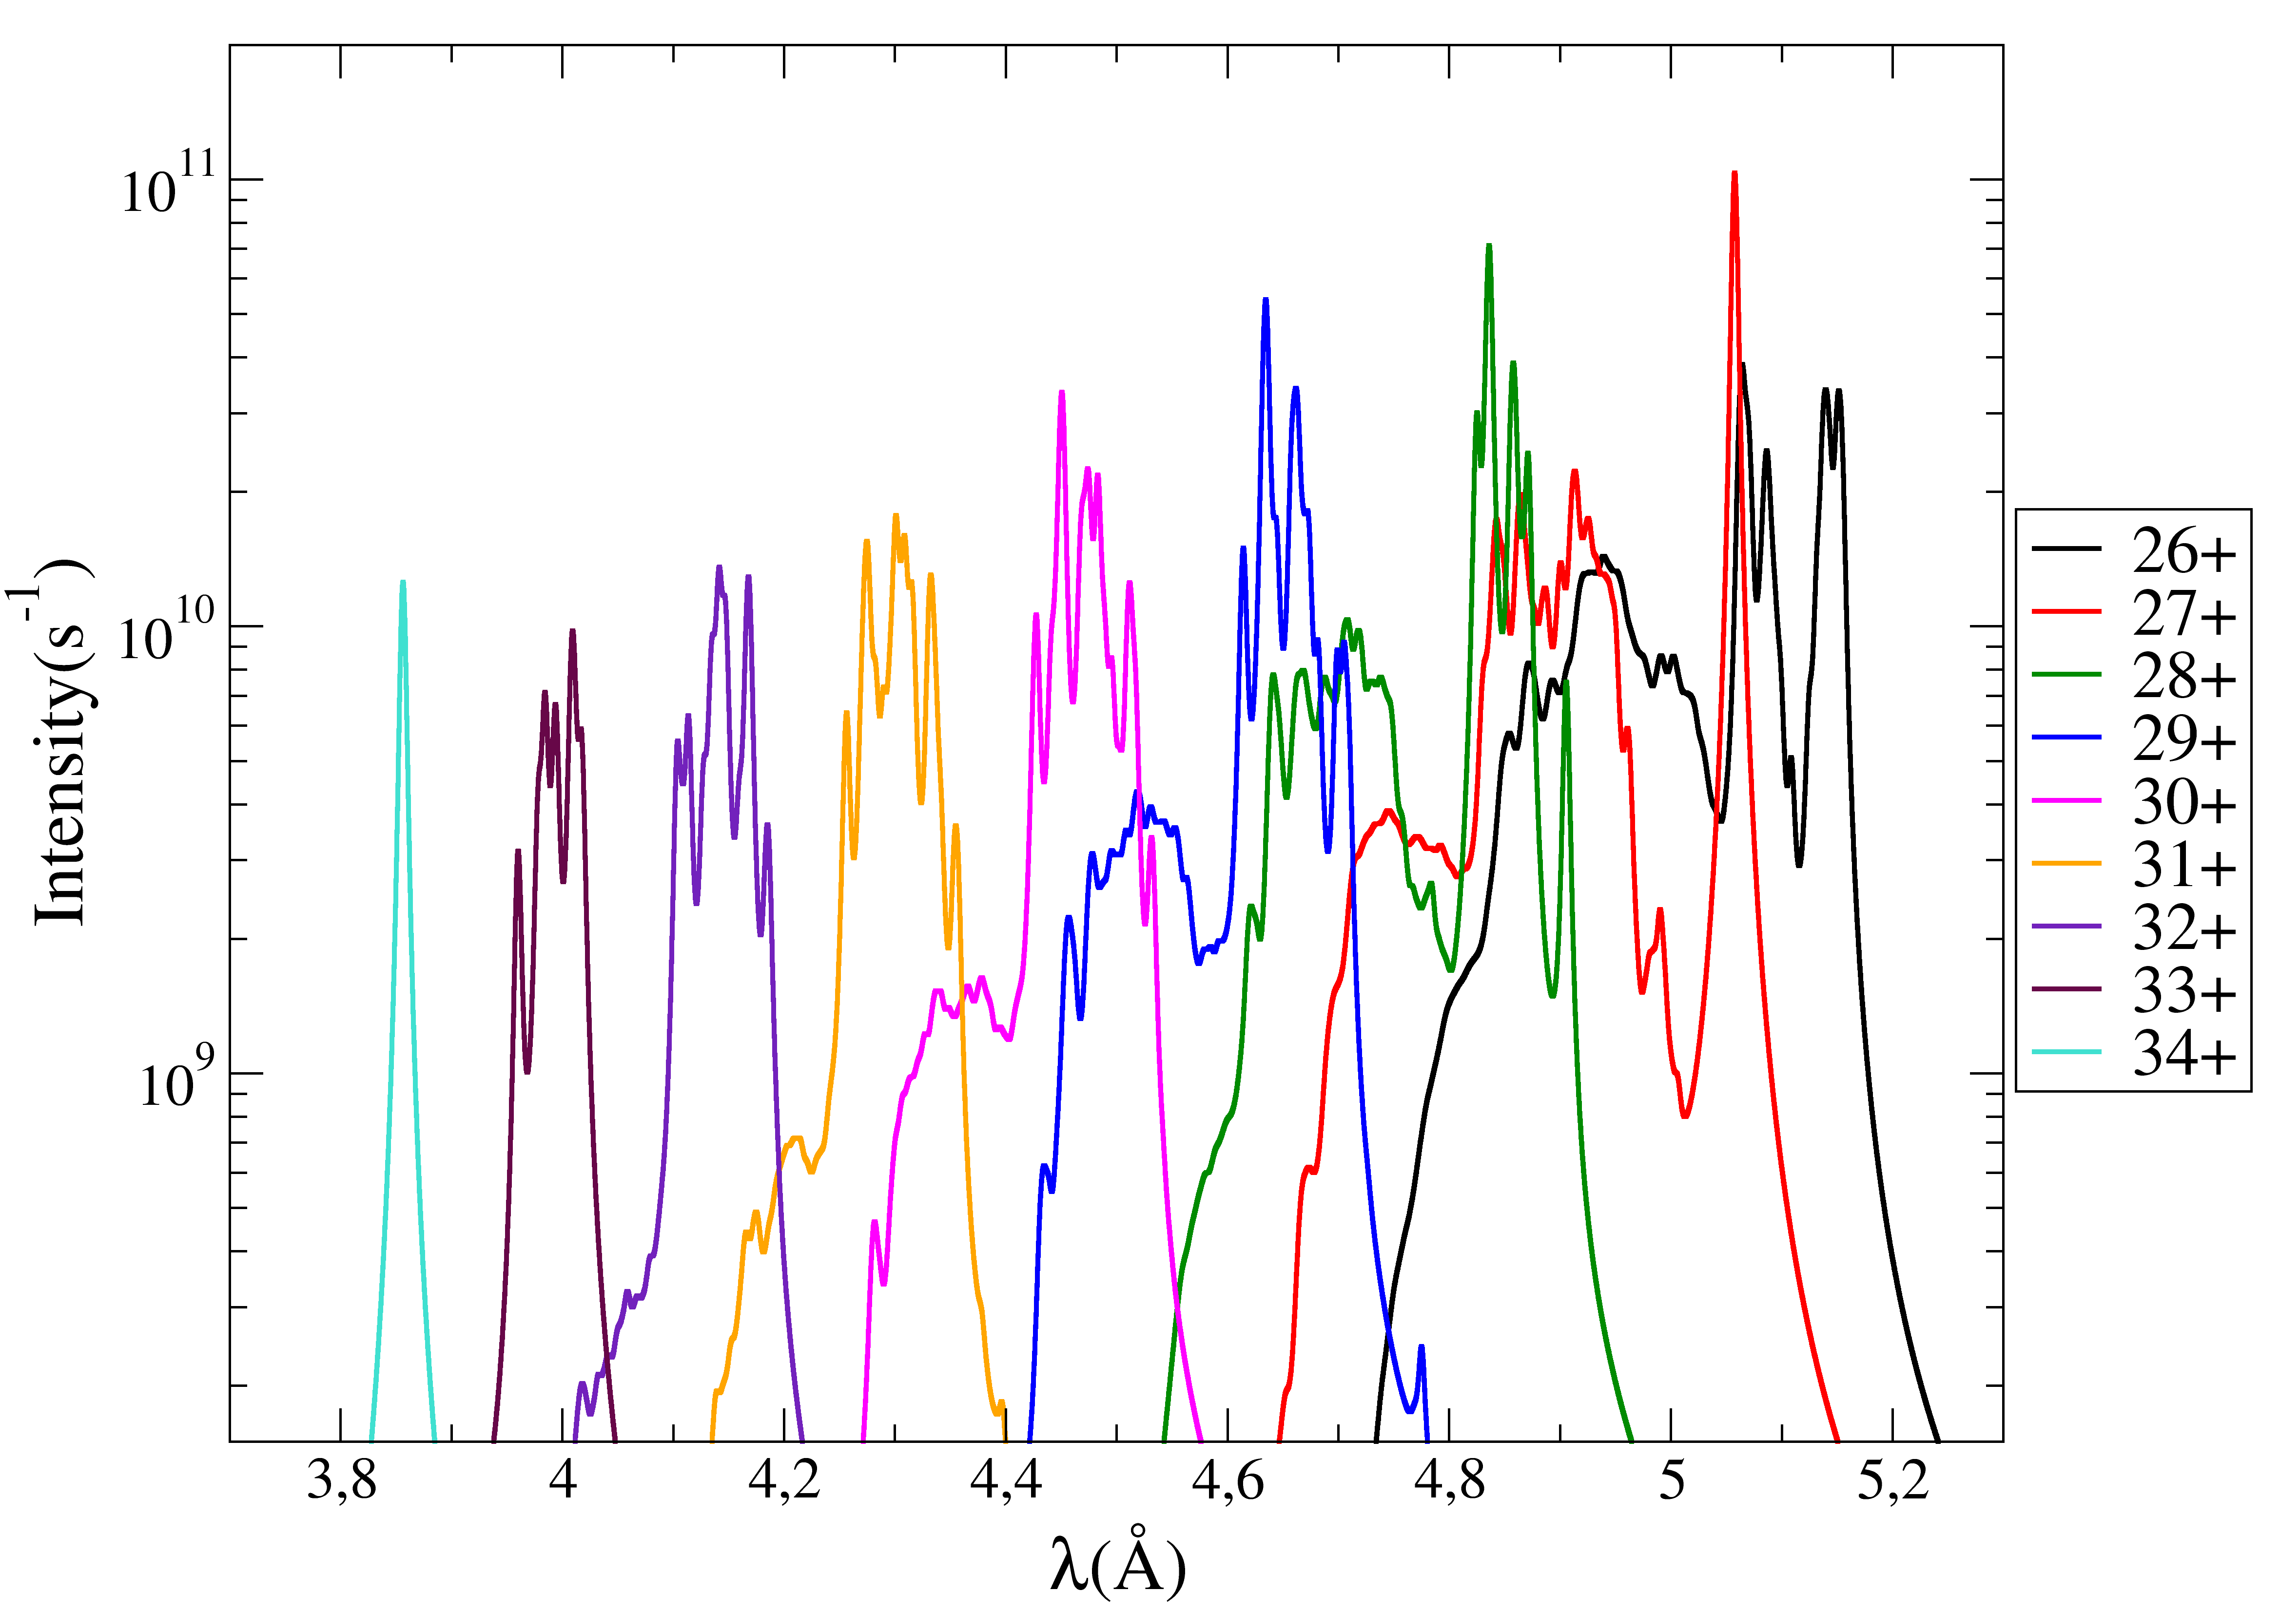
Effect of charge states
Transition N1-L2

Slide 21
MCDF calculations for a transition
Configuration probabilities
MCDF calculations
Energies E_{i}
Intensities I_{i}
99% of the total probability
for the considered transition
Peaks heights
H_{i}∝P_{i}I_{i}
Height max : H_{max}
Intensity max : I_{max}
Other configurations(1%)
If α.P_{i}I_{max}>H_{max}
α : parameter
MCDF calculations
YES
NO
STOP

Slide 22
Probabilities calculations
First step: Bernoulli probability for a configuration i
Using MCDF results: probability for the state i to exist:
A : normalisation factor
n_{j} : electron number in the orbital j
d_{j} : Degeneracy of the orbital j
p_{j} : occupation probability of the orbital j
J_{i} : angular momentum
E_{i} : eigenstate energy
T : temperature
Z : partition function
Partition function at the temperature T:

Slide 23




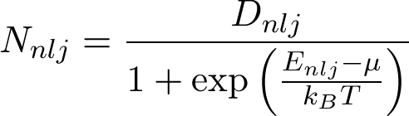
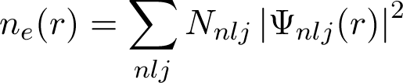
Relativistic Average Atom Model
Potential
(Thomas-Fermi model)
Dirac equation solving
→ Wave functions and binding energies
Poisson equation
→ potential
Fermi-Dirac statistic
→atomic populations
Electronic density

Slide 24
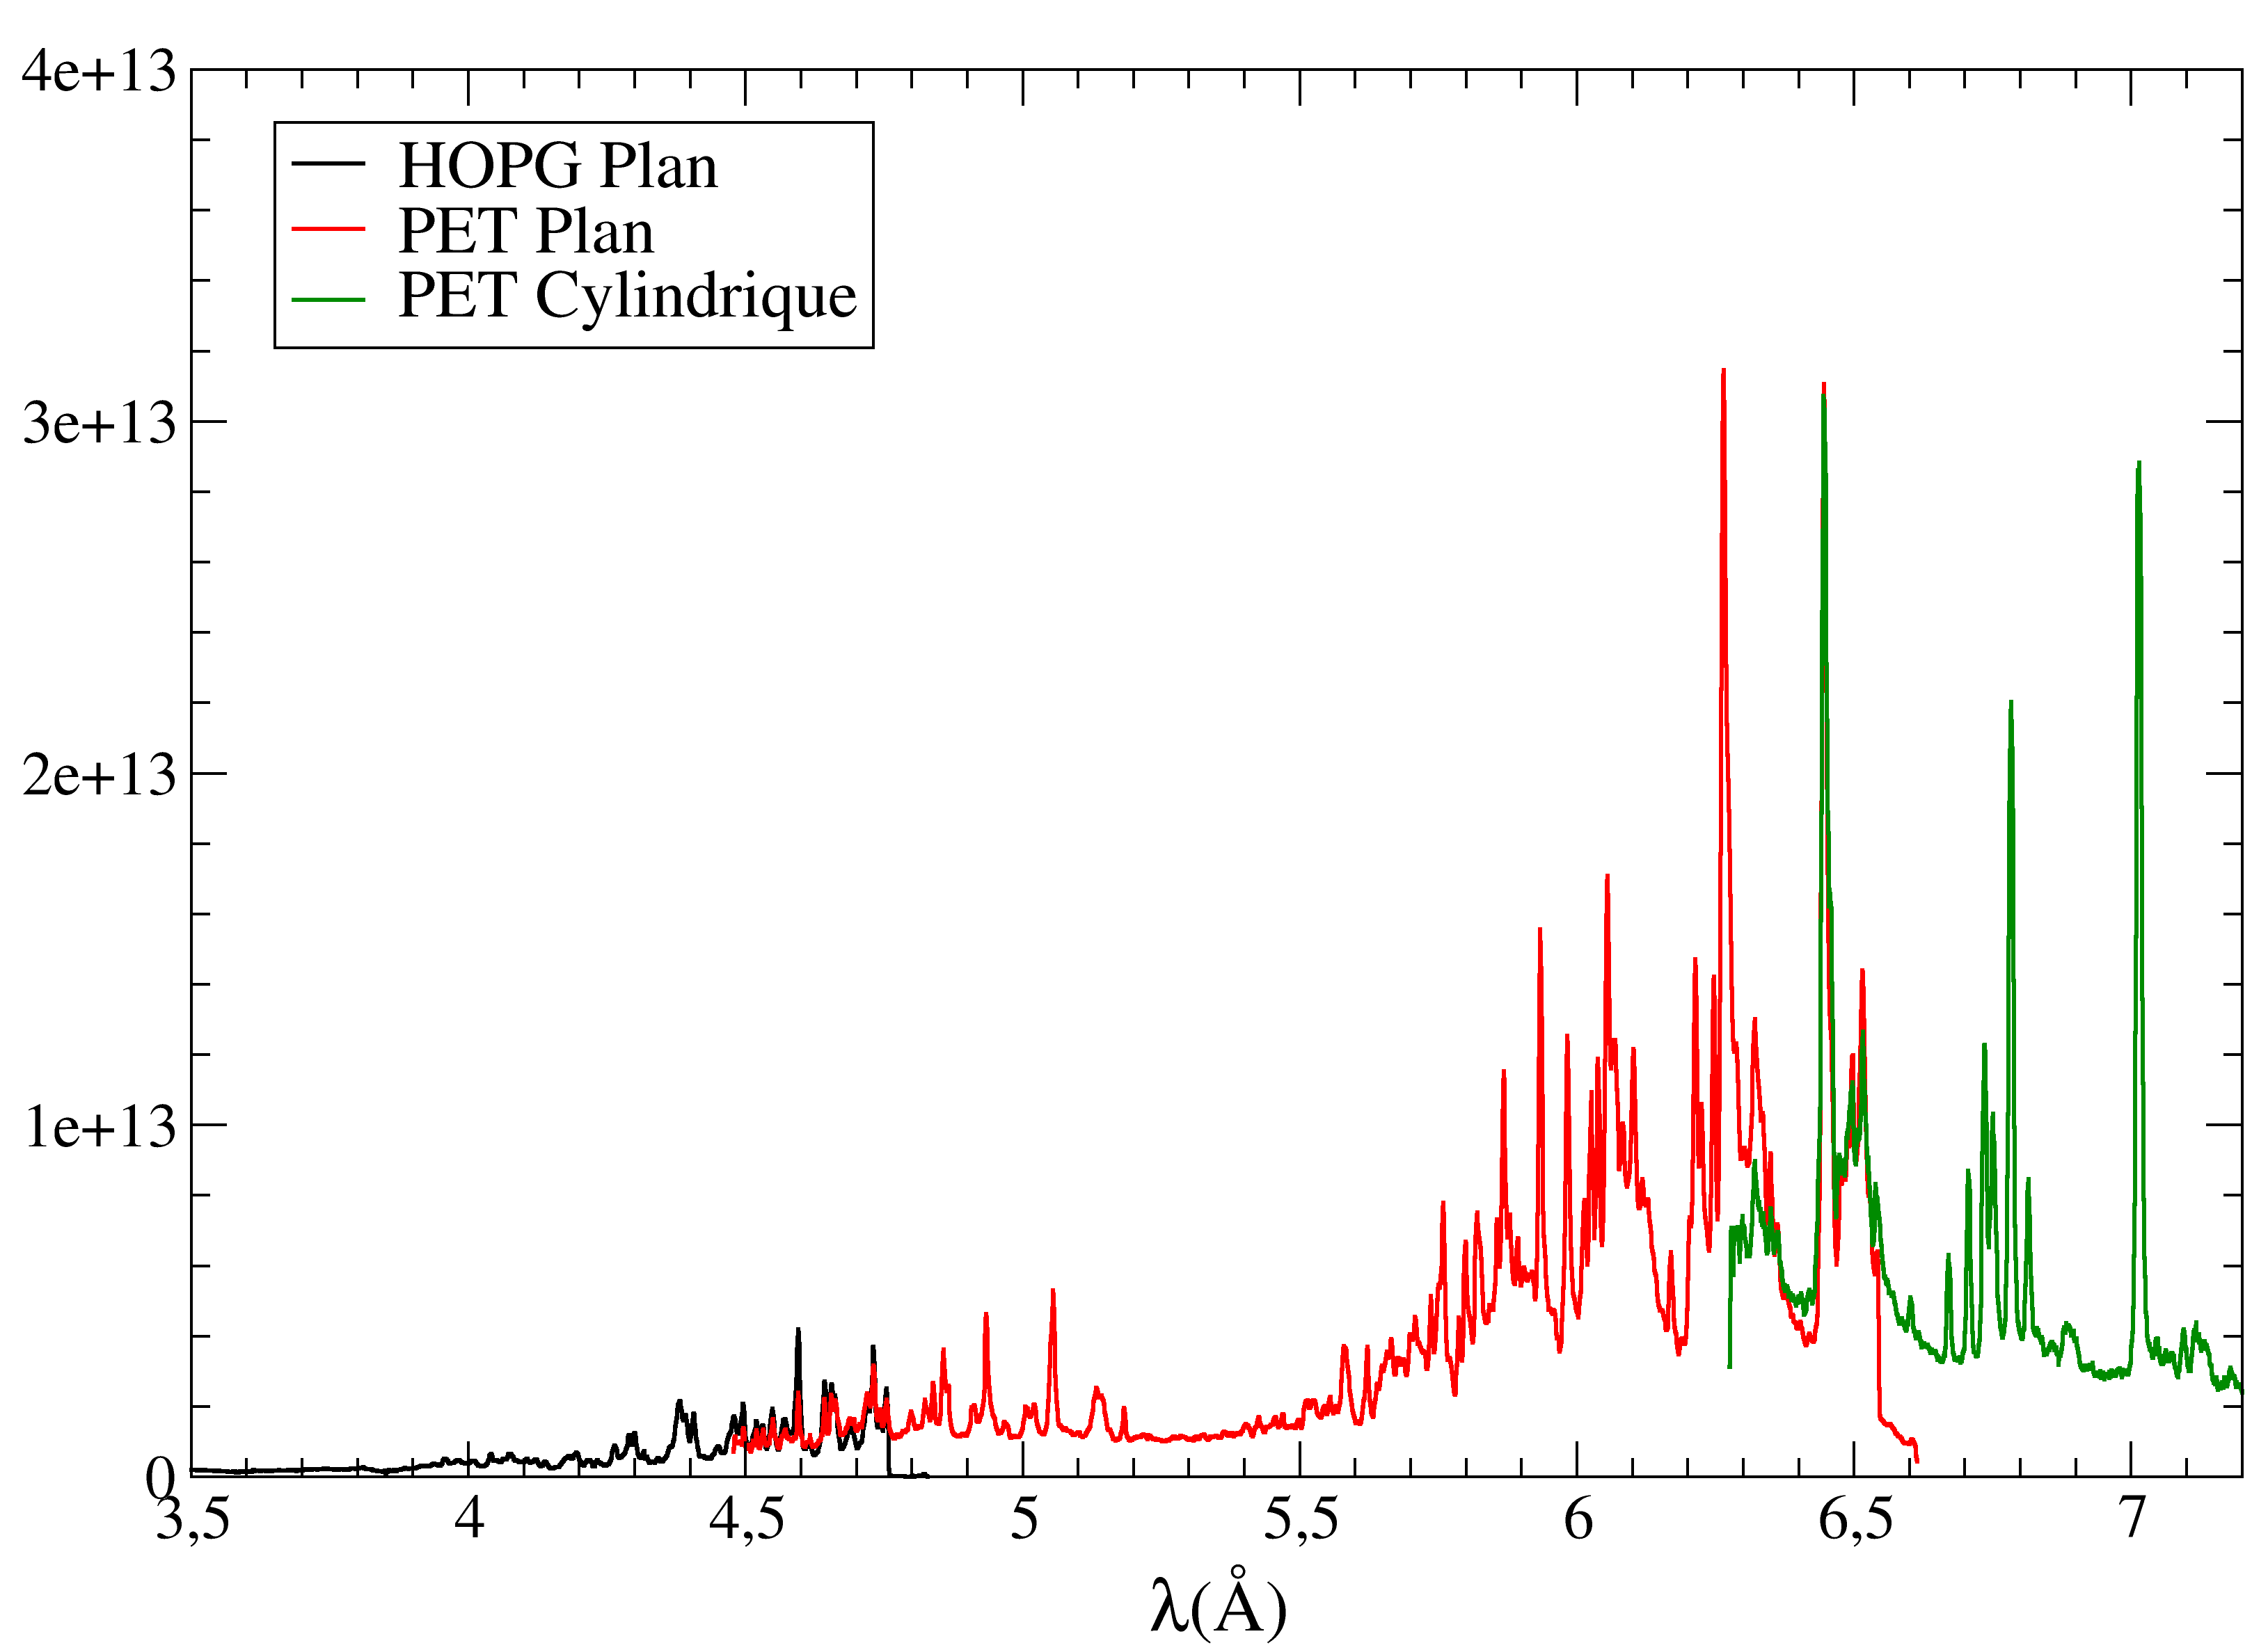
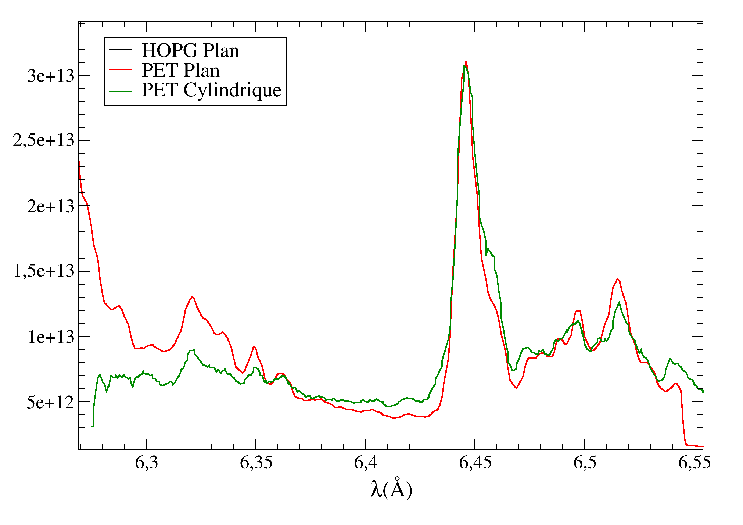
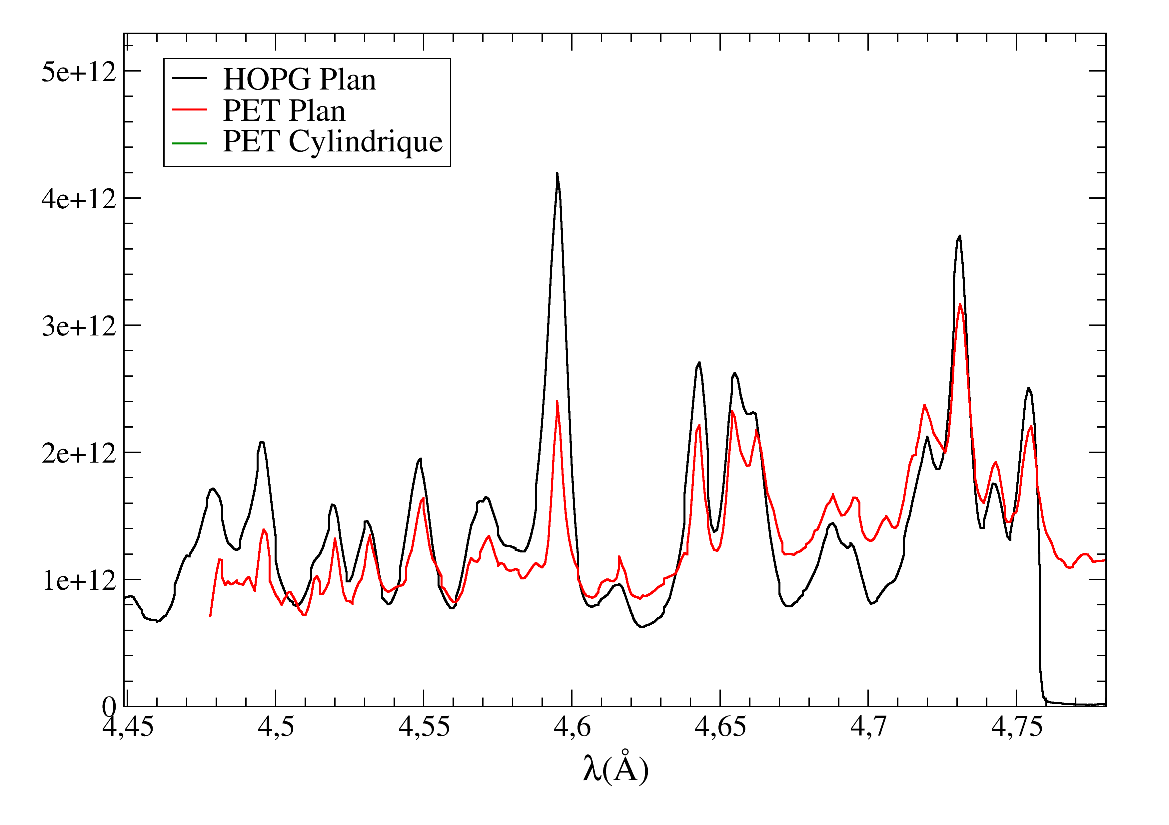
Total spectrum
Filter transmission correction, wavelength and intensity adjustement

Slide 25
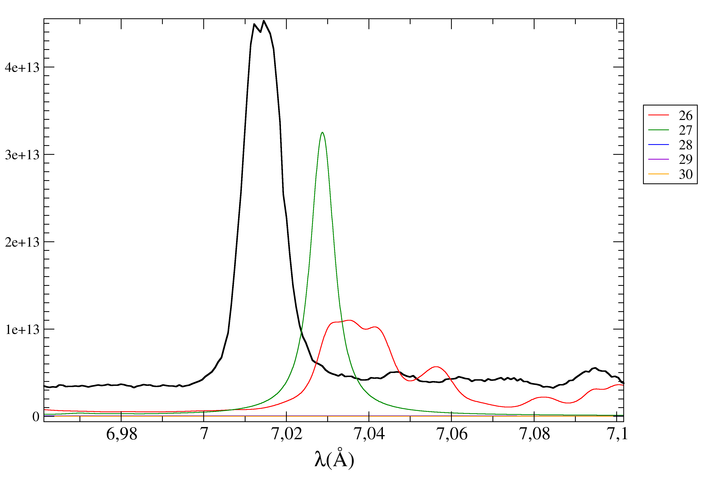
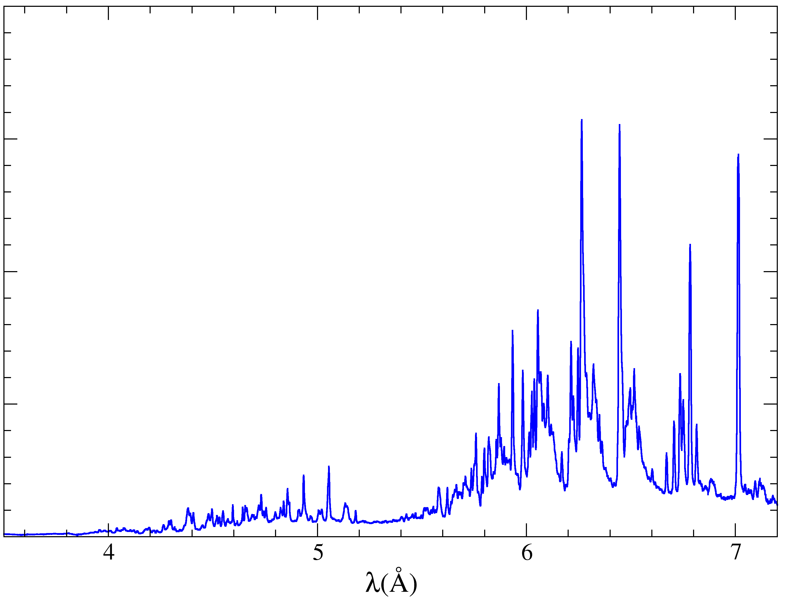
PHELIX-MCDF comparison
27+ M1→L3
Cylindrical
PET

Slide 26
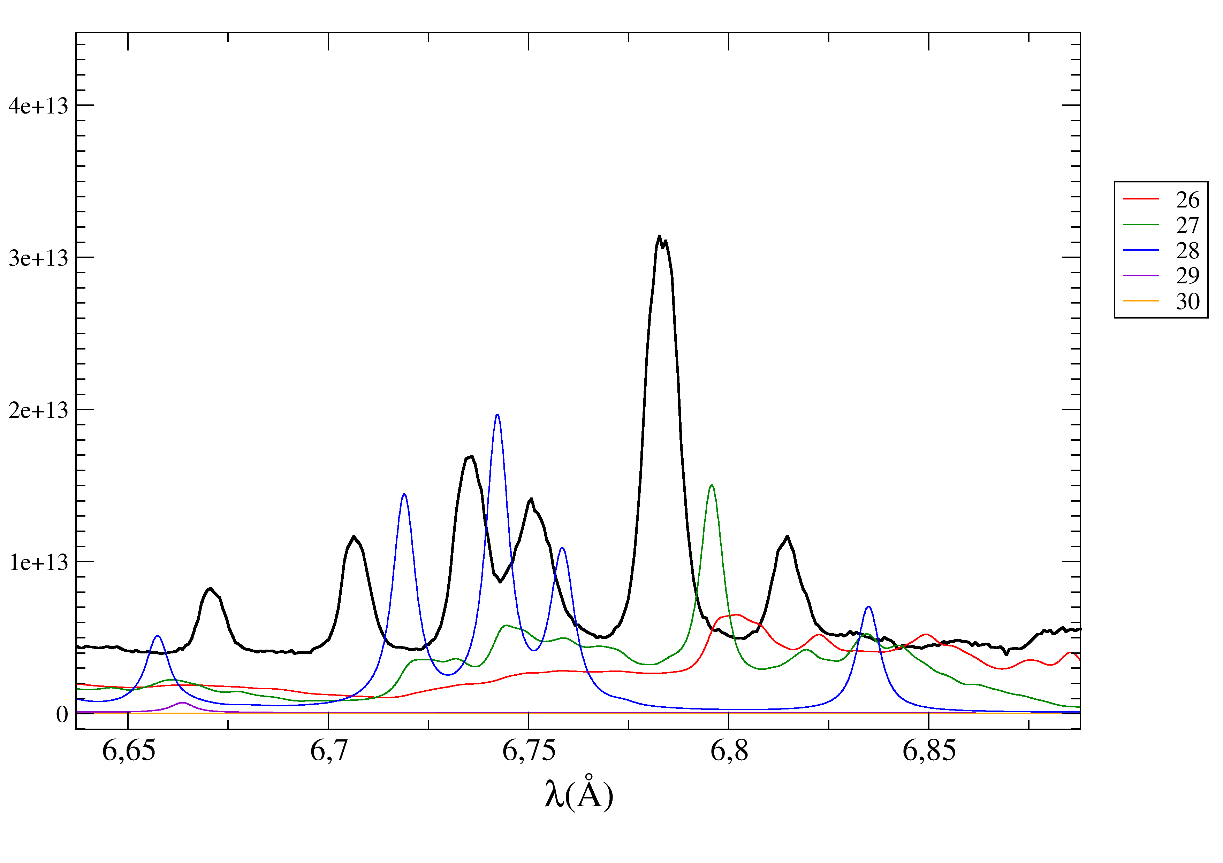
PHELIX-MCDF comparison
Cylindrical
PET
28+ M1→L3
27+ M1→L2
28+ M1→L3
29+ M1→L3
28+ M1→L3

Slide 27
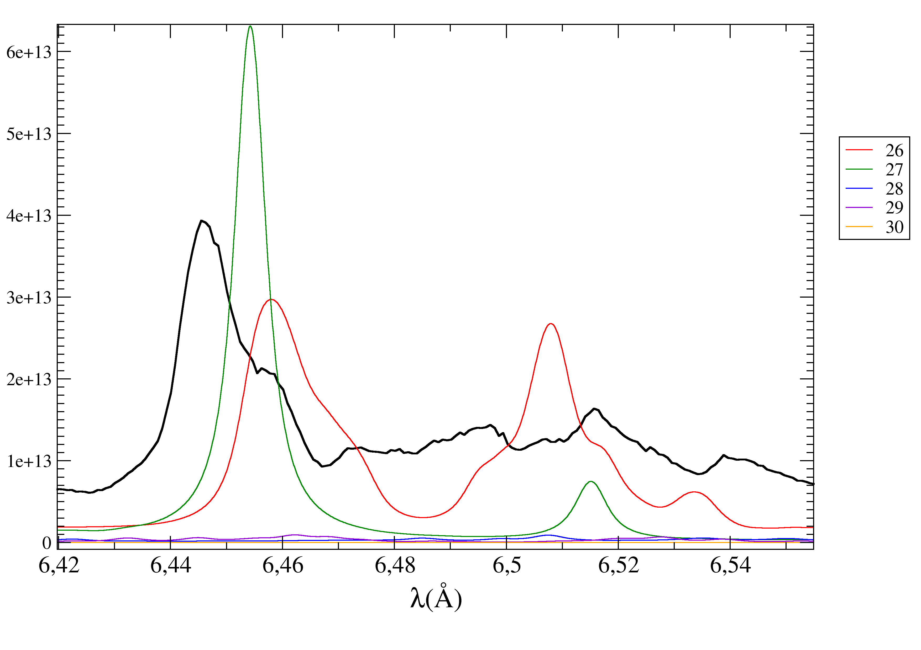
PHELIX-MCDF comparison
26+ M5→L3
27+ M5→L3
Flat
PET
Cylindrical
PET
26+ M5→L3
27+ M4→L3

Slide 28
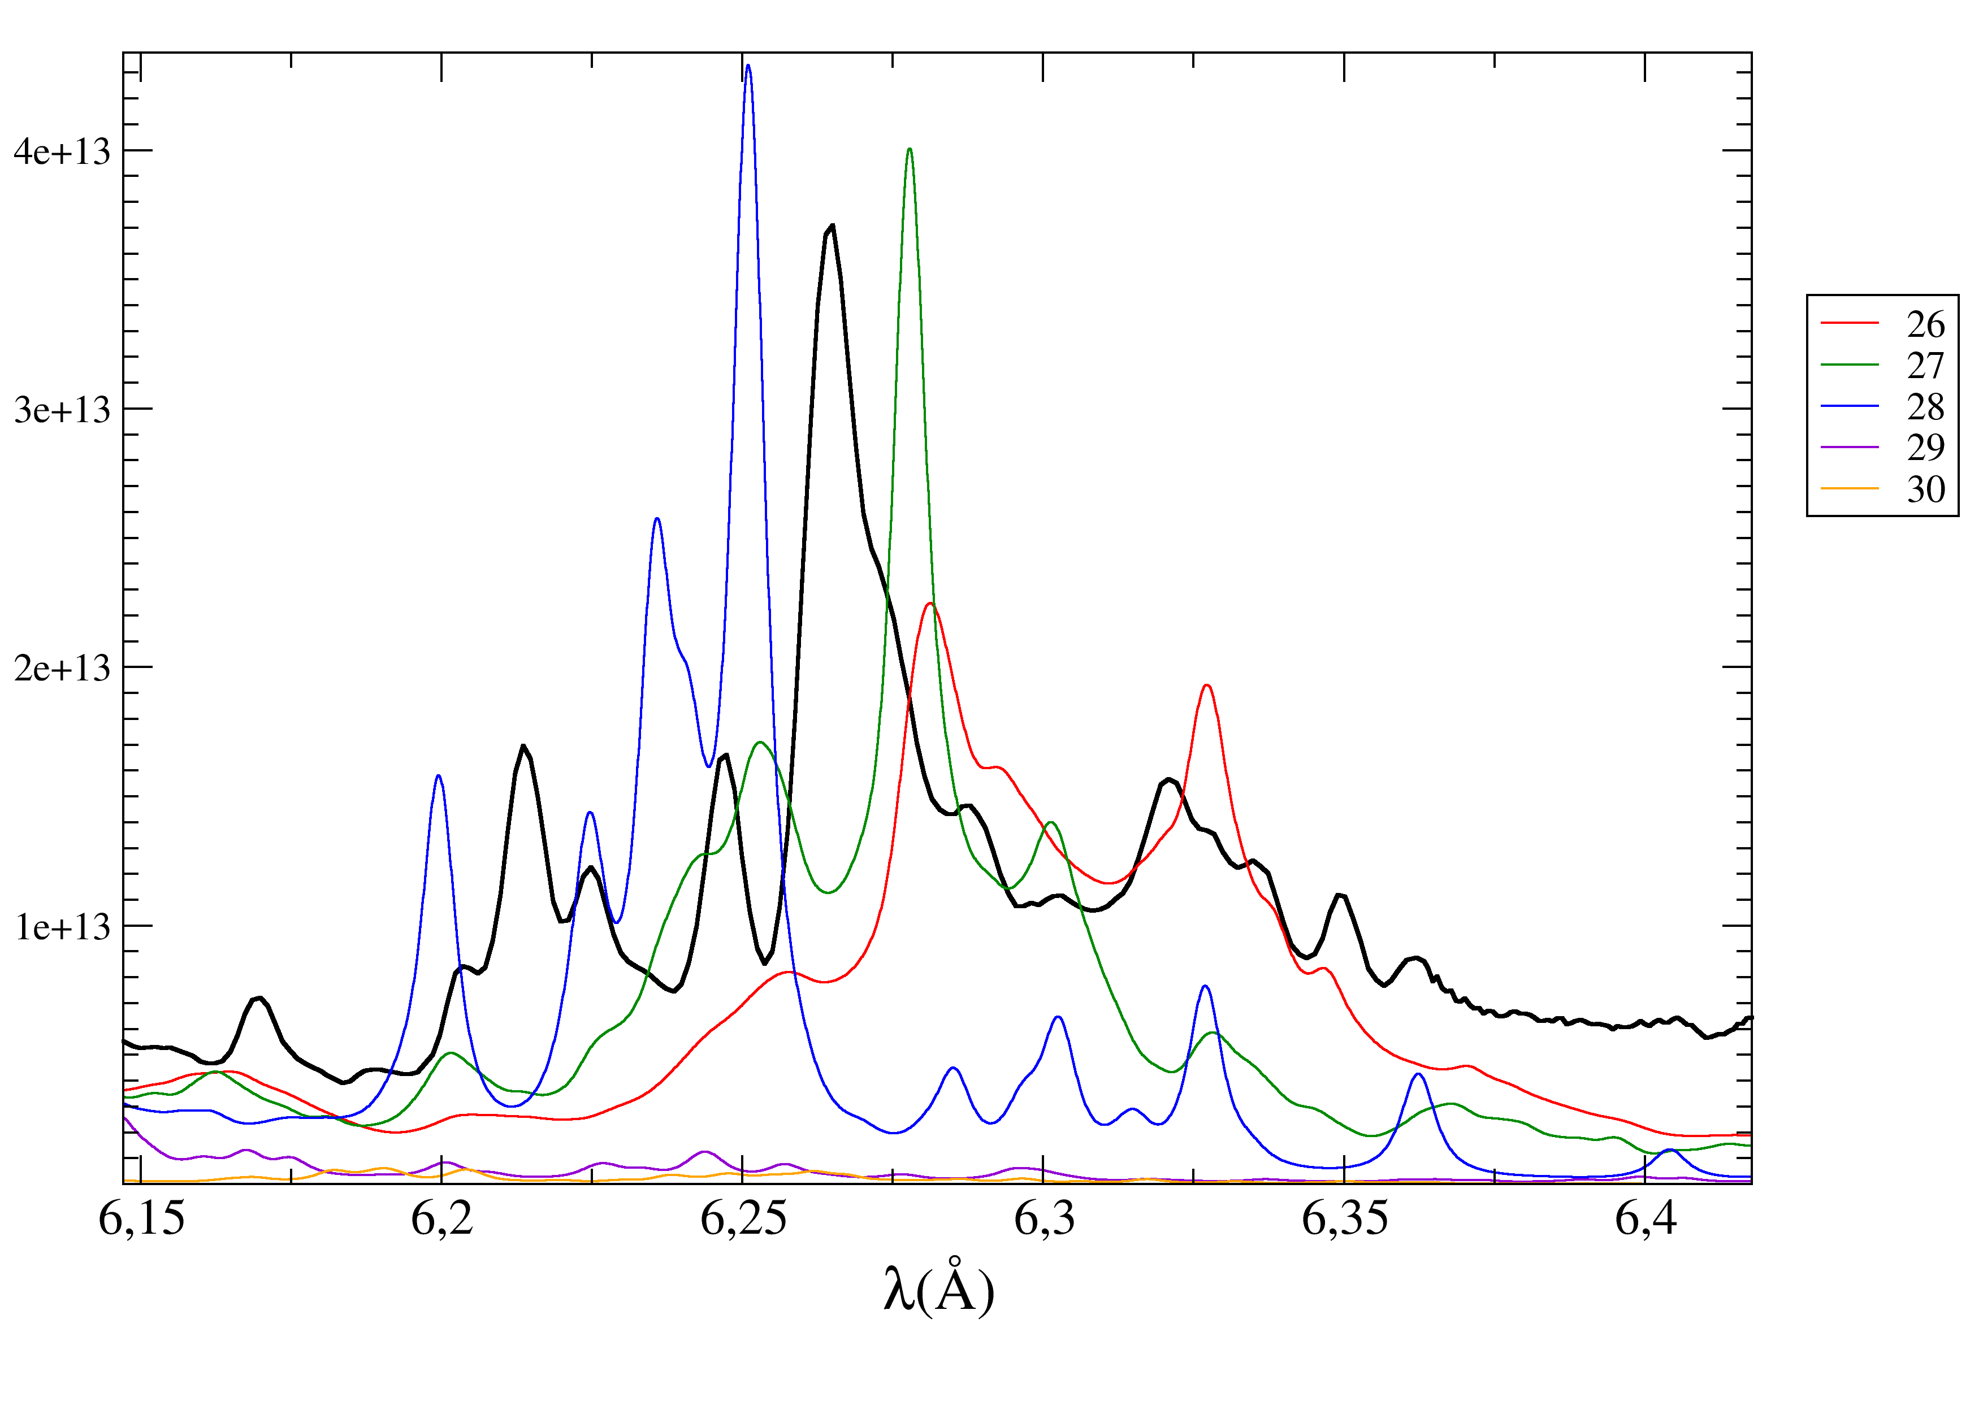
PHELIX-MCDF comparison
26+ M4→L2
27+ M4→L2
Flat
PET

Slide 29
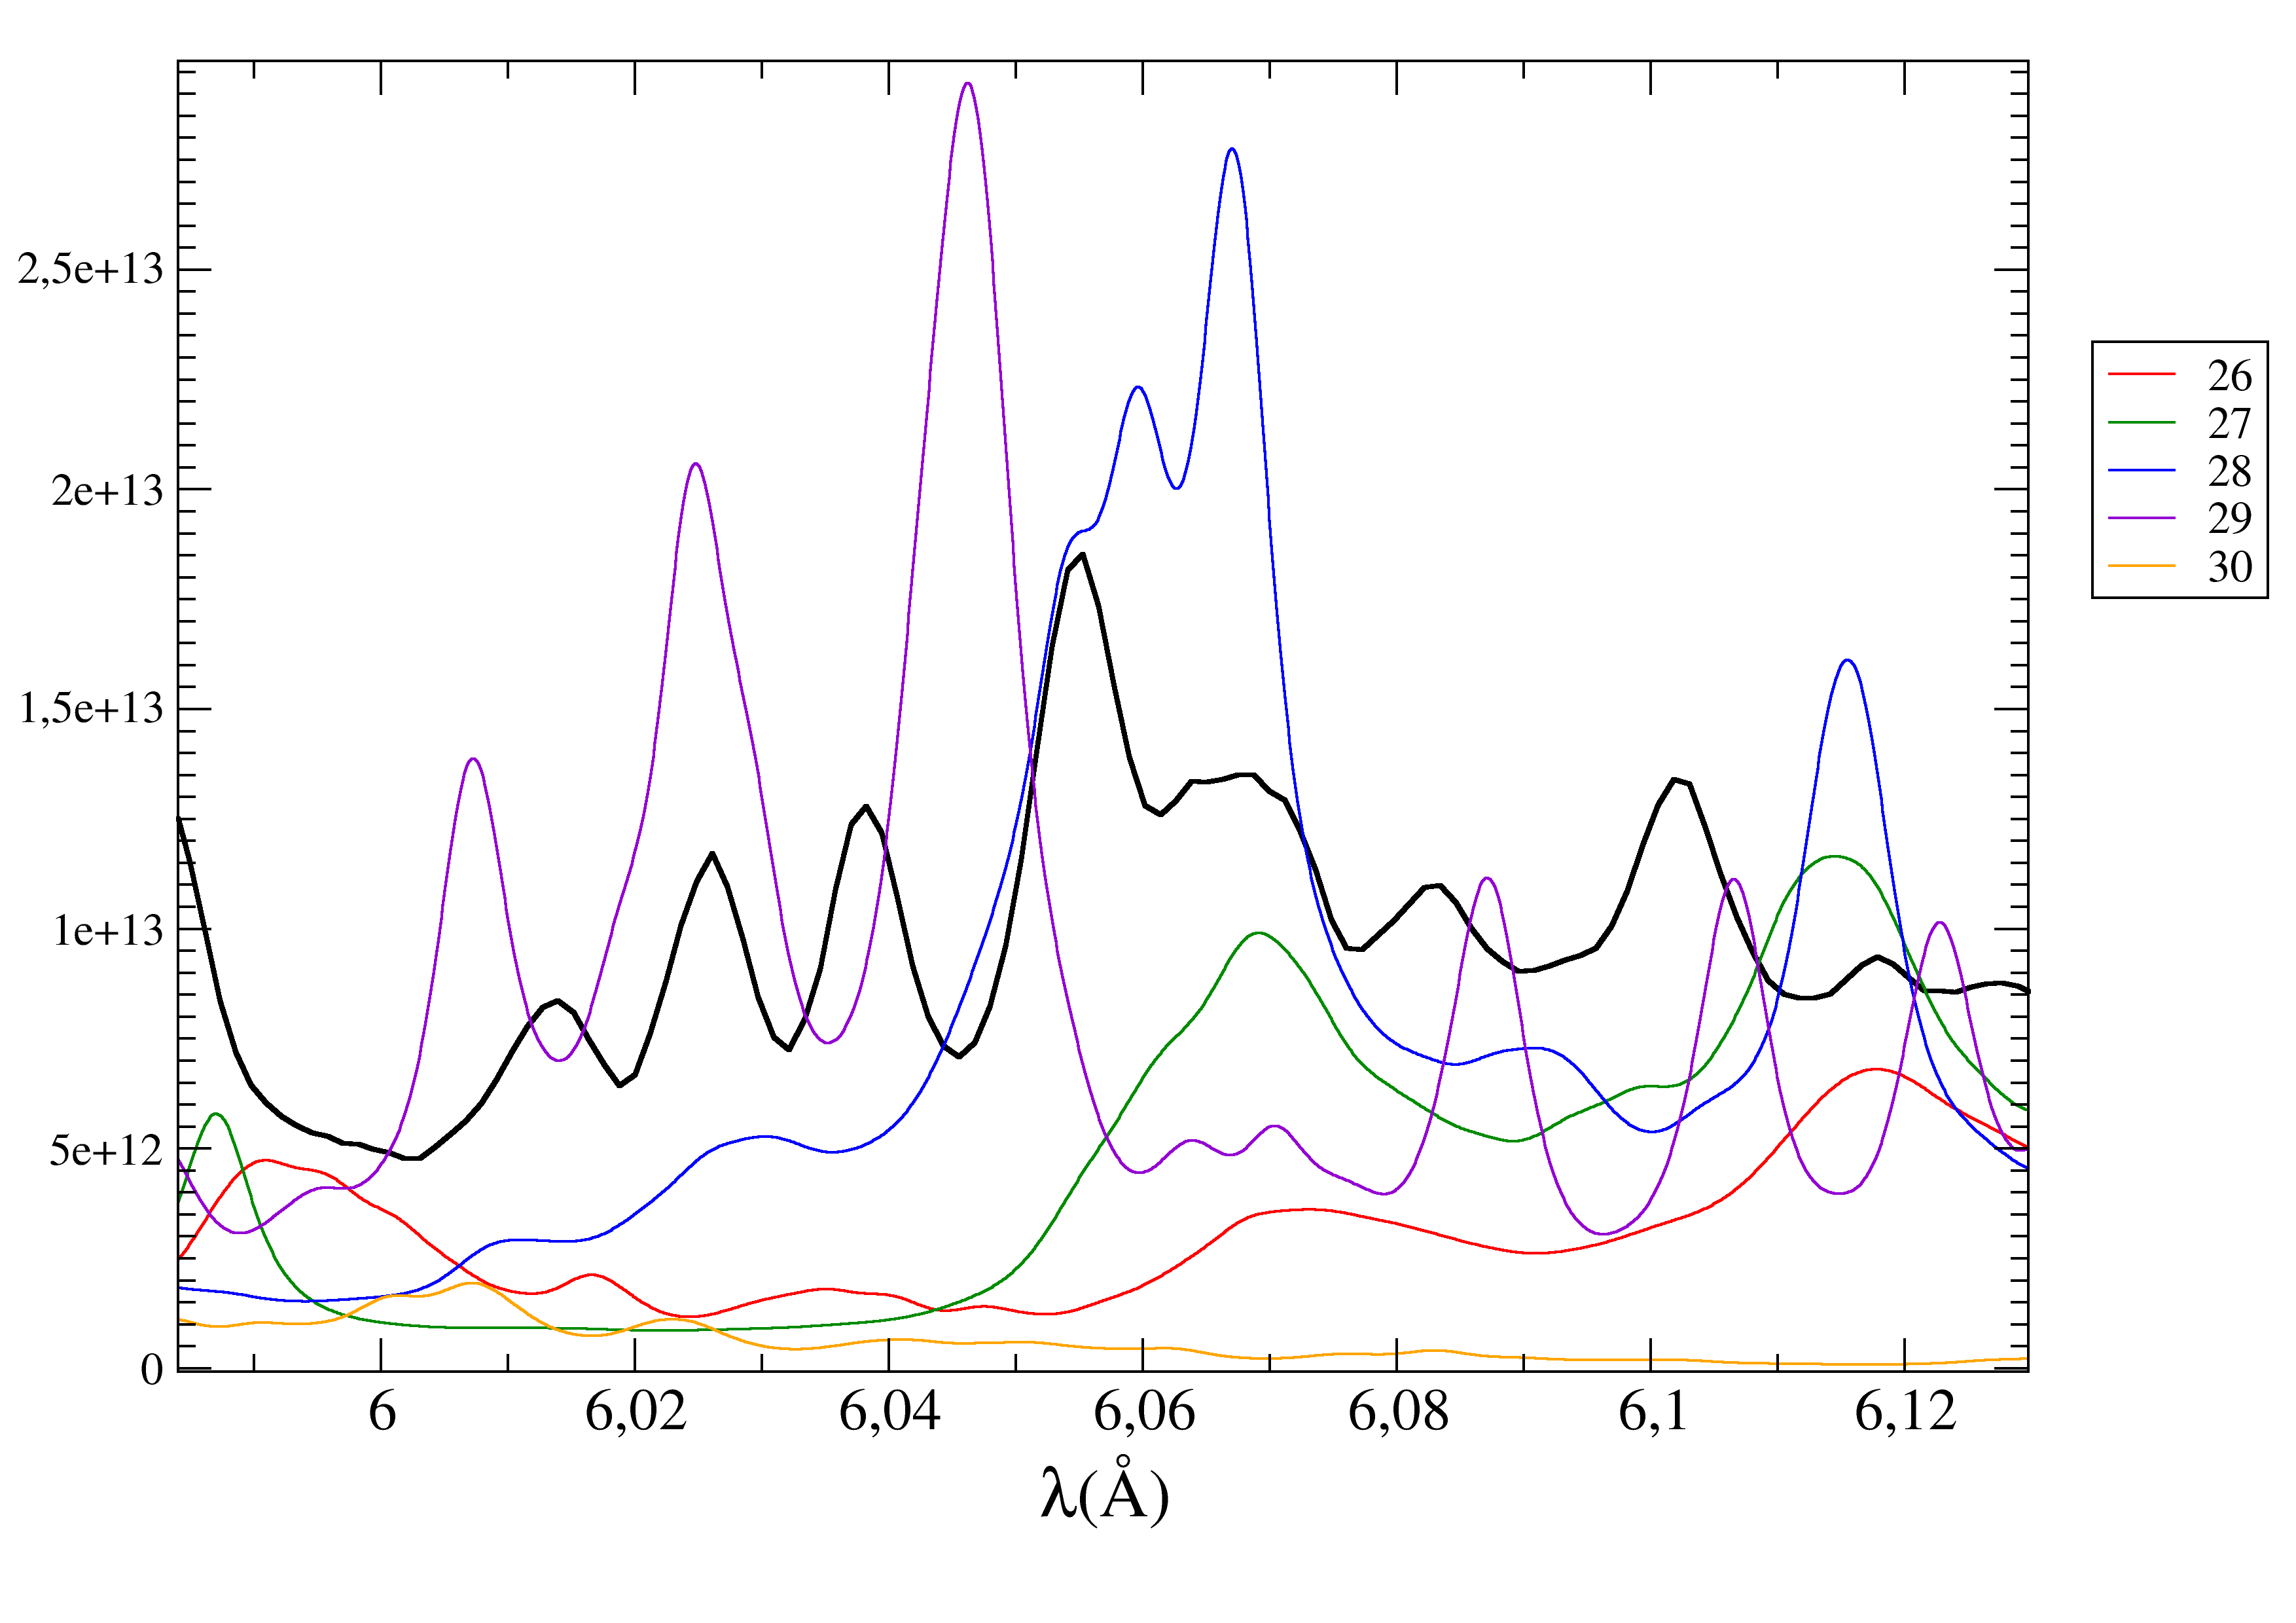
PHELIX-MCDF comparison
29+ M5→L3
28+ M5→L3
Flat
PET
29+ M4→L3

Slide 30
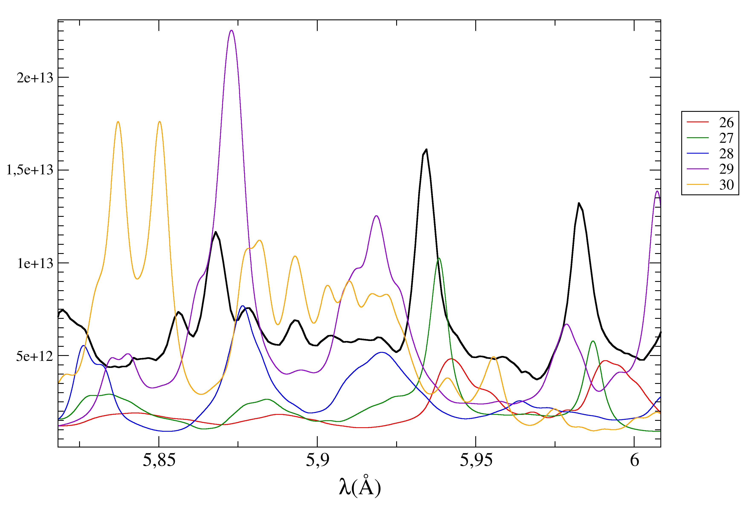
PHELIX-MCDF comparison
28+ M2→L1
29+ M4→L2
26+ M3,M2→L1
27+ M2→L1
Flat
PET
26+ M3→L1
27+ M2,M3→L1

Slide 31
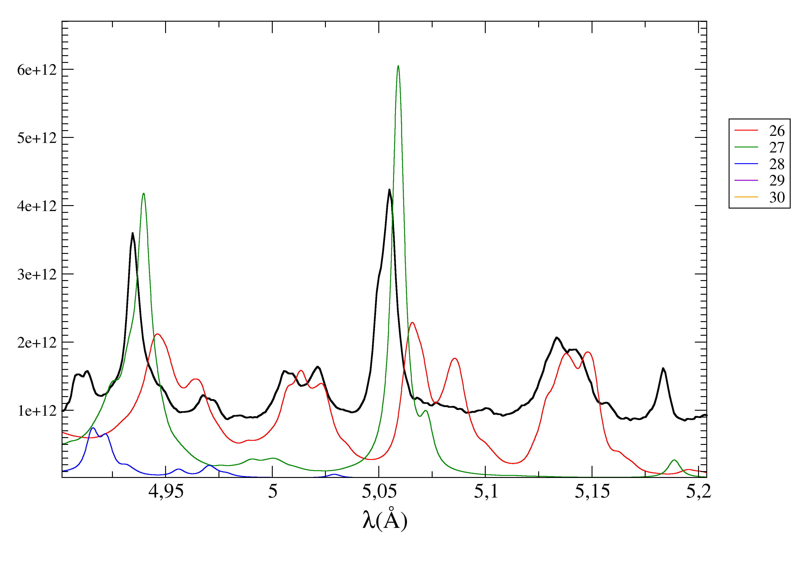
PHELIX-MCDF comparison
26+ N5→L3
27+ N5→L3
Flat
PET
26+ N4 →L2
27+ N4→L2
27+ N1→L3

Slide 32
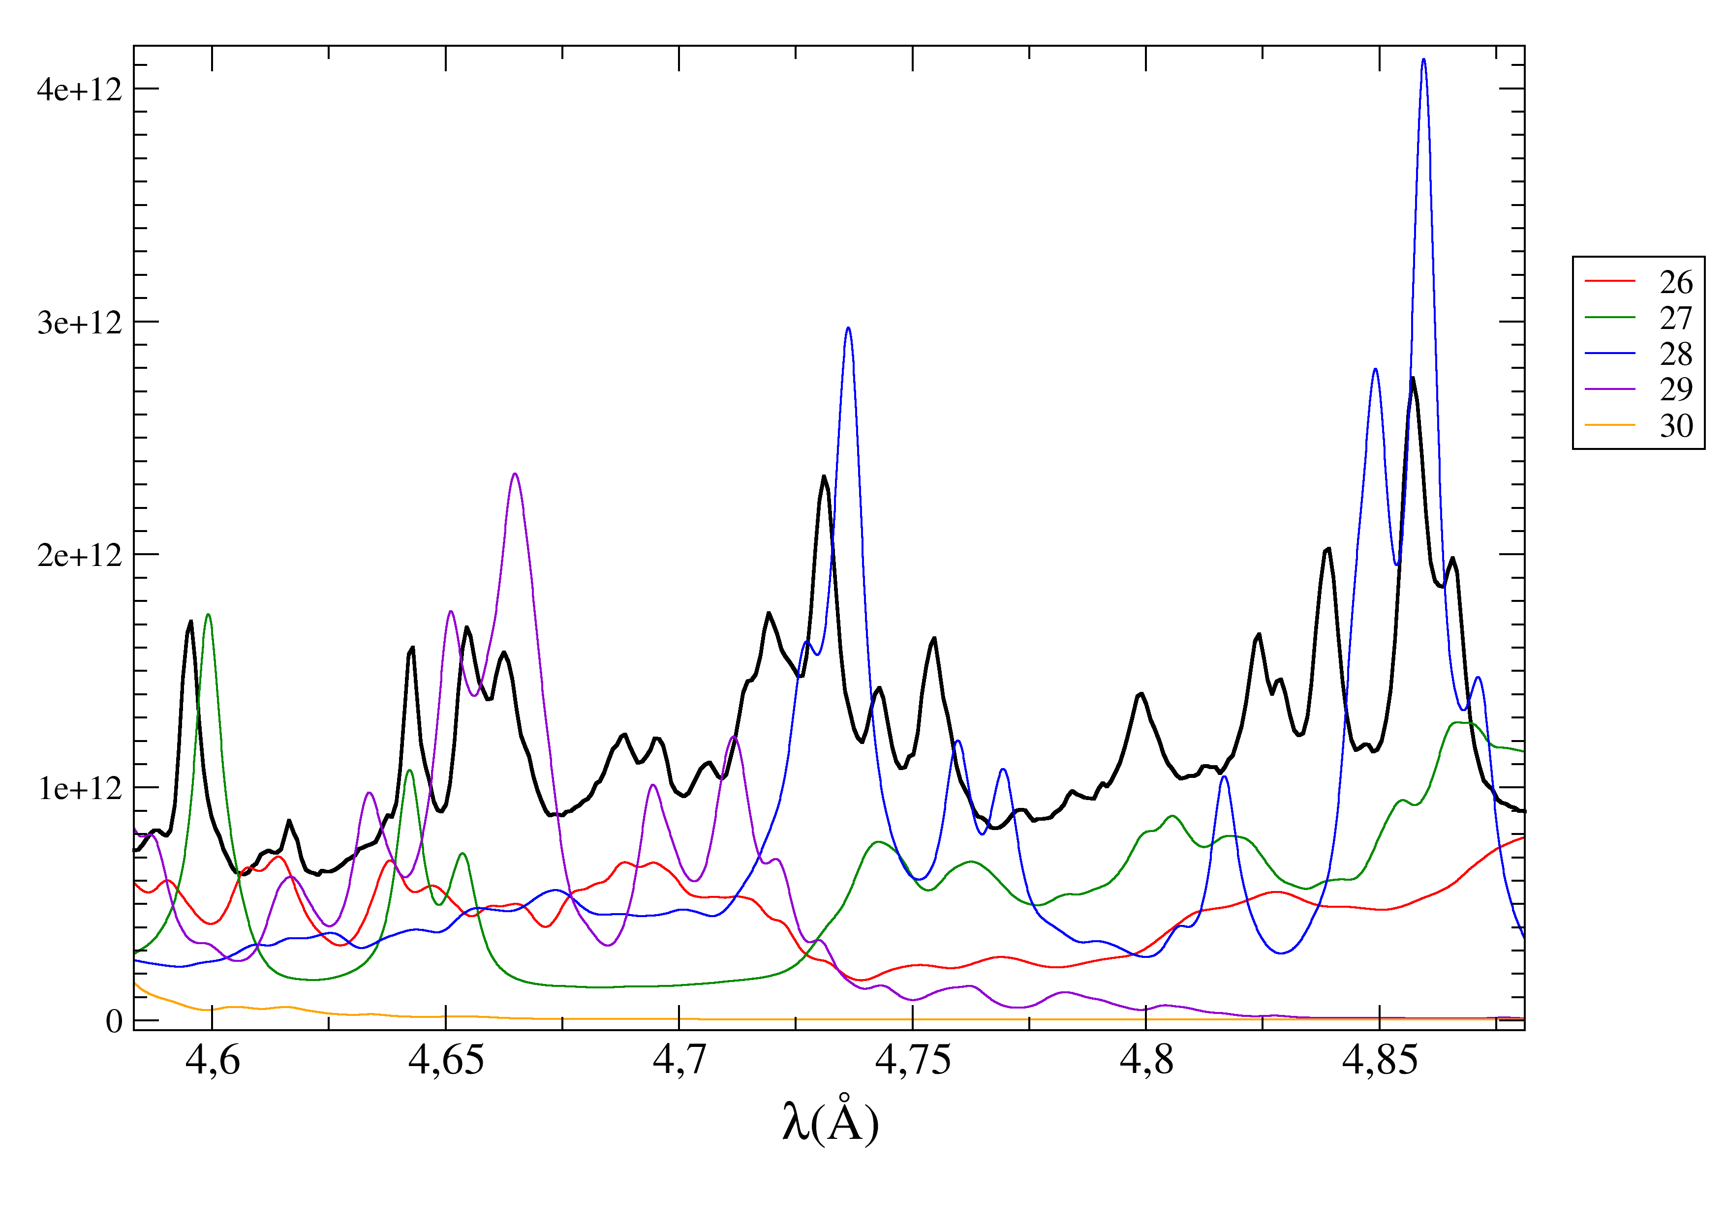
PHELIX-MCDF comparison
Flat
PET
28+ N5→L3
28+ N5→L3
27+ O5→L3

Slide 33
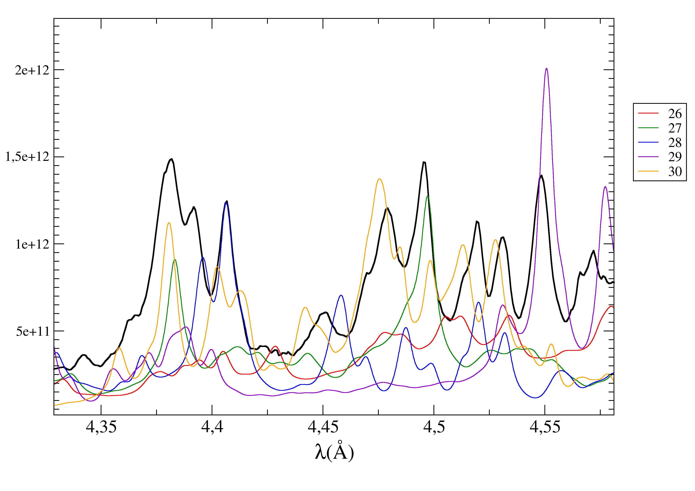
PHELIX-MCDF comparison
HOPG
Flat
PET
29+ N4→L3
27+ O4→L2
27+ P5→L3
28+ O5→L3

Slide 34
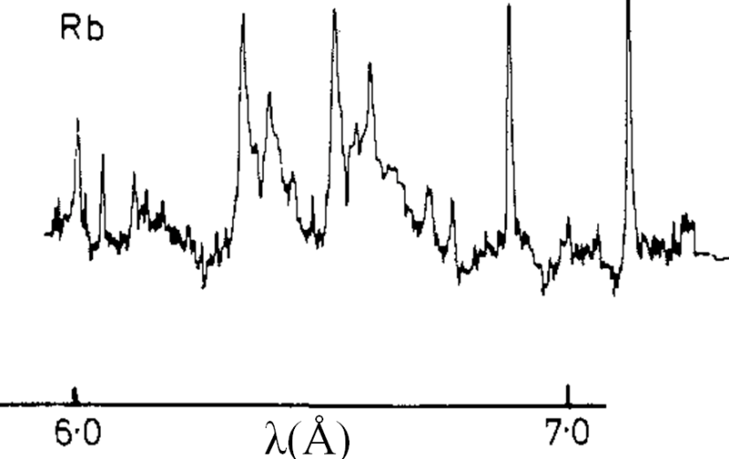
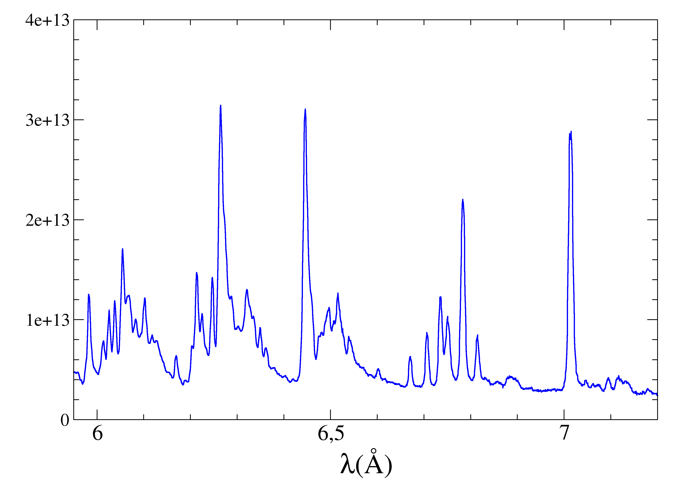
Comparison with published date for Q=27+
I=2.10¹⁴W/cm²
λ exp Phelix (Å) | λ calc MCDF (Å) | λ exp JPB (Å) | λ exp PS (Å) | λ exp PRA (Å) | λ calc JQS (Å)
7.014 | 7.0287 | 7.024(5) |  |  | 7.020
6.783 | 6.7957 | 6.789(5) |  |  | 6.788
6.516 | 6.5152 | 6.519(5) | 6.519(3) |  | 6.521
6.446 | 6.454 | 6.448(5) | 6.454(3) |  | 6.449
6.264 | 6.2777 | 6.286(5) | 6.277(3) |  | 6.267
5.983 | 5.9871 | 5.988(5) | 5.994(3) |  | 5.988
5.934 | 5.9385 | 5.938(5) | 5.945(3) |  | 5.939
5.183 | 5.1886 |  | 5.179(3) |  | 5.182
5.055^{m} | 5.0577 |  | 5.050(3)^{m} | 5.0573(11) | 5.052
~5.05^{m} | 5.0591 |  | 5.044(3)^{m} | 5.0523(11) | 5.050
4.935 | 4.9395 |  | 4.931(3) | 4.9351(10) | 4.934
JPB : J. Phys. B. 12 (1979), 881
PS : Phys. Scr. 21 (1980), 89
PRA : Phys. Rev. A. 47 (1993), 1403
JQS : J. Quant. Spectrosc. Radiat. Transfer. 19(1978), 11

Slide 35
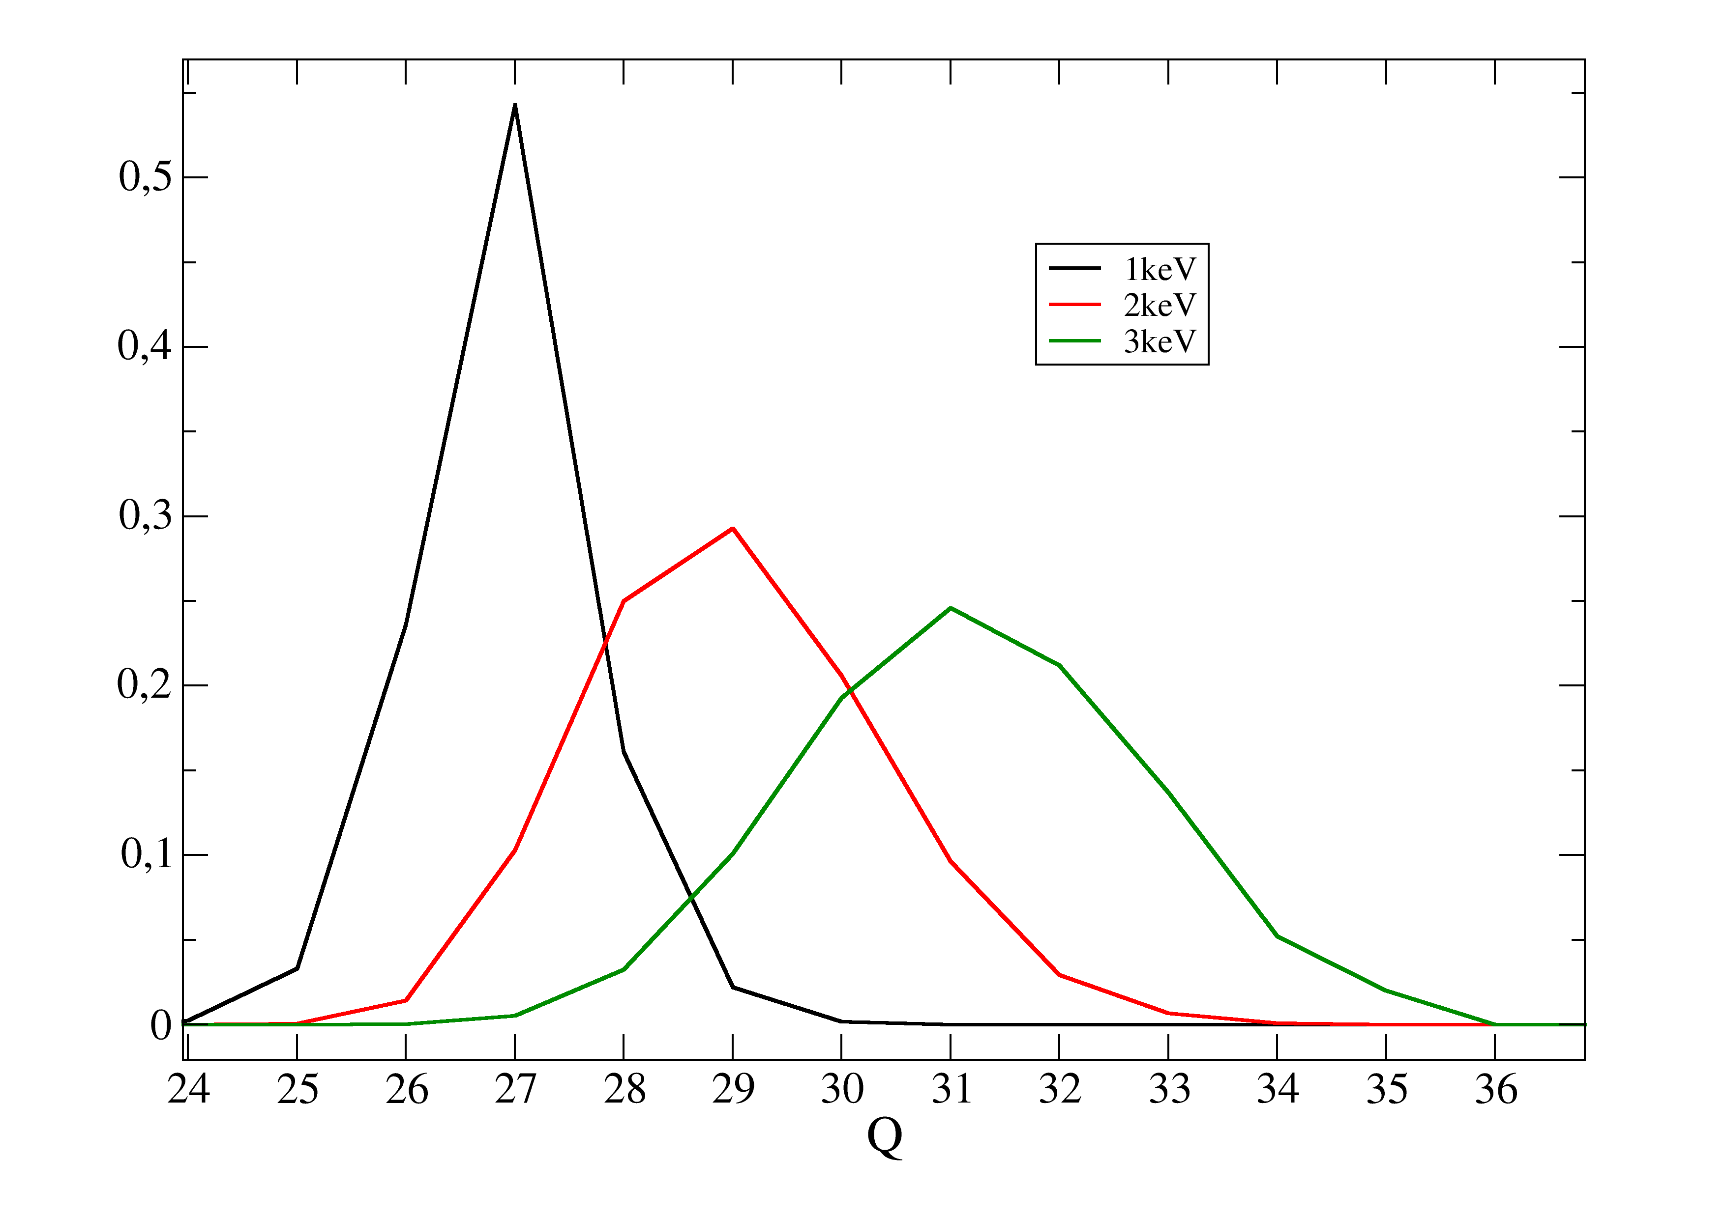
FLYCHK HETL calculations
If identification right ➝ Q=27+ dominant charge state
HETL temperature ∼1keV

Slide 36
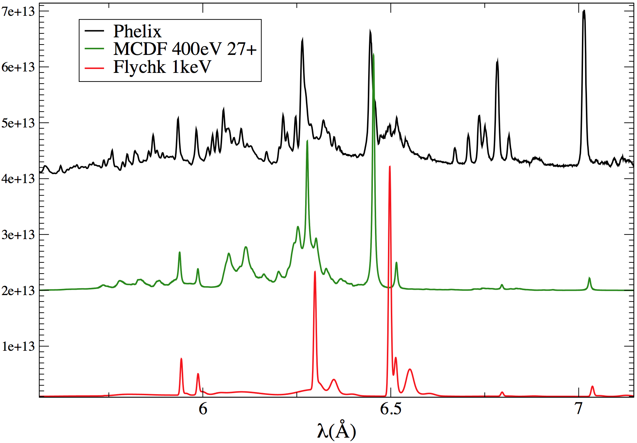
FLYCHK HETL calculations
27+
27+
27+
26+
26+
27+
27+

Slide 37
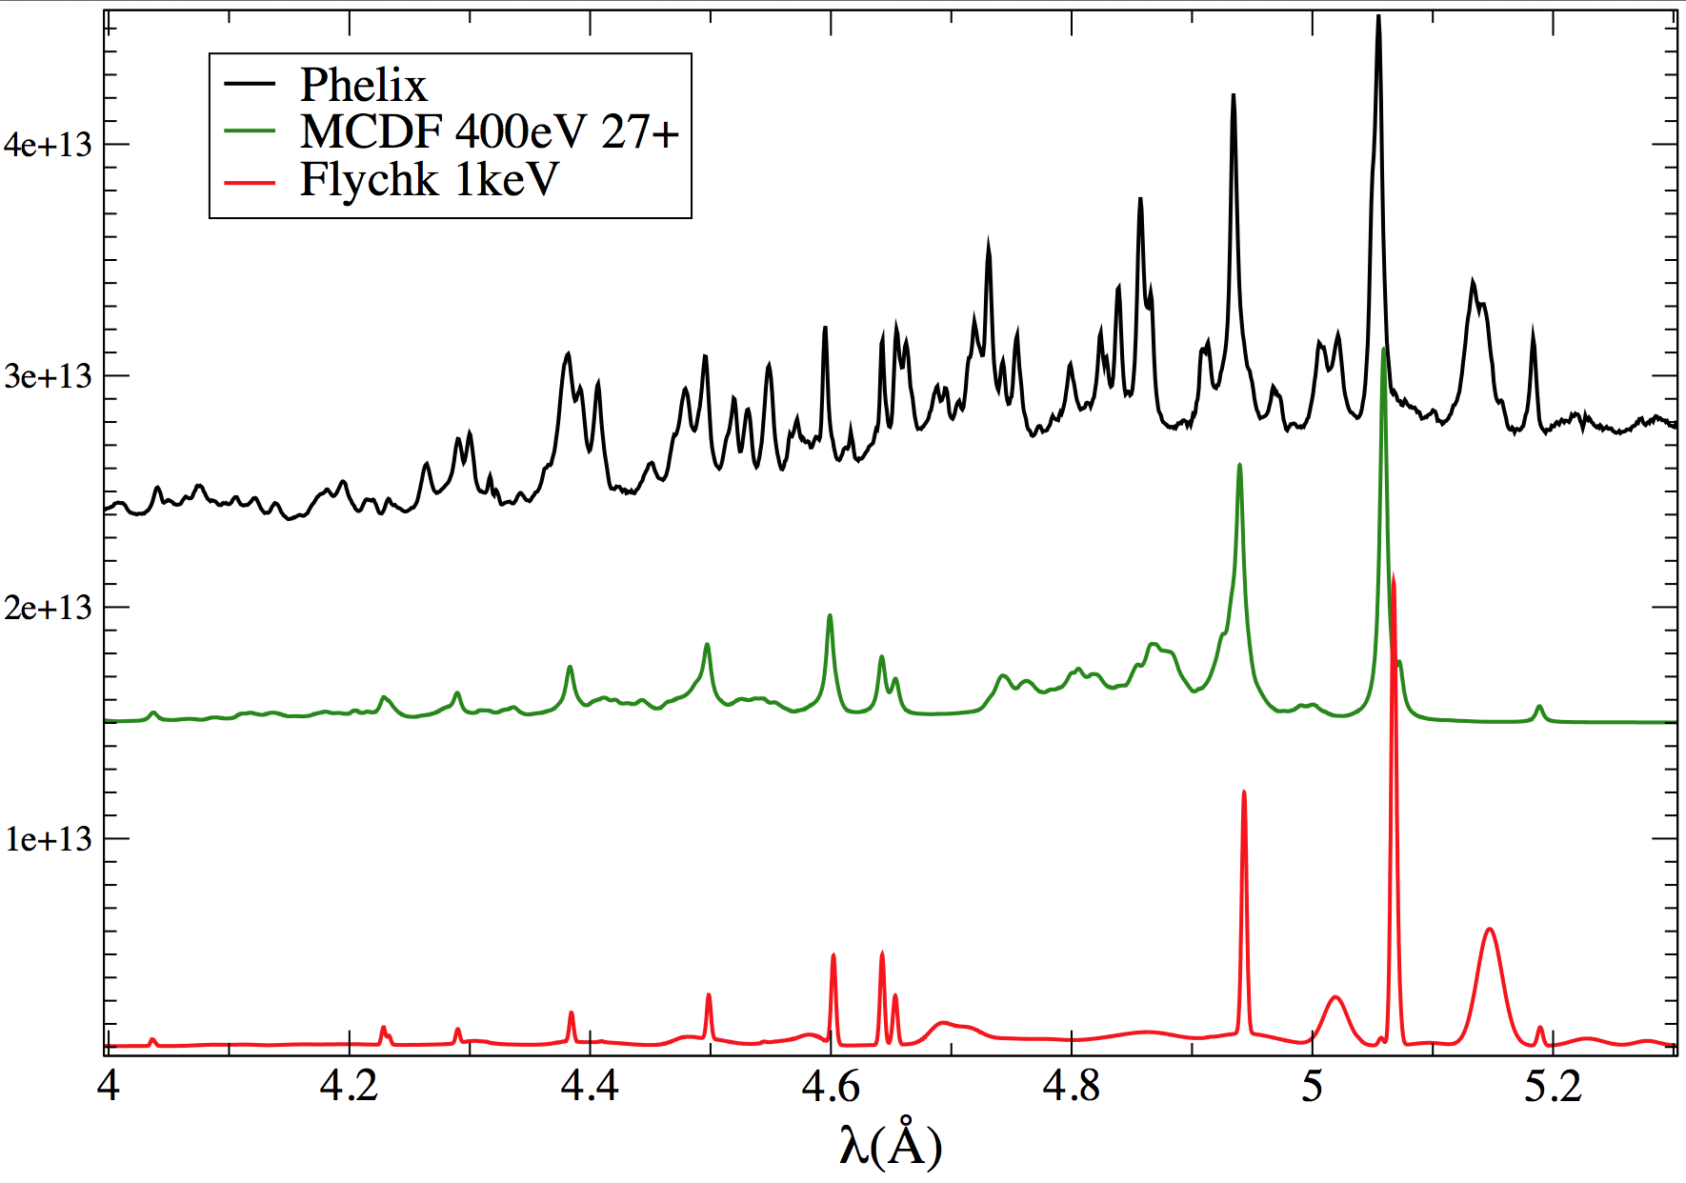
FLYCHK HETL calculations
27+
27+
26+
27+
27+
27+
26+
27+
27+

Slide 38
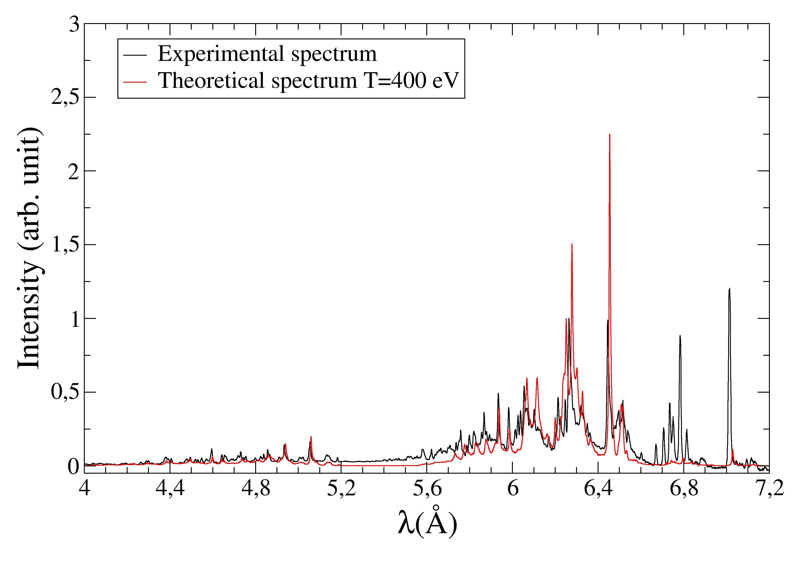
MCDF-FLYCHK theoretical spectra
Theoretical spectrum created with MCDF (T=400eV) with FLYCHK charge state distribution
(1keV)

Slide 39
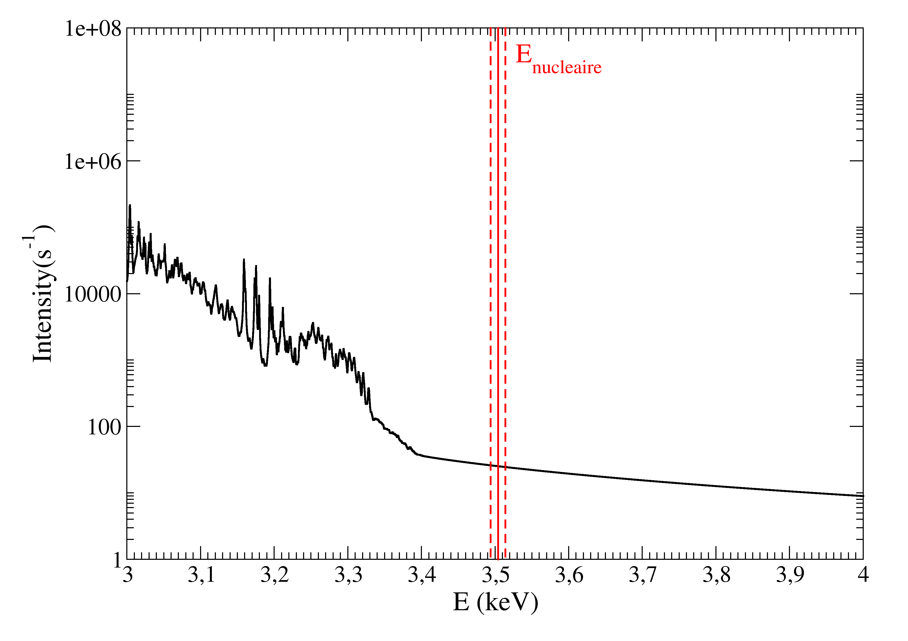
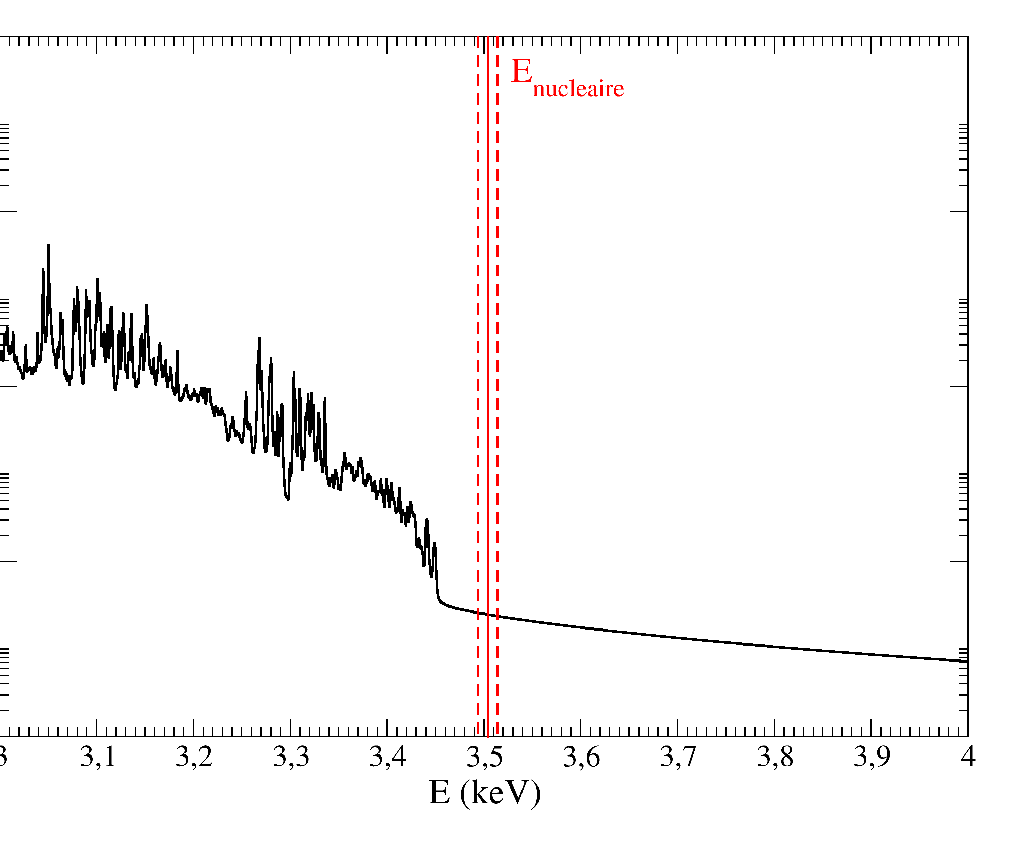
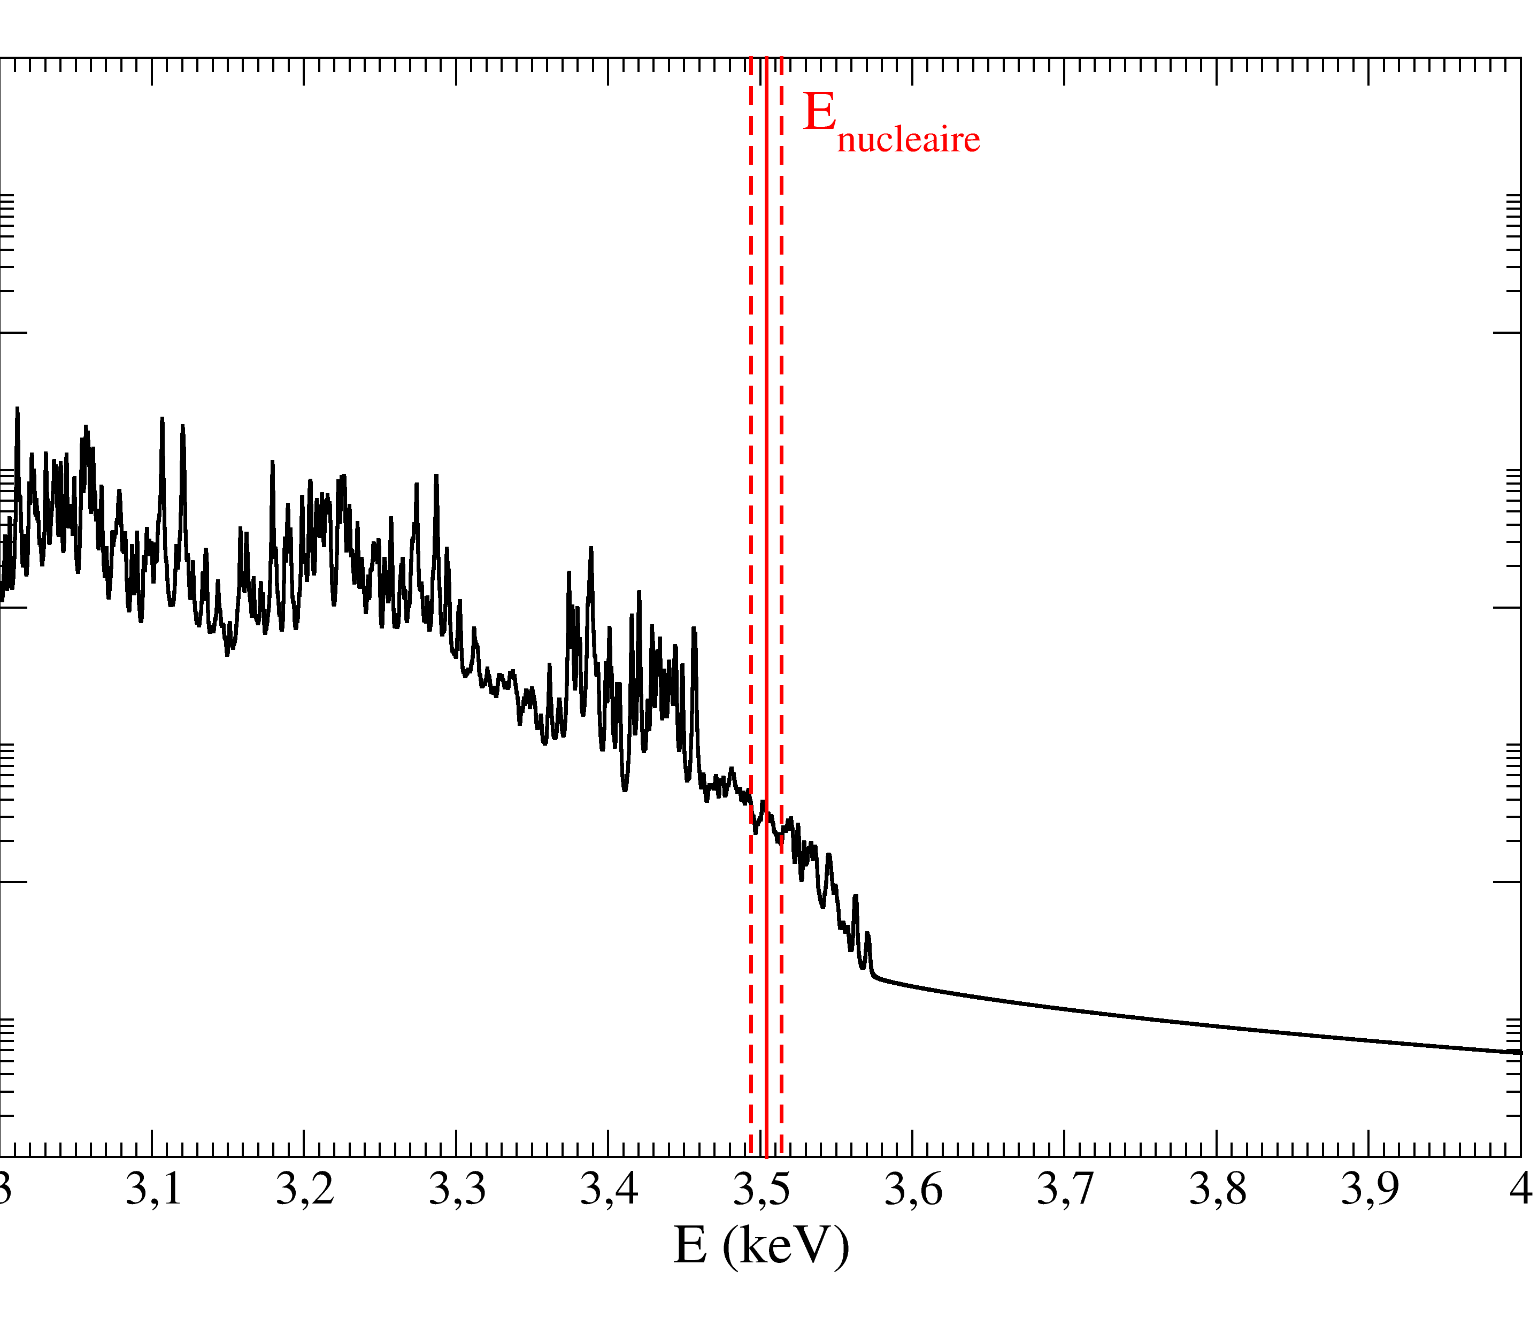
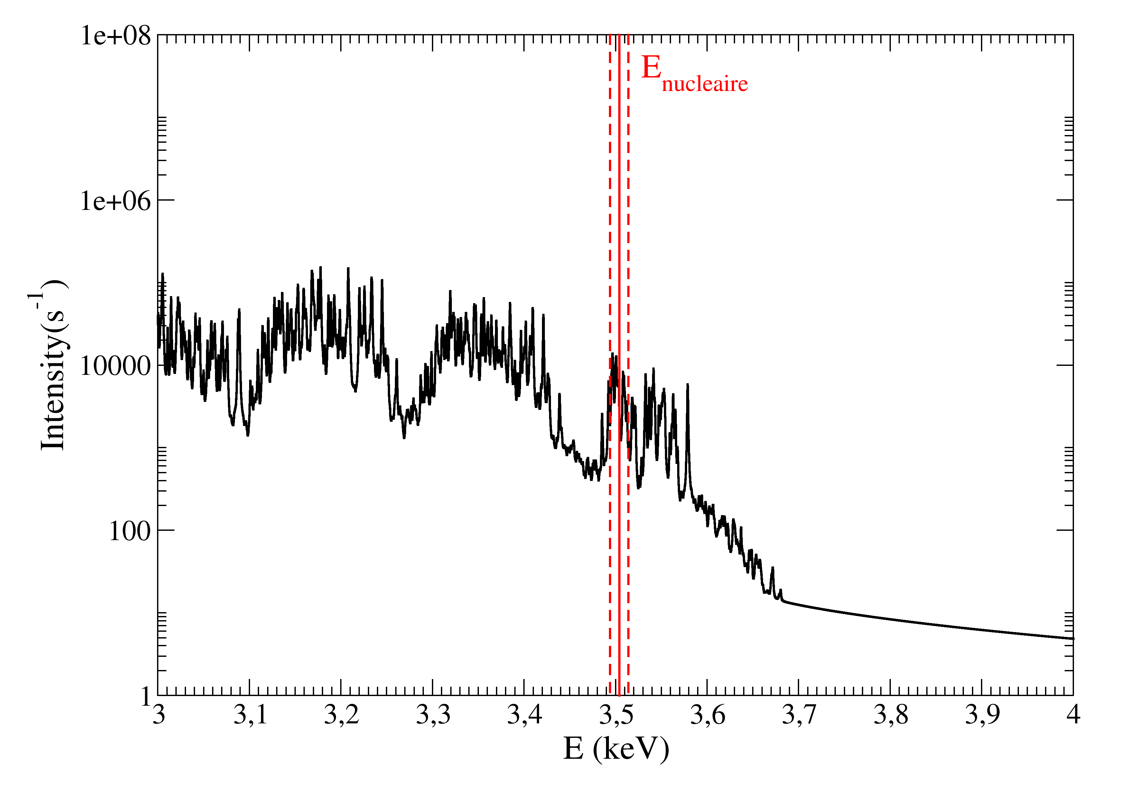


MCDF M1 spectra
M1 Transitions M,N,O,P→L T=400 eV
Q≥30+
28+
29+
30+
31+
32+
33+

Slide 40
E_{nuclear}
E_{nuclear}
e⁻
Nucleus
Nucleus
Photoexcitation
Inelastic electron scattering
E_{electronic}
E_{nuclear}
E_{electronic}
E_{nuclear}
e⁻
0
0
Atom
NEEC
Nucleus
Atom
NEET
Nucleus

