Slide 1



Hard X-ray Radiography
as a
HED Plasma Diagnostic at FAIR
P. Neumayer, EMMI/GSI
EMMI workshop on High Energy Density Plasma Diagnostics at FAIR
GSI/Darmstadt, Sept. 30 – Oct. 2, 2013

Slide 2

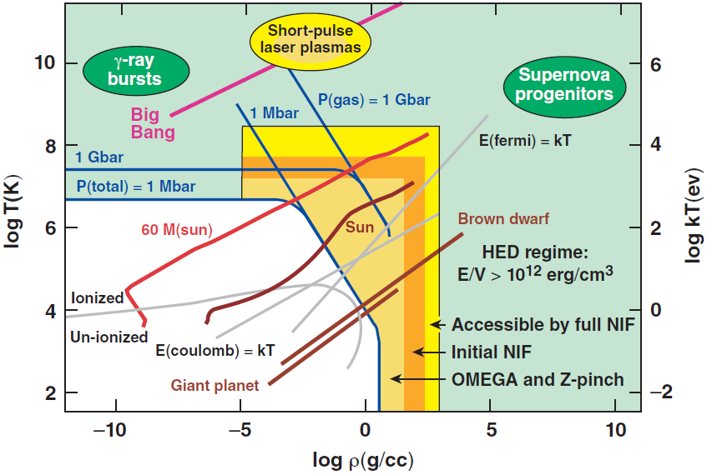
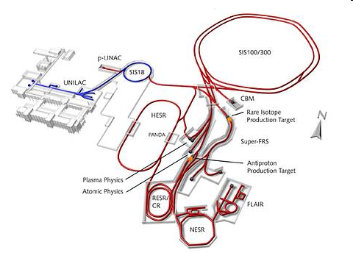

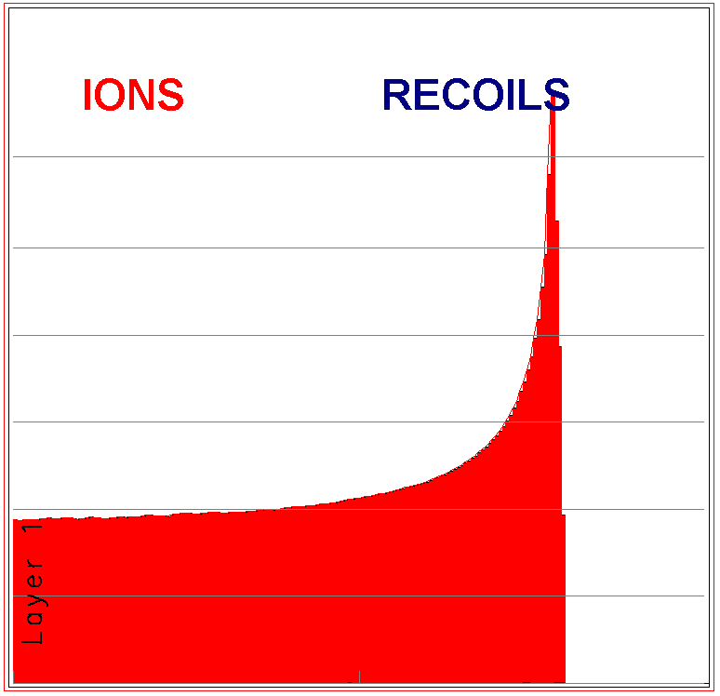
FAIR will offer exciting new possibilities for research in high-energy density matter science
5x10¹¹U-ions
(1.5GeV/u)
U in W
Warm-dense
matter:
E_{pot}~k_{B}T_{i}
E_{F}~k_{B}T_{e}
Energy loss
~2x10¹⁰ eV/mm
Ion beam driven plasmas
large mm-size samples
homogenous
equilibrium conditions
0
10 mm
20 mm

Slide 3
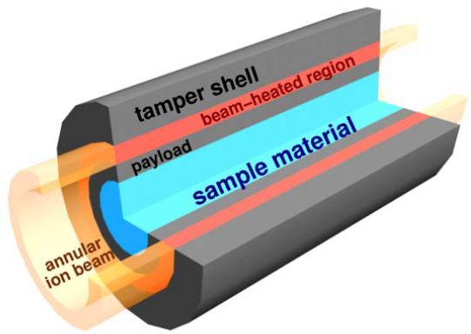
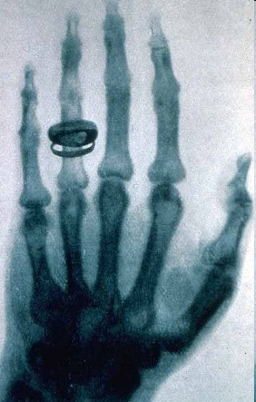
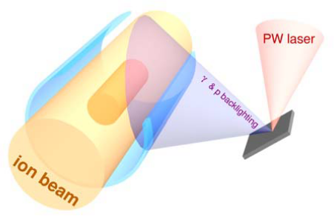
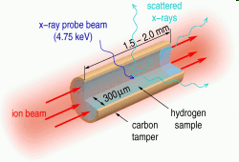
Two collaborations have accepted proposals for an experimental plasma physics program at FAIR
„HEDgeHOB“
„WDM“
Various schemes have been proposed to generate plasmas with FAIR
X-Ray Radiography:
Hydro-motion/target performance
Measure plasma parameter ρ
ρ → ion energy deposition
Dynamic confinement
Primary diagnostic:
e.g. benchmark EOS models
HIHEX
LAPLAS
Quasi-isochoric heating (tamper)
Heavy ion heating and expansion
Near-isentropic compression
All schemes involve/rely on large (or none) hydrodynamic motion over extended times

Slide 4
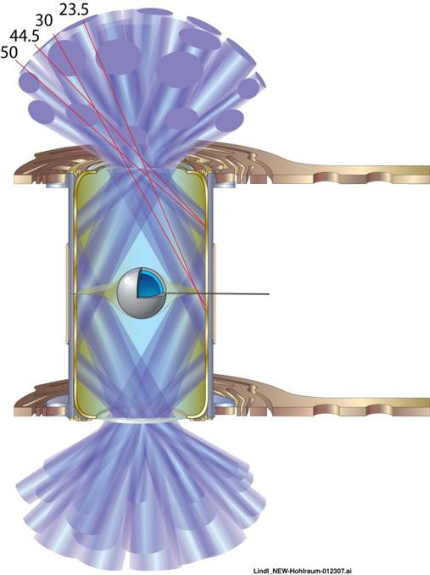
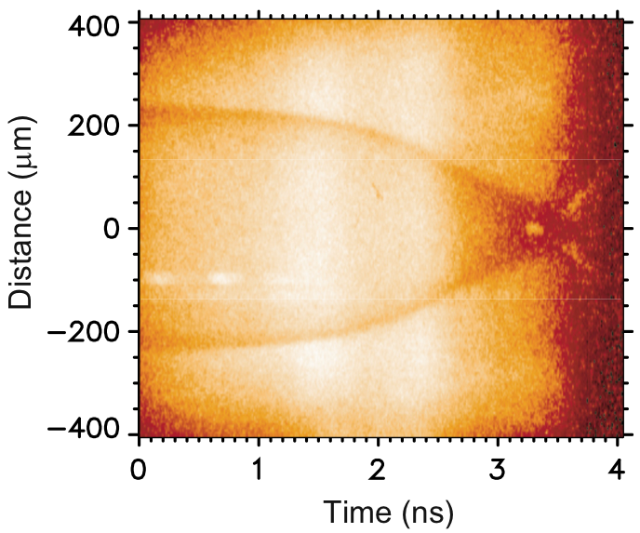
X-Ray Radiography is a primary diagnostic for HED basic science shots at the NIF
„Gbar-EOS“
(indirectly driven convergent shocks)
Streaked radiograph
°
°
°
°
Solid
CH sphere
Radiography (DIM 90-315)
B46 as Backlighters on 5 µm Zn foil at 90, 135
Non-cryogenic target
Hohlraum:
Au wall, Au layer
0.96 mg/cc ⁴He filled
57% Unlined LEH
D. Hicks et al.,
Phys. Plasmas 17, 102703 (2010)
X-ray radiography is employed to determine shock speeds and mass density → infer EOS

Slide 5
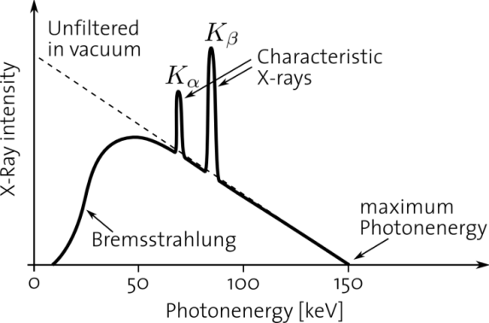
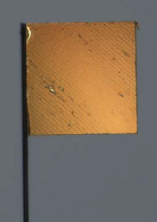
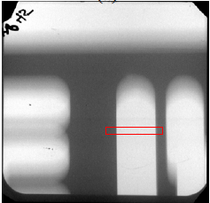
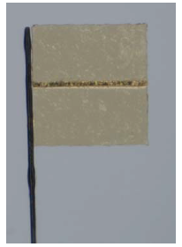
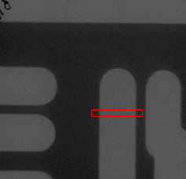
Laser-produced plasma x-ray sources
Long (ns) laser pulses at ~10^{14…16}W/cm²
→Hot (keV) expanding plasma
Line emission from highly-charged ions
E_{photon} <10keV
Duration ~ nanosecond
solid
target
Laser
pulse
<10keV
Short (ps) intense laser pulses (>10¹⁷W/cm²)
→ „hot“ (MeV) electrons
K-shell + bremsstrahlung
E_{photon} ~ keV…MeV
Duration ~10 picoseconds
Emission confined to initial target dimensions
→ small source sizes (10μm demonstrated*)
solid
target
Laser
pulse
keV…MeV
1D
2D
*) H.-S. Park et al.,
Phys. Plasmas 15, 072705 (2008)

Slide 6
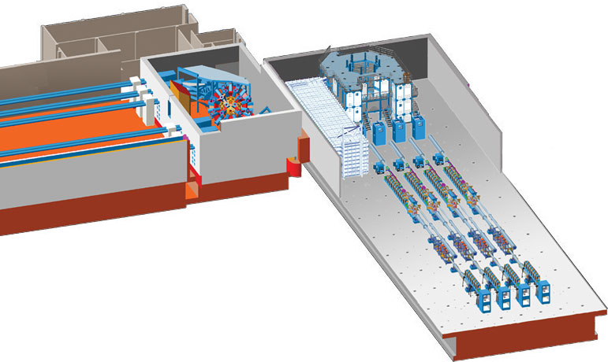
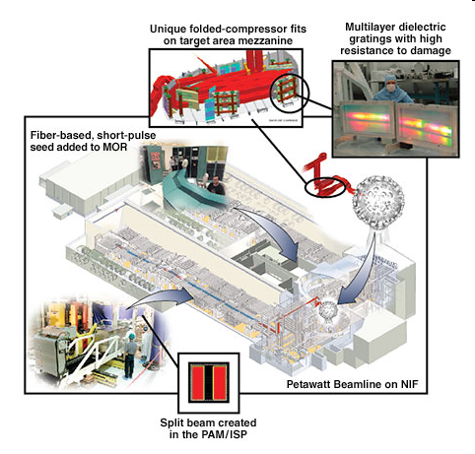
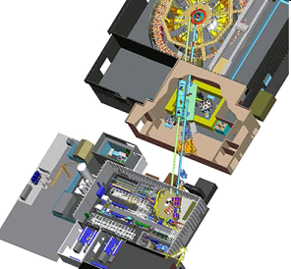
HED facilities upgrade to high-energy short-pulse options for hard x-ray radiography capability
Omega EP
(LLE)
ARC (LLNL)
Z-Petawatt
(SNL)

Slide 7

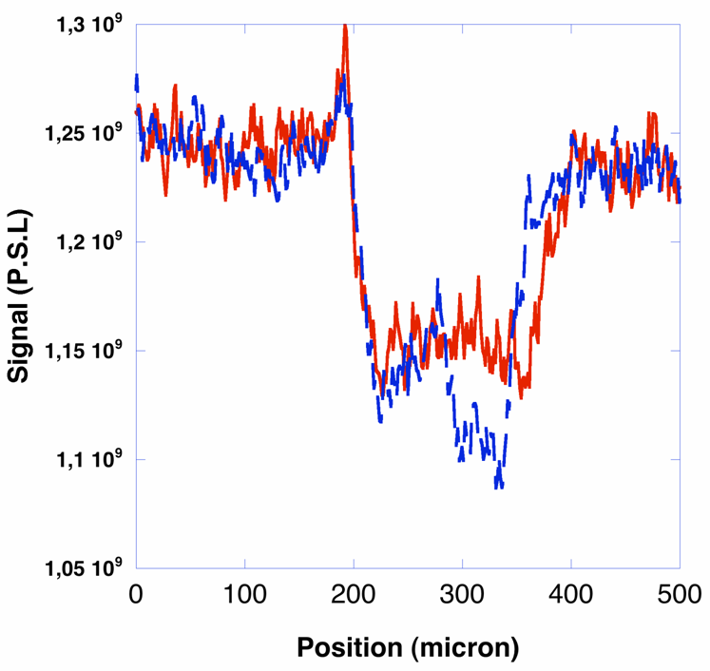
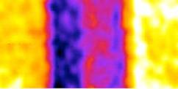
X-ray radiography of a shock front
Backlighter
target (Fe)
Backlighter beam
300J, 5ps
Drive beam
450J, 10ns,
7TW/cm²
Sample
(Boron)
2.3g/cm³
Δt=5.6 ns
4.6g/cm³
Imaging plate
Absolute density measurement
Shock velocity
S. Le Pape et al., Phys. Plasmas 17, 056309 (2010)

Slide 8
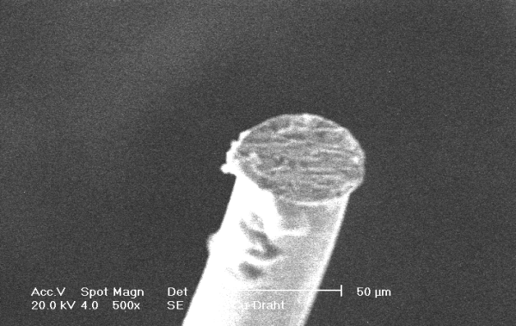

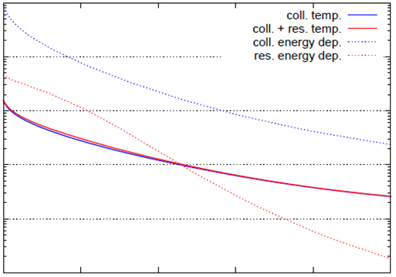
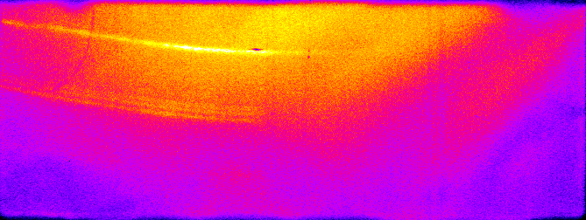
Rapid heating of wire targets with hot electrons
Target:
Ti-Wire (∅50μm)
Polished wire tip
Laser
50μm
Kα
Heα
wire target
T_{hot}=(120±20)keV
η_{Laser→ehot}=14%
PHELIX laser
(50J, 10ps,
≈10¹⁸ W/cm²)
imaging
edge (Ni)
spectrometer
crystal (HOPG)
10³
10²
bulk temperature [eV]
10¹
backlighter
foil
10⁰
0
200
400
600
800
1000
position along wire [μm]

Slide 9
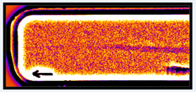
2nd beam drives x-ray backlighter for radiography
radiographic
images
Kα
Heα
wire target
T_{hot}=(120±20)keV
η_{Laser→ehot}=14%
PHELIX laser
(50J, 10ps,
≈10¹⁸ W/cm²)
imaging
edge (Ni)
spectrometer
crystal (HOPG)
10³
10²
bulk temperature [eV]
10¹
Backlighter pulse
(50J, 10ps)
backlighter
foil
10⁰
0
200
400
600
800
1000
position along wire [μm]

Slide 10
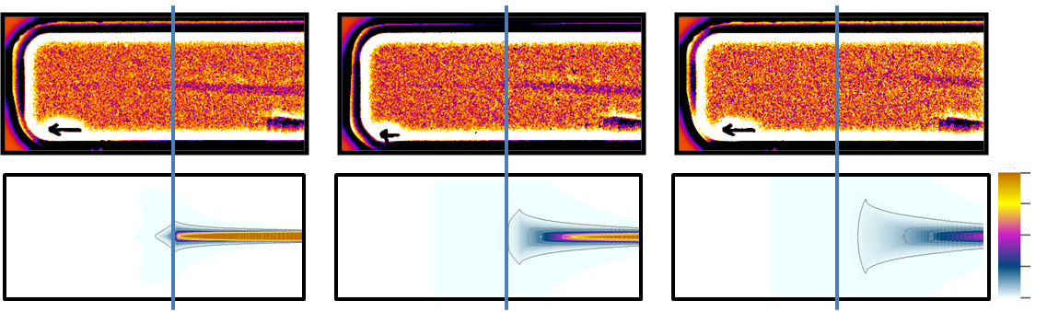
Radiographs show expansion of heated wire, good agreement with rad-hydro simulations
Δt = 0.5ns
1.5ns
3.0ns
20
10
5eV
4.50 g/cc
How about
X-ray radiography of a „real“ FAIR-PP target?
2.25 g/cc
500μm
0.00 g/cc
wire tip
Evolution of central density

Slide 11
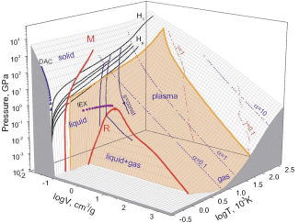
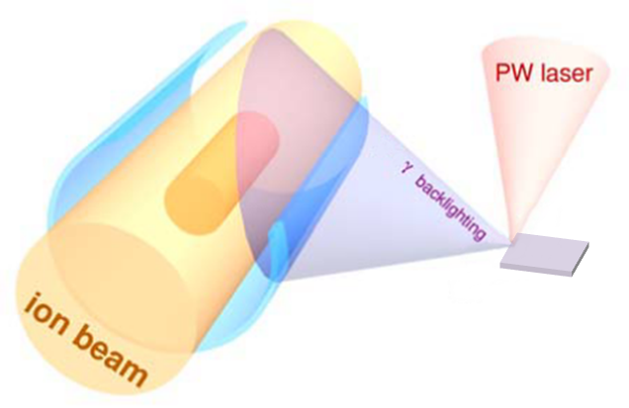
HIHEX: Heavy Ion Heating and EXpansion
Heating by heavy ion pulses
Subsequent expansion
Phase diagram of Lead
Bremsstrahlung emission spectrum
(MC-simulation)
hot-e distribution:
T_{hot} =200keV
E_{hot} =0.1 × 400J
dN/dE [1/MeV/4πsr]
photon energy [MeV]
N. A. Tahir et al.,
Phys. Rev. Lett. 95, 035001 (2005)

Slide 12




Simulated radiographs of „typical“ HIHEX plasma *)
Liquid
T≈3400...6000K, ρ =ρ₀
Critical point region
T≈5600K, ρ ≈4g/cm3
Strongly coupled plasma
T≈4000K, ρ ≈2g/cm3 → Γ ≈ 4
Calibration wedge
(ρr)/ρ_{0,Pb} [μm]
2 mm
0
20
40
75
150
300
600
0
20
40
75
150
300
600
radius [μm]
E_{hot}= 40J, T_{hot}=200keV
Resolution element : 100μm x 10μm
Detector: IP
*) from: N. A. Tahir et al.,
Phys. Rev. Lett. 95, 035001 (2005)

Slide 13
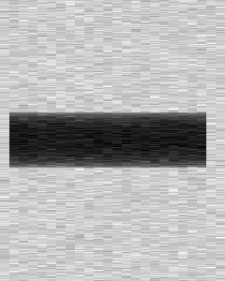



Simulated radiographs of „typical“ HIHEX plasma *)
Liquid
T≈3400...6000K, ρ =ρ₀
Critical point region
T≈5600K, ρ ≈4g/cm3
Strongly coupled plasma
T≈4000K, ρ ≈2g/cm3 → Γ ≈ 4
Calibration wedge
(ρr)/ρ_{0,Pb} [μm]
2 mm
0
20
40
75
150
300
600
0
20
40
75
150
300
600
radius [μm]
E_{hot}= 4J, T_{hot}=200keV
Resolution element : 100μm x 10μm
Detector: IP
*) from: N. A. Tahir et al.,
Phys. Rev. Lett. 95, 035001 (2005)

Slide 14

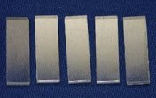
Heavy crystal scintillators for higher QE at >100keV
 | Thickness | density
I.P. | 70-120 μm | ≈ 3 g/cc
LSO | e.g. 1mm | 7.4g/cc
LSO
(1mm)
quantum efficiency
I.P.
photon energy[MeV]
Scintillator-based imaging
scintillation
screen
image
relay
CCD
higher QE in relevant spectral range (0.1...1MeV)
electronic readout
  remote operation
  high rep-rate
γ
PC

Slide 15




Simulated radiographs of „typical“ HIHEX plasma *)
Liquid
T≈3400...6000K, ρ =ρ₀
Critical point region
T≈5600K, ρ ≈4g/cm3
Strongly coupled plasma
T≈4000K, ρ ≈2g/cm3 → Γ ≈ 4
Calibration wedge
(ρr)/ρ_{0,Pb} [μm]
0
20
40
75
150
300
600
0
20
40
75
150
300
600
radius [μm]
E_{hot}= 40J, T_{hot}=200keV
Resolution element : 100μm x 10μm
Detector: LYSO
*) from: N. A. Tahir et al.,
Phys. Rev. Lett. 95, 035001 (2005)

Slide 16

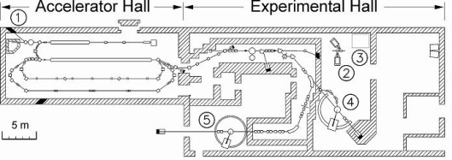
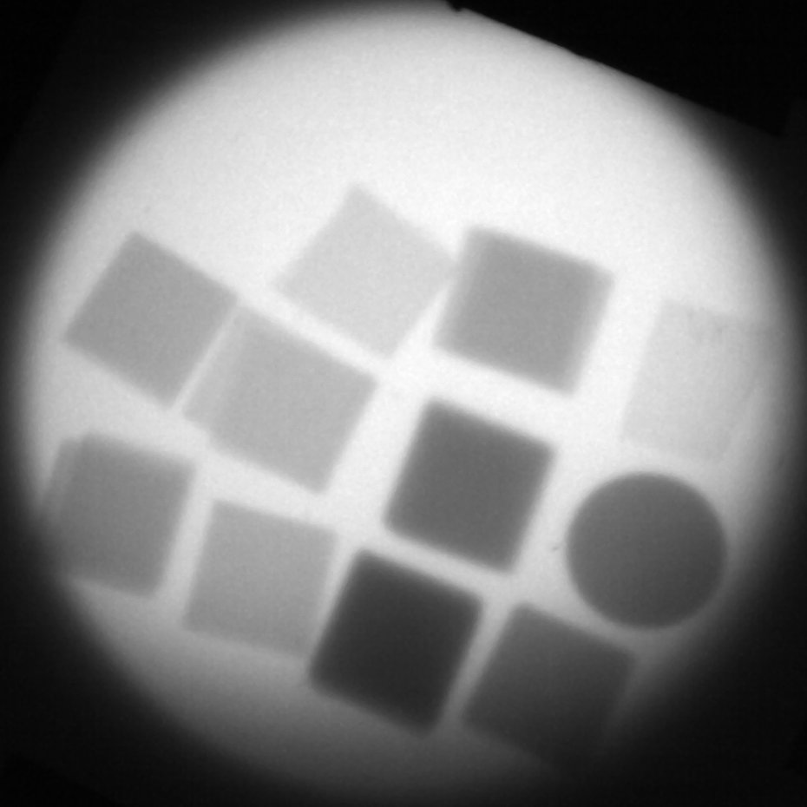
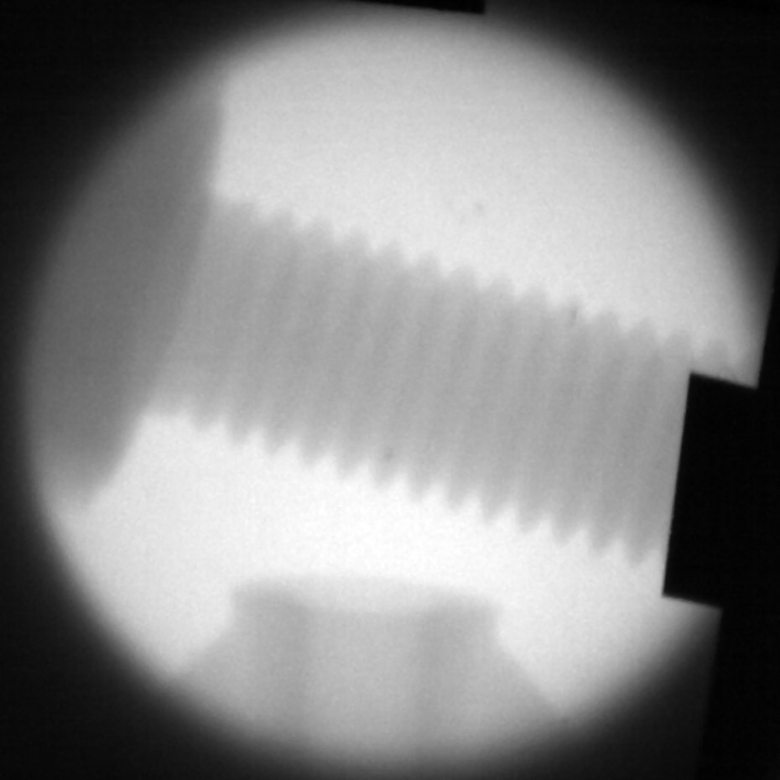
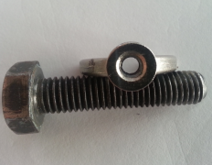
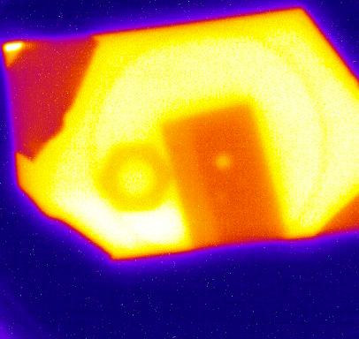
First tests of scintillator-based imaging detector *)
Tantalum filter
M10 screw
10 mm
2
0.5
4
1.5
0.25
E_{e-}=6.5MeV
exposure time: 10s (9.25μA)
4
12
2
8
24
6
(thickness in mm)
Using the PHELIX laser:
E_{Laser}= 100 J / 5 ps
M4 nut
4mm Ta
*) see poster (K. Li)

Slide 17
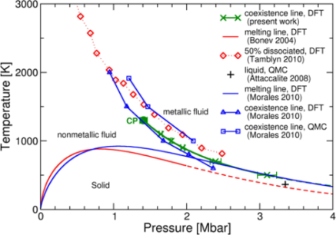
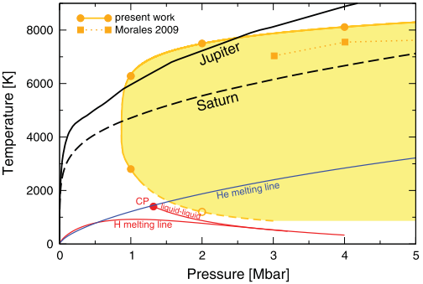
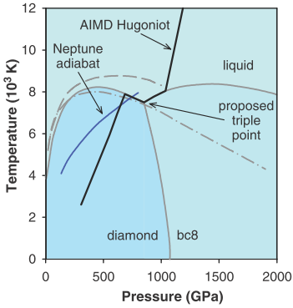
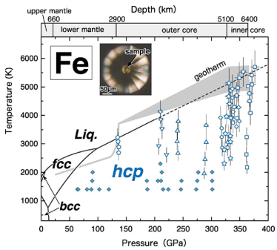
LAPLAS: LAboratory PLAnetary Science
Heavy ion heating of tamper shell
Near-isentropic compression of sample
Metallic hydrogen
H/He demixing
W. Lorenzen et al.,
Phys. Rev. B 82, 195107 (2010)
W. Lorenzen et al.,
PRB 84, 235109 (2011)
liquid diamond, bc8
„superionic“ water
LAPLAS scheme can generate „super-ionic water“
M.D. Knudsen et al.,
Science 322, 1822 (2008)
R. Redmer et al.,
Icarus 211, 798 (2011)
earth core
conditions
N. A. Tahir et al.,
New J. Phys. 12 (2010) 073022
S. Tateno et al.,
Science 330, 359 (2010)

Slide 18
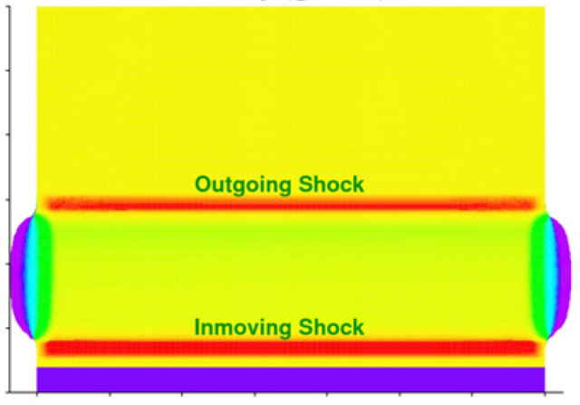
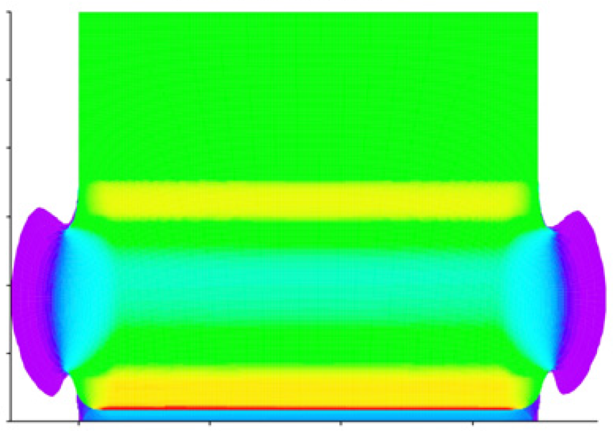
Side-on radiography of LAPLAS configuration *)
t = 0 ns
ρ
[g/cm³]
t = 50 ns
t = 100 ns
3.0
25
25
35
2.5
2.0
Tungsten
radius [mm]
1.5
1.0
0.5
Water
0
0
0
0
0
1
2
3
4
5
6
7
0
1
2
3
4
5
6
7
0
2
4
6
length [mm]
*) from N. A. Tahir et al.,
New J. Phys. 12 (2010) 073022
E_{hot}=40J, T_{hot}=200keV
Source size: 100μm x 10μm
Detector: IP
→ LYSO
radius [μm]

Slide 19
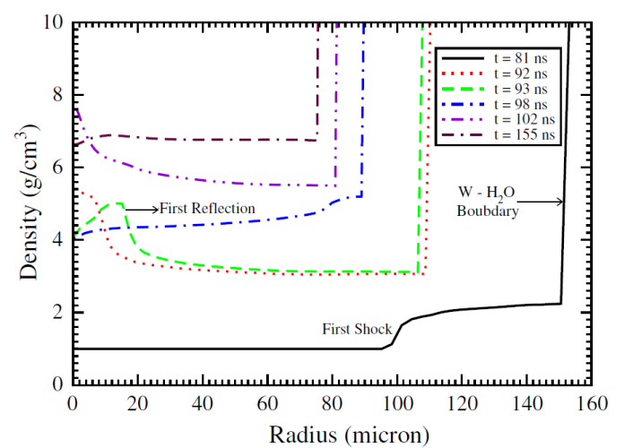

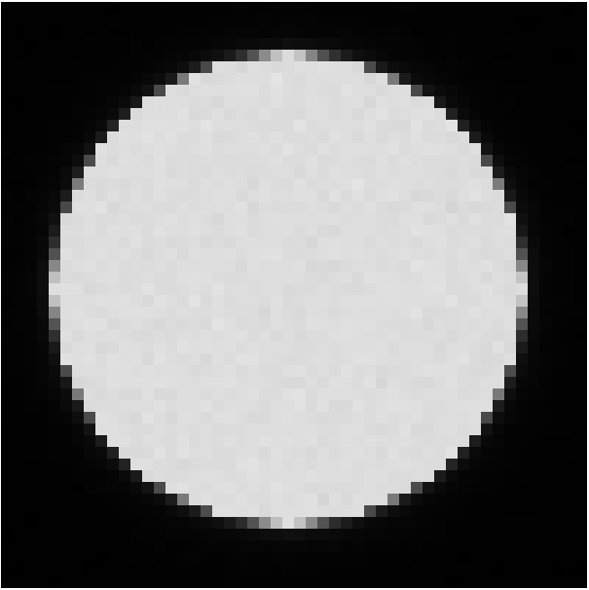

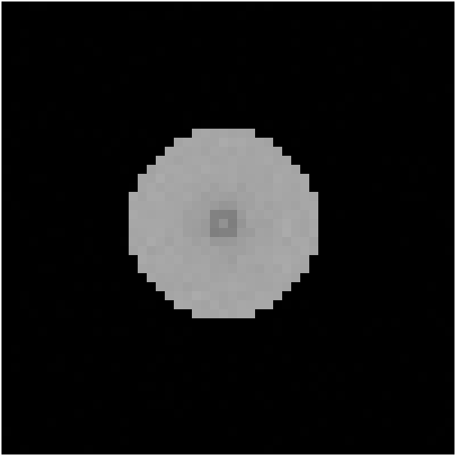

End-on radiography of LAPLAS/H₂O *)
Laser pulse
(400J/ps)
High-Z wire (∅10μm)
t = 0 ns
81 ns
93 ns
155 ns
ρ⋅r [g/cm²]
0
.5
1
2
3
4
5
radius [μm]
E_{hot}= 40J, T_{hot}=200keV
Resolution element : 10μm x 10μm
Detector: IP
*) from N. A. Tahir et al.,
New J. Phys. 12 (2010) 073022

Slide 20
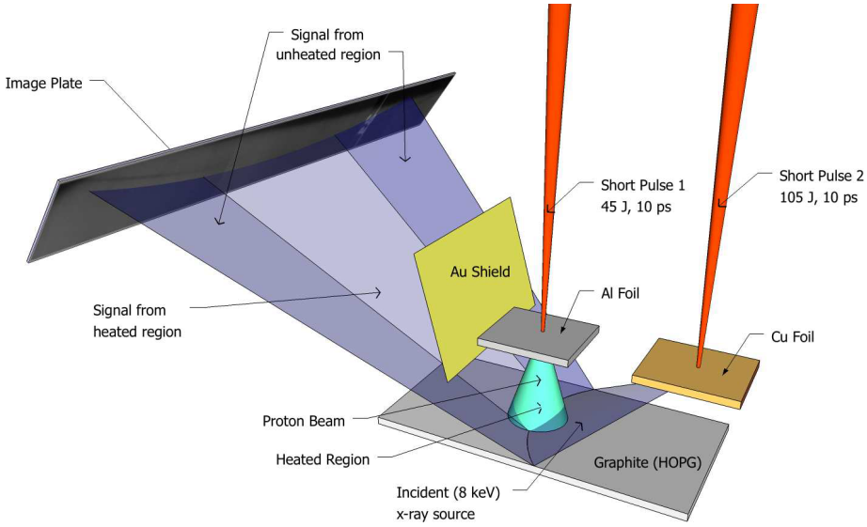
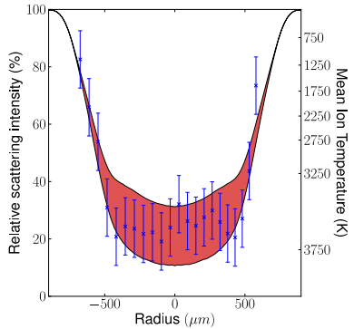
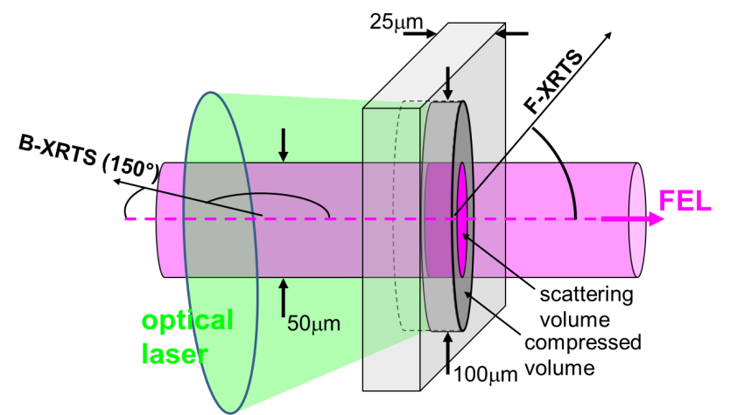
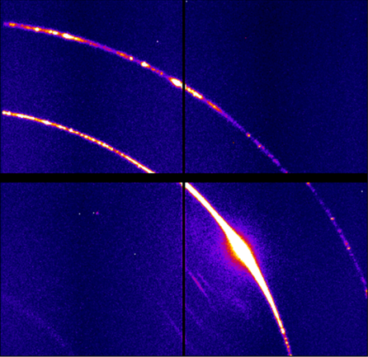
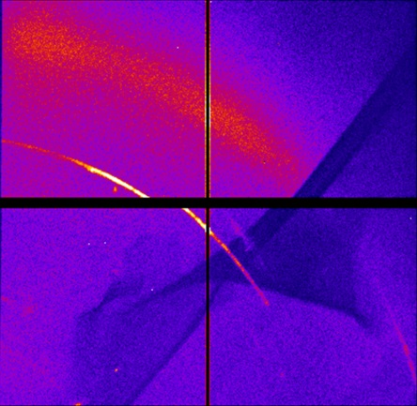

X-ray diffraction crystallography in HED matter
Diffraction of 8keV x-rays (Cu-Ka) from laser-proton heated Carbon
Reduction of diffraction due to lattice heating
$$\sim e^{−2k^{2}\left\langle {u_{⊥}}_{}^{2}\right\rangle }$$
Diffraction of 8keV x-rays (LCLS) from shock-compressed Aluminium
Bragg-reflexes → liquid-like structure
(2,0,0)
(1,1,1)
diffraction angle

Slide 21
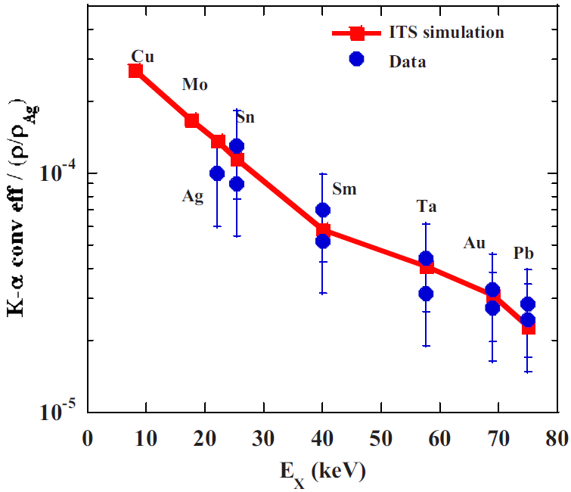
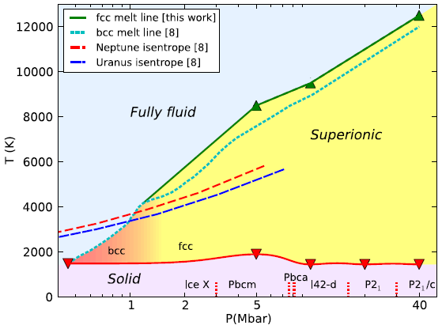
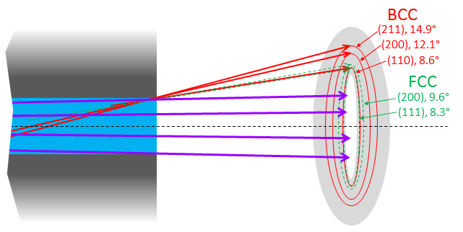


X-ray crystallography of superionic water in LAPLAS
Predicted superionic to superionic phase change *)
transmission (H₂O, 5g/cm²)
H.-S. Park et al.,
Phys. Plasmas 15, 072705 (2008)
Ta-Kα diffraction in H₂O@7g/cm²
BCC
FCC
*) H. F. Wilson et al.,
Phys. Rev. Lett. 110, 151102 (2013)

Slide 22
Conclusions
High-energy short pulse laser driven bremsstrahlung x-ray sources:
well-proven, straight-forward to implement, predictable parameters
suitable backlighter for x-ray radiography
  HIHEX: side-on
  LAPLAS: side-on challenging, but end-on should work
High-energy K-alpha emission from the same source should reveal crystallographic structure → e.g. detect superionic phases of H₂O!
➔ Laser pulses of order 400J/ps will be required
Development of efficient, high-resolution x-ray imaging detectors for E_{ph} ≈ 100keV to 1MeV
Other high-energy laser driven x-ray sources:
Intense line-emission (X-Ray Thomson Scattering)
Broadband VUV (opacity)
Broadband keV (X-Ray Near Absorption Edge Spectroscopy)

Slide 23




Hard X-Ray Detector measures the high-energy bremsstrahlung emission
Filter transmission
Image Plate
Filter
Filter transmission
Photon energy [MeV]
HXRD filter
configuration
I_{laser}~10¹⁸ W/cm²
I_{laser}>10¹⁹ W/cm²
Pb thickness in μm

Slide 24
Infer hot-e spectrum from bremsstrahlung
Genetic algorithm
Best fit to HXRD signals
assume initial dN/dE
calculate Bremsstrahlung spectrum (MC)
calculate detector response
(filter transmission, IP sensitivity)
Compare with measurement („fitness“)
generate new (dN/dE)
Hot electron distribution inferred from bremsstrahlung emission
Exp.
160 keV
1.2 MeV
20 keV
PIC

